Slide 1

SPS status
M. Schenk
for the SPS team
PS / SPS User Meeting 27. June 2024

Slide 2
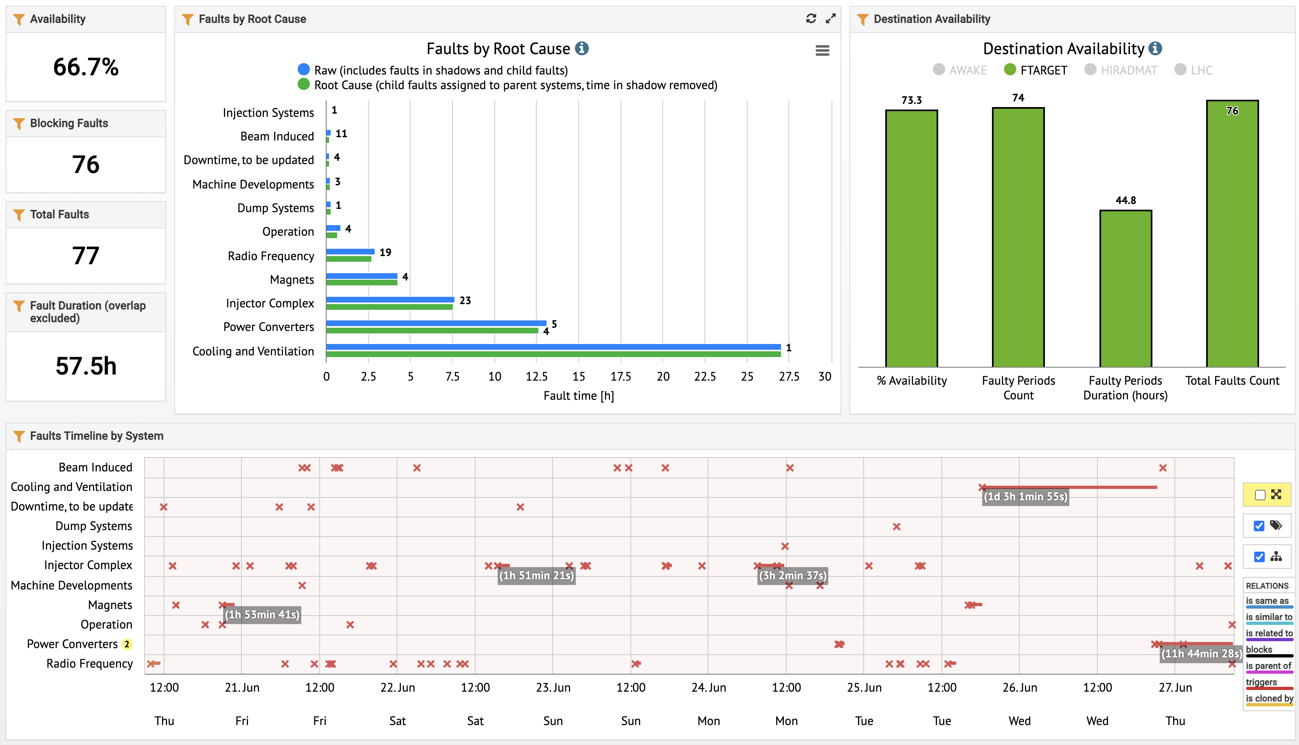
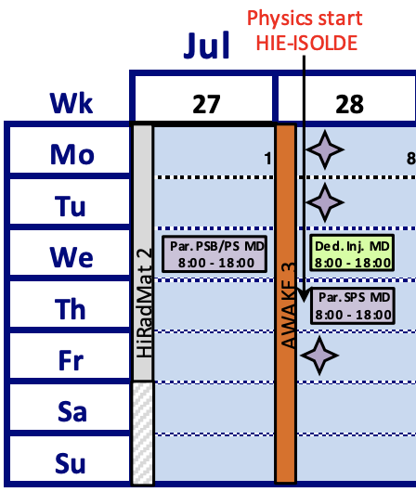
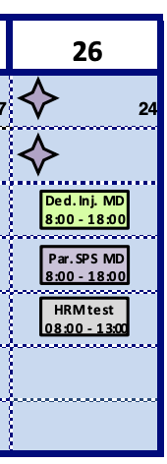
This week
Availability: ~75% NA (Thu – Thu)
Main downtime due to water cooling issue
  Tue PM: coil overtemp. tripping main magnets 2x
  Access showed that MBA 31590 water cooling circuit blocked
  Unblocking attempted by EN-CV and magnet experts had to be aborted at 2:30 AM.
  Wed: repair during daytime
Today
  Now: access due to potentially important water leak in BA3
  Long parallel MD
Friday
  Hiradmat test: 08:00 – 13:00
Other
  NA: monitoring spill harmonics; also following up more closely with EBC parameter
  LHC: extraction orbit check / adjustments needed at SPS; potentially Friday PM after Hiradmat
dedicated MDs moved to Wk 31
Next week
Hiradmat 2 run

Slide 3
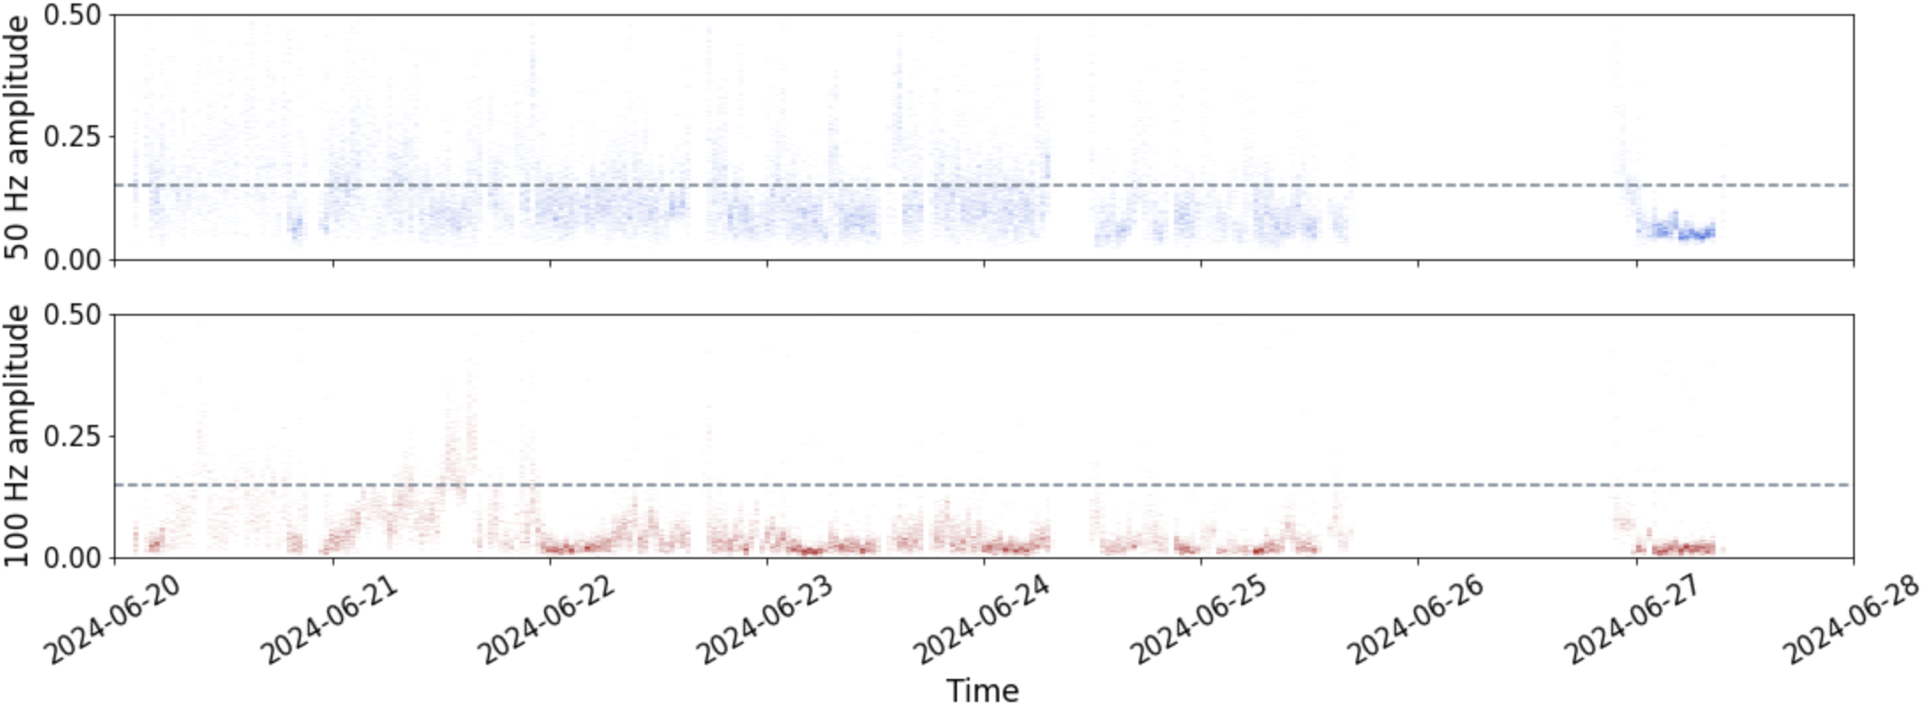
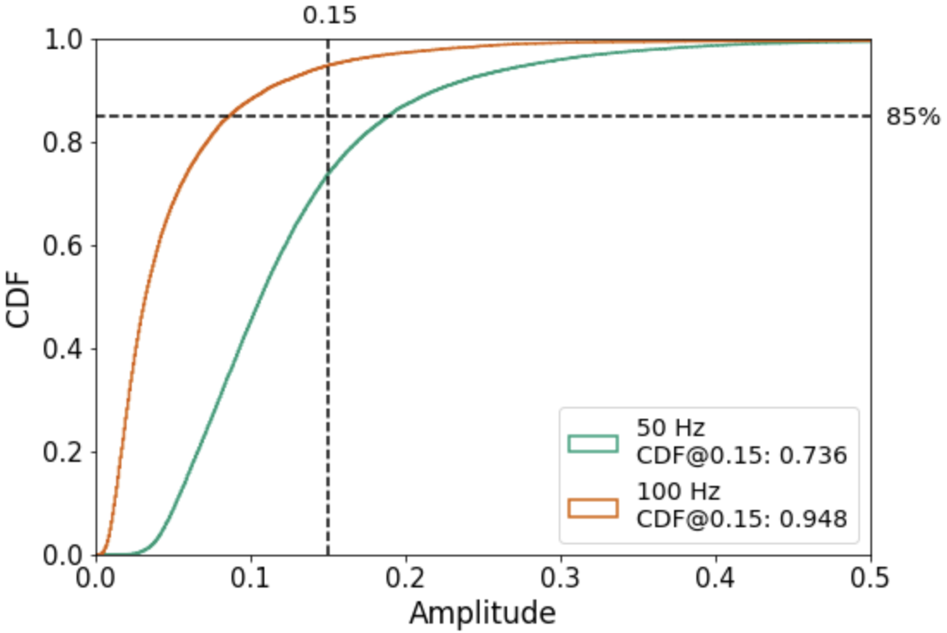
Thu – Thu

