Slide 1

Identifying Events with Two Higgs bosons Each Decaying to Two bottom quarks.
The US ATLAS Summer Undergraduate Program for Exceptional Researchers (SUPER) - University of Pennsylvania

Slide 2


Student:
Isaac Anokye
Alabama A&M University
Department of Computer & Electrical Engineering
Research Mentor:
Professor Dylan Rankin
University of Pennsylvania
Department of Physics & Astronomy

Slide 3
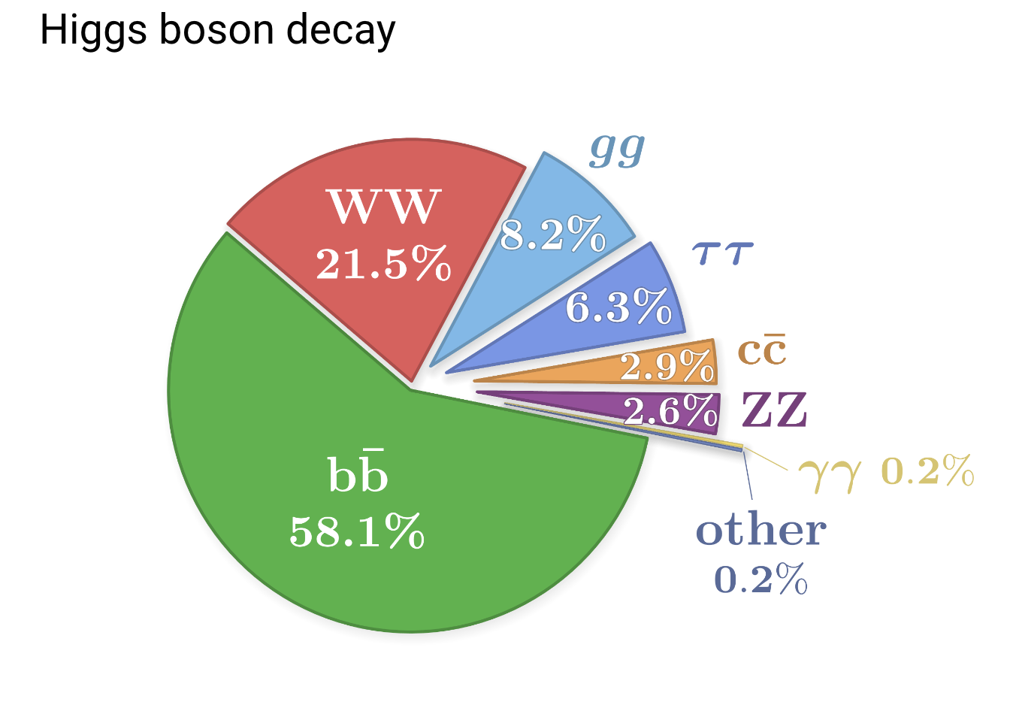
Background Info
The Higgs Boson
The Higgs boson is a fundamental particle associated with the Higgs field, which gives mass to other particles.
Notes:
Understanding its properties, especially its decay modes, is crucial for validating the Standard Model of particle physics and exploring new physics.

Slide 4
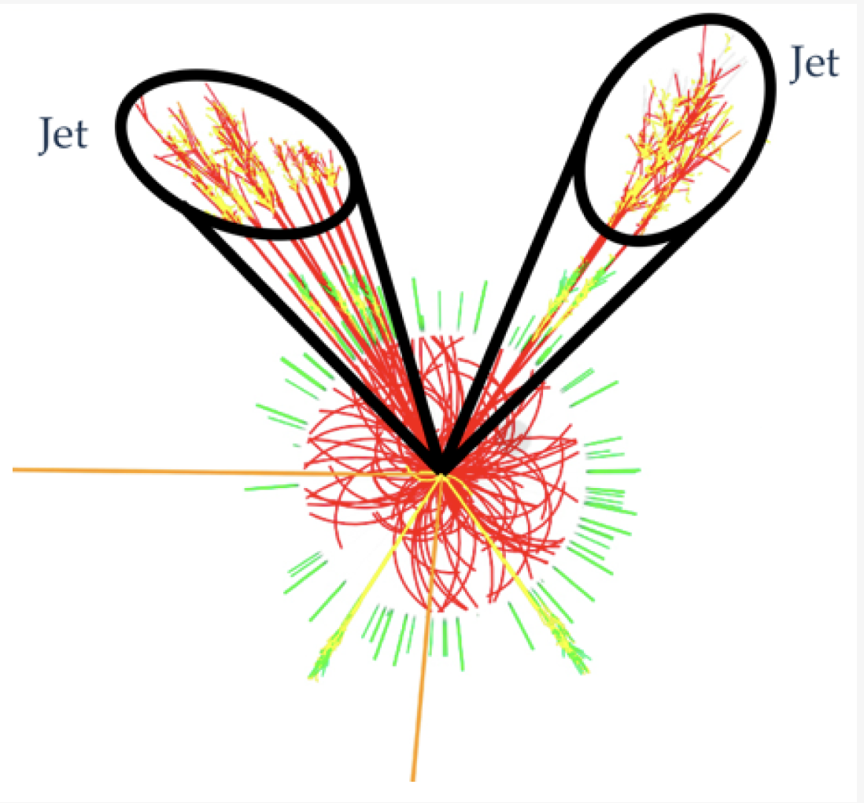
Jets
Jets from quarks are streams of particles produced in high-energy collisions, such as those occurring in particle accelerators like the Large Hadron Collider (LHC).
A jet is a collection of particles (often including quarks and gluons) that are clustered together based on their momenta and spatial proximity.
Notes:
B-quarks are made when the higgs bosons decay and the jets are made when the quarks are energetic and higher energetic collusion produces higher energy jets.

Slide 5
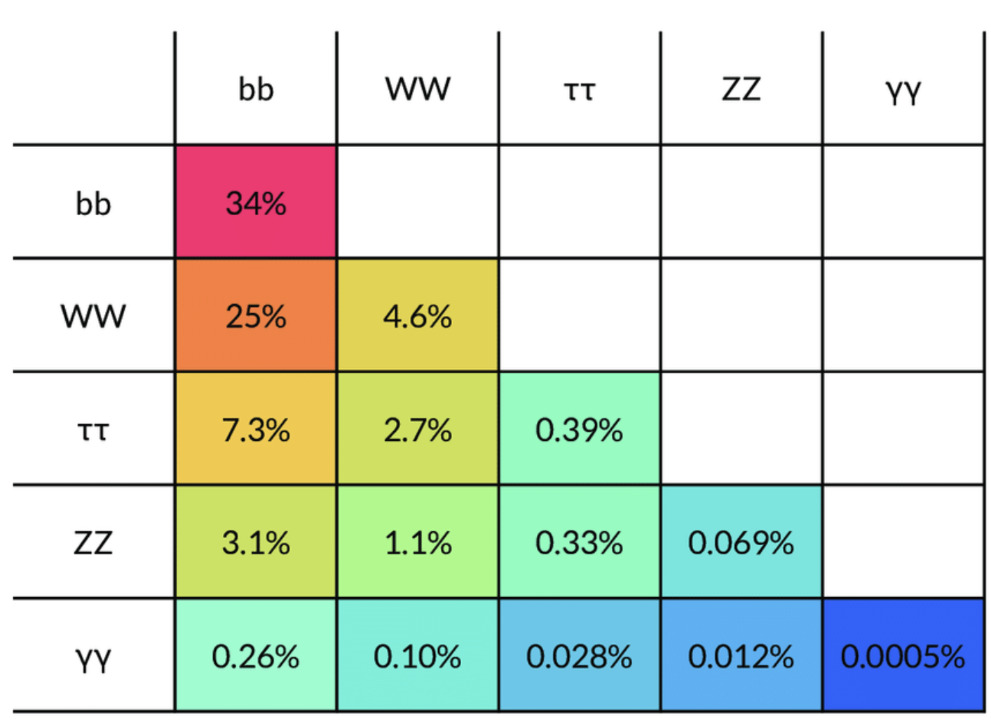
Introduction
During this summer, I have engaged in a research internship under the guidance of Professor Dylan Rankin at the University of Pennsylvania, focusing on identifying and analysing events with two Higgs bosons each decaying to two b quarks.

Slide 6
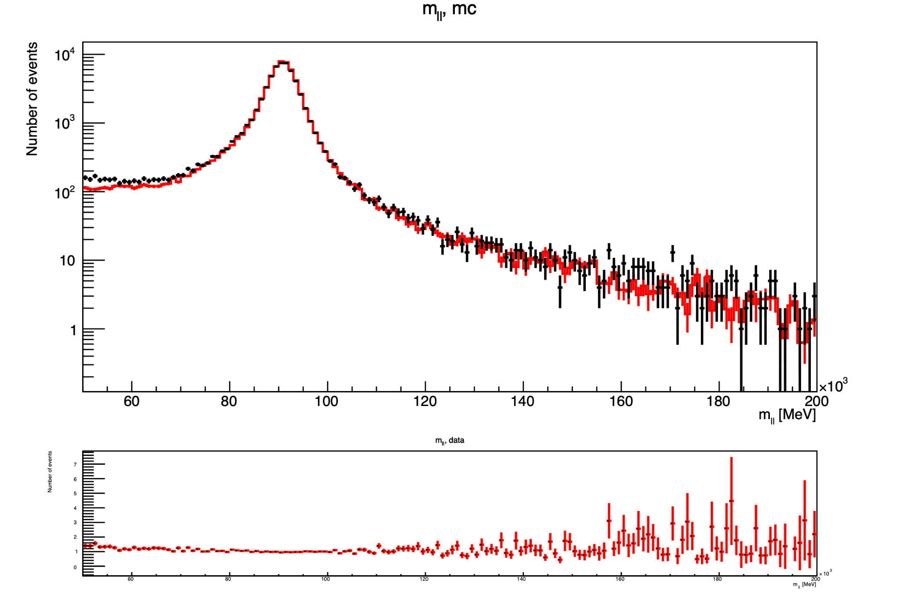
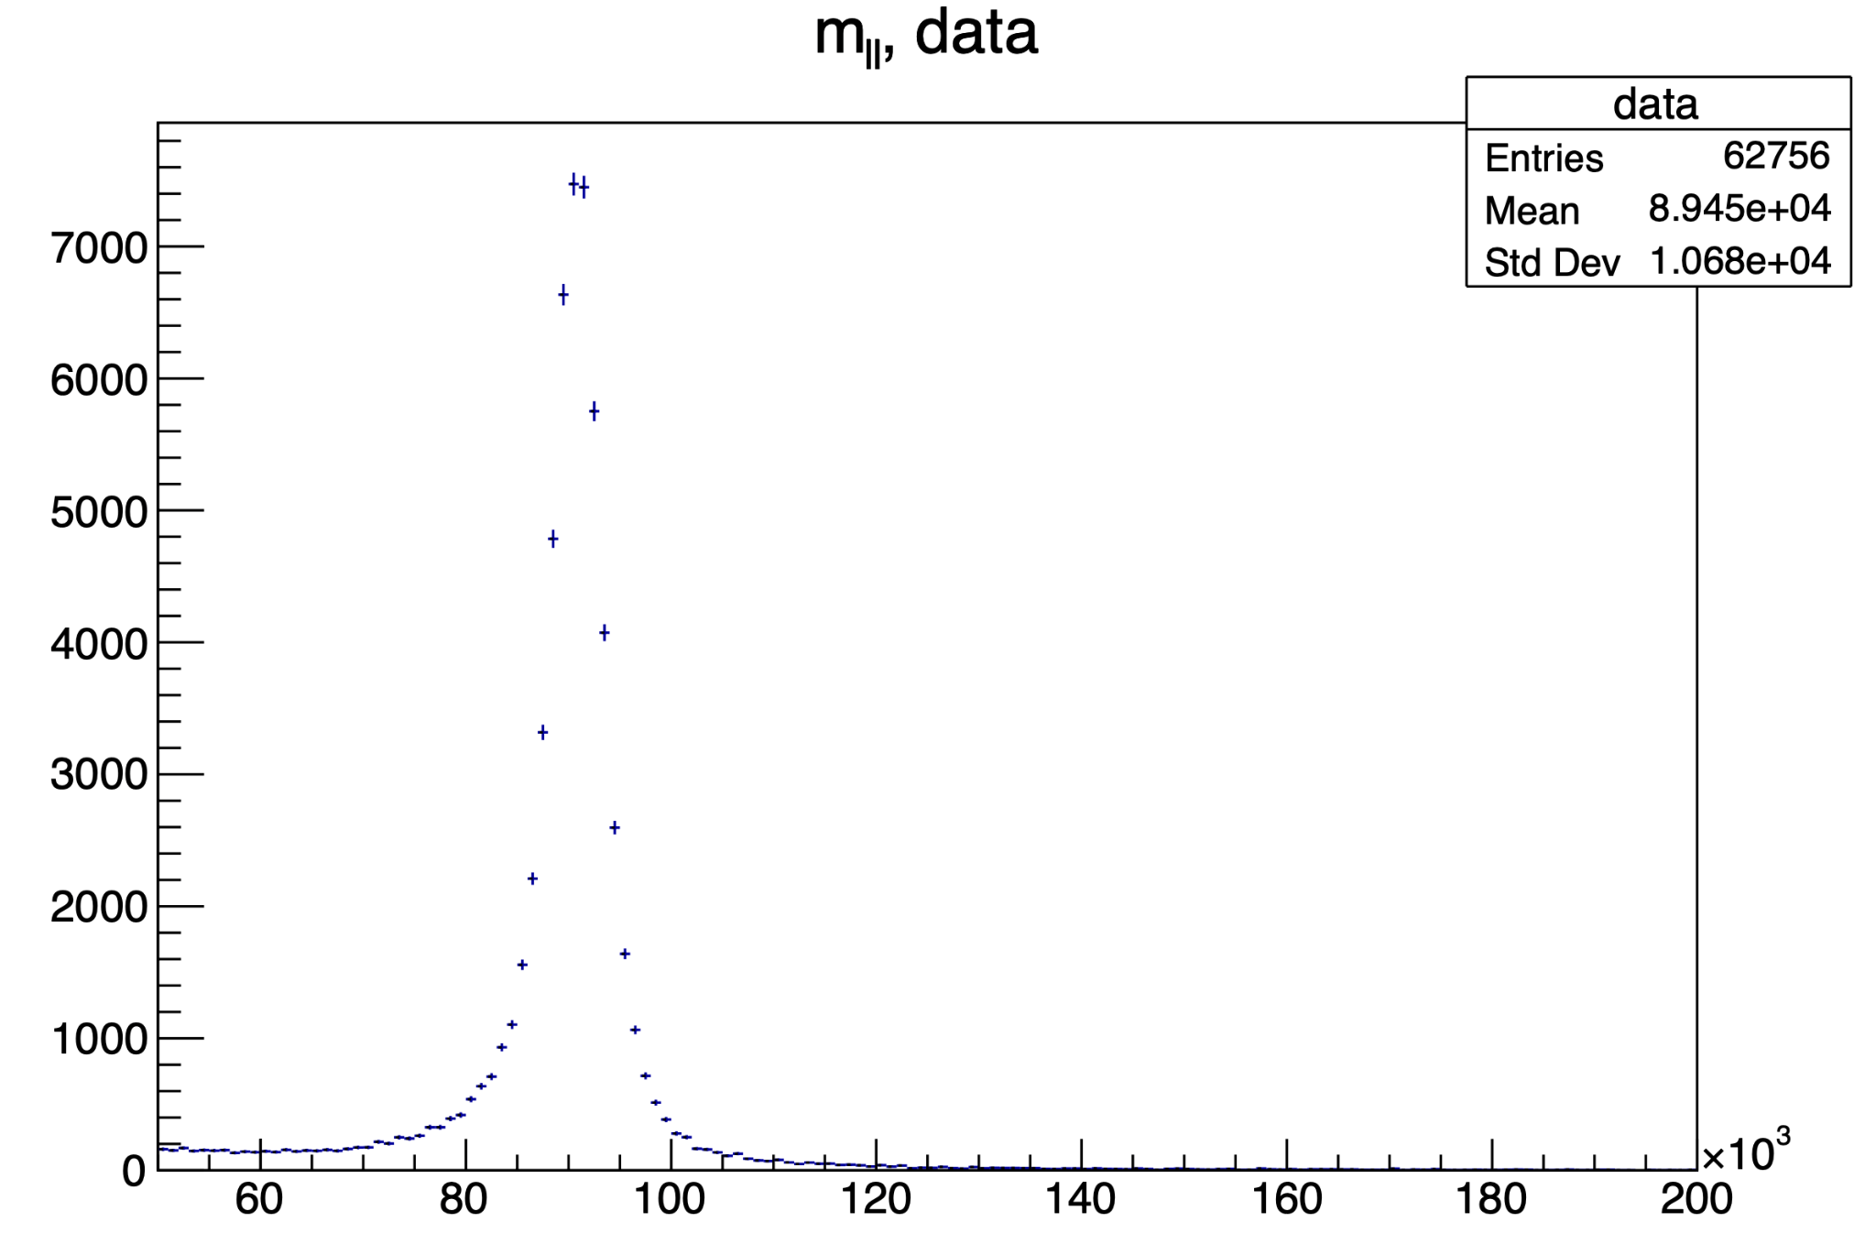
Tutorial: Processing Data from a TTree
The exercises involved processing data from a TTree, the primary tree data structure in ROOT used for storing large datasets.

Slide 7
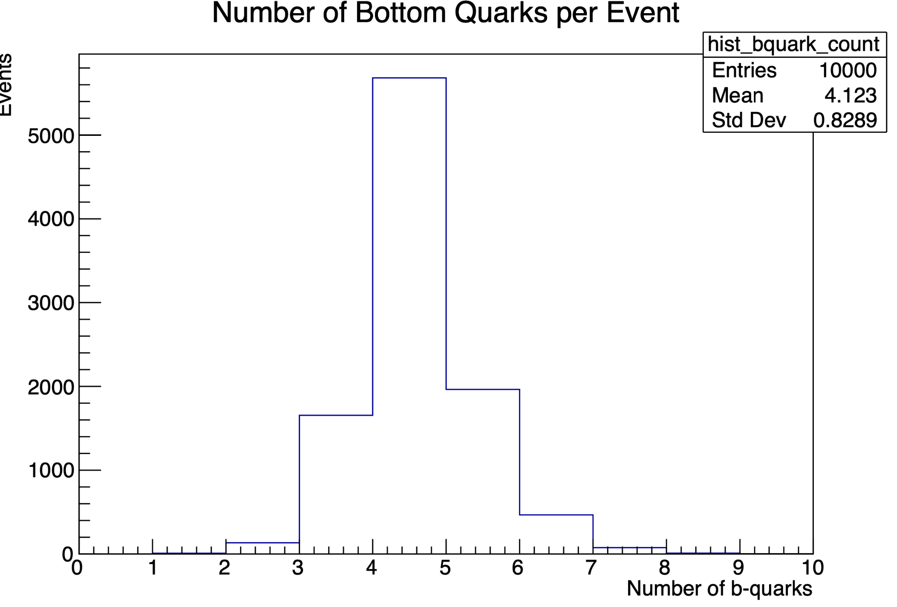
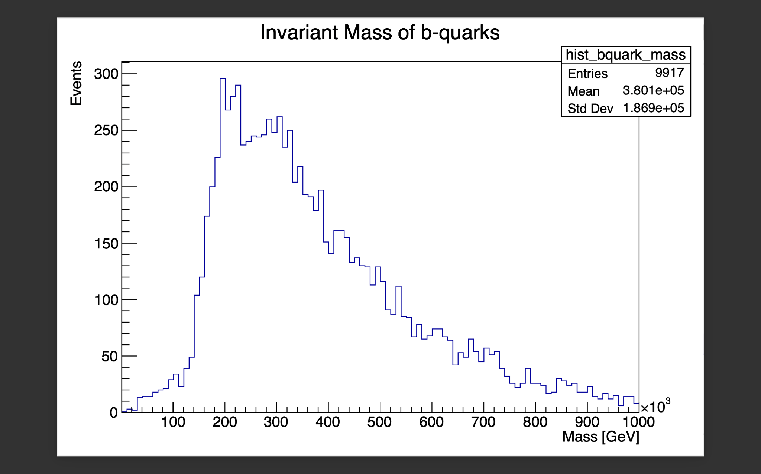
B Quarks vrs Events
The diagram above was expected to show 4 out of the b-quarks, because two of the b-quarks were duplicates.
This is a view of the invariant mass of the b-quark against the number of events.

Slide 8
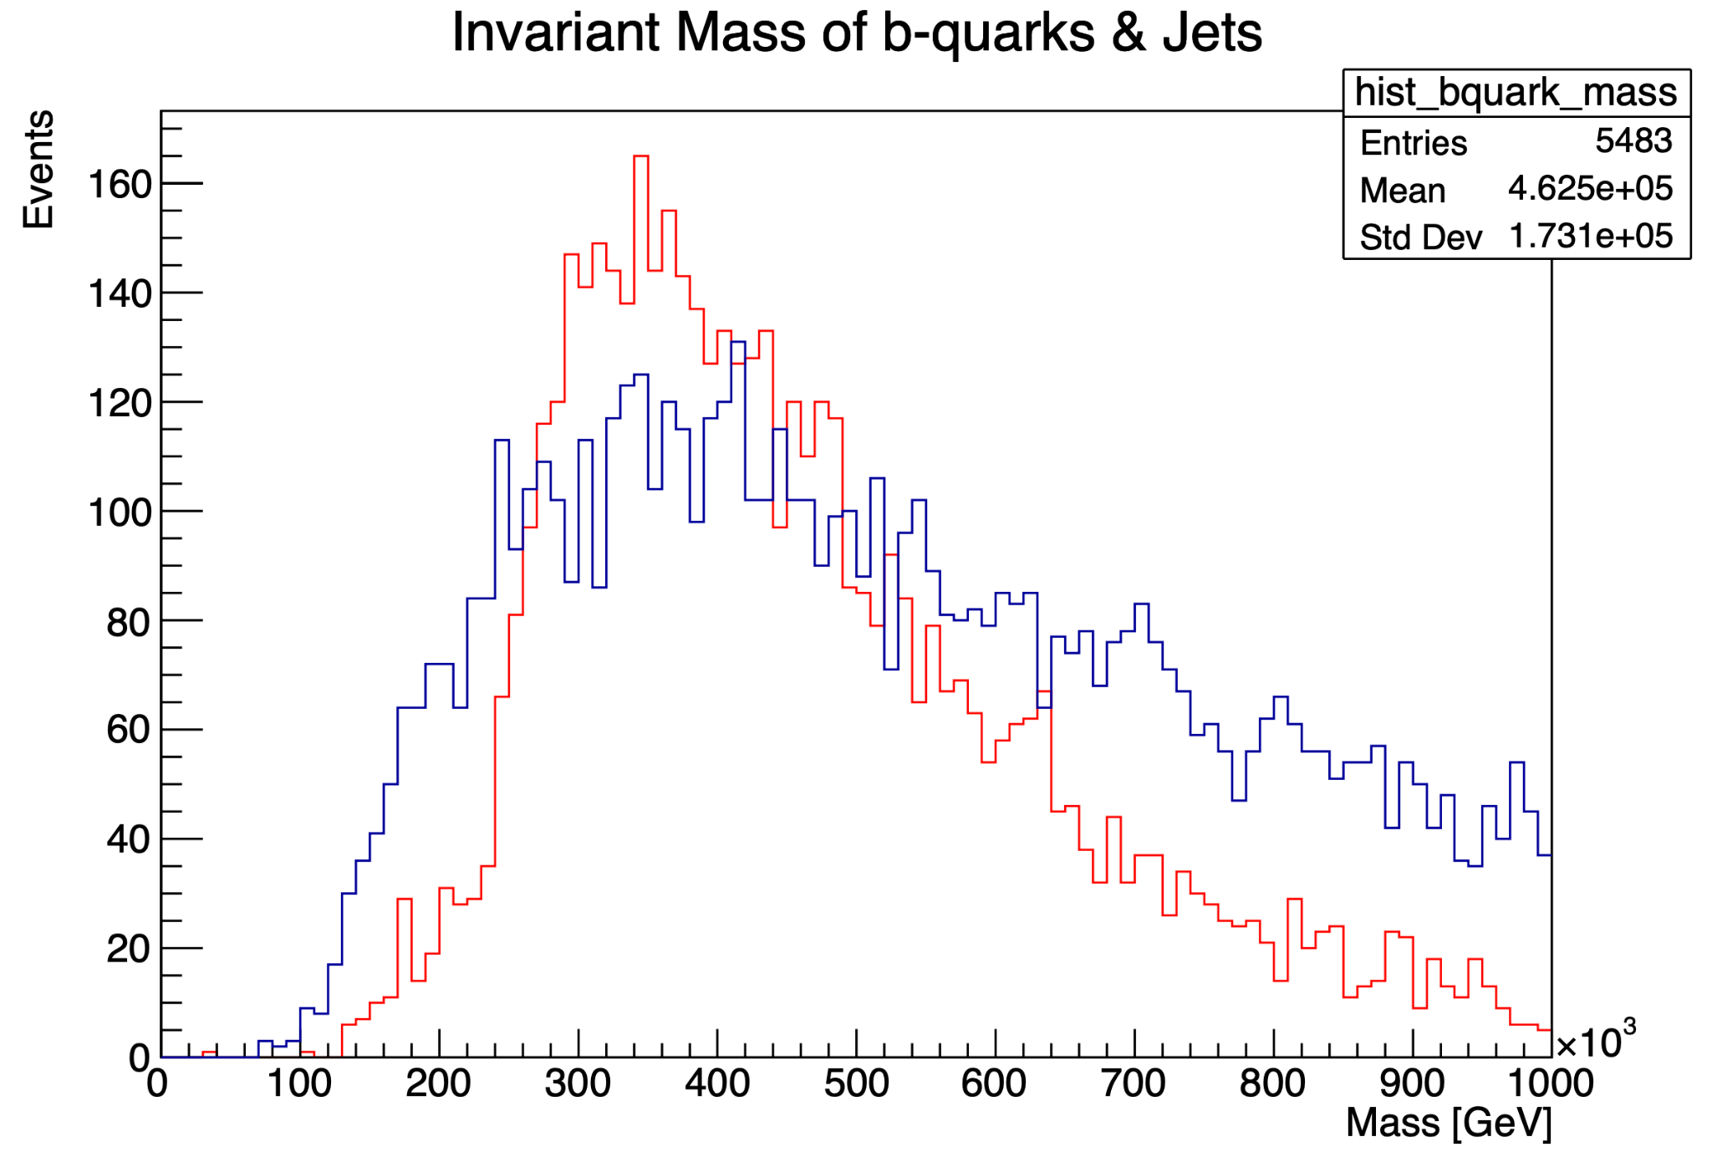
Comparing jets mass with b quarks mass
This is a histogram showing the masses of b-quark and jets verse events.
The red colour indicates b-quarks
The blue colour indicates jets

Slide 9
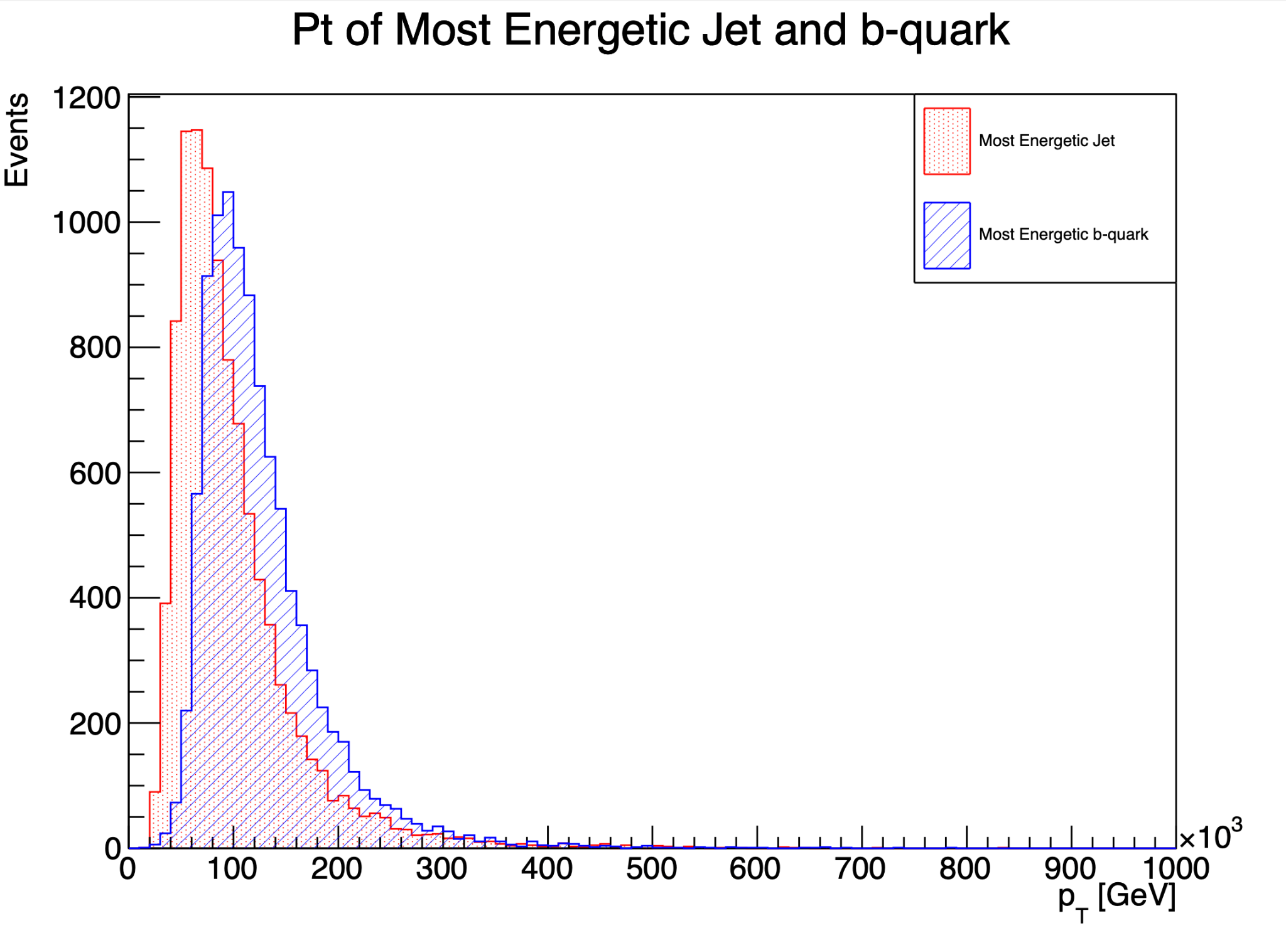
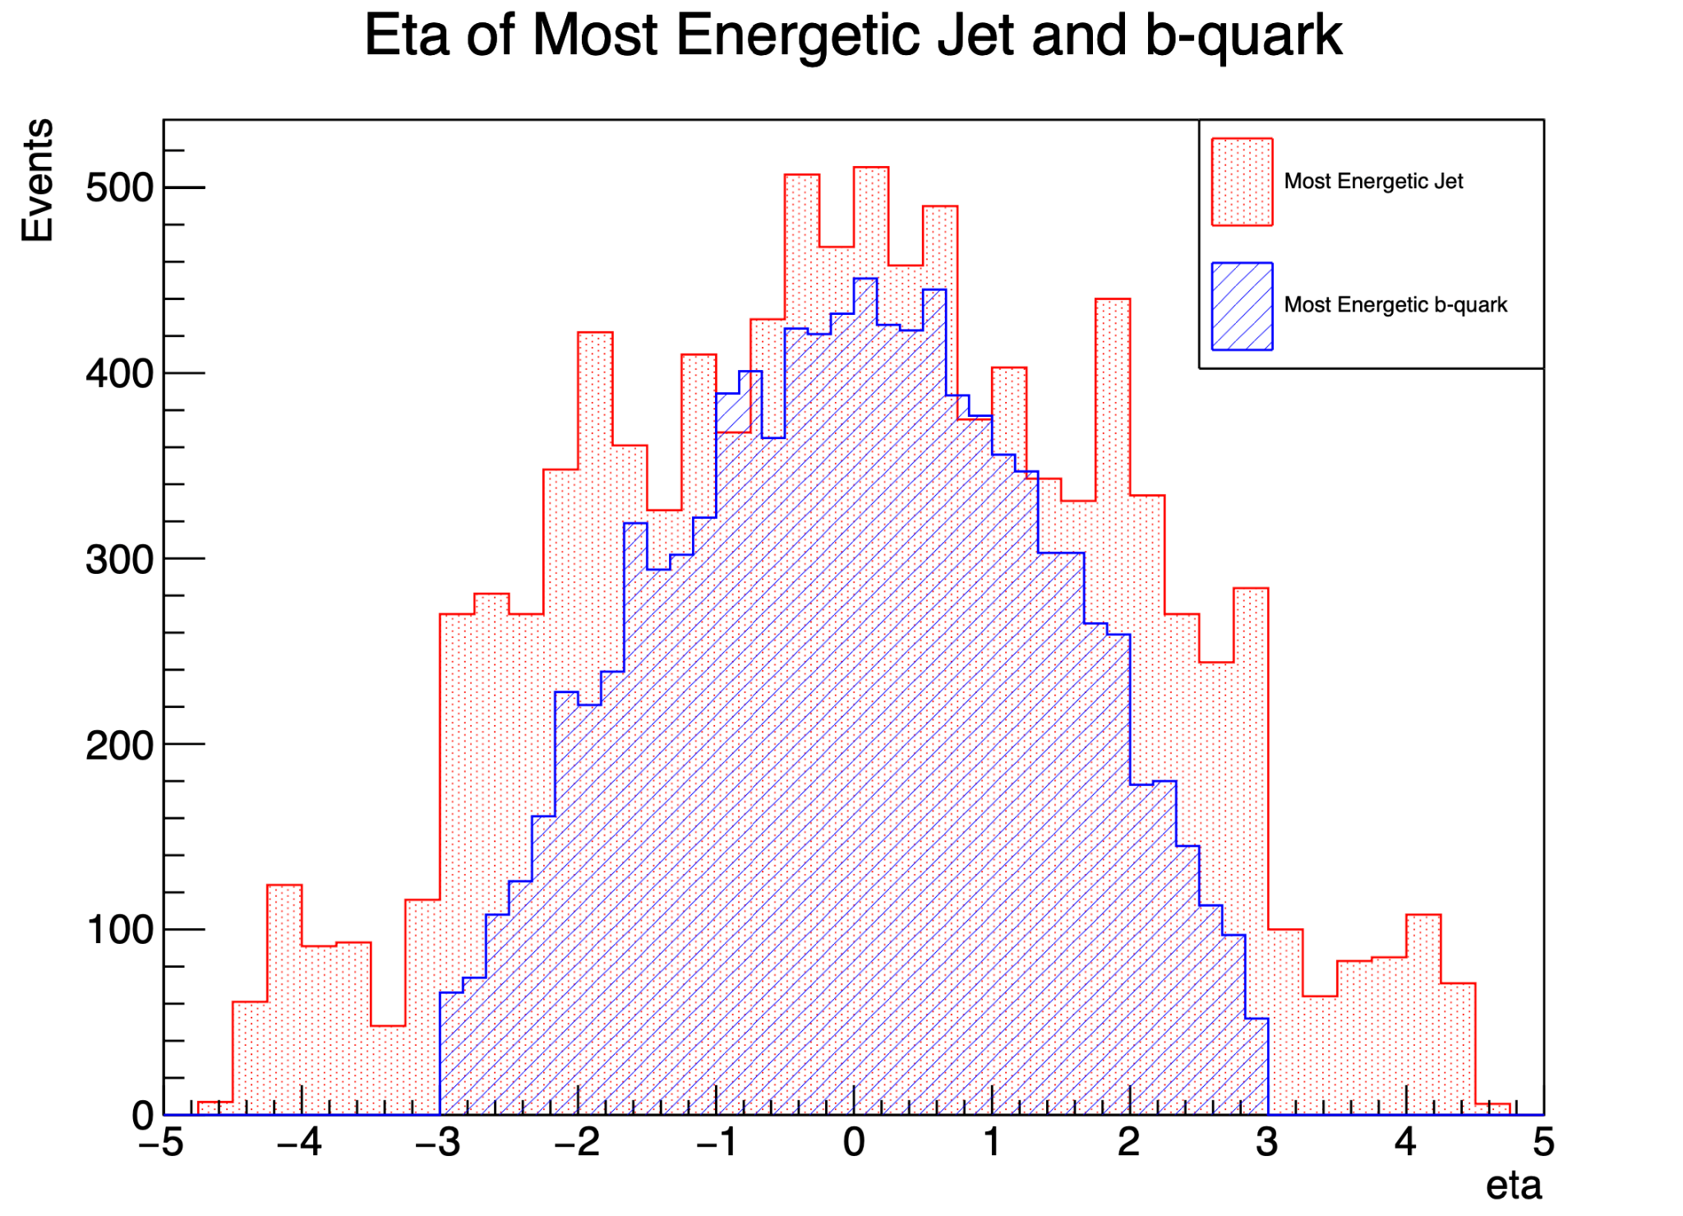
Pt & Eta of the highest pt jet vs b-quark
(a). The b-quark with the highest pT​ is typically the one with the most energy in the transverse plane. The difference between the jet and the quark increases the further down you go.
(b). This refers to the highest transverse momentum of a jet in the event.

Slide 10
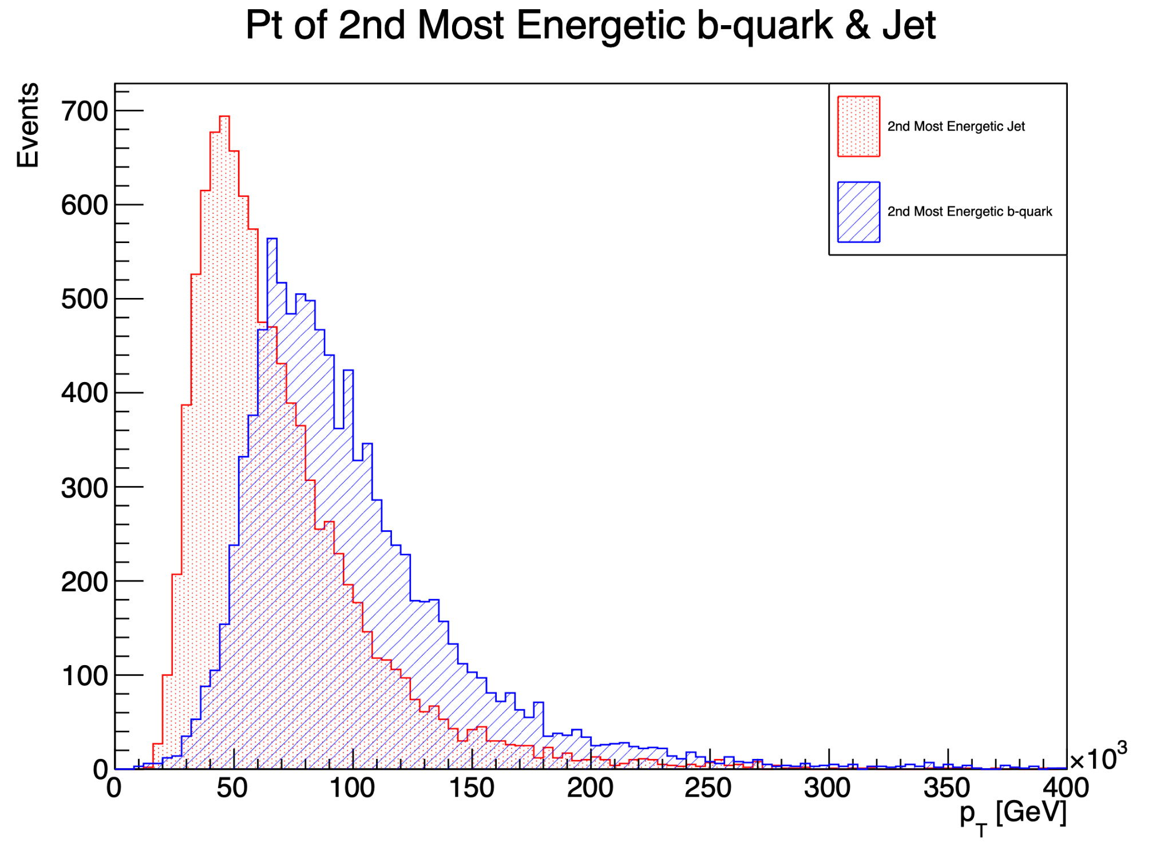
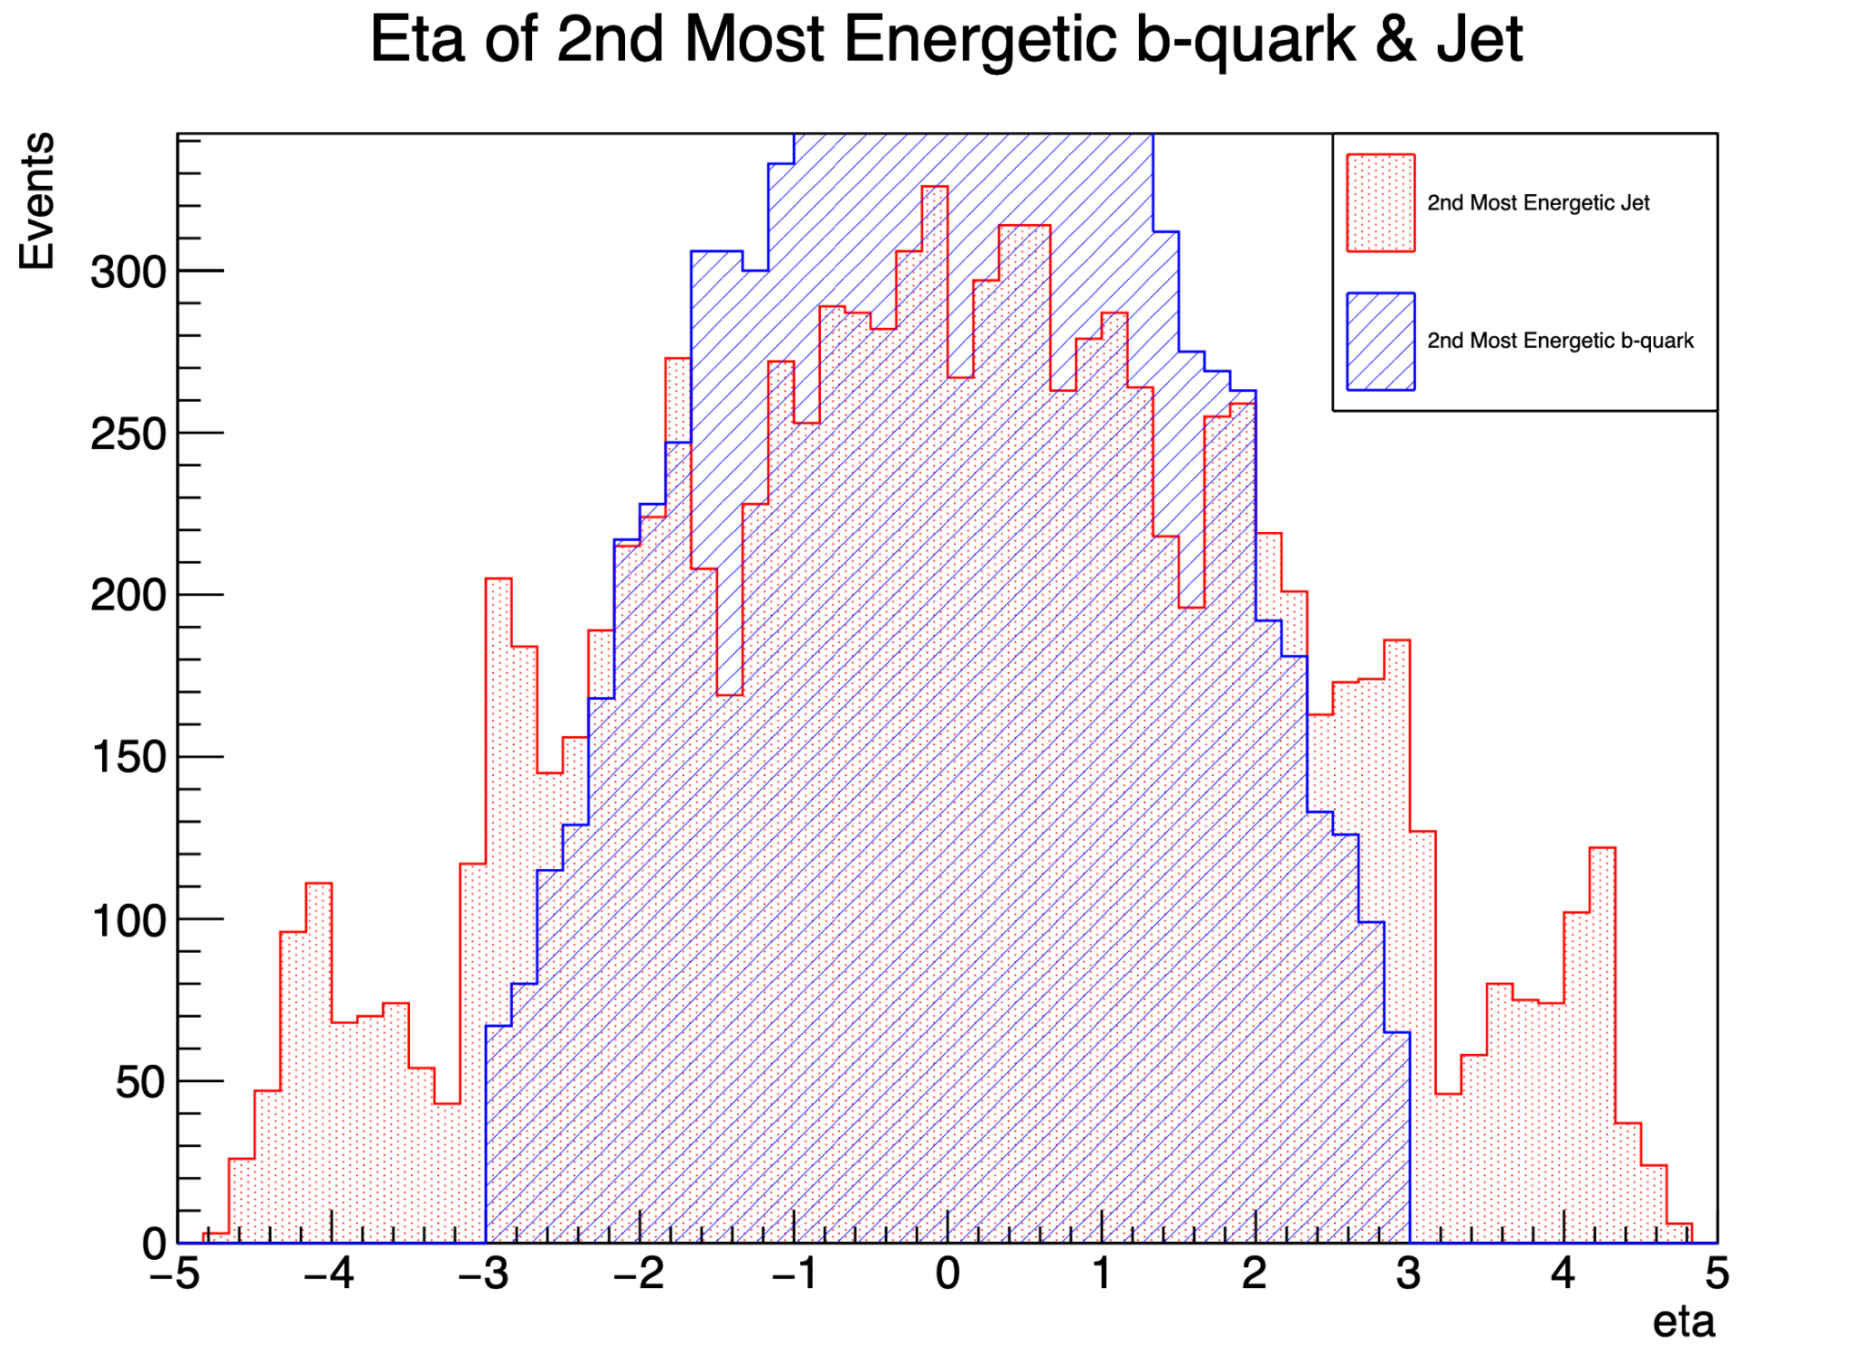
Pt & Eta of the 2nd highest pt jet vs b-quark
This is the 2nd highest transverse momentum among all b-quarks in the event. The b-quark with the highest pT​ is typically the one with the most energy in the transverse plane.
This refers to the 2nd highest transverse momentum of a jet in the event.

Slide 11
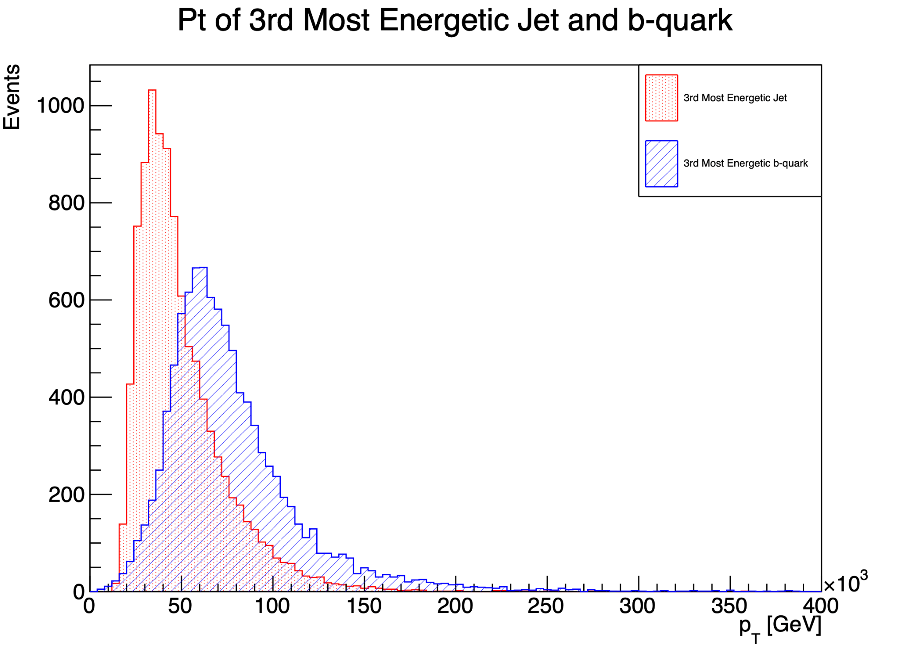
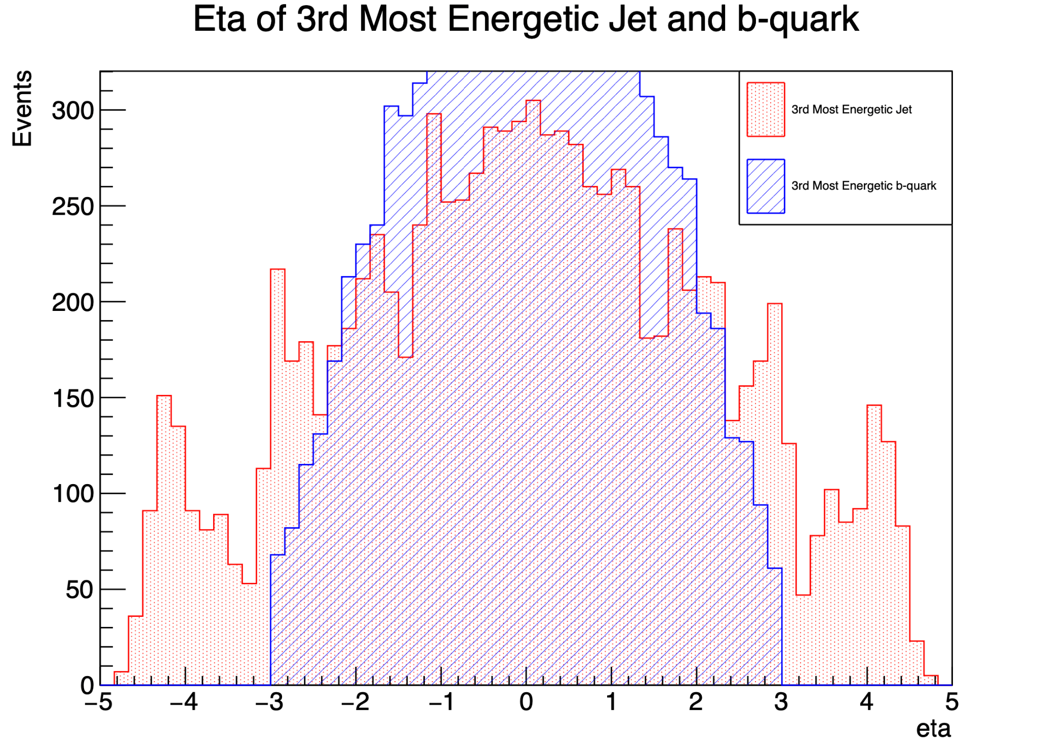
Pt & Eta of the 3rd highest pt jet vs b-quark
This is the 3rd highest transverse momentum among all b-quarks in the event. The b-quark with the highest pT​ is typically the one with the most energy in the transverse plane.
This refers to the 3nd highest transverse momentum of a jet in the event.

Slide 12
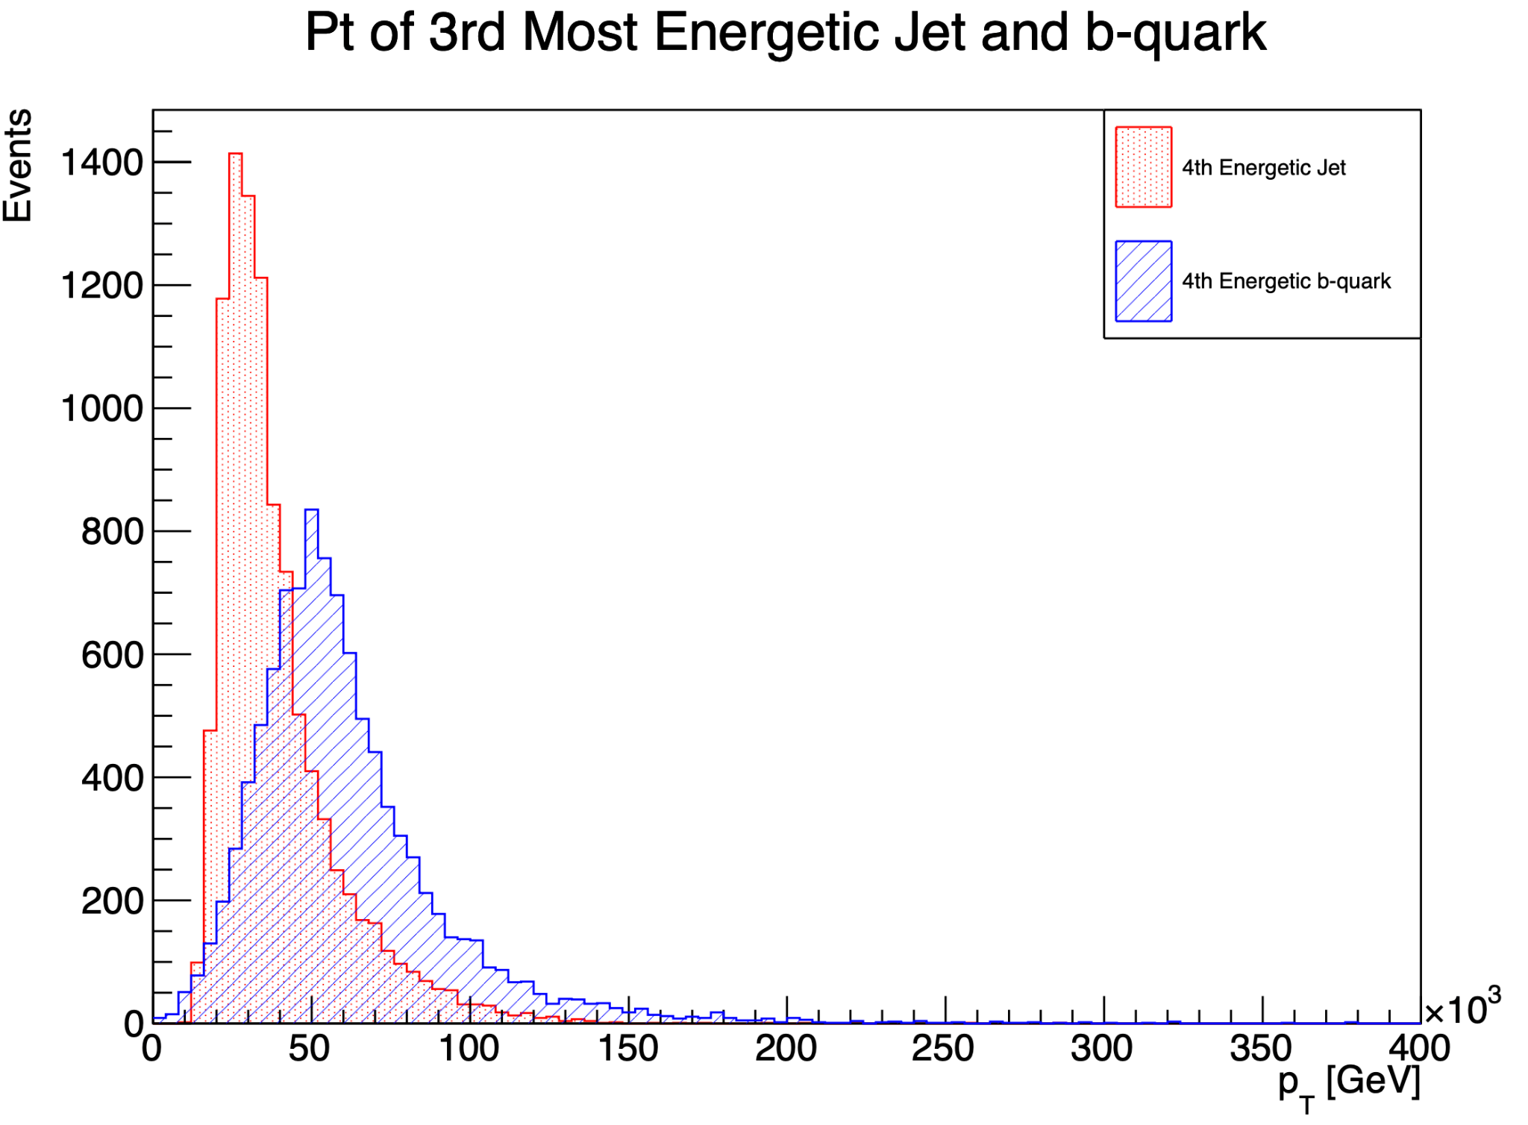
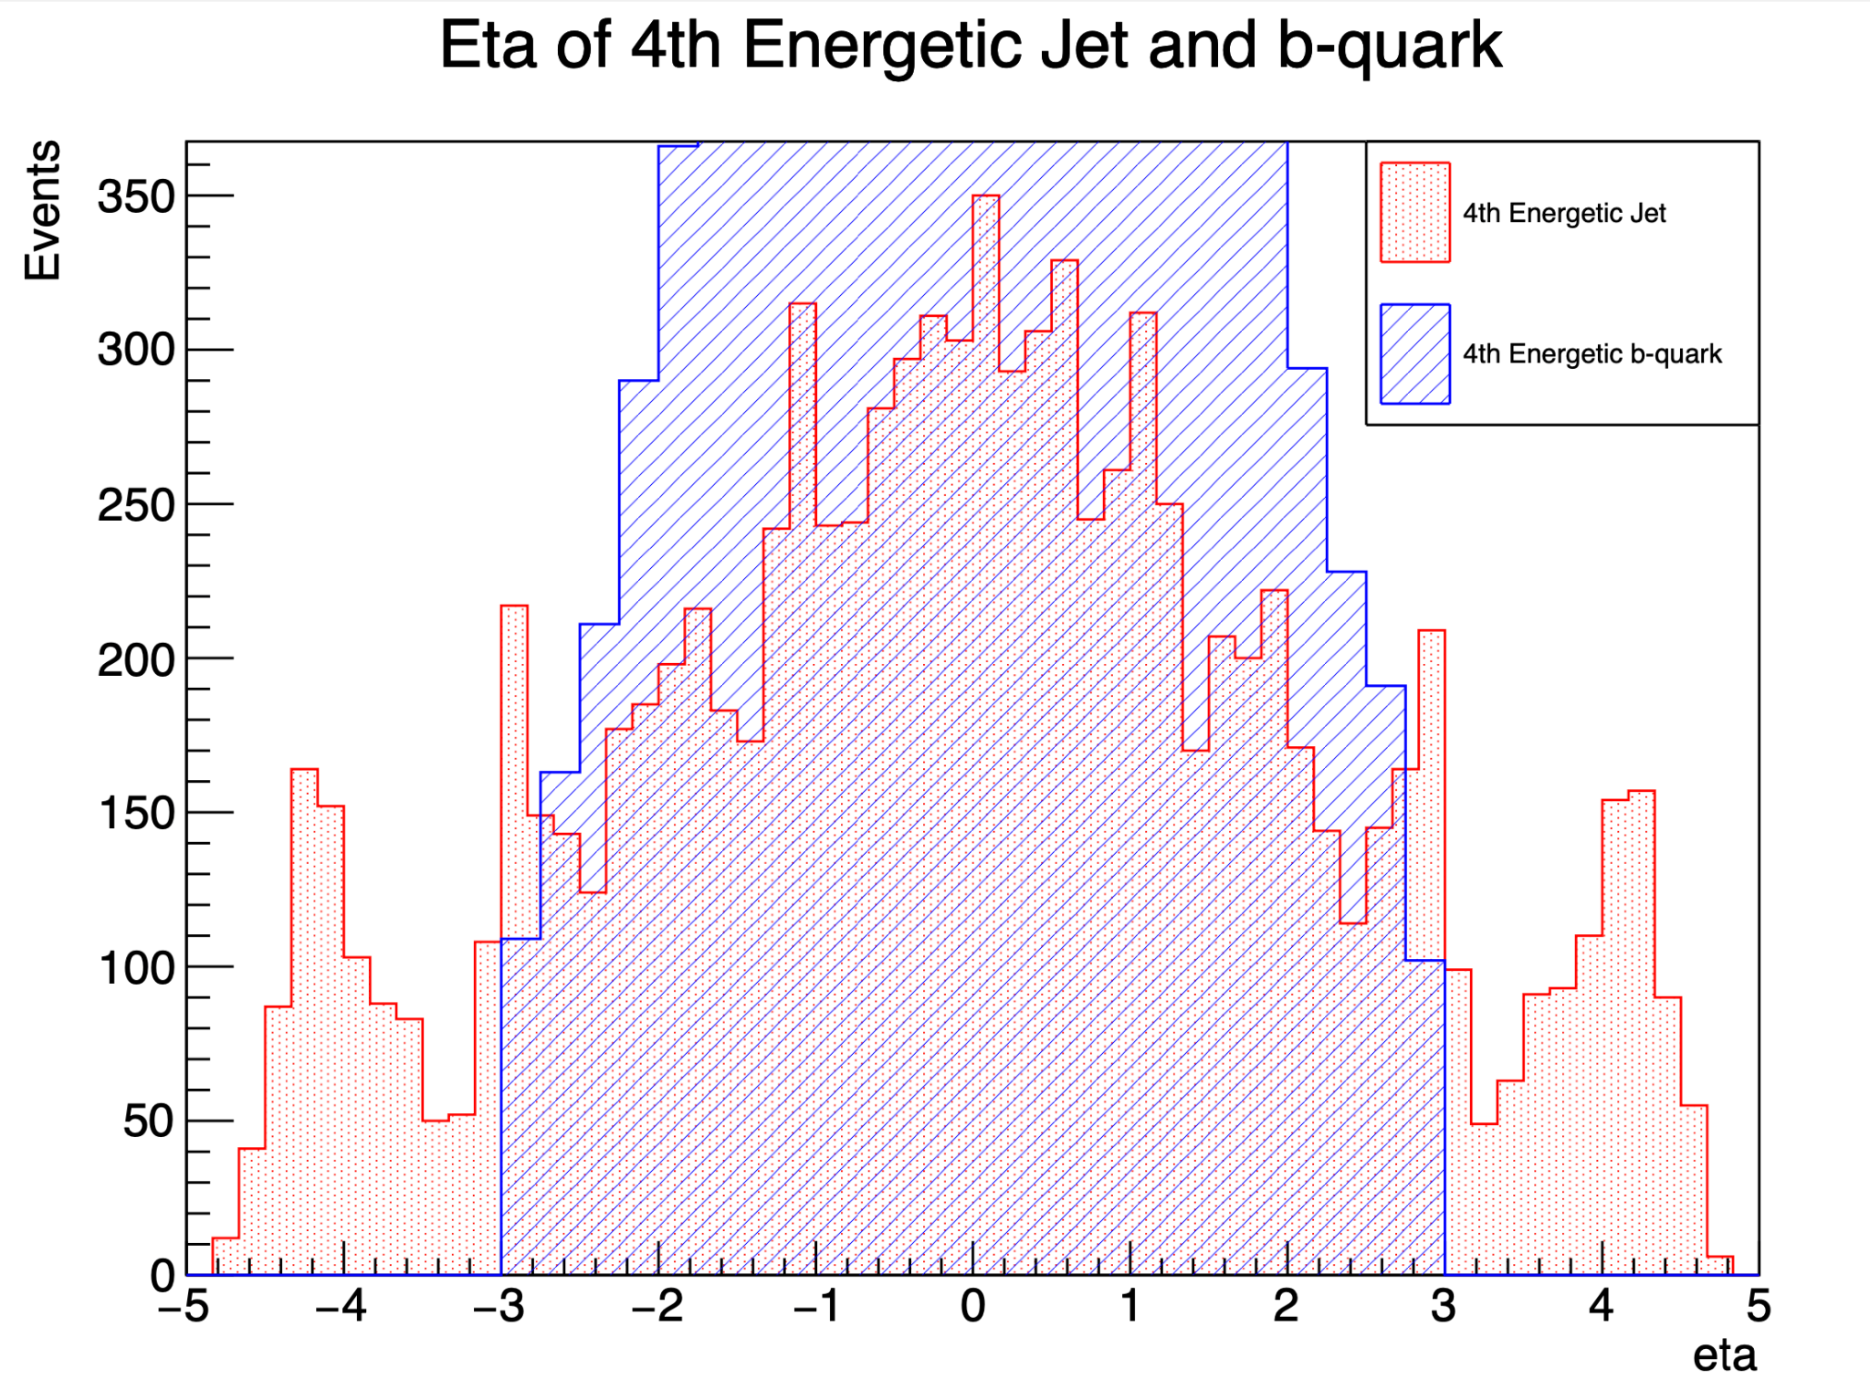
Pt & Eta of the 4th highest pt jet vs b-quark
This is the 4th highest transverse momentum among all b-quarks in the event. The b-quark with the highest pT​ is typically the one with the most energy in the transverse plane.
This refers to the 4th highest transverse momentum of a jet in the event.

Slide 13

Challenges faced during the project
Throughout this project, several challenges emerged, particularly in optimizing data processing techniques and in the interpretation of complex data structures.

Slide 14

Next Steps of Project
Plot analysis of:
Events without 2 higgs bosons (events with just quarks and gluons).
Differences between the jets in those events and the previous. ones.

Slide 15

Conclusion
The skills developed during this project are invaluable for my future academic journey like in data structures class and research project. Each challenge provided a valuable learning opportunity, enhancing my proficiency with pyroot and python programming.

Slide 16
Acknowledgement
I'm grateful to the US ATLAS Summer Undergraduate Program for Exceptional Researchers (SUPER) for this research opportunity, and I extend my deepest thanks to Professor Dylan Rankin for his mentorship.

Slide 17

THANK
YOU

Slide 18
QUESTIONS ?

