Slide 1

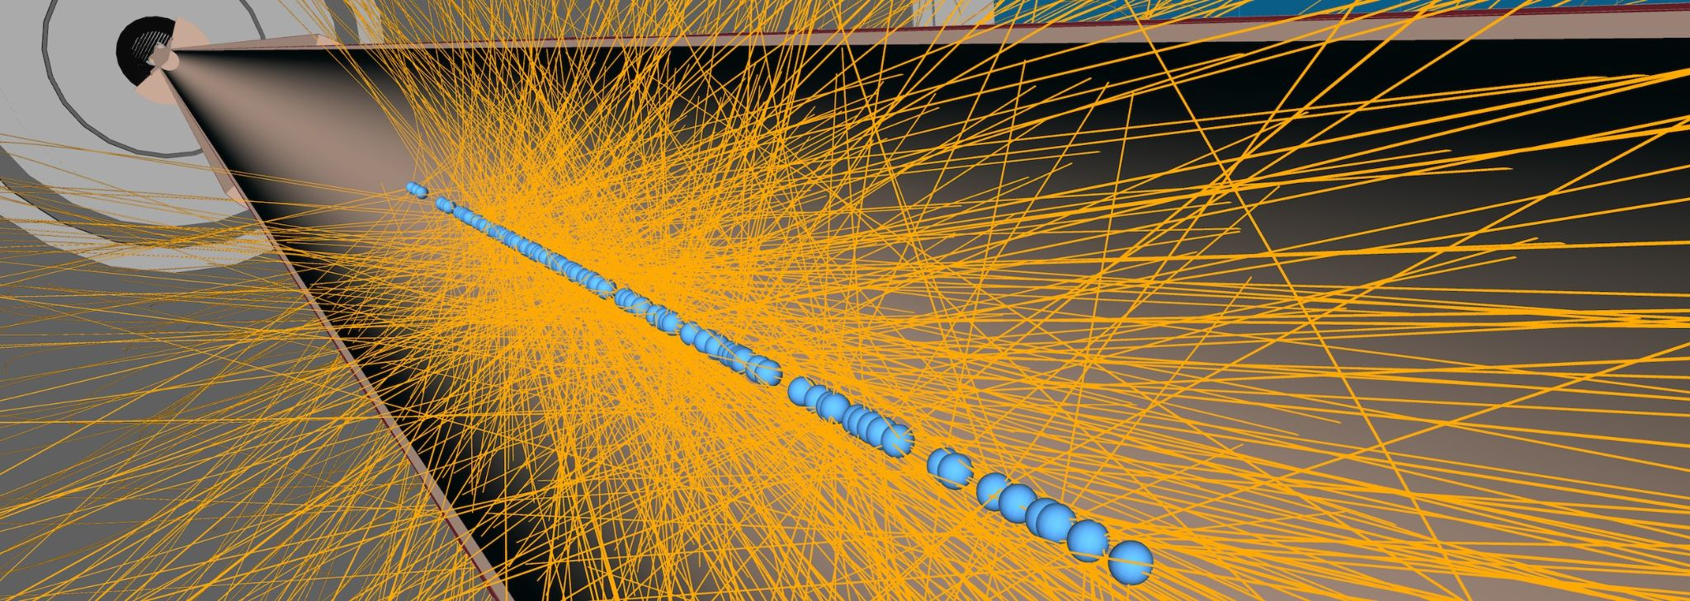
Machine Learning for Pileup Cluster Identification in the ATLAS Calorimeter
I-Tzu Huang, University of Arizona

Slide 2
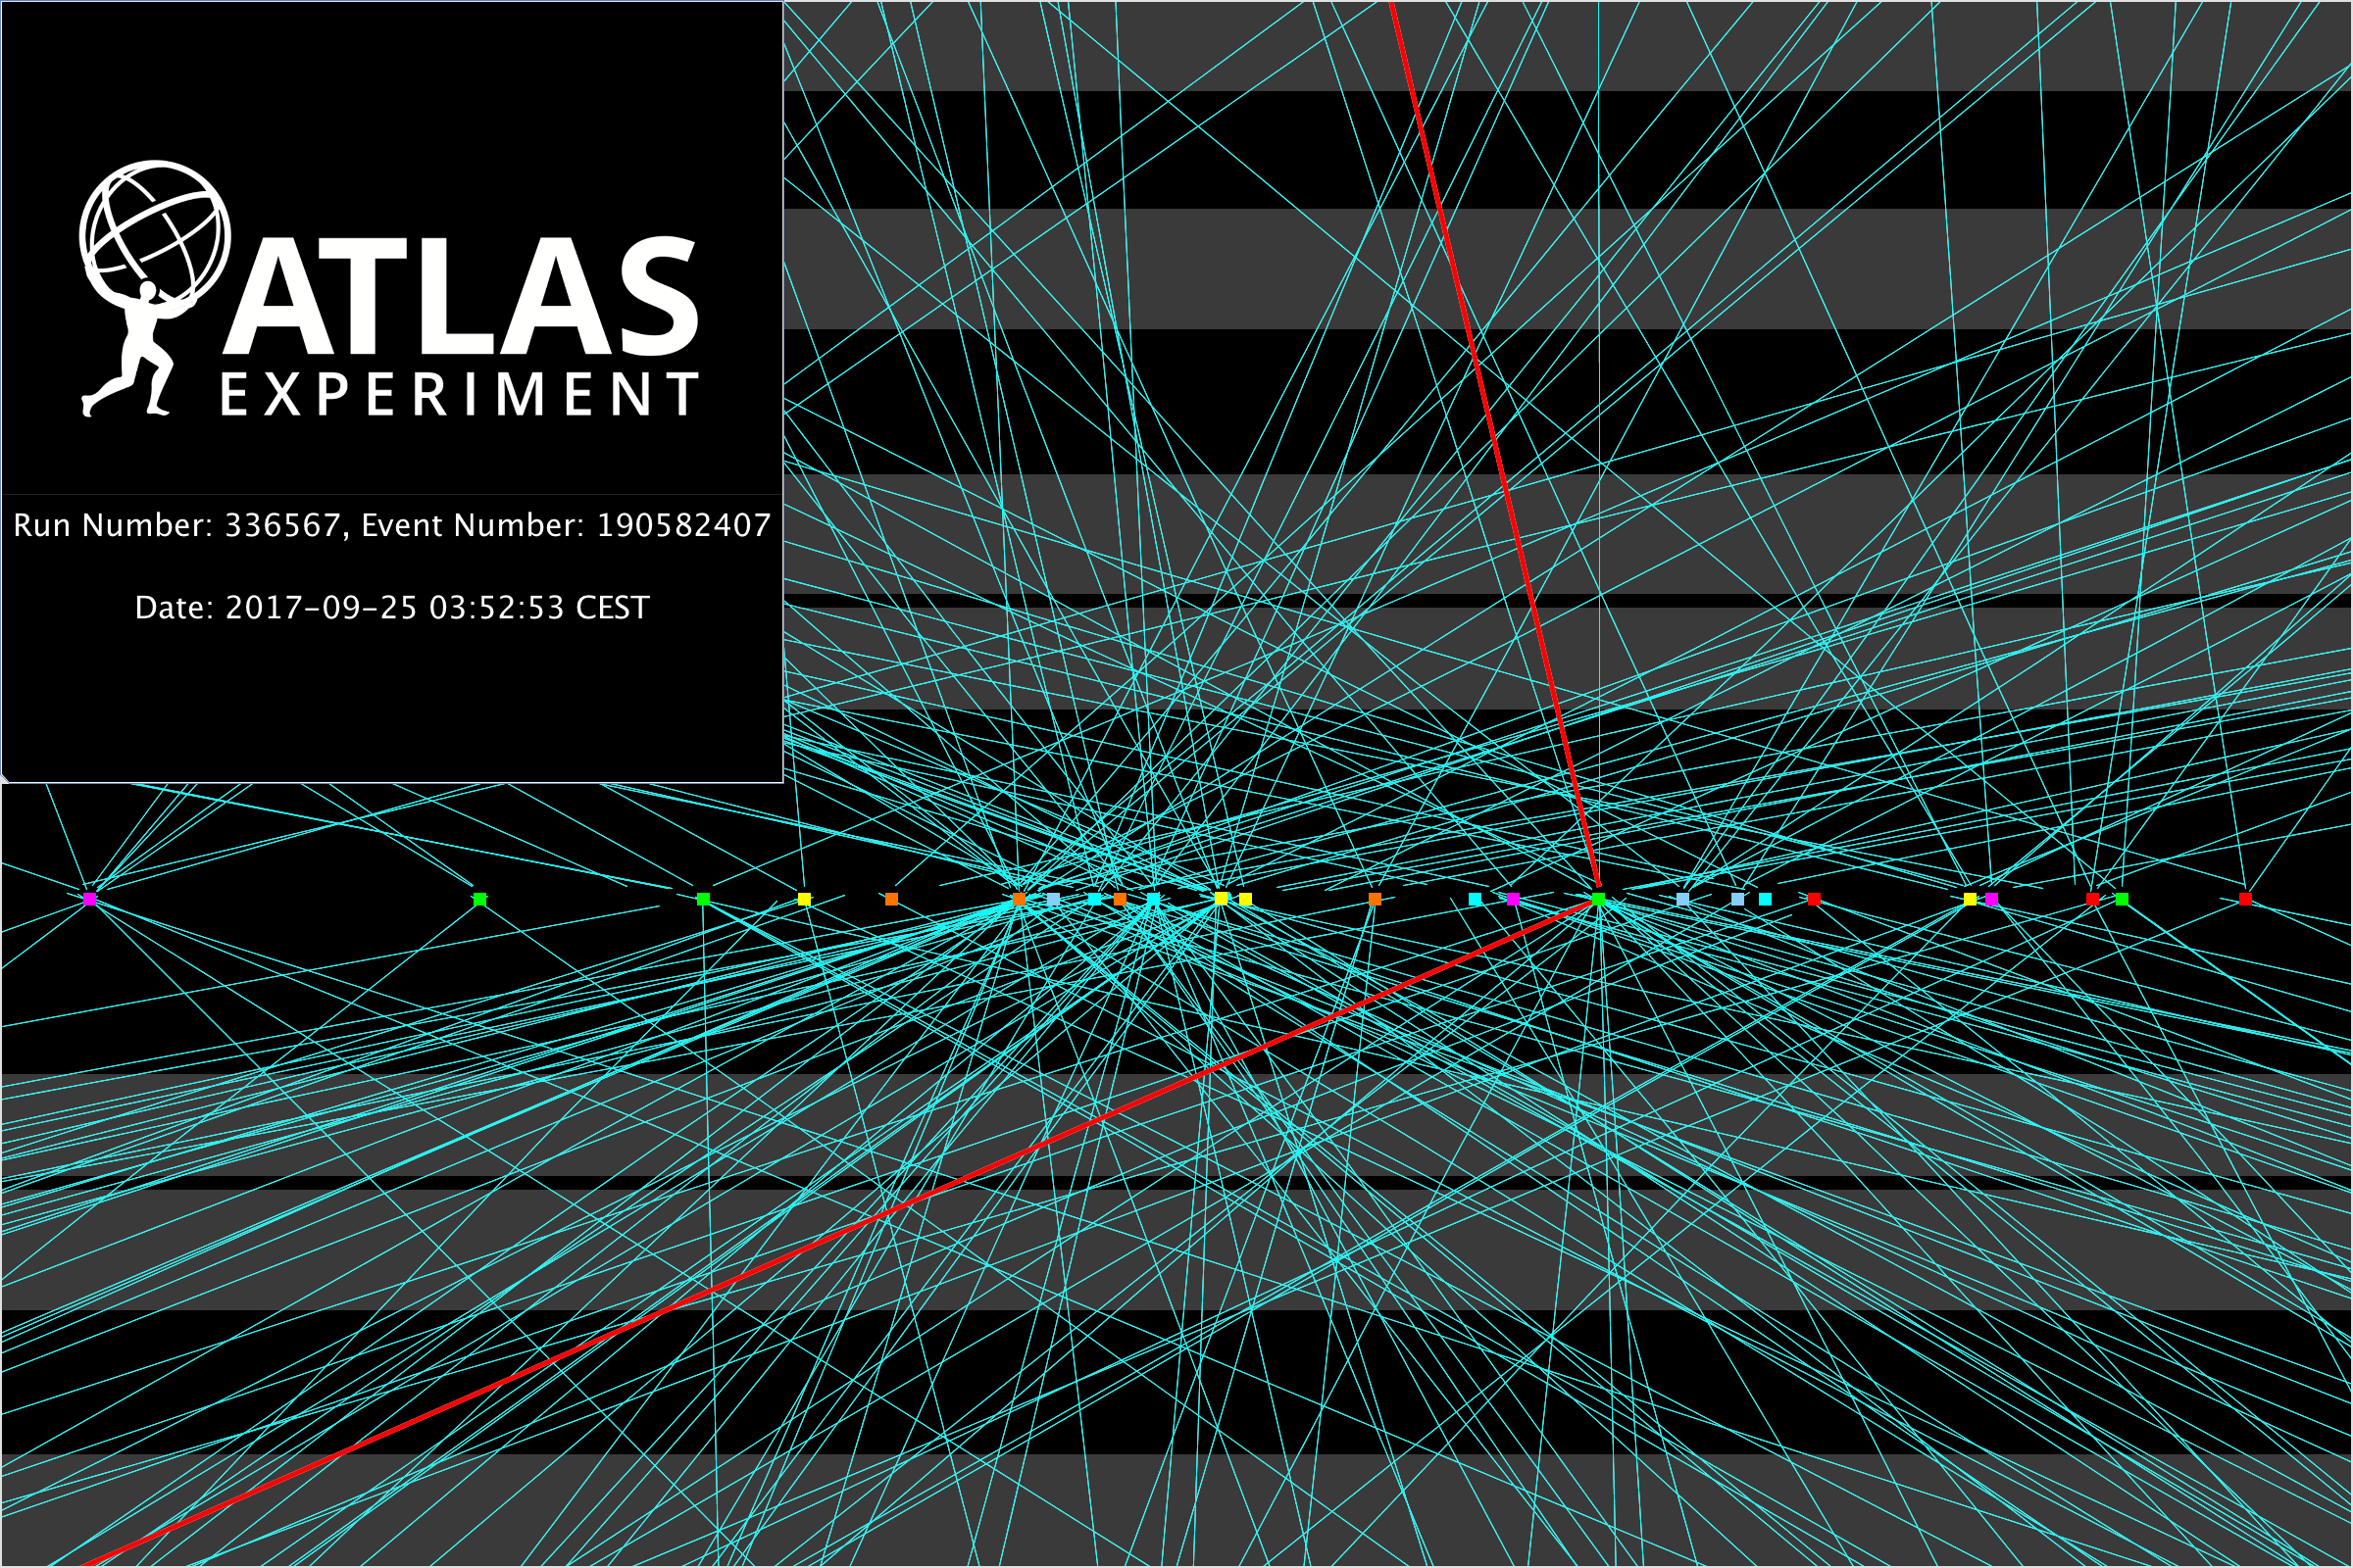

Objective
As the Large Hadron Collider (LHC) luminosity increases, so does the probability of having multiple proton-proton collisions (pileup). In Run 4, there will be 140-200 pileup (PU) collisions due to increased luminosity. These PU collisions degrade the energy and resolution of jets in the calorimeter.
Our goal is to implement and optimize machine learning (ML) algorithms, specifically Deep Neural Networks (DNN) and Graph Neural Networks (GNN), to identify topological clusters associated with PU effects in the ATLAS calorimeter at CERN's LHC.

Slide 3
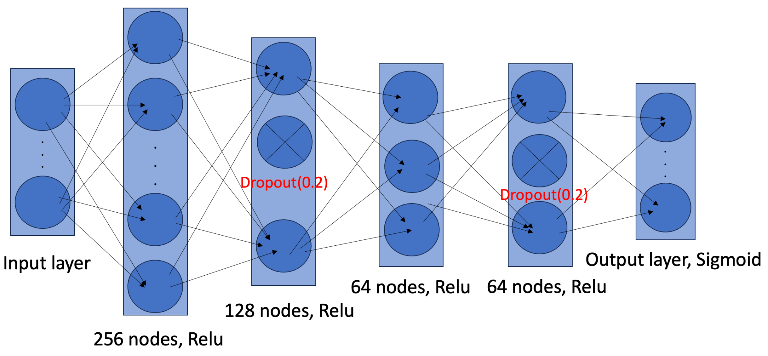
Deep Neural Network
A DNN is used to classify calorimeter topological clusters as either PU or non-PU, which is the target of our machine learning model.
We define a cluster as PU when its True MC energy is less than 0.001 GeV. This threshold is a consequence of the dijet MC simulation, where only the ionization from particles produced in the hard scatter is included in the True cluster energy.

Slide 4
Input Features to the DNN
Shower Depth and Shape
Topology
Signal Strength
cluster_PTD
cluster_FIRST_ENG_DENS
cluster_LONGITUDINAL
cluster_LATERAL
cluster_CENTER_LAMBDA
cluster_CENTER_MAG
cluster_ISOLATION
cluster_SIGNIFICANCE
cluster_CELL_SIGNIFICANCE
Kinematics
Pileup
clusterE
clusterEta
cluster_MASS
nPrimVtx
avgMu
*all of the features have been transformed.
Notes:
backup: feature importance, feature def

Slide 5
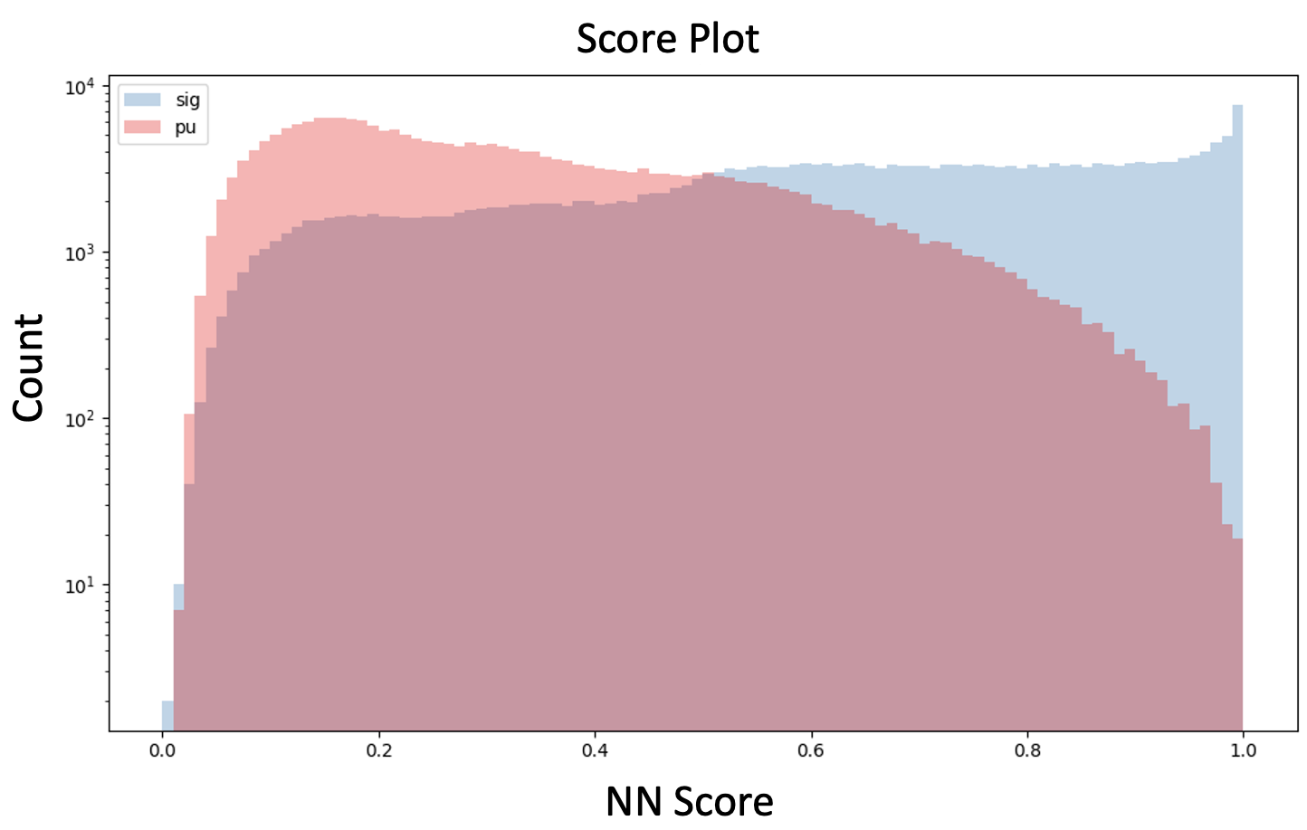
Result
We can observe that the model effectively distinguishes between PU and non-PU clusters in the extreme score regions, but its weaker differentiation in the mid-score range suggests room for improvement.

Slide 6
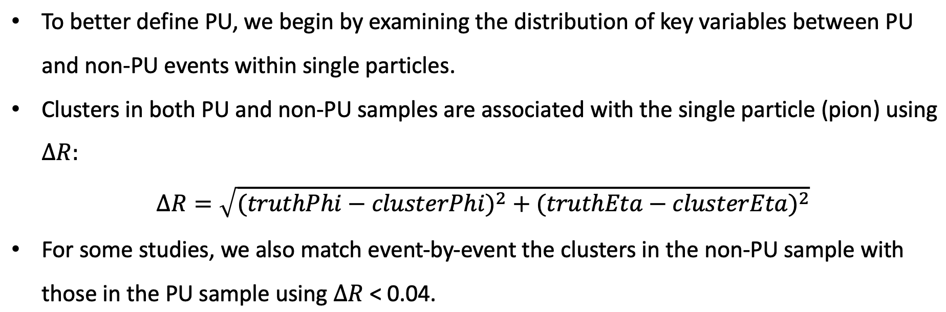
Refining the Definition of Pileup

Slide 7
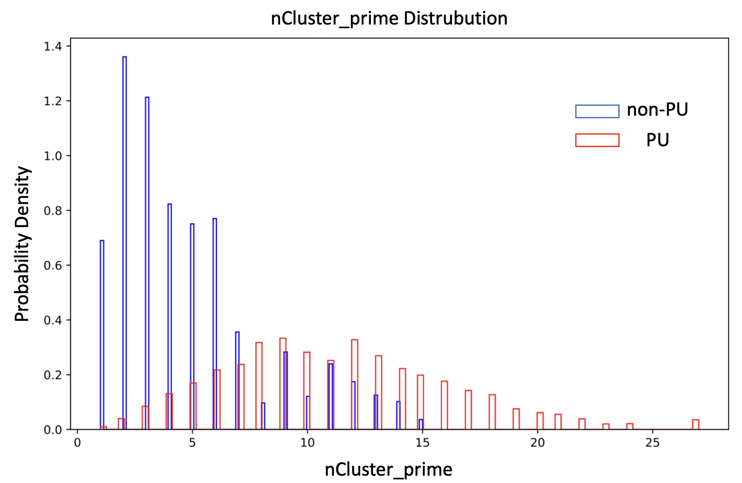
PU/non-PU distribution
nCluster_prime represents the number of clusters that satisfy
∆R < 0.4 with respect to the pion direction for each event.

Slide 8
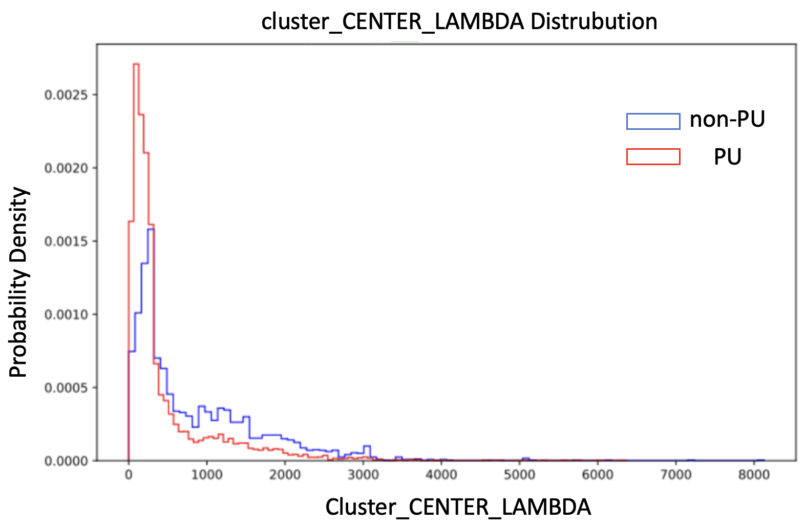
PU/non-PU distribution
Cluster_CENTER_LAMBDA represents the distance of the center of gravity (satisfying ∆R < 0.4) from the front face of the calorimeter.

Slide 9
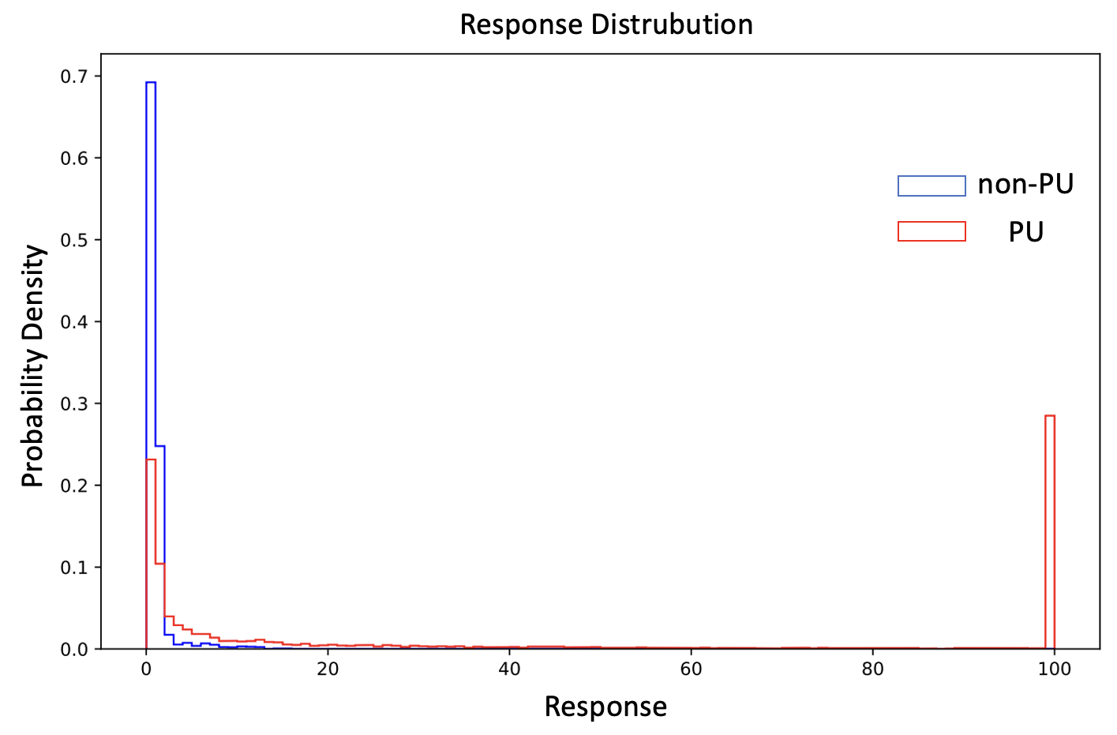
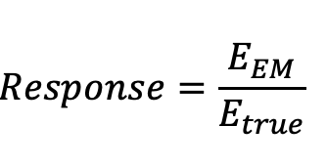
PU/non-PU distribution

Slide 10
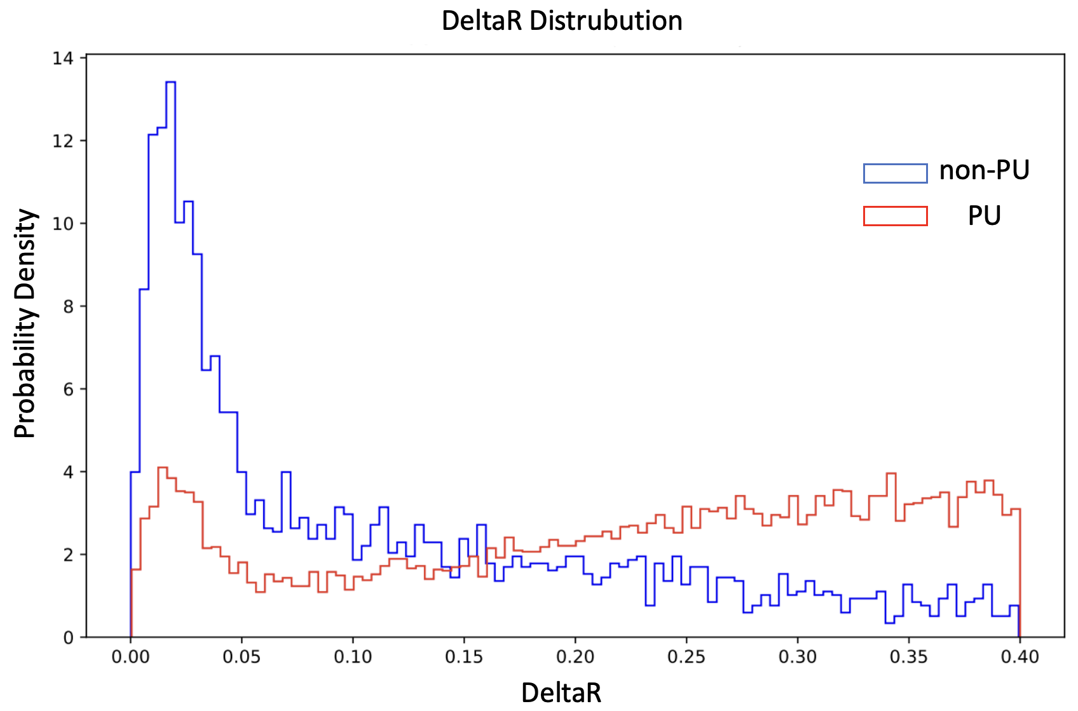
PU/non-PU distribution

Slide 11
Conclusions and Future Work
Conclusion
A DNN was created to classify topological clusters associated with pileup interactions.
The DNN accuracy was only modestly successful (70%) and we believe our target definition was not optimal.
Analyzing single particle distributions for PU and non-PU clusters helped identify key features, such as response and cluster position, for improving the definition of pileup clusters.
Work is in progress retraining the DNN with improved definitions.
Future Work
Once PU clusters are identified, we will use them to correct raw jet energies for PU contributions, by either removing them or deweighting them according to DNN score.
Our ultimate goal is to develop PU corrections to large R jets.

Slide 12
Acknowledgement
This work is supported by the CERN US-ATLAS SUPER program.
Many thanks to Dr. Peter Loch, Dr. Jad Sardain and my advisor, Prof. Kenneth Johns, at the University of Arizona, for their critical suggestions.

Slide 13
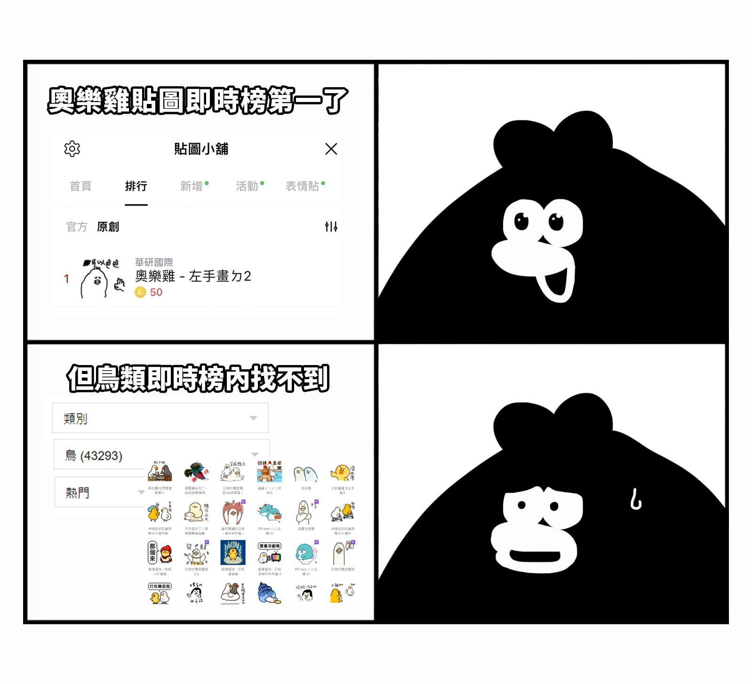
Thank you for listening
Finished the presentation
Q & A

Slide 14
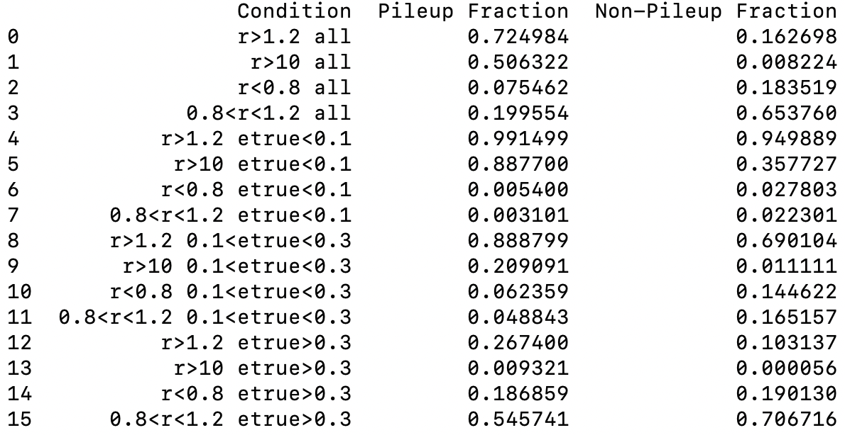
Backup – PU fraction with different definition

Slide 15
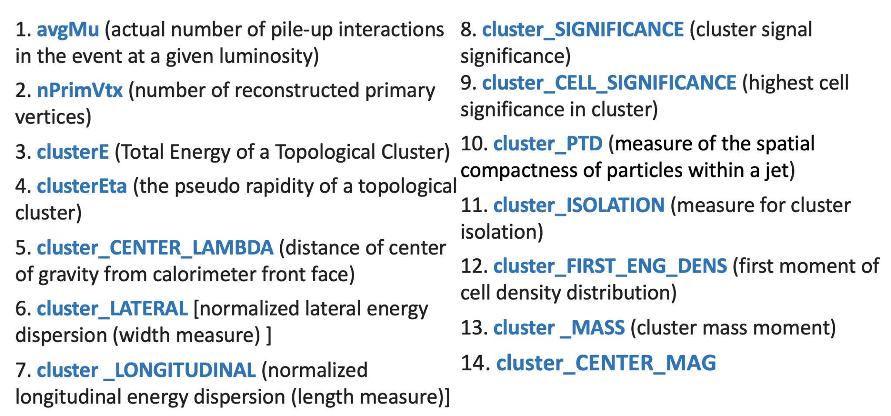
Backup – Input Features

Slide 16
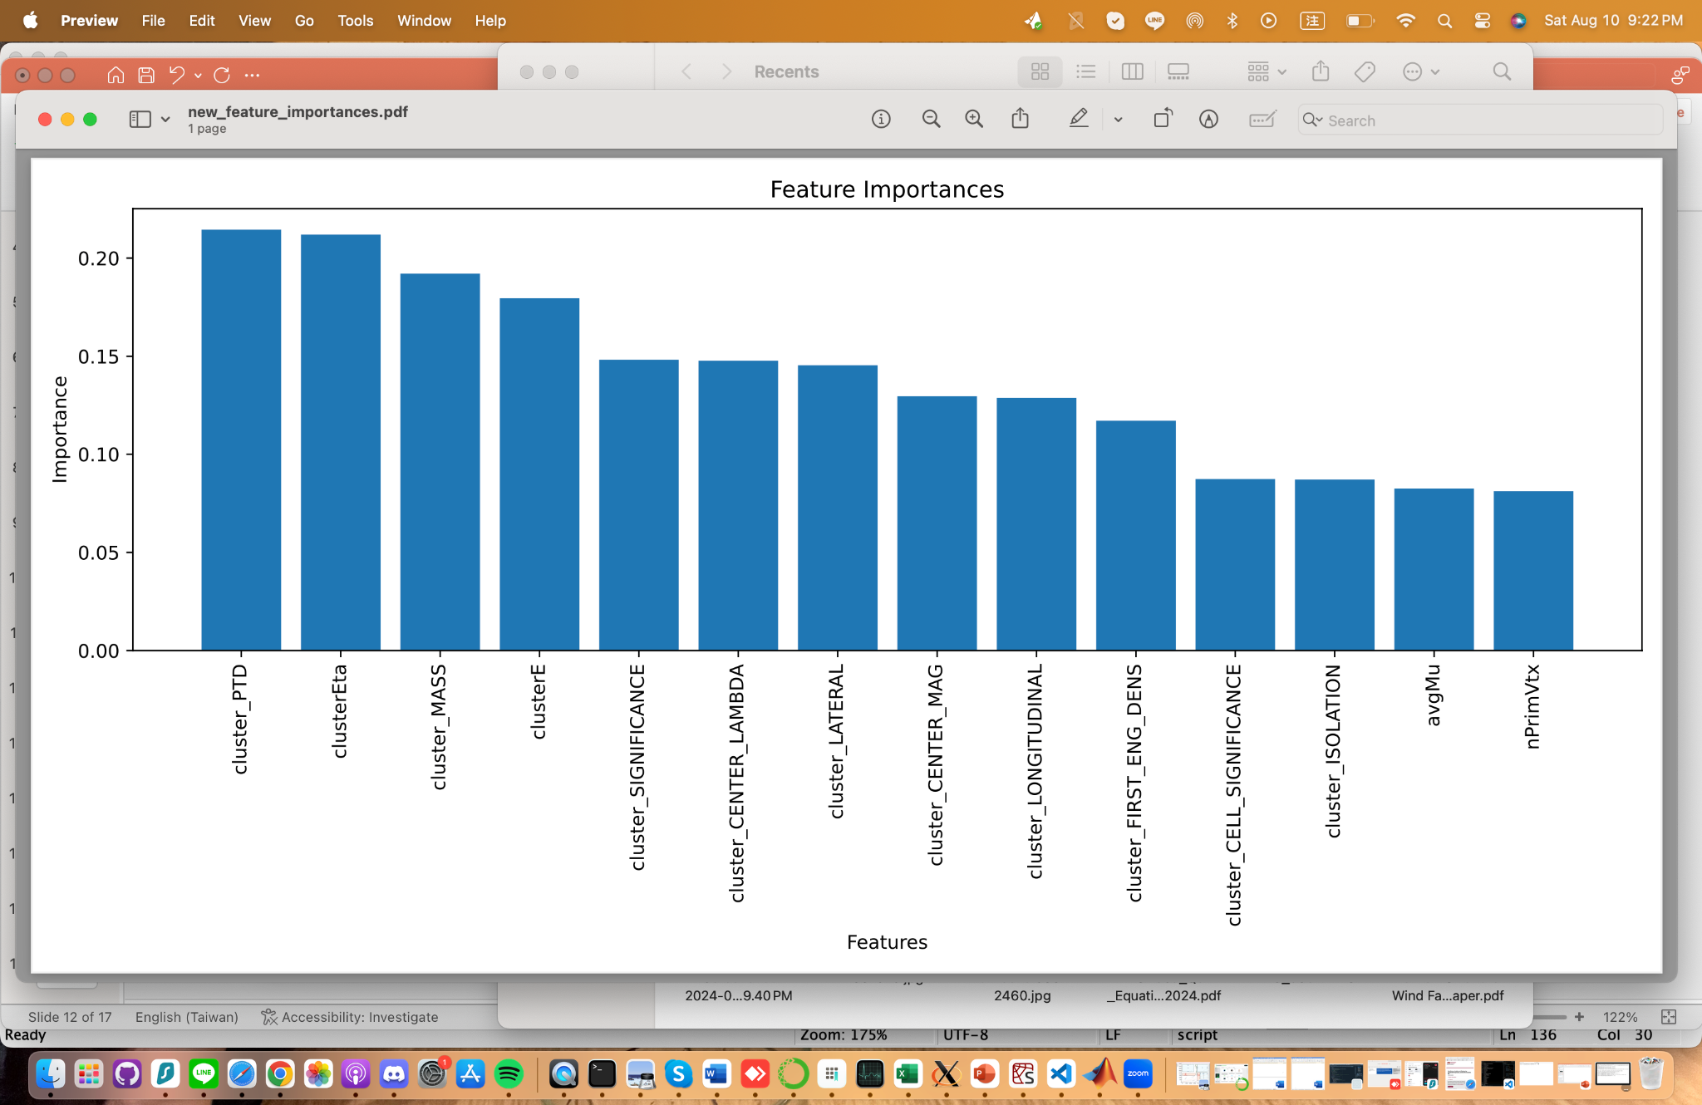
Backup – Features Importance

