Slide 1


Training Neural Networks to Learn Broken Lorentz Symmetries
Shelley Tong
University of California, Irvine

Slide 2
Limitations of Traditional Data Analysis in Particle Physics:
LHC produces vast amounts of data revealing new particles and interactions
Data analysis is challenging due to the sheer volume and complexity
Traditional Data Analysis…
Often reduces data dimensions, oversimplifying the dataset.
Risks overlooking important information.
Machine Learning!

Slide 3
Problems With Machine Learning
Machine Learning in Particle Physics:
  Capable of distilling crucial patterns from high-dimensional, high-volume data.
  Powerful tool for reconstructing particles and identifying events of interest.
However, it still has challenges:
Symmetries in ML networks are idealized and may not reflect real data.
Data collection devices at LHC break these symmetries due to their discrete nature.
Potential solution – data augmentation: a technique to increase training data by modifying existing data.
Not effective for jet deposits in calorimeters due to rotation artifacts.
Post-detector rotation introduces artifacts, leading to incorrect symmetry learning.

Slide 4
Training ML Networks to Learn Broken Symmetries
Goal of my research project:
Explore the impact of imposing symmetries on machine learning models when the symmetry is not exactly conserved in the data.
We focused on situations where Lorentz invariance is violated due to poor detector measurements.

Slide 5
Training ML Networks to Learn Broken Symmetries
Ideally, Lorentz invariance would guarantee that the mass reconstruction for a particle remains consistent regardless of its velocity.
However, the resolution of our detectors varies with the particle's velocity
Particles with high transverse momentum suffer from worse resolution compared to slower-moving particles.
Encounters a violation of Lorentz invariance that is dependent on the transverse momentum (pT) of the particle

Slide 6
This project is divided into two parts:
Implementing an algorithm that reconstructs the invariant mass and a pT-dependent blurring function.
2) Training machine learning classifiers using PyTorch to classify individual events (a pair of muons) as either signal or background.

Slide 7
Signal and Background
We examined Z production from proton-proton collisions: p p → Z → μ+ μ-, using sample collider data from the Large Hadron Collider.
Dominant background: p p → g → b b → μ+ μ-
which results in a falling, exponential decay distribution.

Slide 8
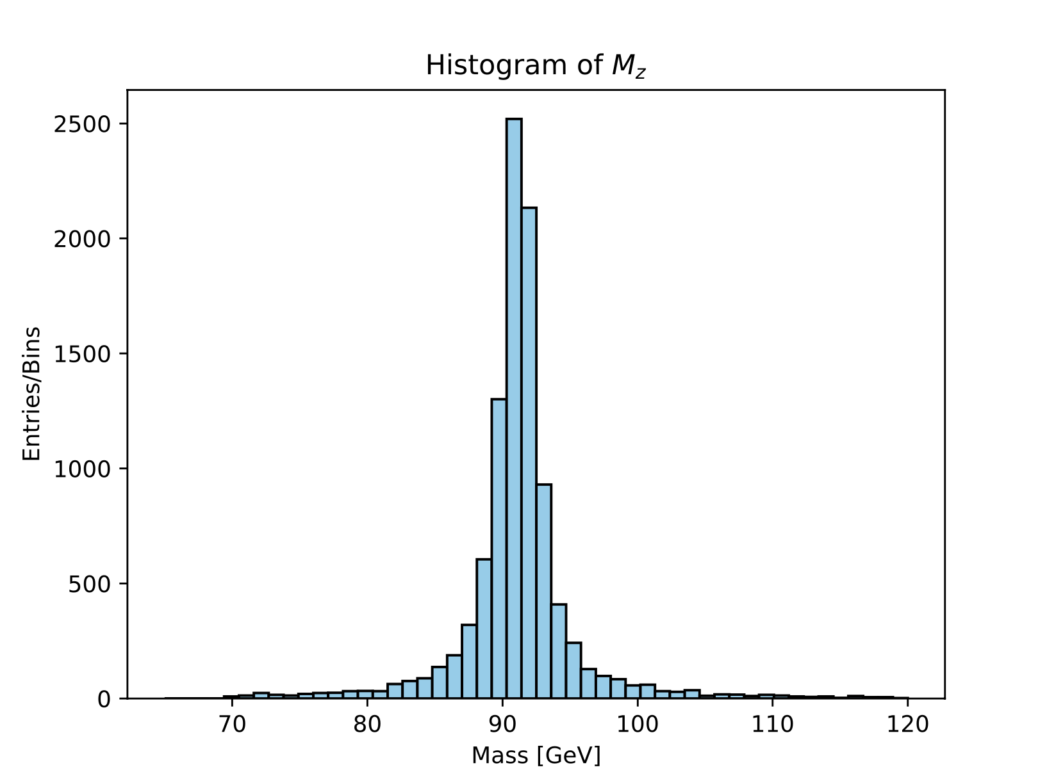
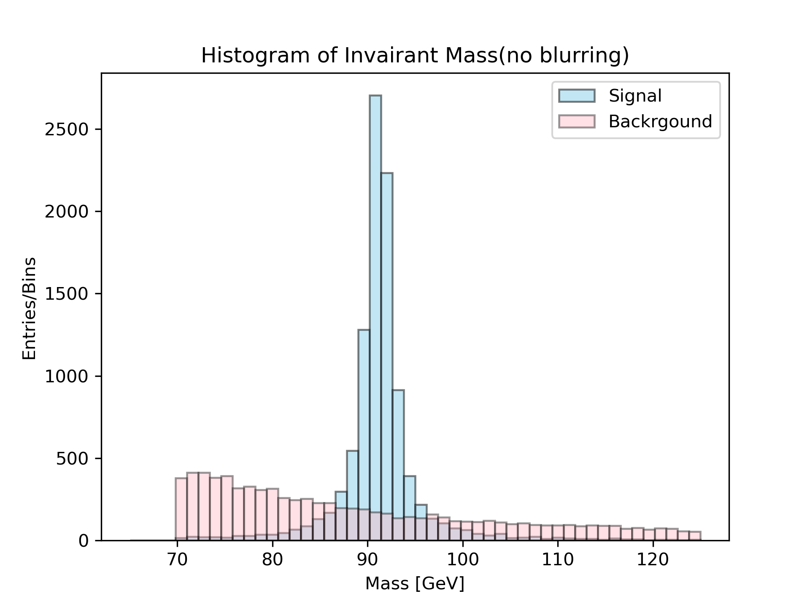
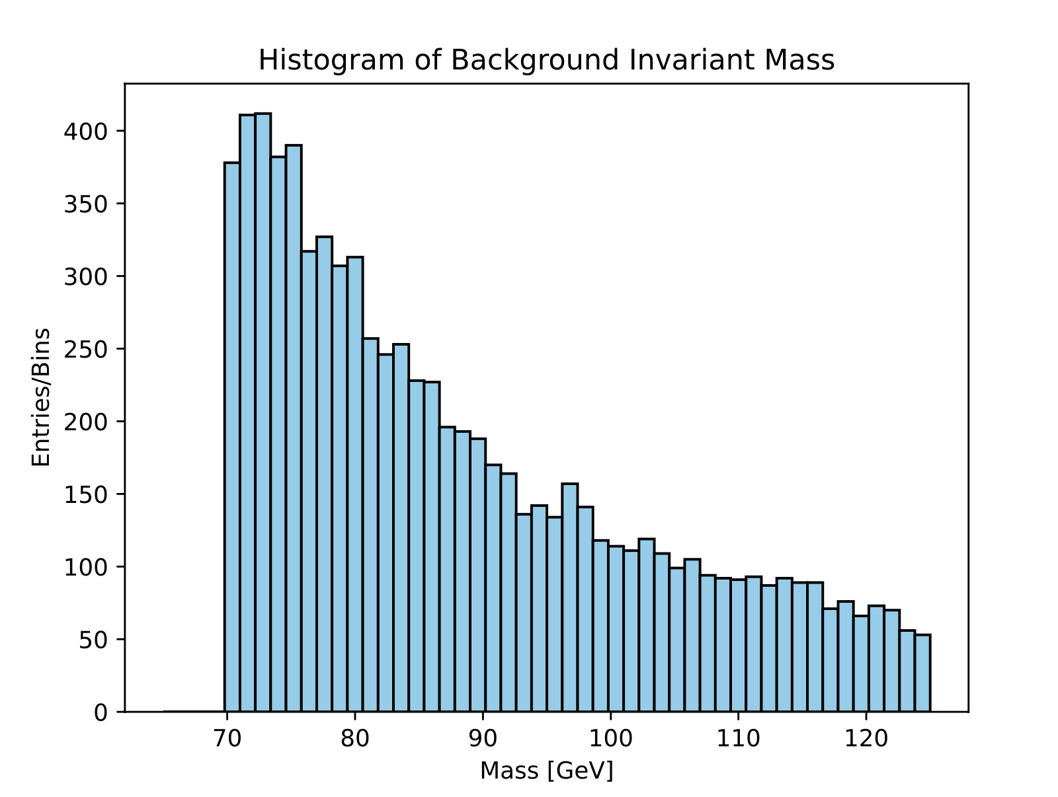
Signal and Background Invariant Mass Histogram

Slide 9
pT-Dependent Resolution Function:
Introduced a pT-dependent resolution function to break Lorentz invariance in perfectly measured muons.
Adds Gaussian noise to px and py with standard deviations proportional to pT.
Gaussian noise set at 0.1 * |pT|, creating a resolution that varies with reference frame.

Slide 10
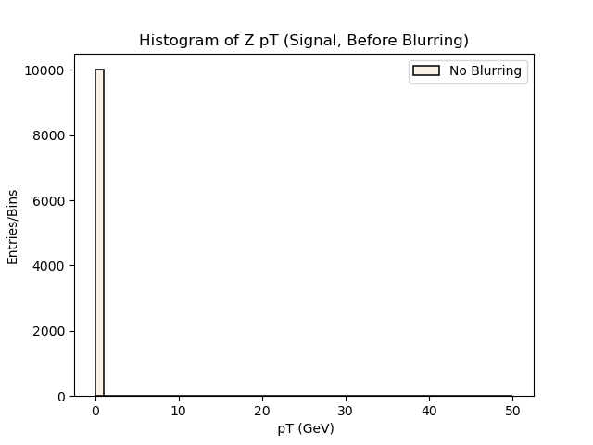
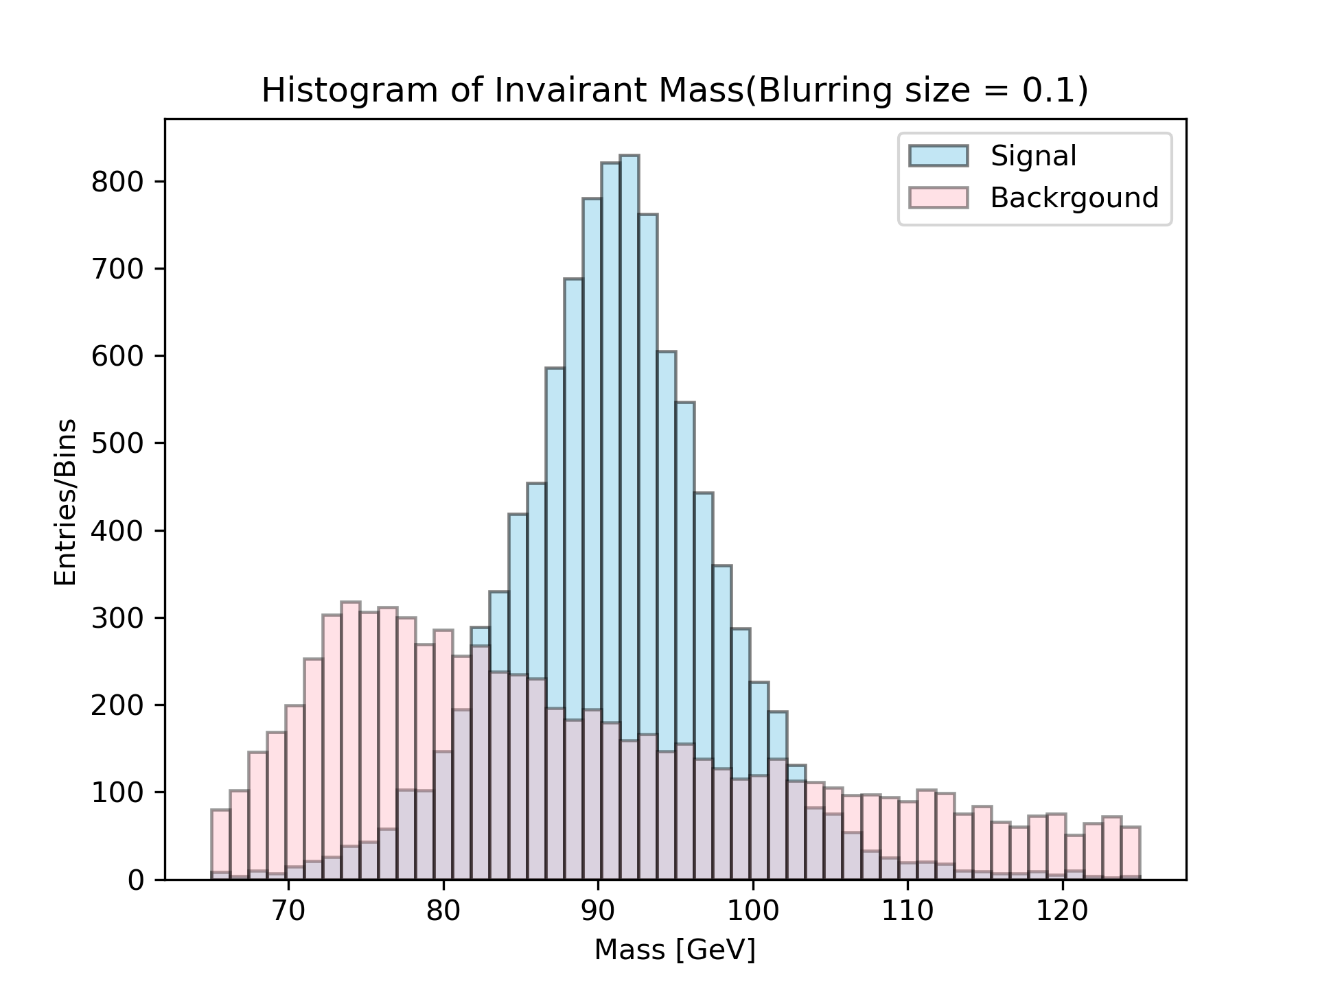
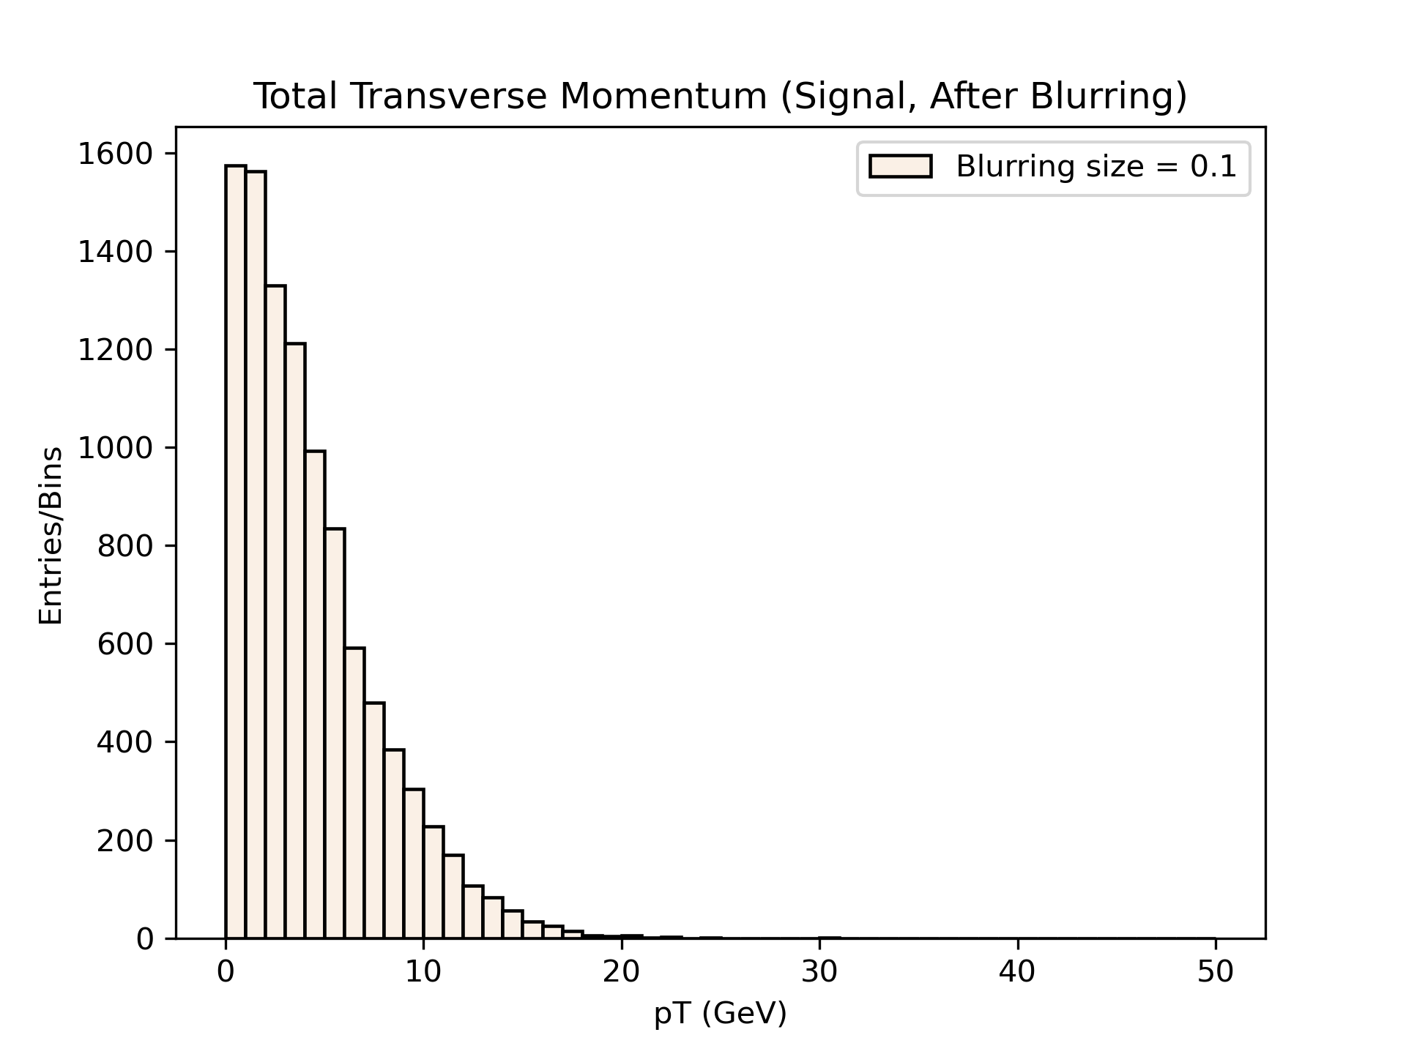
Signal and Background Invariant Mass Histogram (After Blurring)

Slide 11
Implementing Classifiers
The current phase of my project involves implementing and training three classifiers using PyTorch:
A strictly Lorentz invariant classifier.
2) A totally general classifier.
3) A combined classifier with the first two subnets, including a weighting factor indicating the allowed amount of violation.

Slide 12
Implementing Classifiers
We expect the Lorentz-invariant classifier to learn more efficiently but to have suboptimal performance, since the problem includes Lorentz invariance.
The general classifier should achieve maximum performance, but with extensive training.
The weighted classifier should reach the max performance more rapidly than the general one.

Slide 13
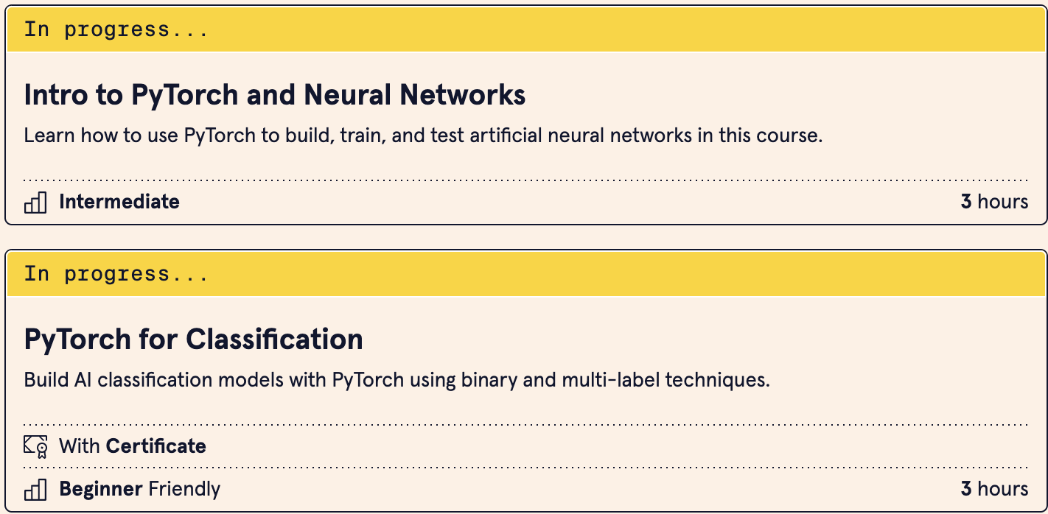
Challenges
Having no prior experience with Machine Learning at the start of this project, I have been taking online ML classes to learn how to build and train classifiers using PyTorch.

Slide 14
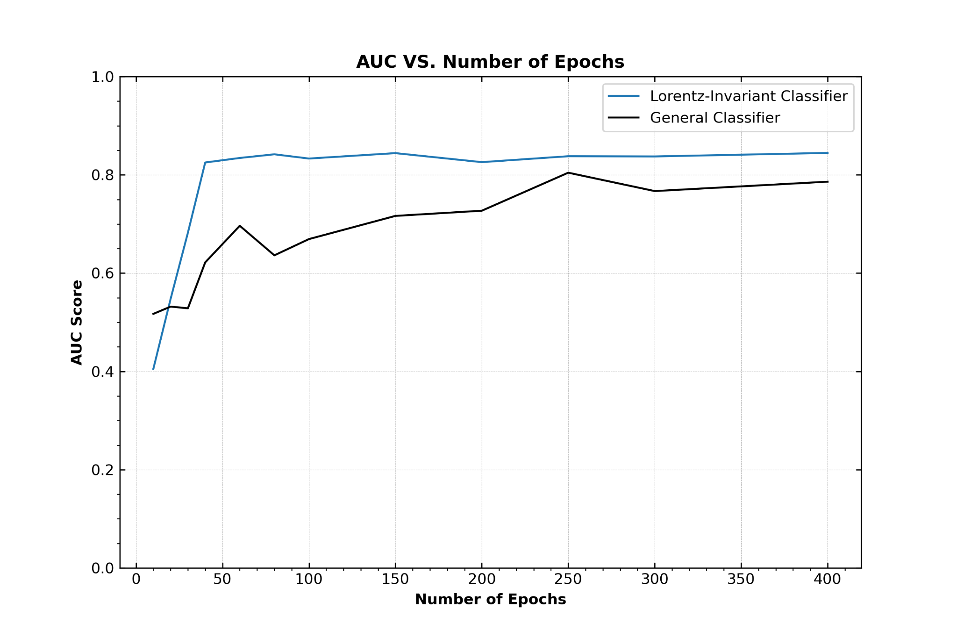
Preliminary Results: AUC Score

Slide 15
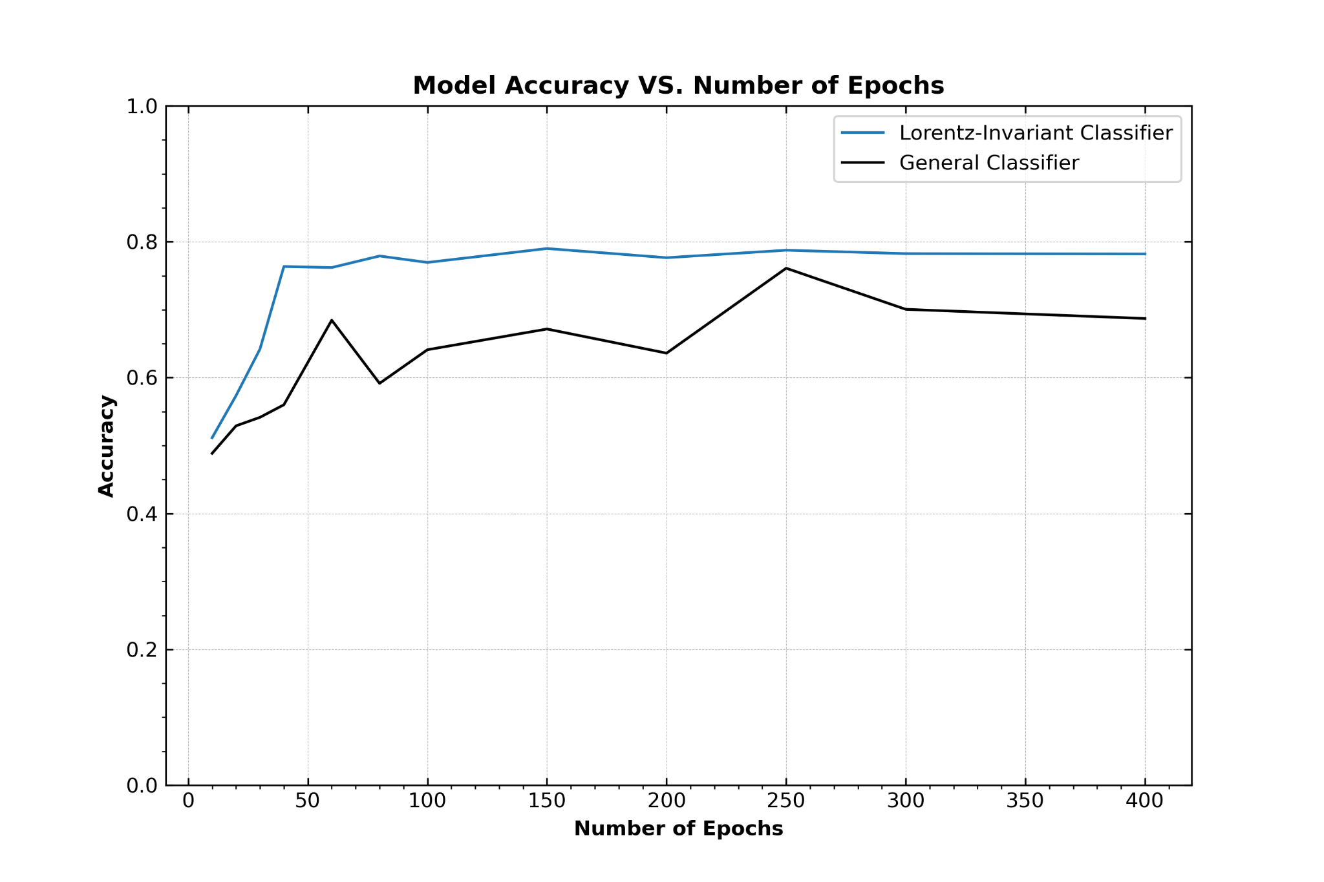
Preliminary Results: Accuracy

Slide 16
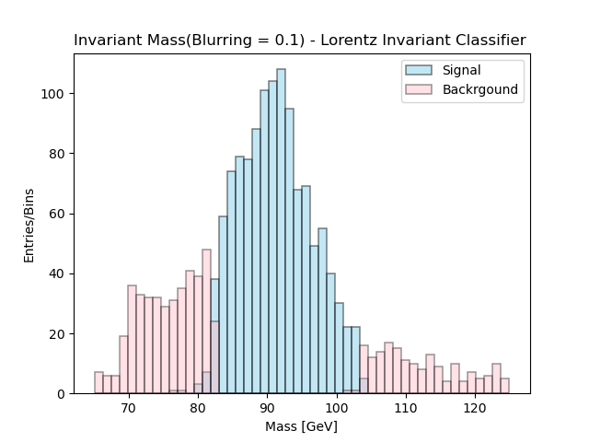
Lorentz Invariant Classifier: Preliminary Results

Slide 17
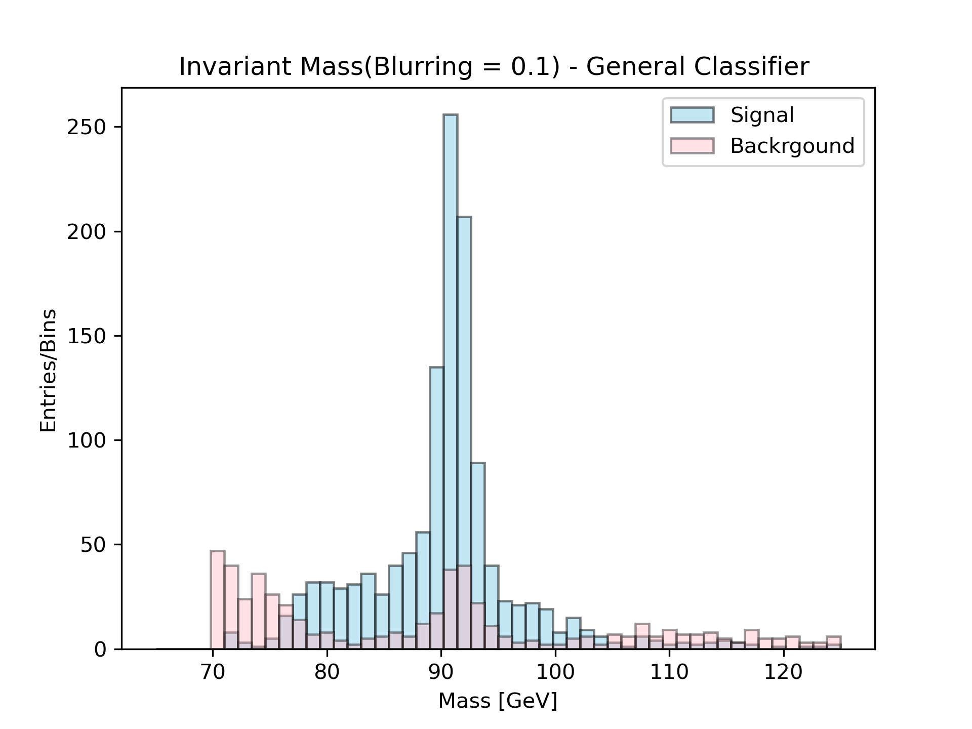
General Classifier: Preliminary Results

Slide 18
Next Steps:
Finish implementing the hybrid classifier.
Fine-tune the three classifiers for better performance and accuracy,
Train & test the ML models on data with different blurring sizes (0.01, 0.05, 0.3).

Slide 19
References:
[1] Karagiorgi, Georgia, et al. "Machine learning in the search for new fundamental physics." Nature Reviews Physics 4.6 (2022): 399-412.
[2] L. Alzubaidi, J. Zhang, A. Humaidi, et al., J Big Data 8, 53 (2021), URL https://doi.org/10.1186/s40537-021-00444-8.
[3] T. Cohen and M. Welling, in Proceedings of The 33rd International Conference on Machine Learning, edited by M. F. Balcan and K. Q. Weinberger (PMLR, New York, New York, USA, 2016), vol. 48 of Proceedings of Machine Learning Research, pp. 2990–2999, URL https://proceedings.mlr.press/v48/cohenc16.html.
[4] Witkowski, Edmund, and Daniel Whiteson. "Learning Broken Symmetries with Resimulation and Encouraged Invariance." arXiv preprint arXiv:2311.05952 (2023).

