Slide 1
CERN - ET Coordination meeting
Kick-off
Luigi SCIBILE
Meeting 10-07-2024

Slide 2
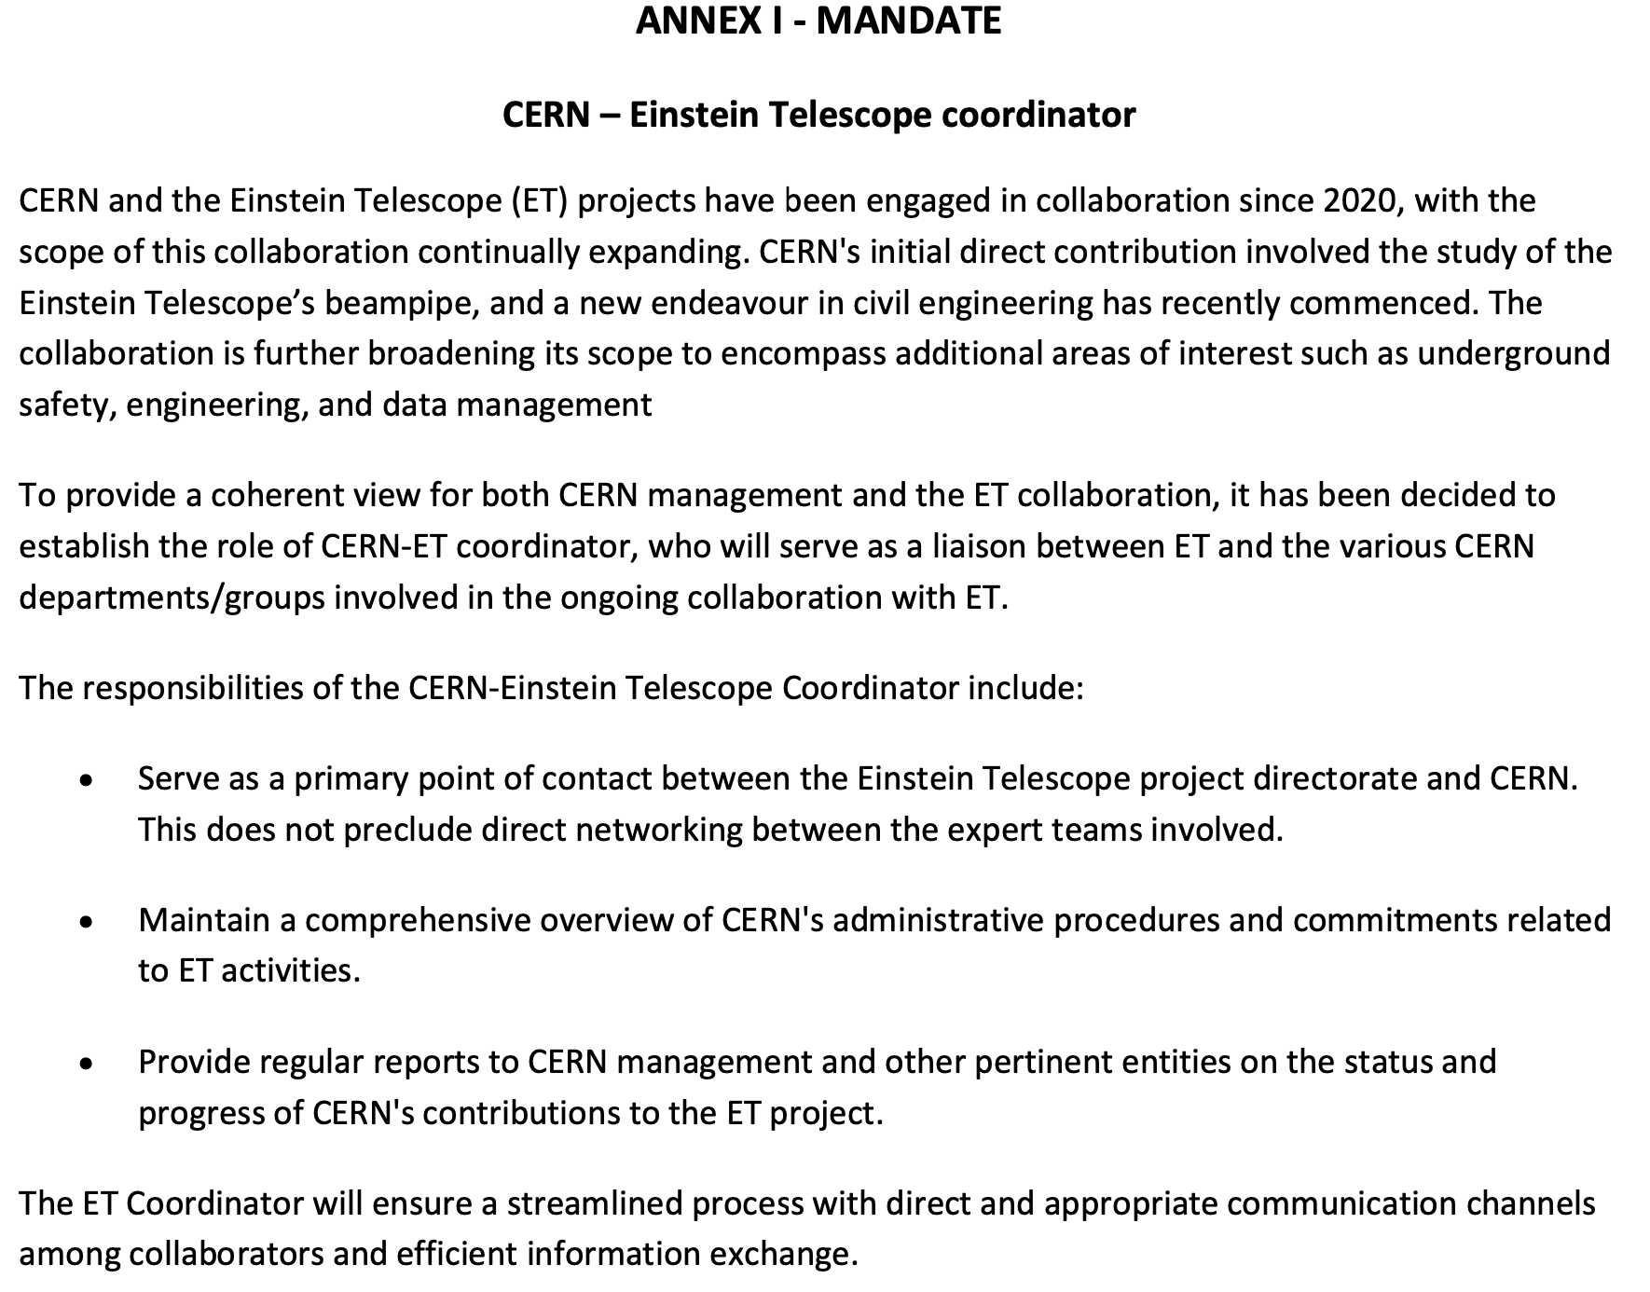
CERN – ET coordinator: mandate
  Provide a coherent view.
  Serve as a primary point of contact.
  Maintain a comprehensive overview of CERN's administrative procedures and commitments.
  Provide regular reports.

Slide 3
CERN – ET coordination: organisation
  Roles:
      Technical contacts (or delegates, as defined in the various addenda) manage their corresponding contribution.
      Coordinator: (1) provides an overall view of the CERN contribution, (2) serves as primary point of contact, (3) Maintain a comprehensive overview of CERN's administrative procedures and commitments, (4) provide regular reports and (5) organise “regular” coordination meetings with the Technical contacts of each addenda and ET counterparts.
  Monthly/Quarterly coordination meetings with ET counterparts.
  Annual general communication meeting with all contributors and ET counterparts.
  Annual steering meeting with ATS, SCE and HSE and ET management.
  Event based proactive communication

Slide 4
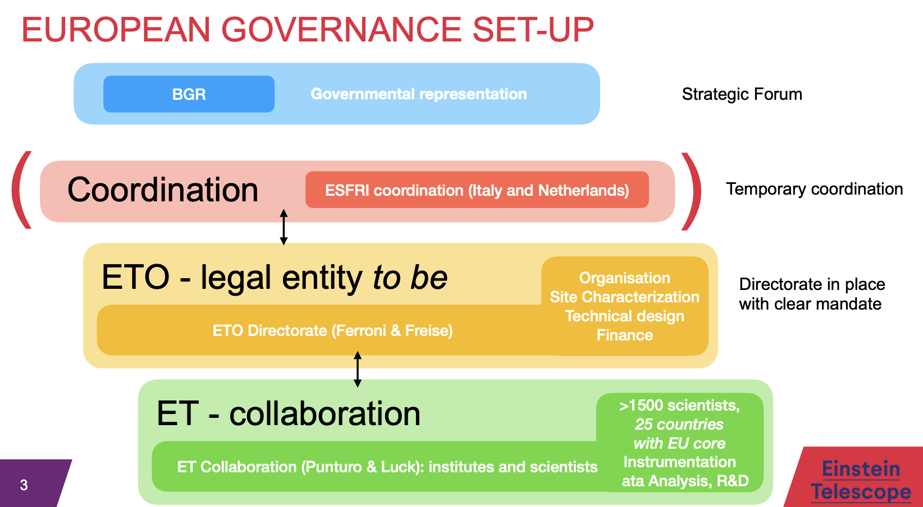
CERN – ET: Overview
ET is a collaboration between several laboratory and has no legal entity yet.
ET is in the Preparatory Phase (ESFRI def.)
CERN is collaborating with ET Organisation (ETO)

Slide 5
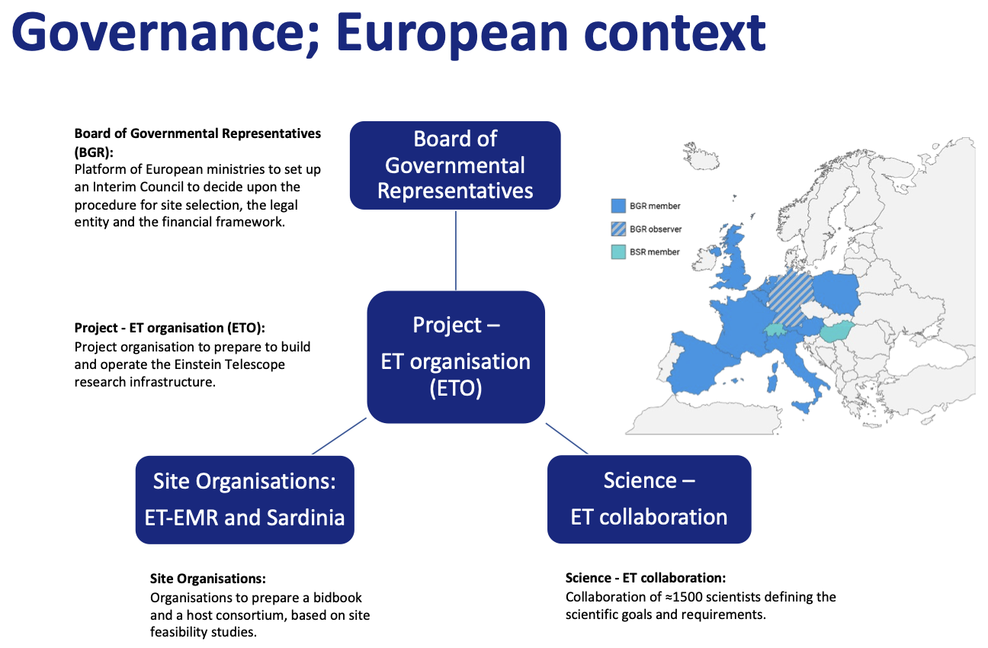
CERN – ET: Overview
Slide extracted from: https://indico.ifae.es/event/1930/contributions/8302/attachments/2626/4111/ETcoord-2024-ETPP-06-17-v2.pdf

Slide 6
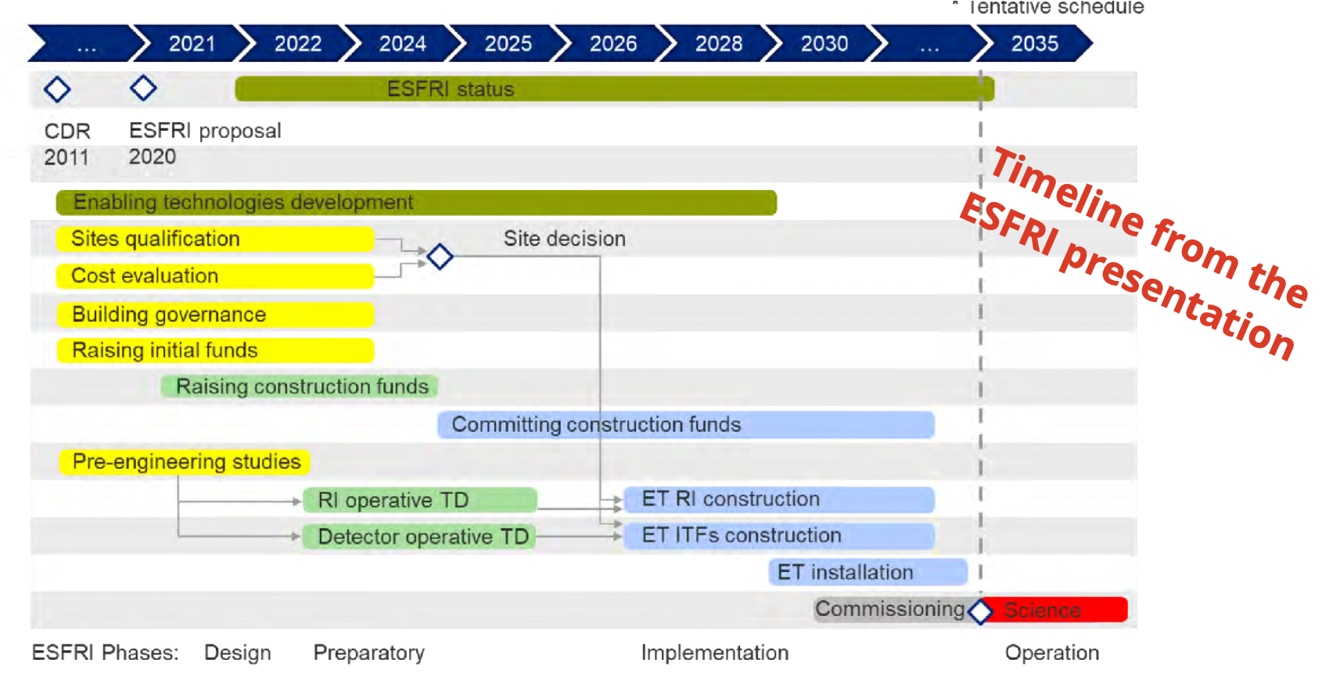
CERN – ET: Overview
Current roadmap obsolete
New ET roadmap being prepared
Triangle vs 2L still being debated.....discussions going on if cost estimate of the two options should be done before site decision.
New optical layout was produced for the triangle configuration and it is being cascaded to the detector infrastructure. It should be completed by September 2024. A similar process is being carried out for the 2L configuration...to be completed by December 2024.

Slide 7
CERN – ET: Status
In progress:
  ET Vacuum Pipe -> Extension being prepared that will run until Q3 2027.
  ET Civil Engineering
Being prepared:
  Engineering (with EN) and safety (with HSE) support for ET infrastructure.
  ET Costing support.
Under preliminary discussion:
  ET Alignment and metrology.
  ET Cryogenics.

Slide 8
CERN – ET: ET Events
Past ET events:
  XIV Symposium in Maastricht 6–10 May 2024: https://indico.ego-gw.it/event/710/
  1st ET Organization plenary meeting in Amsterdam 27–28 May 2024 : https://agenda.infn.it/event/41148/
  ET-PP annual meeting in Barcelona 17-19 June 2024: https://indico.ifae.es/event/1930
Forthcoming ET events:
  3rd ET Annual Collaboration meeting, November 2024.

Slide 9
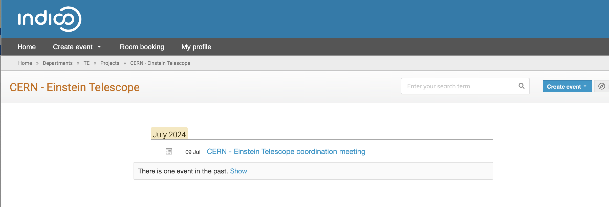
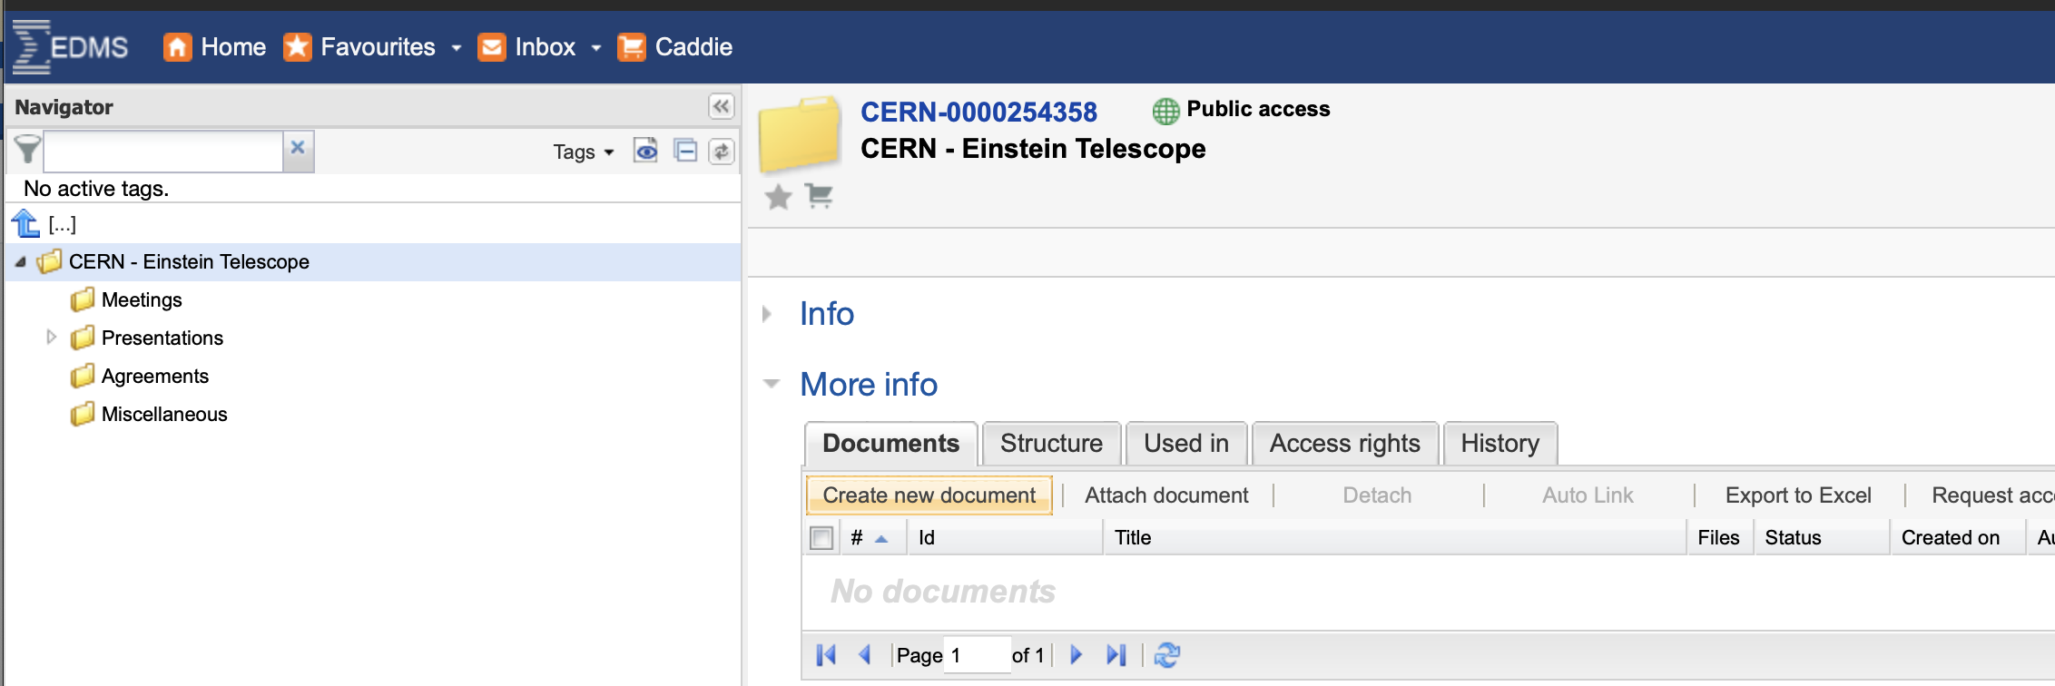
CERN – ET coordination: Logistics.
  Meetings in Indico dedicated category
  Documents and minutes in EDMS
  Egroup for communications CERN-EinsteinTelescope@cern.ch

