Slide 2
Mechanical analysis of MBHDP301b assembly and test
Carmen Abad on behalf 11Tesla team
Diego Perini, Ruth Diaz Vez, Cedric Garion, Marco Morrone, Francois-Olivier Pincot, Frederic Savary, Attilio Milanese, Susana Izquierdo Bermudez, Nicolas Bourcey, Nicholas Lusa, Sebastien Luzieux, Michael Guinchard, Sylvain Mugnier, Franco Julio Mangiarotti, Gerard Willering, Jerome Freuvrier, Filip Kosowski, Jean-Luc Guyon, Patrick Viret
Meeting category:
https://indico.cern.ch/category/5095/
Meeting:
https://indico.cern.ch/event/1430746/

Slide 3
Content
Introduction
    Context
    Magnet new mechanical features
Magnet fabrication
  Mechanical instrumentation
  Coils
  Shimming plan
  End cage
Cold test results
Mechanical measurements
  Some words
  Collar nose stress
  Magnet end plate bullets
  End cage rods
Conclusion
References

Slide 4
1. Introduction

Slide 5
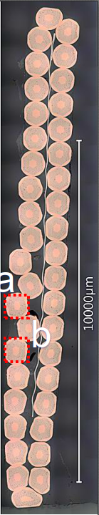
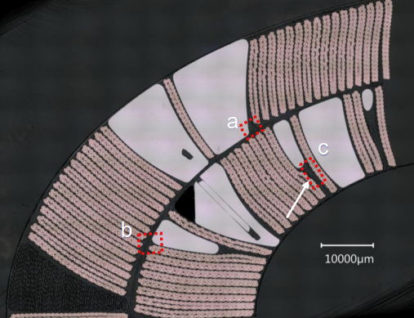
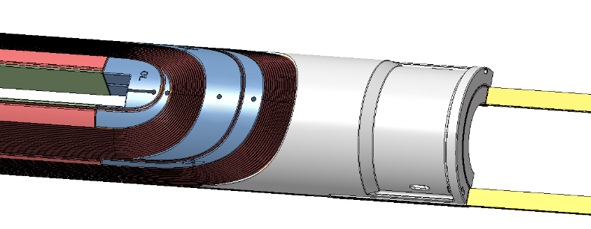
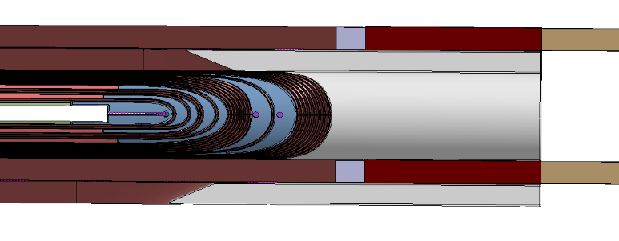
Context
Tomography analysis
After the test of four 11T series magnets (S1, S2, S3, S4), three of them showed performance degradation and the quenches were localized primarily in the coil heads. These results led to the decision not to install the 11T magnets during Long Shutdown 2 (LS2) and to reassess the next steps. Subsequent research metallographic analysis and comparison with a 3D FEA analysis [1] revealed high stress areas in the coil ends, that correspond to the quench localizations in S2 and S4. Tomography analysis showed strand pop outs.
Two types of issues were identified, internal to the coils and external to the coils. The internal are outside of the scope of this study because they can’t be addressed without manufacturing new coils. The external identified are:
C-MAC - Review of the 11 T magnet programme - Rehearsal (February 25, 2021) · Indico (cern.ch)
High stressed areas and stress singularities after collaring in the coil outer layer's first turn.
High stressed areas and stress singularities after cool-down in the coil outer layer's first turn.
High peak stresses during powering in the coil inner layer turns.
Non-optimal coil end support for the electromagnetic axial force difference in between the blocks.
Non-optimal axial loading. S2 & S3 cold masses had a loosened and deformed axial loading screw (bullet).
Notes:
The upgrade of the Large Hadron Collider, Hi-Luminosity (HL-LHC) project had planned to replace some LHC dipoles by 11Tesla dipoles. To this end, several 11T model magnets were manufactured and tested, demonstrating the robustness of Nb3Sn, as seen in the model SP107 [1]. However, this performance has not been reproduced in the long magnets. Four 11Tesla series magnets were tested. While the first magnet (S1) reached nominal current after a few training quenches and exhibited good training memory after thermal cycling, the subsequent three magnets showed performance degradation, either upon the first cooldown (S3) or after two or more cooldowns (S2 and S4).

Slide 6
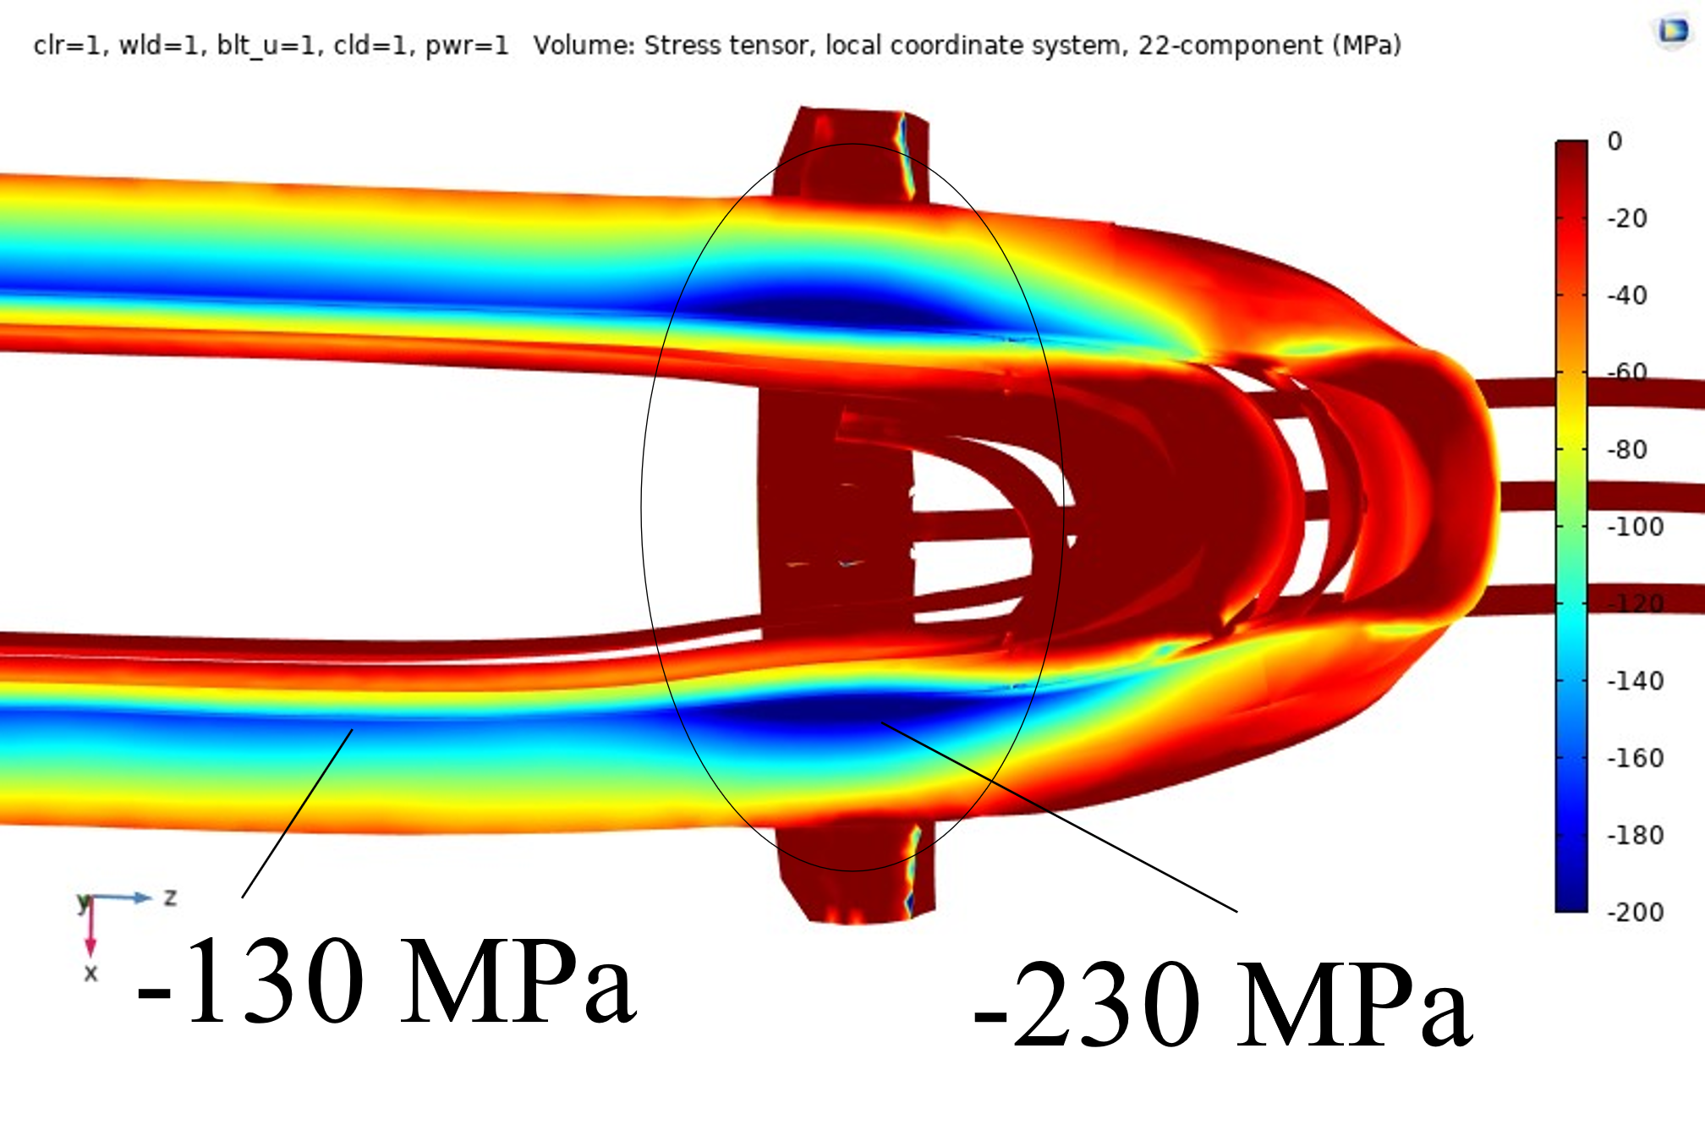
Magnet new mechanical features
To assess the high stressed areas, new mechanical features are installed in a double aperture hybrid prototype.
Mitigation measures 1 (Aperture 1, SP301)
New shimming plan with excess reduction in the ends.
Pole material change from Titanium to austenitic Stainless Steel.
With these two new features a reduction of the high peak stresses during powering is observed in the 3D FEA [1].
Mitigation measures 2 (Aperture 2, SP302)
Mitigation measures 1 + end cage system
Objective: compact the head coil blocks during powering and improve the axial loading.
Drawback: azimuthal stress in coil inner layer increase at the position of the end cage
In previous models, the peak stresses on the mid plane has been found as one of the limitation for the coil performance [2].
Courtesy of M. Morrone C. Garion
Notes:
To asses the stresses during collaring…
The reduction of the stresses during cool down will be assessed with the pole material change….
These two solutions are also aimed to reduce the high peak stresses during powering.

Slide 7
2. Magnet fabrication

Slide 8
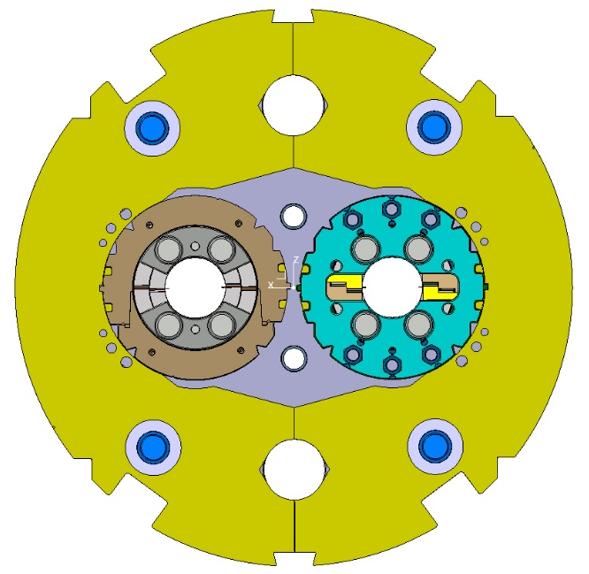
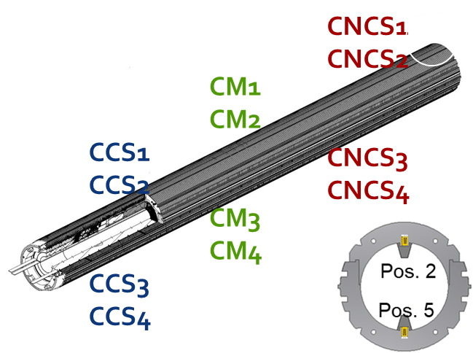
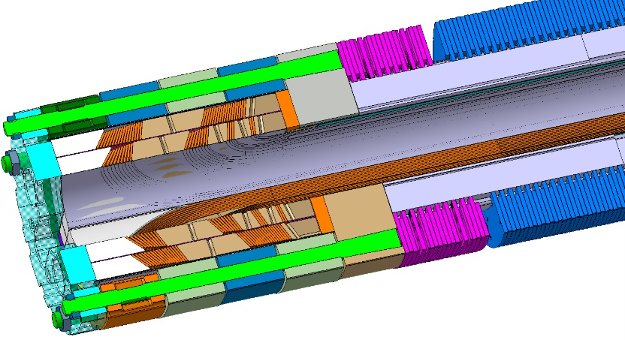
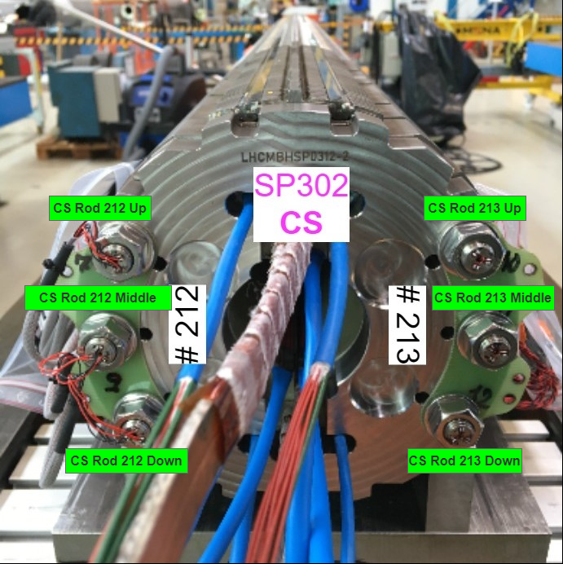
Mechanical instrumentation
SP301
12 instrumented collars
8 Bullet gauges
SP302
12 instrumented collars
8 Bullet gauges
12 Tie rods (End cage)
Courtesy of S. Mugnier EDMS #2711698
Instrumented SS Shell
Notes:
To better understand the behavior of the magnet during assembly and powering, a comprehensive instrumentation plan was developed.

Slide 9
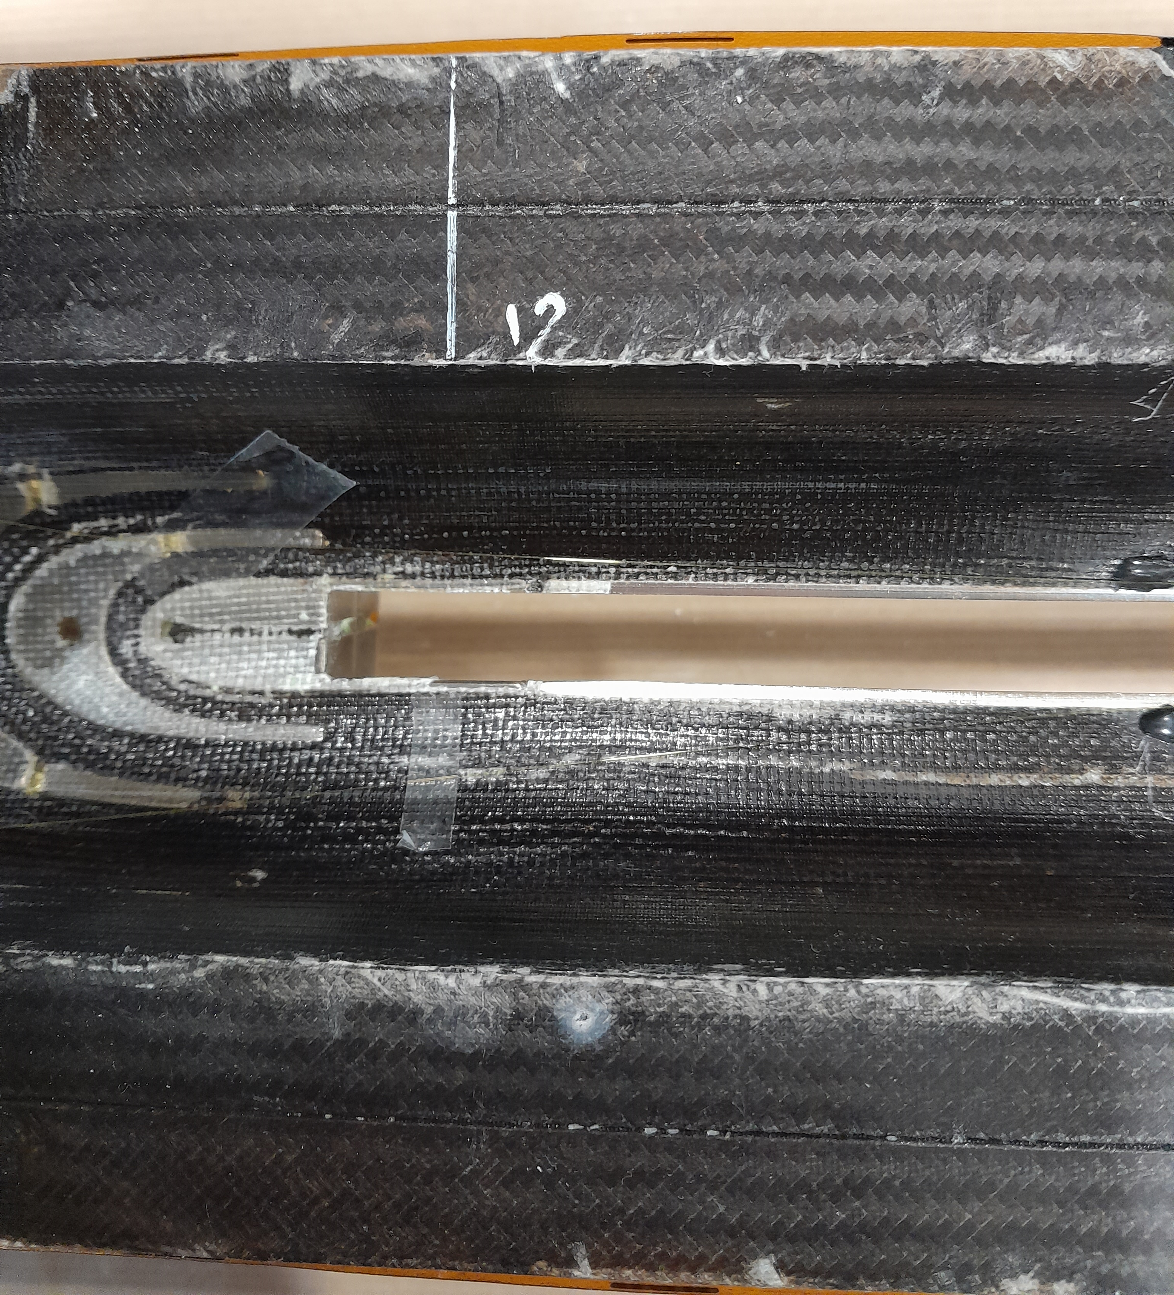
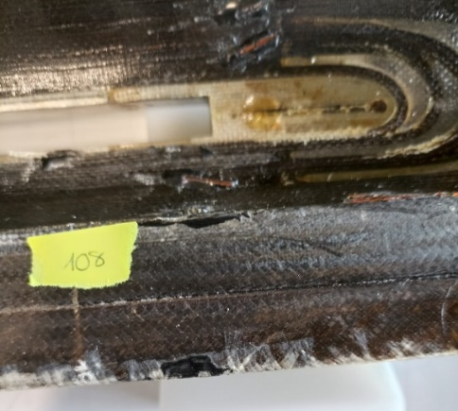
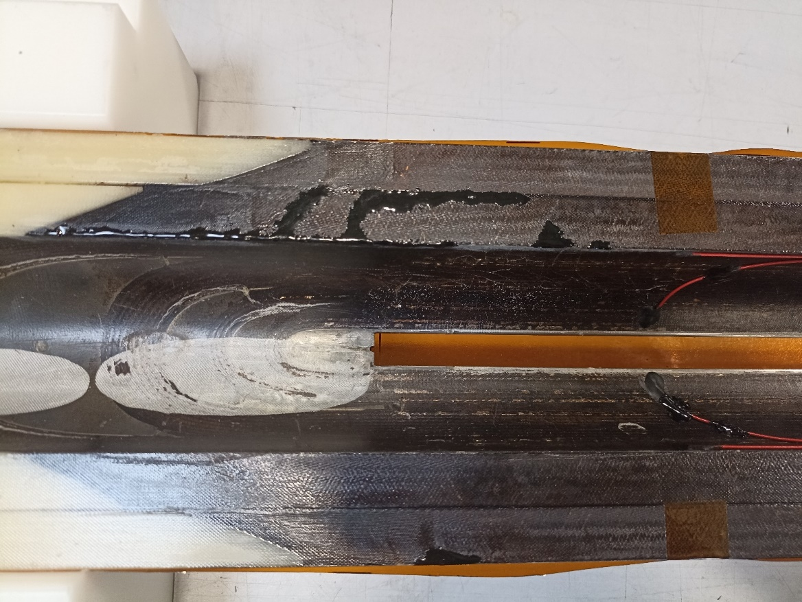
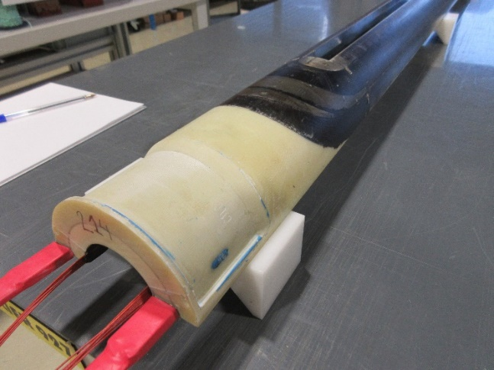
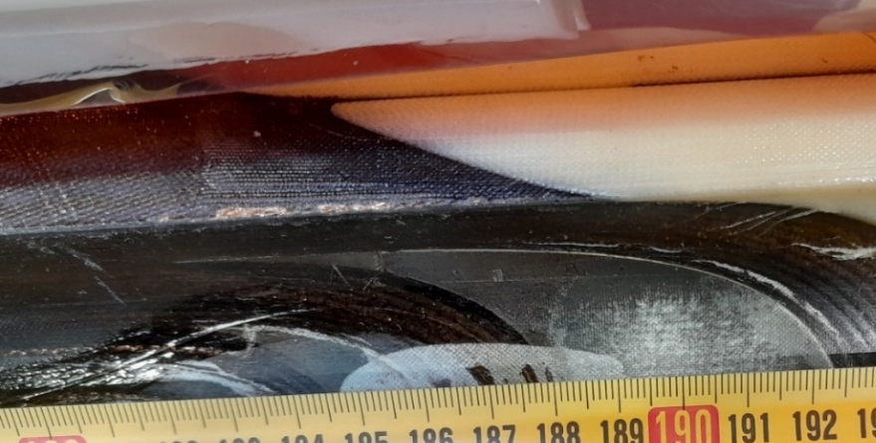
Coils
Discussed in https://indico.cern.ch/event/1326626/
SP301
SP302
Coil 108 - reused
1st generation, RRP cable
Coil 212 - reused
2nd generation, PIT cable
epoxy resin adhesive (stycast)
212 Mid plane left
Coil 214 – new
2nd generation, PIT cable
Coil 213 - reused
2nd generation, PIT cable
visible conductor
213 Mid plane right
Coil 213
Notes:
coil 108 is made from the first-generation RRP (Rod Restack Process) type wire with a keystone angle of 0.79°,
while coils 212, 213, and 214 are made from the second-generation PIT (Powder In Tube) cable with a keystone angle of 0.45°.

Slide 10
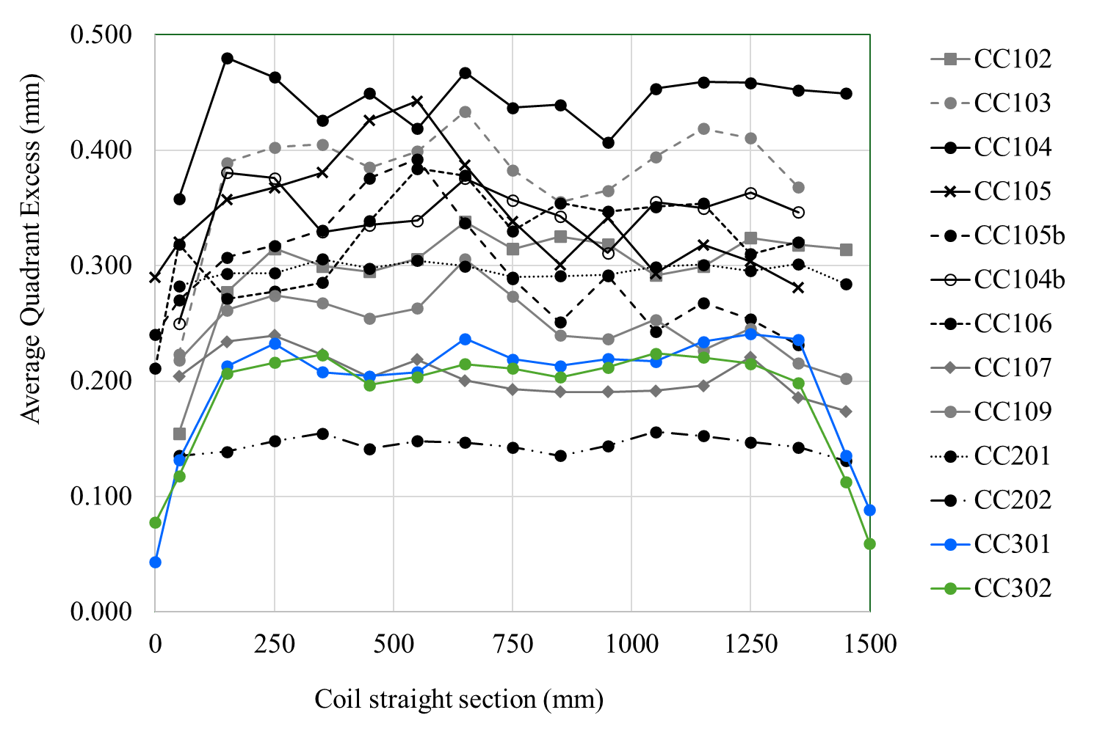
Shimming plan
Excess reduction in the last 150 mm until 75 um approximately.
Measurements of the virgin coil used because the equivalent stiffness of the coil depends on the maximum stress previously seen by the coil mid-plane [3].
Measurements reports: 108, 212, 213, 214.

Slide 11
3. Cold test results

Slide 12
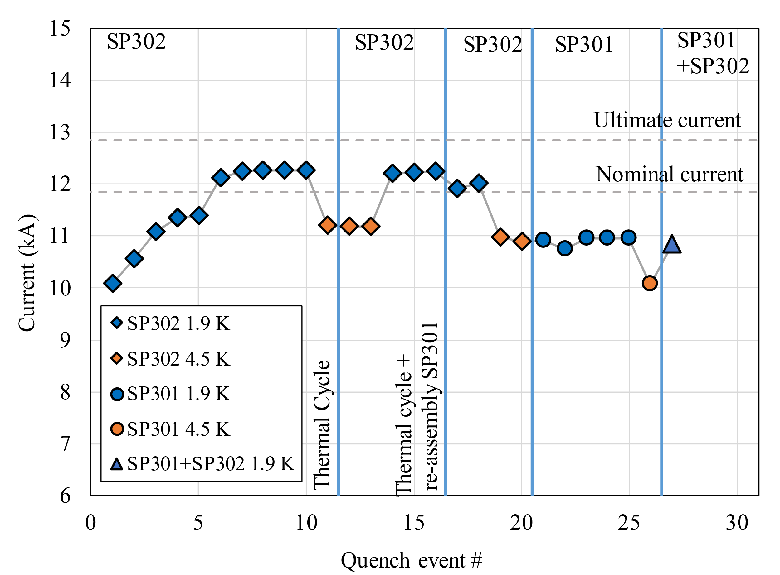
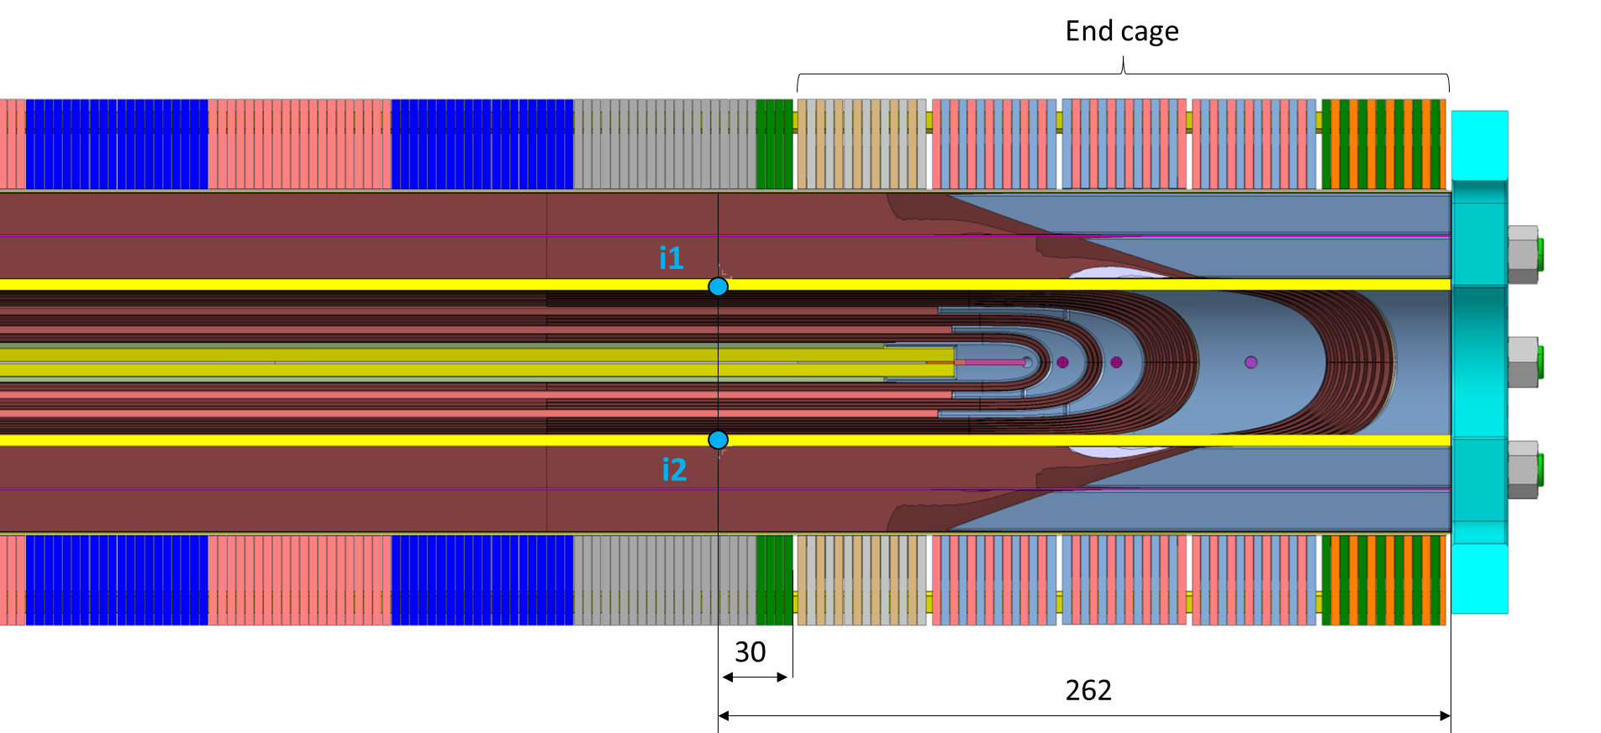
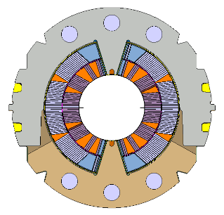
Test 1
Test 2
Test 1:
Powering of SP302: limit 12.2 kA at 1.9k, 500 A less than these coils in DP201 magnet [4]; location coil 213 NCS mid plane inner layer, close to the end cage location.
No powering of SP301, HL-LHC NCR.
Test 2:
Powering of SP302: limit 12 kA at 1.9k, 200A less than in test 1; location coil 213 NCS mid plane inner layer, close to the end cage location.
Powering of SP301: limit 10.9 kA at 1.9 K, coil 108 NCS inner layer first turn mid plane + head. Coil 108 reached 13.2 kA at 1.9 K on its previous test in magnet DP101 [2].
Ramp rate 10 A/s
SP302
213 MP right
212 MP left
Quench
From https://indico.cern.ch/event/1417760/ G. Willering
Notes:
The model magnet was tested under cold conditions primarily for mechanical measurements,
with no specific expectations regarding the current level achievable during powering due to the reuse of coils.
Quench locations were observed using voltage taps installed in the coils.

Slide 13
4. Mechanical measurements

Slide 14
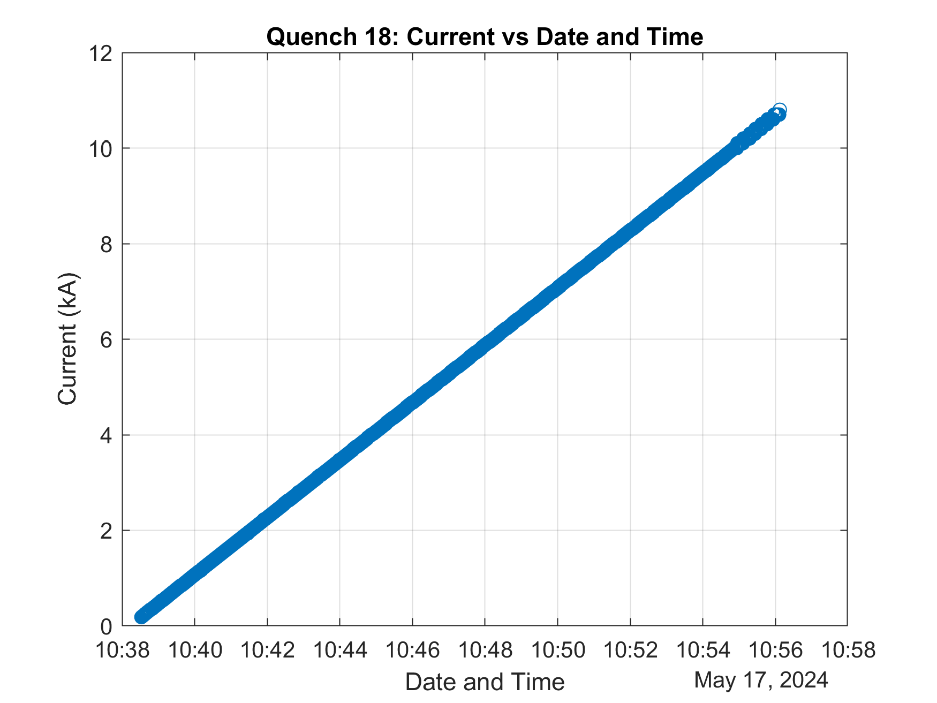
Some words
Ramp to quench used for the mechanical measurements analysis. It is the last ramp of the test that reached 10.8 kA.
The 3D model [1]:
Long magnet
Symmetry
Connection side
Friction between coil and collars
Collars and yoke are bulk but with modified properties to consider the longitudinal behaviour
Collaring is not modelled. It directly applies a displacement to the coils.
Powering at nominal current 11.85 kA
Roxie axial electromagnetic forces: Fz=477kN/collared coil + Volumetric forces calculated in Comsol.

Slide 15
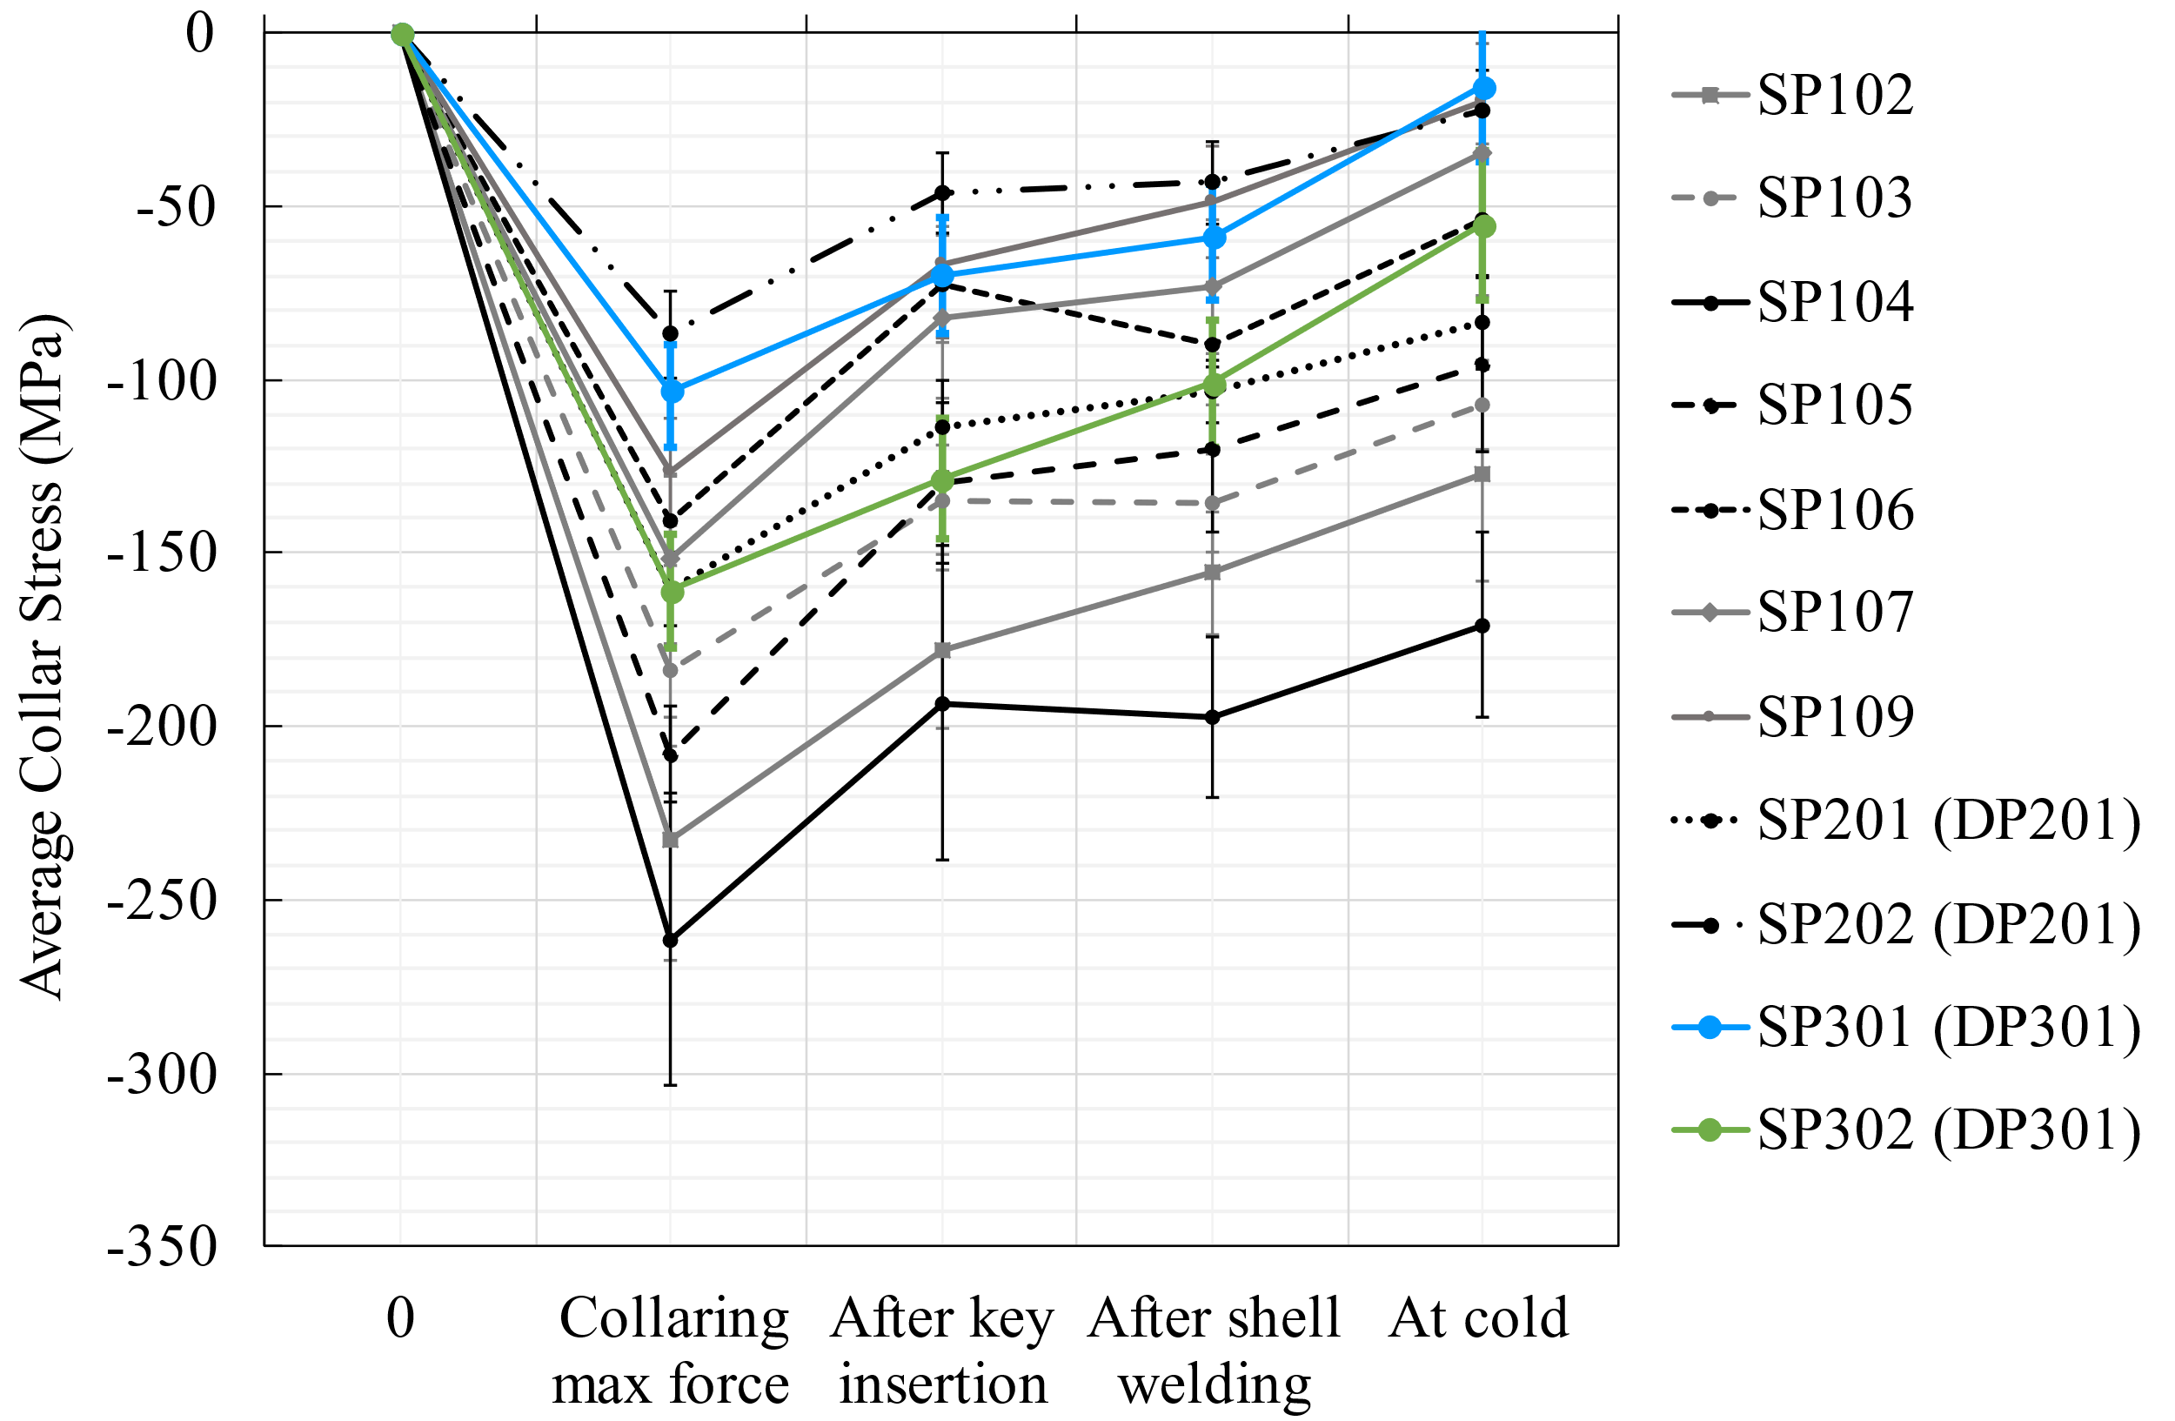
Collar nose stress (1)
The delta cool down in SP301 and SP302 (44 MPa) is bigger than the average observed in previous models (27 MPa) due to the larger thermal contraction of the stainless-steel pole (2.95 mm/m) compared to titanium (1.7 mm/m). In the graph, only the middle section collars are represented, but the connection side and non-connection side show the same results for delta cool down.
This difference has been verified using a 2D model of a 1-in-1 magnet, which showed that the delta cool down for 200 um excess is 35 MPa for stainless steel pole, compared to 22 MPa in the titanium pole.
Middle section collars

Slide 16
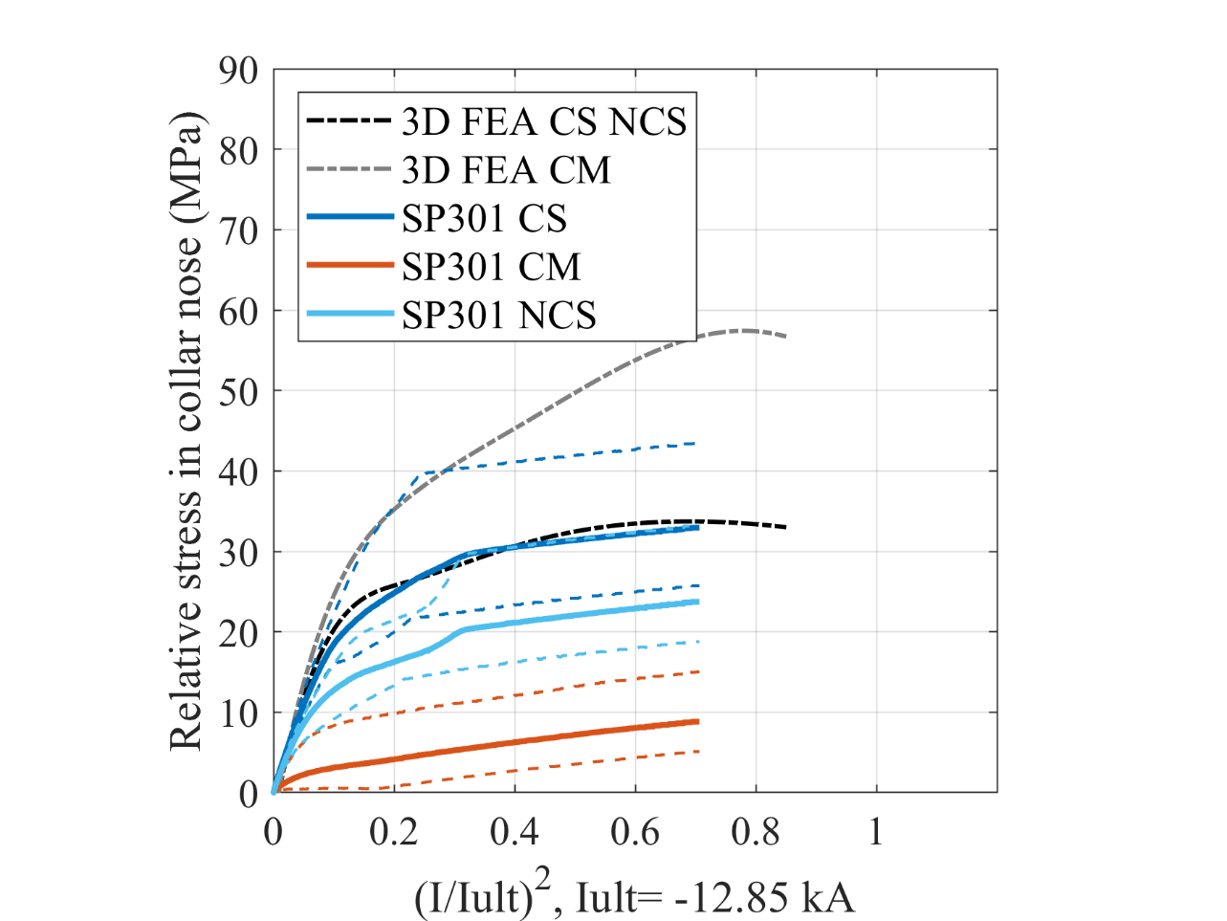
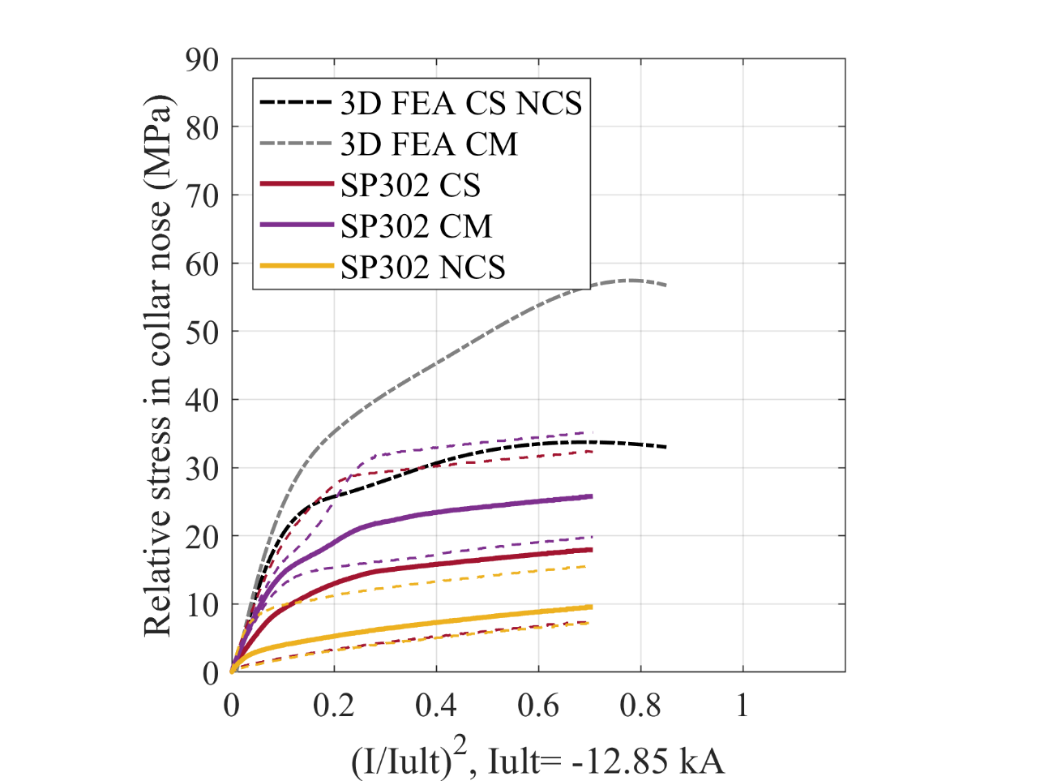
Collar nose stress (2)
The continuous lines represent the average of the collars section, average of four collars.
The dotted lines represent the maximum and minimum measured in the collars section.
FEA lines in different longitudinal positions: FEA CS NCS (quadrant excess 225 um), FEA CM (quadrant excess 275 um)

Slide 17
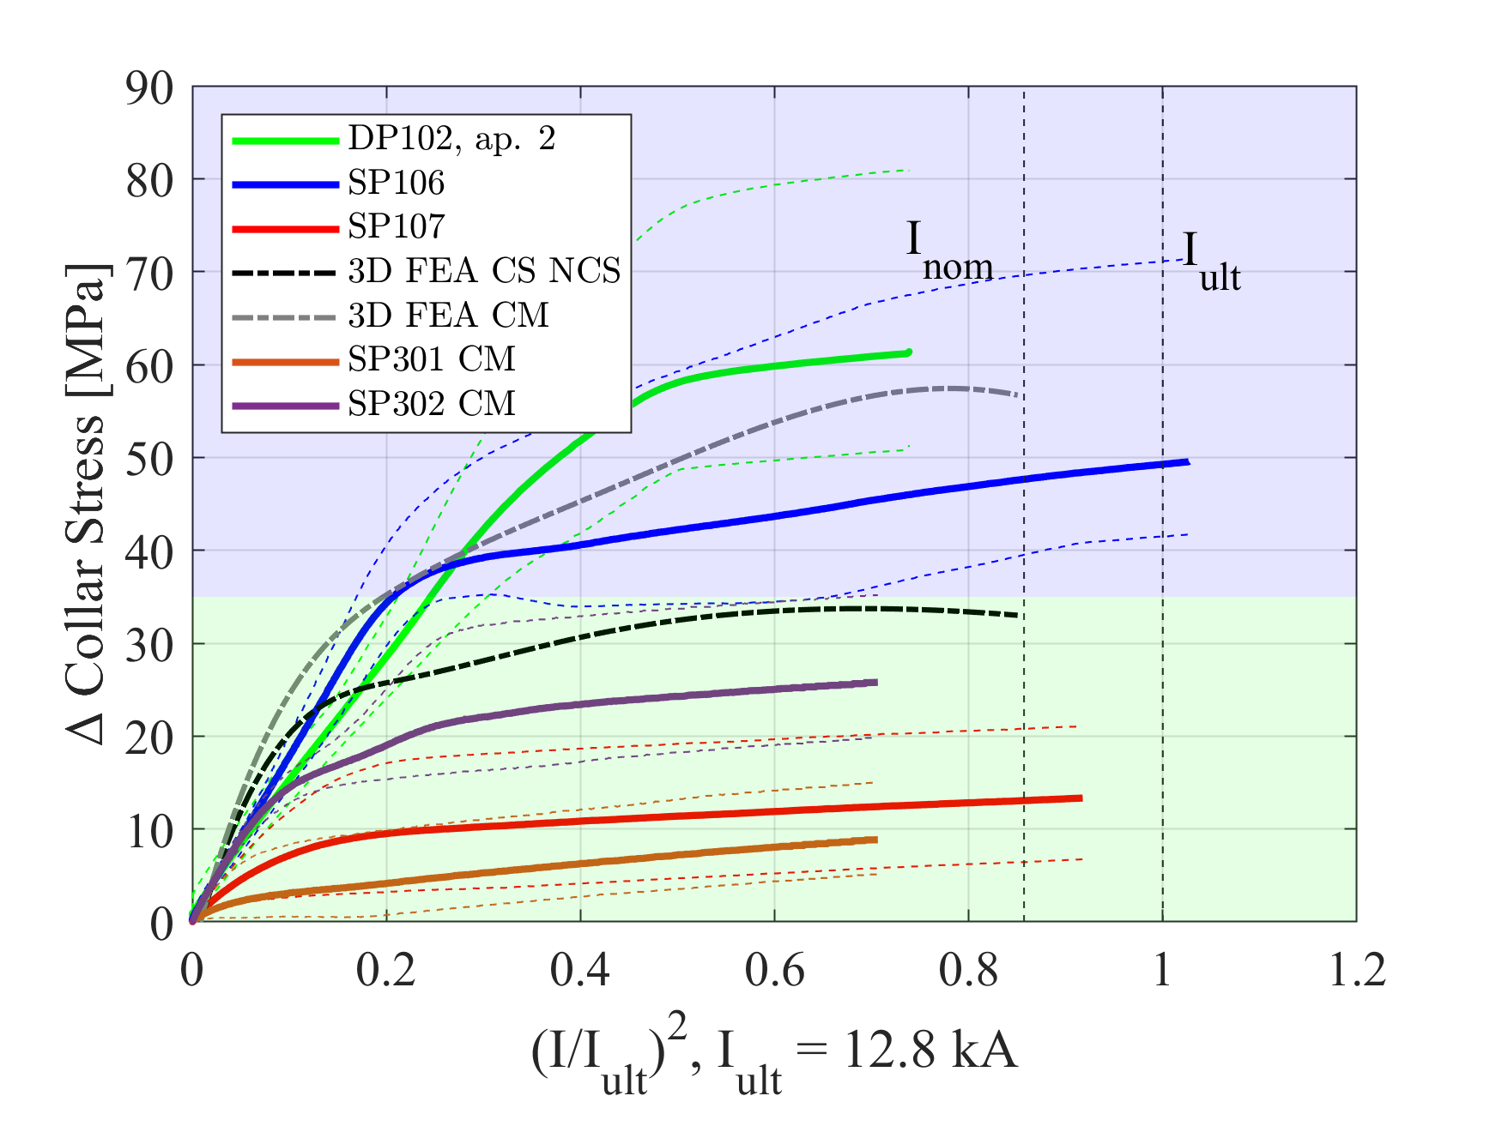
Collar nose stress (3)
Zone excess
0.3 mm/quadrant
Zone excess
0.2 mm/quadrant

Slide 18
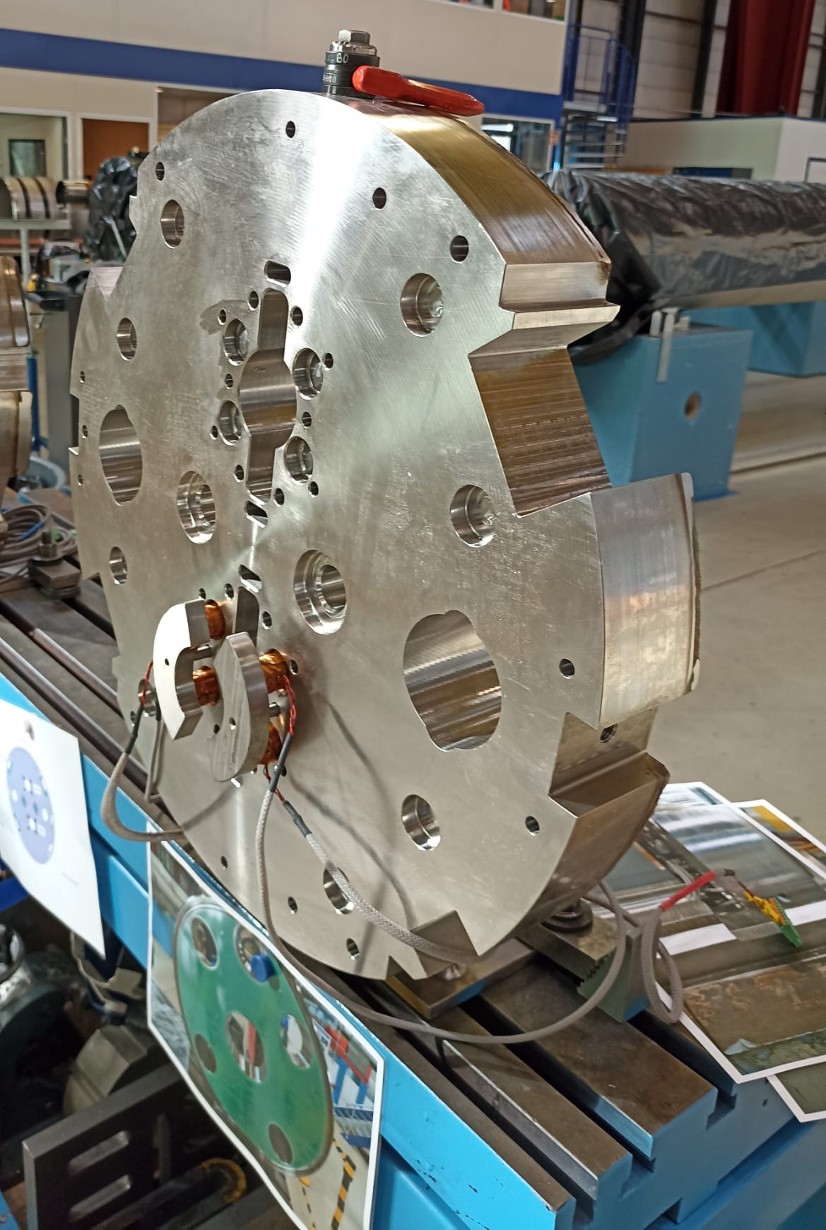
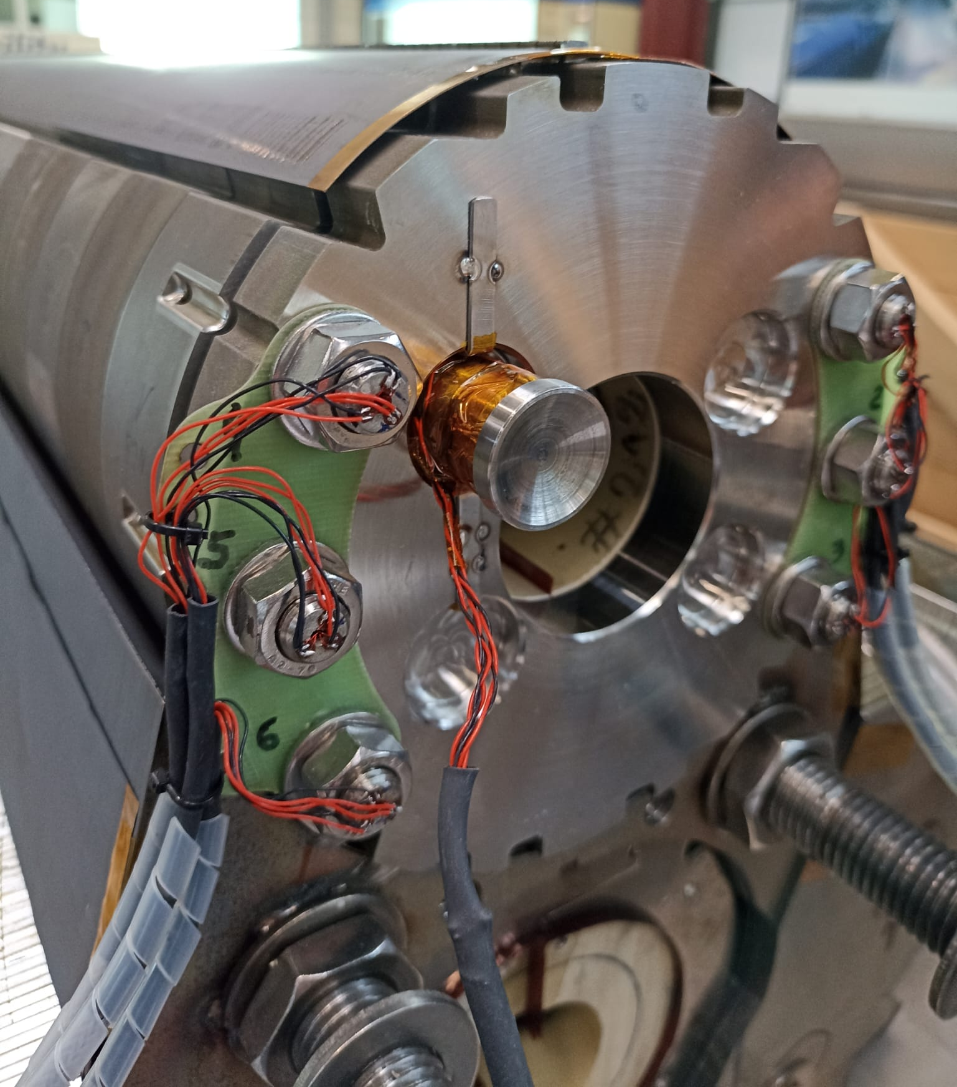
Magnet end plate bullets (1)
SP302
SP301
Notes:
The forces transfer are homogenized by the end plate of the end cage

Slide 19
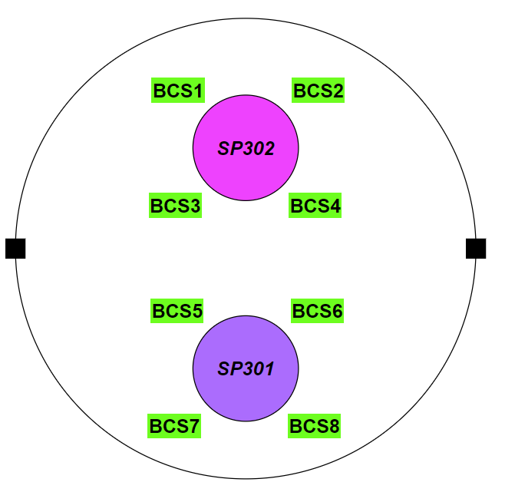
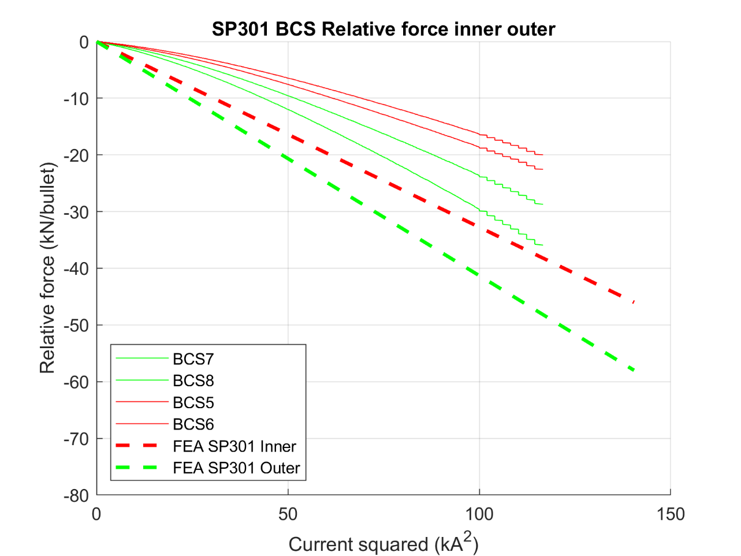
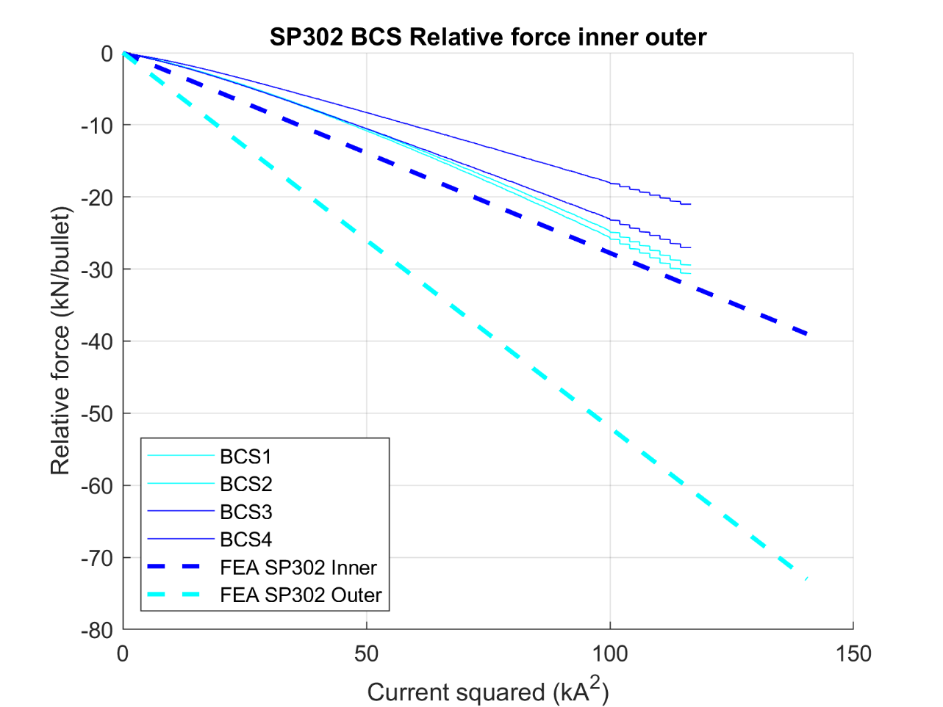
Magnet end plate bullets (2)
Outer
Inner
Inner
During powering
Only connection side represented.
Values sifted to 0 kN at 0 kA.
More forces transferred to the outer bullets.
Outer
Notes:
Slopes are ok with respect to the fea, Initial nonlinearity due to the contact phase.

Slide 20
Magnet end plate bullets (3)
Extra information after meeting:
Bullets in the 11Tesla model DP101
Bullets delta cooldown comparison all the models
Recovered of values before and after quench
CS
Min=12kA
Max=37 kA
Range=25 kA
NCS
Min=7kA
Max=34 kA
Range=27 kA
CS
Min=23 kA
Max=29 kA
Range= 6 kA
NCS
Min=23 kA
Max=38 kA
Range=15 kA
From EDMS #2711698 S. Mugnier

Slide 21
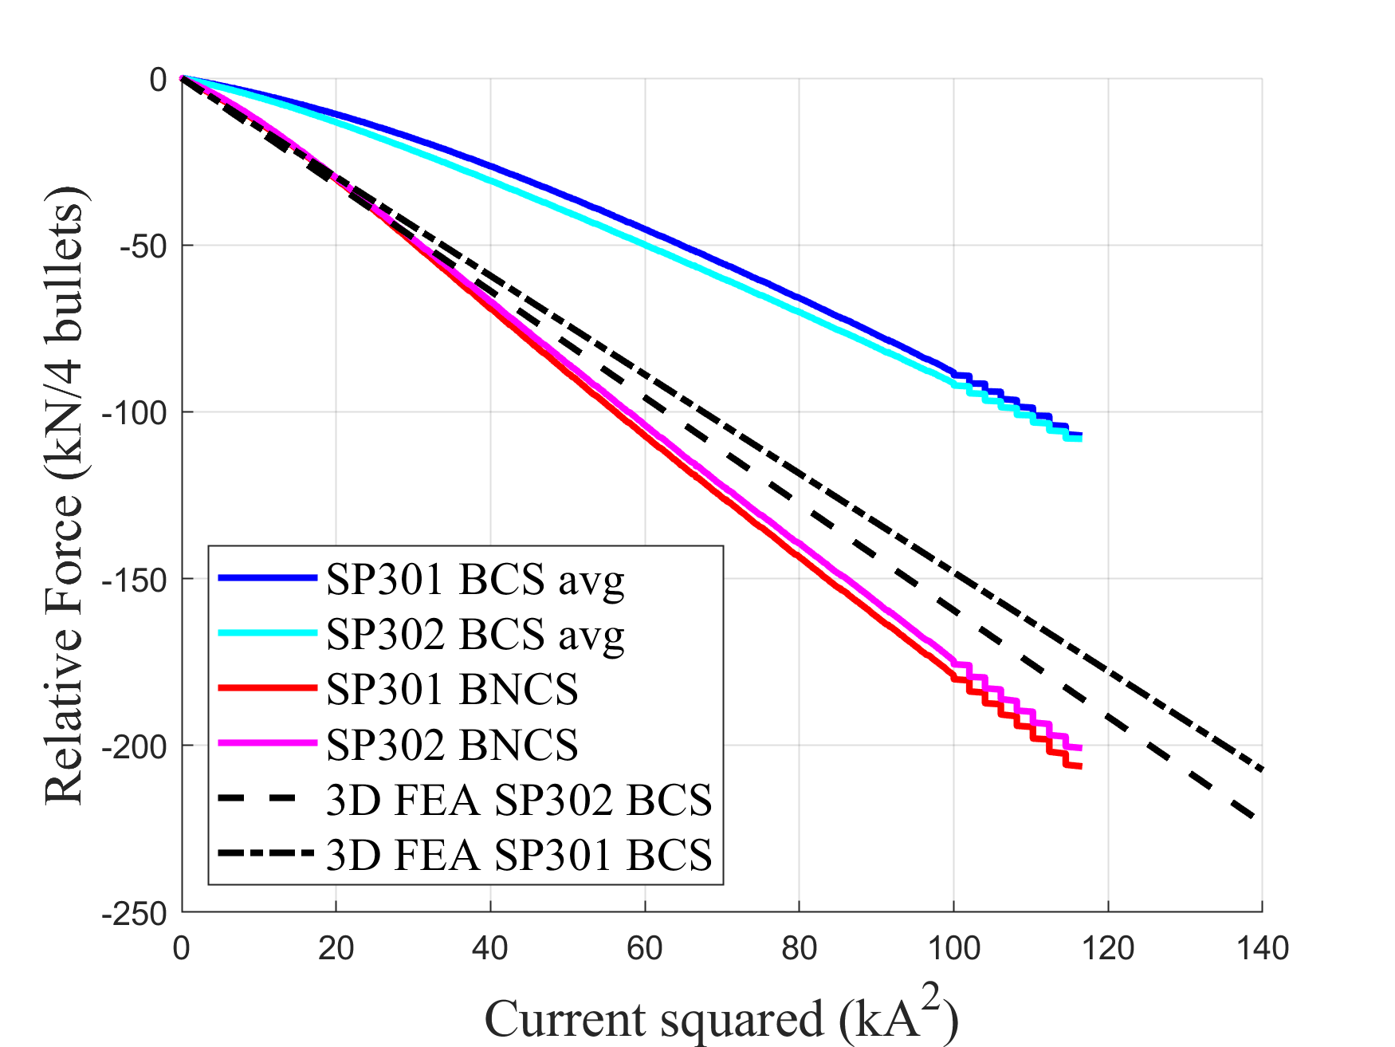


Magnet end plate bullets (4)
Higher slope in non connection side, consistent with previous double aperture models [2].
This phenomenon is attributed to the length difference of both sides, resulting in increased frictional force dissipation on the connection side. These measurements are valuable for calibrating numerical models.
The forces transmitted to the bullets are inversely proportional to the length of the side:
The sum of the transferred forces to the bullets per aperture is the same but the spread is slightly larger in the aperture without end cage.
30% Fem
$$\frac{l_{headCS}}{l_{headNCS}}=1.7$$
$$\frac{F_{em_bulletsNCS}}{F_{em_bulletsCS}}=1.7$$
50% Fem

Slide 22
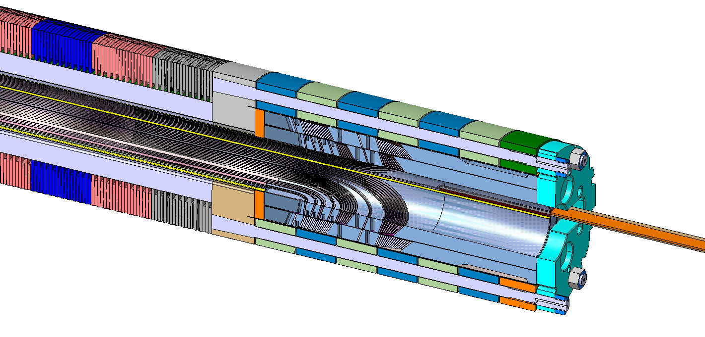
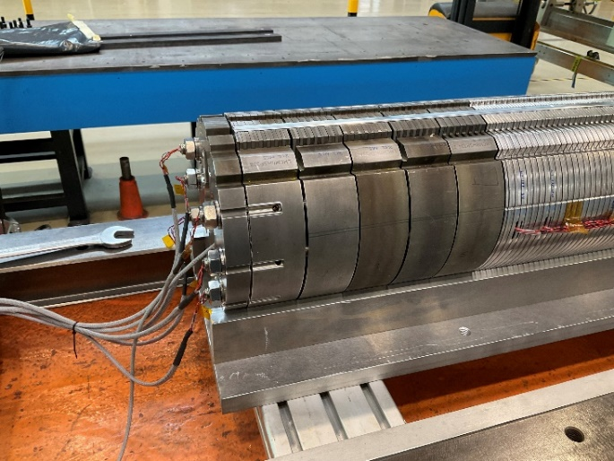
End cage rods (1)
End cage activation – room temperature
Preload with 12% of the electromagnetic forces, 29 kN/coil. Loading report. The rods compress the coil head.
Cool down – 1.9k
During cooldown, some compression is lost, but the heads are still held by the rods.
Energization – 1.9k
During magnet energization, the end cage follows the coil head as it moves with the electromagnetic forces towards the outside of the magnet, compacting the coil head blocks together and preventing detachment between them due to the differential electromagnetic forces across the different blocks.
Fem
Fem

Slide 23
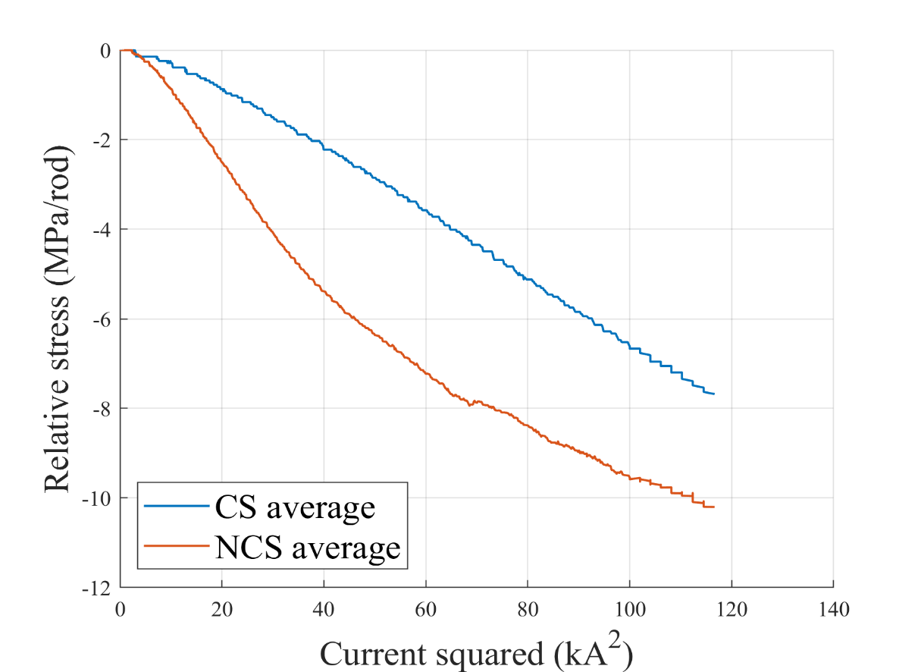
End cage rods (2)
Good agreement in the delta cool-down between the 3D model and the strain gauges reading.
No agreement in powering phase; the model shows an average delta powering of 52 MPa, almost 5 times larger.
No linear behaviour of the non-connection side rods during powering.
Big unbalance in the rods stresses in after cool down and powering.
Lost the data of two rods in CS: one during assembly and another in the cluster D insertion.
The rods are always under tension, ensuring constant compaction of the coil head.
 | SP302 Rods train gauges (MPa) |  |  | 3D FEA (MPa)
 | Loading | Cold | Powering | Loading | Cold | Powering
CS | 90 (92,116,99,75,68) | 81 (136,78,56,55) | 71 (128,63,49,44) | 115 | 100 | 48 (33,48,64)
NCS | 68 (76,98,48,57,64,62) | 52 (32,78,37,73,58,35) | 38 (7,62,30,52,41,33) | - | - | -

Slide 24
5. Conclusions
The model magnet was tested under cold conditions for mechanical measurements, with no specific expectations regarding the current level achievable during powering due to the reuse of coils.
MECHANICAL MEASUREMENTS
The effect of the material pole change is visible in the cool down reading of the collar nose stresses. The 3D model correctly represents collar behaviour during powering.
The factor of the electromagnetic forces transferred to the bullets in both CS (30%) and NCS (50%) configurations is inversely proportional to the length of the head. The aperture with the end cage, SP302, shows a smaller spread of the transfer forces during cool down and powering due to the homogenization of axial loading by the end cage end plate. This configuration also shows more reproducible values than SP301 after warm-up in the test bench.
The end cage rods remain under tension, ensuring coil head compaction. However, performance limitations of the coils prevent definitive conclusions regarding axial support improvement.
QUENCH PERFORMANCE
Despite no alterations in the aperture SP302 between tests, the local damage increased (loss of 200 A in quench current) after thermal cycle and magnet re-assembly.
In SP302, the quench appears near the end cage; however, it cannot be confirmed that this is due to the end cage, as the coils were damaged and repaired (increasing the mid-plane thickness) in this area.
In SP301, the quench occurs at a very low current. Coil 108 seems to have significant damage in the mid plane and head coil head inner layer segment. This damage was likely not generated during the assembly of the presented magnet, as coil 214 does not exhibit similar limitations.

Slide 25
6. References
[1] C. Garion, M. Morrone, "Mitigation solutions on the 11 T magnet," CERN Internal technical note, Geneva, 2022.
[2] S. Izquierdo et al., "Mechanical analysis of the Nb3Sn 11 T dipole short models for the High Luminosity Large Hadron Collider"
[3] J. L. Rudeiros Fernandez“Characterization of the Mechanical Properties of Nb3Sn Coils” IEEE Transactions on applied superconductivity, vol. 29, no. 5, AUGUST 2019, Art. no. 8401205.
[4] E. Gautheron et al., "Pre-Load Studies on a 2-m Long Nb3Sn 11 T Model Magnet for the High Luminosity Upgrade of the LHC“

Slide 27
Collaring parameters of the reused coils for the magnet MBHDP301b

Slide 28
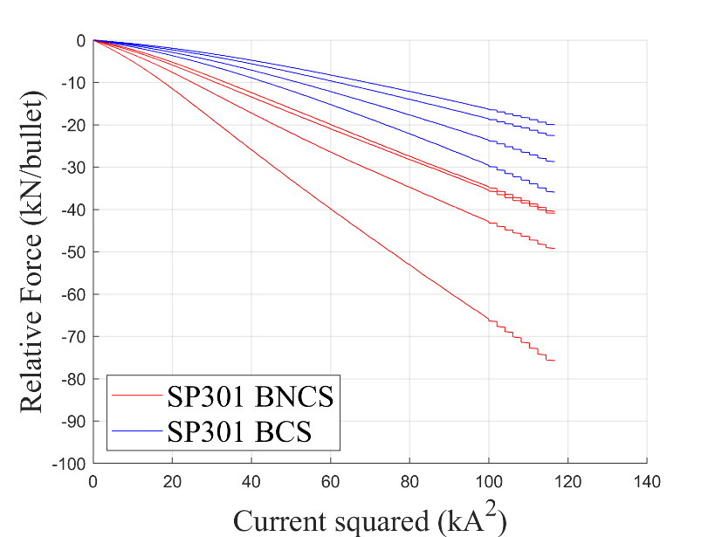
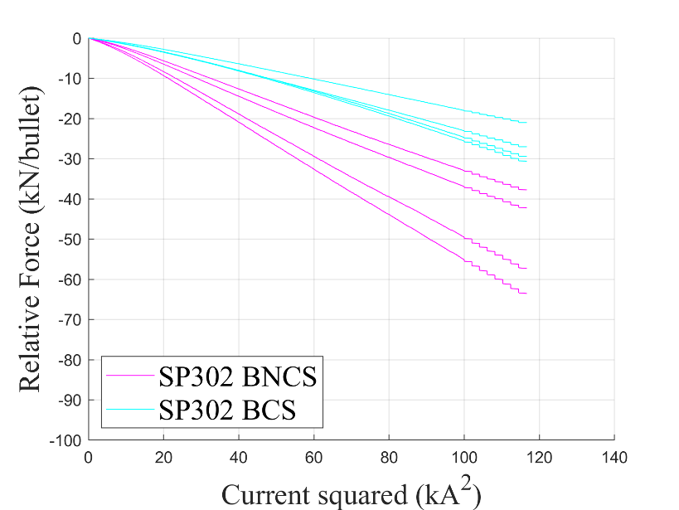
Bullets range of values during powering
Bigger spread of the bullets during powering in the aperture without end cage SP301

Slide 29
End cage rods from loading to cool down
Courtesy of S. Mugnier EDMS #2711698

Slide 30


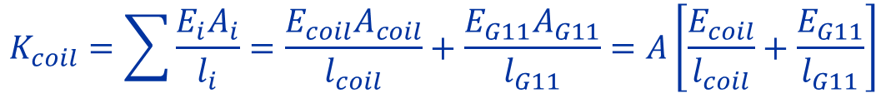
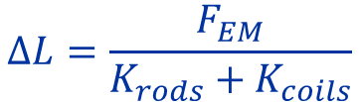
Analytical calculation of coil head elongation
$$∆L=\frac{F_{EM}}{K_{coil}}$$
$$∆L=\frac{F_{EM}}{K_{rods}+K_{coils}}$$
$$K_{coil}=\sum{\frac{E_{i}A_{i}}{l_{i}}=\frac{E_{coil}A_{coil}}{l_{coil}}}+\frac{E_{G11}A_{G11}}{l_{G11}}=A\left[\frac{E_{coil}}{l_{coil}}+\frac{E_{G11}}{l_{G11}}\right]$$
$$K_{rods}=\frac{EA}{l}$$

Slide 31
Slides added after the meeting
C. Abad Cabrera

Slide 32
Bullets - magnet DP101
CS
Min=5kA
Max=26 kA
Range=21 kA
NCS
Min=2kA
Max=34 kA
Range=32 kA
There is a big spread in values after cool down in the model DP101, bigger range in NCS.

Slide 33
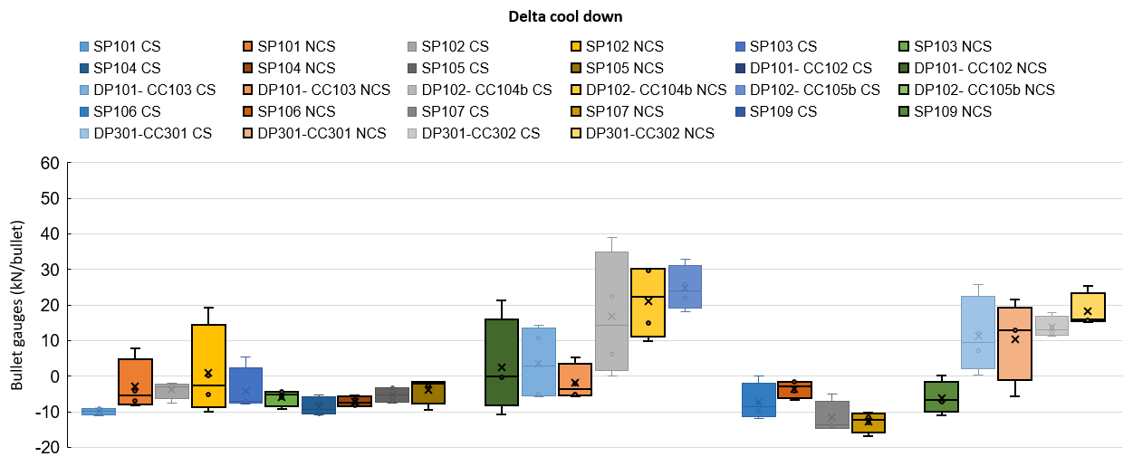
Bullets in all models – Delta cool down
PF=Packing factor
DP102 (PF 98 %)
DP301 (PF 98 %)
DP101 (PF 100%)
CC301
CC302
SP10X (PF 100%)
SP10X (PF 100%)
Aperture SP302 (DP301) has the smallest range of bullet values after cooldown among the double-aperture magnets.

Slide 34
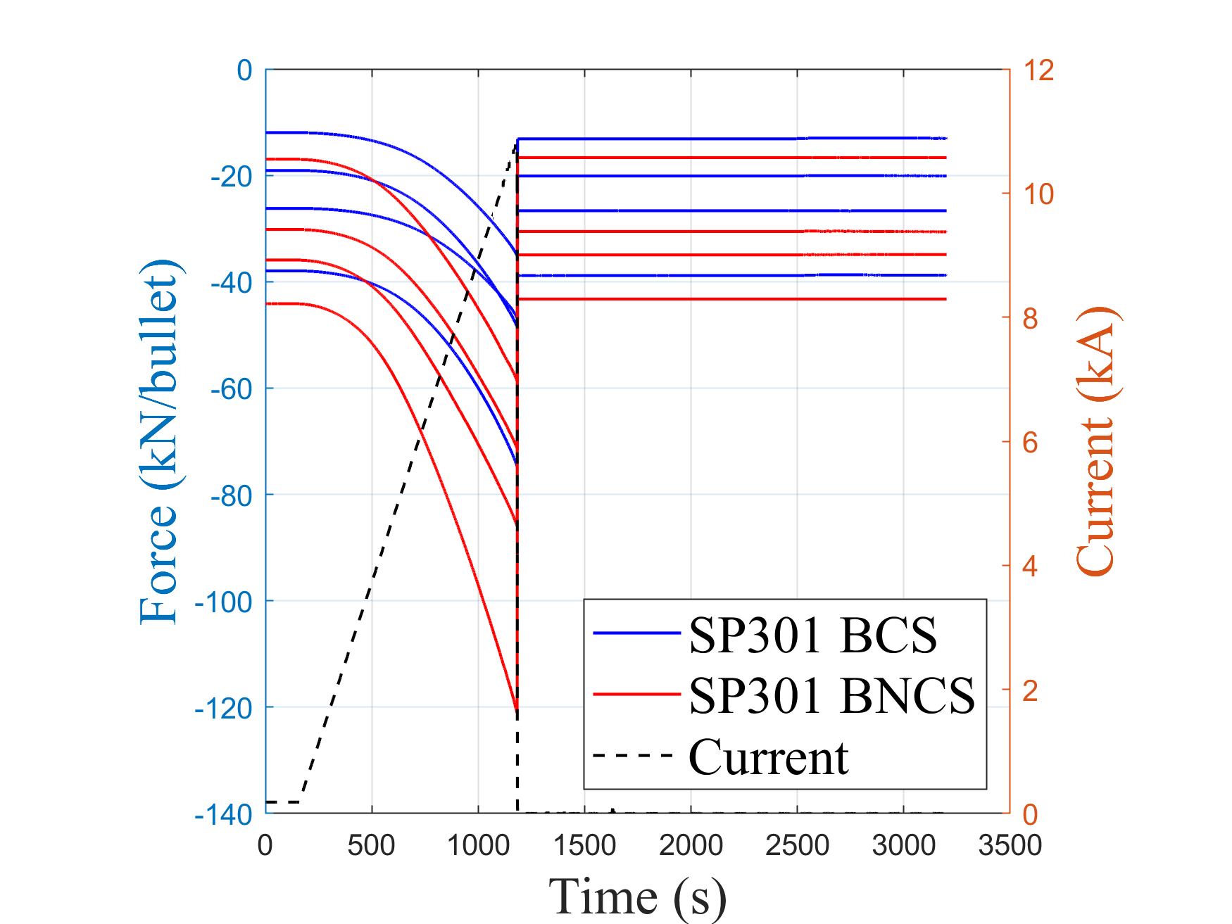
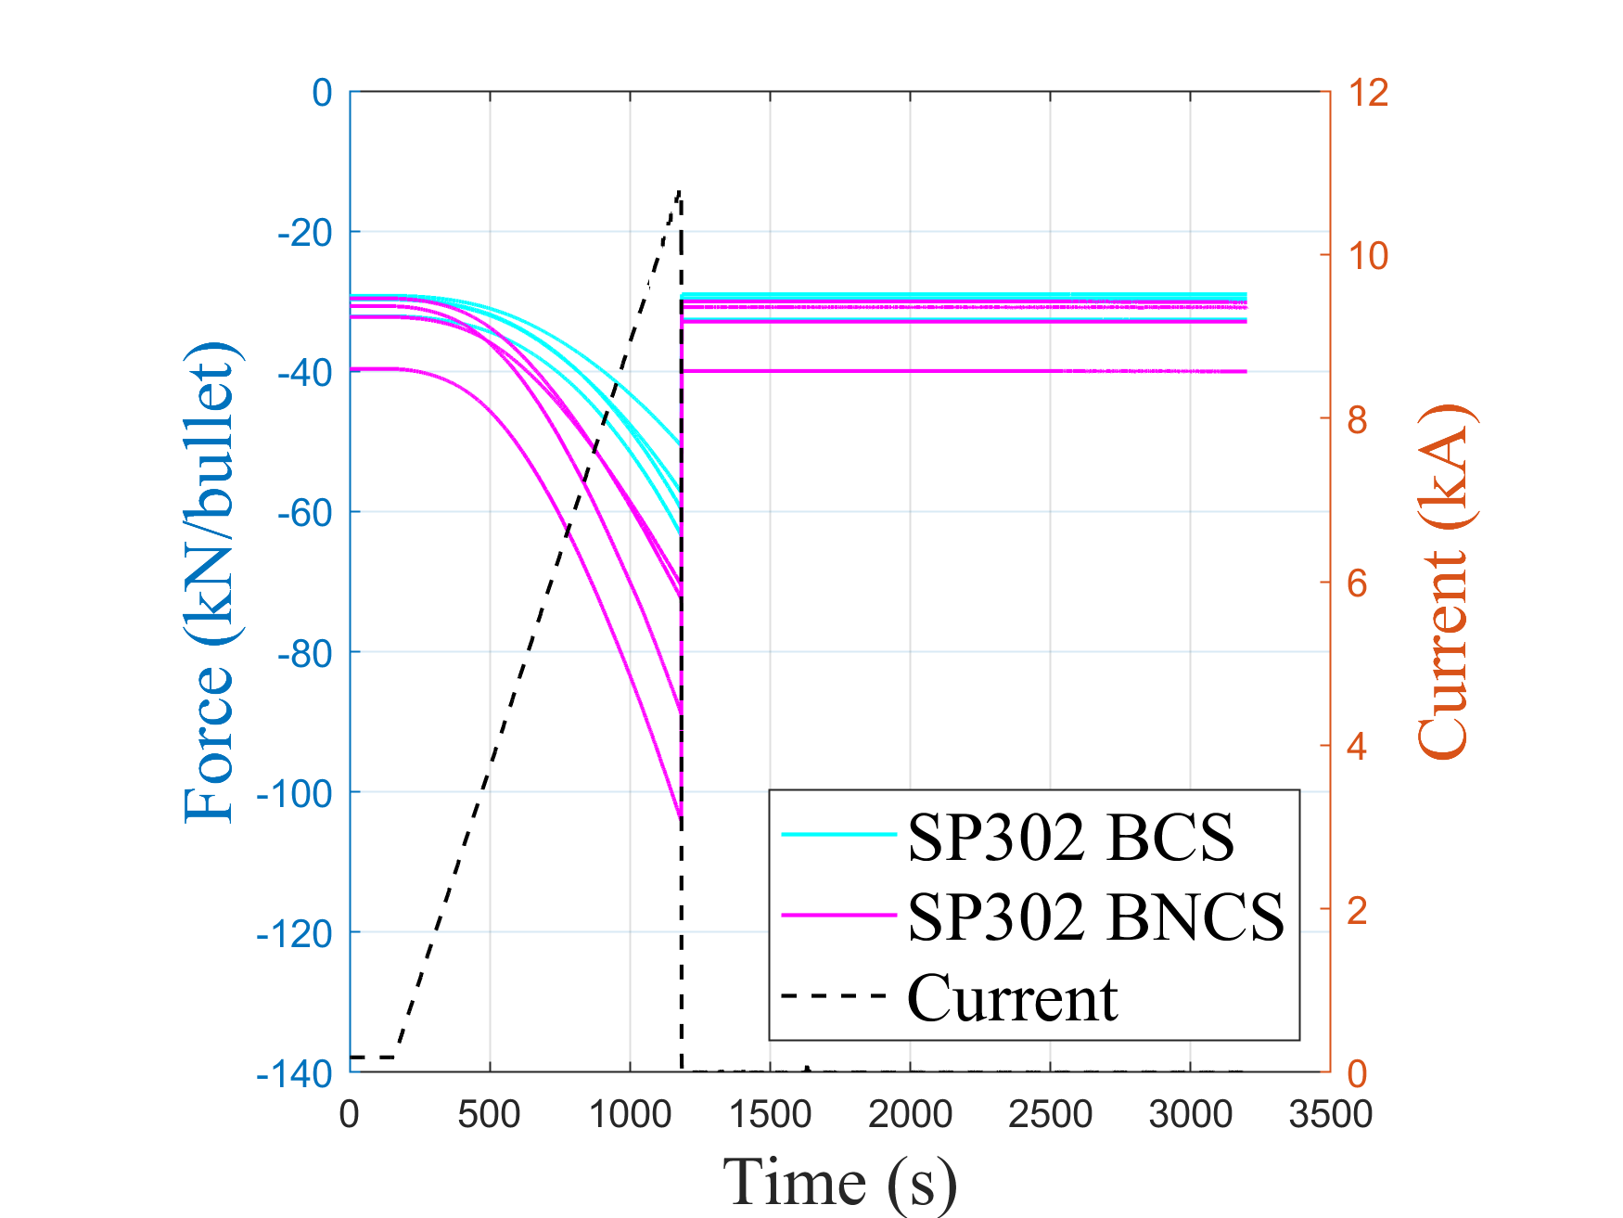
Bullets value before and after quench
The compression in the bullets is fully recovered after quenching.

