Slide 1


MD11603 - Measuring crabbing induced by Head-On Beam Beam
Andrea Fornara
(University of Manchester, CERN)
02/07/2024
Supervisors: Rob Appleby, Guido Sterbini
Thanks to: Xavier Buffat, Michi Hostettler, Tom Levens, Georges Trad
Thanks also to Elleanor Lamb and MD11643 team for the time!

Slide 2
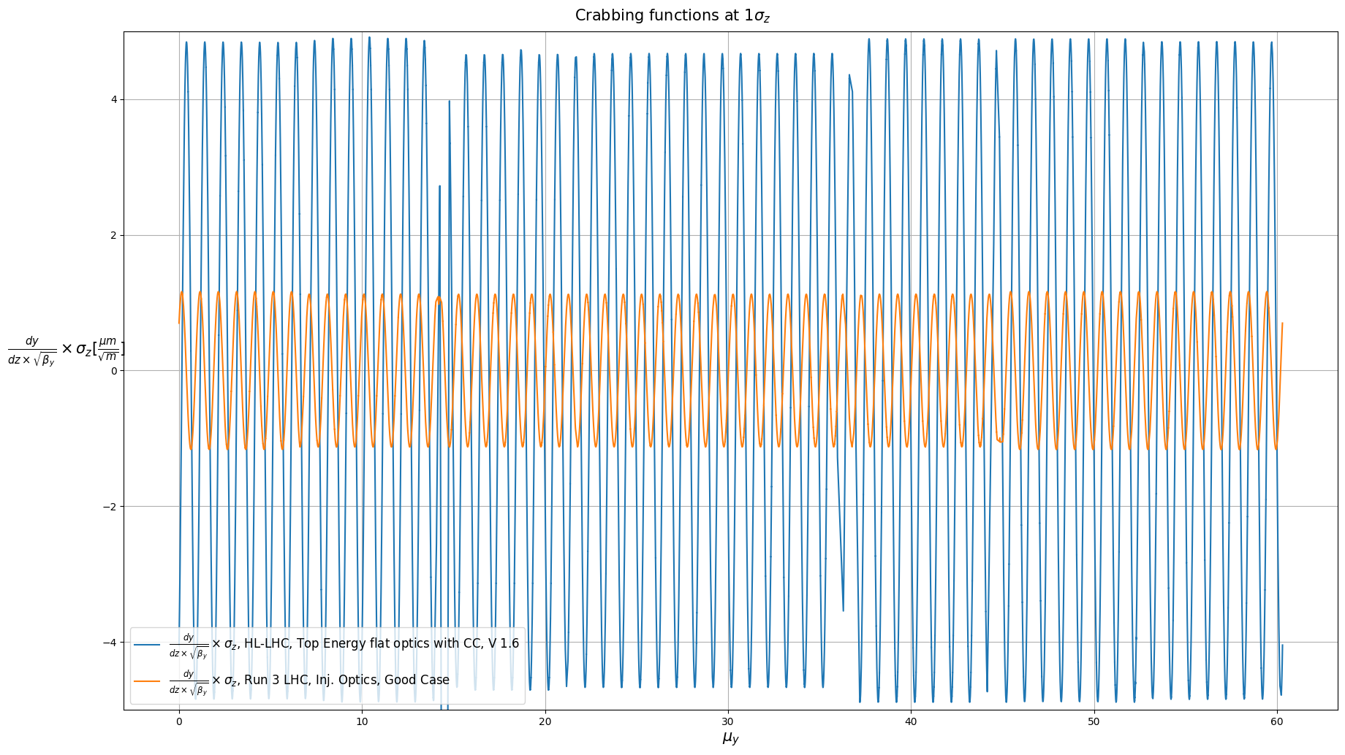
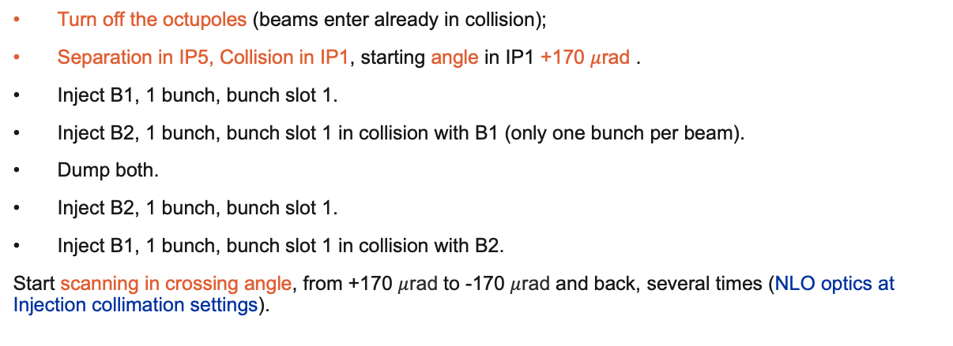
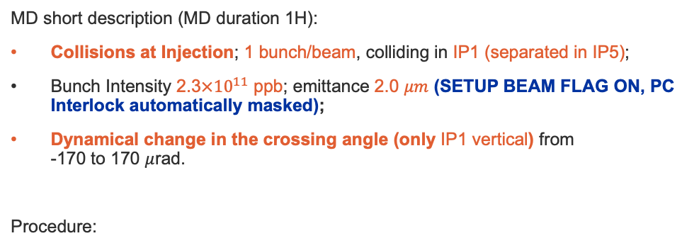
Measuring crabbing induced by Head-On Beam Beam (HOBB)
Aim of the MD: to measure HOBB induced crabbing for the first time in the LHC.
MD short description (MD duration 1H):
Collisions at Injection; 1 bunch/beam, colliding in IP1 (separated in IP5);
Bunch Intensity 2.3$×{10}^{11}$ ppb; emittance 2.0 $μm$ (SETUP BEAM FLAG ON, PC Interlock automatically masked);
Dynamical change in the crossing angle (only IP1 vertical) from
-170 to 170 $μ$rad.
Procedure:
Turn off the octupoles (beams enter already in collision);
Separation in IP5, Collision in IP1, starting angle in IP1 +170 $μ$rad .
Inject B1, 1 bunch, bunch slot 1.
Inject B2, 1 bunch, bunch slot 1 in collision with B1 (only one bunch per beam).
Dump both.
Inject B2, 1 bunch, bunch slot 1.
Inject B1, 1 bunch, bunch slot 1 in collision with B2.
Start scanning in crossing angle, from +170 $μ$rad to -170 $μ$rad and back, several times (NLO optics at Injection collimation settings).
The two are of the same order of magnitude, and putting to test the LHC instrumentation to be ready for Crab Cavities would be a very important step in the update process towards HL-LHC.

Slide 3
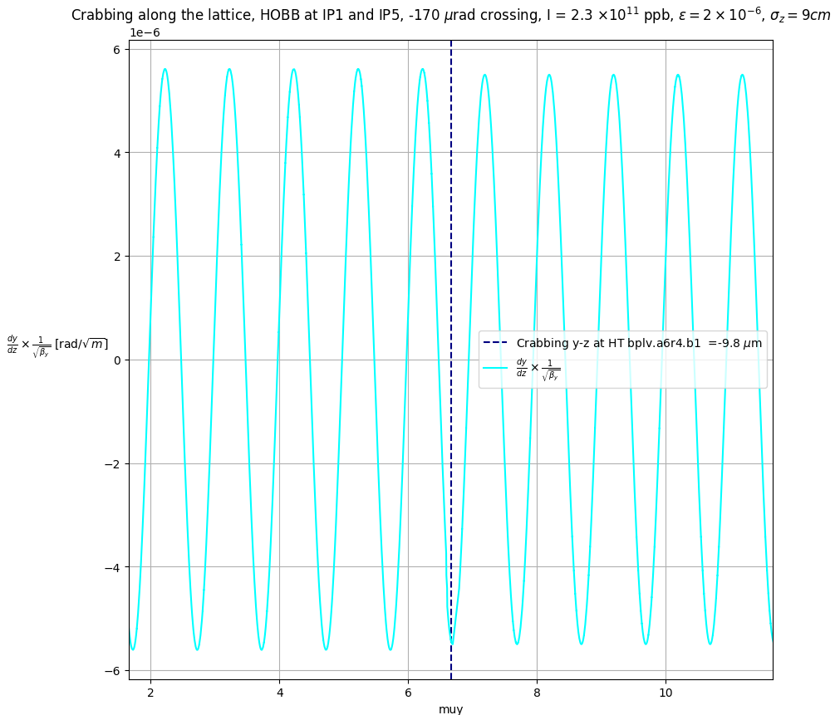
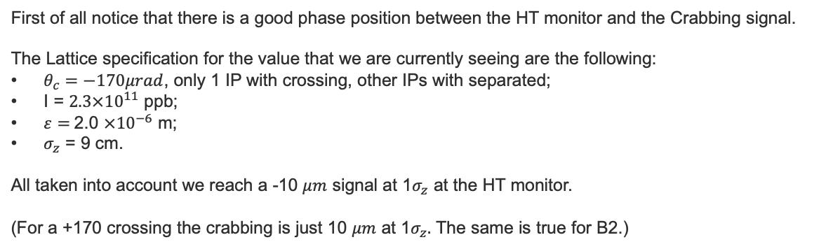
Head On Beam Beam crabbing at the HT location from simulation
Thanks to derivative mapping in Xsuite we can retrieve the value of the crabbing at the HT monitor location.
First of all notice that there is a good phase position between the HT monitor and the Crabbing signal.
The Lattice specification for the value that we are currently seeing are the following:
$θ_{c}=−170μrad$, only 1 IP with crossing, other IPs with separated;
I = $2.3×{10}^{11}$ ppb;
$ε=$2.0 $×{10}^{−6}$ m;
$σ_{z}$ = 9 cm.
All taken into account we reach a -10 $μm$ signal at 1$σ_{z}$ at the HT monitor.
(For a +170 crossing the crabbing is just 10 $μm$ at 1$σ_{z}.$ The same is true for B2.)

Slide 4
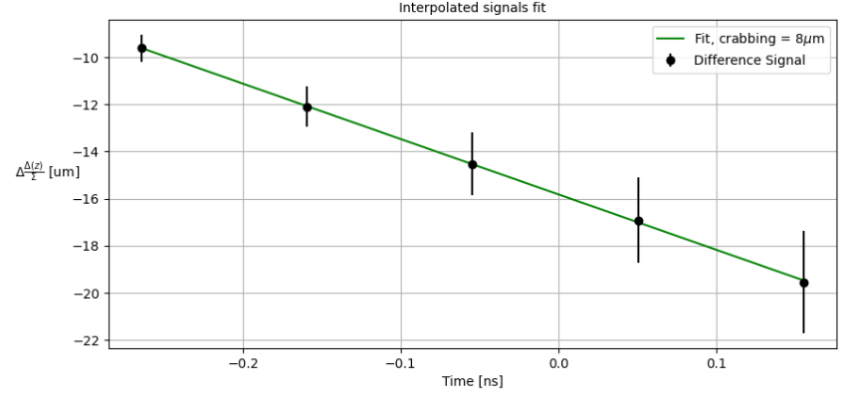
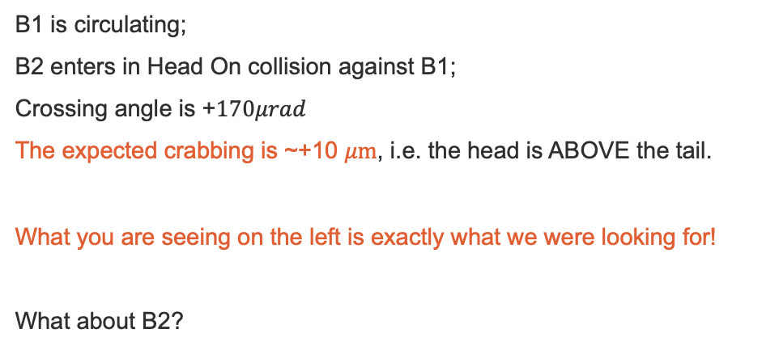
Preliminary results, B1 at collision
B1 is circulating;
B2 enters in Head On collision against B1;
Crossing angle is +$170μrad$
The expected crabbing is ~+10 $μm$, i.e. the head is ABOVE the tail.
What you are seeing on the left is exactly what we were looking for!
What about B2?

Slide 5
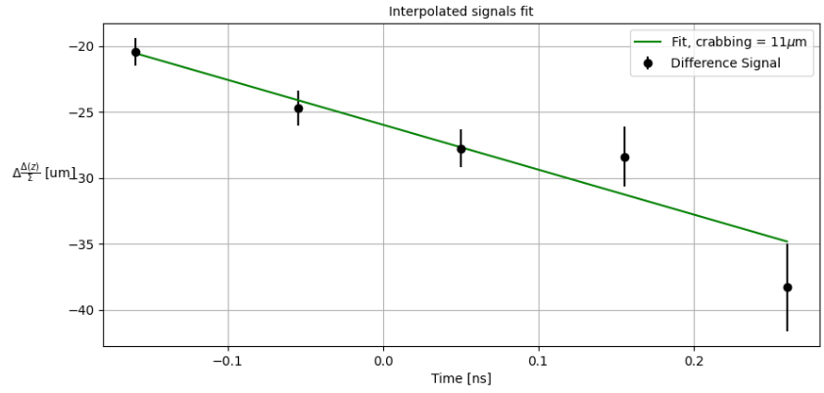
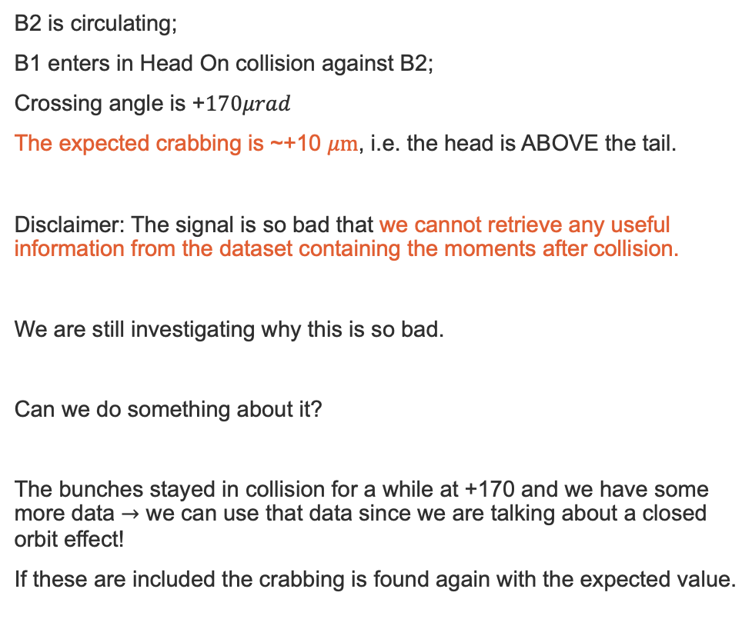
Preliminary results, B2 at collision
B2 is circulating;
B1 enters in Head On collision against B2;
Crossing angle is +$170μrad$
The expected crabbing is ~+10 $μm$, i.e. the head is ABOVE the tail.
Disclaimer: The signal is so bad that we cannot retrieve any useful information from the dataset containing the moments after collision.
We are still investigating why this is so bad.
Can we do something about it?
The bunches stayed in collision for a while at +170 and we have some more data $→$ we can use that data since we are talking about a closed orbit effect!
If these are included the crabbing is found again with the expected value.

Slide 6
Conclusions
The results presented are yet preliminary and much more can be done on these (very) noisy datasets, to qualify the HT monitor for the best.
The datasets related to the scans also show the expected behavior, so this is really going in the direction that we want.
So in MD11603 we were able to:
Study an effect that produces crabbing even without Crab Cavities;
Test the HT Monitor capabilities on very small signals comparable to the residual crabbing in HL-LHC;
Measure for the first time a crabbing orbit in the LHC.

Slide 7
Thank you!

