Slide 1


MD7203: Rematched IR7 optics for improved cleaning performance and impedance
B. Lindström, R. Bruce, X. Buffat, R. de Maria, A. Donadon,
L. Giacomel, D. Mirarchi, M. Monikowska, N. Mounet, S. Redaelli,
D. Veres, F. Van der Veken
Thanks to: S. Fartoukh, M. Solfaroli, R. Tomás,
J. Wenninger, MD coordinators, LHC OP, OMC team
2nd July 2024 – LSWG

Slide 2
Introduction and Motivation
HL-LHC beam intensity and brightness produces significant challenges:
  Beam losses in IR7 DS could cause quenches
  Impedance can cause instabilities
Beam losses:
  Mitigate them using TCLDs installed between two 11T dipoles
  → Alternative strategy for risk mitigation
Impedance:
  Low-impedance collimators introduced (LS2, LS3),
  Relaxed collimator settings
  Further reduction of impedance to improve margins
→ new optics to mitigate both!

Slide 3
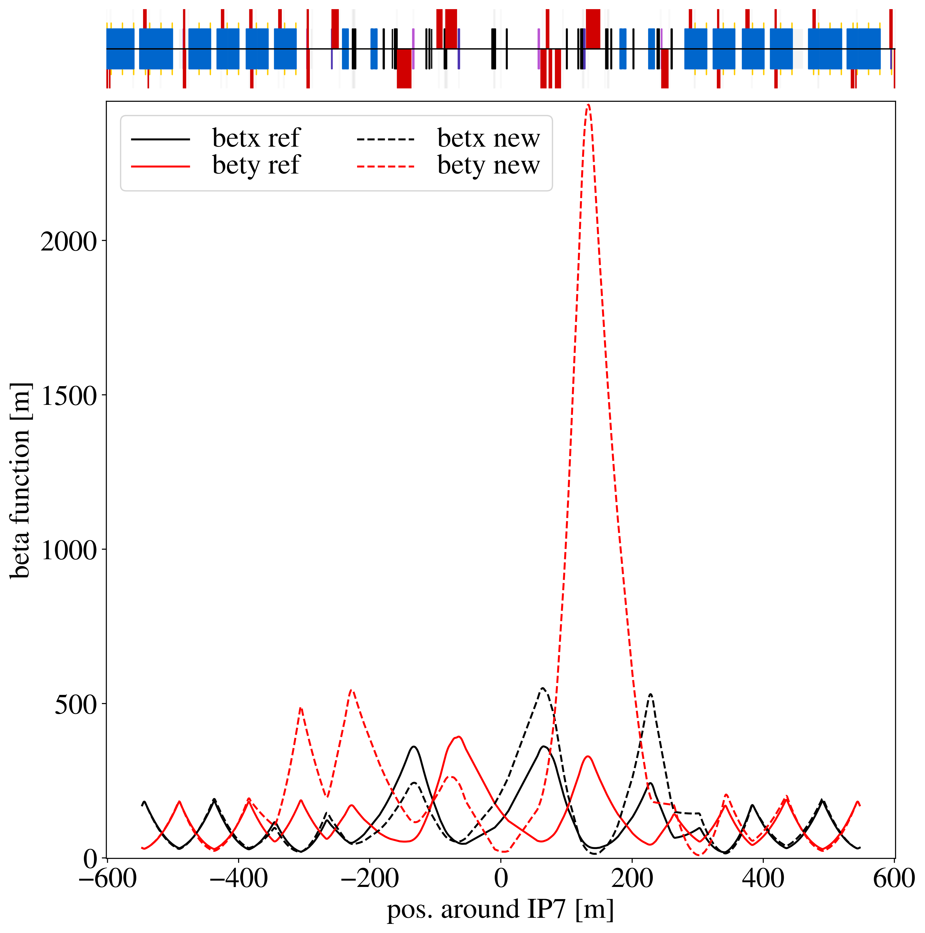
New IR7 optics^{1,2}
Increase collimator beta functions
  Larger normalized kicks on scattered particles
  → larger probability of absorbing them in TCS / TCLAs
  Larger physical gaps → lower impedance
Increase single pass dispersion at TCS / TCLAs
  Increased through optics rematch
  Off-momentum particles scattered by TCP more
  likely intercepted before reaching the DS
B2
1: R. Bruce et al, https://doi.org/10.18429/JACoW-IPAC2021-MOPAB006
2: B. Lindstrom et al, https://doi.org/10.18429/JACoW-IPAC2022-TUPOTK062

Slide 4
First MDs
MD7203: New IR7 optics for improved cleaning and impedance
  Only IR7 changed
  First validation at FT only, real cycle requires combined ramp & desqueeze
  2024-05-16
  Steps overview:
    Optics measured in first fill
    Nominal ramp to FT
    Reference loss maps and impedance measurements
    Desqueeze optics in IR7
    Collimator alignment
    Loss maps and impedance measurements
MD11243: HL-LHC optics cycle (part 1)
  New optics whole machine
  Initial assessment of feasibility of IR3 / IR7 desqueeze during ramp
  2024-06-06 / 2024-06-08
  Steps overview:
    New injection optics
    Optics measurements / corrections
    Alignment at injection
    Combined ramp and desqueeze in IR3 and IR7
    Optics measurements / corrections
    Alignment at FT
    Aperture measurement
    Ramp with tight collimator settings and loss maps at different energies (only B2)

Slide 5
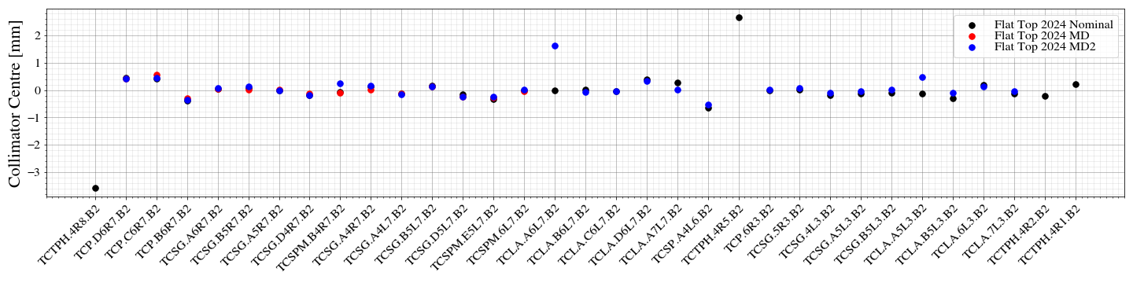
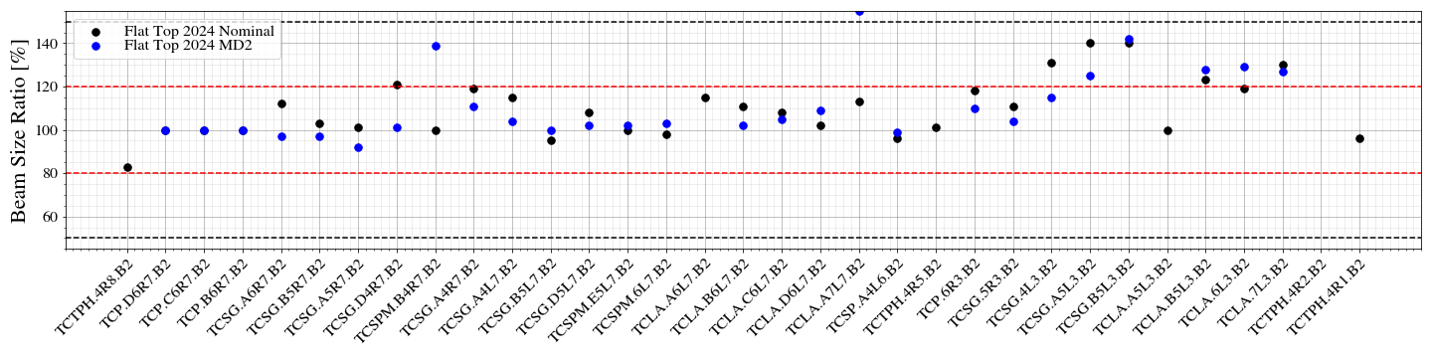
Collimator centers
Excellent agreement of collimator centers between MD optics and nominal
  No change expected, but critical to check that OFB updated properly to new cycle
A few outliers, likely caused by erroneous loss spike detection during alignment

Slide 6
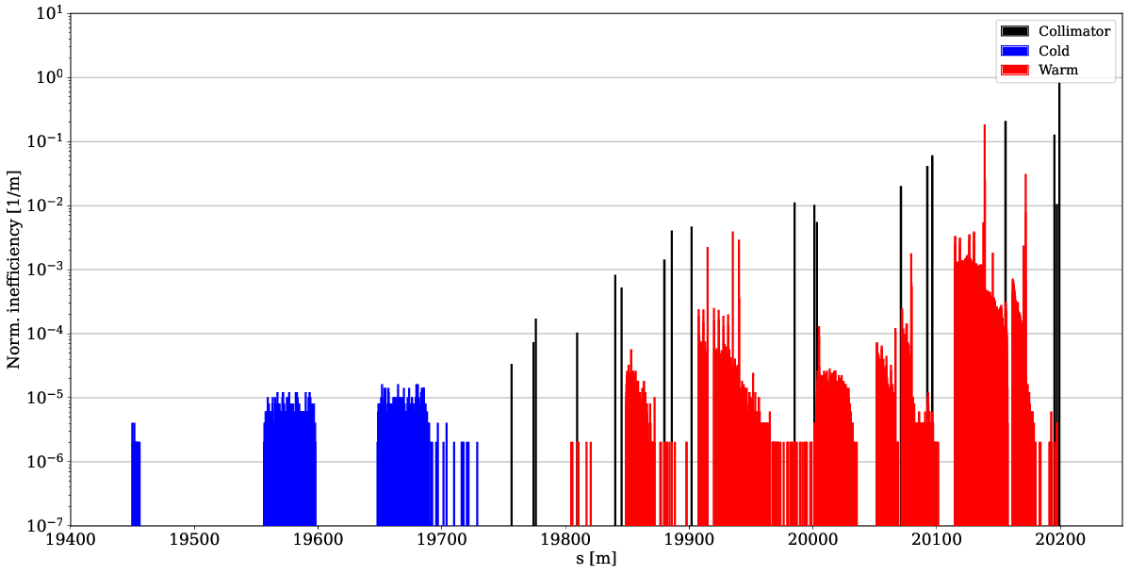
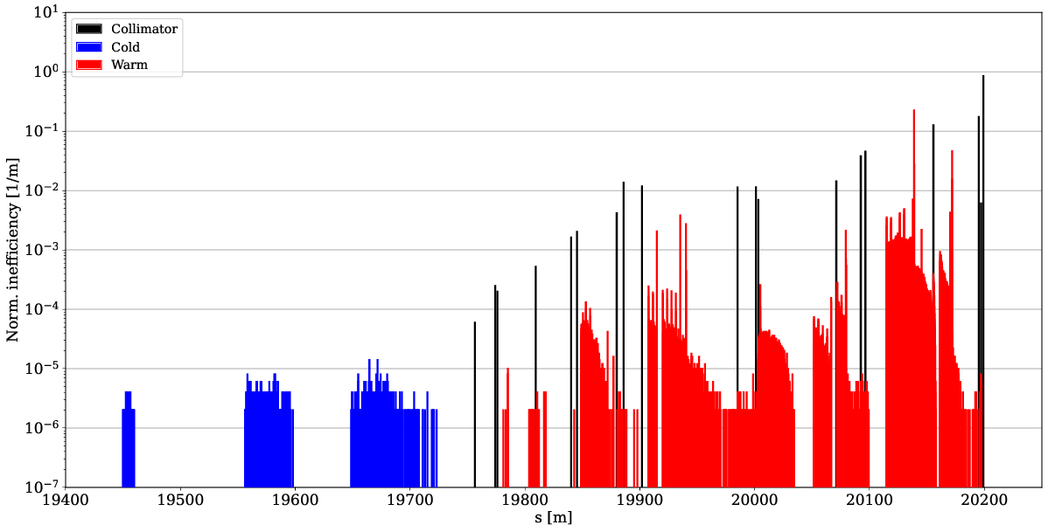
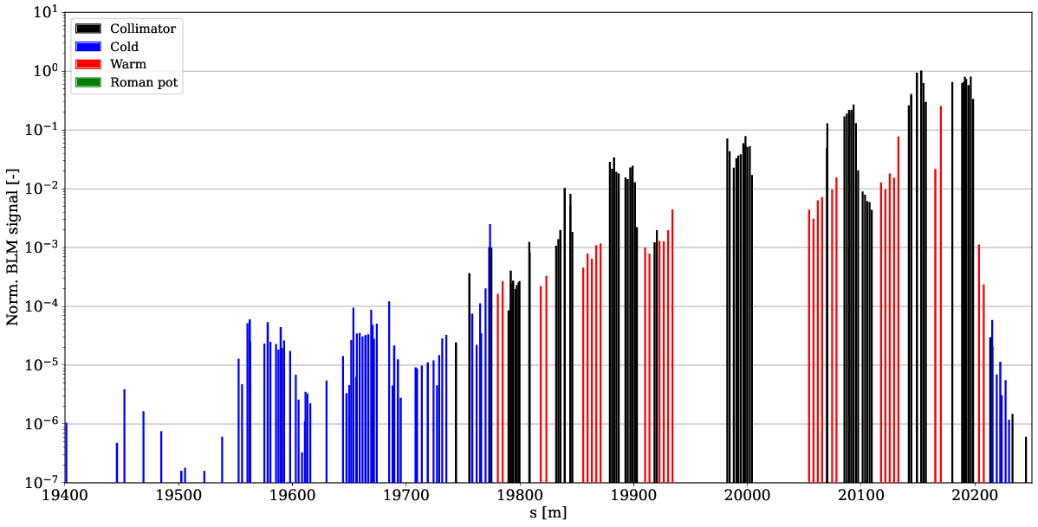
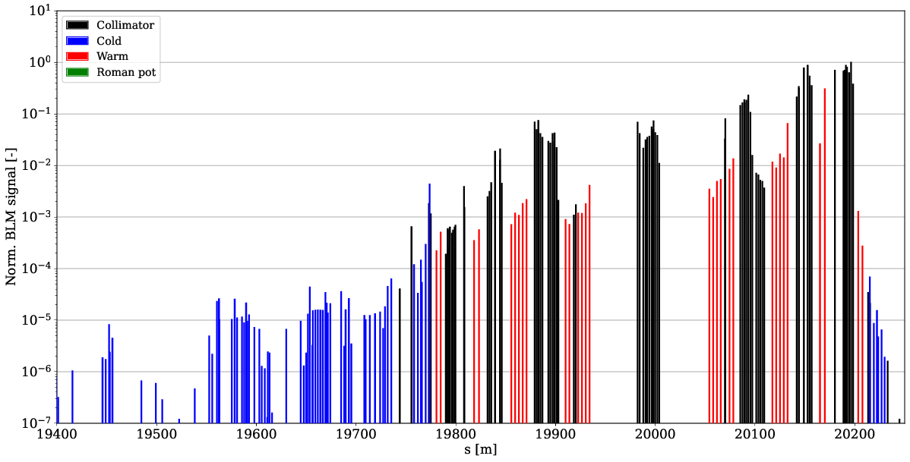
B2V losses (FT – IR7 MD)
Secondary stages catch more losses – less leakage to DS
Simulated 60 % improvement – measured 53 % (σ=7.4 %)
nominal sim.
IR7 MD sim.
nominal meas.
IR7 MD meas.

Slide 7
B2V losses (FT – IR7 MD)
Secondary stages catch more losses – less leakage to DS
Simulated 60 % improvement – measured 53 % (σ=7.4 %)
nominal sim.
IR7 MD sim.
nominal meas.
IR7 MD meas.

Slide 8
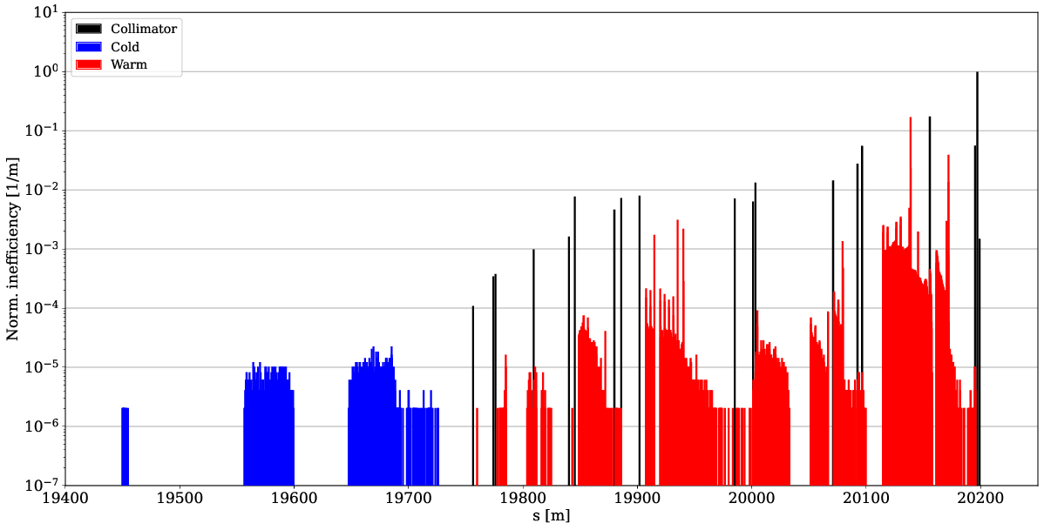
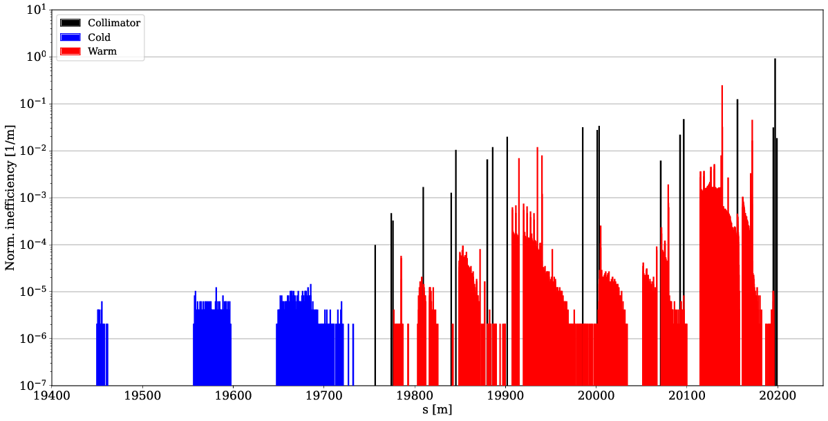
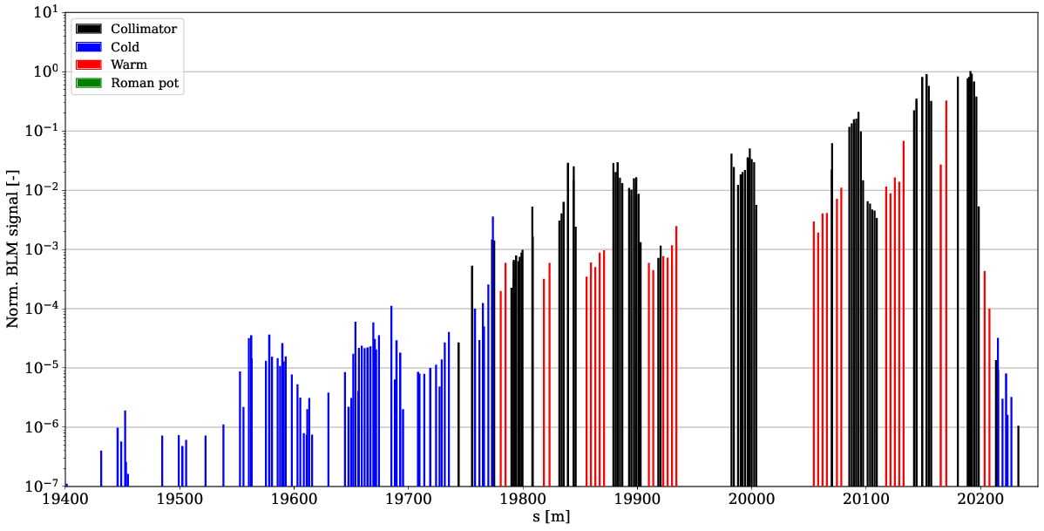
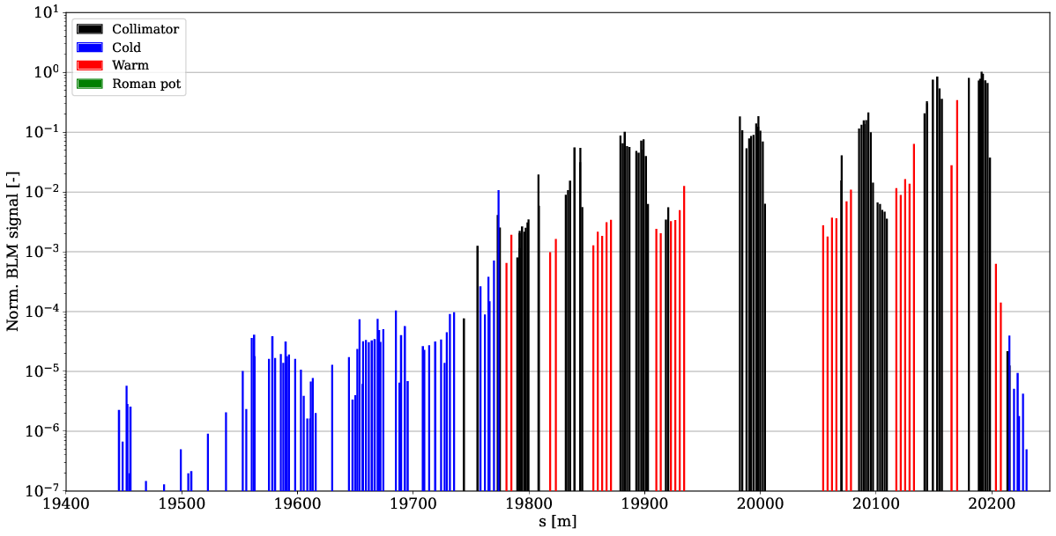
B2H losses (FT – IR7 MD)
Simulated 37 % improvement – measured 19 %
nominal sim.
IR7 MD sim.
nominal meas.
IR7 MD meas.

Slide 9

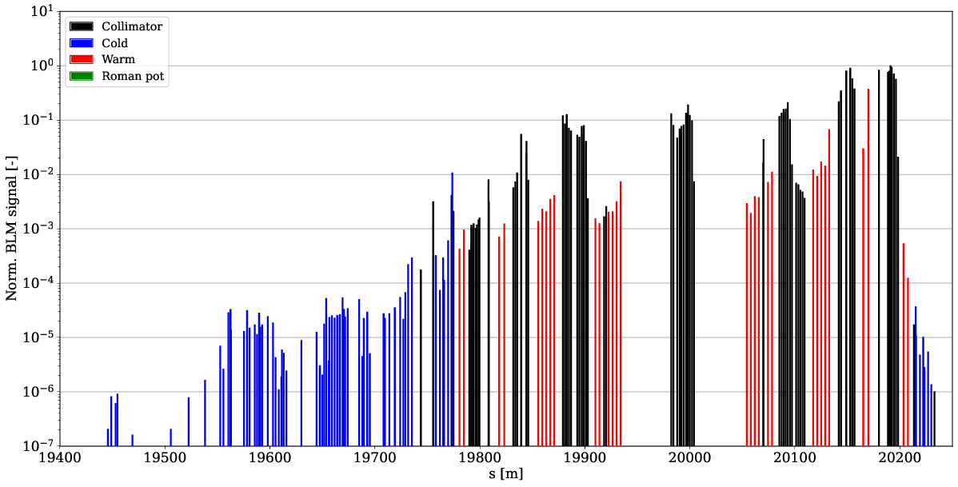
B2H losses (FT – HL MD)
Simulated 61 % improvement – measured 61 %
nominal sim.
HL MD sim.
nominal meas.
HL MD meas.

Slide 10
B2H losses (IR7 MD vs HL MD)
Not obvious why smaller than expected improvement in IR7 MD
O(1e-5) differences – needs detailed analysis
IR7 MD sim.
HL MD sim.
IR7 MD meas.
HL MD meas.

Slide 11
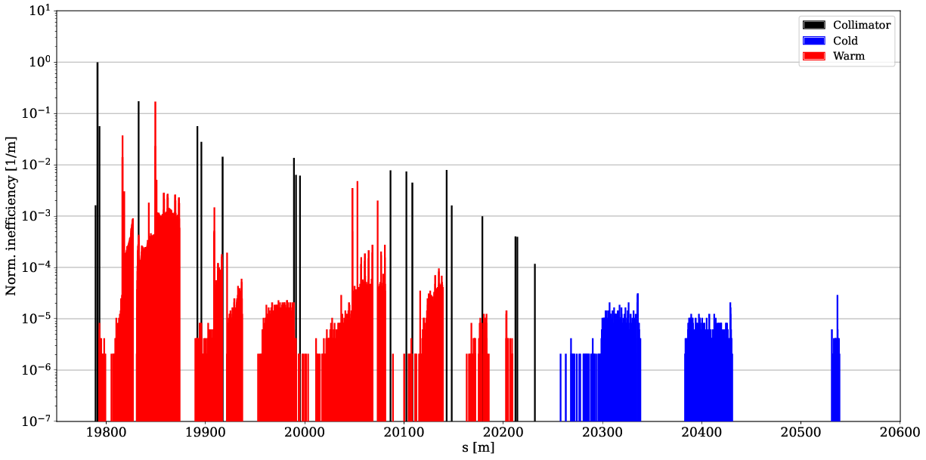
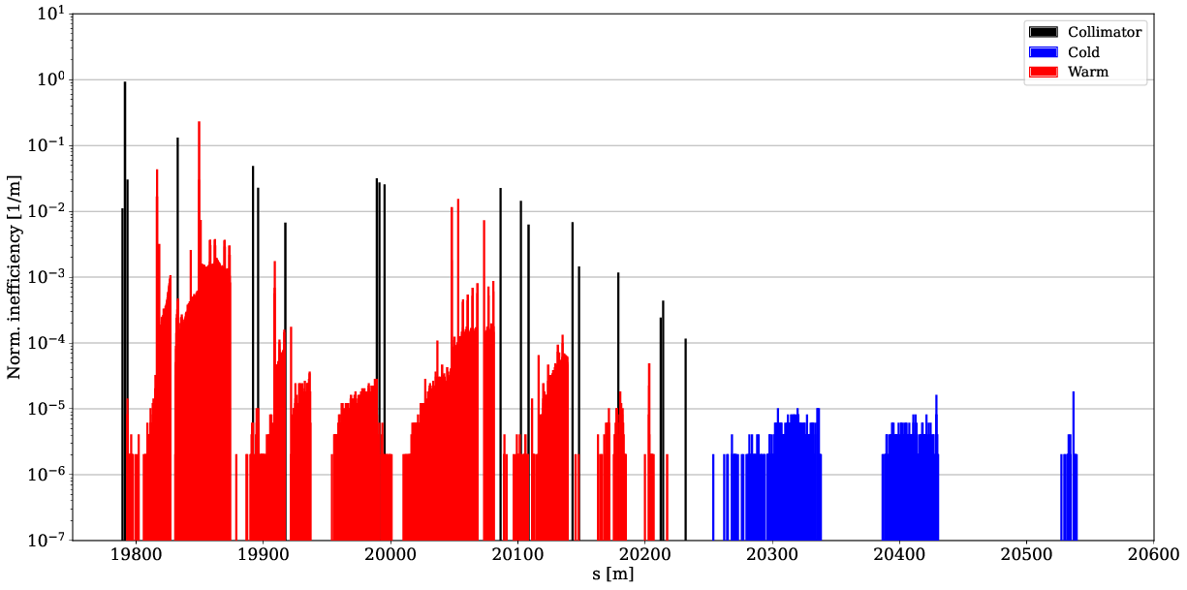
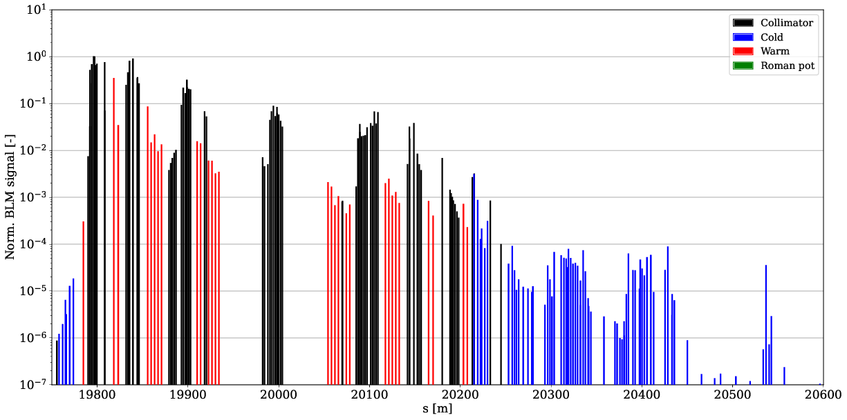
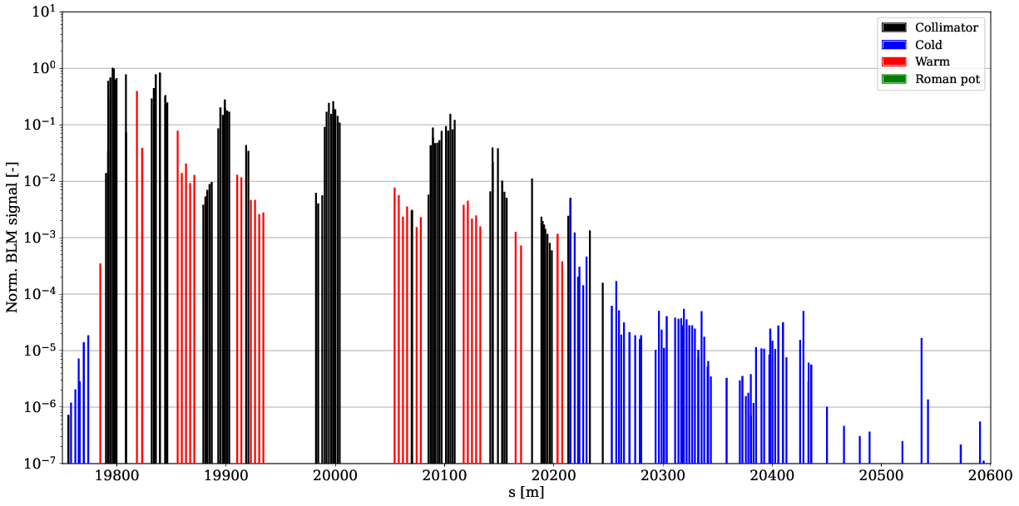
B1H losses (FT – IR7 MD)
Simulated 39 % improvement – measured 45 %
nominal sim.
IR7 MD sim.
nominal meas.
IR7 MD meas.

Slide 12

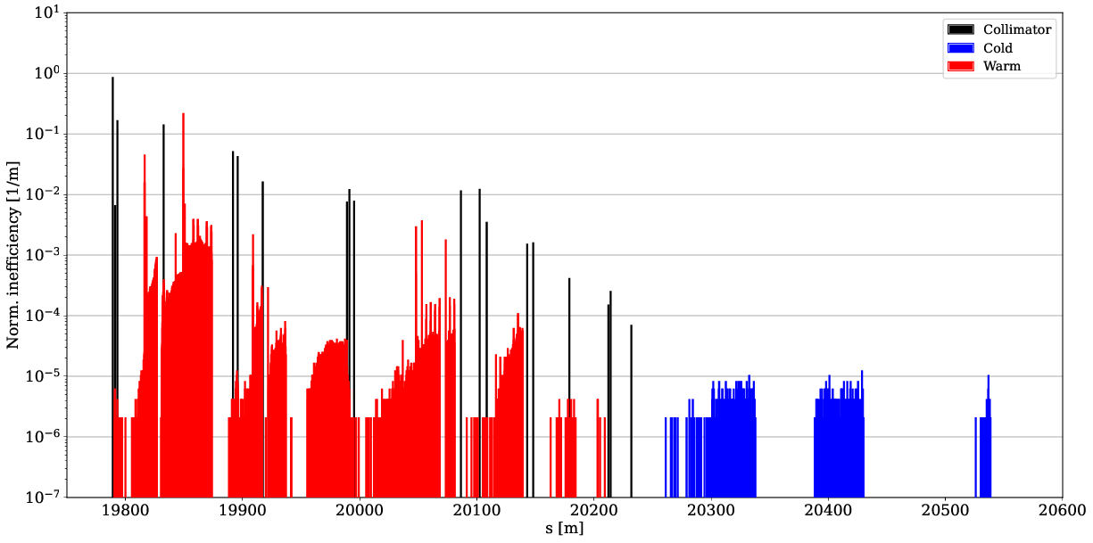
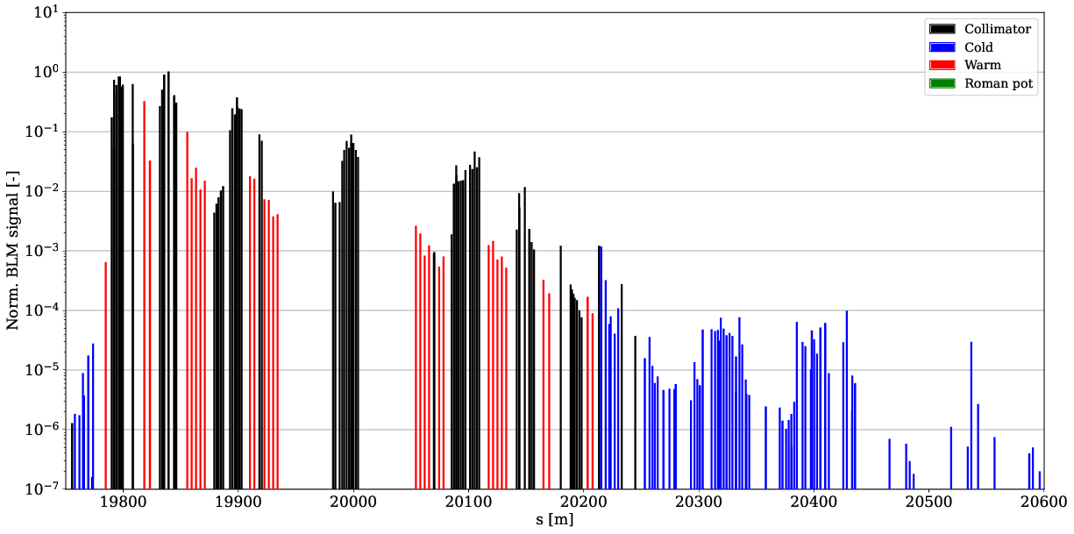
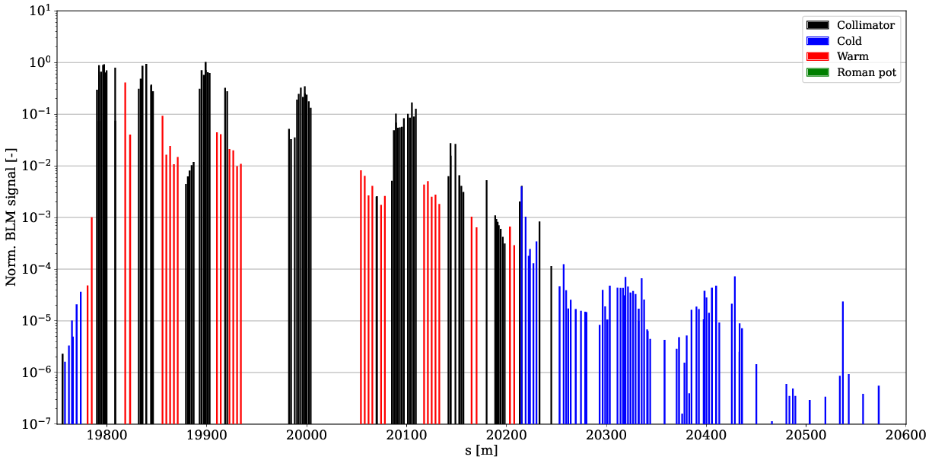
B1V losses (FT – IR7 MD)
Simulated 65 % improvement – measured 52 %
nominal sim.
IR7 MD sim.
nominal meas.
IR7 MD meas.

Slide 13
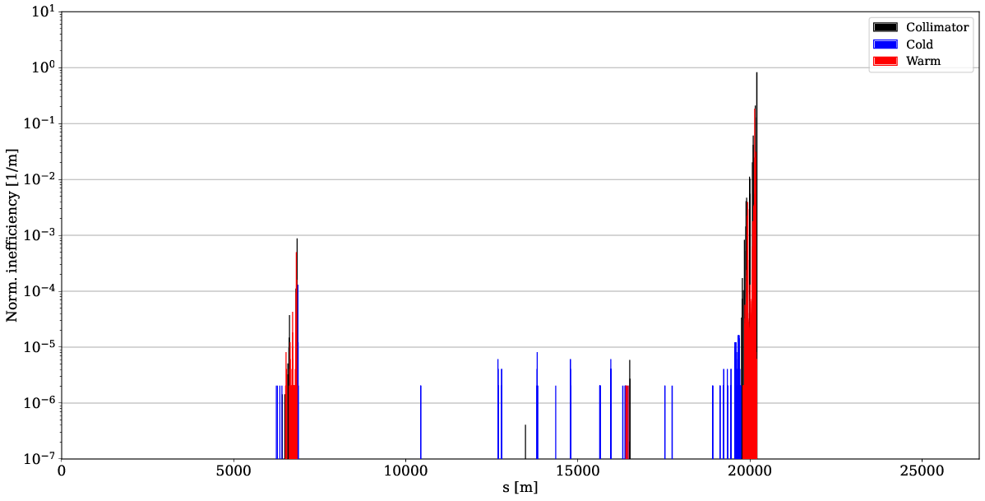
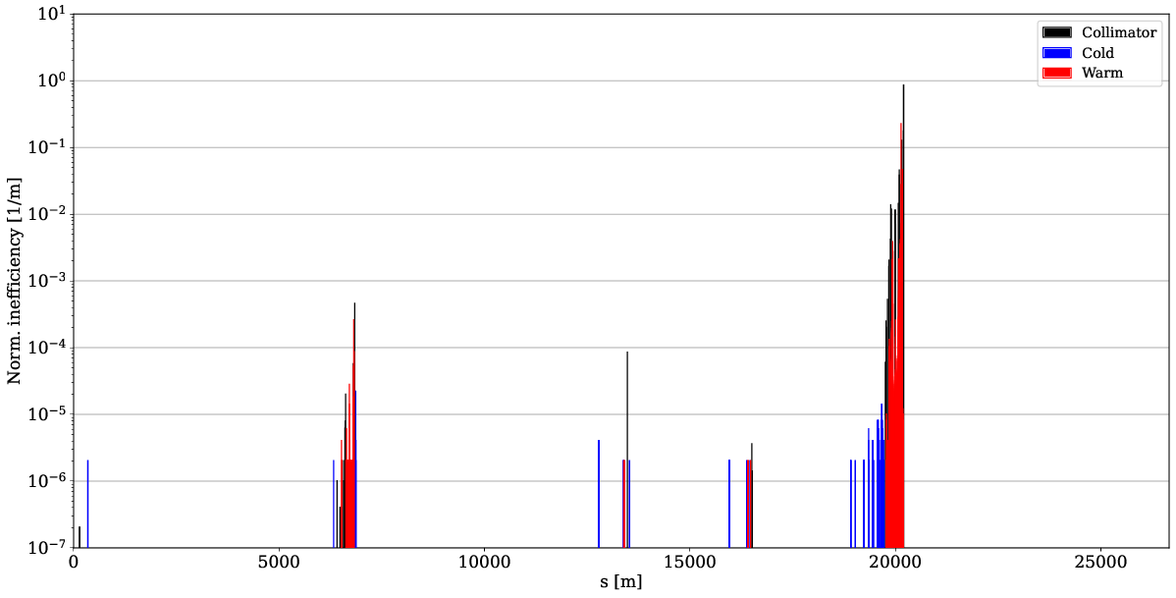
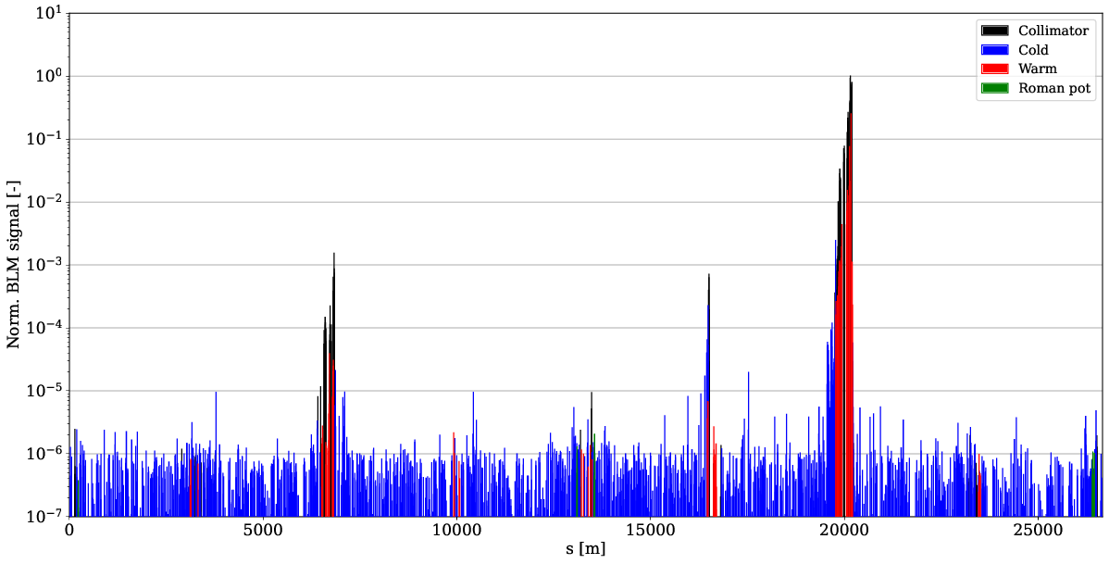
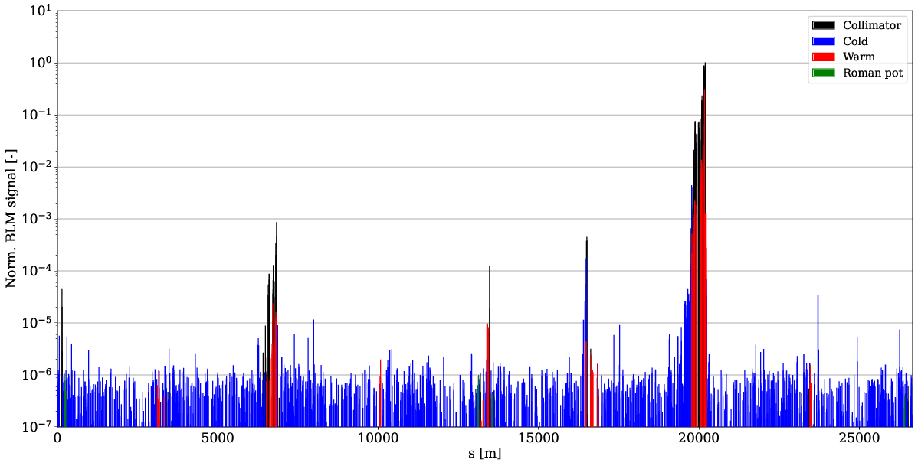
TCT losses – B2V
Significant increase of TCT losses
TCT power load and detector background should be evaluated
Can be mitigated with phase advance from TCP to TCT
n.b. TCTs at 18 sigma, go to 8.5 sigma during levelling
nominal sim.
IR7 MD sim.
nominal meas.
IR7 MD meas.

Slide 14
Impedance – tune shift measurements
Measured between one normal and one half indiv, before and after optics transition (following coll. alignment)
tune shift
 | B1H | B1V | B2H | B2V
reference | 1.26e-4 | 1.85e-4 | 1.79e-4 | 1.44e-4
new optics | 1.18e-4 | 1.32e-4 | 1.30e-4 | 1.28e-4
gain | 4 % | 26 % | 33 % | 19 %
bunch intensity
 | B1 indiv | B1 half | B2 indiv | B2 half
reference | 9.55e10 | 5.77e10 | 9.68e10 | 6.06e10
new optics | 9.40e10 | 5.75e10 | 9.88e10 | 5.76e10

Slide 15
Summary of observables
Fractional change new optics compared to reference
DS improved in all cases
Meas. σ = 0.074
Numbers in () not reliable due to very low absolute losses
 | B1H |  | B1V |  | B2H |  |  |  | B2V
 | IR7 MD |  | IR7 MD |  | IR7 MD |  | HL MD |  | IR7 MD |  | HL MD
 | sim | meas | sim | meas | sim | meas | sim | meas | sim | meas | sim | meas
DS1 | 0.44 | 0.63 | 0.33 | 0.60 | 0.57 | 0.81 | 0.36 | 0.42 | 0.40 | 0.36 | 0.40 | 0.44
TCT1 | 3.06 | 1.04 | 2.71 | 3.59 | (0) | 3.78 | 1.05 | 1.23 | (inf) | 1.90 | (inf) | 0.61
TCT2 | (0) | 2.92 | (0) | 1.08 | (0) | 1.16 | (0) | 1.38 | (0) | 0.98 | (0) | 0.64
TCT5 | 0.99 | 2.45 | (0) | 1.15 | 15.8 | 7.89 | 2.55 | 3.79 | (217) | 3.71 | 1.07 | 0.86
TCT8 | (206) | 21.0 | (269) | 13.8 | (0) | 1.11 | (0) | 1.56 | (0) | 0.96 | (inf) | 0.77
IR3 vs IR7 | 1.14 | 1.57 | 0.89 | 0.80 | 0.50 | 0.84 | 0.35 | 0.56 | 0.54 | 0.56 | 0.50 | 0.45

Slide 16
Conclusions and next steps
Very promising results on cleaning performance
  DS leakage cut by 19 - 61 % in all cases
  Simulations seem to overestimate the improvement in some cases
    detailed analysis ongoing
  TCT losses increase but can be mitigated if necessary
    phase advance constraint already planned for HL optics
  IR3 / IR7 loss balance shifts -- in general larger fraction of losses in IR7
Significant reduction of impedance by 19 – 33 %
  B1H outlier – to be understood
Next steps:
  Integrate IR7 optics squeeze in nominal 2024 ramp and test in MD
  Test ramp+squeeze with trains to evaluate steady state losses
  Complete full set of loss maps (during ramp, off-momentum and ASD)
  Orbit bump to improve cleaning further
  Mitigate TCT losses
  Cross-check (potential) increase of background with experiments

Slide 17
Conclusions and next steps
Very promising results on cleaning performance
  DS leakage cut by 19 - 61 % in all cases
  Simulations seem to overestimate the improvement in some cases
    detailed analysis ongoing
  TCT losses increase but can be mitigated if necessary
    phase advance constraint already planned for HL optics
  IR3 / IR7 loss balance shifts -- in general larger fraction of losses in IR7
Significant reduction of impedance by 19 – 33 %
  B1H outlier – to be understood
Next steps:
  Integrate IR7 optics squeeze in nominal 2024 ramp and test in MD
  Test ramp+squeeze with trains to evaluate steady state losses
  Complete full set of loss maps (during ramp, off-momentum and ASD)
  Orbit bump to improve cleaning further
  Mitigate TCT losses
  Cross-check (potential) increase of background with experiments

Slide 18
Thanks a lot to OP, OMC and MD coordinators for the very strong support!

Slide 19
IR3 / IR7 balance of losses – B2V
Balance of losses between IRs has implications for radiation dose
Can go up or down, here down by 44 % in IR3
Only preliminary indication – no off-momentum loss maps yet
nominal sim.
IR7 MD sim.
nominal meas.
IR7 MD meas.

Slide 20
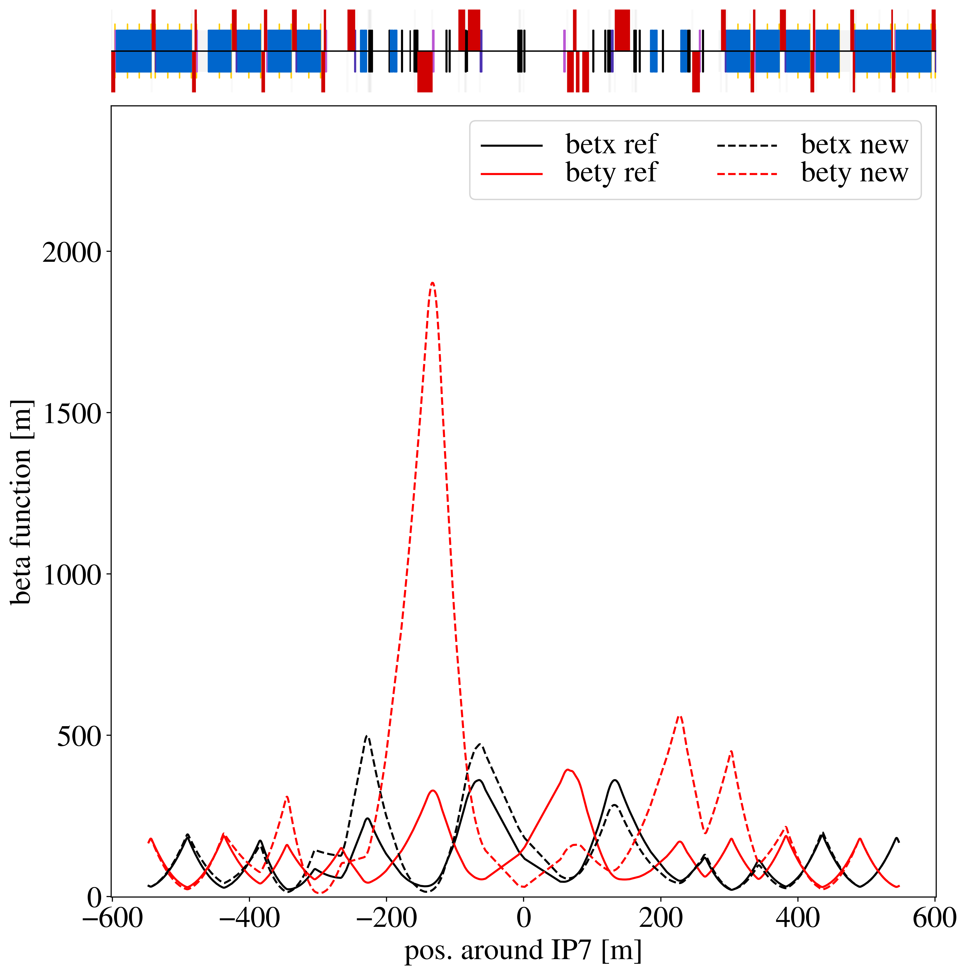
Beta functions

Slide 21
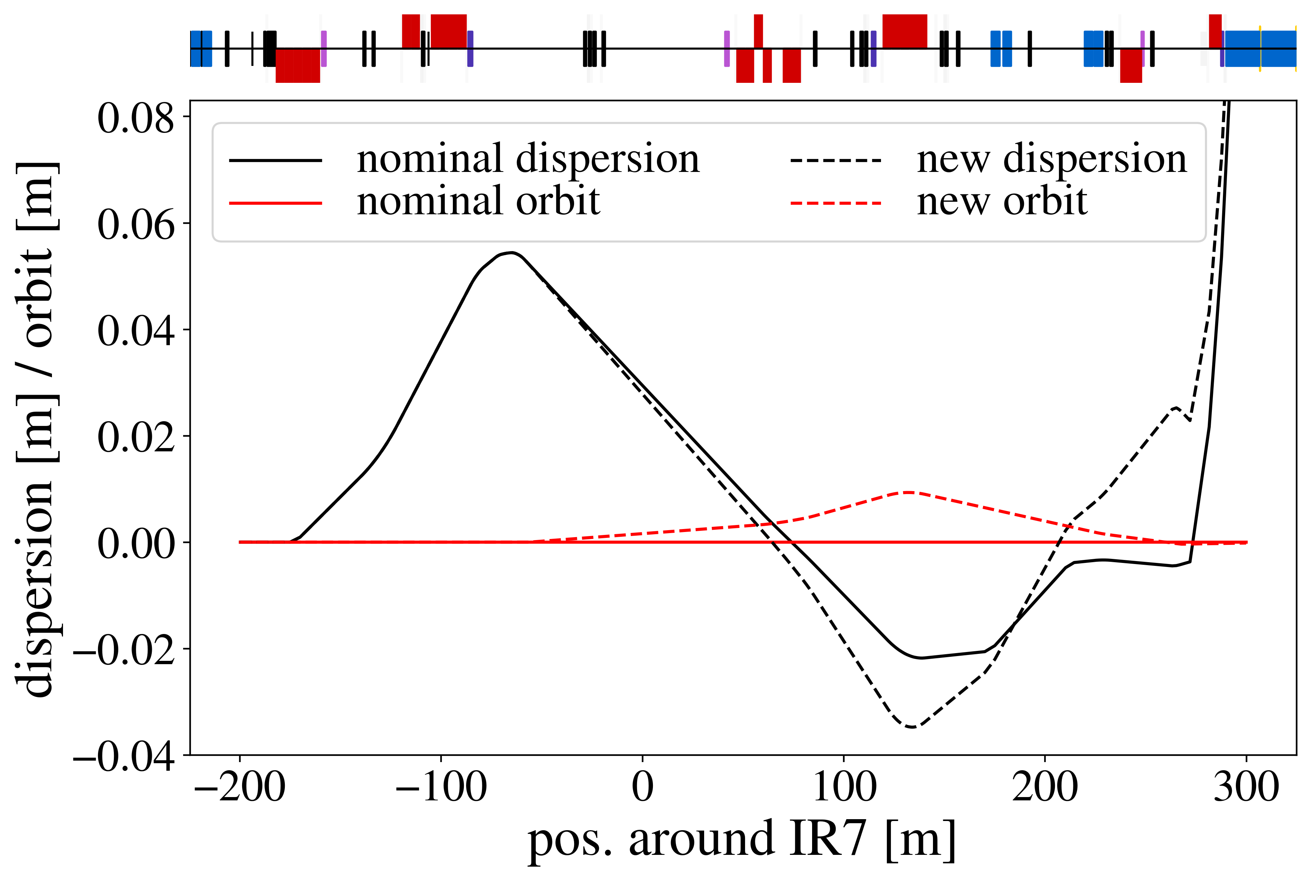
Dispersion
The two large kicks per bump are at locations of small dispersion (0.1-0.2 m), so it should be Ok for the length change of the orbits – Jörg
mcbwh.4l7.b1: 34 % of max
mcbch.7r7.b1: 50 % of max
mcbch.9r7.b1: -3.7 % of max

Slide 22
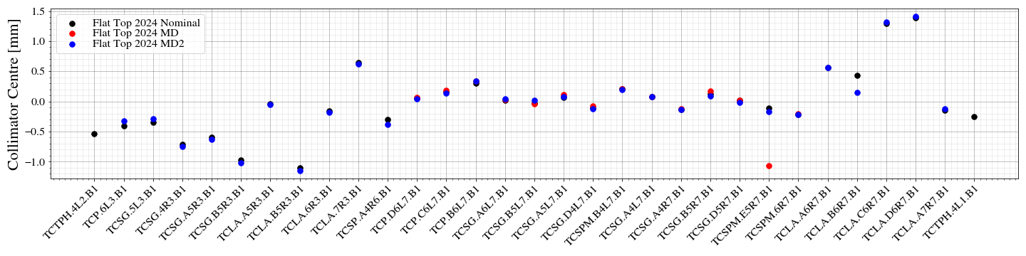
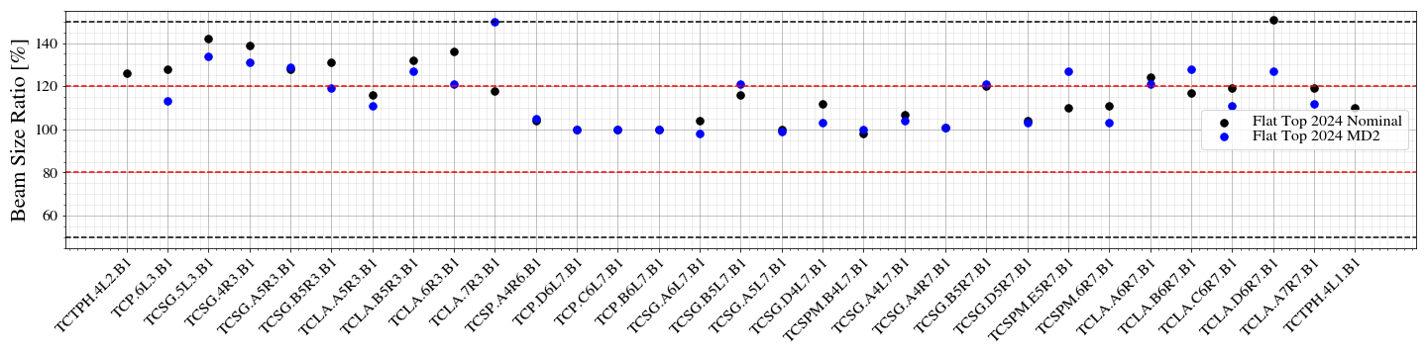
Collimator centers
Excellent agreement of collimator centers between MD optics and nominal
A few outliers, likely caused by erroneous loss spike detection during alignment

