Slide 1
MD12263 - Weak-Strong investigation of Long-Range Beam-beam
T. Persson, X. Buffat, J. Dilly, M. Hostettler, E.H. Maclean, U. Kar, K. Skoufaris, G. Sterbini, R. Tomas

Slide 2
Motivation
The linear and nonlinear optics commissioning is based on measurements of pilot bunches
This year we saw the importance of a two-beam effect in the hierarchy breakage of the collimators
  Will be even more important in HL-LHC where intensity is higher and β* smaller
  Need a method to measure these effects and benchmark simulations!
    Measuring with two strong-beam is very difficult because when you excite on it has a strong impact on the other -> Difficult to measure and model correctly
  Solution:
    A weak beam containing pilot intensity is used to probe the effect of the strong
    Additional benefit of this is that we can have collimators in coarse

Slide 3
Operational setup and experience
Created a special sequence
  Changes to high-intensity only for beam 1
3 pilot bunches for beam 2
  1 with no LR, 1 with LR in 1/2/5/8 and one only in IR1/5
Removed the common BPMs from the orbit feedback since there could be strange effects having a strong and a weak beam
Nominal collimators to 30 cm
  Opened the collimators for Beam 2 using a sequence to the optics measurements settings (NLO at 30cm, beam 1 was deactivated)
Separated the beams by ~5 sigma in order to only have LRBB (no head-on)
Some manual skipping in the nominal sequence for things such as longitudinal blow-up
Extremely smooth and now technical issues with this novel setup!

Slide 4
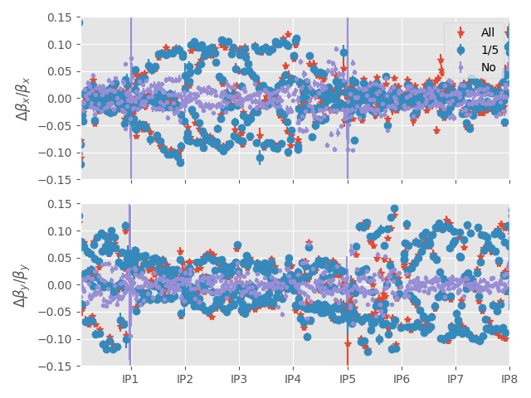
Impact on β-beat
The β-beat relative to the ideal model
With LRBB we go up a peak of 15%
  Without LRBB it is around ~7%

Slide 5
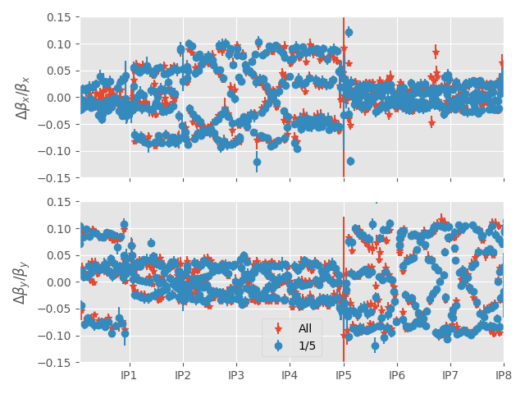
Impact on β-beat (2)
The β-beat with using the bunch without LRBB as a reference
~10% difference between bunches with LRBB and the one without
Small impact from the LRBB in IR2/8 (as expected)

Slide 6
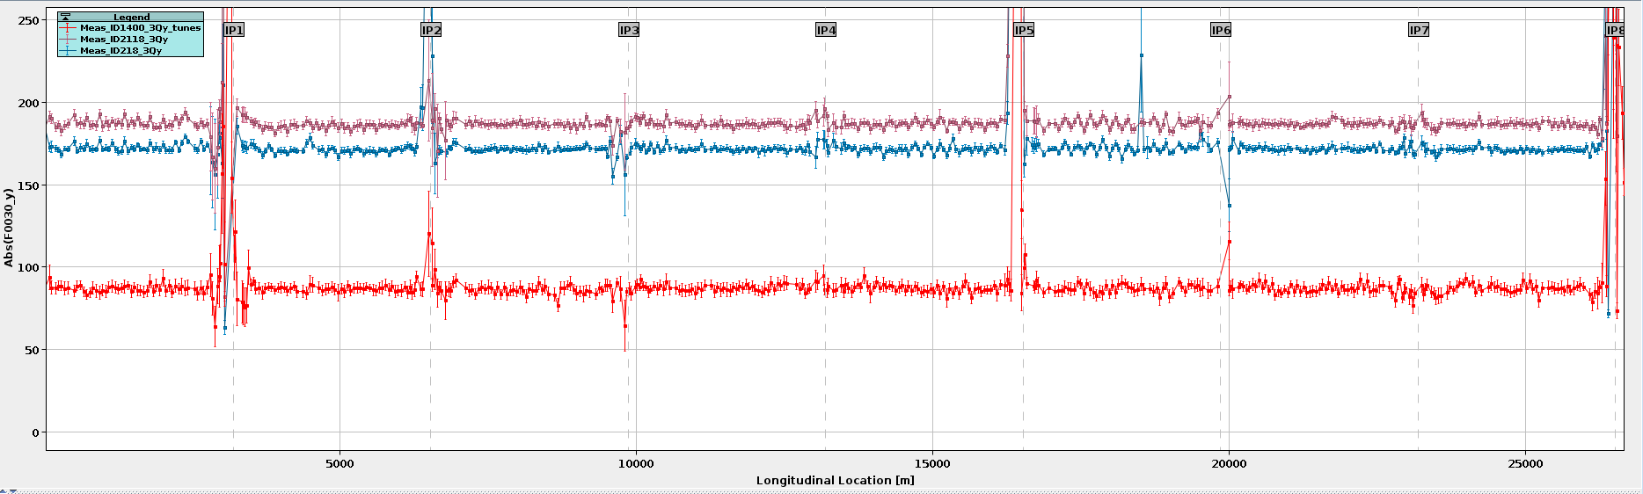
Impact on 3Qy
The f₀₀₃₀ doubled in amplitude from the bunches with LRBB bunches
  Shown to be one of the ingredients for explaining the hierarchy breakage!
  We are working on a correction method to include these effects

Slide 7
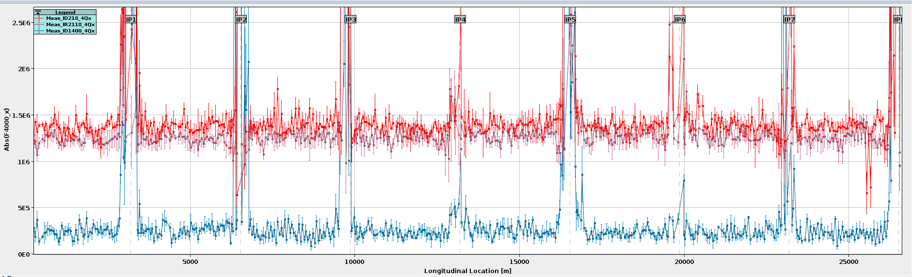
Impact on 4Qx
The LRBB increases the significantly, as expected

Slide 8
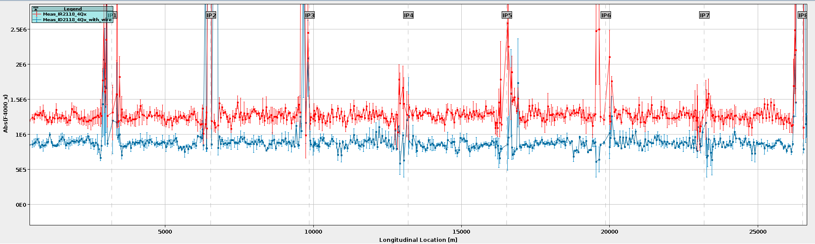
The effect of the LRBB wire compensator on 4Qx
Turning on the wire reduced the measured f₄₀₀₀
  To be compared to simulation

Slide 9
Conclusion and Outlook
Significant β-beat between the bunch with no LR and the ones with LR was shown
An increase of the 3Qy from LR was also measured
  Direct impact on the hierarchy breakage!
Impact on the 4Qx with and without the LRBB wire was shown
  Simulations to be done to benchmark
The MD has opened the possibility of a new avenue of MDs where a weak beam can be used to probe a strong
  Interest already expressed by the e-cloud team for a similar setup.
  Plan to benchmark results to pyTrain and other simulation codes
  One could consider if this kind of measurement should be part of the intensity ramp-up

Slide 10
Thanks to everyone who helped!
Also, a big thanks to the MD coordinators for the flexibility with slotting in the MDs when I was available!

