Slide 1
SHAKTI Processors Overview
Kotteeswaran Ekambaram
Senior Project Advisor | SHAKTI Lab | RISE Group

Slide 2
Genesis of SHAKTI
SHAKTI is an IIT-Madras coordinated initiative to develop a family of open source processors ranging from microcontrollers to server-grade multi-core processors.
Today the SHAKTI initiative is building a comprehensive silicon ecosystem that will provide industry-grade open source processors, AI/ML accelerators, communication fabrics, interconnects and storage controllers.
5 startups spun off from this initiative.

Slide 3
Shakti - Timeline
SHAKTI was born
Tape outs
Funding from MeiTY
Industry adoption
2013
2017
2018
2019
Exploring ISA
Approached by UCB to adopt RISC-V.
Defined 3 major classes
of cores : E-Class,
C-Class and I-Class
● RISECREEK:
- Tapeout of C-class
on Intel’s 22nm FFL
● RIMO:
- Tapeout of C-class
on SCL’s 180nm
SHAKTI gets official
funding, and India
Microprocessor
Development
Program (IMDP) begins
IGCAR adopts SHAKTI
ISRO adopts SHAKTI
Thales funds SafeRV
Moushik:
  (an E-class based SoC) is taped-out at SCL 180nm

Slide 4
Shakti - Timeline
-
Swadeshi 𝛍P Challenge
Startups
Secure
Accelerate
2020
2021
2022
2023
National level challenge was launched to design innovative solutions based on SoCs designed by SHAKTI .
Three startups spin off from Shakti
Mindgrove
Securweave
Vyoma
Secure Shakti
Tape in for IISU at SCL
Fifth startup, Shakra
Shaktimaan - AI accelerator
I-class 2.0

Slide 5


Shakti Ecosystem
Open Source Baseline Cores
Complete Design to Layout Flow
Interconnects and Fabrics
FPGA + SDK + IDE
Peripheral Device IPs
Domain Specific Cores

Slide 6
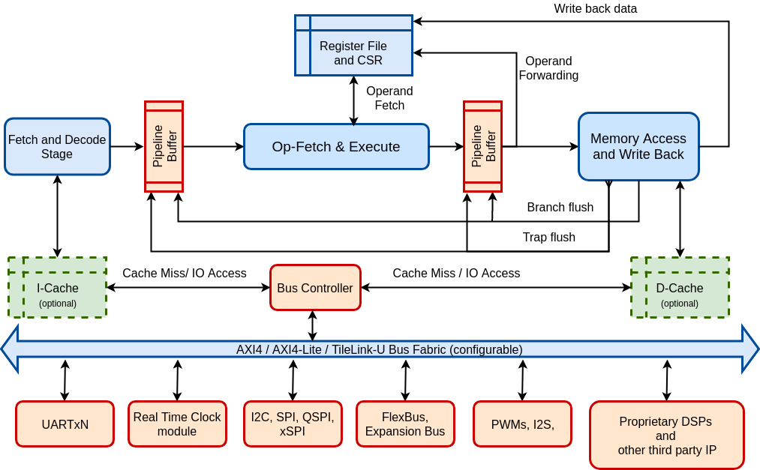
Shakti E-Class
In-order 3 stage 32/64 bit microcontroller supporting a subset of RISC-V ISA.
Low area and power consumption - operational freq. of < 400MHz on silicon.
Optimized variants for FPGA based soft-cores.
AXI4/AXI4-Lite/TileLink peripherals supported.
Positioned against ARM’s M class cores.
Open source IP supporting RV*IMAC.
OpenOCD based SoC debug support through JTAG.
IoT devices, Edge Devices, Robotic Control, Smart cards

Slide 7
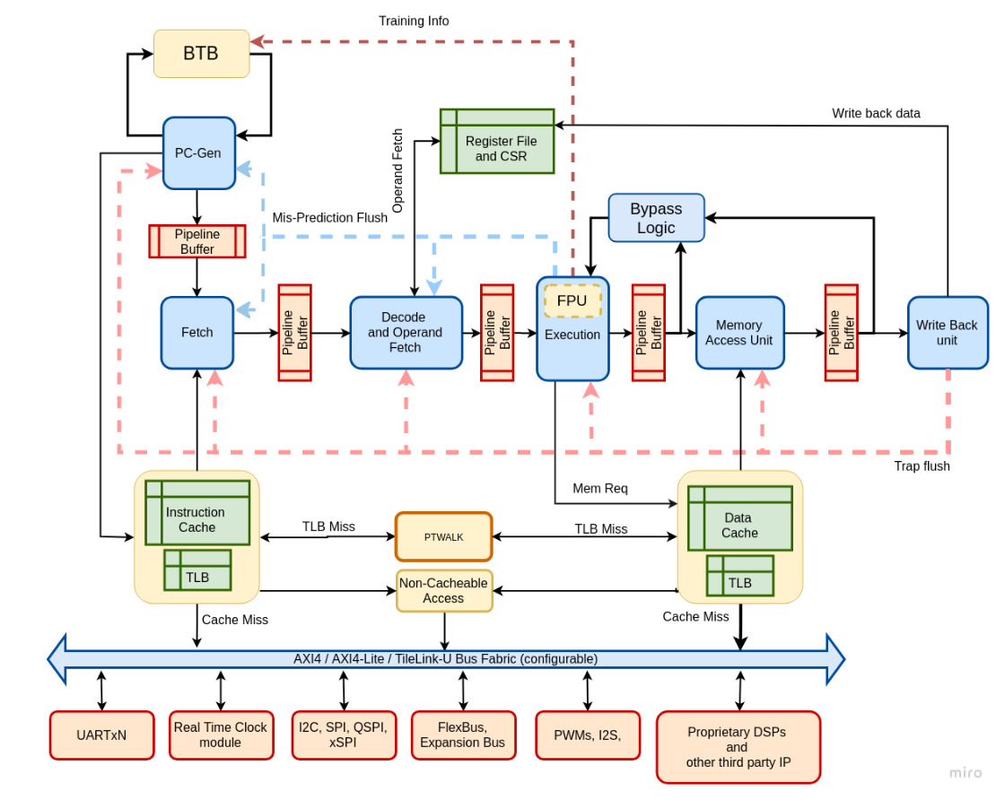
Shakti C-Class
An in-order 6-stage 64-bit core supporting the entire stable RISC-V ISA.
Targets mid-range compute systems: upto 1GHz.
Variants for low-power and high-performance.
Positioned against ARM’s Cortex A35/A55
Supports RISC-V ISA:
  RV64IMAFDC.
  Latest privilege spec of RISC-V ISA.
  Supports the sv39/48 virtualization scheme.
Caches: 16KB Instruction and Data caches.
Includes operand bypass for better performance.
Includes a High performance branch predictor with a Return-Address-Stack.
Boots RISC-V linux os.
Secure Computing, IoT & Edge Computing hubs, Auto/Aerospace/Industrial Controls

Slide 8
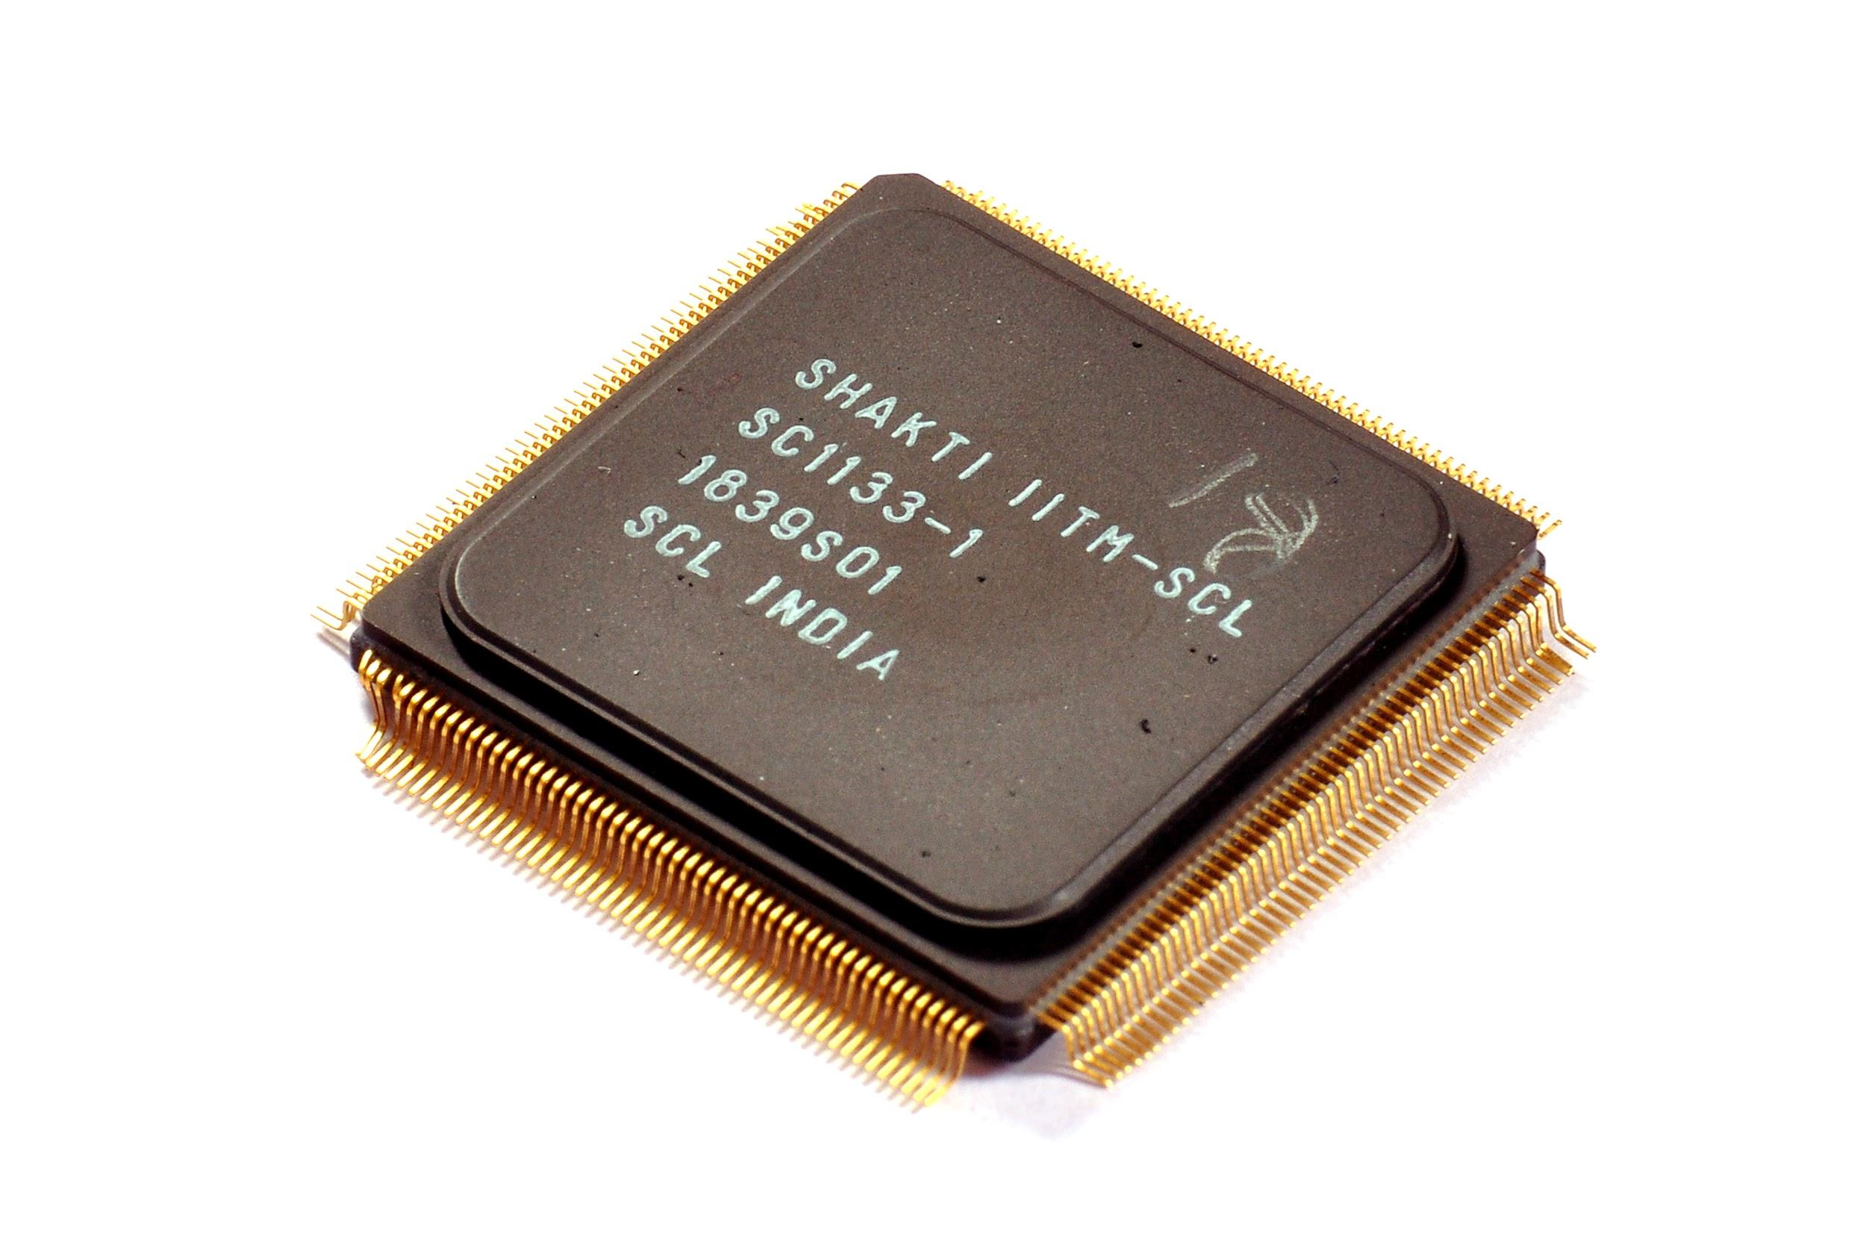
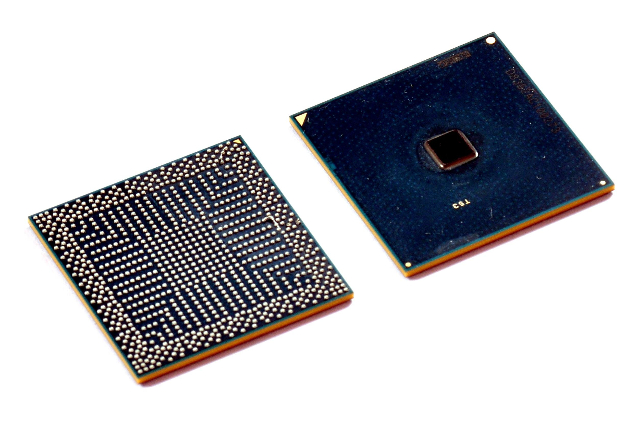
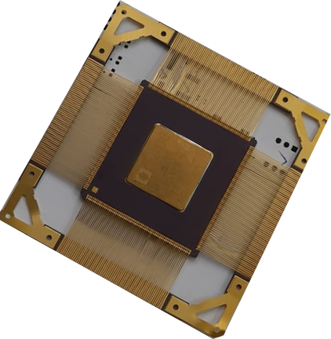
Shakti Tape Outs
RIMO
Risecreek
Moushik
Core: Shakti C-Class Core
Technology: 180nm CMOS
Gate Count: 2.2Million
Package: BGA
Frequency: 70MHz
I-Cache and D-Cache: 32KB each
ISA: RV64IMAFD
I2C, QSPI, UART, TCM
Core: Shakti C-Class Core
Technology: 22nm FinFet
Gate Count: 370K
Package: BGA
Frequency: 350MHz
I-Cache and D-Cache: 16KB each
ISA: RV64IMAFD
Sequential low overhead IEEE-754 compliant Single and Double Precision FPUs
Core: Shakti E-Class Core
Technology: 180nm
Gate Count: 647k
Package: 256 pin CQFP
Functional: IOs - 103
Frequency: 75-100MHz
ISA:RV32IMAC
PWM, SPI,GPIO,UART QSPI,I2C,SDRAM,JTAG,Pinmux

Slide 9
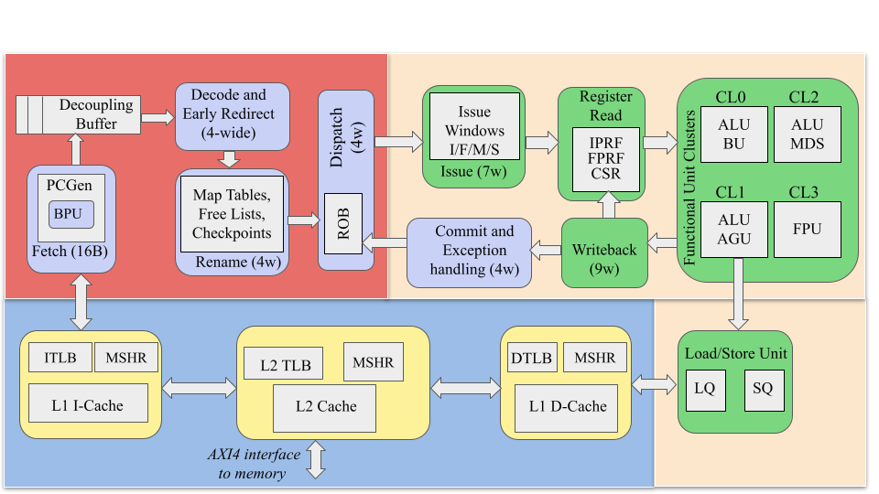
Shakti I-Class
64-bit superscalar, out-of-order RISC-V core for general purpose applications
ISA: RV64IMAFDC, ZiFencei, ZiCSR
4-wide out-of-order processor, 12-stage integer pipeline
Supervisor mode sv39, supports RISC-V Linux
AXI4 interface
Hardware Performance Monitors
Configurable core, implementation in BSV
One of the first OoO processors from India (soon to be open-source)

Slide 10
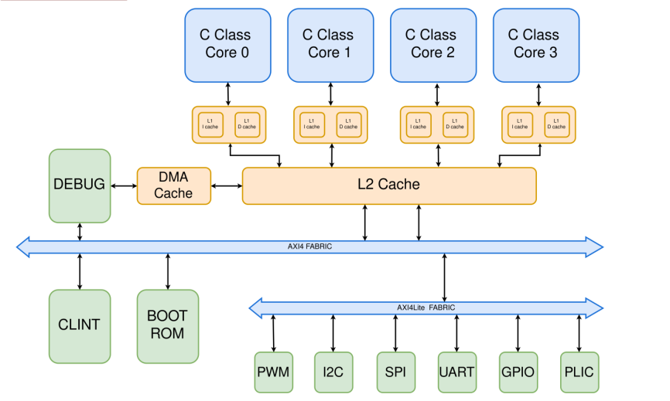
Shakti Multicore (Parashakti)
Connects N number of Shakti C-class cores.
Fully supports Atomic spec (A extension) of RISCV - used to implement locks in multicore systems.
Cache coherence: MESI protocol, implementation from flute
CLINT Peripheral /hart timer.
Inter processor Interrupts.
AXI4 interface
OpenOCD based debug through JTAG
Configurable core, implementation in BSV
SoC tried out on Aldec and profpga
Simulation support
Target Applications: Desktop, Server, Mobiles, etc

Slide 11
Secure Shakti
C -class with cryptographic accelerators
Secures the system from
  bootkit,
  rootkit
  malware vulnerabilities.
Three levels of protection.
  Hardware High Assurance Boot (HHAB)
  OpenSBI and Secure u-boot
  Hypervisor
Hypervisor
Runtime security
Prevents unauthorized privilege escalations
Protects sensitive memory regions
Ensures critical hardware settings are immutable
Open SBI & UBoot
Software Crypto Accelerators
2nd level boot security
Prevents modified rootfs from execution
High Assurance Boot
Boot time security
Hardware with crypto accelerators
Prevents modified bootloaders from execution

Slide 12



Software Development Activities
Software Development Kit
Support for current versions of C and E class.
Driver support for PLIC, CLIC, SPI, QSPI, UART, I2C and PWM.
Standalone mode supported on E class.
Multilevel logging, Direct Flash programming, MMU support added.
ESP8266 & ESP 32, FTDI, External Flashes and many sensors integrated.
Arduino compatible board and peripheral support added.
Highlights of the SDK
Clean separation between drivers, boot, core and application layers
Easily portable to any RISC-V based architecture
Multiple sensors connected and proven with SHAKTI-SDK.
OS Support

Slide 13


Startups

Slide 14
SHAKTI-F: Fault Tolerant Microprocessor Architecture
Dr. Gopalakrishnan Srinivasan
Assistant Professor, Computer Science and Engineering, IIT Madras

Slide 15
Shakti F-Class (circa 2015)
Objective: Protect the storage elements and ALU from soft and hard Single Event Effects (SEEs)
  Uses Error Correcting Codes (ECC) to tolerate errors in caches and registers (PC and architectural registers)
  Proposed Recomputing with Complemented Operands (RECOMPO) with dual modular redundancy for the ALU
  Identifies parts of the circuitry that need to be radiation hardened
Key results
  Incurs minimal overheads (20% area increase and 25% performance penalty) compared to double/ triple modular redundancy
  Offers 45% reduction in power consumption
  Runs at 330 MHz in 55 nm technology node

Slide 16
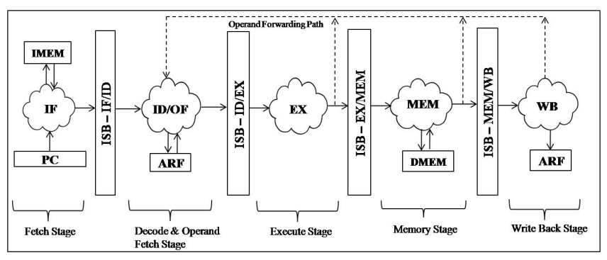
Shakti-C Recap
Shakti-F is a fault tolerant version of the (older) Shakti C-class

Slide 17
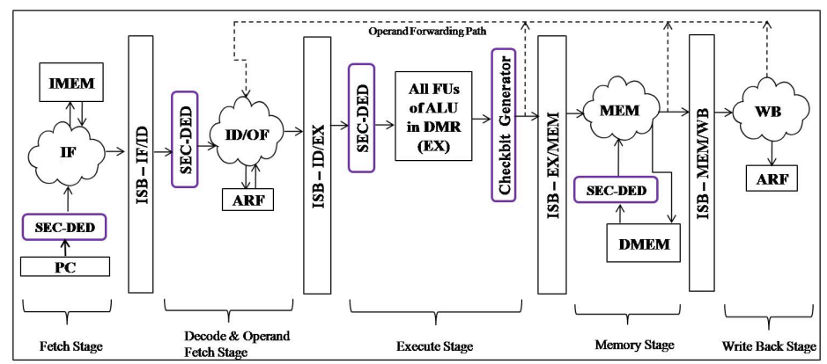
Shakti-F: Fault Tolerance for Caches and Registers
Key storage elements are fault protected using SEC-DED
Ref: S. Gupta, N. Gala, G. S. Madhusudan and V. Kamakoti, "SHAKTI-F: A Fault Tolerant Microprocessor Architecture," 2015 IEEE 24th Asian Test Symposium (ATS), Mumbai, India, 2015, pp. 163-168, doi: 10.1109/ATS.2015.35

Slide 18
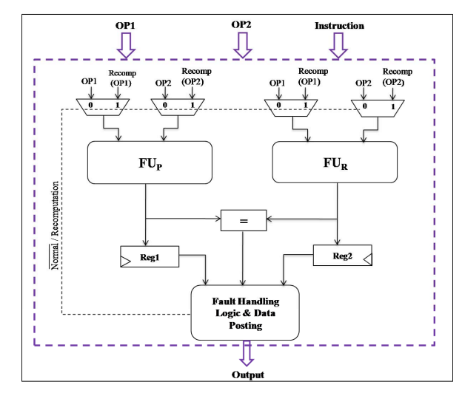
Shakti-F: Fault Tolerance for ALU
Primary and redundant functional units for fault detection
Faults are categorized into soft (transient) and hard (permanent) errors
RECOMPO based method is used to isolate the faulty functional unit

Slide 19
Shakti-F: Future Directions
Incorporate fault tolerance across the hardware and software stack
Software-level approaches
  Checkpointing algorithms that mirror data across redundant systems
Hardware-level approaches
  Incorporate ALU-level fault tolerance for floating point units
  Revisit double/triple modular redundancy at the core and SoC level

Slide 20
Shakti Verification
Lavanya Jagadeeswaran
Senior Project Officer | SHAKTI Lab | RISE Group
CEO/Founder | Vyoma Systems

Slide 21
SHAKTI Verification
SHAKTI Verification is based on open-source tools and the framework is maintained commonly for various classes of RISC-V cores like C-Class, E-Class, I-Class maximizing reuse.
Comprehensive suites of directed and random assembly tests are simulated on the Bluespec generated verilog design using Verilator
Processor verification incorporates ISA level state checking at every instruction execution along with end of test memory check.
Self-checking frameworks are developed to aid simulation and FPGA level verification

Slide 22
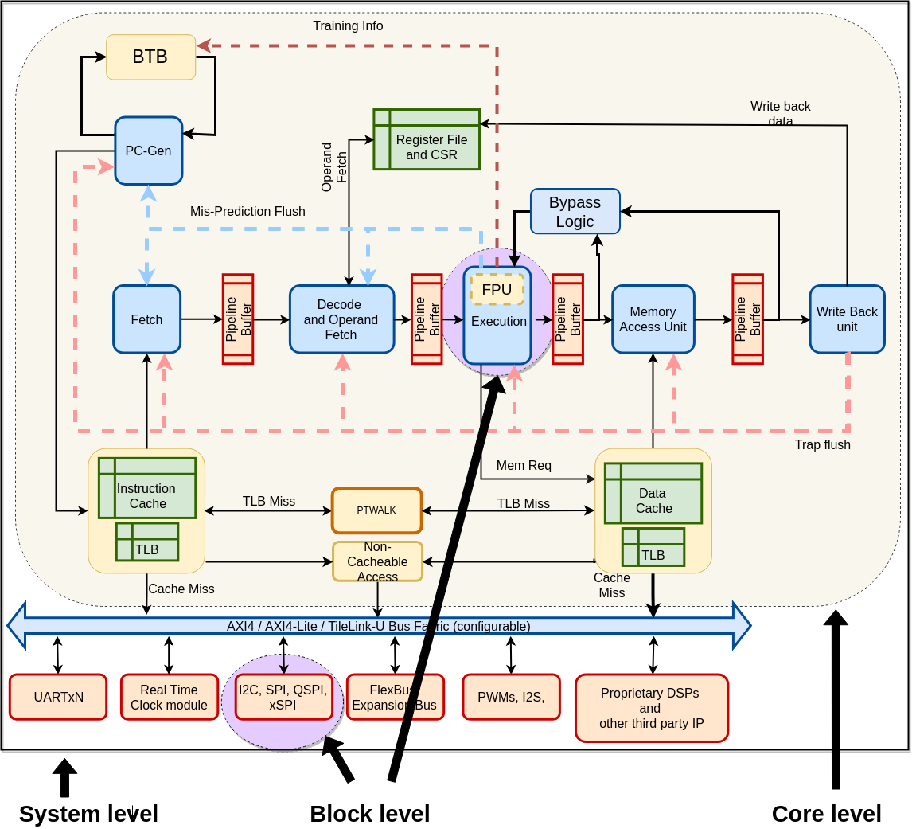
SHAKTI Verification Levels
Block level
  UVM methodology
  Interaction with DUT using CoCoTb libraries
Core level
  RISC-V core verification
  Framework generating and simulating directed/random tests
System level
  Simulation & FPGA based verification

Slide 23
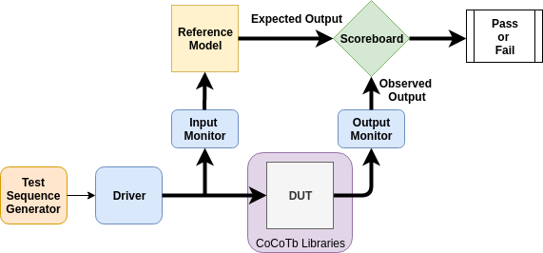
SHAKTI Verification Methodology
Test Suite Development & Generation
Compiler toolchain
Test Generators and Test Suites: SHAKTI’s AAPG, Berkeleys riscv-torture, Google’s riscv-dv, FP tests, Hypervisor tests
Reference Model Spike
Python based UVM Test Bench
Utilities for parallel simulation and verification closure
RISC-V Toolchain for Test Compilation
Reference Model Development
Test Bench for Processor State Comparison
Regression & Coverage Collection

