Slide 1
Diversity & Inclusion

Slide 2
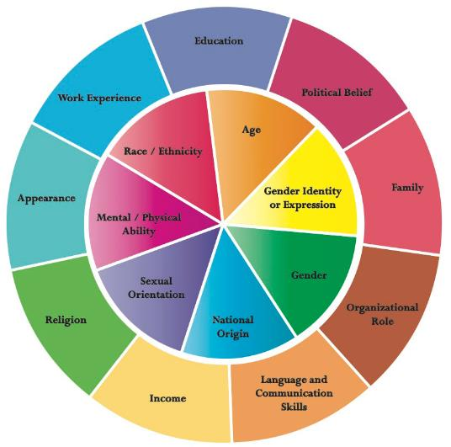
Diversity & Inclusion: the basics
Diversity celebrates differences between individuals and groups:
  - values
  - nationality
  - gender
  - education
  - social background
Inclusive cultures make people feel respected and valued for who they are as an individual or group:
  - equal opportunities
  - fair treatment
  - collaborative work environment
  -embracing differences
  - diverse voices sought and heard
To read: "Why Diverse Teams are Smarter" - HBR
To watch: Inclusion Starts With "I"
and: A Pixar animated short on fitting in
Ongoing objective: embed D&I in processes & workplace culture

Slide 3
Diversity & Inclusion: the business case
“The particle physics
community commits to
placing the principles of
equality, diversity & inclusion
at the heart of all the
physics community’s
activities.”
- ESPP 2020 update
Gender Equality Plans
in place by 2022
= New EC requirement
for all public research
organisations seeking funding
under Horizon Europe.
Companies with more diverse management teams have 19% higher revenues due to innovation.
- BCG 2018
As an International Organisation,
we need to reflect the diverse communities of our Member States

Slide 4

Diversity & Inclusion: for scientific excellence
Diversity & Inclusion at
CERN is based on the three principles of :
appreciating differences, fostering equality,
promoting collaboration
CERN's Diversity value

Slide 5
Diversity = No.1 most appreciated workplace attribute*
Mission/ Scientific Contribution
Pride
Benefits and
Remuneration
Diversity
Diversity | 256
Mission/Scientific Contribution | 251
Other | 187
Colleagues and Collaboration | 132
The work itself | 131
Work environment | 83
Challenges | 78
Technologies | 63
Benefits and Remuneration | 57
Pride | 32
Technologies
Other
Challenges
Colleagues
The work
itself
*Since the CERN Staff Survey 2019

Slide 6
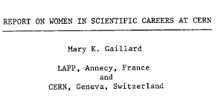
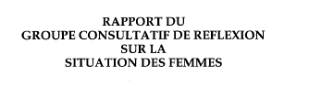
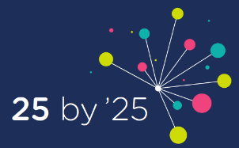
1983
1992
Creation of an Equal Opportunity Office
First E.O and nondiscrimination statement published
1996
History of
D&I at CERN
2010
Introduction of Code of Conduct
Creation of the Ombuds role
Professionalization of the Harassment resolution process
Diversity Office and Policy created
2012
2019
Diversity & Inclusion Programme
2021
ED endorses first Nationality & Gender Strategy

Slide 7



“We commit to
placing the principles of
equality, diversity & inclusion
at the heart of all the
physics community’s
activities.”
- ESPP 2020 update
OUR VISION
scientific excellence through diversity and inclusion
OUR GOAL
to increase the nationality and gender diversity
of Staff & Fellows (MPE) population by 2025
The STRATEGY
GENDER target
NATIONALITY indicator
(aspirational)
Leadership-led
Leverage existing progress: gender balance increased in Senior Management
25% as an average across MPE population (not per Department)
Diversity & inclusion in recruitment (and talent pipelines), promotion, training, communications
Sustainable actions toward long-term gender parity
(not a cap, not a quota)
GOAL:
With a particular focus on women in STEM:
GOAL:
With a particular focus on under-represented MS and a more balanced return by 2025:
from 21%
in 2020
address nationality clusters
> 25%
25% in 2025
and increase our conscious efforts toward nationality diversity in recruitment & retention

Slide 8
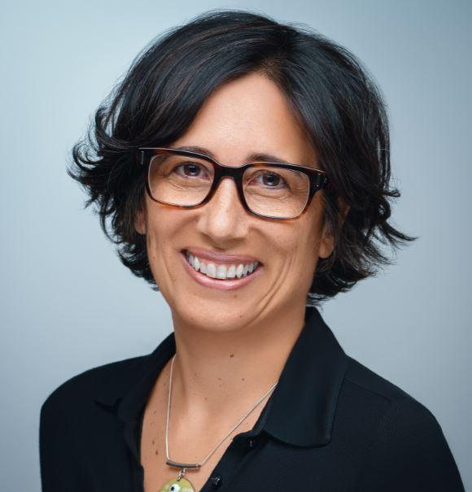
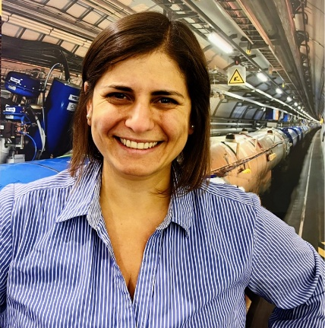
The Diversity & Inclusion (“D&I”) Programme
Louise Carvalho
D&I Programme Leader
Melania Coletta
D&I Adviser
Reporting directly to the Human Resources Department Head
+ the departmental Diversity & Inclusion Officers,
and the D&I Roundtable members.

Slide 9
Want to know more?
Mission/ Scientific Contribution
Pride
Visit our website:
https://diversity-and-inclusion.web.cern.ch/
Benefits and Remuneration
Diversity
Tech- nologies
Other
Challenges
Colleagues
The work itself

