Slide 1
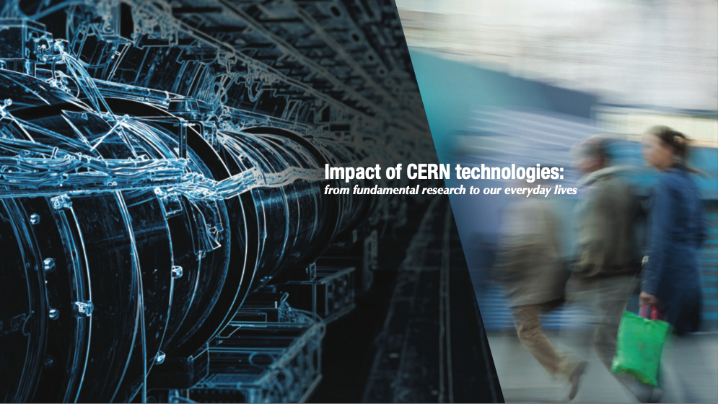
From CERN technologies to impactful innovations
Photo: CERN
Manuela Cirilli,
Medical Applications Adviser
CERN Knowledge Transfer group
Photo: CNAO treatment room

Slide 2
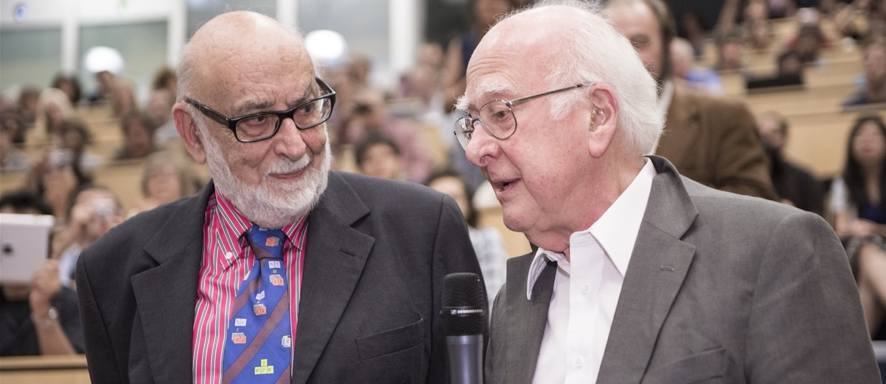
CERN: where the Higgs boson was discovered
François Englert and Peter Higgs. With Robert Brout, they proposed the mechanism in 1964.

Slide 3
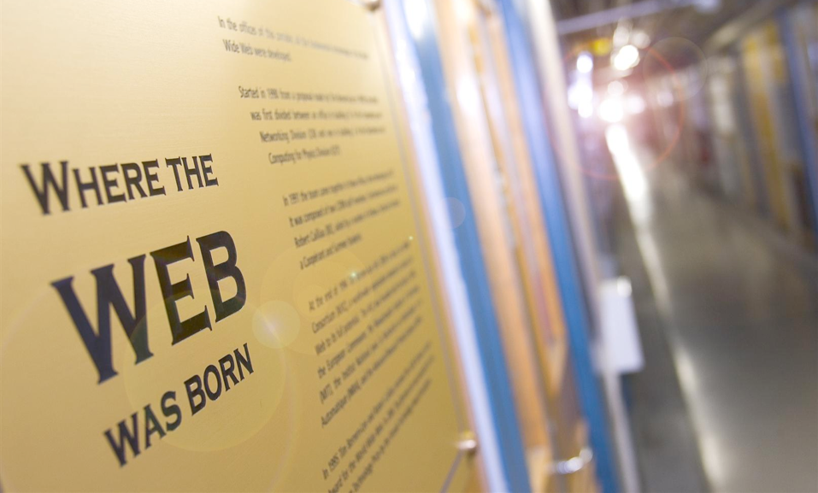

Slide 4
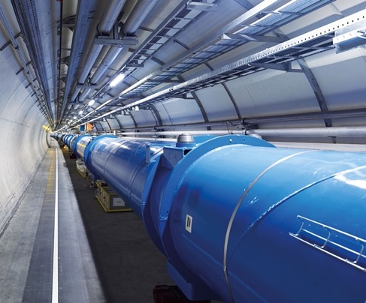
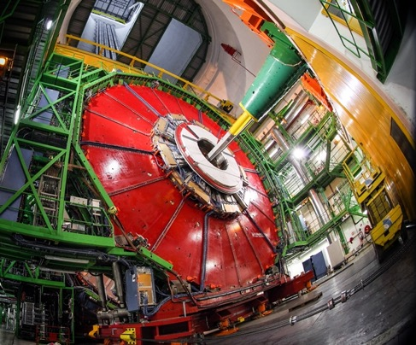
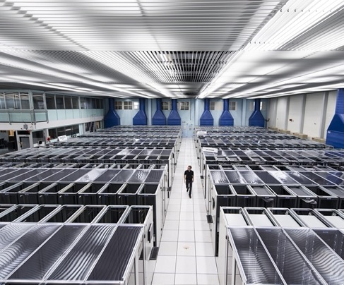
Particle physics technologies
ACCELERATORS
DETECTORS
COMPUTING

Slide 5
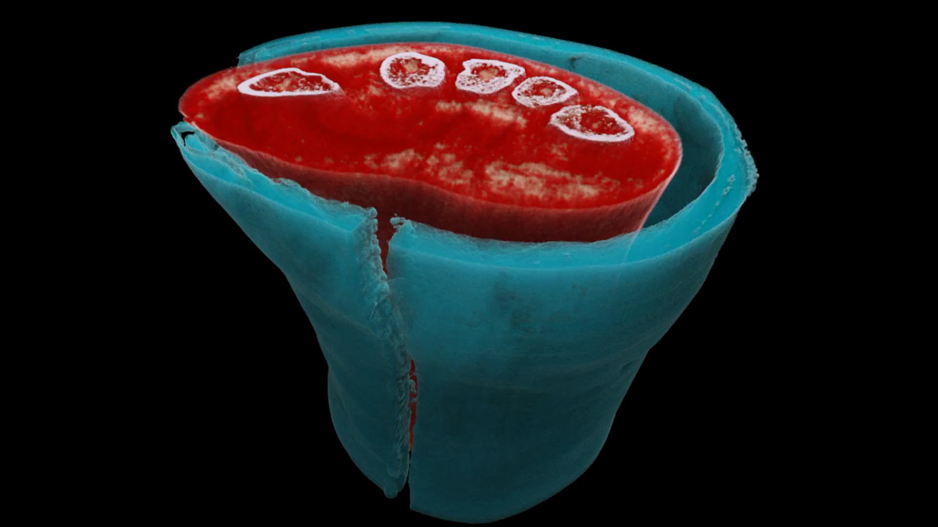



Slide 6

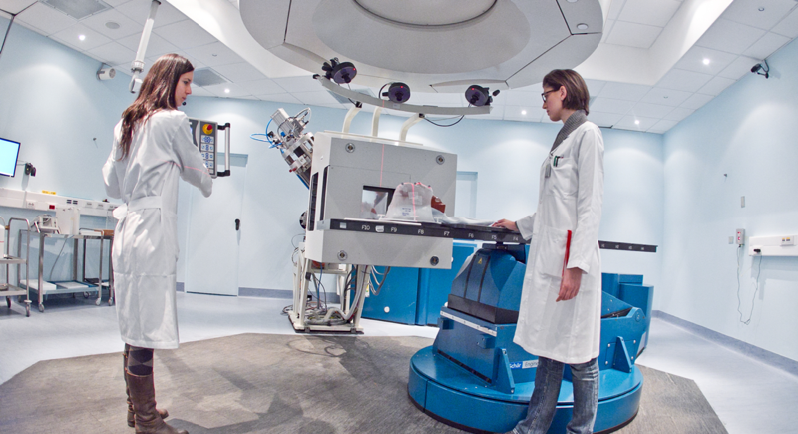
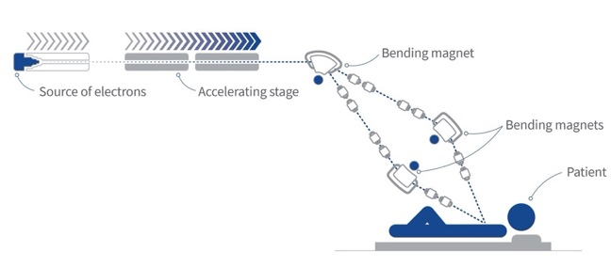
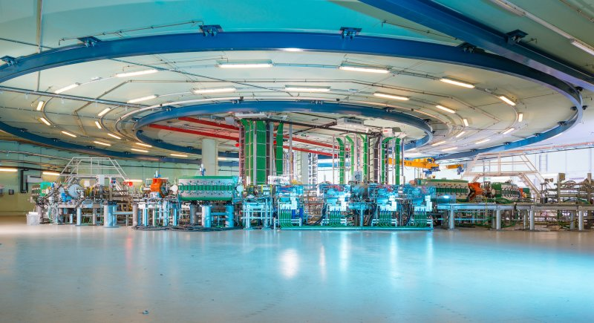
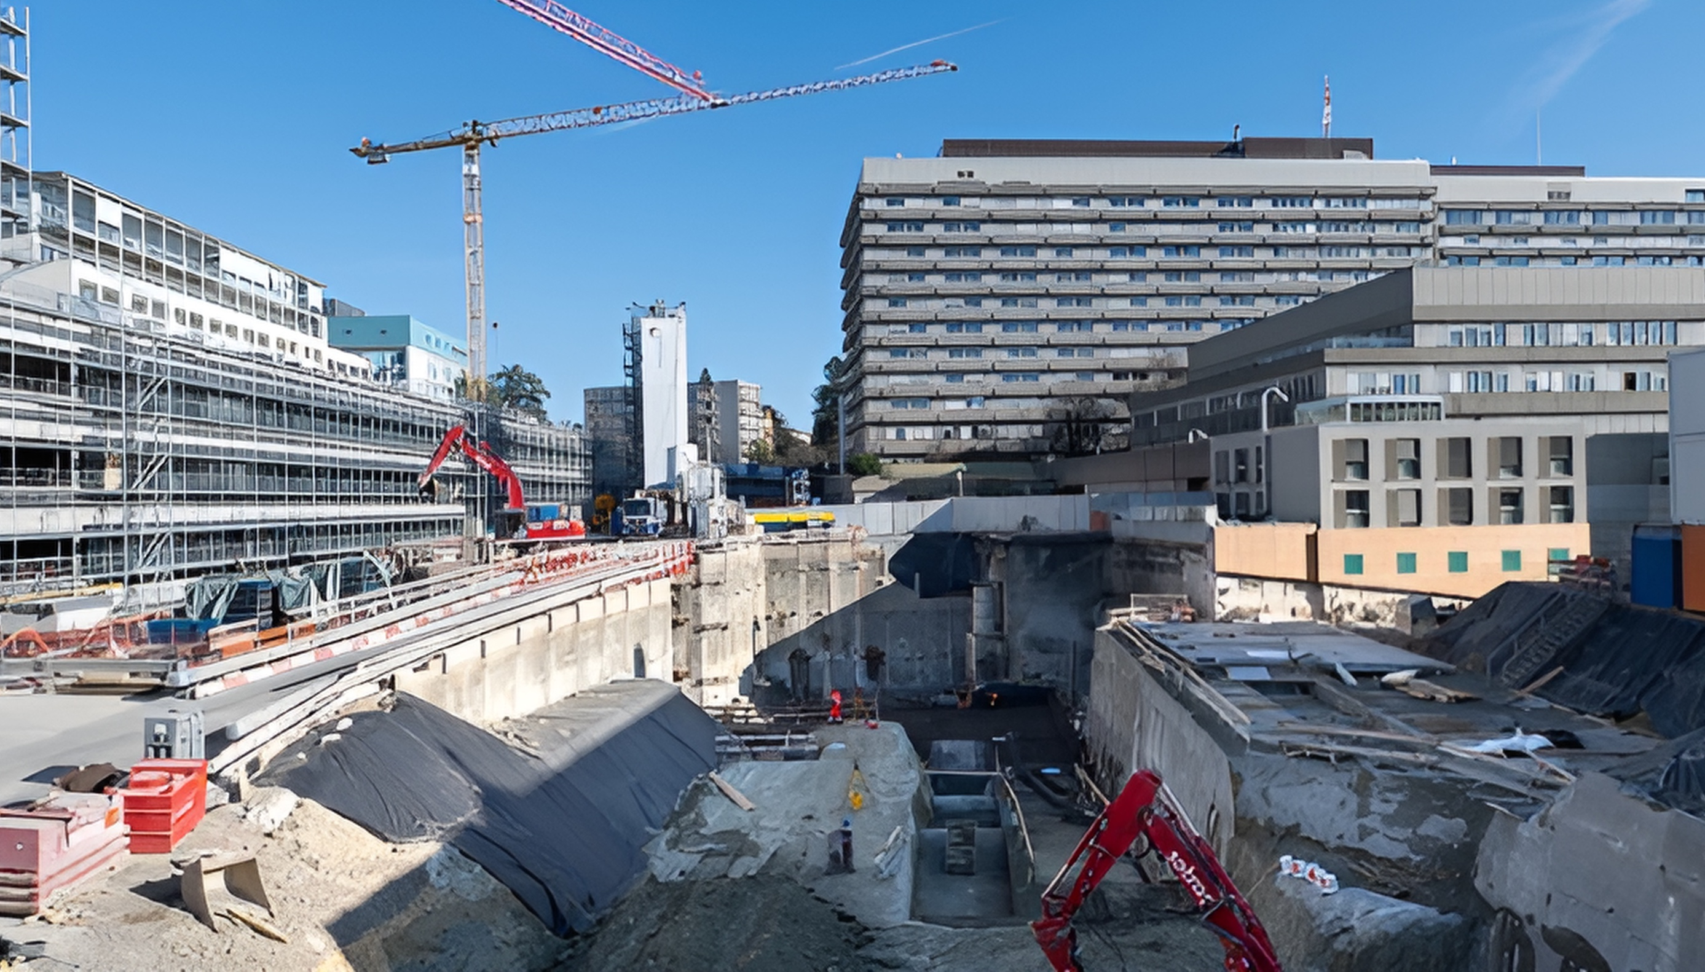

Hadron therapy
Very High-Energy Electron radiotherapy
CLIC technology for a FLASH VHEE facility being built in collaboration with CHUV (Lausanne University Hospital) and THERYQ (ALCEN Group)

Slide 7

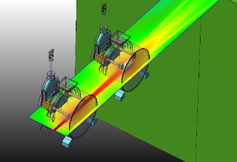
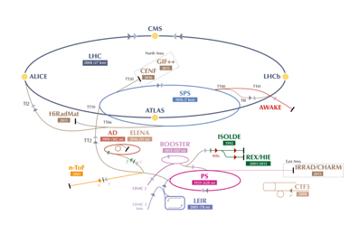
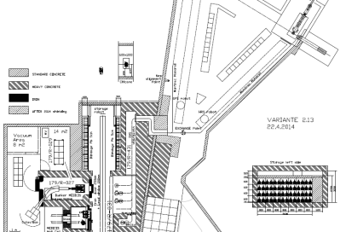
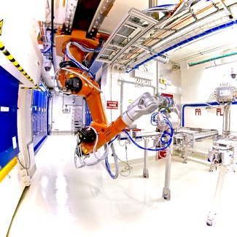
CERN-MEDICIS
Non-conventional isotopes collected by mass separation for new medical applications
MEDICIS Target Irradiation
MEDICIS
1.4 GeV protons
ISOLDE
“Free” proton beam
(otherwise lost in the dump)
Rail
Conveyor
System
MEDICIS Laboratory
Manuela.Cirilli@cern.ch
7

Slide 8

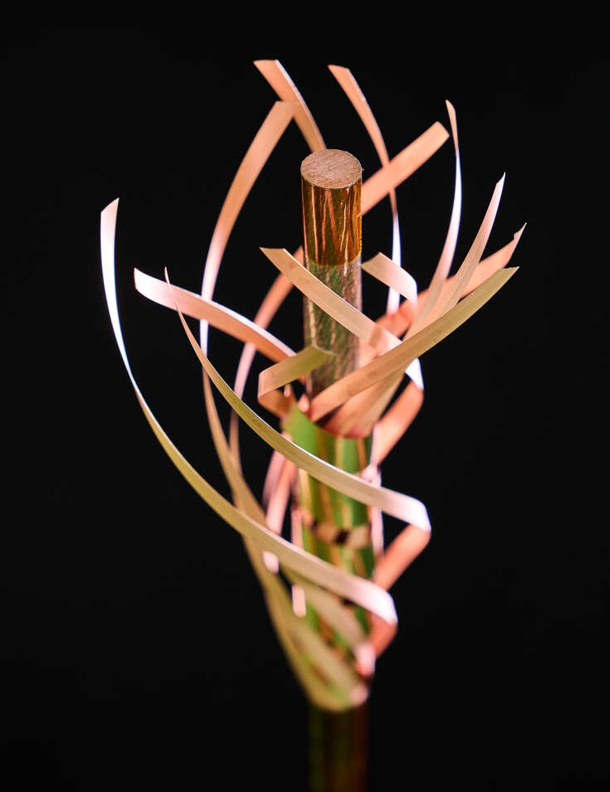
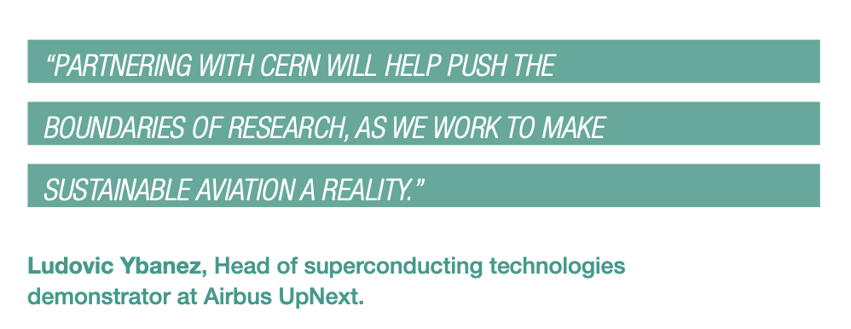
CERN and Airbus UpNext, a wholly owned subsidiary of Airbus, are exploring the potential use of superconducting technologies developed by CERN in the electrical distribution systems of future hydrogen-powered aircraft.

Slide 9
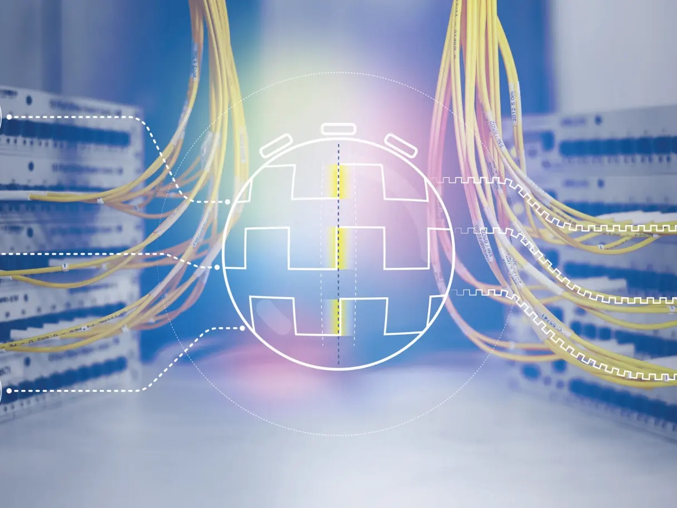
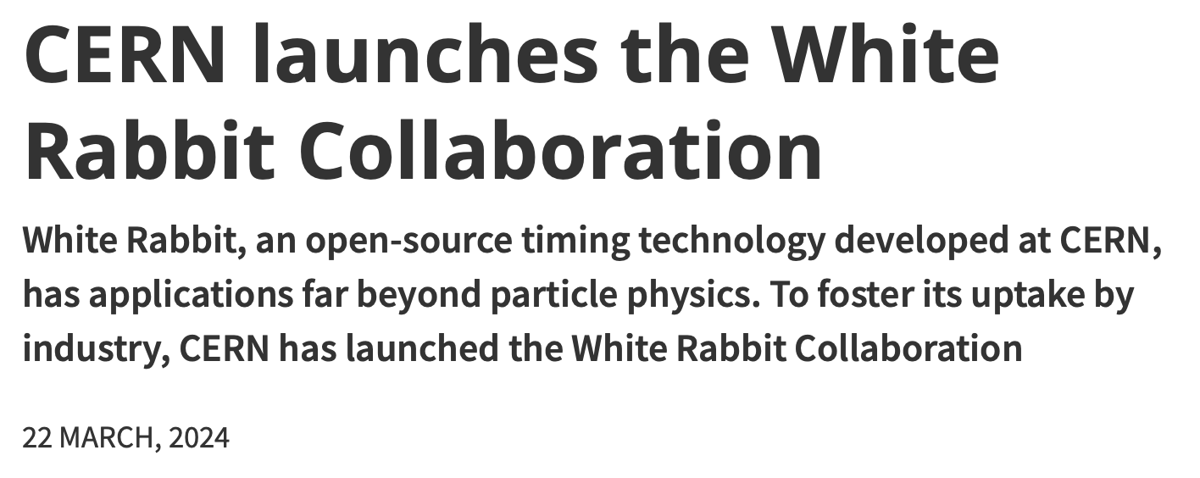
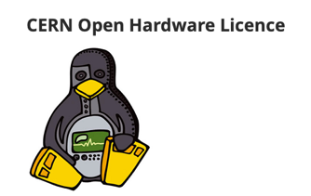
White Rabbit
A novel time- synchronisation system that offers sub-nanosecond accuracy and precision of a few picoseconds.
Fully open hardware and software
Since 2020, included in the worldwide IEEE industry standard called Precision Time Protocol (PTP)

Slide 10
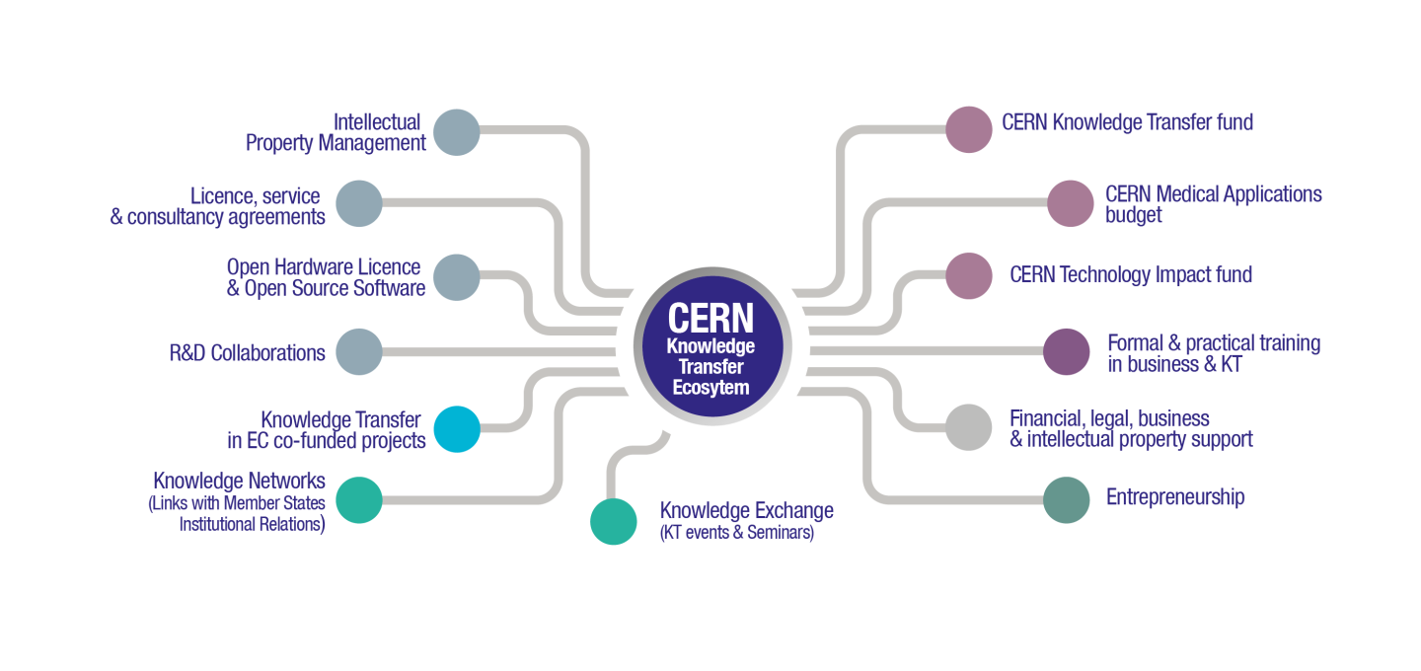

Slide 11
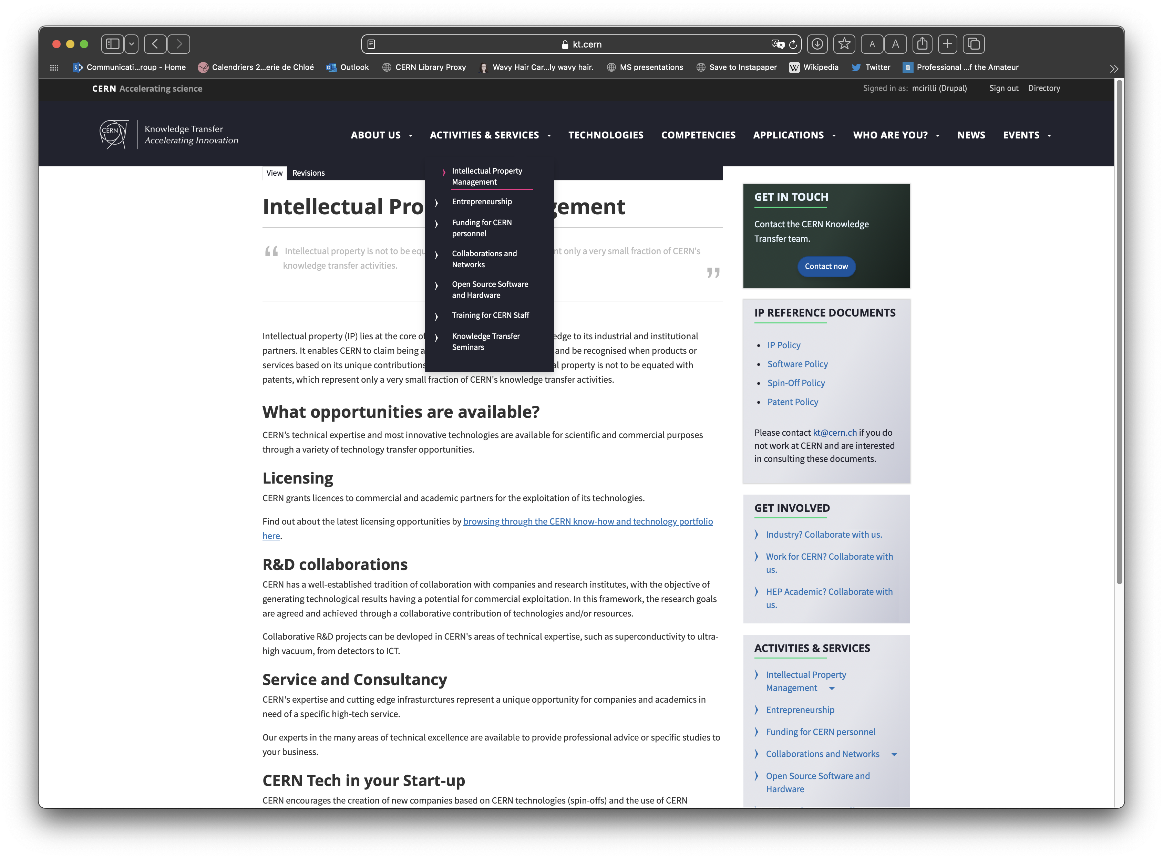
https://kt.cern/activities-services/intellectual-property-management

Slide 12
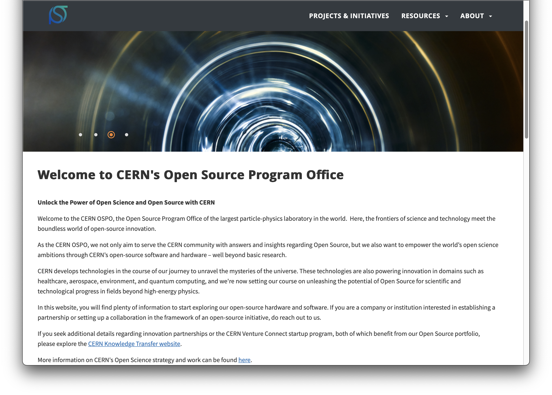

https://opensource.web.cern.ch

Slide 13
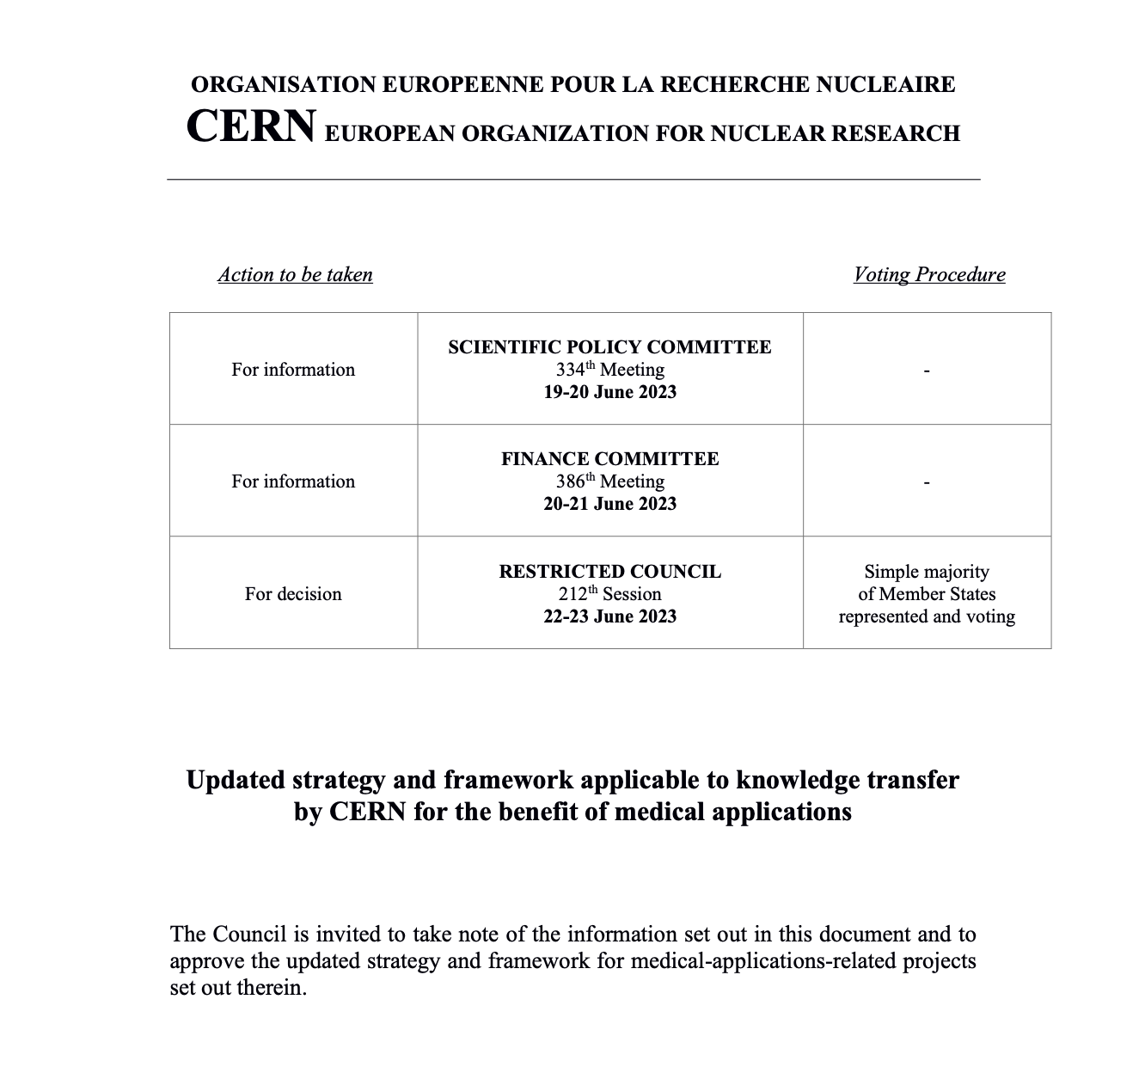
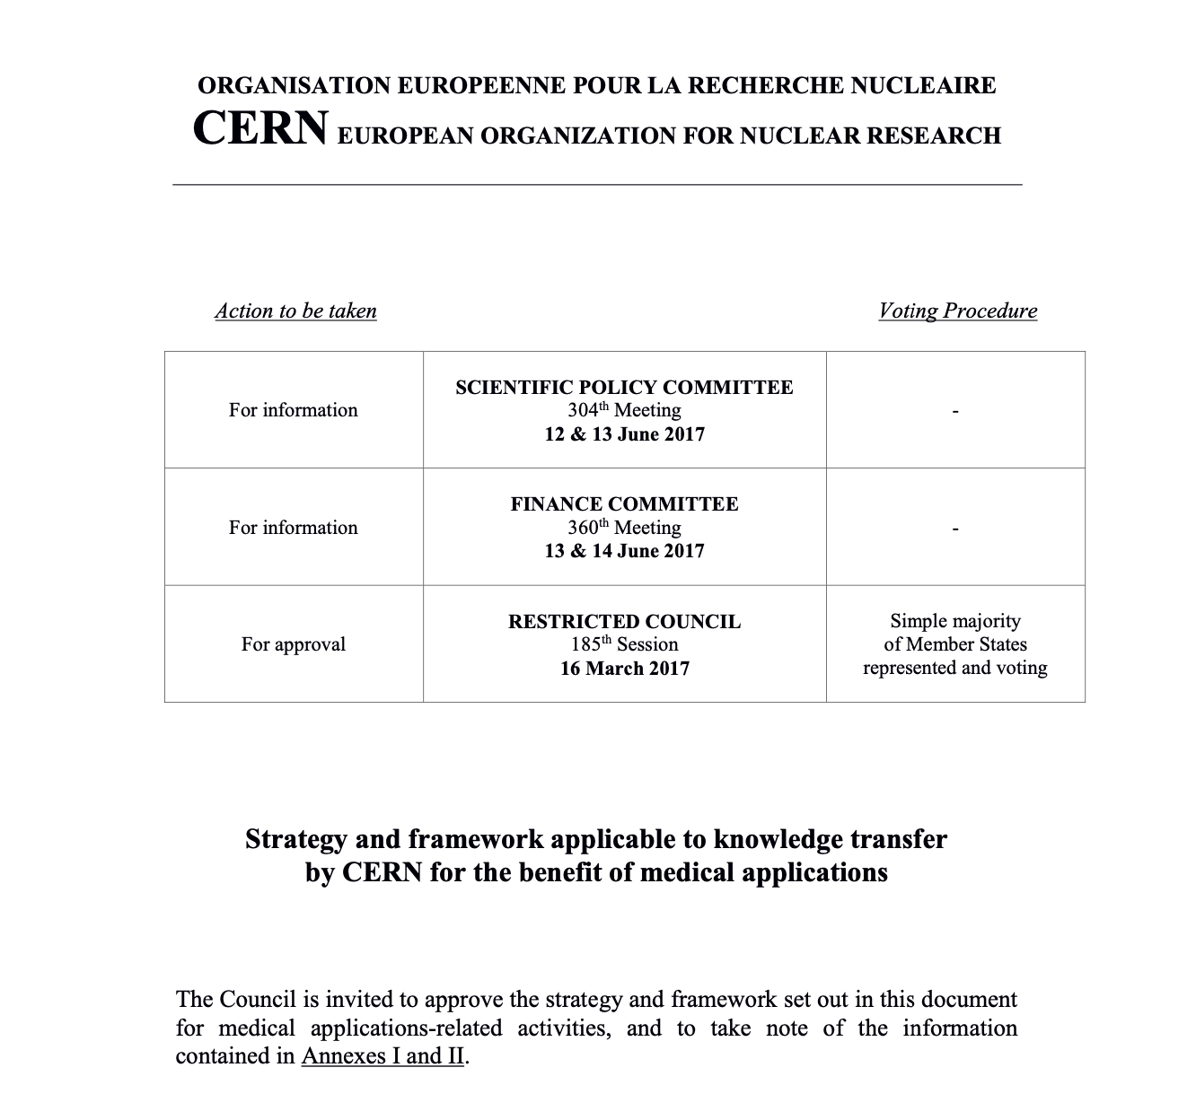
https://cds.cern.ch/record/2864317?ln=en
Notes:
The Knowledge Transfer group at CERN aims to engage with experts in science, technology and industry in order to create opportunities for the transfer of CERN’s technology and know-how.
The ultimate goal is to accelerate innovation and maximise the global positive impact of CERN on society. This is done by promoting and transferring the technological and human capital developed at CERN.
The CERN KT group promotes CERN as a centre of technological excellence, and promotes the positive impact of fundamental research organisations on society.
Additional resources:
https://kt.cern/about-us

Slide 14
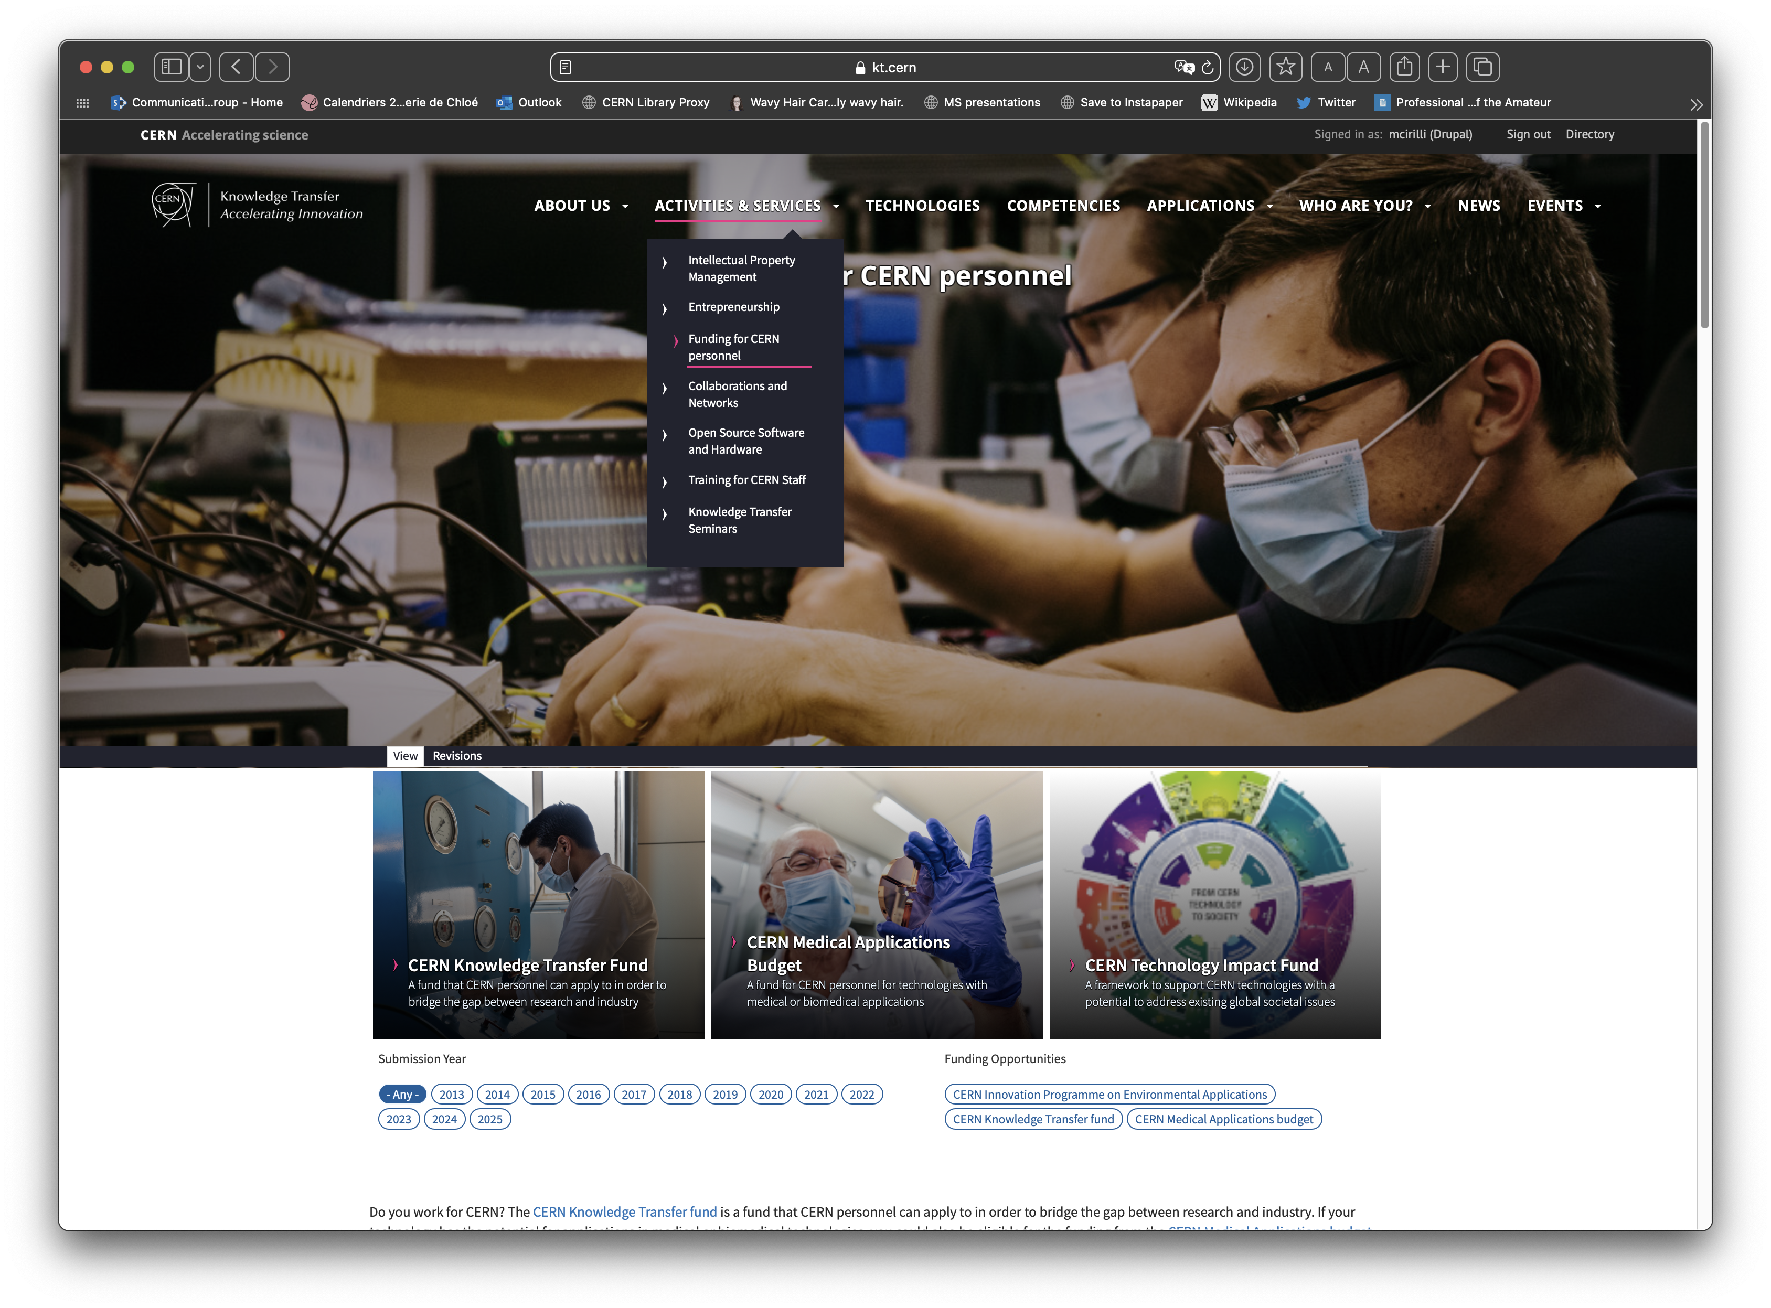
https://kt.cern/activities-services/funding-cern-personnel
Notes:
The Knowledge Transfer group at CERN aims to engage with experts in science, technology and industry in order to create opportunities for the transfer of CERN’s technology and know-how.
The ultimate goal is to accelerate innovation and maximise the global positive impact of CERN on society. This is done by promoting and transferring the technological and human capital developed at CERN.
The CERN KT group promotes CERN as a centre of technological excellence, and promotes the positive impact of fundamental research organisations on society.
Additional resources:
https://kt.cern/about-us

Slide 15





CERN Venture Connect
Connect with investors
and venture startup economy
Access breakthrough
CERN technologies
Get 0% equity,
express agreements
2% royalty only
revenues higher than 1MCHF

Slide 16
Our mission
Accelerate innovation, primarily in the CERN Member and Associate Member States, through:
identifying unmet needs and shaping innovation partnerships in selected
domains together with startups, industry and institutes
ensuring the effective transfer of its technology and know-how
to societal applications
maintaining a strong and diverse IP portfolio, and scouting for innovative and potentially disruptive technologies and know-how at CERN
enabling economic growth for startups and established businesses
increasing political support and funding opportunities for knowledge transfer activities at CERN

Slide 17
CERN Knowledge Transfer vision
Our vision is for CERN to be a world-recognised actor
in achieving a society that can collaboratively harness
basic research’s inventiveness, know-how, and technology
to tackle the most pressing global challenges
Notes:
The Knowledge Transfer group at CERN aims to engage with experts in science, technology and industry in order to create opportunities for the transfer of CERN’s technology and know-how.
The ultimate goal is to accelerate innovation and maximise the global positive impact of CERN on society. This is done by promoting and transferring the technological and human capital developed at CERN.
The CERN KT group promotes CERN as a centre of technological excellence, and promotes the positive impact of fundamental research organisations on society.
Additional resources:
https://kt.cern/about-us

Slide 18
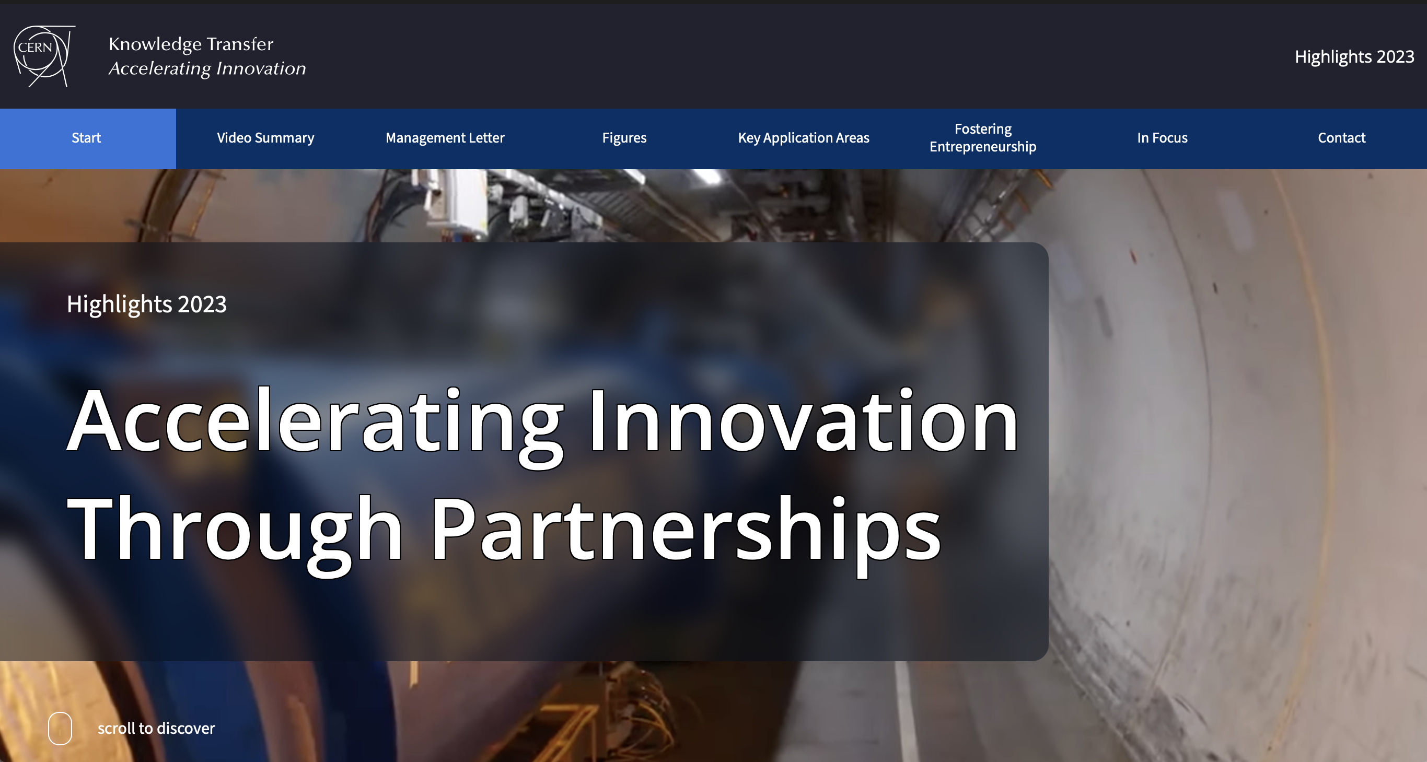
https://report2023-kt.web.cern.ch
MEET US AT THE BOOTH OUTSIDE!
Follow us on LinkedIn
https://www.linkedin.com/showcase/cern-innovation-partnerships/

