Slide 1
PENSION FUND
Preparing for retirement
Emilie CLERC – Benefits Service 8 October 2024

Slide 2
Retirement Pension - Reminder
Member on or before 31.12.2011
65 years of age
Member as from 01.01.2012
67 years of age
2% of your last reference salary, per year of membership
Entitlement as from 5 years of service
35 years of membership
1.85% of the average of the last 36 months of reference salary, per year of membership
Entitlement as from 5 years of service
37 years and 10 months of membership

Slide 3
What are my retirement options?
Retirement
Retire at applicable retirement age (65/67)
Receive pension payments as from the 1st day of the month following 65/67
Anticipated Retirement
Available any time as from 50/52
Deferred Retirement
End of contract before retirement age
Defer payment of pension until retirement age or as from 50/52
Pension amount is reduced depending on age according to the factors mentioned in the Rules

Slide 4
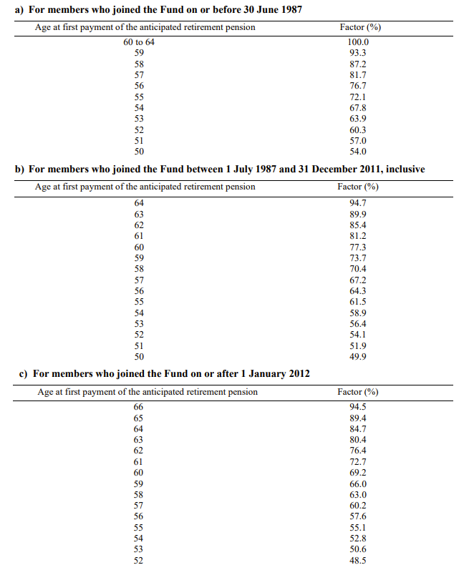
If anticipated, how is it calculated?
Amount:
Retirement pension * relevant factor according to the age

Slide 5
Will I have other benefits added or contributions deducted?
Benefits that may be added to the basic pension (if applicable):
+ family allowance (if married or unmarried with dependent children)
+ child allowance (if dependent children)
Contributions deducted from the basic pension (optional):
health insurance (main premium + complementary for spouse if applicable)
life insurance
Reminder:
Educational fees are not reimbursed to beneficiaries

Slide 6
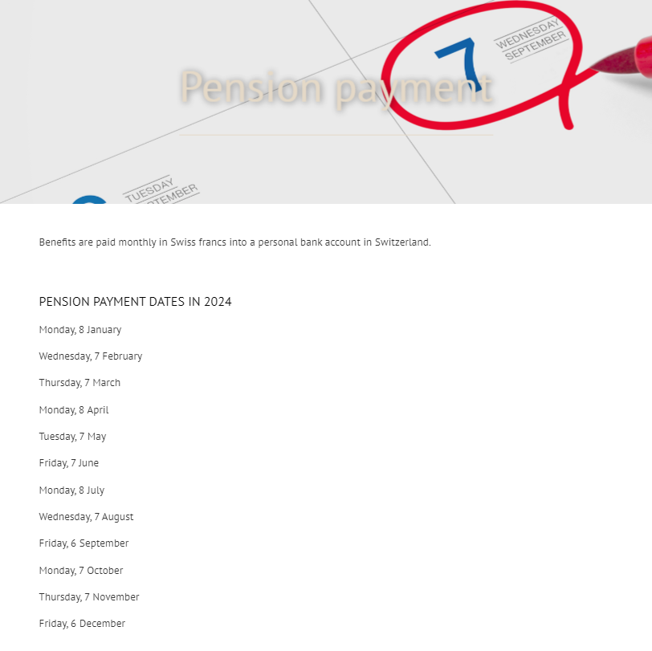
How and when do I receive my pension?
Pensions are paid, in CHF, into a personal bank account in Switzerland
Joint accounts accepted to avoid delay in the payment of surviving spouse’s pension
Pensions are paid between the 6th and the 8th of each month for the current month
Payment dates can be found on our website and in the December CERN Bulletin

Slide 7
What formalities do I need to complete?
Application for a pension
Spouse Health Insurance & Professional Income Declaration (SHIPID) (if applicable)
Life insurance (if applicable)
Sent three months before the contract end date or before physical departure from the Organisation

Slide 8
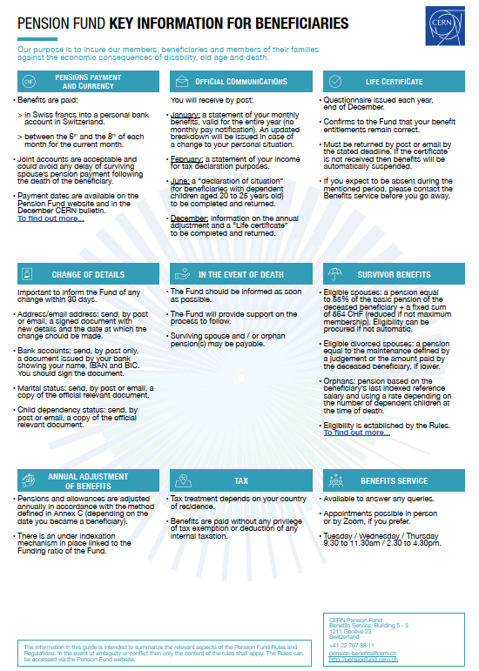
What communication will I receive on retirement?
Currently, all communication are sent, by post, to the main beneficiary or legal representative only
On your pension start date you will receive a pension entitlement letter and a document with “key information for beneficiaries”

Slide 9
What communication will I receive during the year?
January
February
June
November
December
Breakdown of monthly benefits
Sent annually
Statement for declaration of income
Benefits are paid without any tax exemption nor deduction of any internal taxation
Annual adjustment
Information on your annual adjustment
Life Certificate
Declaration of dependent children
To ensure entitlement to dependent child allowance (if applicable)
Updated if financial situation changes
Proof of enrolment required by October
Confirms your benefits entitlement
Subject to the relevant taxation rules in your country of residence
«Declaration of situation» provided in July
Allowance suspended in case of failure to return the documents
No monthly pay notification
To be returned by 31 January
If absent during this period, contact the Benefits Service
Payment suspended in case of failure to return the form
Details of your individual Purchasing Power Loss (PPL) account

Slide 10
Change of personal data, what do I have to do?
Important to inform the Benefits Service, within 30 calendar days, of any change in your personal data (marital status, address, bank account, etc.).

Slide 11
What happens in the event of death?
The Benefits Service should be informed as soon as possible
The Service will provide support on the process to follow
Surviving spouse and/or orphan pension(s) may be payable according to the Rules

Slide 12
Will my spouse receive a pension?
Entitlement
Surviving spouse’s pension
If the marriage/partnership dates from at least 5 years prior to the decease
Married prior to contract end date
Amount
55% of the basic pension of the deceased beneficiary + a fixed sum of 564 CHF (on the basis of the maximum years of membership)
Please note
No automatic entitlement if married as a beneficiary
Right can be procured
Family allowance is not paid even if the right is procured

Slide 13
What about my ex-spouse(s)?
Entitlement
Surviving spouse’s pension
The marriage had lasted at least 10 years
The divorced spouse was receiving an alimony from the dead beneficiary
The divorced spouse is at least 45 years of age at the time of the death of the beneficiary
The divorce spouse has not re-married
Amount
Amount of the alimony due
or
Amount of the alimony paid by the dead beneficiary if lower
Please note
Total amount of the surviving spouse’s and orphan’s pensions cannot exceed the benefits paid to the dead beneficiary

Slide 14
And my children?
Entitlement
Orphan’s pension
Due to a "dependent child" recognised by CERN before the end of contract
Up to the age of 20 if unmarried and not in a full-time employment
Between 20 and 25 years of age if unmarried and in full-time education or vocational training
Amount
Percentage of the beneficiary’s last indexed reference salary:
  24% for 1 orphan
  34% for 2 orphans, etc.
Please note
Children born after the contract end date have no right to orphan’s pension

Slide 15
Are my benefits subject to indexation?
Benefits are adjusted annually in accordance with the method defined in the Rules and Regulations, depending on your service end date
There is an under-indexation mechanism in place linked to the Funding ratio of the Fund
How is the adjustment calculated?
You will receive information in December each year regarding your annual adjustment and how it is calculated
If CVI is positive
CVI * funding ratio
(to maximum of actuarial inflation parameter)
If CVI is zero
no adjustment is granted
If CVI is negative
No adjustment
(but no decrease of benefits)
CVI = Geneva Cost of Living (August to August)
Funding ratio is the accounting measure mentioned in the latest Annual report

Slide 16
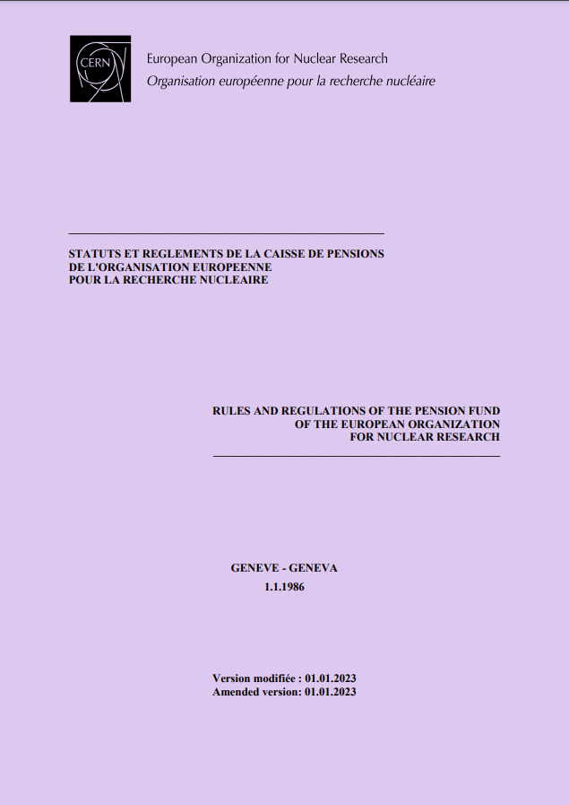
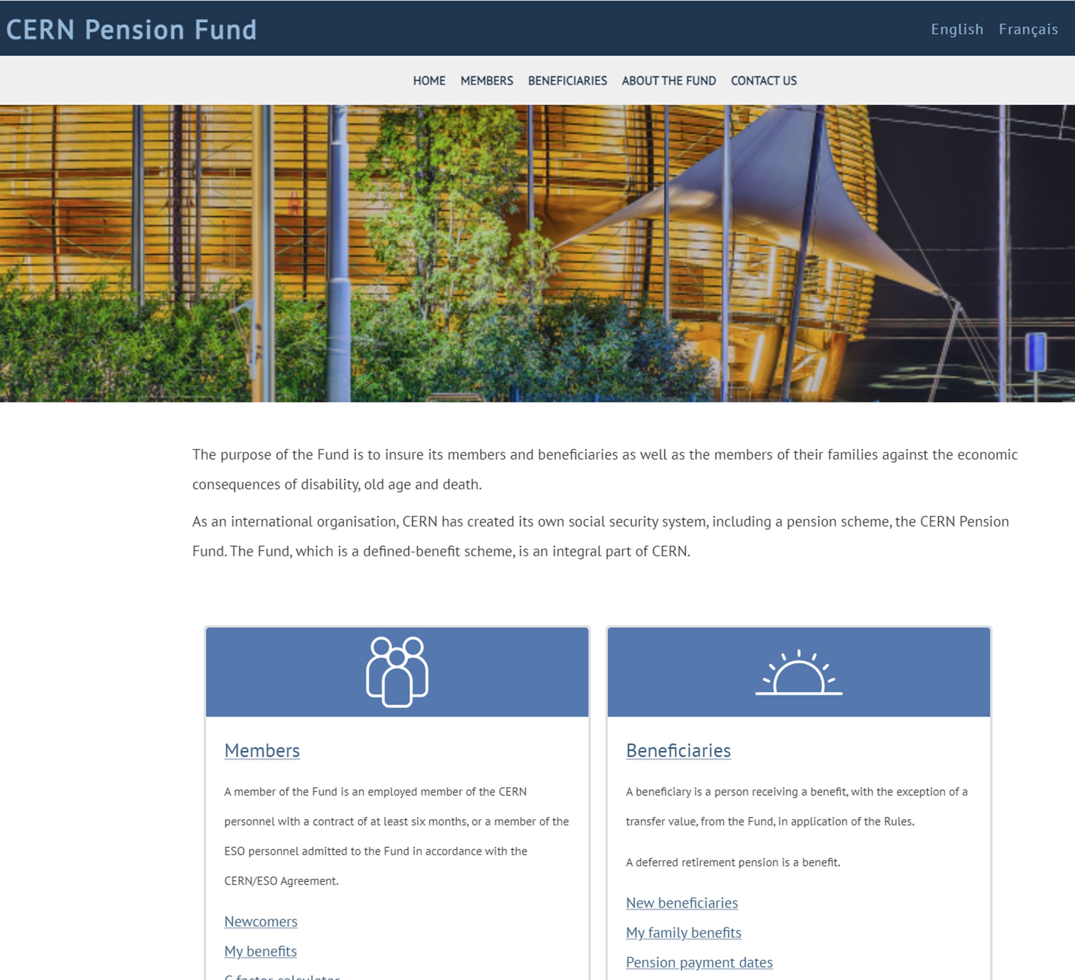
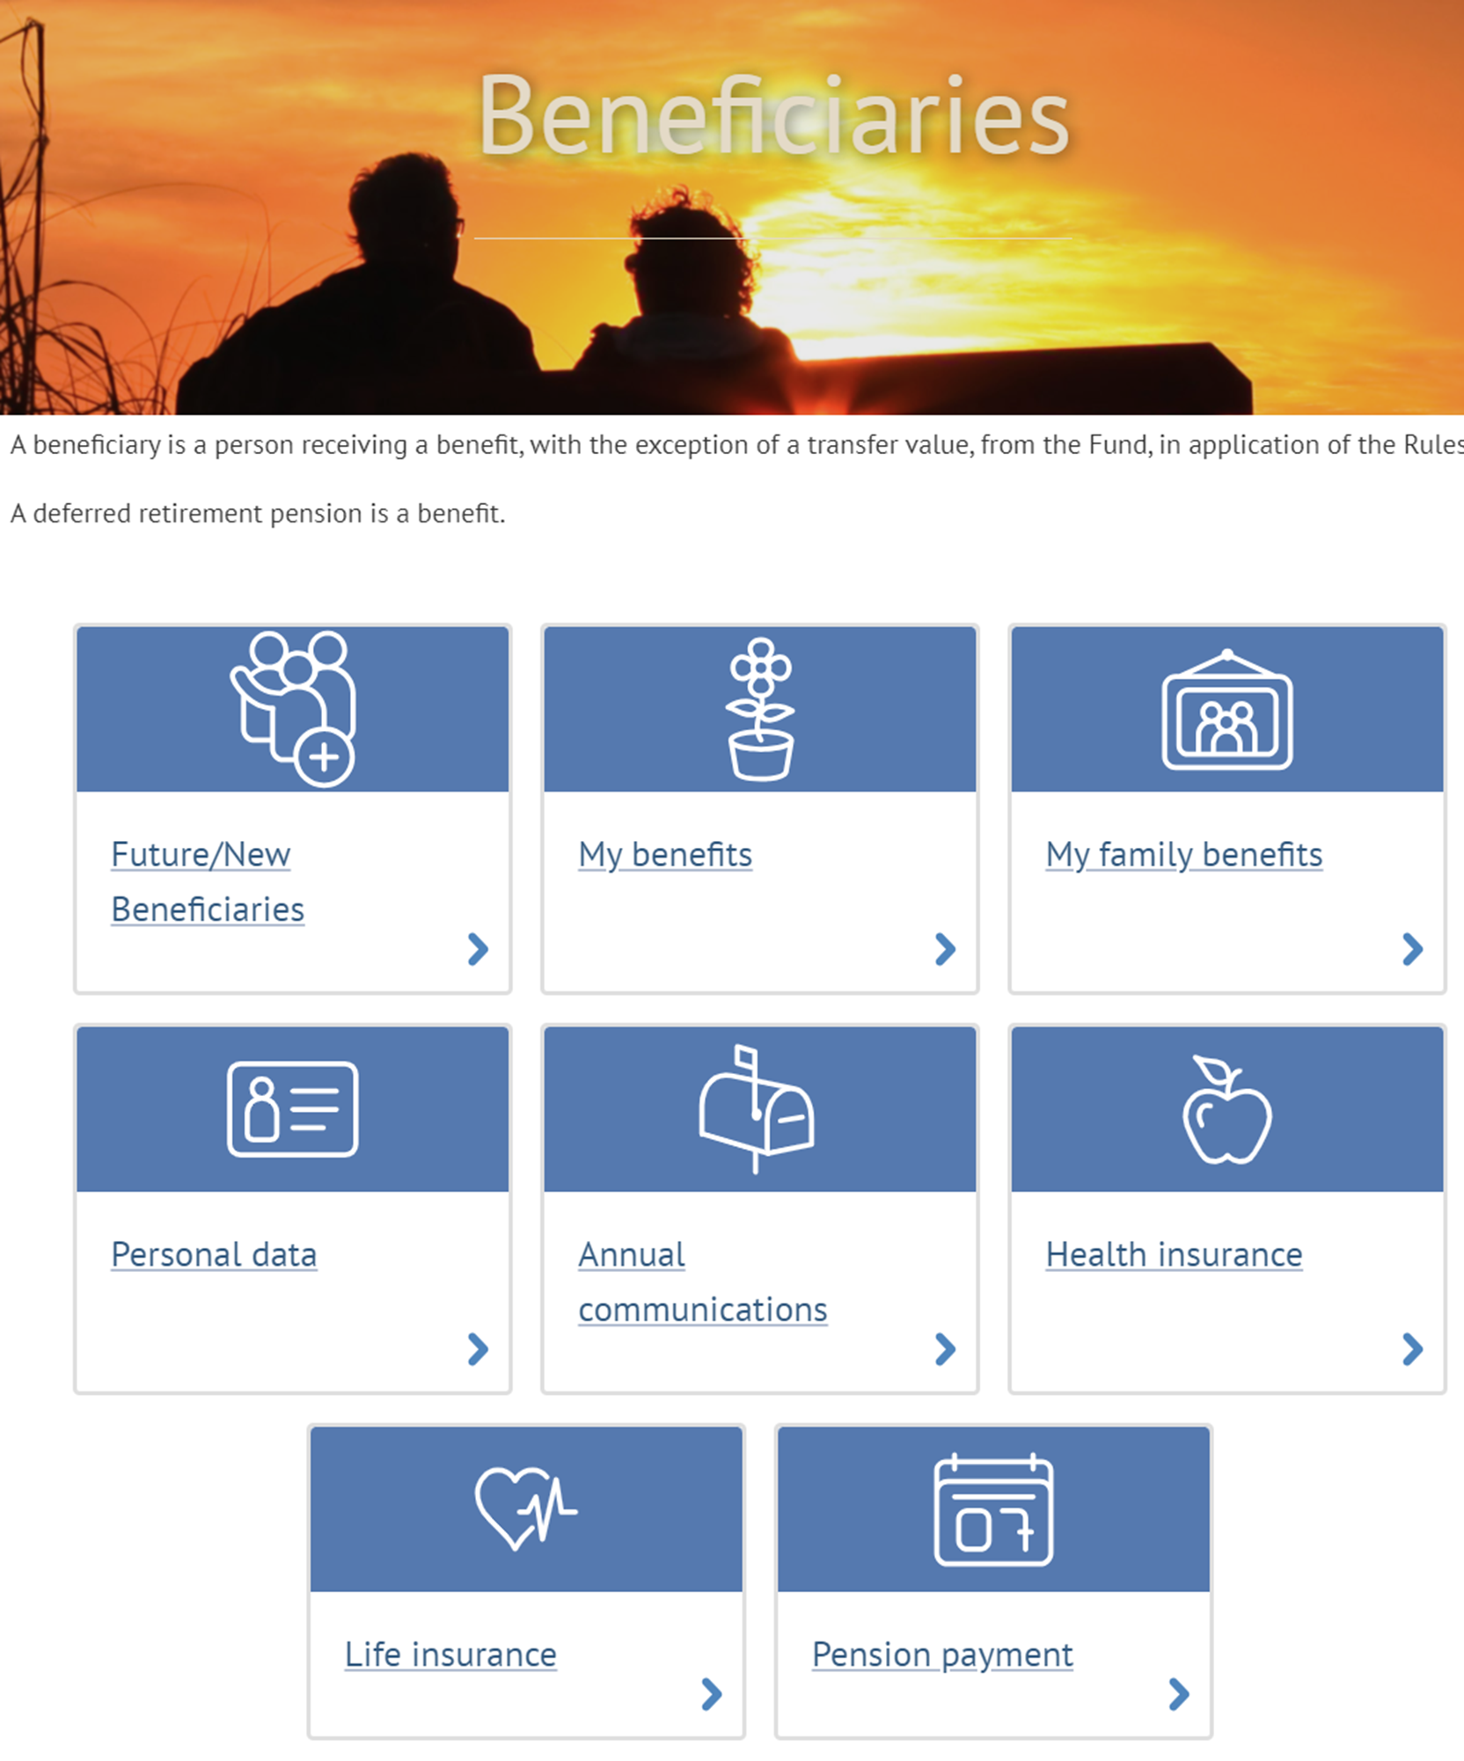
Where can I find out more about my pension?
Our website has a section dedicated for beneficiaries
Pension Fund Rules & Regulations

Slide 17
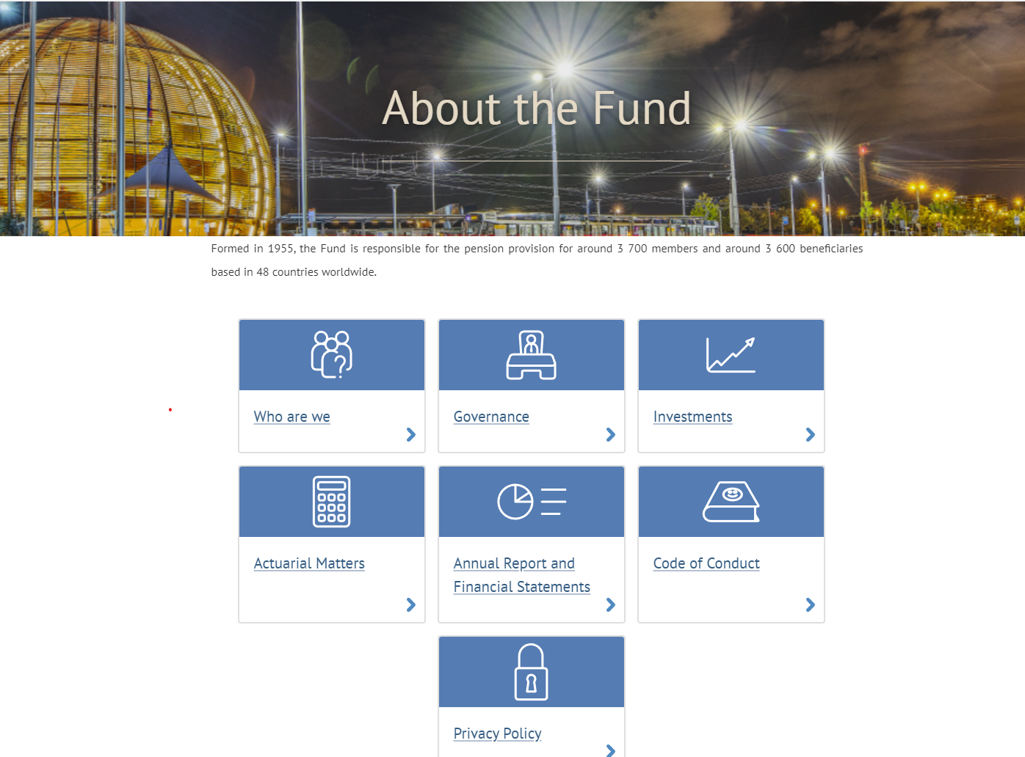

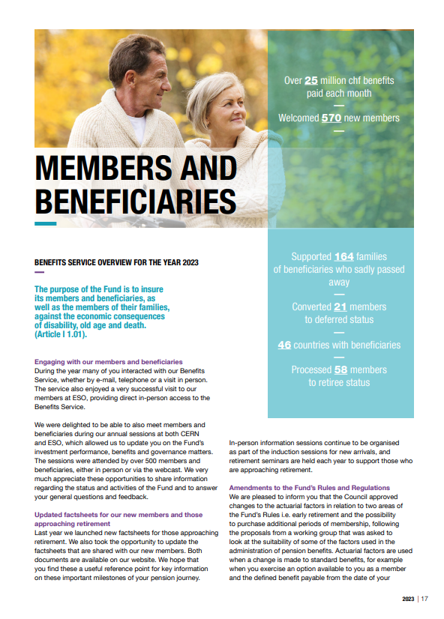
And what about the Pension Fund?
Our website has general information on the Pension Fund
Our Annual Report and Financial Statements includes updates from the year
Annual Information Meeting
17 October 2024
2.30pm
Council Chamber

Slide 18




Benefits Service – we are here to help
Aïsha Bankolé
Emilie Clerc
Pilar Herguedas
Garance Louvin
pension-benefits@cern.ch
+41 22 767 88 11
http://pensionfund.cern.ch
Building 5/5 (Meyrin)

