Slide 1
Technical Meeting on MQXFB07 Coils:
Introduction
Susana Izquierdo Bermudez, Nicholas Lusa, Penelope Quassolo, Lucie Baudin
Technical meeting to review coils for MQXFB07 (11 July 2024) · Indico (cern.ch)
11/07/2024

Slide 2
Objective
Summarize manufacturing data and non-conformities for the coils to be assembled in MQXFB07, built using the same procedures as MQXFB03/04/05/06 coils
Agenda
  Conductor and cable: J. Fleiter, S. Hopkins
  Coil fabrication: N. Lusa
  Coil ordering: E. Ravaioli and P. Matilde Quassolo

Slide 3
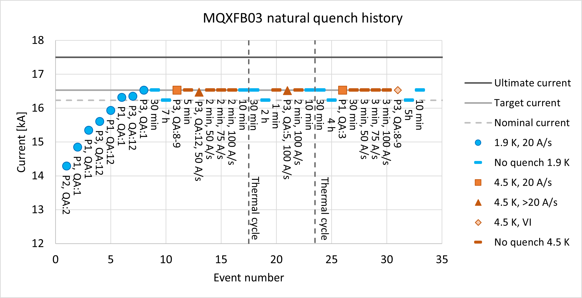
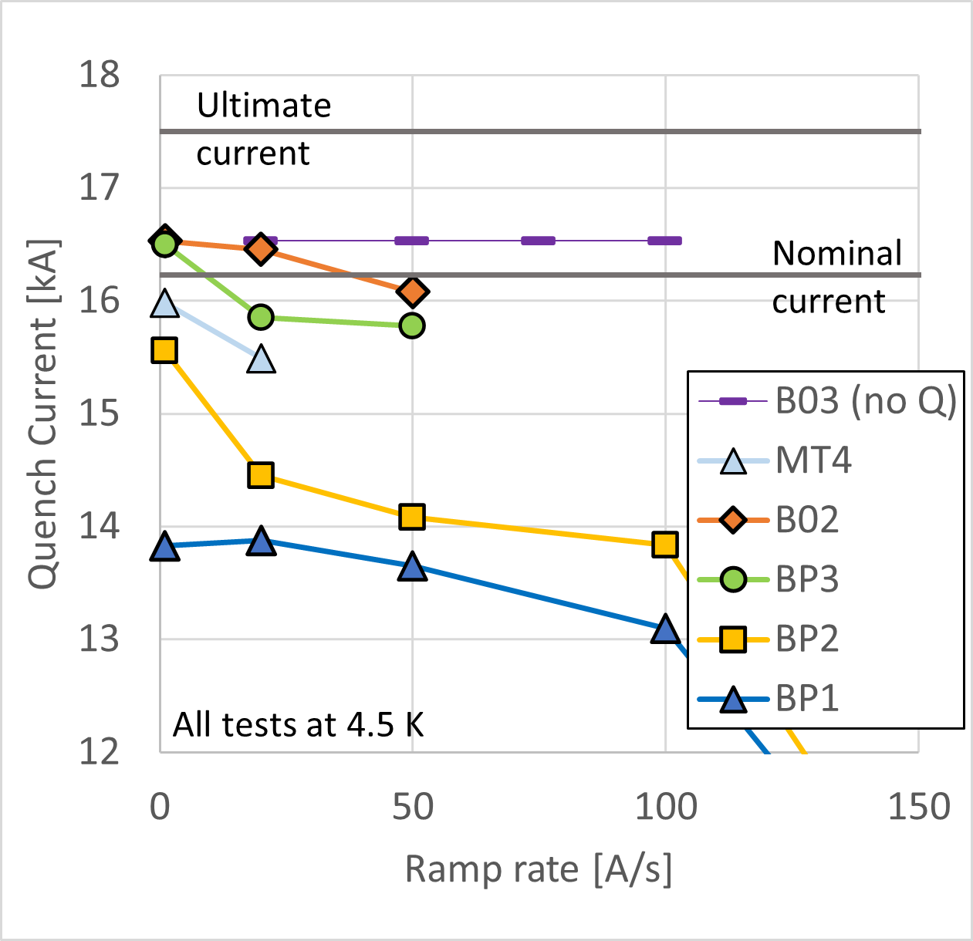
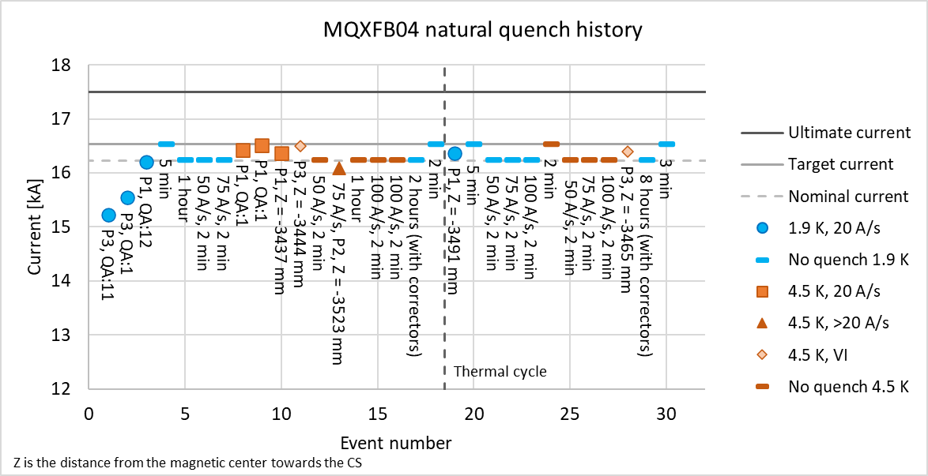
Introduction – MQXFB magnet performance
  MQXFB03 implement a series of features to improve the coils→ no signs of conductor limitation
  MQXFB04 confirms the results
  Status of next magnets:
    MQXFB05: cryostating ongoing, plan to test mid-august
    MQXFB05: cold mass assembly ongoing, plan to test January 2025

Slide 4
Main documents –
Acceptance criteria
Acceptance Criteria
Conductor performance | EDMS 2268225
Heat treatment | EDMS 2333499
Impregnation | EDMS 2428078
Coil geometry | EDMS 2496377
Electrical tests | EDMS 2447487
Also see:
  MIP: EDMS 1996152
  Flow Chart: EDMS 1736688

Slide 5
Main fabrication reports
MTF link (FUFs, NCR and all info) | CR138 | CR145 | CR146 | CR147
Conductor performance | 3012883 | 3101766 | 3132280 | 3132282
Cabling | 2772486 | 3058659 | 2822508 | 2963109
Heat treatment | 2977423 | 3073618 | 3088813 | 3103305
Coil geometry | 3057190 | 3102082 | 3130007 | 3132192
Final electrical tests | 3044255 | 3089514 | 3102951 | 3128588

