Slide 1
MQXFB07 Coils:
Coil fabrication, manufacturing data and NC
N. Lusa, S. Izquierdo Bermudez, L. Baudin, A. Vieitez Suarez, J. Axensalva, P. M. Quassolo, L. Grand-Clement, R. Berthet, O. Housiaux,
On behalf of MQXFB Coil Fabrication and QA team
https://indico.cern.ch/event/1431144/
11/07/2024

Slide 2
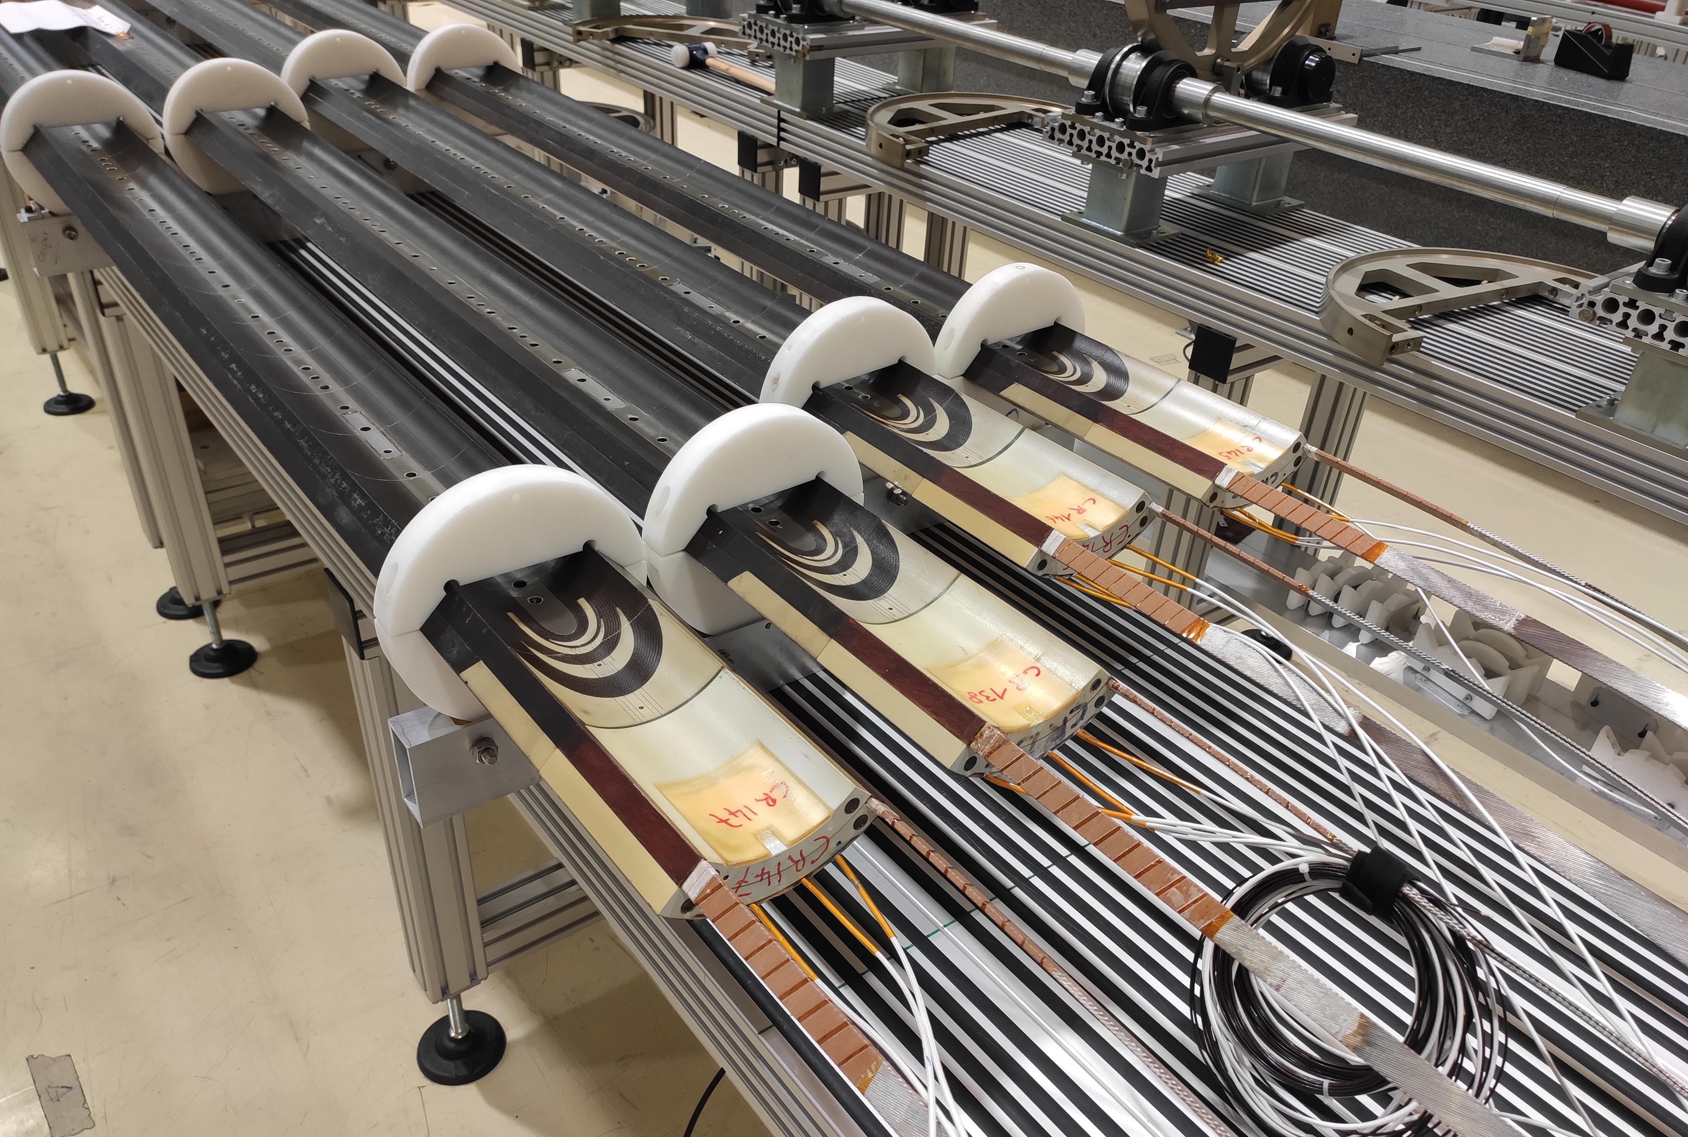
Coils for MQXFB07
Virgin coils available at the time of assembling MQXFB07
  Coil 109: Spare coil of MQXFBP1 (no b₆ correction)
  Coil 114: Quarantined, due to the electrical insulation issue QH to coil
  Coil 116: Quarantined, due to conductor damage during handling
  Coil 122: Conform coil
  Coils 138*-145-146-147: Coils proposed for MQXFB07
    Coil 138 was quarantined, due to overheat during impregnation process preceding epoxy injection

Slide 3
Outline
Manufacturing data
Non-conformities
Conclusion/Proposal

Slide 4
Outline
Manufacturing data
  Analysis of MQXFBP2 coils and comparison improvements with respect to MQXFBP1 available here
  Analysis of MQXFBP3 coils and comparison improvements with respect to MQXFBP2 available here
  Analysis of MQXFB02 coils and comparison improvements with respect to MQXFBP3 available here
  Analysis of MQXFB03 coils and comparison improvements with respect to MQXFB02 available here
  Coil fabrication data and non-conformities of MQXFB04 coils available here
  Coil fabrication data and non-conformities of MQXFB05 coils available here
  Coil fabrication data and non-conformities of MQXFB06 coils available here
Non-conformities
Conclusion/Proposal

Slide 5
Insulation thickness

Slide 6
Torque monitoring during reaction fixture closure
The torque required to close the fixture is directly linked to the number of heating cycle the bolts were subjected to
  Nominal torque required: 160 Nm
  For B07 coils nominal torque was required (no need to further increase the torque)
Torque applied to close the reaction fixture (M20 bolts) [Nm]
 | CR138 | CR145 | CR146 | CR147
Final torque applied to the fixture | 160 | 160 | 160 | 160

Slide 7
Coil elongation during reaction fixture opening
Coil elongation during reaction fixture opening
Magnet | Coil # | CS [mm] | NCS [mm] | Total [mm] | Total/L_{m} | Fab. Line
B03 | CR128, 129, 130, 131 | 2.6 - 4.2 | 3.1 - 4.8 | 5.7 - 8.7 | 0.8 - 1.2 ‰ | CERN
B04 | CR132, 133, 134, 135 | 2.1 - 4.3 | 2.9 - 3.8 | 5.1 - 8.0 | 0.7 - 1.1 ‰
B05 | CR136, 137, 139, 140 | 2.0 - 3.4 | 2.1 - 3.6 | 4.1 - 7.0 | 0.6 - 1.0 ‰
B06 | CR141, 142, 143, 144 | 2.9 - 3.4 | 2.8 - 3.7 | 5.8 - 6.6 | 0.8 - 0.9 ‰
B07 (proposal) | CR138 | 2.7 | 3.3 | 6.0 | 0.8 ‰
 | CR145 | 2.0 | 2.6 | 4.6 | 0.6 ‰
 | CR146 | 3.4 | 3.5 | 6.9 | 1.0 ‰
 | CR147 | 2.1 | 2.6 | 4.7 | 0.7 ‰
 | AUP 146 -147 | 2.9 - 3.6 | 0.6 - 0.4 | 3.6 - 4 | 0.8 ‰ - 0.9 ‰ | FNAL
 | AUP 237 -238 | 1.6 - 2.1 | 1.6 - 2.1 | 3.1 - 4.1 | 0.7 ‰ - 1 ‰ | BNL

Slide 8
Pole gaps
In the latest coils (CR127-CR144), pole gaps in the middle of the coil are not closed after reaction, as it is the case for AUP coils (see additional slides)
Pole gap 1.5 mm
Pole gap 1.1 mm

Slide 9
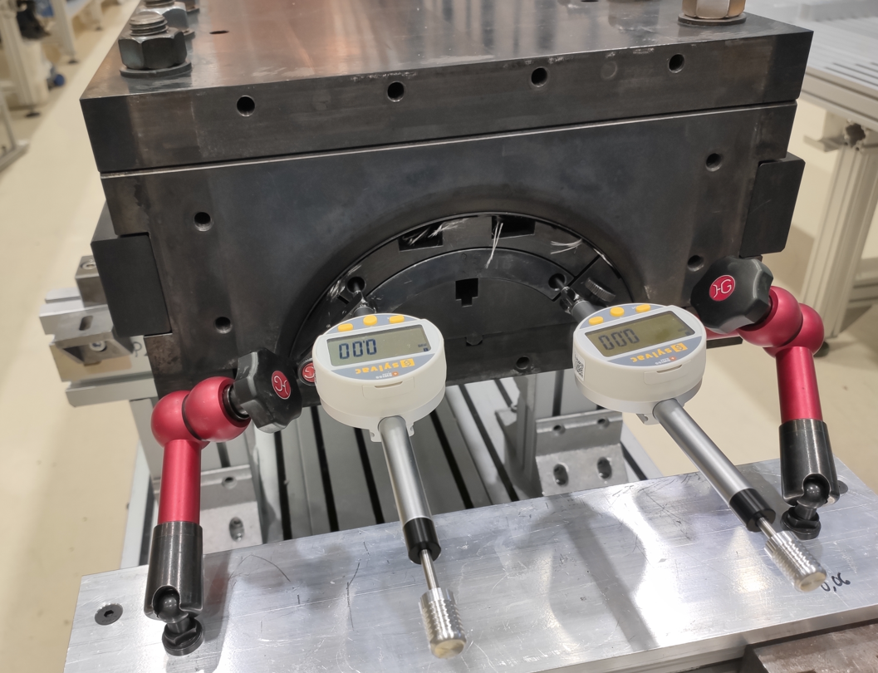
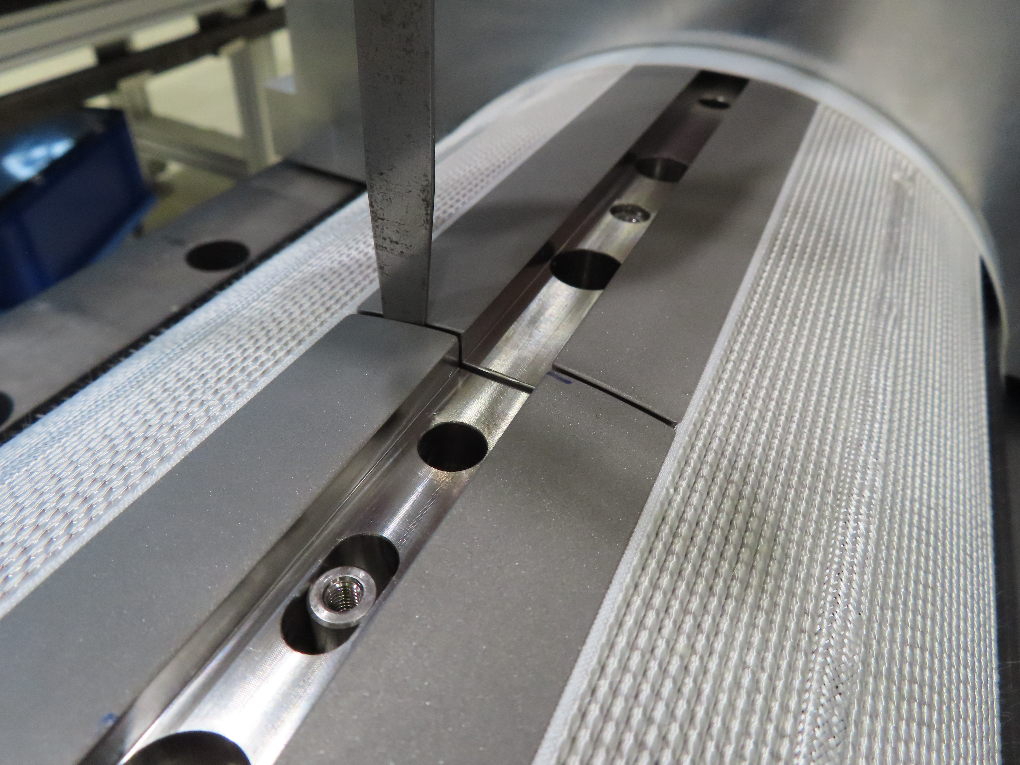
Pole gaps vs Coil elongation
To avoid tensioning the SC cable, the total pole gap must be higher than the coil elongation
  The plotted total pole gap correspond to minimum value (feeler gauge measurement, precision 0.05 mm)
  The coil elongation measurement is done using dial gauges (much more precise, precision 0.01 mm)
Pole gap will be increased in the next CR150
Coils where the elongation is close the total pole gap

Slide 10
Coil hump after reaction

Slide 11
Impregnation fixture closure
  Very reproducible from coil to coil
    OL impregnation closure: 60 Nm
    IL impregnation closure: 120 Nm (never needed more)
  Gap between blocks/plate is measured at determined steps of the closure
  Since coil CR142, 1st tightening step at 20 Nm (instead of 10 Nm)

Slide 12
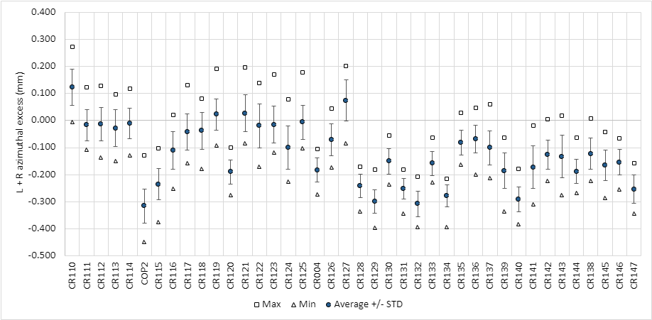
Impregnated coil geometry (Faro arm) - L+R
The coils do not have ‘belly’

Slide 13
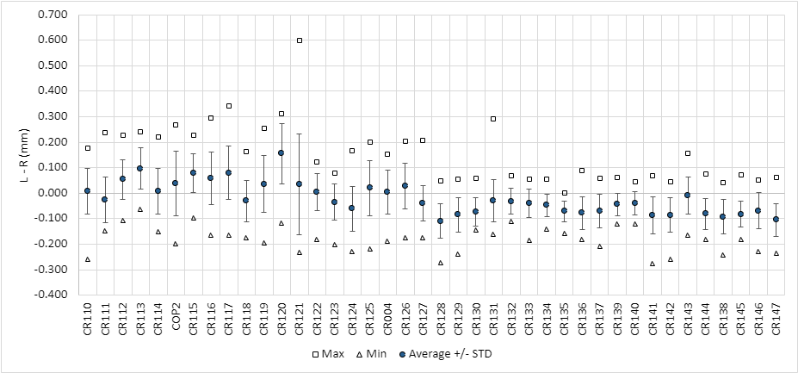
Impregnated coil geometry (Faro arm) – L-R
In terms of asymmetry, within specification (<0.3 mm) → no need of pole key machining

Slide 14
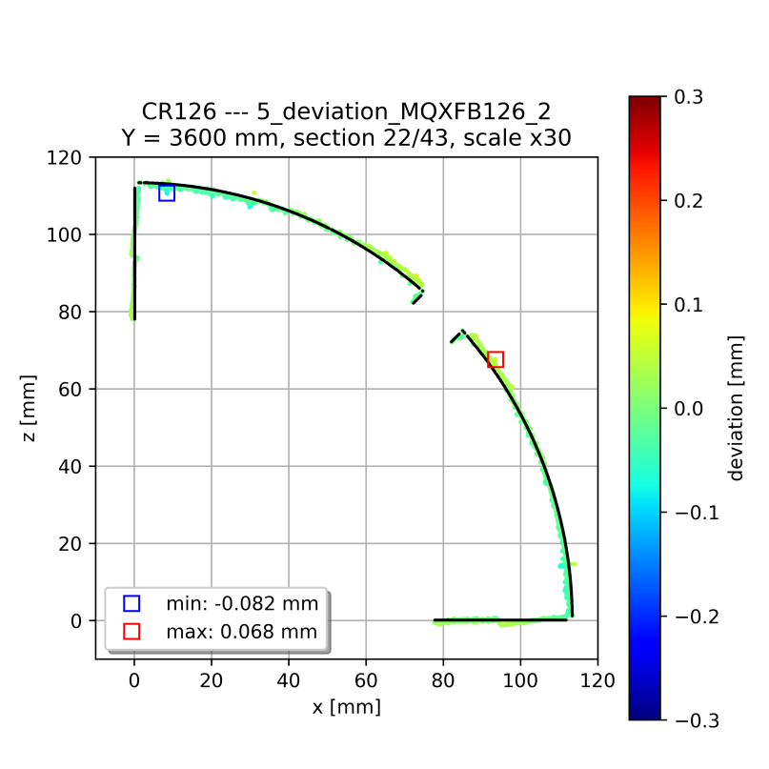
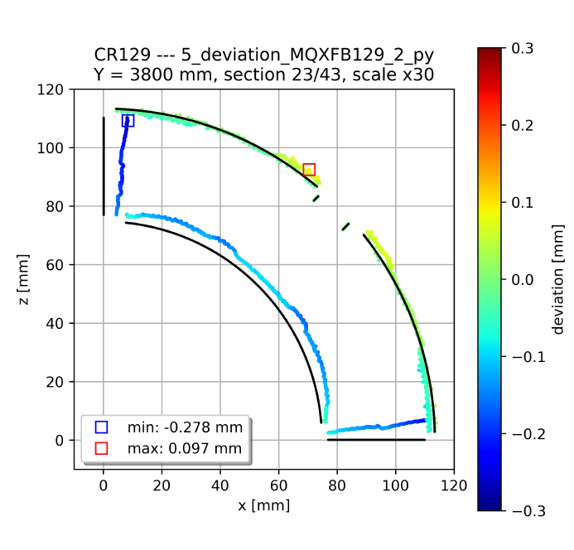
Impregnated coil geometry (Faro arm)
Typical cross-section standard coil
Systematic behavior in terms of coil shape to previous coils without binder: mid-plane has a little ‘wedge’ (the coil covers 89.6 degrees instead of 90 degrees)
Based on FEM we expect ≈ 15 MPa increase in the mid-plane stress (inner edge) under conservative assumptions, confirmed with a mock-up test, see https://indico.cern.ch/event/1260584/
Typical cross-section coil without binder in the OL
Further detail about coil metrology in Penelope’s presentation

Slide 15
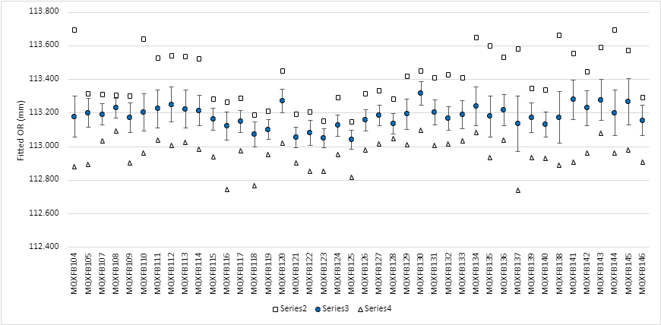
Impregnated coil geometry (Faro arm) - OR
The proposed coils are very similar in terms of OR

Slide 16
Final coil length
The total pole gap starting from coil 133 is 6.2 mm smaller
B03
Pole gap change (1.5 mm → 1.1 mm)
B04
B05
B07 proposal
B06

Slide 17
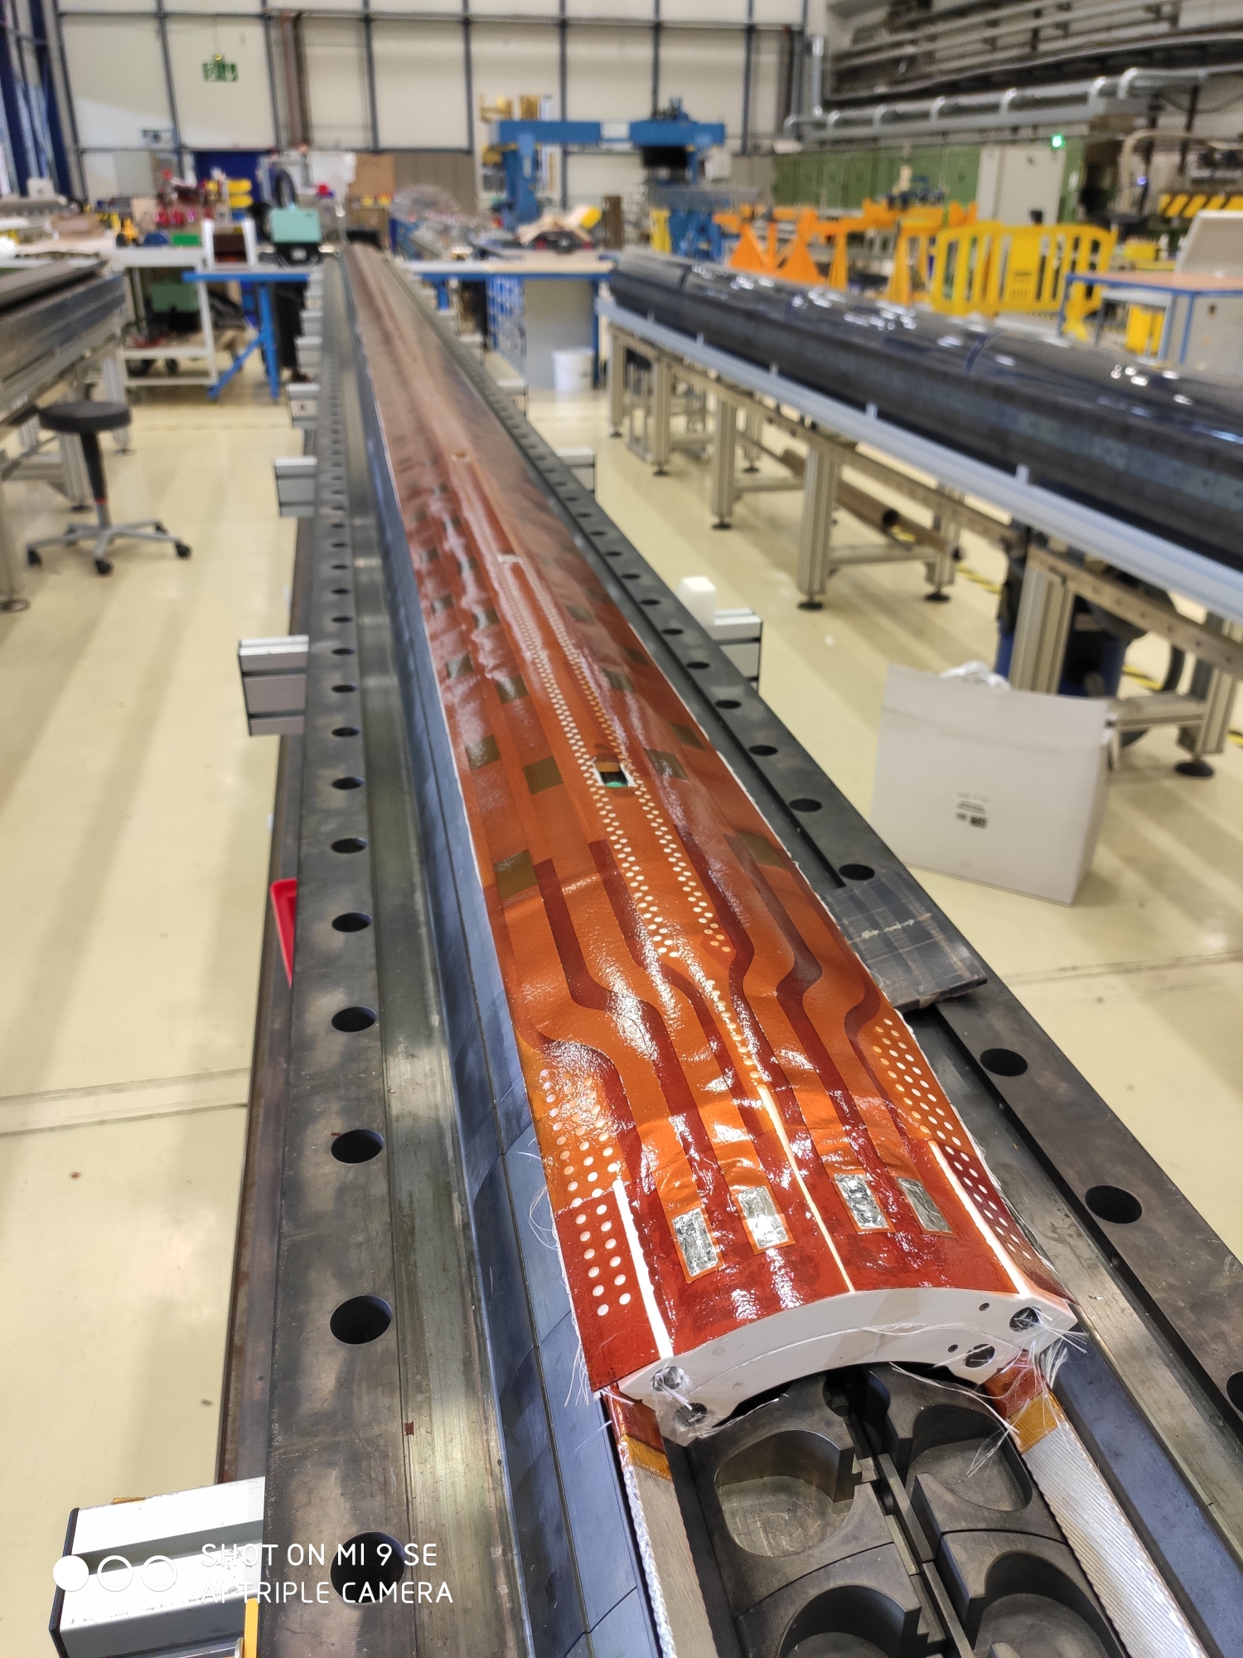
Dielectric strength
Coil to pole
Since coil 114, coil to pole insulation always above the minimum desired thanks to the reduction of ceramic binder and the use of heat cleaned fiber glass around the pole
QH to coil
From coil 126, ‘mini-swap’ quench heaters with improved fabrication process and higher qualification test voltages (see EDMS 2646046)
  From production performance monitoring plots EDMS 2374351

Slide 18
Dielectric strength

Slide 19
Outline
Manufacturing data
Non-conformities
Conclusion/Proposal

Slide 20
Analysis of non-conformities
CR138 | 2962606 | Issue during RHT cycle | Non-critical level 2
 | 2961736 | RHT parameters out of specification | Non-critical level 2
 | 3011012 | Lower temperature locally during heating up to 110°C (impregnation cycle) | Non-critical level 1
 | 2974448 | Over-heating during impregnation cycle | Critical level 3
 | 3128109 | Cable insulation damaged | Non-critical level 1
CR145 | 3073728 | Dwell1 and dwell2 durations out of specifications | Non-critical level 1
 | 2884016 | Dwell3 homogeneity out of range | Non-critical level 1
CR146 | 3083049 | Inner layer connection cable damaged during core removal | Non-critical level 2
 | 3088822 | Dwell1 and dwell2 durations out of specifications | Non-critical level 1
CR147 | 3088717 | IR1 end part coating damaged after IL curing | Non-critical level 1
 | 3101915 | Dwell1 and dwell2 durations out of specifications | Non-critical level 1
 | 2884016 | Dwell3 homogeneity out of range | Non-critical level 1
Very minor, not described in further detail in the slides
Described in detail in the next slides
Series of minor nonconformities in heat treatment, see next slides

Slide 21
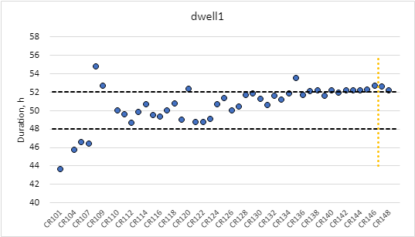
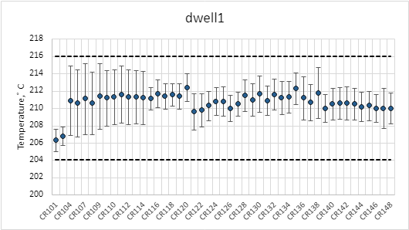
RHT NCR – dwell1
The duration of dwell1 is out of specification in all the 4 coils:
  CR138: 52.09 h
  CR145: 52.17 h
  CR146: 52.61 h
  CR147: 52.53 h
  Spec. 52 h maximum allowed
Temperature homogeneity within specification
Dwell1 duration reduced

Slide 22
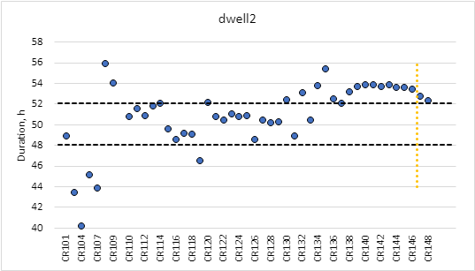
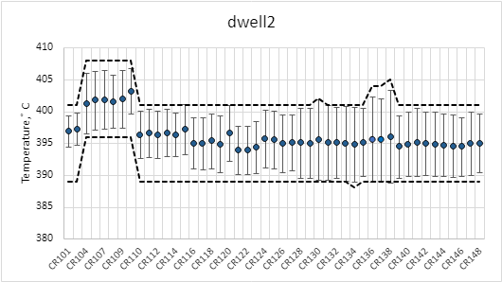
RHT NCR – dwell2
The duration of dwell2 is out of specification in all the 4 coils:
  CR138: 53.09 h
  CR145: 53.54 h
  CR146: 53.38 h
  CR147: 52.67 h
  Spec. 52 h maximum allowed
In coil CR138 (previously in CR136 and CR137) the upper band of the plateau had to be increased from 401°C to 404°C
  TCs close to the RE of the mould were warmer
  Furnace intervention after CR138 RHT (see next slides)
Dwell2 duration reduced

Slide 23
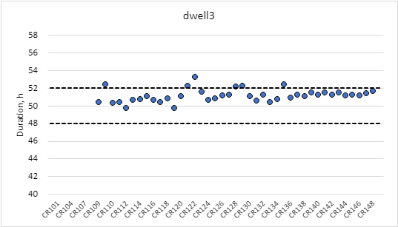
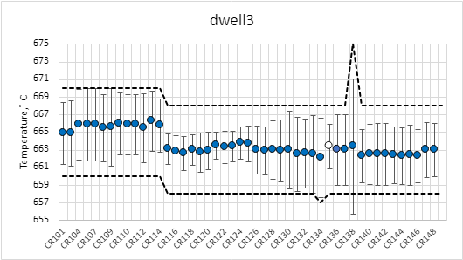
RHT NCR – dwell3
The duration of dwell3 is within specification for the 4 coils (52 h max. allowed)
In CR138, 3 TCs were out of range (TT17, TT19 and TT37)
  Max. temperature measured: 675°C
  Max. temperature allowed: 668°C
  Root cause analysis pointed to the melting of the fuse 3F6
  NCR 2962606 and NCR 2961736
Dwell3 mean H/2 out of spec
  CR138: 7.7°C
  CR145: 3.4°C
  CR146: 3°C
  CR147: 3.1°C
  Spec. 3°C maximum allowed

Slide 24
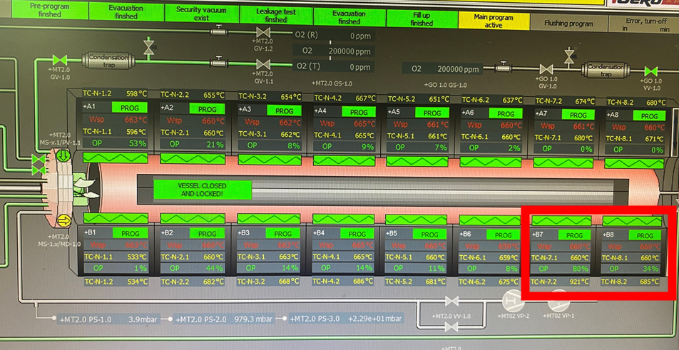
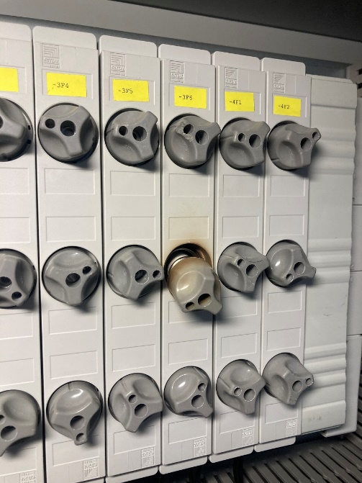
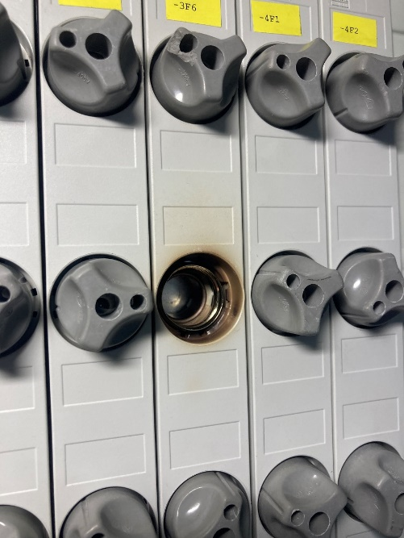
CR138 (NCR 2962606) → Furnace intervention
The furnace has several heating zones
along the length
  A1-B1: LE of the mould (door)
  A8-B8: RE of the mould
During the 3rd plateau, issue in B7 zone which was not regulating correctly the temperature
  Adjacent heating zones B6 and B8 provide more heat flow so the temperature increased above the target
Root cause analysis showed a B7 zone fuse heavily damaged which was then replaced
  Electrical check of the heating resistances of the furnace and of the elctrical circuit → ok
  Preventive action:
  Check of the fuses every 3 months in the preventive maintenance planning
  Implementation of phase controller on each of the static relays to monitor any missing phase

Slide 25
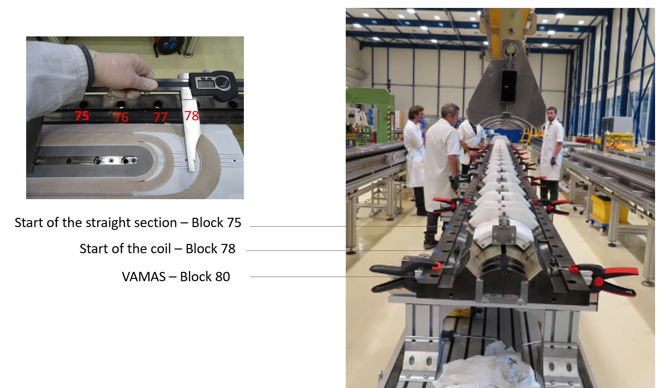
CR138 (NCR 2961736) → RHT parameters out of spec
The impact of the NCR 2962606 on the coil is translated in several parameters out of spec
  T_{max dwell2}: 416°C (max. allowed 401°C)
  T_{max dwell3}: 675°C (max. allowed 668°C)
  Dwell2 _{H/2 homogeneity}: 7.3°C (max. allowed 5°C)
  Dwell3 _{H/2 homogeneity}: 7.7°C (max. allowed 3°C)
Anomalous heating in the rear part of the oven (TCs17, 19, 37) located in block #75 reached the higher temperature, i.e. 675°C
  Assess the impact of the over temperature on Ic and RRR in that location
  VAMAS samples placed in RE of the mould allow for conservative
  assessment
As explained by S. Hopkins (EDMS 3012883)
  RRR in RE of the coil is reduced w.r.t. standard coils, minimum measured
  173 (minimum required 100) → RRR in specification
  Ic test samples heavily oxidised in RE of the mould but measurement
  within specification
    CC sample: Ic increase of 2.2% / 7.4% at 12 T/15 T (at 4.3 K)
    COC sample: Ic increase of 2.4% / 7.6% at 12 T/15 T (at 4.3 K)

Slide 26
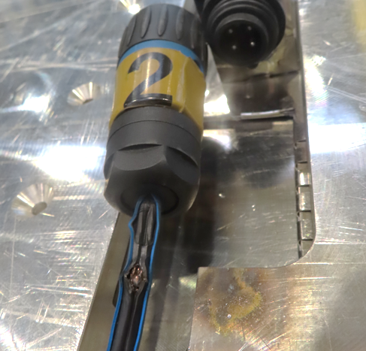
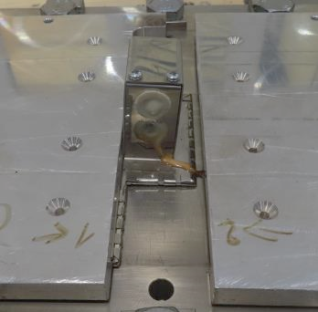
CR138 (NCR 2974448) → Over heating during impregnation cycle
NCR deeply discussed during CW group meeting on December the 6th (indico 1355007)
  During the tests performed prior to inject the epoxy resin into the mould, an issue caused the stop of the operations and the opening of the mould
  Instead of degassing at 110°C, the mould was heated up to 250/300°C for 24 hours (best guess based on findings)
What did it happen?
  In the impregnation machine there are 2 sets of TCs (for MQXFB and 11T coils)
  The correct TCs were installed in the mould but the wrong connector was plugged in the impregnation machine (11T connector)
    Monitoring of the 11T TCs which were in contact with the impregnation machine table so "in the air"
    We were blind at the level of the mould temperature
  When 110°C were set for the degassing cycle, the heating plates ran at maximum power
    Short circuit between power connector and heating plate #2 appeared, causing tripping of the circuit breaker and stop of all heaters
    Investigation of the root causes

Slide 27
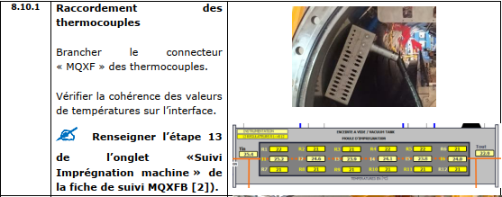
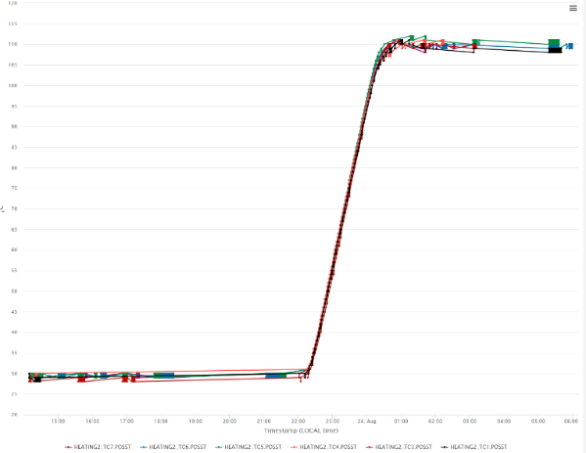
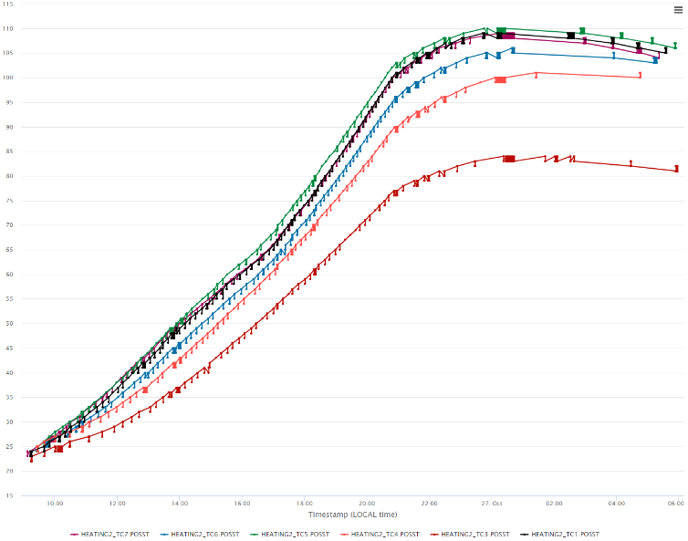
Why did it happen? → Human errors
  The wrong connector was plugged by the operator (procedure not followed)
  Parallel activities on another mould were 11T TCs were installed during the days preeceding the MQXFB coil
    Reason why the 11T TCs and plug were not hidden as usual
  Direct monitoring of the degassing cycle not done
    Unusual behavior could have been detected
Typical degassing cycle
CR138 degassing cycle

Slide 28
Action plan and results
  Opening of the impregnation mould to further investigate
  Perform splice analyses:
    Splice resistance measurement at RT → Within the acceptable range EDMS 2975146
    Visual inspection → A leakage/migration of SnAg was observed towards the extremities of the splice EDMS 2975146
    X-rays to check the quality of the joint compared to a conform splice Nb₃Sn-NbTi sample → X-rays confirmed a migration of the solder from the splice area (about 20% w.r.t. reference) EDMS 2975595
    Assess the performance degradation of the NbTi cable → NbTi cables were impacted by the overheating (27% of Ic degradation at 8T at 1.8K and around 6% at 0.5 - 2T) EDMS 3007813
  Assess potential damage of the Nb₃Sn reacted cable → No damage
  Replace all the polyimide parts (splice insulation and QH)
  Visual inspect the coil
  Replace all damaged parts and install fresh S2 glass → NCR 3128109
  Consolidation of the impregnation machine, replace the wiring and implementation of plugs with oriented slots to avoid any connection error
  Preventive action:
    Regular reminders to the impregnation machine operators to strictly follow the procedures and check lists

Slide 29
Last updates
  Magnet MQXFA17 experienced a similar NCR where the NbTi leads were overheated during splicing (EDMS 3119668)
  The magnet was cold tested and did not show any limitation at the level of the splice region
  Moreover the splice resistance was measured and within specifications
For all those reasons, we propose to use CR138 for MQXFB07

Slide 30
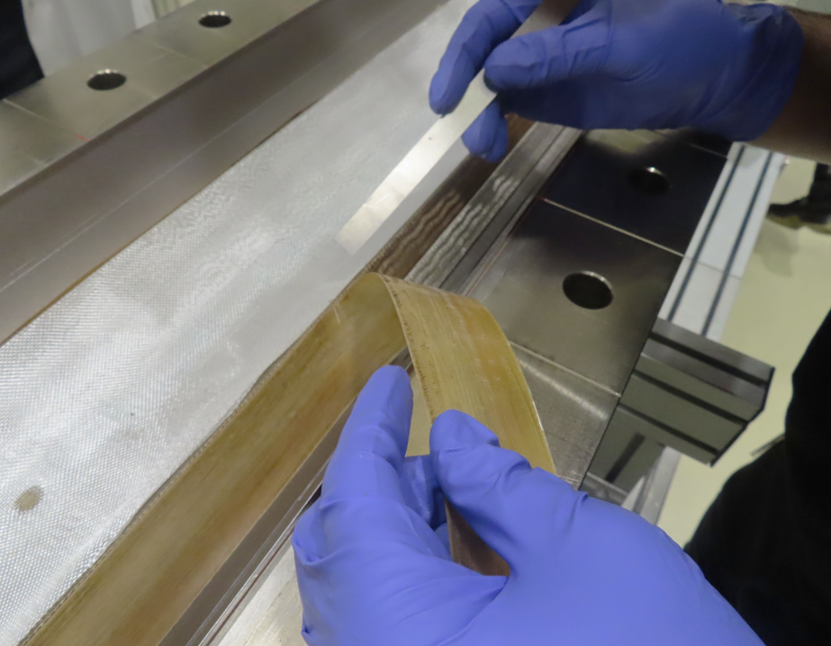
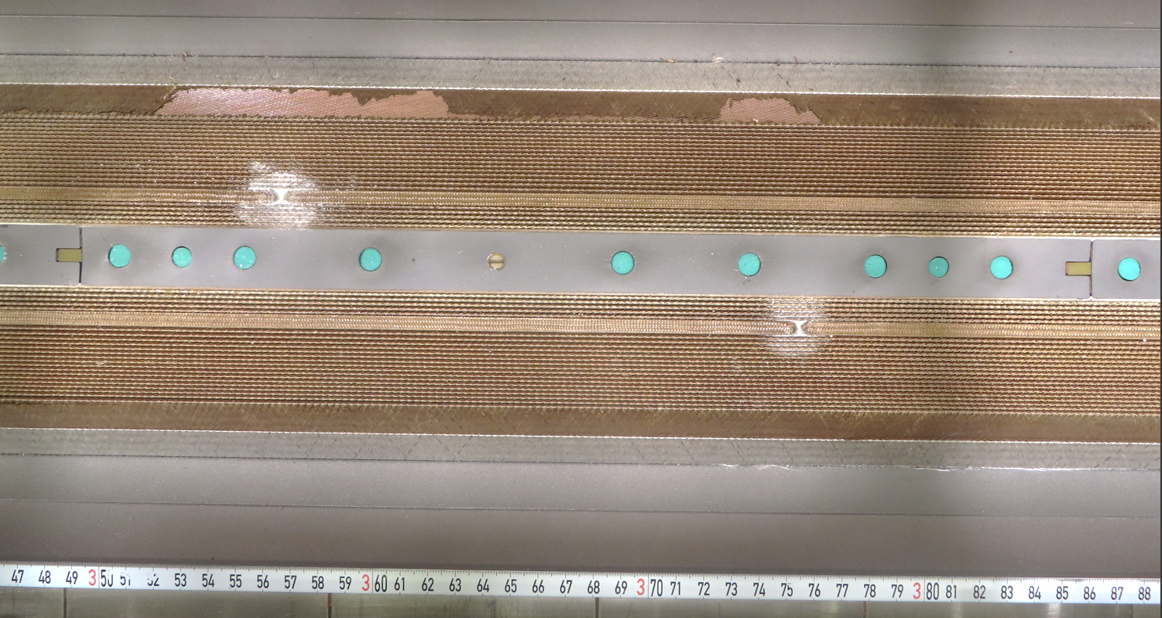
CR138 (NCR 3128109) → Cable insulation damaged
After the NCR 2974448 the mould was opened to inspect the coil and replace the damaged parts
The G11 midplane shim was partially glued to the midplane of the coil (opposite layer jump)
  During its removal, parts of the S2 glass insulation were stuck to the G11
  Removal of the fragile S2 glass over about 200 mm
  Local installation of fresh S2 glass to repair and new G11 shims

Slide 31
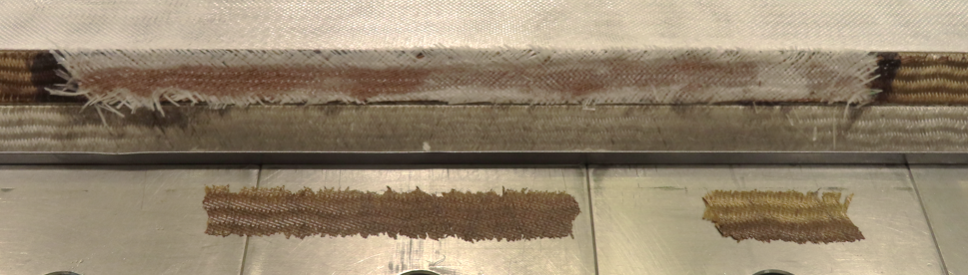
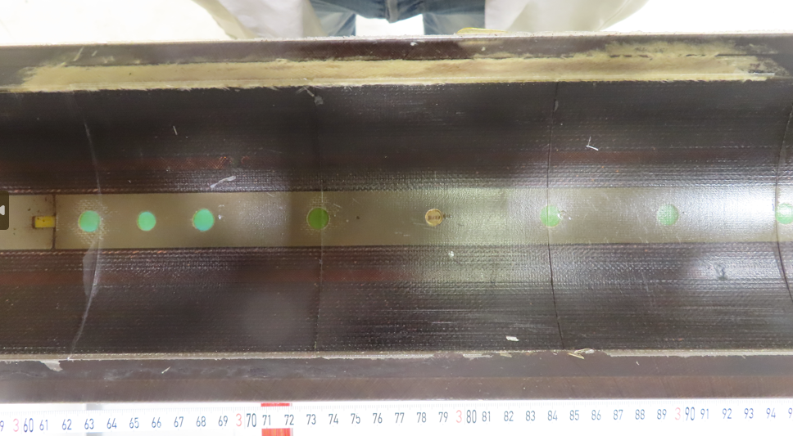
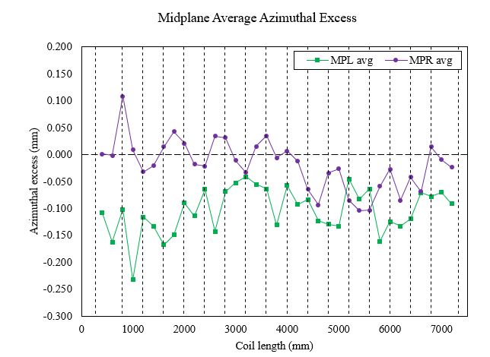
CR138 (NCR 3128109) → Cable insulation damaged
The geometrical measurement showed no over thickness in the repair location EDMS 3057190

Slide 32
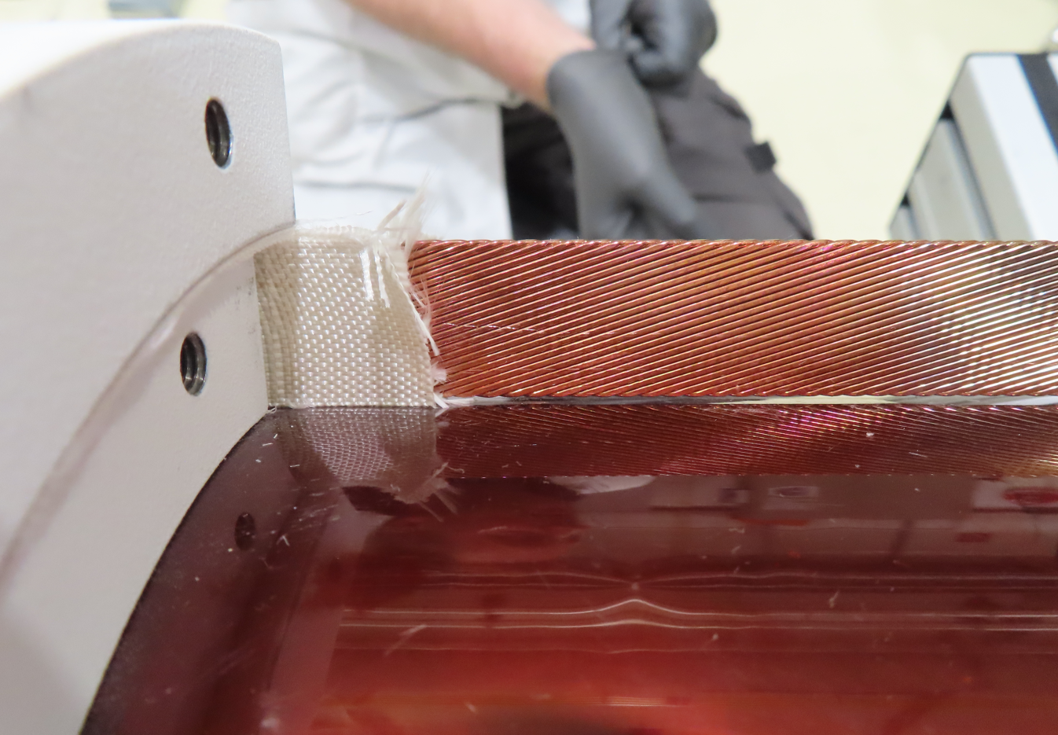
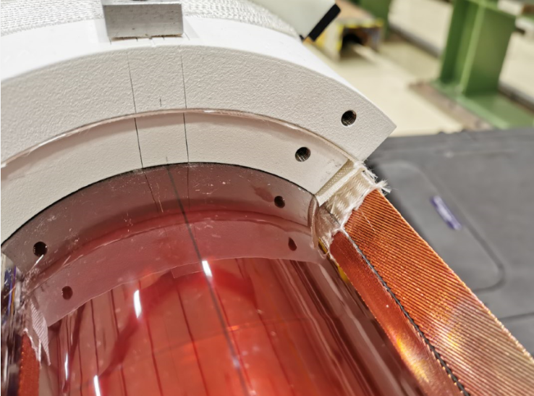
CR146 (NCR3083049) – Inner layer connection cable damaged
The inner layer cable exiting from the coil was damaged during the removal of the S2 glass insulation, prior to remove the core
Normally a 0.05 mm thick shim is inserted between the cable and the S2 glass then the fiberglass is cut
During the cut of the S2 glass with a blade, the shim was not correctly kept by the operator, so it slipped away and the cable underneath was superficially damaged

Slide 33
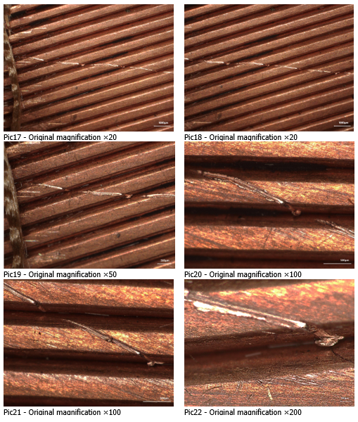
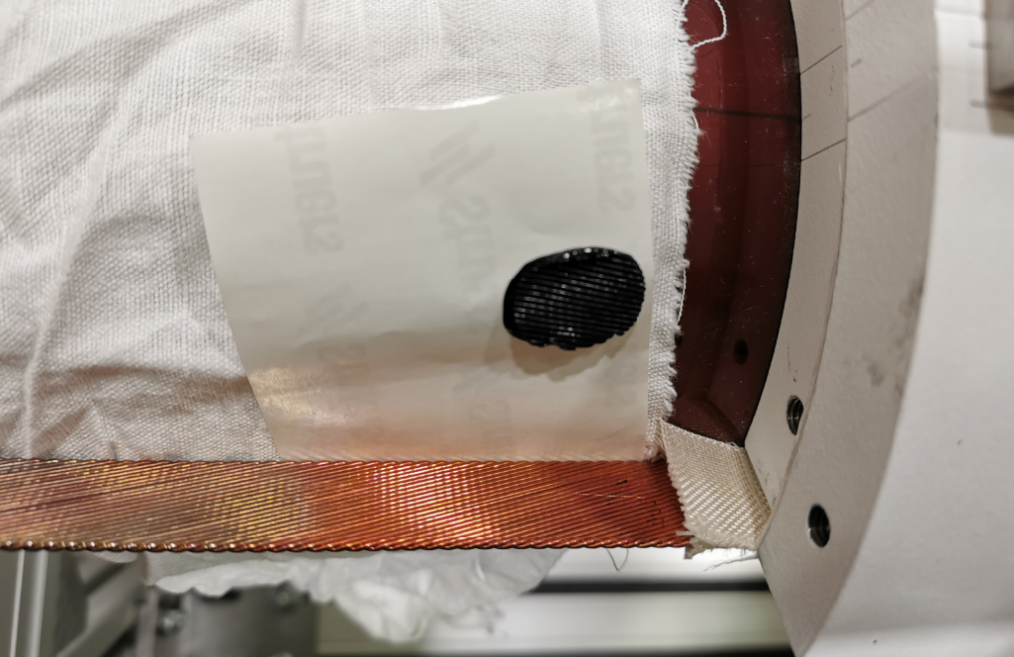
CR146 (NCR3083049) – Inner layer connection cable damaged
Action plan:
  Optical inspection of the cable before/after RHT
  Replica of the damage to measure the depth of the cut
  Result of the analysis:
    The optical inspection showed that only the copper was affected by the scratch
    The measurement of the replica showed a maximum depth of the cut of 21.6 µm (more details in M. Crouvizier report EDMS 3083153)
    The optical inspection of the cable after RHT did not reveal any tin leak
Pictures of the cable after RHT

Slide 34
Outline
Manufacturing data
Non-conformities
Conclusion/Proposal

Slide 35
Conclusion/Proposal
Use CR138 - CR145 - CR146 - CR147 for MQXFB07 assembly
The coil instrumentation will start in 2 weeks and the magnet loading is planned for end of September/beginning of October

Slide 36
Thank you!

Slide 37
Additional slides

Slide 38
Coil elongation when opening the reaction fixture
        LE side: 4.85 mm (5.30 mm at the end)
        RE side: 4.80 mm (5.50 mm at the end)
        Total = 10.8 mm
        LE side: 3.90 mm (4.19 mm at the end)
        RE side: 3.58 mm (4.08 mm at the end)
        Total = 8.3 mm
        LE side: 3.40 mm (3.90 mm at the end)
        RE side: 4.10 mm (4.77 mm at the end)
        Total = 8.7 mm
From coil 130, only the total elongation is traced

Slide 39
Pole gaps
In transition coils the pole gaps was increased: 0.9 mm → 1.5 mm
The absence of binder on the OL has an impact on the gap change after reaction
  Fully binder cured coils: ~ 1 mm/m
  Partially binder cured coils: ~ 0.8 mm/m
Comparing to AUP, coils with binder in both layers have a similar relaxation due to the heat treatment (1.1 mm/m AUP vs 1 mm/m CERN) and about half of the relaxation after winding (due to the lower winding tension at CERN)
In the latest coils (CR127-CR144), poles gaps in the middle of the coil are not closed after reaction, as it is the case for AUP coils

Slide 40
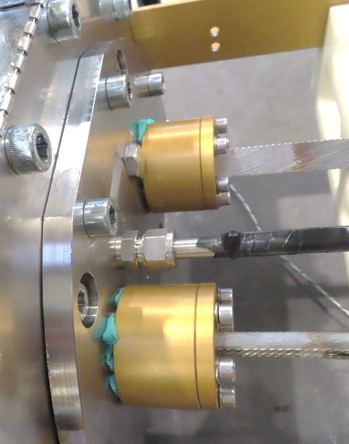
CR138 (NCR 2974448) → Over heating during impregnation cycle
  Some plastic parts were partially melted and damaged:
    Plug covers 3D printed in TPU95 at around 245°C
    Power cable sheats damaged (melting temperature around 300°C)
    Leads silicon joints damaged
  No tin-silver leakage have been observed at the level of the leads existing the mould (T_{m} = 227°C)
Temperature estimation: 250/300°C

Slide 41
Action plan
  Opening of the impregnation mould to further investigate
  Perform splice analyses:
    Splice resistance measurement at RT
    Visual inspection
    X-rays to check the quality of the joint compared to a conform splice Nb₃Sn-NbTi sample
  Assess the performance degradation of the NbTi cable
  Assess potential damage of the Nb₃Sn reacted cable
  Replace all the polyimide parts (splice insulation and QH)
  Visual inspect the coil
  Replace all damaged parts and install fresh S2 glass
  Replace the impregnation machine wiring and implementation of plugs with oriented slots to avoid any connection error
  Preventive action:
    Regular reminders to the impregnation machine operators to strictly follow the procedures and check lists

Slide 42
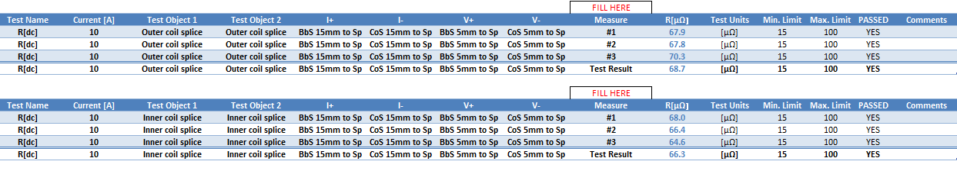
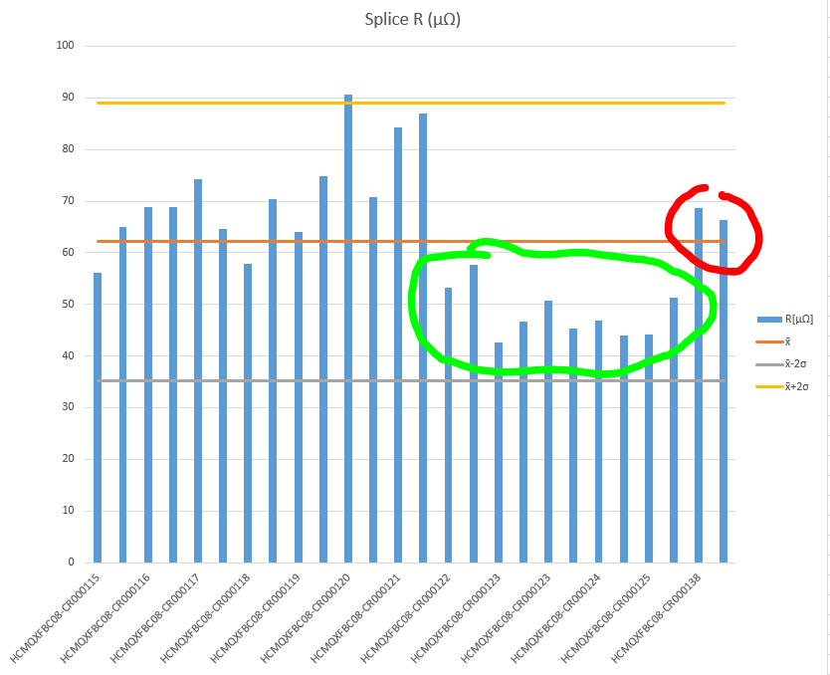
Splice analyses
  Splice resistance at RT (test results on EDMS 2975146)
    Acceptance range: 15 – 100 µΩ
    Measured range: 66 – 69 µΩ
  This result does not tell us the splice is good but at least it tells it is not bad

Slide 43
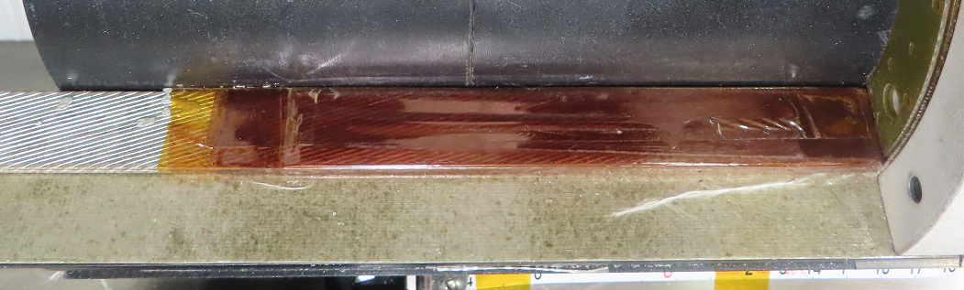
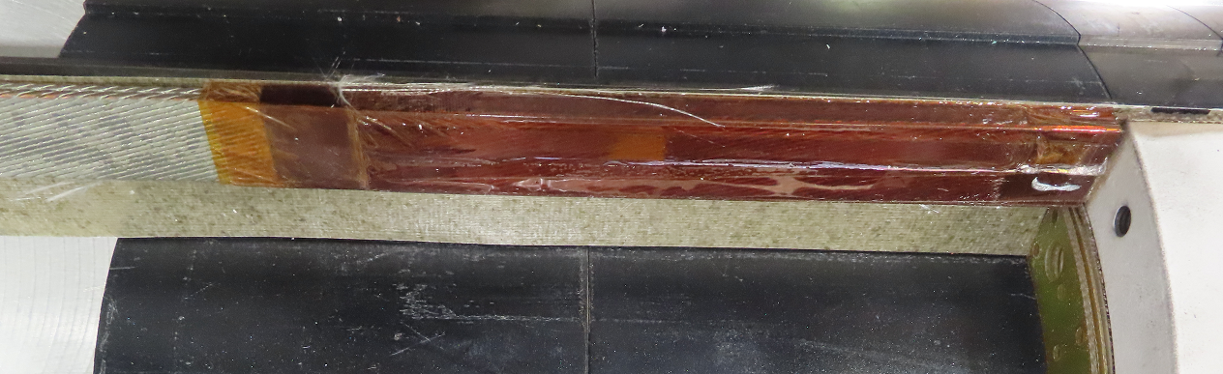
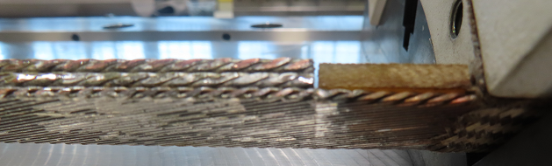
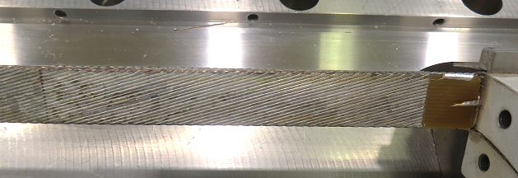
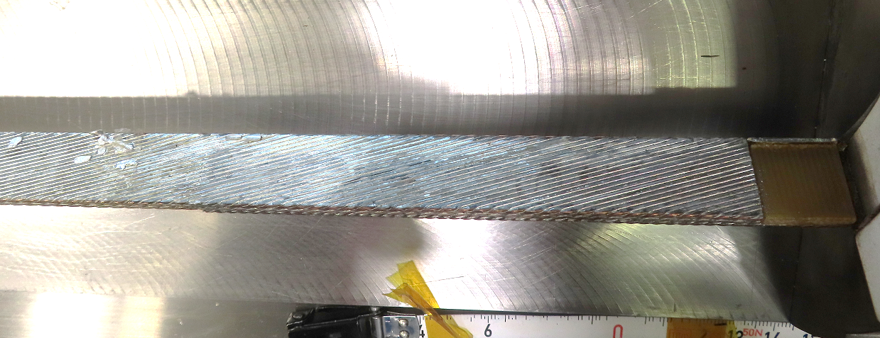
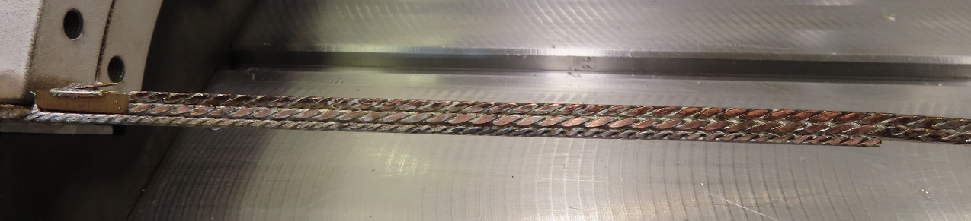
Splice analyses
  Splice visual inspection (all pictures available on EDMS 2975146)
    Tin-silver drops at the extremities of the splice insulation
    Once the insulation removed, more SnAg was observed at the extremities of the splice region (towards the coil ends and towards mould end for the IL splice)
    " Leopard skin" effect observed on both NbTi cables
IL splice
OL splice
  The splices have been impacted by the impregnation mould overheating

Slide 44
Splice analyses
  Splice x-rays (report available on EDMS 2975595)
    LMF production team provided the following samples to EN-MME-MM team:
      Extracted splice from impregnated coil CR120
      2 Nb₃Sn-NbTi splice mock-ups manufactured on-purpose
      1 Nb₃Sn reacted cable and 2 NbTi cables fixed together with tape
    Those samples were used to figure out the reference situation and could make comparisons
    The interpretation of the images is not easy
      RESULT: The penetration of the solder is worse with respect to the reference sample by 20%
What to do with the splices?
  The typical resistance at cold is 0.2 – 0.3 nΩ (requirement < 1nΩ)
  High risk of damaging Nb₃Sn cable when improving the quality of the joint

Slide 45
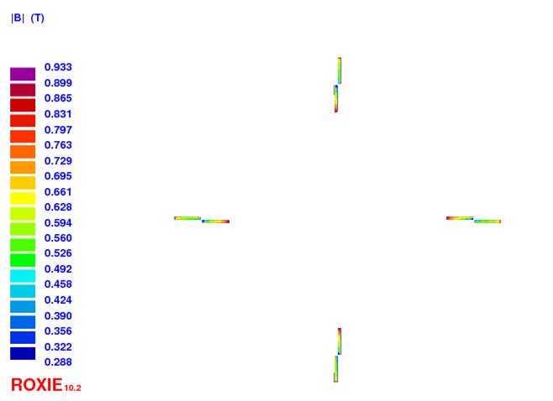
NbTi performance degradation
  TE-MSC-LSC team carried out Ic measurements on NbTi wires heated at 300°C for 24 hours
    NbTi strands showed a degradation of the Ic of 27% at 8T and 1.8K (Ic measurements)
    From magnetization measurements, the treatment: magnetization ratio suggests a Jc degradation of around 31% at 8T (comparable to the value from transport measurements) and around 6% at 0.5-2T
Susana computed the magnetic field in the splice region for assessment of the NbTi:
  At nominal operation conditions, it is less than 1T
  If we assume that current goes through the 2 leads homogeneously, the current density is 1400A/mm²
  Based on those results, we have margin for operation

Slide 46
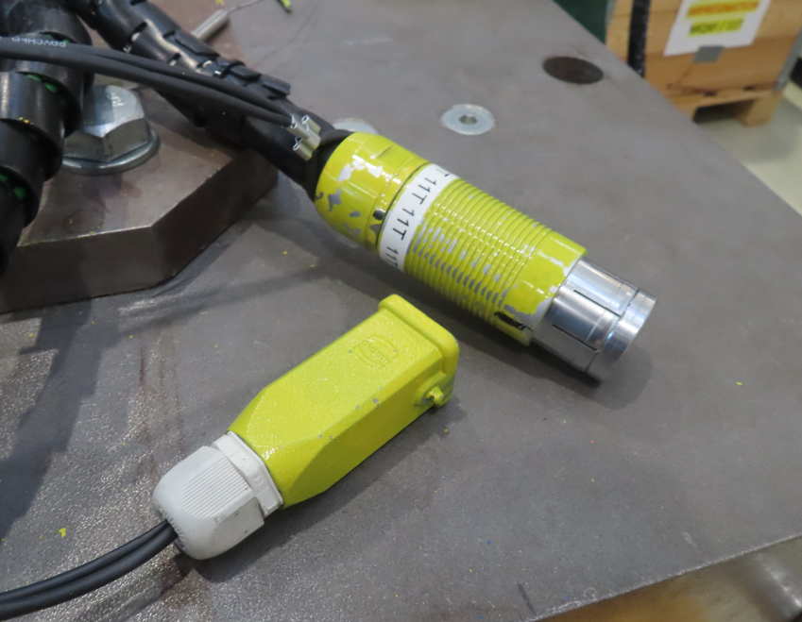
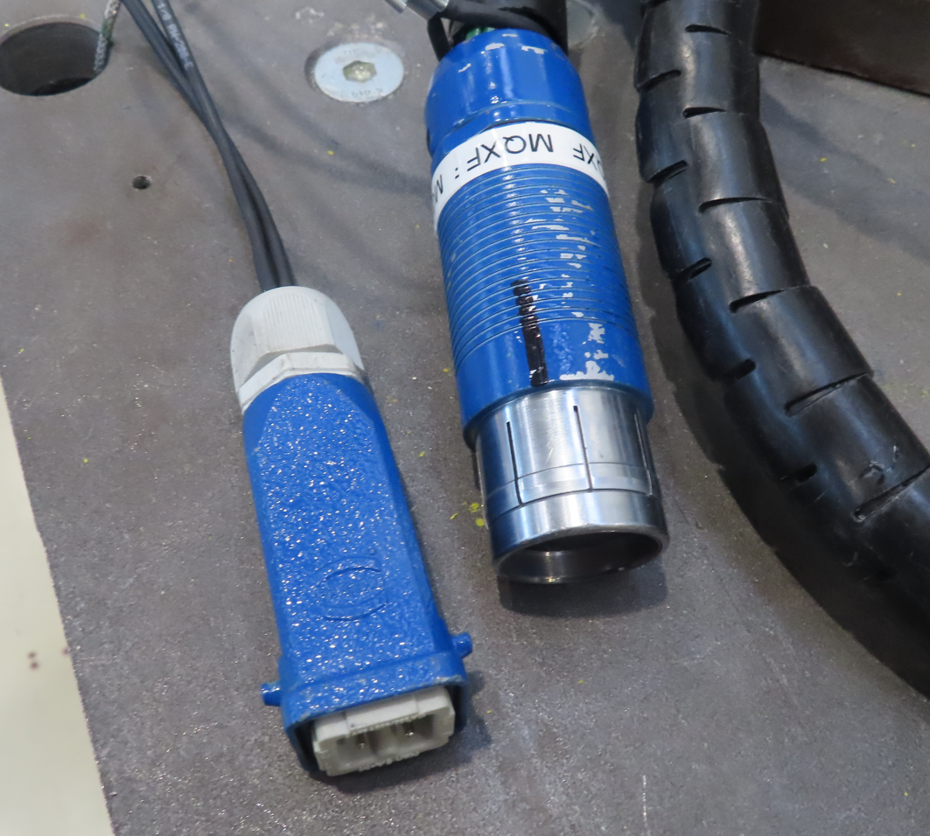
Impregnation machine consolidation
  Heating plates power wiring were replaced
  Implementation of two new plugs of MQXFB and 11T TCs with oriented keys and painted differently

