Slide 1


APEL Update
GridPP52, August 2024
Tom Dack
Notes:
The abstract pattern can be removed or repositioned if required. Be careful to ‘Send to Back’ so that it does not obscure any important information.

Slide 2

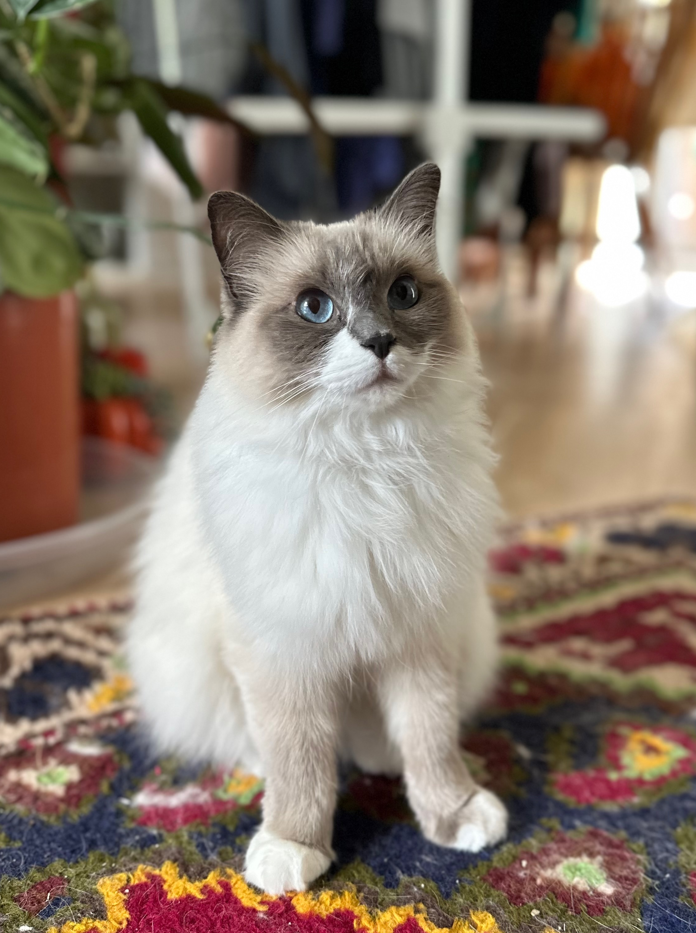
Introduction to the APEL Team
Team Leader: Tom Dack
Service Manager & Lead Developer: Adrian Coveney
Federating Services Team Developer: Saiteja Vennapusa
Operational/Development Support: Greg Corbett
Further Operational Support as part of Federating Services on-duty currently provided by Rose Cooper
Honorary Members:
Pasta
Toastie

Slide 3
Development Updates
Notes:
The abstract pattern can be removed or repositioned if required. Be careful to ‘Send to Back’ so that it does not obscure any important information.

Slide 4
Development Work Completed during June-July 2024
Planning Increment 1
SL7 Migration Prep for APEL Server
  As part of this, moving APEL Server from dedicated hardware to VM platform
    This provides better sustainability and management of the service
    Puts APEL with the RAL Quattor Configuration management platform
    Moves database to managed Galera cluster
Accounting for interTwin
  A simple accounting system (similar to IRIS dashboard) has been deployed
  Work within the interTwin space – including storage, GPU, and Kubernetes accounting – will deliver value for GridPP and IRIS down the road

Slide 5
Development Work Completed during Aug-Sept 2024
Planning Increment 2
SL7 Migration Wrap-Up
  IRIS Accounting hosts and other VMWare hosts migrated
  Final steps for main server migration underway
New Release for APEL software
  Py3 client fix for LDAP issue [github.com/apel/apel/issues/375]
  Fix for VOMS attribute parsing when no Role/Capability present [github.com/apel/apel/issues/374]
  Support for deletion of stale Cloud Accounting summaries [github.com/apel/apel/issues/217]
interTwin
  Next steps to deploy accounting platform

Slide 6
Development Work Completed during Aug-Sept 2024
Planning Increment 2
HEPScore
  HEPScore testing currently underway, targeting a late Sept/early Oct rollout
  Greg Corbett is coordinating our side of HEPScore testing, working with Julia Andreeva and the HEPScore WG
  Testing so far has been with the sites:
  These cover a range of clients and message types, from HTCondor with the APEL Client, ARC, and more bespoke clients.
CERN-PROD | KIT | FZK-LCG2 | PIC
UNI-FREIBURG | INFN-CNAF-LHCB | IN2P3-CC | RAL-LCG2

Slide 7
Development Work Completed during Aug-Sept 2024
Planning Increment 2
HEPScore – cont.
  As a summary on each:
    CERN-PROD – successfully sending test normalised data
    KIT, FZK-LCG2 and PIC – all using HTCondor with the APEL client, and have successfully tested sending individual job records
    UNI-FREIBURG and INFN-CNAF-LHCB – both are using more bespoke means to send data, which have been tested successfully
    RAL-LCG2 – have successfully sent test data
    IN2P3-CC is ongoing via GGUS 163458, they’ve just got back to us 28/08 in fact - so we will progress with validating the data.
    We are also waiting to hear back from OSG and the TUBITAK site.
  Working with CESGA’s contractors, the issue with the staging version of the EGI Accounting Portal has been identified, and should be soon sorted
Notes:
That was a big blocker on completing testing, as sites sending us data is a bit moot when it’s not being displayed in a Portal.

Slide 8
Development Work Planned For Oct-Nov 2024
Planning Increment 3
Final HEPScore deployments
  Targeting to be wrapped up by 25th October, depending on planning & scheduling
Deployment and re-release of new pub/sync service
  Validation service, primarily used by EGI
  It is anticipated that this will benefit other communities also
The previous two are the last notable items on the current backlog
We anticipate that in the second half of this PI, we will be able to look at new feature development for APEL
  A notable item in this list includes support for WLCG Tokens

Slide 9
Operational Updates
Notes:
The abstract pattern can be removed or repositioned if required. Be careful to ‘Send to Back’ so that it does not obscure any important information.

Slide 10
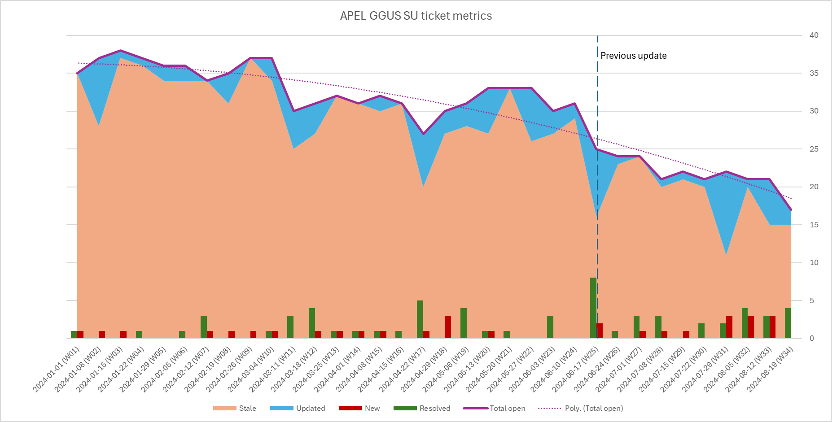
Ticketing and Support Improvements

Slide 11
Ticketing and Support Improvements
Ticketing has been a previous pain point – but improved processes and prioritisation has helped improvements in this space
Next Steps:
  Re-organisation of on duty responsibilities within the team, to have On Duty responsible for first-response & triage, which can be escalated to service manager team as needed
  Improved shared knowledge between Federating Services Team service knowledge, to prevent single points of failure
  Ongoing recruitment for a role split between CA service manager and FED team helpdesk/service manager

Slide 12
Closing Remarks
Notes:
The abstract pattern can be removed or repositioned if required. Be careful to ‘Send to Back’ so that it does not obscure any important information.

Slide 13
Closing Remarks
A busy year for APEL, for several reasons
Service is now in a much healthier state
  Positive trajectory for service development and operations
  Better stakeholder engagement with WLCG – engaging and sharing the team planning process
  Nearing the position where the team can start delivering new features

Slide 14


Notes:
The abstract pattern can be removed or repositioned if required. Be careful to ‘Send to Back’ so that it does not obscure any important information.

