Slide 1



+
ARM compute @ Glasgow
Status & Updates
Emanuele Simili GridPP52 Ambleside - 29 August 2024
Notes:
PoW @ GridPP

Slide 2
Outline
Update on Glasgow cluster (heterogeneous compute)
- ScotGrid Glasgow cluster fully updated
- ARM & x86 resources “transparently” available through CE endpoints
- Physics Validation updates (June 2024)
Benchmarking and Power Measurement
- updates on HEPscore/Watt & Frequency Scan
- new IPMI validation campaign against external PDU
- first step in testing RISC-V architecture for HEP
Upcoming conferences
- Few contributions will be presented at HTCondor workshop (AMS, Sep. 2024)
- A plenary and a few track talks accepted at CHEP 2024 (KRK, Oct. 2024)
Outlook …
Notes:
outline

Slide 3

in-House (production)
~ 1.5k cores
2xIntel40ht: Dual Socket Intel XEON 10-Core CPU E5-2630 v4 (HP)
CPU: 2 * x86 Intel(R) Xeon(R) E5-2630 v4, 10C/20HT @ 2.2GHz (TDP 85W)
RAM: 160GB (4 x 32GB + 4 x 8GB) DDR4 2400 MHz → 4 GB/core
HDD: 2TB disk SATA @ ‎7200 RPM
~ 5k cores
2xAMD64ht: Dual Socket AMD EPYC 7513 32-Core Processor (DELL)
CPU: 2 * x86 AMD EPYC 7513 (Milano), 32C/64HT @ 2.6GHz (TDP 200W)
RAM: 512GB (16 x 32GB) DDR4 3200MT/s → 4 GB/core
HDD: 3.84TB SSD SATA Read Intensive
~ 7.5k cores
2xAMD64ht: Dual Socket AMD EPYC 7452 32-Core Processor (DELL)
CPU: 2 * x86 AMD EPYC 7452 (Roma), 32C/64HT @ 2.35GHz (TDP 200W)
RAM: 512GB (16 x 32GB) DDR4 3200MT/s → 4 GB/core
HDD: 3.84TB SSD SATA Read Intensive
~ 2k cores
2*ARM80c: Dual Socket Ampere Altra Q80-30 80-Core Processor (Ampere)
CPU: 2 * ARM Ampere Q80-30, 80C @ 3GHz (TDP 210W)
RAM: 512GB (32 x 16GB or 16 x 32GB) DDR4 3200MT/s → 3.2 GB/core
HDD: 2 * 1TB NVMe
~ 2k cores
ARM128c: Single Socket Ampere Altra Max M128-30 128-Core Processor (SuperMicro)
CPU: ARM Ampere M128-30, 128C @ 3GHz (TDP 250W)
RAM: 512GB (8 x 64 GB) DDR4 3200MHz → 4 GB/core
HDD: 8TB NVMe
Notes:
hardware currently in production at Glasgow Tier2 compute cluster

Slide 4
Cluster Update
We have completed the update of our Tier2 cluster at Glasgow, due to the long-awaited End Of Life (in June 2024) of CentOS7, which we used for the past 4-5 years:
- all compute nodes and services updated to Alma 9
- all CEPH nodes updated to Alma 8 and CEPH v14 (Nautilus), next: Pacific
- batch system updated to HTCondor 10.0, ARC-CE v6.20 (waiting for v7), no ARGUS
- updated monitoring services: Prometheus 2.5, Loki 3, Grafana 11, …
- updated management stuff: Ansible v2.14, GitLab v17.3, …
- installed perfSONAR 5.1 testpoint (rather than toolkit)
Notes:
updates

Slide 5


Heterogeneous Compute Cluster
We started providing ARM resources by creating a separate queue for ARM (former ce-test endpoint).
Then, after upgrading the whole HTCondor cluster to v10, we tried to join the queues …
This is the idealized view of our heterogeneous computing cluster:
~15k cores (ht)
jobs
wn_x86
wn_x86
wn_x86
UKI-SCOTGRID-GLASGOW_CEPH
wn_x86
wn_x86
wn_x86
wn_x86
wn_x86
x86 queue
wn_x86
ce01.gla.scotgrid.ac.uk
ce02.gla.scotgrid.ac.uk
Condor Manager
ce03.gla.scotgrid.ac.uk
~4k cores
ce04.gla.scotgrid.ac.uk
wn_ARM
wn_ARM
wn_ARM
ARM queue
wn_ARM
wn_ARM
wn_ARM
wn_ARM
decommissioned
ce-test.gla.scotgrid.ac.uk
The condor_requirements setting in the ARC-CE configuration modifies the ClassAd for the jobs that ARC submits to Condor by inserting an architecture request (*)
Notes:
ce01.gla.scotgrid.ac.uk
ce02.gla.scotgrid.ac.uk
ce03.gla.scotgrid.ac.uk
ce04.gla.scotgrid.ac.uk
ce-test.gla.scotgrid.ac.uk

Slide 6
Heterogeneous Compute Cluster Issues
In reality, we only enabled the dual queue on ce03, because not all VOs can deal with the architecture settings (e.g., BioMed), and we kept the ce-test entry point because it is still in use by some VOs, while the other ces are still single queue (x86).
So, this is the actual view of our heterogeneous compute cluster:
~15k cores (ht)
jobs
wn_x86
wn_x86
wn_x86
UKI-SCOTGRID-GLASGOW_CEPH
wn_x86
wn_x86
wn_x86
wn_x86
wn_x86
x86 queue
wn_x86
ce01.gla.scotgrid.ac.uk
ce02.gla.scotgrid.ac.uk
Condor Manager
ce03.gla.scotgrid.ac.uk
~4k cores
ce04.gla.scotgrid.ac.uk
wn_ARM
wn_ARM
wn_ARM
ARM queue
wn_ARM
wn_ARM
wn_ARM
wn_ARM
… soon to be decommissioned
ce-test.gla.scotgrid.ac.uk
We are still in a transitioning state, but as more VOs adhere to the dual queue standard, we hope to make the dual queue submission mechanism more ideal …
Notes:
dual queue issues

Slide 7
Heterogeneous Compute Cluster Config
(*) The condor_requirements setting in the ARC-CE configuration modifies the ClassAd for the jobs that ARC submits to Condor by inserting an architecture request.
Because … HTCondor doesn't have a concept of queues: it matches jobs to resources based on their ClassAd, which includes an architecture entry …
[queue:condor]
comment = Condor queue
condor_requirements = (Arch == "X86_64" && (TARGET.GPUs IS UNDEFINED || TARGET.GPUs == 0))
[queue:condor_arm]
comment = Condor queue (ARM)
condor_requirements = (Arch == "aarch64" && (TARGET.GPUs IS UNDEFINED || TARGET.GPUs == 0))
[queue:condor_gpu]
comment = Condor queue (x86 + GPU)
condor_requirements = TARGET.GPUs > 0
This also works for GPU queue (tested already !)
What VOs need to do is to ensure that their job submission mechanism specifies the appropriate ARC queue (i.e., what architecture they are targeting).
Note: the ARC default queue selection appeared buggy in earlier version of ARC v6, hopefully it will improve in v7.
Notes:
dual queue config

Slide 8
ARM Physics Validation
Most LHC experiments (ATLAS, CMS, ALICE) have done a first round of extensive Physics Validation campaigns against our ARM cluster @ Glasgow:
  ATLAS: Full simulation and Reconstruction are physics validated.
      ATLAS is ready for pledged ARM resources!
  CMS: Physics validation on ARM mostly successful, but not conclusive.
  CMS is not in a position to use ARM processors in production!
  ALICE: Extensive test of MC simulation jobs, no analysis workflows.
  Recommends ARM segregation or mixed queue with enable/disable!
  LHCb: Groundwork & test samples done, full physics validation not done.
  Production use of ARM unlikely before end of 2024!
Latest reports from GDB (June 2024 @ CERN): https://indico.cern.ch/event/1356135/
It’s time for VOs to start sending ARM jobs our way … we have over 4k ARM cores !
☺
😐
😐
☹
Notes:
GDB (June 2024 @ CERN): https://indico.cern.ch/event/1356135/
ATLAS: https://indico.cern.ch/event/1356135/contributions/5971895/attachments/2875966/5036670/20240612%20ARM%20for%20ATLAS.pdf
(all ok, ready to pledge)
CMS: https://indico.cern.ch/event/1356135/contributions/5971888/attachments/2875790/5036232/GDB_WLCG_CMS_Adriano_12Jun24_Pub.pdf
(ok Monte Carlo simulations, significant differences for detector data, not ready to pledge)
ALICE: https://indico.cern.ch/event/1356135/contributions/5971898/attachments/2875360/5035311/ARM%20in%20ALICE.pdf
(ok MC simulation jobs, no analysis workflows)
LHCb: https://indico.cern.ch/event/1356135/contributions/5971887/attachments/2873979/5036103/20240612%20GDB%20-%20ARM%20status%20(1).pdf
(groundwork done, full physics validation not done, creation of test-samples demonstrated, production use of ARM unlikely before end of 2024)

Slide 9


in-House Testing
AMD96ht: Single AMD EPYC 7003 48-Core Processor (GIGABYTE)
CPU: x86 AMD EPYC 7643, 48C/96HT @ 2.3GHz (TDP 225W)
RAM: 256GB (16 x 16GB) DDR4 3200MHz → 2.7 GB/core
HDD: 3.84TB SSD SATA
2xAMD48ht+GPU: Dual Socket AMD EPYC 7443 24-Core Processor (DELL)
CPU: 2* AMD EPYC 7443, 24C/48HT @ 2.3GHz (TDP 200W)
GPU: 2* NVIDIA A100 PCIe 80GB (TDP 300W)
RAM: 256GB (16 x 16GB) DDR4 3200MHz → 2.7 GB/core
HDD: 480GB SSD SATA + 5TB SSD SCSI
ARM80c: Single socket Ampere Altra Q80-30 80-Core Processor (GIGABYTE)
CPU: ARM Ampere Q80-30, 80C @ 3GHz (TDP 210W)
RAM: 256GB (16 x 16GB) DDR4 3200MHz → 3.2 GB/core
HDD: 3.84TB SSD SATA
Grace144c: Dual Socket* NVidia Grace 144-Core Processor (SuperMicro)
CPU: NVidia Grace 144-Core 480GB DDR5 @ 3.4GHz (TDP 500W)
RAM: 480GB (on chip) DDR5 4237MHz → 3.3 GB/core
HDD: 1TB NVMe + 4TB NVMe
Notes:
in-house

Slide 10
Remote Testing
2*AMD256ht: Dual Socket AMD EPYC 9754 128-Core Processor (SuperMicro)
CPU: 2 * x86 AMD EPYC 9754 (Bergamo), 128C/256HT @ 3.1GHz (TDP 360W)
RAM: 1.536TB (24 x 64GB) DDR4 3200MHz → 3 GB/core
HDD: 512GB NVMe + 3.84TB SSD
OS: Rocky 9.2
SuperMicro
SuperMicro
AMD128ht: Single Socket AMD EPYC 8534P 64-Core Processor (SuperMicro)
CPU: AMD EPYC 8534P (Siena), 64C/128HT @ 3.1GHz (TDP 200W)
RAM: 576GB (6 x 96GB) DDR5 3200MT/s → 4.5 GB/core
HDD: 1TB NVMe Storage
OS: Rocky 8.8
SuperMicro
ARM128c: Single Socket Ampere Altra Max M128-28 128-Core Processor (XMA)
CPU: ARM Ampere M128-28, 128C @ 2.8GHz (TDP 250W)
RAM: 512GB (8 x 64GB) DDR4 3200MHz → 4 GB/core
HDD: 1TB NVMe Storage
OS: Rocky 8.8
XMA
Coming soon : AmpereOne (96 - 192 cores)
… we expect to get remote access to a test box next month!
SuperMicro
Notes:
AmpereOne: https://amperecomputing.com/briefs/ampereone-family-product-brief

Slide 11
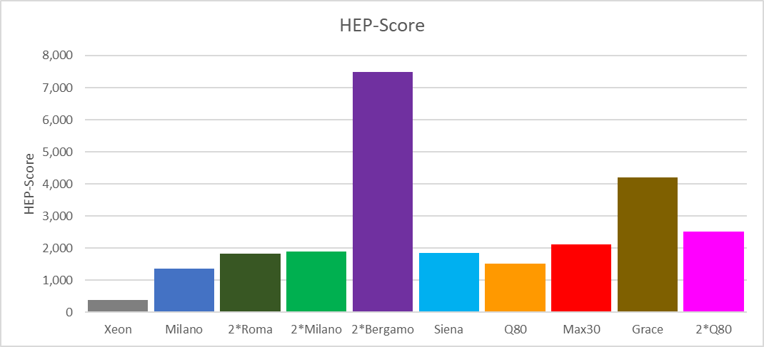
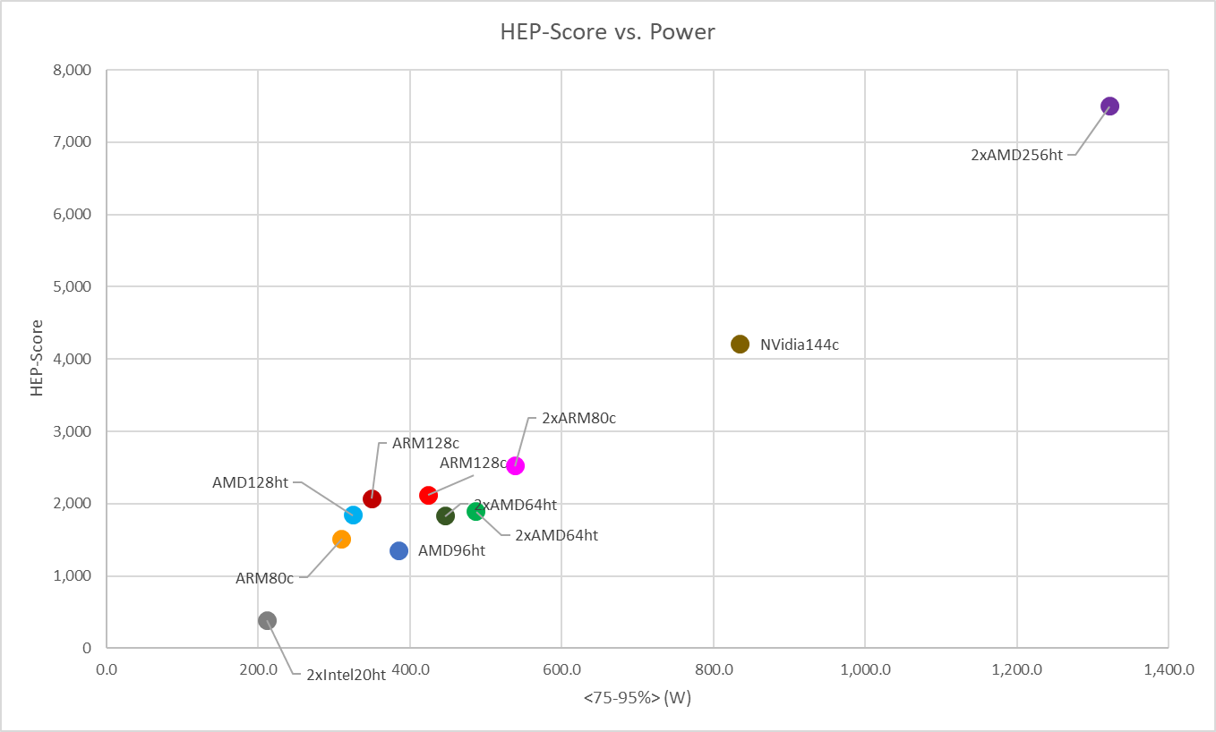
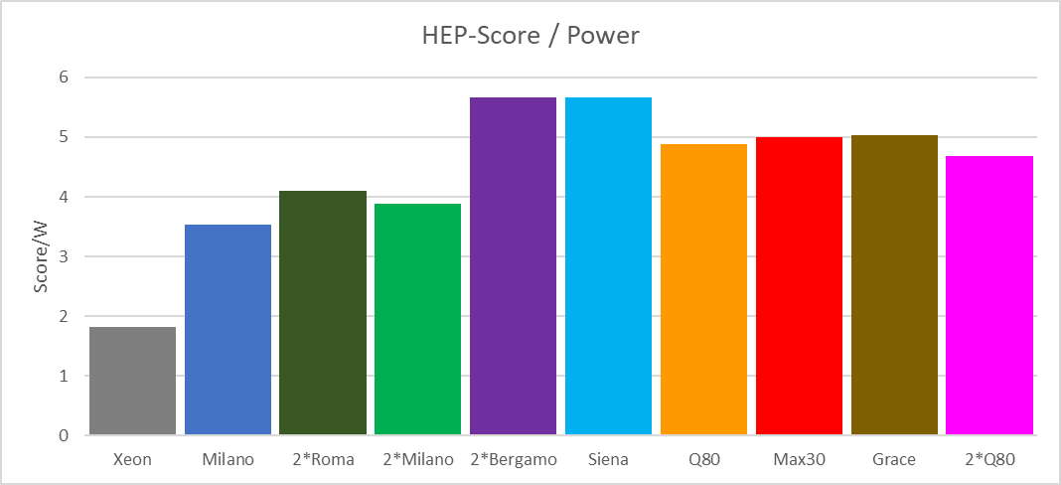
HEPscore/Watt
Using the new Figure of Merit (<75-95%> quantile average) as best proxy for Power, we estimate the Performance per Watt as HEP-Score/Power FoM. (Note: replaced Altra Max M128-28 with M128-30).
*
*
Notes:
… but, this is not the whole story: each machine runs at its highest frequency (conservative governor), and frequency directly affects power usage.
See next slide (!)

Slide 12
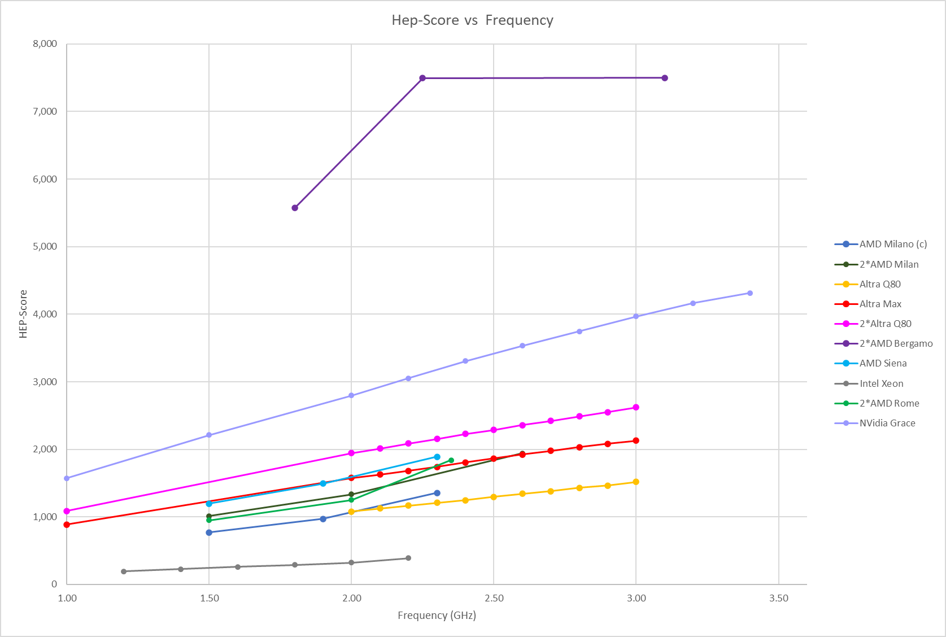
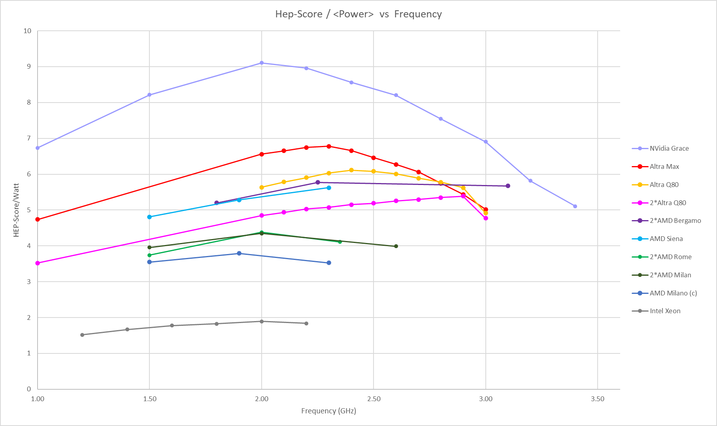
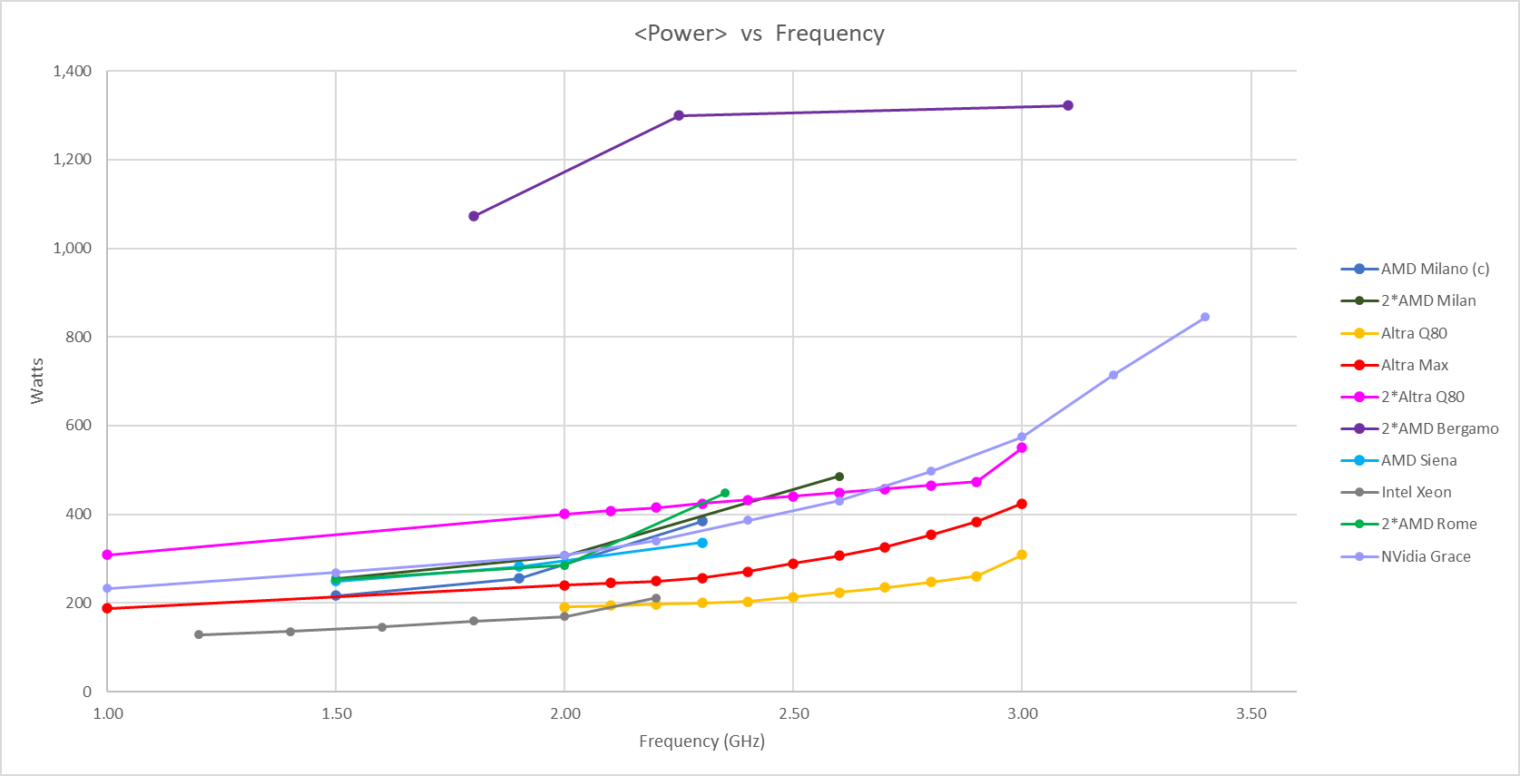
Frequency Scan (update)
HEP-Score/Watt vs. CPU Frequency gives a better picture of hardware potentials and shows optimal performances per watt at mid frequency range. Plots have been updated with the most recent Power F.o.M. and a scan of the whole Altra Max frequency range, thanks to the newly acquired M128-30 nodes.
x86
ARM
Notes:
(!) see performance/watt of Max vs Grace …
NOTE: the x coordinate shows the “nominal” frequency, i.e., the frequency that has been set via ‘cpupower frequency-set’.
This does not always stay constant during the run, especially x86 have a “high frequency” turbo mode that is switched on/off depending on load.

Slide 13
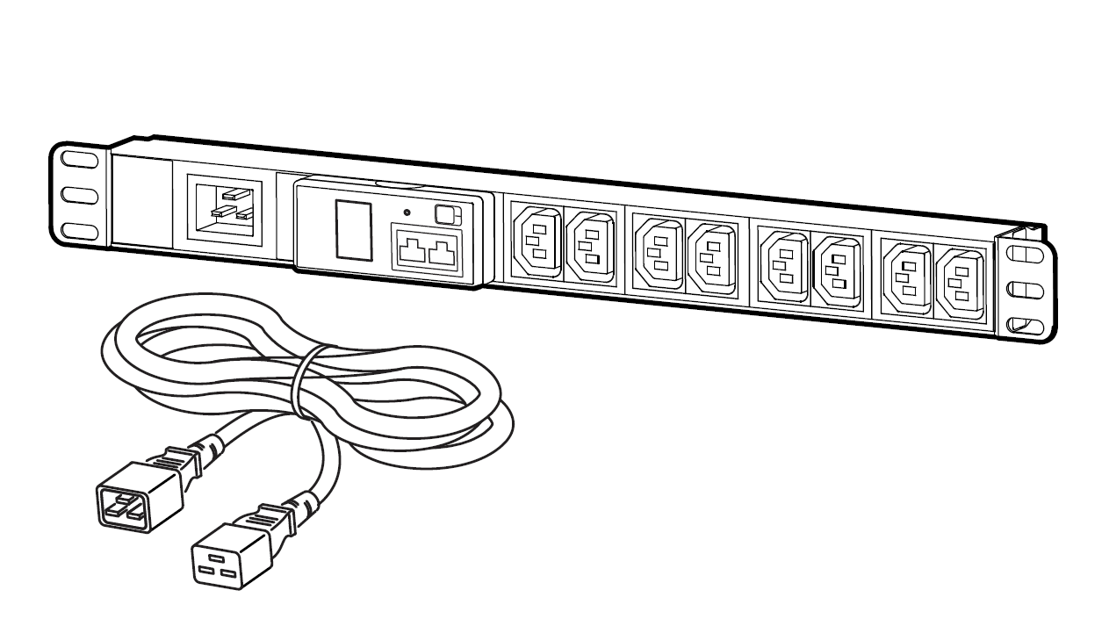
IPMI Validation
We acquired a metered PDU with remote readings and we are validating our IPMI power readings against the PDU. This is our current configuration:
Milk-V Pioneer : Single socket RISC-V 64-Core
AMD96ht: Single AMD EPYC 7003 48-Core
ARM80c: Single socket Ampere Altra Q80-30 80-Core
Grace144c: Dual Socket NVidia Grace 144-Core
Notes:
PDU specs: APC Easy Rack PDU, Metered, 1U, 1 Phase, 3.7kW, 230V, 16A, 8 x C13 outlets, IEC60320 C20 inlet

Slide 14
Validation Strategy
The PDU provides a single reading, so we measured the baseline with all machines off:
Base consumption is extremely stable at 67 Watts
When off, the AMD, ARM and Grace test boxes each draw about 16 W for IPMI/OOB services, RISC-V next to nothing, as it’s a desktop PC with no BMC.
For testing, we turned on one machine at each time, and collected Power readings from:
IPMI (via ipmitool “Instantaneous Power”) ;
PDU (via ModBus “Active power”), with sampling interval 5 sec for both.
We ran 3 tests: stress (10 min.) , sleep (10 min.) , HEP-Score (3-6h) …
This strategy was motivated by minimizing the presence in the data center … we also tried a different approach, by connecting a single machine per time to the PDU and measuring power usage during stress and sleep. Results are still being interpreted.
Notes:
baseline

Slide 15
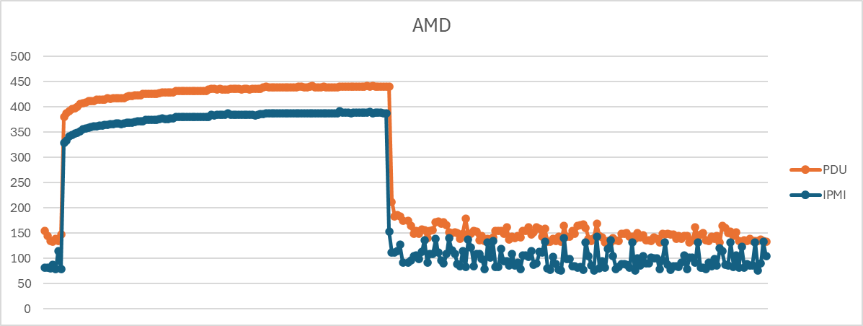
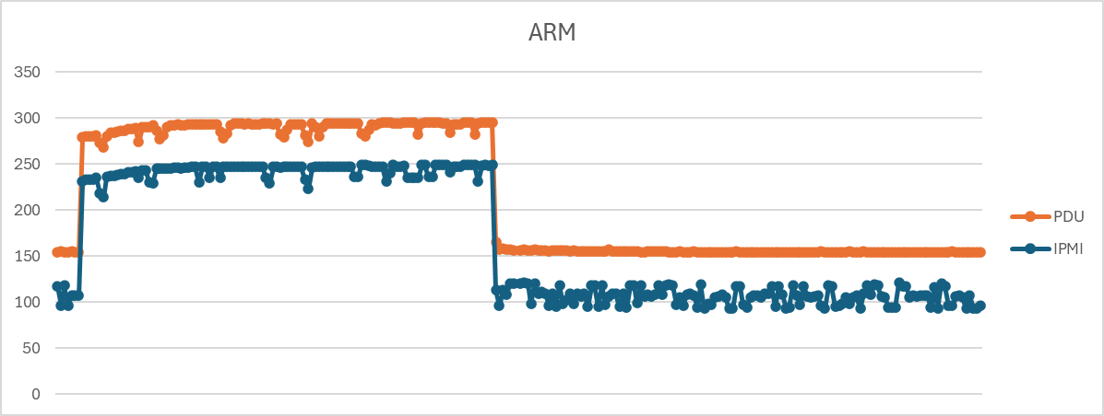
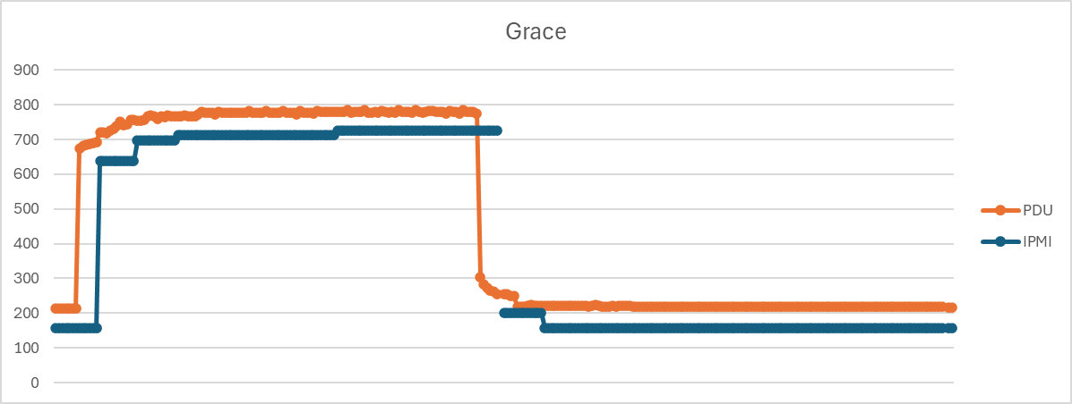
Validation Results (preliminary)
Here a first comparison of 3 machines running stress and a sleep job, one after the other:
stress sleep
stress sleep
We’d expect difference (Δ=PDU-IPMI) to have small oscillation around the 67 Watts baseline … but it is not really the case.
Known issues:
- there seem to be a lot more oscillations in idle (sleep) than at full load (stress), probably due to lower efficiency of the PSUs at lower output levels, and variation in background load having a relatively larger impact;
- the export scripts tend to skip beats or introduces delays, making the two time-series asynchronous;
- PDU readings show a longer tail (?) …
67
stress sleep
Work in Progress
Notes:
Key points:
* We believe we understand the difference between the IPMI and PDU readings: largely due to OOB services on the nodes which were offline during the tests (16 W from Eclipse / Grace).
* We can quantify the difference between IPMI and PDU readings for a single host (e.g. ~1% on Eclipse hosts under load, about 4.5% on Grace when idle), but this needs to be done for each type of hardware and at various load levels. IPMI accuracy / usefulness will vary from one type of host to another. There will likely not be a general rule, which we knew. These are preliminary results, and there is work to be done here.
* Our Eclipse test nodes exhibit significant variation when idle which makes characterisation tricky. Grace is much more consistent. This could be due to relative price point of the hardware, i.e. cheap PSUs in the Eclipse boxes?
Worthy of further consideration: powering a node down will reduce power dissipation, but can totally mess with your PF, presumably as PF correction in the PSUs is ineffective / inactive when only minimal power is supplied. Will have to correct elsewhere to keep utility suppliers happy.

Slide 16
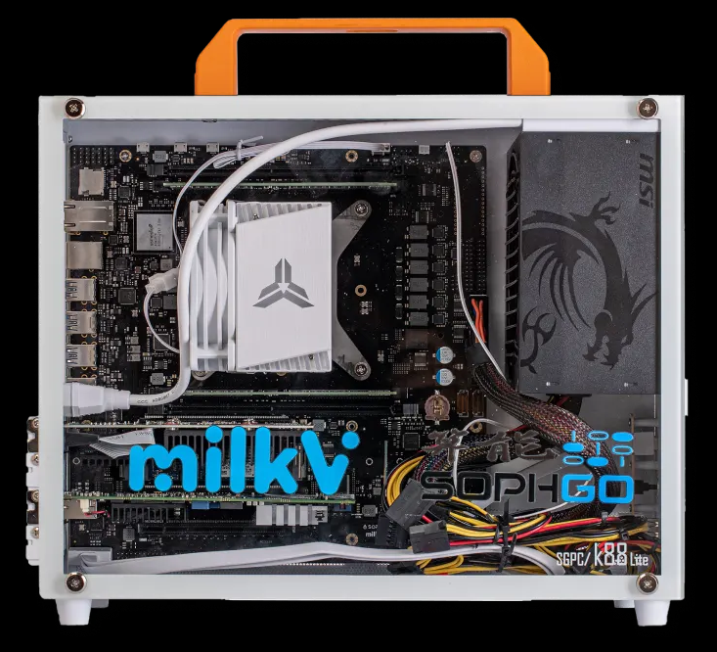
RISC-V testing
We have acquired a RISC-V desktop PC and started experimenting with it:
Milk-V Pioneer : Single socket RISC-V 64-Core Processor (Milk-V)
CPU: SOPHON SG2042 (64 Core C920, RVV 0.71) riscv64 @ 2GHz (TDP 120W)
RAM: 128GB (4 x 32GB) DDR4 3600 MT/s → 2 GB/core
HDD: 1TB PCIe 3.0 NVMe
OS: Fedora 38
Main motivations:
- Open-source and royalty-free architecture,
- Extremely low power usage (140 Watts @ full load - 64 cores),
- Growing ecosystem and potential for fast innovation (e.g., EPI will build on RISC-V).
Progress:
- We managed to compile and install ROOT, CVMFS and XRootD by building locally from source:
  ROOT: https://github.com/hahnjo/root.git (RISC-V ported version)
  CVMFS: https://github.com/cvmfs/cvmfs.git (original Git)
  XRootD: https://github.com/xrootd/xrootd (original Git)
- Tommaso (INFN) managed to compile and run Geant4, also by building from source:
  Geant4: https://gitlab.cern.ch/geant4/geant4 (original Git)
- Muzafar (CMS) made some progress in porting the CMSSW framework to RISC-V:
most code can be ported, major issues are PyTorch & TensorFlow compatibility.
Notes:
European Processor Initiative (EPI):
https://en.wikipedia.org/wiki/European_Processor_Initiative
https://www.european-processor-initiative.eu/
Here's a quick list of key motivations for adopting RISC-V architecture:
Open-source and royalty-free
Customizable and extensible
Lower power consumption
Reduced costs
Independence from proprietary architectures
Scalability across different applications
Growing ecosystem and community support
Potential for faster innovation
Alignment with European Processor Initiative (EPI)
Simplified licensing and compliance

Slide 17
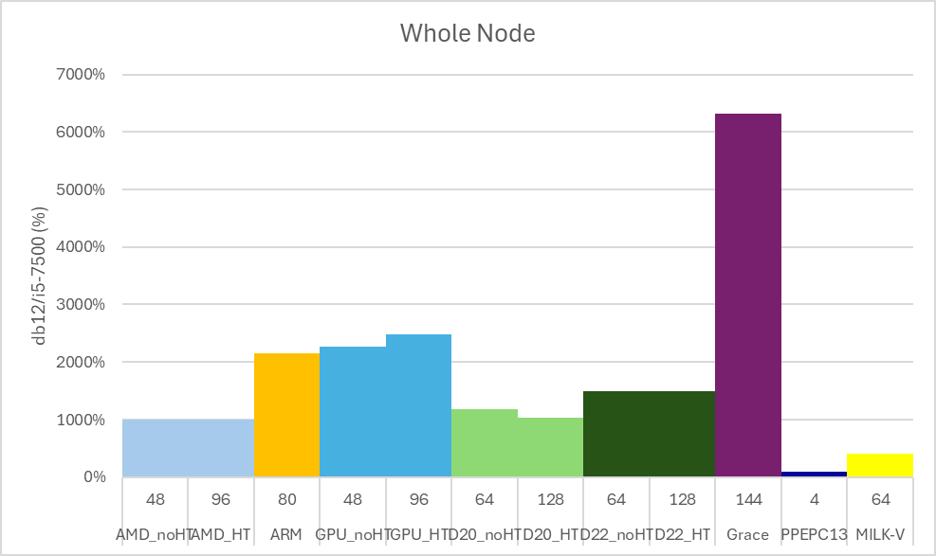
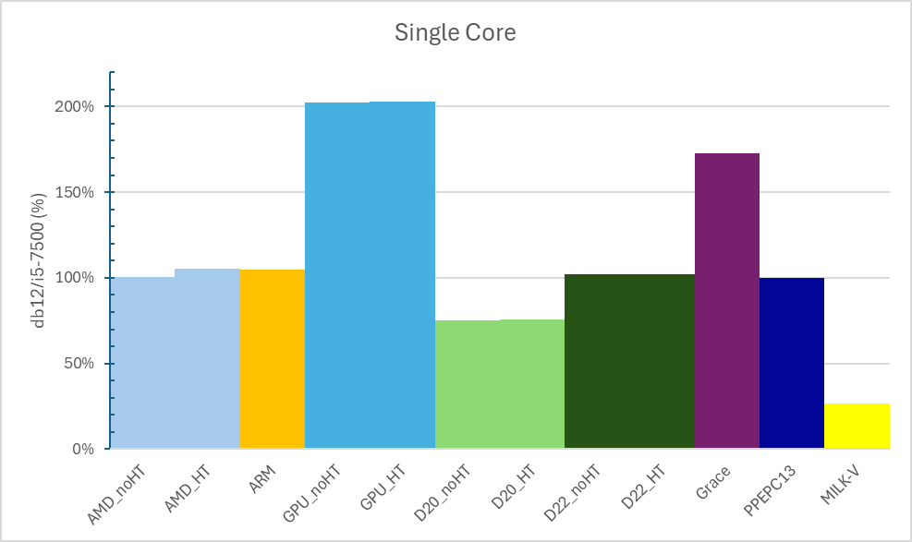
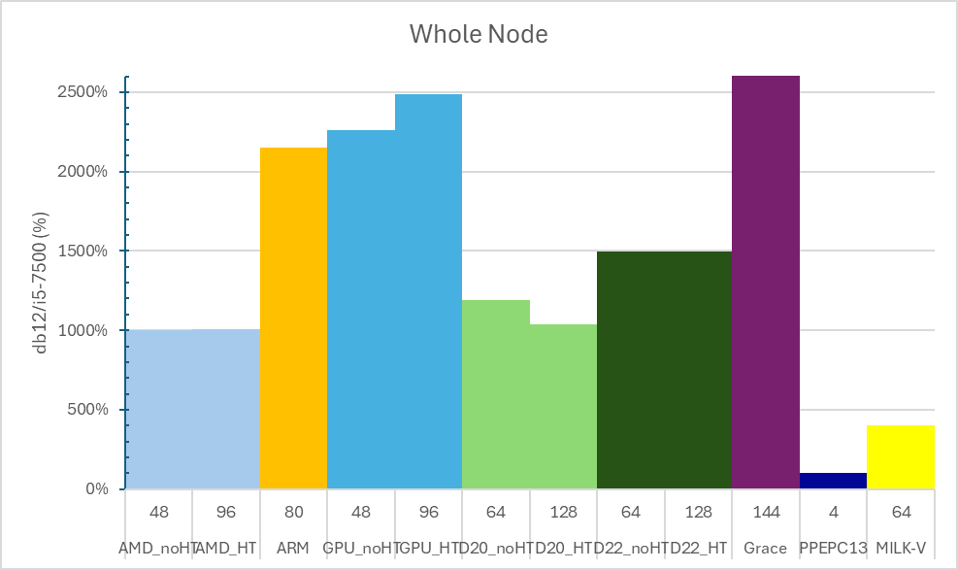
RISC Results (preliminary)
We could run ROOT tests, ROOT benchmarks, and DB12 on RISC and few other architectures.
Results are a bit tricky to compare, because not all machines can run all benchmarks …
Work in Progress
So far, DB12 is the only benchmark that could run on all hardware !
Notes:
ROOT: https://github.com/hahnjo/root.git
CVMFS: https://github.com/cvmfs/cvmfs.git
XRootD: https://github.com/xrootd/xrootd
Geant4: https://gitlab.cern.ch/geant4/geant4
DB12: https://github.com/DIRACGrid/DB12
HEP-Score: https://gitlab.cern.ch/hep-benchmarks/hep-score
indeed … RISC-V does not seem that good when compared to other chips, but its main selling point is the low power usage!

Slide 18
Upcoming Conferences
Talks accepted at CHEP (Krakow, October 2024)
Simulating the Carbon Cost of Grid Sites
Main Authors: David Britton; Steve Lloyd
Comparative efficiency of HEP codes across languages and architectures
Main Author: Samuel Cadellin Skipsey
Heterogeneous Computing and Power Efficiency in HEP
Main Author: Emanuele Simili
Taking on RISC for Energy-Efficient Computing in HEP
Main Authors: Emanuele Simili; Tommaso Boccali; Shazad Muzafar
On-Grid GPU development via interactive HTCondor jobs and Analysis Facility style workflows
Main Author: Albert Gyorgy Borbely
Contributions at the HTCondor Workshop (NIKHEF, September 2024)
(titles to be defined)
Main Authors: Emanuele Simili & Albert Borbely
Notes:
output

Slide 19
Outlook
Improve on the methodology and develop an Analysis framework:
- energy measurement is now integrated in HEP-Score
- HEP-Score analysis package (HEPiX summer student is studying
aggregation metrics, e.g., k-mean: https://indico.cern.ch/event/1433496/)
Follow up on RISC-V updates and integration:
- Actively participate in the testing and benchmarking cycle
- Look into new hardware solutions (RISC servers?)
Keep exploring new hardware:
- benchmark GPU+CPU using Celeritas (Bruno)
- test the newly released AmpereOne …
- what’s next?
Notes:
outlook

Slide 20

end
Emanuele Simili GridPP52 Ambleside - 29 August 2024
Notes:
end

Slide 21
- Major work undertaken at your site since last GridPP meeting (April to July 24)​
- Added 2,304 Ampere Altra Max M128-30 cores​
- Migrated to EL9 and HTCondor 10​
- set-up a heterogeneous endpoint with dual queue (ARM & x86)
2 - Key problems faced and resolved during this time. ​
- dealing with a dual queue is tricky, and not all VOs can cope with it
​
3 - Pending issues and plans for resolving the existing issues. ​
- Upgrades to ARC 7 and latest version of HTCondor​
​
4 - Projection of resource availability for next year, will there be any change in the capacity and how much ​
- No significant change expected
Notes:
Glasgow updates

Slide 22
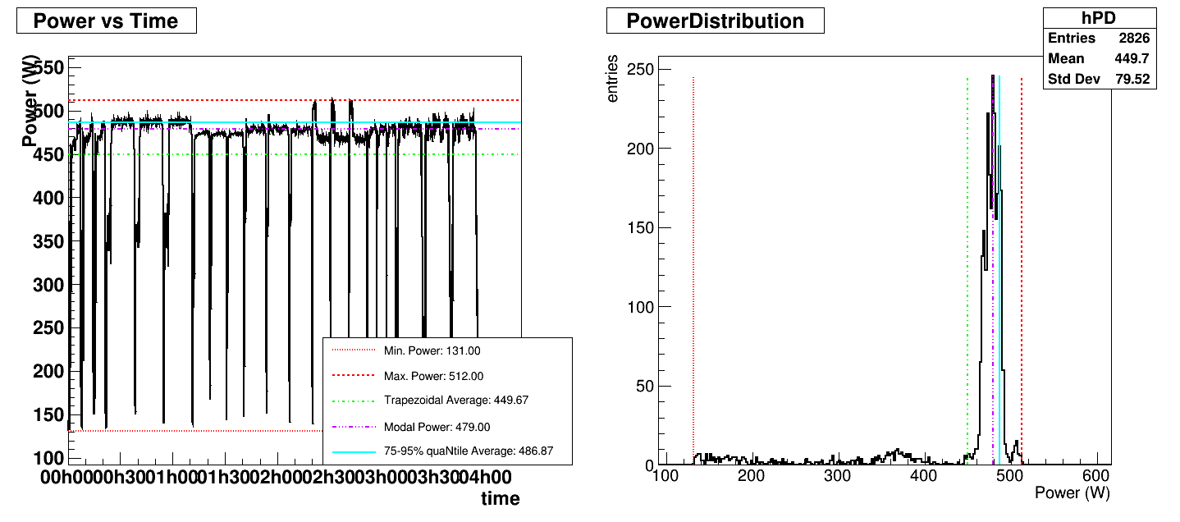
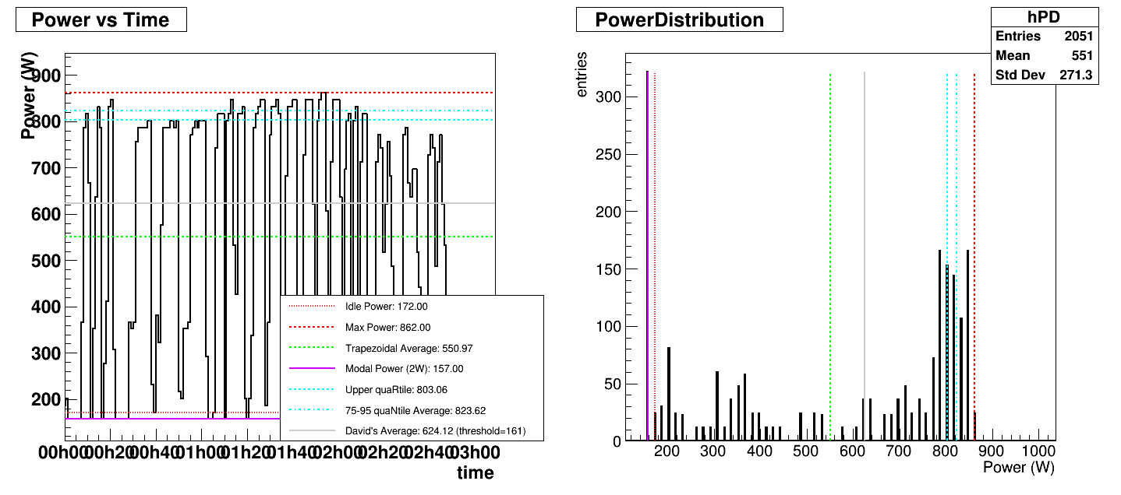
What Watt
New Figure of Merit (FoM), i.e., the best proxy of power usage for standard HEP workloads:
FoM should be easy to implement, we could fit this peak, but there are other ways of doing it.
Arrange the data in power order and perform an upper quaRtile average, but removing the top 5% of data
2*AMD64ht
*
<75-95%> Blue line sits nicely in the plateau
75-95% quaNtile
average
Modal power also sits in the plateau – but we found edge cases where this breaks (e.g., Grace has a very steady idle state)
Notes:
Wordy explanation/motivation:
Neither the Max nor the Average power is the best way of characterizing the performance. The Max can be exaggerated by significant 'spikes' that can momentarily be higher than the plateau; the average is suppressed by the low-power start-up phase that can extend to 20% of the run-time for the short jobs in the HEP-Score suite. Thus, using Max power will underestimate HEP-Score/Watt and using Average power will overestimate HEP-Score/Watt. Instead, we propose to use the average power calculated from the 75-95% quaNtile. The upper quartile eliminates most of the start-up phase that would be over-emphasized by short benchmarking jobs, while the cut of the highest 5% prevents power spikes to have any significant effect.
The result is relatively insensitive to the shape of the distribution and well fits the upper plateau in the power drain plots, while giving less importance to the start-up phase and to isolated spikes in power. It can be noted that the modal power itself (the mode of the power distribution, corresponding to the most common power-draw) is a good estimate for single workloads, but not for the combination of different workloads in the HEP-Score suite that can have different power draws.

Slide 23
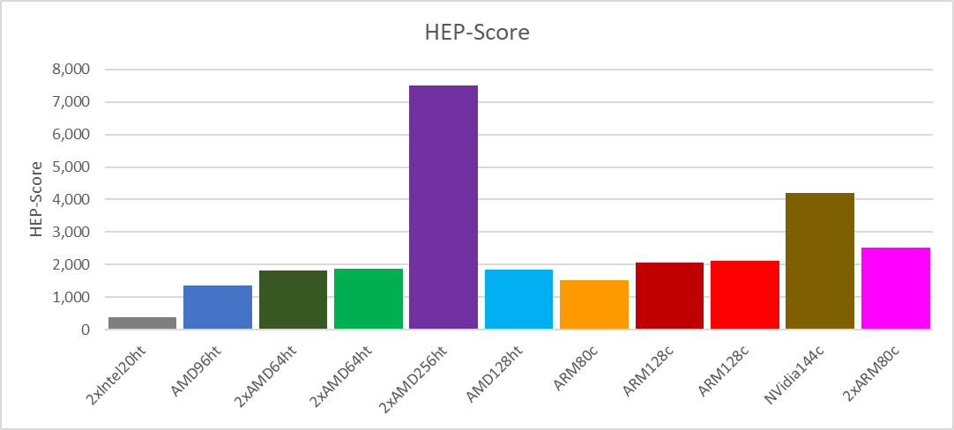
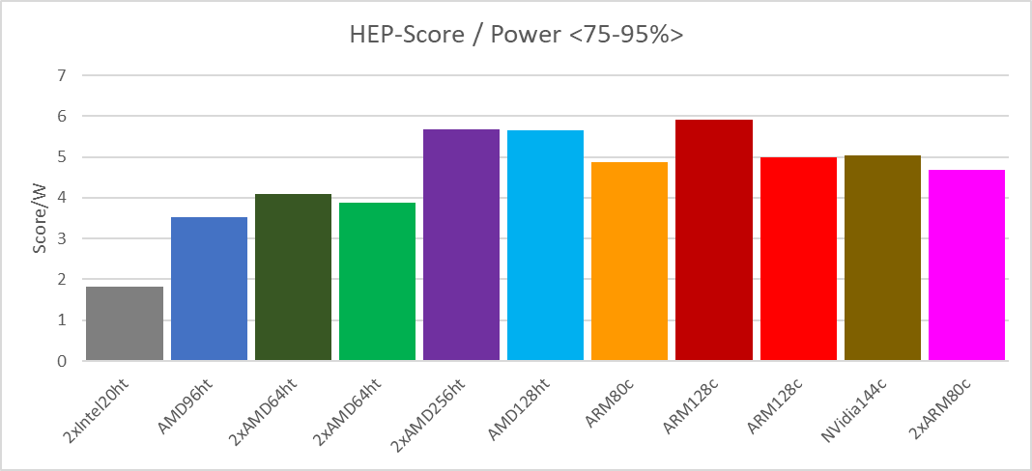
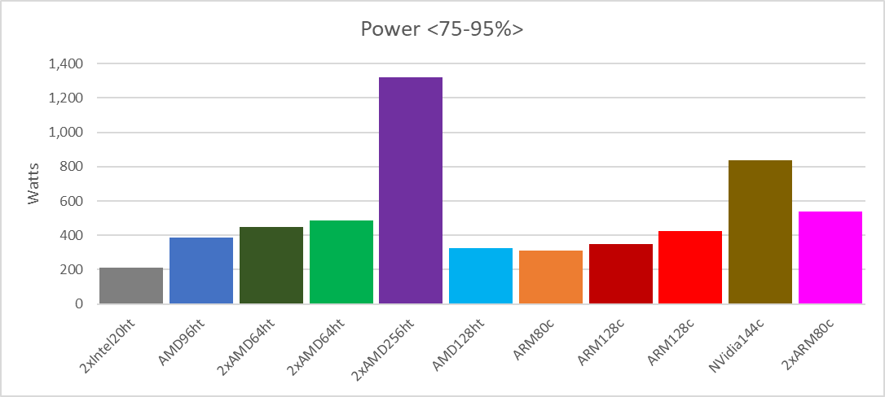
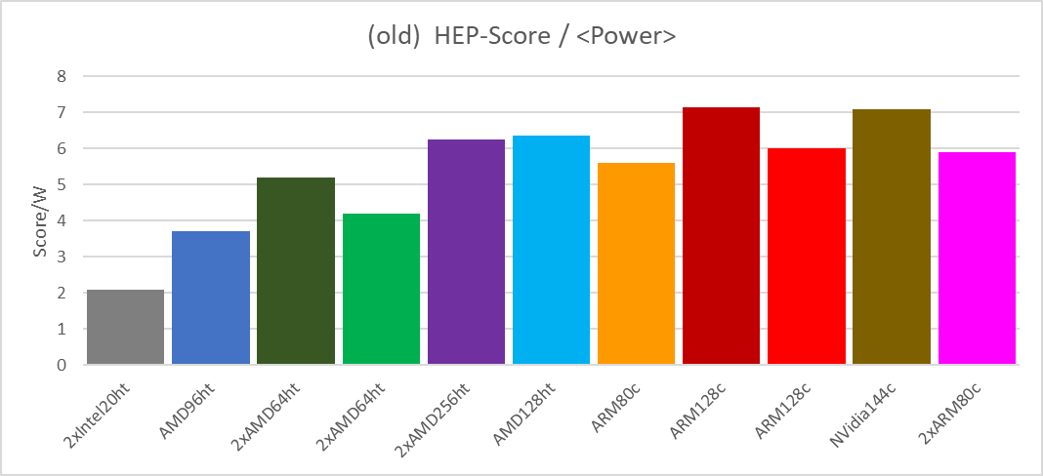
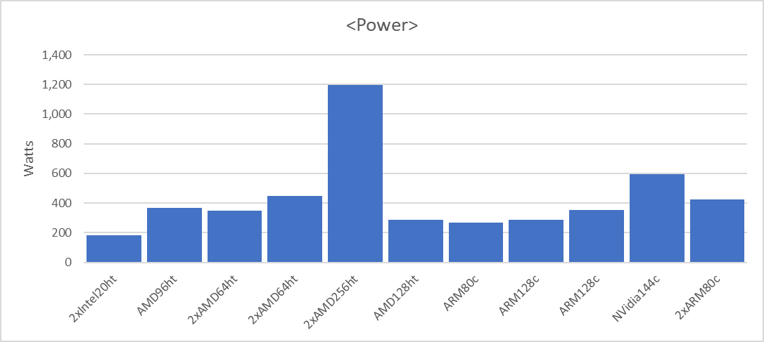
HEPscore/Watt (comparing old & new )
removed for consistency
Notes:
… to better understand the HEP-Score/Watt graph: the ranking slightly changed with the new definition power F.o.M.
Also confirmed by the Frequency Scan: the HEP-Score shown here corresponds to the last data point in the frequency plot (i.e., the highest frequency set).

Slide 24
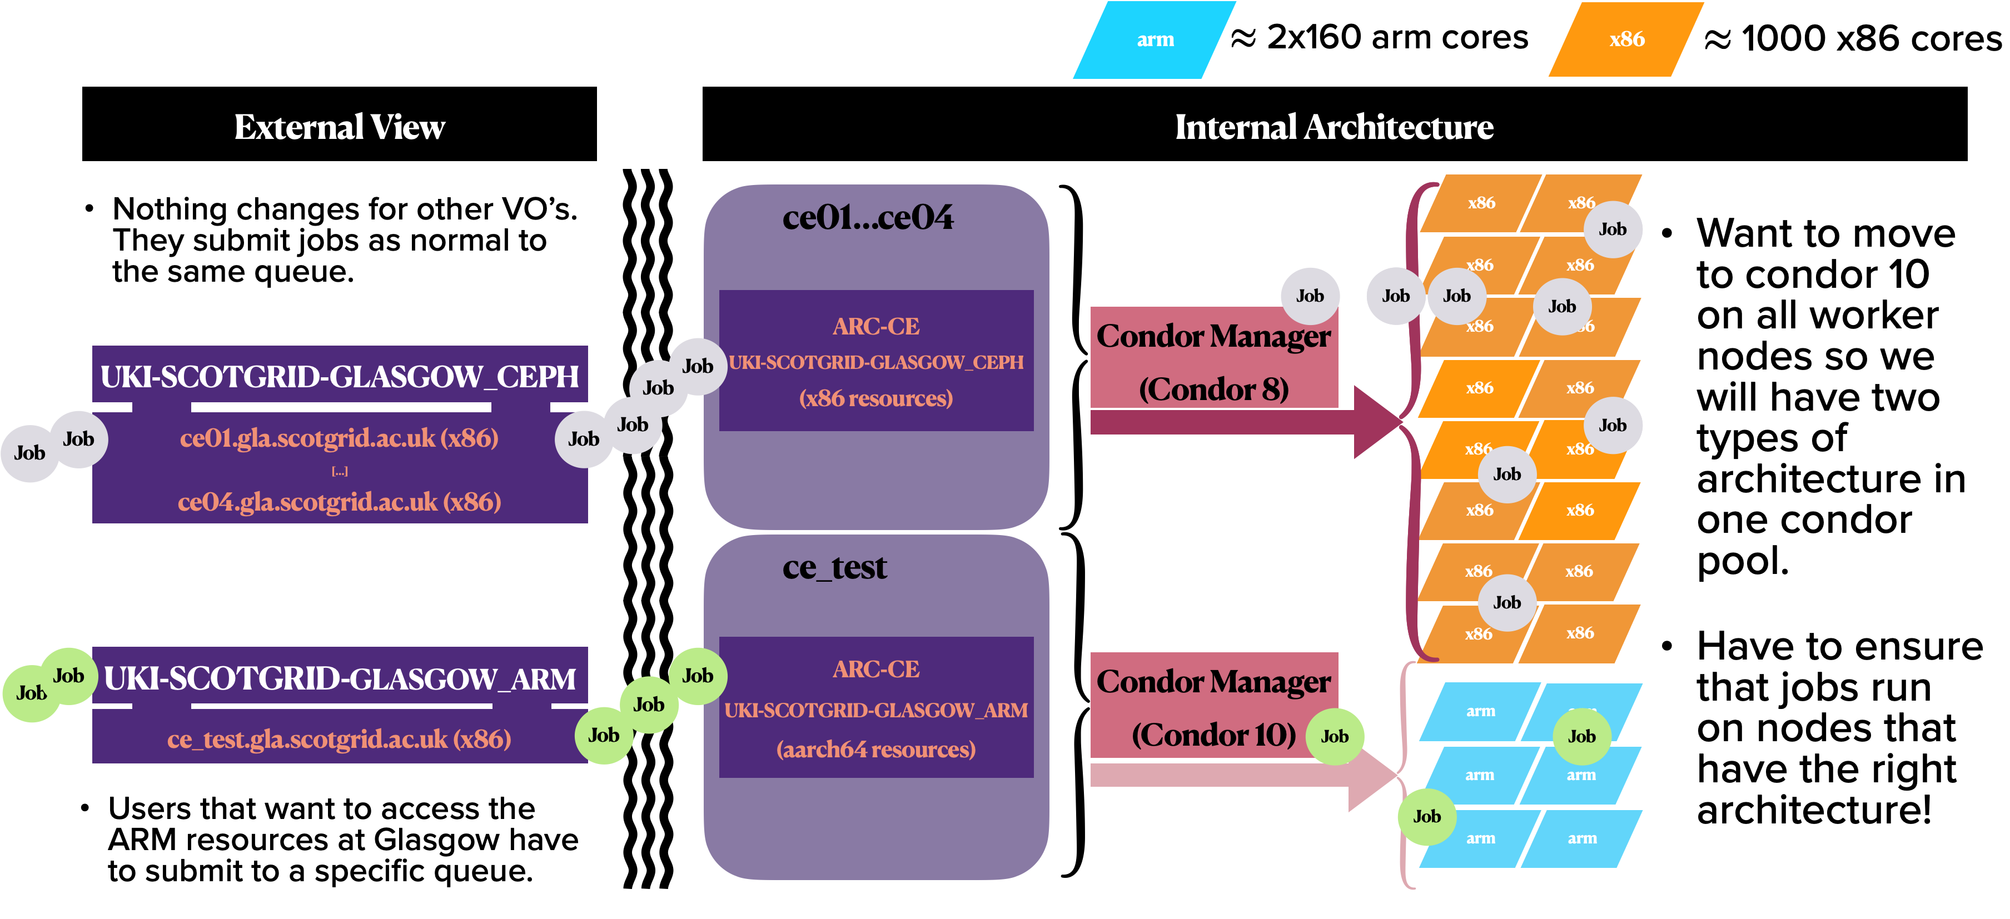
ARM + x86 Farm @ Glasgow
Job submission chain @ ScotGrid Glasgow:
~ 4000
~17000
Condor10
Notes:
Dwayne’s

Slide 25
Results^ (preliminary)
We could run ROOT tests, ROOT benchmarks, and DB12 … results are a bit tricky to compare, because not all machines can run all benchmarks …
So far, DB12 is the only benchmark that can run on all hardware !
Notes:
ROOT: https://github.com/hahnjo/root.git
CVMFS: https://github.com/cvmfs/cvmfs.git
XRootD: https://github.com/xrootd/xrootd
Geant4: https://gitlab.cern.ch/geant4/geant4
DB12: https://github.com/DIRACGrid/DB12
HEP-Score: https://gitlab.cern.ch/hep-benchmarks/hep-score

Slide 26
Notes:
…

