Slide 1
RF cavity designs for ion therapy linacs
Alexej Grudiev, Stefano Benedetti, CERN
Ions2018 workshop, Archamps, 19-21 June 2018

Slide 2
Outline
High frequency (HF)-RFQ linac cavity design
Interdigital H-mode (IH) accelerating structure at 750 MHz
High gradient backward travelling wave (BTW-HG) accelerating structure
Side coupled linac (SCL): high gradient versus high efficiency
Conclusion

Slide 3
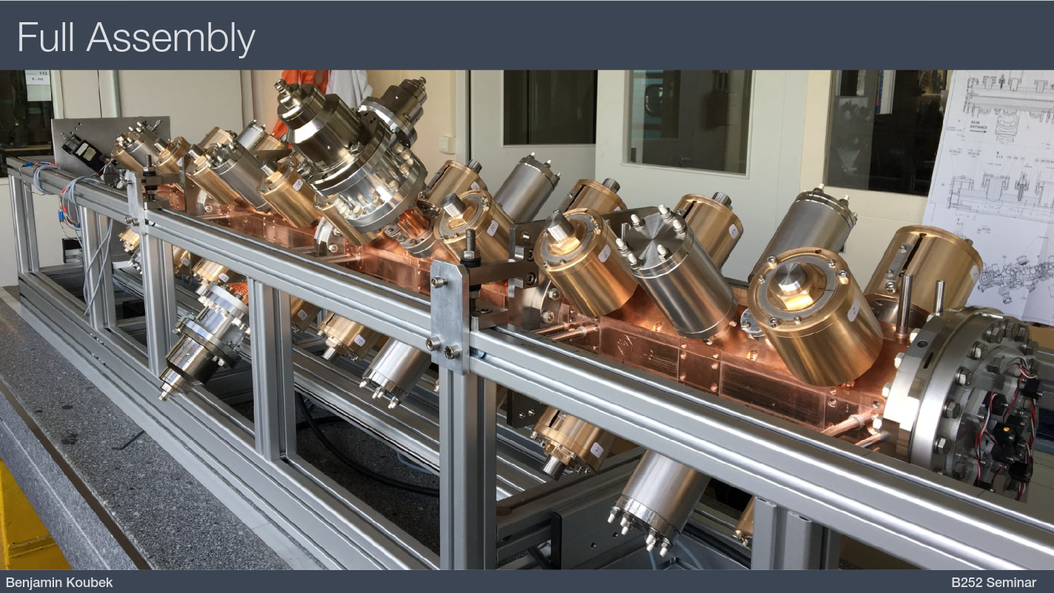
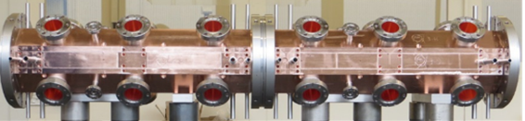
HF-RFQ: main features of the design at 750 MHz
Higher injection efficiency into 3 GHz linac
Compact RFQ cavity
High (for RFQ linacs) accelerating gradient: 2.5 MeV/m
Higher frequency -> high ohmic losses. Optimized cavity shape for lower losses
Four coaxial couplers provide RF power combination in the cavity:
  Compact, low cost power couplers and RF windows from PEEK
  Smaller perturbation of RF fields
The same vacuum flange is used for tuners, pumping port and RF power couplers

Slide 4
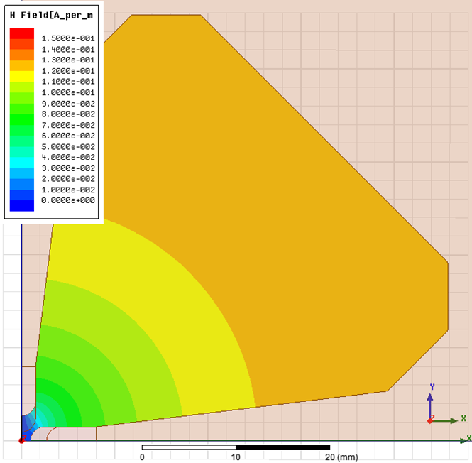
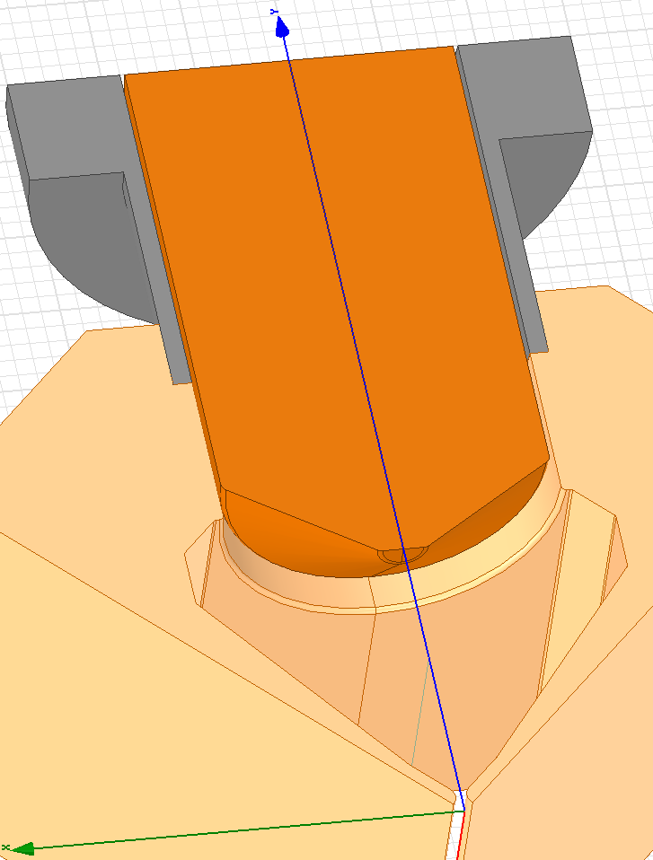
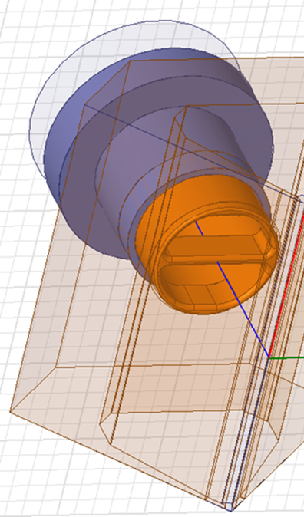
RF design to minimize the ohmic losses
2D cross-section of RFQ
Conical tuners cross-section
Vacuum pumping ports

Slide 5
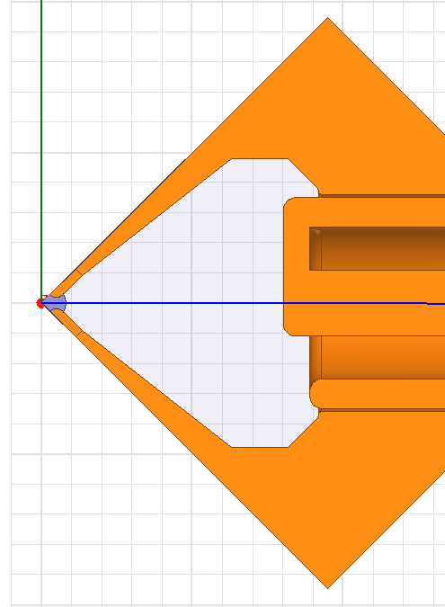
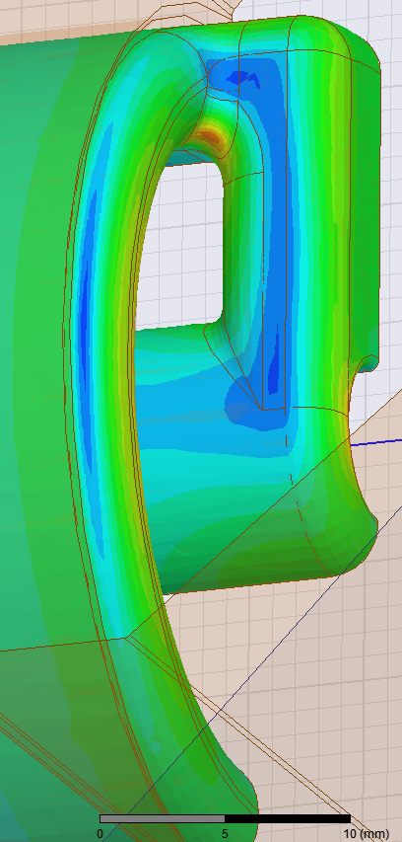
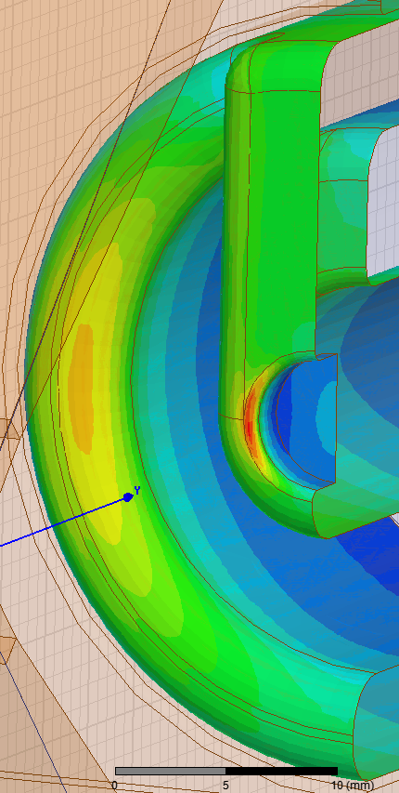
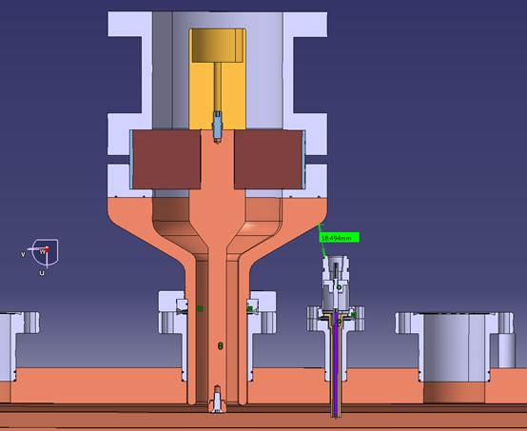
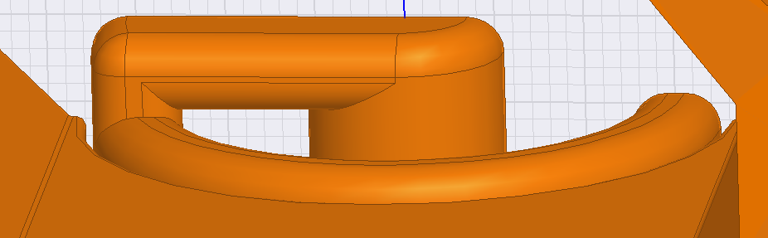
Coaxial coupler design with PEEK RF window
H-field
Cross-section of RFQ with RF power coupler and Rf probe

Slide 6
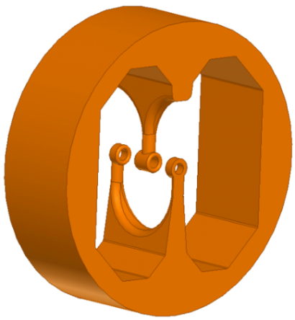
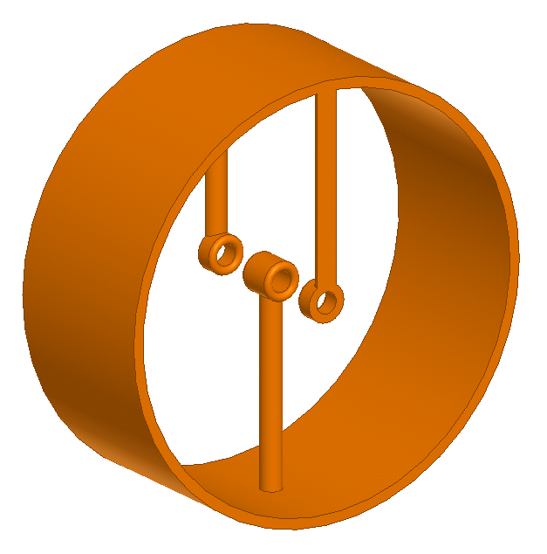
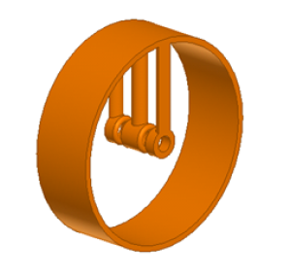
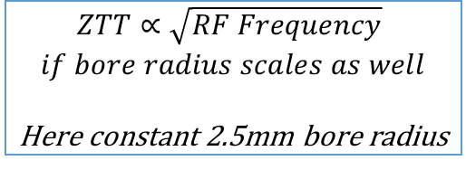
The 750 MHz IH structure for low energy linac
DTL 3 GHz
IH 750 MHz opt
IH 750 MHz
$$ZTT∝\sqrt{RF Frequency}$$
$$if bore radius scales as well$$
Here constant 2.5mm bore radius
Notes:
Many structures studied. TE, TM (IH, CH, DTL, CCL)
Two frequencies, 750 MHz, 3 GHz
DTL too short, even if it works at 2pi mode
IH optimized solutions: RF details skipped, optimization of all the parameters. (You have current flowing through the stems, you can impact much more than on a DTL design)

Slide 7
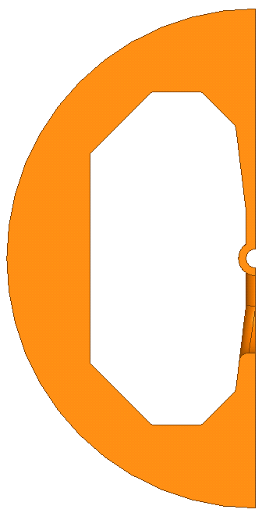
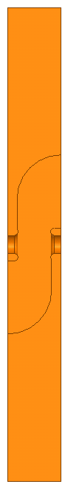
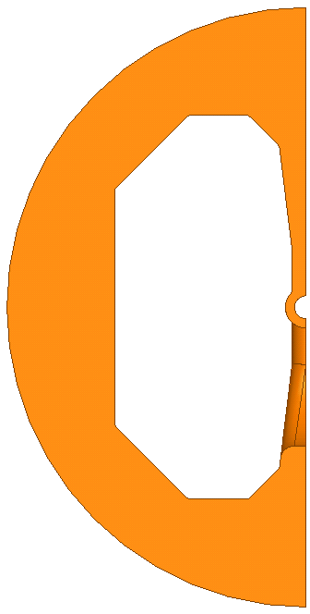
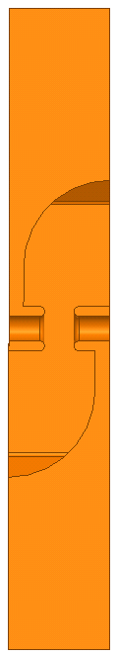
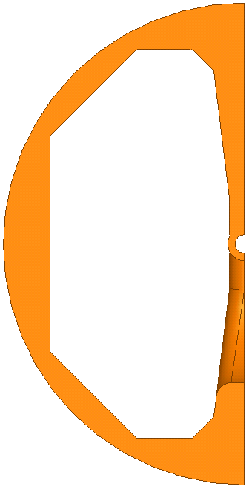
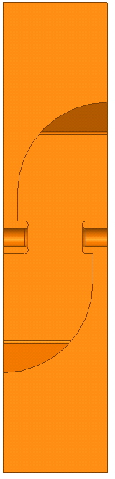
2.5 – 10 MeV IH accelerating structures
2.5 MeV – 522.5 MΩ/m
5 MeV – 410.2 MΩ/m
10 MeV – 296.1 MΩ/m
Q | R/Q | T
10074 | 52072 | 0.780
Q | R/Q | T
10732 | 38224 | 0.826
Q | R/Q | T
11681 | 25352 | 0.842
Lcell | Gap | S. Rad
14.561 | 9 | 2.5
Lcell | Gap | S. Rad
20.586 | 11 | 3
Lcell | Gap | S. Rad
28.949 | 15 | 4

Slide 8
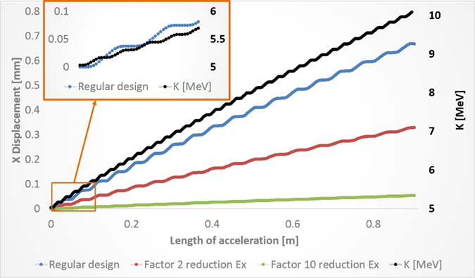
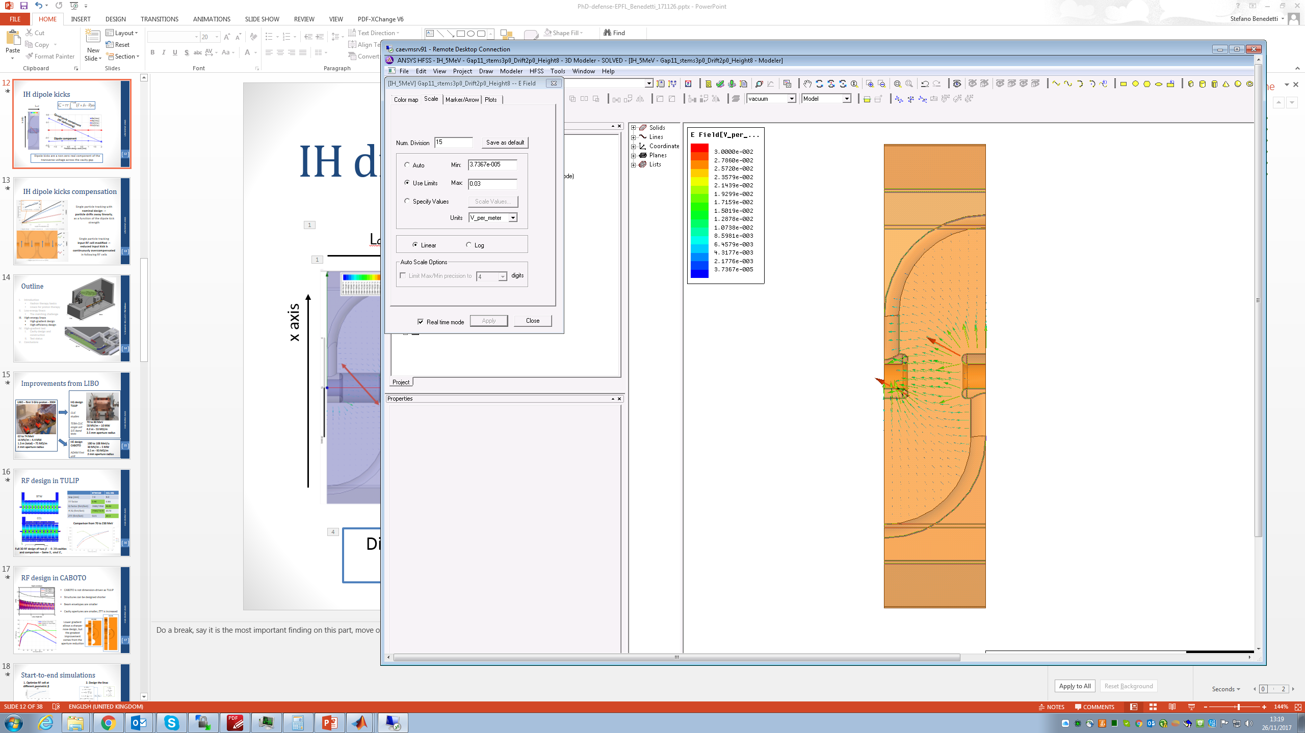
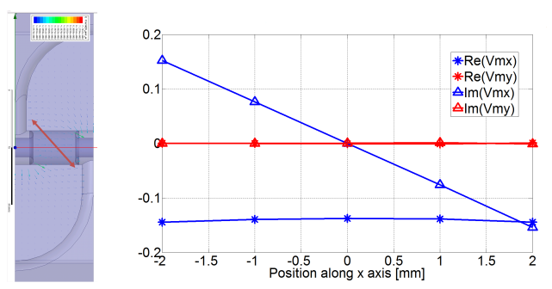
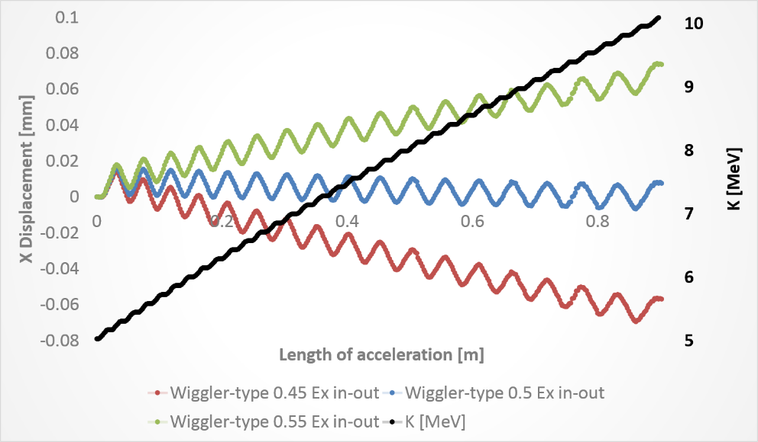
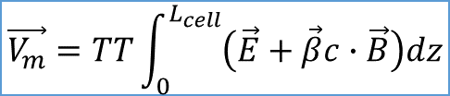
IH dipole kicks
Local compensation
Lcell
$$\vec{V_{m}}=TT\int_{0}^{L_{cell}}{\left(\vec{E}+\vec{β}c∙\vec{B}\right)dz}$$
x axis
Quadrupole component (RF defocusing)
Global compensation
Dipole component
Dipole kicks are a non-zero real component of the transverse voltage across the cavity gap
Notes:
Do a break, say it is the most important finding on this part, move one side to the other of the slides

Slide 9
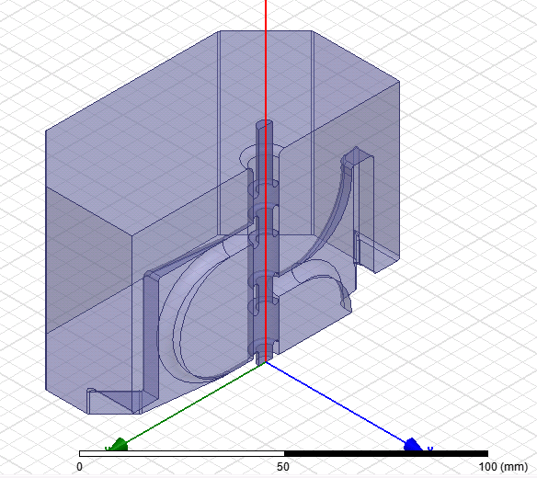
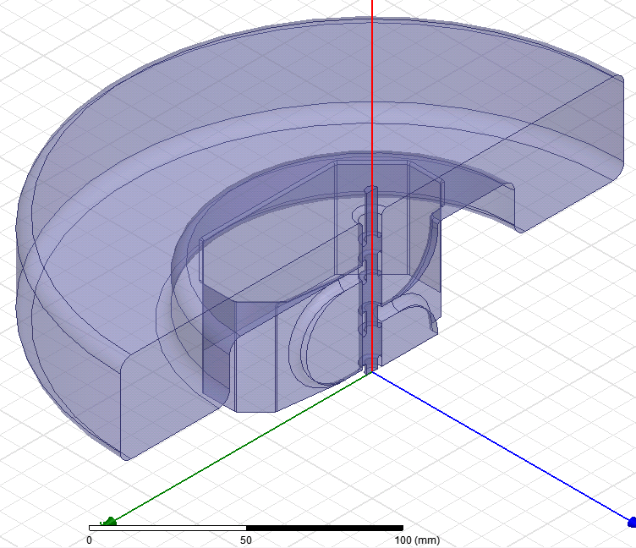
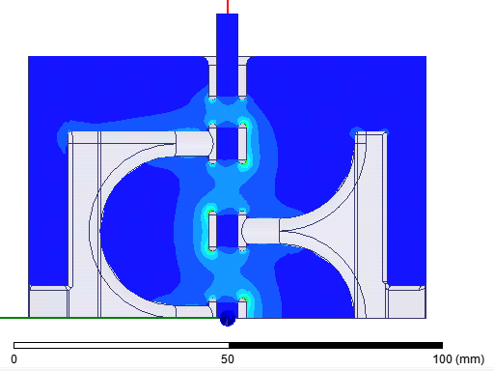
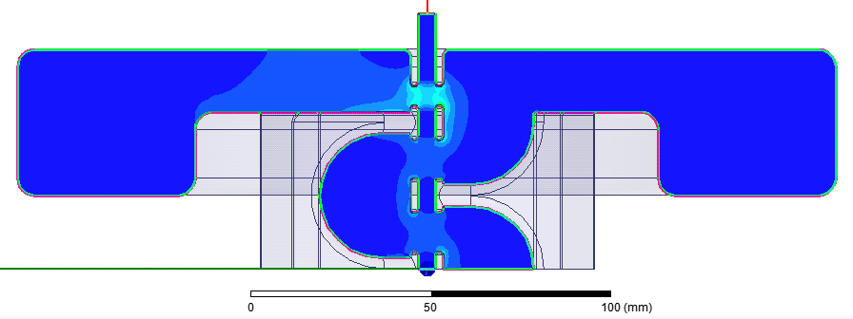
End cell design in IH structure
Matching frequency
with end cell diameter
with inwards cavity
ZTT = 90 Mohm/m
Matching frequency
with inwards cavities but outer volume is fixed
ZTT = 175 Mohm/m
Three cells ZTT (0.5gap) is 89.6 Mohm/m
TERA Foundation – CLUSTER design

Slide 10
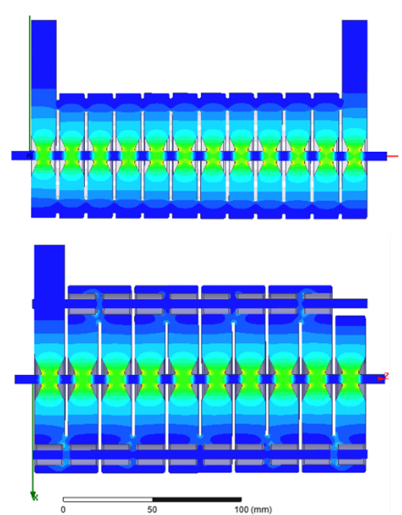
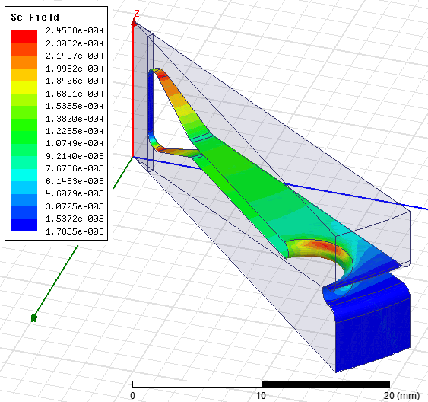
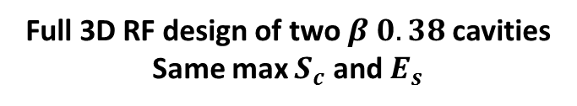
RF design of high gradient BTW and SCL
 | BTW150 | SCL-HG
Gap [mm] | 7.0 | 9.0
TT factor | 0.90 | 0.86
Q-factor (first/last) | 7000/7450 | 9140
R’/Q (first/last) [Ω/m] | 7430/7370 | 6570
ZTT (first/last) [MΩ/m] | 52/55 | 60.0
BTW-HG
Sc in BTW cell: 1/32 segment
SCL-HG
Comparison from 70 to 230 MeV
Cells are optimized to have minimum:
Full 3D RF design of two $β 0.38$ cavities Same max $S_{c}$ and $E_{s}$
Notes:
Highlight that input couplers where also designed
CCL wins for Q factor mainly
Difference get negligible at higher geometrical betas. Due to non RF considerations, we decided to propose the BTW design for the high gradient TULIP linac.
Same surface fields constraints

Slide 11
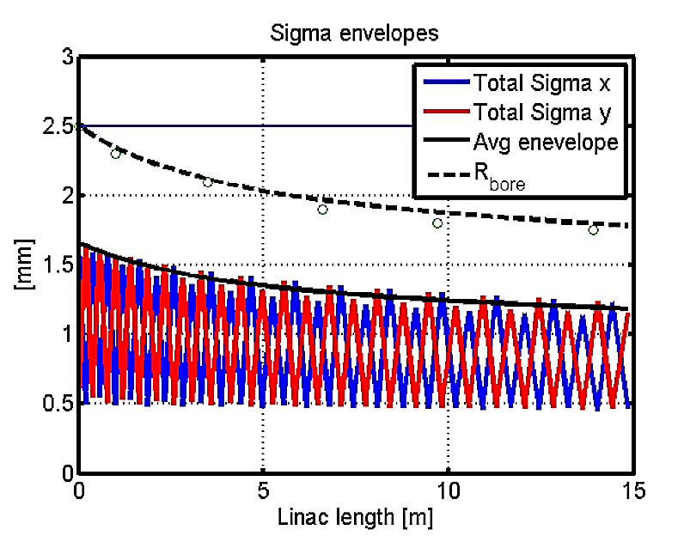
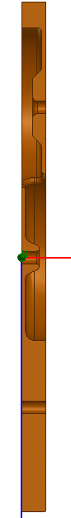
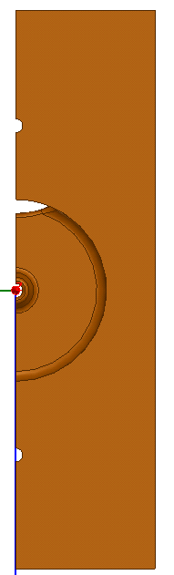
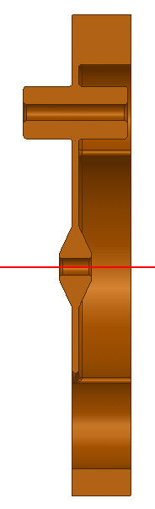
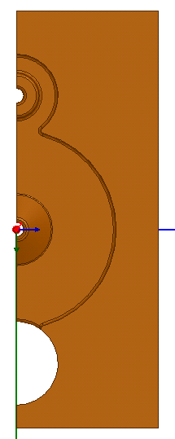
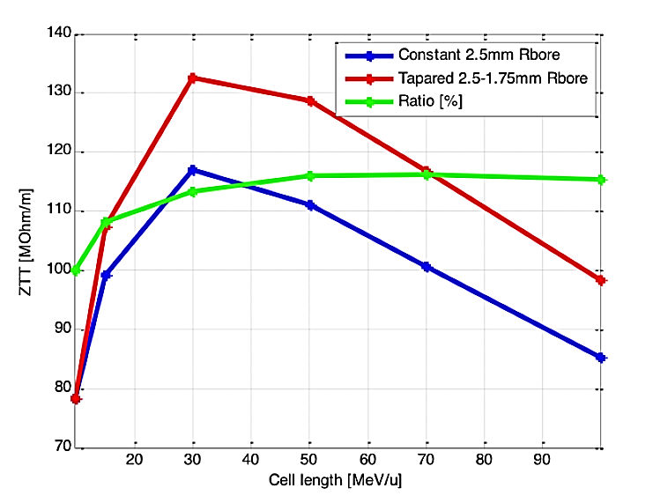
RF design of high efficiency SCL for CABOTO
CABOTO may need lower gradient to reduce power consumption
Structures can be designed shorter
Beam envelopes are smaller
Cavity apertures are smaller
ZTT is higher, RF power is lower
SCL-BL
SCL-HG
Lower gradient allows a sharper nose design,
BUT
the greatest improvement comes from the aperture reduction
Notes:
CCL BL is the ADE design!!
My CCL for CABOTO: septum 2mm (though to be discussed, for Rno…), not coupled solution studied
Lower radius advantage gets important for the CCL part. (14 % more ZTT going from 2.5 to 2mm)

Slide 12
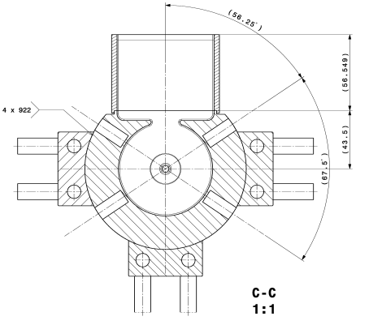
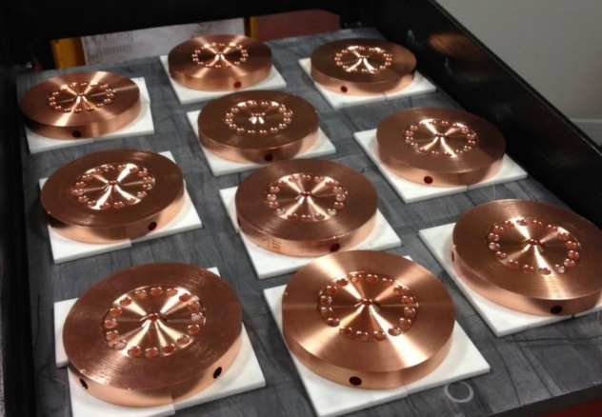
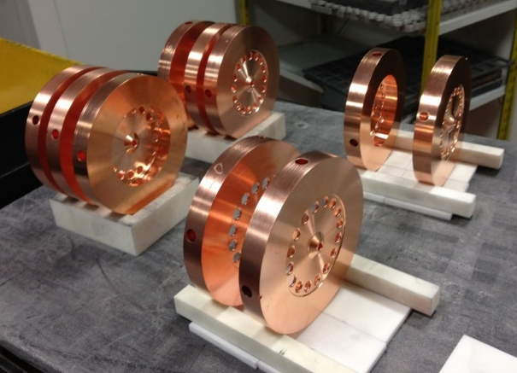
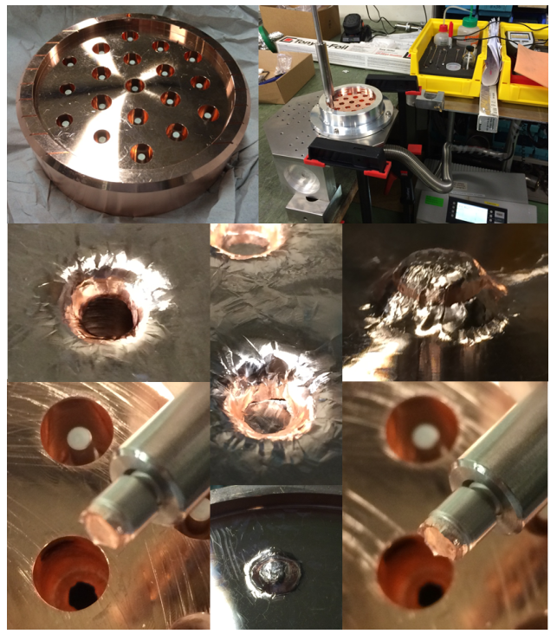
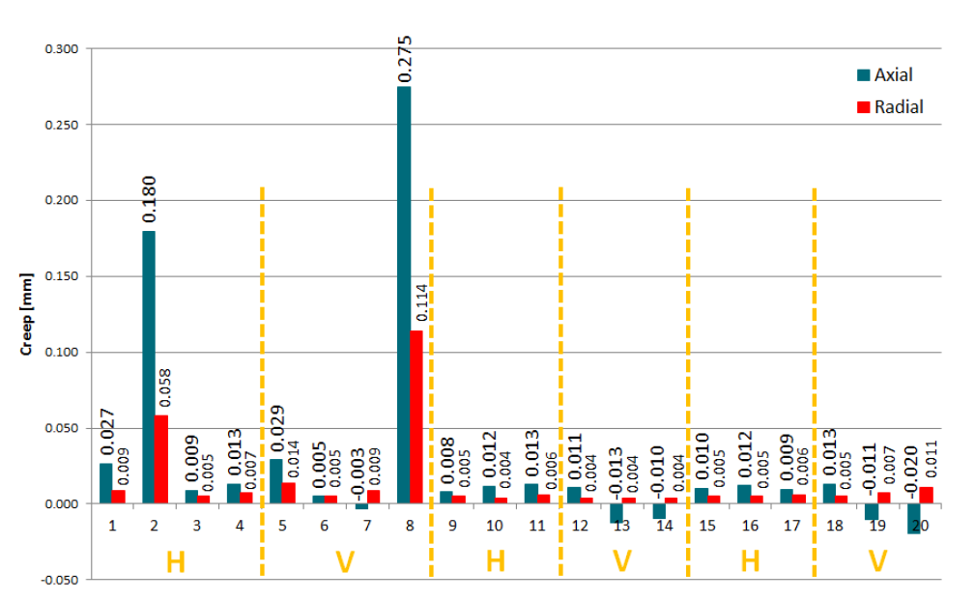
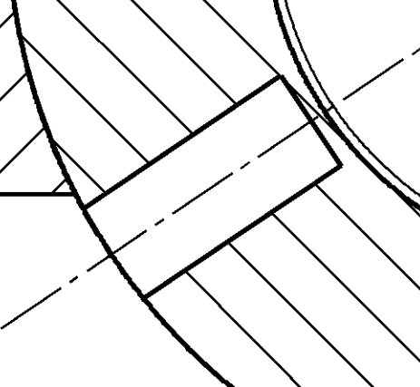
Mechanical tests: Creep and tuning pins
H2 bonding – 1050 C max temperature
20 mock-up RF cells tested Horizontal and vertical
4 dimple tuners per RF cell,
10.5 mm diameter,
1.6 mm wall thickness
Test of Different Thickness
Results for the 2 mm septum
Average axial deformation 13μm, radial 6μm
Notes:
Creep tests, three were performed. Eventually we chose a 2mm septum thickness, key parameter for RF efficiency, but has to guarantee mechanical stability.

Slide 13
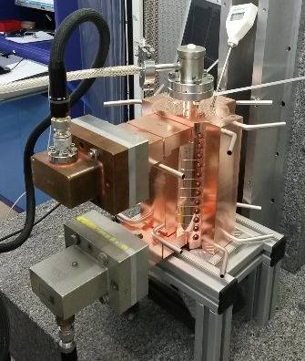
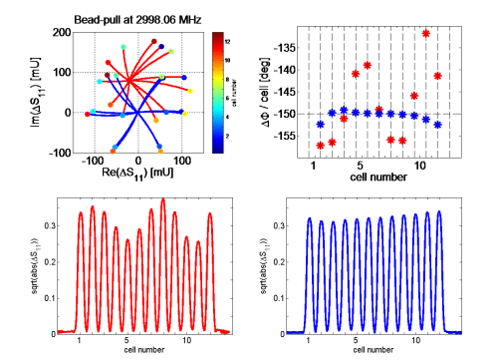
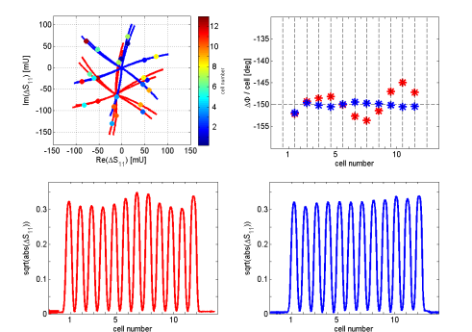
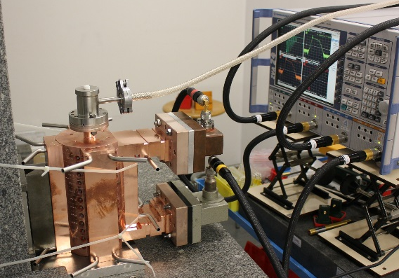
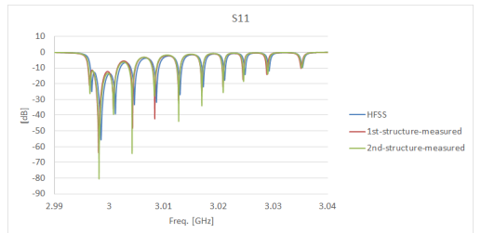
RF measurements and tuning
1st prototype – under HG test
2nd prototype
Before tuning
After tuning
The cavity would be actually ready to accelerate particles
Notes:
Discuss all the graphs

Slide 14
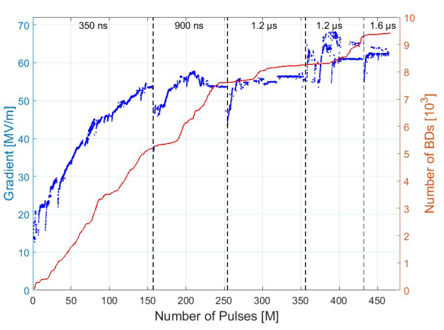

BTW150 high power RF conditioning history
62 MV/m at RF pulse length of 1.6us
Breakdown rate is < 10e-5 bpp
The prototype installed in CLIC CTF2
Notes:
Preliminary! (55/50)^16=4.6 (1.3/2.5)^3=0.14 -> 2.5e-6/4.6/0.14=4.2e-6

Slide 15
Conclusion and outlook
All-linac based solution is a promising technology choice for ion therapy
Several concepts have been elaborated and different RF structures have been designed to cover the full range of ion energy
POSSIBLE NEXT STEPS
  Overall optimization taking into account user requirements as well as beam dynamics and RF constraints together with installation and operation cost
  Prototyping and high power testing of key RF components is essential for technical design of the accelerator and assessment of its reliability and cost

Slide 16
Thank you !

