Slide 1

Ideas and Technologies for a next generation facility for medical research and therapy with ions, Archamps, FR (ESI), 19-21 June 2018
SC SYNCHROTRON AND GANTRY BASED ON CANTED COSINE THETA MAGNETS
E. Benedetto,
N. Al Harbi, U. Amaldi, D. Bergesio, A. Garonna, V. Ljubicic, P. Riboni, TERA Foundation
Experts:
F. Wenander, J. Pitters, C. Carli, S. Benedetti, M. Martino, CERN
A. Pikin, BNL
Collaborators:
G. Arduini, D. Tommasini, CERN
B. Auchmann, CERN/PSI
L. Brouwer, S. Prestemon, LBNL

Slide 2
Proposal: Compact synchrotron and gantry
C⁶⁺ up to 430 MeV/u
  …and other light ions (He)
Full treatment in one cycle
  10¹⁰ C⁶⁺ (10x10x10 cm³ target)
SC technology (CCT) makes it compact
  Ring: ~27 m length
  Gantry: 5.3 m height

Slide 3
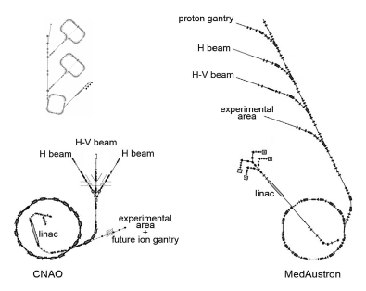
Proposal: Compact synchrotron and gantry
Compact! compared to PIMMS-derived facilities

Slide 4
Outline
Magnets technology
Synchrotron
Lattice
Injection/extraction considerations
Gantry
Optics and mechanical
Dose delivery

Slide 5
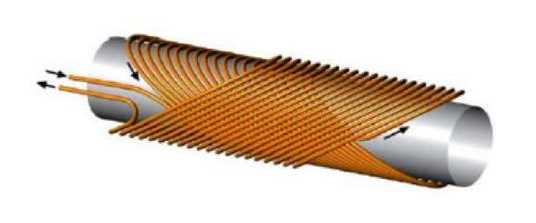
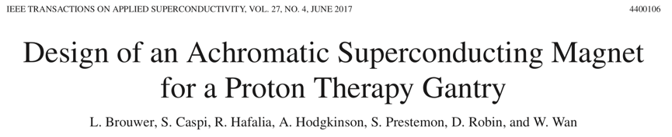
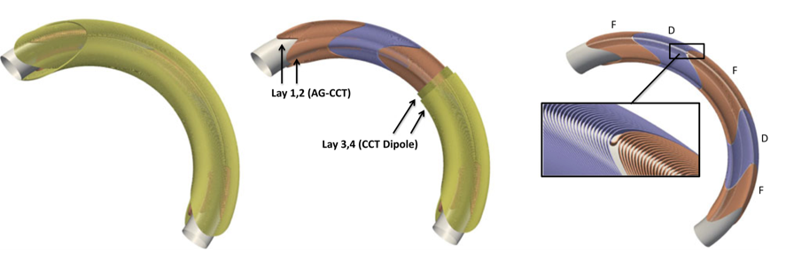
Magnets: Canted Cosine Theta
Pure dipole field
  2 tilted solenoids
Nested quadrupoles
  add extra layers

Slide 6
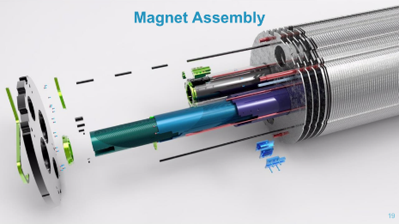
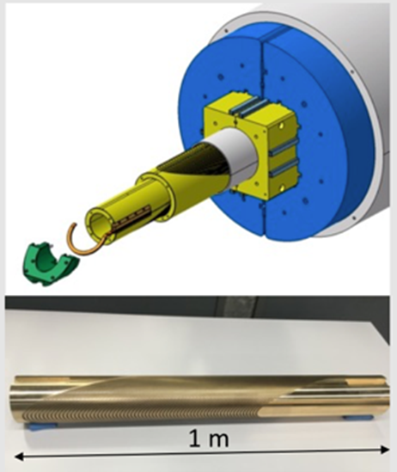
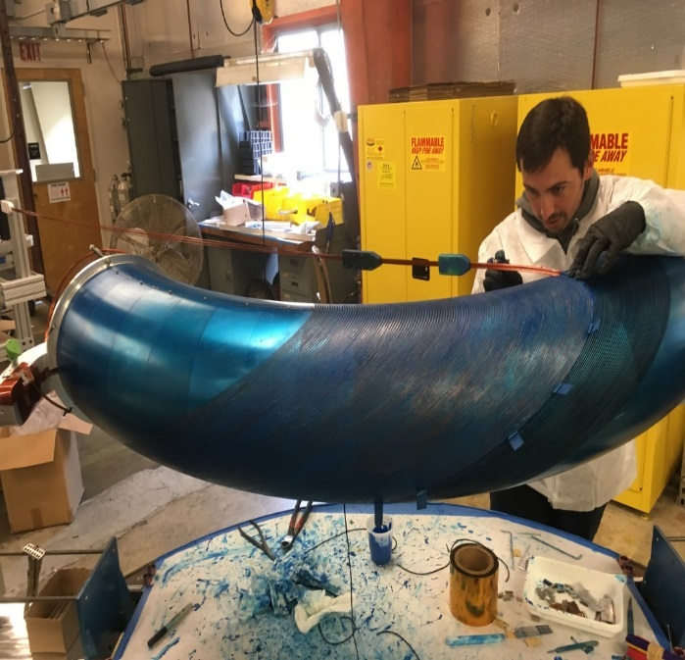
Magnets: Canted Cosine Theta
HL-LHC correctors
PSI 16-T CCT Design
for FCC-hh
LBNL gantry

Slide 7
Magnets for the optics
Design choices:
90⁰ bends with nested quads
Powered in series
Bmax=3.5 T
ρ=1.90 m
F
D
D
kf=-kd=~1 m⁻²
→ ~6.6 T/m @ 3.5T
F
PRELIMINARY
Apertures magnets (g.f.r.) diameter:
Gantry: 30 mm
Ring: 60 mm

Slide 8
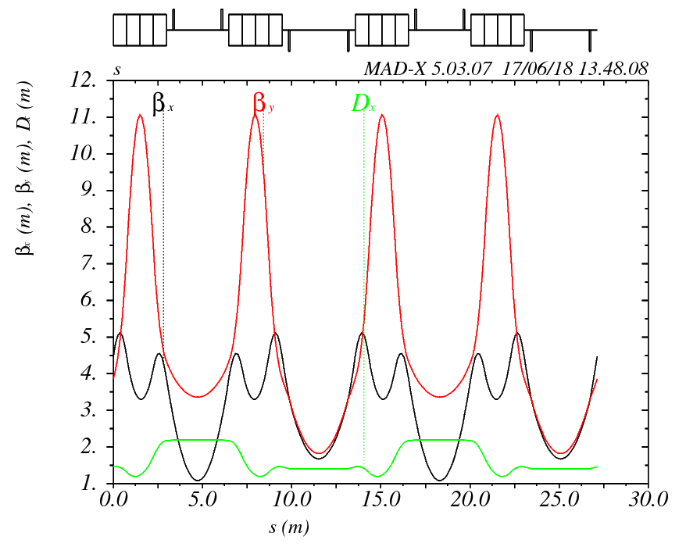
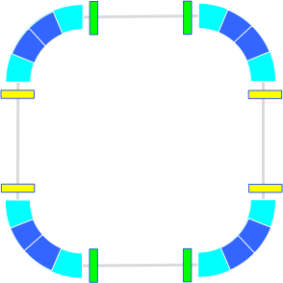
Lattice
γ_{tr} >1.43(@430 MeV/n)
Qx~1.67 for slow extraction
(1.67, 1.13)
kq1
kq2
3 m
ρ=1.90 m
PRELIMINARY
kb~0.6 m-1
→ 4 T/m @ 3.5T
3.6 m

Slide 9
Injection, Linac & Source
MultiTurn injection @ 10 MeV/u:
Need ~10¹⁰ C⁺⁶ in ~100 turns x 0.6 μs (rev. period)
Synergies with CERN:
EBIS MEDeGUN (F. Wenander et al.)
  compact source (1A e- current) w. small emittance: ~0.03π mm mrad, norm.
  C⁺⁶ ions, short pulses @180 Hz (developed for CABOTO linac)
  we need longer trap length, i.e. 1m (vs. 25 cm) & no rep. rate requirements
  10¹⁰ is on the limit !!!
  OR: source as ~RHIC EBIS (5A e- current, larger intensity but also emittance)
High frequency RFQ for ions (V. Bencini, A. Lombardi et al.)
IH structure (S. Benedetti et al.)

Slide 10
Extraction
Δμ~90⁰ between septa
Slow extraction with RF knock-out
Qx~1.67 (3rd order)
ES
MS
PRELIMINARY
Orbit correctors
Sextupoles:
resonance
phase
Q’_{x}, Q’_{y}

Slide 11
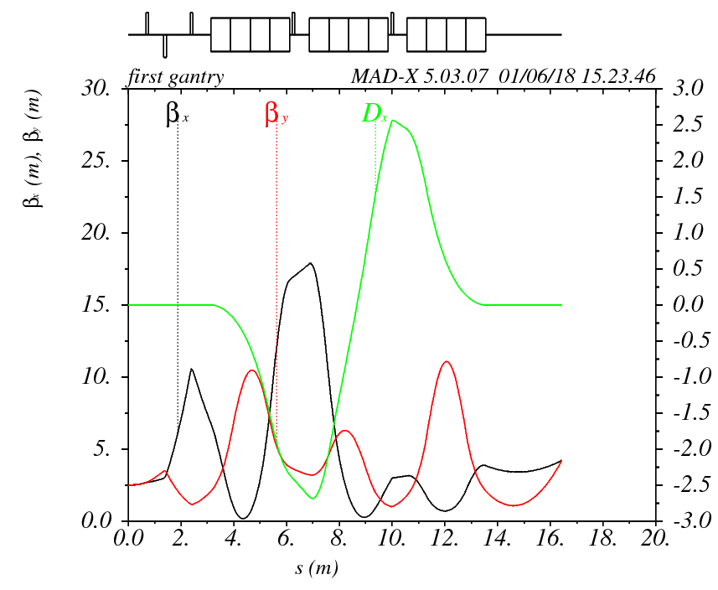
Gantry
PRELIMINARY
Rotation independent
Achromat
RE11=RE33=1.3
FWHM=4mm @ isocenter
kb=0.8m⁻²
→ ~6T/m @ 3.5T
5.3 m
SMx
SMy
2.82 m

Slide 12
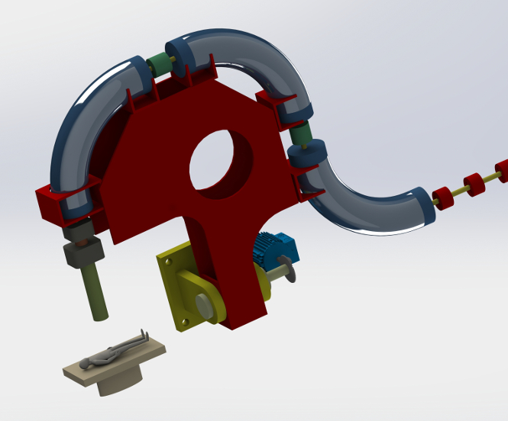
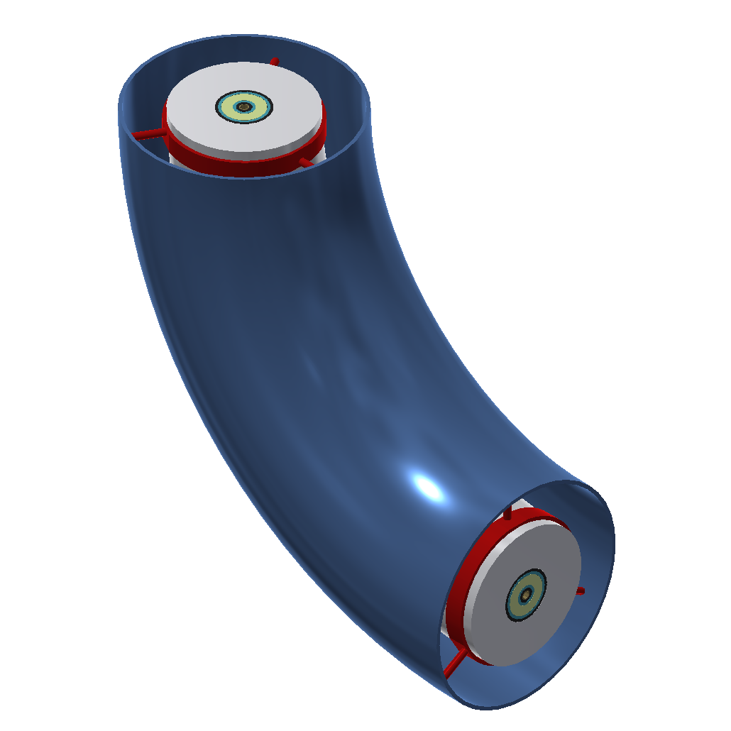
Gantry mechanical concept
Radius ~5.3 m
< 20 T (without supports)
Magnet:
  gfr (chamber)=15 mm radius
  Outer radius (iron)= 370 mm
warm
cold
warm

Slide 13
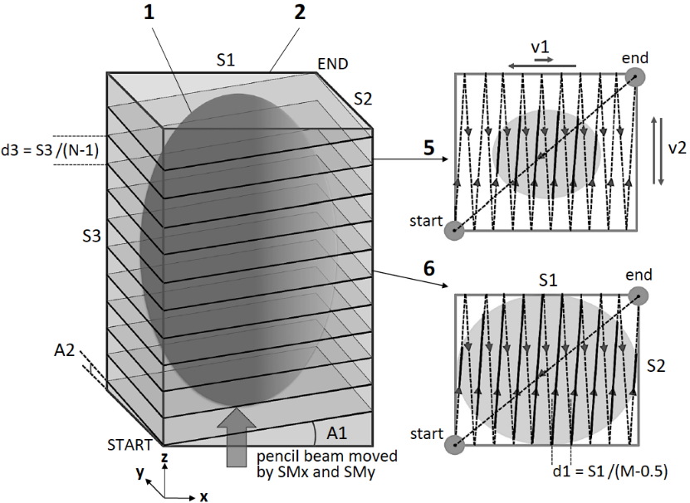
Extraction and dose delivery
Field stability at extraction → reduce intensity spikes
  CCT dipoles windings have large inductance (not the quads)
  All dipoles and nested quads powered in series + current trims
  Switch mode power supplies (>50kHz)
Oblique Raster Scanning method → see A.Garonna’s talk
  Assuming 10x10x10 cm³ volume:
    Dose delivery in 20s FAST!!!
    10¹⁰ C⁶⁺
  dB/dt ~0.05 T/s SLOW !!!
    Ramp ~60s (10→ 430 MeV/u)
    Less cryogenics for SC magnets
    Eddy currents ~negligible

Slide 14
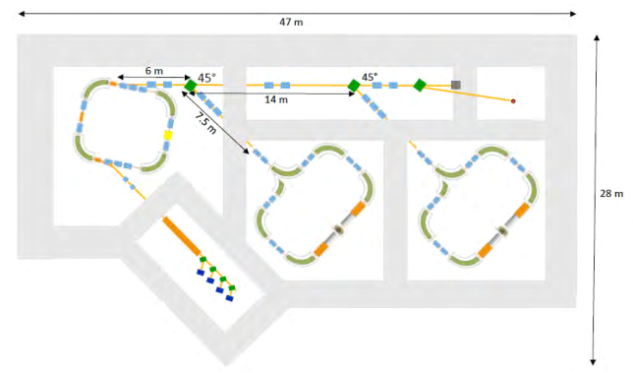
Summary
Proposal of compact design:
  with Canted Cosine Theta magnets
  Bmax=3.5T
  90⁰ bends with nested quads
  Ring 27 m, gantry R=5.3 m
Preliminary study of Synchrotron & Gantry
Synergies with CERN developments:
  Canted Cosine Theta magnets, for HL-LHC
  High frequency RFQ, IH and MEDeGUN EBIS, for medical C⁶⁺ linac

