Slide 2
A Versatile Wideband RF System Design
M.Paoluzzi – BE-RF

Slide 3
Same Basic Numbers from RF Point Of View
Synchrotrons for Hadron Therapy typical energies :
  Injection at few MeV
  Extraction at few hundreds MeV
Particles’ β substantial increases from injection to extraction
Beam revolution frequency :
  Injection at few hundreds of kHz
  Extraction at few MHz (10-20 MHz for small machines)
Large frequency range f_{ext}/f_{inj}≈ 10 or higher
For slow cycling machines required voltage are few kV (tens of kV or RCS)

Slide 4
Modern Magnetic Alloys
Modern Magnetic Alloys (MA) are now of common use for RF cavities up to 10 – 20 MHz. Among others :
  Vitrovac from Vacuumschmelze (CNAO)
  Nanoperm from Magnetec (GSI)
  Finemet from Hitachi Metals (CERN, MedAustron, J-PARC)
  FS from Toshiba (HIMAC)
All MA exhibit a low quality factor allowing wideband operation → no tuning
Saturation and Curie temperature are substantially higher than for ferrite → higher acceleration gradient

Slide 5
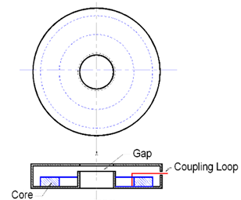
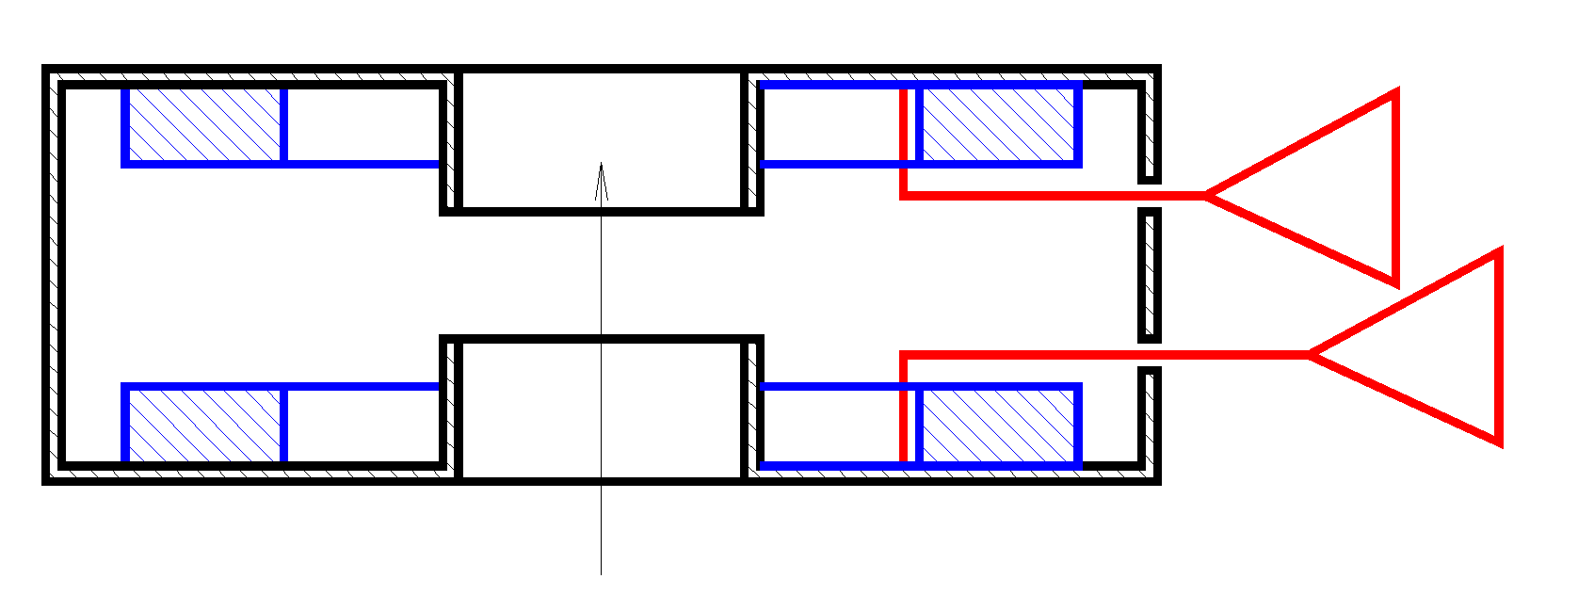
Basic Cell : Basic Choices
New RF system for the CERN PS Booster RF upgrade project
Design to replace the three existing ones (C02, C04 and C16) → 0.6 to 18 MHz
Selected material Finemet® FT3L
At low and mid frequency, stacking more cores across a gap proportionally increases the total impedance.
At high frequency the response is mainly limited by the structure capacitance that becomes effective earlier.
Full exploitation of wideband characteristics when using a single core or one on each side of the gap driven in push-pull.

Slide 6
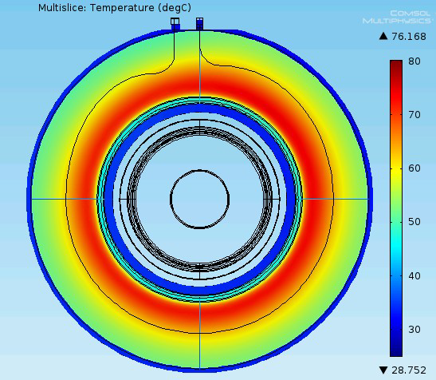
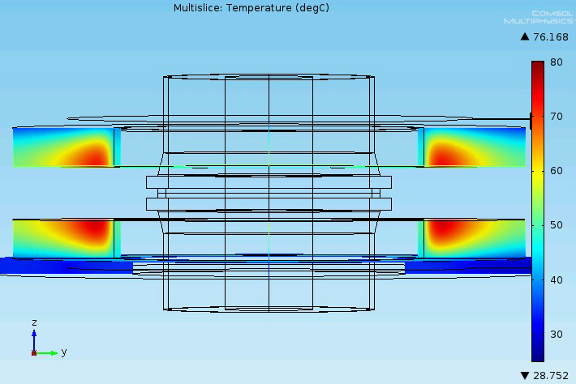
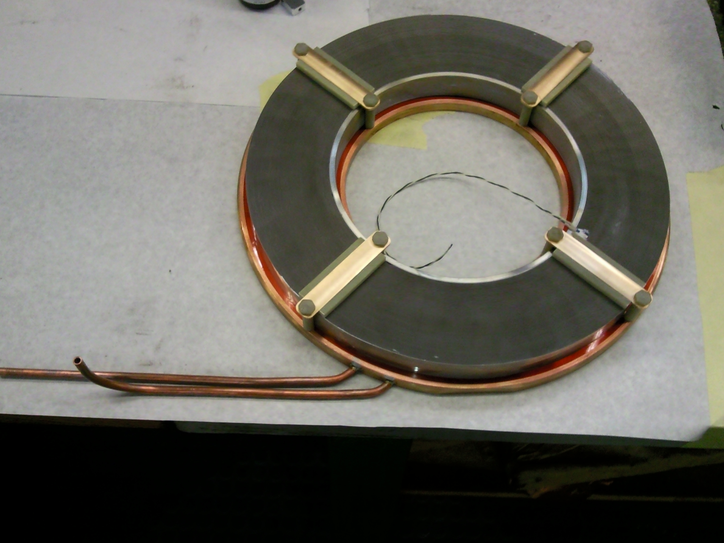
Basic Cell : Dimensions, Cooling, RF Voltage
Core dimensions dictated by PS Booster limitations : 330/200/25 mm.
Indirect water cooling selected.
 |  | 750 W Water T_{in}=18 ˚C Water T_{out}=33 ˚C 3 litres/min
Assuming 100°C maximum in the core one ring can dissipate 1 kW.
From measure RF losses, a two cores cell can provide 0.7 - 1.5 kV_{PK} in the frequency range 0.1 - 100 MHz.
This power level can be provided by a compact solid-state amplifier.
The cell longitudinal length is 130 mm.

Slide 7
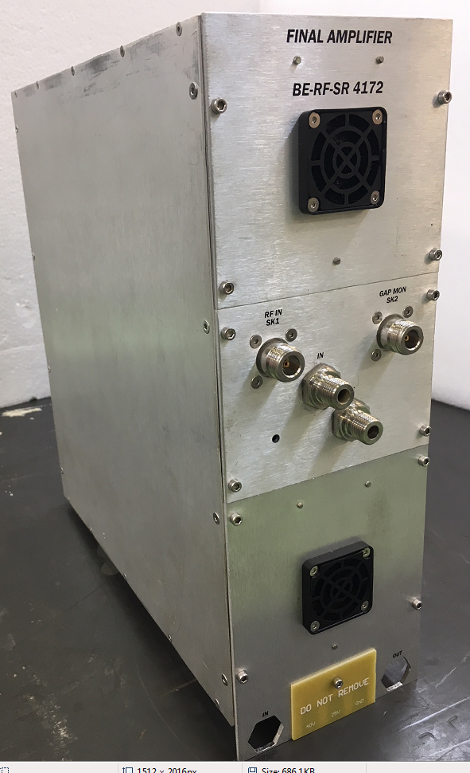
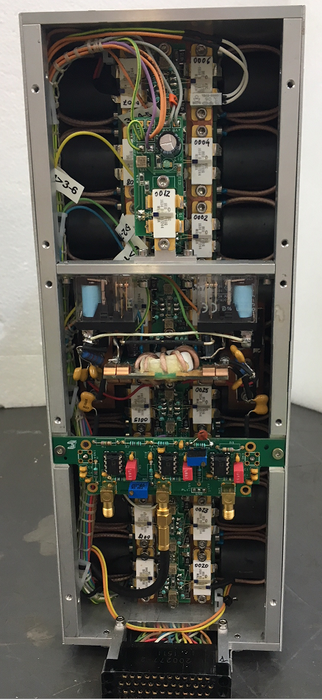
Basic Cell : RF Power Amplifier
Best RF performances achievable with the RF Power amplifier placed near by the load.
Single box (H323/D295/W120 mm) containing two 1.6 kW power stages with common drive.
  Push-pull version with two 2 x 1.6 kW outputs
  Single-ended version with single 3.2 kW output
Operation frequency 0.1 MHz to 70 MHz (limited power above 10 MHz).
Plug-in unit.
Peculiar configuration selected to minimizes complexity and allow implementation of fast RF feedback.
Radiation tolerant devices and design including radiation effects compensation.
De-rated use of power devices, built-in redundancy and reserves

Slide 8
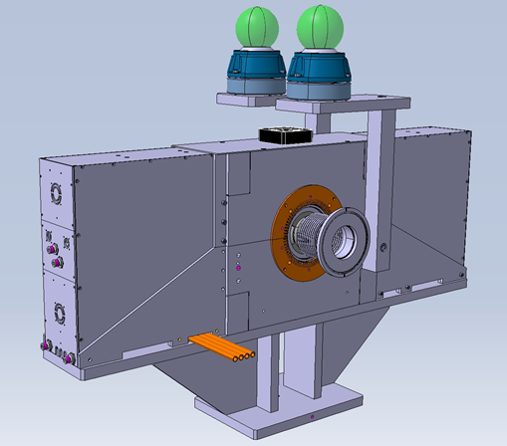
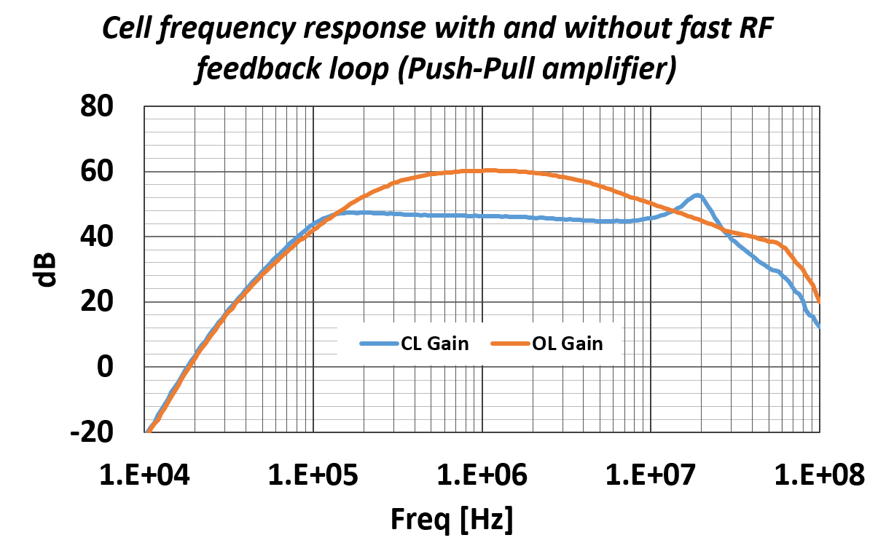
Basic Cell : Layout and response
Operation from 100 kHz to 20 MHz
With Push-Pull amplifier:
  800 V_{PK} from 0.5 MHz to 5 MHz (limitations outside this range)
With Single-Ended amplifier on each side
  1 kV_{PK} from 0.5 MHz to 10 MHz (limitations outside this range)
Optional fast RF feedback loop gain (PP amplifier).
Gap voltage monitor
Gap relay
Cell layout and dimensions
Central Resonator with amplifier emplacement on each side
350.0
424.0
130.0
1020.0

Slide 9
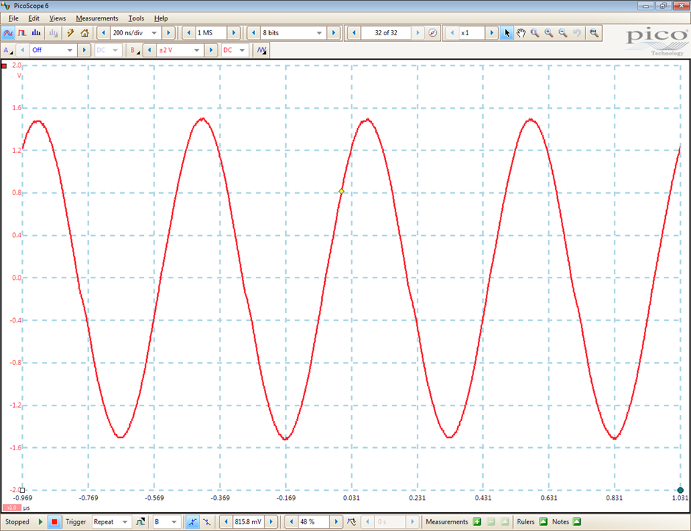
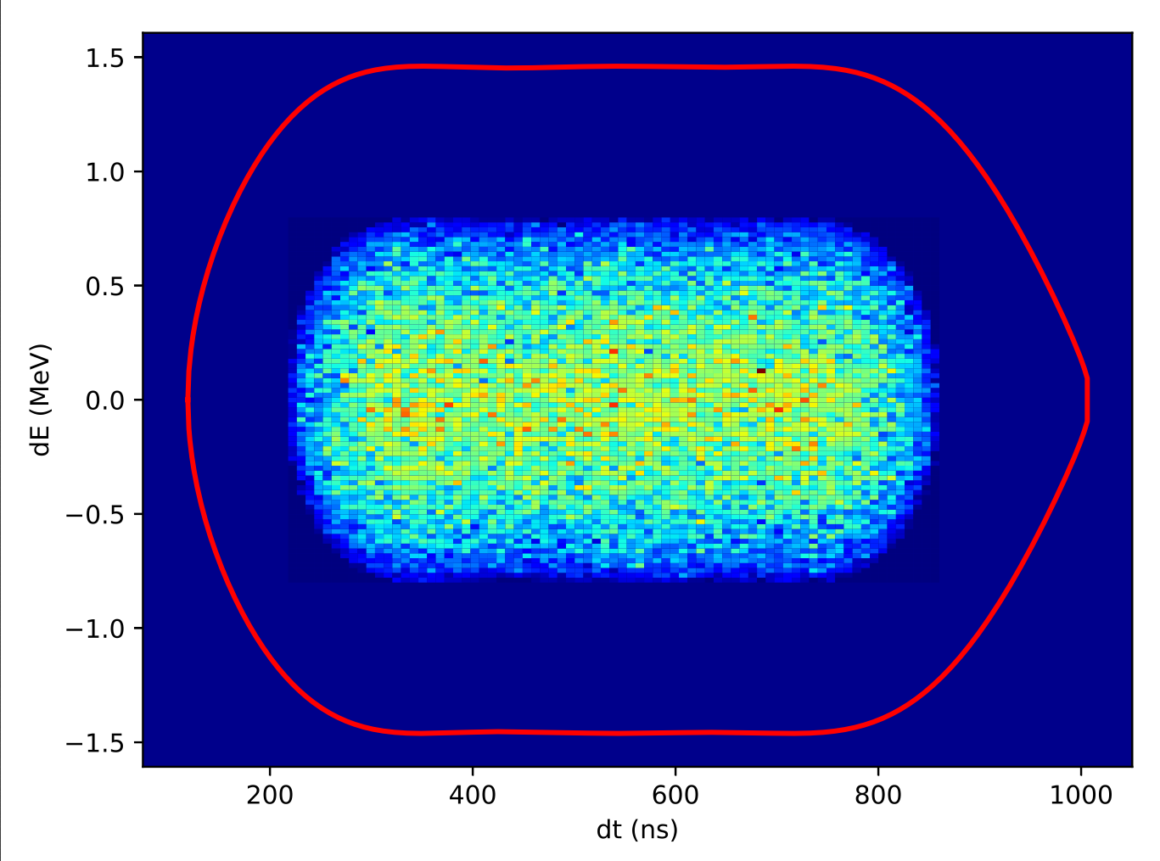
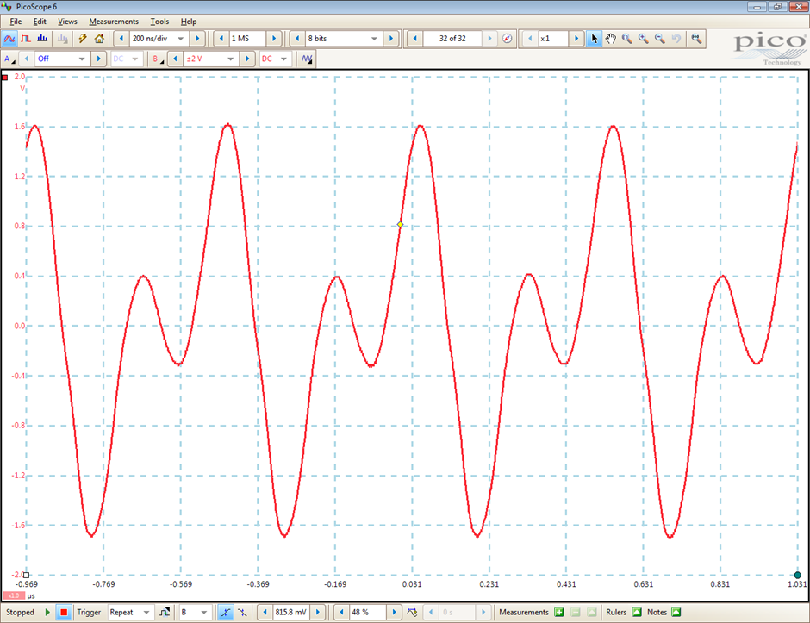
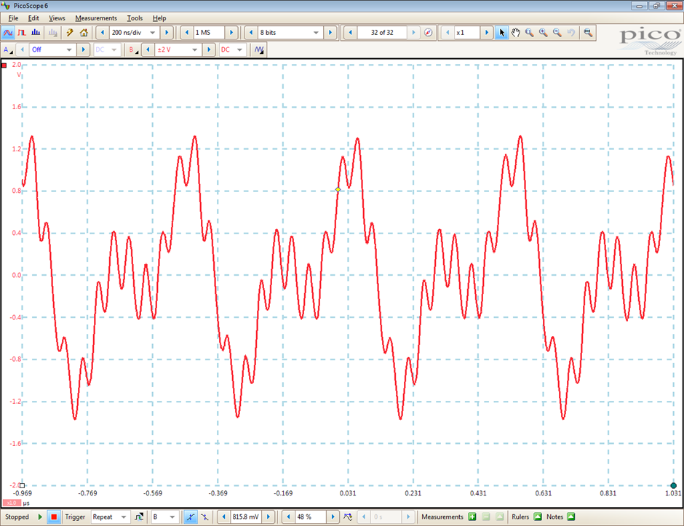
Basic Cell : Multi-harmonic operation
h1+h2
h1
h1+h2+h3
h1+h2+h3
h1-+h2
Courtesy S. Abright
Courtesy S. Abright
h1+h2+h10

Slide 10
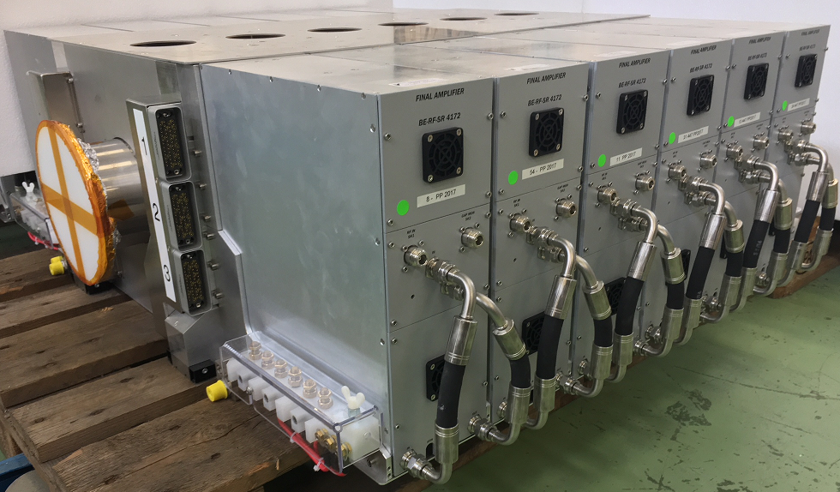
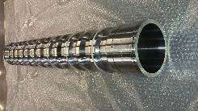
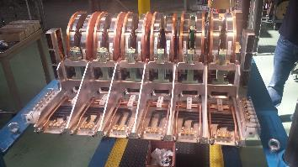
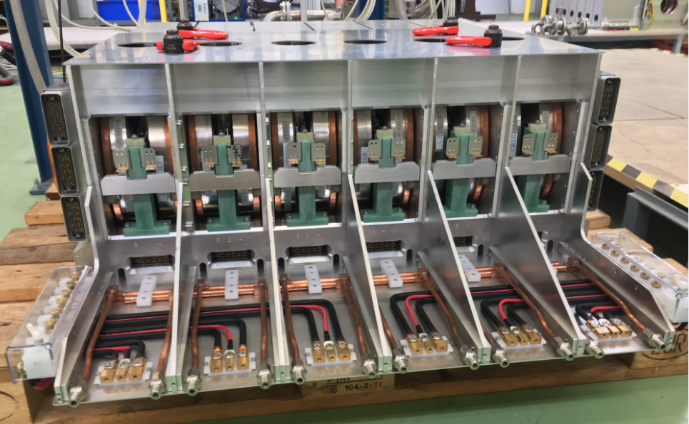
Application : CERN PS Booster
Frequency range : 0.6 to 18 MHz
Total nominal voltage : 22 kV (Max 28 kV)
Cell voltage : Nominal 610 V
One Push-Pull amplifier per cell
36 cells in groups of 6 per ring
144 cells total in the machine

Slide 11
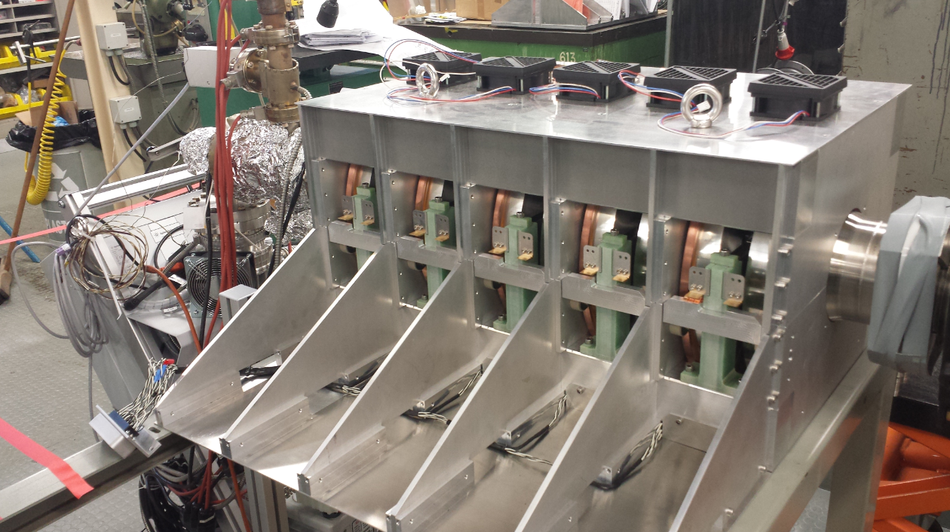
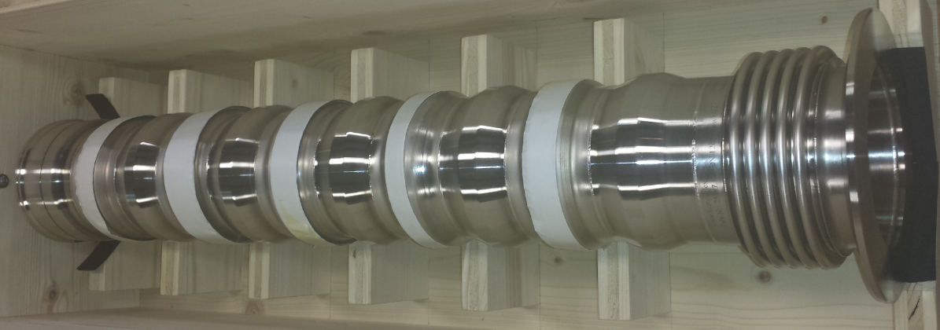
Application : CERN AD
Frequency range : 0.174 to 3 MHz
Total nominal voltage : 3 kV
Cell voltage : Nominal 600 V (Max 800 V)
One Push-Pull amplifier per cell
Group of 5 cells
(Re-use of PSB Prototype system)

Slide 12

Application : ELENA
Frequency range : 0.15 to 2.3 MHz
Total nominal voltage : 500 V above 500 kHz (Max 800 V)
100 V below 500 kHz
One Push-Pull amplifier
Single cell
Special vacuum chamber (bakeable)

Slide 13
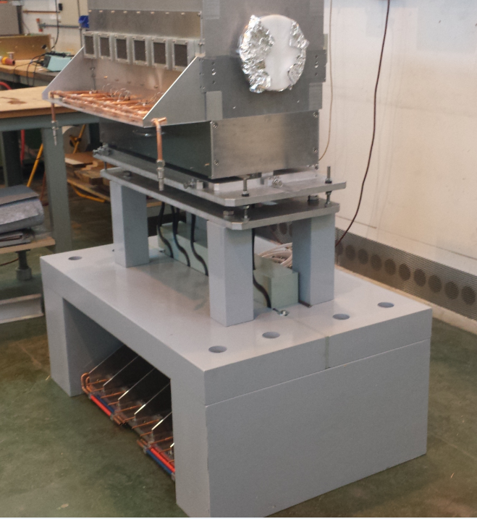
Application : PS Longitudinal Damper
Frequency range : 0.45 to 10 MHz
Total nominal voltage : 5 kV
Cell voltage : Nominal 830 V (Max 1000 V)
Two Single-Ended amplifiers per cell
Group of 6 cells
Displace RF Power Amplifier (radiation shielding)
Doubled RF Power (two amplifiers per cell)

Slide 14
Conclusion
Modern Magnetic Alloys are nowadays a natural choice for low-medium energy synchrotron RF systems
Wide frequency ranges can be covered without tuning
Can be driven by solid-state amplifiers
The configuration approach (maximum bandwidth, solid-state amplifier) proved very flexible at CERN
The system seems also adapted for medical synchrotrons.

Slide 15
Thank you for your attention

