Slide 1

Helium as a range probe in carbon ion therapy
C. Graeff, J. Seco, N. Saito et al

Slide 2
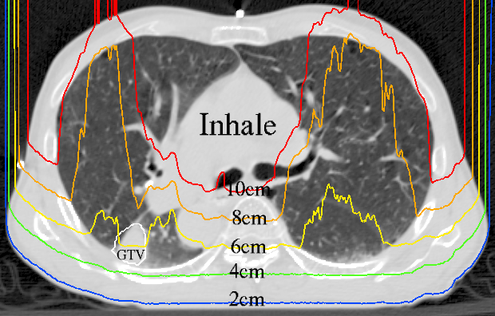
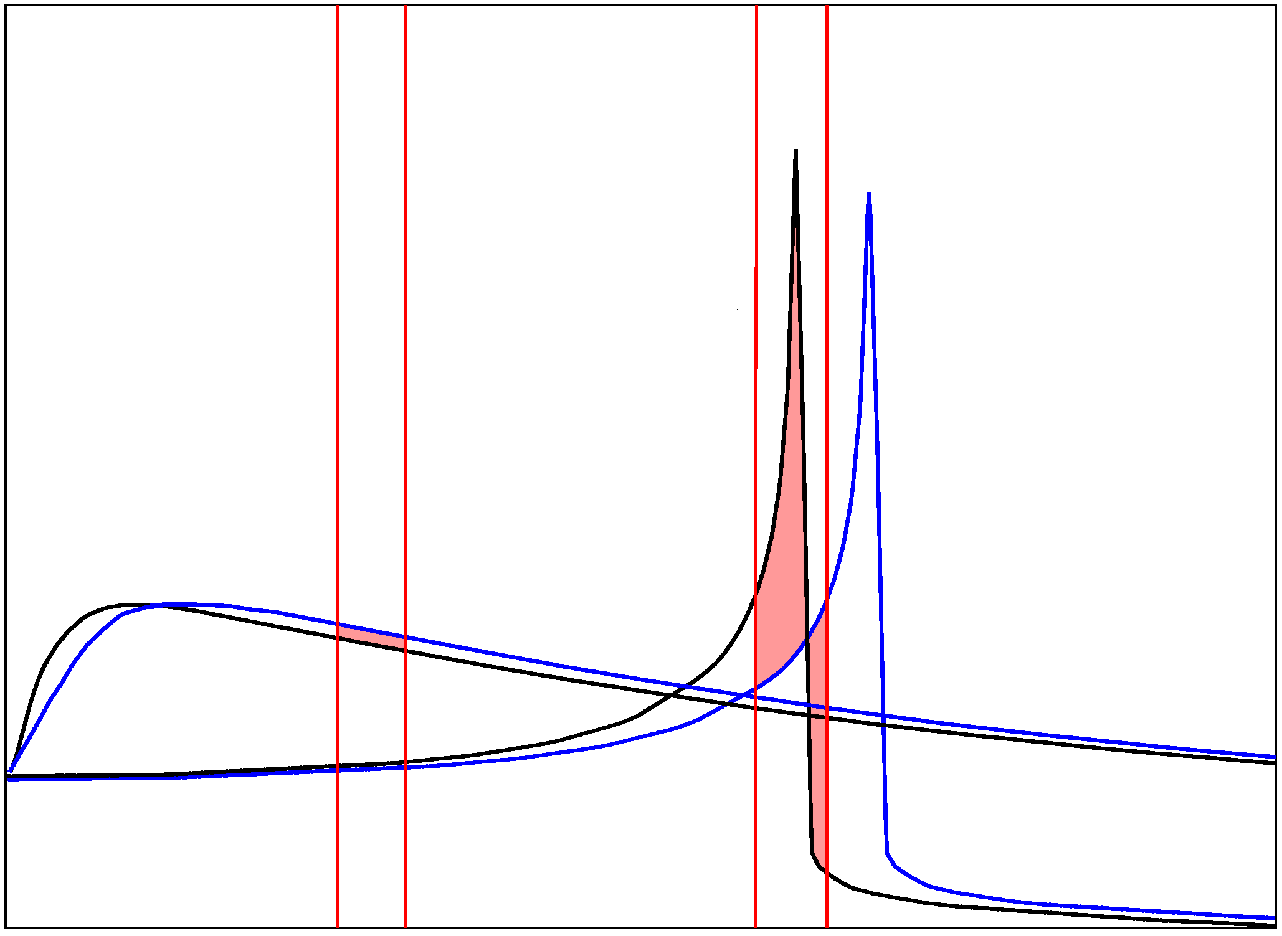
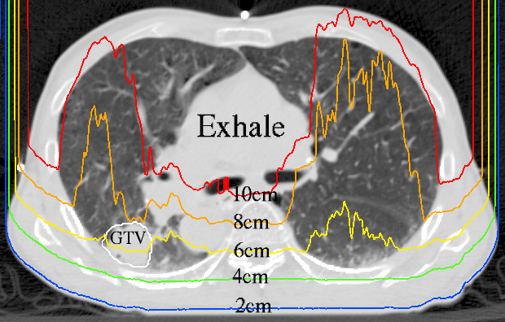
Range uncertainty - a major issue
¹²C
dose
photons
range

Slide 3
A mixed He-C beam
Fully ionized Helium and Carbon – (nearly) same mass:charge ratio
Can be accelerated to same velocity - range of ⁴He²⁺ ≈ 3 x range of ¹²C⁶⁺
Stops in target
Exits patient,
stops in detector

Slide 4
Monte Carlo: Carbon fragments vs. primary Helium
Simple test setup: parallel plates of soft tissue, lung, and tumor
Residual range of all particles exiting distal phantom plane recorded
Helium can be separated from Carbon fragment tail
soft tissue
tumor
lung
soft tissue
Residual range behind phantom

Slide 5
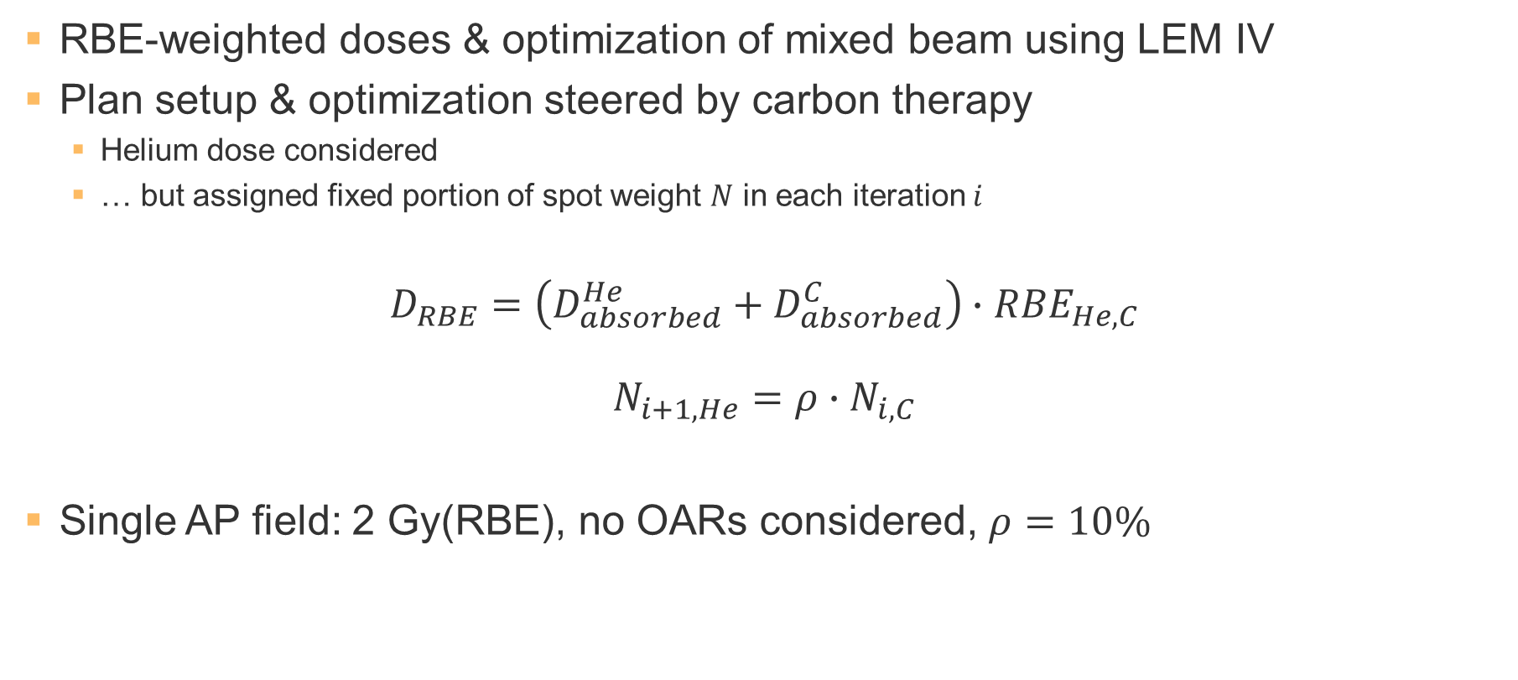
Feasibility test: a patient simulation
RBE-weighted doses & optimization of mixed beam using LEM IV
Plan setup & optimization steered by carbon therapy
  Helium dose considered
  … but assigned fixed portion of spot weight $N$ in each iteration $i$
$$D_{RBE}=\left(D_{absorbed}^{He}+D_{absorbed}^{C}\right)∙{RBE}_{He, C}$$
$$N_{i+1,He}={ρ∙N}_{i,C}$$
Single AP field: 2 Gy(RBE), no OARs considered, $ρ=10\%$

Slide 6
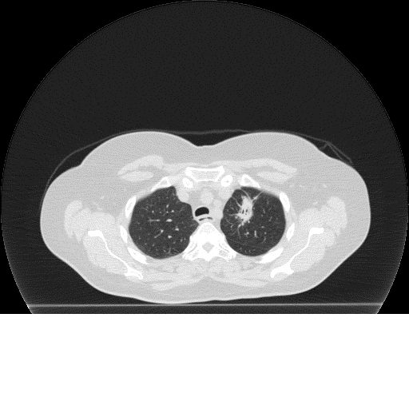
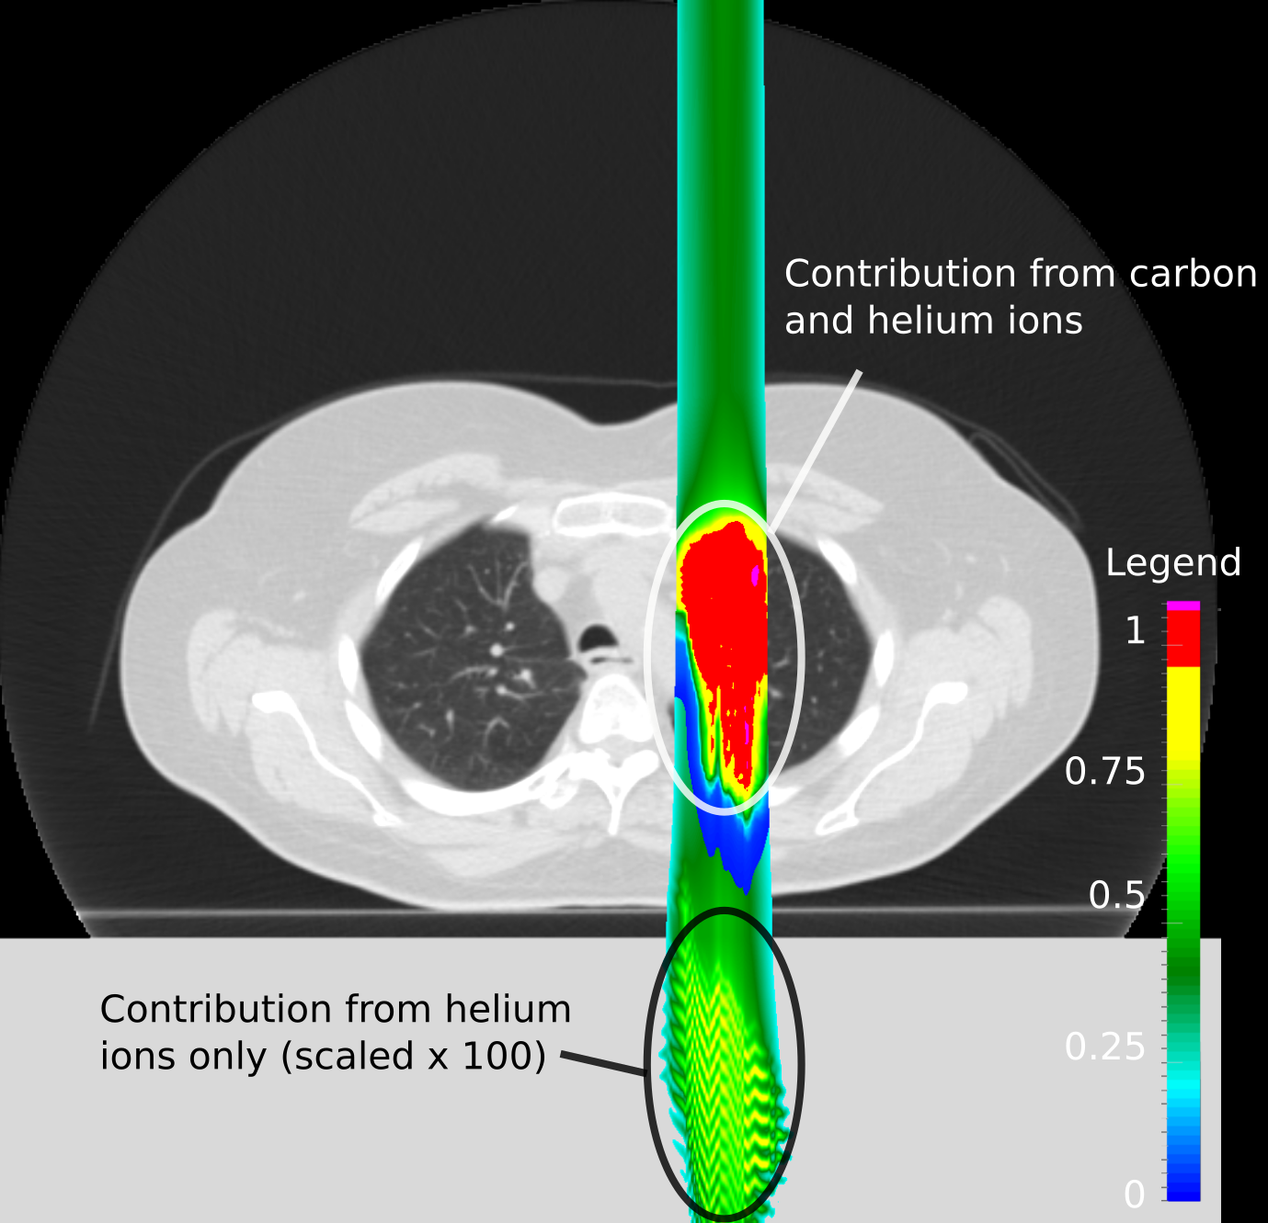
Image-guided particle therapy
Beam‘ eye view
dose profile
(next slide)

Slide 7
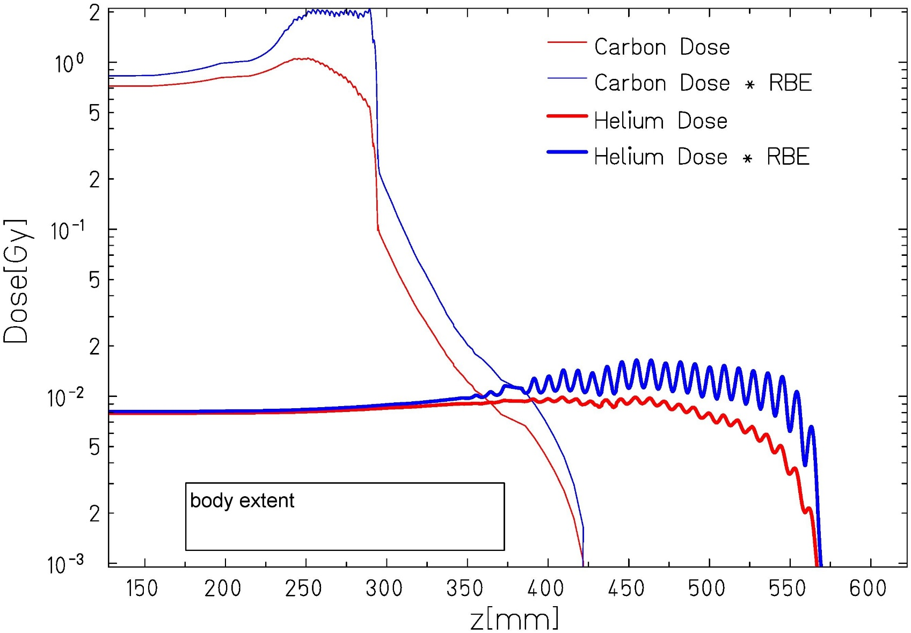
Dose profile along central beam axis
Helium dose ~ 0.5% of target dose
log-scale!
Air
Patient
Detector block
Range [mm_{H2O}]

Slide 8
Preliminary: Range detection under motion
Time-resolved simulation of same plan as for static test
Dose calculated for each motion phase of 400 ms
  Plan simulated for GSI Cave M: 26 IES in 56 spills
  single breathing trajectory with 4 sec period
  Dose calculated for each consecutive motion phase
Mimicking an IC / scintillator stack:
Dose integrated on each CT plane perpendicular to the beam
Quantification of range ongoing –
qualitative impression for consecutive motion phases, single energy

Slide 9
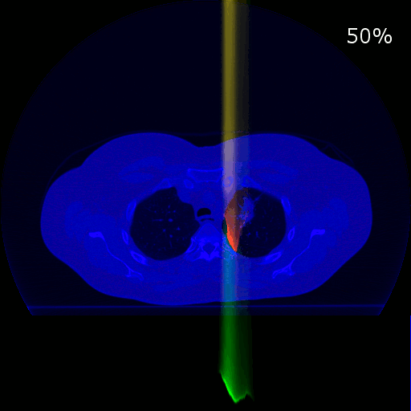
Preliminary: Range detection under motion
Carbon
Helium
Motion phases #555 to #550; E = 210.83 MeV/u

Slide 10
Integral dose perpendicular to beam

Slide 11
Outlook
Simulations show feasibility for online portal imaging and range detection
at low additional dose (<0.5% at 10 % He)
Clinical relevance: Identify suitable patients
  Carbon range to tumor sets energy, Helium not always exits patient
Technical challenges
  Multiple / mixed ion sources required
  Mass-charge ratio differs by 0.6 ‰ – challenge in synchrotron
  Technical feasibility needs to be shown,
  i.e. stable injection, acceleration and extraction of mixed beam
  Experimental investigation will start with separate ion beams at GSI this fall

