Slide 1




ODDERON EXCHANGE
OBSERVATION AND PROPERTIES
T. Csörgő^{1,2} , T. Novák², R. Pasechnik ³, A. Ster ¹ and I. Szanyi ^{1,4}
¹ Wigner RCP, Budapest, Hungary
² MATE KRC, Gyöngyös, Hungary
³ University of Lund, Lund, Sweden
⁴ Eötvös University, Budapest, Hungary
Intro to Odderon exchange
Model independent results:
Significance at least 6.26 σ
Model dependent results:
Significance at least 7.08 σ
New results at 8 TeV
1: H(x) scaling
2: ReBB Model vs ATLAS and TOTEM
Summary
Universe 2024, 10(6),264; https://doi.org/10.3390/universe10060264 | arXiv:2405.06733 [hep-ph]

Slide 2
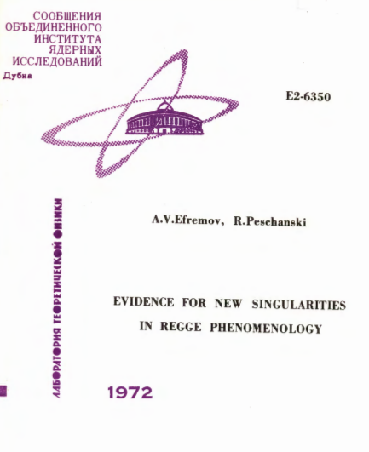
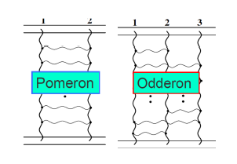
Odderon: 48 years old scientific puzzle
Odderon: L. Lukaszuk, B. Nicolescu,
Lett. Nuovo Cim. 8, 405 (1973)
Received: 31 July 1973
Odderon is an odd component of elastic scattering:
Changes sign for crossing
2
Odderon name coined: D. Joynson, E. Leader, B. Nicolescu, C. Lopez, Nuovo Cim. 30A, 345 (1975) - Well established in QCD by now !
Honorable mention: A. V. Efremov, R. Peschanski, JINR-E2-6350 (1972)

Slide 3
Odderon: elusive experimentally
Odderon search at ISR: indication but no conclusive result
Breakstone et al, Phys. Rev. Lett. 54, 2180 (1985): CL = 99.9 %
Indication of Odderon
CL = 99.9 %,
Significance: 3.35 σ
Terminology for this talk:
Agreement if statistical significance is < 3 σ
Indication of signal if 3 σ ≤ significance < 5 σ
Evidence or observation of signal if 5 σ ≤ significance
Discovery of signal if 5 σ ≤ significance for the first time.
Accepted discovery if Clay Mathematical Institute (CMI) criteria satisfied.
Miscovery if CMI criteria for Millenium Prize Problems are not satisfied.
3

Slide 4
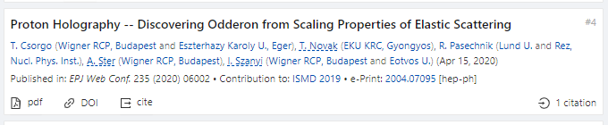
Odderon: first observation with > 5 σ
EPJ Web of Conf. (2020) 235: 06005
https://doi.org/10.1051/epjconf/202023506002
First publication of an at least 5.0 σ (6.26 σ) odderon effect:
May 11, 2020,
EPJ Web of Conf. 235 (2020) 06002
in an anonymously refereed / peer reviewed conference proceedigs.
(Proc. ISMD 2019, Santa Fe, USA)
4

Slide 5

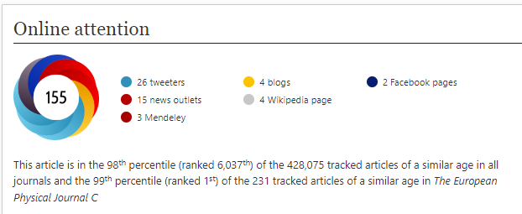
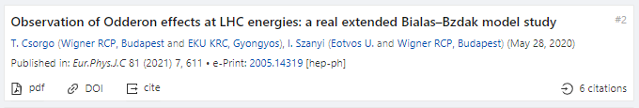
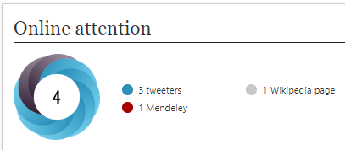
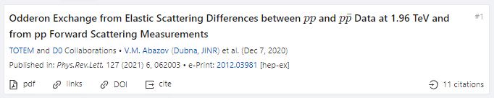
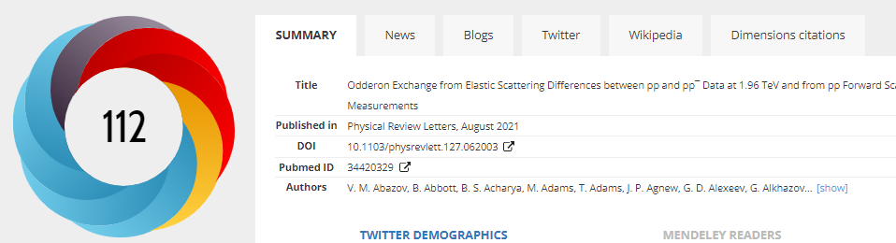
First journal publications, Odderon > 5 σ
Hungarian-Swedish team:
Eur. Phys. J. C (2021) 81: 180, Published: 23 February 2021
https://doi.org/10.1140/epjc/s10052-021-08867-6
Hungarian team, model of Polish origin:
Eur. Phys. J. C (2021) 81:611 , Published: 13 July 2021
https://doi.org/10.1140/epjc/s10052-021-09381-5
5
D0 and TOTEM Collaborations:
Phys. Rev. Lett. 127 (2021) 6, 062003, Published: 4 August 2021
https://doi.org/10.1103/PhysRevLett.127.062003

Slide 6

Hungarian-Swedish team, Odderon > 6.26 σ
Eur. Phys. J. C (2021) 81: 180, published February 2021
https://doi.org/10.1140/epjc/s10052-021-08867-6
H(x) = 1/(B σ_{el}) dσ/dt vs x = - B t
B ≡ B₀(s) from now on
x = - B t = - B₀(s) t
6
S: Model independent Odderon significance ≥ 6.26 σ
C1: All D0 and TOTEM published data at 1.96, 2.76 and 7.0 TeV
C2: domain of validity is still determined model dependently.

Slide 7
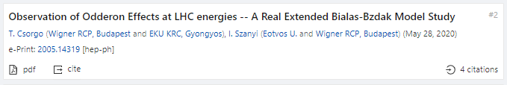
Hungarian team, Polish model, Odderon > 7.08 σ
Eur. Phys. J. C (2021) 81:611, published July 2021
https://doi.org/10.1140/epjc/s10052-021-09381-5
1.96 TeV
2.76 TeV
7 TeV
With new 8 TeV data:
Model dependent certainty
Eur. Phys. J. C (2022) 82, 827, published September 2022
https://doi.org/10.1140/epjc/s10052-022-10770-7
S: Model dependent Odderon significance ≥ 7.08 σ
C1: All D0 and TOTEM published data at 1.96, 2.76, and 7.0 TeV
C2: domain of validity extended to both pp and pbarp
But limited to 0.37 ≤ −t ≤ 1.2 GeV² and 0.546 ≤ sqrt(s) ≤ 7 → 8 TeV
7
Model dependent, Real Extended Bialas-Bzdak theory results,
Odderon significance ≥ 7.08 σ, from 1.96 and 2.76 TeV data only

Slide 8
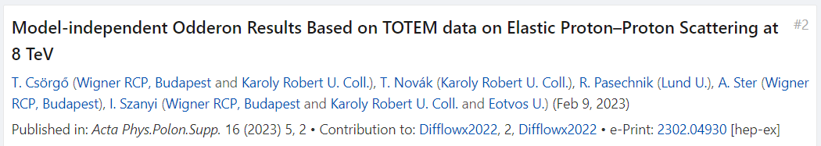
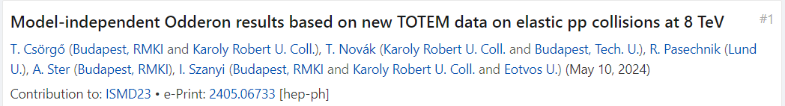
2023-24: new O observations with > 5 σ
Hungarian – Swedish team, new TOTEM data at 8 TeV:
Model-independent H(x) scaling method
Proc. Diffraction and Low-x 2022 by T. Csörgő
8 TeV data confirm and strengthen the Odderon signal
Hungarian – Swedish team, scaling method:
New TOTEM 8 TeV data vs H(x) scaling:
MDPI Universe (2024) 10(6), 264;
Detailed peer reviewed paper, see talk of A. Ster
Universe 2024, 10(6),264; https://doi.org/10.3390/universe10060264 | arXiv:2405.06733 [hep-ph]
What about domain of validity, model independently?
-- stay tuned… coming soon
8

Slide 9
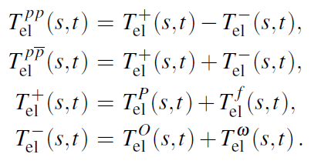
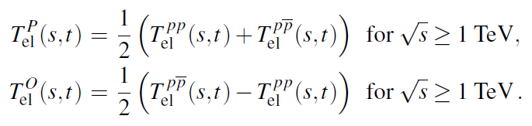
Looking for Crossing-Odd(eron) effects
Three simple consequences:
9
Odderon differential cross-section from pp and ppbar collisions, Reggeized Philips-Barger:
A. Ster, L. Jenkovszky, T. Cs., arxiv:1501.03860, Phys.Rev.D 91 (2015) 7, 074018

Slide 10



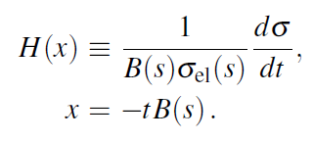
Scaling in the diffractive cone region
Advantages:
1) H(x) ~ exp(-x) in the diffractive cone
2) Start from a place that you know
3) Measurable both for pp and pbarp
10

Slide 11
NEW RESULTS 1
H(x) SCALING, USING 8 TeV

Slide 12
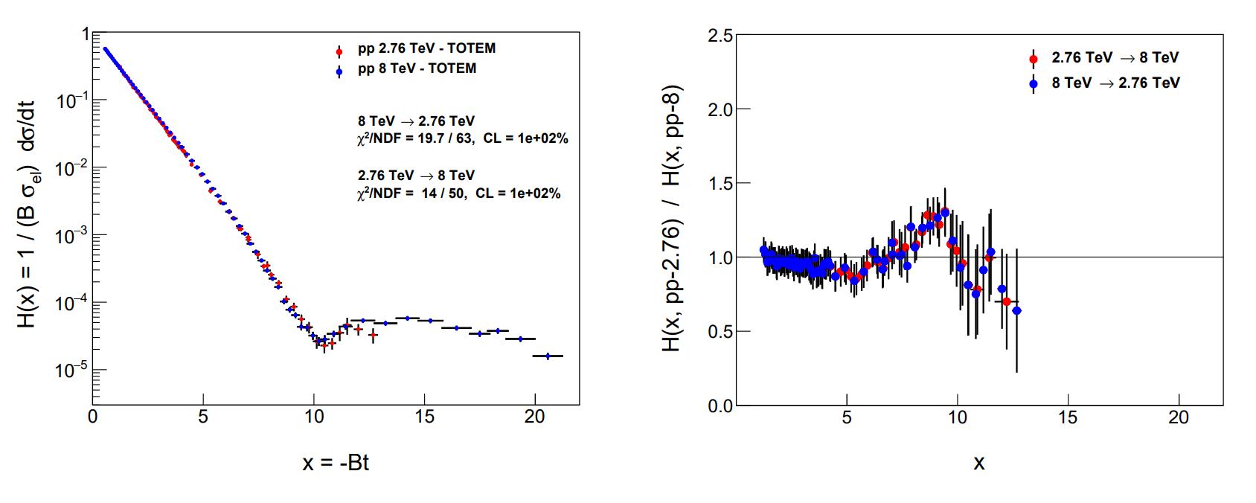
e-Print:
2405.06733 [hep-ph]
Test of H(x) scaling: 8 vs 2.76 TeV
e-Print:
2405.06733 [hep-ph]
12
Between 2.76 and 8 TeV, H(x) scaling observed!
Hungarian-Swedish team, e-Print: 2405.06733 [hep-ph],
MDPI Universe 2024, 10(6), 264

Slide 13
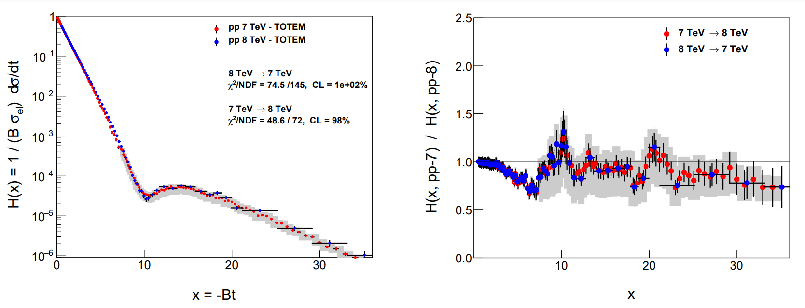
e-Print:
2405.06733 [hep-ph]
Test of H(x) scaling: 8 vs 7 TeV TOTEM
e-Print:
2405.06733 [hep-ph]
13
Between 7 and 8 TeV, H(x) scaling observed, but …
Hungarian-Swedish team, e-Print: 2405.06733 [hep-ph],
MDPI Universe 2024, 10(6), 264

Slide 14
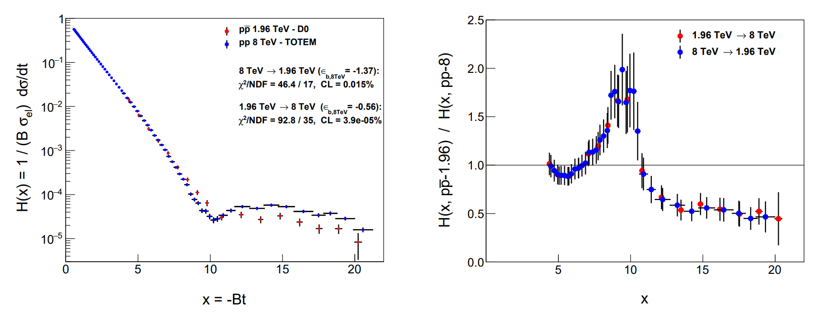
e-Print:
2405.06733 [hep-ph]
Odderon of H(x) scaling: 8 vs 1.96 TeV
e-Print:
2405.06733 [hep-ph]
Between 1.96 and 8 TeV, H(x|s,pp) and H(x|s,pbarp) are clearly different, with 3 < 3.79 < 5 σ
Hungarian-Swedish team, e-Print: 2405.06733 [hep-ph],
MDPI Universe 2024, 10(6), 264
14

Slide 15
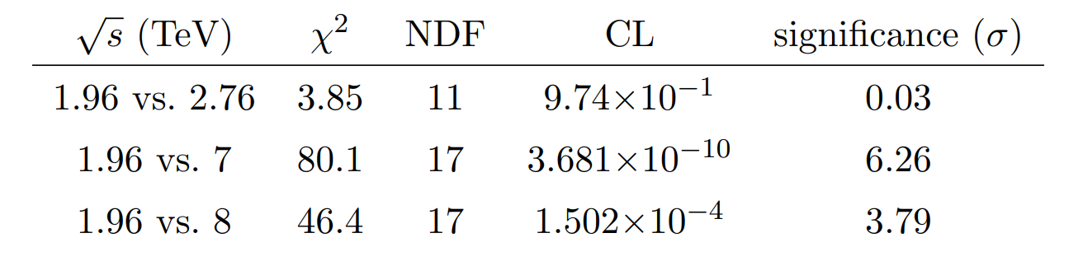
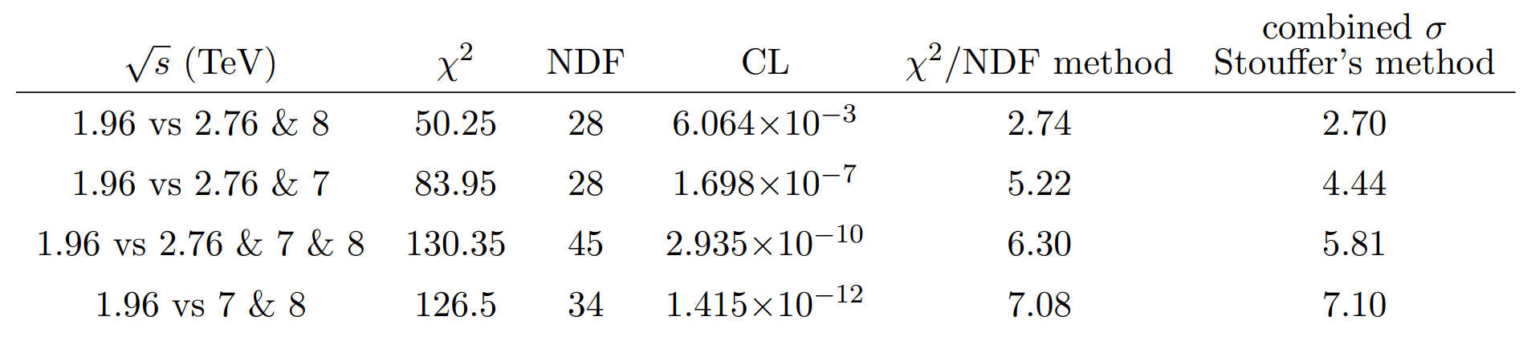
e-Print:
2405.06733 [hep-ph]
Odderon significances from H(x) scaling
e-Print:
2405.06733 [hep-ph]
If 1.96, 2.76, 7 and 8 TeV data are combined, H(x) significances on all data results in 5 < 5.8 σ
If 1.96, 7 and 8 TeV data are combined, at least 7.08 σ.
Hungarian-Swedish team, e-Print: 2405.06733 [hep-ph],
MDPI Universe 2024, 10(6), 264
15

Slide 16
NEW RESULTS 2
Low-t extension of ReBB
7 and 8 TeV pp
(cross-check, without Levy)

Slide 17
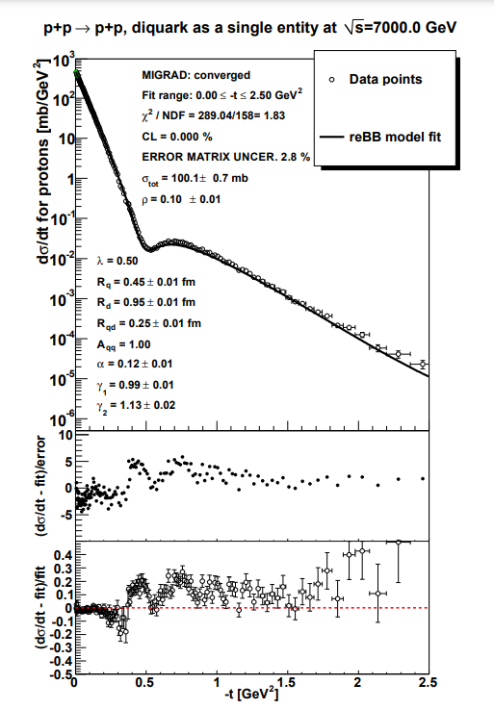
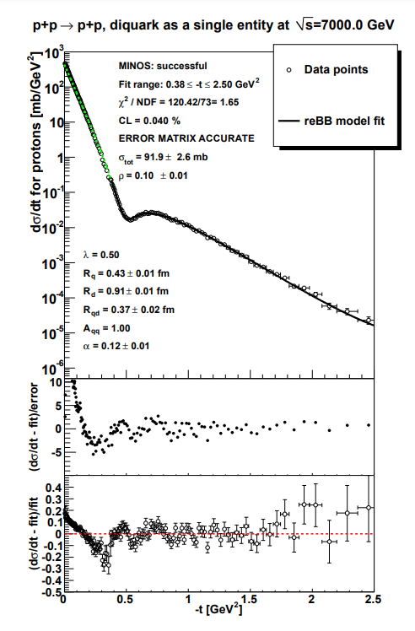
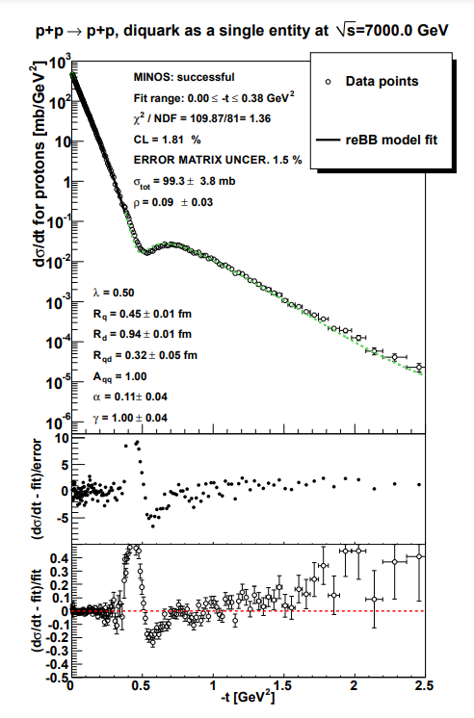
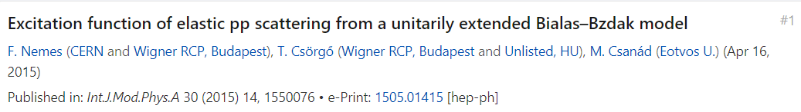
Statement of the problem, with old chi2
17
TOTEM low-t vs TOTEM-large-t fit acceptable at 7 TeV, but
The two datasets could not be ReBB fitted without a PHENIX method !

Slide 18
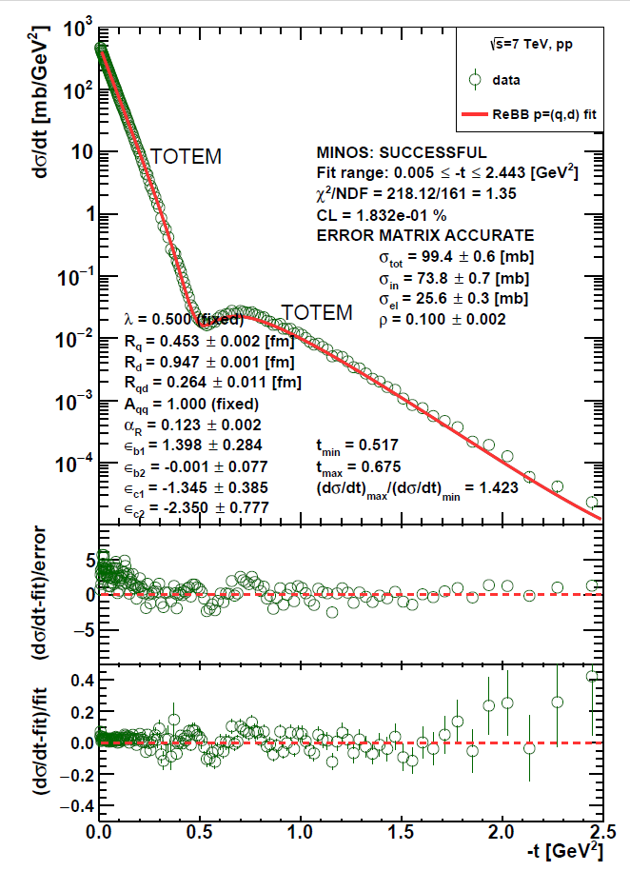
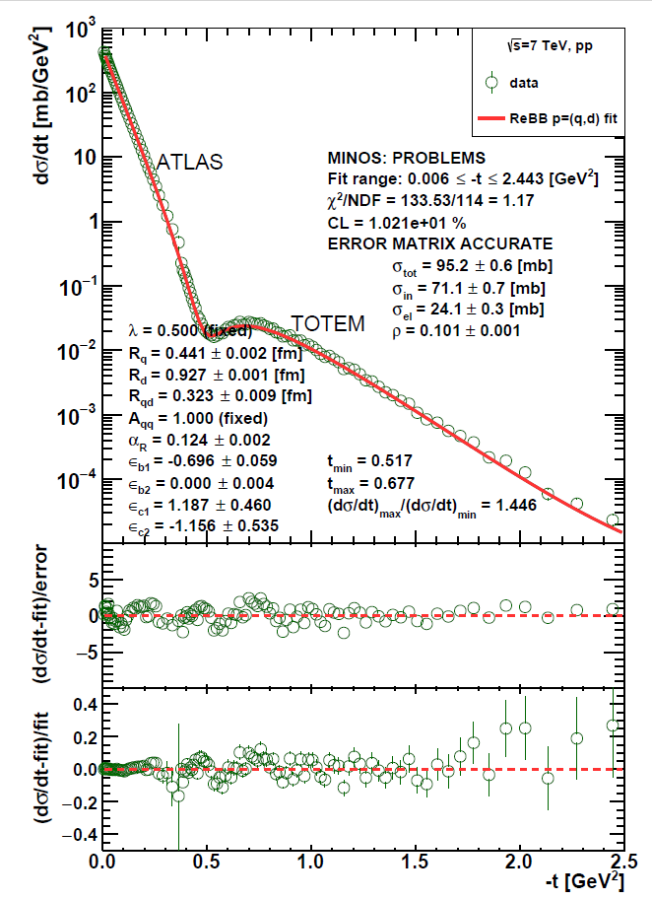
ReBB model extension to low –t, 7 TeV
18
TOTEM low-t vs TOTEM-large-t fit acceptable at 7 TeV, using using PHENIX method of covariance diagonalization, but ...
ATLAS low-t vs TOTEM-large-t fit successful at 7 TeV !

Slide 19
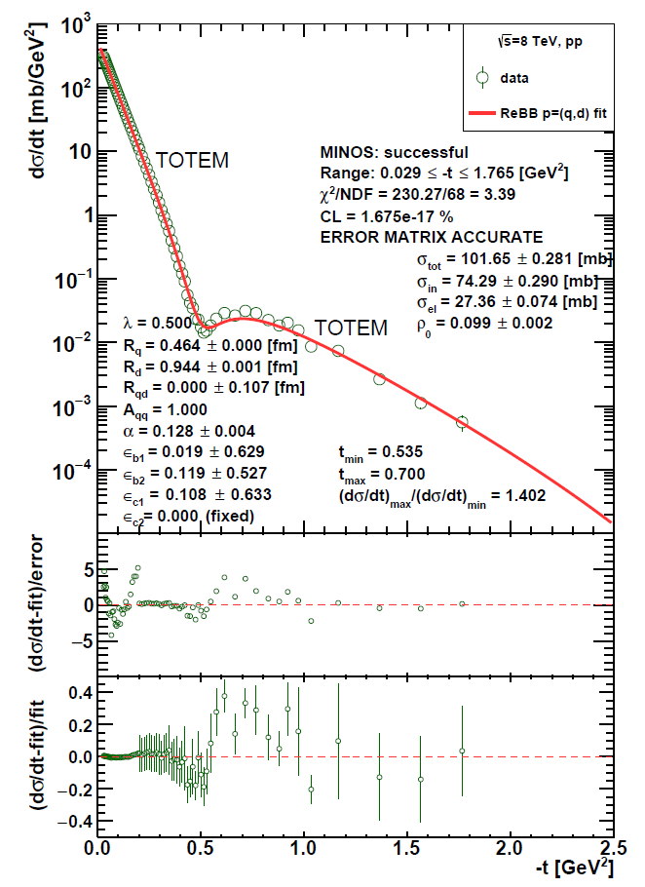
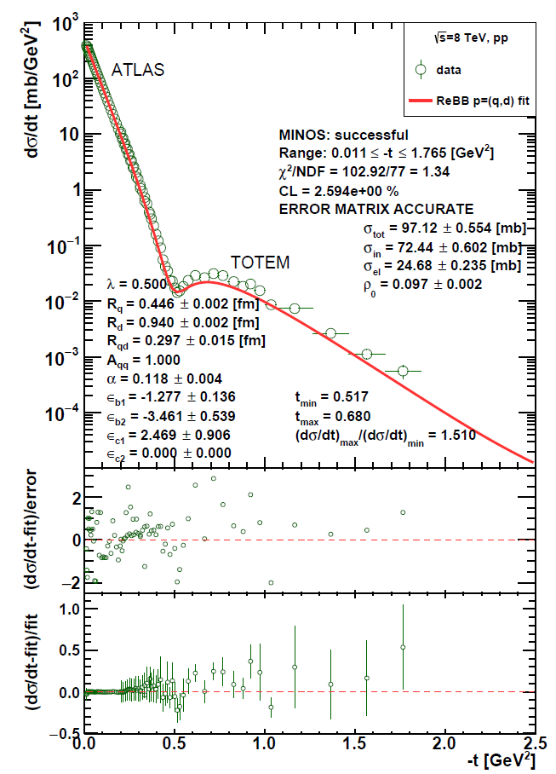
ReBB model extension to low –t, 8 TeV
19
TOTEM low-t vs TOTEM-large-t fit FAILS at 8 TeV, but ...
ATLAS low-t vs TOTEM-large-t fit SUCCESSFUL at 8 TeV !

Slide 20
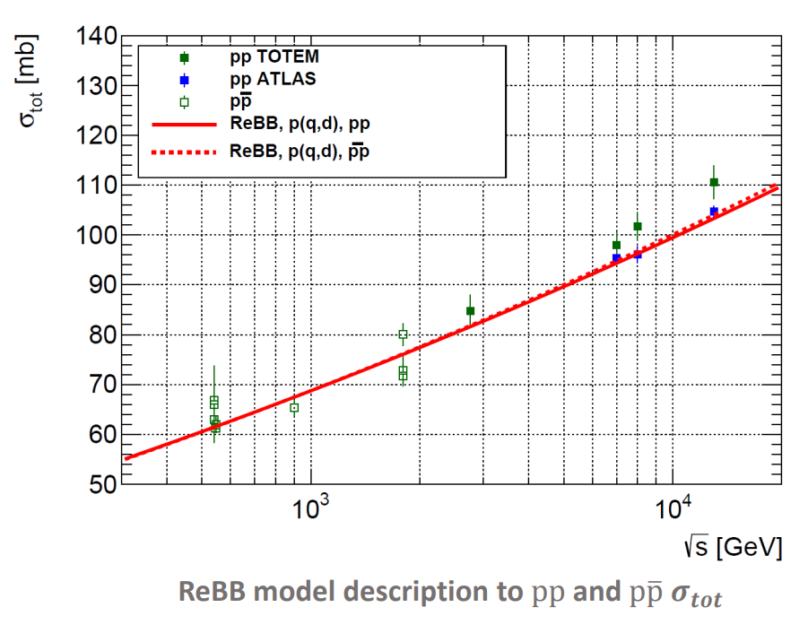
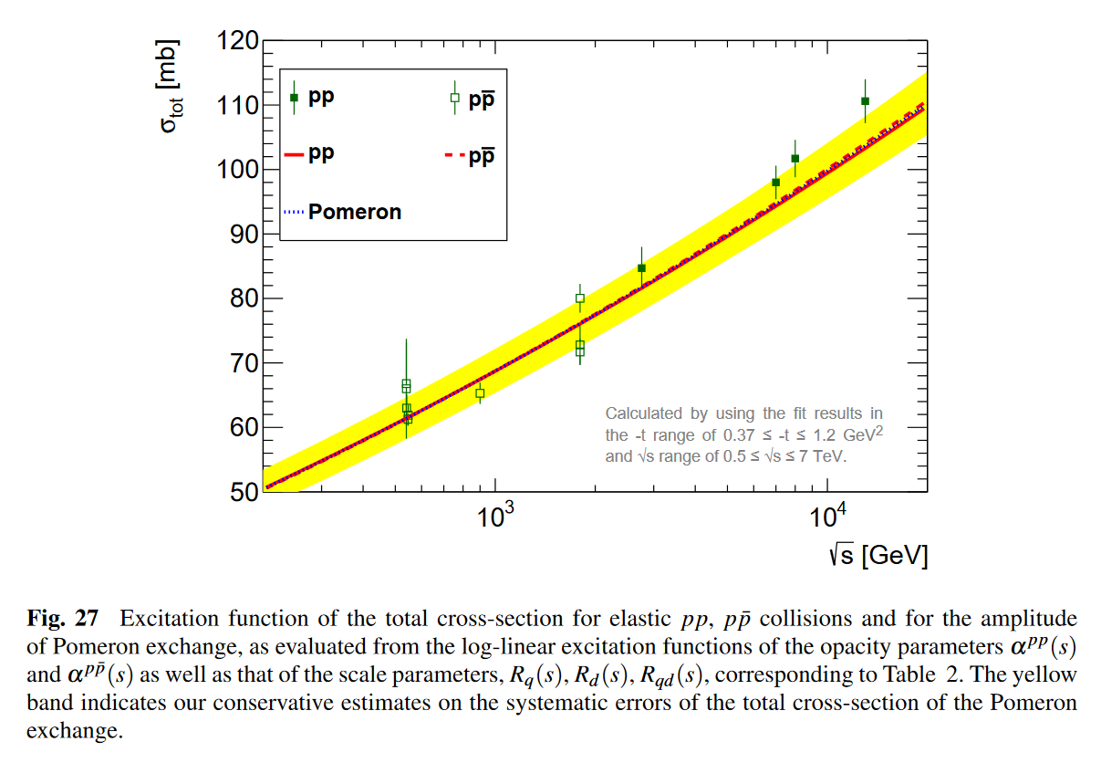
ReBB at low –t vs ATLAS and TOTEM σ_{tot}
ReBB prediction vs TOTEM data at low -t:
ReBB prediction vs ATLAS and TOTEM data at low -t:
T. Csörgő and I. Szanyi, Eur.Phys.J.C 81 (2021) 7, 611 •e-Print: 2005.14319 [hep-ph]

Slide 21
Detailed Summary and Conclusions
New 8 TeV TOTEM data strenghten
Odderon signal using H(x) scaling method
New 8 TeV TOTEM data strenghten
Odderon signal using ReBB model
ReBB fit range can be extended to low –t at 8 TeV, if ATLAS data
are used instead of TOTEM low –t data

Slide 22
THANK YOU !
QUESTIONS?

Slide 23
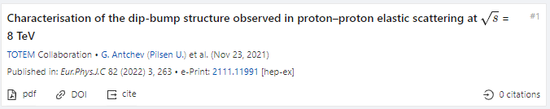
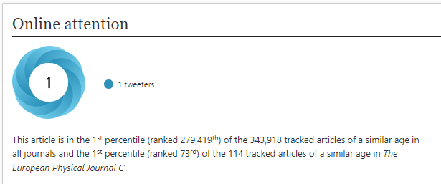
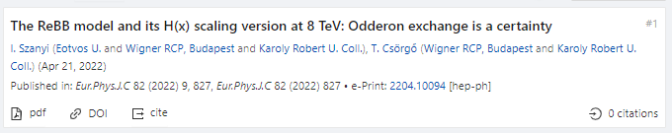
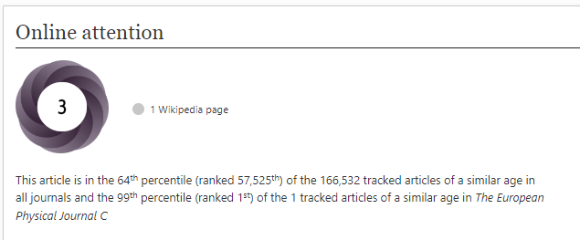
2022 observations of Odderon with > 5 σ
TOTEM Collaboration:
8 TeV: EPJ C (2022) 82, 263 (2022).Published: March 26, 2022
https://doi.org/10.1140/epjc/s10052-022-10065-x
Publishes final data for D0-TOTEM PRL published in 2021
Hungarian team, model of Polish origin:
New TOTEM 8 TeV data vs ReBB model predictions:
EPJ C 82 (2022) 9, 827. Published: Sept 19, 2022
In the ReBB model, Odderon exchange is a certainty
Presented at Zimányi’22 by I. Szanyi
What about model independent results?
23

Slide 24
NEW RESULTS 3
Simple Levy fits at small –t
(For details, see talk of I. Szanyi)

Slide 25
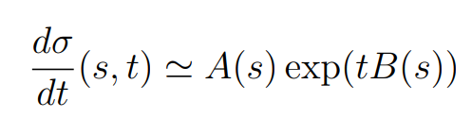
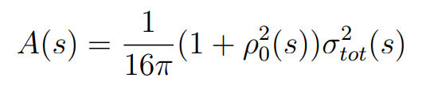
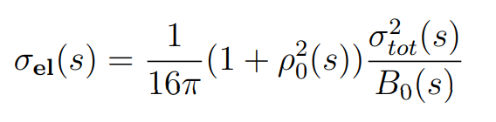
Review: Elastic scattering at small -t
25
If Odderon exists: signals possible both at t = 0 and at –t > 0.
Where the significance of the signal is coming from?

Slide 26
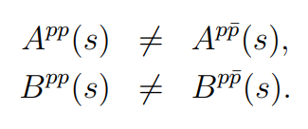

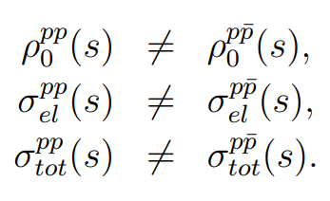
Odderon Search at small -t
valid for
Some simple consequences at small –t, Gaussian sources:
If any of
is statistically significant
26

Slide 27
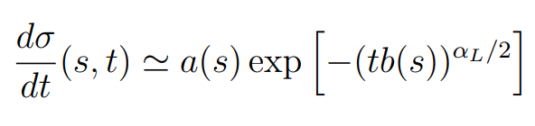
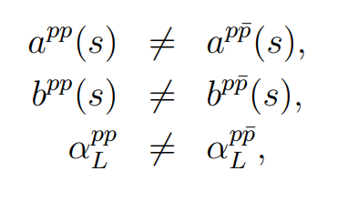

Odderon Search at small -t
valid for
Some simple consequences at small –t, Levy sources:
If any of
is statistically significant
27

Slide 28
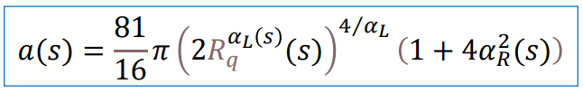


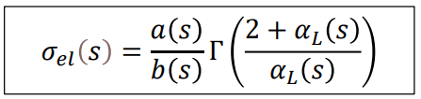

Levy generalized Bialas-Bzdak Model
Simple results at small -t:
From data fits: R_{q}, R_{d}, R_{qd}, α_{L} is same in pp and pbarb
But!
28

Slide 29
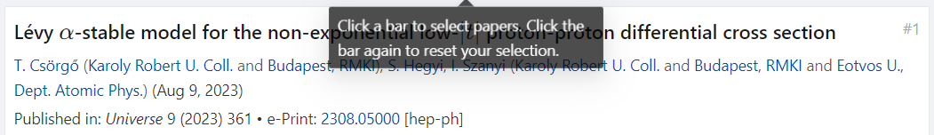
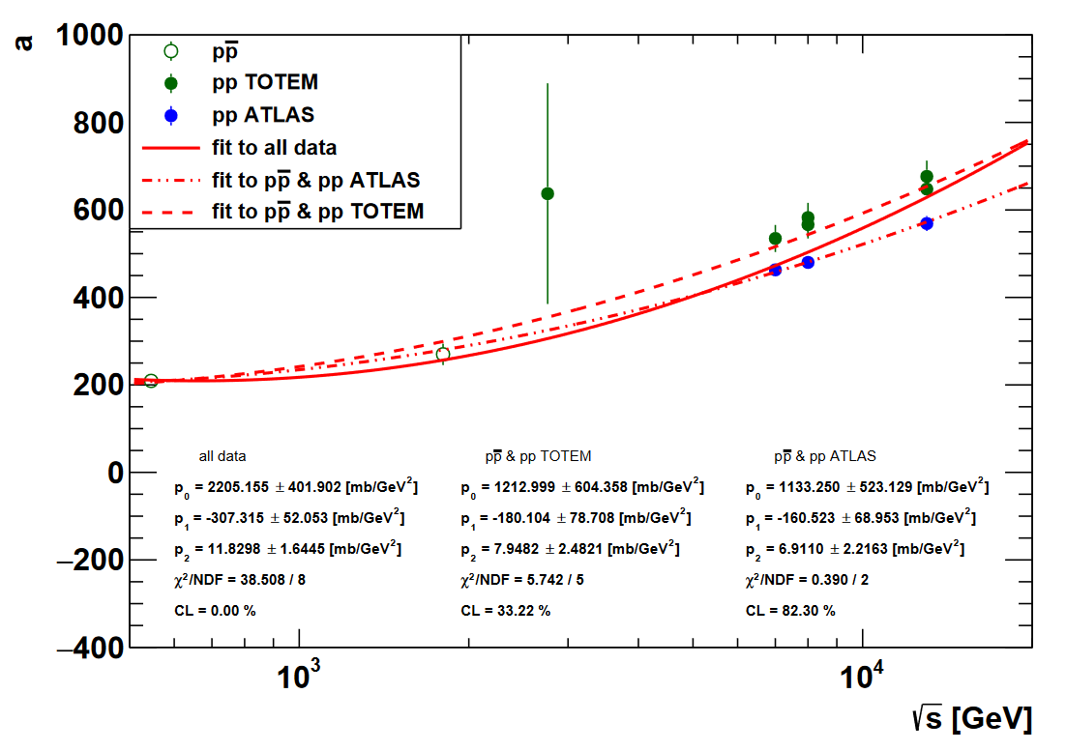

Slide 30
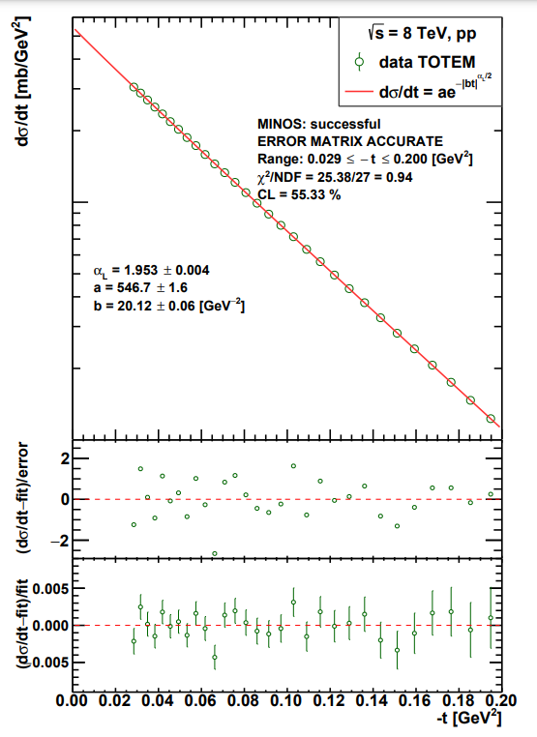
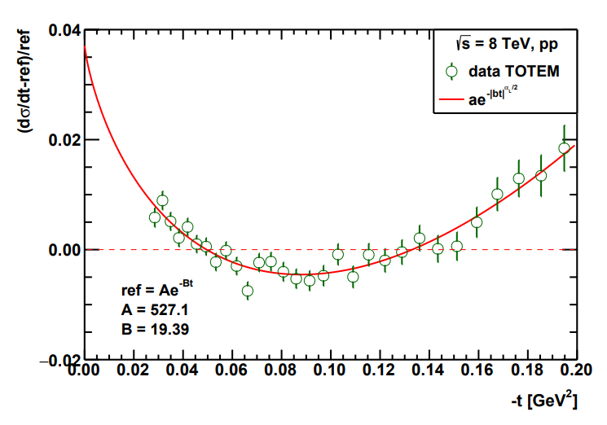
From Glauber’s theory, p=(q,d)
Good quality fits at 8 TeV and also
at every low –t dataset for pp, pbarp

Slide 31
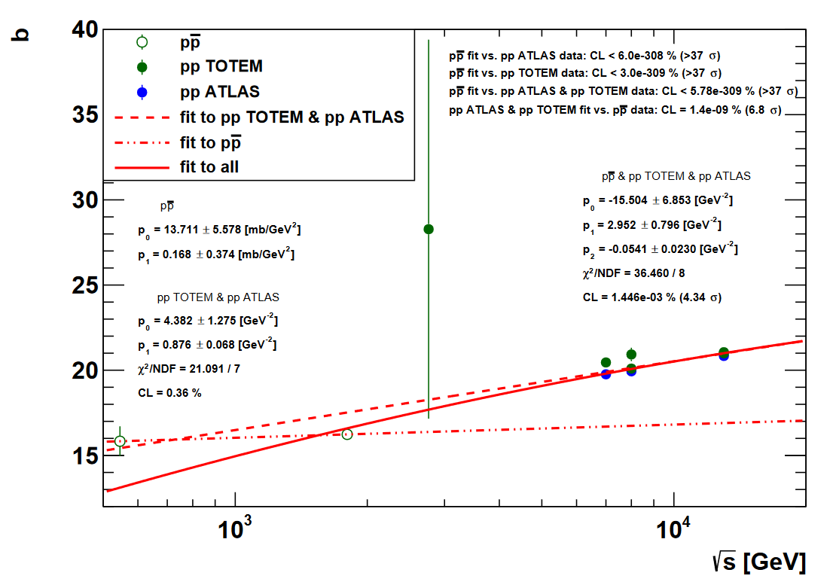

Slide 32
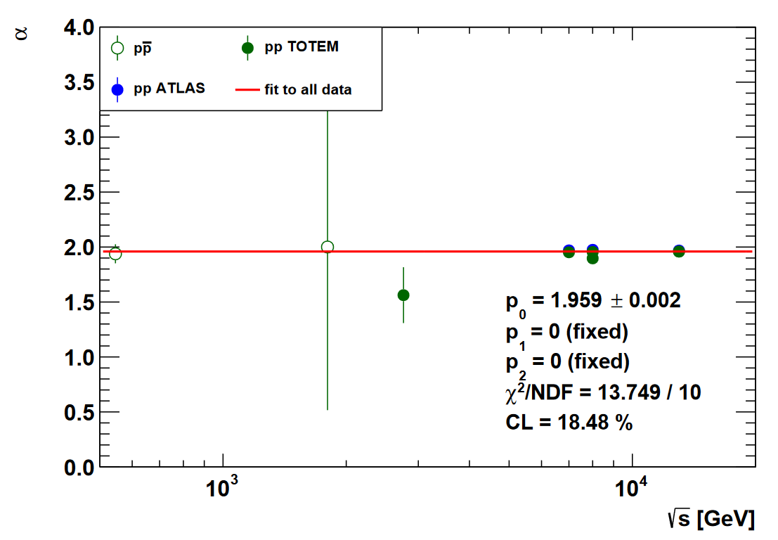

Slide 33
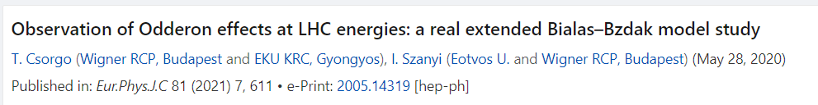
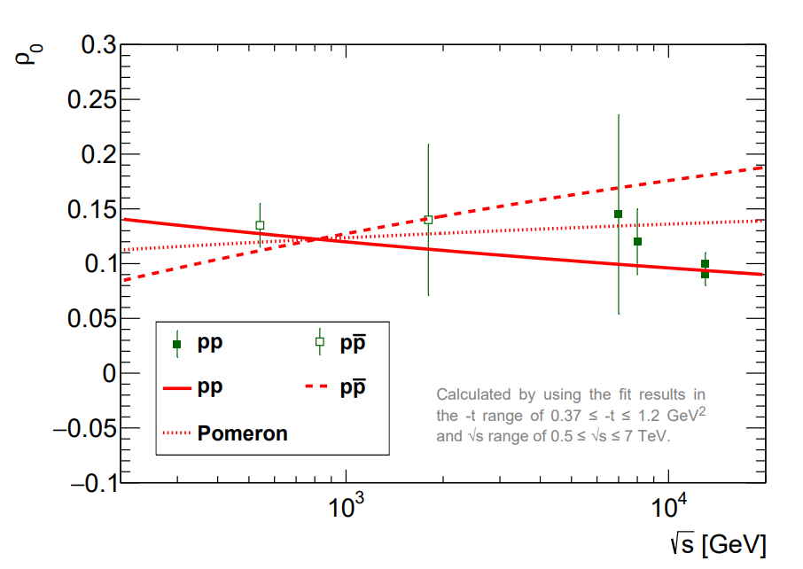

ρ₀ from fits to data
From data fits: R_{q}, R_{d}, R_{qd} is the same, but
α ∼ ρ (opacity) is not the same in pp and pbarb
33

Slide 34


Levy + Bialas-Bzdak at small t
Easy to fit model, with dramatic consequences
Strong form of Pomeranchuk theorem,
with small signals of odderon exchange in
optical point, ρ and elastic cross-section! Tests are needed…

Slide 35

Formalism: elastic scattering
35
Basic problem: dσ/dt measures an amplitude, modulus squared.
If Odderon exists: signals in elastic scattering at t = 0 and at –t > 0.

Slide 36
Formalism in b space
36
Impact parameter or b space:
elastic scattering interferes with propagation w/o collisions: Genuine quantum physics.
Complex opacity function Ω(s,b) (eikonal, from unitarity)
0 ≤ P(s,b) ≤ 1 : inelastic scattering has a probabilistic interpretation

Slide 37


Mandelstam variables
p₁,p₂: four-momenta
before elastic scattering
p₃,p₄: four-momenta
after elastic scattering
s: square of the cms energy
t: square of four-momentum transfer
37

Slide 38
Odderon and QCD in Laymen’s Terms
p₁
p₃
g₁
g₂
g₃
O = (g₁, g₂, g₃)
p₂
p₄
Pomeron (2+4+…) gluon in pp:
(RGB)+(RGB) → (GRB)+(GRB)
Odderon (3+5+… gluon) in pp:
(RGB)+(RGB) → (GBR)+(BRG)
Well established in QCD
38

Slide 39
Odderon and elastic collisions
p₁
p₃
g₁
g₂
g₃
O = (g₁, g₂, g₃)
p₂
p₄
Odderon exchange: both pp and pp
(RGB)+(RBG) → (BRG)+(BGR)
Changes sign for crossing
p₁
p₃
g₃
g₁
g₂
O = (g₁, g₂, g₃)
p₂
p₄
39

