Slide 1
Heavy tailed distributions in high energy physics
Nemzetközi Tudományos Napok
2024

Slide 2
Outline
Stable distributions and their representations
Application in HBT measurements
Application in multiplicity measurements
Summary

Slide 3
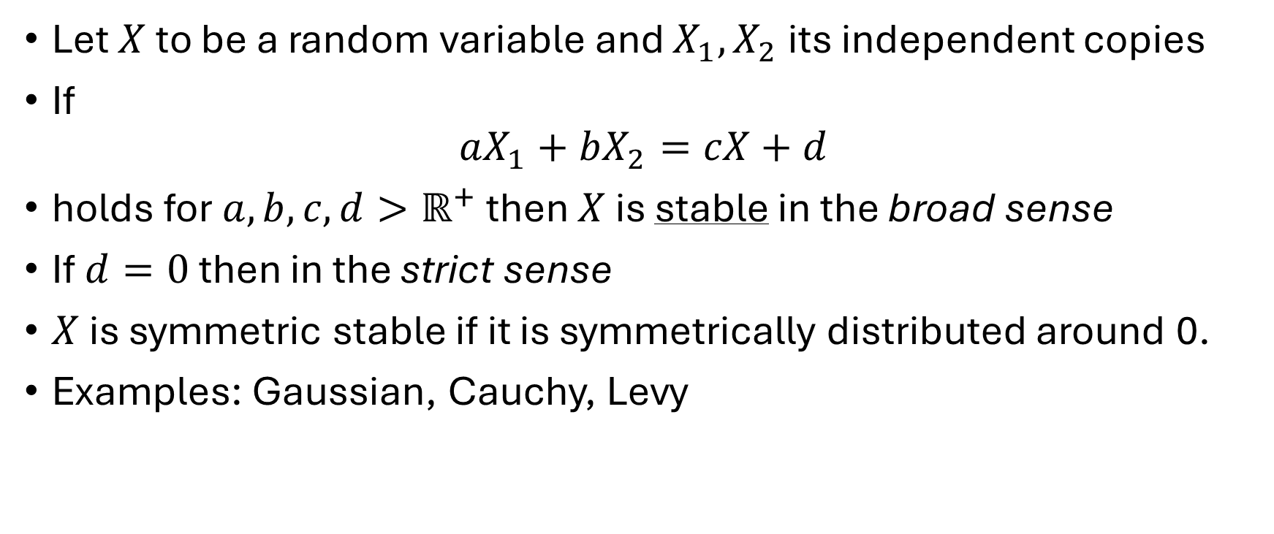
Stable distributions
Let $X$ to be a random variable and $X_{1},X_{2}$ its independent copies
If
$$aX_{1}+bX_{2}=cX+d$$
holds for $a, b, c, d>ℝ^{+}$ then $X$ is stable in the broad sense
If $d=0$ then in the strict sense
$X$ is symmetric stable if it is symmetrically distributed around 0.
Examples: Gaussian, Cauchy, Levy

Slide 4
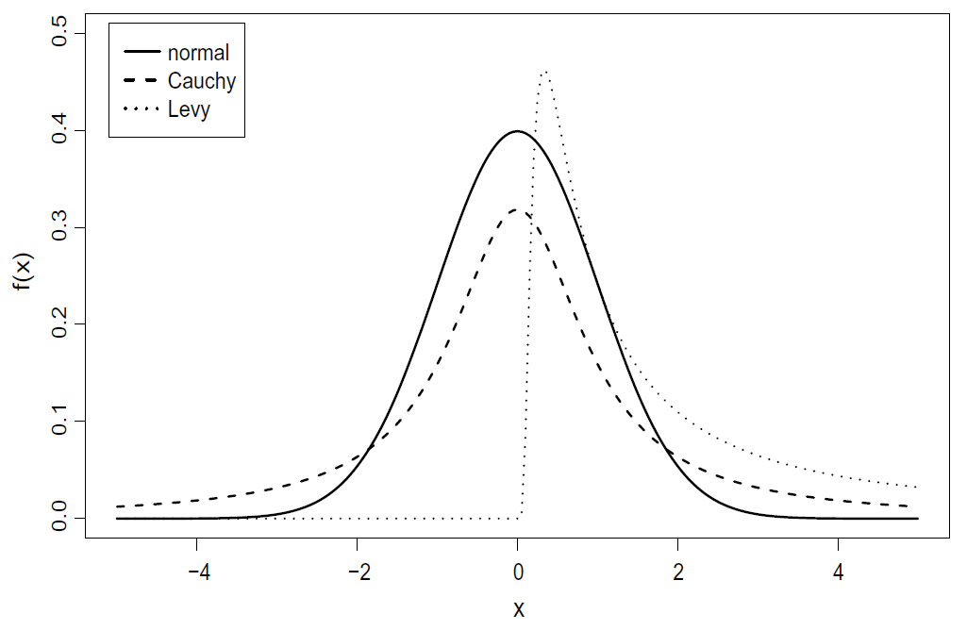

Examples
Gaussian: $X∼N\left(μ,σ^{2}\right)$
$$f\left(x\right)=\frac{1}{\sqrt{2π}σ}\exp\left(−\frac{{\left(x−μ\right)}^{2}}{2σ^{2}}\right)$$
Cauchy: $X∼Cauchy\left(γ,δ\right)$
$$f\left(x\right)=\frac{\frac{γ}{π} }{γ^{2}+{\left(x−δ\right)}^{2}}$$
Levy: $X∼Levy\left(γ,δ\right)$
$$f\left(x\right)=\sqrt{\frac{γ}{2π}}\frac{1}{{\left(x−δ\right)}^{3/2}}\exp\left(−\frac{γ}{2\left(x−δ\right)}\right)$$

Slide 5
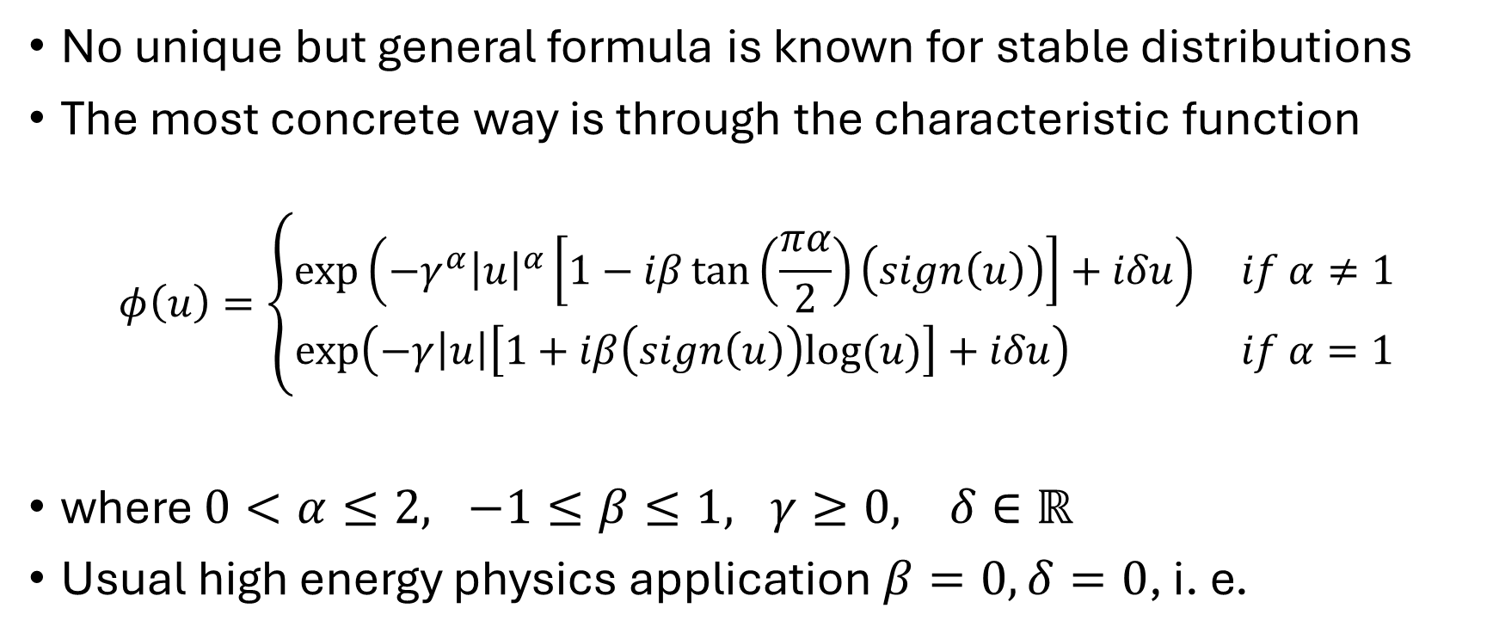
Parametrizations – 1
No unique but general formula is known for stable distributions
The most concrete way is through the characteristic function
$$φ\left(u\right)=\left\{\begin{aligned}\exp\left(−{γ^{α}\left|u\right|}^{α}\left[1−iβ\tan\left(\frac{πα}{2}\right)\left(sign\left(u\right)\right)\right]+iδu\right) if α≠1 \\ \exp\left(−γ\left|u\right|\left[1+iβ\left(sign\left(u\right)\right)log⁡(u)\right]+iδu\right) if α=1\end{aligned}\right.$$
where $0<α≤2, −1≤β≤1, γ≥0, δ∈ℝ$
Usual high energy physics application $β=0, δ=0$, i. e.
$$φ\left(u\right)=\exp\left(−γ^{α}{\left|u\right|}^{α}\right) ⇒ S\left(α,0,γ,0;x\right)=∫e^{iux}φ\left(u\right)$$

Slide 6
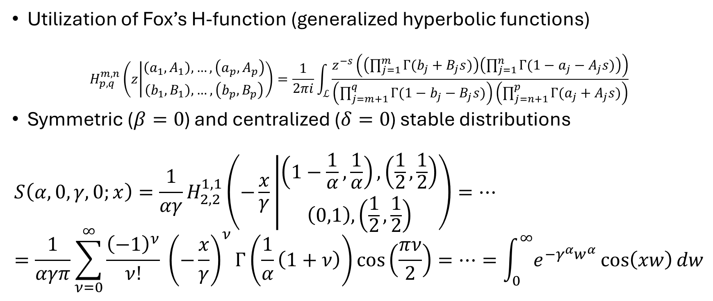
Parametrizations – 2
Utilization of Fox’s H-function (generalized hyperbolic functions)
$$H_{p,q}^{m,n}\left(z | \begin{matrix}\left(a_{1},A_{1}\right),…,\left(a_{p},A_{p}\right) \\ \left(b_{1},B_{1}\right),…,\left(b_{p},B_{p}\right)\end{matrix}\right)=\frac{1}{2πi}\int_{ℒ}{\frac{z^{−s}\left(\left(\prod_{j=1}^{m}{Γ(b_{j}+B_{j}s})\right)\left(\prod_{j=1}^{n}{Γ({1−a}_{j}−A_{j}s})\right)\right)}{\left(\prod_{j=m+1}^{q}{Γ(1−b_{j}−B_{j}s})\right)\left(\prod_{j=n+1}^{p}{Γ(a_{j}+A_{j}s})\right)}}$$
Symmetric ($β=0$) and centralized ($δ=0$) stable distributions
$$S\left(α,0,γ,0;x\right)=\frac{1}{αγ}H_{2,2}^{1,1}\left(−\frac{x}{γ} | \begin{matrix}\left(1−\frac{1}{α},\frac{1}{α}\right),\left(\frac{1}{2},\frac{1}{2}\right) \\ \left(0,1\right),\left(\frac{1}{2},\frac{1}{2}\right)\end{matrix}\right)=…=\frac{1}{αγπ}\sum_{ν=0}^{∞}{\frac{{\left(−1\right)}^{ν}}{ν!} {\left(−\frac{x}{γ}\right)}^{ν}Γ\left(\frac{1}{α}\left(1+ν\right)\right)\cos\left(\frac{πν}{2}\right)}=…=\int_{0}^{∞}{e^{−γ^{α}w^{α}}\cos\left(xw\right)}dw$$

Slide 7
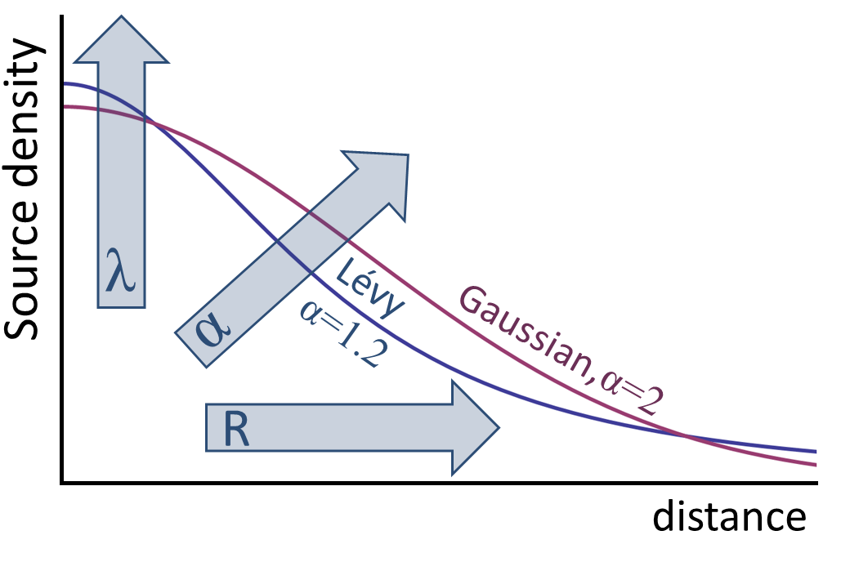
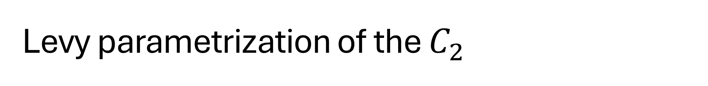

Levy parametrization of the $C_{2}$
Generalized Gaussian – Levy distribution
$$ℒ\left(α,R,r\right)=\frac{1}{{\left(2π\right)}^{3}}∫d^{3}q e^{iqr}e^{−\frac{1}{2}{\left|qR\right|}^{α}}$$
$α=2$: Gaussian, $α=1$: Cauchy, $0<α≤2$: Levy
Assume the source to be Levy! $C_{2}\left(Q\right)=1+λe^{{\left(RQ\right)}^{α}}$
$λ(K):$ core-halo parameter
$R(K)$: Levy-scale parameter
$α(K)$: Levy index of stability

Slide 8
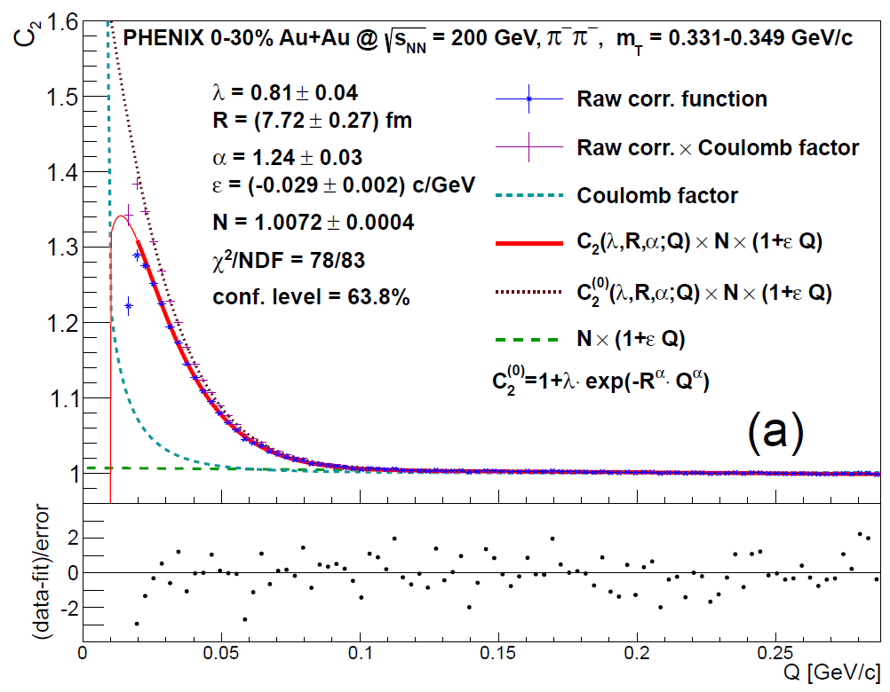
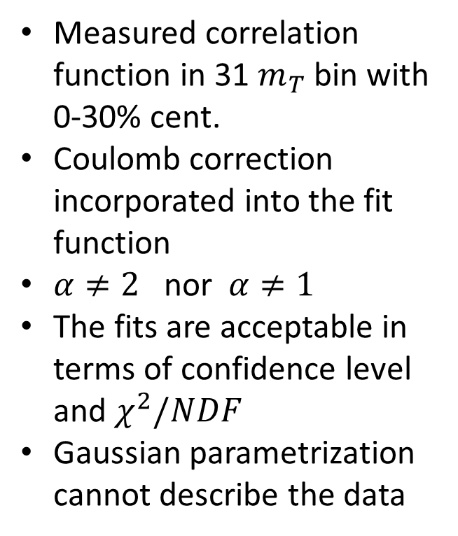
The first results – PHENIX 0-30% Au+Au
Measured correlation function in 31 $m_{T}$ bin with 0-30% cent.
Coulomb correction incorporated into the fit function
$α≠2$ nor $α≠1$
The fits are acceptable in terms of confidence level and $χ^{2}/NDF$
Gaussian parametrization cannot describe the data

Slide 9
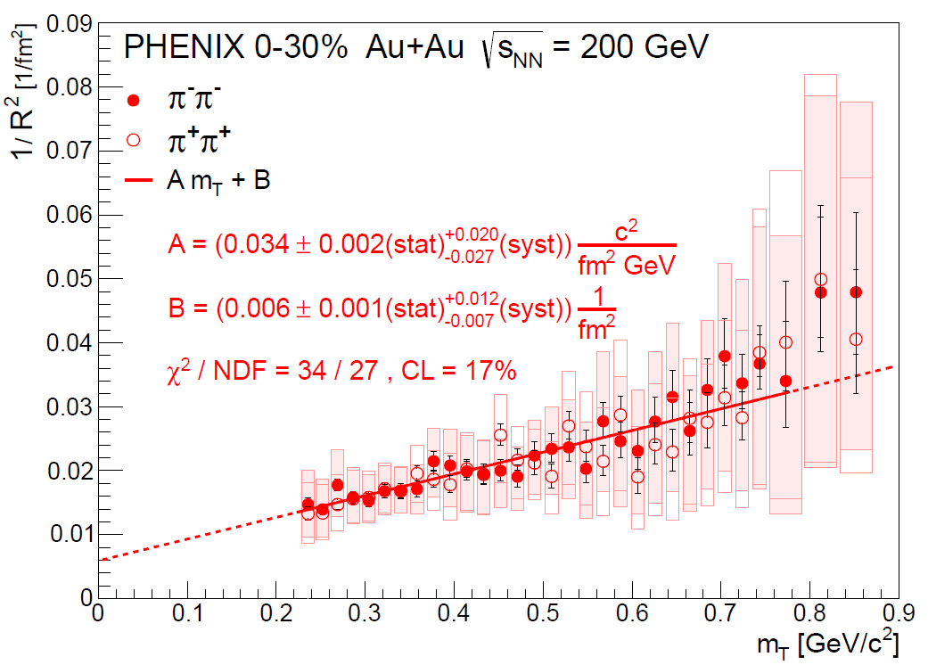
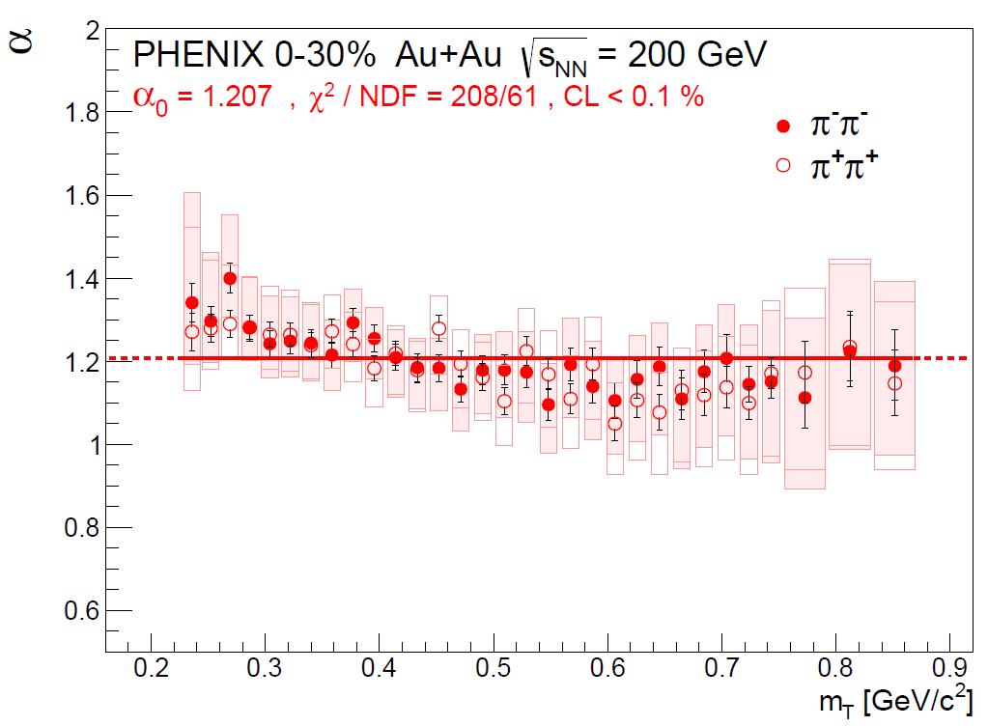
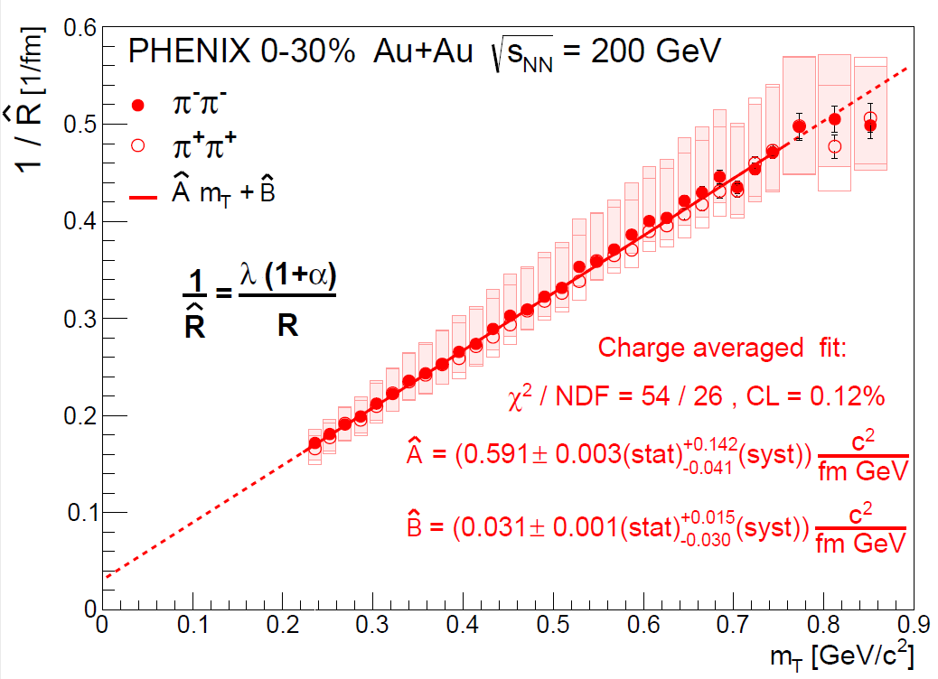
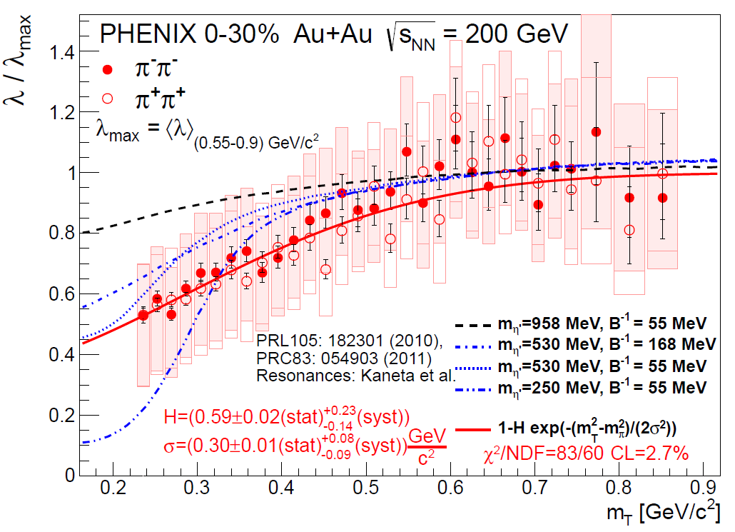
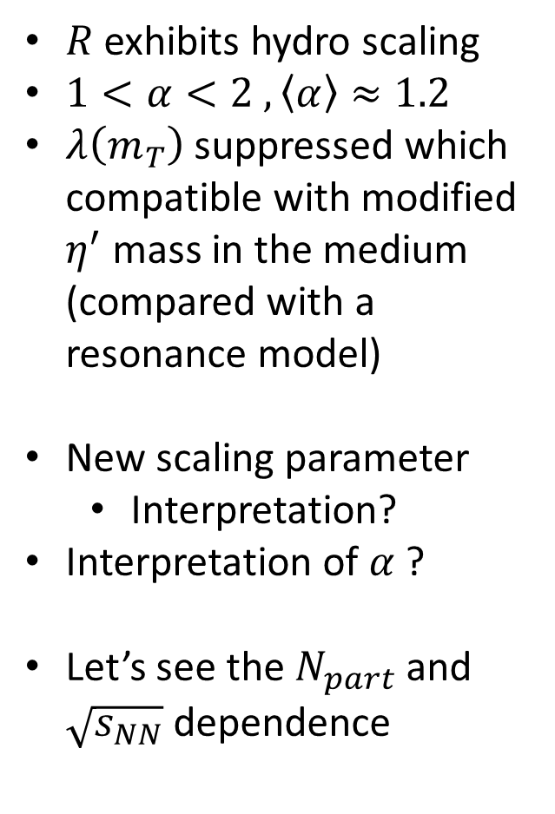
The first results – PHENIX 0-30%, Au+Au
$R$ exhibits hydro scaling
$1<α<2 , \left\langle α\right\rangle ≈1.2$
$λ\left(m_{T}\right)$ suppressed which compatible with modified $η^{′}$ mass in the medium (compared with a resonance model)
New scaling parameter
  Interpretation?
Interpretation of $α$ ?
Let’s see the $N_{part}$ and $\sqrt{s_{NN}}$ dependence

Slide 10
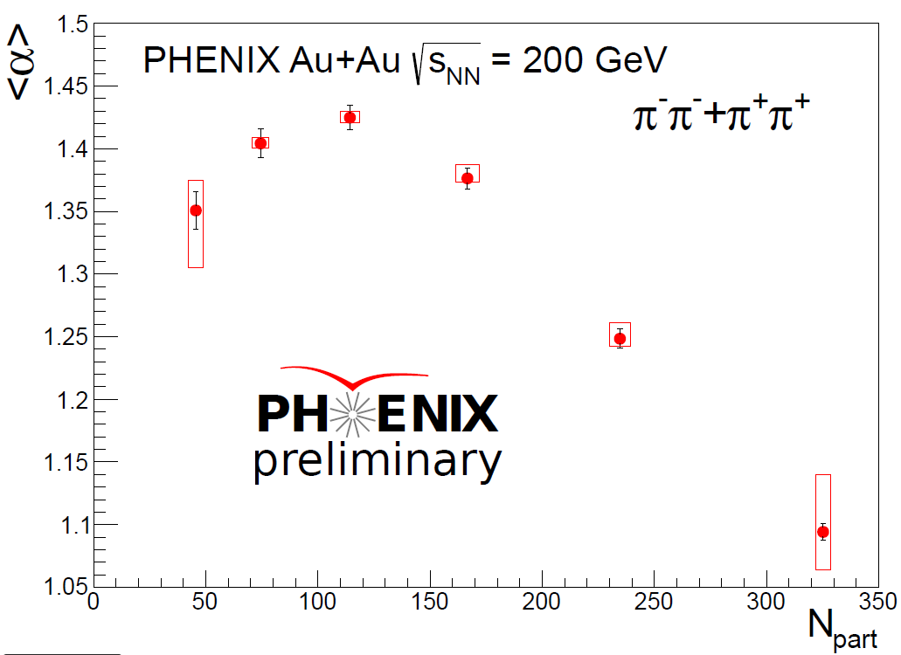
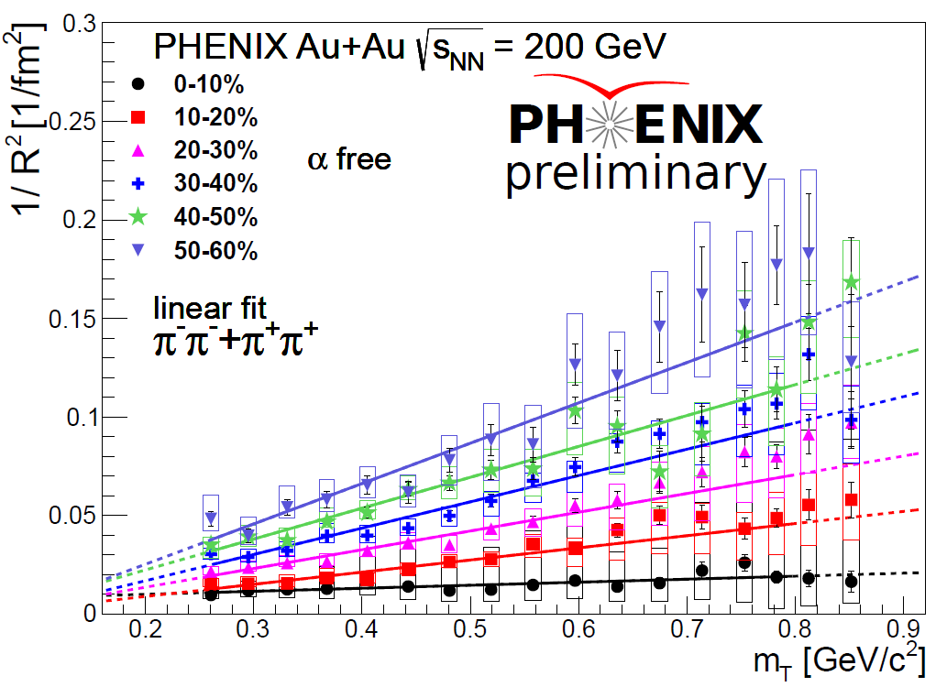
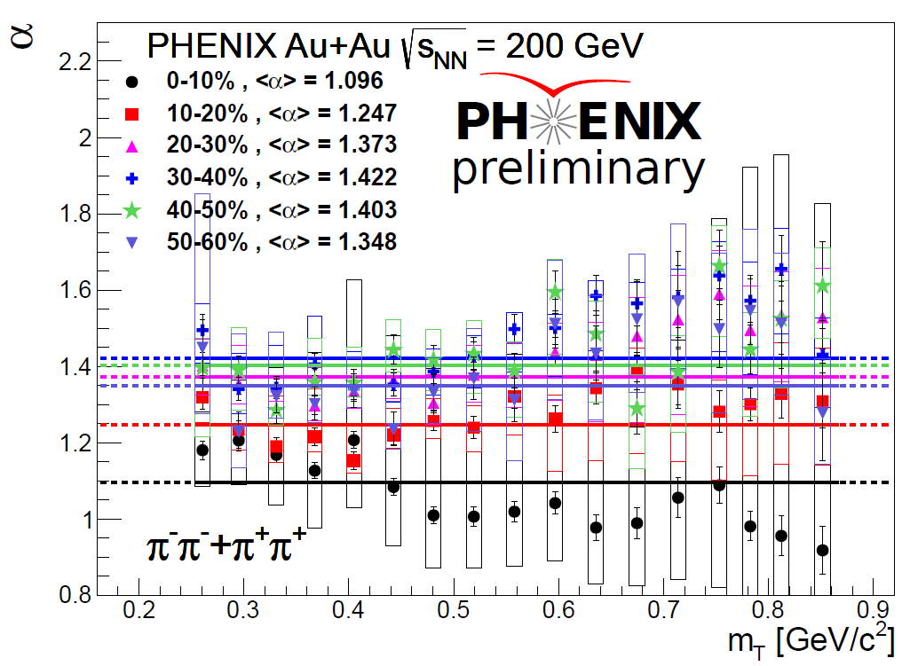
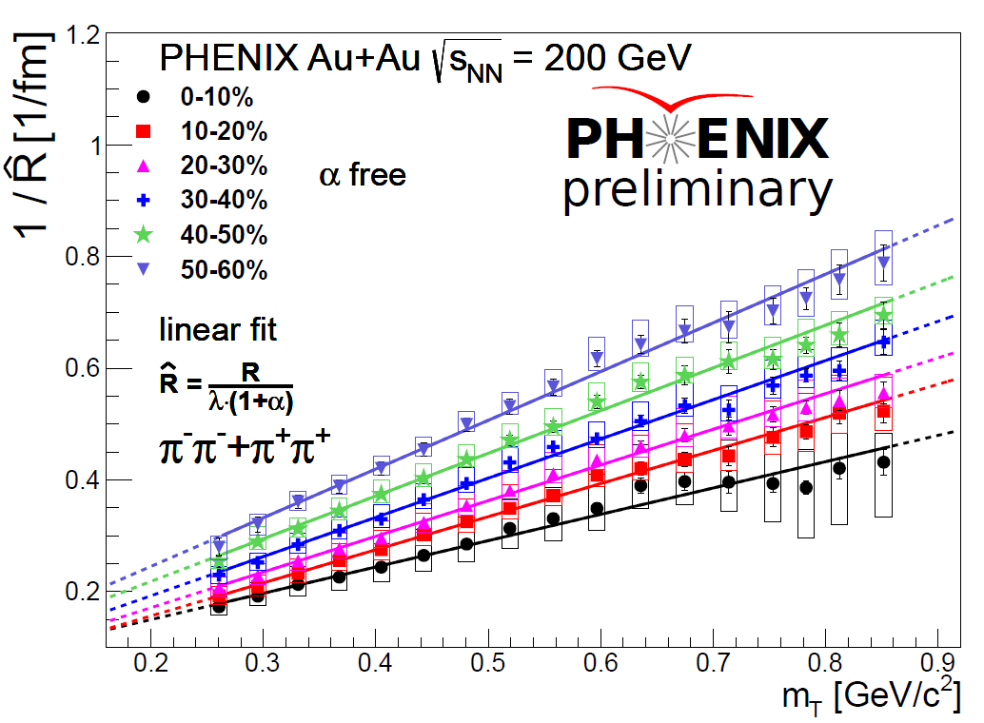
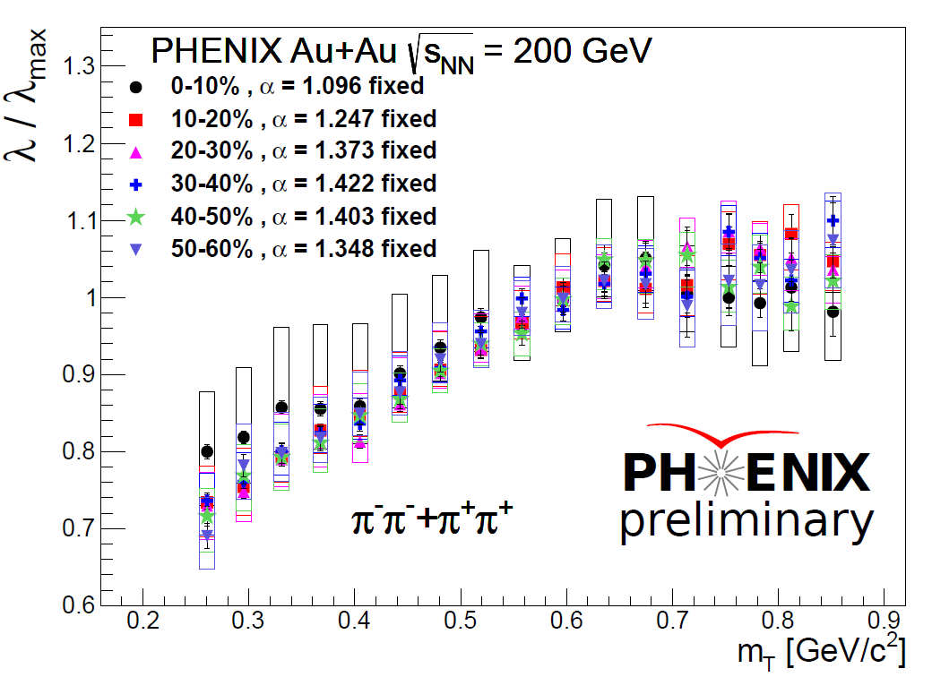
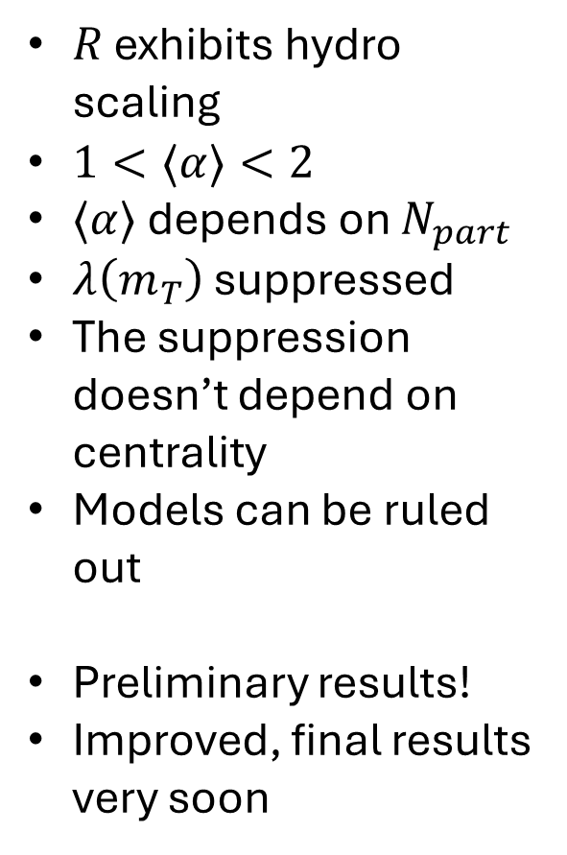
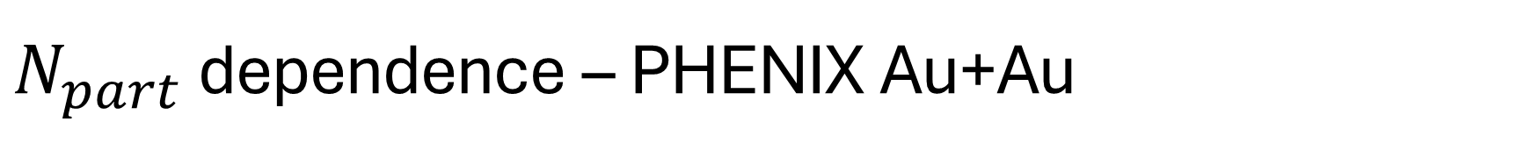
$N_{part}$ dependence – PHENIX Au+Au
$R$ exhibits hydro scaling
$1<⟨α⟩<2$
$⟨α⟩$ depends on $N_{part}$
$λ\left(m_{T}\right)$ suppressed
The suppression doesn’t depend on centrality
Models can be ruled out
Preliminary results!
Improved, final results very soon

Slide 11
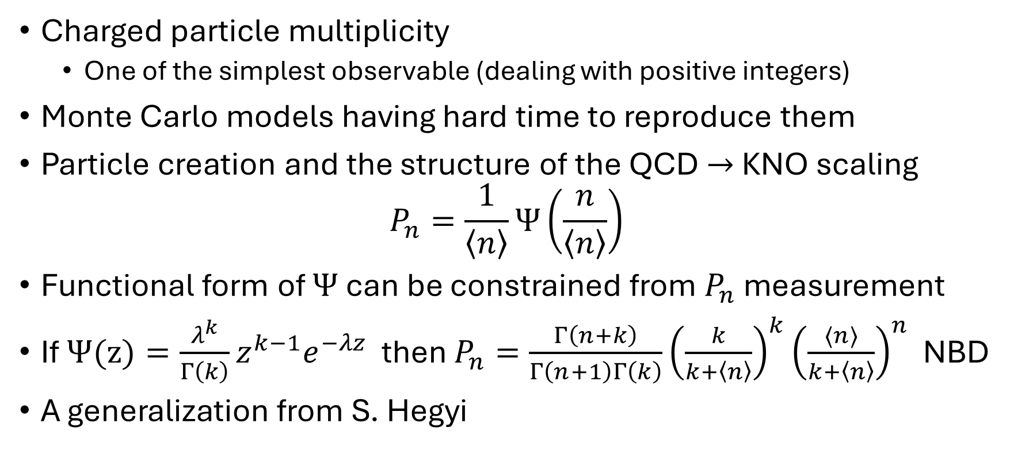
Application in multiplicity measurement
Charged particle multiplicity
  One of the simplest observable (dealing with positive integers)
Monte Carlo models having hard time to reproduce them
Particle creation and the structure of the QCD $→$ KNO scaling
$$P_{n}=\frac{1}{\left\langle n\right\rangle }Ψ\left(\frac{n}{\left\langle n\right\rangle }\right)$$
Functional form of $Ψ$ can be constrained from $P_{n}$ measurement
If $Ψ(z)=\frac{λ^{k}}{Γ\left(k\right)}z^{k−1}e^{−λz}$ then $P_{n}=\frac{Γ\left(n+k\right)}{Γ\left(n+1\right)Γ\left(k\right)}{\left(\frac{k}{k+\left\langle n\right\rangle }\right)}^{k}{\left(\frac{⟨n⟩}{k+\left\langle n\right\rangle }\right)}^{n}$ NBD
A generalization from S. Hegyi

Slide 12
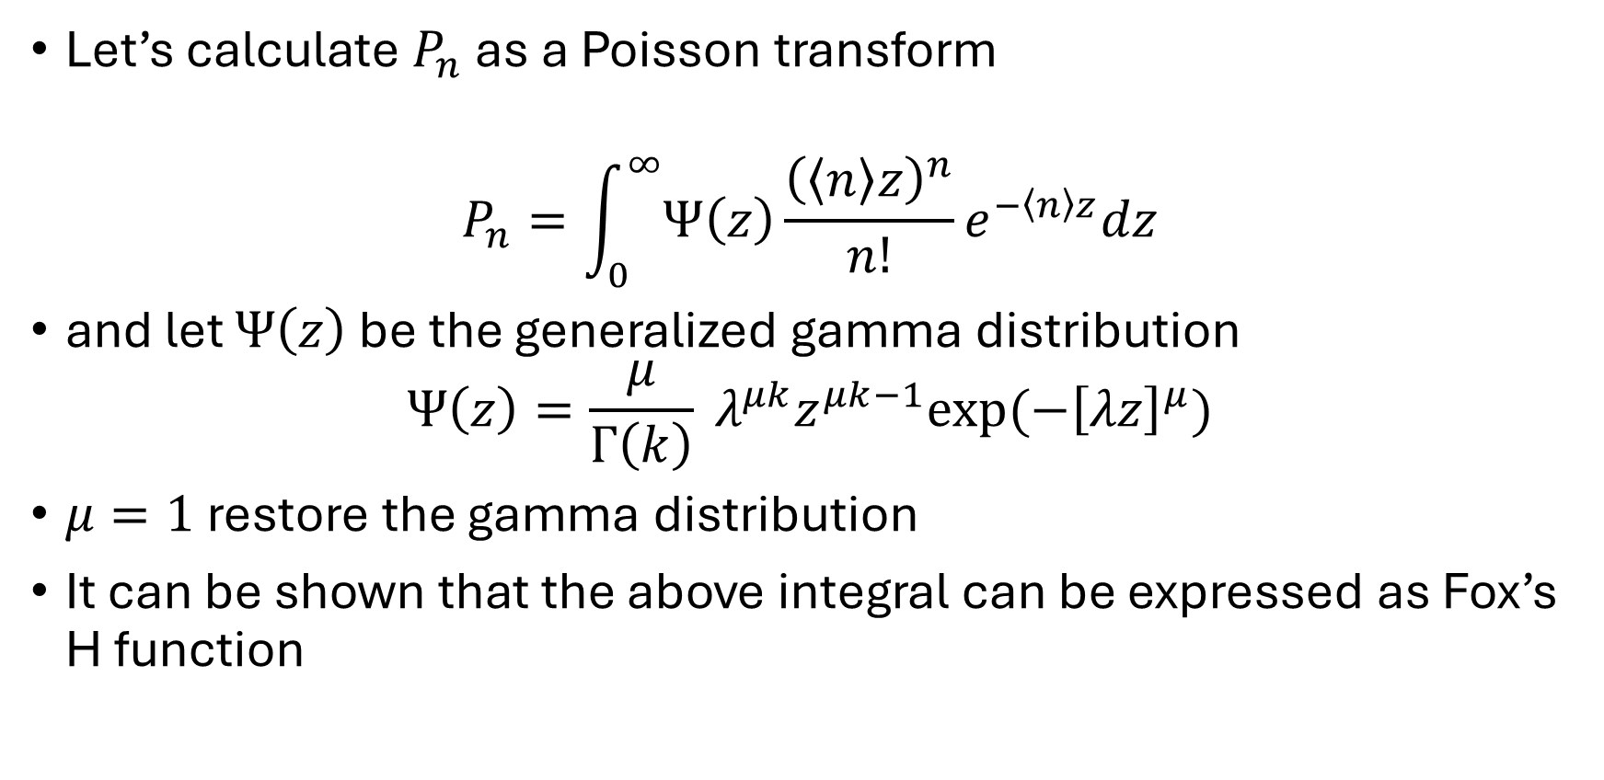
Generalized NBD
Let’s calculate $P_{n}$ as a Poisson transform
$$P_{n}=\int_{0}^{∞}{Ψ\left(z\right)}\frac{{\left(\left\langle n\right\rangle z\right)}^{n}}{n!}e^{−\left\langle n\right\rangle z}dz$$
and let $Ψ\left(z\right)$ be the generalized gamma distribution
$$Ψ\left(z\right)=\frac{μ}{Γ\left(k\right)} λ^{μk}z^{μk−1}exp⁡(−{\left[λz\right]}^{μ})$$
$μ=1$ restore the gamma distribution
It can be shown that the above integral can be expressed as Fox’s H function

Slide 13
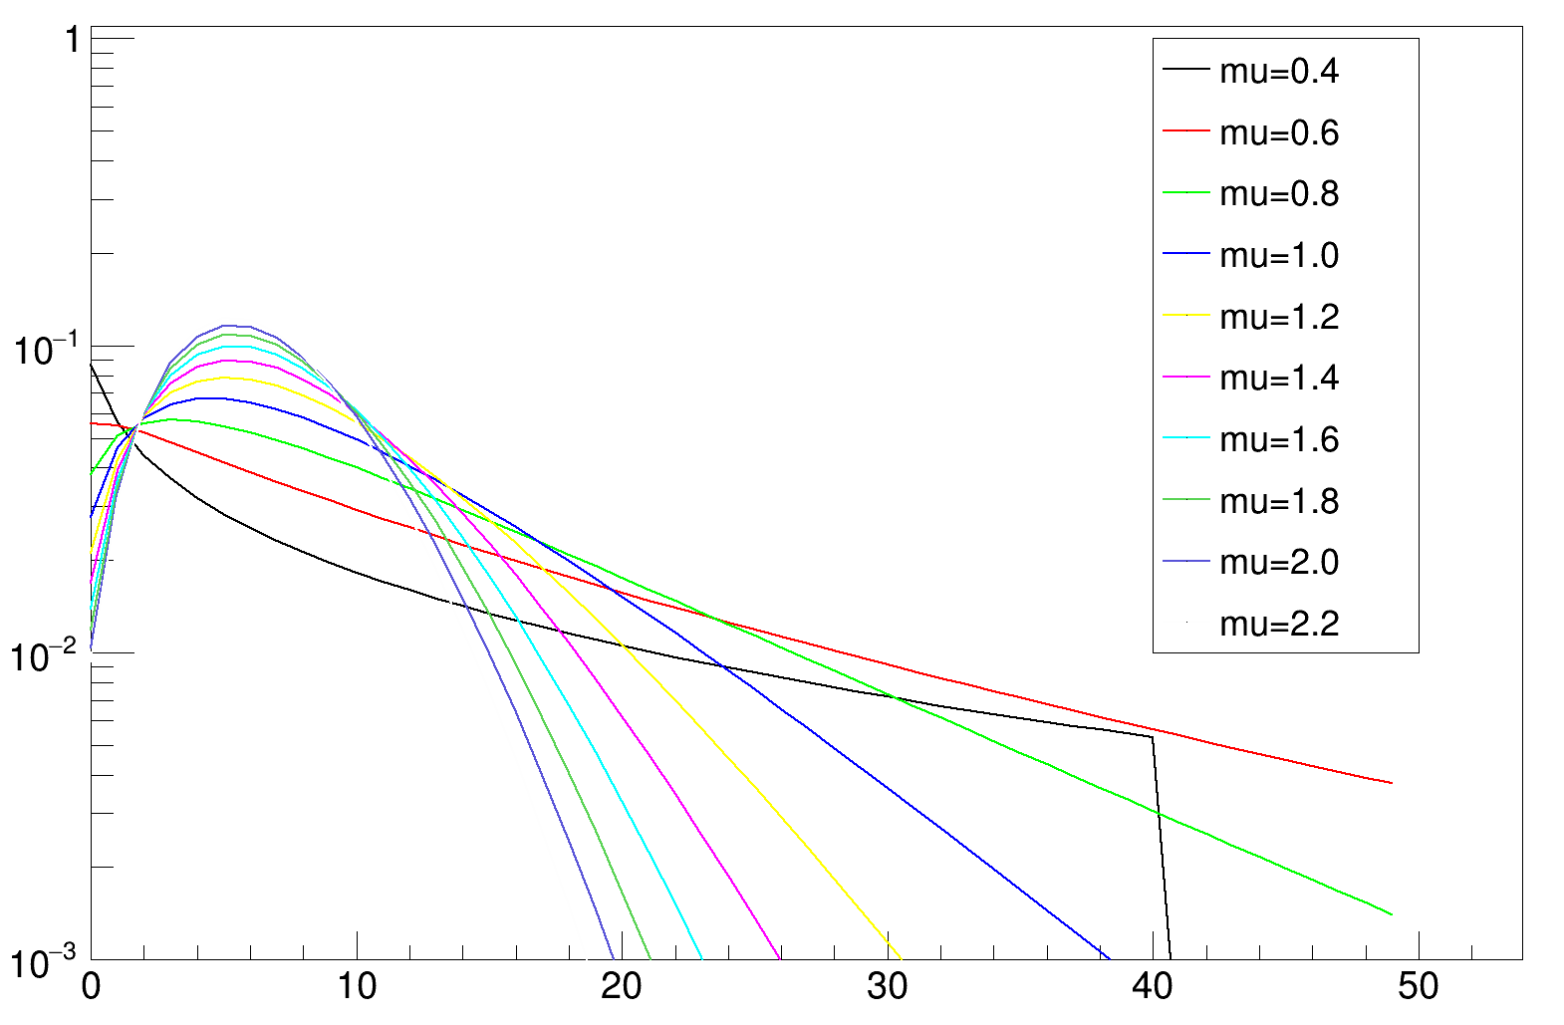
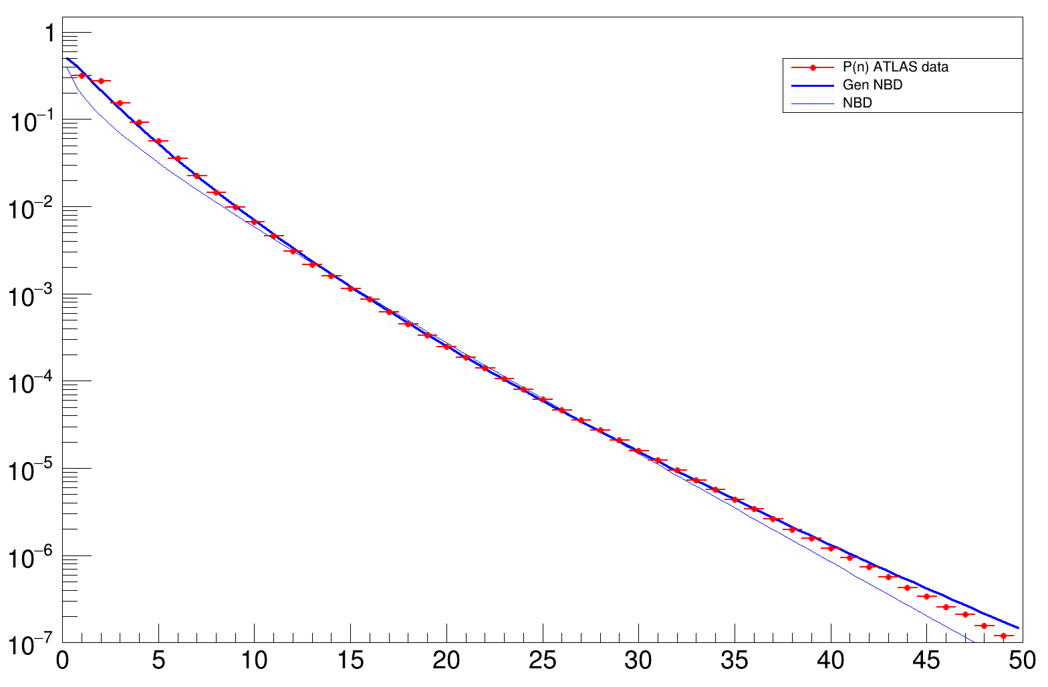
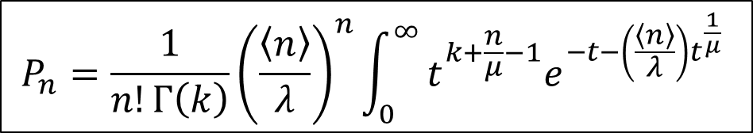
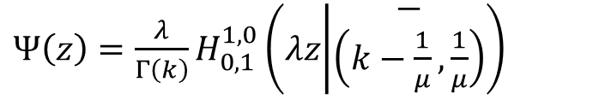
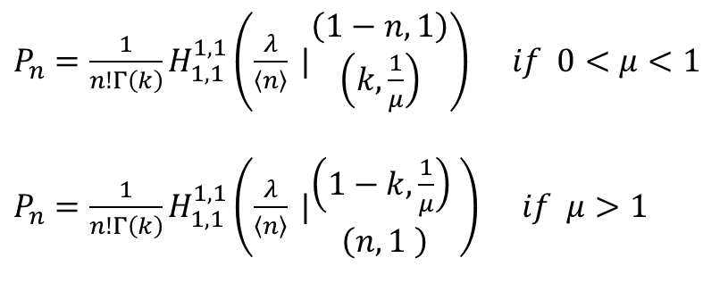
Generalized NBD – Fox’s H function
$Ψ\left(z\right)=\frac{λ}{Γ\left(k\right)}H_{0,1}^{1,0}\left(λz | \begin{matrix}− \\ \left(k−\frac{1}{μ},\frac{1}{μ}\right)\end{matrix}\right)$
$P_{n}=\frac{1}{n!Γ\left(k\right)}H_{1,1}^{1,1}\left(\frac{λ}{\left\langle n\right\rangle } |\begin{matrix}\left(1−n,1\right) \\ \left(k,\frac{1}{μ}\right)\end{matrix}\right) if 0<μ<1$
$P_{n}=\frac{1}{n!Γ\left(k\right)}H_{1,1}^{1,1}\left(\frac{λ}{\left\langle n\right\rangle } |\begin{matrix}\left(1−k,\frac{1}{μ}\right) \\ \left(n,1 \right)\end{matrix}\right) if μ>1$
$$P_{n}=\frac{1}{n!Γ\left(k\right)}{\left(\frac{\left\langle n\right\rangle }{λ}\right)}^{n}\int_{0}^{∞}{t^{k+\frac{n}{μ}−1}e^{−t−\left(\frac{\left\langle n\right\rangle }{λ}\right)t^{\frac{1}{μ}}} }$$
Details and more applications:
[1] , [2] , [3] , [4] , [5]

Slide 14
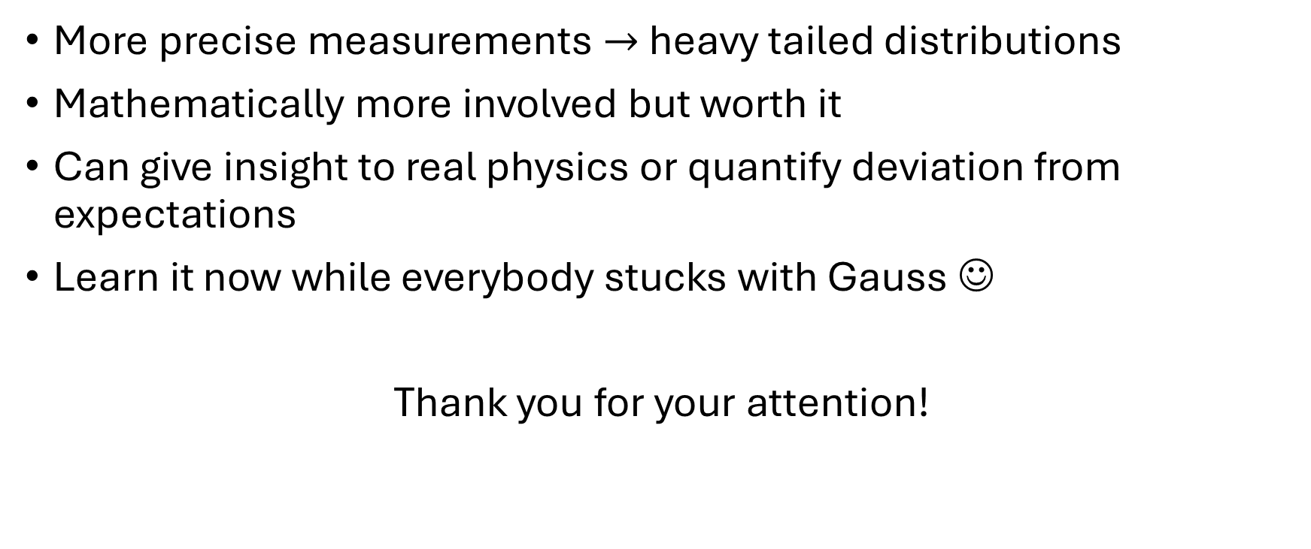
Summary
More precise measurements $→$ heavy tailed distributions
Mathematically more involved but worth it
Can give insight to real physics or quantify deviation from expectations
Learn it now while everybody stucks with Gauss ☺
Thank you for your attention!

