Slide 1
Semester Project
LVPS capacitive load tests
Tamara Leuthold

Slide 2
Overview
LVPS
Measurement setup
Ramp up speed measurements
    Ramp up parameter vs. risetime
    Derivative of ramp up voltage
Capacitive load measurements
    First tests
    Python script
    Capacitive load tests
Summary

Slide 3
LVPS
    Second conversion step in the powering concept
    Convert 380 V DC to 12 V DC
    Located in a hazardous environment (radiation and magnetic field)
    Needs strict and redundant OVP
Notes:
- the low voltage power supplies are the second step of the updated power distribution chain of the CMS
- convert 380 V DC to 12 V DC
there are important technical requirements:
- located 40 m from front end electronics -> needs to be tolerant to radiation and magnetic field
- strict and redundant OVP to protect point of load DC-DC converters

Slide 4
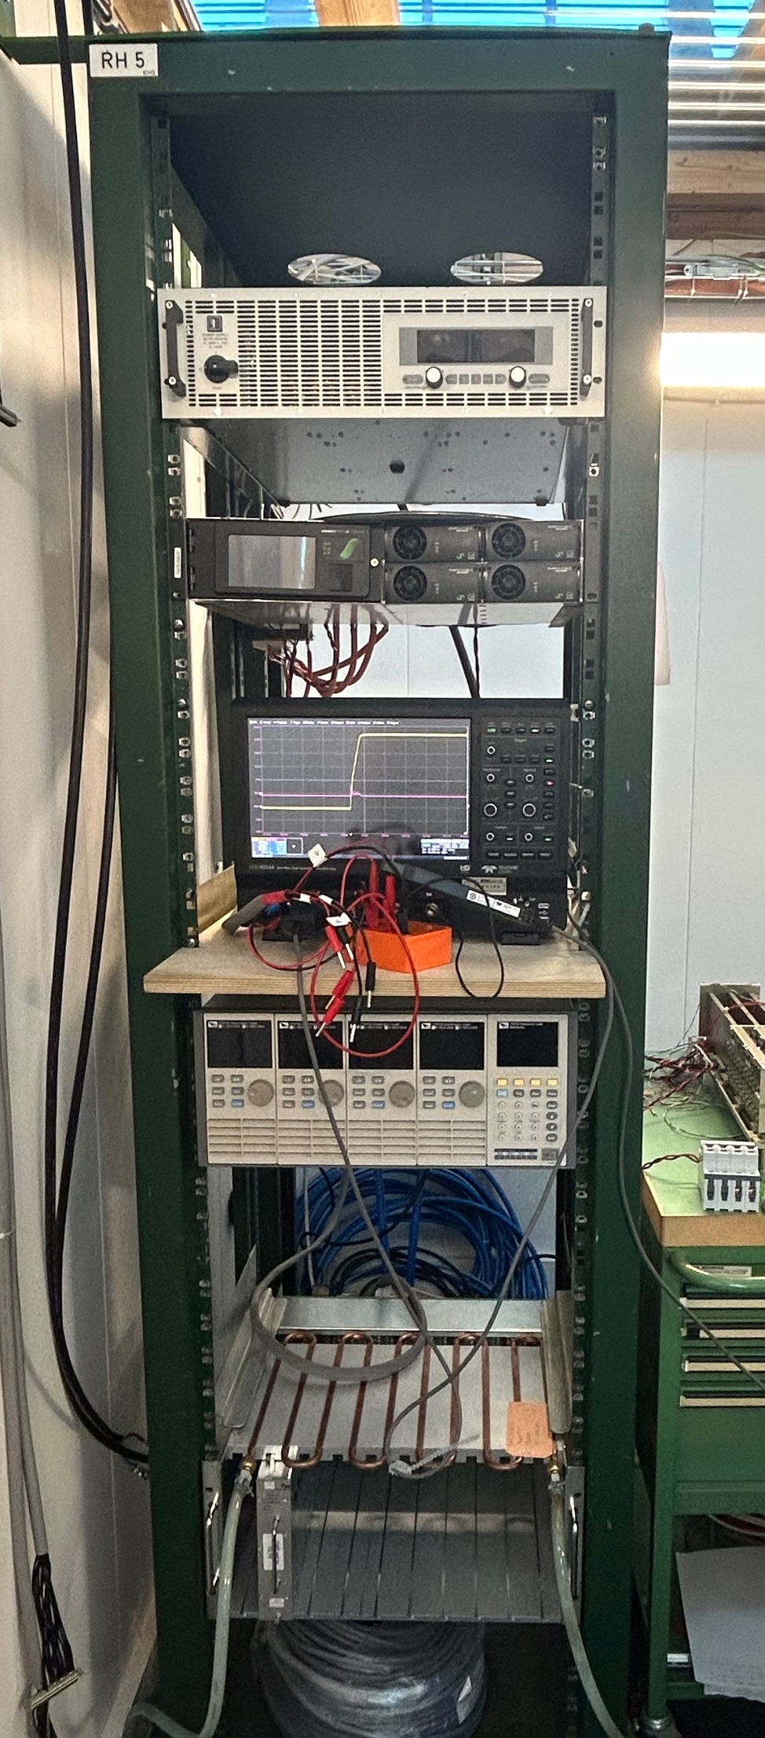
Measurement Setup
    380 V DC power supply
    Oscilloscope
    LVPS module
    Water cooling

Slide 5
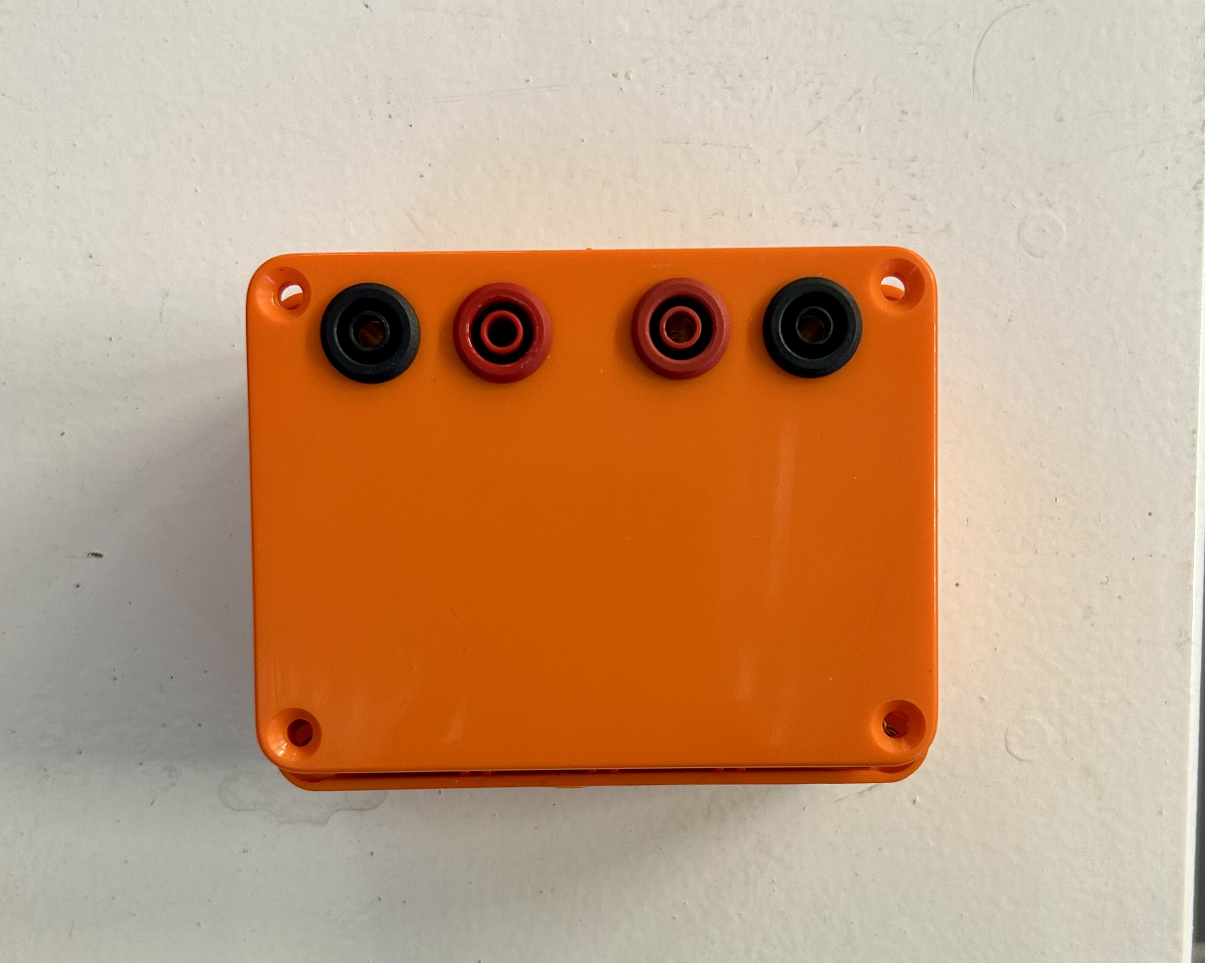
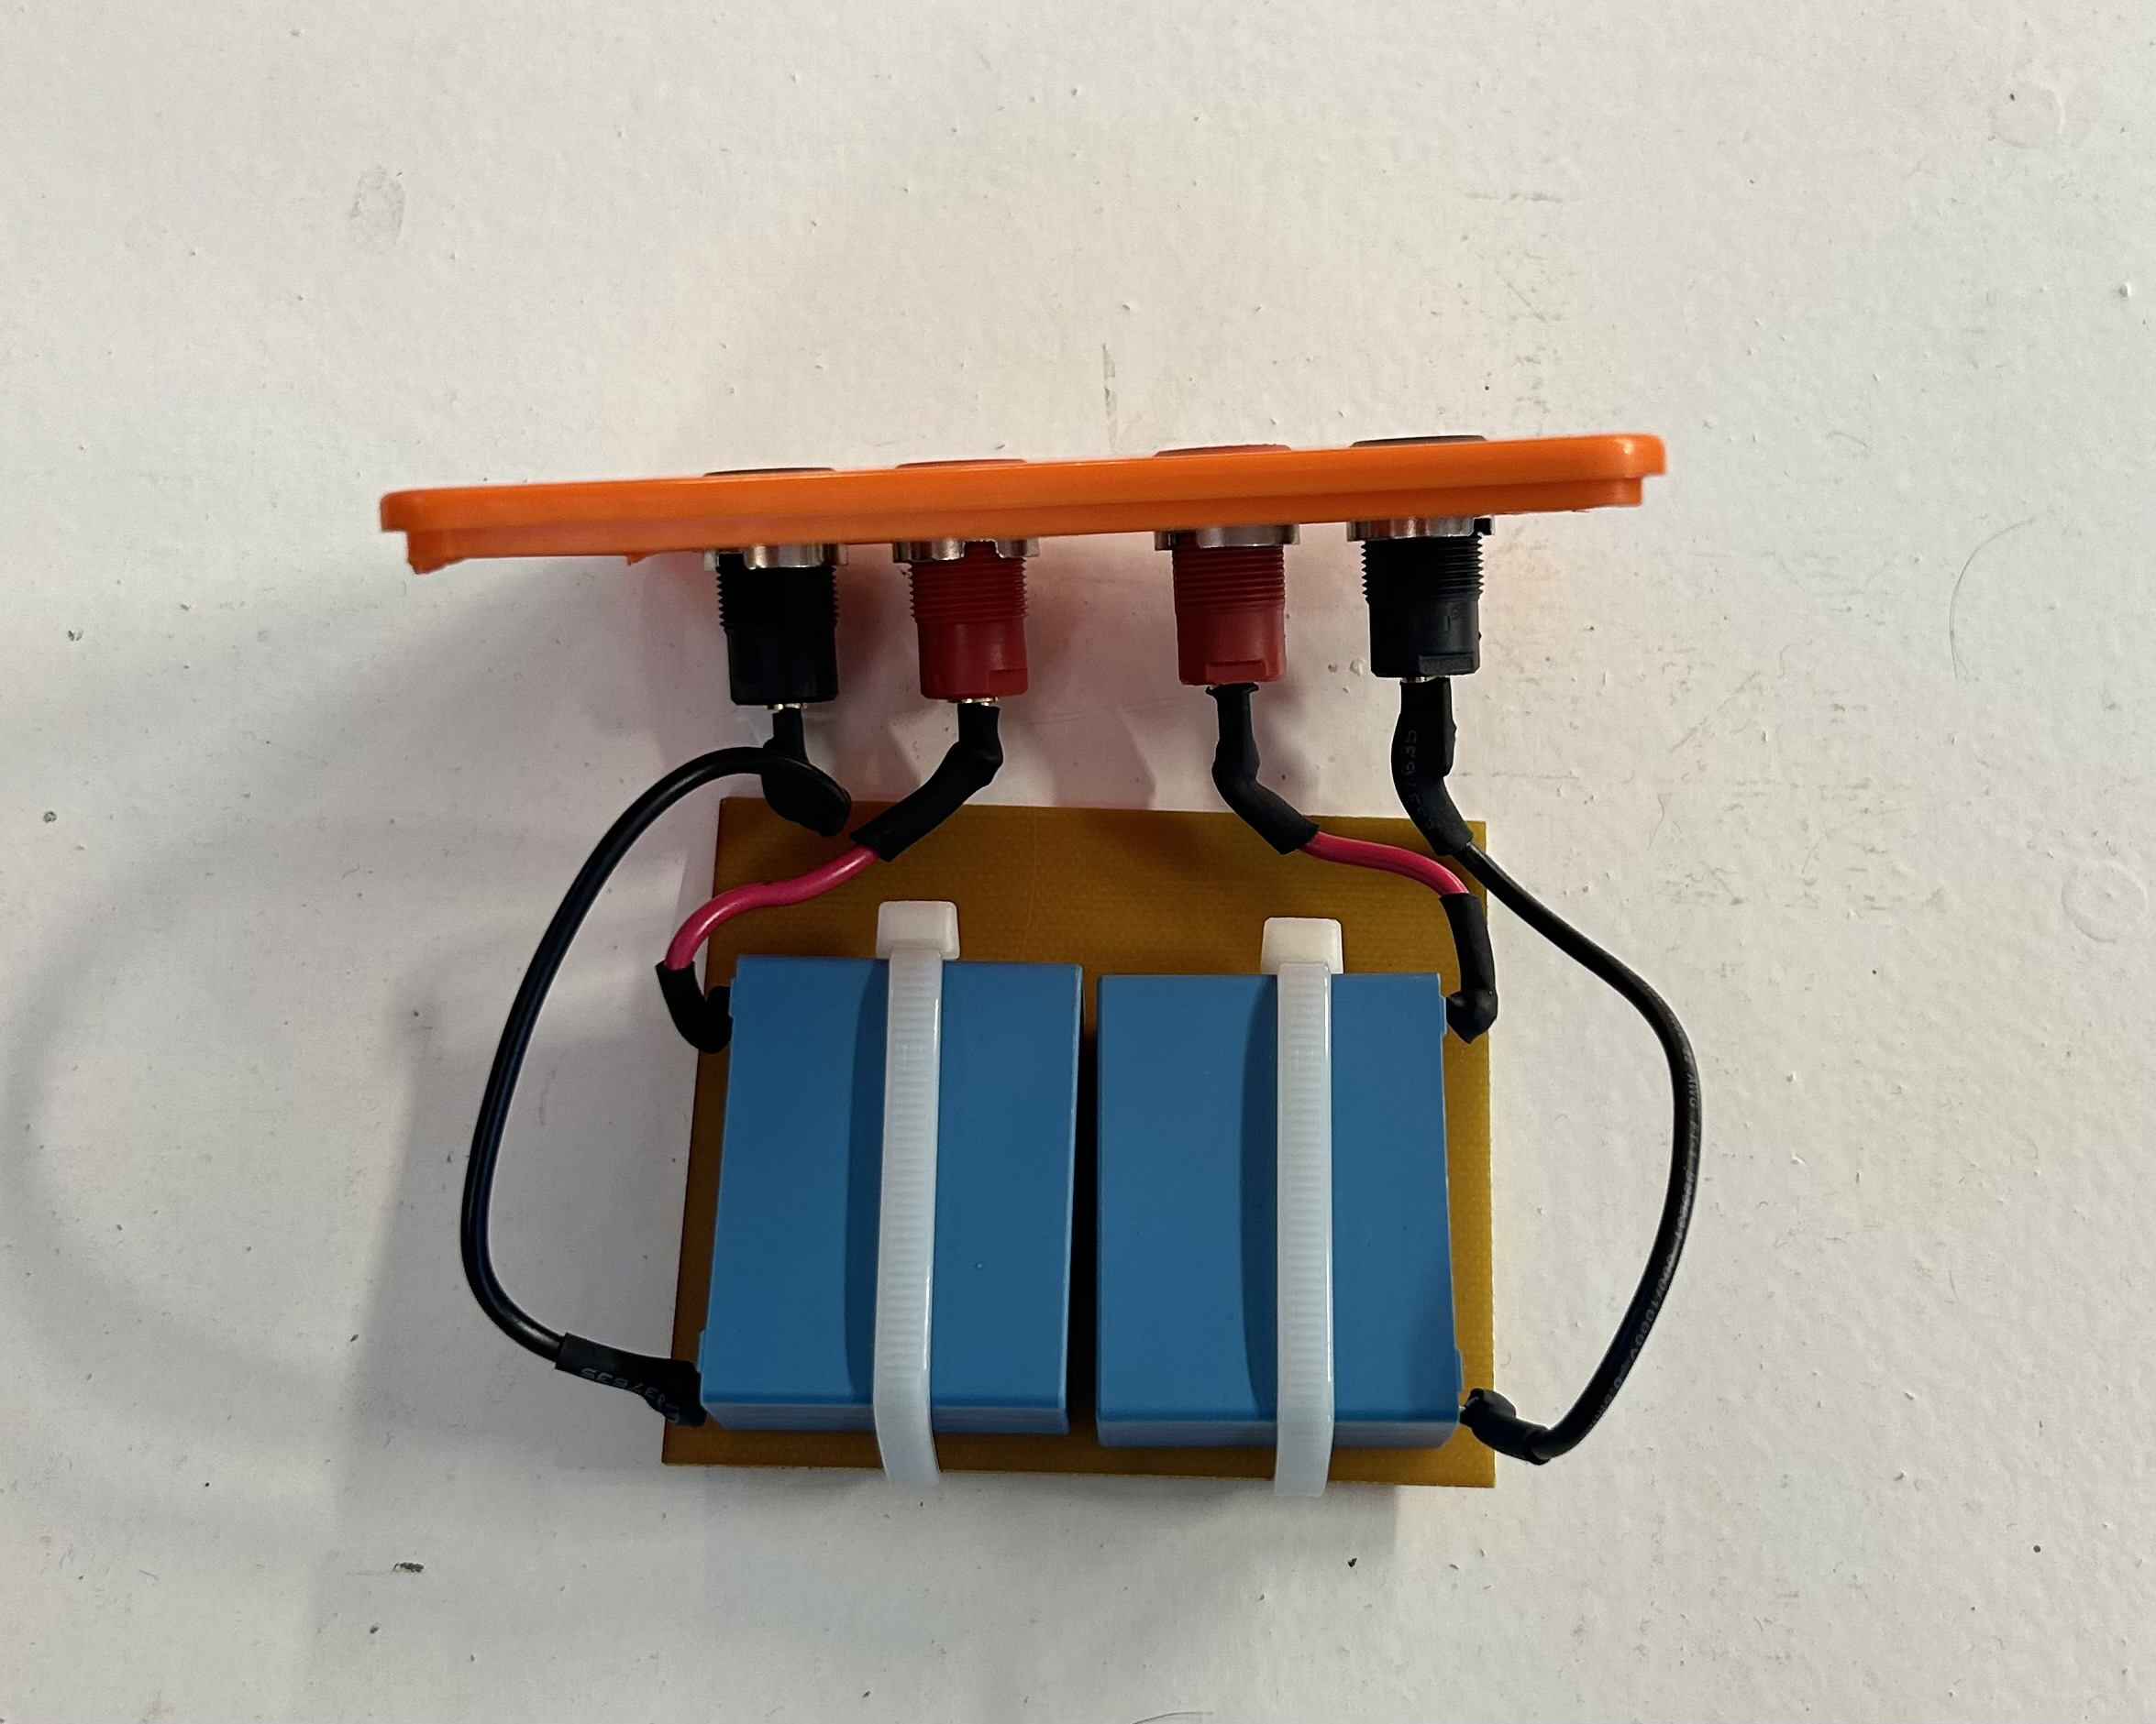
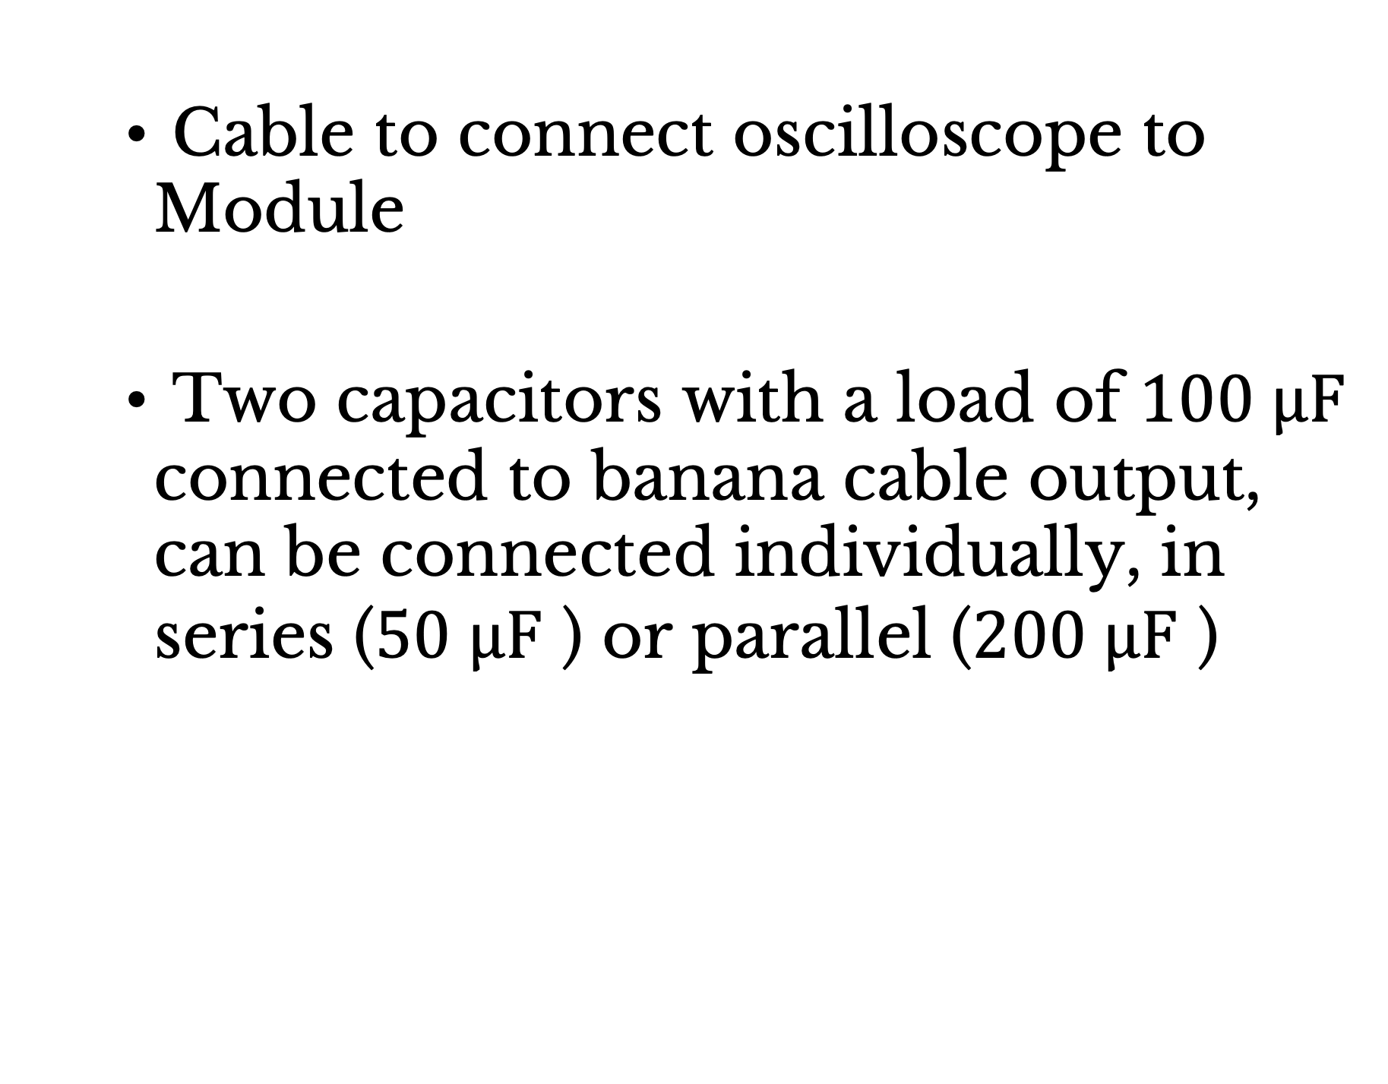
Measurement Setup
    Cable to connect oscilloscope to Module
    Two capacitors with a load of $100 μF$ connected to banana cable output, can be connected individually, in series ($50 μF$ ) or parallel ($200 μF$ )
Notes:
- needed a cable with special output to fit modules (built it with Ashley)
- box with two capacitors with a load of 100 mikro F, that are connected to banana outputs
-> can be connected in 3 ways
--> measuring circuit

Slide 6
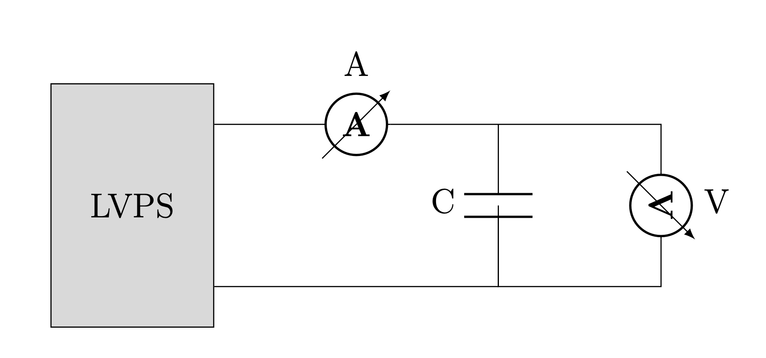
Measurement Setup
Notes:
the measurement circuit you can see here
- voltage and current were measured by the oscilloscope
- capacitance was either: 50, 100 or 200 mikroF

Slide 7
Ramp up speed measurements
    Measuring voltage waveform at ramp up for 13 ramp up parameters from 1 to 128
    Linear fit for ramp up speed and risetime
    Resample voltage signal to 200 samples
    Derivative of filtered voltage signal using finite differences
Notes:
- WIENER-Control is software allows to operate and monitor the channel of the modules
- WIENER-Control only allows to set ramp up parameters which are not given in V/s
- we want ramp up speed and risetime form 10% to 90% max. voltage
-> measured waveforms at ramp up for 13 ramp up parameters from1 to 128 (this range is interesting for operation)
- linear fit
- obtain information about instantaneous ramp up speed -> resample voltage
- derivative

Slide 8
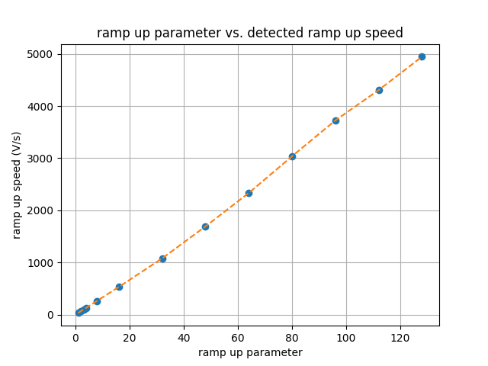
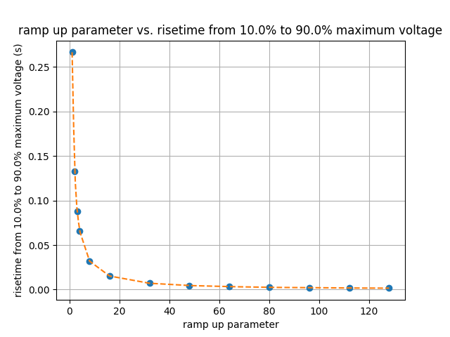
Ramp up speed measurements
    Ramp up parameter vs. risetime
Notes:
- now we can use interpolation to choose a ramp up parameter which corresponds to a desired risetime

Slide 9
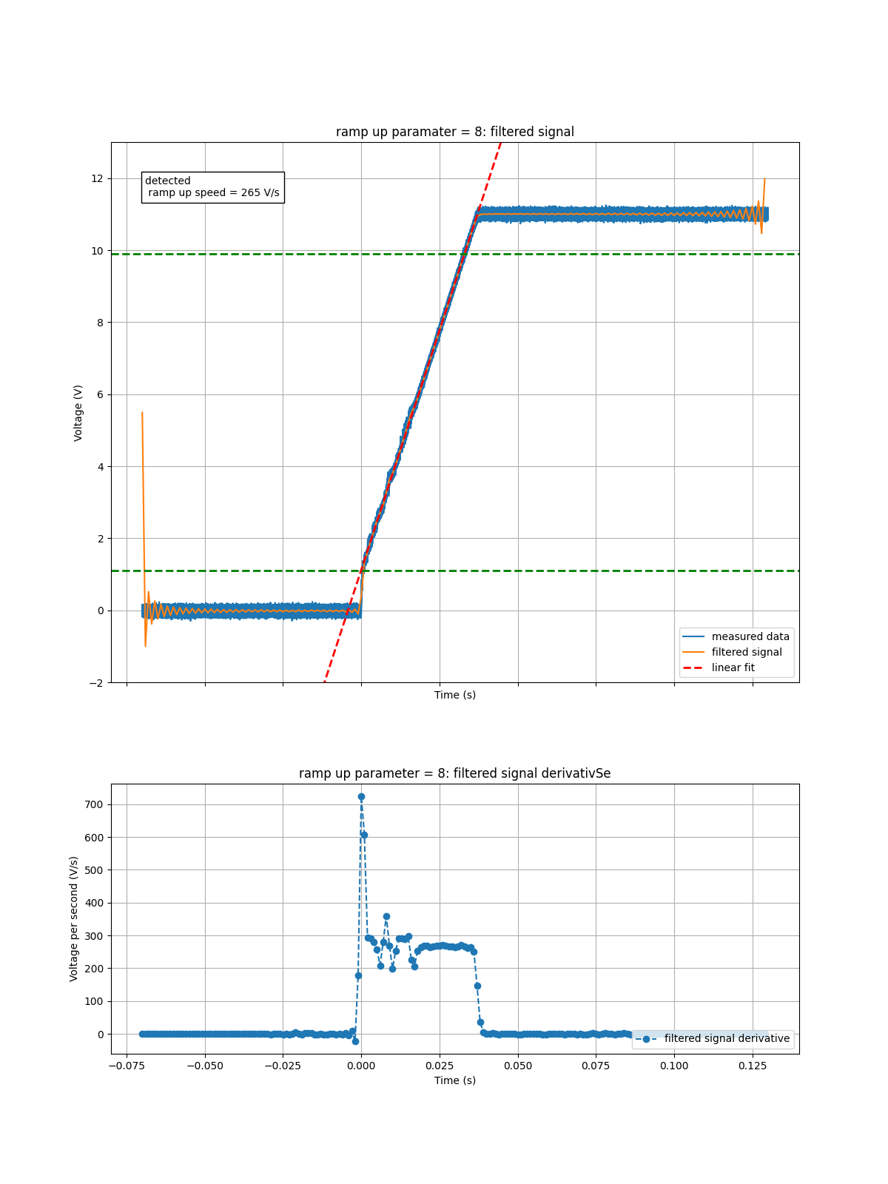
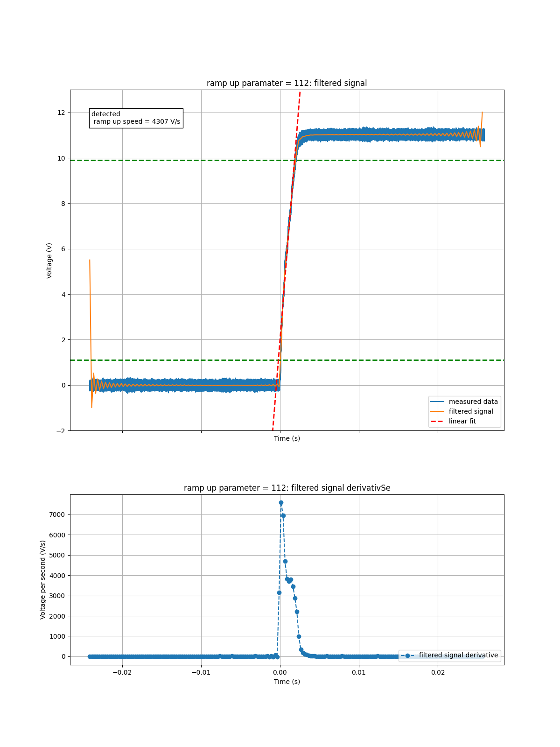
Ramp up speed measurements
    Ramp up parameter 8
    Ramp up parameter 112
Notes:
- fitted plots and derivative
- blue : signal
- orange : fit
- red : linear fit -> ramp up speed and risetime
- green lines show the voltage range from 10% to 90% maximum voltage
- derivative of filtered signal
- without edges

Slide 10
Capacitive load measurements
    First capacitive load tests on channel 1 of module M2
    Python script
    Module M2 tests at two different temperatures
    Module M6 tests
Notes:
- first tests to see how channels respond to the loads
- python script: allows to remotely control oscilloscope and channels and perform measurements
used the script:
- module M2 test at 2 different T
- same tests on module M6

Slide 11
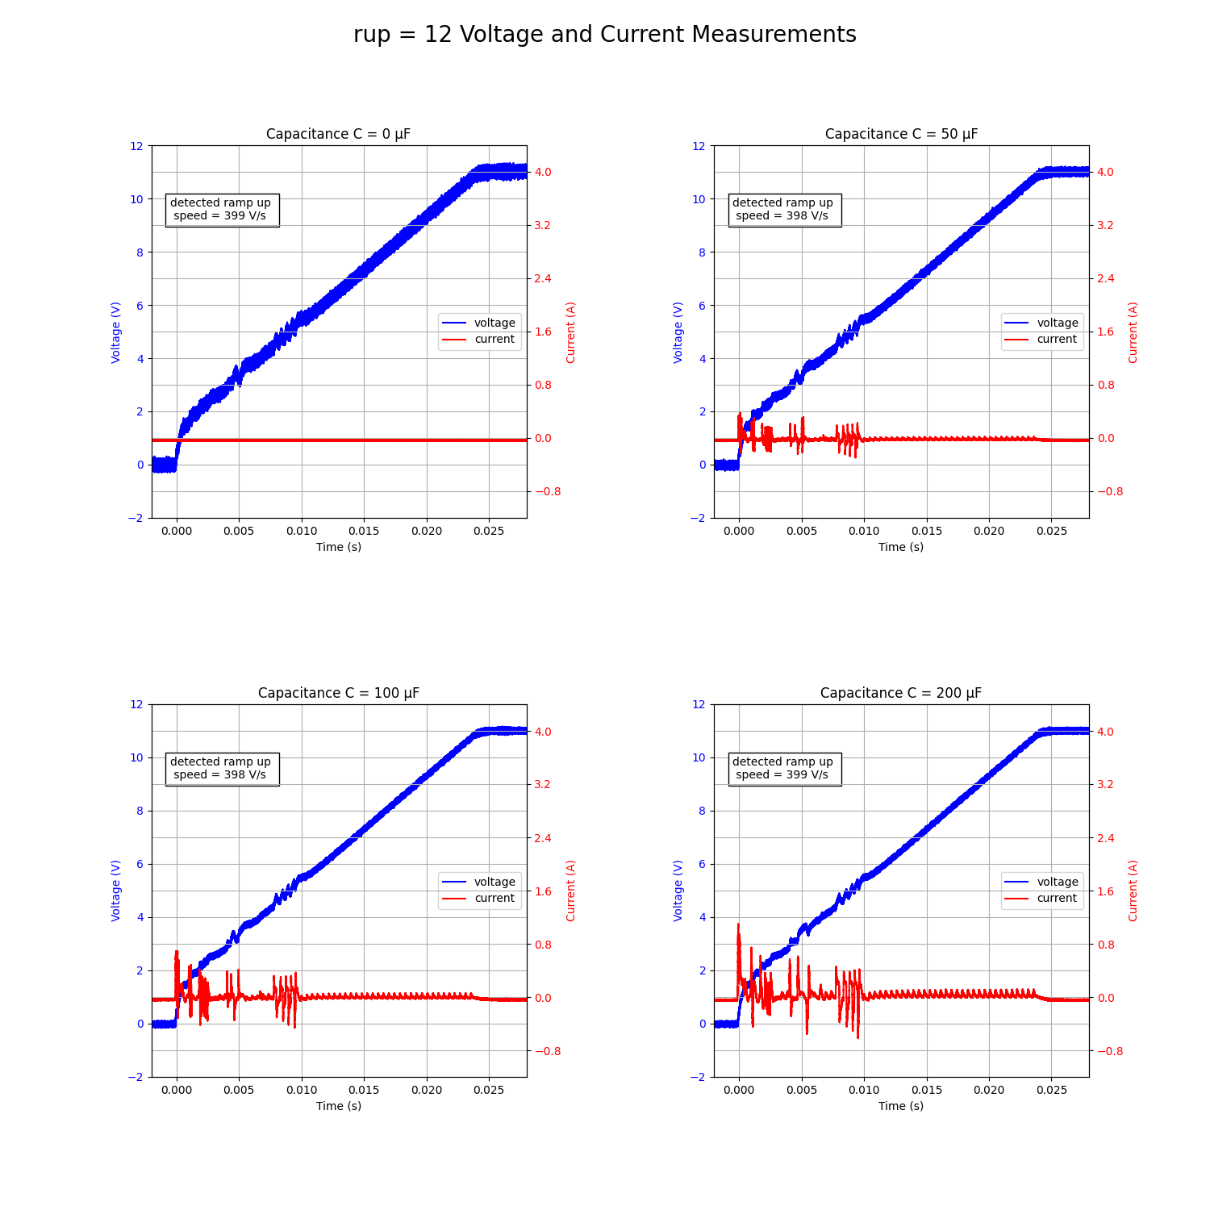
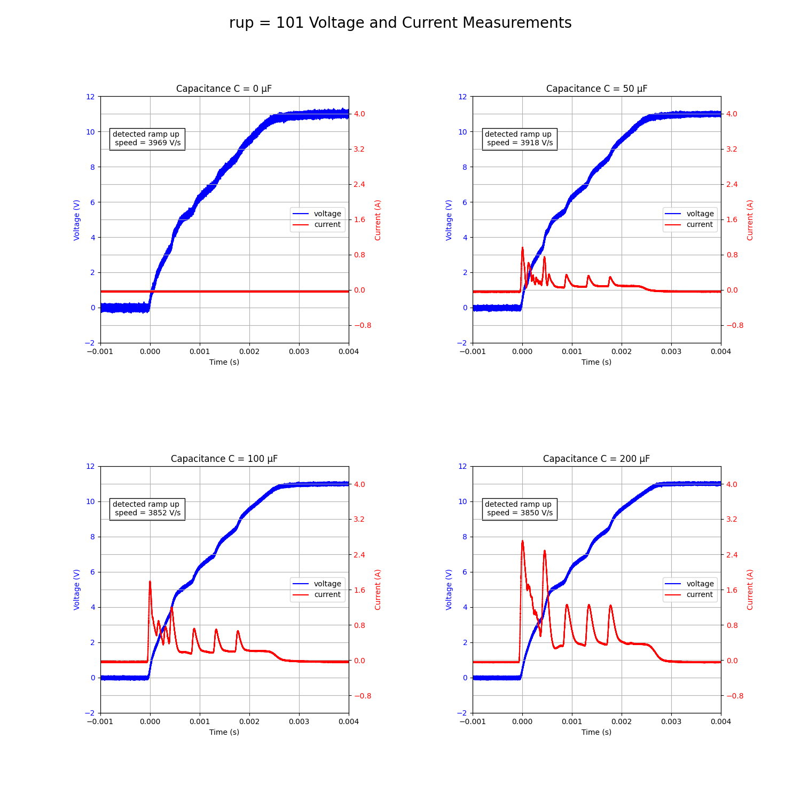
Capacitive load measurements
    First capacitive load tests on channel 1 of module M2
Notes:
- chose ramp up parameters 12 (=20ms) and 101 (=2ms)
- measured channel 1 of module M2 for these ramp up speed
- made measurements for all capacitive loads
Current = red, voltage = blue

Slide 12
Capacitive load measurements
    Python script
    Set trigger and panel settings on oscilloscope remotely
    Remotely turn on channels for chosen parameters (output voltage, ramp up parameter, OCP)
    Plot voltage and current waveform and computed ramp up speed for channels that did not trip
Notes:
- idea of python script: use it to test channels of modules
- remote control of oscilloscope: set trigger and panel
- remotely control channels: turn on voltage with desired parameters: output voltage, ramp up parameter, OCP
- plots
- derived ramp up speed same way as before (linear fit between 10% and 90% maximum voltage)

Slide 13
Capacitive load measurements
    Module M2 tests at two different temperatures
    Output voltages:
      10 V
      11 V
      12 V*
    Ramp up parameters:
      12
      101
    OCP limits:
      0.5 A
      1 A
      1.5 A
      2.5 A
Notes:
python script now used for module tests on module M2
these are the tested parameters
12 V -> only for 4 channels (OVP)

Slide 14
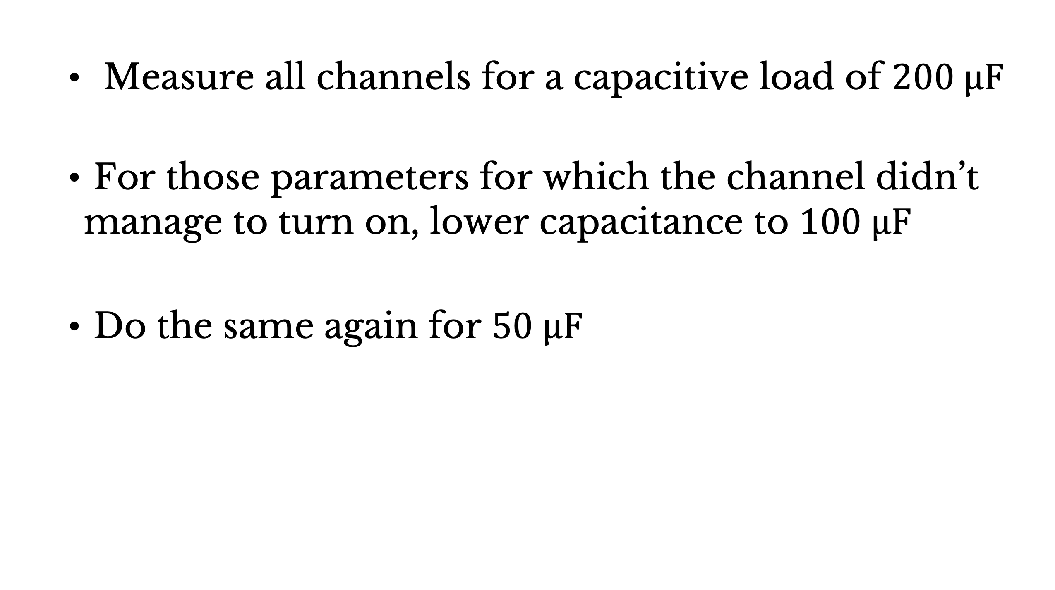
Capacitive load measurements
    Measure all channels for a capacitive load of $200 μF$
    For those parameters for which the channel didn’t manage to turn on, lower capacitance to $100 μF$
    Do the same again for $50 μF$
Notes:
- the ide was to test all parameter settings at highest capacitive load
- then lower the capacitance for the settings that tripped
- again

Slide 15
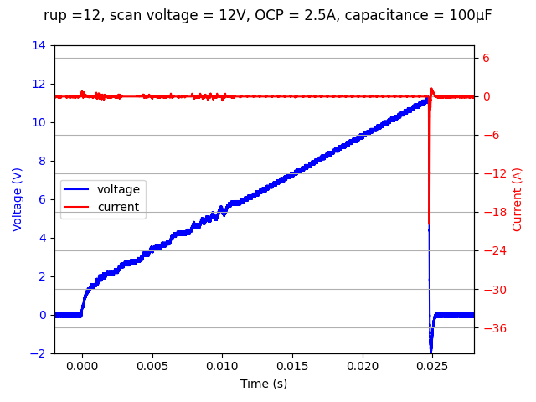
Capacitive load measurements
    Sudden voltage drop before 12 V was reached
    -> OVP
Notes:
RESULTS:
- 4 channels showed this really sudden voltage drop before 12 V
- extreme negative current
- found out that the OVP was set below 12 V, current from discharge of capacitor
-> Continued measurements only for 10, 11 V

Slide 16
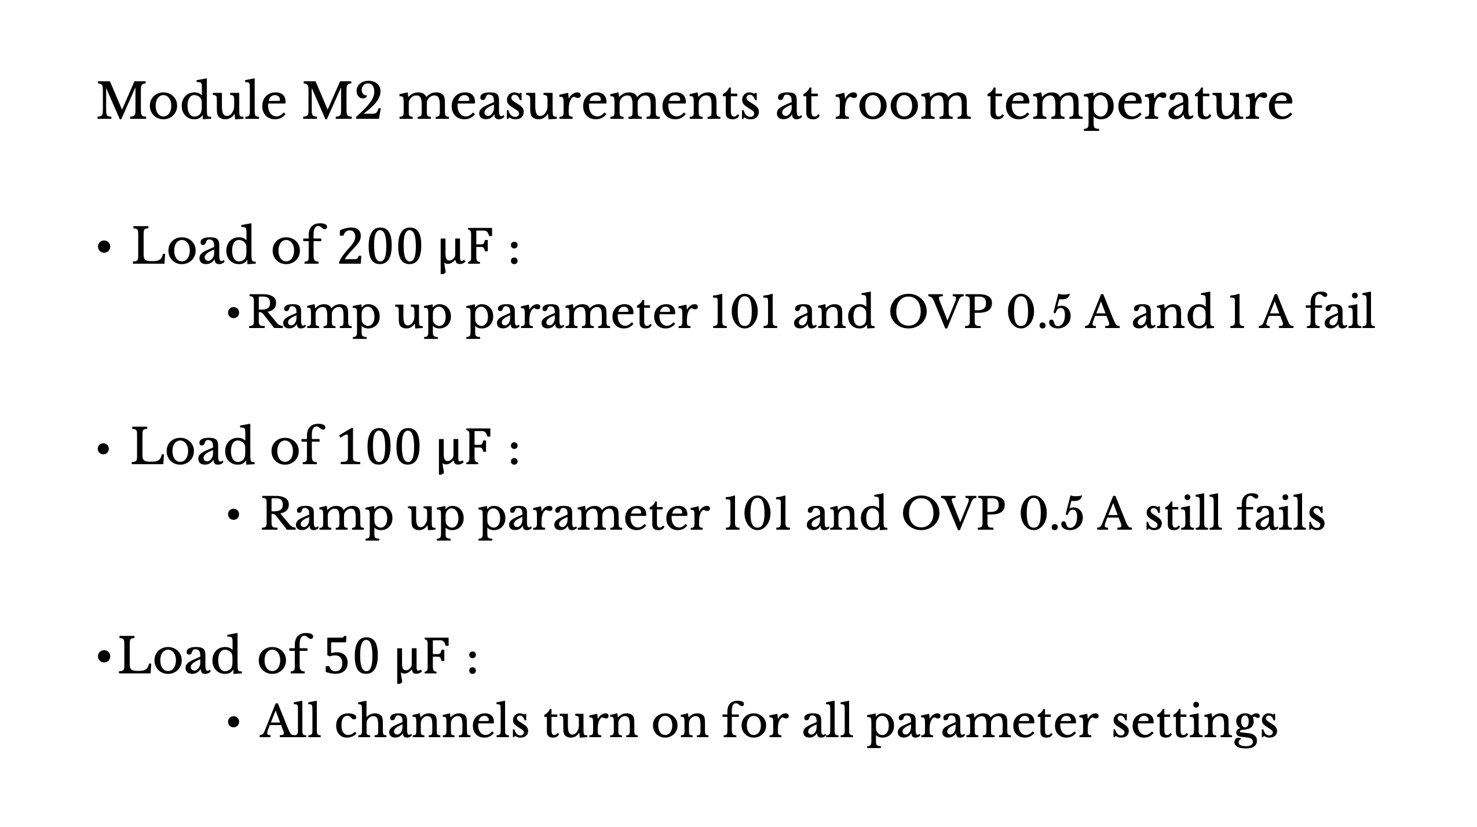
Capacitive load measurements
    Module M2 measurements at room temperature
    Load of $200 μF$ :
          Ramp up parameter 101 and OVP 0.5 A and 1 A fail
    Load of $100 μF$ :
          Ramp up parameter 101 and OVP 0.5 A still fails
    Load of $50 μF$ :
          All channels turn on for all parameter settings
Notes:
RESULTS:
all channels showed the same behaviour:
- 200 mikroF -> faster ramp up speed: two lowest OCP limits trips
- 100 mikroF -> lowest OCP limits still trips
- 50 mikroF -> all channels turn on

Slide 17
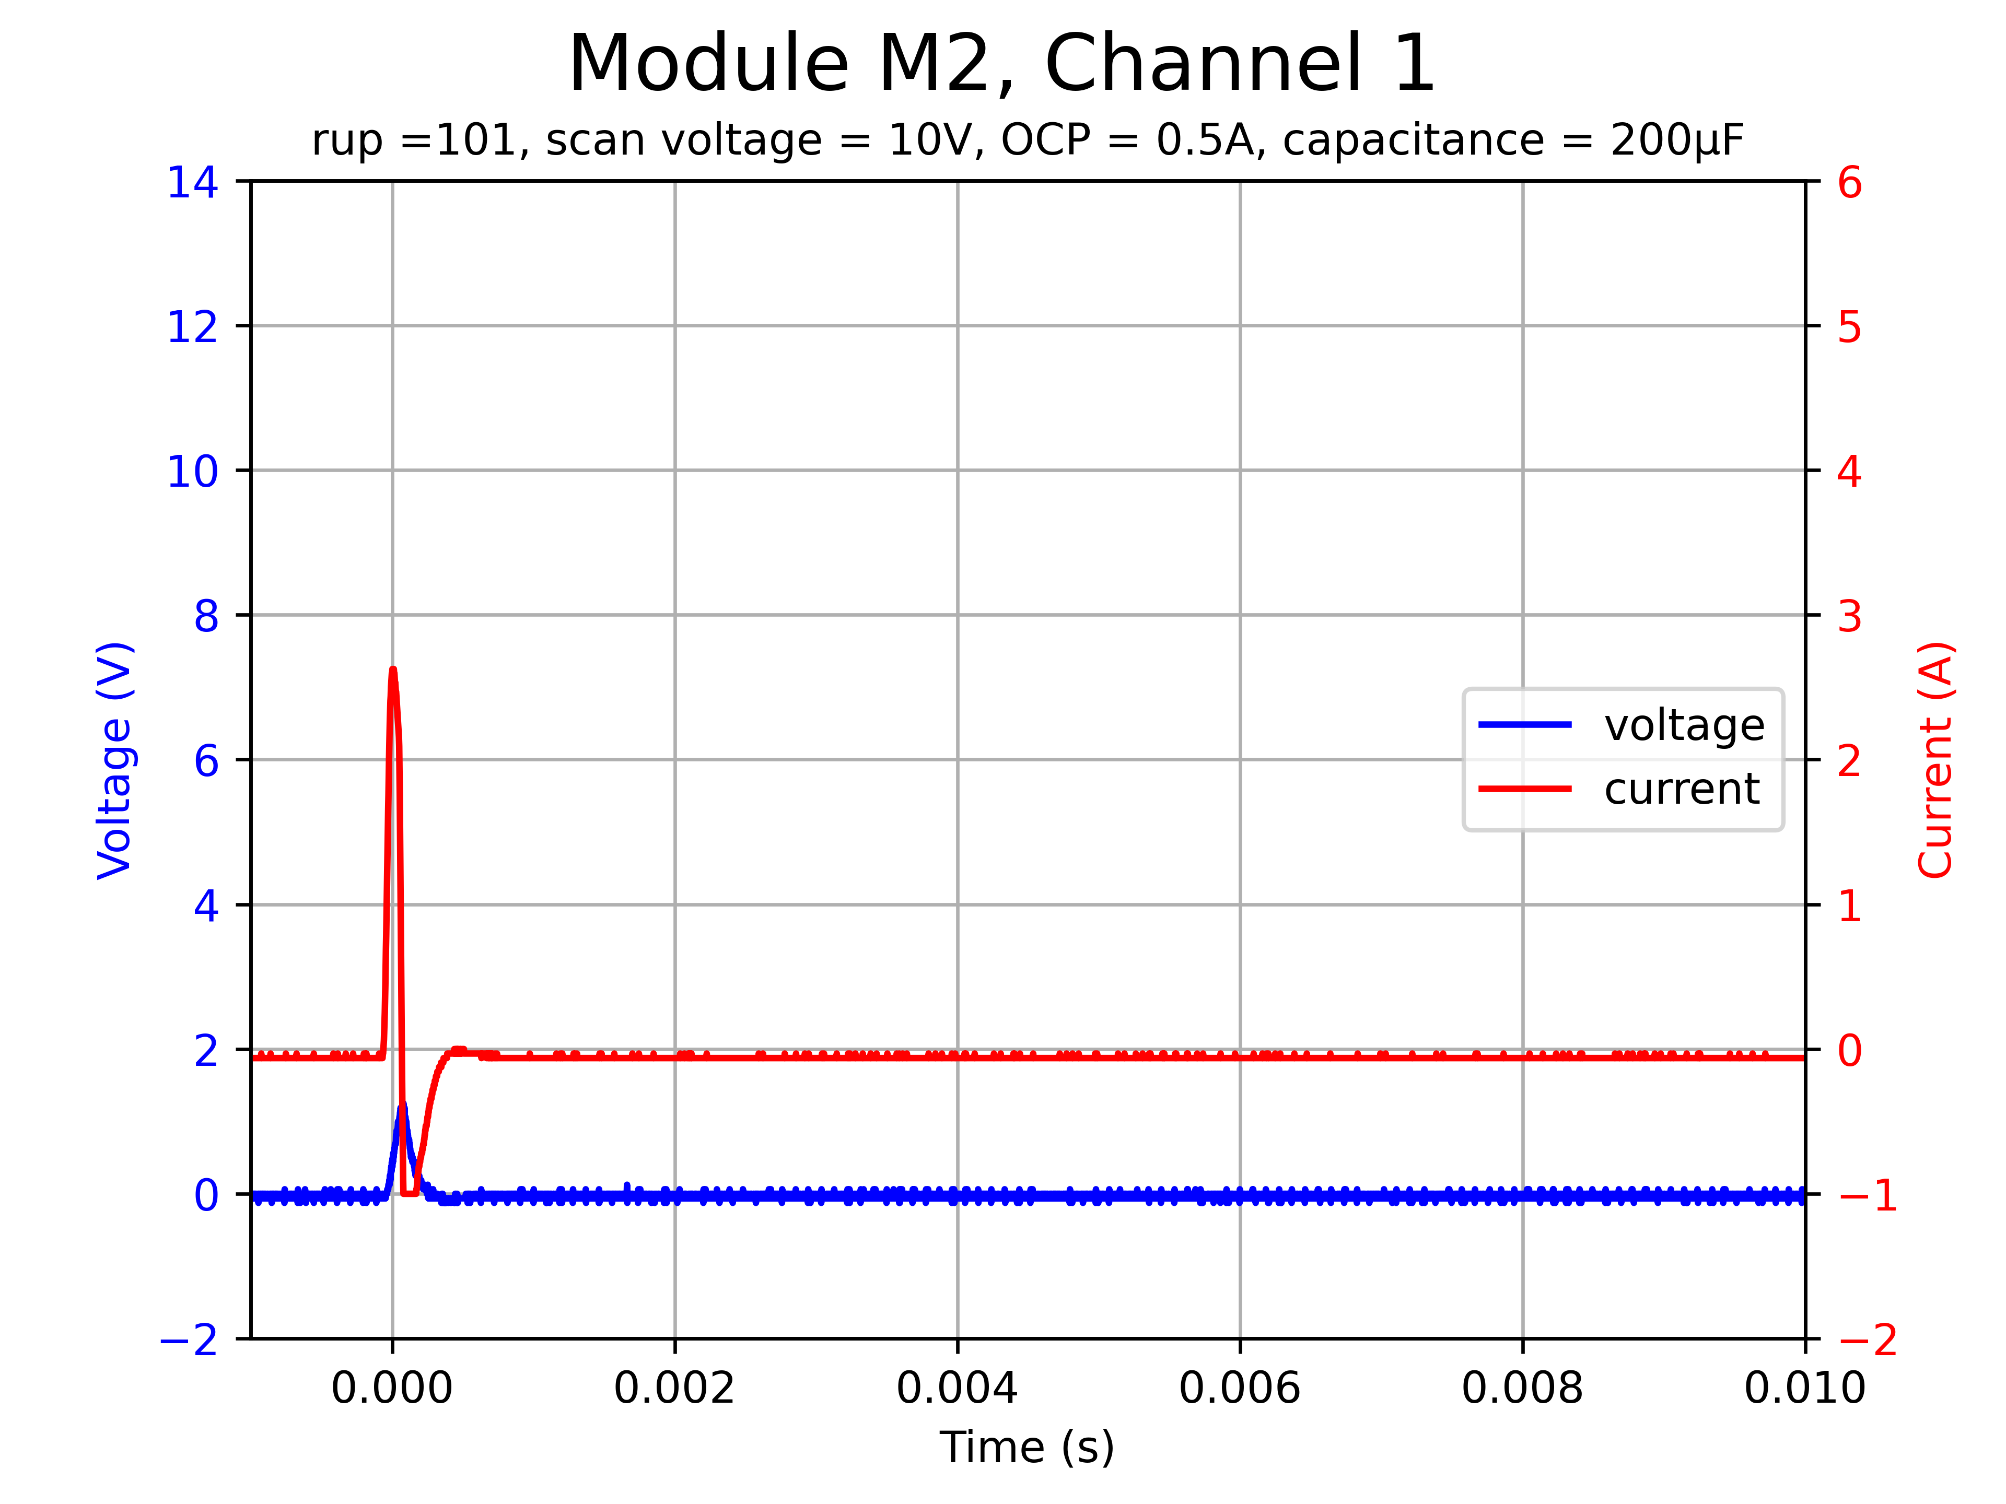
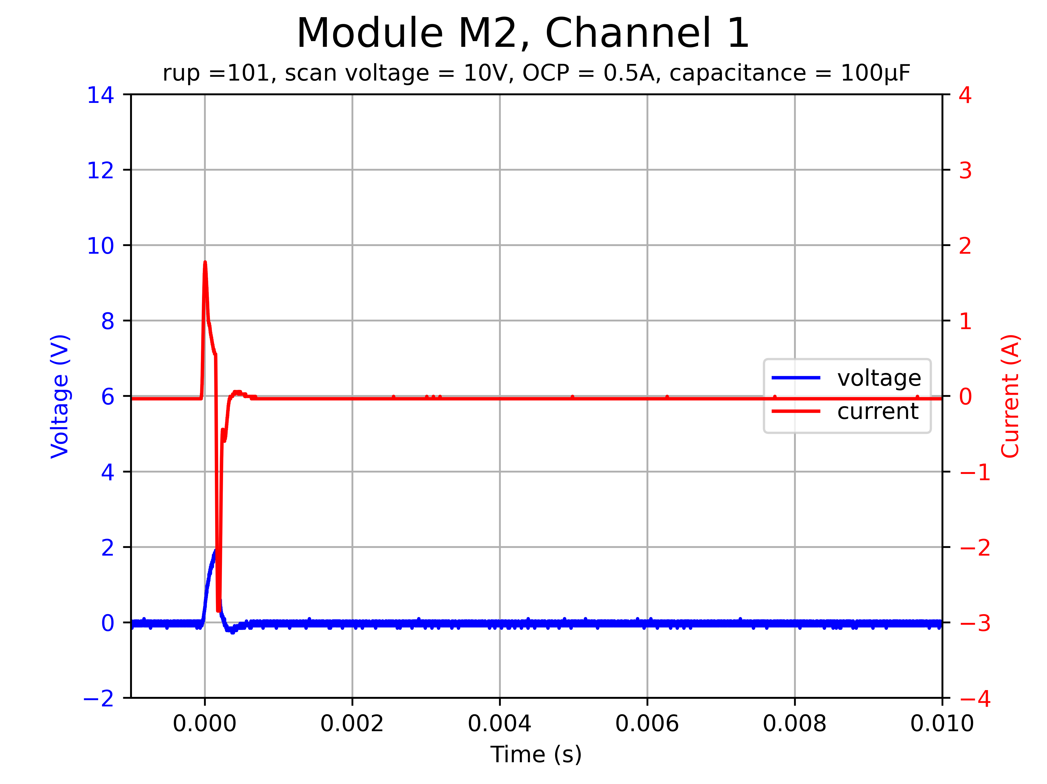
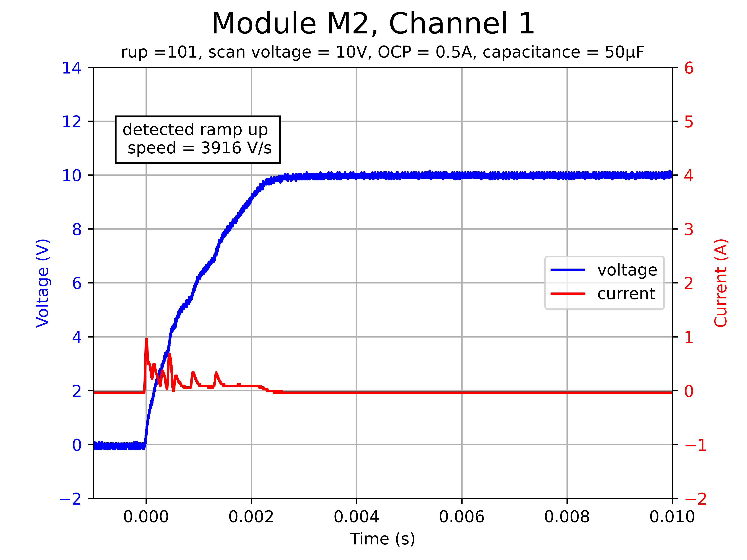



Capacitive load measurements
    Module M2 measurements at room temperature
    $200 μF$
    $100 μF$
    $50 μF$
Notes:
Example of channel 1 at lowest OCP 0.5 A
Trips at about 1 A
it should trip; for some period of time OCP disabled (=increased threshold for this time)
Increased threshold more or less 3 times

Slide 18
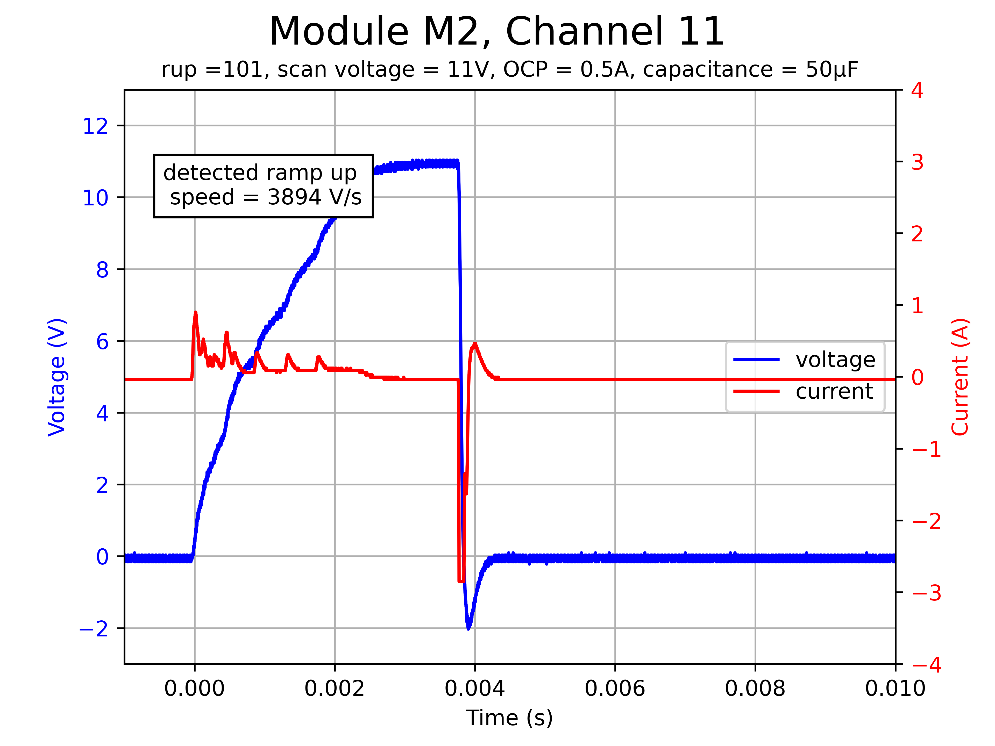
Capacitive load measurements
    Module M2 measurements at room temperature
    Channel 11 trips for 11 V
    and OCP 0.5 A at every
    capacitive load
    → OVP lower than for
    other channels
Notes:
ANOTHER RESULT:
Krzysztof helped me to find out that this is because the OVP on this channel is somehow lower than on the other channels
Needs to be checked
Actually requested ovp at 11V →expected behaviour

Slide 19
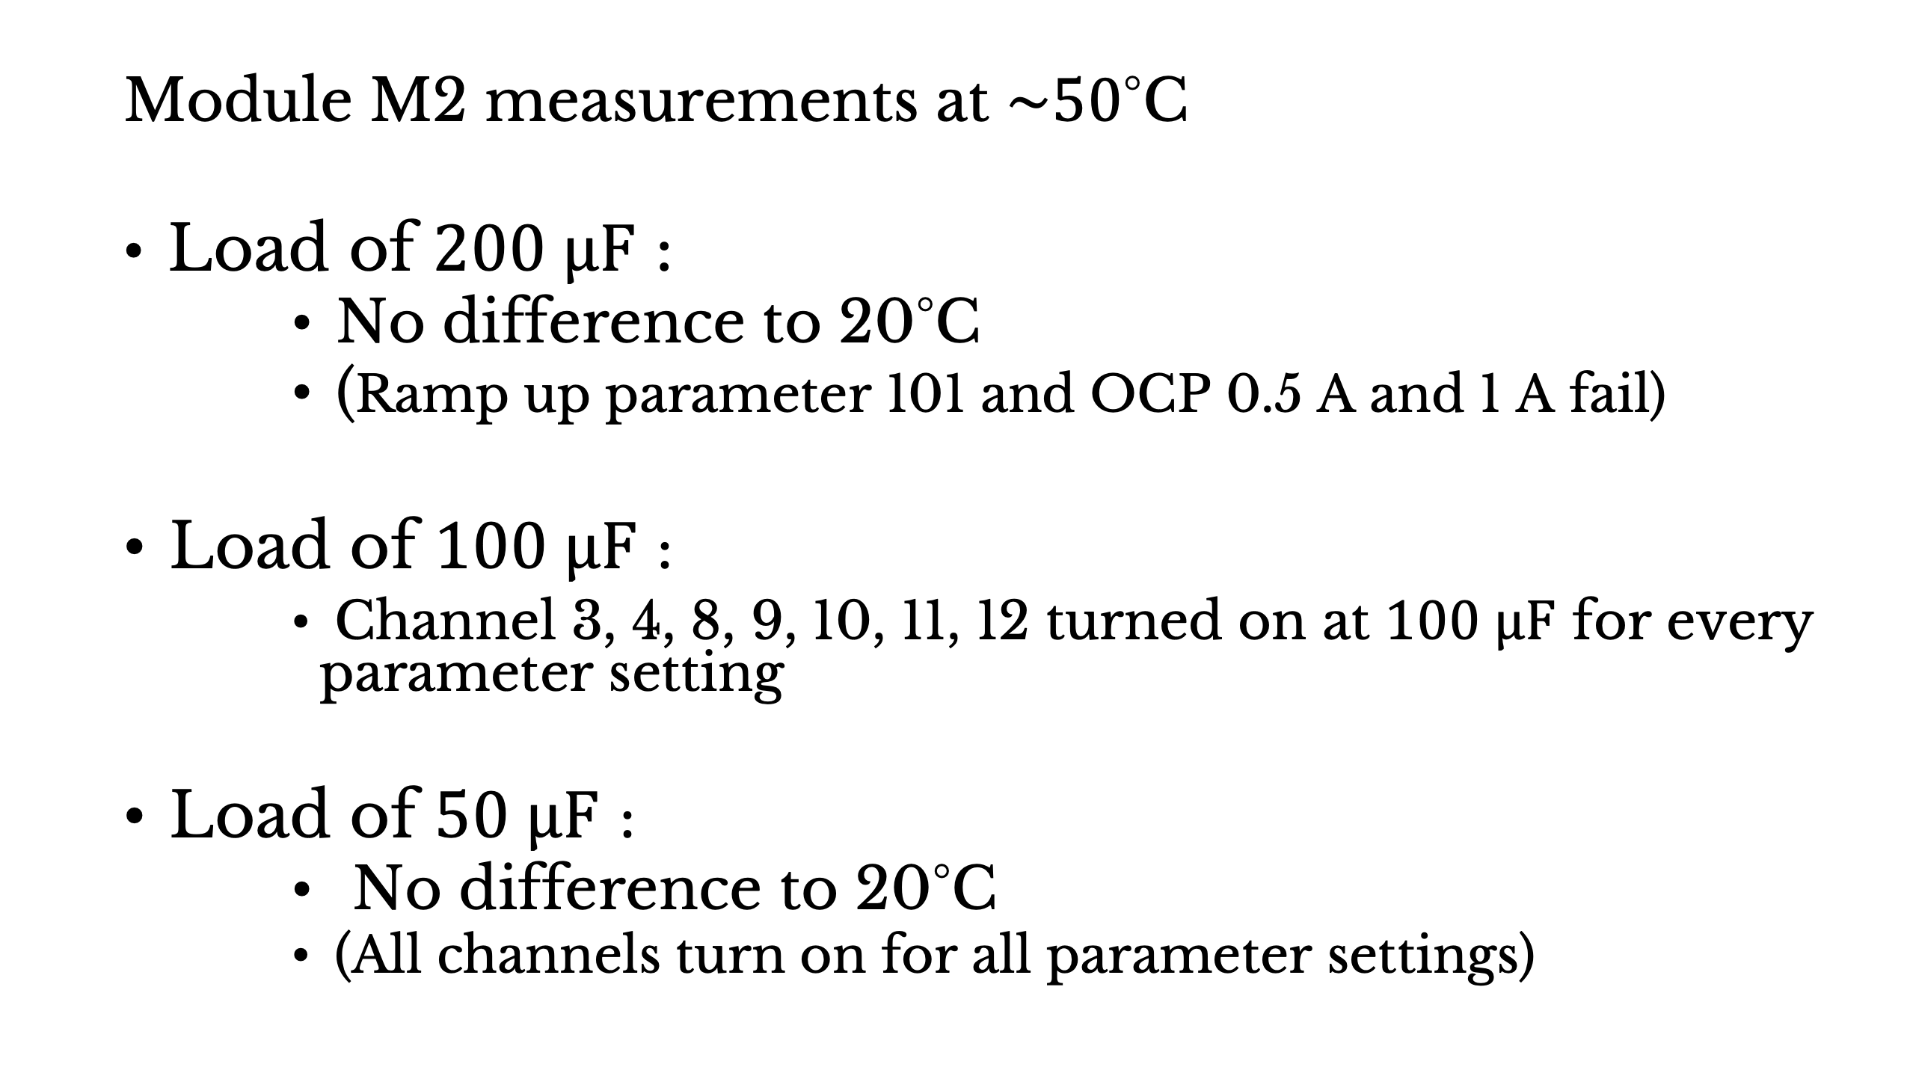
Capacitive load measurements
    Module M2 measurements at $\sim 50$°C
    Load of $200 μF$ :
          No difference to 20°C
          (Ramp up parameter 101 and OCP 0.5 A and 1 A fail)
    Load of $100 μF$ :
          Channel 3, 4, 8, 9, 10, 11, 12 turned on at $100 μF$ for every parameter setting
    Load of $50 μF$ :
          No difference to 20°C
          (All channels turn on for all parameter settings)
Notes:
went on performing the same measurements at higher temperature of 50°C
- 200 mikroF : same behaviour (two lowest OCP fail at higher ramp up speed)
- 100 mikroF: 7 channels turned on for every setting
- 50 mikroF rest of channels which did not turn on turned on now
-> Current readout changes with temperature; OCP slightly higher but enough to runn channels at 100 mikroF
SO FOR EXAMPLE CHANNEL 3 --> next slide

Slide 20
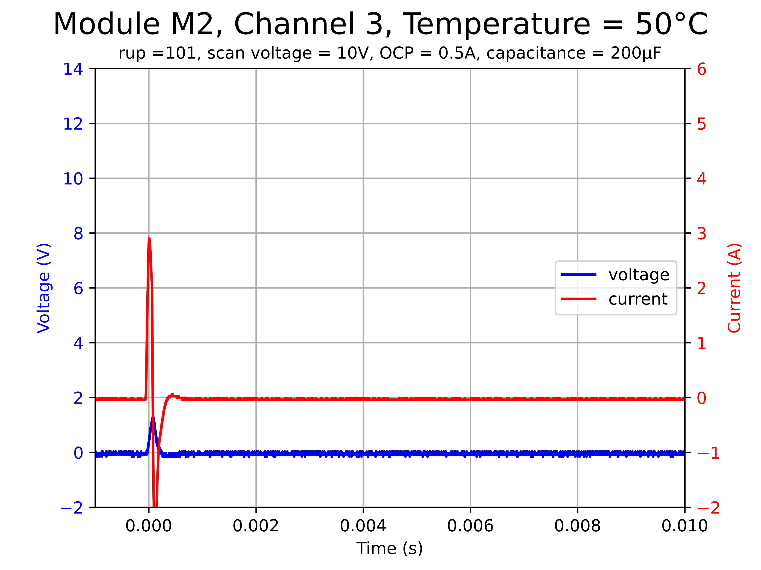
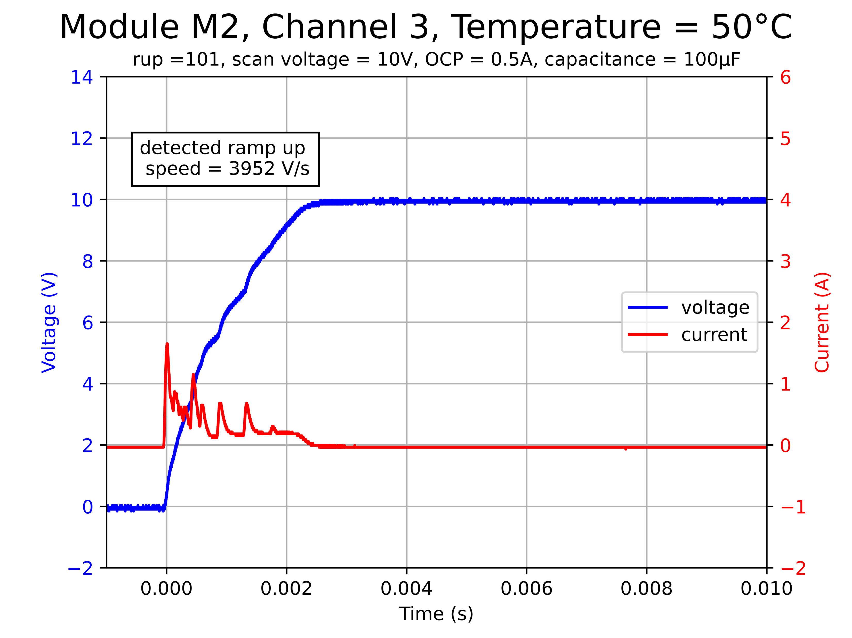



Capacitive load measurements
    Module M2 measurements at $\sim 50$°C
    $200 μF$
    $100 μF$
Notes:
- for example channel 3 tripped at OCP 0.5 for 200 mikroF but turned on for 100 mikroF
- at 100 mikroF and lower temperature, it did not turn on before

Slide 21
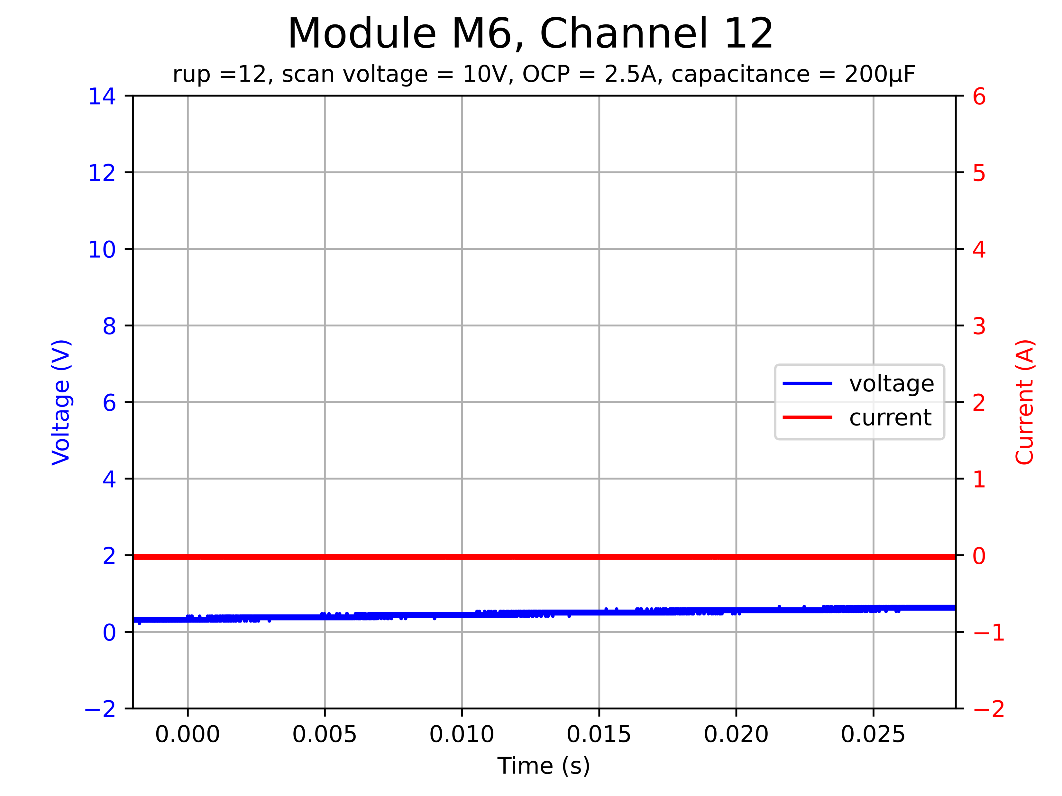
Capacitive load measurements
    Module M6 measurements at room temperature
    It was confirmed that
    Channel 12 is broken
Notes:
Channel 12 did not turn on at all
for no parameter setting
→ It was already known (just confirmed)

Slide 22
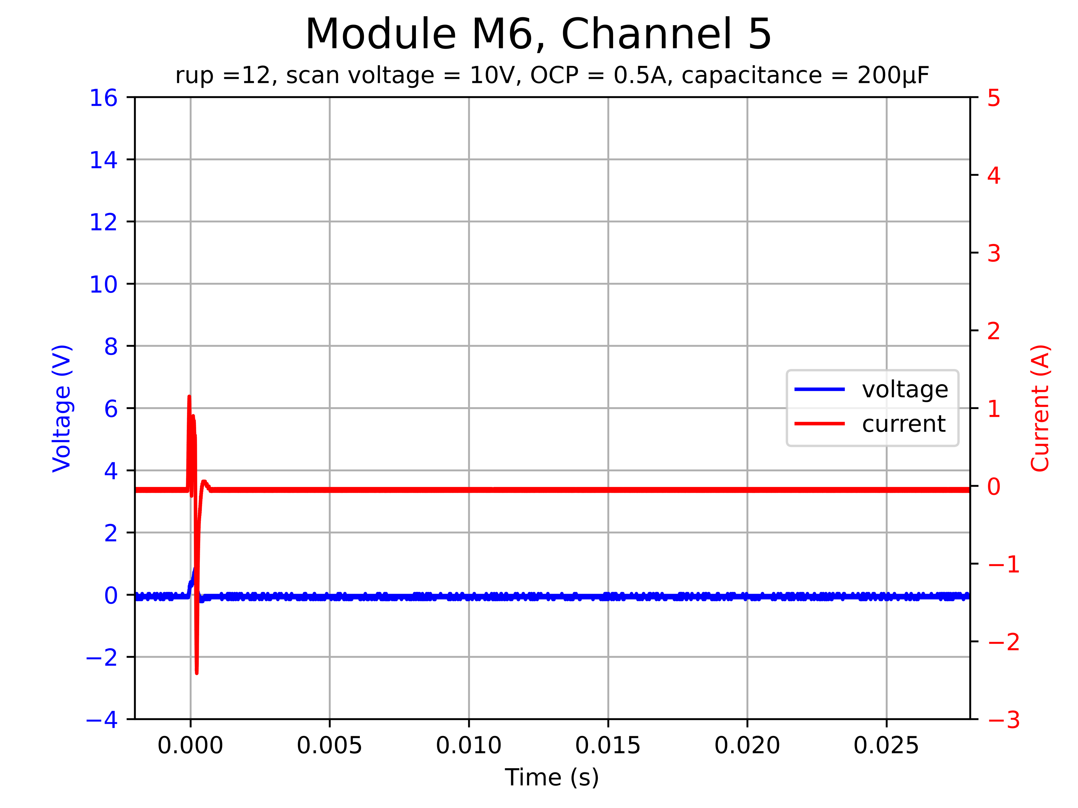
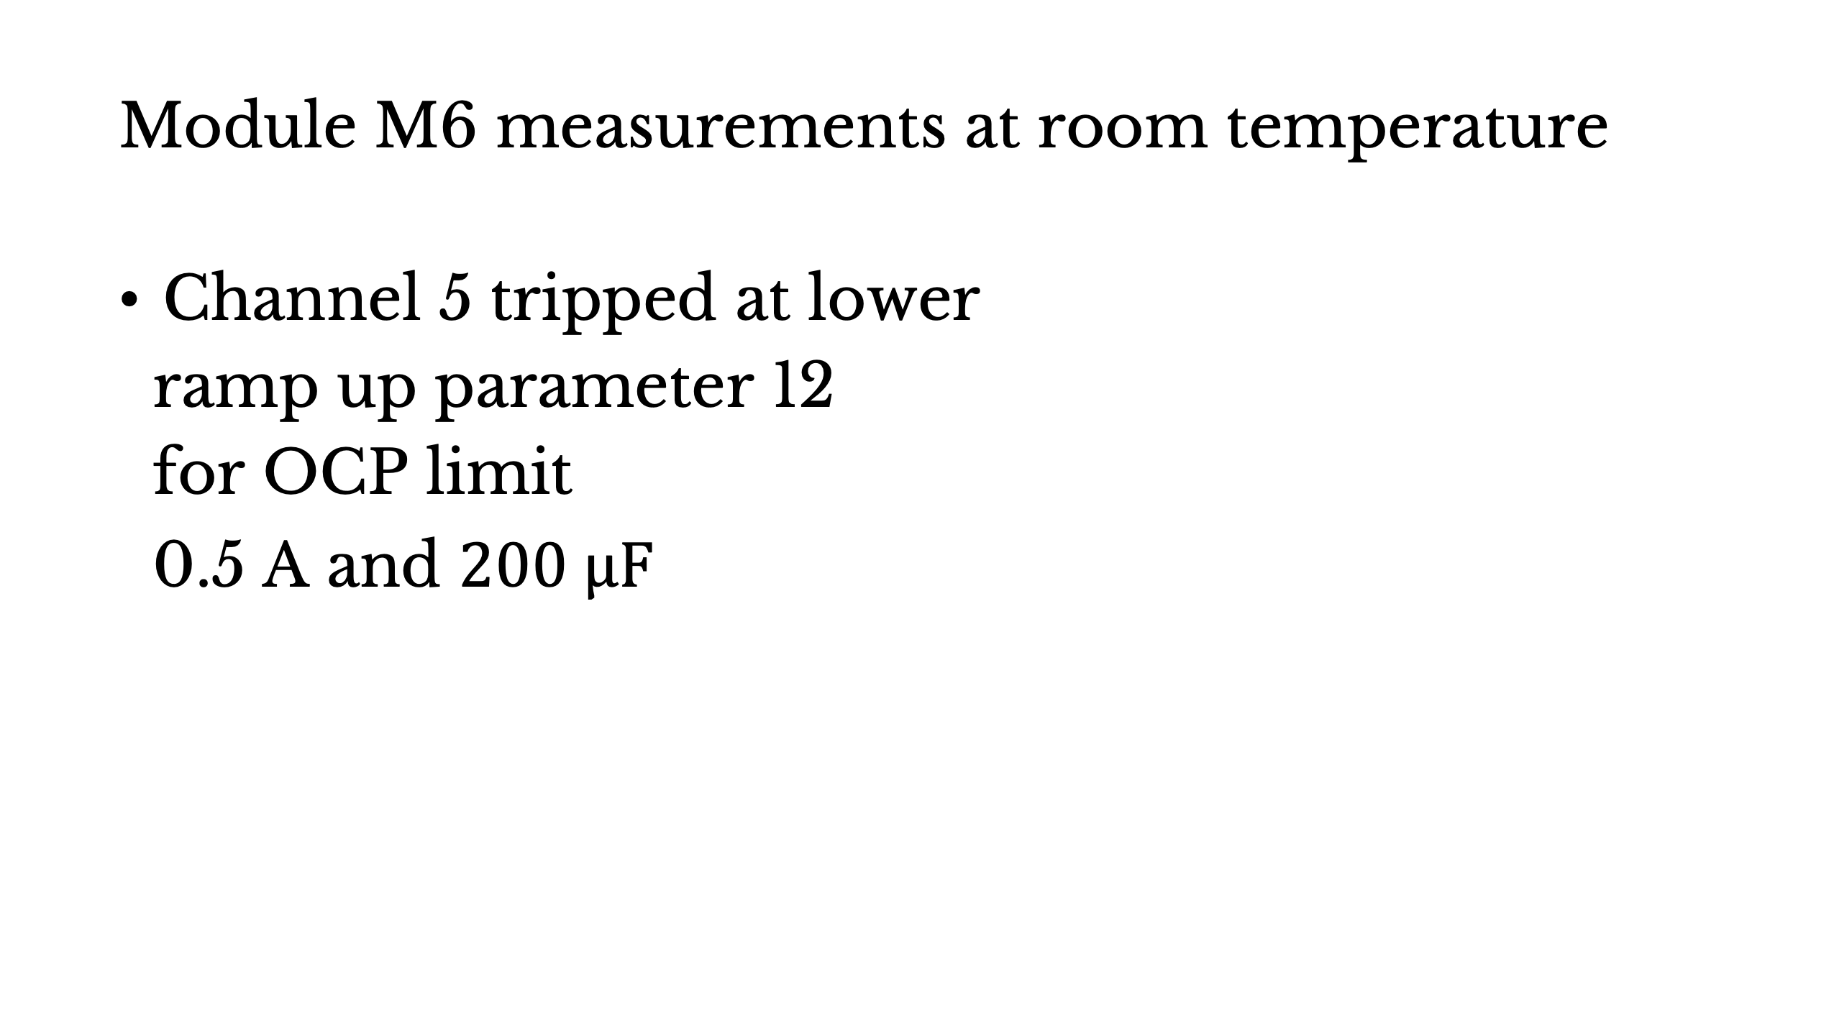
Capacitive load measurements
    Module M6 measurements at room temperature
    Channel 5 tripped at lower
    ramp up parameter 12
    for OCP limit
    0.5 A and $200 μF$
Notes:
DIFFERENCES VERSUS OTHER CHANNELS
- channel 5 failed to turn on for a setting for which it did on module M2
- for all other channels, they turned on under these parameter settings

Slide 23
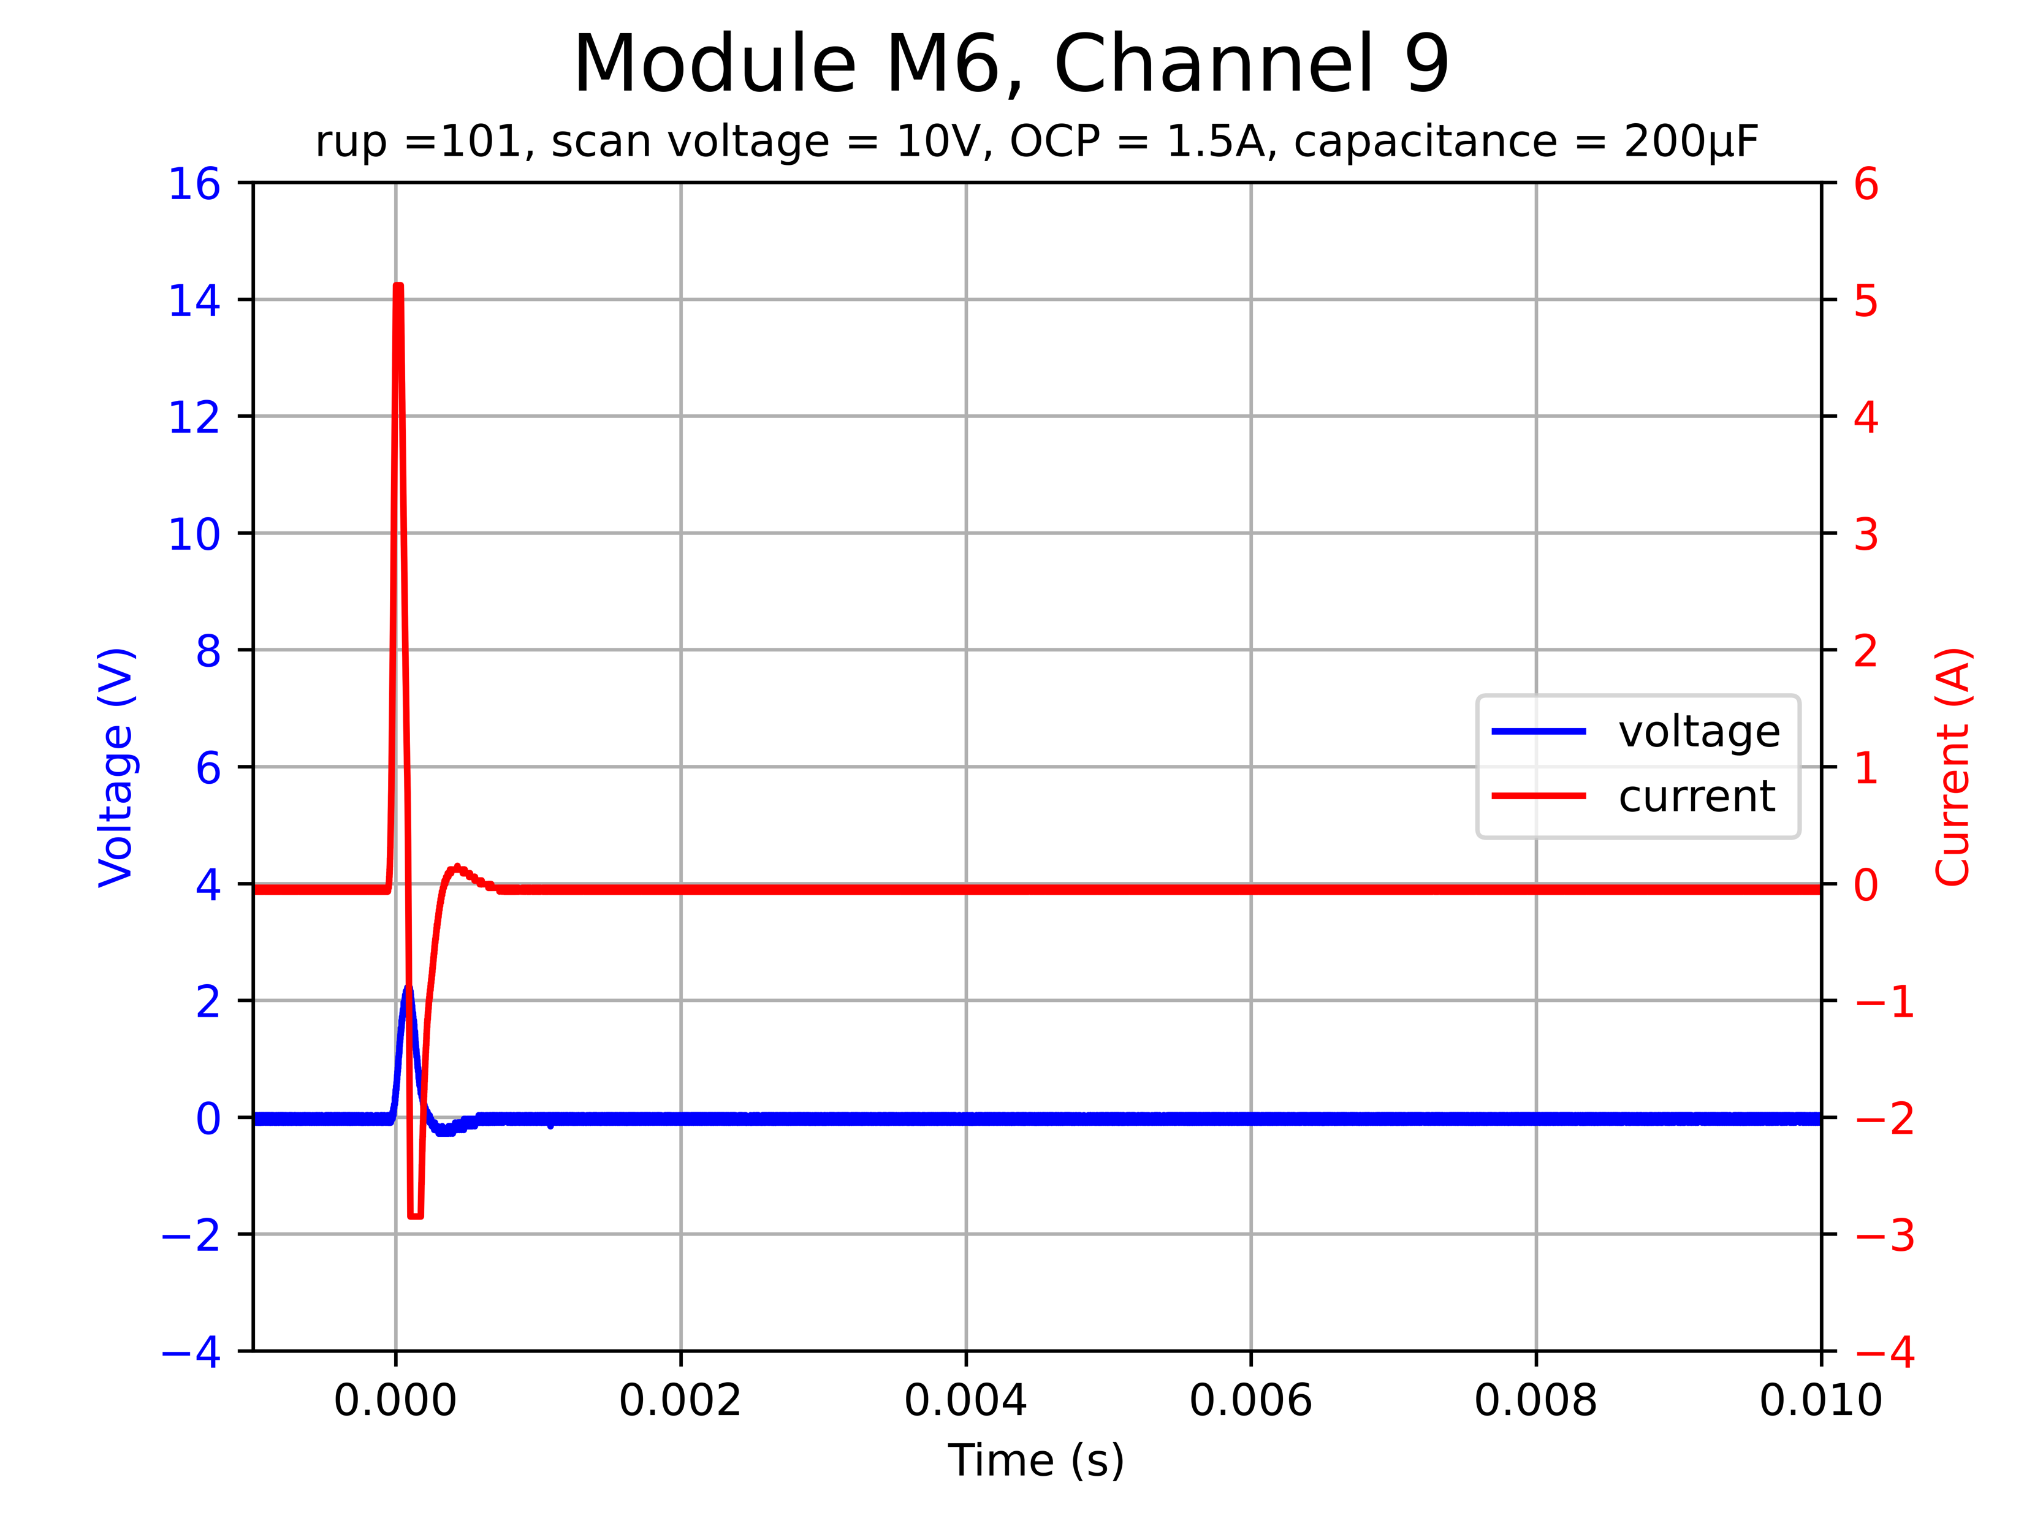

Capacitive load measurements
    Module M6 measurements at room temperature
    Channel 9 tripped at
    ramp up parameter 101
    for OPC 1.5 A and $200 μF$
Notes:
- channel 9 did not turn on for OCP 1.5 which it did in all other cases

Slide 24
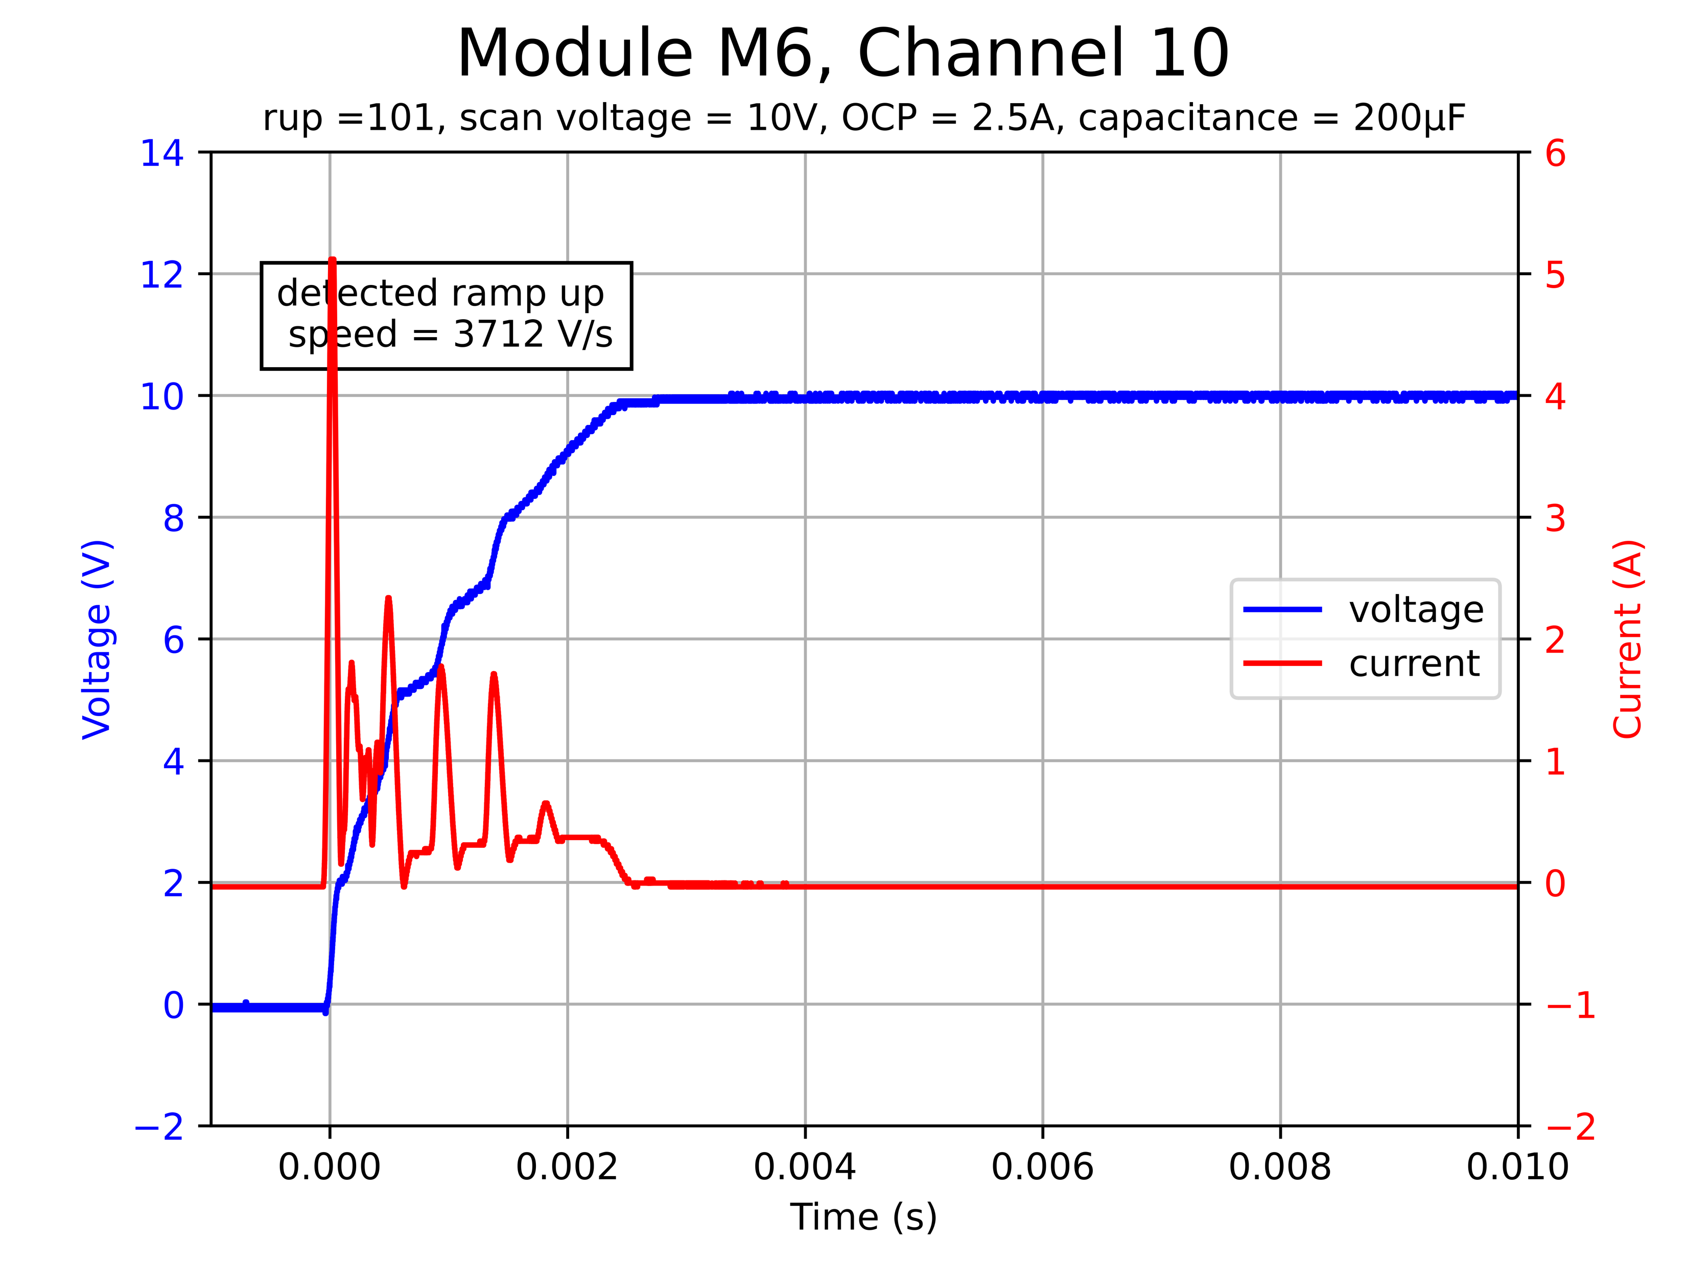
Capacitive load measurements
    Module M6 measurements at room temperature
    Higher inrush current
    for channels 5, 9 and 10
Notes:
I ALSO OBSERVED ABOUT THESE TWO CHANNELS AND CHANNEL 10:
- then I also observed higher inrush current for the 3 channels 5, 9, 10
- I don’t know why that is

Slide 25
Summary
    Script which scales ramp up parameters to standard units is ready to be reused in the future
    Script to remotely acquire waveforms from oscilloscope
    OCP is temperature dependent and at higher temperature higher inrush current is permitted
    OCP may trip due to inrush current, if the current is 3 times higher than the OCP settings

Slide 26
Thank you!

