Slide 1
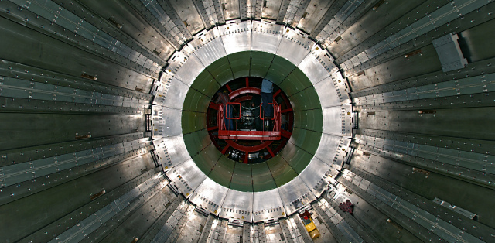
Devoloping a protoype humidity sensor
Lukas Lazek
Summer Student
27 June 2024, CERN

Slide 2
Overview
Motivation behind using a new sensor.
Physics behind humidity and thermal conduction.
Working principles of negative temperature coefficient (NTC) thermistors, and the sensor.
Measurements and results.
Discussion and future R&D ideas.

Slide 3
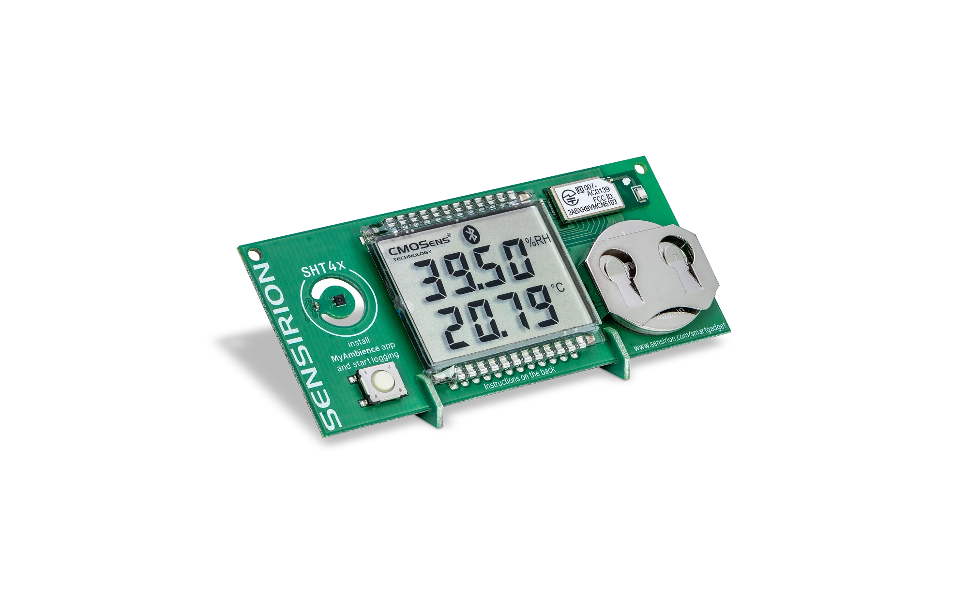
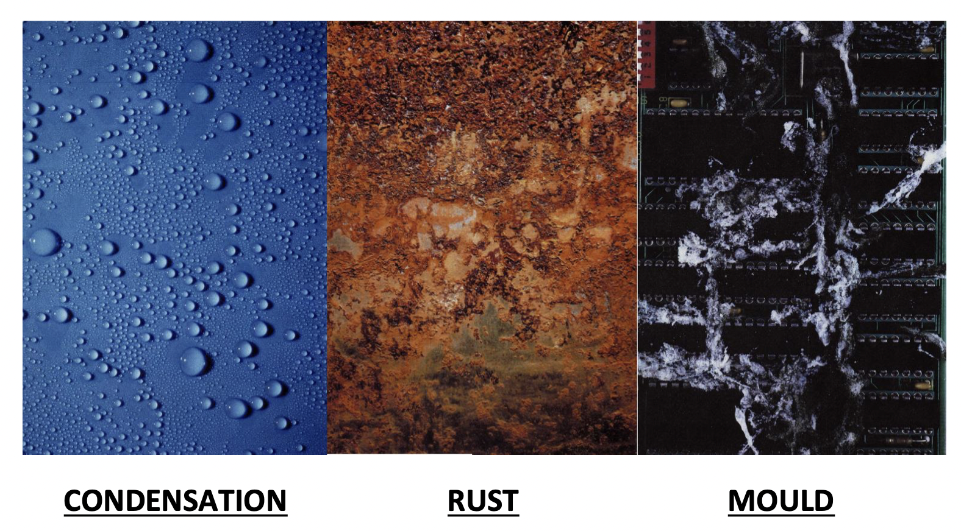
Why use a new sensor?
Few issues/doubts in the past
Current design is partially custom made
Industry-made sensors are not radiation protected
Werner had a dream!
  Four cables and signal measurable with a keithley MM

Slide 4

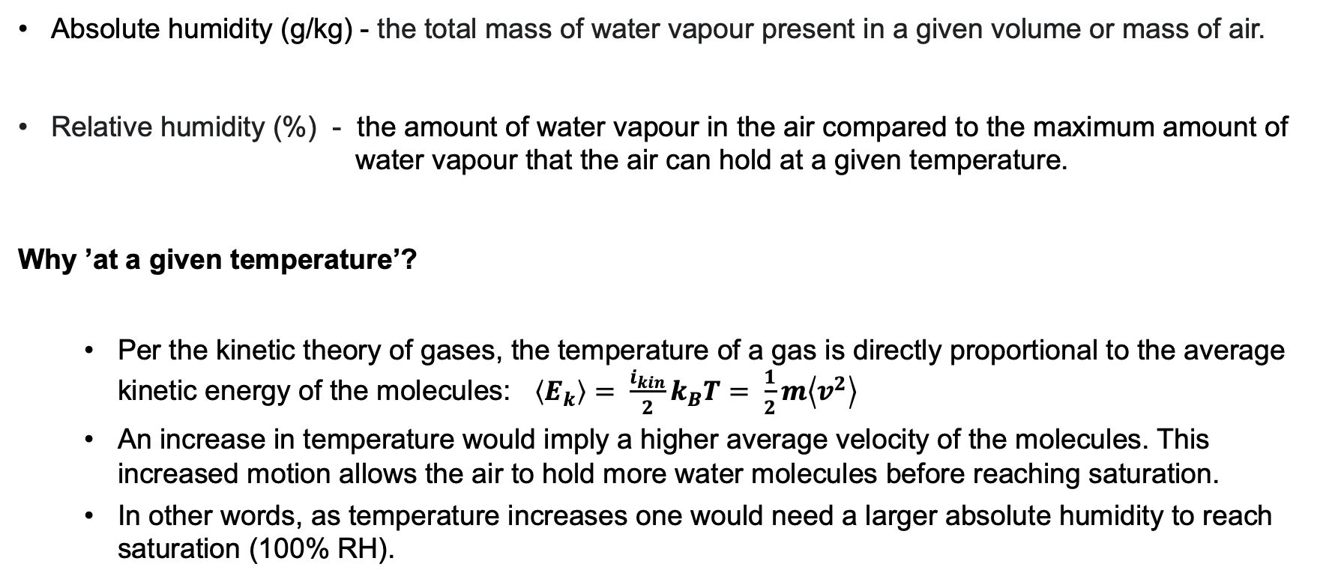
What is humidity?
Absolute humidity (g/kg) - the total mass of water vapour present in a given volume or mass of air.
Relative humidity (%) - the amount of water vapour in the air compared to the maximum amount of water vapour that the air can hold at a given temperature.
Why ’at a given temperature’?
    Per the kinetic theory of gases, the temperature of a gas is directly proportional to the average kinetic energy of the molecules: $\left\langle E_{k}\right\rangle = \frac{i_{kin}}{2}k_{B}T= \frac{1}{2}m\left\langle v^{2}\right\rangle$
    An increase in temperature would imply a higher average velocity of the molecules. This increased motion allows the air to hold more water molecules before reaching saturation.
    In other words, as temperature increases one would need a larger absolute humidity to reach saturation (100% RH).
Notes:
Saturation water vapor pressure rises

Slide 5
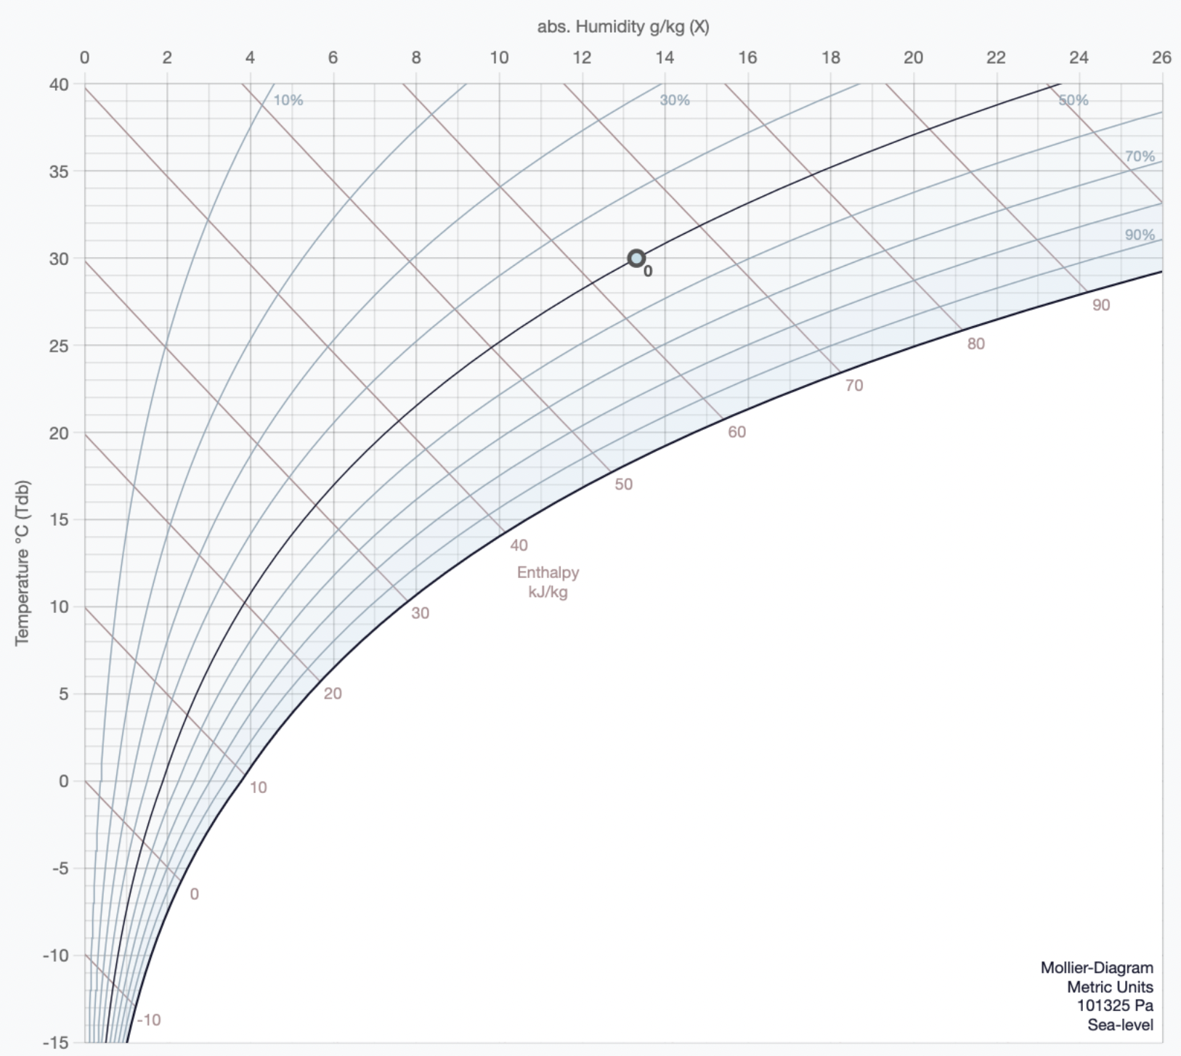

Slide 6
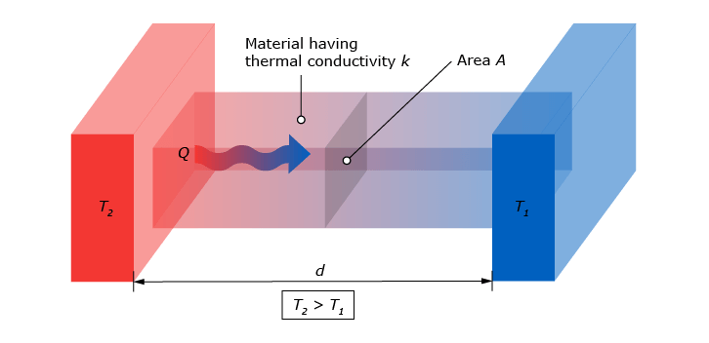
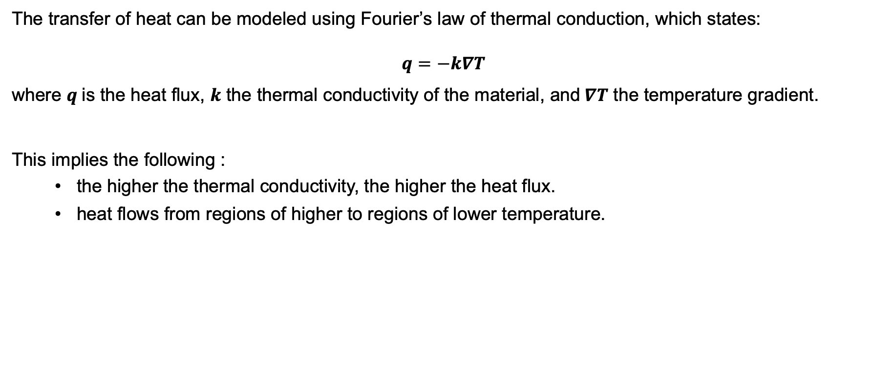
Thermal conduction
The transfer of heat can be modeled using Fourier’s law of thermal conduction, which states:
$$q=−k∇T$$
where $q$is the heat flux, $k$ the thermal conductivity of the material, and$∇T$ the temperature gradient.
This implies the following :
    the higher the thermal conductivity, the higher the heat flux.
    heat flows from regions of higher to regions of lower temperature.

Slide 7
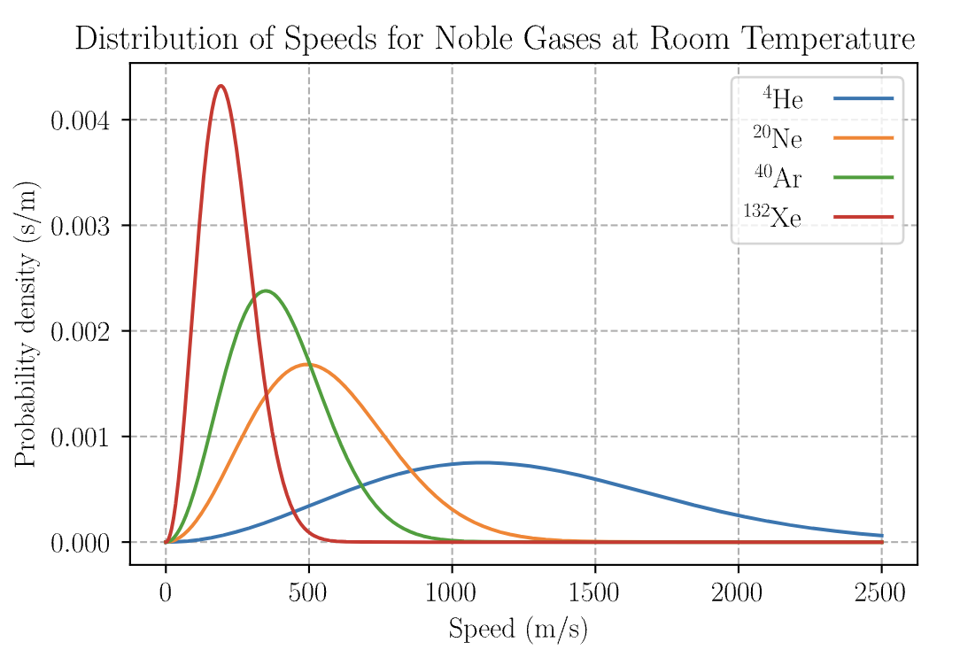
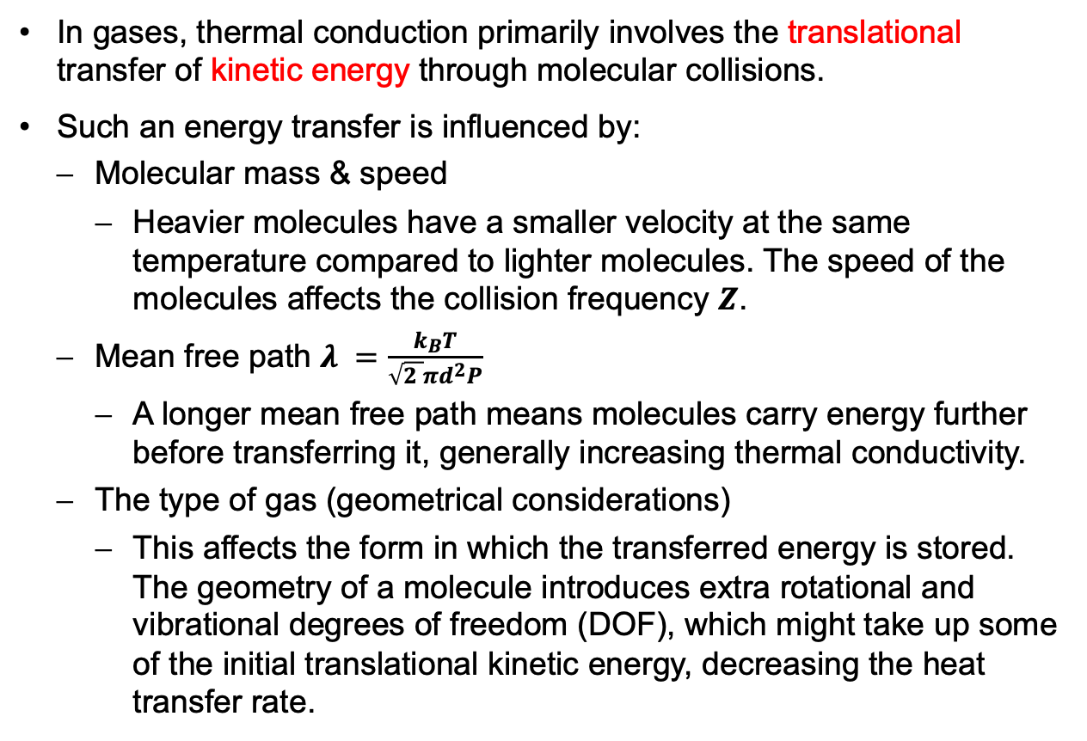
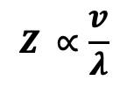
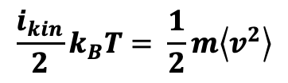
Thermal conduction in gases
In gases, thermal conduction primarily involves the translational transfer of kinetic energy through molecular collisions.
Such an energy transfer is influenced by:
  Molecular mass & speed
    Heavier molecules have a smaller velocity at the same temperature compared to lighter molecules. The speed of the molecules affects the collision frequency $Z$.
  Mean free path $λ =\frac{k_{B}T}{\sqrt{2 }πd^{2}P}$
    A longer mean free path means molecules carry energy further before transferring it, generally increasing thermal conductivity.
  The type of gas (geometrical considerations)
    This affects the form in which the transferred energy is stored. The geometry of a molecule introduces extra rotational and vibrational degrees of freedom (DOF), which might take up some of the initial translational kinetic energy, decreasing the heat transfer rate.
$$\frac{i_{kin}}{2}k_{B}T= \frac{1}{2}m\left\langle v^{2}\right\rangle$$
$$Z ∝\frac{v}{λ}$$
Notes:
The frequency and efficiency of those collisionsin transferring translational kinetic energy dictates the heat flow rate => thermal conductivity

Slide 8
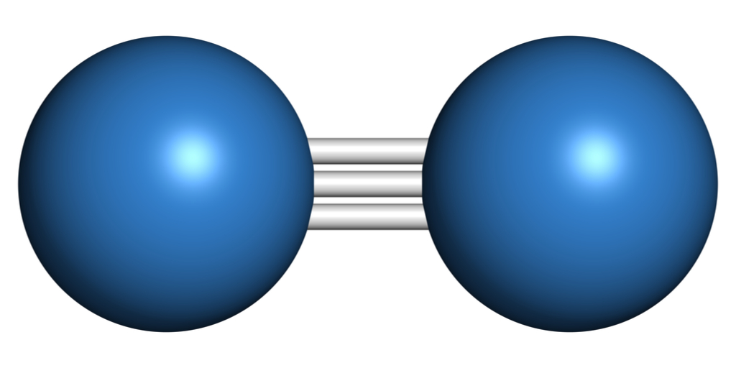
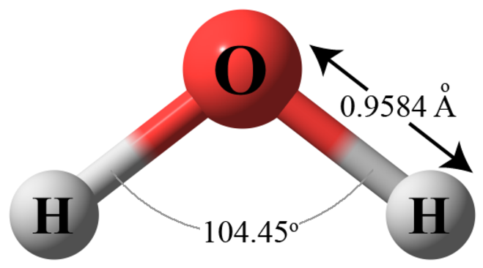

Slide 9
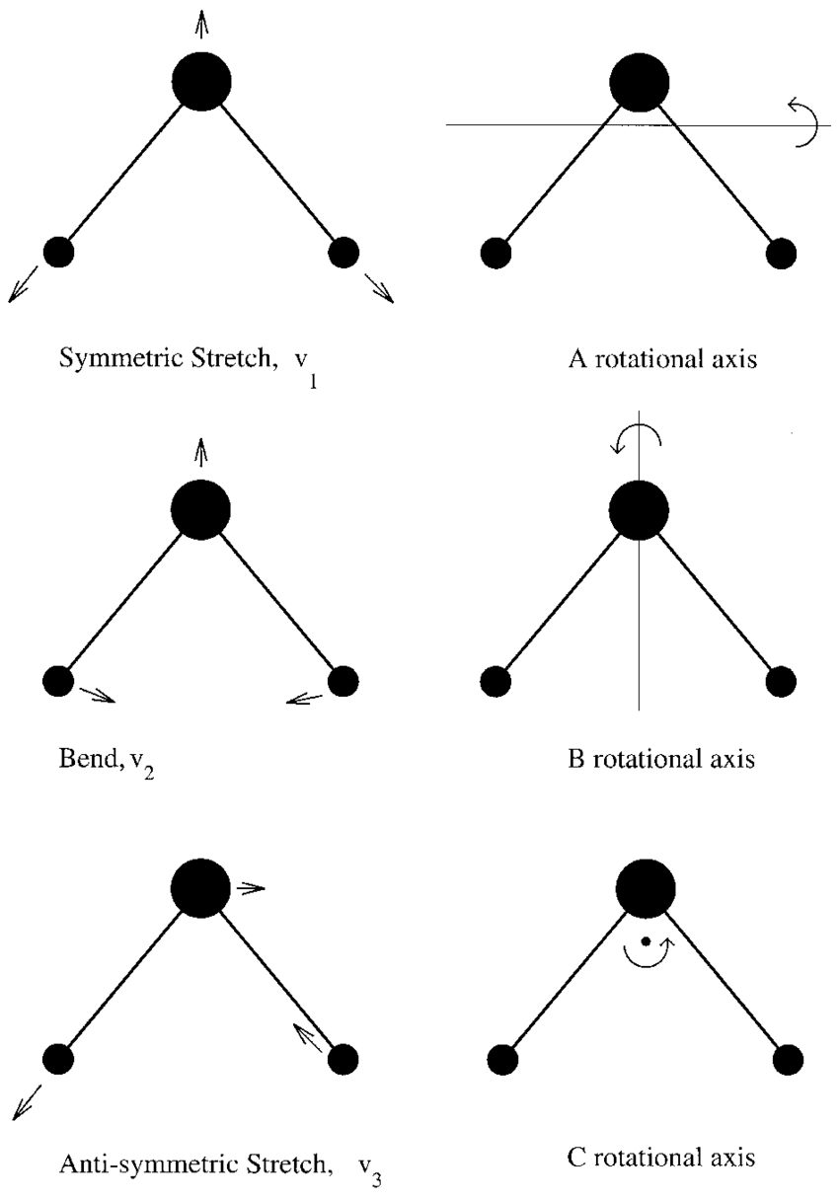
Vibrational modes
energy levels:
0.227eV
0.099eV
0.233eV

Slide 10
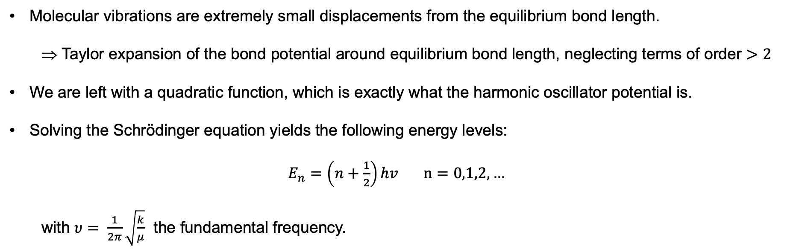
Quantum mechanical treatment of the vibrational modes
Molecular vibrations are extremely small displacements from the equilibrium bond length.
  Taylor expansion of the bond potential around equilibrium bond length, neglecting terms of order $>2$
We are left with a quadratic function, which is exactly what the harmonic oscillator potential is.
Solving the Schrödinger equation yields the following energy levels:
              $E_{n}=\left(n+\frac{1}{2}\right)hv n=0,1,2,…$
  with $υ= \frac{1}{2π}\sqrt{\frac{k}{μ}}$ the fundamental frequency.

Slide 11
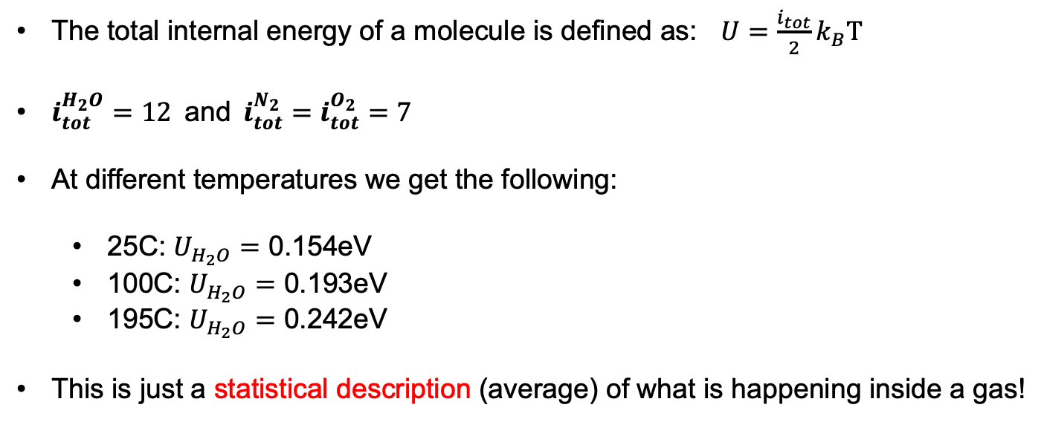
Can the vibrational modes be populated?
The total internal energy of a molecule is defined as: $U=\frac{i_{tot}}{2}k_{B}T$
$i_{tot}^{H_{2}O}=12$and$i_{tot}^{N_{2}}=i_{tot}^{O_{2}}=7$
At different temperatures we get the following:
  25C: $U_{H_{2}O}=\text{0.154}\text{eV}$
  100C: $U_{H_{2}O}=\text{0.}\text{193}\text{eV}$
  195C: $U_{H_{2}O}=\text{0.242}$eV
This is just a statistical description (average) of what is happening inside a gas!

Slide 12
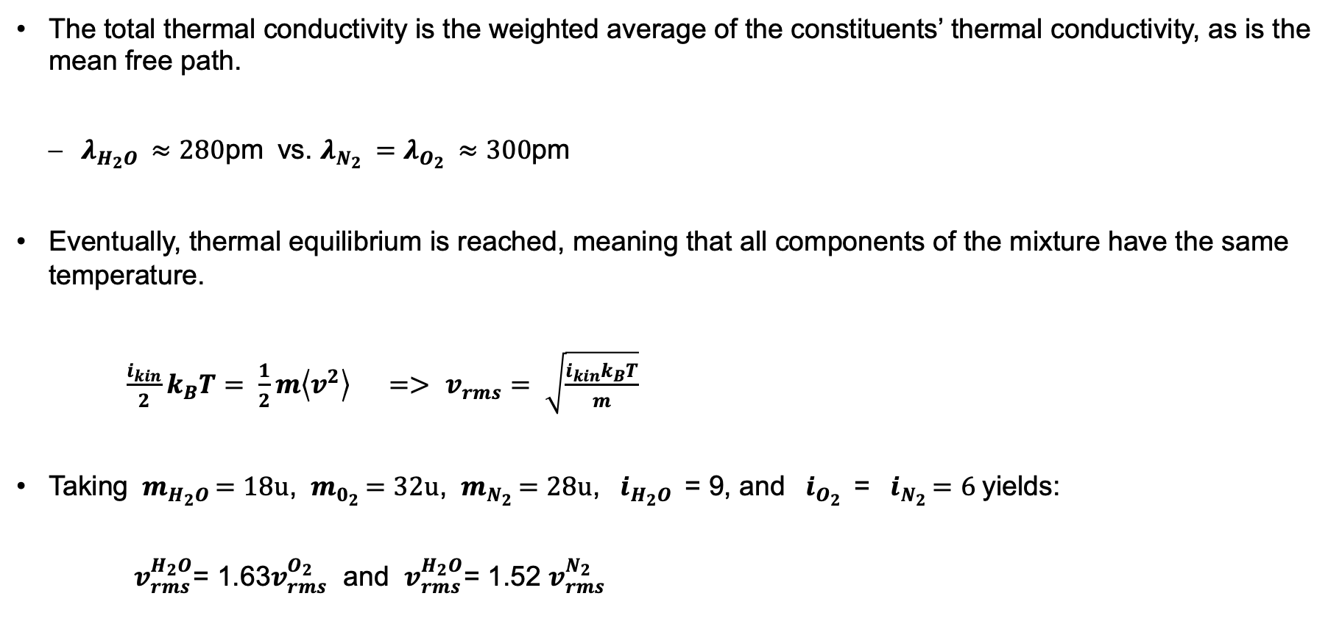
What is the consequence of a mixture of gases?
The total thermal conductivity is the weighted average of the constituents’ thermal conductivity, as is the mean free path.
  $λ_{H_{2}O }≈280$pm vs. $λ_{N_{2} }=λ_{O_{2} }≈300$pm
Eventually, thermal equilibrium is reached, meaning that all components of the mixture have the same temperature.
  $\frac{i_{kin}}{2}k_{B}T= \frac{1}{2}m\left\langle v^{2}\right\rangle$ $=>$ $v_{rms}= \sqrt{\frac{i_{kin}k_{B}T}{m}}$
Taking ${ m}_{H_{2}O }=18u$, ${ m}_{0_{2} }=32u$, ${ m}_{N_{2} }=28u$, ${ i}_{H_{2}O }$ = 9, and ${ i}_{O_{2} }$ = ${ i}_{N_{2} }=6$yields:
    $v_{rms}^{H_{2}O}$= 1.63$v_{rms}^{O_{2}}$ and $v_{rms}^{H_{2}O}$= 1.52 $v_{rms}^{N_{2}}$

Slide 13
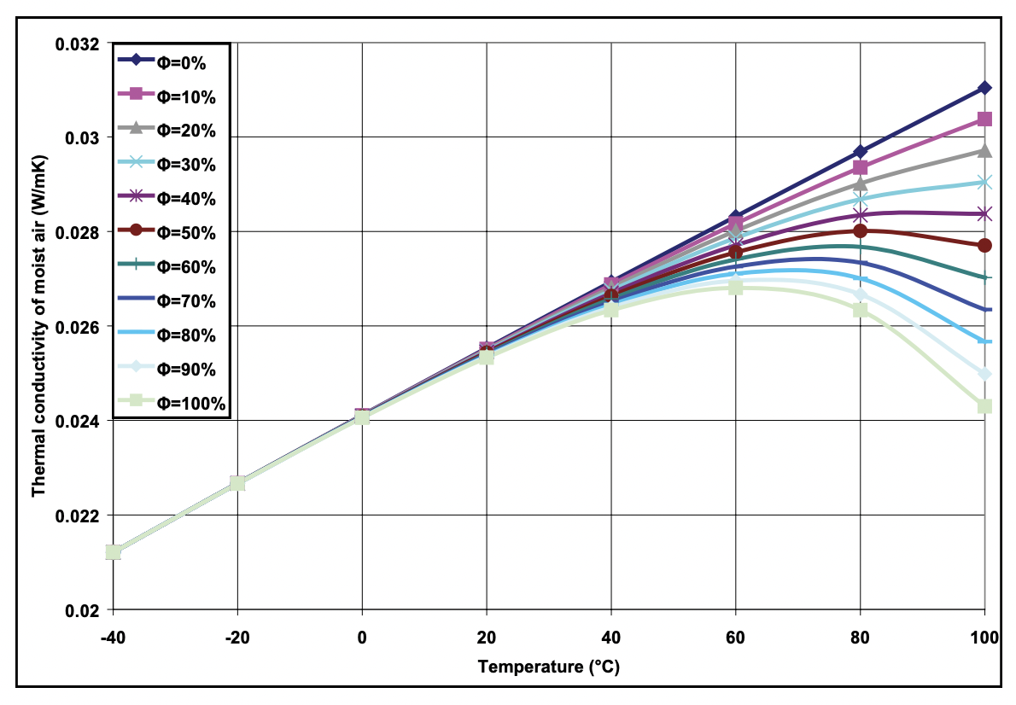
Water vapour’s influence on thermal conductivity of air

Slide 14

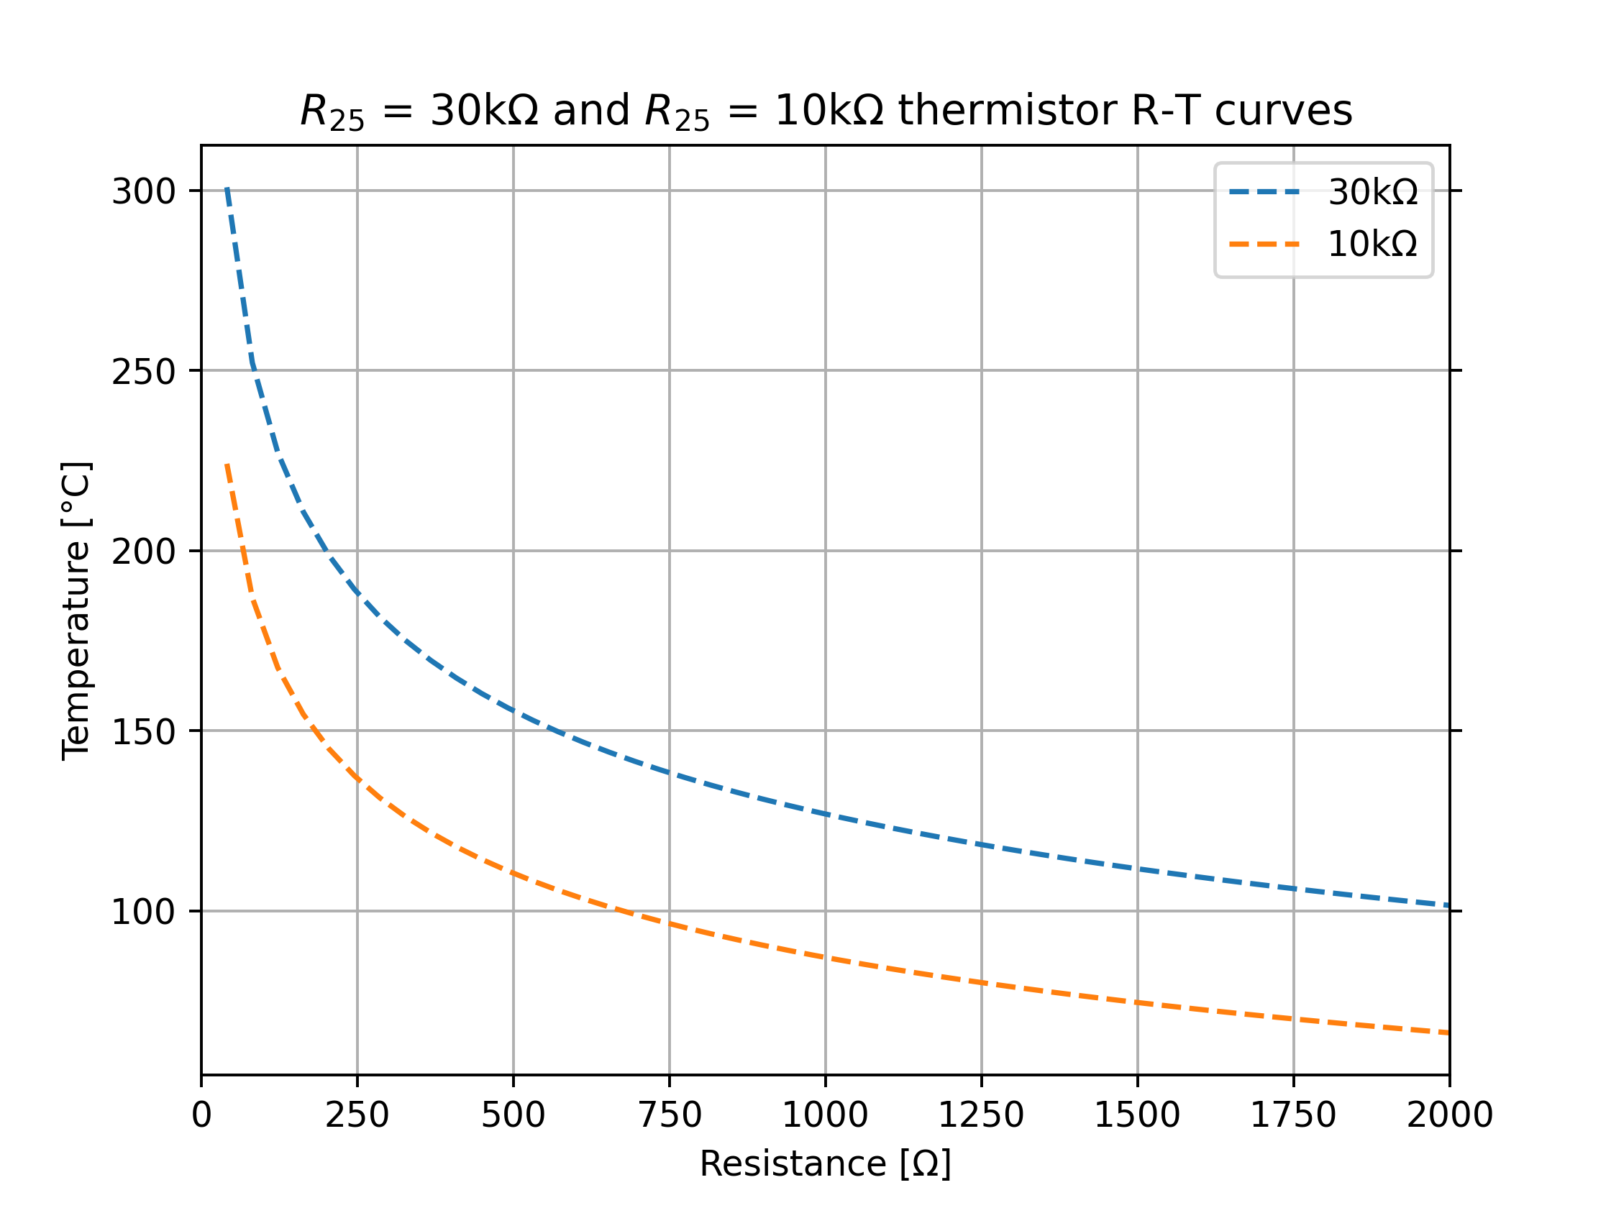
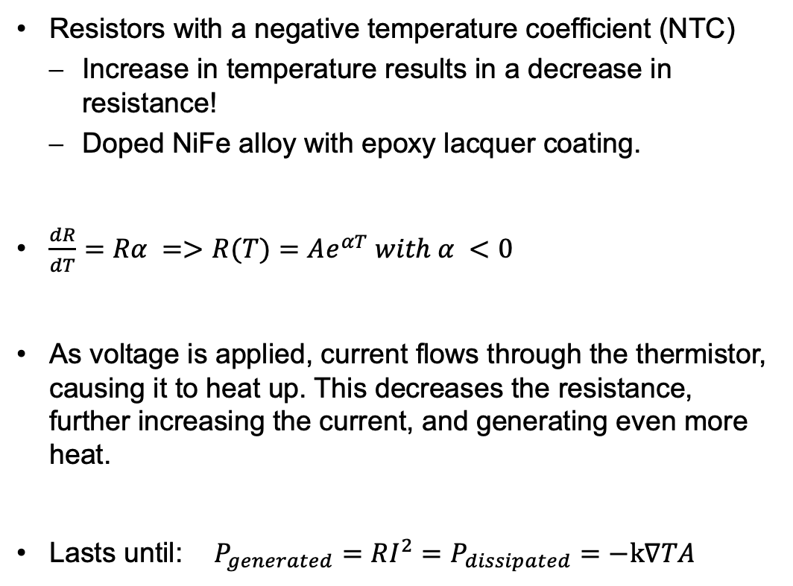
NTC Thermistors
Resistors with a negative temperature coefficient (NTC)
  Increase in temperature results in a decrease in resistance!
  Doped NiFe alloy with epoxy lacquer coating.
$\frac{dR}{dT}=Rα =>R(T)=Ae^{αT} with α <0$
As voltage is applied, current flows through the thermistor, causing it to heat up. This decreases the resistance, further increasing the current, and generating even more heat.
Lasts until:$P_{generated}=RI^{2}=P_{dissipated}=−k∇TA$

Slide 15
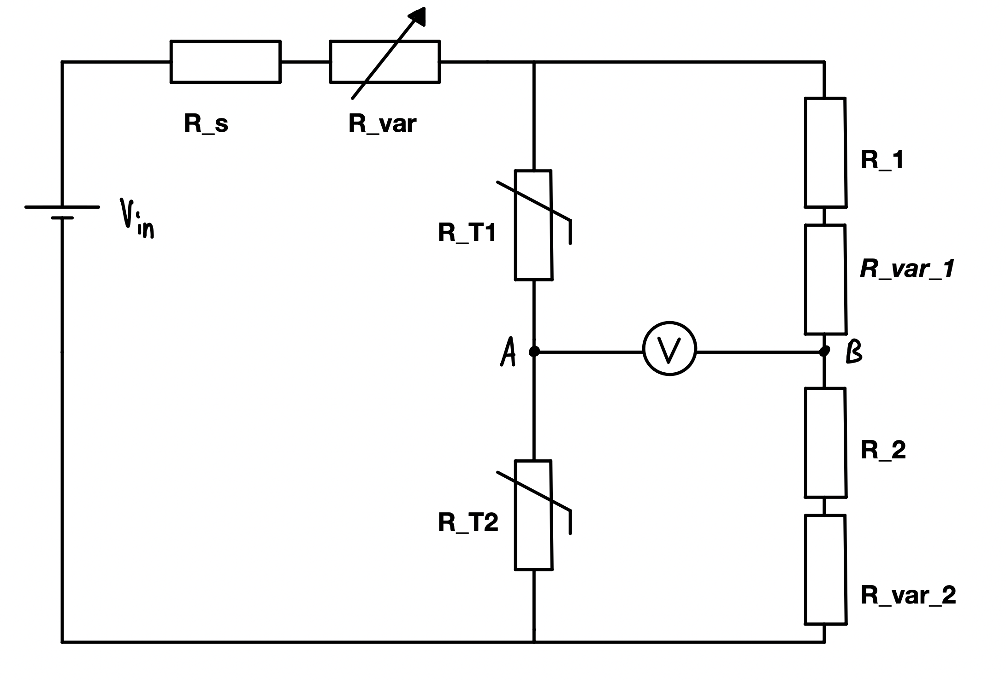
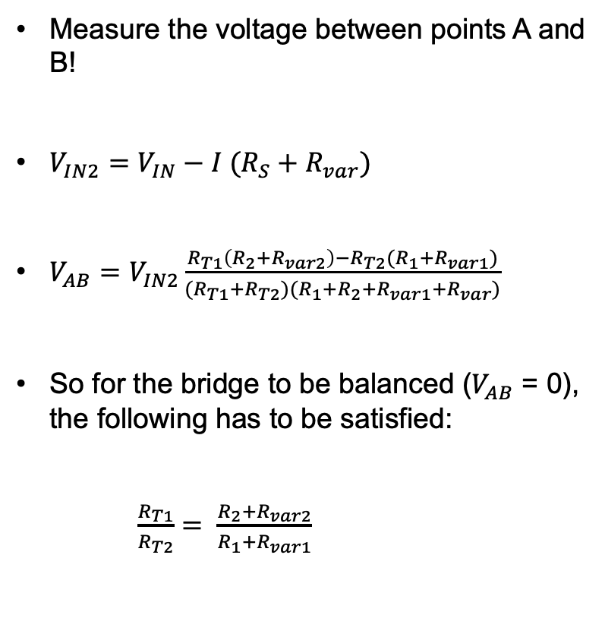
Operational principle of the sensor!
Measure the voltage between points A and B!
$V_{IN2}=V_{IN}−I (R_{S}+R_{var})$
$V_{AB}=V_{IN2}\frac{R_{T1}\left(R_{2}+R_{var2}\right)−R_{T2}(R_{1}+R_{var1})}{(R_{T1}+R_{T2})(R_{1}+R_{2}+R_{var1}+R_{var})}$
So for the bridge to be balanced ($V_{AB}$ = 0), the following has to be satisfied:
$\frac{R_{T1}}{R_{T2}}= \frac{R_{2}+R_{var2}}{R_{1}+R_{var1}}$

Slide 16
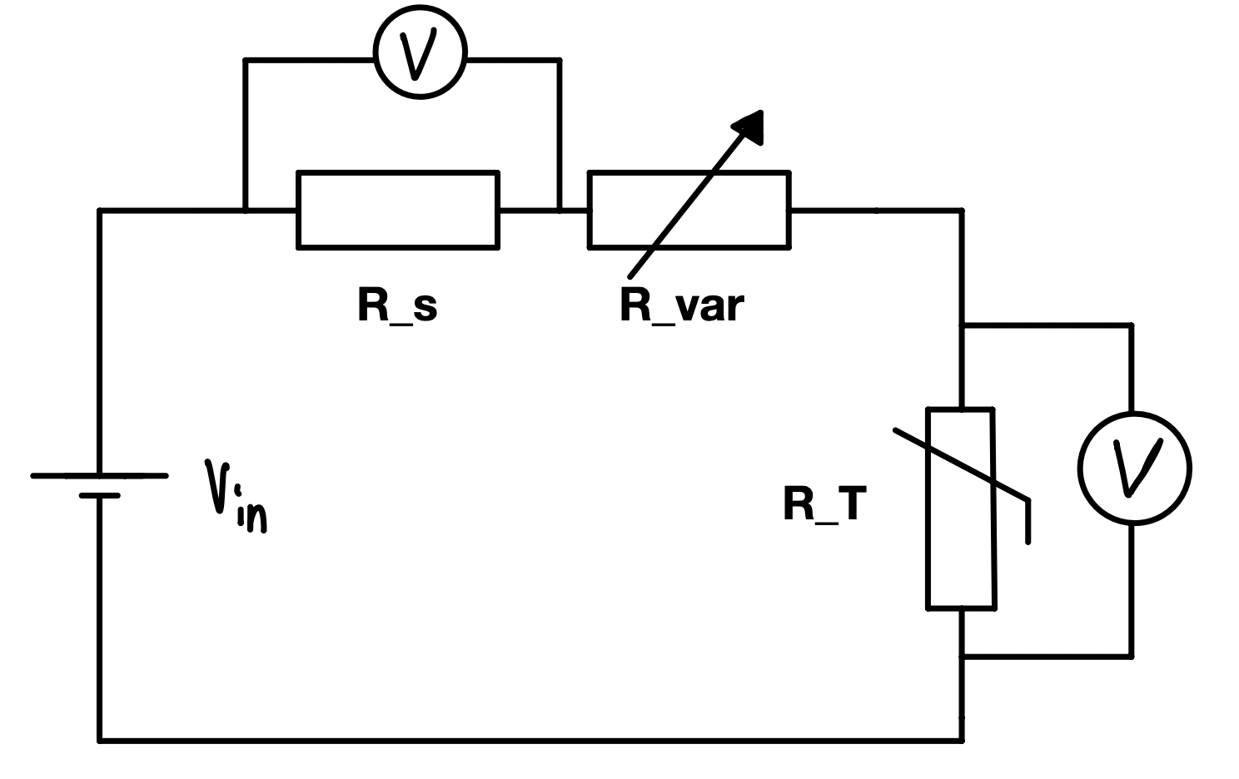
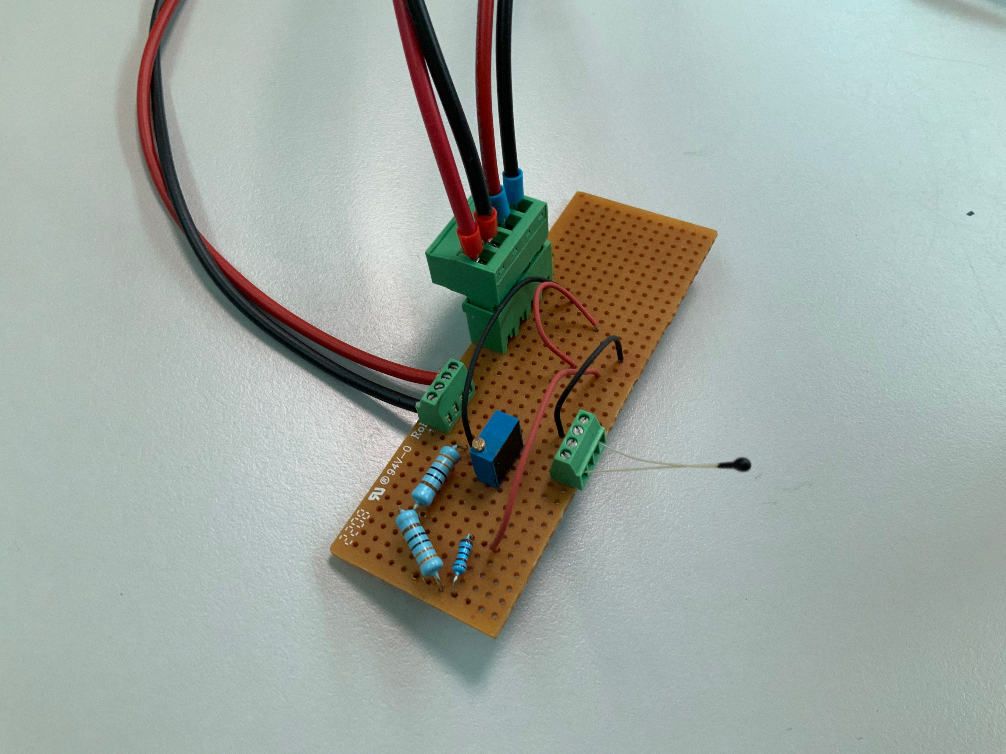

First measurements
No knowledge about the thermistor‘s behaviour
under different currents.
$=>$ determining I-T dependance

Slide 17
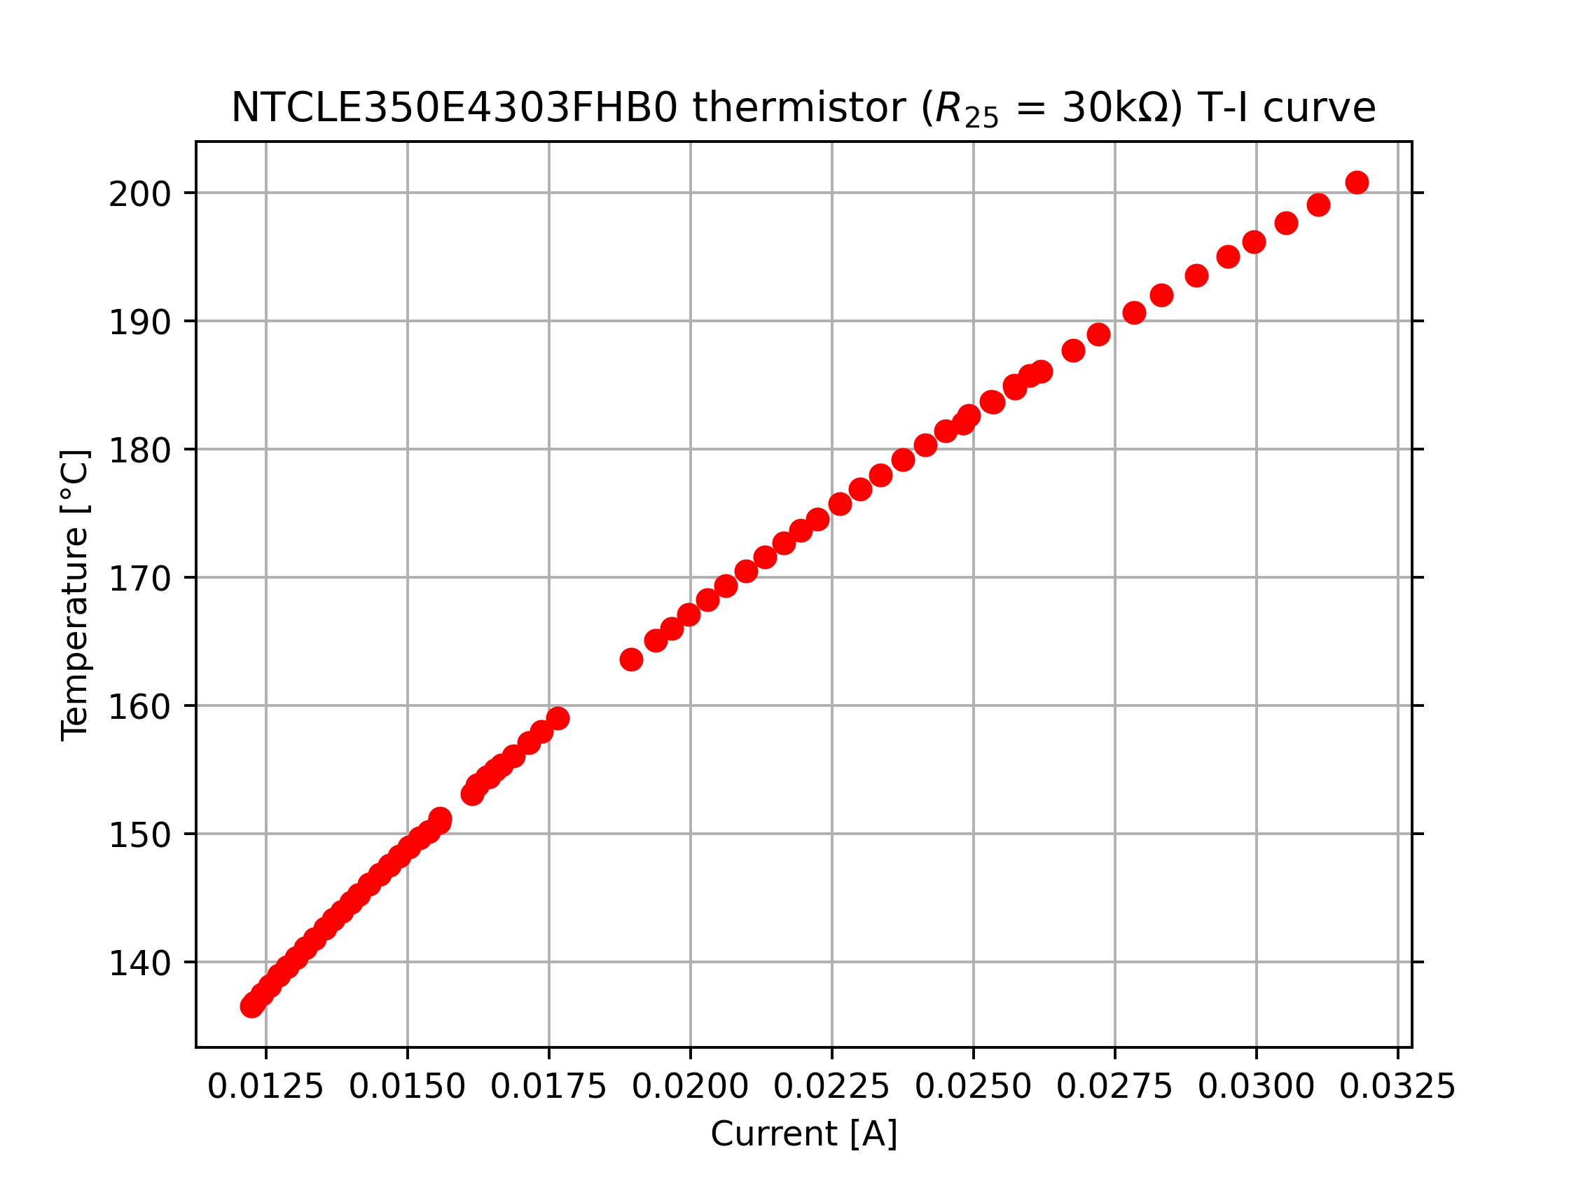
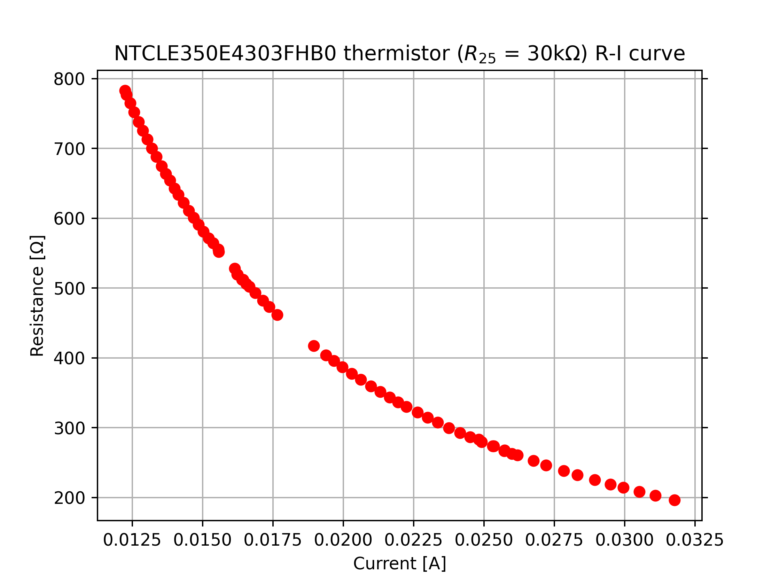
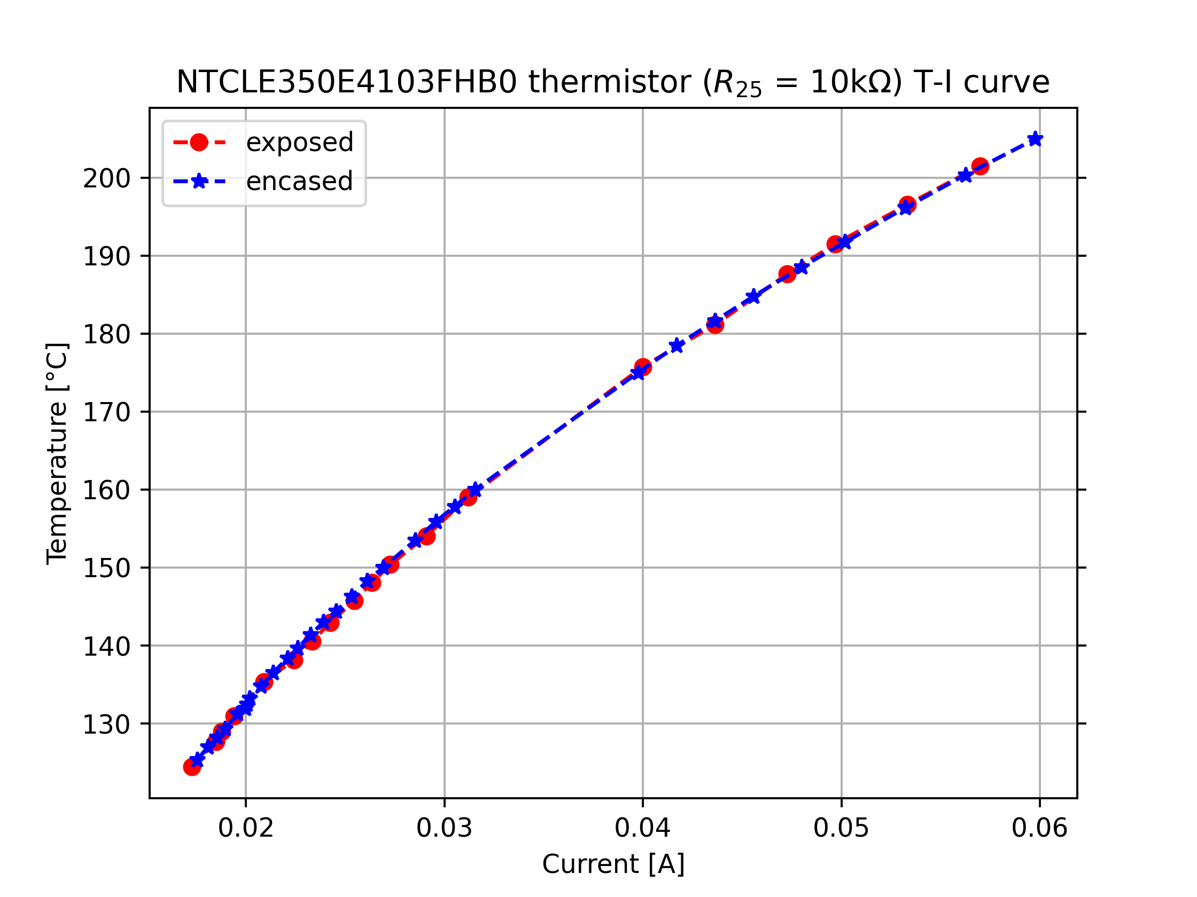
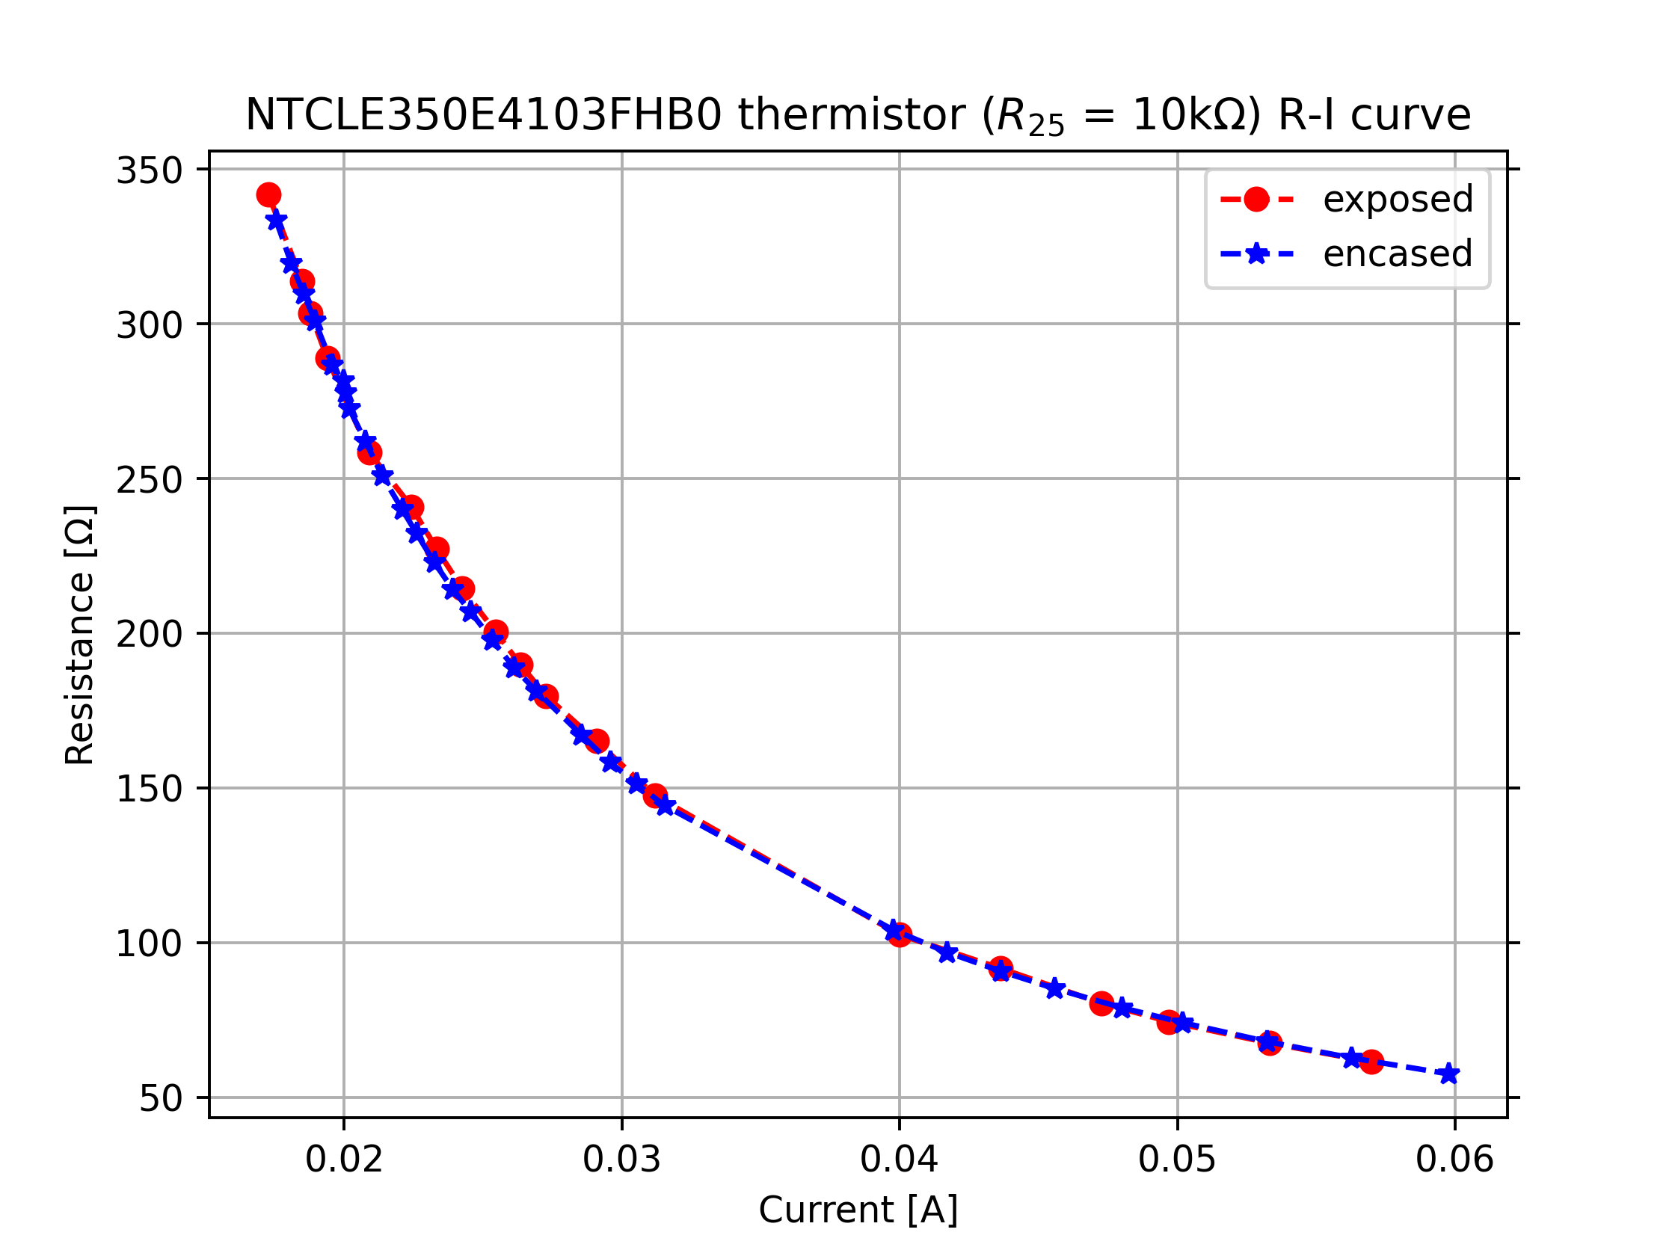

Slide 18
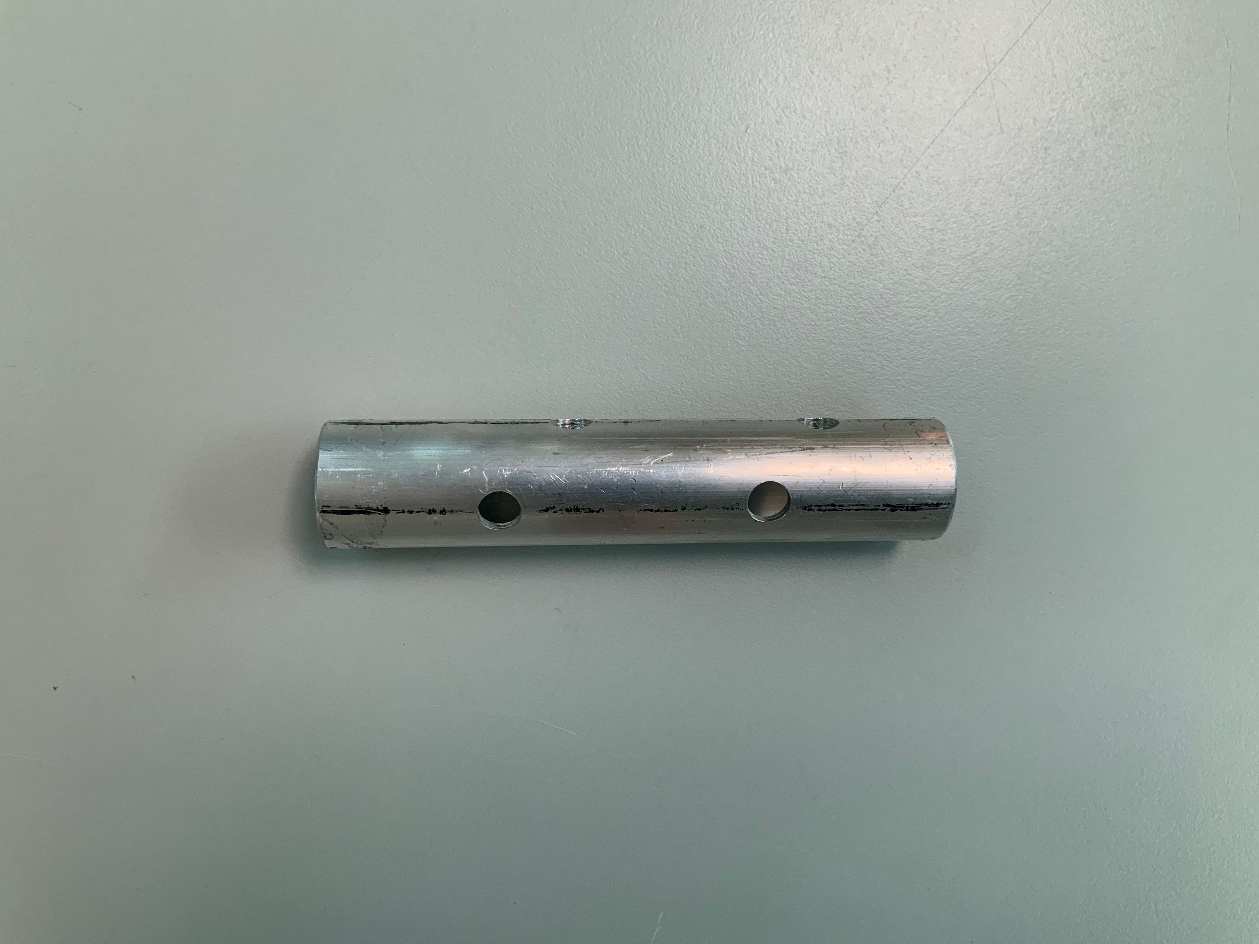
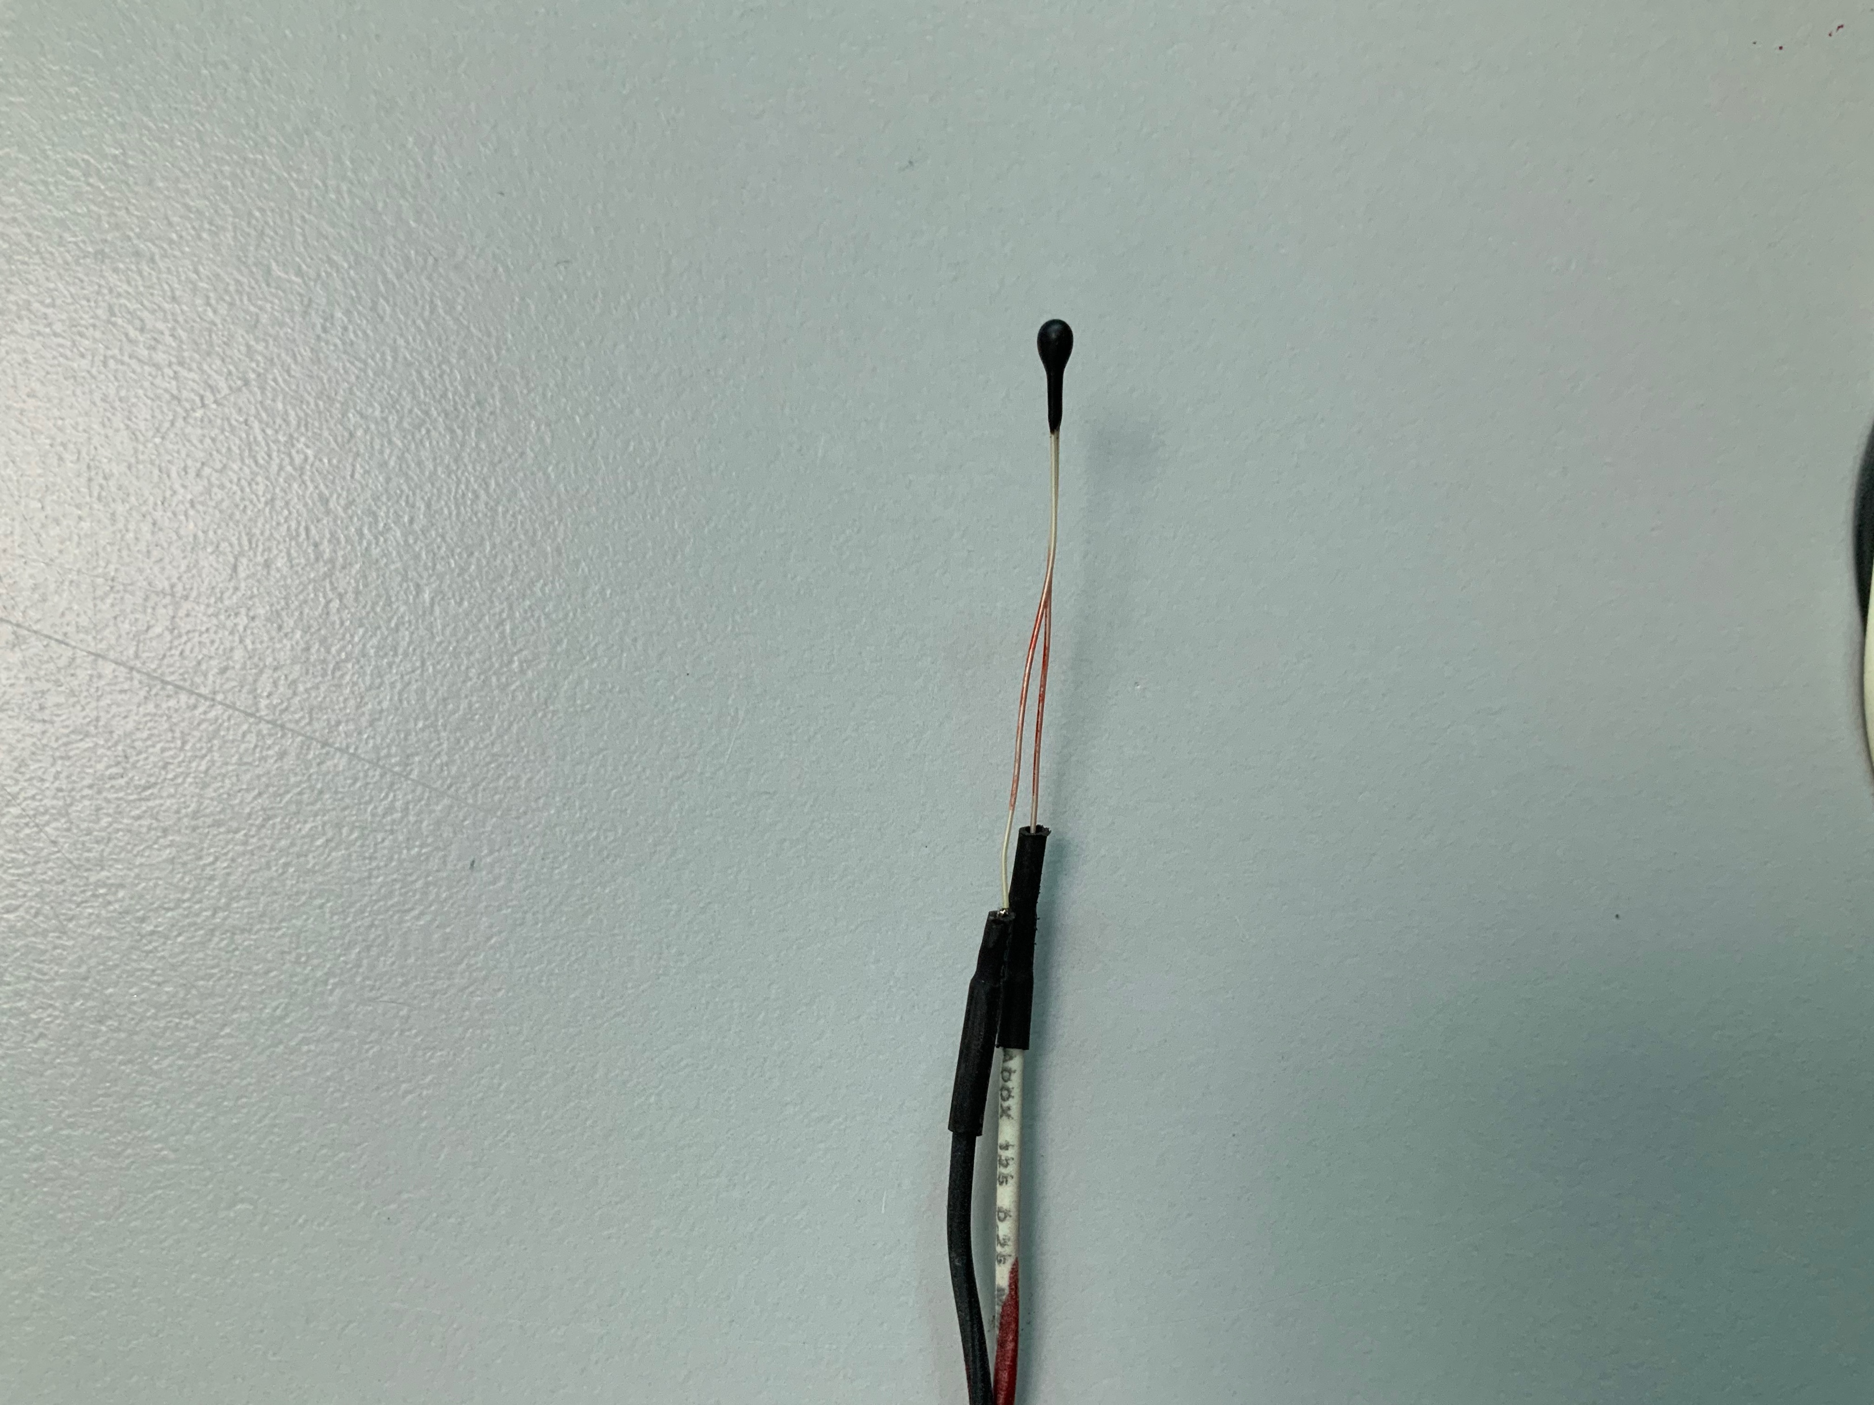
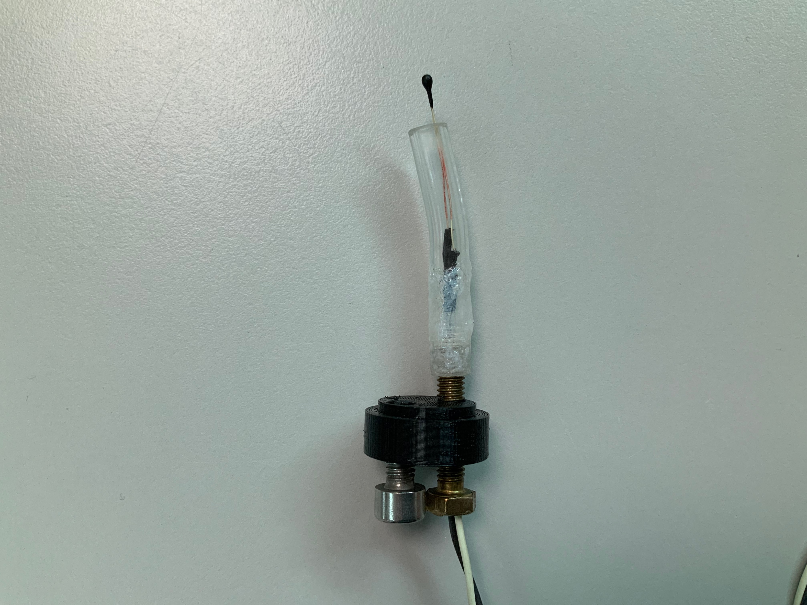
Building the encasings

Slide 19
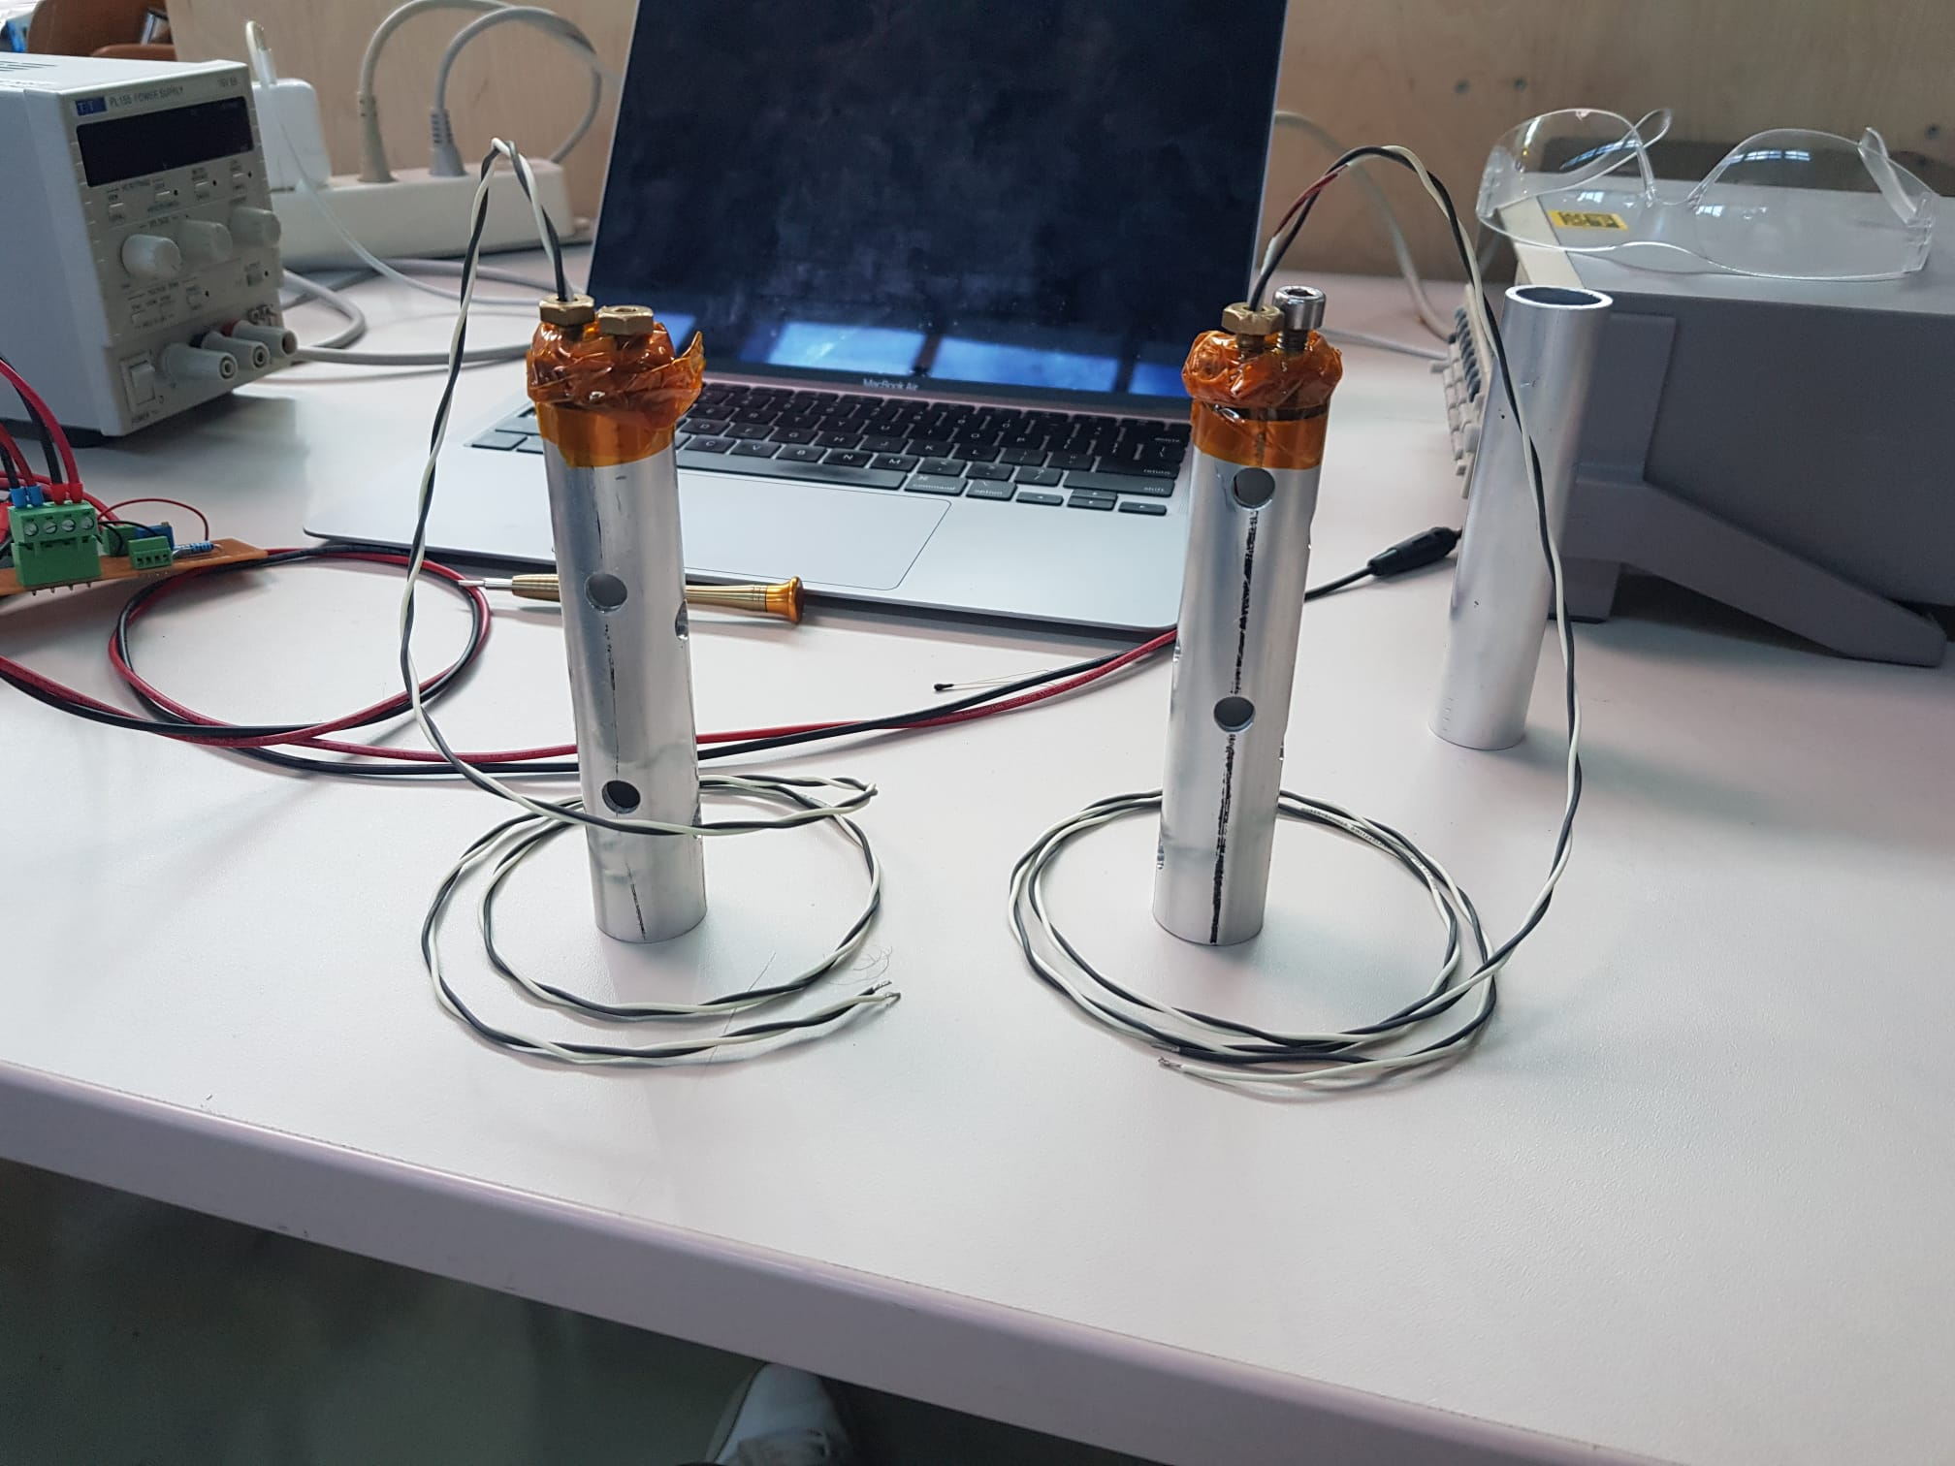

Slide 20
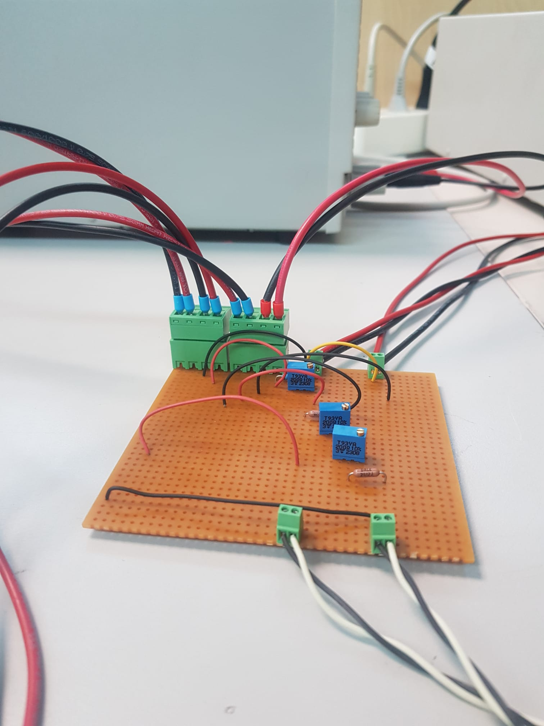
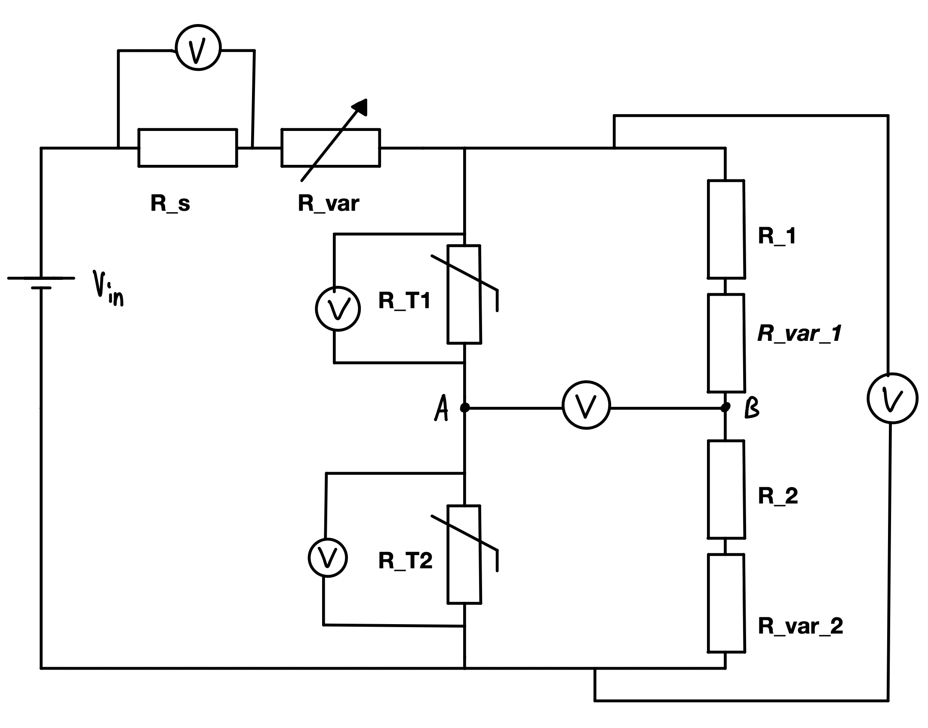
Building the Wheatstone bridge!

Slide 21
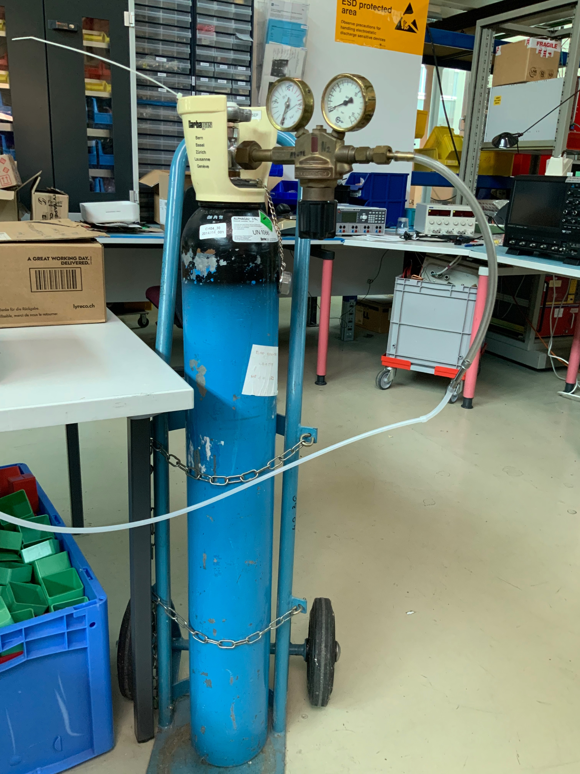
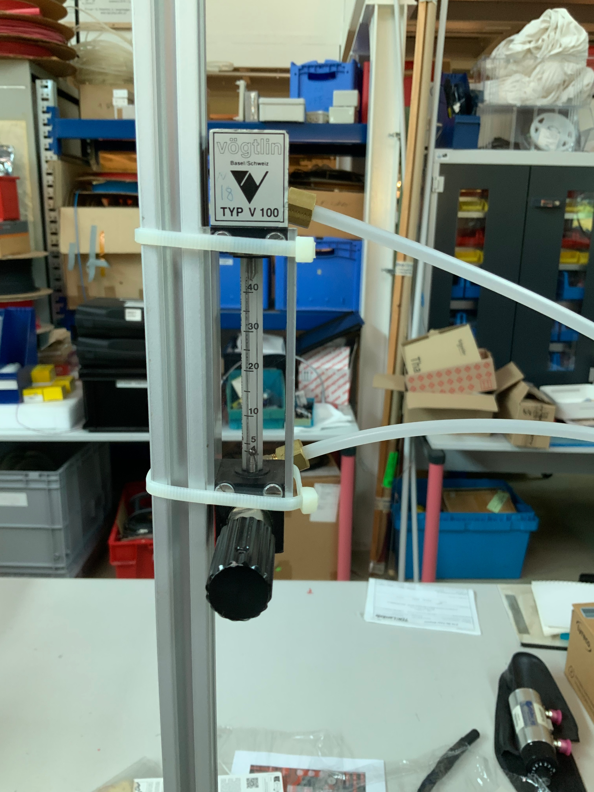

Slide 22
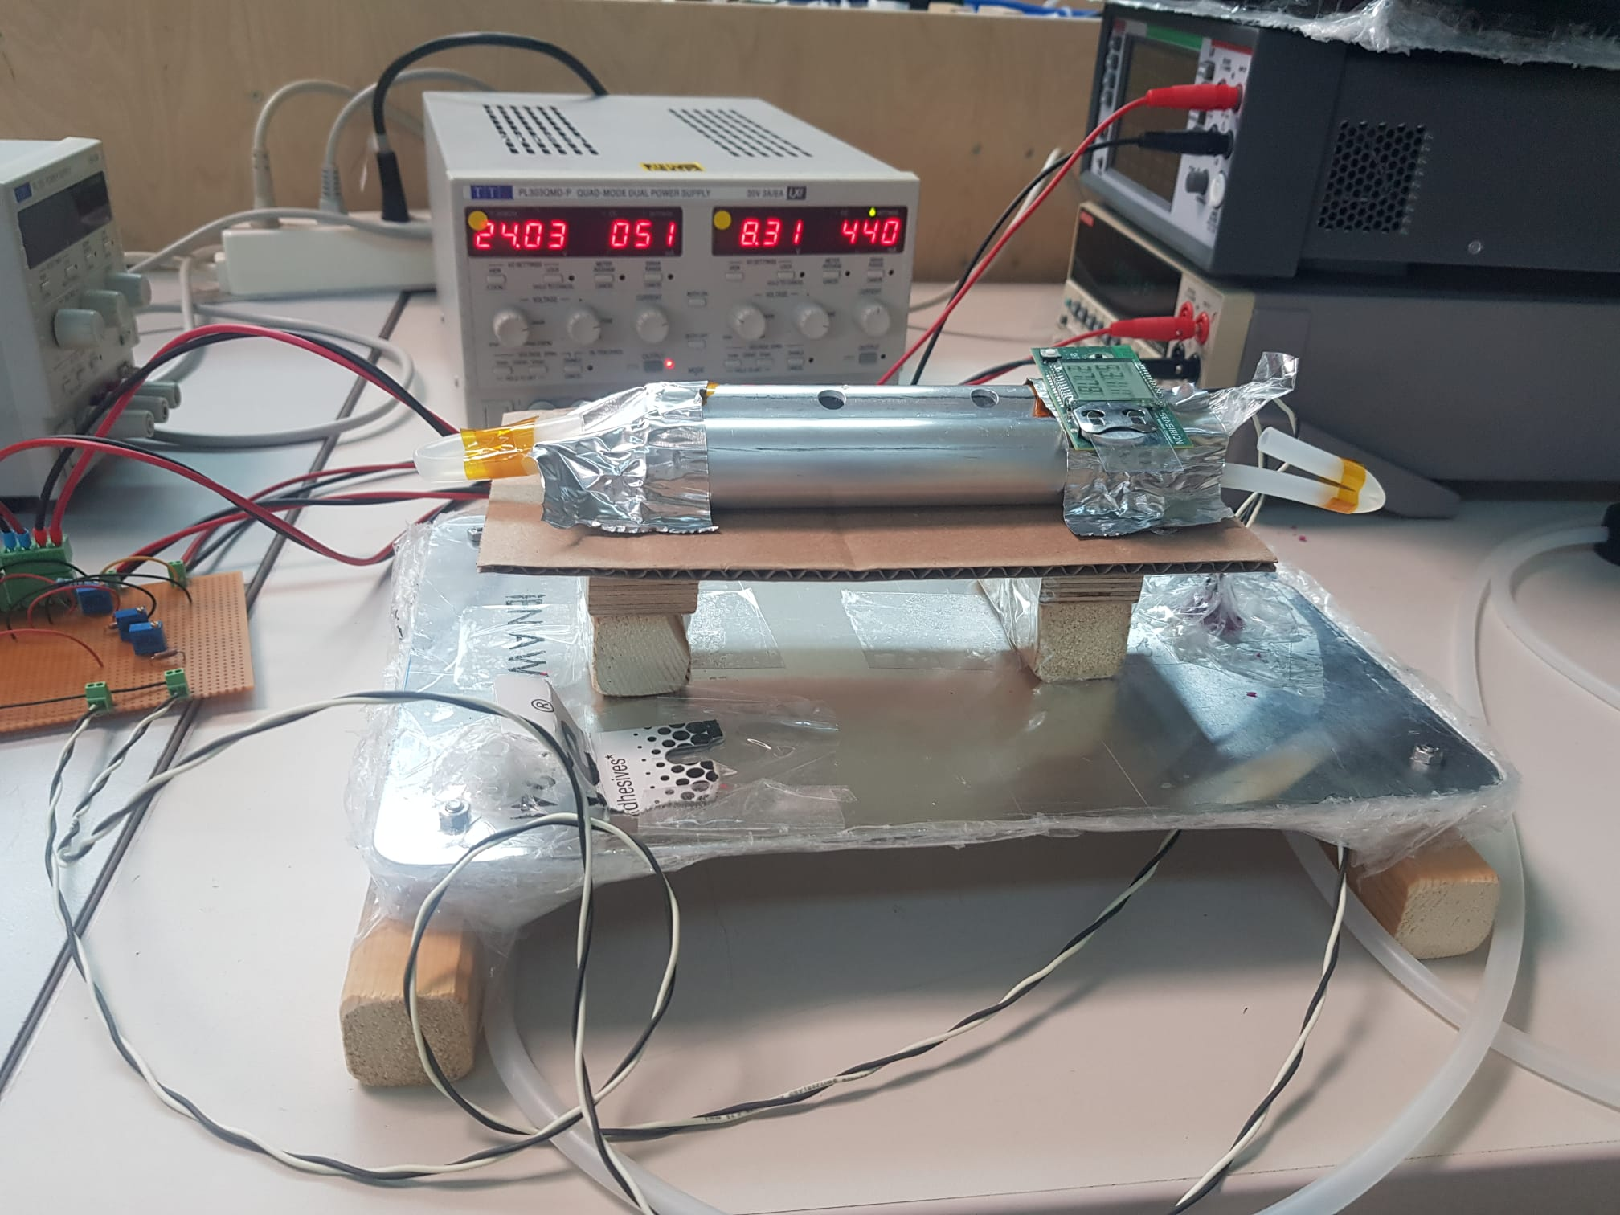
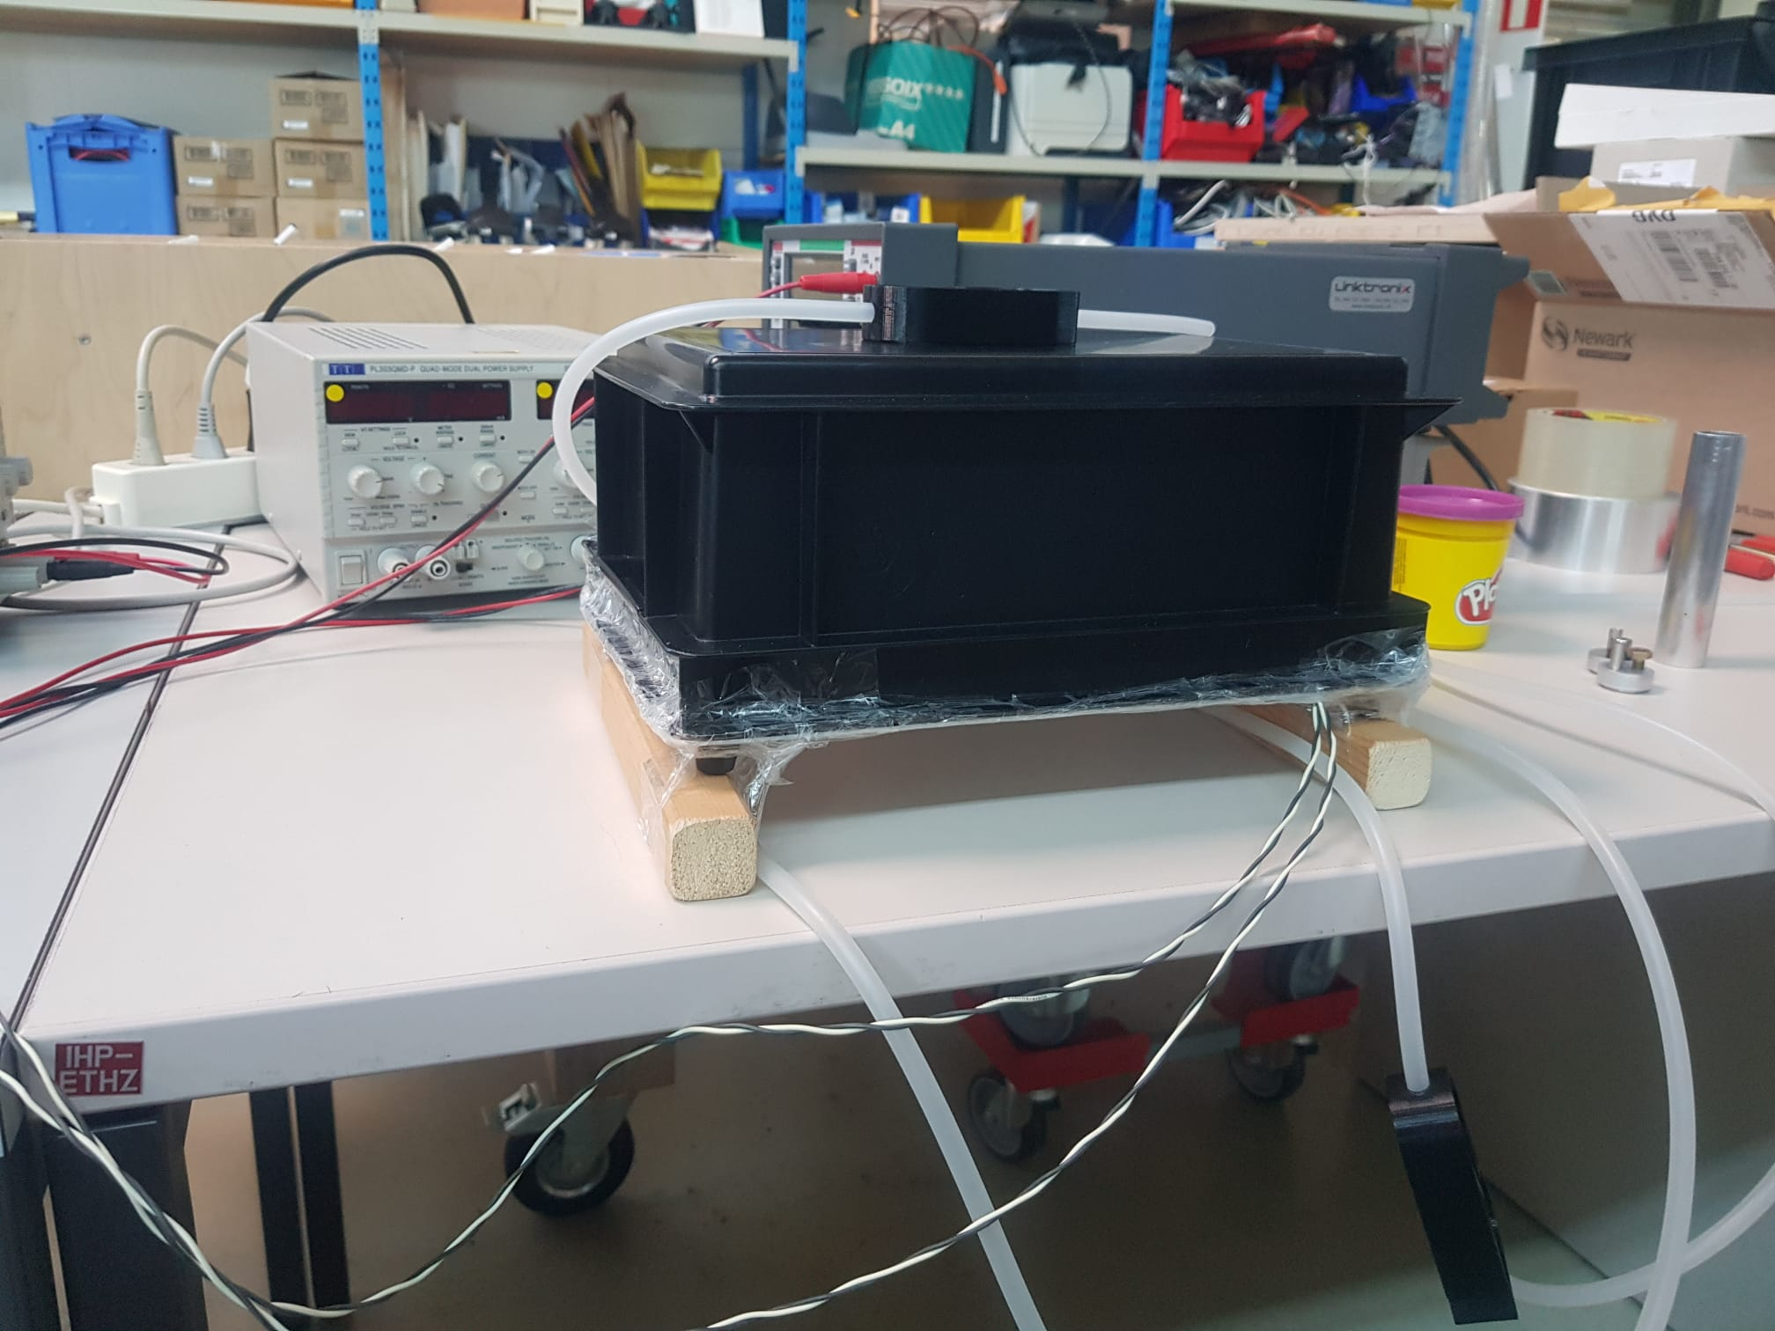
The first of many boxes :D

Slide 23
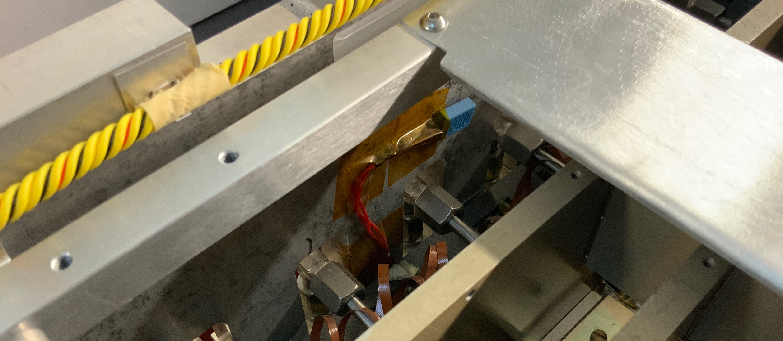

Slide 24
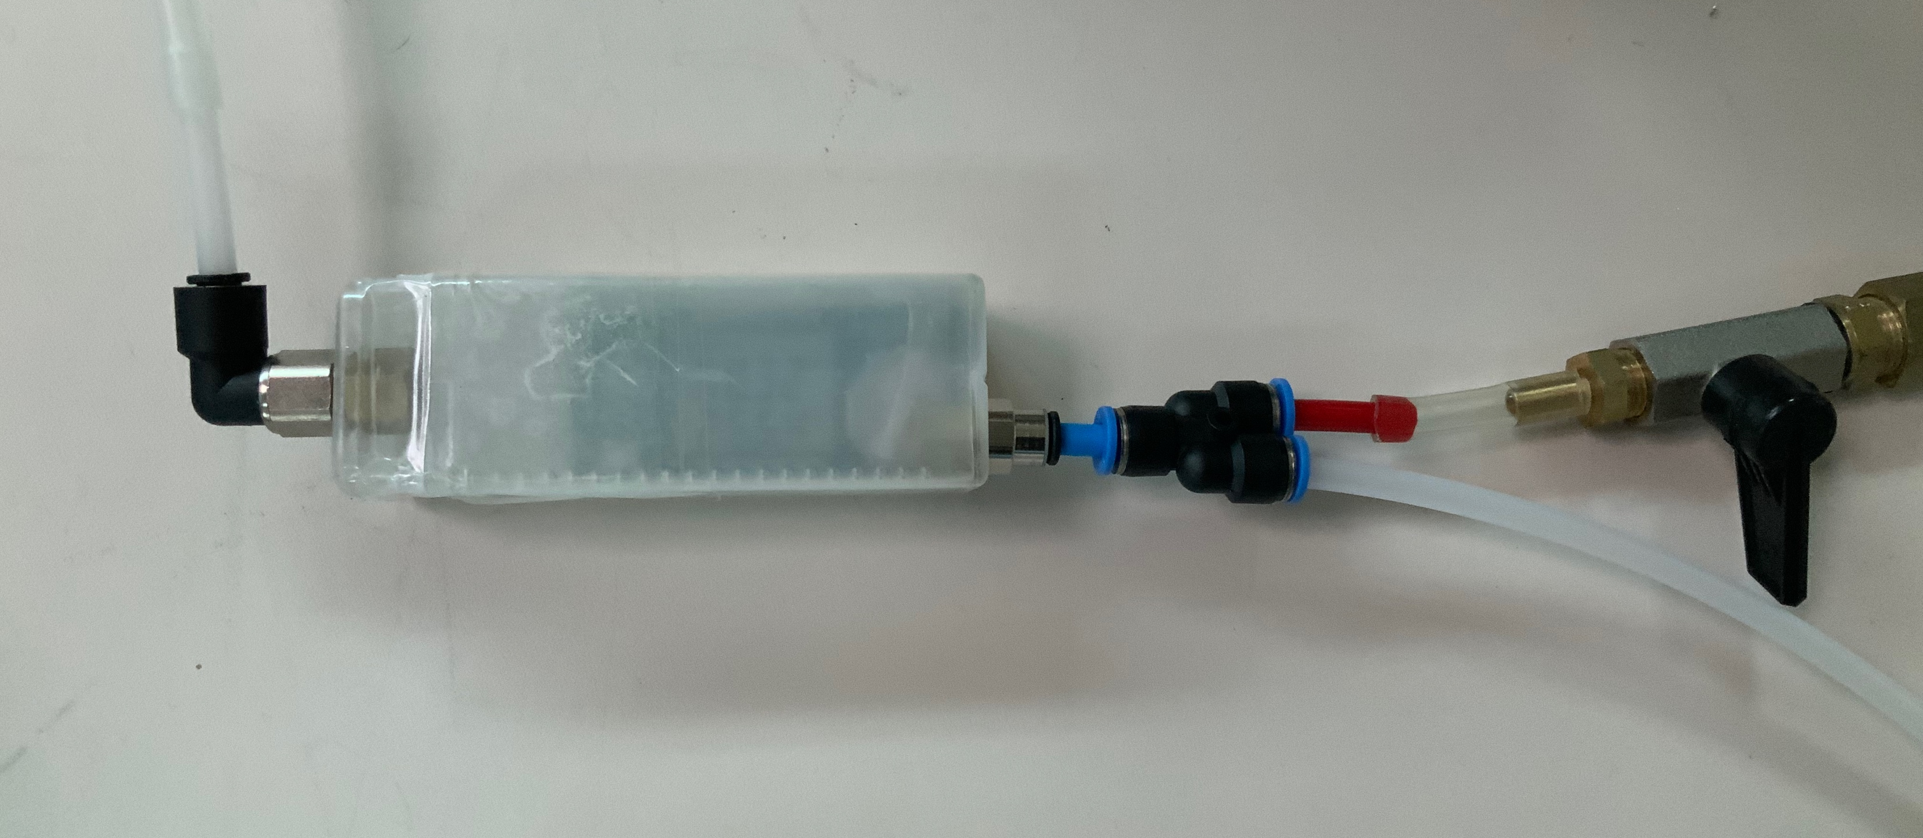

Slide 25
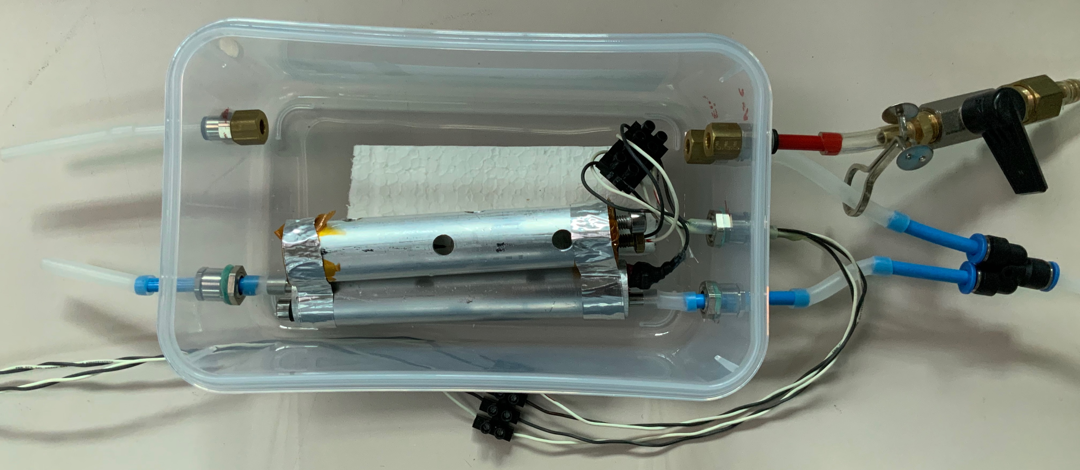

Slide 26
Achieving constant RH values with various salts
Goal: Calibration curve mV output vs. RH at a given Temperature !
Problem: Need stable RH values :(
Solution: Saturated solutions of salts!
  Each salt has a characteristic equilibrium vapour pressure at a given temperature. The salt will absorb water vapor from the air or release water vapor to the air until the partial pressure of the water vapor in the air reaches the equilibrium vapor pressure of the solution.
    Magnesium nitrate hexahydrate: ~55% RH at 25C
    Magnesium chloride: ~33% RH at 25C
    Sodium chloride: ~75% RH at 25C
Notes:
We have a saturated solution -> any additional salt added will remain undissolved in the solution!
prepare a saturated NaCl solution by adding NaCl to water until no more salt can dissolve and some solid salt remains.
This additional salt acts as a buffer! - >
If the relative humidity in the environment decreases, the solution releases water vapor by dissolving more salt. If the relative humidity increases, the solution absorbs water vapor, leading to precipitation of some salt.

Slide 27
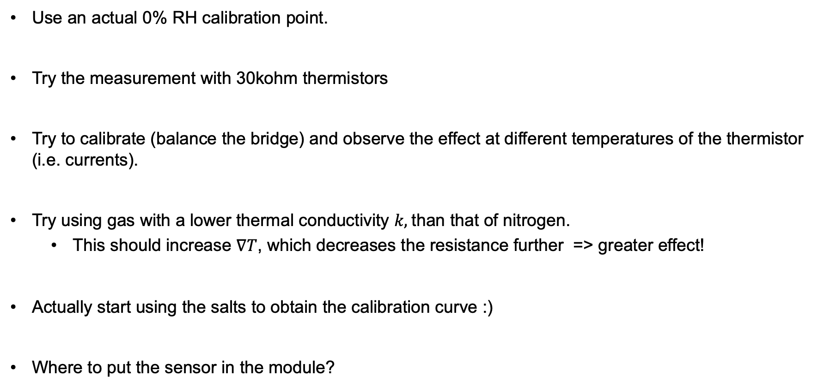
Improvement ideas and future considerations
Use an actual 0% RH calibration point.
Try the measurement with 30kohm thermistors
Try to calibrate (balance the bridge) and observe the effect at different temperatures of the thermistor (i.e. currents).
Try using gas with a lower thermal conductivity $k,$than that of nitrogen.
  This should increase $∇T$, which decreases the resistance further => greater effect!
Actually start using the salts to obtain the calibration curve :)
Where to put the sensor in the module?

Slide 28
Thank you!

