Slide 1



Warm-Cold Correlations and Status of the MQXFA Low-b magnets for the HL-LHC
F. Kurian, G. Ambrosio, J. DiMarco, G. Sabbi
with contributions from the whole MQXFA team

Slide 2
Acknowledgement
US HL-LHC Accelerator Upgrade Project (AUP)
  BNL: K. Amm, M. Anerella, A. Ben Yahia, A. Ghosh, H. Hocker, P. Joshi, F. Kurian, J. Muratore, J. Schmalzle, P. Wanderer, W. McKean
  FNAL: G. Ambrosio, G. Apollinari, M. Baldini, J. Blowers, R. Bossert, R. Carcagno, G. Chlachidze, J. DiMarco, S. Feher, S. Krave, V. Lombardo, C. Narug, A. Nobrega, V. Marinozzi, C. Orozco, T. Page, S. Stoynev, T. Strauss, M. Turenne, D. Turrioni, A. Vouris, M. Yu
  LBNL: D. Cheng, J. A. Doyle, P. Ferracin, L. Garcia Fajardo, M. Marchevsky, M. Naus, I. Pong, S. Prestemon, K. Ray, G. Sabbi, M. Solis, G. Vallone, X. Wang
  NHMFL: L. Cooley, J. Levitan, J. Lu, R. Walsh
CERN: HL-LHC Project
  G. Arnau Izquierdo, A. Ballarino, M. Bajko, C. Barth, N. Bourcey, B. Bulat, M. Cruovizier, A. Devred, H. Felice, S. Ferradas Troitino, L. Fiscarelli, J. Fleiter, M. Guinchard, O. Housiaux, S. Izquierdo Bermudez, N. Lusa, F. Mangiarotti, A. Milanese, A. Moros, P. Moyret, C. Petrone, J.C. Perez, H. Prin, R. Principe, P. M. Quassolo, E. Ravaioli, T. Sahner, S. Sgobba, P. Tavares Coutinho Borges De Sousa, E. Todesco, J. Ferradas Troitino, R. Van Weelderen, G. Willering

Slide 3
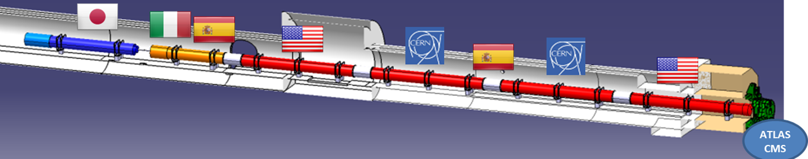
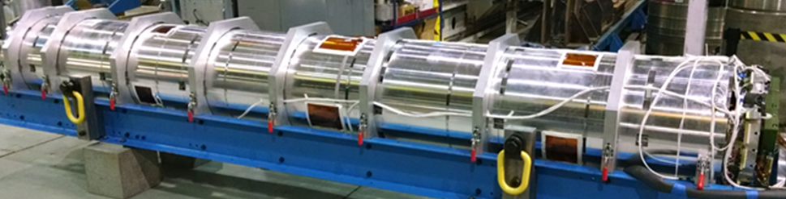
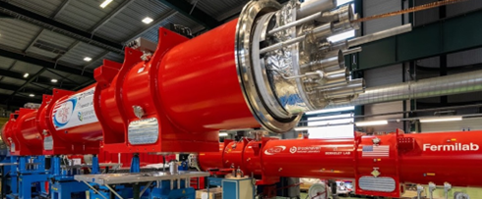

MQXFA: US Low-b Quadrupoles for HL-LHC
Q3
Q1
Magnet
(MQXFA)
Cold Mass
(LMQXFA)
20 Magnets
  16 magnets for 8 Q1/Q3 to be installed in LHC tunnel
  4 magnets for 2 Q1/Q3 commissioning spares

Slide 4
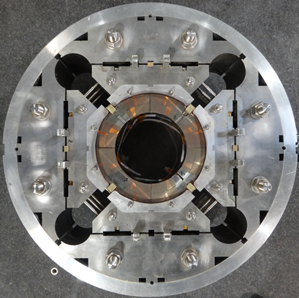
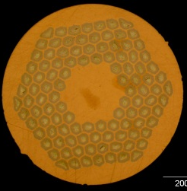
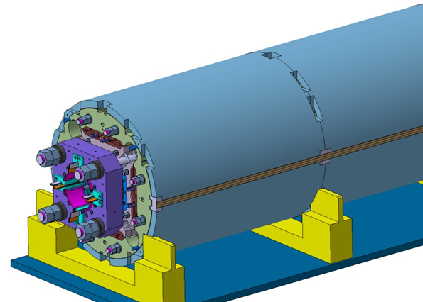
MQXFA/B Design
Parameter | Unit | MQXFA/B
Coil aperture | mm | 150
Magnetic length | m | 4.2/7.15
N. of layers |  | 2
N. of turns Inner-Outer layer |  | 22-28
Operation temperature | K | 1.9
Nominal gradient | T/m | 132.2
Nominal current | kA | 16.23
Peak field at nom. current | T | 11.3
Stored energy at nom. curr. | MJ/m | 1.15
Diff. inductance | mH/m | 8.26
Strand diameter | mm | 0.85
Strand number |  | 40
Cable width | mm | 18.15
Cable mid thickness | mm | 1.525
Keystone angle |  | 0.4
Nb₃Sn Conductor
RRP 108/127
P. Ferracin et al., “Development of MQXF, the Nb₃Sn Low-β Quadrupole for the HiLumi LHC ” IEEE Trans App. Supercond. Vol. 26, no. 4, 4000207
G. Ambrosio et al., “First Test Results of the 150 mm Aperture IR Quadrupole Models for the High Luminosity LHC” NAPAC16, FERMILAB-CONF-16-440-TD

Slide 5

MQXFA Status Summary
Control Account | Component status wrt Baseline | Comments
Strand procurement & QC (FNAL, FSU) | >98% complete | Procuring spare cond.
Cable fabrication & insulation (LBNL) | 100% complete
Coil part procurement (FNAL) | >98% complete | 2 sets in procurement
Coil fabrication (FNAL) | 96% complete | Last 3 coils
Coil fabrication (BNL) | 100% complete
Magnet part procurement (LBNL) | 100% complete
Magnet assembly (LBNL) | 81% complete | 17 magnets complete
Main task is magnet assembly. (Supported by 4 reviews / meetings per magnet)
More details in
“Sat-Mo-Po.06-08: Strain measurements on the coils of the MQXFA magnets during the vertical test in liquid helium”
and
“Sat-Mo-Po.06-03: Evaluation of the room temperature field quality measurements of HL-LHC MQXFA magnet assemblies
MQXFA at BNL after shipment from LBNL

Slide 6
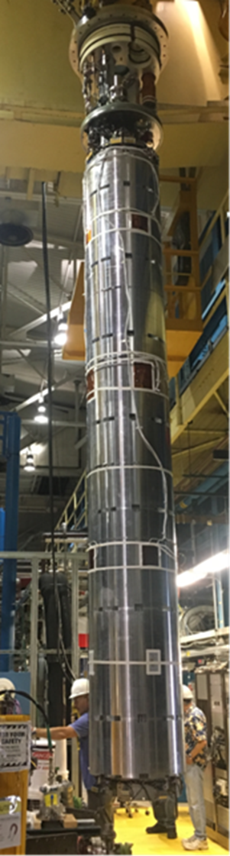
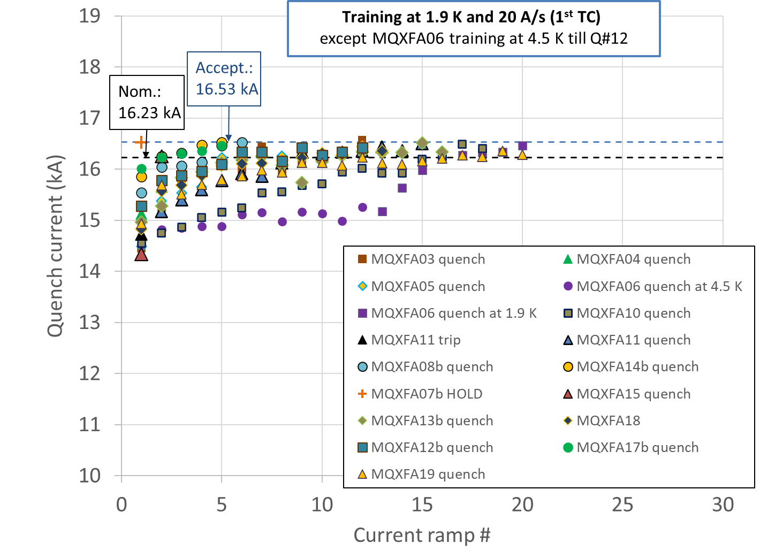
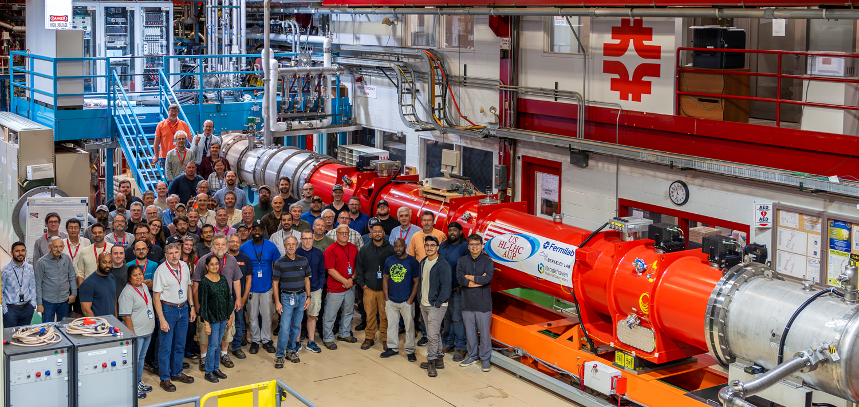
Magnet Tests
15 magnets met requirements during vertical test @ BNL
  4 magnets (MQXFA07/08/13/17) needed a coil change to meet requirements
  1 magnet (MQXFA16) is waiting for a coil change
  MQXFA05 passed an Endurance Test
  MQXFA11 demonstrated resilience (after highway crash)
MQXFA magnet being moved to vertical test station at BNL
All magnets will be tested vertically, with only one Thermal Cycle because of budget constrains.
After test of 1st Cryo-assembly at FNAL
6 magnets met requirements during horizontal test @ FNAL
6

Slide 7
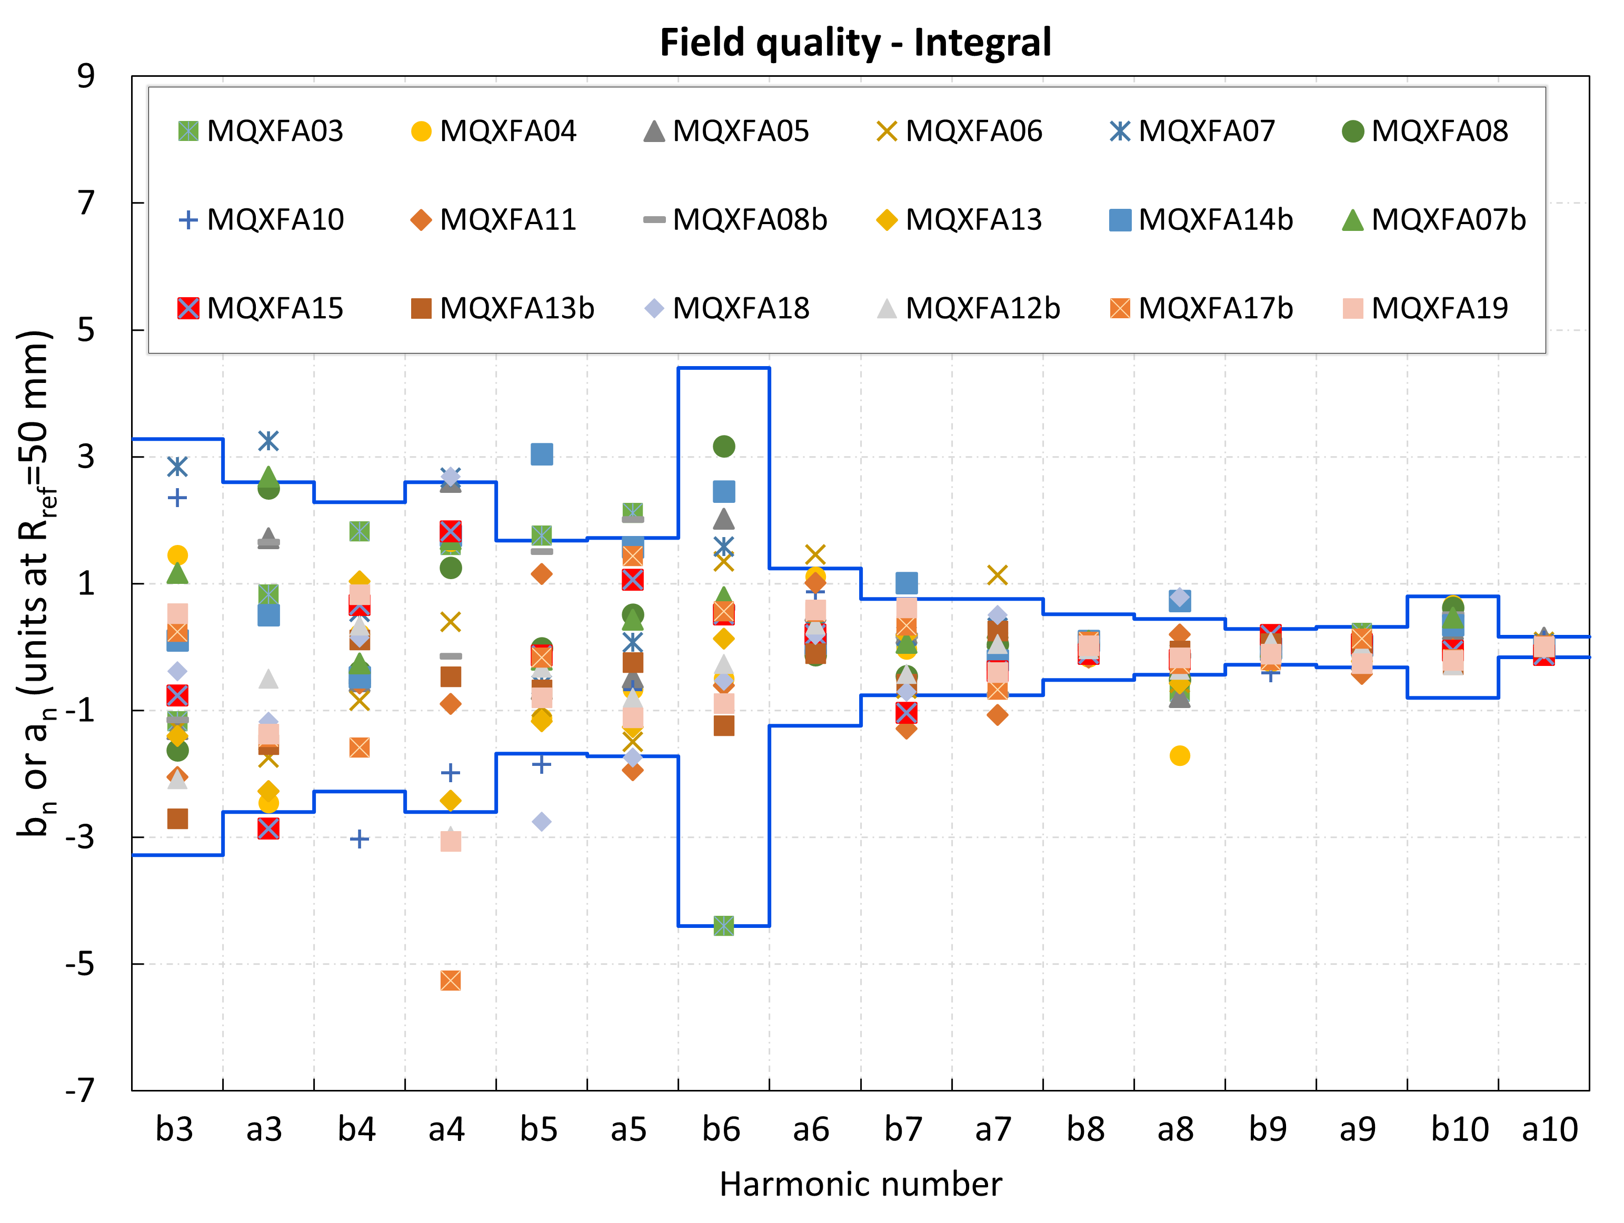
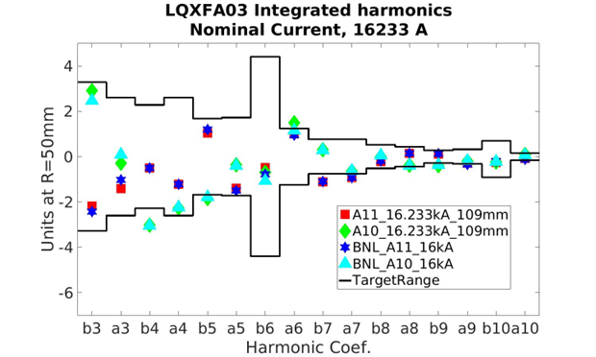
Integral Harmonics at Nominal Current
b6 correction introduced in one coil of MQXFA04 and all subsequent coils:
125 um shift toward midplane
Magnetic shims used in several magnets to correct low order harmonics
Good agreement btw vertical (BNL) and horizontal (FNAL) tests.
FQ compensation between magnets in same cryostat
Before b6 correction in cross-section
- J. Muratore, et al. "Test results of the first pre-series quadrupole magnets for the LHC hi-lumi upgrade." IEEE TAS vol. 31, no. 5,(2021), art. 4001804.

Slide 8
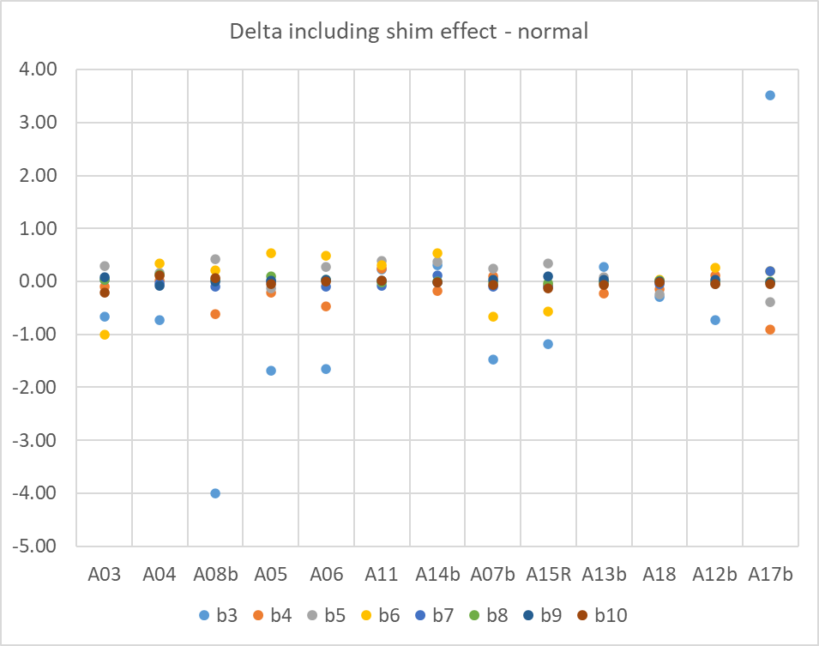
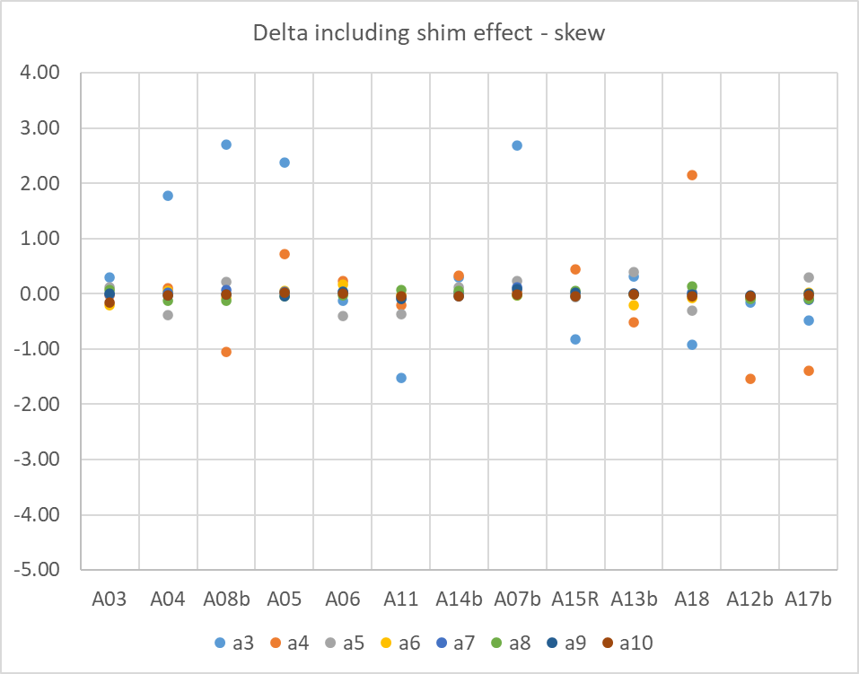
Harmonics: Warm – Cold correlations
Delta (cold/nominal/BNL-warm/LBNL) including the expected magnetic shim change
No shims
Shims applied
No shims
Shims applied
Magnets ordered by fabrication sequence except for 08b moved next to 04 to group shims/no shims

Slide 9
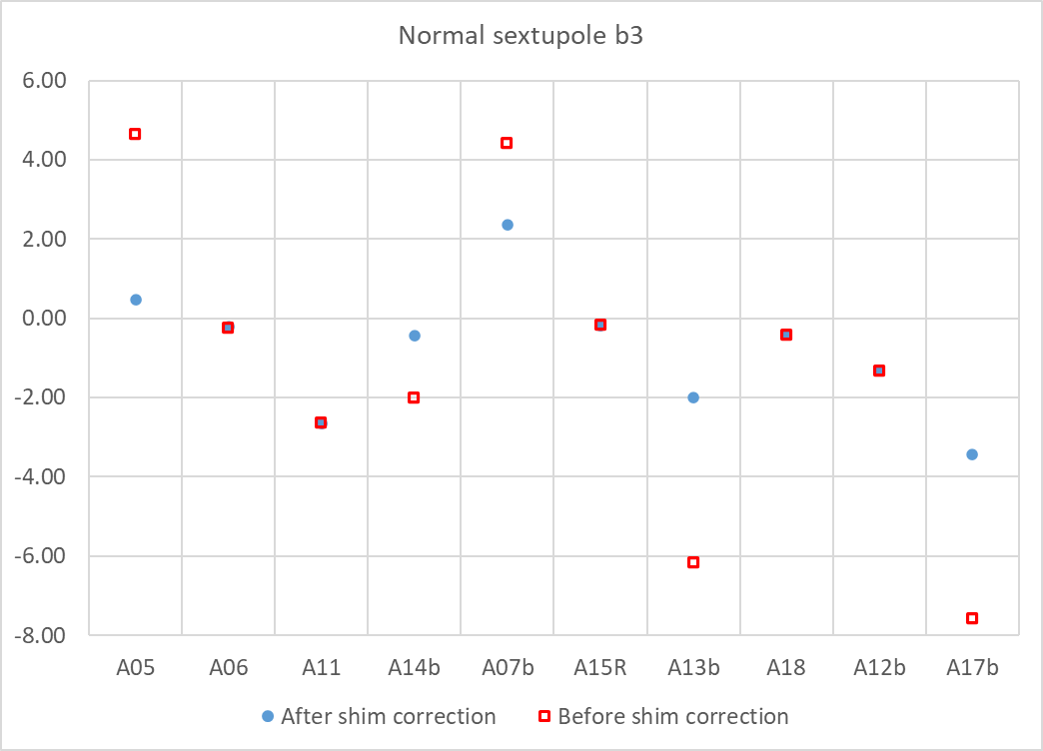
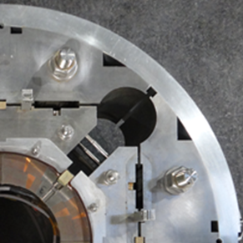
Magnetic Shims Effect
Before and after shim correction - Only magnets with shims, b3
Magnetic shims are inserted in bladder slots after magnet prestress

Slide 10
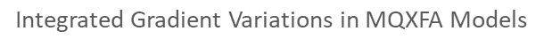
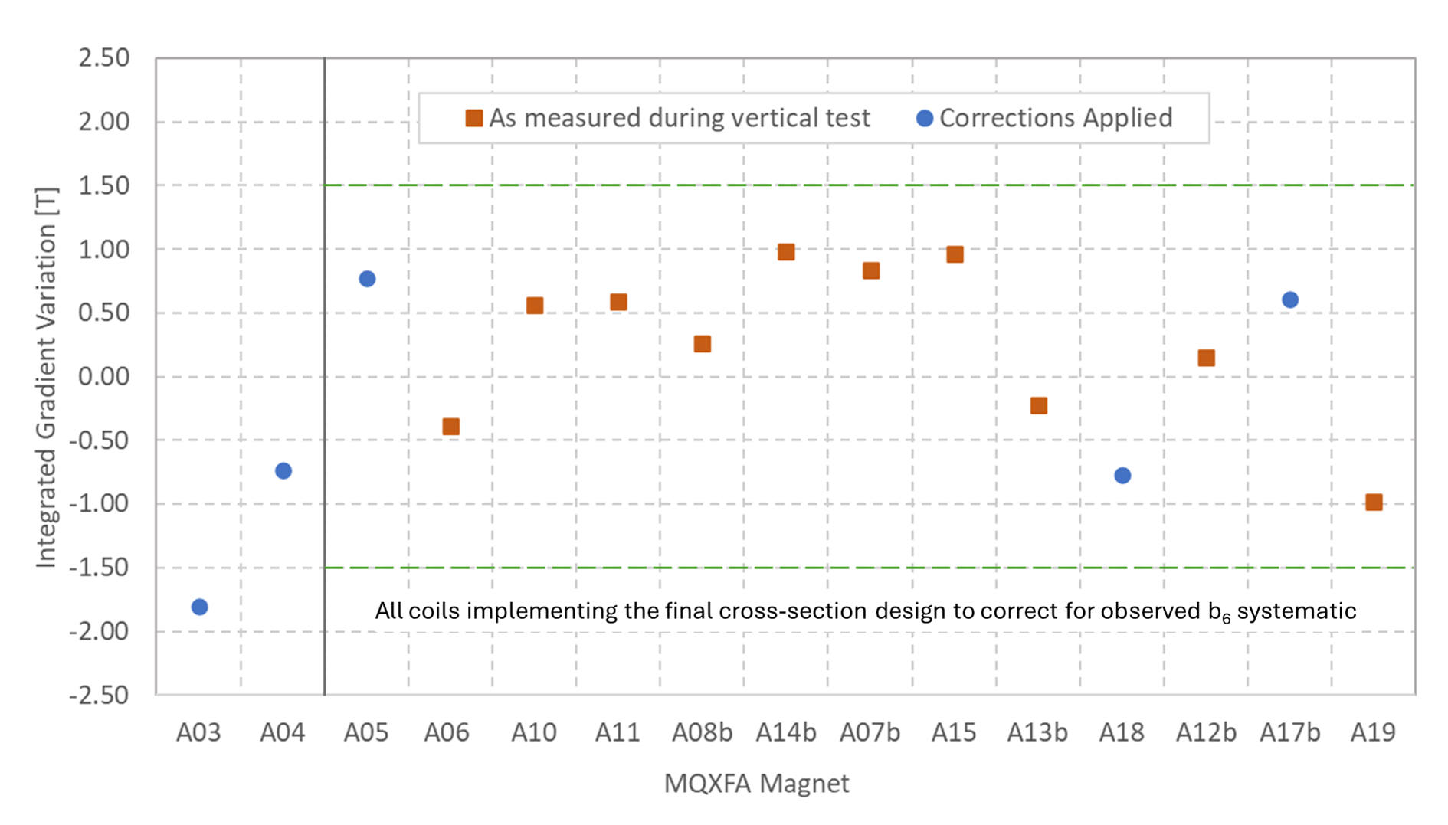
Integrated Gradient
Integrated Gradient Variations in MQXFA magnets (vertical test)
Mid range IG at 16.23 kA: 562.2 T
For a consistent comparison, correction factors were applied to several magnets to account for measurements taken at different currents and changes in the measurement setup and coil design
Courtesy of G. Sabbi, A. Ben Yahia and F. Kurian
Acceptance criteria states that IG of all magnets with identical cross section should be within a 3 T interval (+/- 1.5 T interval is indicated by green dotted lines)
For magnets with different cross-section (A03-A04) acceptable interval is 6 T
Estimated IG increase due to 4 magnetic shims is 0.15% (~0.8 T)
Variations warm (LBNL) to cold (BNL), and cold vertical (BNL) to cold horizontal (FNAL) are within ~ 10 unit

Slide 11
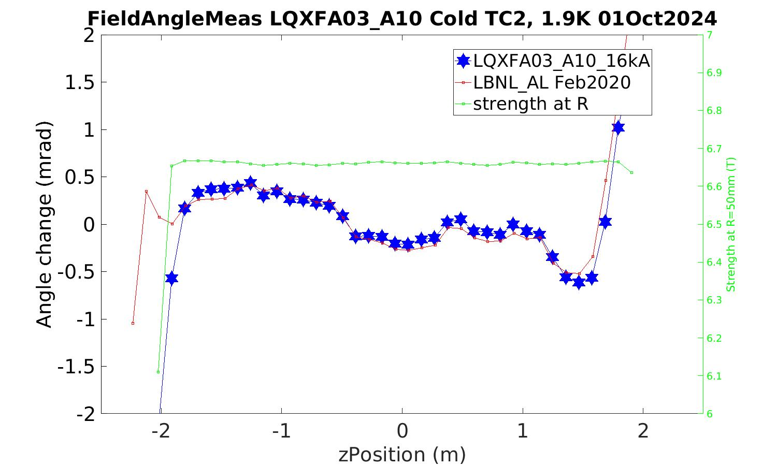
Field Angle & Alignment Warm-Cold
Very good agreement in field angle measurements at warm (LBNL) and cold powering (FNAL)
Same for other alignment measurements
  ➔ allows disassembly and reassembly if spec not met

Slide 12
Conclusions
Fabrication and test of the MQXFA bare-magnets for HL-LHC Inner Triplets is in the final stage
15 MQXFA magnets met requirements during vertical test
Field Quality is consistent with expectations
Integrated Gradient and Alignment requirements are met
Warm FQ and alignment measurements are in good agreement with cold measurements, and together with magnetic shims have been extremely useful to meet requirements and expectations

Slide 13
Back up Slides

Slide 14
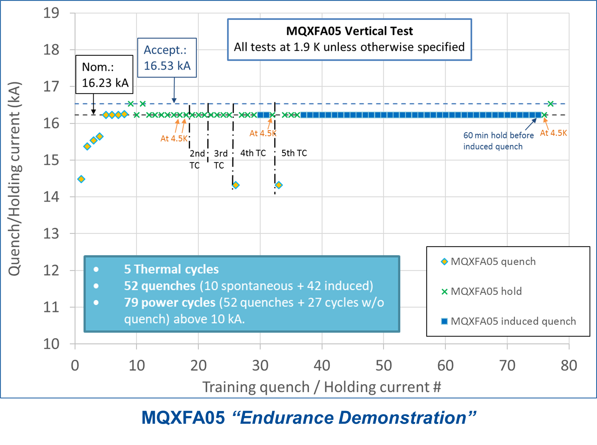

“Endurance” & “Resilience” Demonstrations
+ 2 additional thermal cycles in CA02
All magnets that met requirements demonstrated very good memory and temperature margin:
I_nom @ 4.5 K

Slide 15
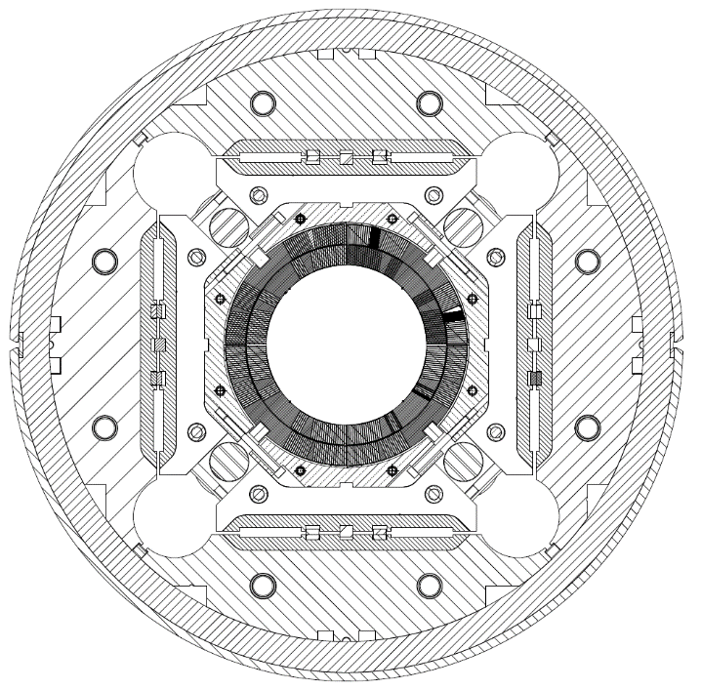
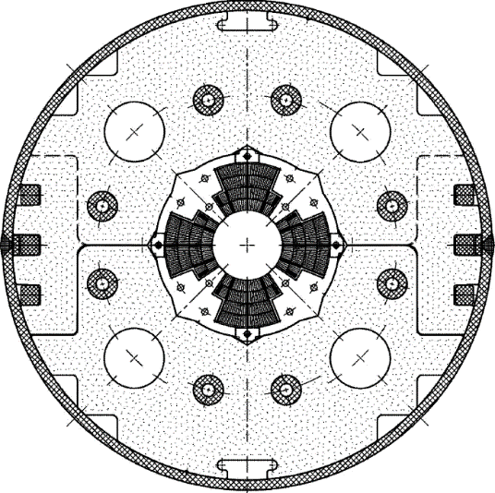
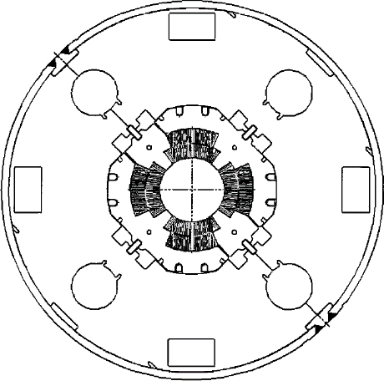
Low-β quadrupole magnets from LHC to HL-LHC
Cold mass OD from 490/420 to 630 mm
More than double the aperture: from 70 to 150 mm
~4 times the e.m. forces in straight section
~6 times the e.m. forces in the ends
State of the art quadrupoles at the time of LHC construction
MQXF
MQXA
MQXB
Same scale for all 3 plots

Slide 16
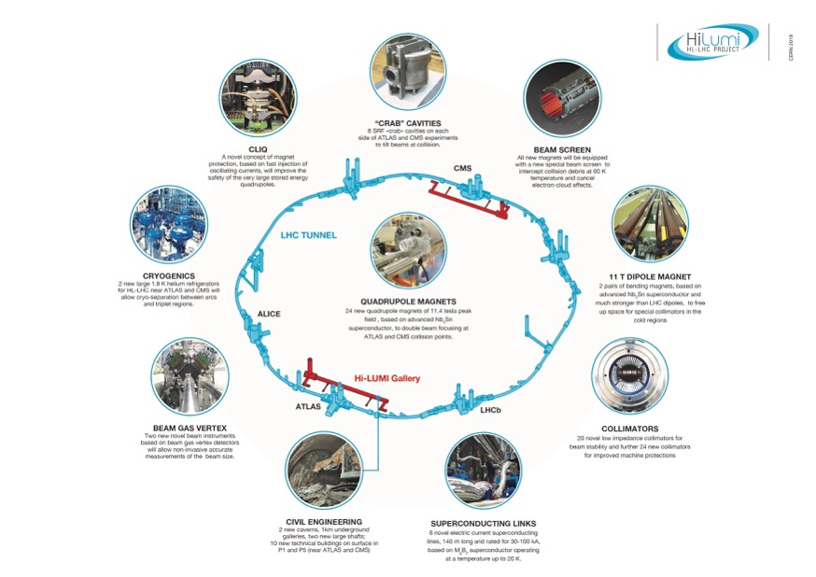

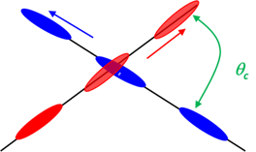
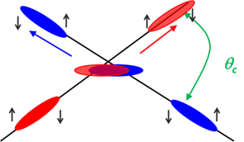
US Contribution to HL-LHC
HL-LHC AUP
Quad
Magnets
Beam size
Crab
Cavities
From HL-LHC Project Leader
O. Bruning - CERN
HL-LHC: from 300 fb⁻¹ to 3000/4000 fb⁻¹
LARP (DOE supported R&D Program) established the necessary technology for the HL-LHC Focusing Magnets and Crab Cavities
DOE baselined HL-LHC Accelerator Upgrade Project (AUP), coordinating efforts from US Labs (FNAL, BNL, LBNL with contributions from SLAC, JLAB, ODU & FSU)
Slide by G. Apollinari
Notes:
Overall goal

