Slide 1
Progress on the EDIPO 2 test facility
(Sat-Af-Or1-03)
X. Sarasola,
P. Bruzzone,
N. Bykovskiy,
J. Greenwood,
T. Nes,
K. Sedlak
July 5th, 2025

Slide 2
Motivation and design targets
SULTAN has been pivotal in qualifying forced-flow conductors in the last three decades.
Rising demand towards:
  High current conductors (beyond 100 kA)
  Conductors for high field magnets (partly driven by the development of HTS)
EDIPO 2 will enhance the background B field and the aperture size while keeping attractive features from SULTAN and EDIPO
Since January 2025, the ETH board (ERI dispatch) funds the construction of EDIPO 2 (as part of the Swiss Fusion Hub)
 | SULTAN (SPC) | EDIPO (SPC) | FRESCA2 (CERN) | EDIPO 2 | Units
B_{center aperture} | 10.9 | 12.35 | 13 (14.6) | 15 | T
Aperture size | 94×144 | 90×141 | Ø100 | 144×144 | mm
Homogeneous field length (1%) | 320 | 680 | 650 | 900 | mm
Sample current | ≤100 | ≤100 | ≤ 32 (50) | >100 | kA
Sample operating temperature | 4.5 to 50 | 4.5 to 50 | 1.9 & 4.2 | 4.5 to 50 | K

Slide 3
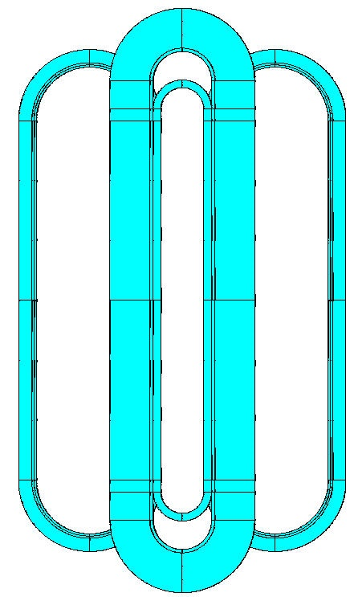
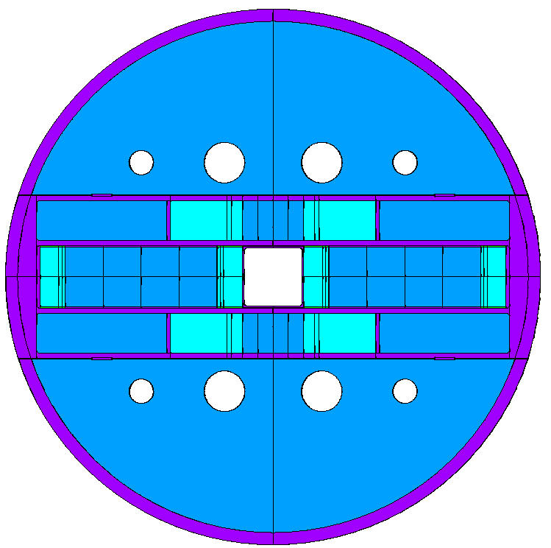
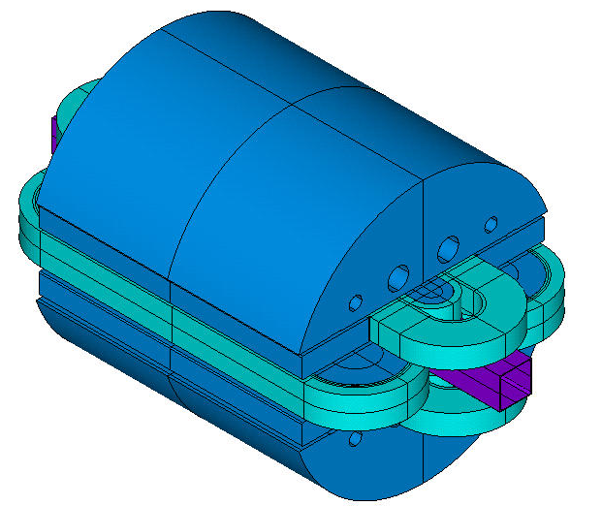
Conceptual design of the EDIPO 2 magnet
Dipole based on two pairs of planar racetrack coils:
  Bath cooled (4.2 K), high j_{eng} winding pack (as opposed to SULTAN and EDIPO1)
  Operating current ≤ 18 kA (limited by existing power supply)
    It requires a large cross-section of superconductor
  There is no 3D transition in the coil ends:
    No hardway bending → Presumably no performance limitation in the ends region
    Simplifies manufacturing
    Simplifies management of mechanical stress

Slide 4
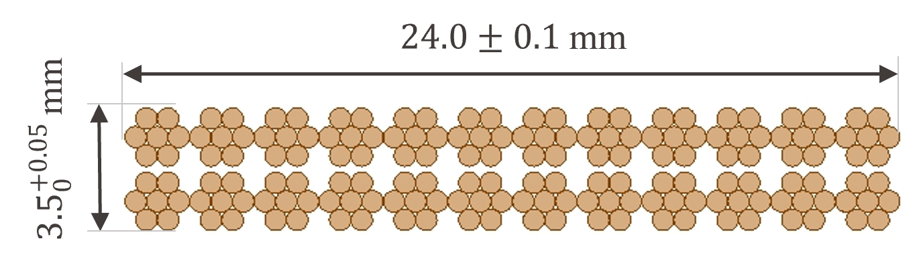
Cable design
Nb₃Sn high-j_{c} strand:
  j_{c,nc} ≥ 2600 A/mm² at 12 T and 4.2 K, 0.7 mm diam, Cu:nCu = 1.0
  Two procurements from Bruker:
    ~110 kg for the prototype cabling (delivered in Dec 2023)
    1.6 tons for the production of the magnet (expected delivery in Jan 2026)
Cable based on a flat two-stage design: 24×(6+1), 0.7 mm
  Cabling R&D activities (copper dummy):
    Two industrial partners + CERN were qualified in 2024 to produce this cable
  Nb₃Sn prototype cable:
    Production of 150 m at WST (expected delivery in Q3 2025)
  Nb₃Sn production cable:
    Call for tender to be launched in Q4 2025

Slide 5
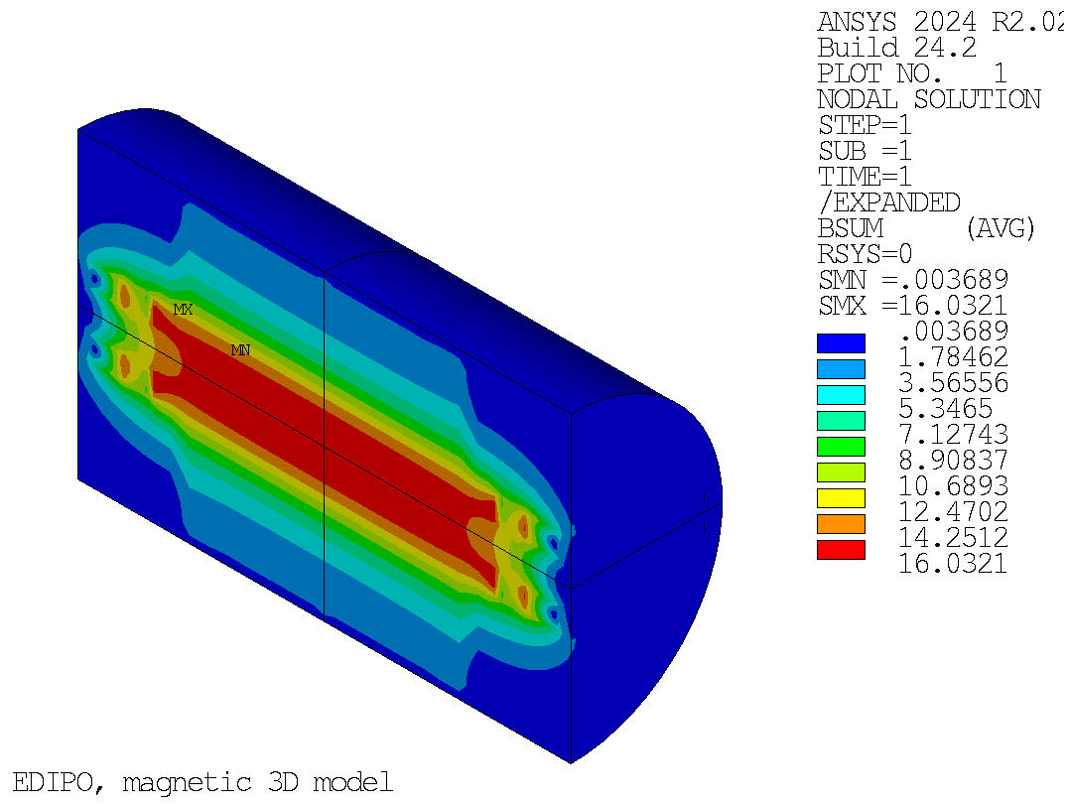
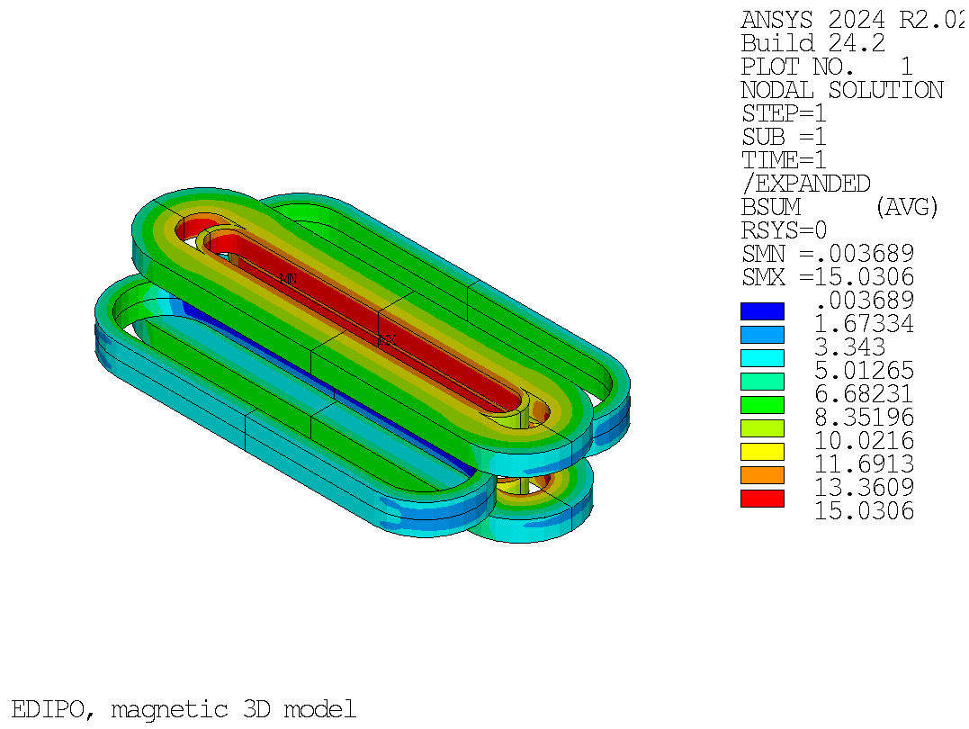
Magnetostatic 3D analysis
I_{op} = 0.85×I_{ss}
 | I_{op} = 0.85×I_{ss} | I_{op} = I_{max}
Cable layout | 24×(6+1), 0.7 mm diam
Number of turns | Side coils: 2×6×16 Vertical coils: 2×4×46
Total number of turns, n_{total} | 560
Total area of insulated conductor | 52886 |  | mm²
Operating current, I_{op} | 17.438 (85%×I_{ss}) | 18.00 (87.7%×I_{ss}) | kA
B field in the center of the aperture, B₀ | 14.99 | 15.43 | T
Peak B field in the coils, B_{peak} | 15.03 | 15.47 | T
Total ampere-turns, I_{total} | 9.77 | 10.08 | MAt
Total magnet stored energy, E_{total} | 20.8 | 22.1 | MJ
Magnet self-inductance, L | 136.5 |  | mH
Engineering current density, j_{eng} | 184.6 | 190.6 | A/mm²
Copper current density, j_{Cu} | 523.3 | 540.1 | A/mm²
B field in the magnet
B field in the winding pack
https://doi.org/10.1109/TASC.2025.3526109

Slide 6
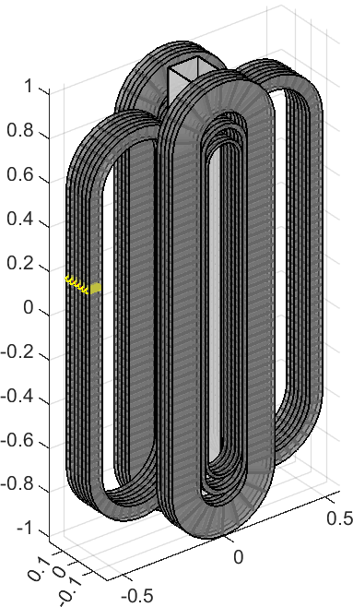
3D quench analysis
$C\frac{∂T}{∂t}=q_{joule}+\frac{∂}{∂x}\left(k\frac{∂T}{∂x}\right)+q_{transverse}−q_{cooling}+q_{external}$ [W/m³]
→ 56’000 nodes to evaluate heat propagation in 3-D (560 turns x 100 nodes per turn)
Protection scheme based exclusively on energy extraction:
  Assumed delay time: 100 ms
  V_{max} = ±0.9 kV (assuming symmetric grounding)
  T_{max} = 280 K for the operation at 18 kA and V_{th} = 0.1 V detection threshold
(Poster by T. Nes, Fri-Af-Po.02-04)
Coil terminal voltage [kV]
Hot spot temperature [K]
Time [s]
Time [s]

Slide 7
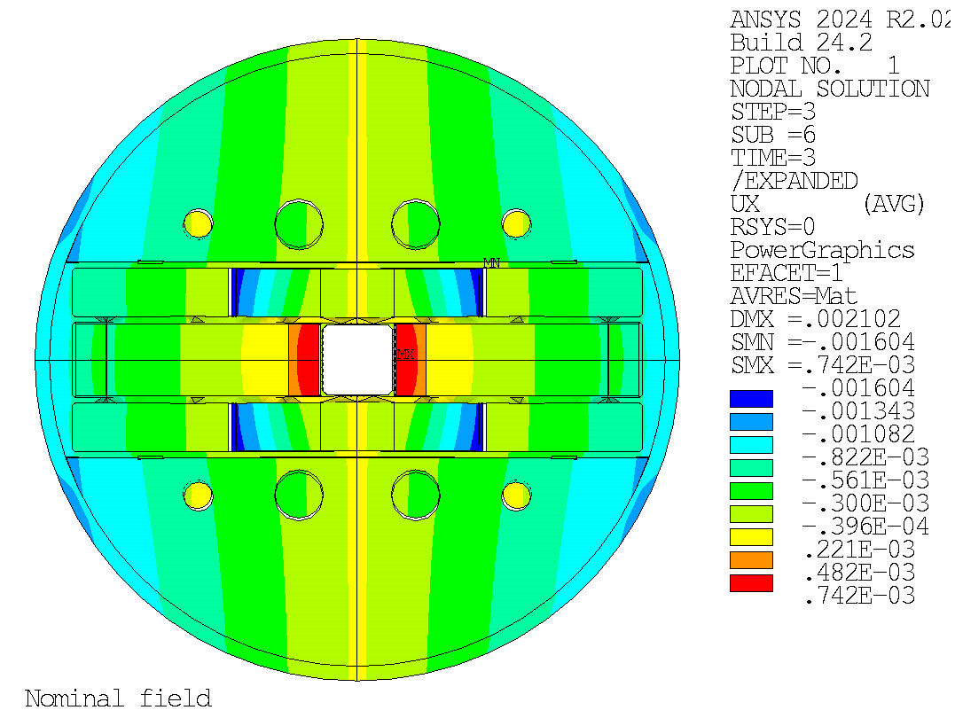
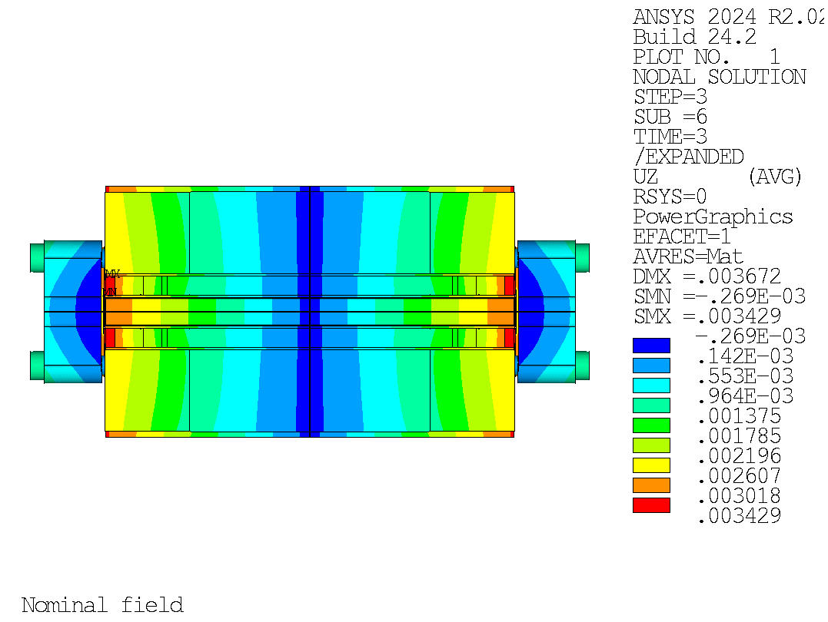
Mechanical 3D analysis
Coils assembled in a steel casing
Lorentz forces reacted by the casing and a 30-mm-thick steel shell
Vertical coils are preloaded to maintain stress/strain within allowable limits
Side coils cannot be preloaded. During operation:
  They detach from the poles
  The test well is stress-free
Deformation during operation
Transversal cross-section
Longitudinal cross-section

Slide 8
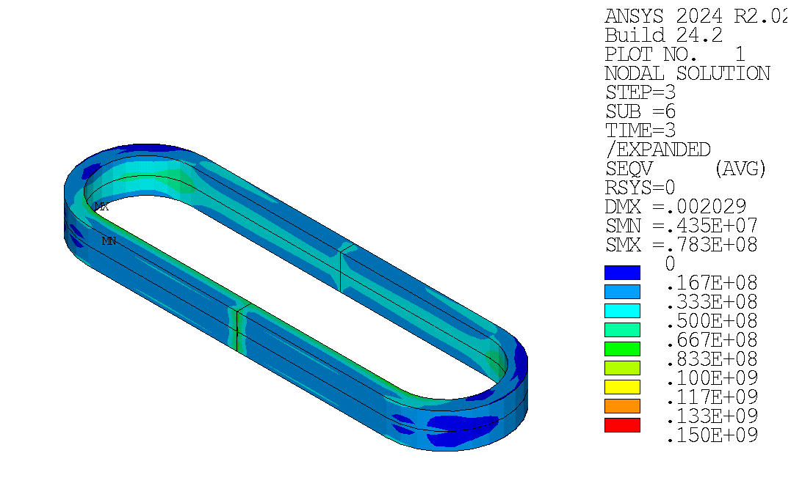
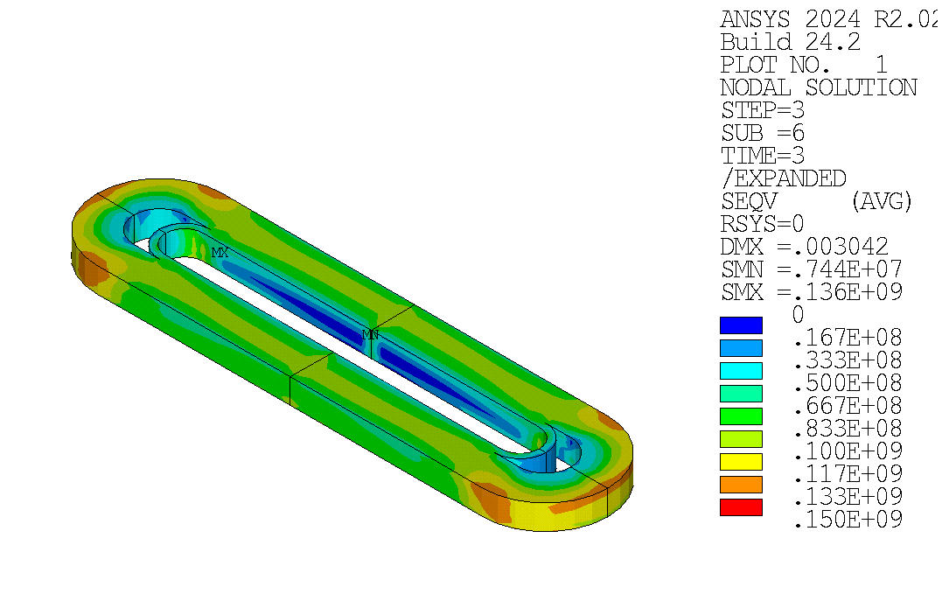
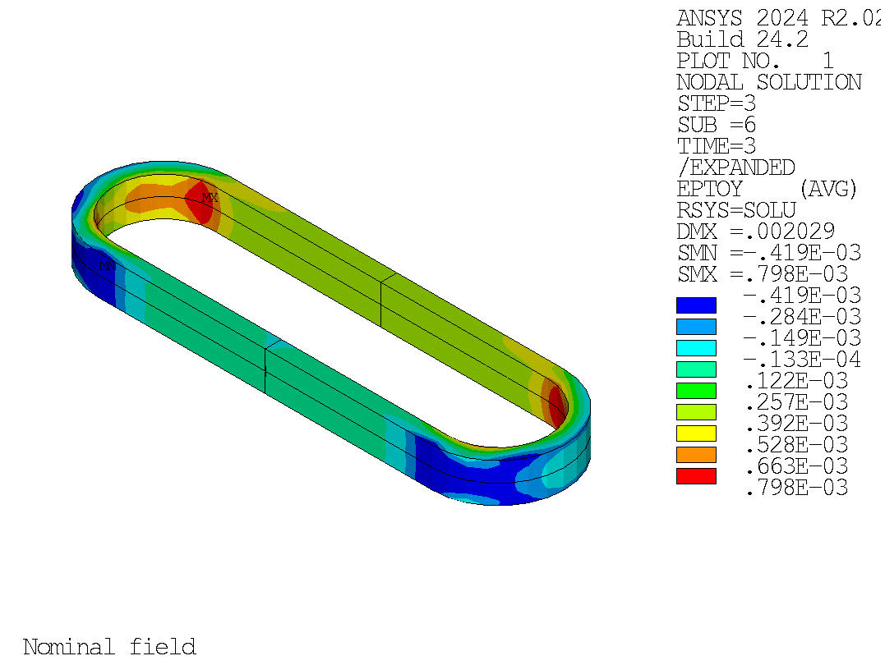
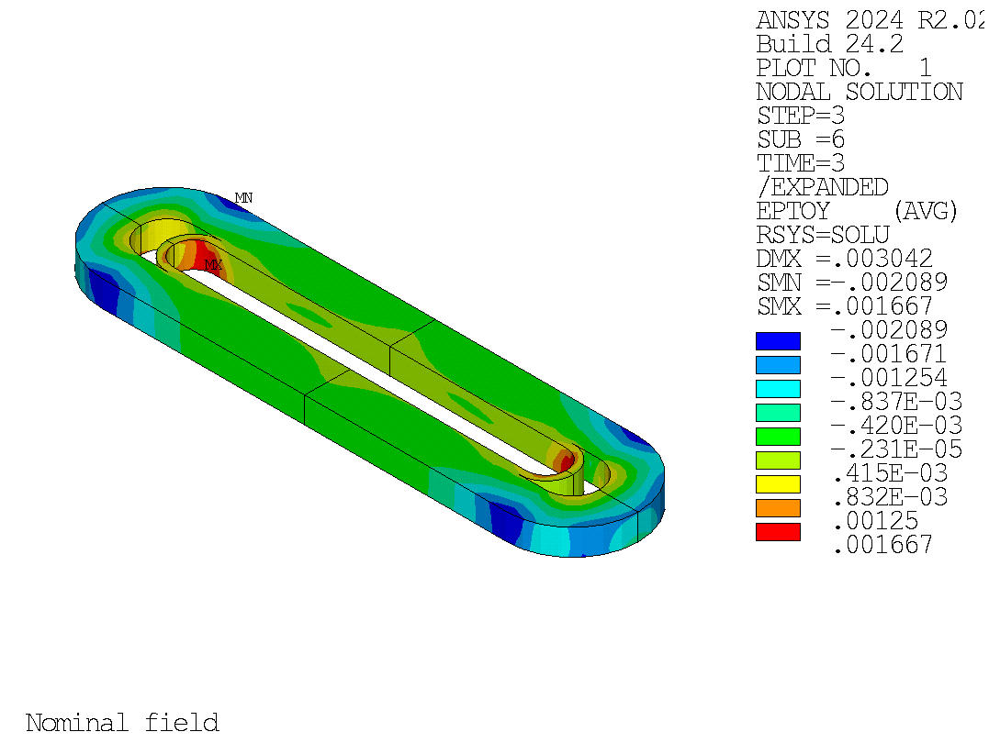
Mechanical 3D analysis
Side coils at B = 15 T
Vertical coils at B = 15 T
von Misses stress
    σ_{eq} ≤ 78 MPa
von Misses stress
    σ_{eq} ≤ 136 MPa
    ε_{L} ranging from -0.04 and +0.08%.
    ε_{L} ranging from -0.2 and +0.16%.
Longitudinal strain
Longitudinal strain
(Poster by X. Sarasola, Sat-Mo-Po.03-03)
https://doi.org/10.1109/TASC.2025.3526109

Slide 9
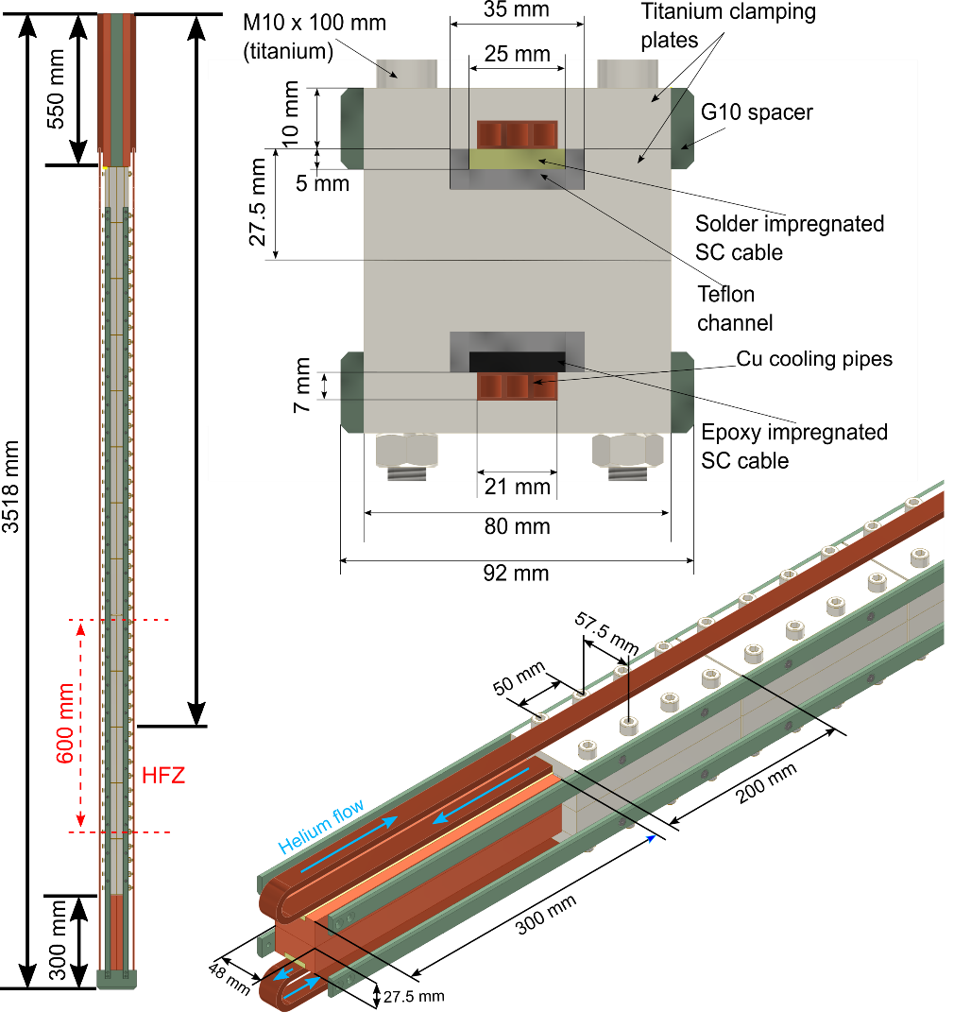
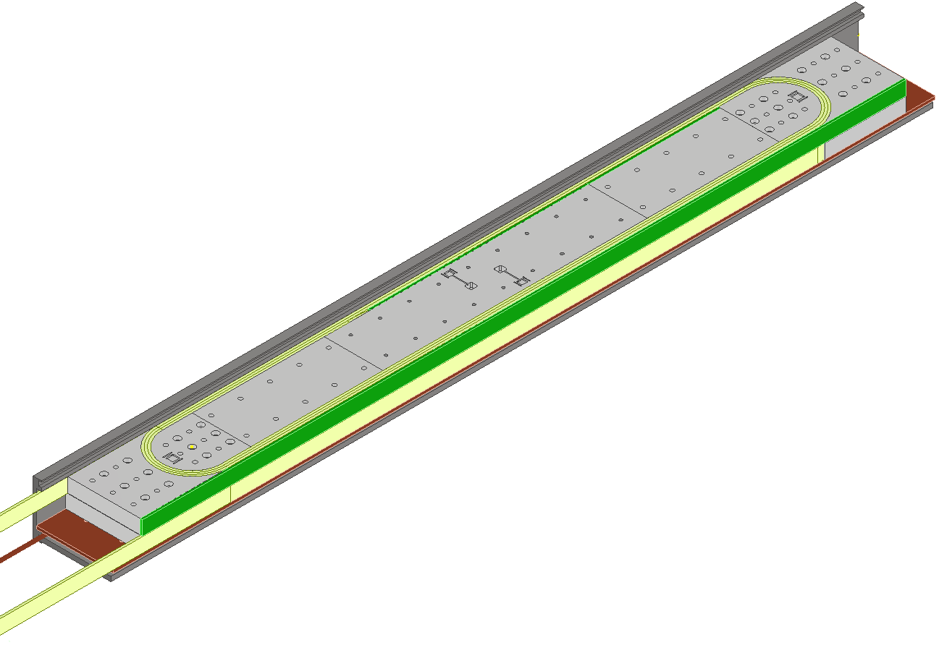
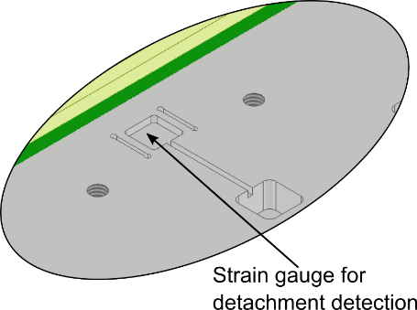
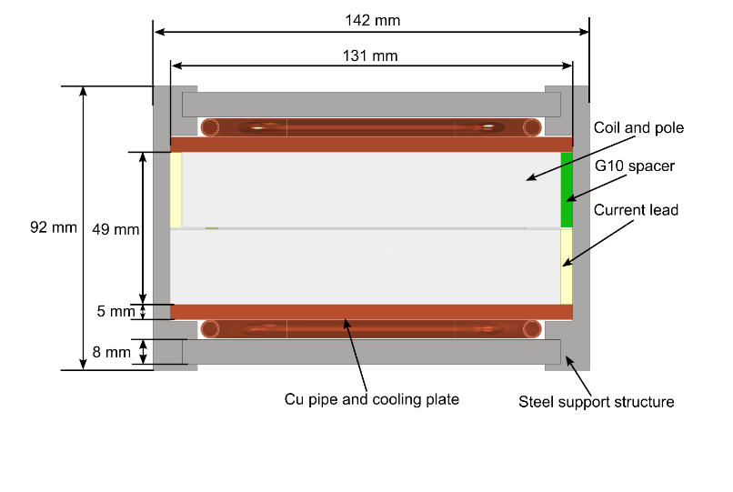
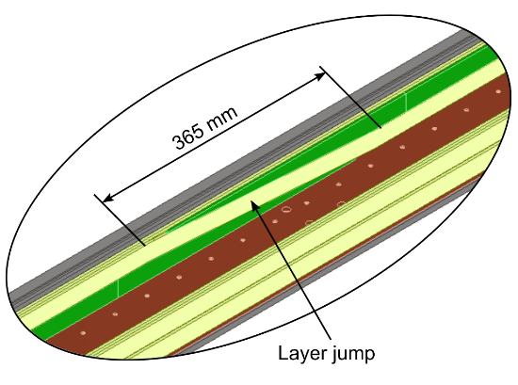
Magnet R&D activities and manufacturing design
Goal: de-risk technologies associated with the EDIPO2 magnet design
Contract recently signed with ASG (completion by the end of 2026)
Cable and subscale coil tests planned in SULTAN in 2026:
  Nb₃Sn cable and joints
  Subscale coil
  (pancake transitions and detachable poles)

Slide 10
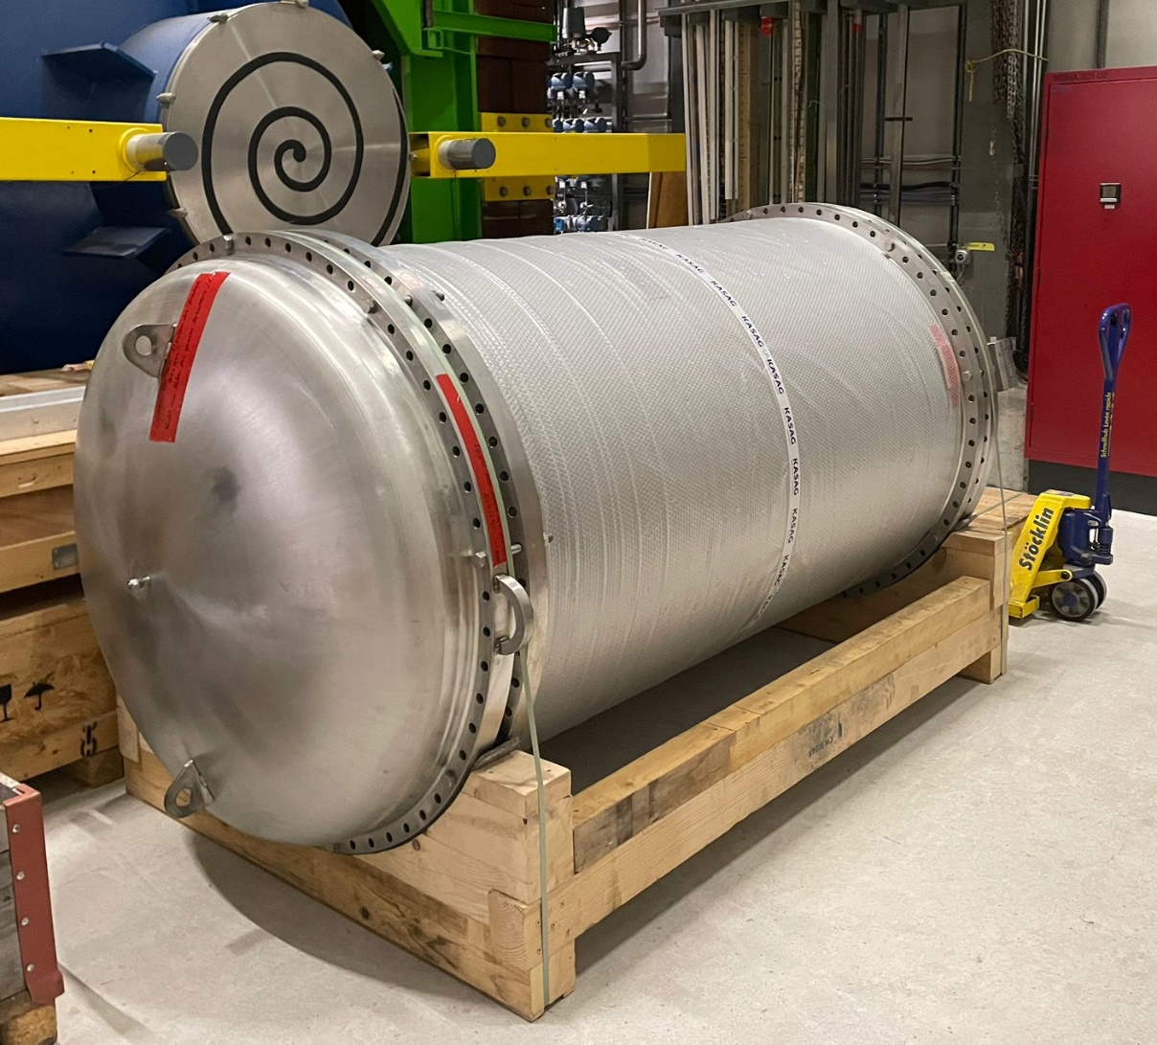
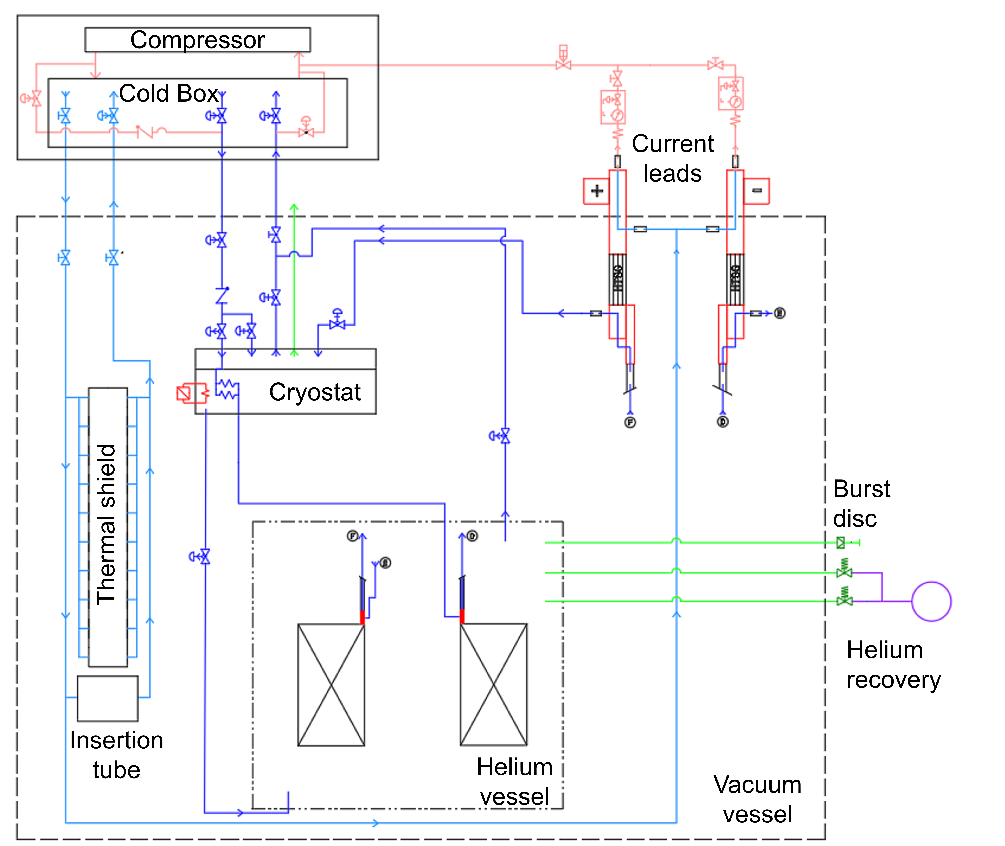
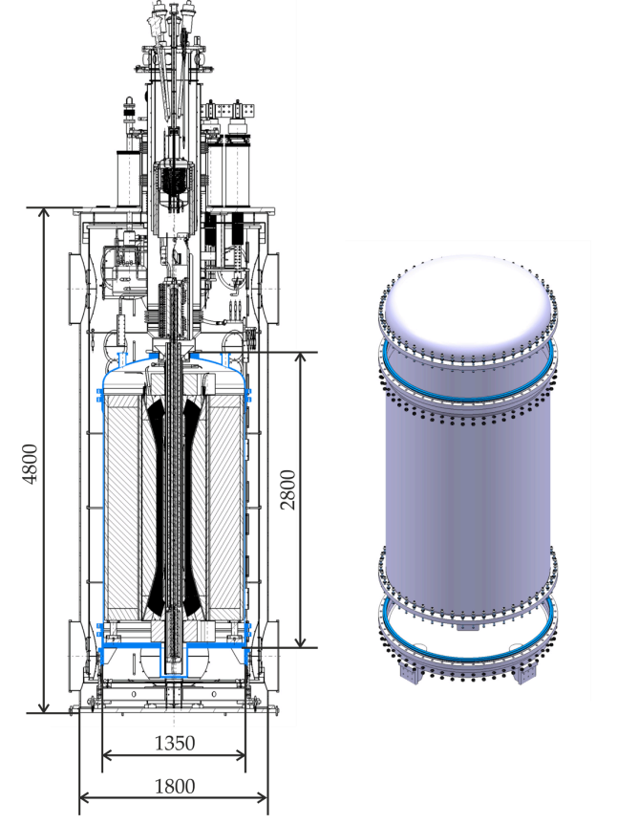
Cooling / Cryogenics
EDIPO 1 was based on a CICC design (cooled by a forced-flow of supercritical He)
The EDIPO 2 magnet will be bath-cooled at 4.2 K
  Volume: ~100 l
New helium vessel
Modified cryogenic circuit (preliminary)
https://doi.org/10.1016/j.cryogenics.2023.103648
(Poster by T. Nes, Thu-Af-Po.10-04)

Slide 11
Conclusions and Outlook
EDIPO 2 will generate a background field of 15 T in a large aperture (144×144 mm²)
Use of a Nb₃Sn two-stage cable design for high operating current
Dipole purely based on the use of planar racetrack coils:
  No hardway bending
  Simplification of the coil manufacturing
  The vertical coils are pre-loaded, but not the side coils
Outlook:
  Ongoing industrial contracts:
    High-j_{c} Nb₃Sn wire: procurement of 1.6 tons (delivery in Jan 2026)
    Cable:
      Production of 150 m of Nb₃Sn prototype cable (delivery in Q3 2025)
      Call for tender for the magnet production cable to be launched in Q4 2025
    Magnet R&D activities (completion by the end of 2026):
      Including production of a subscale coil and test in SULTAN
    Magnet manufacturing design (completion by the end of 2026)
  Modify the EDIPO2 cryogenic circuit.

Slide 12
Thanks for your attention!

