Slide 1

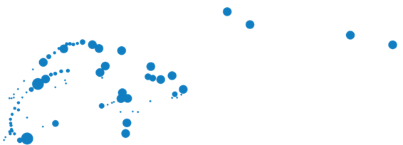
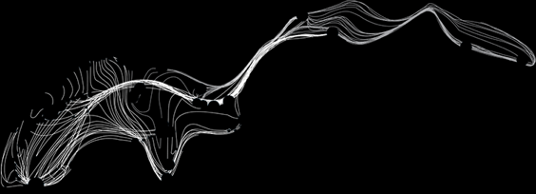


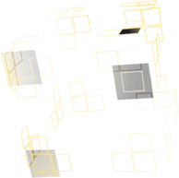

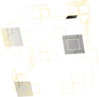



UNIVERSITY OF TWENTE.
Measurement and FE modelling critical transverse loading limits of REBCO round cables for fusion
A. Nijhuis^{1,3} ,G. Anniballi¹, J. Rietberg¹, N. van Dusschoten¹, V.J. Ellenbroek^{1,2},
R. Lübkemann³, J. Leferink³, C. Soyarslan², A.H. van den Boogaard², J.D. Weiss⁴, K. Radcliff ⁴, D.C. van der Laan⁴, H. Jin⁵, C. Zhou^{1,5}, W. Yu⁵, J.G. Qin⁵, E. Garibaldi⁶, M. Breschi⁶
¹ University of Twente, Faculty of Science & Technology, Enschede, The Netherlands
² University of Twente, Faculty of Engineering Technology, Enschede, The Netherlands
³ Foundation SuperACT, Hengelo, The Netherlands
⁴ Advanced Conductor Technologies, Boulder, CO & University of Colorado, Boulder, CO, USA
⁵ Institute of Plasma Physics, Chinese Academy of Sciences, China
⁶ University of Bologna, Bologna, Italy
ASIPP
MT29 Boston July 2025

Slide 2

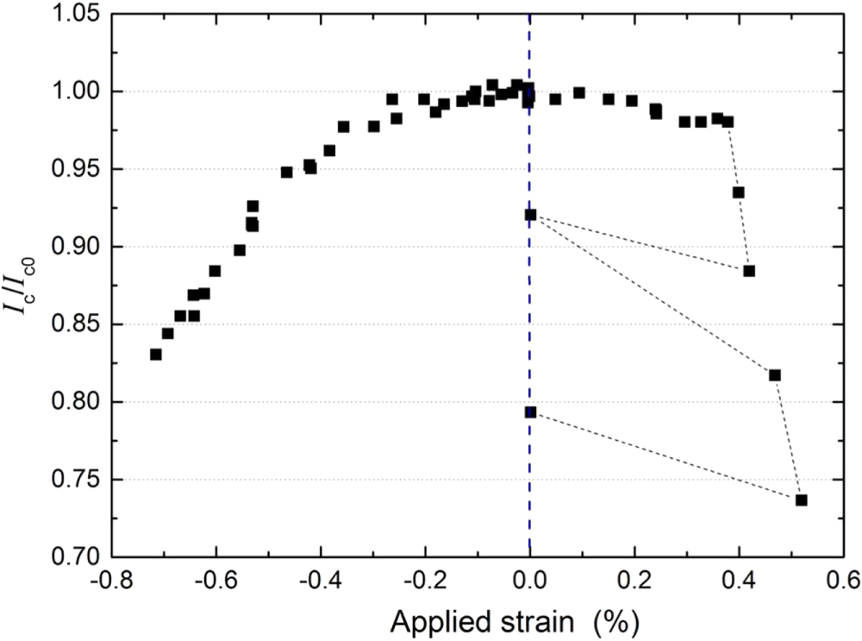
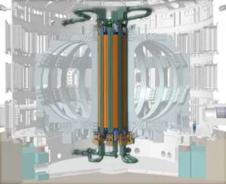
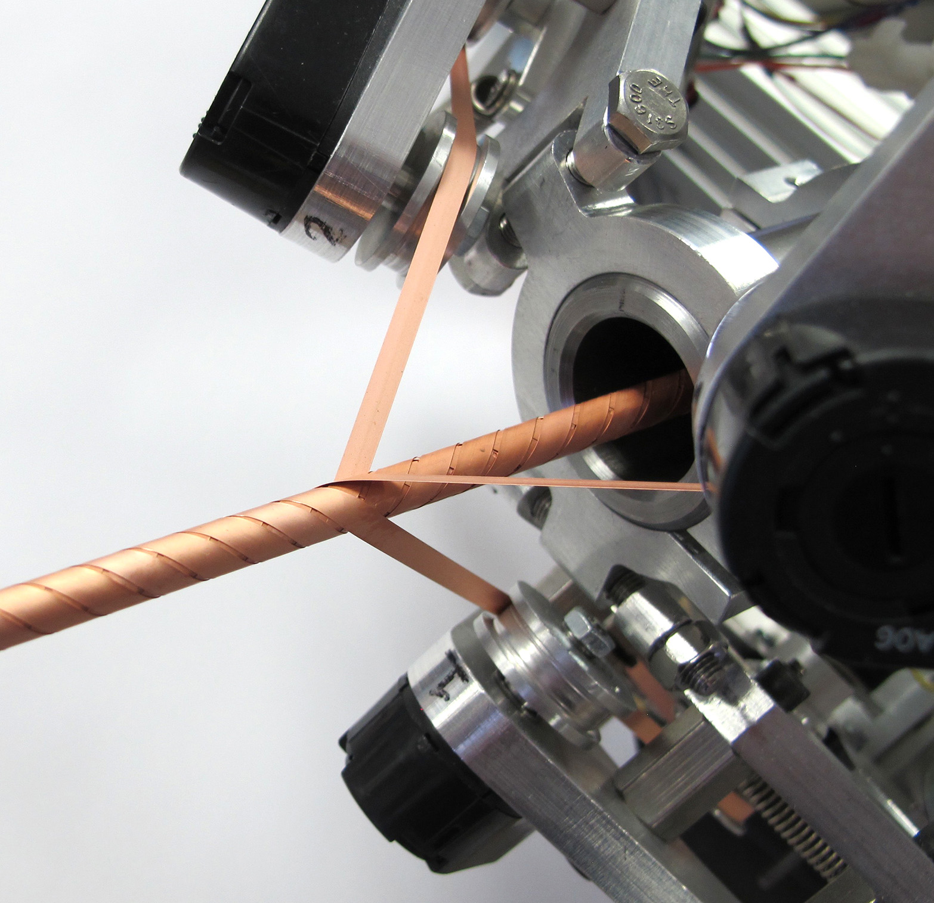
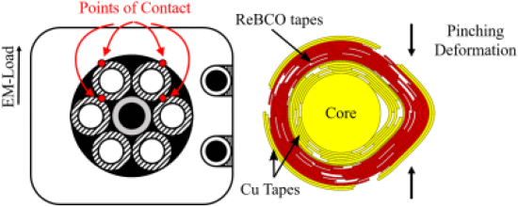
CORC-CICC Design for fusion
I_{c} of REBCO tape is strain sensitive.
Fusion reactors HTS CS-Coils:
Magnetic Field ~ 18 – 20 T
Current ~ 40 – 60 kA
High Lorentz Load ~ 1,000 kN/m
IxB | I [kA] | B [T] | F [kN/m]
BEST | 42 | 20 | 840
EU-DEMO | 60 | 18 | 1,080
K Ilin et al 2015
Supercond. Sci. Technol. 28 055006
Large transverse load deforms tape & REBCO layer.
Strain exceeding irreversibility limit → Critical current degradation
Integrated approach:
Composite cables for high transverse load.
Experimental characterization of tape and cable properties.
CICC Conductor design optimization with FEModel.
T. Mulder, et al. IEEE Transactions on Applied Superconductivity, 30, no. 4, pp. 1-5, 2020, 4800605, doi: 10.1109/TASC.2020.2968251.
UNIVERSITY OF TWENTE.
2

Slide 3
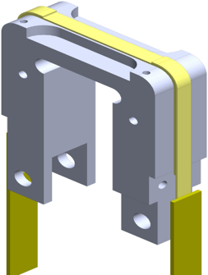
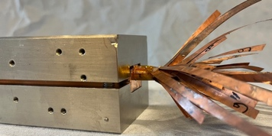
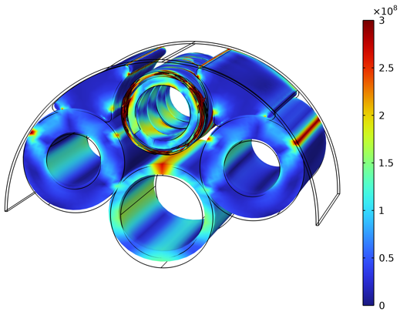
Conductor design optimization
Single tape testing
Axial stress
Axial strain
TransverseStress
Winding
Cable transverse load testing
Critical current
Transverse stiffness d(F)
Inter tape contact resistance R_{c}
FE cable model
Materials
Design
UNIVERSITY OF TWENTE.

Slide 4

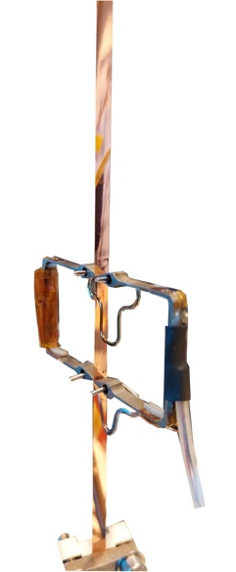
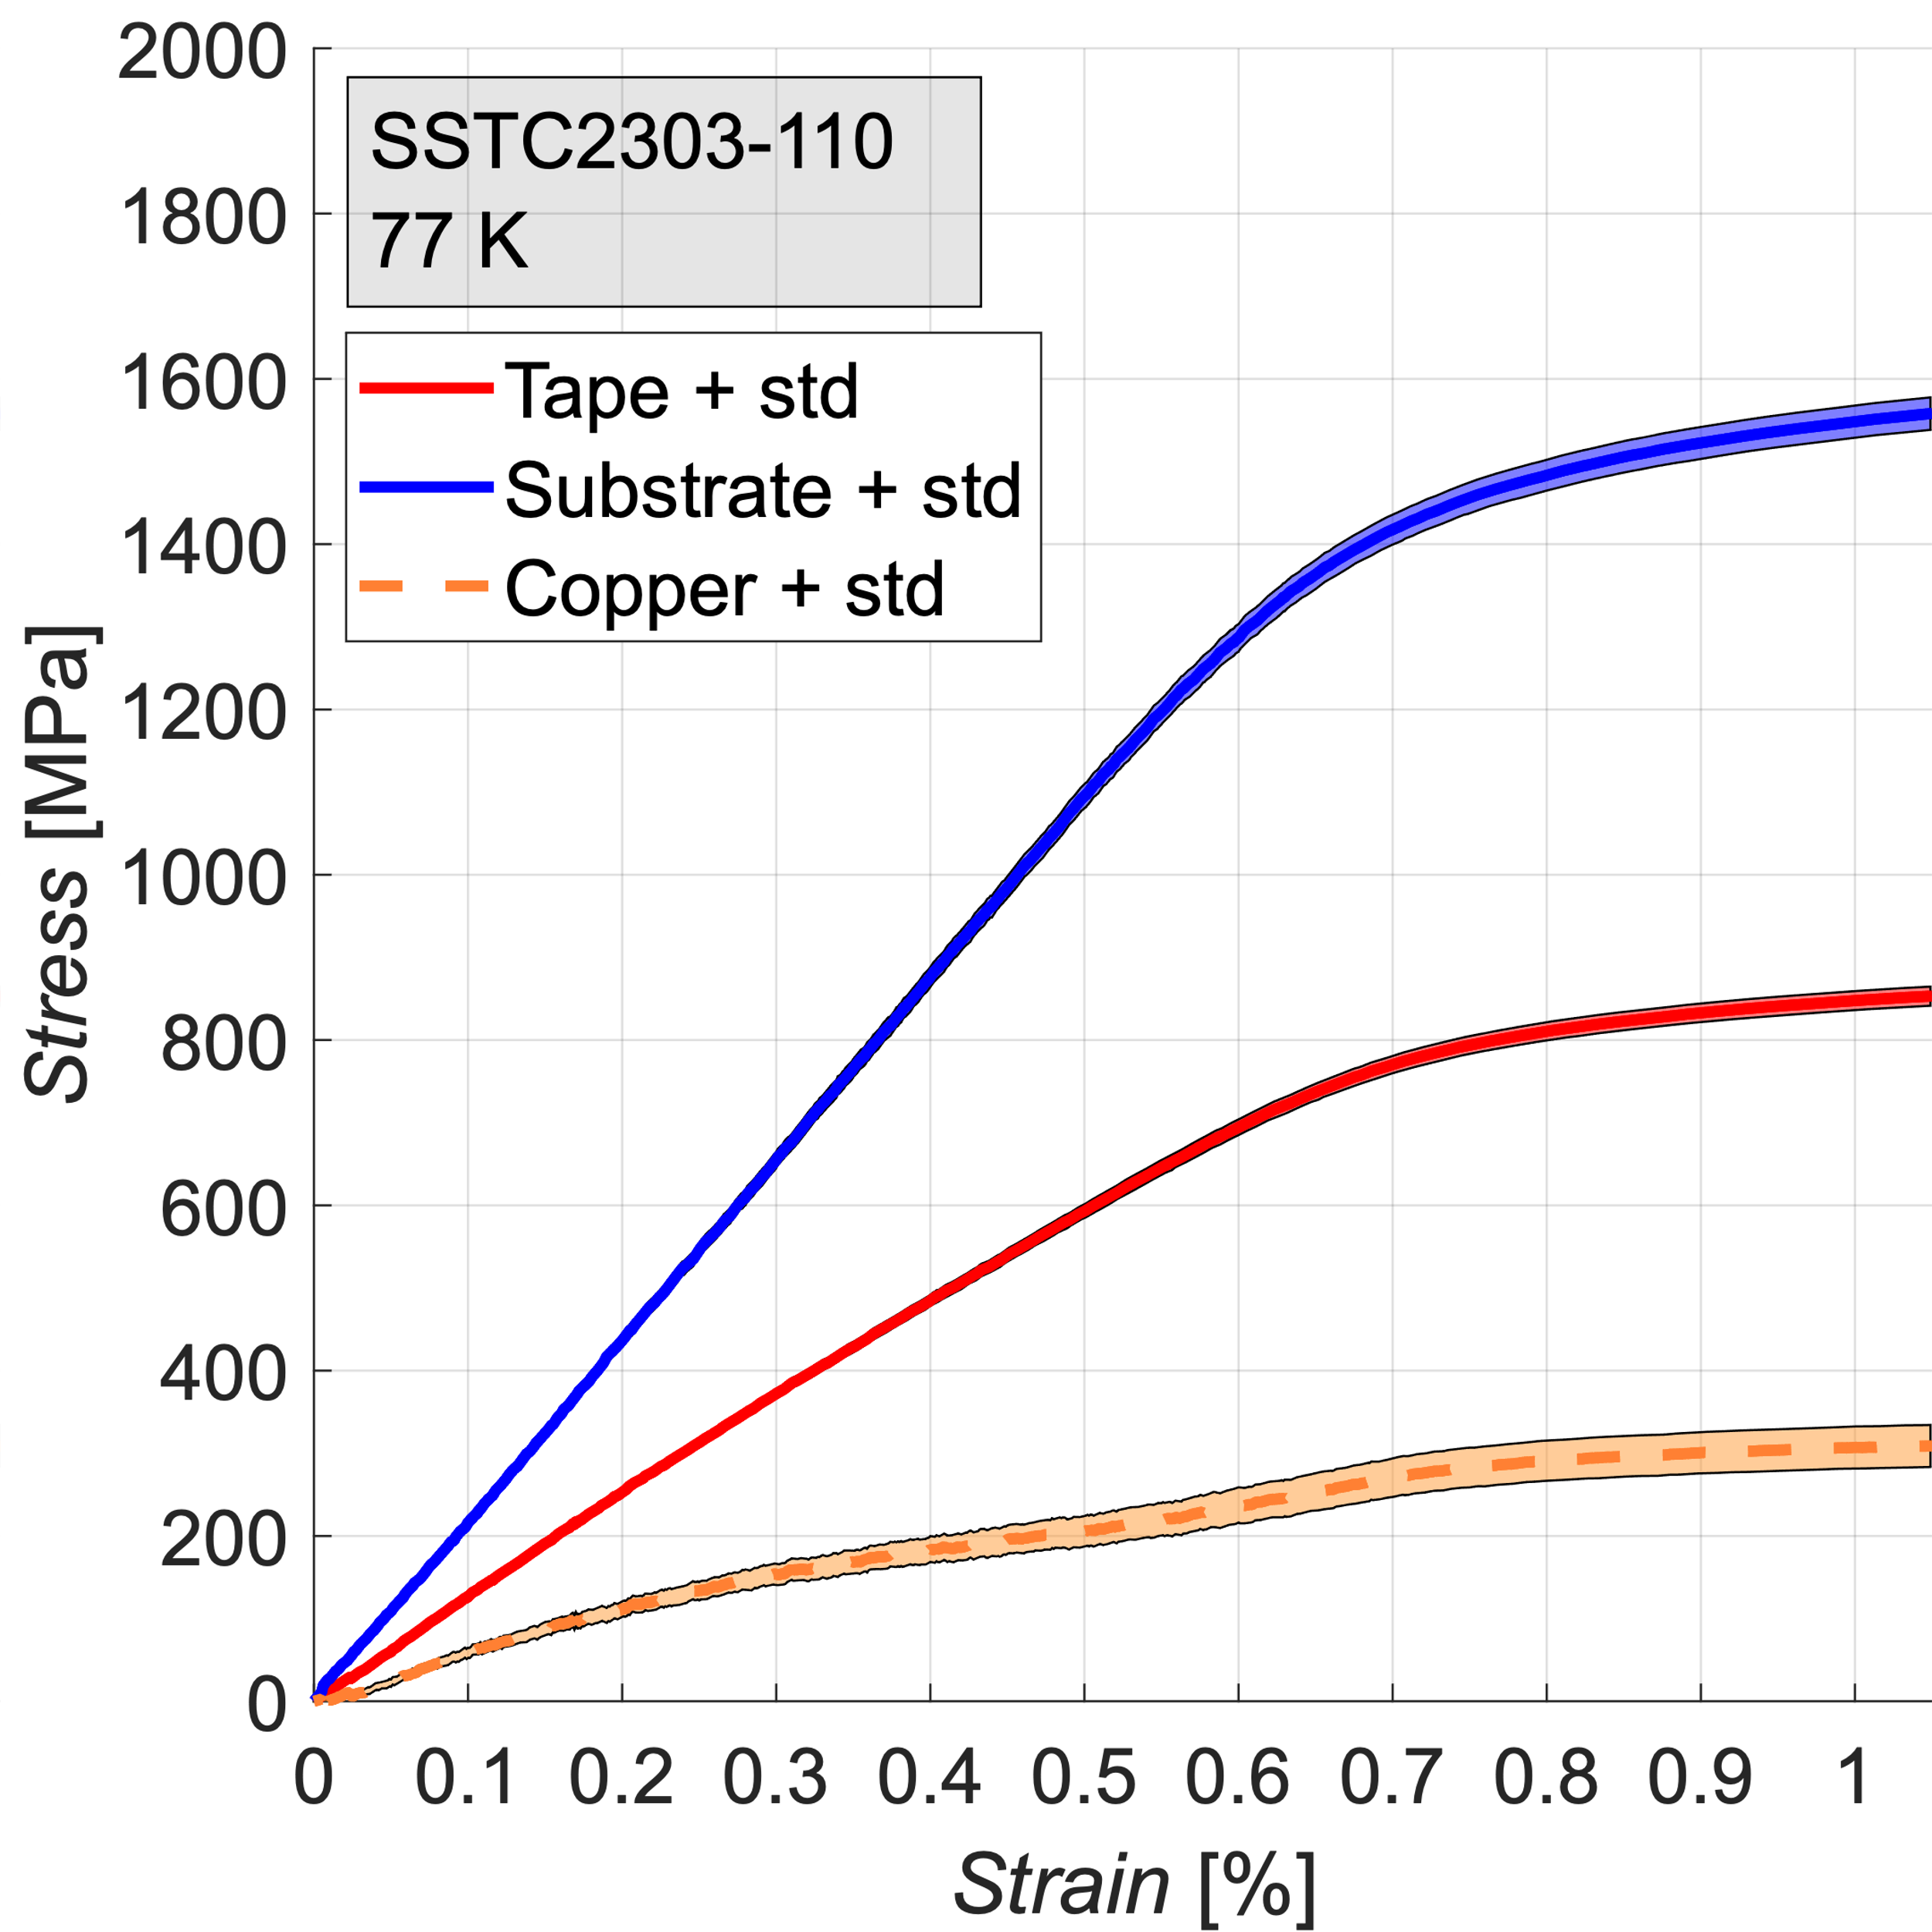
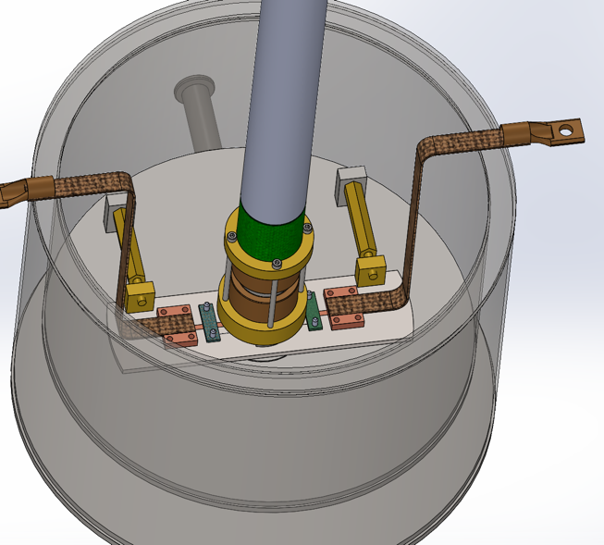
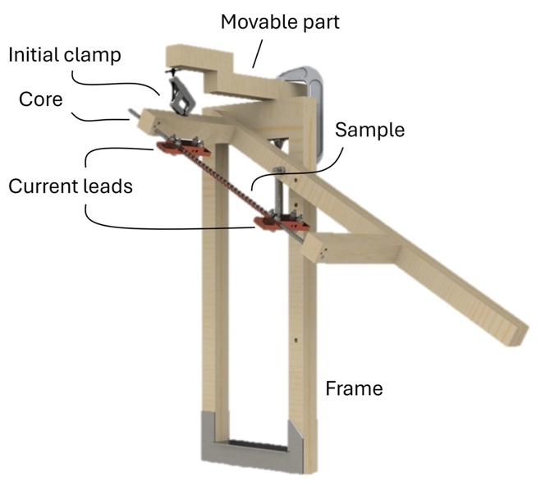
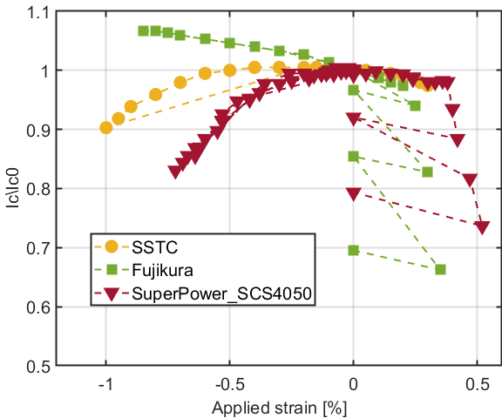
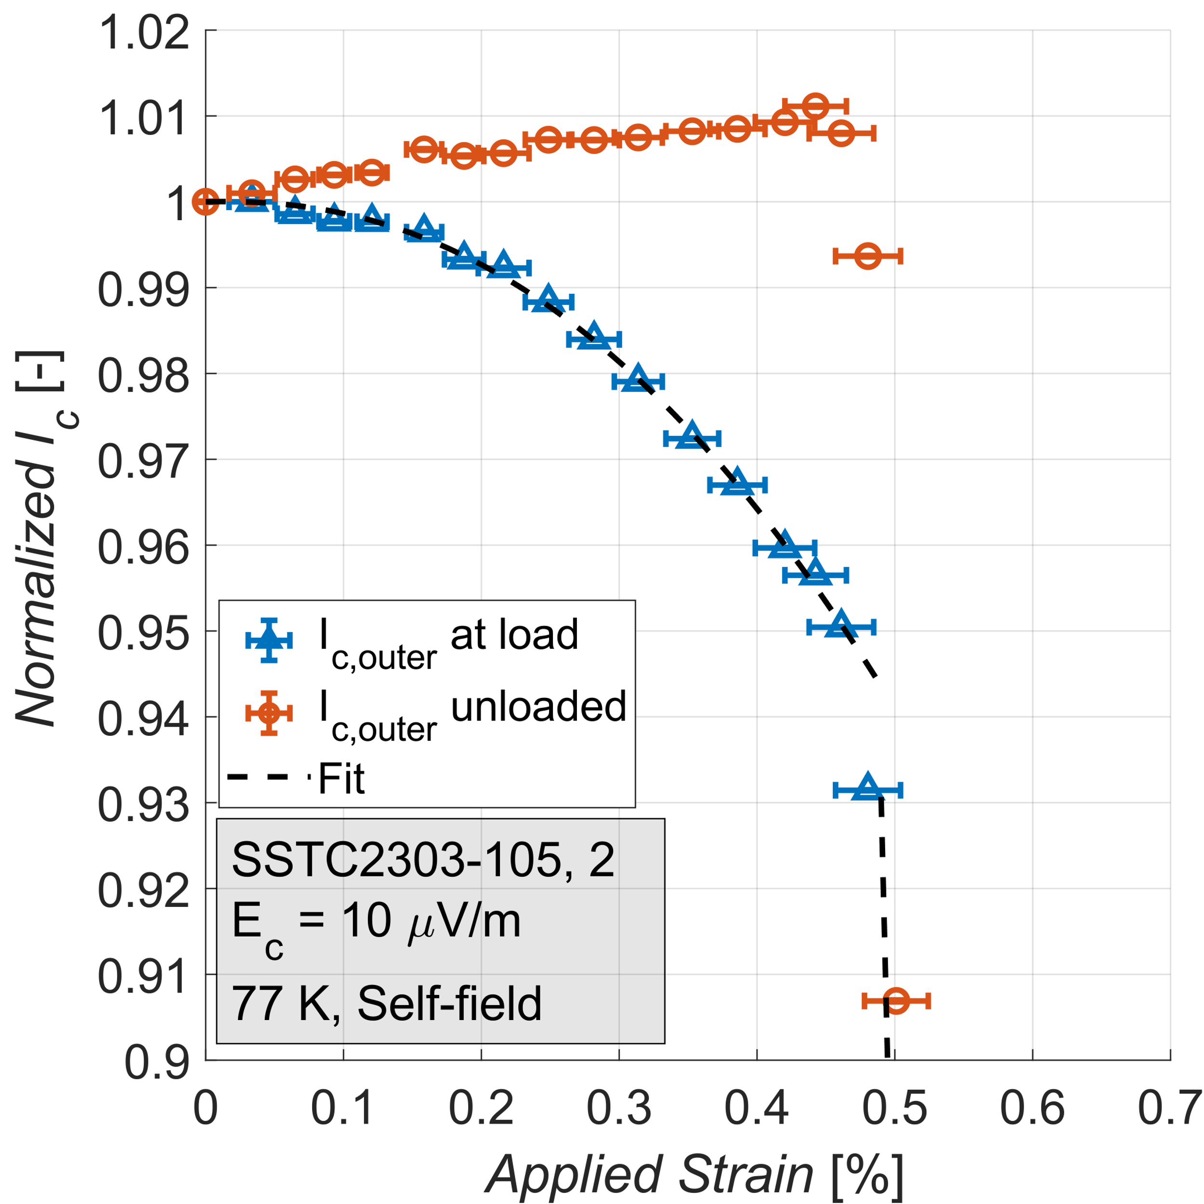
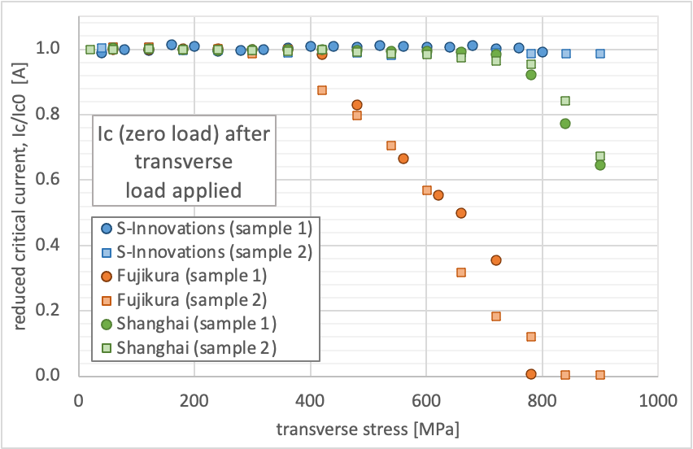
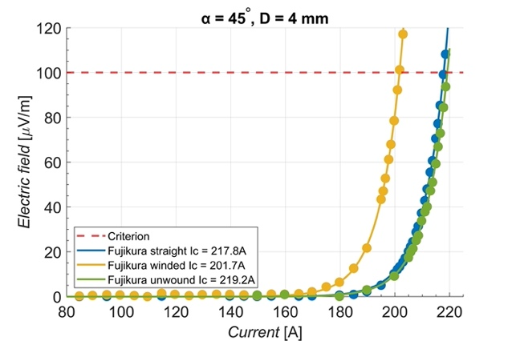
Single tape: I_{c} – mechanical testing
U-Spring axial tensile & compressive strain I_{c}(B,T,ε)
Axial tensile stress, mechanical properties, I_{c} & ε_{irr}
Transverse stress, I_{c} & σ_{irr} (77 K)
Winding angle I_{c} & min core diam. (77 K)
UNIVERSITY OF TWENTE.

Slide 5
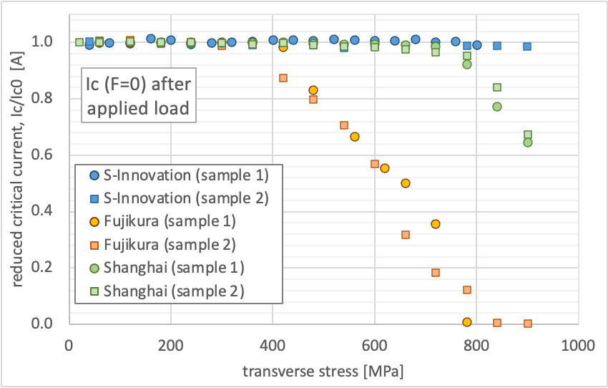
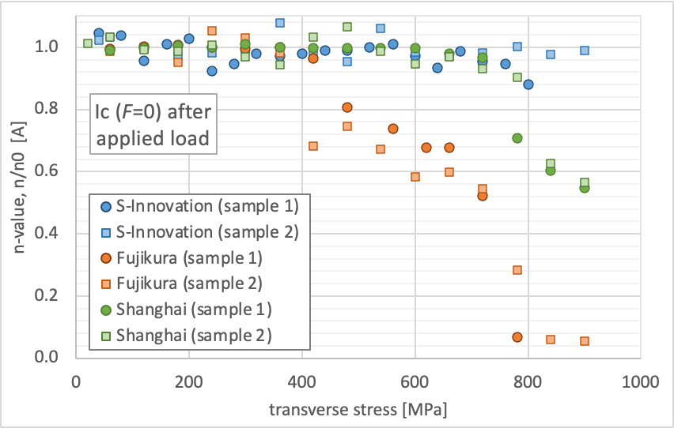
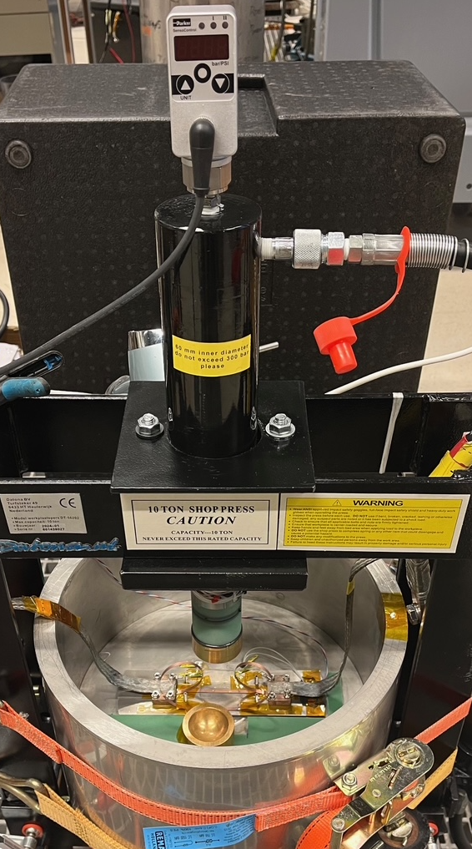
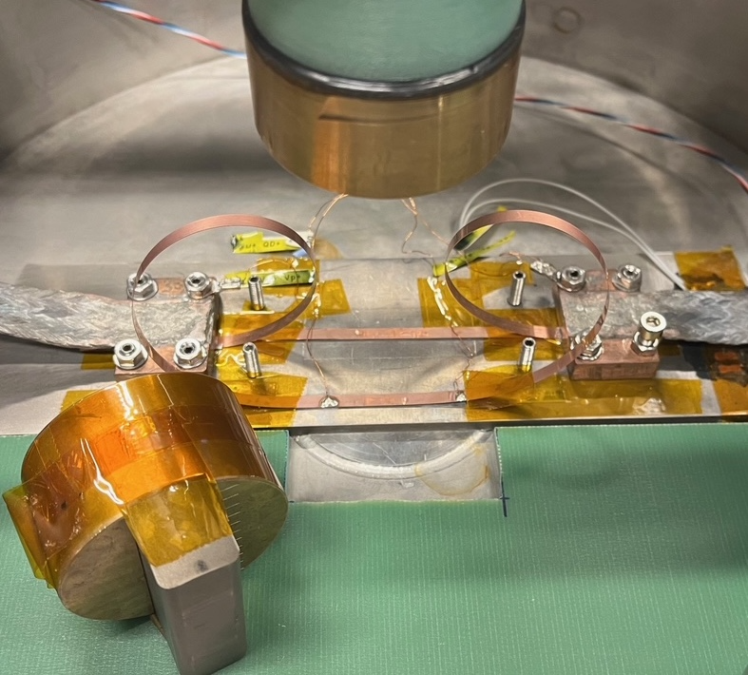
Transverse load (10 x 4 mm²)
I_{c}/I_{c0} and n/n₀ at zero load after applied stress.
Tape | 𝜎_{irr} [MPa]
S-Innovation | 900
Fujikura, 22-0012-09 | 400
SSCT, ST2903-105 | 750
UNIVERSITY OF TWENTE.

Slide 6
Conductor design optimization
Single tape testing
Axial stress
Axial strain
TransverseStress
Winding
Cable transverse load testing
Critical current
Transverse stiffness d(F)
Inter tape contact resistance R_{c}
FE cable model
Materials
Design
UNIVERSITY OF TWENTE.

Slide 7
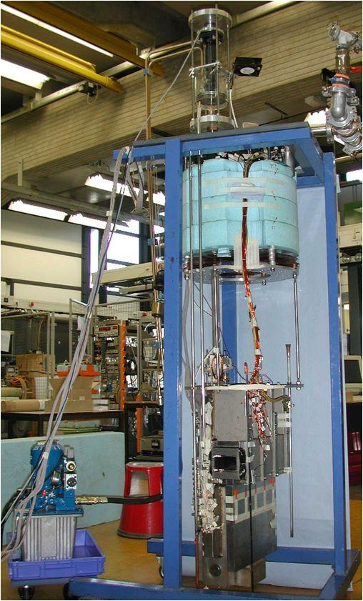
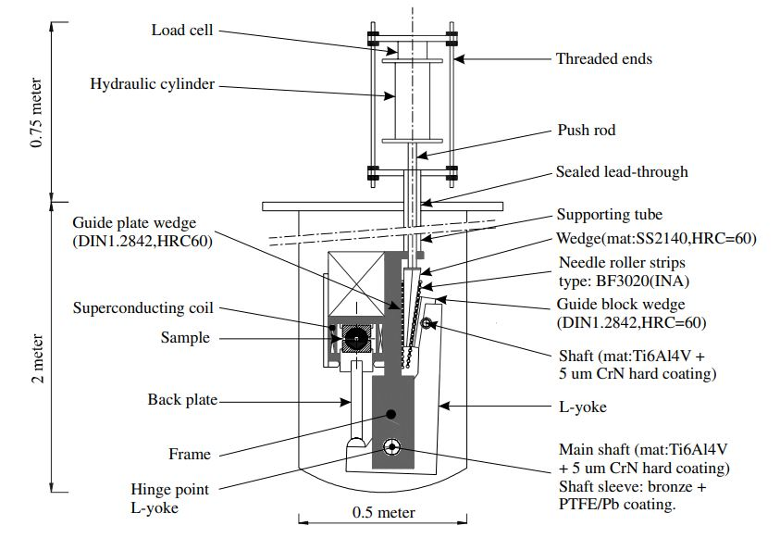
Transverse load: Twente Cable Press
Hydraulic press based on principle of lever mechanism and wedge
Sample length: 400 mm
Measuring: I_{c}, R_{c}, force, displacement and AC loss (only at 4.2 K).
T-operating temperatures: 4.2 and 77 K
UNIVERSITY OF TWENTE.
7

Slide 8
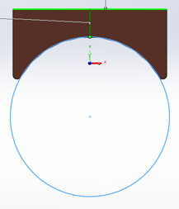
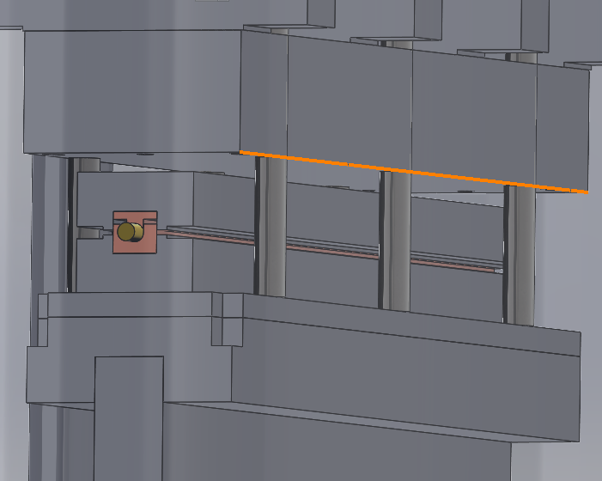
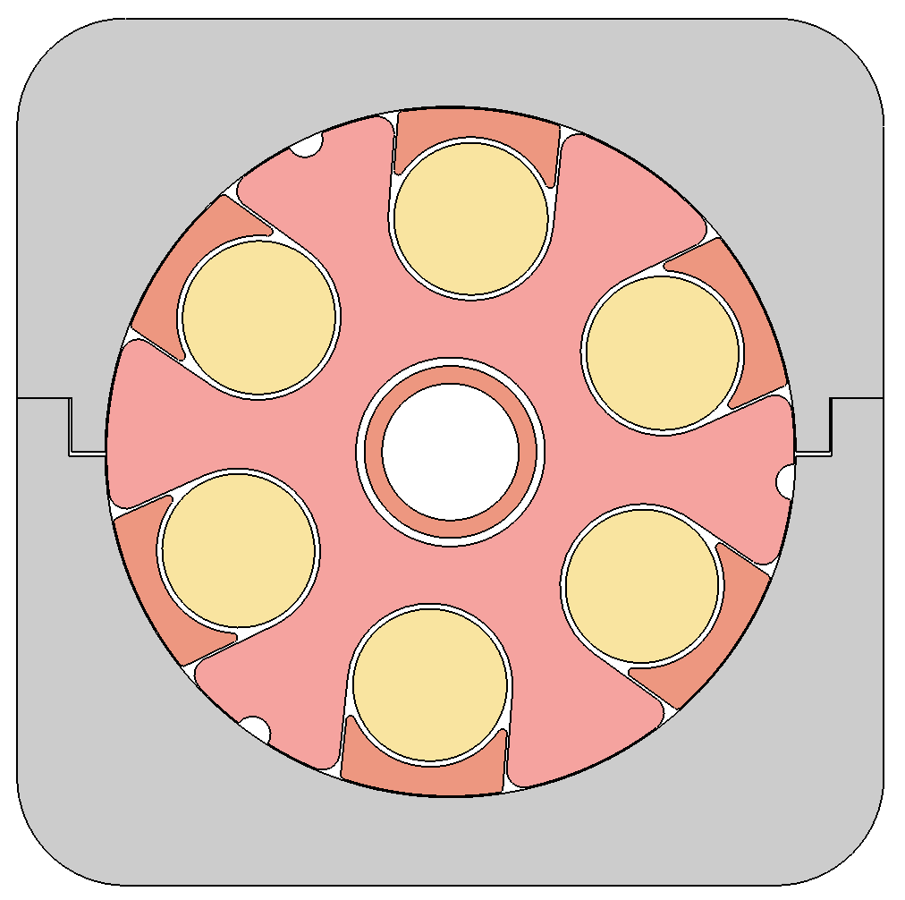
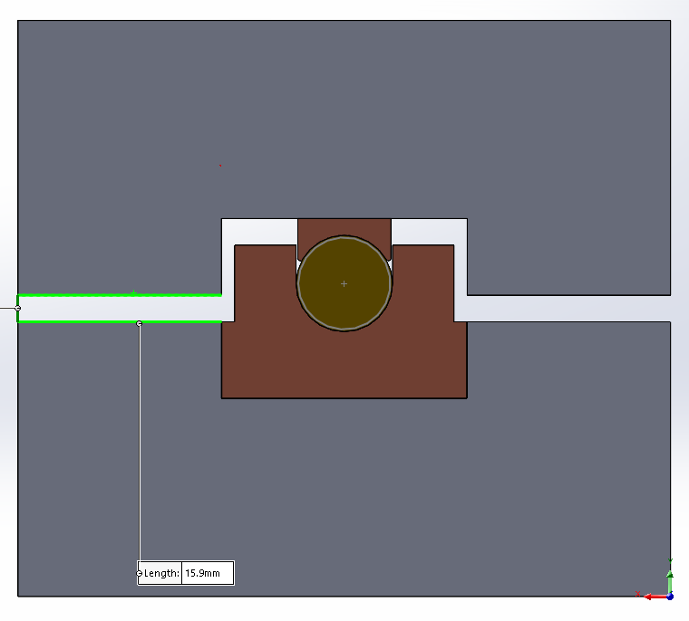
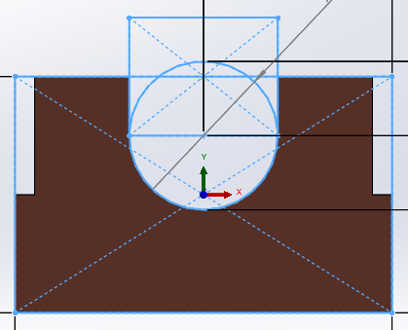
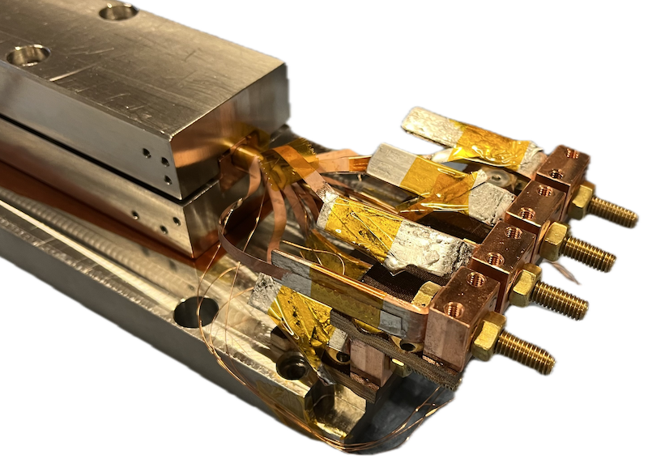
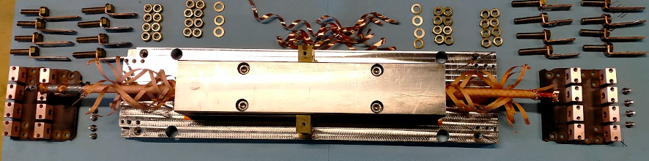

ACT CORC©-CICC Twente Press test sample
Extruded C101 Cu Keystones
Cu keystone
SS support
7 mm
OD
Central cooling tube
Machined C110 Cu support
CORC© cable used in ACT Sultan sample with 36 tapes, OD of 7.04 mm (including thin plastic tube) in groove with 7.54 mm.
Selected tapes (8) for critical current and inter-tape contact resistance measurements.
UNIVERSITY OF TWENTE.
8

Slide 9
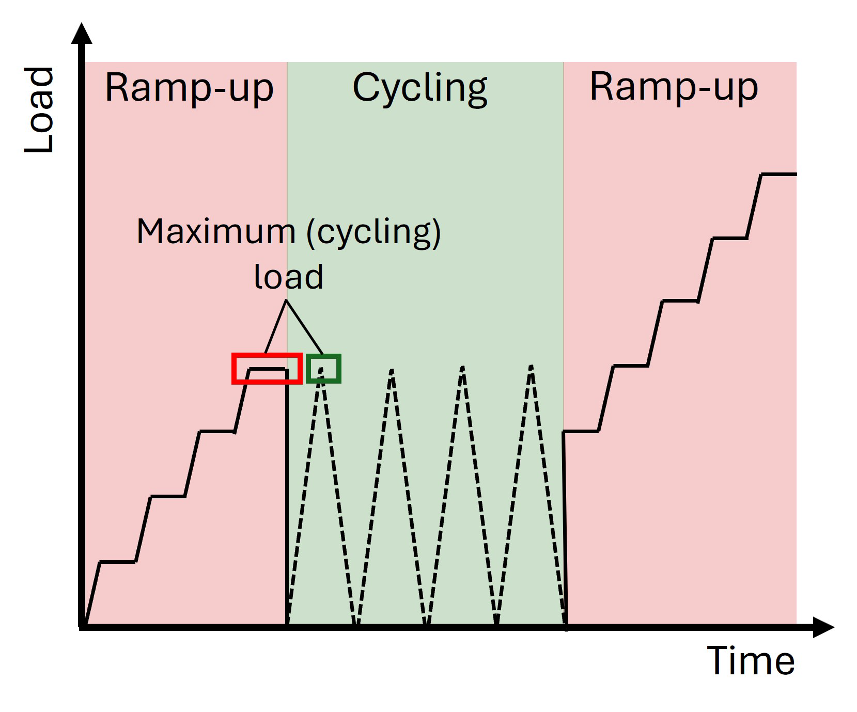
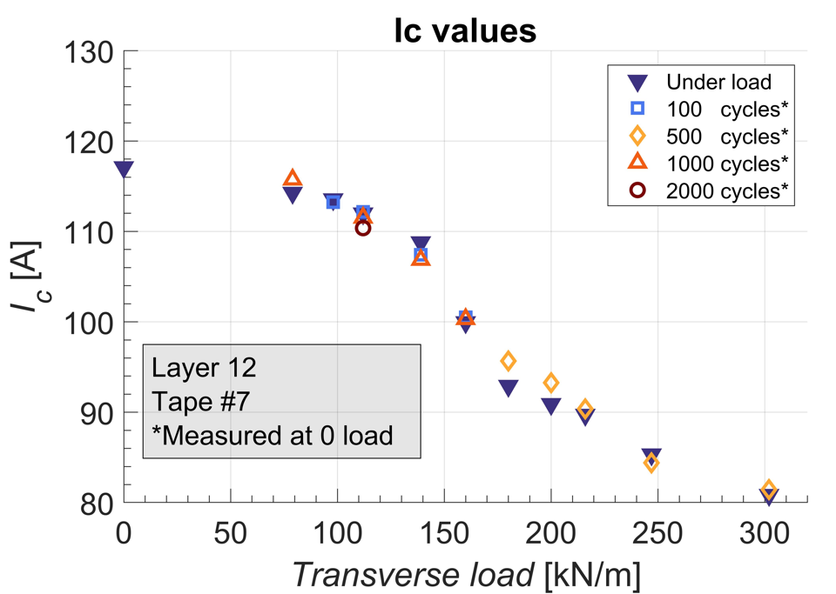
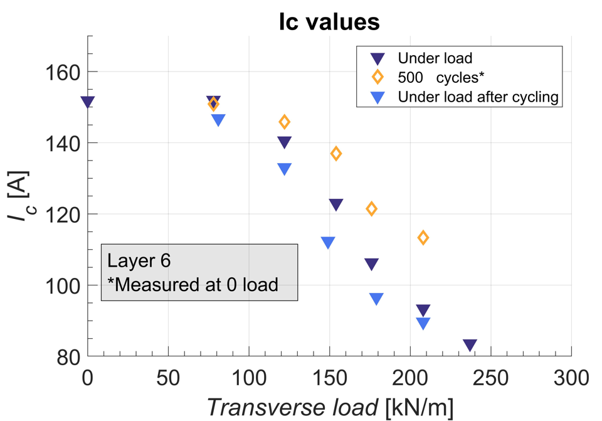
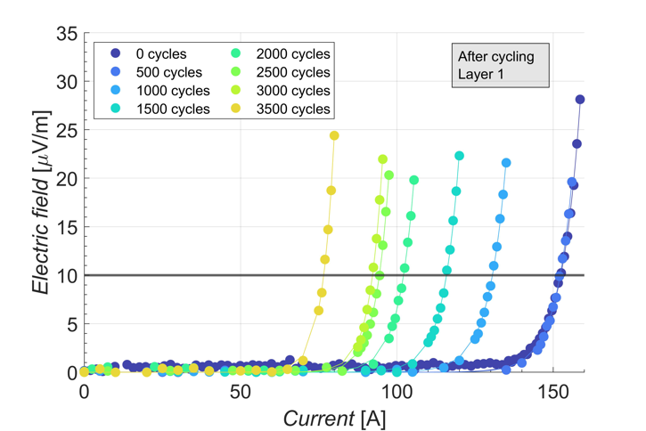
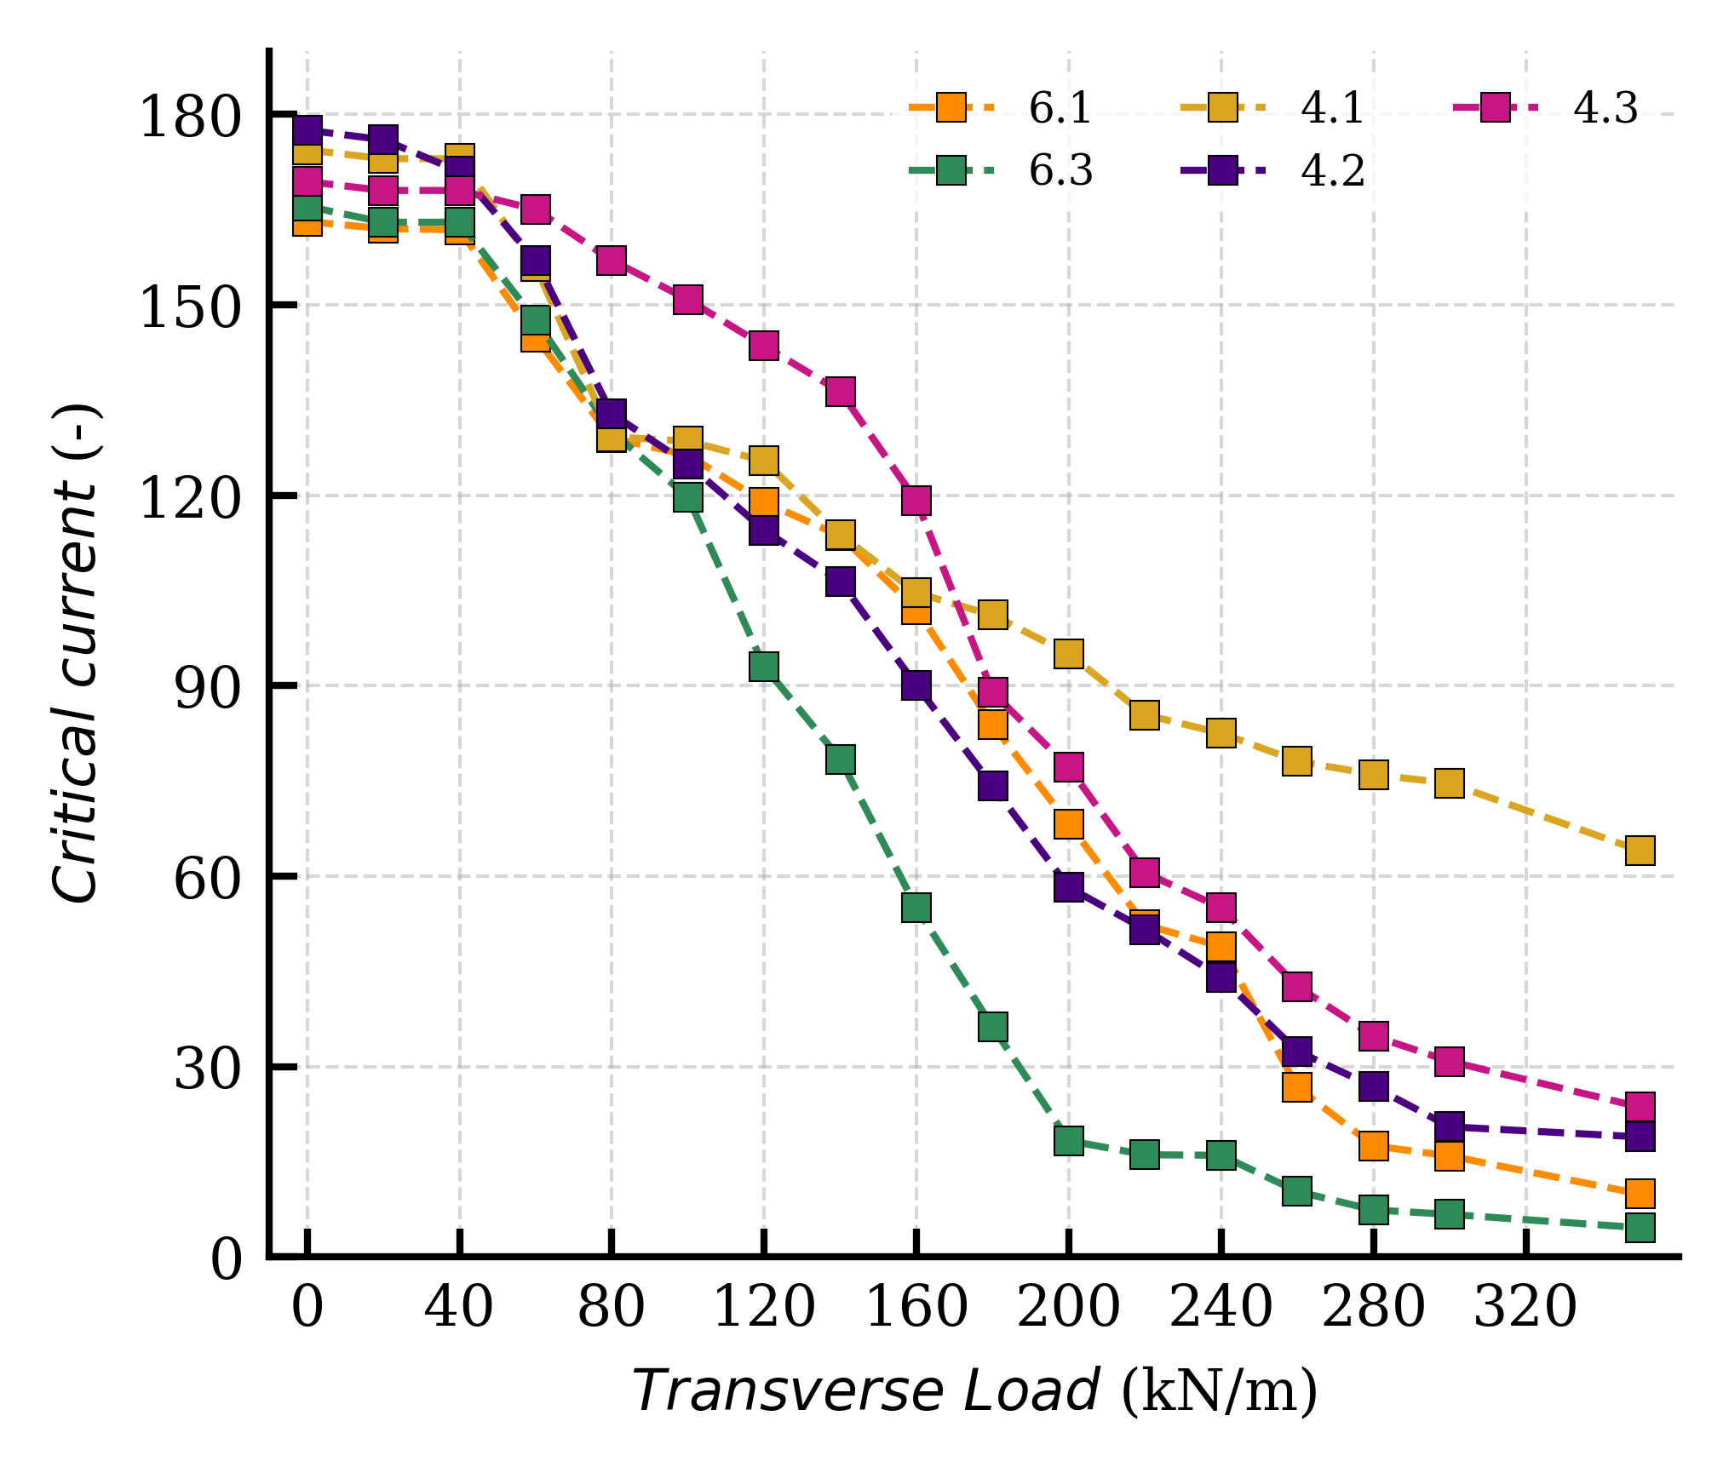
CORC© Twente Press ACT #1,2 & 3
Sub-cable parameters both samples
Tape Manufacturer | SuperPower
SC Tapes | 36
Tape width | 4 mm
Tape thickness | 63 μm
Substrate thickness | 50 μm
Copper thickness | 5 μm
Spacing | 0.5 mm
Core | Cu Rod
Core OD | 5.34mm
Strain window | [-1.3%, 0.45%]
ACT sample #1
ACT sample #2
9,000 cycles successive F-increases
(E_{c}=10 μV/m), n-value (22-21)
Irreversible degradation = critical load (CL):
ACT samples CL<~ 90 kN/m.
ACT sample #3
UNIVERSITY OF TWENTE.
9

Slide 10
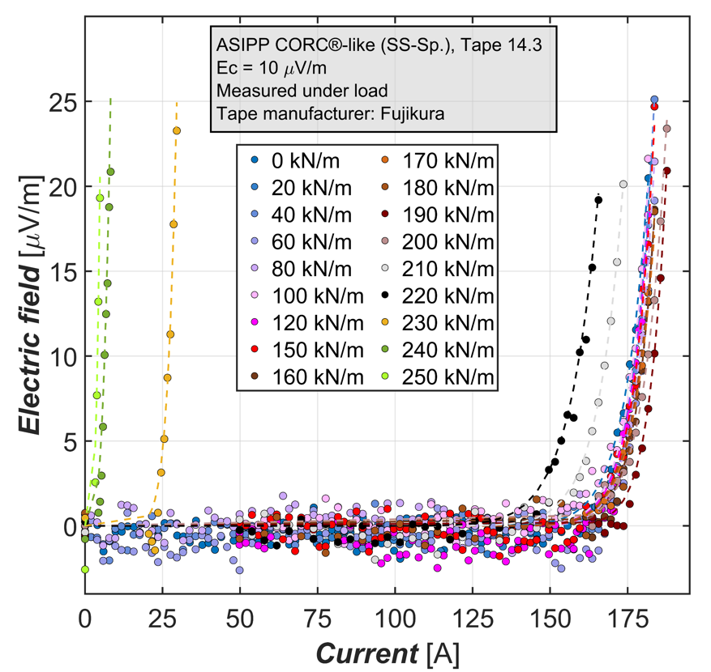
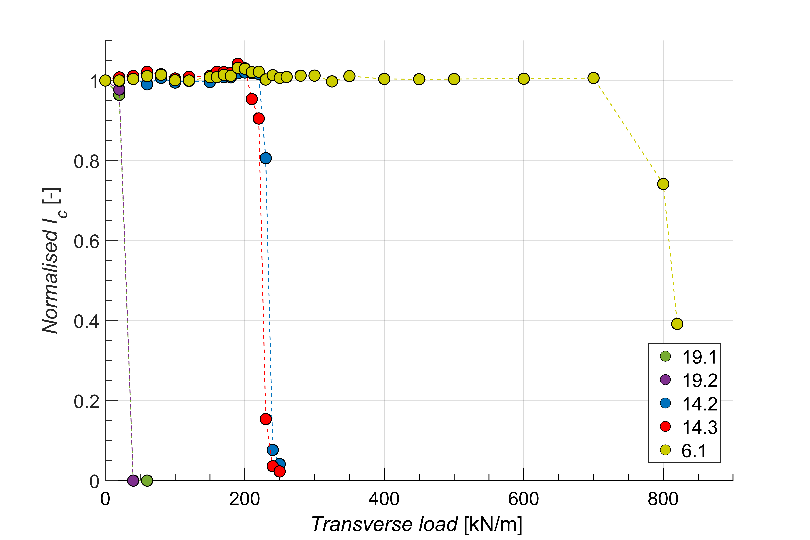
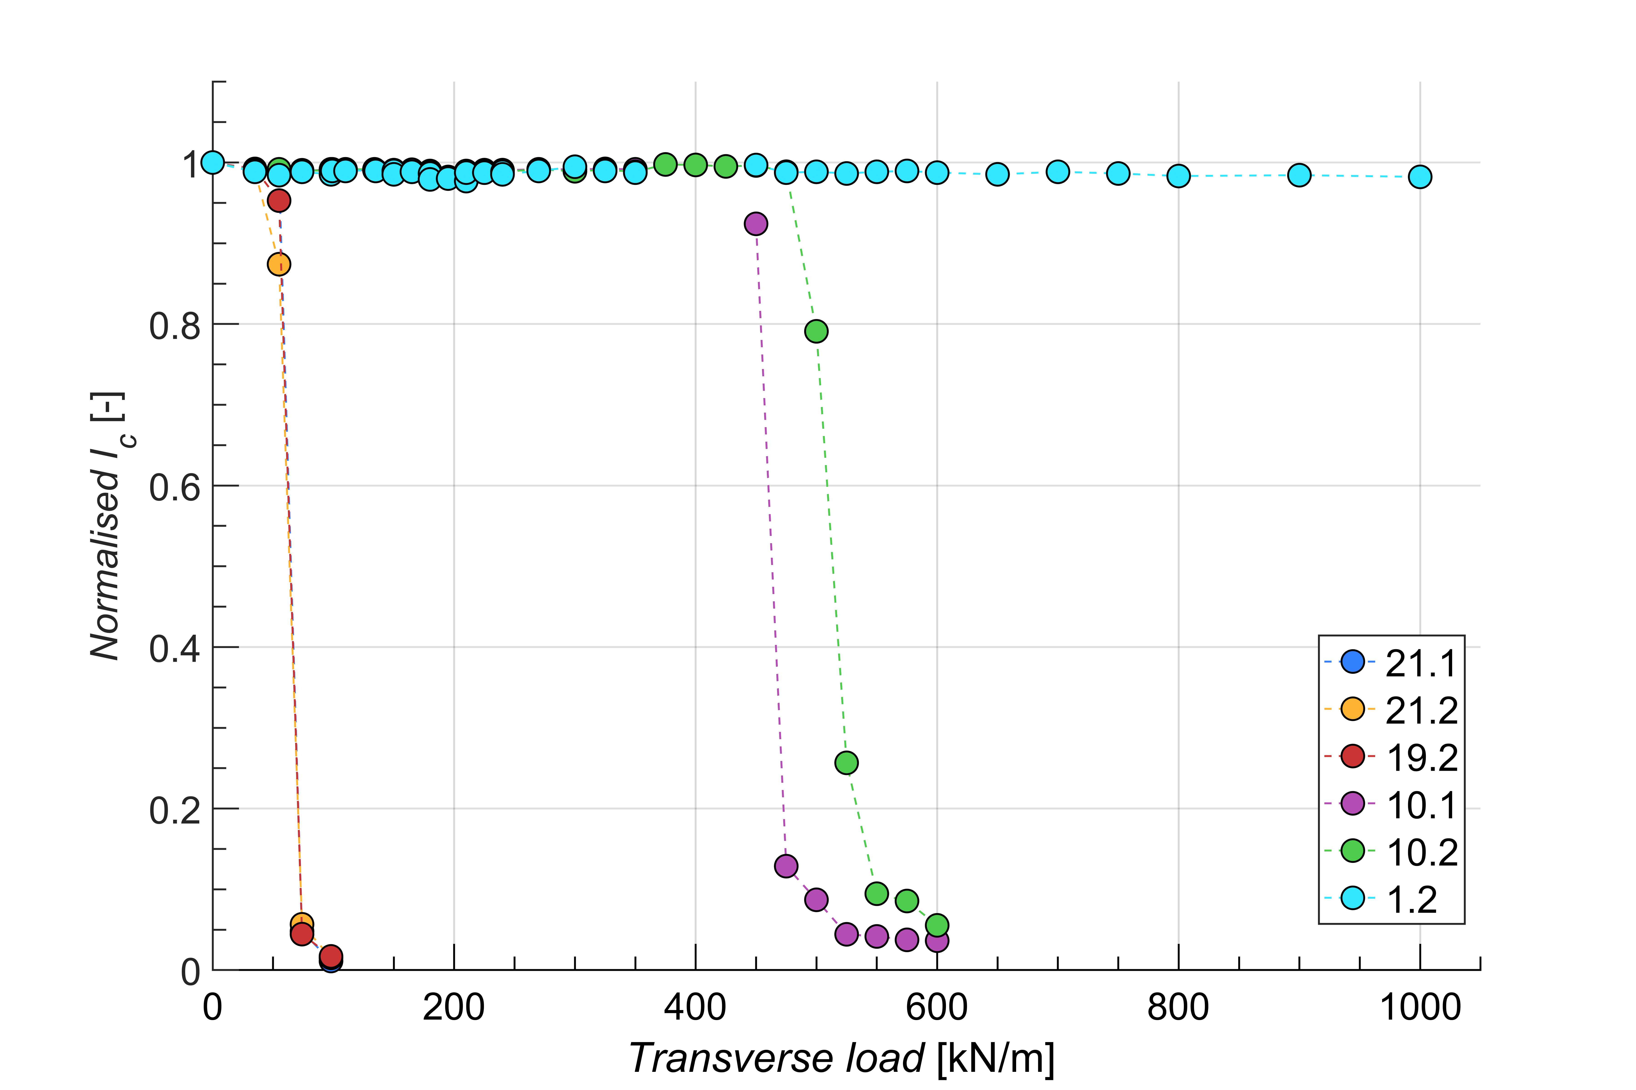
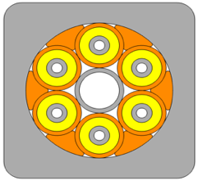
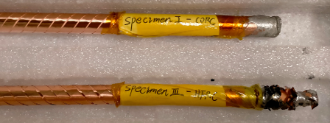
Twente Press ASIPP sample #1 & #3
Main parameters ASIPP
ASIPP Sultan # | #3 | #1
tape supplier | Fujikura | SSTC
Core OD | 4.0 mm | 4.6 mm
SC tape layer | 16 | 22
tape No. layer | 2x3 Cu+ SC(2x4+3x8+4x4)+4x2 Cu | SC(2x4+3x7+ 4x11)+4x1 Cu
tape No. | 48 | 73
winding angle | 33.5-49° | 36.5-56°
gap | ~0.6 mm | 0.4 mm
OD | ~8.6 mm | 9.6 mm
width | 4 mm | 4 mm
thickness | 0.11 mm | 0.10 mm
Ic @ 77K,SF | 160 -210 A | 160-190 A
ASIPP sample #3
Spiral core
ASIPP sample #3, degradation for
spiral at 210 kN/m (x6=1,260 kN/m).
solid core 450 kN/m (x6=2,700 kN/m).
ACT samples ~ 90 kN/m < (x6=540 kN/m).
Main difference with ATC samples:
radius Cu profile matches to cable.
no plastic tube around cable.
cable 1,000 kN/m ~ tape 200 MPa (σ_{trans})
ASIPP sample #1
Solid Cu core
UNIVERSITY OF TWENTE.
10

Slide 11
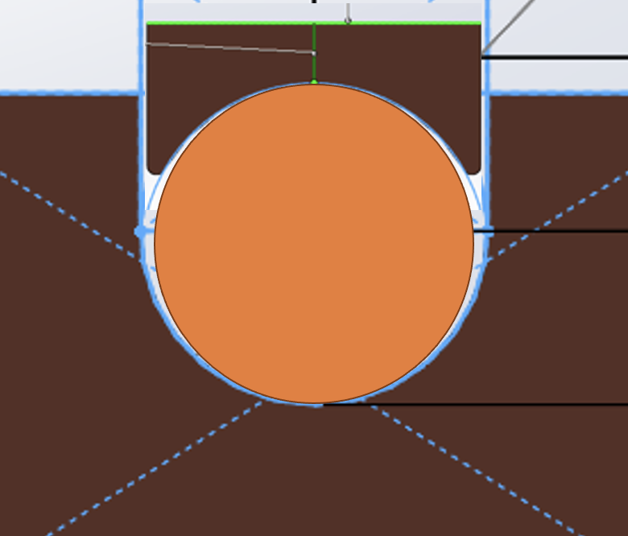
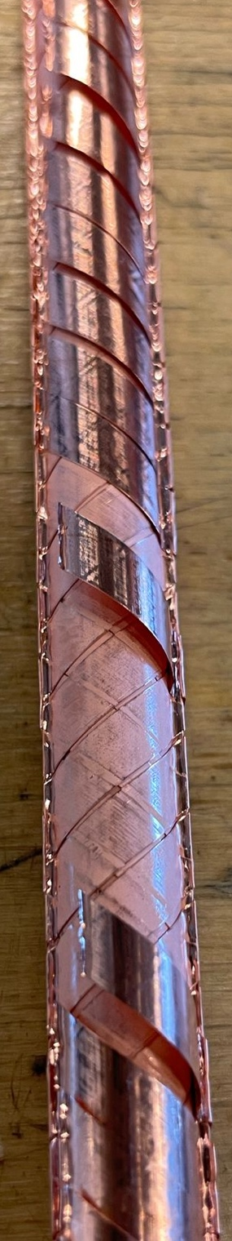
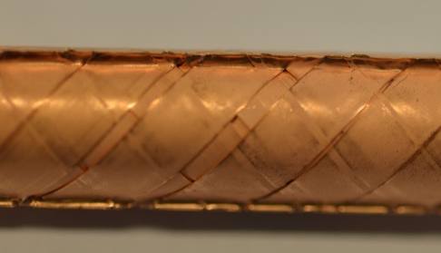
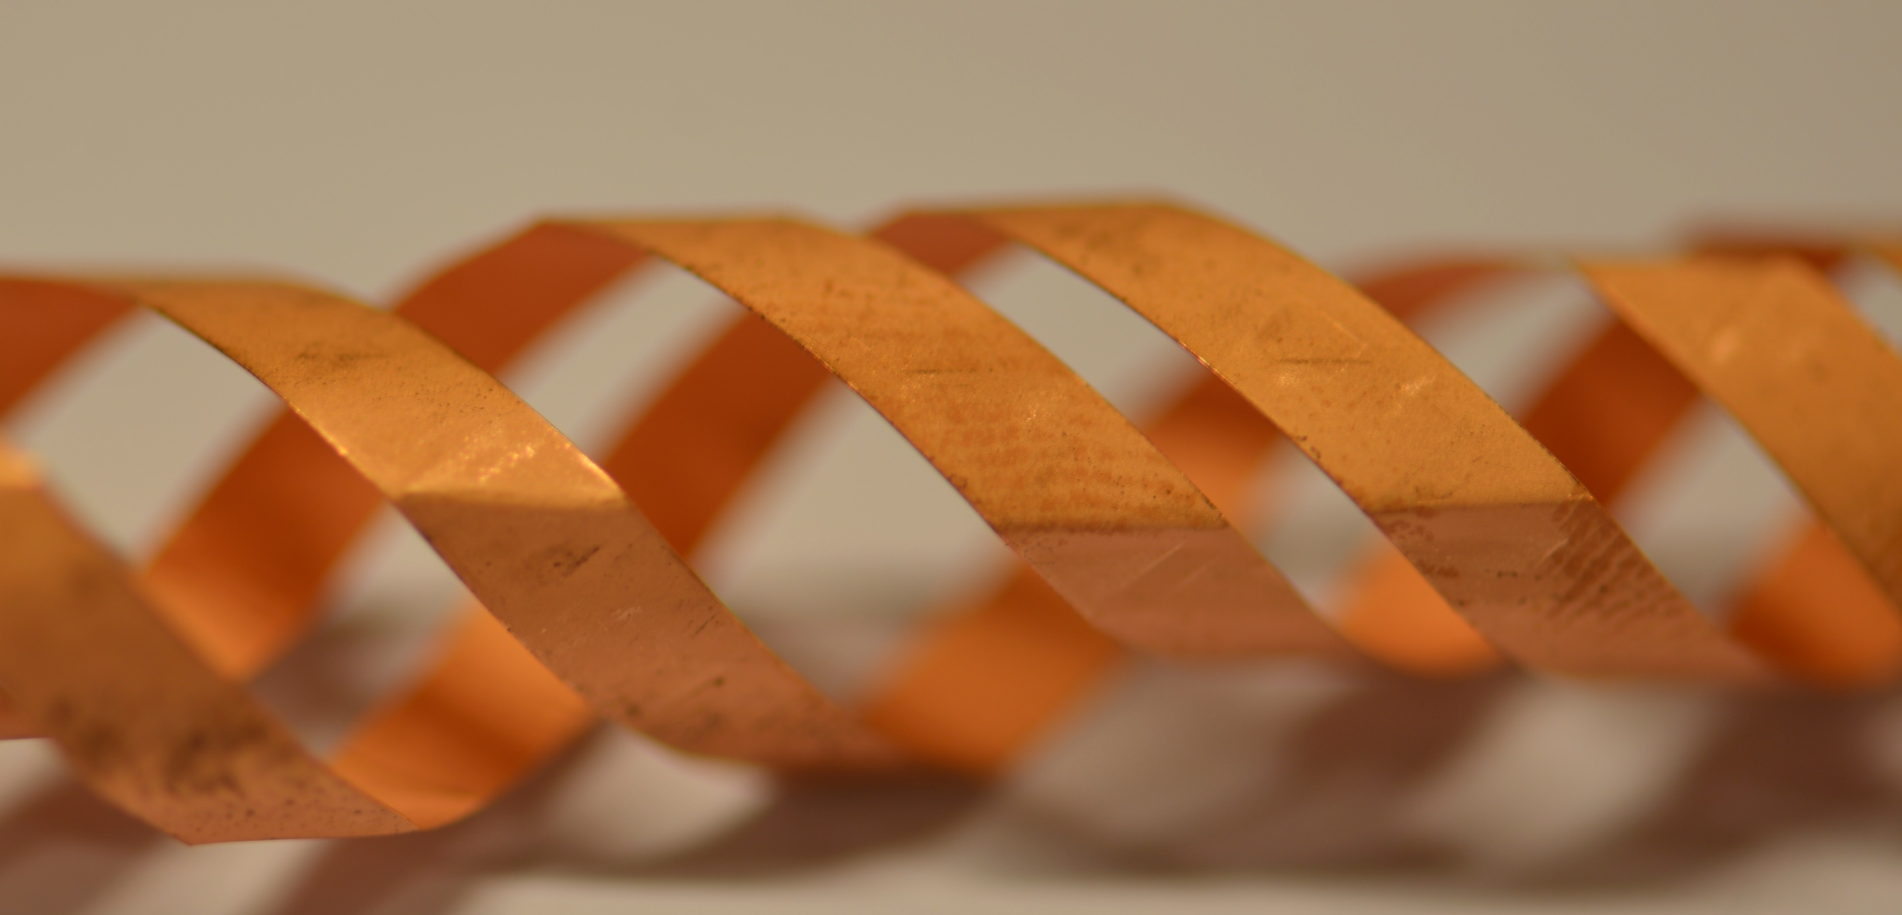
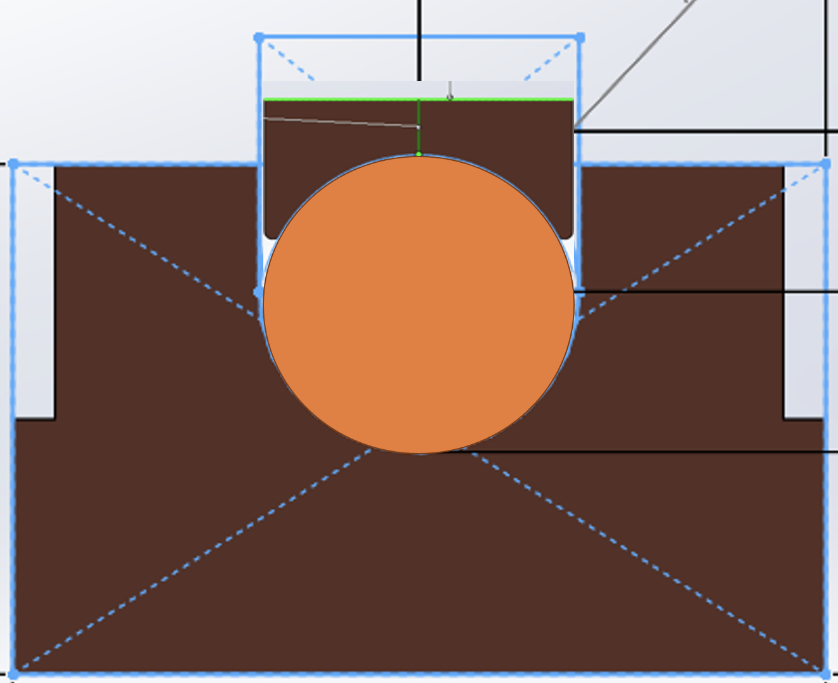
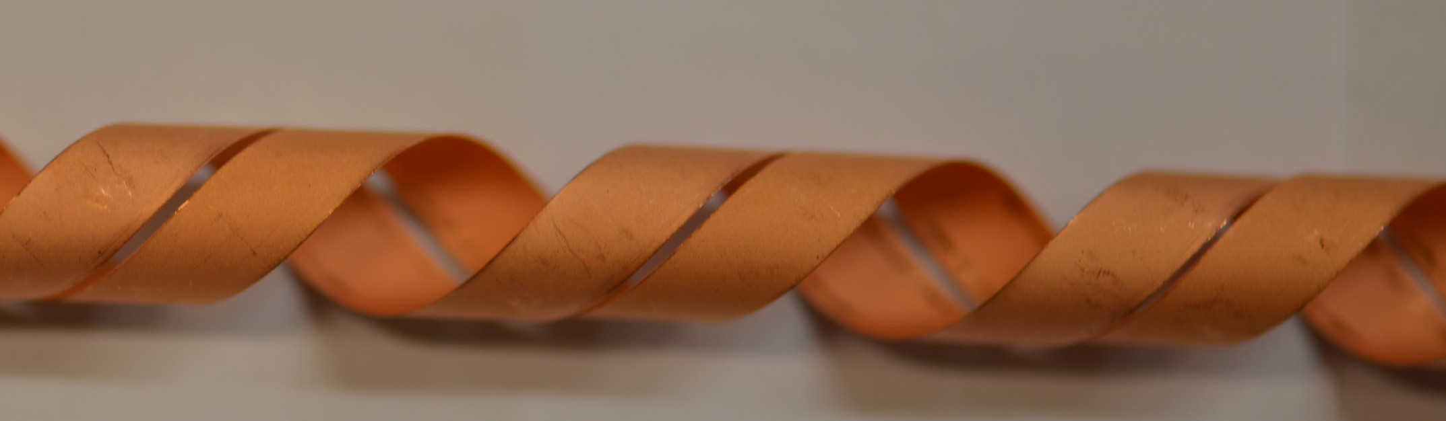
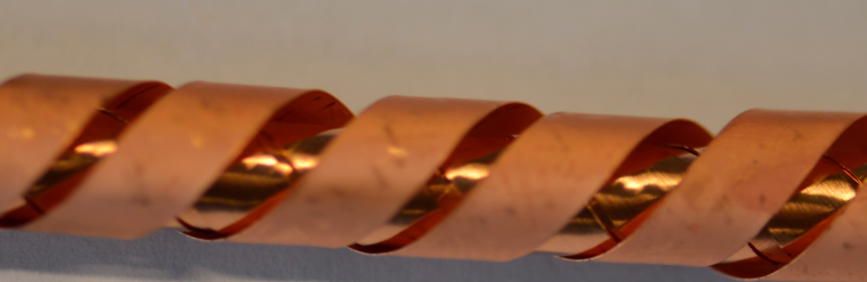
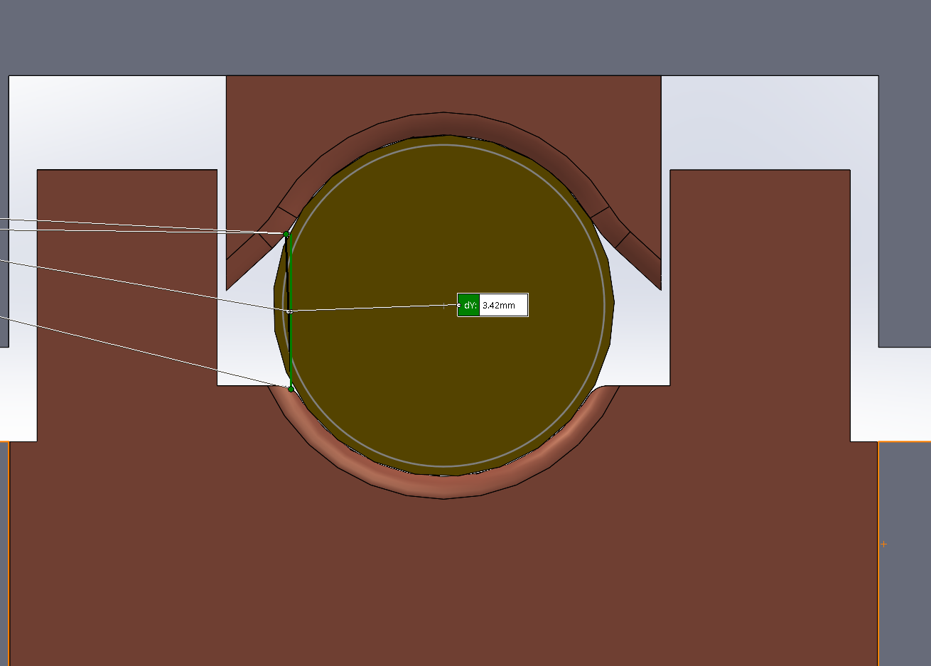

Cable outer layer damage, Press test
ASIPP #1, layer 22
ACT cables: < 90 kN/m
Cu groove and key-stone have larger radius than cable (stress concentration?).
r-cable
r-Cu-groove
ASIPP #1, layer 10
ASIPP cables: Middle layers withstand 450 kN/m, more homogeneous distributed contact.
Groove and cable radius match, outer tapes squeezed (→ kinking).
ASIPP #1, layer 1
ASIPP #3, layer 4
Remedies: ACT #3
Space needed for cable to “breath”?
ACT #1 & 2, no damage
Press testing
UNIVERSITY OF TWENTE.
11

Slide 12







ACT #1 & 2, ASIPP #1 & 3 (spiral), Press F(d)
ACT #1
ACT #2
ASIPP #3
ASIPP #1
ACT #3
12 layers
12 layers
12 layers
16 layers (SS spiral)
22 layers
void/layer - sample | ACT #1 | ACT #2 | ACT #3 | ASIPP #3 | ASIPP #1
(d_{meas} @150kN/m) [μm] | 150 | 190 | 250 | 700 | 500
tape thickness (t) [μm] | 63 |  |  | 110
void/layer: (D_{out}-D_{in})/(2N)-t [μm] | 12 |  |  | 11 | 12
void fraction cable X-section [%] | 16 |  |  | 9 | 10
Two stiffness regimes
K. Wang, Y. Gao, W. Luo, Y. Zhou, A. Nijhuis, Nonlinear contact behavior of HTS tapes during pancake coiling and CORC cabling, Supercond. Sci. Technol. 34 (2021) 075003 https://doi.org/10.1088/1361-6668/abf710
12
UNIVERSITY OF TWENTE.

Slide 13

Contact resistance results: R_{c}(F)
Contact resistance: initial R_{c} and after 3,000 cycles, 2 to 10 𝜇𝛺m in all conductors (under load).
R_{c} evolution with cycling in qualitative agreement (peak).
UNIVERSITY OF TWENTE.
13

Slide 14
Conductor design optimization
Single tape testing
Axial stress
Axial strain
TransverseStress
Winding
Cable transverse load testing
Critical current
Transverse stiffness d(F)
Inter tape contact resistance R_{c}
FE cable model
Materials
Design
UNIVERSITY OF TWENTE.

Slide 15




Model validation – experimental data
ACT single CORC© experiment with transverse anvil loading.
Parameters
Tapes | 12
Layers | 6
Tape width | 3 mm
d-Tape | 44 μm
d- Substrate | 30 μm
d-Copper | 5 μm
Gap spacing | 0.5 mm
Core | Cu/SS rod
Strain window | [-1.3 %, 0.45 %]
SS core
Cu core
NCR = no current sharing between tapes.
PCR = perfect current sharing between tapes.
Good match irreversibility limits:
model versus experiment
D.C. van der Laan et al, 2018 Supercond Sci Technol 32, DOI:10.1088/1361-6668/aae8bf
D.C. van der Laan et al 2019 Supercond. Sci. Technol. 32 015002
D.C. van der Laan, private communication.
UNIVERSITY OF TWENTE.

Slide 16











Simulations: gap, Cu-tube, EM/ML load
F
Gap spacing = 1 mm
Gap spacing = 0.5 mm
ACT cable result compared with 0.5 and 1.0 mm Cu tube.
Strain distribution with 0.5 mm Cu-wall thickness.
Smaller gap reduces voids and tape bending.
Left 2 plots: displacement (μm) for Mech and Electromagnetic Load at 200 kN/m (bending).
Right: Difference body load (EM) and Mechanical Load for different tape thicknesses and gap sizes.
Critical transverse EM load < mechanical load (30%).
UNIVERSITY OF TWENTE.

Slide 17




ASIPP CICC; Cu tube core, 1,080 kN/m
Cu tube core, 1 mm d_{wall}
1,200 kN/m, Cu tube, 1 mm d_{wall}
Cu tube core, 3 mm d_{wall}
REBCO von Mises: 90 MPa
Cu tube vM stress: 118 MPa,
near yielding stress
REBCO von Mises: 108 MPa
UNIVERSITY OF TWENTE.
17

Slide 18



ASIPP CICC; Cu core-SS spring, 1080 kN/m
Solid Cu core
SS spiral core
SS spiral core
REBCO von Mises stress:
110 MPa
REBCO von Mises stress:
110 MPa
SS spiral peak von Mises stress:
280 MPa
Significantly below yielding limit
Improved cooling
UNIVERSITY OF TWENTE.
18

Slide 19



Model - SULTAN vs Twente Press results
ASIPP #3 with spiral core in CORC cables (HFRC)
2023: CORC Model EM critical EM load
prediction: 1,000 kN/m and ML 1,320 kN/m
2024 Sultan test:
L-leg: CORCs with spiral core, T_{cs} decreased ~1 K after 80 kA load; EM load = 825 kN/m
R-leg, with CORC cables with solid Cu-core, no degradation up to 80 kA
2025 Twente Press: ASIPP sample #3, Mechanical load degradation for spiral core at 210 kN/m (x6= 1,260 kN/m
FEModel EM load correction: 0.7 x 1,260 = 880 kN/m
Tcs@40kA, 10.85T
UNIVERSITY OF TWENTE.
19

Slide 20
Summary
Cable Press test in agreement with ASIPP Sultan, FEModel and measured REBCO tape properties.
Press critical transverse load CORC®-like cables (5 samples) varies from <100 to 450 kN/m (x 6 =500 to 2,700 kN/m).
Optimizations:
  Gap limit between tapes of same layer
  EM: Cu tube around CORC
  CICC central SS spiral
Contact resistance: evolution with load cycling (with maximum around 10 cycles). Initial Rc and after 3,000 cycles, 2 to 10 𝜇𝛺m (under load).
UNIVERSITY OF TWENTE.

Slide 21
Thank you!
UNIVERSITY OF TWENTE.

