Slide 1
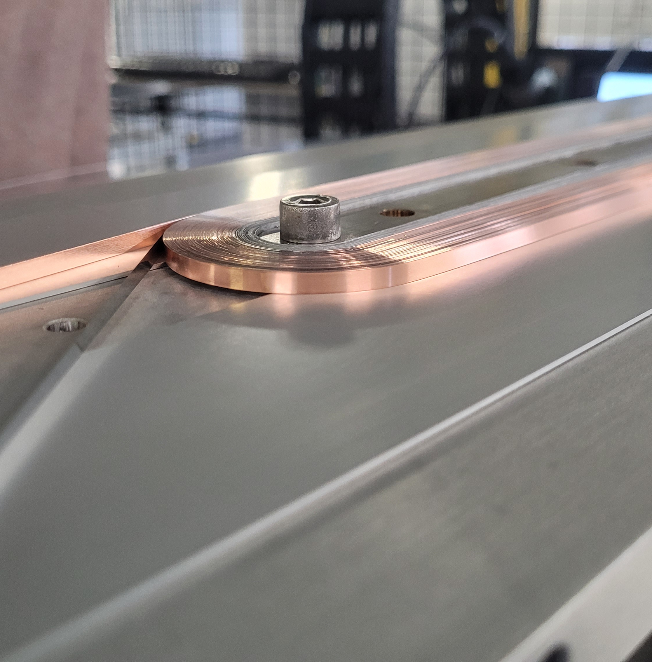


Metal as Insulation REBCO racetracks coils: development, fabrication, and cryogenic testing at CEA Paris-Saclay
Wed-Af-Or1-03
Thibault Lécrevisse (CEA) on behalf of CEA team
Amalia Ballarino, Algirdas Baskys (CERN)
+ Many thanks to CNRS Néel Institute and LNCMI for helping with the 4.2 K tests (A. Badel, J. Vialle & P. Tixador ; J.B. Song & X. Chaud)

Slide 2
Outline
REBCO Metal Insulated RaceTrack program overview
RaceTrack fabrication process
RaceTrack RT9
Double RaceTrack DRT10-11
Summary and perspectives

Slide 3
1. REBCO Metal Insulated Racetrack program overview
Why Metal Insulated (MI) RaceTrack (RT) coils for accelerator magnets developments?
  Less risks of damaging the coil (vs Insulated)
  More compact and stronger than insulated (no soft insulation)
  Lot of knowledge on MI winding process at CEA (UHF solenoid NOUGAT*)
  Magnet transfer function equivalent to an insulated magnet in steady state
  Insulated Racetrack already studied at CERN
What is expected ?
  Design limits evaluation (quench current, mechanics…)
  Protection study at high current density
  Magnet transfer function in transient behavior
  Make a first step toward a 14 T REBCO block magnet
  Obtain benchmark data for numerical models
Insulated Racetrack by A. Baskys et al
Today at 2:30 PM
Wed-Af-Po.03-02: Development and testing of REBCO racetrack model coils at CERN
* Philippe Fazilleau et al, doi: 10.1016/j.cryogenics.2020.103053

Slide 4
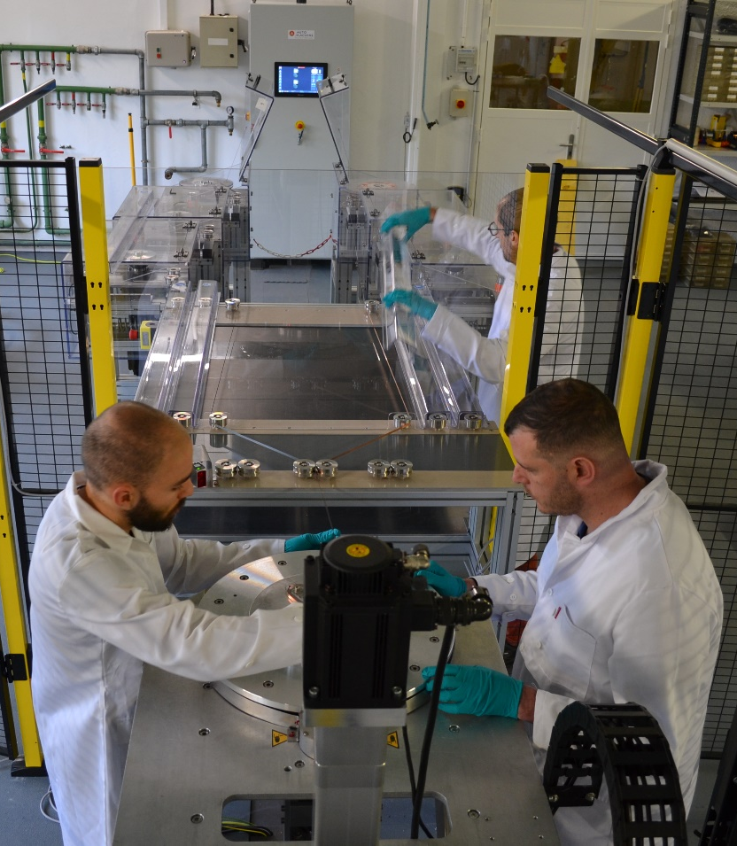
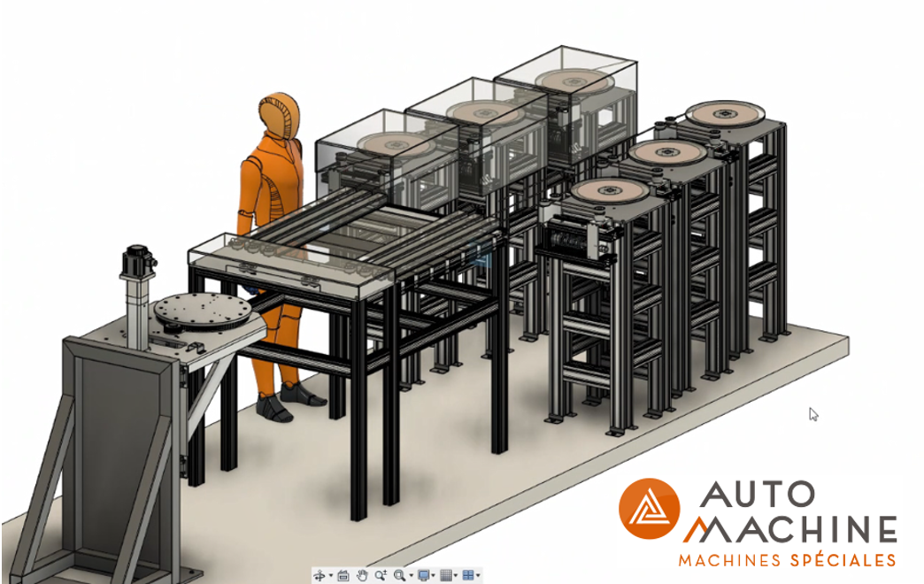

2. Racetrack fabrication process
CEA HTS winding machine
Current configuration :
Up to 6 tapes (controlled tensioning)
Up to 230 N per tape (individual)
Up to 1 m in diameter
Up to 500 mm in height for the assembly
All process parameters are logged
Spools
Guiding rolls
Winding plate
This work has benefited from a government grant managed by the french national research agency under the future investment program (PIA) (PIA3 FASUM ANR-21-ESRE-0027)

Slide 5
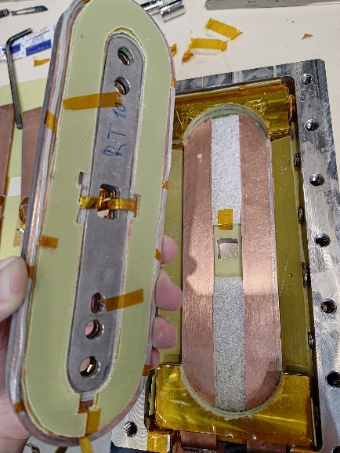
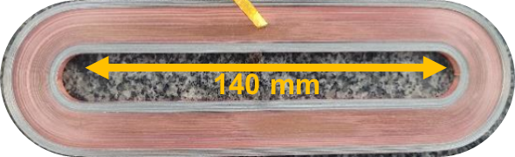
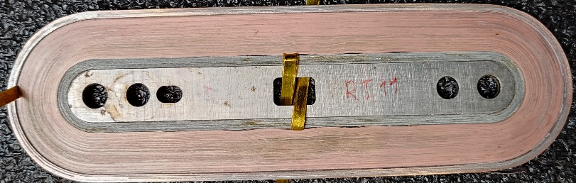
2. Racetrack fabrication process
Typical racetrack coils
First version: Racetrack without mandrel
Hall probe holder position
MI REBCO winding
Inner/outer copper rings
(soldered copper tape)
Racetrack in structure for tests
27 mm
130-150 turns typically
Single REBCO tape (4 mm wide)
  Shanghai Superconductor Technology Oct-2024 tape
Thin co-wound steel (30 µm thick)
Copper rings current leads (2-3 mm thick)
Current version: Racetrack with mandrel

Slide 6
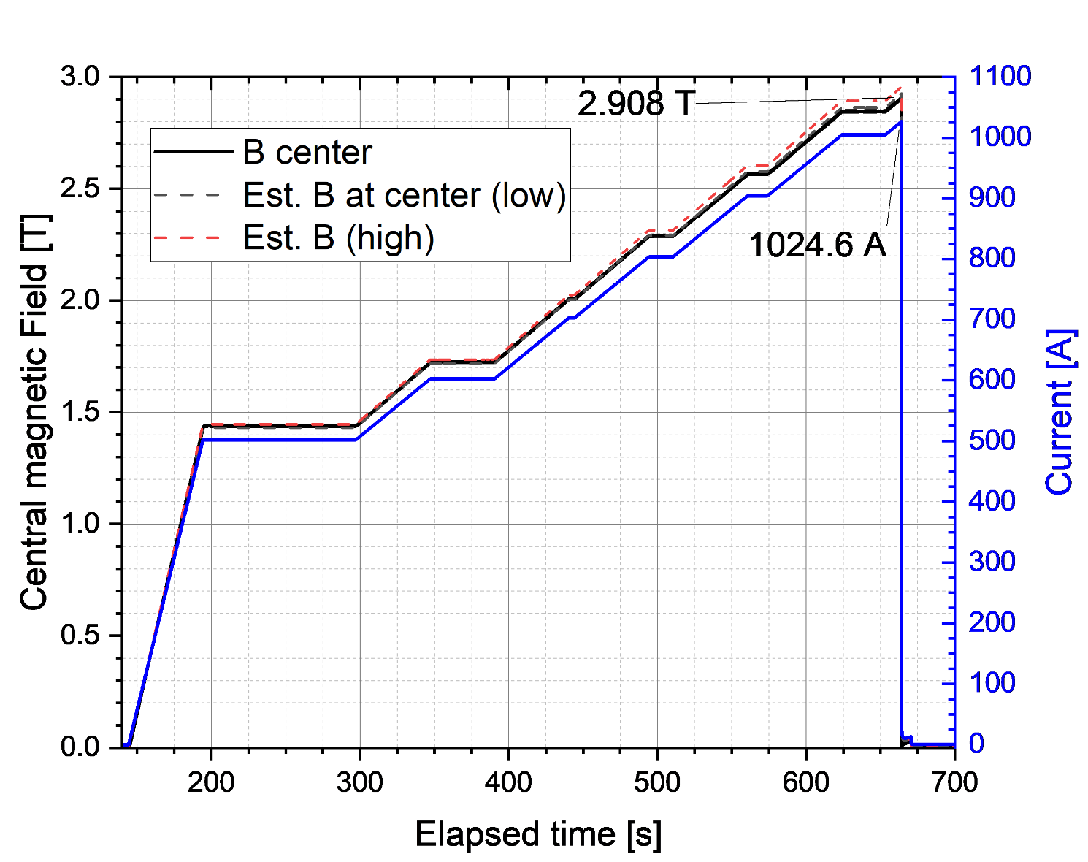
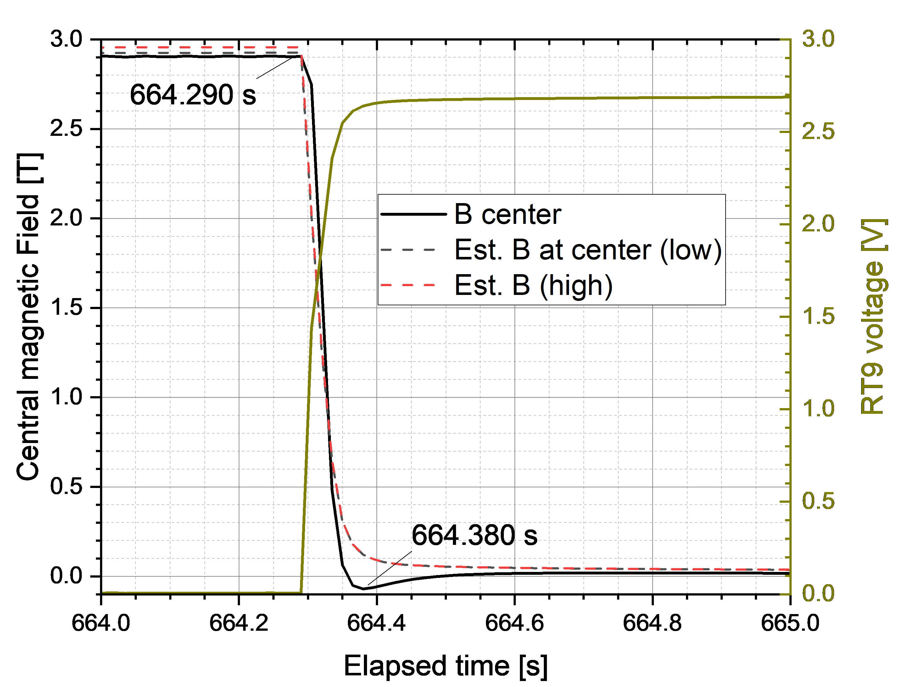
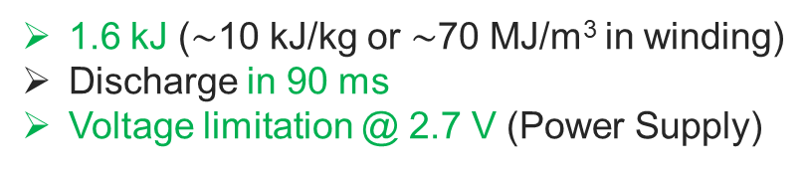

3. Racetrack RT9: main results @4.2 K (CNRS Grenoble)
RT9 : 135 turns
Test Limit 1 (quench #1)
2.91 T
**
1025 A
2 A/s
2 A/s
2 A/s
2.9 T (center) @ 2560 A/mm² *!
(8.5 T peak on REBCO tape)
10 A/s
10 A/s → $\sim$28-30 mT/s
1.6 kJ ($\sim$10 kJ/kg or $\sim$70 MJ/m³ in winding)
Discharge in 90 ms
Voltage limitation @ 2.7 V (Power Supply)
* Overall current density considering the whole turn thickness (engineering current density)
** High/Low estimation with/without two current two soldered current-lead turns

Slide 7
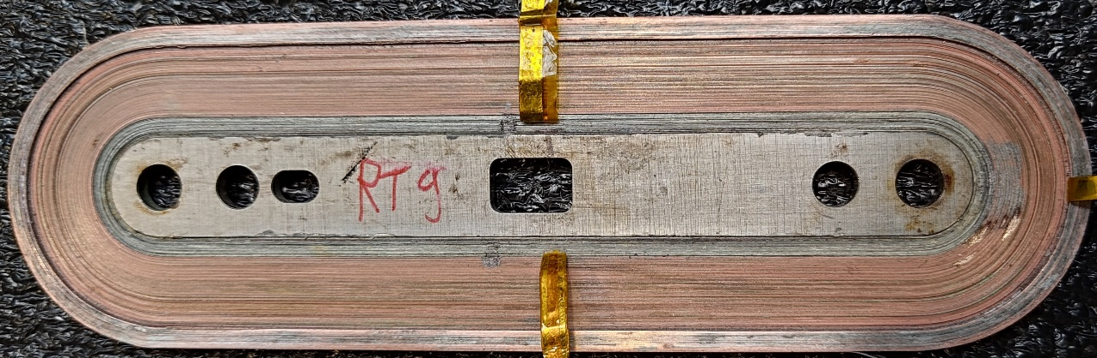
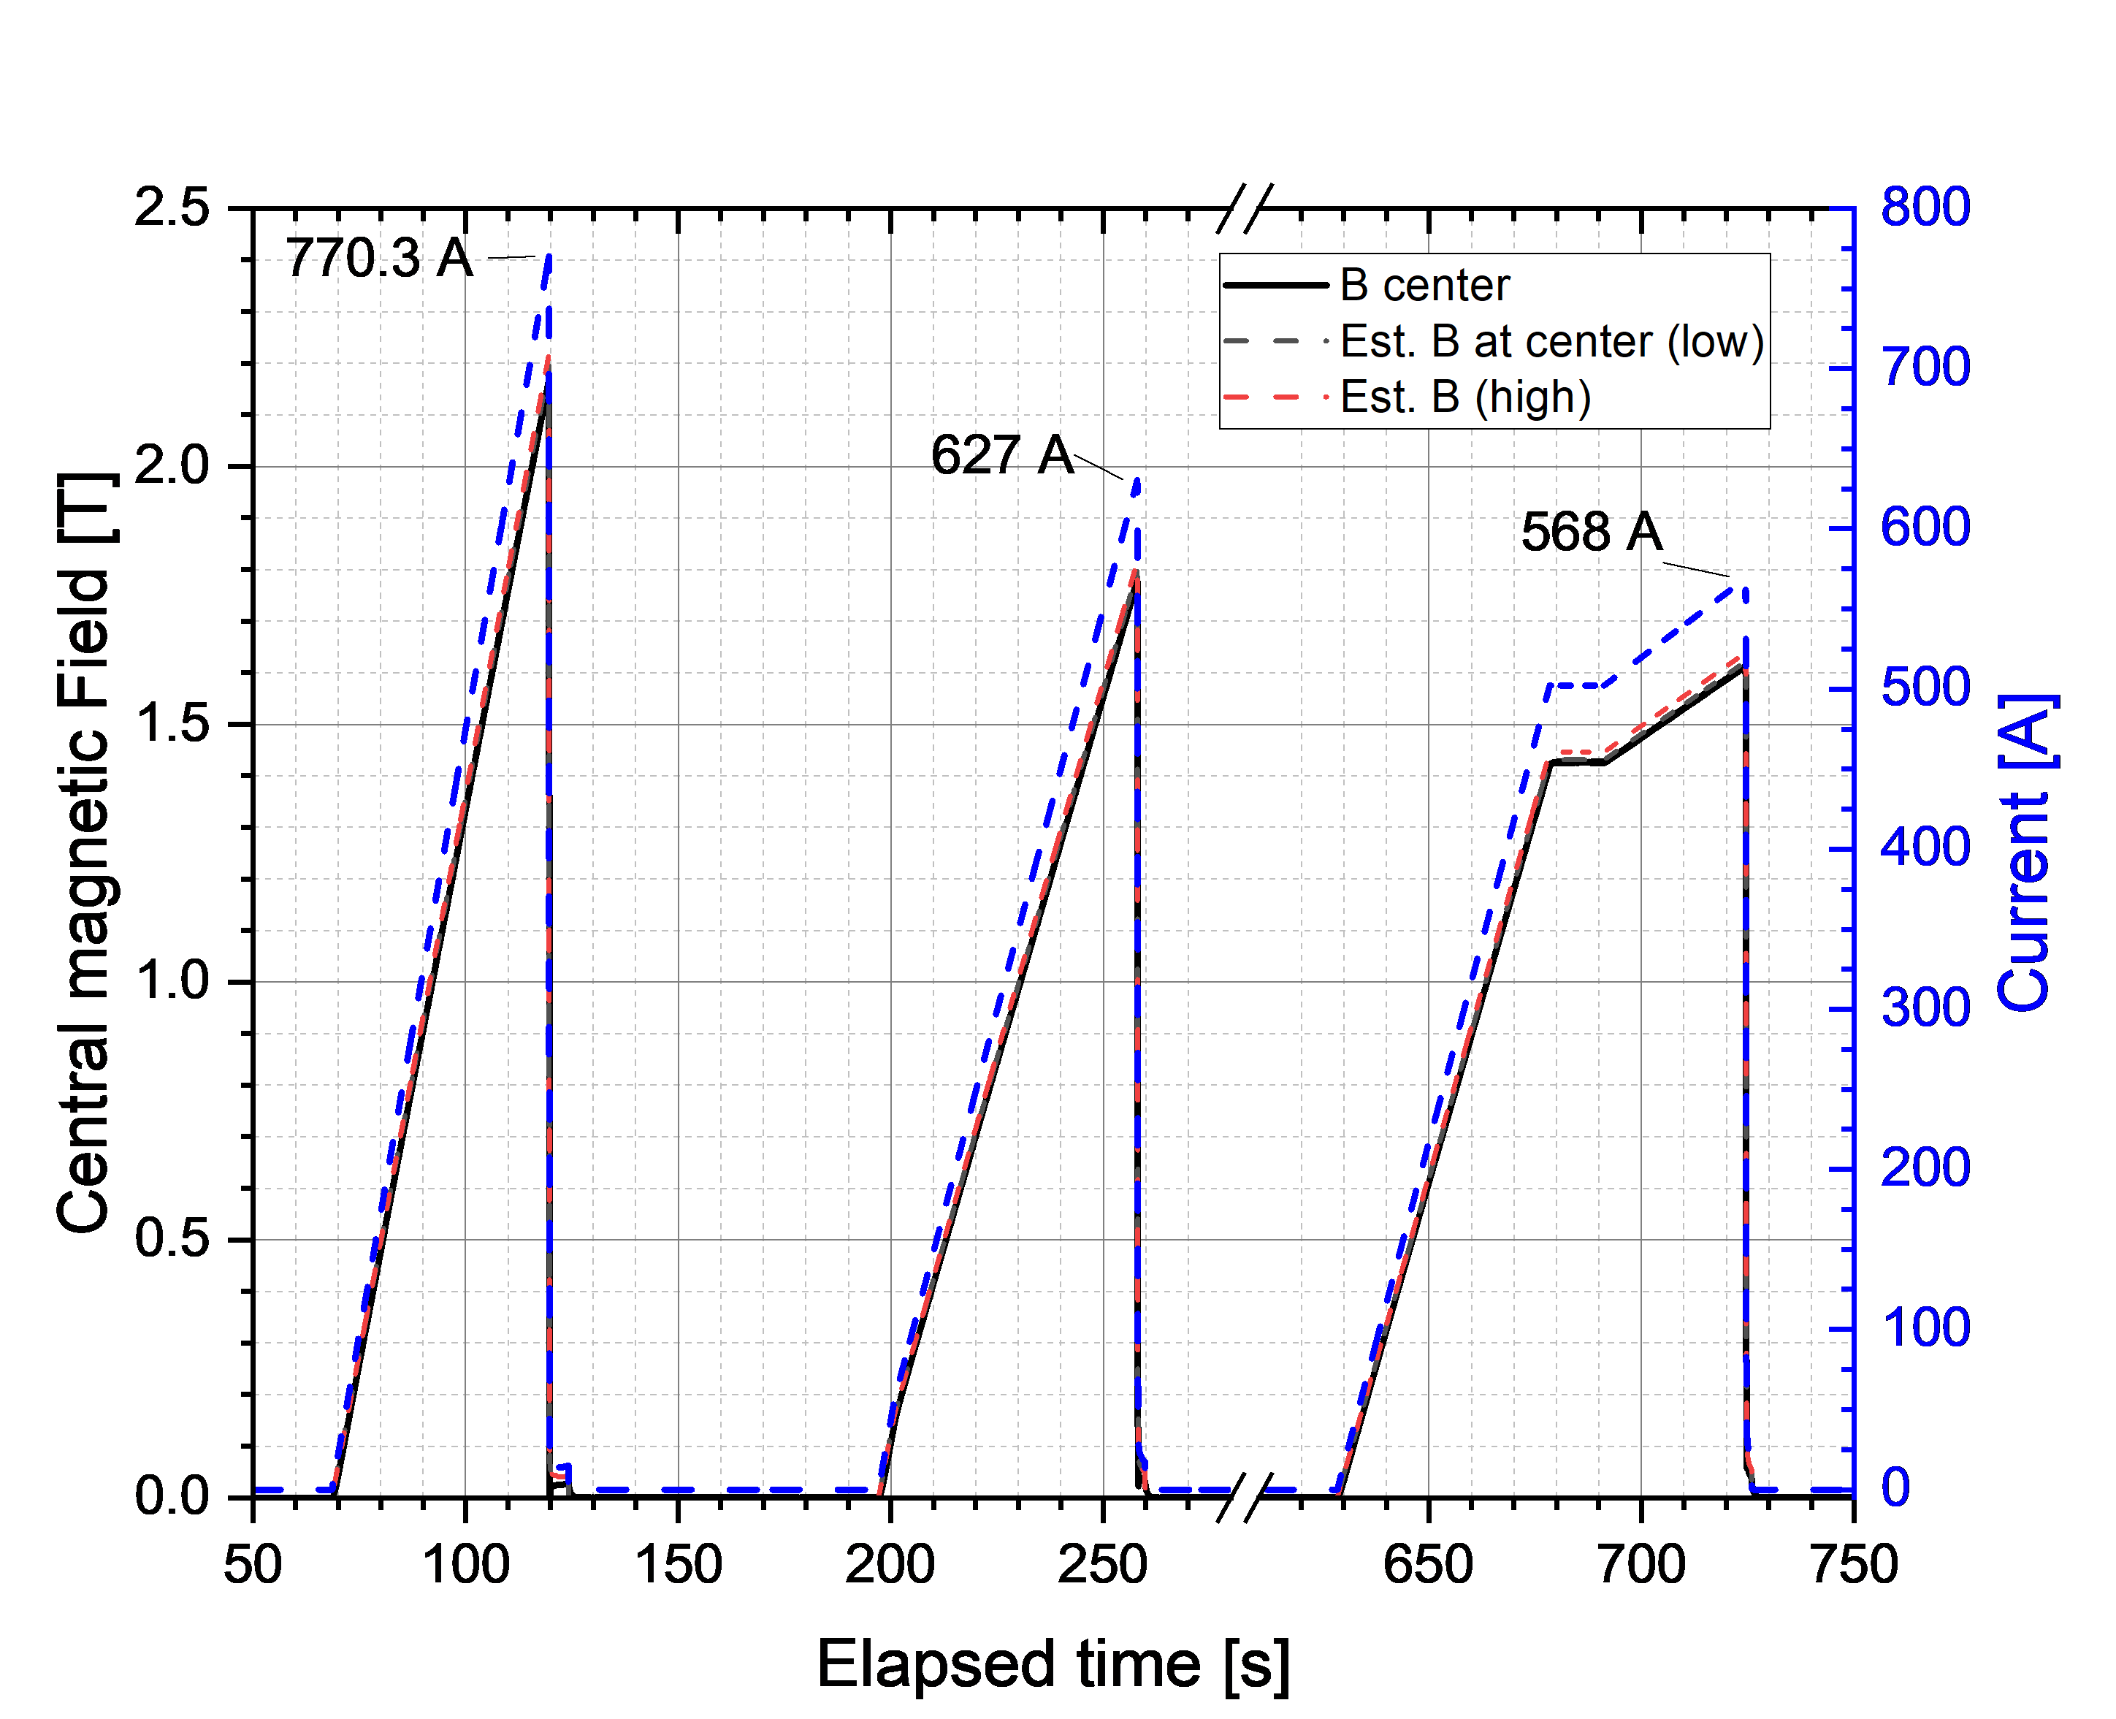
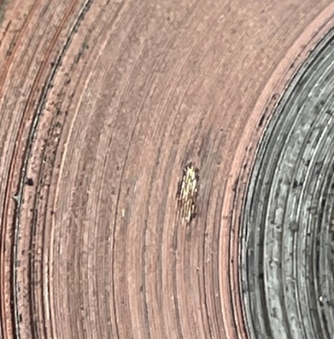
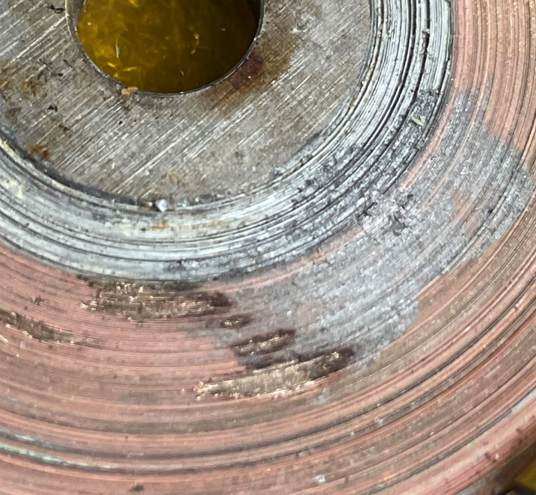

3. Racetrack RT9: main results @4.2 K (CNRS Grenoble)
Quench # 2-3-4
Not the same $\frac{di}{dt}$
Damage
Damage
Not broken but damaged
Still generating above 99% of initial Field up to quench
About 30-40% of turns locally damaged
Still need to understand the cause

Slide 8
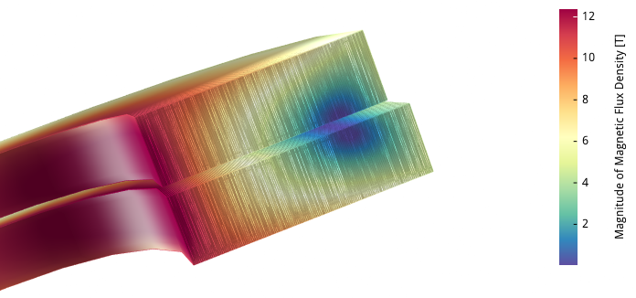
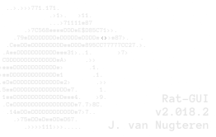
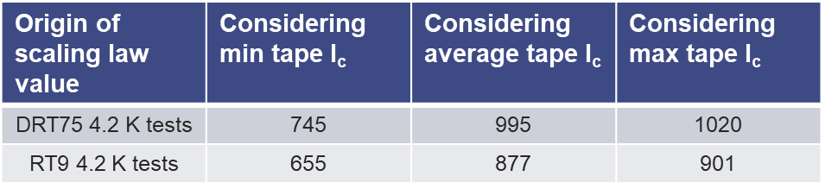
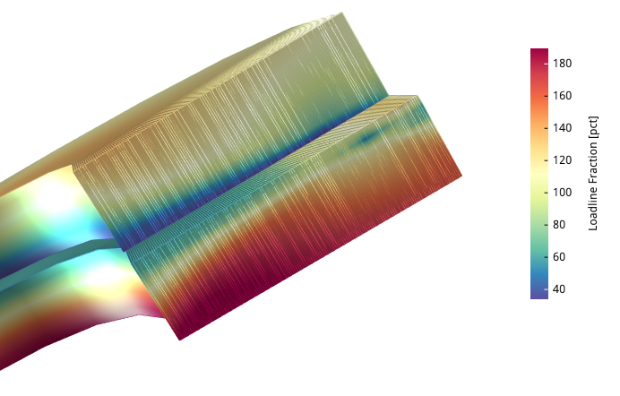
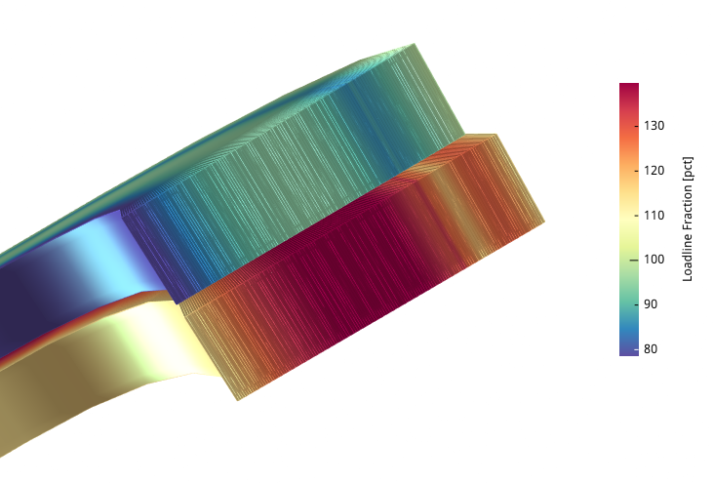
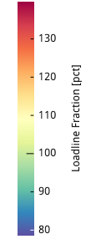
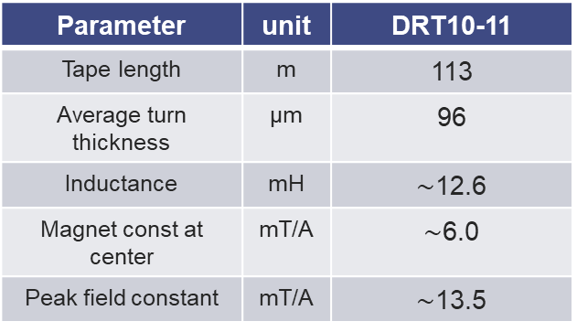
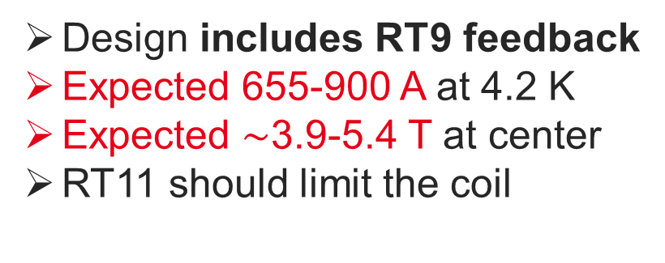
4. Double Racetrack DRT10-11: design
4.2 K DRT10-11 design using Rat-GUI software with Fleiter-Bristow I_{c} fit (no magnetization included)
Parameter | unit | DRT10-11
Tape length | m | 113
Average turn thickness | µm | 96
Inductance | mH | $\sim$12.6
Magnet const at center | mT/A | $\sim$6.0
Peak field constant | mT/A | $\sim$13.5
@ 915 A
135 turns
RT10
I_{c,min} 77 K, SF : 263 A
146 turns
RT11
I_{c,min} 77 K, SF : 238 A
Peak : 12.35 T
Design includes RT9 feedback
Expected 655-900 A at 4.2 K
Expected $\sim$3.9-5.4 T at center
RT11 should limit the coil
@ 915 A
RT10
RT11
Local %LL @ 4.2 K
With Current Sharing %LL @ 4.2 K

Slide 9
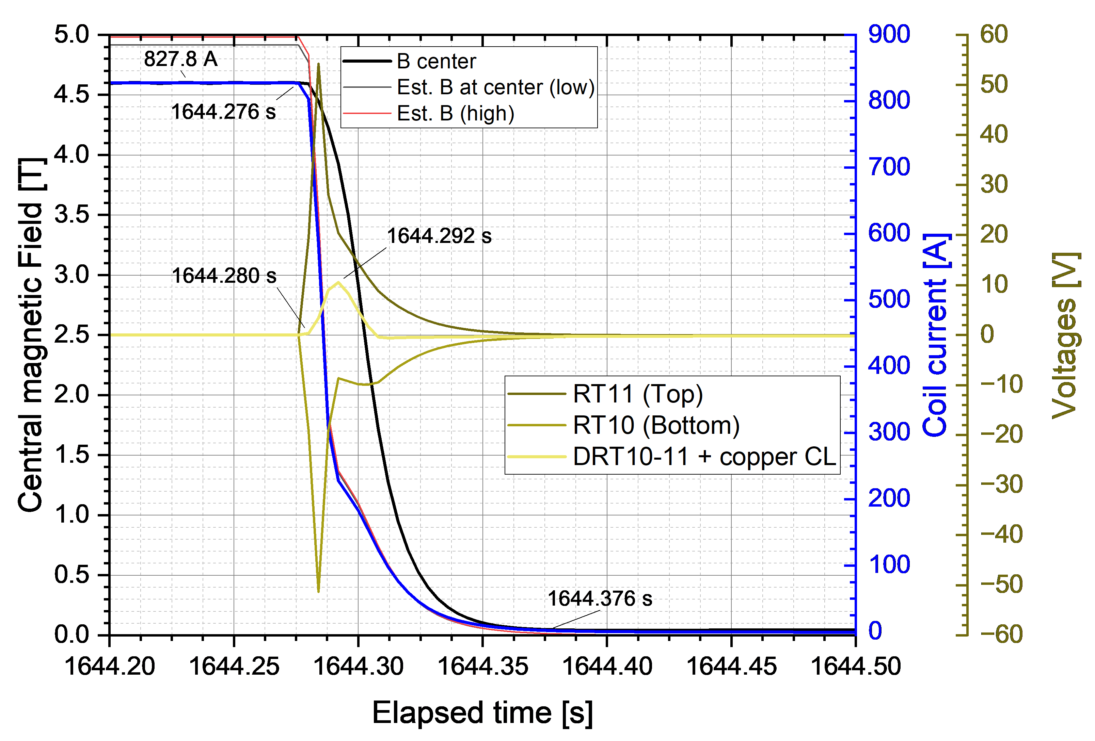
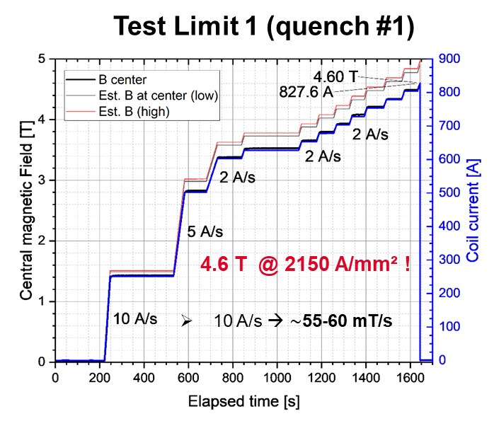
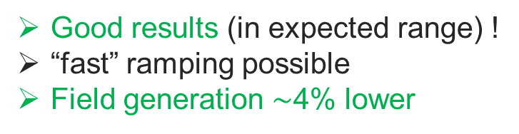
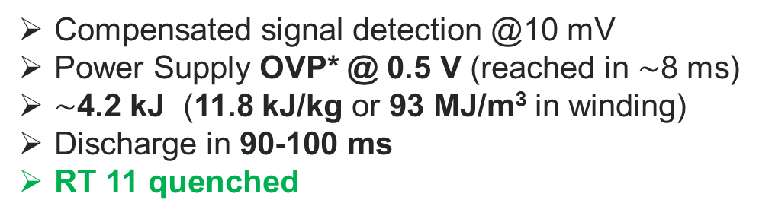
4. Double Racetrack DRT10-11: 4.2 K main results
(10.5 V PS internal protection)
(PS OVP)
Compensated signal detection @10 mV
Power Supply OVP* @ 0.5 V (reached in $\sim$8 ms)
$\sim$4.2 kJ (11.8 kJ/kg or 93 MJ/m³ in winding)
Discharge in 90-100 ms
RT 11 quenched
Good results (in expected range) !
“fast” ramping possible
Field generation $\sim$4% lower
* OVP: Over Voltage Protection

Slide 10
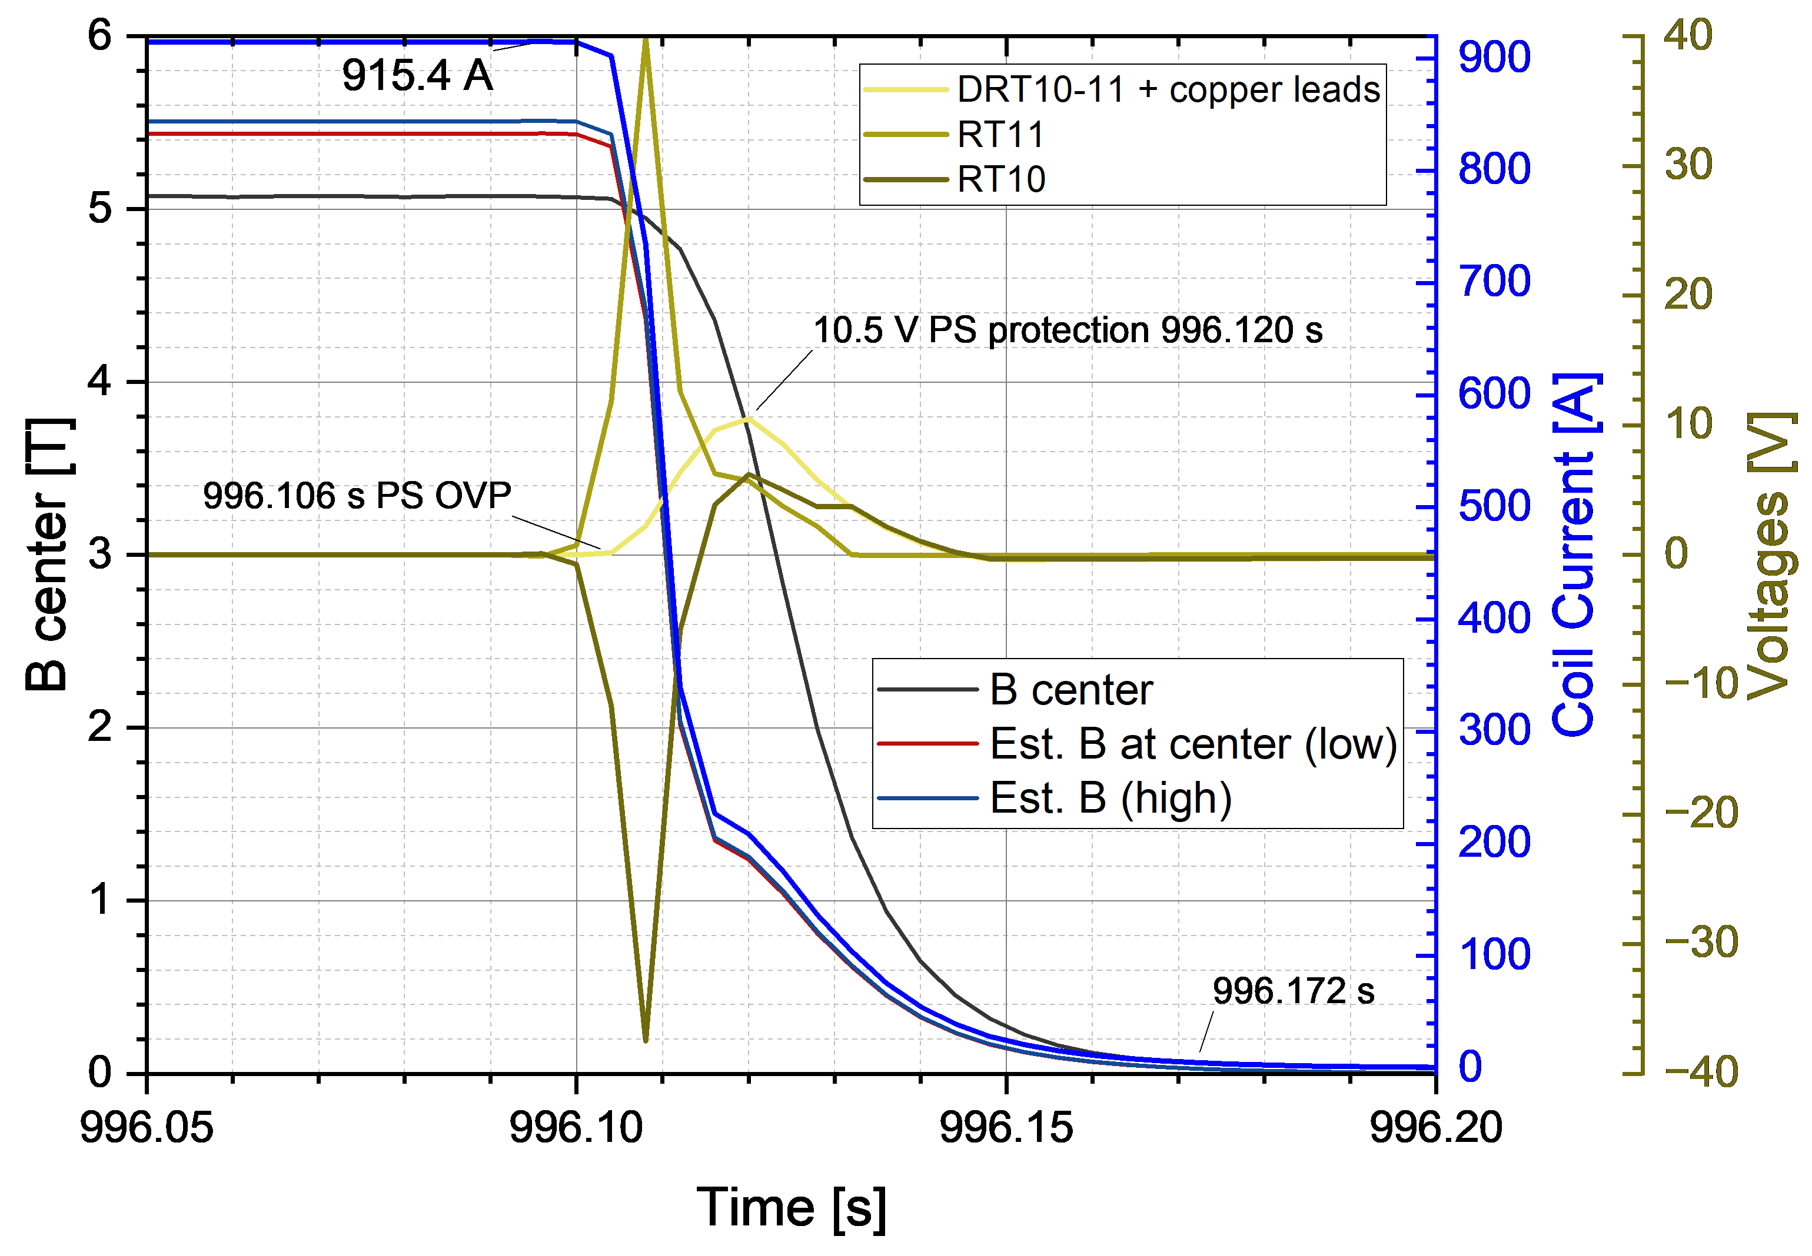
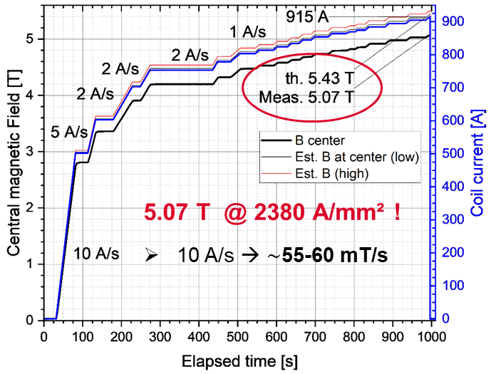
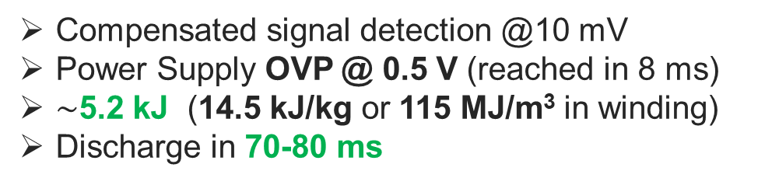
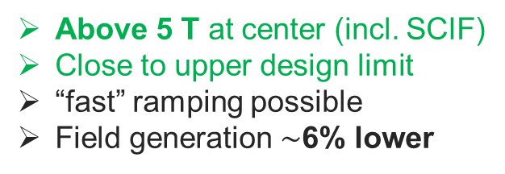
4. Double Racetrack DRT10-11: 4.2 K main results
Quench # 2
Quench # 2
Compensated signal detection @10 mV
Power Supply OVP @ 0.5 V (reached in 8 ms)
$\sim$5.2 kJ (14.5 kJ/kg or 115 MJ/m³ in winding)
Discharge in 70-80 ms
Above 5 T at center (incl. SCIF)
Close to upper design limit
“fast” ramping possible
Field generation $\sim$6% lower

Slide 11
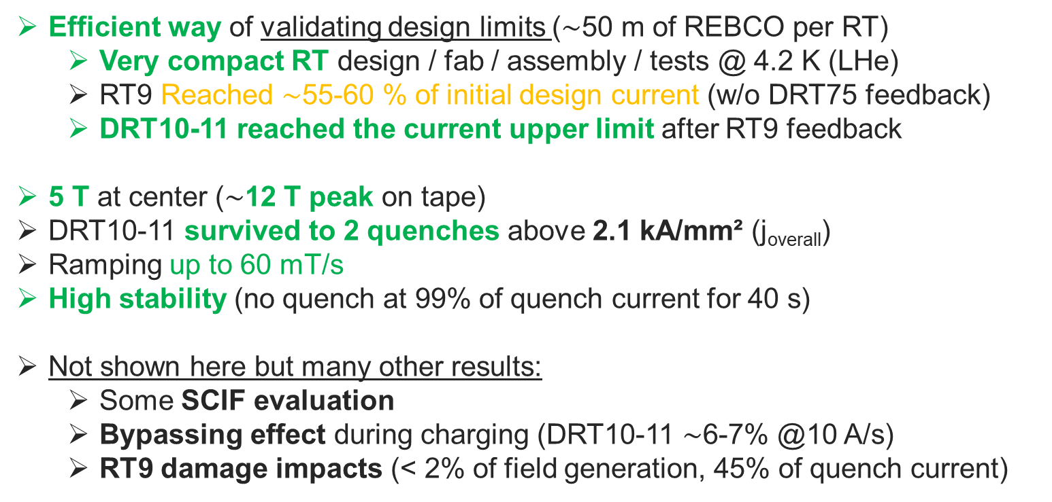
5. Summary and perspectives
Efficient way of validating design limits ($\sim$50 m of REBCO per RT)
  Very compact RT design / fab / assembly / tests @ 4.2 K (LHe)
  RT9 Reached $\sim$55-60 % of initial design current (w/o DRT75 feedback)
  DRT10-11 reached the current upper limit after RT9 feedback
5 T at center ($\sim$12 T peak on tape)
DRT10-11 survived to 2 quenches above 2.1 kA/mm² (j_{overall})
Ramping up to 60 mT/s
High stability (no quench at 99% of quench current for 40 s)
Not shown here but many other results:
  Some SCIF evaluation
  Bypassing effect during charging (DRT10-11 $\sim$6-7% @10 A/s)
  RT9 damage impacts (< 2% of field generation, 45% of quench current)
We now need
To confirm these results with new coils and longer tests
To compare measurements with models

Slide 12
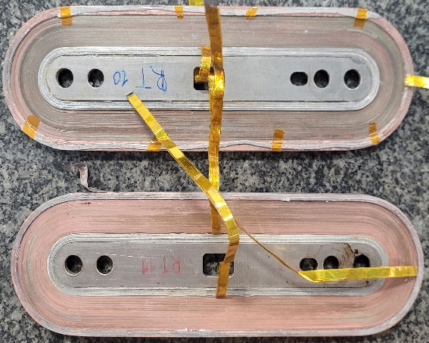
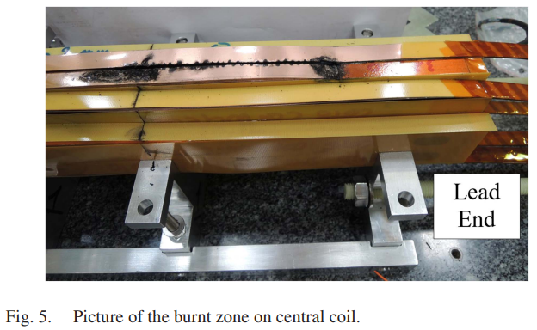
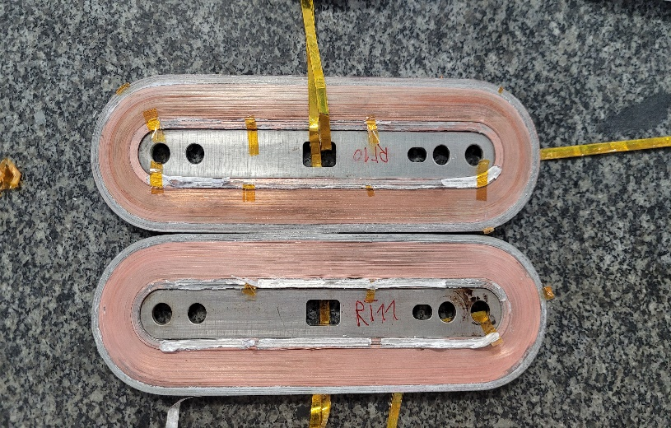
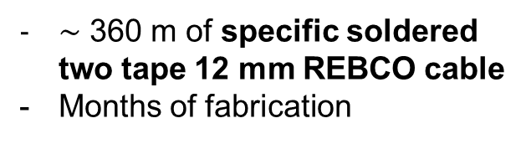
5. Summary and perspectives
One point to remember :
MI DRT10-11
Design limit accuracy of HTS REBCO coil is still complex
Our developments with MI technology allow low risks and fast tests
Breaking a small coil is always better than an expensive magnet
CEA Ins. EUCARD block magnet
MI RT9
2560 A/mm²
2.9 T
1.6 kJ
73 J/cm³
2560 A/mm²
2.9 T
1.6 kJ
73 J/cm³
270 A/mm²
5.4 T
10.4 kJ
2.2 J/cm³
270 A/mm²
5.4 T
10.4 kJ
2.2 J/cm³
2380 A/mm²
5.1 T
5.2 kJ
115 J/cm³
2380 A/mm²
5.1 T
5.2 kJ
115 J/cm³
2025
2016
54 m of 4 mm-wide REBCO tape
3 days of fabrication
Damaged
2025
$\sim$ 360 m of specific soldered two tape 12 mm REBCO cable
Months of fabrication
113 m of 4mm-wide REBCO tape
6 days of fabrication
Step by step mitigated the risks
BUT high energy is the target !
Damaged
M. Durante et al, doi: 10.1109/TASC.2024.3356499
Not damaged

Slide 13





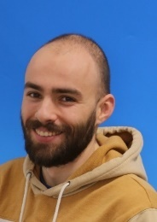





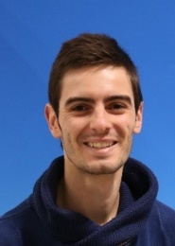

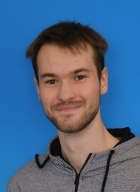
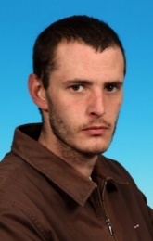
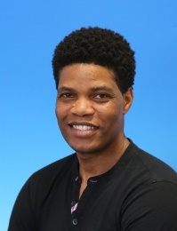

Thank you for your attention
T. Lécrevisse
M. Durochat
G. Lenoir
Many thanks to :
CEA HTS team
CNRS Néel Institute colleagues (A. Badel, J. Vialle, P. Tixador)
CNRS LNCMI colleagues (X. Chaud, J. Song)
CERN project team
High Field magnet program for funding part of this work
French National Research Agency for funding the winding machine procurement
T. Barabe
B. Maloeuvre
E. Benoist
C. Genot
A. Caunes
A. Blondelle
S. Somson
E. Pepinter
T. Lécrevisse : thibault.lecrevisse@cea.fr
26/06/2025
13

Slide 14
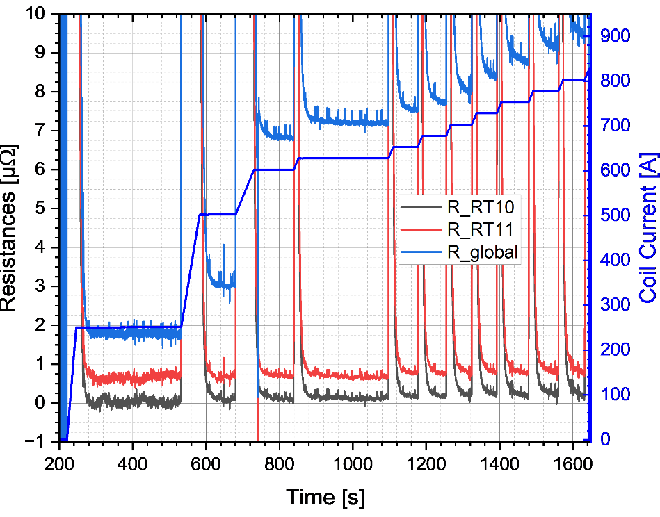
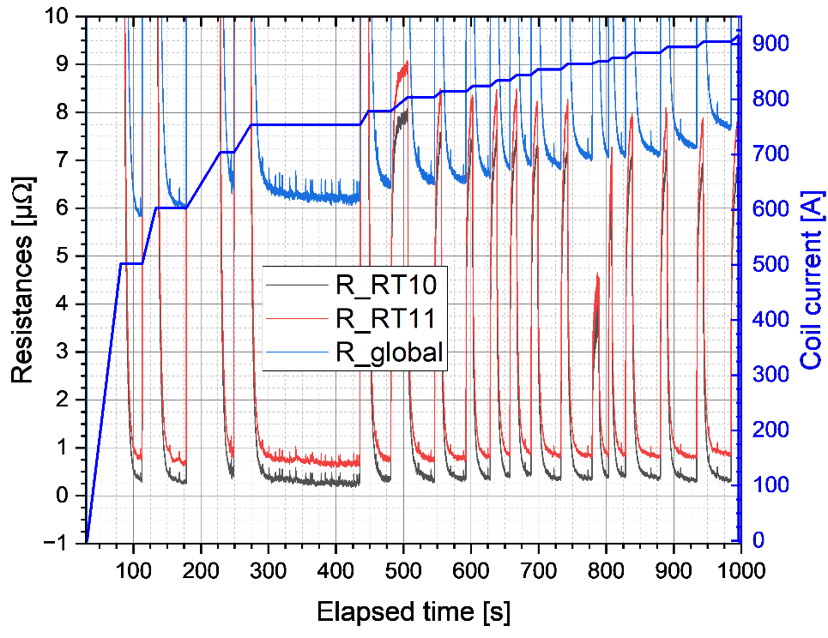
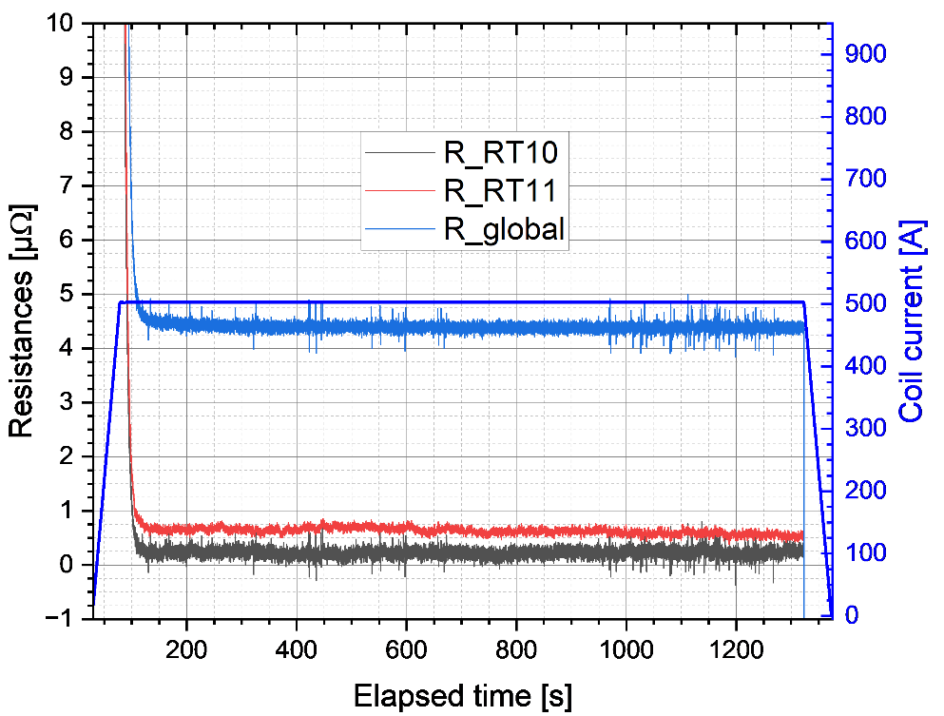
Backup slides
DRT 10-11 Resistances and inductances evolution during tests (chronological tests from left to right)
Quench # 1
Quench # 2
Long step check
Inductance @ 10 A/s [mH] | RT10 | RT11 | DRT10-11
Calculated | 5.96 | 6.46 | 12.56
Quench #1 | 5.65 | 6.03 | 11.80
Quench #2 | 5.67 | 6.07 | 11.95
Long step | 5.62 | 6.03 | 11.78
No significant change of coils’ resistances
Increase of connections’ resistances @ 500 A after first quench test
No Inductance change in measurement accuracy range @ 10 A/s

Slide 15
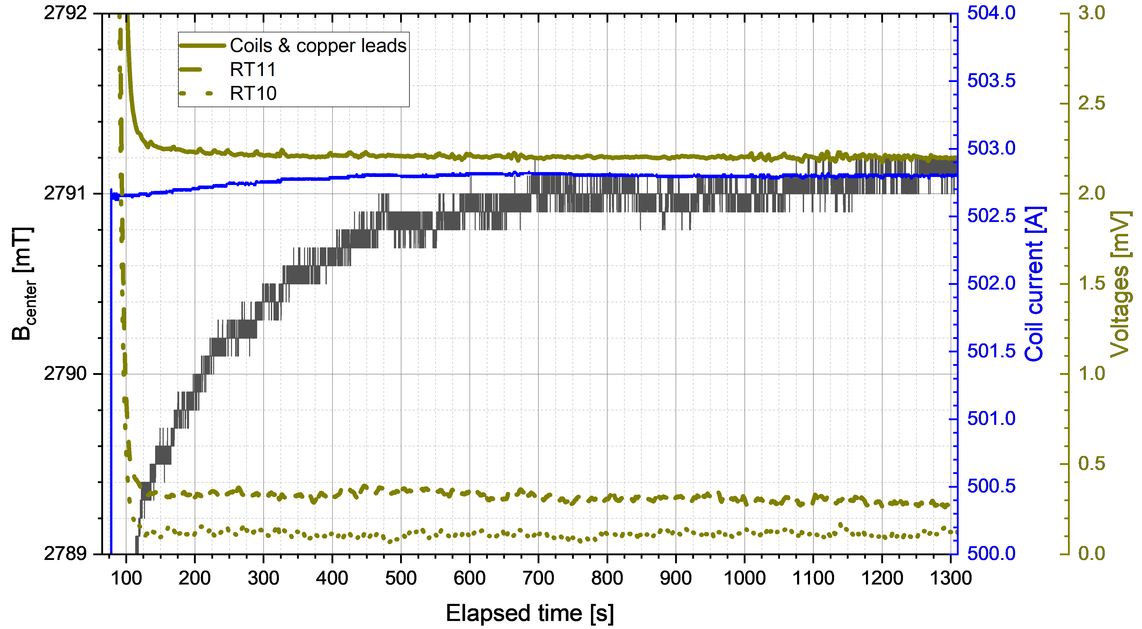
Backup slides
DRTR10-11 : long plateaus at 500 A (B, I, U versus time)
Signals stable after transient
Slight increase of B (SCIF relaxation ?)
100-400 µV @ 500 A on racetracks

