Slide 1
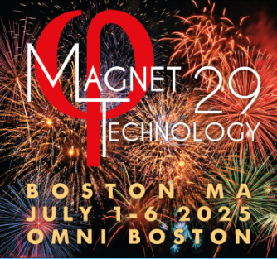

A Pulse Forming Network for Quench Protection of Superconducting Magnets
Fri-Mo-Or6-05 - Quench Detection and Protection I
John Rogers, Kwangming Kim, Iain Dixon, Hongyu Bai
July 4th, 2025
This work was performed at the National High Magnetic Field Laboratory, which is supported by National Science Foundation Cooperative Agreement No. DMR-2131790, DMR-2128556, and the State of Florida

Slide 2
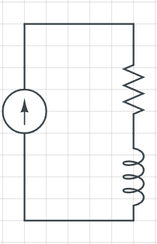

Introduction
Quench protection strategies for SC magnets:
Active Protection (inserting energy into magnet to actively drive volumetric quench)
Quench Heaters
CLIQ / FLIQ
SC Magnet

Slide 3
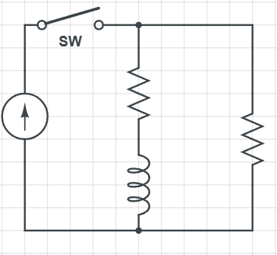
Introduction
Quench protection strategies for SC magnets:
Active Protection (inserting energy into magnet to actively drive volumetric quench)
Quench Heaters
CLIQ / FLIQ
Passive Protection (removing energy from the magnet using passive electrical devices)
Dump Resistor(s)
Inductively Coupled Dump Coils / Quench Backs
SC Magnet

Slide 4

Introduction
Quench protection strategies for SC magnets:
Active Protection (inserting energy into magnet to actively drive volumetric quench)
Quench Heaters
CLIQ / FLIQ
Passive Protection (removing energy from the magnet using passive electrical devices)
Dump Resistor(s)
Inductively Coupled Dump Coils / Quench Backs
Key question for active protection strategies:
What is the energy source?

Slide 5
Typical Energy Sources
Typical energy sources for active quench protection systems:

Slide 6
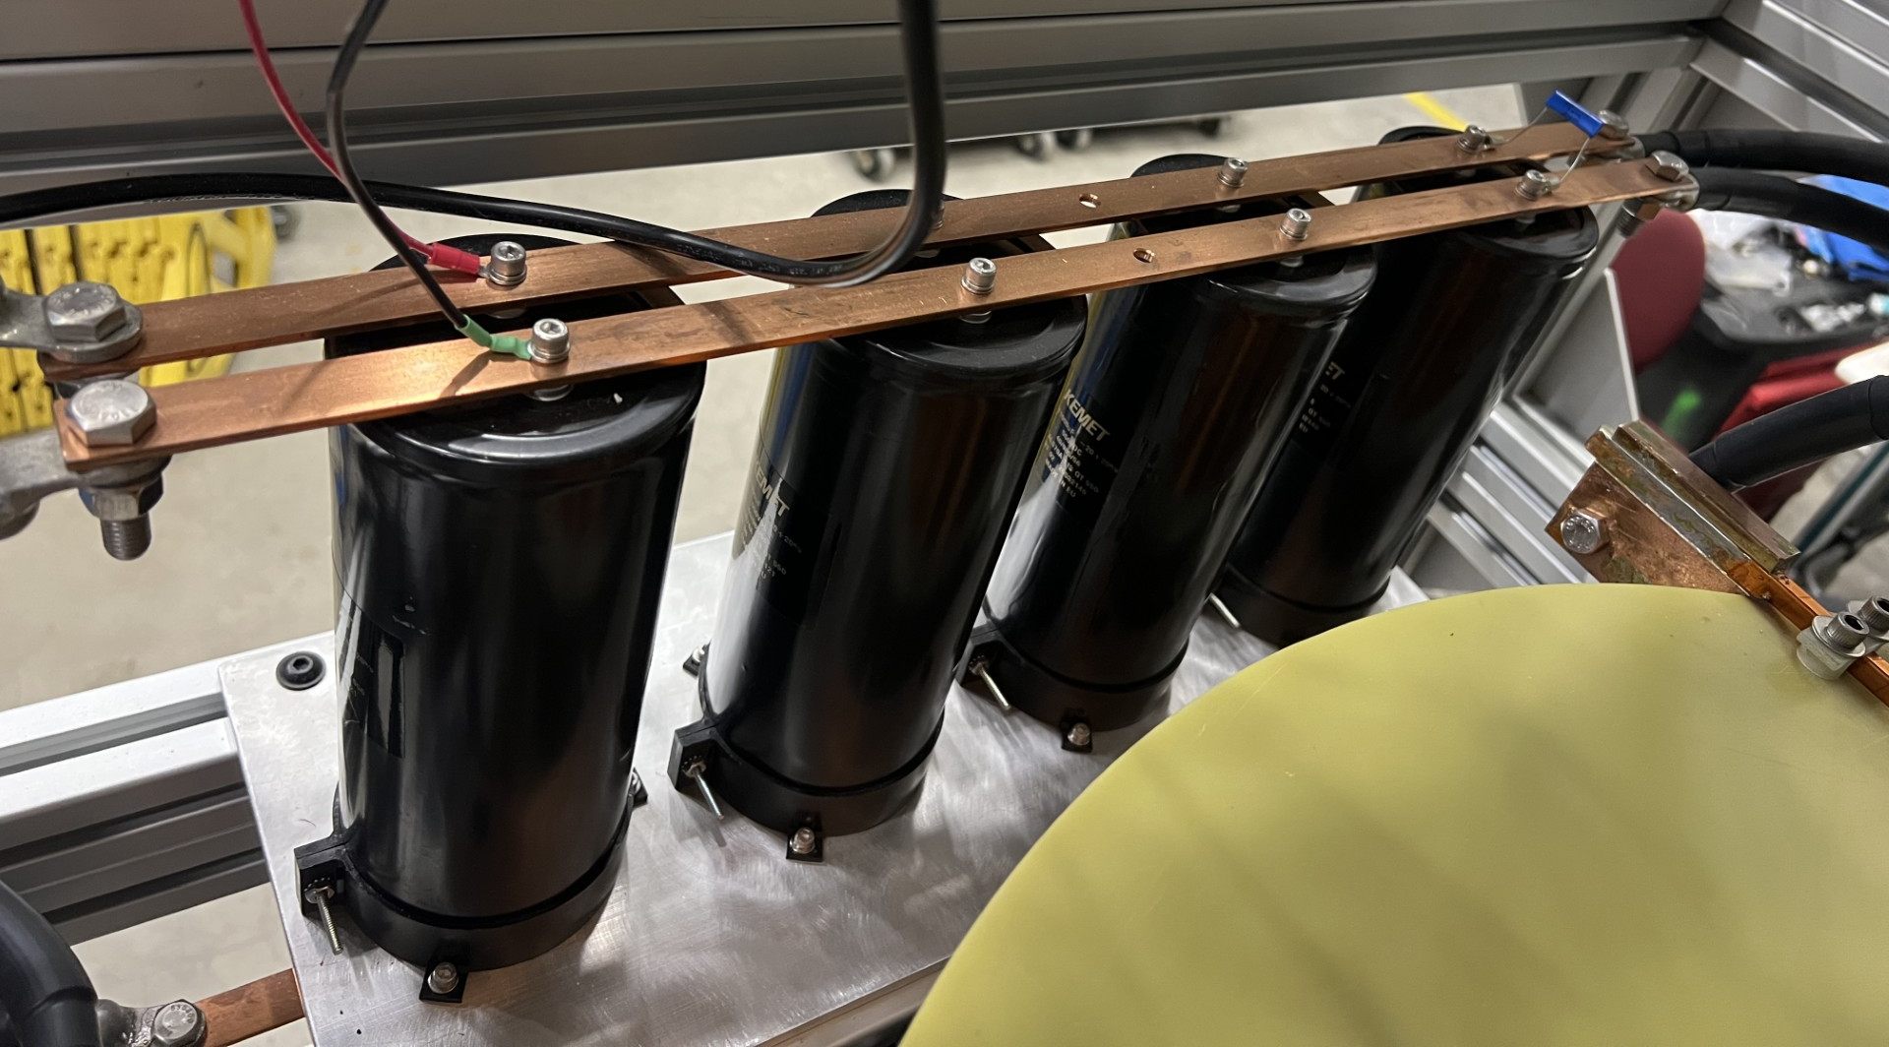
Typical Energy Sources
Typical energy sources for active quench protection systems:
Capacitor banks
Pro – deliver energy very quickly, ~instant rise time
Pro – only charged when in use
Con – exponential voltage/current decay profile
Con – large initial voltage/current
Bank of 4 capacitors in parallel

Slide 7
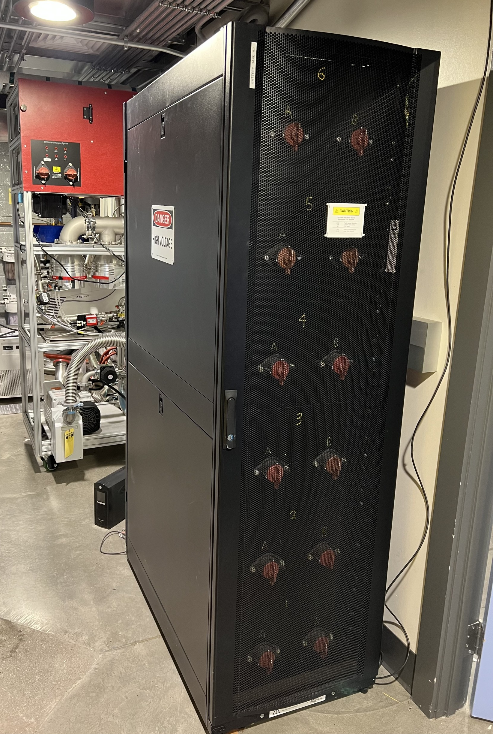
Typical Energy Sources
Typical energy sources for active quench protection systems:
Capacitor banks
Pro – deliver energy very quickly, ~instant rise time
Pro – only charged when in use
Con – exponential voltage/current decay profile
Con – large initial voltage/current
Battery banks
Pro – delivers a square, predictable voltage pulse
Con – must always stay charged (potentially volatile)
Con – can only deliver a small fraction of total stored energy
Con – must be switched on and off
32 T battery bank energy source

Slide 8
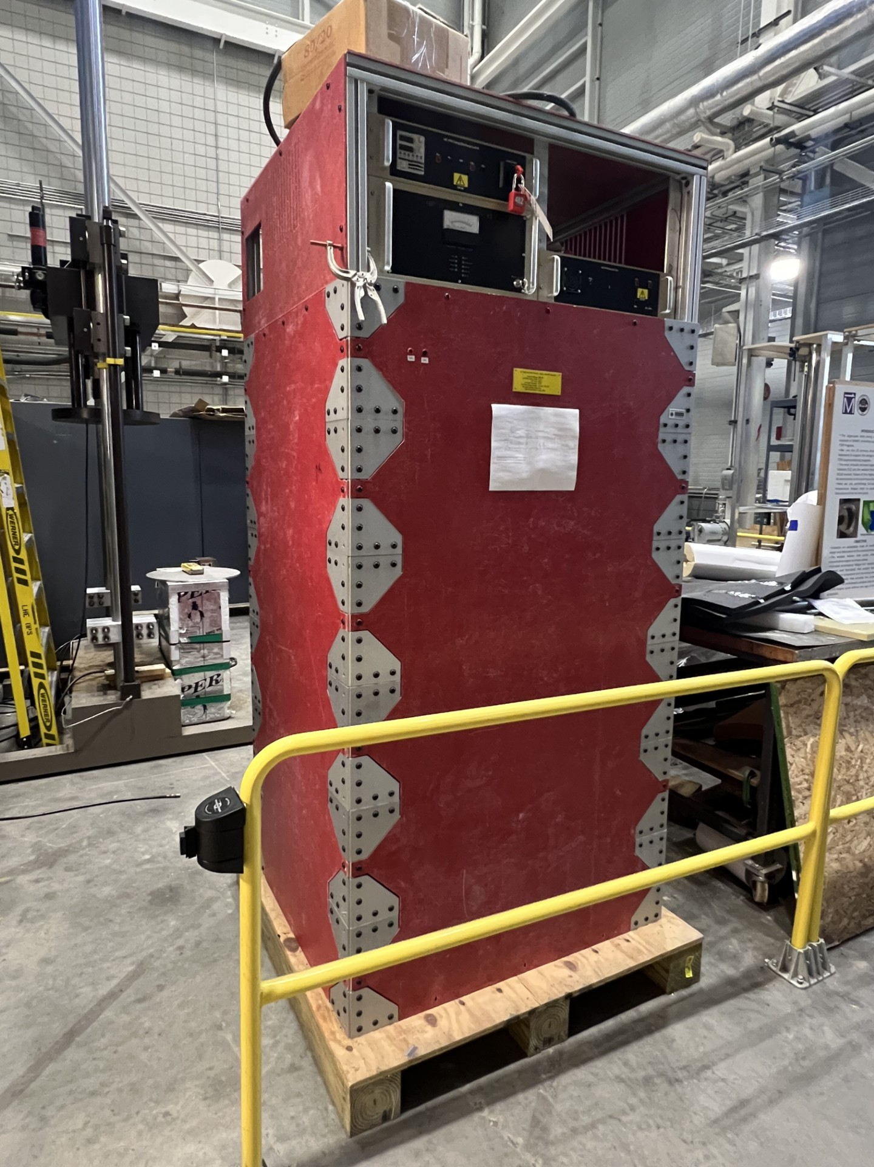
Typical Energy Sources
Typical energy sources for active quench protection systems:
Capacitor banks
Pro – deliver energy very quickly, ~instant rise time
Pro – only charged when in use
Con – exponential voltage/current decay profile
Con – large initial voltage/current
Battery banks
Pro – delivers a square, predictable voltage pulse
Con – must always stay charged (potentially volatile)
Con – can only deliver a small fraction of total stored energy
Con – must be switched on and off
Pulse forming networks (PFN)
Pro – delivers a somewhat square voltage/current pulse
Pro – only charged when in use (capacitors store the energy)
Pro – no large spike in initial voltage/current
Con – addition of inductors increases size and cost
Con – scalability issues (more on this later)
Con – slow rise time
Mysterious red box containing the test coil series PFN…what could be inside?

Slide 9
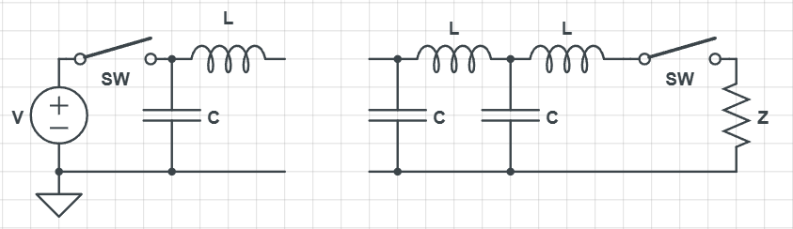
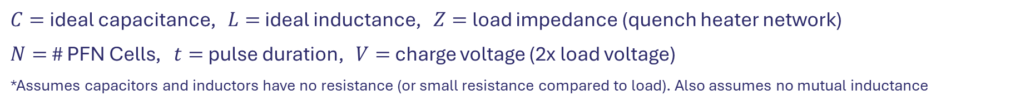





Rayleigh Line PFN
A PFN architecture where (conveniently) all network capacitors/inductors have the same capacitance/inductance
Ideal* Rayleigh Line PFN: $C=\frac{t}{2NZ}$ $L=\frac{Zt}{2N}$
$$…$$
$$n=N$$
$$n=2$$
$$n=1$$
$C=$ ideal capacitance, $L=$ ideal inductance, $Z=$ load impedance (quench heater network)
$N=$ # PFN Cells, $t=$ pulse duration, $V=$ charge voltage (2x load voltage)
*Assumes capacitors and inductors have no resistance (or small resistance compared to load). Also assumes no mutual inductance

Slide 10
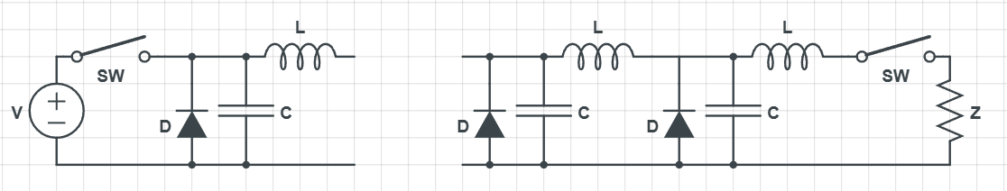




Rayleigh Line PFN
A PFN architecture where (conveniently) all network capacitors/inductors have the same capacitance/inductance
Our PFN designs use aluminum electrolytic capacitors which are not bipolar
Good for high energy applications
Uses diodes to protect from backward charging
$$n=N$$
$$…$$
$$n=2$$
$$n=1$$

Slide 11
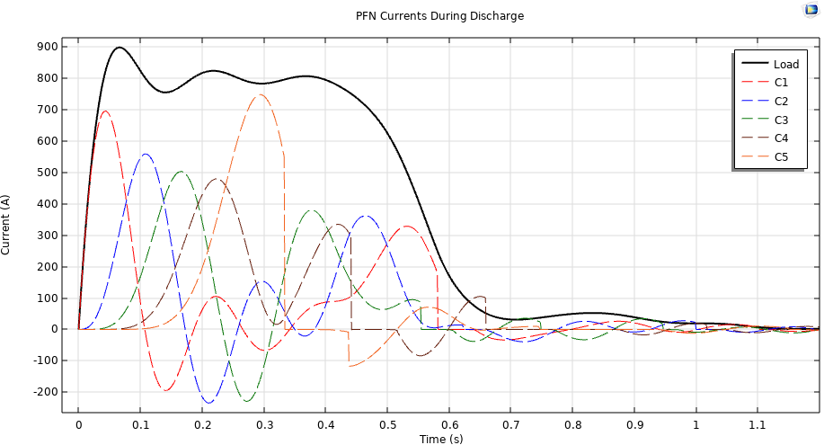
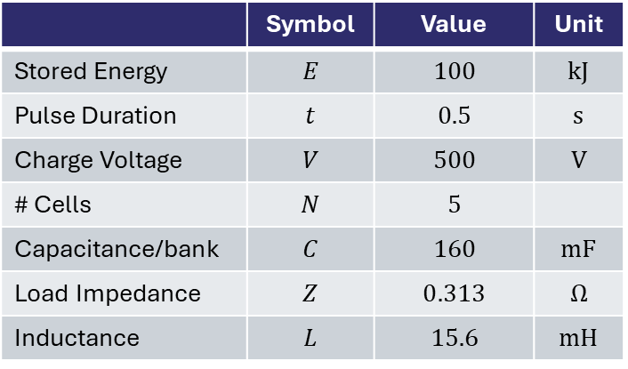
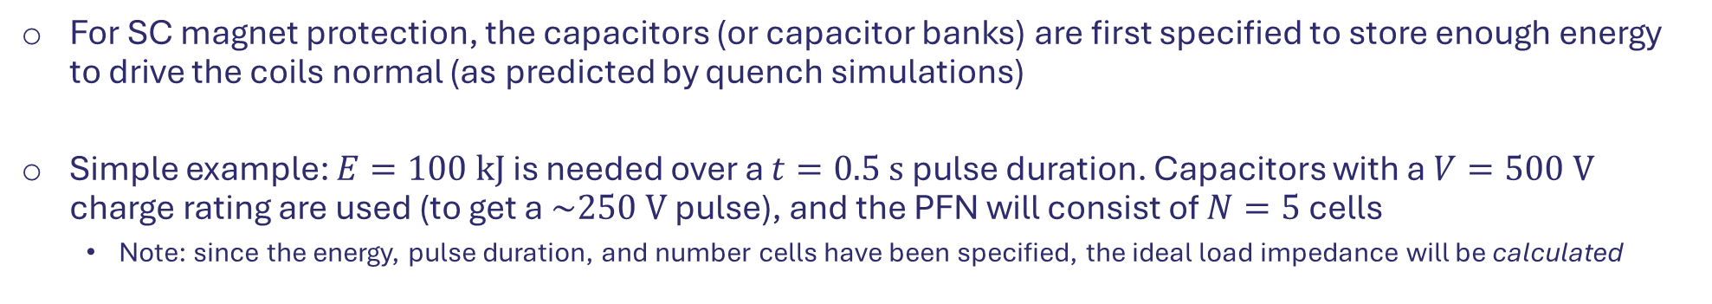
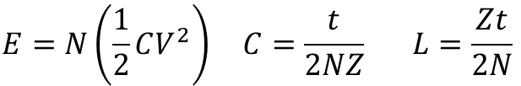
Rayleigh Line PFN: Design Strategy
For SC magnet protection, the capacitors (or capacitor banks) are first specified to store enough energy to drive the coils normal (as predicted by quench simulations)
Simple example: $E=100 kJ$ is needed over a $t=0.5 s$ pulse duration. Capacitors with a $V=500 V$ charge rating are used (to get a $\sim 250 V$ pulse), and the PFN will consist of $N=5$ cells
Note: since the energy, pulse duration, and number cells have been specified, the ideal load impedance will be calculated
$$E=N\left(\frac{1}{2}CV^{2}\right) C=\frac{t}{2NZ} L=\frac{Zt}{2N}$$
~66 ms
 | Symbol | Value | Unit
Stored Energy | $$E$$ | $$100$$ | $$kJ$$
Pulse Duration | $$t$$ | $$0.5$$ | $$s$$
Charge Voltage | $$V$$ | $$500$$ | $$V$$
# Cells | $$N$$ | $$5$$
Capacitance/bank | $$C$$ | $$160$$ | $$mF$$
Load Impedance | $$Z$$ | $$0.313$$ | $$Ω$$
Inductance | $$L$$ | $$15.6$$ | $$mH$$

Slide 12
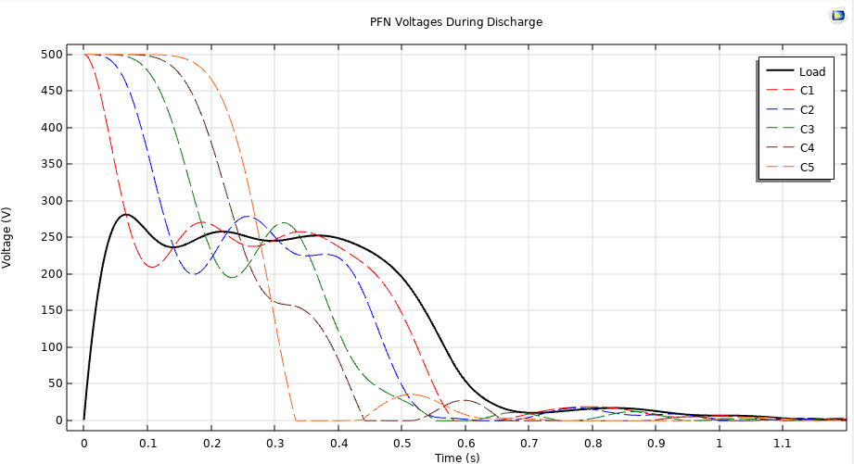
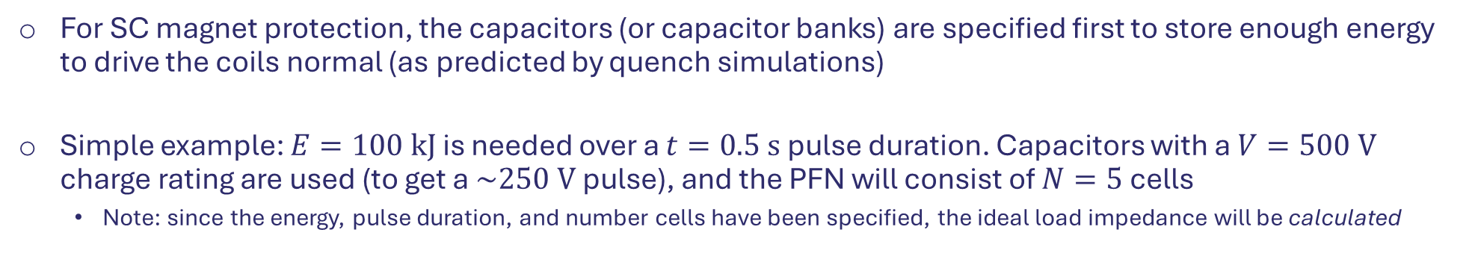
Rayleigh Line PFN: Design Strategy
For SC magnet protection, the capacitors (or capacitor banks) are specified first to store enough energy to drive the coils normal (as predicted by quench simulations)
Simple example: $E=100 kJ$ is needed over a $t=0.5 s$ pulse duration. Capacitors with a $V=500 V$ charge rating are used (to get a $\sim 250 V$ pulse), and the PFN will consist of $N=5$ cells
Note: since the energy, pulse duration, and number cells have been specified, the ideal load impedance will be calculated
$$E=N\left(\frac{1}{2}CV^{2}\right) C=\frac{t}{2NZ} L=\frac{Zt}{2N}$$
 | Symbol | Value | Unit
Stored Energy | $$E$$ | $$100$$ | $$kJ$$
Pulse Duration | $$t$$ | $$0.5$$ | $$s$$
Charge Voltage | $$V$$ | $$500$$ | $$V$$
# Cells | $$N$$ | $$5$$
Capacitance/bank | $$C$$ | $$160$$ | $$mF$$
Load Impedance | $$Z$$ | $$0.313$$ | $$Ω$$
Inductance | $$L$$ | $$15.6$$ | $$mH$$

Slide 13
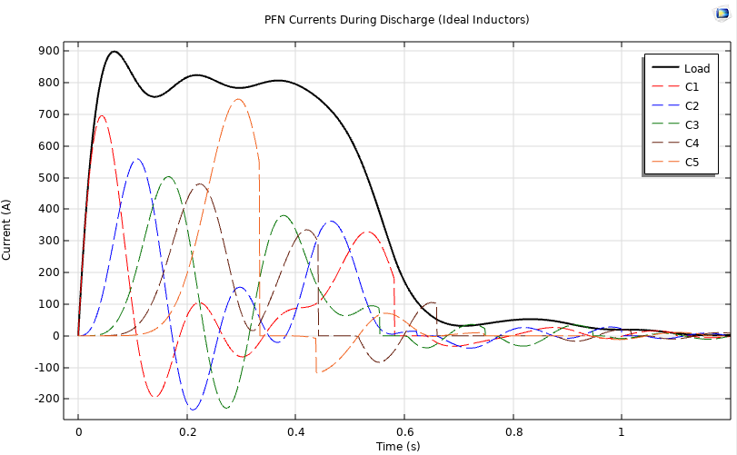
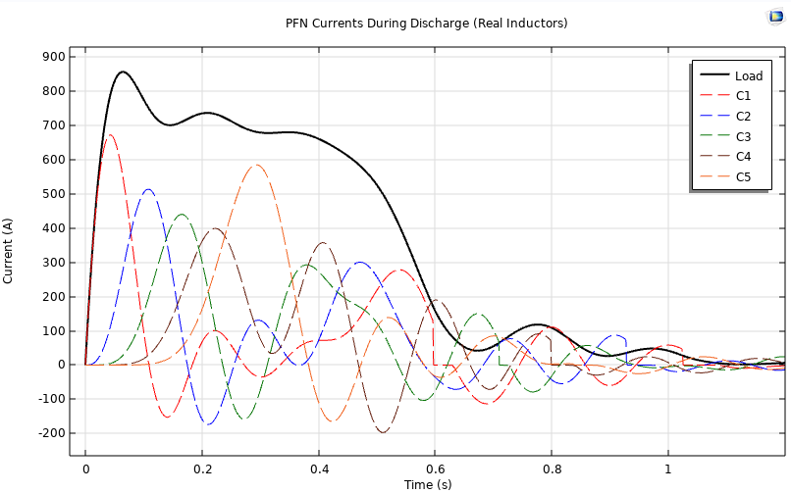
Rayleigh Line PFN: Design Strategy
However, real inductors and capacitors have a non-zero resistance
Banks of capacitors in parallel typically have low net resistance and are ~negligible
Large inductors have significant resistance and change the behavior of the network (and reduce energy delivered to load)
Mutual inductance must also be considered (but is ignored here)
Ideal Inductors
Real Inductors
Stored Energy | 100 | kJ
Load Energy | 100 | kJ
Efficiency | 100%
Stored Energy | 100 | kJ
Load Energy | 79.2 | kJ
Efficiency | 79.2%

Slide 14
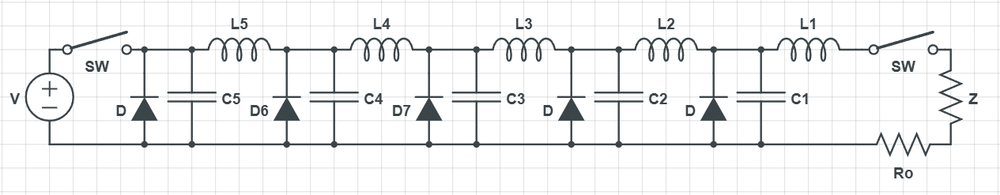
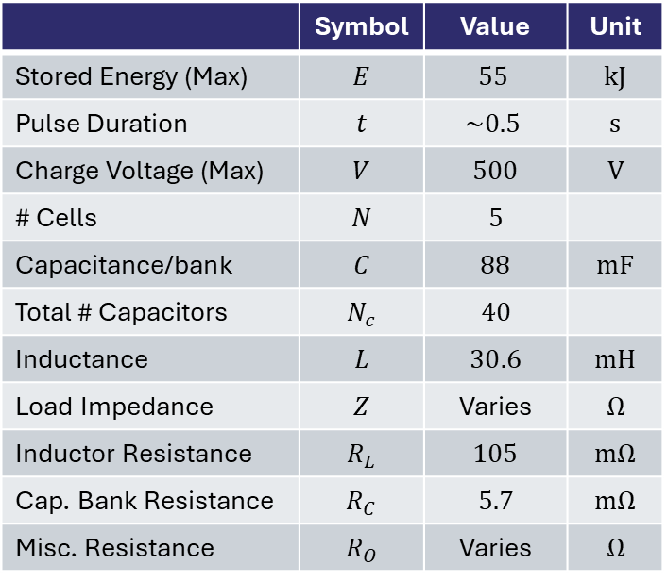
Test Coil Series PFN
NHMFL has tested a series of REBCO pancake-wound coils
TC1, TC2, TC2b, TC2c, LSC
All used a quench heater based active protection system (see Dr. Dharmendra Shukla’s poster, July 5th at 9:30 AM, Ensemble Ballroom!!!)
All used same PFN as the energy source for the protection system (at different charge voltages)
Mutual inductance between all inductors is also considered
PFN designed by Bertram Green, 2021
 | Symbol | Value | Unit
Stored Energy (Max) | $$E$$ | $$55$$ | $$kJ$$
Pulse Duration | $$t$$ | $$\sim 0.5$$ | $$s$$
Charge Voltage (Max) | $$V$$ | $$500$$ | $$V$$
# Cells | $$N$$ | $$5$$
Capacitance/bank | $$C$$ | $88$ | $$mF$$
Total # Capacitors | $$N_{c}$$ | $$40$$
Inductance | $$L$$ | $$30.6$$ | $$mH$$
Load Impedance | $$Z$$ | Varies | $$Ω$$
Inductor Resistance | $$R_{L}$$ | $$105$$ | $$mΩ$$
Cap. Bank Resistance | $$R_{C}$$ | $$5.7$$ | $$mΩ$$
Misc. Resistance | $$R_{O}$$ | Varies | $$Ω$$

Slide 15
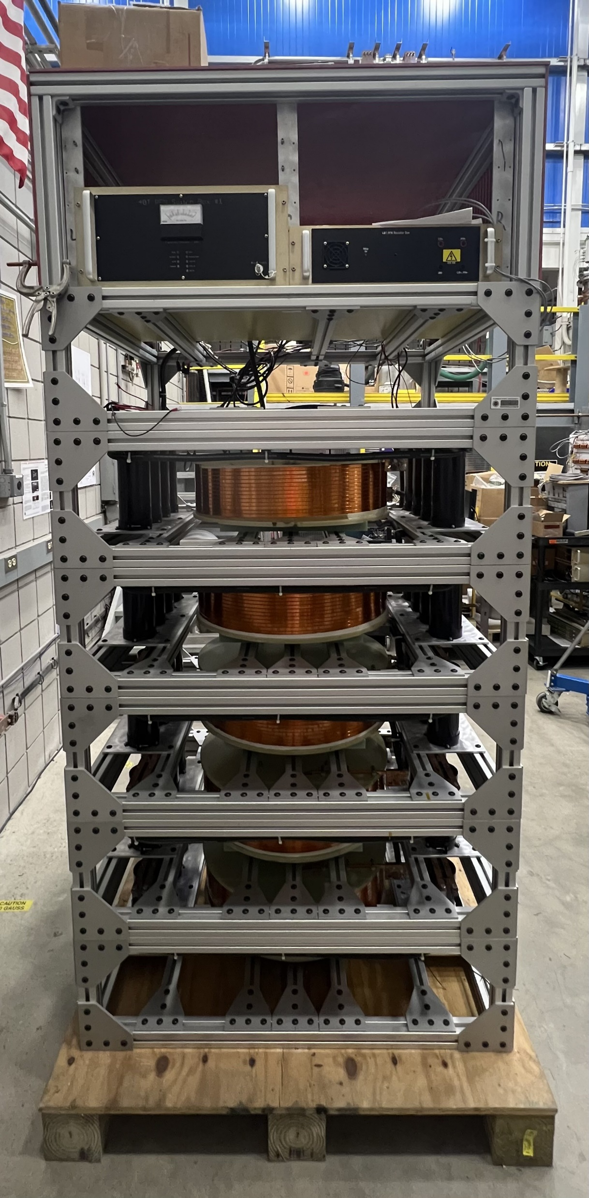
Test Coil Series PFN
NHMFL has tested a series of REBCO pancake-wound coils
TC1, TC2, TC2b, TC2c, LSC
All used a quench heater based active protection system (see Dr. Dharmendra Shukla’s poster, July 5th at 9:30 AM, Ensemble Ballroom!!!)
All used same PFN as the energy source for the protection system (at different charge voltages)
Mutual inductance between all inductors is also considered
PFN designed by Bertram Green, 2021
Cap. Banks
Inductors

Slide 16
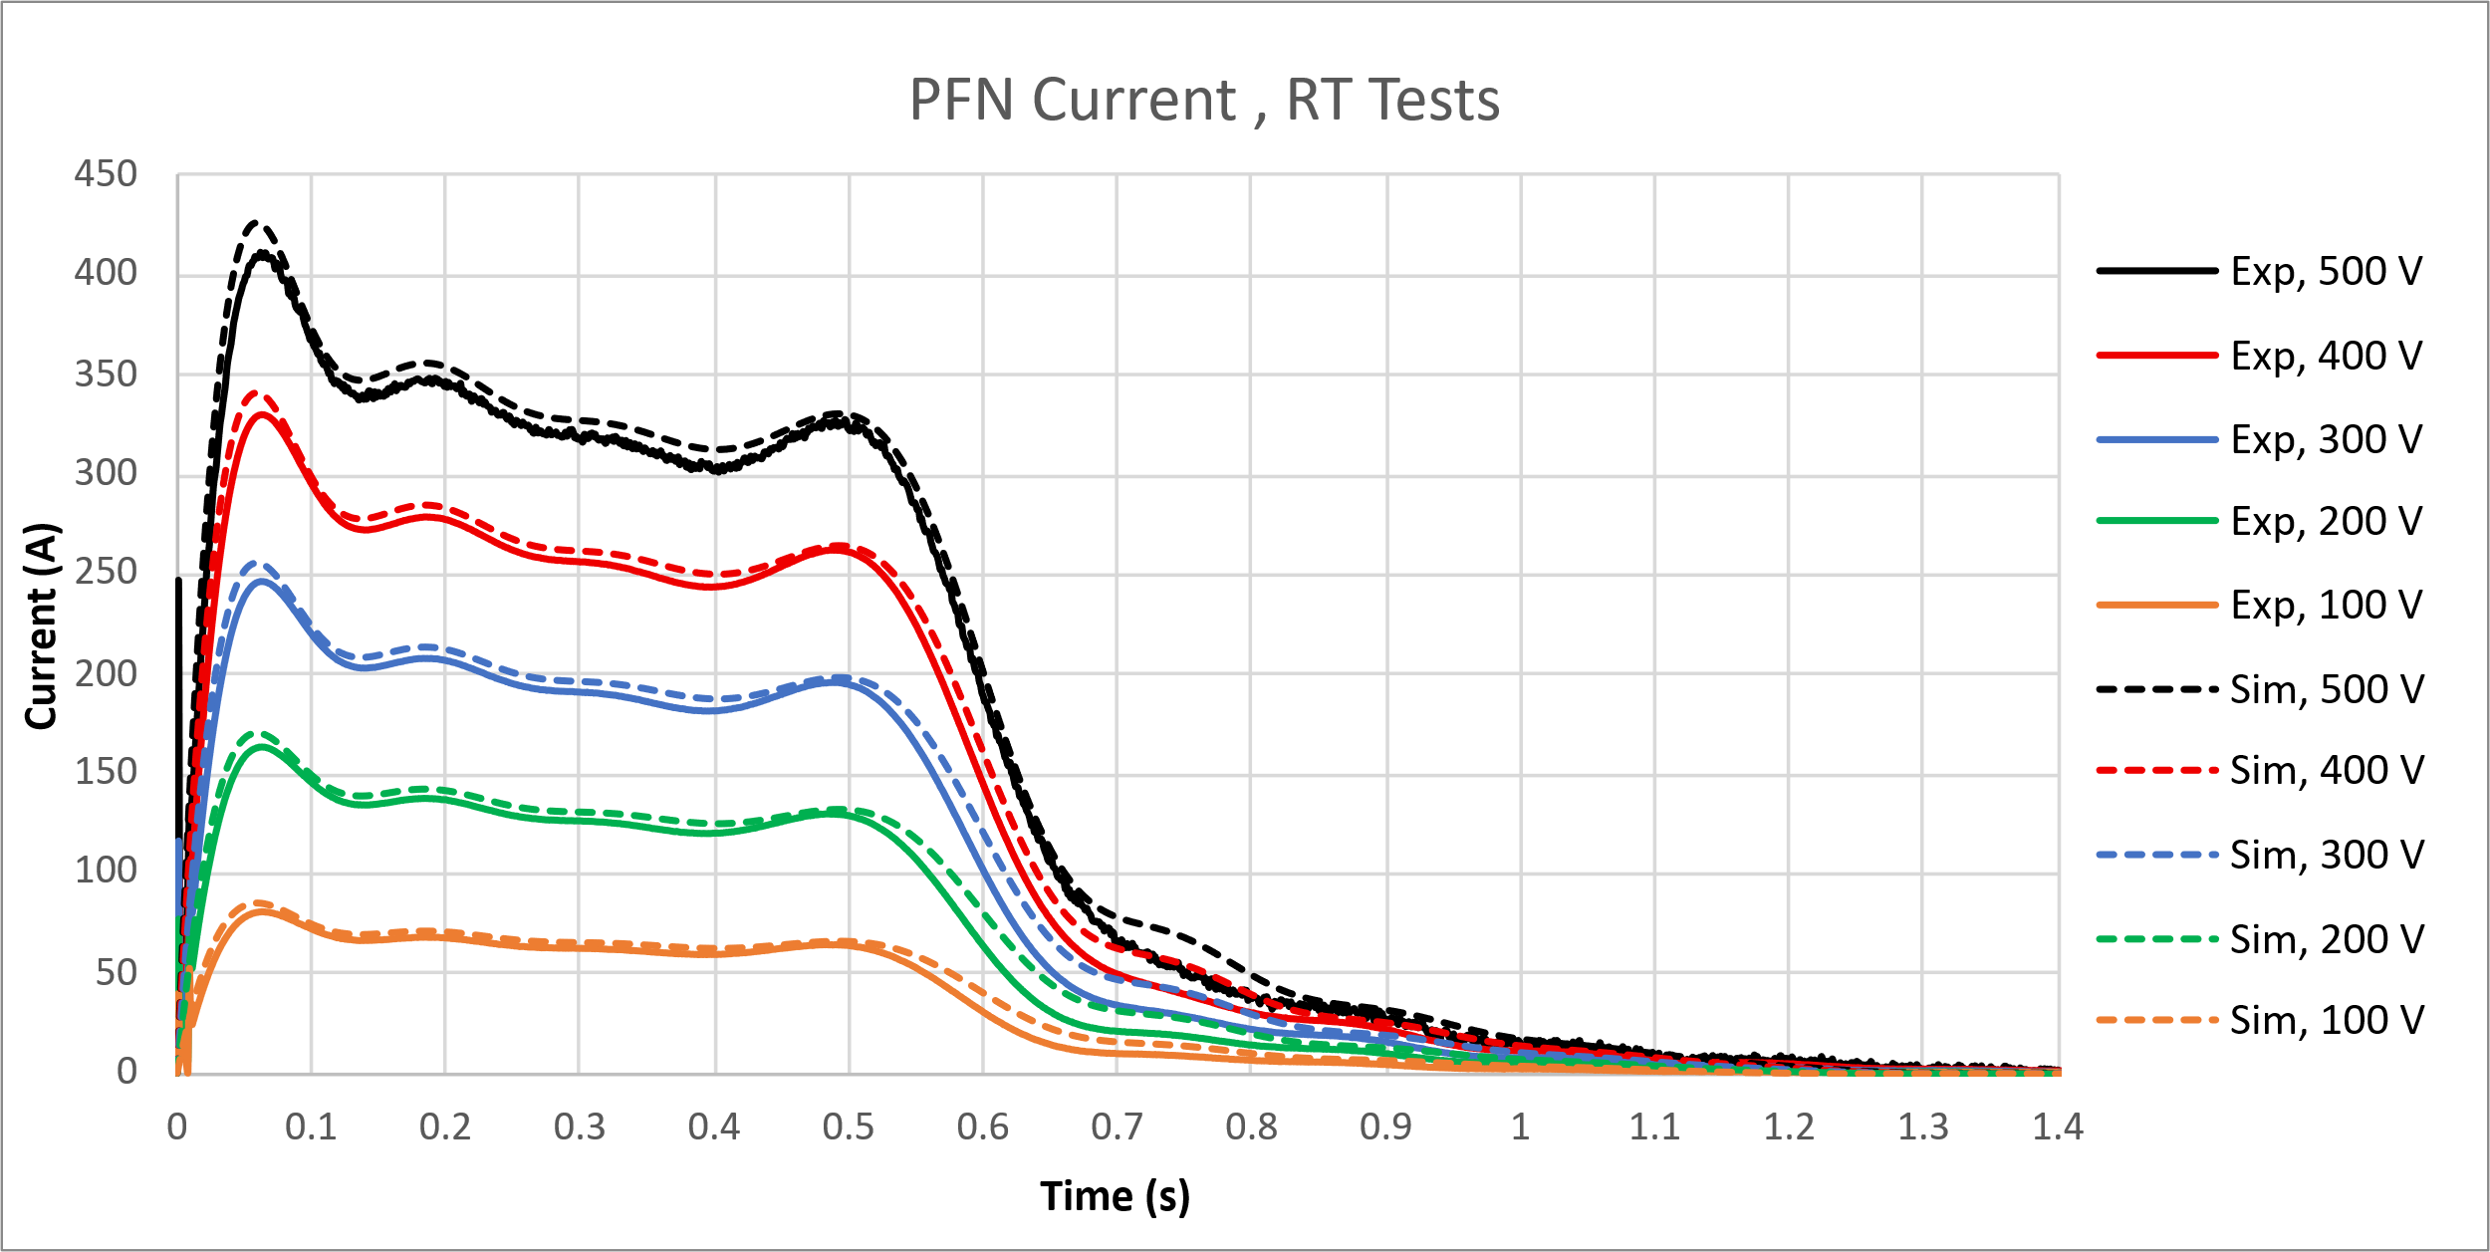
Test Coil Series PFN: Performance
Room temperature testing
$Z=0.44 Ω, R_{O}=0.1 Ω$
~60 ms

Slide 17
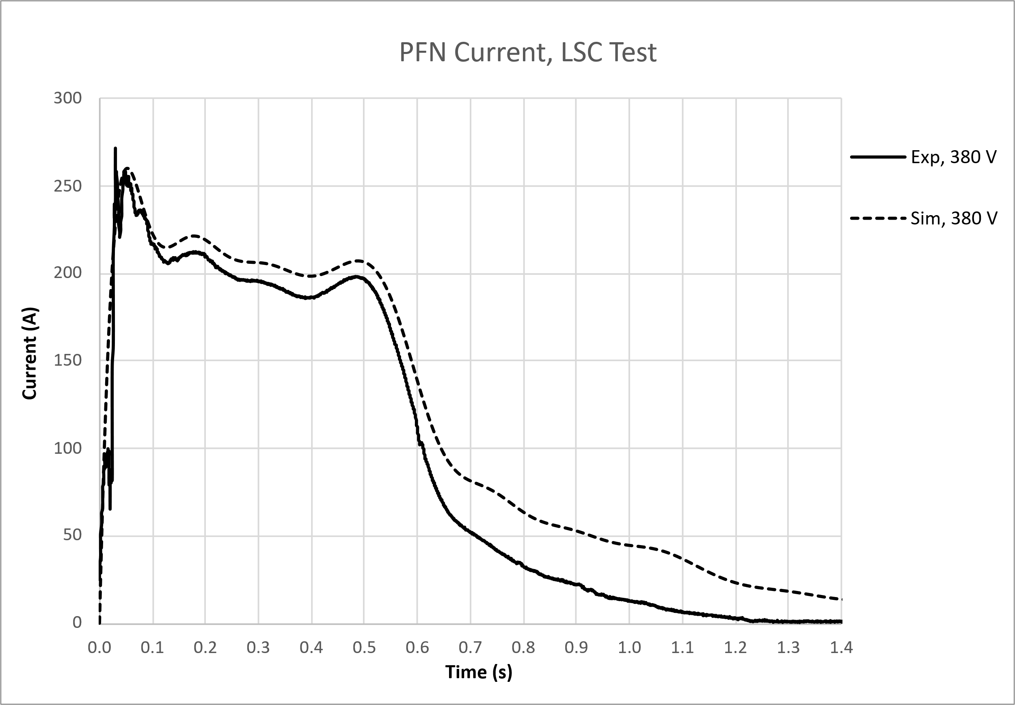
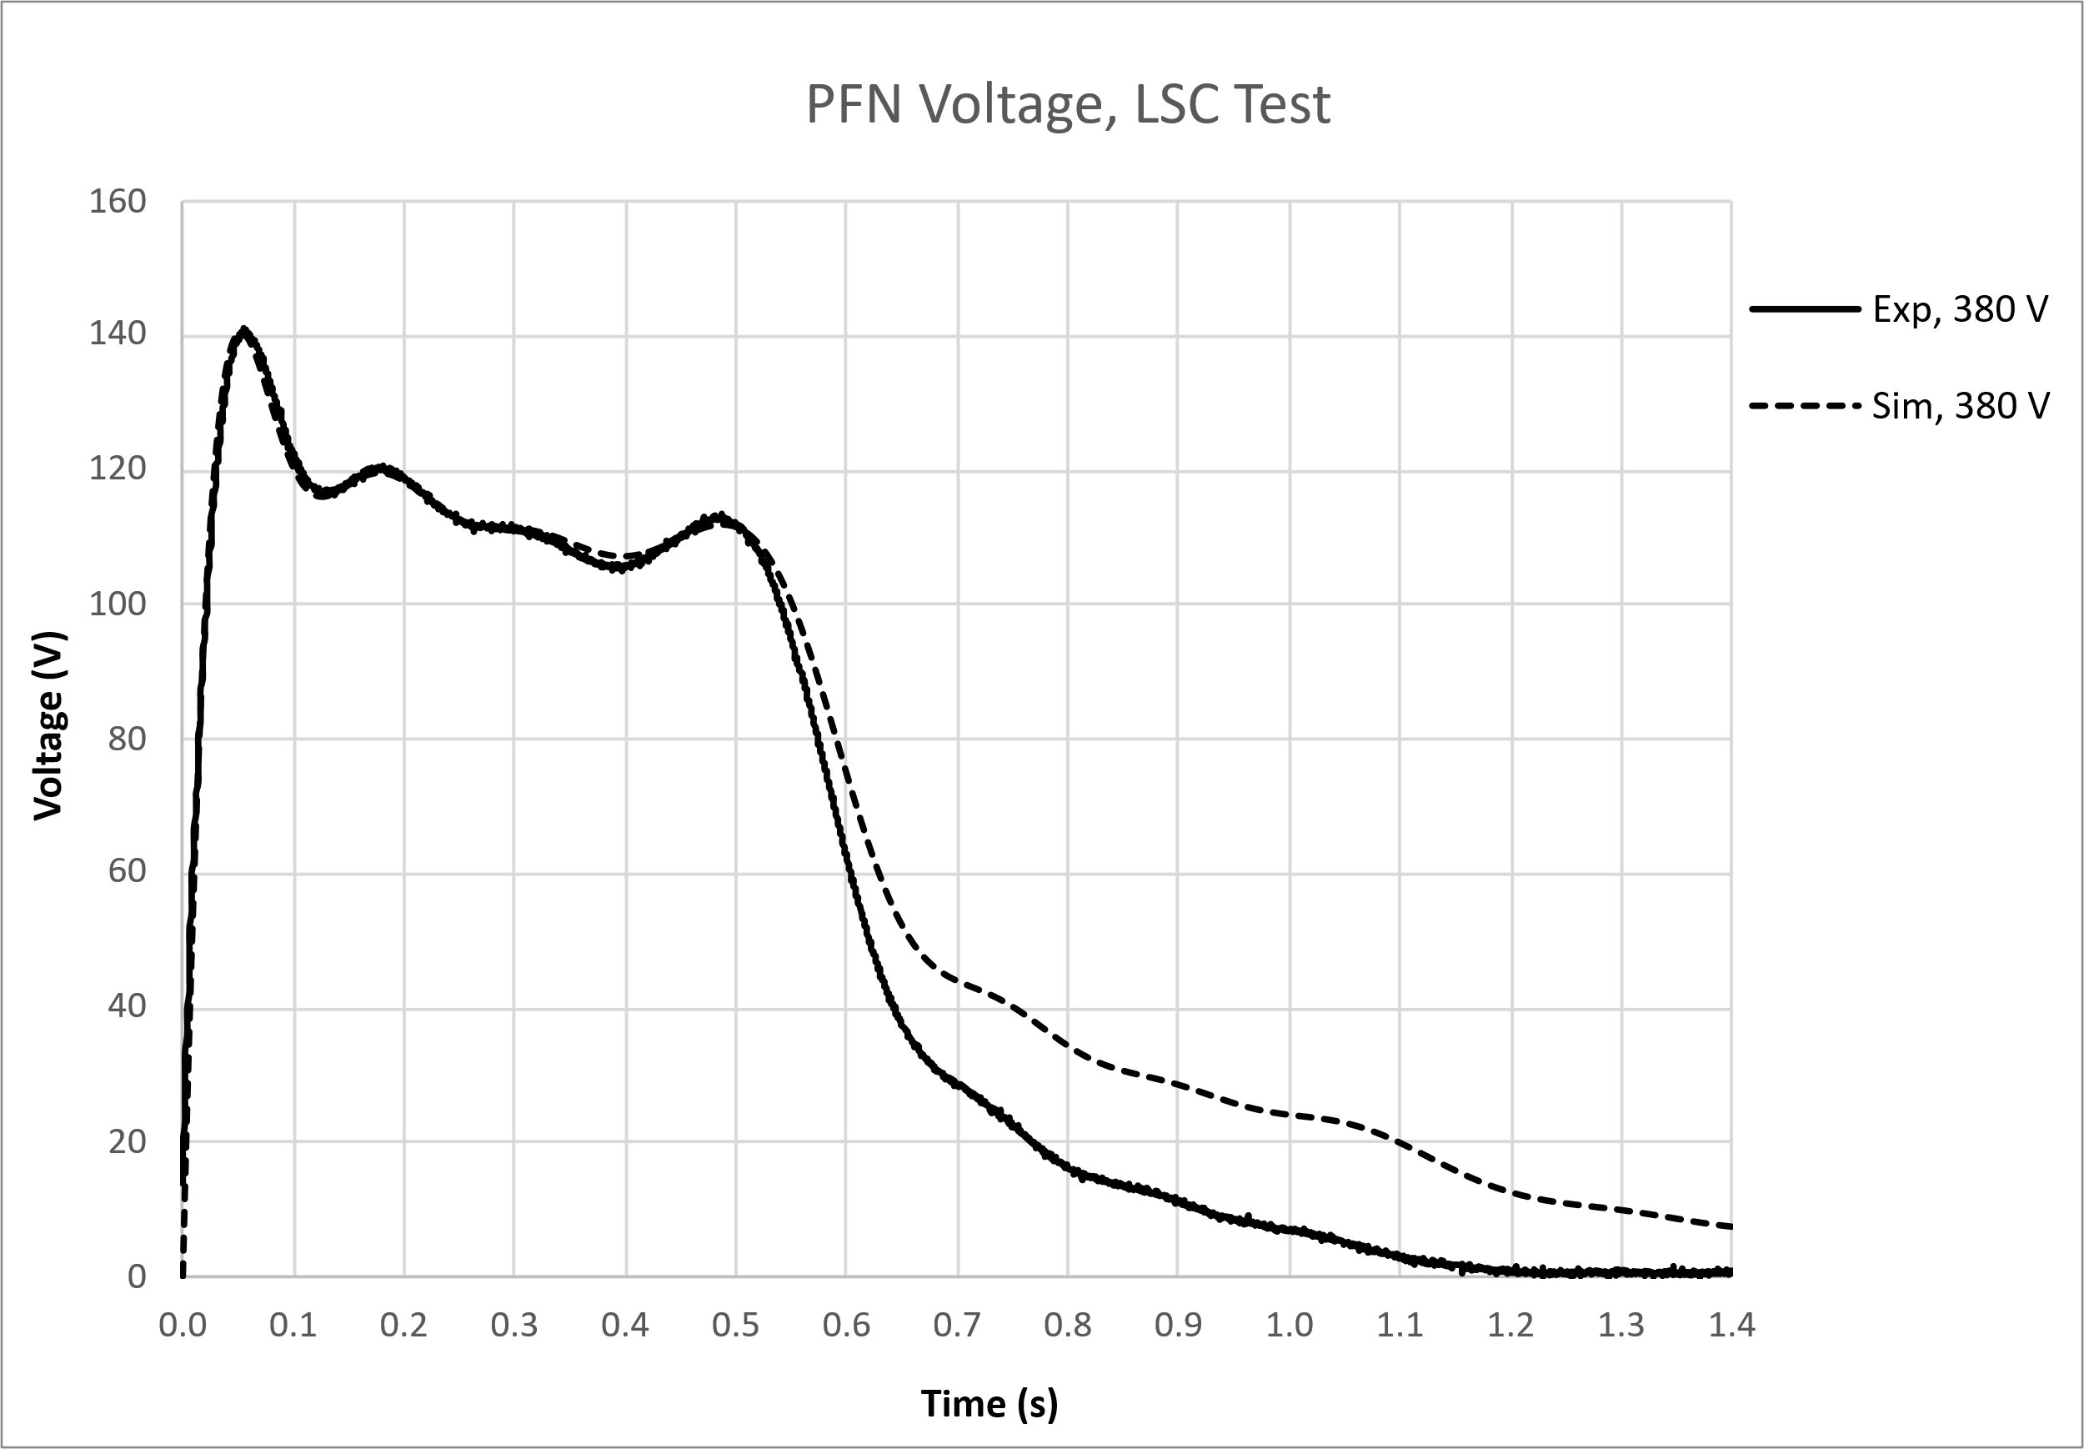
Test Coil Series PFN: Performance
Use in LSC protection system (LHe Temperature)
$Z=0.54 Ω, R_{O}=0.32 Ω$
~53 ms

Slide 18
Modified PFN
Modifications to the PFN have been proposed for future tests and designs…
Removing the L1 inductor significantly reduces the rise time of the PFN
C1 becomes the first stage of the PFN and is no longer delayed by L1
Comes with a trade-off, the pulse will have a large initial spike in voltage/current
This can be okay! A square pulse is not necessary!

Slide 19
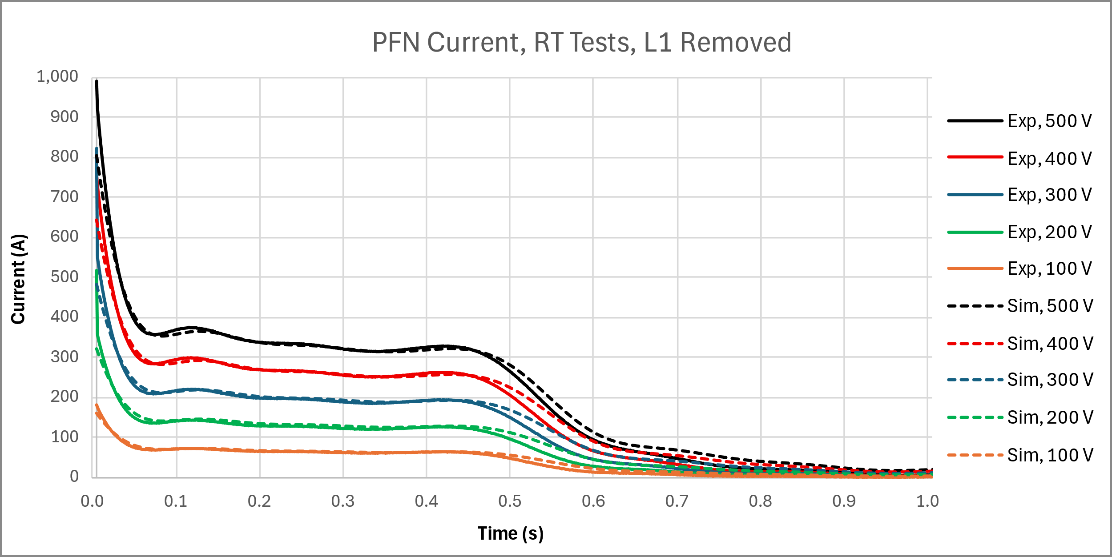
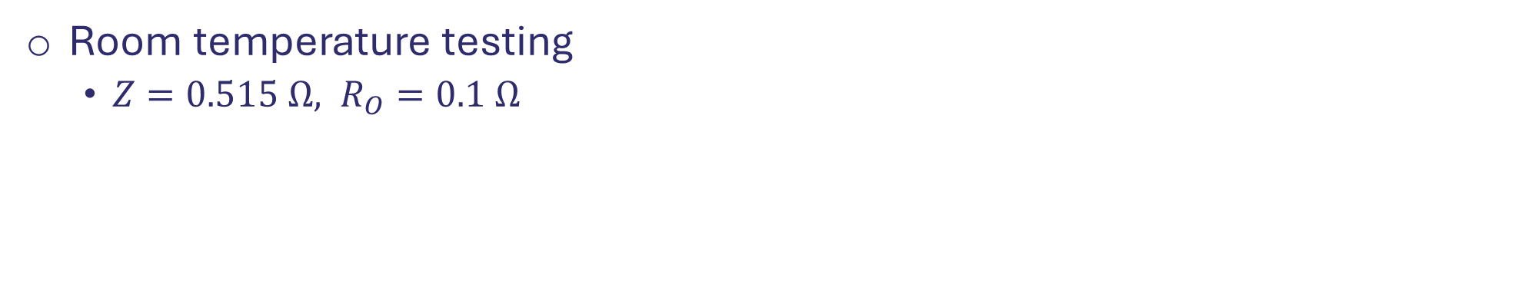
Modified PFN: Performance
Room temperature testing
$Z=0.515 Ω, R_{O}=0.1 Ω$

Slide 20
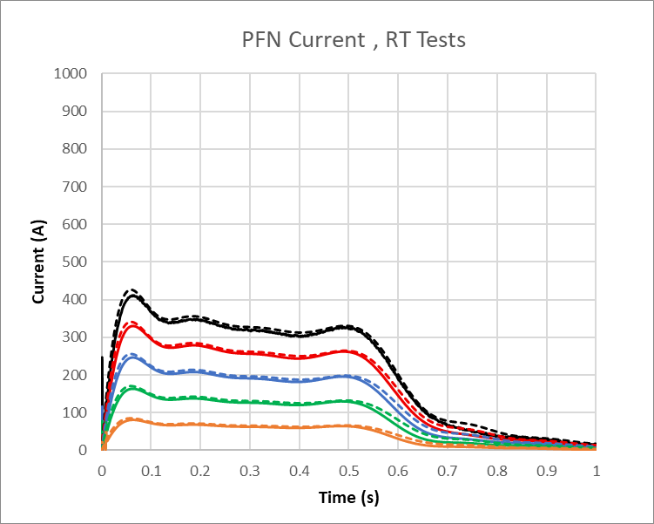
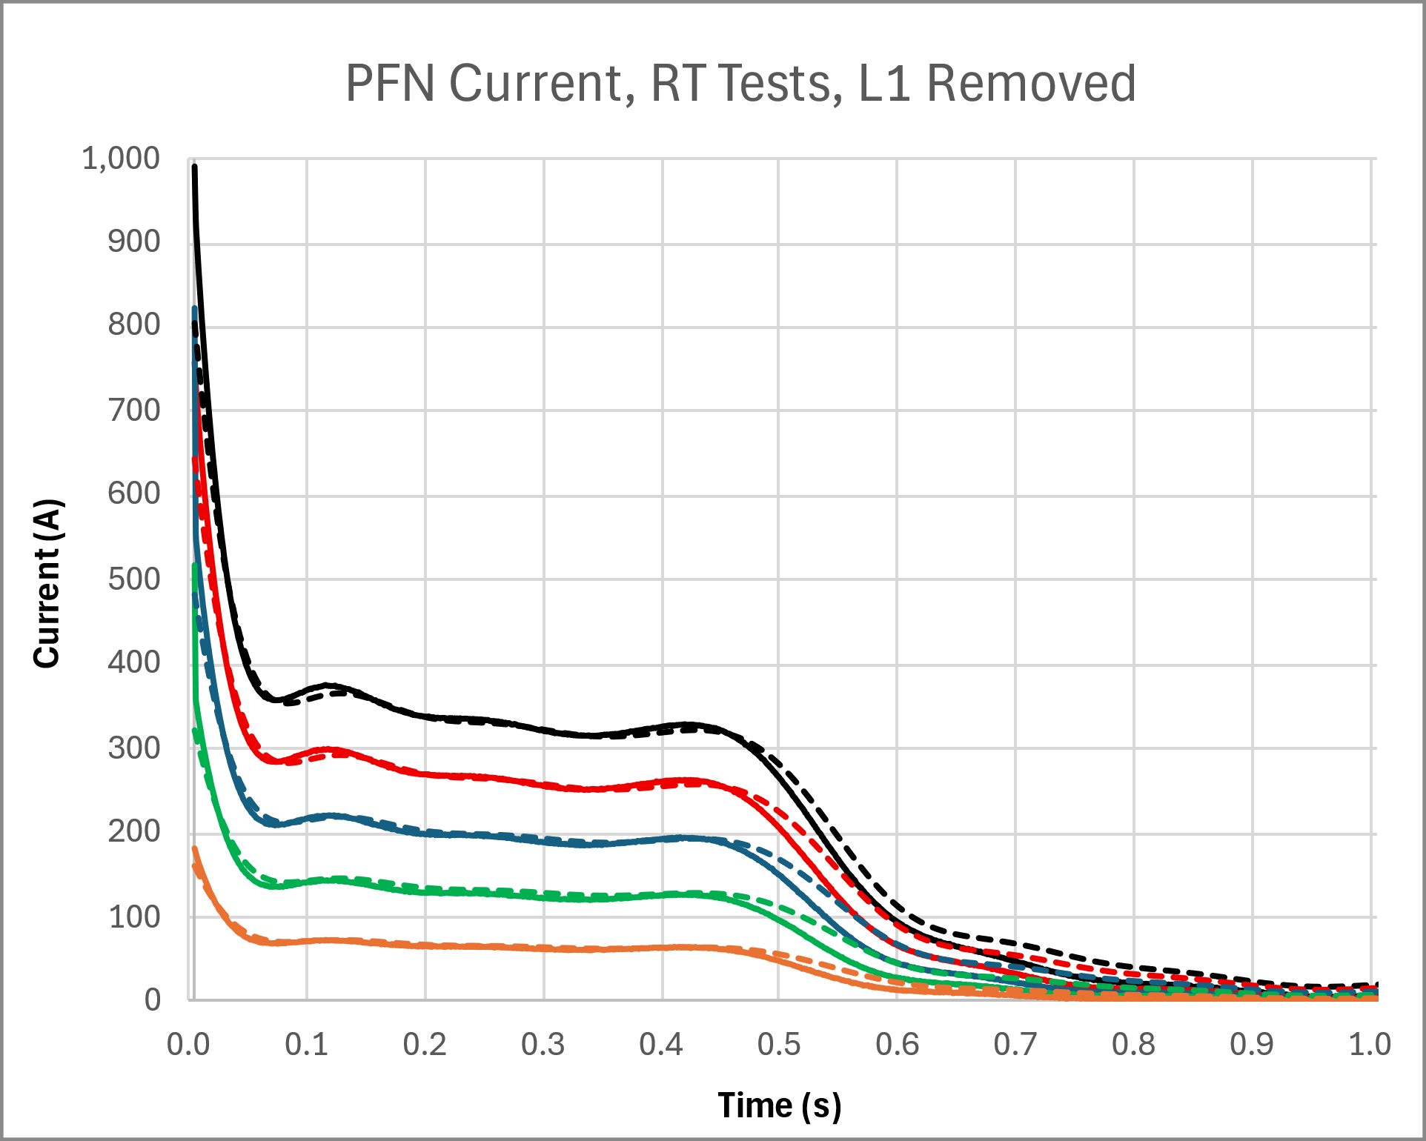
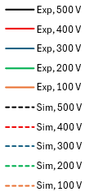
Performance With/Without L1

Slide 21
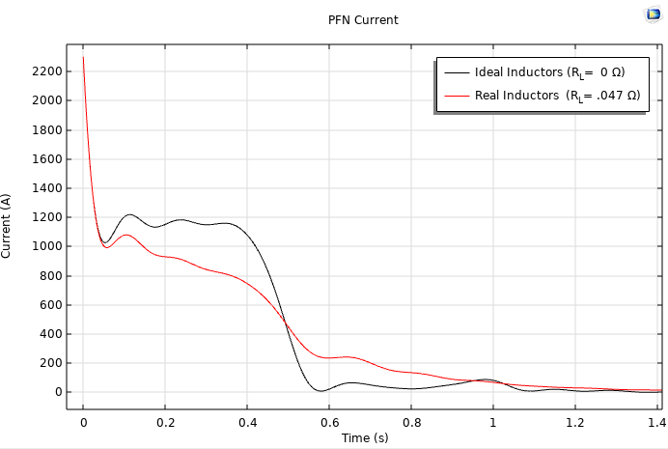
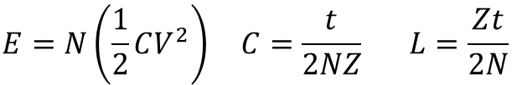
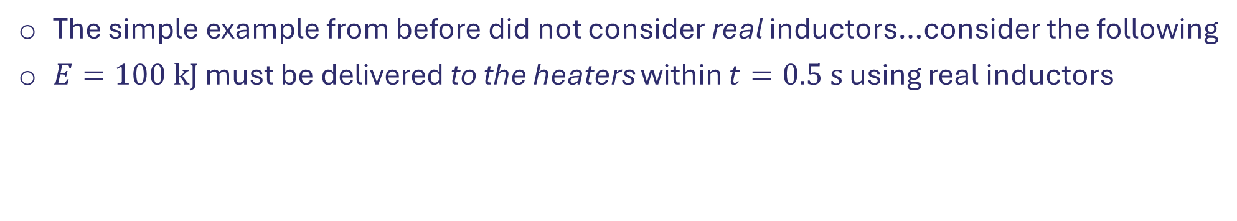
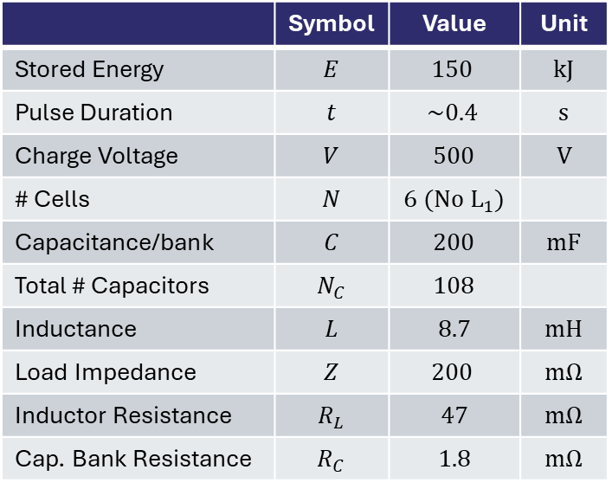
Limitations to Scaling-Up
The simple example from before did not consider real inductors…consider the following
$E=100 kJ$ must be delivered to the heaters within $t=0.5 s$ using real inductors
 | Symbol | Value | Unit
Stored Energy | $$E$$ | $$150$$ | $$kJ$$
Pulse Duration | $$t$$ | $$\sim 0.4$$ | $$s$$
Charge Voltage | $$V$$ | $$500$$ | $$V$$
# Cells | $$N$$ | $$6 (No L_{1})$$
Capacitance/bank | $$C$$ | $$200$$ | $$mF$$
Total # Capacitors | $$N_{C}$$ | $$108$$
Inductance | $$L$$ | $$8.7$$ | $$mH$$
Load Impedance | $$Z$$ | $$200$$ | $$mΩ$$
Inductor Resistance | $$R_{L}$$ | $$47$$ | $$mΩ$$
Cap. Bank Resistance | $$R_{C}$$ | $$1.8$$ | $$mΩ$$
$$E=N\left(\frac{1}{2}CV^{2}\right) C=\frac{t}{2NZ} L=\frac{Zt}{2N}$$

Slide 22
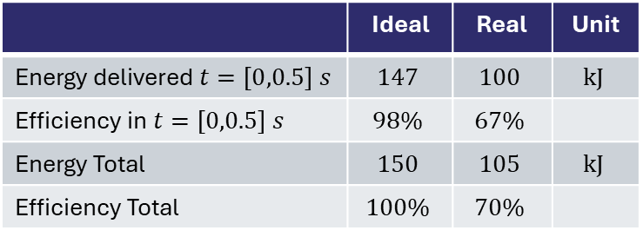
Limitations to Scaling-Up
The simple example from before did not consider real inductors…consider the following
$E=100 kJ$ must be delivered to the heaters within $t=0.5 s$ using real inductors
 | Symbol | Value | Unit
Stored Energy | $$E$$ | $$150$$ | $$kJ$$
Pulse Duration | $$t$$ | $$\sim 0.4$$ | $$s$$
Charge Voltage | $$V$$ | $$500$$ | $$V$$
# Cells | $$N$$ | $$6 (No L_{1})$$
Capacitance/bank | $$C$$ | $$200$$ | $$mF$$
Total # Capacitors | $$N_{C}$$ | $$108$$
Inductance | $$L$$ | $$8.7$$ | $$mH$$
Load Impedance | $$Z$$ | $$200$$ | $$mΩ$$
Inductor Resistance | $$R_{L}$$ | $$47$$ | $$mΩ$$
Cap. Bank Resistance | $$R_{C}$$ | $$1.8$$ | $$mΩ$$
 | Ideal | Real | Unit
Energy delivered $t=\left[0,0.5\right] s$ | $$147$$ | $$100$$ | $$kJ$$
Efficiency in $t=\left[0,0.5\right] s$ | $$98\%$$ | $$67\%$$
Energy Total | $$150$$ | $$105$$ | $$kJ$$
Efficiency Total | $$100\%$$ | $$70\%$$
As the required energy increases, the efficiency decreases
$$E=N\left(\frac{1}{2}CV^{2}\right) C=\frac{t}{2NZ} L=\frac{Zt}{2N}$$

Slide 23
Conclusion
General design strategies and considerations have been presented for a PFN energy source for active protection of SC magnets
A Rayleigh Line PFN has been constructed, tested, and used as the energy source for a quench heater based active protection system
Experimental performance of the PFN generally agrees well with simulation
A modified PFN with a purely capacitive first stage has been conceptualized and tested
The rise time of the modified PFN is nearly instant while preserving the ~square profile for the latter half of the pulse
Limitations to scaling up for applications requiring higher energies have been presented

Slide 24
Thanks for your attention! Questions/Comments?
This work was performed at the National High Magnetic Field Laboratory, which is supported by National Science Foundation Cooperative Agreement No. DMR-2131790, DMR-2128556, and the State of Florida

Slide 25
References / Attributions
Images: https://www.vecteezy.com/free-png/fire, https://pngtree.com/freepng/wood-log-lumber-pile-cartoon_6955308.html
Circuits drawn using: circuitlab.com

Slide 26
Supplemental Material

Slide 27
Supp: What is a PFN?
A pulse-forming network (PFN) is an electric circuit that accumulates electrical energy over a comparatively long time and then releases the stored energy in the form of a relatively square pulse of comparatively brief duration for various pulsed power applications
A PFN typically consists of a series of high-voltage energy-storage capacitors and inductors. These components are interconnected as a "ladder network" that behaves similarly to a length of transmission line
Pulse-forming network, Wikipedia, https://en.wikipedia.org/wiki/Pulse-forming_network

Slide 28
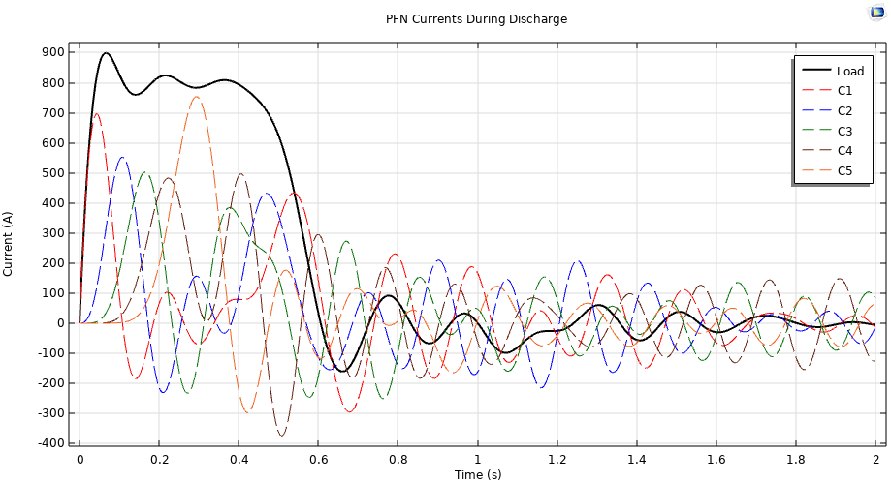
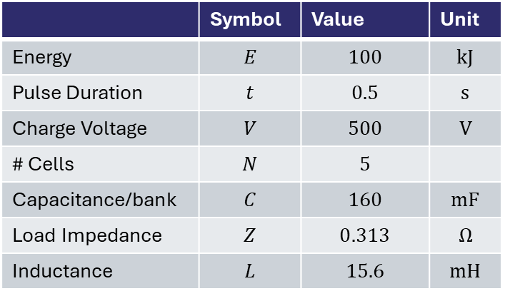
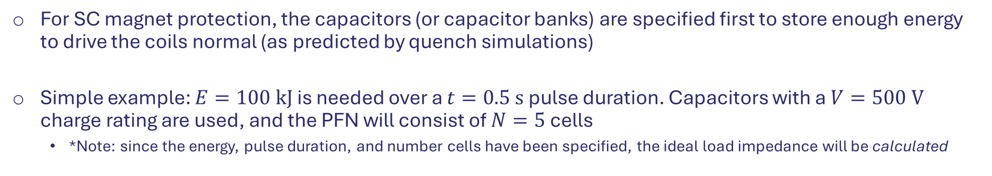
Supp: Rayleigh Line PFN, No Diodes
For SC magnet protection, the capacitors (or capacitor banks) are specified first to store enough energy to drive the coils normal (as predicted by quench simulations)
Simple example: $E=100 kJ$ is needed over a $t=0.5 s$ pulse duration. Capacitors with a $V=500 V$ charge rating are used, and the PFN will consist of $N=5$ cells
*Note: since the energy, pulse duration, and number cells have been specified, the ideal load impedance will be calculated
$$E=N\left(\frac{1}{2}CV^{2}\right) C=\frac{t}{2NZ} L=\frac{Zt}{2N}$$
 | Symbol | Value | Unit
Energy | $$E$$ | $$100$$ | $$kJ$$
Pulse Duration | $$t$$ | $$0.5$$ | $$s$$
Charge Voltage | $$V$$ | $$500$$ | $$V$$
# Cells | $$N$$ | $$5$$
Capacitance/bank | $$C$$ | $$160$$ | $$mF$$
Load Impedance | $$Z$$ | $$0.313$$ | $$Ω$$
Inductance | $$L$$ | $$15.6$$ | $$mH$$

Slide 29
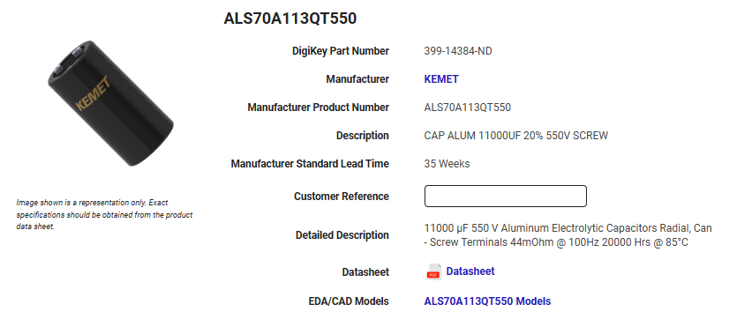
Supp: Capacitors
Banks consist of $N$ capacitors in parallel
Chosen capacitor model:

Slide 30
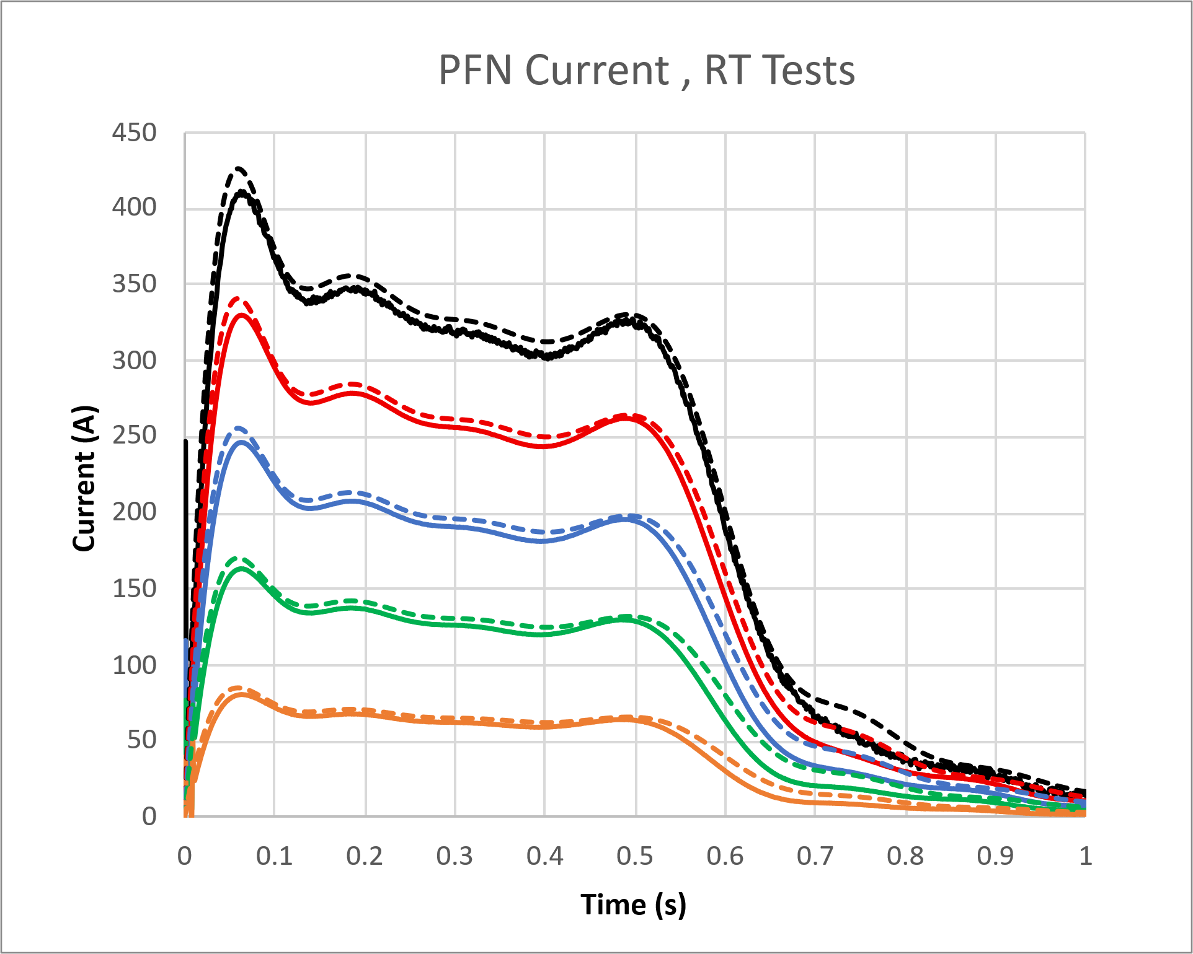
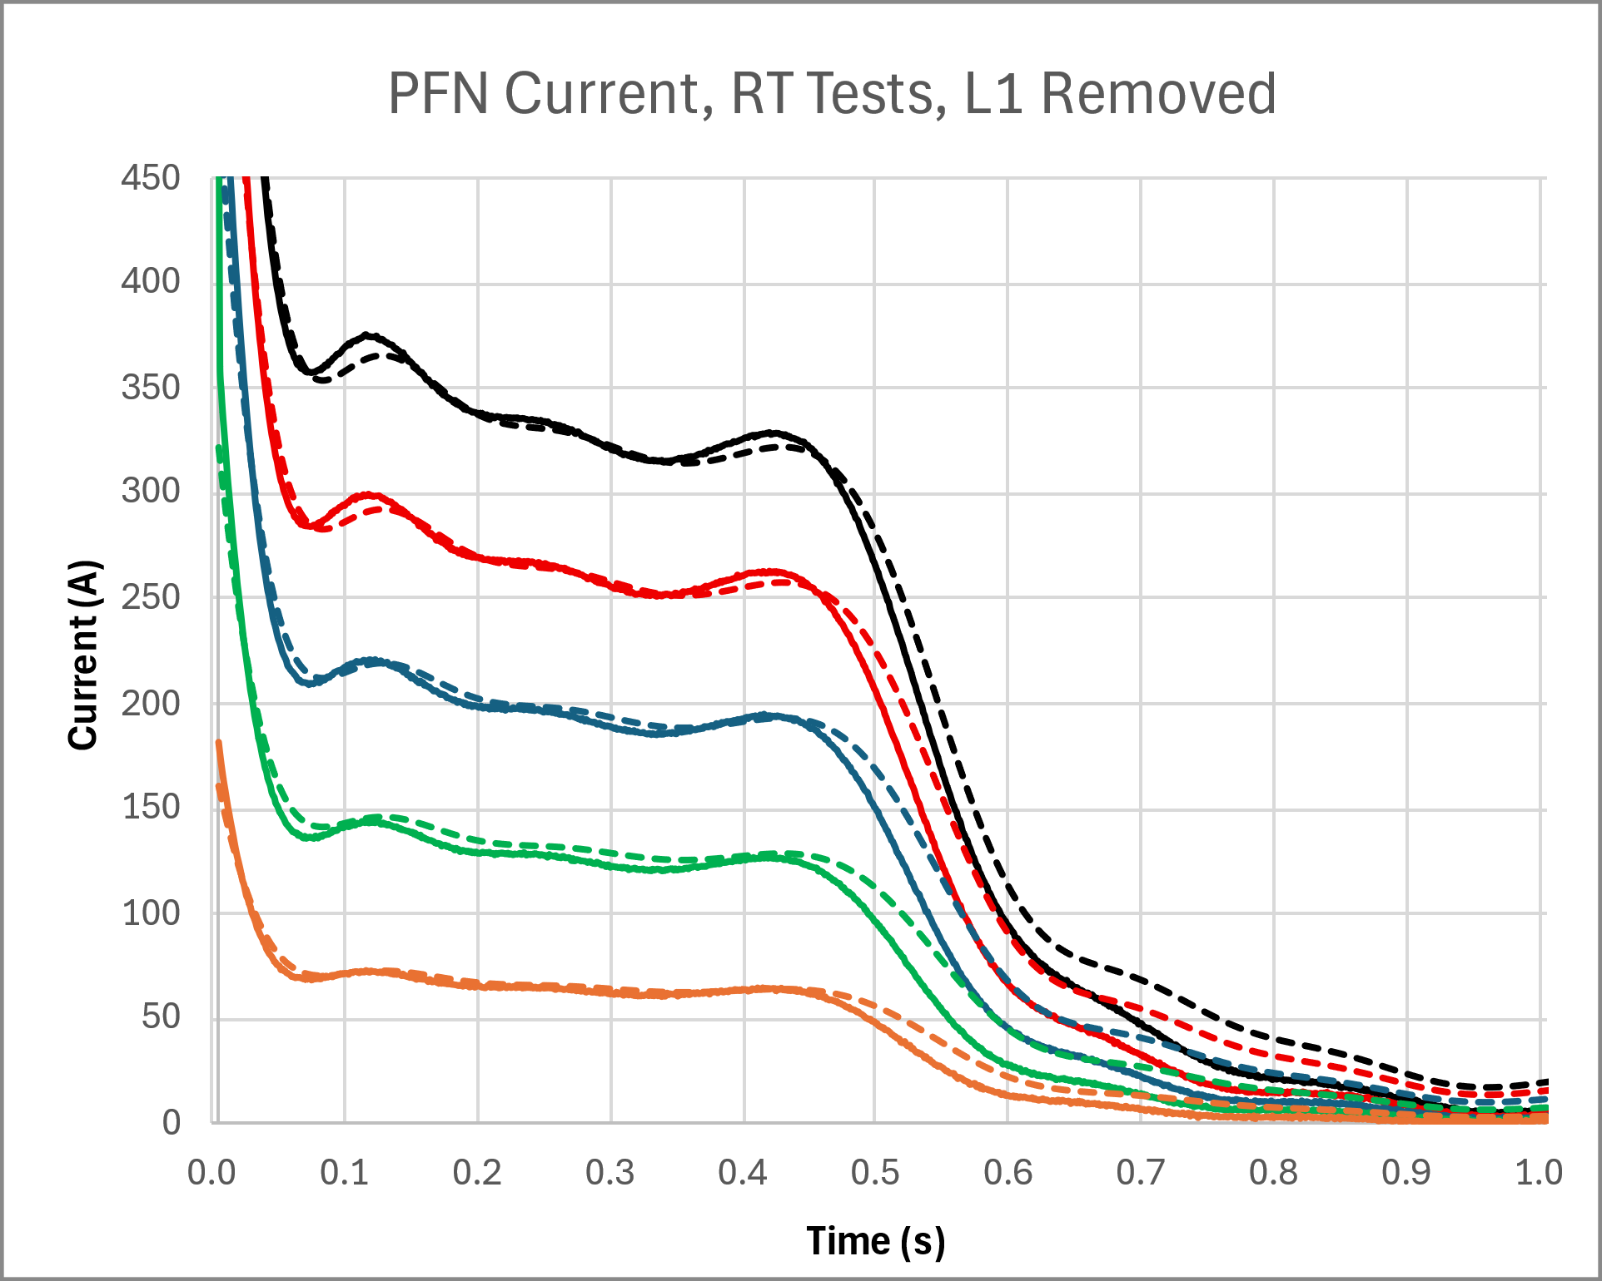
Supp: Performance With/Without L1

Slide 31
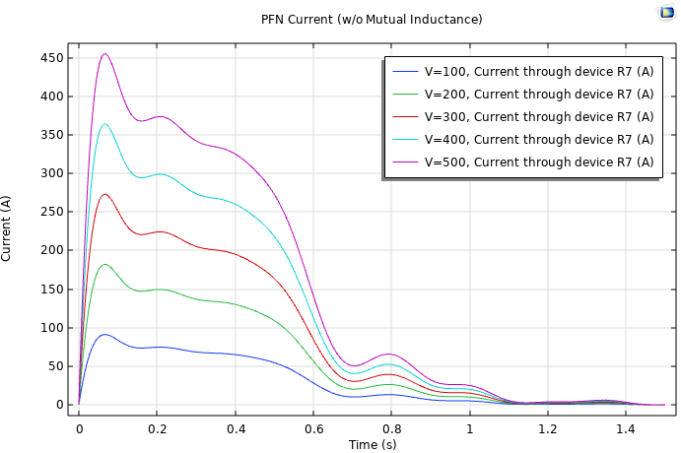
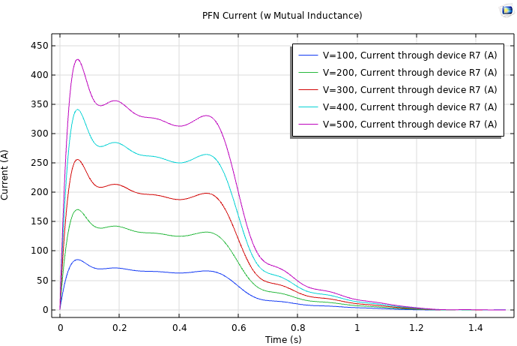
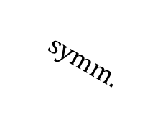
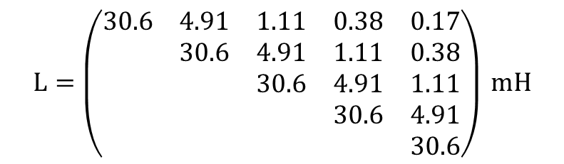
Supp: With/Without Mutual L
$$L=\left(\begin{matrix}30.6 & 4.91 & 1.11 & 0.38 & 0.17 \\ & 30.6 & 4.91 & 1.11 & 0.38 \\ & & 30.6 & 4.91 & 1.11 \\ & & & 30.6 & 4.91 \\ & & & & 30.6\end{matrix}\right) mH$$
$$symm.$$

Slide 32
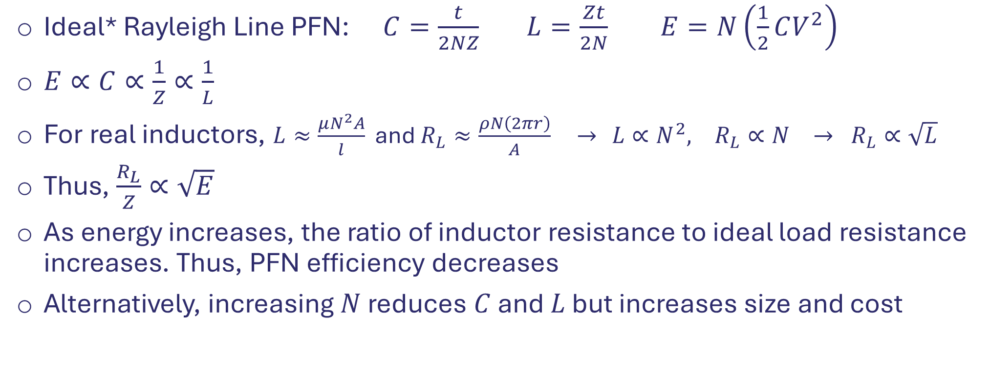
Supp: Scalability
Ideal* Rayleigh Line PFN: $C=\frac{t}{2NZ}$ $L=\frac{Zt}{2N}$ $E=N\left(\frac{1}{2}CV^{2}\right)$
$E∝C∝\frac{1}{Z}∝\frac{1}{L}$
For real inductors, $L≈\frac{μN^{2}A}{l}$ and $R_{L}≈\frac{ρN\left(2πr\right)}{A}$ $→$ $L∝N^{2}, R_{L}∝N → R_{L}∝\sqrt{L}$
Thus, $\frac{R_{L}}{Z}∝\sqrt{E}$
As energy increases, the ratio of inductor resistance to ideal load resistance increases. Thus, PFN efficiency decreases
Alternatively, increasing $N$ reduces $C$ and $L$ but increases size and cost
$C=$ ideal capacitance, $L=$ ideal inductance, $Z=$ load impedance (quench heater network)
$N=$ # PFN Cells, $t=$ pulse duration, $V=$ charge voltage (2x load voltage)
*Assumes capacitors and inductors have no resistance (or small resistance compared to load). Also assumes no mutual inductance

