Slide 1




Exploring Hybrid Designs for a 14 T Common Coil Demonstrator Magnet (DAISY)
J.A. García-Matos, C. Martins, F. Toral (CIEMAT)
J.C. Pérez, E. Todesco (CERN)

Slide 2
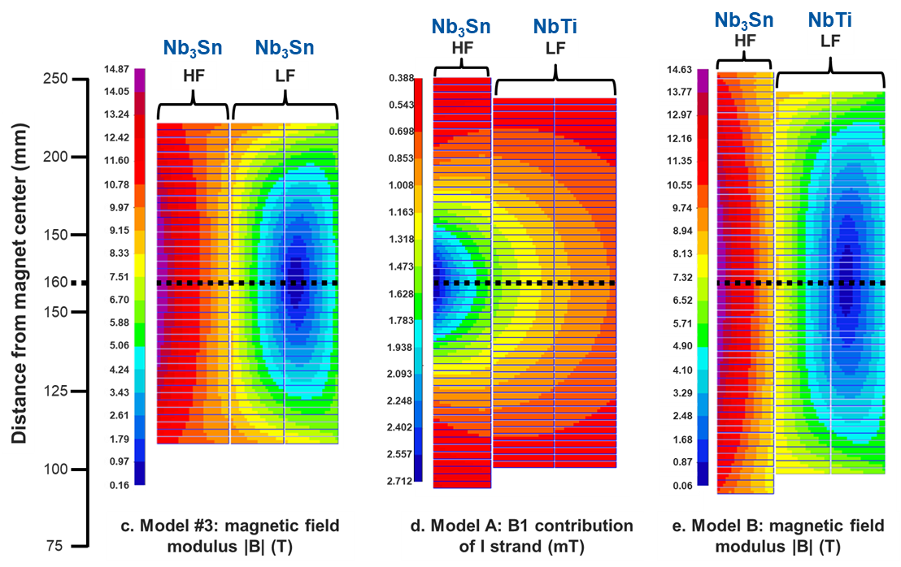
CIEMAT’s contribution to the HFM program.
14 T prototype magnet based on common coil topology.
It honors Margarita Salas [1].
Previous study (ASC24) [2]:
Several designs evaluated with a fixed iron geometry at 1.9 K (limited field quality).
Promising results using NbTi for the low field region (LHC main dipole inner layer strand).
Feasible!
Better superconductor usage!
[1] PUM! estudio, “Margarita Salas: The legacy of a lifetime devoted to science,” Fundación Margarita Salas. Accessed: Jul. 10, 2024. [Online]. Available: https://fundacionmargaritasalas.com/en/margarita-salas-en/
[2] J. Á. García-Matos, C. M. Jardim, F. Toral, J. C. Perez, and E. Todesco, “Magnetic Design of a 14 T Common Coil Demonstrator Magnet (DAISY),” IEEE Transactions on Applied Superconductivity, vol. 35, no. 5, Art. no. 4002605, Aug. 2025, doi: 10.1109/TASC.2025.3537069.

Slide 3
Hybrid common coil:
a cost-effective solution for FCC-hh
Strands | ERMC-1 | MBINL*
Material | NB₃Sn | NbTi
Diameter [mm] | 1 | 1.2
Cu / Non Cu ratio | 0.9 | 1
Cu Area per strand [mm²] | 0.37 | 0.57
The use of NbTi instead of Nb₃Sn in a hybrid dipole:
Decrease superconductor material cost.
Reduce coil fabrication complexity: easier handling, no reaction, not so easy to degrade.
Potentially decrease of AC losses and magnetic instabilities.
*NbTi strand hypothesis (Suppliers consults ongoing)
Parameter | Value | Units
Operational field target | 14 | T
Free aperture diameter | 50 | mm
b₃ / a₂ | <10 | units
Other multipoles | <1 | units
Multipole variation from injection | <30 | units
Intrabeam distance | 320 | Mm
Straight section length | 0.5 | M
Magnetic length | 0.8 | M
Physical length | ≈1 | m
Outer diameter | <800 | mm
Load (1.9 K) | 80 | %
Operating temperature | 1.9 | K
Non-Cu J_{c} (16 T, 4.22 K) | 1200 | A/mm²
J_{o} | 350-600 | A/mm²
Equivalent coil width | 50-55 | mm
Protection system | Dump resistor | mΩ
Protection time margin | 40 | ms
Max. voltage | 1000 | V
Main goals:
Explore hybrid designs with accelerator-like features: Field quality, low multipole variation, efficiency.
Compare with pure Nb₃Sn reference and accelerator-like designs to determine if they keep being cost-effective.

Slide 4

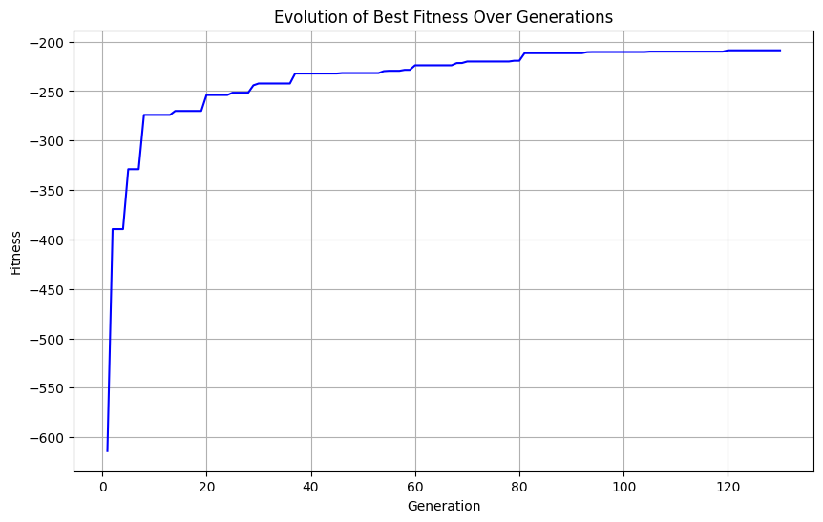
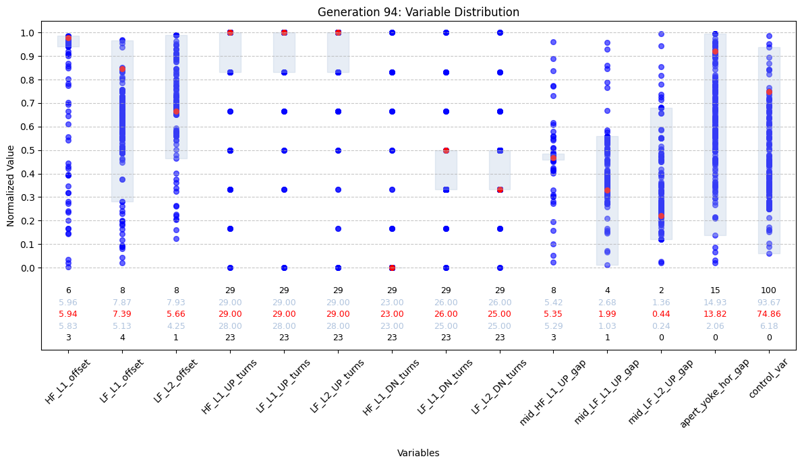
Methodology
Optimal design
QH
EQW
FQ
LOAD
Tailored Genetic Algorithm (GA) + RoxieApi:
More flexibility and control over the algorithm behavior.
Deeper insights during the solving process.
Inclusion of variables not computed by Roxie.
Interdependencies between input variables.
Weighting the GA fitness function :
Equivalent width (EQW): Tends to adapt the coil shape for the better contribution of each strand to B1, decreasing turns and strands per cable.
Field quality (FQ): Tends to use a lot of superconductor and produce tall coils (less strands, more turns).
Quench performance (QH): Penalizing J_{Cu} avoid using fewer strands than necessary, controlling hot spot temperature.
Load requirement (LOAD): Usually tends to use more strands than necessary. It is the easier to manually tune later.

Slide 5
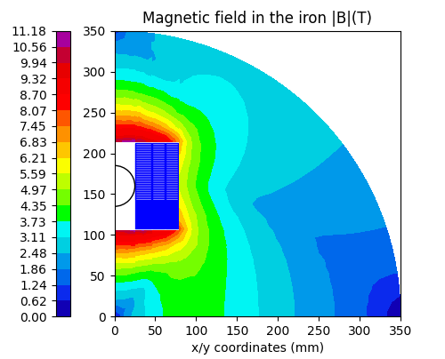
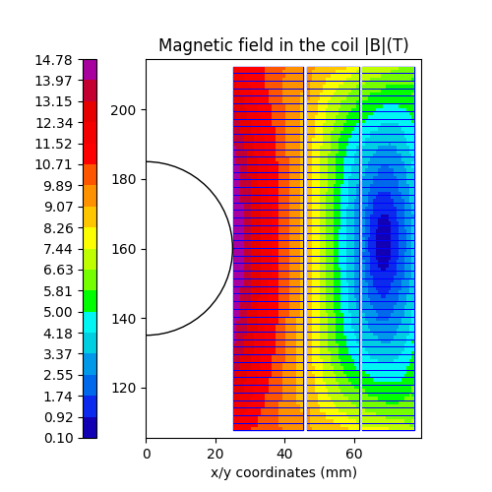
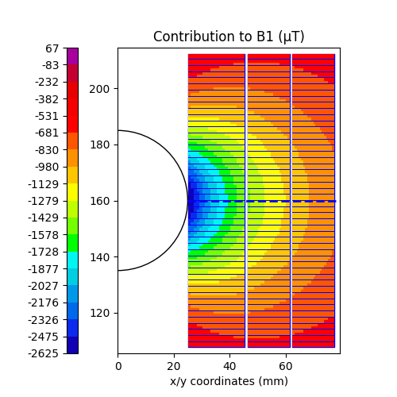
REF1: Minimum amount of superconductor
REF1 will be our reference model:
No good field quality: solid coil blocks.
Large multipole variation with the current: iron close to aperture.
But… Maximum superconductor efficiency.
*All models for 320 mm of intrabeam distance and 14T in a 50 mm aperture

Slide 6
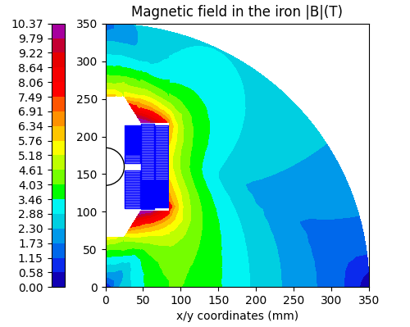
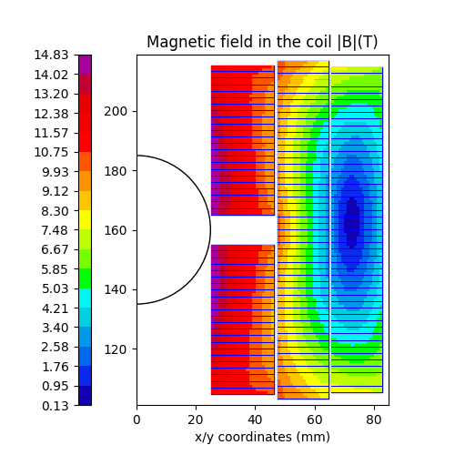
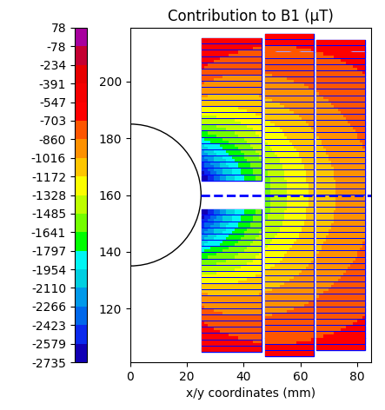
REF2: Low multipole variation with the current
REF2 is an intermediate step:
Better field quality, but not good enough: 10 mm midplane gap at high field coil.
Sextupole variation is decreased by placing the iron further from the aperture.
55 mm coil equiv. width: 13% more Nb₃Sn
Next step is to improve field quality.
*All models for 320 mm of intrabeam distance and 14T in a 50 mm aperture
*All models for 320 mm of intrabeam distance and 14T in a 50 mm aperture

Slide 7
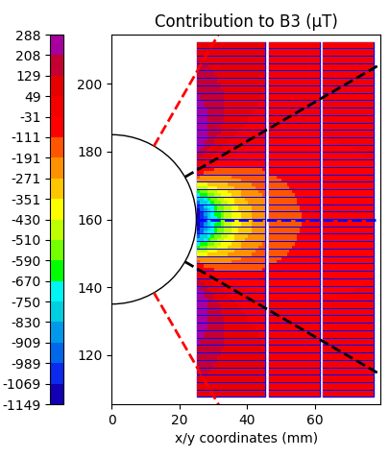

Dealing with a large sextupole in a common coil magnet
Midplane region → B₁ and B₃
B₃ contribution ↓ 1/r³
Usual approach: placing ancillary coils in the highlighted areas.
Upper region discarded to avoid non-planar coils.
Maximum contribution (+)
Null contribution (0)
Minimum contribution (-)

Slide 8
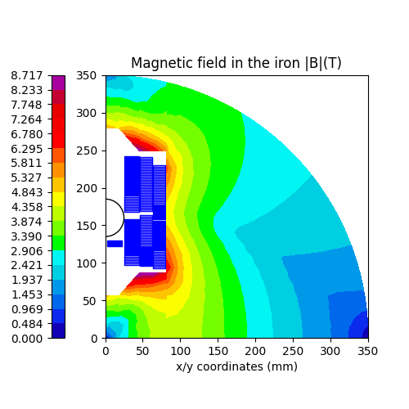
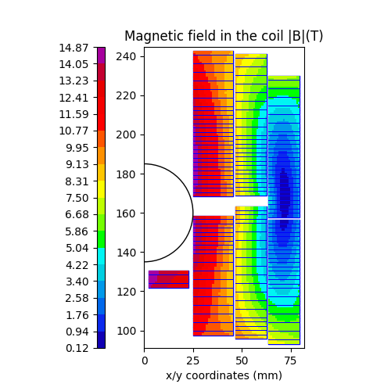
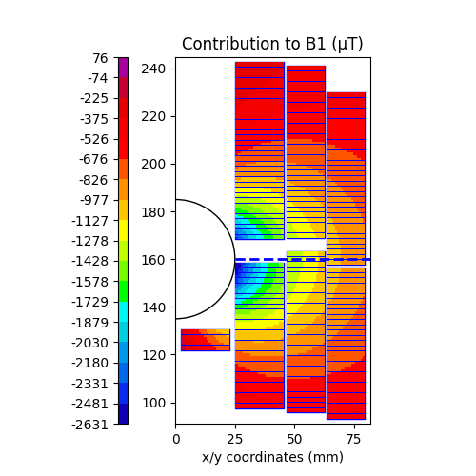
SN0: exploring the asymmetric field quality coil (I)
SN0 try to use asymmetric common coil design as proposed by PSI on SMACC1 [3]:
Sextupole and its variation are decreased.
63 mm coil equiv. width: 42% more Nb3Sn.
Inefficient for DAISY. Why?
[3] D. Araujo, B. Auchmann, A. Brem, T. Michlmayr, A. Haziot, and E. Ravaioli, “Electromechanical Design of Nb3Sn Stress Managed Asymmetric Common-Coils,” IEEE Trans. Appl. Supercond., vol. 35, no. 5, pp. 1–5, Aug. 2025, doi: 10.1109/TASC.2025.3532906.
*All models for 320 mm of intrabeam distance and 14T in a 50 mm aperture

Slide 9
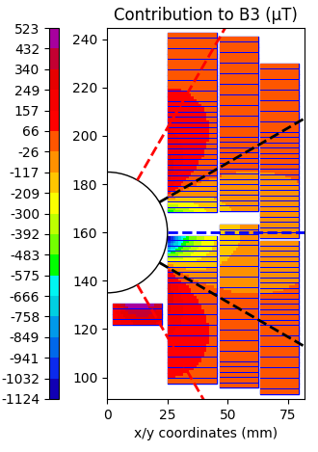
SN0: exploring the asymmetric field quality coil (II)
Sextupole can be compensated but the midplane gap is still large, losing efficiency.
F_{y}
F_{y}
F_{y}
Mechanics!! This additional coil is pushed towards the aperture. Some gap for support is required.
A more efficient approach is required to decrease the sextupole in DAISY.
Wide cables get close to the vertical axis : high peak field/load low efficiency.
Low contribution to B₁.
Few strands hit the maximum B₃ contribution region.

Slide 10
Dealing with a large sextupole: What if…?
…we move the lower turns of the high field coil towards aperture?

Slide 11
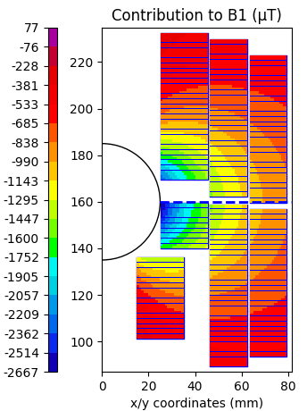
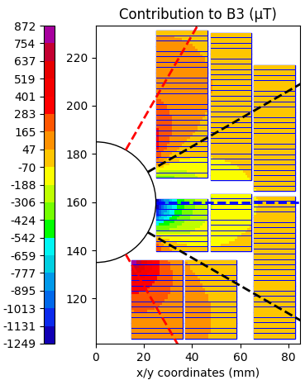
Dealing with a large sextupole: What if…?
…we move the lower turns of the high field coil towards aperture?
Single or double layer additional “Field quality” coil.
More efficient sextupole compensation.
Better contribution to B1 (gap further from the aperture).
A casing could hold the electromagnetic forces + partial support from the other coils.
SN1
SN2
F_{y}
F_{y}

Slide 12

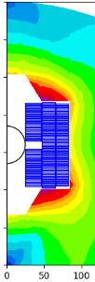
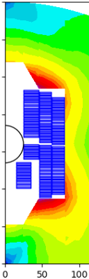
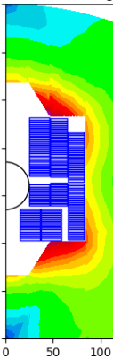
Comparing pure Nb₃Sn models
Displacing the lower turns of high field coil is more efficient than the original asymmetric case (SN0) for DAISY.
59 mm coil equiv. width: 27% more Nb₃Sn, instead of 42%.
*All models for 320 mm of intrabeam distance and 14T in a 50 mm aperture

Slide 13
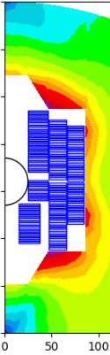
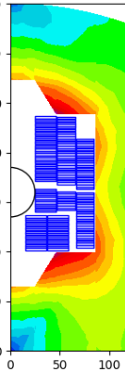
Comparing hybrid models with pure Nb₃Sn ones
Accelerator-like features.
Less efficient in equiv. coil width but large Nb₃Sn savings.
Temperature margin at NbTi is around 2K, more than current LHC main dipoles (1.4K).
NbTi
NbTi
*All models for 320 mm of intrabeam distance and 14T in a 50 mm aperture

Slide 14
Conclusions
CIEMAT is actively contributing to the HFM Programme through the development of common coil magnet designs.
We have obtained promising results for hybrid magnets combining Nb₃Sn and NbTi coils.
Accelerator-like 14 T magnets appear feasible, using NbTi in the low-field region, pointing toward a viable path for cost-effective solutions.
While challenges remain, such as mechanical support or long magnet protection, the hybrid approach shows strong potential moving forward.
Our first demonstrator, DAISY, will focus on validating hybrid magnet mechanics in a common coil configuration, without targeting full accelerator-grade field quality in the initial phase.
In the next step, we aim to develop a hybrid common coil magnet that meets full accelerator field quality requirements, building on the foundation laid by DAISY.

Slide 15
Extra slides

Slide 16

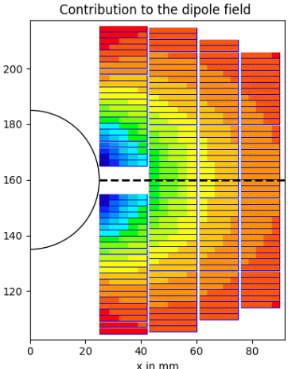



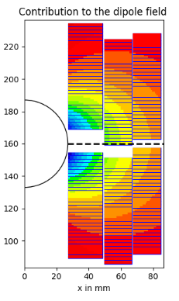

Tuning the GA fitness function
Script #1
Roxie23 environment
Start
Optimal design
Input data
QH
EQW
FQ
LOAD
Genetic Algorithm
(in-house development)
Roxie23
(RoxieAPI [4])
Optimal design results & plots
Equivalent width (EQW): Tends to adapt the coil shape for the better contribution of each strand to the main field, decreasing turns and strands per cable.
Field quality (FQ): Tends to use a lot of superconductor and makes the coils tall (less strands, more turns).
Quench performance (QH): Penalizing J_{cu} avoid using fewer strands than necessary, therefore, controlling hot spot temperature.
Load requirement (LOAD): Usually tends to use more strands than necessary. It is the easier to manually tune later.
Manual tuning of the model
model.output
Coherent cable libraries
model_induc.output
Script #2
Compute quench and retrieve results
Quench computation [5]
Model
comparison
Results
Stop
[4] M. Bonora, ‘Interfacing with ROXIE: Scripting, Python, and Model Based Design’, presented at the ROXIE Users Workshop: ROXIE 23 Launch Event, Accessed: Jan. 23, 2024. [Online]. Available: https://indico.cern.ch/event/1318061/contributions/5574693/attachments/2711597/4708647/interfacing_roxie.pdf
[5] T. Salmi et al., ‘Quench protection analysis integrated in the design of dipoles for the Future Circular Collider’, Phys. Rev. Accel. Beams, vol. 20, no. 3, p. 032401, Mar. 2017, doi: 10.1103/PhysRevAccelBeams.20.032401.
[1] M. Bonora, ‘Interfacing with ROXIE: Scripting, Python, and Model Based Design’, presented at the ROXIE Users Workshop: ROXIE 23 Launch Event, Accessed: Jan. 23, 2024. [Online]. Available: https://indico.cern.ch/event/1318061/contributions/5574693/attachments/2711597/4708647/interfacing_roxie.pdf
[2] T. Salmi et al., ‘Quench protection analysis integrated in the design of dipoles for the Future Circular Collider’, Phys. Rev. Accel. Beams, vol. 20, no. 3, p. 032401, Mar. 2017, doi: 10.1103/PhysRevAccelBeams.20.032401.

