Slide 1
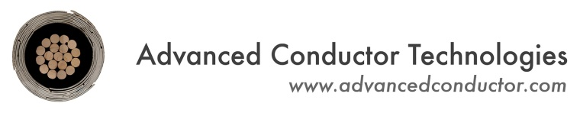



Development of high-field dipole and solenoid magnets using the latest generation of CORC® cables and wires
Danko van der Laan & Jeremy Weiss*
Advanced Conductor Technologies & University of Colorado, Boulder, Colorado, USA
*Now with High Temperature Superconductors Inc.
Sven Dönges & Kyle Radcliff
Advanced Conductor Technologies, Boulder, Colorado, USA
Dima Abraimov
Applied Superconductivity Center, National High Magnetic Field Laboratory, Tallahassee, Florida, U.S.A.
Xiaorong Wang, Yufan Yan, Lukas Brouwer, Hugh Higley & Soren Prestemon
Lawrence Berkeley National Laboratory, Berkeley, California, U.S.A.
MT29 2025, Boston, Massachusetts, July 5th, 2025

Slide 2
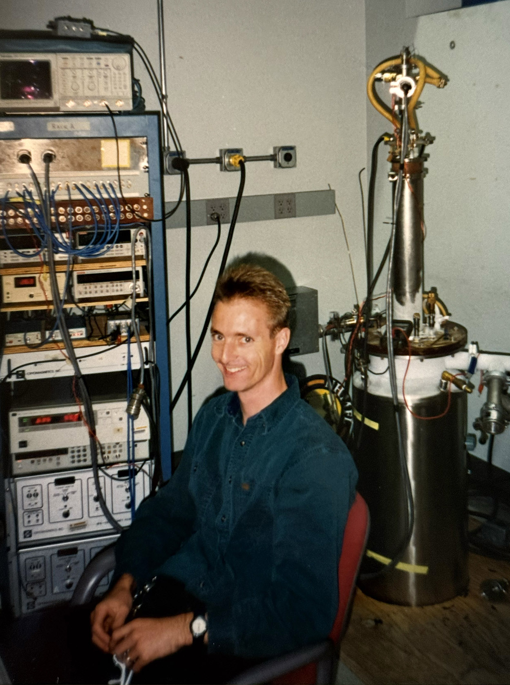
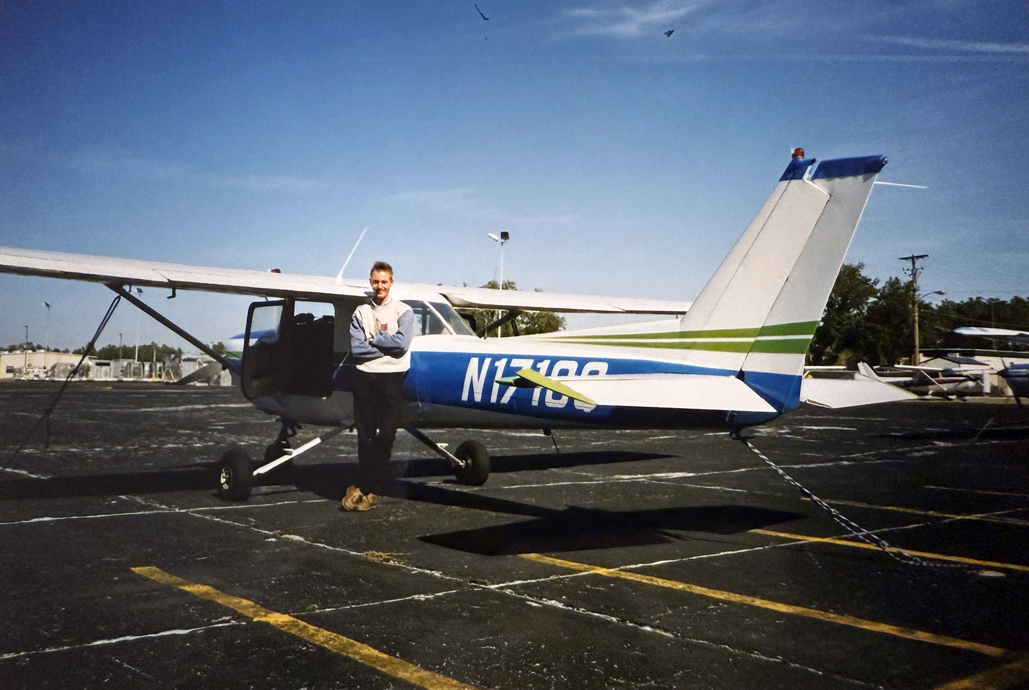
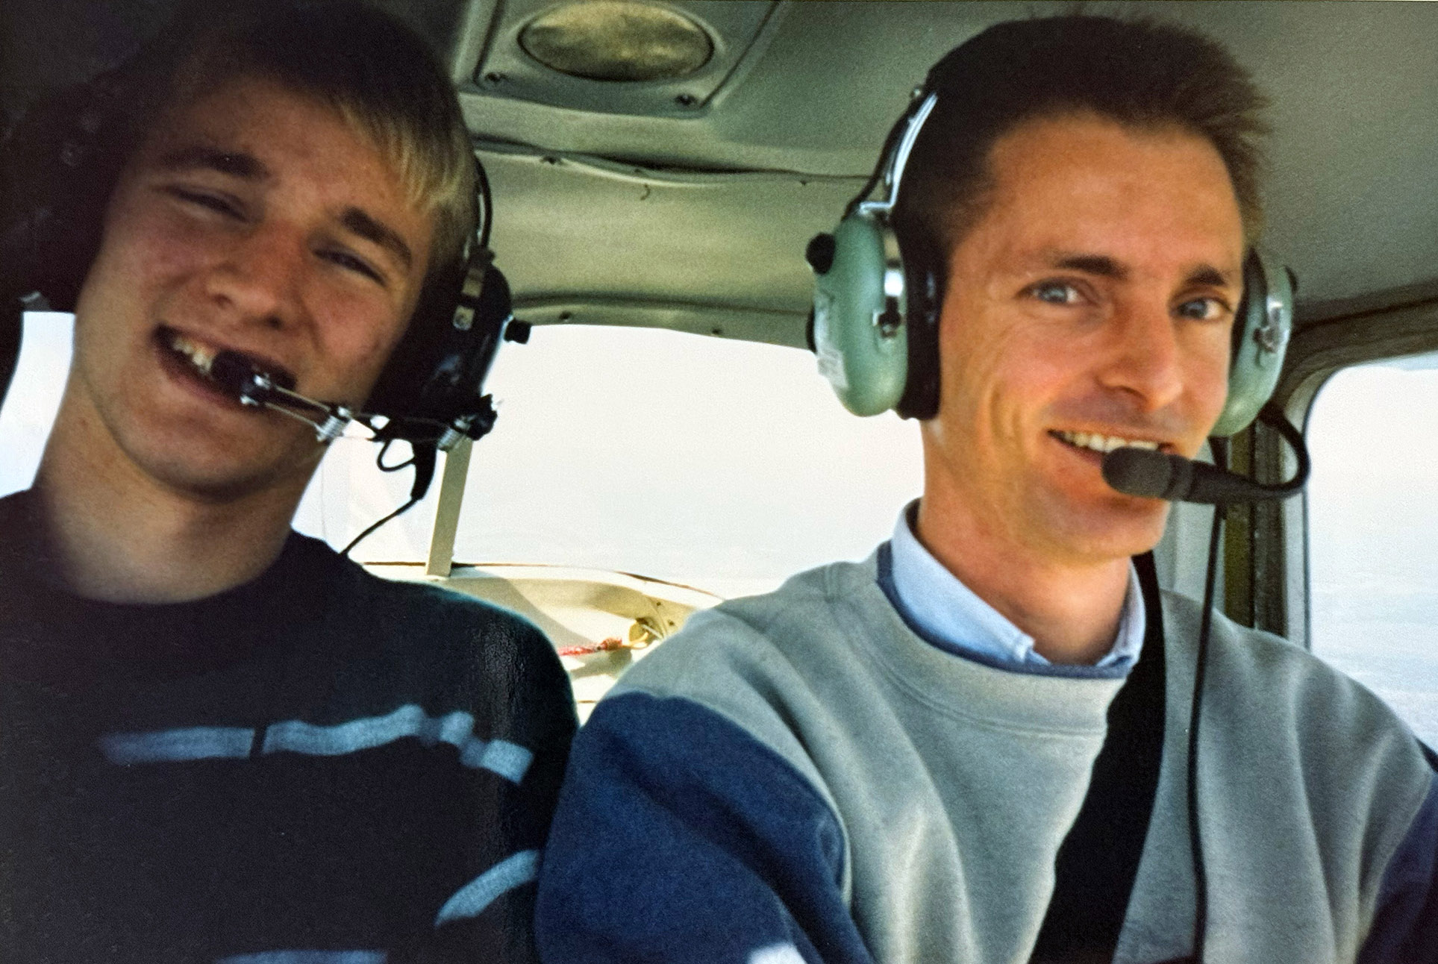
Impact of Huub Weijers on my early career in superconductivity
1997: Huub became my first first supervisor
August – December 1997 internship at the NHMFL (Lorenz force stress-strain disc)
Important lessons from Huub
Always make sure your nitrogen shield has a pressure relieve valve that you can’t close!
Never freeze uncured Stycast with LN₂ in an attempt to use it another day
And lots of fun!
Pilot Huub
2

Slide 3
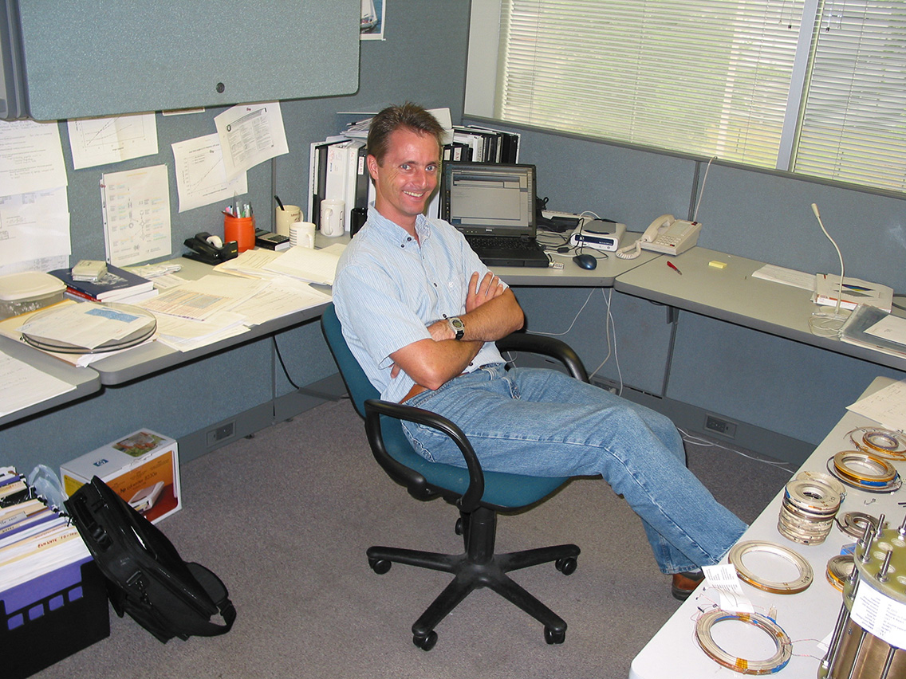
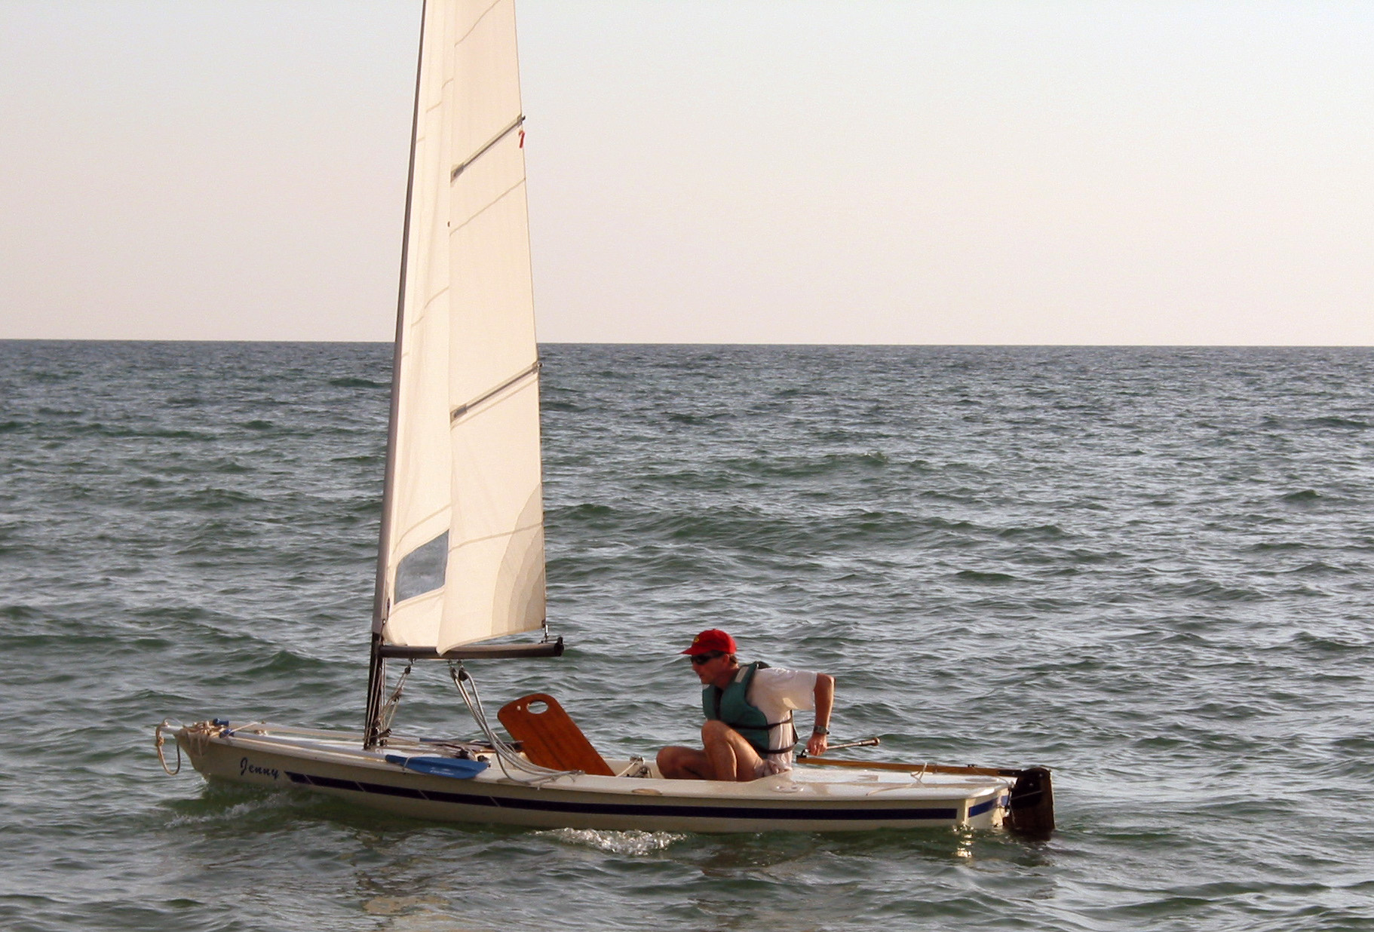
Impact of Huub Weijers on my early career in superconductivity (Cont.)
2000 – 2002: Initial 2 years of my Ph.D. spent at the NHMFL
Many practical lessons learned from Huub
My early exposure to HTS magnets
Another important lesson from Huub
When you go sailing: bring the sail!
3

Slide 4
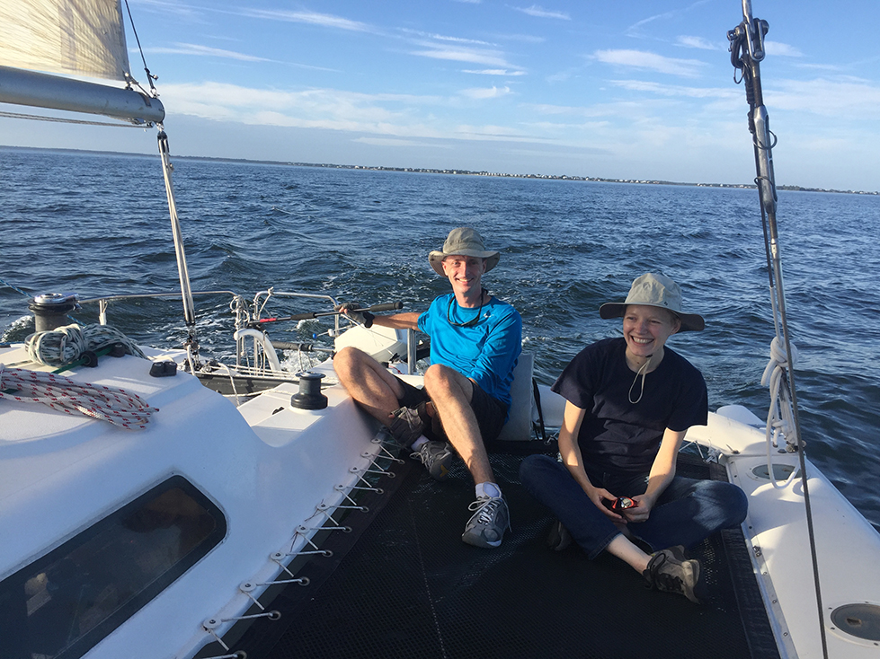
Huub enjoying the success of 32 T
4

Slide 5
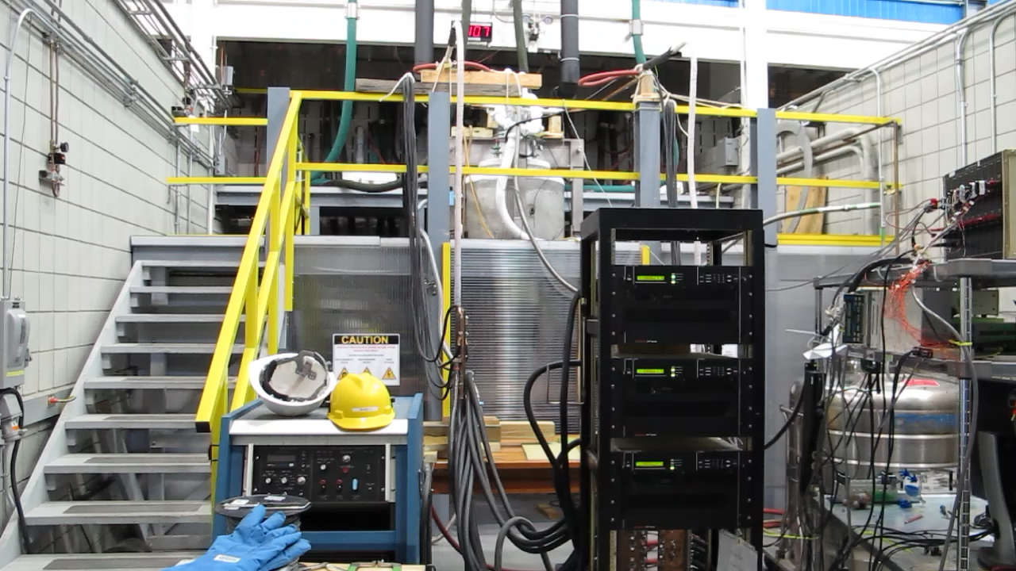
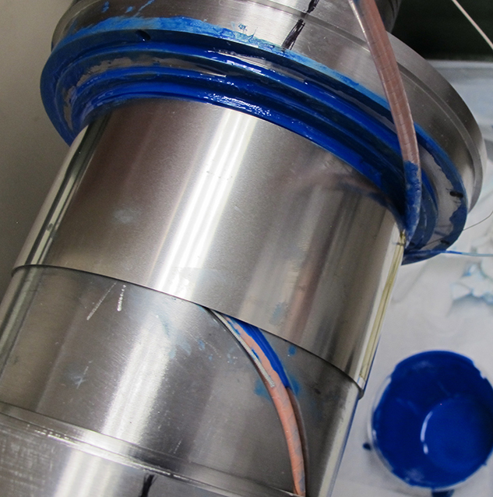
Huub’s impact on CORC® cables and magnets
Huub was an important supporter of CORC® cable testing at 20 T
He used his NHMFL funds to setup the test facility for CORC® cables at 20 T in Cell 4
He made Patrick Noyes and George Miller available for technical support for each of the test campaigns
Huub supported the development of CORC® cable terminations
He arranged for Gerard Willering to support early work in understanding the effect of terminations on current distribution
He made available the “Joint Test Facility” transferred from ORNL to the NHMFL
Huub played a vital role in developing CORC® insert solenoids
He made us understand the importance of interlayer support between the CORC® windings
He was vocal about the importance of developing high-field CORC® solenoids within the NHMFL
5

Slide 6
Development of accelerator magnets based CORC® wires
6

Slide 7
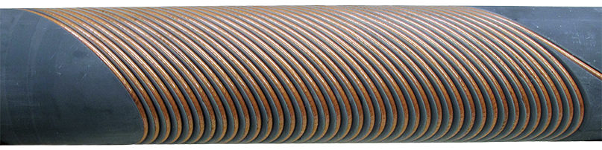
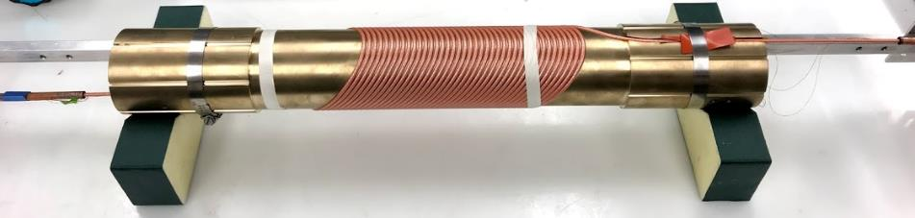
Canted-cosine-theta dipole magnet development based on CORC® wires
Development of low-inductance 20 T dipole CCT magnet by
Developing and demonstrating the CORC®-based CCT magnet technology
Improve the in-field and bending performance of CORC® wires
2017: Demonstration of 1.2 T (CCT-C1)
2-Layer coil, 40 turns per layer
Low-J_{e}, 16-tape CORC® wire
Generated 1.2 T at 4.5 kA
2020: Demonstration of 2.9 T (CCT-C2)
4-Layer coil, 40 turns per layer
Medium-J_{e}, 30-tape CORC® wire
Generated 2.9 T at 6.5 kA
CORC® CCT-C1
CORC® CCT-C2
A 1.2-T canted cos θ dipole magnet using high-temperature superconducting CORC® wires, X. Wang, et al., Supercond. Sci. Technol. 32, 075002 (2019)
Development and performance of a 2.9 Tesla dipole magnet using high-temperature superconducting CORC® wires, X. Wang, et al., Supercond. Sci. Technol. 34, 015012 (2021)
7

Slide 8
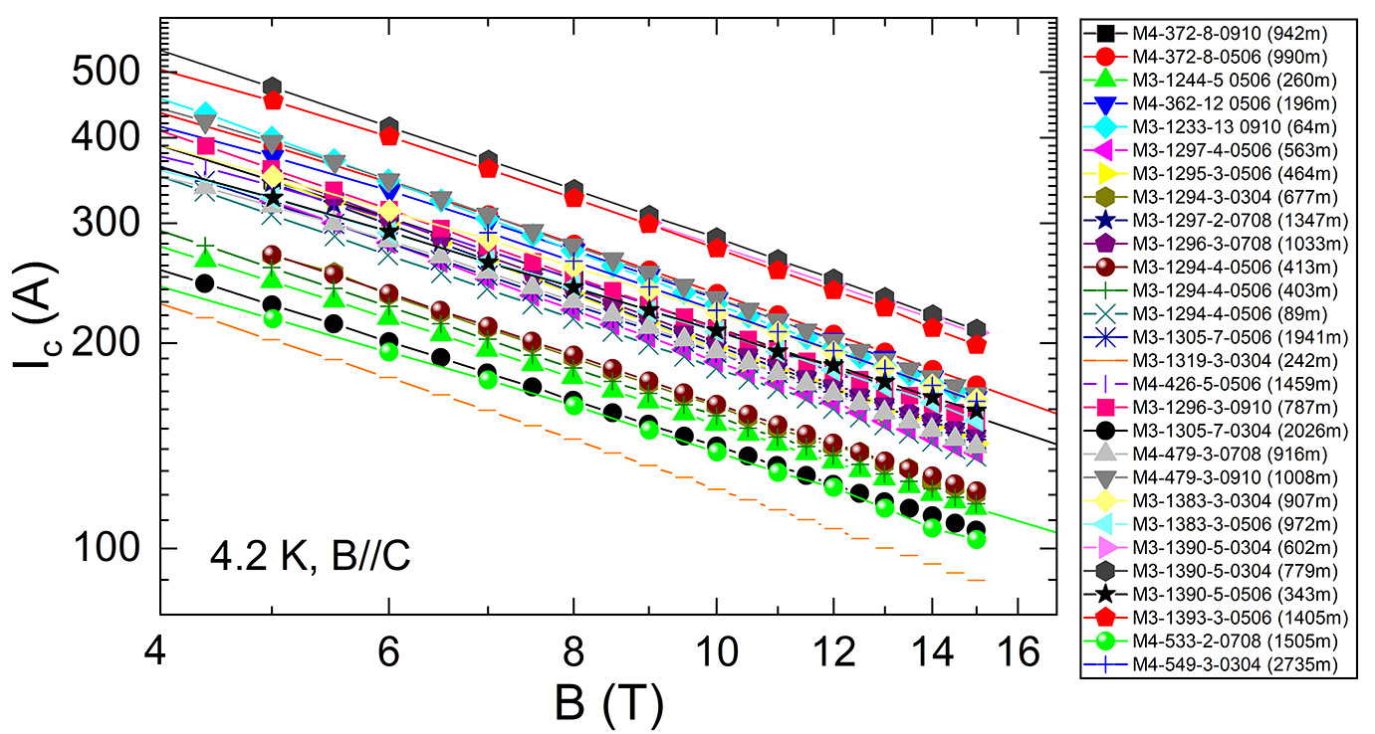
Development for magnet CCT-C3 with 5 T dipole field
How to reach 5 T in CCT-C3?
Magnet containing 6 layers with 40 turns each, requiring 145 meters of CORC® wire
Maintaining the same 30 mm bending radius at poles as CCT-C2
Develop high-J_{e} CORC® wire from 30 tapes using SuperPower’s ”HM” formulation
Performance of SuperPower SCS2030-AP tape 2016 - 2020
Performance of SuperPower SCS2030-HM tape 2021 - 2022
8

Slide 9
Improvement of CORC® wire bending flexibility
Improve bending flexibility of standard 30-tape CORC® wire
Reduce bending degradation for 30 mm bending radius from 20 – 30 % as seen in CCT-C2
Allow future CCT magnets to be based on 20 mm bending radius
CCT-C2 (AP based) CORC® wire
70 – 80 % I_{c} retention at 30 mm radius
CORC® wire (SuperPower HM)
91.8 % I_{c} retention at 25 mm radius
80.3 % I_{c} retention at 17.5 mm radius
CORC® wire (Shanghai Superconductor)
~100 % I_{c} retention at 30 mm radius
97 % I_{c} retention at 20 mm radius
83.5 % I_{c} retention at 15 mm radius
Extensive optimization followed
Danko van der Laan, Jeremy Weiss, Kyle Radcliff and Dmytro Abraimov, Supercond. Sci. Technol. 37 115007 (2024)
9

Slide 10
Latest performance of 30-tape CORC® wires at 4.2 K
SuperPower HM tape
Shanghai Superconductor tape
SuperOx tape
CORC® wire (SuperPower HM tapes)
Tested at 31.5 mm radius hairpin
New record J_{e}(20 T) of 530 A/mm²
87 % of tape performance at 12 T
CORC® wire (SST tapes)
Tested at 20 mm radius hairpin
J_{e}(20 T) of 465 A/mm²
90 % of tape performance at 11 T
CORC® wire (SuperOx tapes)
Tested at 31.5 mm radius hairpin
J_{e}(20 T) of 388 A/mm²
79.6 % of tape performance at 11 T
Danko van der Laan, Jeremy Weiss, Kyle Radcliff and Dmytro Abraimov, Supercond. Sci. Technol. 37 115007 (2024)
10

Slide 11
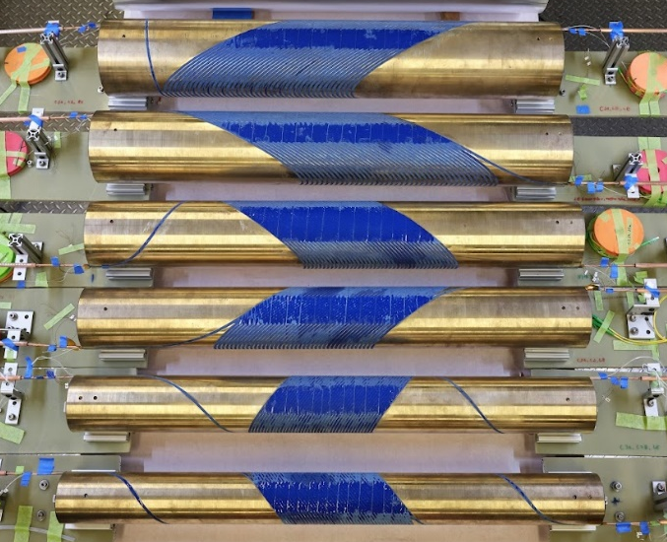
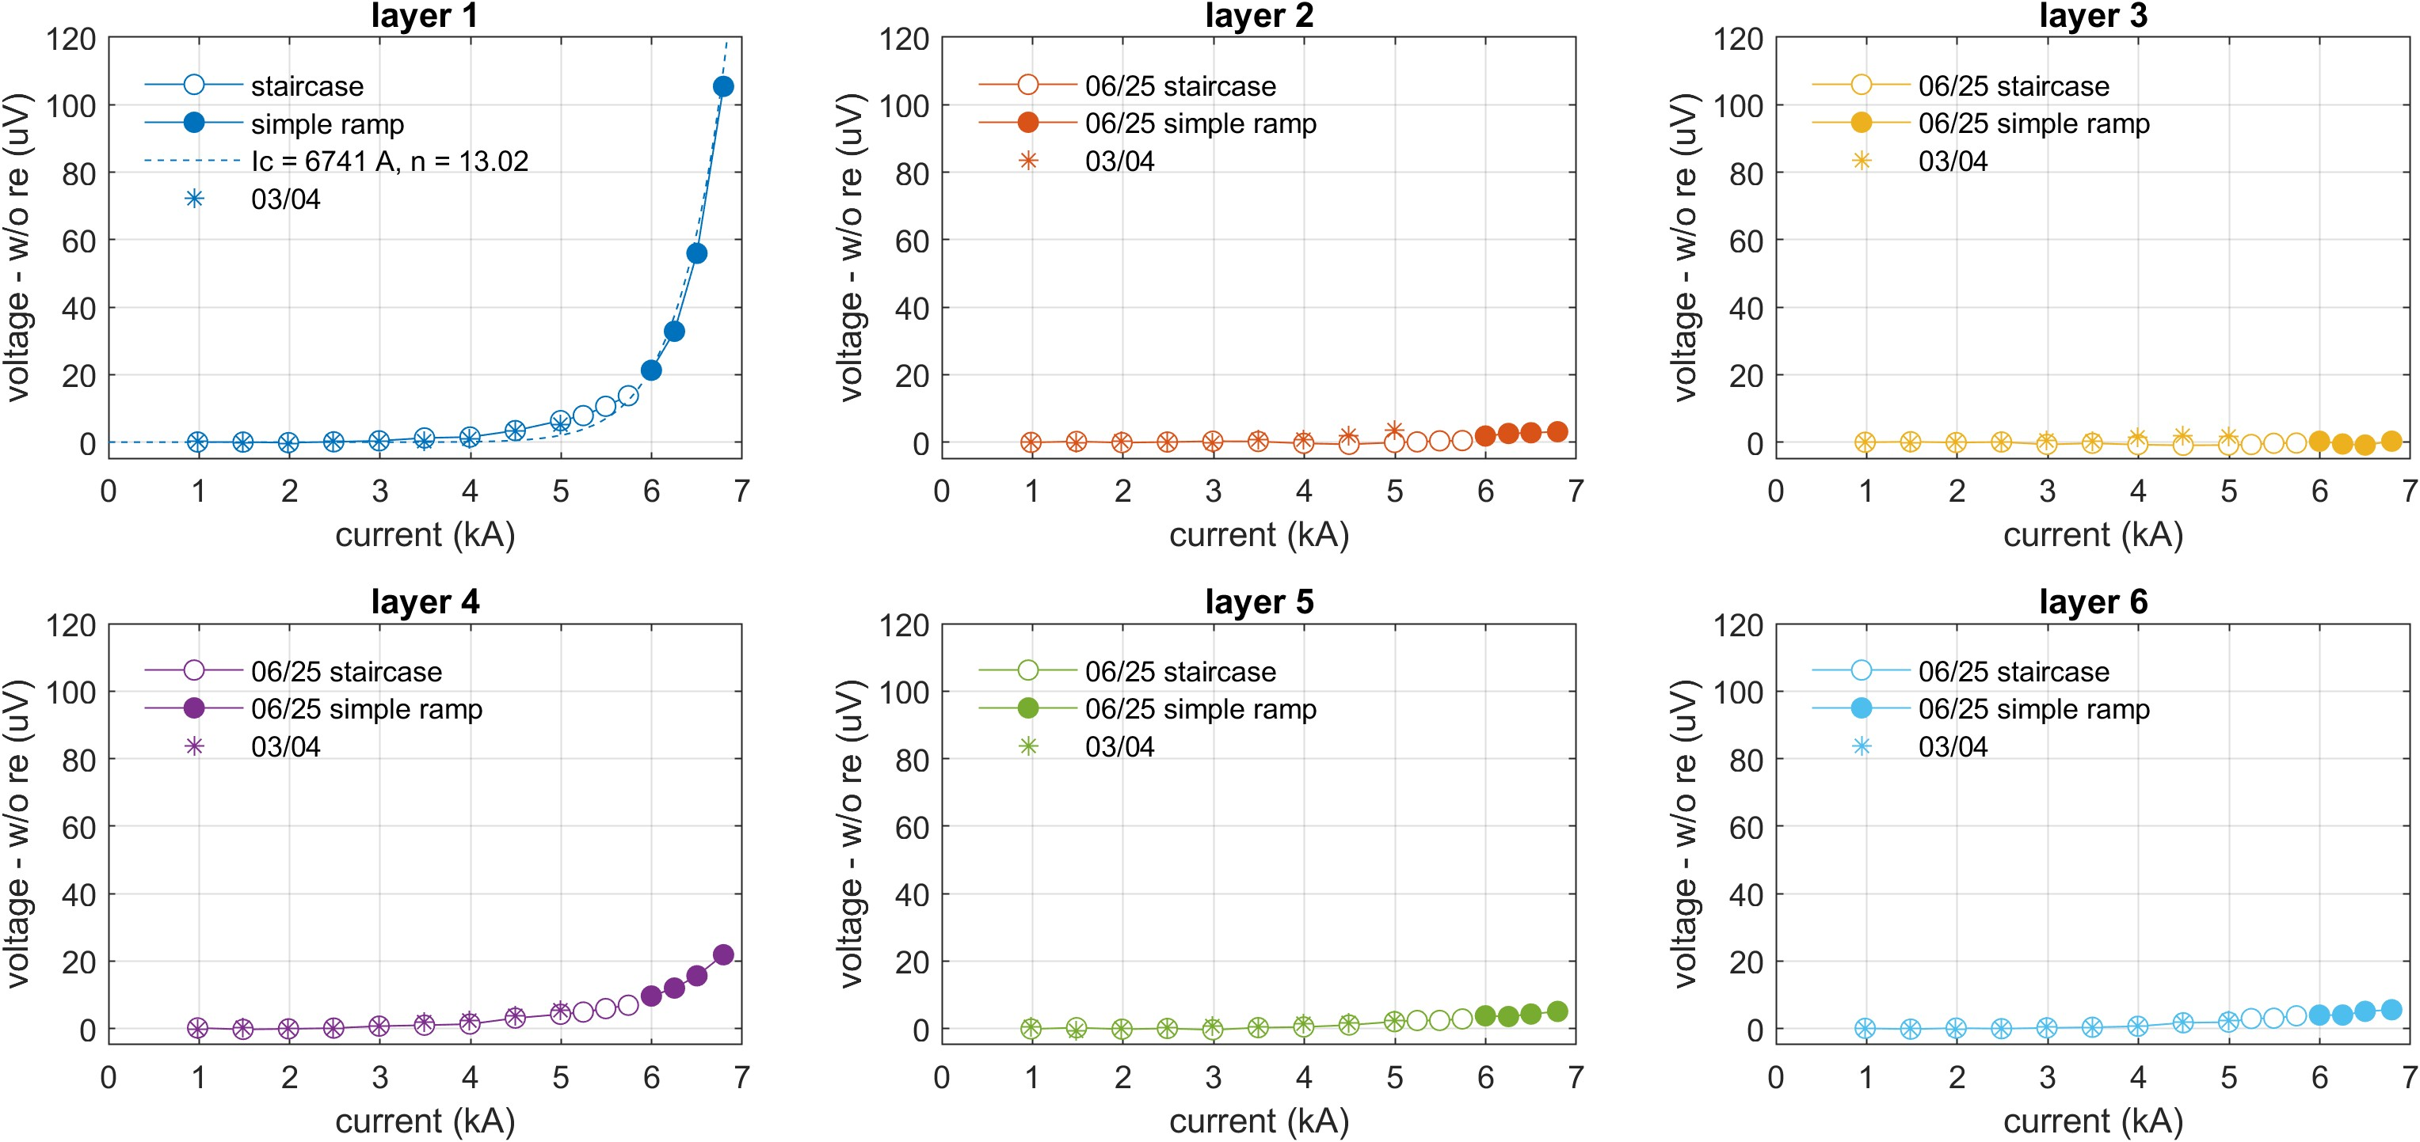
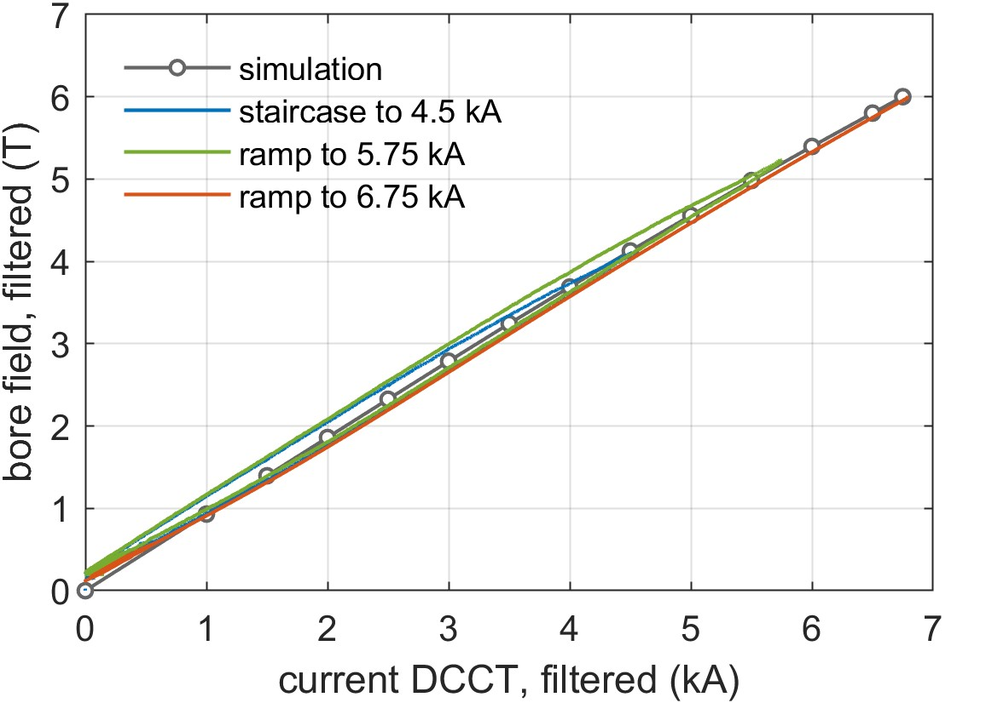
Initial results of dipole magnet CCT-C3: 6 T!
Magnet CCT-C3 exceeded its target of 5 T dipole field!
Dipole field of 6 T achieved at 6.75 kA
Much lower CORC® wire bending degradation than 30 % as assumed in the original magnet design
Inner layer (Layer 1) transition started and reached about 0.1 μV/cm but may have room to reach a dipole field of 6.2 – 6.3 T!
6.0 T
See Yufan Yan talk Wed-Af-Or1-01
11

Slide 12
Development of high-field CORC® solenoids
12

Slide 13
Development of low-inductance 40 T CORC® solenoids
Considerations for achieving 40 T
Combine several CORC® solenoids with an LTS outsert
Operate the CORC® solenoids as stand-alone HTS magnet (allows for 20 K operation)
Use of several nested CORC® coils
Operate most, or all CORC® coils in series
Develop CORC® conductors optimized for each coil
50 mm
< 300 mm
CORC® coil examples
Inner coil with 25 mm radius based on three parallel CORC® wires
Middle coil based on a single CORC® cable
Outer coil based on a CORC® cable containing two separate phases, operated in series
12 T
+
28 T
13

Slide 14
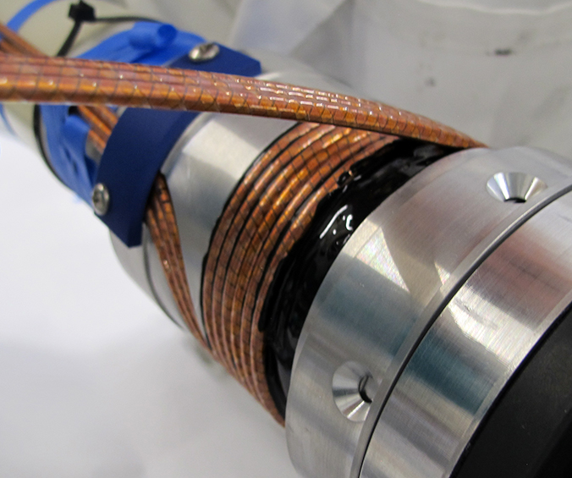
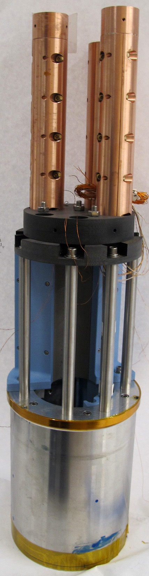
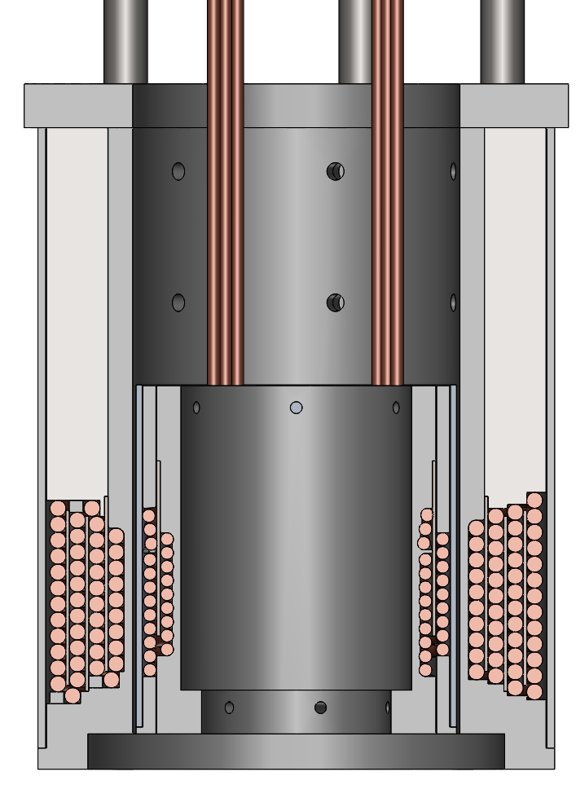
Demonstration of series-connected CORC® solenoids
Series-connection of inner and middle coil
Inner coil wound from three parallel CORC® wires
3 turns per layer, 2 layers
Middle coil based on a single CORC® cable
46 turns, 4 layers (magnet from 2019)
Results
Hall sensors show even current distribution between the three parallel CORC® wires
Peak axial field of 5.14 T reached at 10 kA
5.14 T at 10 kA
150 mm
90 mm
60 mm
14

Slide 15
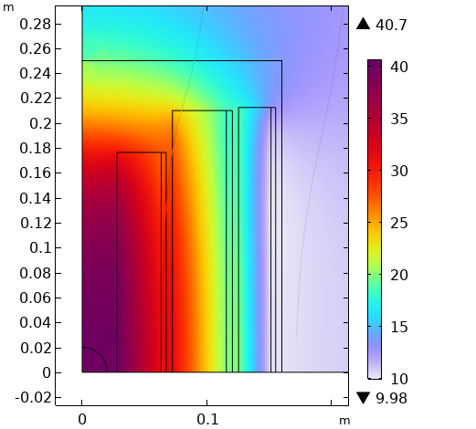
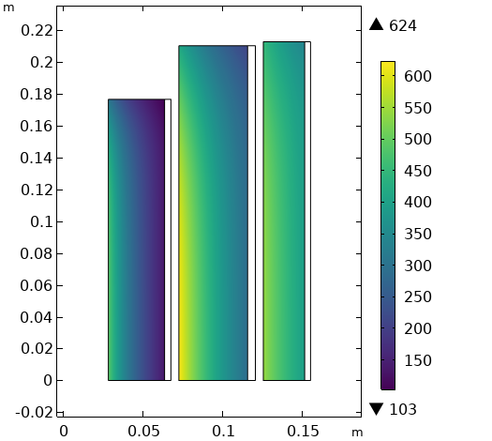

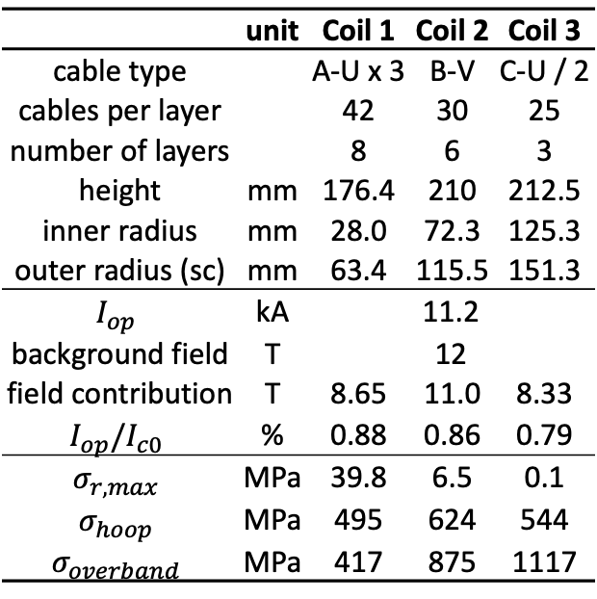

Series-connected 40 T low-inductance CORC® solenoids
Initial iteration of 40 T solenoid
50 mm bore
12 T LTS outsert (Oxford Instruments)
Three CORC® coils connected in series
Stainless steel overbanding over each coil
Operating at 11.2 kA at 80 - 88 % of I_{c}
 | unit | Coil 1 | Coil 2 | Coil 3
cable type |  | A-U x 3 | B-V | C-U / 2
cables per layer |  | 42 | 30 | 25
number of layers |  | 8 | 6 | 3
height | mm | 176.4 | 210 | 212.5
inner radius | mm | 28.0 | 72.3 | 125.3
outer radius (sc) | mm | 63.4 | 115.5 | 151.3
$$I_{op}$$ | kA | 11.2
background field | T | 12
field contribution | T | 8.65 | 11.0 | 8.33
$$I_{op}/I_{c0}$$ | % | 0.88 | 0.86 | 0.79
$$σ_{r, max}$$ | MPa | 39.8 | 6.5 | 0.1
$$σ_{hoop}$$ | MPa | 495 | 624 | 544
$$σ_{overband}$$ | MPa | 417 | 875 | 1117
$$\left|B\right| (T)$$
$$σ_{φ} (MPa)$$
See Yufan Yan Poster Fri-Af-Po.06-06
15

Slide 16
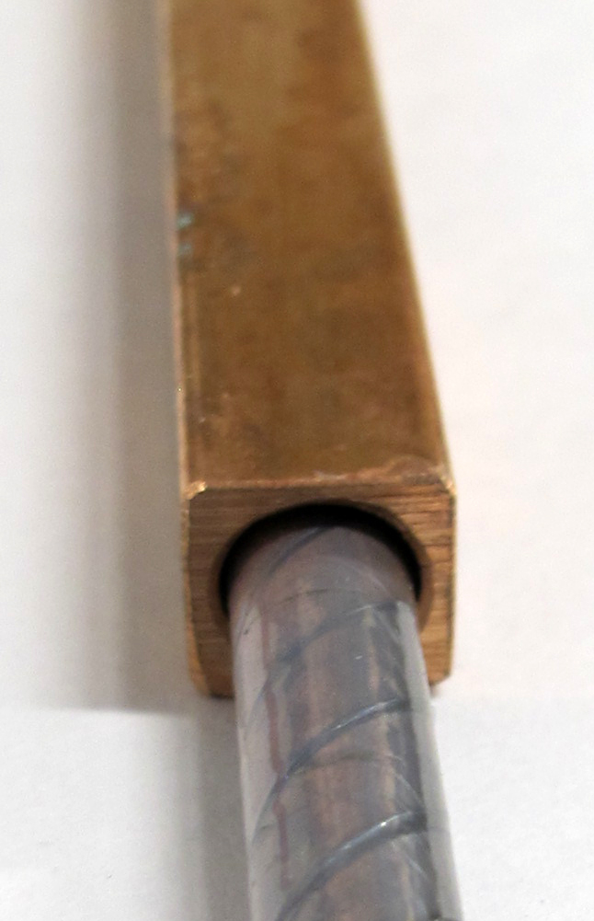
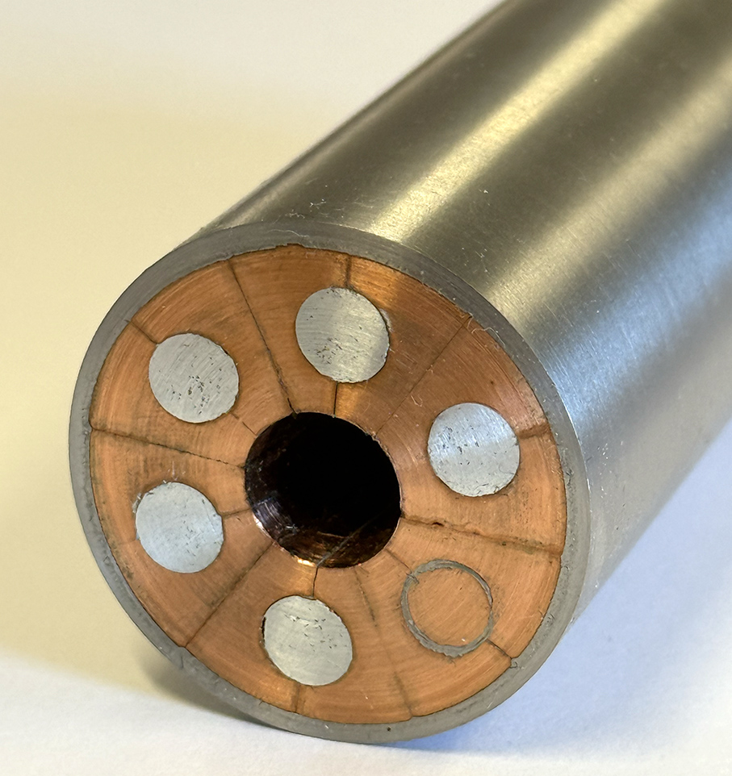
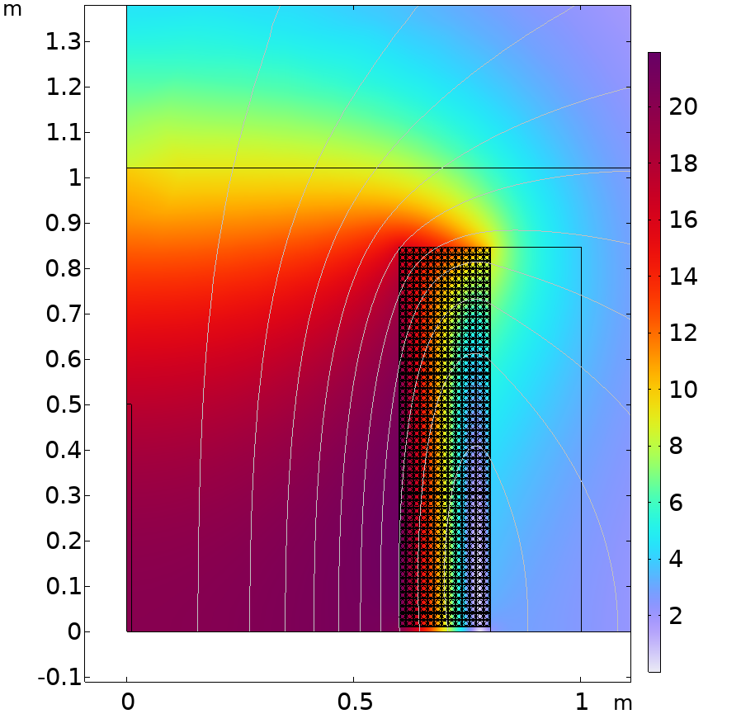
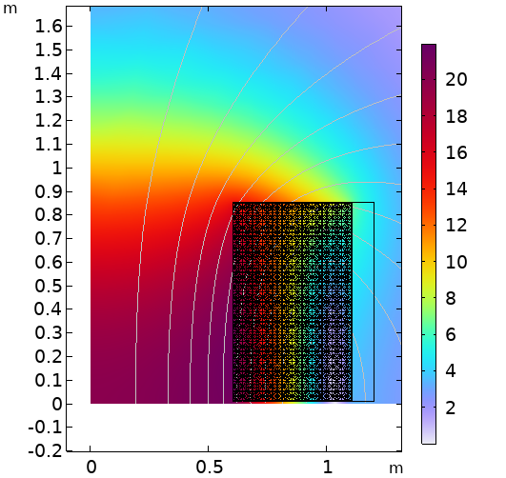

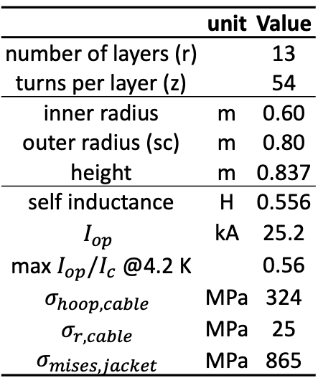

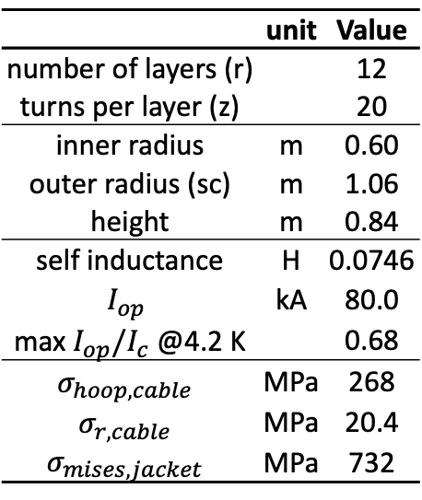
20 T Large-bore CORC® solenoids
Initial iterations of large-bore 20 T solenoids
Single CORC® coil
1.2 m bore as needed for the muon collider target and capture solenoids
Two options are considered
6-around-1 CORC®-CICC
Jacketed CORC® cable
 | unit | Value
number of layers (r) |  | 12
turns per layer (z) |  | 20
inner radius | m | 0.60
outer radius (sc) | m | 1.06
height | m | 0.84
self inductance | H | 0.0746
$$I_{op}$$ | kA | 80.0
max $I_{op}/I_{c}$ @4.2 K |  | 0.68
$$σ_{hoop, cable}$$ | MPa | 268
$$σ_{r, cable}$$ | MPa | 20.4
$$σ_{mises, jacket}$$ | MPa | 732
 | unit | Value
number of layers (r) |  | 13
turns per layer (z) |  | 54
inner radius | m | 0.60
outer radius (sc) | m | 0.80
height | m | 0.837
self inductance | H | 0.556
$$I_{op}$$ | kA | 25.2
max $I_{op}/I_{c}$ @4.2 K |  | 0.56
$$σ_{hoop, cable}$$ | MPa | 324
$$σ_{r, cable}$$ | MPa | 25
$$σ_{mises, jacket}$$ | MPa | 865
$$|B|(T)$$
$$\left|B\right| (T)$$
See Yufan Yan Poster Fri-Af-Po.06-06
16

Slide 17
Summary
Development of high-J_{e} CORC® wires with increased bending flexibility
An extensive optimization of CORC® wires has resulted in much better bending flexibility:
  I_{c} retention of 97.5 % at 20 mm radius improved from 78 % I_{c} retention at 30 mm radius
  I_{c} retention of 83.5 % at 15 mm radius
CORC® wires have demonstrated very high current densities, while bent to small diameters:
  J_{e}(20 T) of 530 A/mm² achieved in CORC® wire wound from SuperPower HM tape with 87 % I_{c} retention at 31.5 mm bending radius
  J_{e}(20 T) of 465 A/mm² achieved in CORC® wire wound from Shanghai Superconductor production tape with 90 % I_{c} retention at 20 mm bending radius
Development of accelerator magnets based on CORC® wires
Canted-cosine-theta magnets have demonstrated 1.2 T and 2.9 T dipole fields
The improved bending performance of CORC® wires resulted in a dipole field of 6 T in the latest CCT magnet, overshooting its 5 T target by 20 %
A new program developing low-inductance, high-field solenoids from CORC® cables is about to start
40 T hybrid and stand-alone solenoids with 50 mm bore
20 T stand-alone solenoids with 1.2 meter diameter bore
17

