Slide 1

A Spectrometer Design That Fulfills EIC Interaction Region Machine Detector Interface Requirements
B. Parker¹, M. Anerella¹, Y. Bai¹, J. Becker¹, J. Escallier¹, P. Joshi¹, M. Kumar¹, A. Marone¹, C. Runyan¹, V. Teotia¹ and H. Witte²
¹ Brookhaven National Laboratory
² MIT Bates Research & Engineering Center
Oral Contribution ID: Fri-Mo-Or4-01

Slide 2
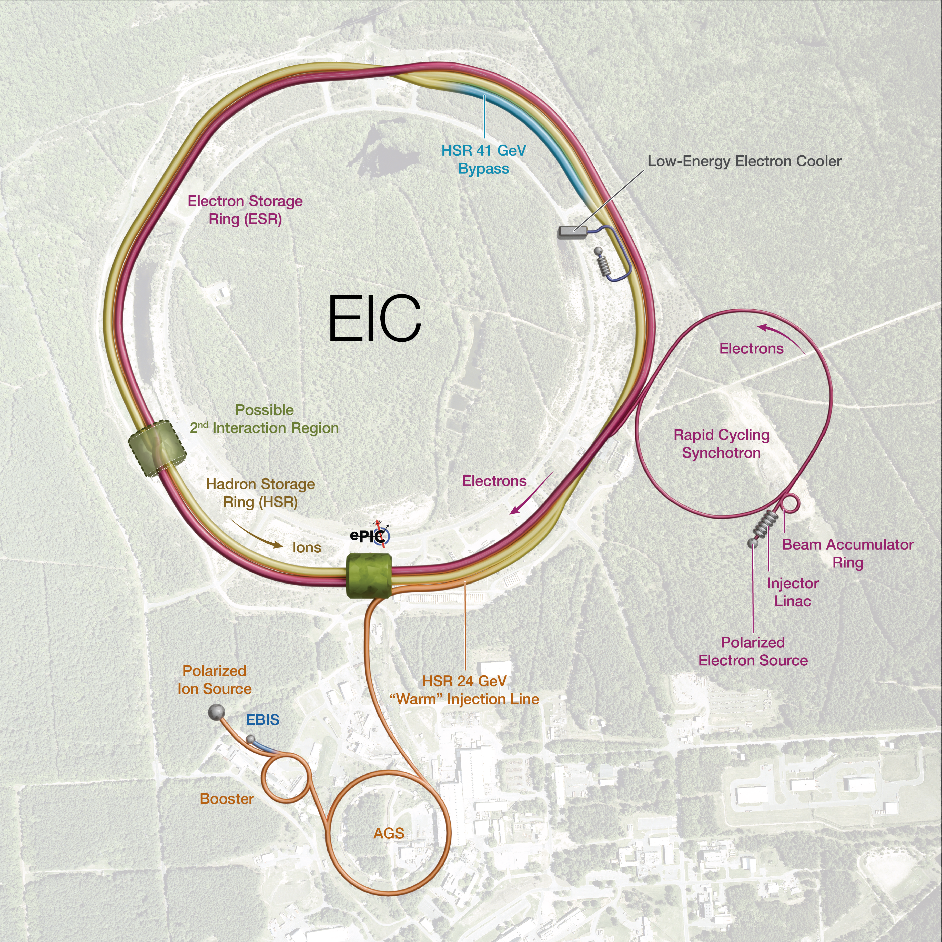
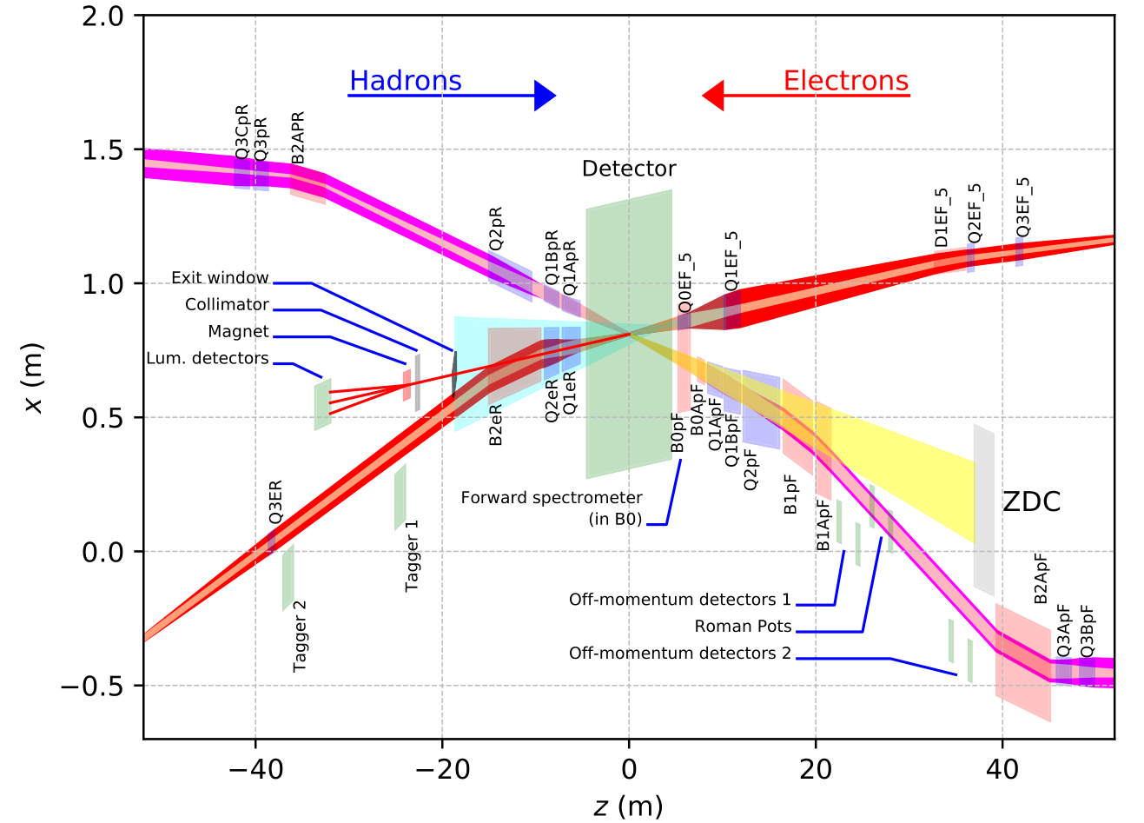
EIC High Level Requirements Impacting B0
EIC Facility Performance Goals:
High Luminosity: L= 10³³ – 10³⁴cm⁻²sec⁻¹
Large Ion Species Range: protons – Uranium, E_{beam} = 41 – 275 GeV
  The hadron storage ring (HSR) will be ramping
  The HSR crosses transition for heavy ions (ramp speed matters)
  Constant field at all hadron storage energies for B0 Spectrometer
Electron-Hadron collisions:
Three different electron energies (5/10/18 GeV)
25 mrad total crossing angle
So the e & h beam pipes are very close at the B0 location
Use existing RHIC facility infrastructure
  Support structure needed for B0 inside experimental hall
EIC Layout
12
10
2
8
4
6
IR6 Details
25 mrad
B0PF-Q0EF are the combined B0 magnets described in this talk.
(compressed z-scale)

Slide 3
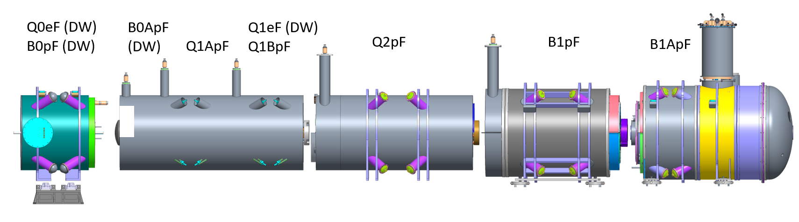
IR6 Straight with New Superconducting Magnets
EIC EPIC DETECTOR
Rear Side
(e-beam Direction)
B0PF-Q0EF in IR Hall
Forward Side
(h-beam Direction)
Forward Cryostats
IR6 Hall
CAD Model by K. Hamdi
See talk M. Anerella, Mo-Or4-02, this session.

Slide 4
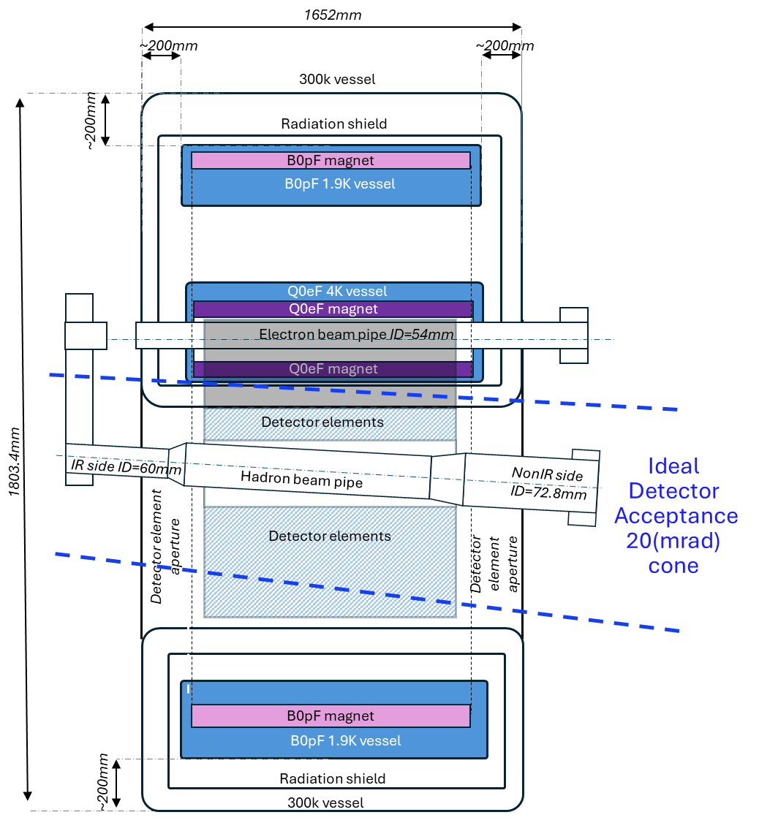
B0PF-Q0EF Design Requirement Challenges
Figure from B0 PDR Document
Experiment needs spectrometer to catch particles at angle too small for main detector but too large to make it through forward apertures to Roman Pots and ZDC.
The electron ring needs a first focusing quadrupole as close as possible to the IP (overlap detector elements).
Hadron ring needs to start beam separation as soon as possible to clear the downstream crab cavities.
Starting the hadron focusing closer to IP is also helpful.
Unlike for other forward magnets, there is not enough space for magnetic yoke material between the electron and hadron coil structures (strong field cross-talk???).
e-beam
h-beam
Our solution is to combine these magnets and put the Q0EF focusing structure “inside” the main B0PF coils.

Slide 5
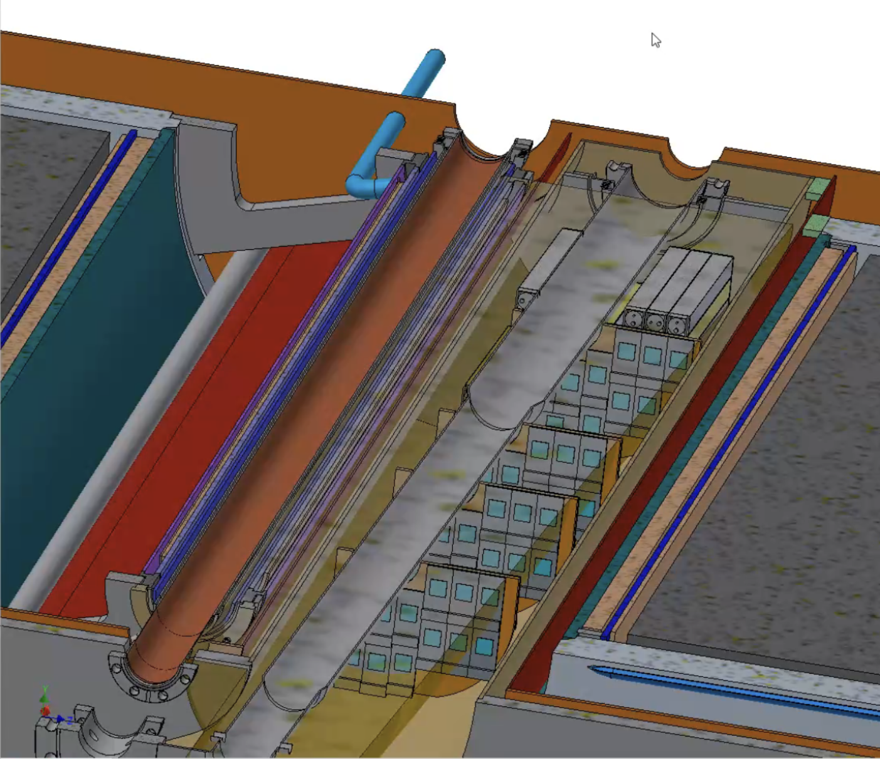
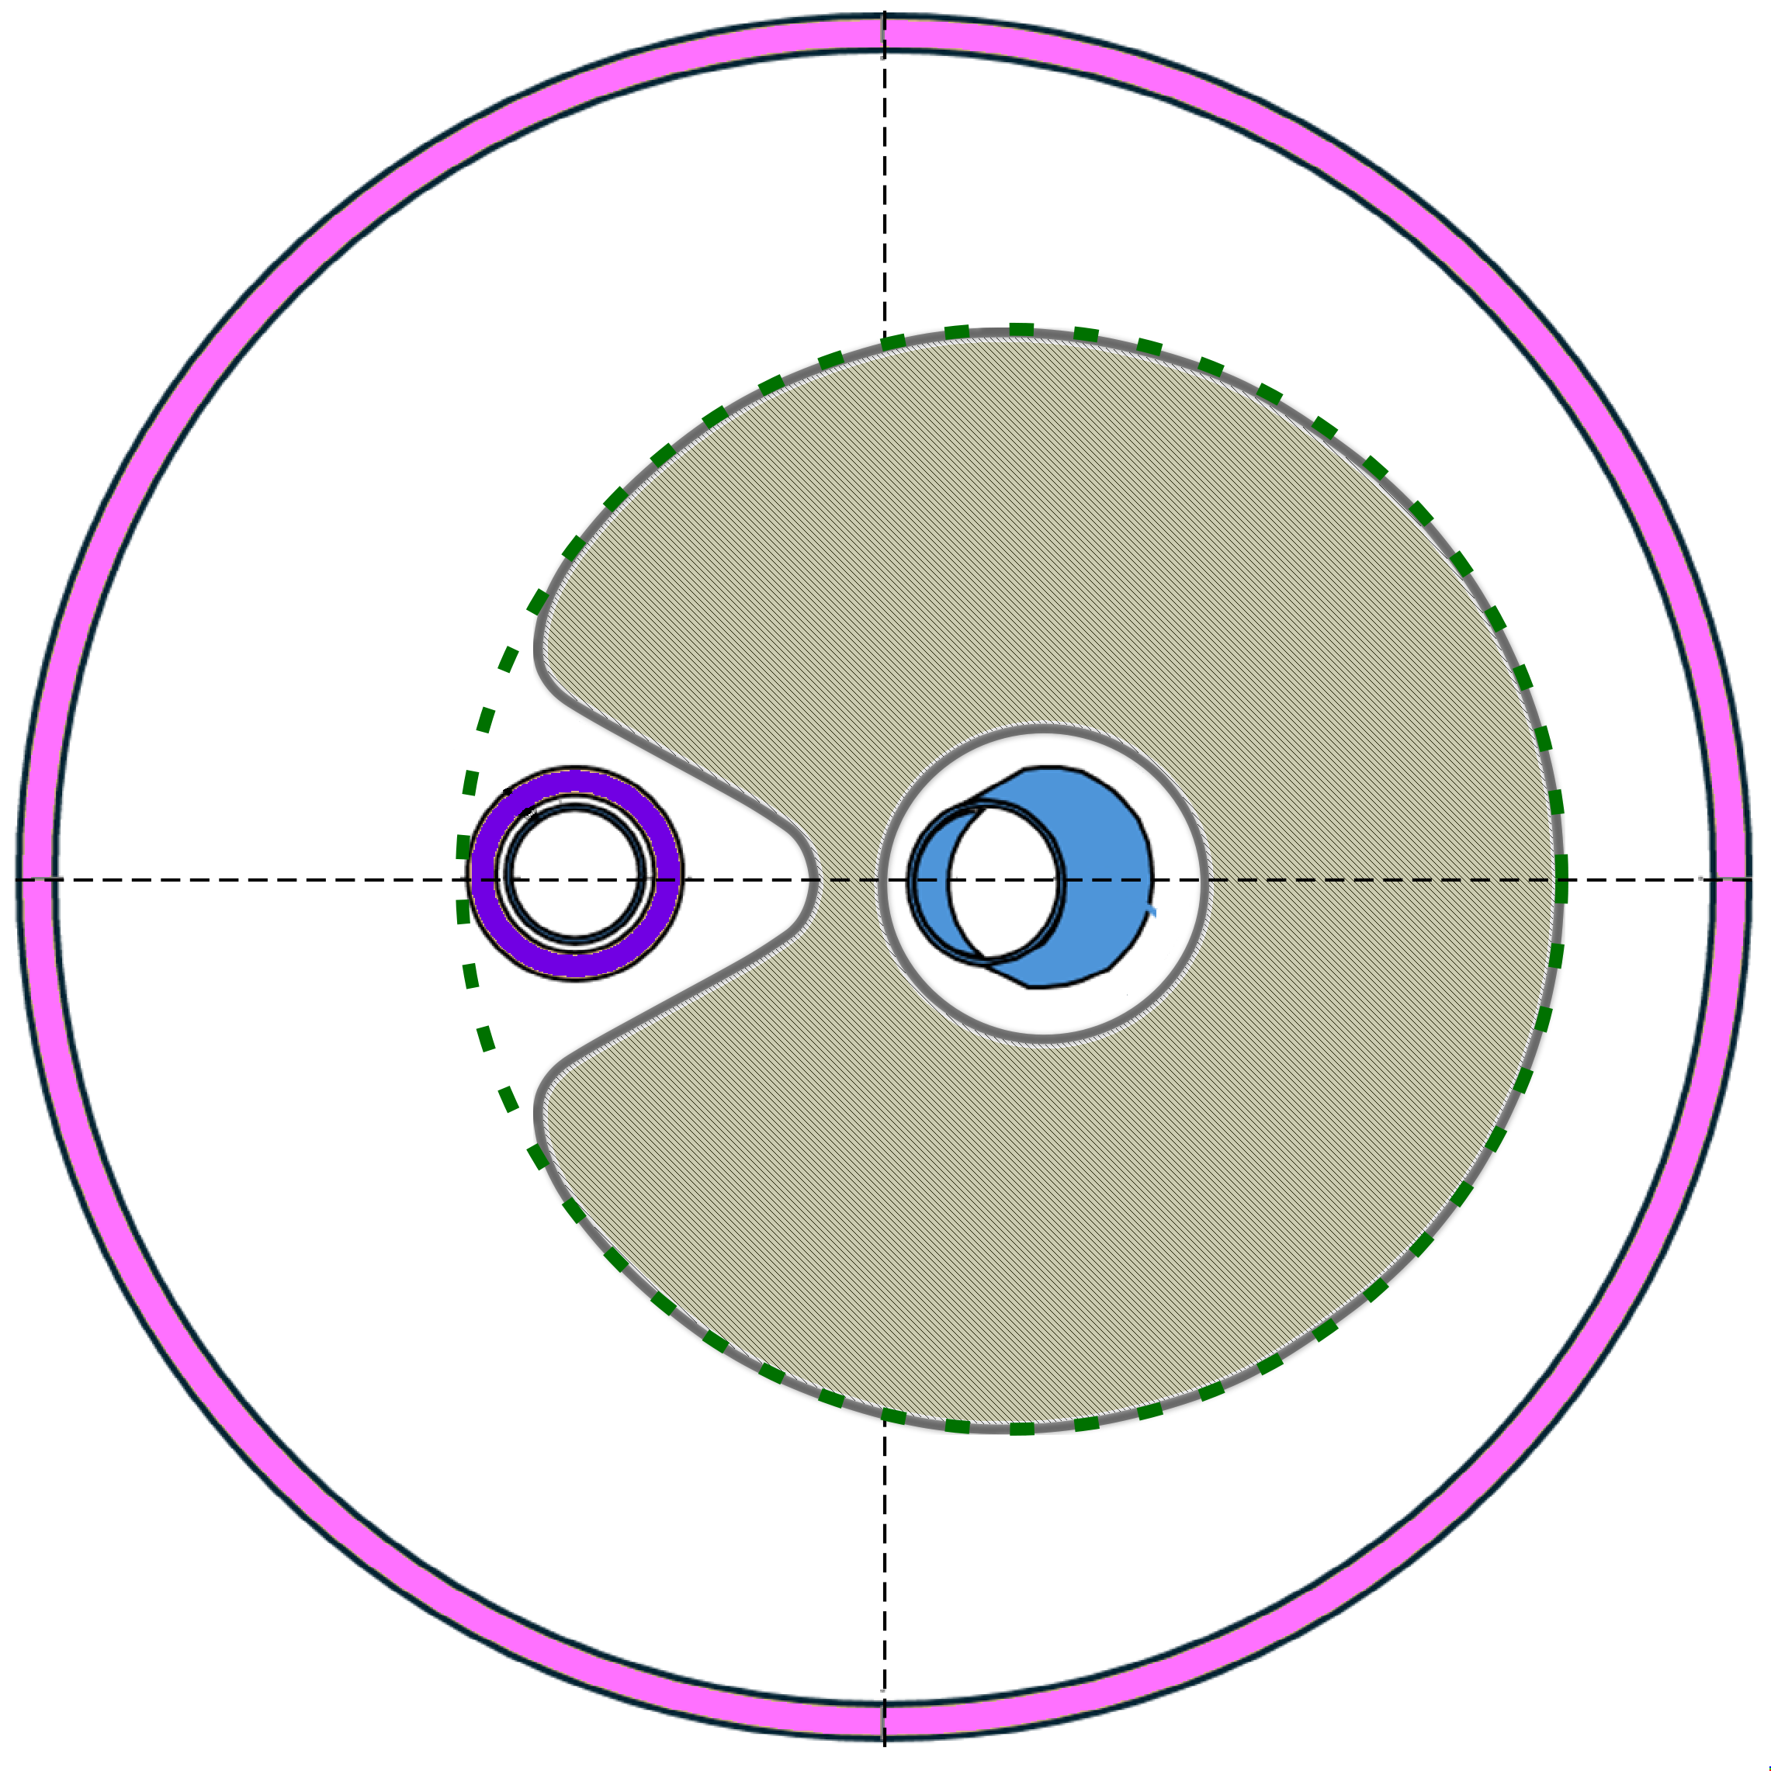
B0PF-Q0EF Geometric Layout
Q0EF is first e-beam IR quad and is near to B0PF warm space for detector elements.
25 mrad crossing angle & 20 mrad acceptance cone → Q0EF overlaps this space.
Green cone shows 20 mrad acceptance
1.9K B0PF Inner Cold Mass
Surface
Idealized
Space for
Detectors
Actual Warm Space Available for Detectors
4.5K Q0EF
Coil Space
Electron Beam Pipe
Hadron
Beam
Pipe
Electron
Beam
Pipe
Hadron Beam Pipe
Detector Elements

Slide 6
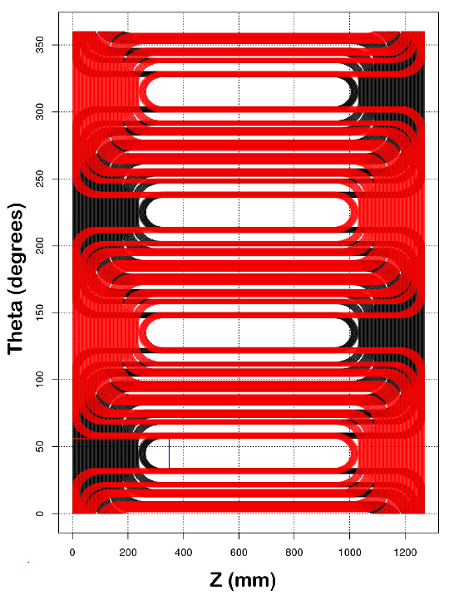
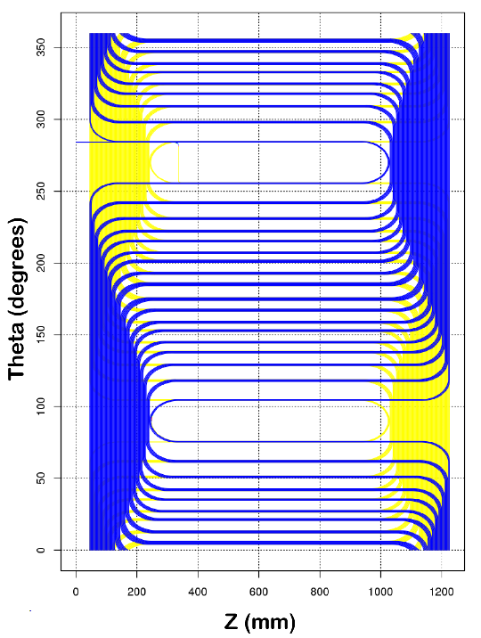
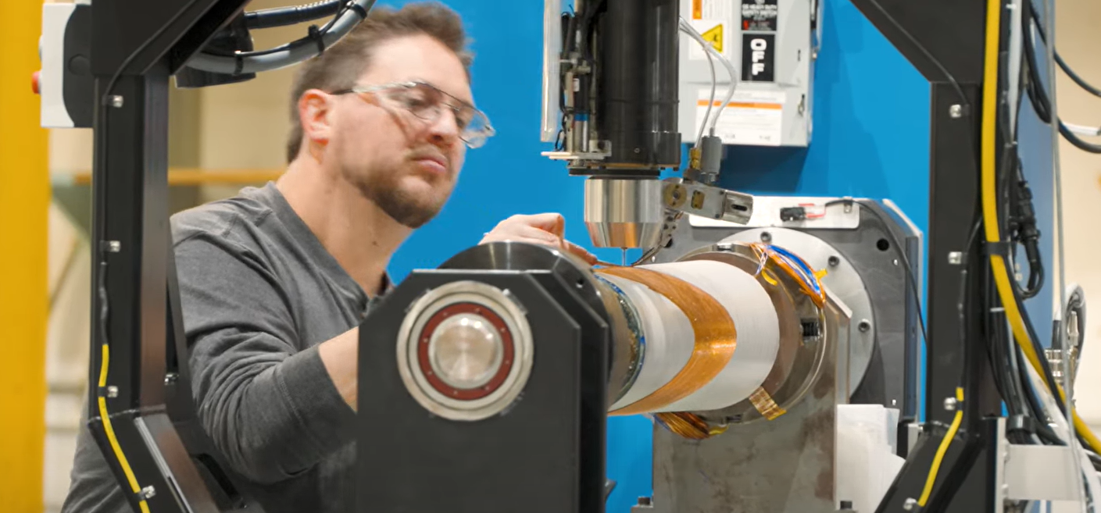
Combined Function B0PF Coil Optimization
B0PF Quad Serpentine Coilset A
B0PF Dipole Serpentine Coilset
BNL Direct Wind Machine
YouTube Direct Wind Video
Coils are Serpentine patterns wound in layer pairs using BNL Direct Wind.
Coil ends and pattern lengths are set to minimize e-beam field excursions.*
Number of layers and turn ratios are set to run quad and dipole in series.
Dipole is wound on a separate support tube from the quadrupole layers (for relative angular adjustment).
*We must avoid making a strong wiggler magnet pointed at IP!

Slide 7
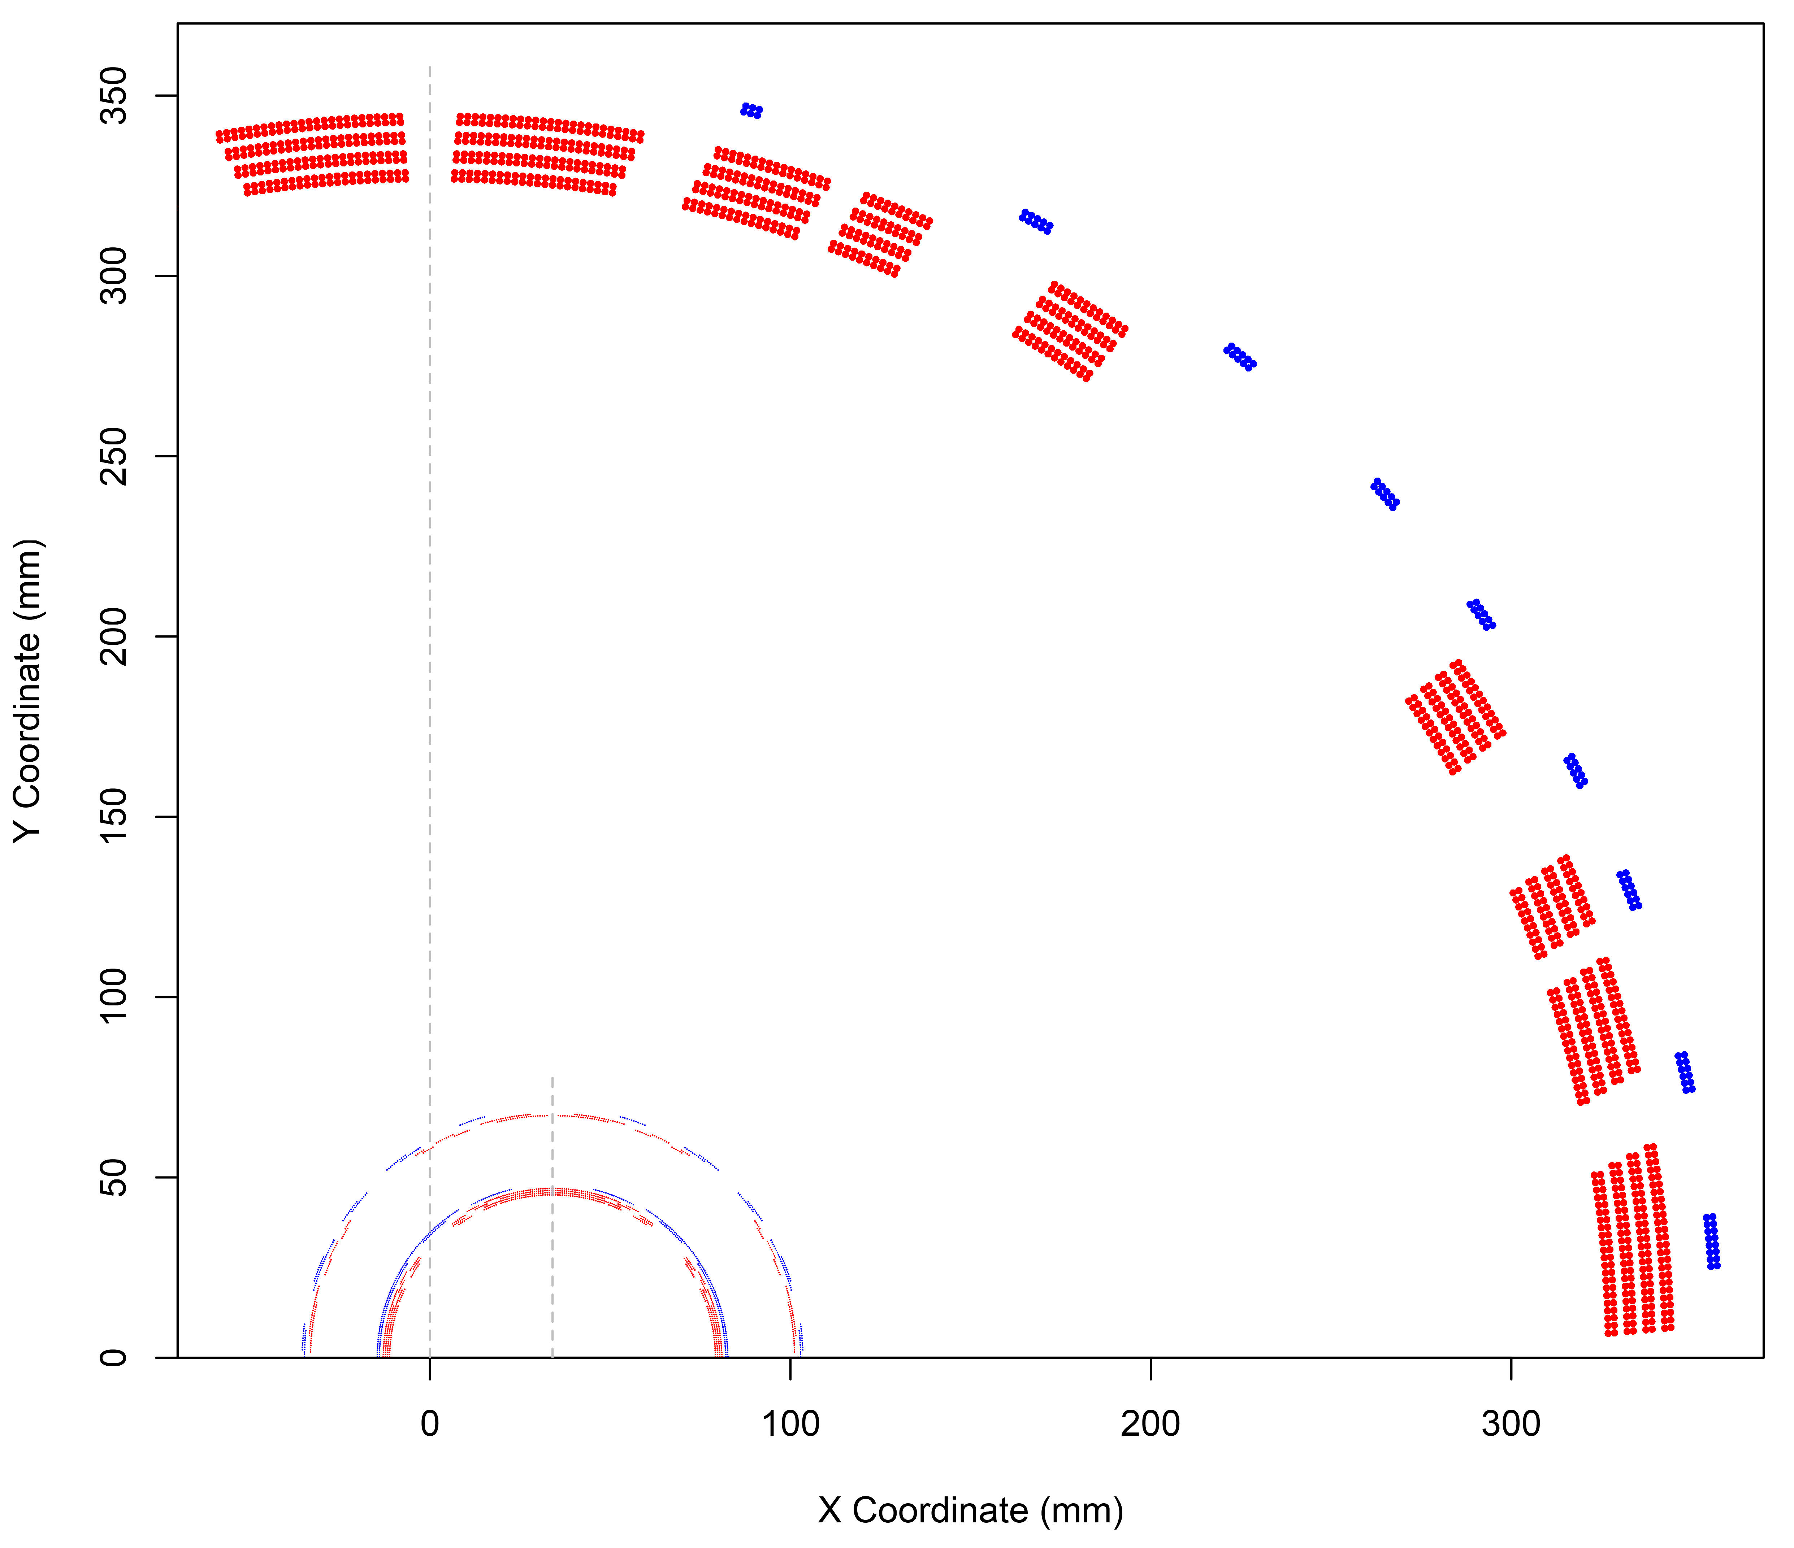
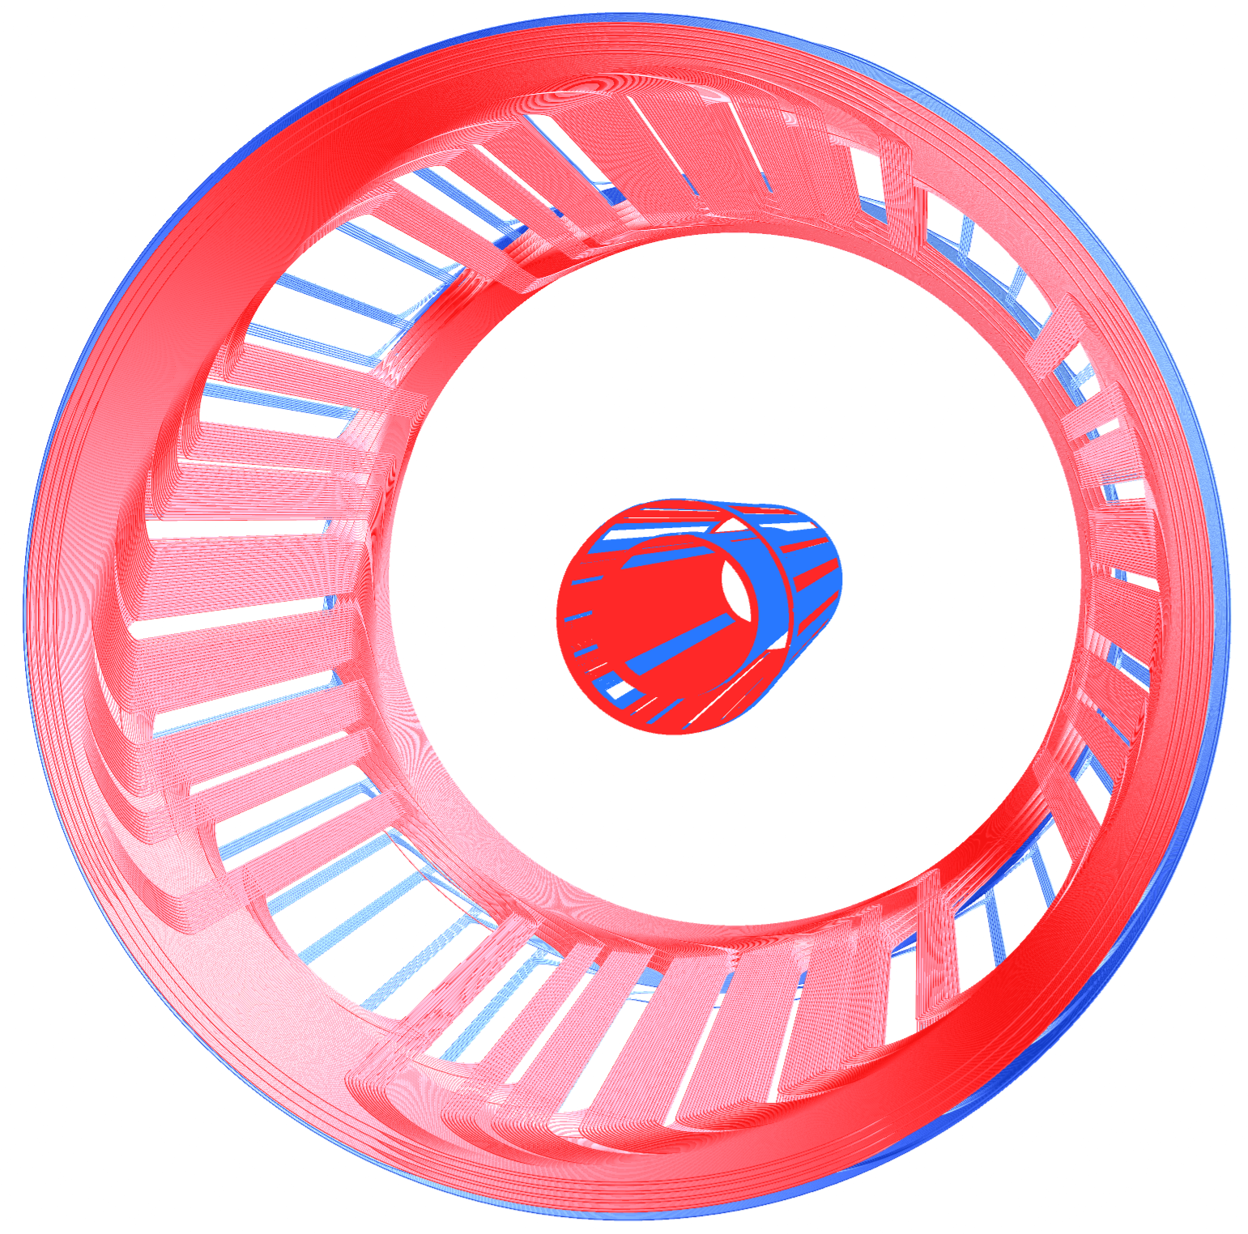
B0PF-Q0EF Superconducting Coil Layouts
3D View
2D Section
B0PF Coil Axis
B0 Dipole Layers
B0 Quad Layers
Q0EF Axis @ 34 mm
Q0 Gradient Tuning Layers
Q0 Dipole Corrector

Slide 8
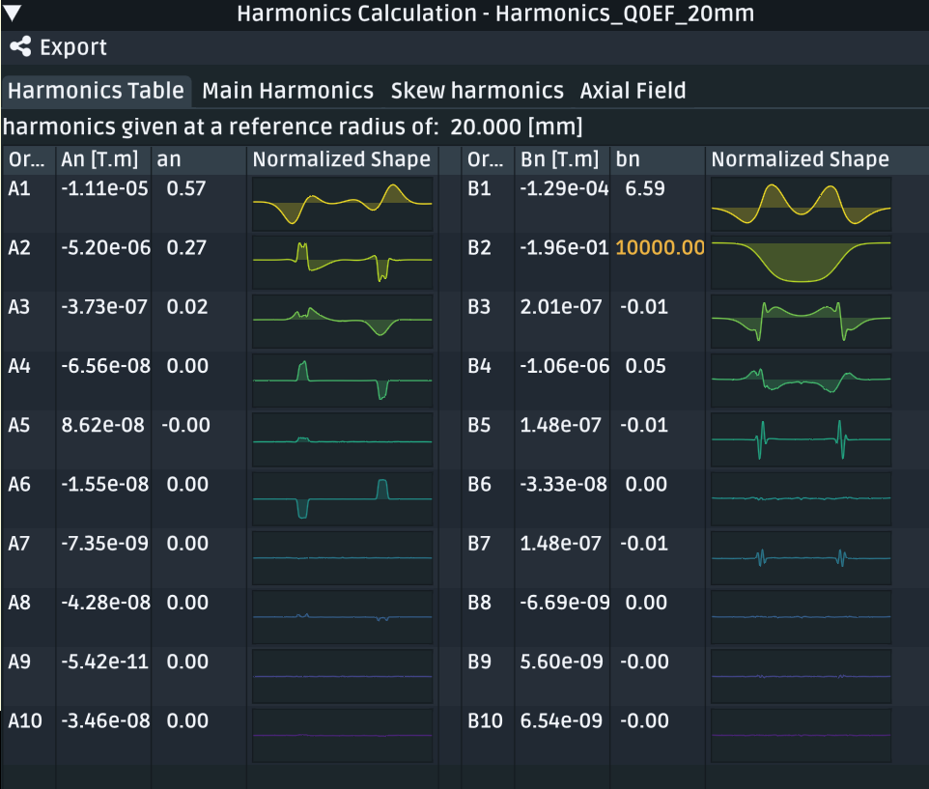
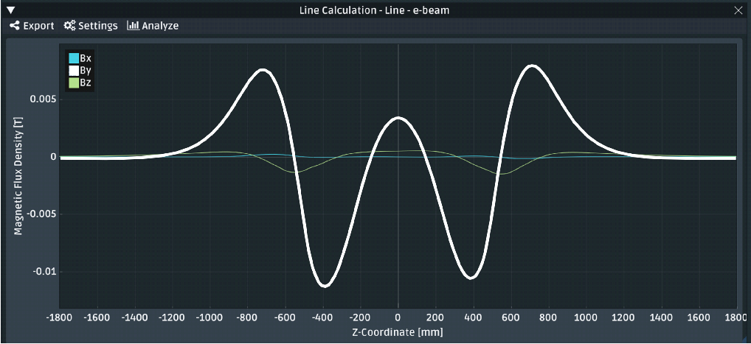
Resulting Q0EF Quadrupole Due To B0PF Coils
Q0EF Harmonics at R_{ref} = 20 mm
*
Q0EF Residual Field at the Beam Axis
Present beam tube ID is 53.85 mm
IP Side
Non-IP Side
Integrated By
is 4e-6 THm
Gradient Tuning Coil Operation
18 GeV -16.20 T, Iop = -71.1 A
10 GeV -9.00 T, Iop = 8.9 A
5 GeV -4.50 T, Iop = 58.9 A
Assume 100 A, bipolar, power supplies.
Note: During course of design optimization, the dipole corrector field was reduced from about 700 gauss to present 76 gauss. Dipole corrector needed for orbit control and compensating imperfect main-coil field cancellation.
*Synrad requirement figure of merit is to minimize integral B² at e-beam axis.

Slide 9
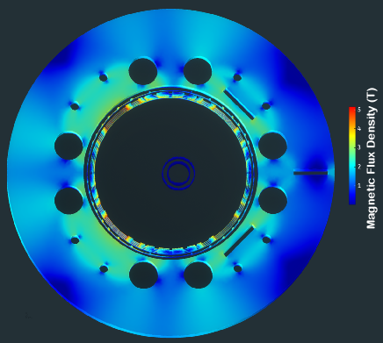
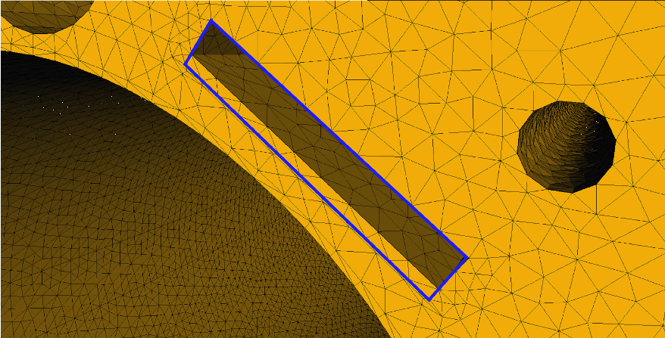
B0PF-Q0EF Magnetic Yoke Optimization
B0PF–Q0EF Magnetic Flux
Yoke Slots for Field Harmonic Tuning (Detail)
Fields cancel on this side
Tuning Slot
Fields add on this side
Tuning Slot
Q0EF
B0PF
Analyze field harmonics w.r.t. coil axis at 2/3 coil radius (e.g. 218 mm).
Using slots shown, empty gives +24 units b3 while full yields -34 units
Optimum has 7.2 mm of fill with magnetic shimming (as shown above).
Tuning Slot
During collisions, B0 main field is kept constant; however, during hadron injection, field is temporarily reduced, and we find at 10% operating current that the b3 harmonic content at the hadron beam axis is small, -0.7 units.

Slide 10
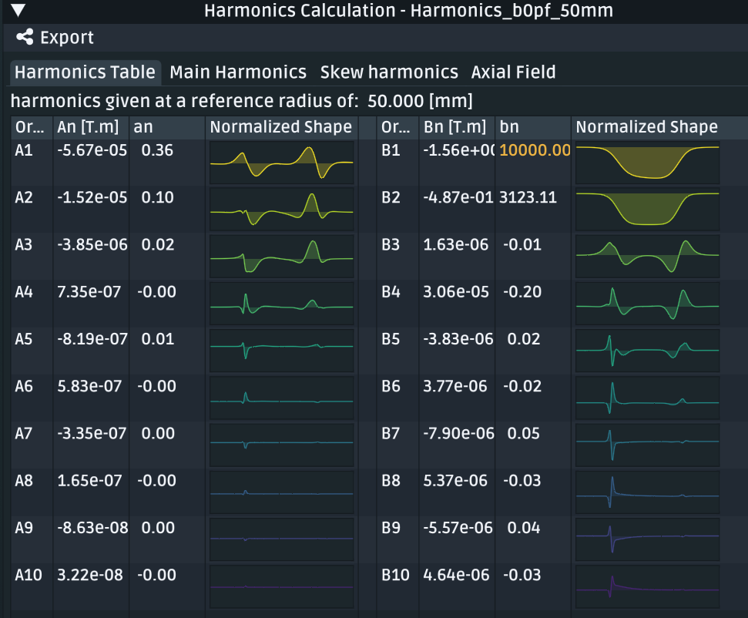
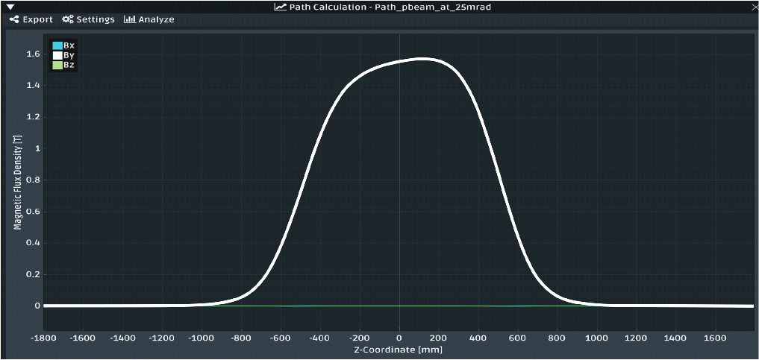
Resulting B0PF Field Harmonics
B0PF Harmonics at R_{ref} = 50 mm
B0PF Field, By, at Hadron Beam Axis (25 mrad)
Present beam tube ID runs from 27 to 36 mm†
For I_{op} = 1143 A
Integral = 1.56 THm
IP Side
Non-IP Side
Hadron beam passes through combined function field at 25 mrad angle; thus, field profile is not symmetric about longitudinal center.
With 326. mm inner coil radius and 1.27 m coil pattern length, the effective magnetic length is 1.00 m (central field 1.56 T).
Integrated gradient is -9.74 T (vertically focusing for hadrons).
†50 mm reference radius displayed for historical reasons; with smaller R_{ref} unwanted harmonics will be even smaller.

Slide 11
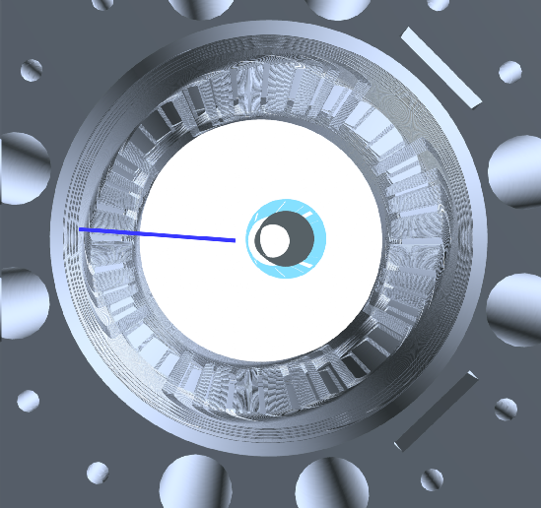
Avoiding Poor B0PF Harmonics Due to e-Beam Coils
When the Q0EF gradient tuning coil is energized appropriately for 18 GeV or 5 GeV operation, there is an unacceptably large swing (−39 to +29 units) in unwanted b3 field harmonics at the hadron beam.
And because of this −/+ swing it is not possible to correct these harmonics at every energy using only the yoke harmonic adjustment tuning features.
However, much like the ILC QD0 baseline design, we can use a larger radius quadrupole coil with an opposite polarity (connected in series) to kill off the Q0EF external field (e.g. we use active shielding).
The electron dipole corrector also has its own active shield connected in series.
Active Shield Coils
h-Beam Path
Note: As we will see later, the active shield coils also cancel the mutual inductance of Q0EF with respect to the main B0PF coils which is important for quench protection.

Slide 12
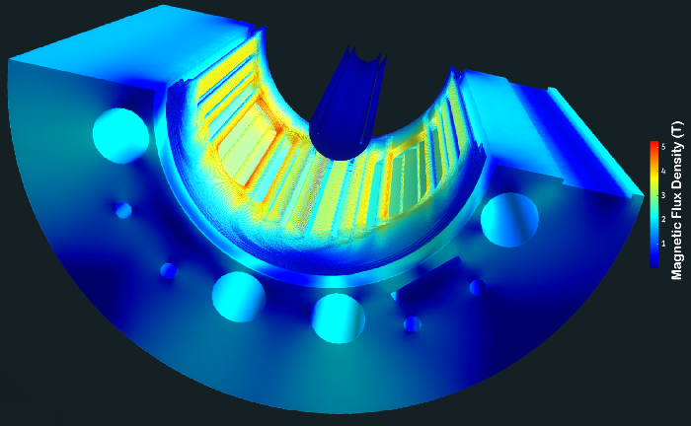
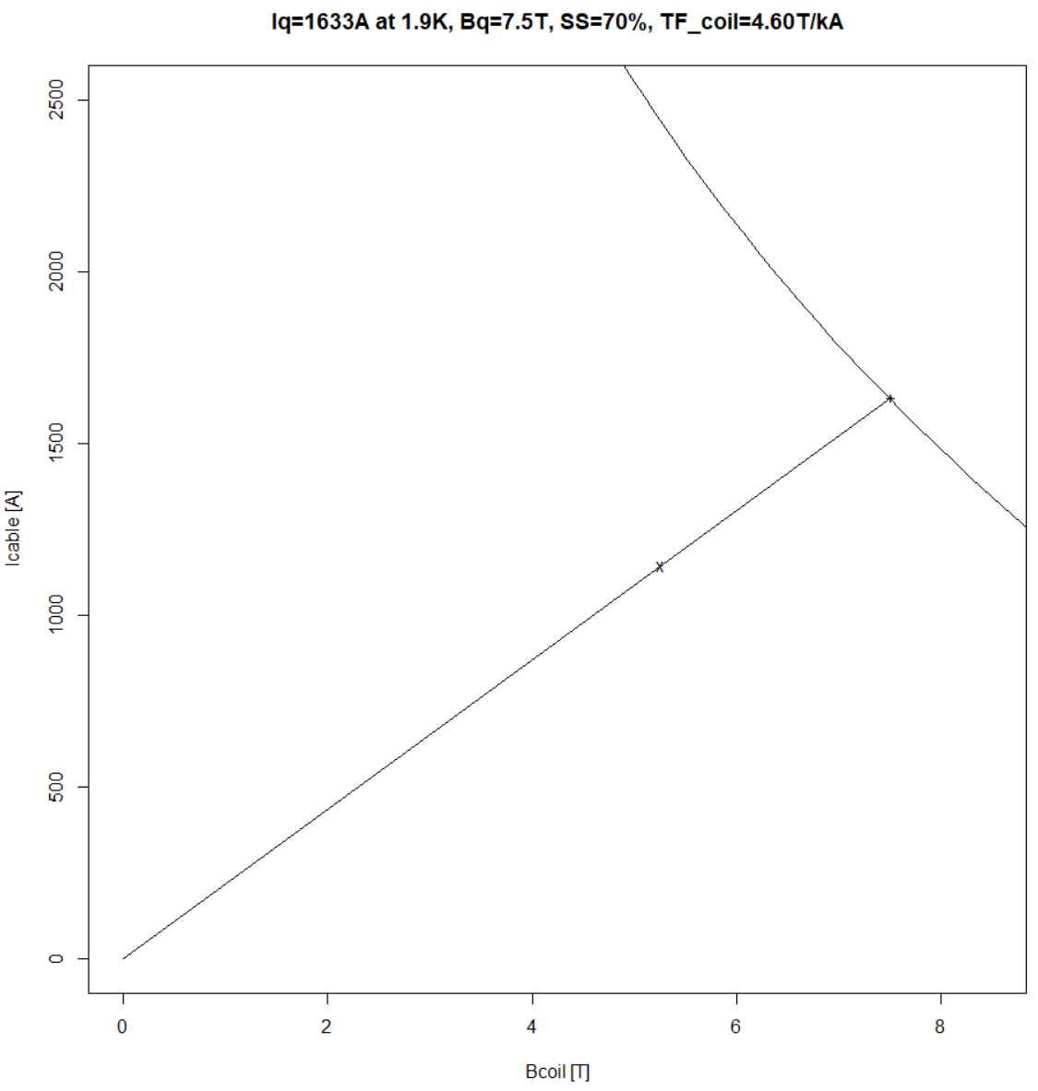
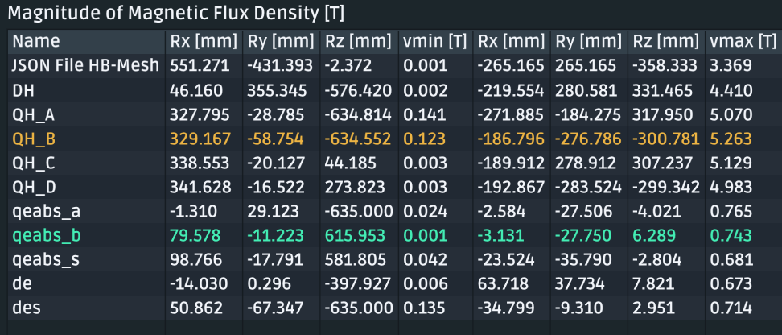
B0PF-Q0EF Peak Fields and Operating Margin
B0PF–Q0EF Magnetic Flux
B0PF Operating Margin Calculation
Q0EF / Corrector
I_{op} = 1143 A, so
(1633-1143)/1143
gives 43% margin
High-field side
B0PF
B_{coil} [T]
T_{op} = 1.9 K
Cu:SC = 1.75:1
B0PF
(uninsulated)
Q0PF
Corrector
Q0EF uses 0.330 mm wire, Cu:SC = 1.6 and for 18 GeV, 4.5 K operation has 177% operating margin.

Slide 13
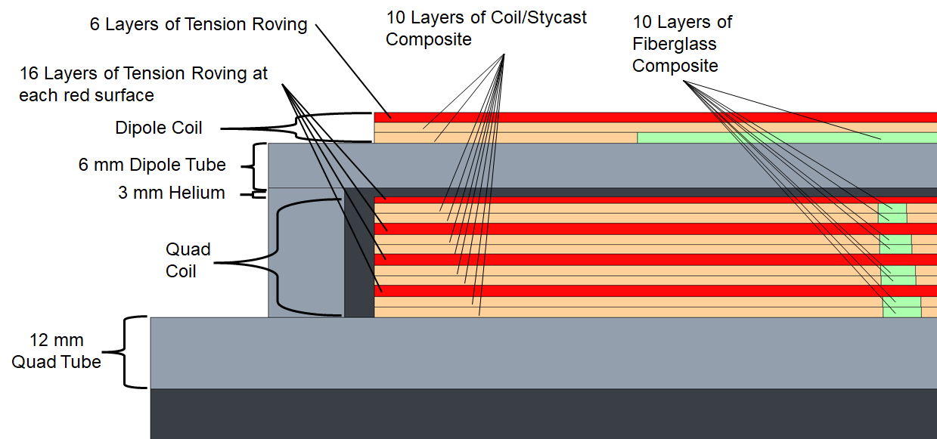
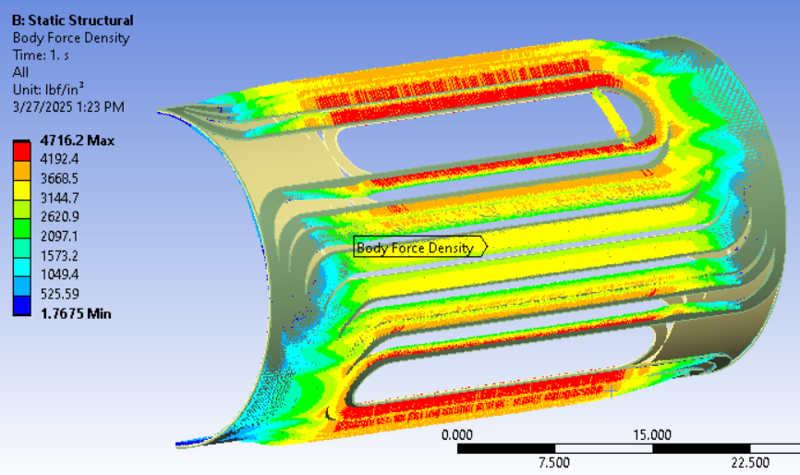
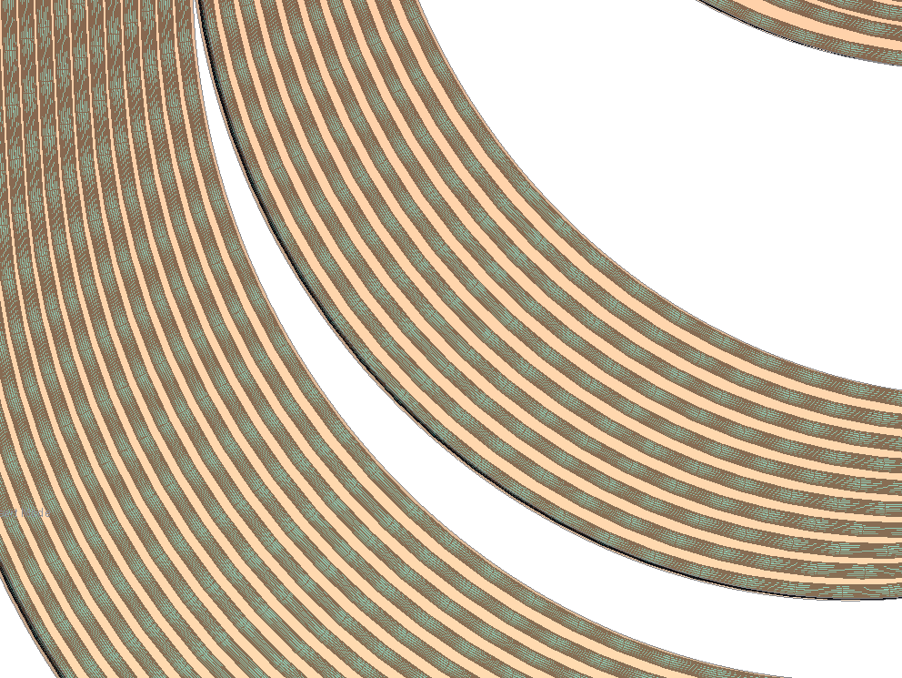
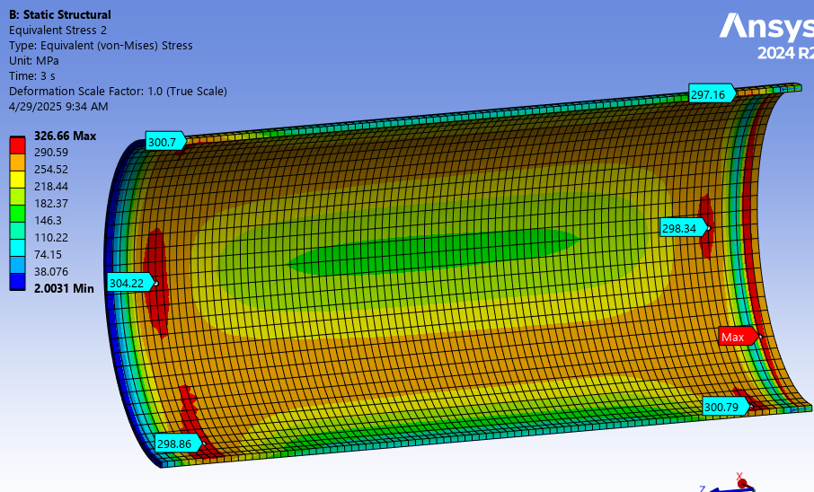
B0PF Mechanical Design Calculations
Imported body force density (N/m³) from the magnetic model (115,732 data points/layer).
Each coil force spreadsheet is imported only to the corresponding mechanical model layer.
Forces are scaled according to volume fraction of coil to total volume coil+stycast.
  Average composite composition: % Coil = 52% % Stycast = 48%
B0PF Mechanical Model Calculation Layer Schematic
Stycast
Conductor
Turns
Body Force Density
Quad Support Tube
Von Mises Stress
(Prestress+Thermal+Excitation)
Model checked from warm, to cooldown, and energized used to validate prestress.
Results used to set necessary fiber wrap.
Only 47 microns for the net coil deflection going from cool down to full excitation.
Determined that quad support tube needs to be fabricated high-strength Nitronic-50.
Coil Composition Breakdown
CAD Modeling & other calculations by
C. Runyan and A. Marone BNL/SMD
304.22 MPa Max

Slide 14
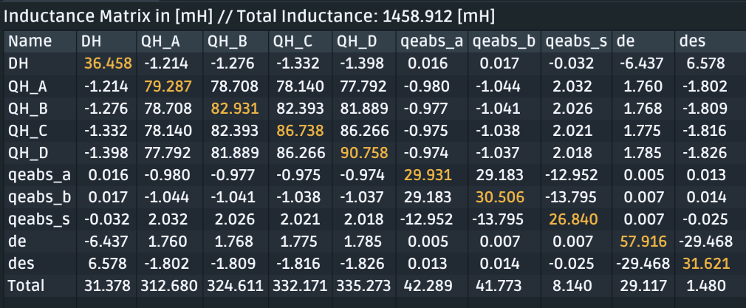
B0PF-Q0EF Electrical Design and Stored Energy
B0PF–Q0EF Inductance Matrix
B0PF main coils are wound with 1.42 mm diameter 6-around-1 round cable (7xØ0.473 mm wire) with I_{op} of 1143. A and a large stored energy of 875. kJ.
The Q0EF gradient tuning and corrector dipole are both wound with 0.330 mm diameter single-strand wire, and they have respective operating currents of -71 to +59 A (quad) and 3.5 A (dipole).
Before we adopted active shielding for the Q0EF coils, there was a concern that even if a relatively small fraction of the main B0 stored energy ends up in Q0EF, this might present a severe quench protection challenge (with the small wire used).
However, with active shielding the net coupling of these coils with the main B0PF is essentially zero.
B0PF Quad has 4 coilsets, A-D, for 8 layers
B0PF Dipole has 1 coilset, DH, for 2 layers
Q0EF Quad has 3 coilsets, A-B,S for 6 layers
Q0EF Dipole has 2 coilsets, DE,DES, for 4 layers
B0PF Quad+Dipole: 1.34 H total inductance
Q0EF Quad Coil: 92. mH total inductance
Q0EF Corrector: 30. mH total inductance
Rat model gives peak field and inductance for quench protection as well as coil force distribution for mechanical calculations.

Slide 15
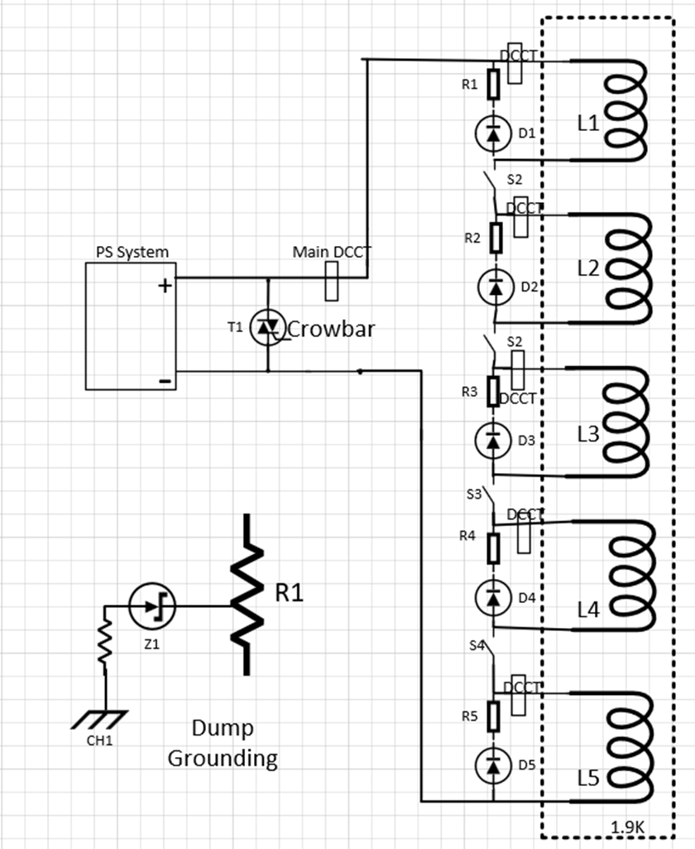
B0PF-Q0EF Quench Protection System
Quench Protection B0PF Coils
Energy Extraction
Circuit B0PF
B0PF has all coil-sets (quad and dipole) powered electrically in series with a single power supply.
Due to large inductance, B0PF has 5 independent external energy extraction circuits at quench.
Each external dump resistor is center-tapped to ground to reduce the coil-voltage to ground.
This scheme has inherent five-fold redundancy.
Design permits quench heaters installed on every second layer to reduce peak quench temperature.
R_{dump} = 1.6 Ω
Quench Protection Q0EF Coils
The actively shielded Q0EF gradient tuning and dipole corrector coils are much lower current and inductance with little stored energy; however, it is crucial that they do not couple magnetically to B0PF coils (with 875kJ).
Circuit design: P. Joshi and M. Kumar BNL/SMD

Slide 16
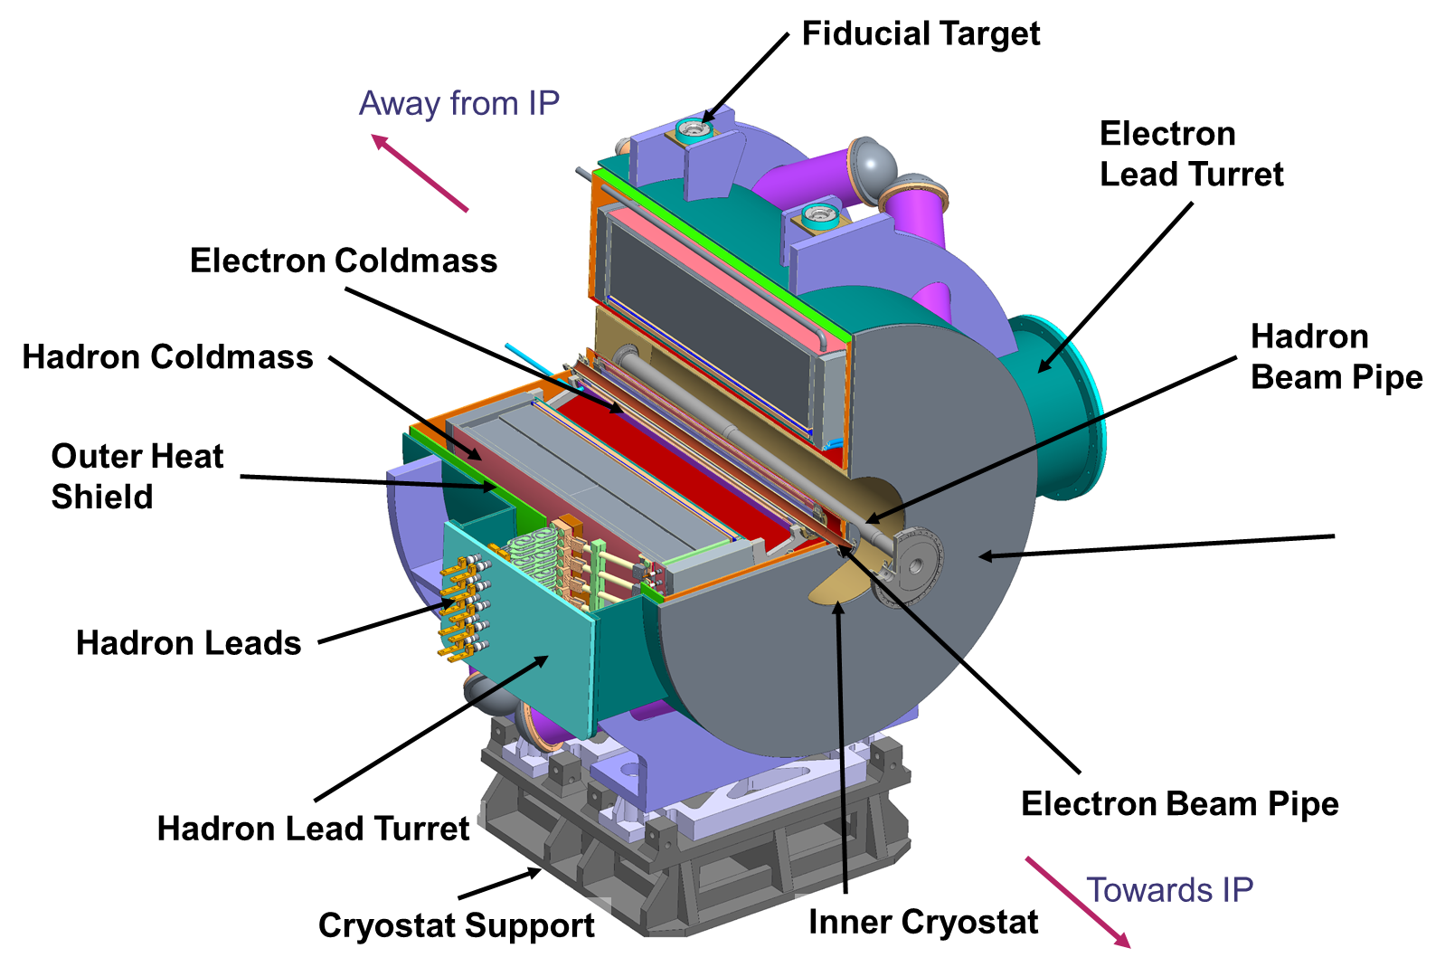
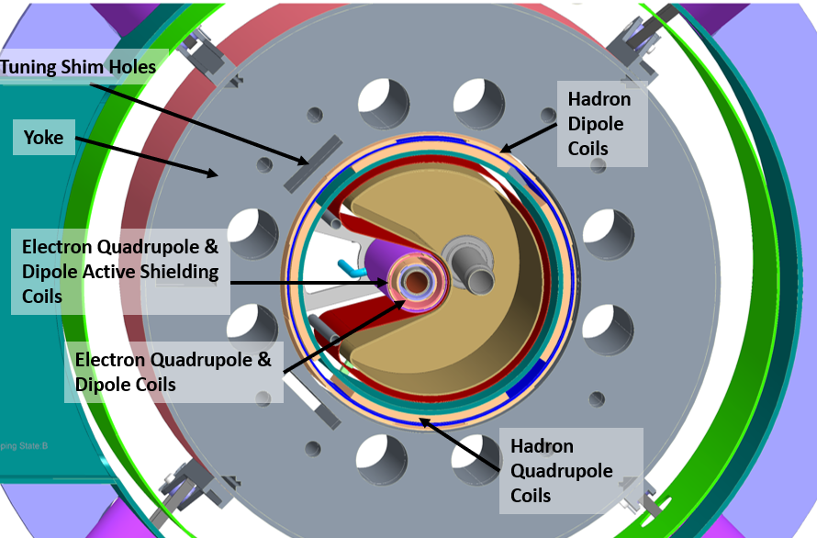
B0PF-Q0EF Preliminary Design Summary
B0PF Parameter | Requirement
Nominal Integrated Field | 1.56 T·m
Effective Magnetic length | 1 m
Coil Aperture | Ø 656 mm
Nominal Current | 1143 A
Central Field & Gradient - Peak Field | 1.56 T & 9.74 T/m – 5.2 T
Stored Energy | 875 KJ
Iron Yoke OD | Ø 1400 mm
Q0EF Parameter | Requirement∗
Nominal Integrated Gradient | 16 T
Effective Magnetic length | 1 m
Coil Aperture | Ø 90 mm
Nominal Current | 71 A
Central Field - Peak Field | 16 T/m – 0.76 T
Stored Energy | 0.23 KJ
Iron Yoke OD | Ø 1400 mm
Parameters for 18 GeV operation, where the net gradient comes from combination of Q0EF gradient tuning coil and background B0PF field. At 10 GeV the gradient tuning coil is nearly off (reversed current @ 9A).
B0PF cold mass weight ≈30,000 lbs (yoke ≈22,200 lbs) and is suspended by 8 straps; Q0EF cold mass ≈120 lbs and is supported by B0PF cold mass.

Slide 17
B0PF-Q0EF EIC Preliminary Design Review
B0PF-Q0EF successfully passed its EIC Project (60% Stage) Preliminary Design Review (PDR) held June 11-12, 2025 (Michael Lamm/FNAL chair).
  Overall design maturity is sufficient to proceed with final design. However, present design has some risks that would be more correctly evaluated after successful fabrication & testing of a prototype coil.
  Regarding plans to validate performance, committee recognizes that there is an additional need for preliminary validation of the design against the requirements before building the final object.
  Strongly recommend building a prototype coil/magnet; would significantly reduce risks associated with this design. Prototype should be representative: inductance, Lorentz forces and structural complexity.
We have identified additional mechanical and electrical design studies, motivated by this PDR, that will be soon undertaken.
We are also exploring possible scenarios for small-scale ancillary hardware risk mitigation studies as well as fabrication and testing of a coil / magnet prototype... as was recommended by the committee.
Thank you for your kind attention.

