Slide 1



Development status of the HTS SECAS conductor for a full-size test sample
July 5, 2025
Abstract ID: Sat-Af-Spe1-04
L. Muzzi
This work has been carried out within the framework of the EUROfusion Consortium, funded by the European Union via the Euratom Research and Training Programme (Grant Agreement No 101052200 — EUROfusion). Views and opinions expressed are however those of the author(s) only and do not necessarily reflect those of the European Union or the European Commission. Neither the European Union nor the European Commission can be held responsible for them.
M. Bombardieri, G. Celentano, S. Chiarelli, V. Corato, G. De Marzi, R. Freda, F. Maierna, M. Marchetti, A. Masi, L. Merli, M. Seri, A. della Corte, A. Formichetti, R. Righetti, M. Breschi, G. Colombo, M. A. Caponero, A. Polimadei, W. Hong

Slide 2



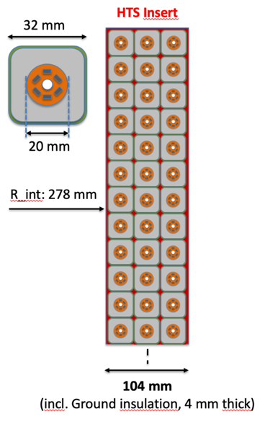
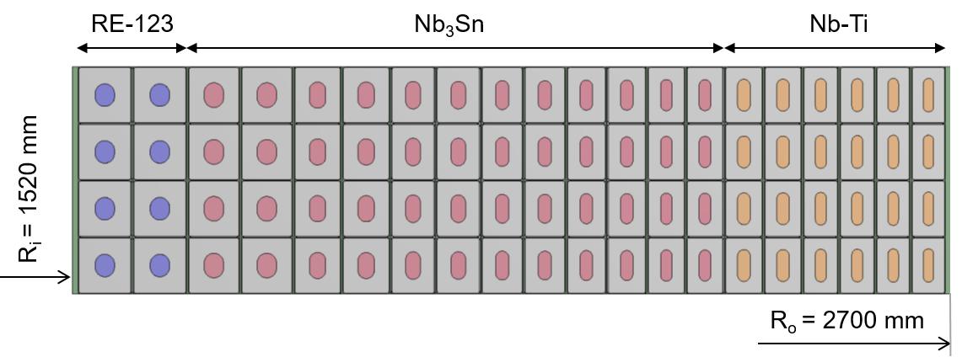
Introduction and Motivation
European DEMO Design studies
DTT Central Solenoid
Inner module
Nb₃Sn outer coil stack
Strategic interest in developing high-current HTS conductors, for example for a hybrid (LTS + HTS) Central Solenoid, to improve performance, i.e. magnetic flux capability.
→ Layer winding with grading on superconductor and stainless-steel.
PF1
PF2
PF3
PF4
PF6
PF5
REBCO inner module
→ Corato - Sun-Mo-Or1-05
The addition of the 7th HTS module allows a magnetic flux improvement of about 10%

Slide 3
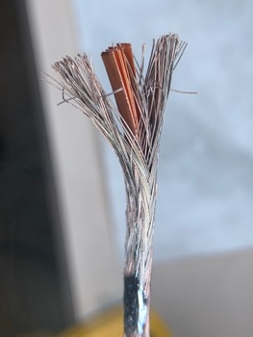
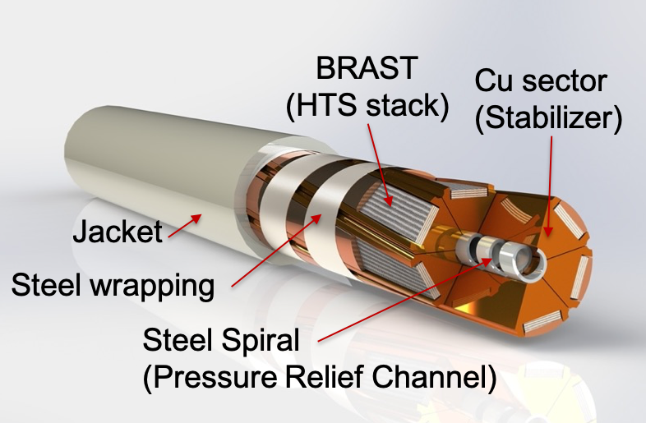
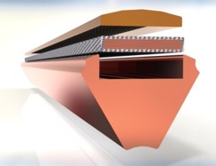
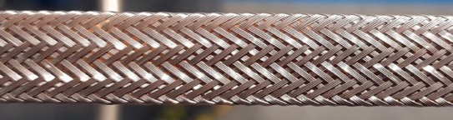
Introduction and Motivation
European DEMO Design studies
DTT Central Solenoid
Milestone: qualification of the SECAS
SECtor ASsembled cable (SECAS) CICC concept
based on BRAided STacks of tapes (BRAST)
Multi-Stage Cable Processing
Cu sector
In this talk: qualification activities of the SECAS design, performance, and manufacturing approach
L. Muzzi, et al., IEEE TAS 2023
Sat-Af-Spe1-04

Slide 4
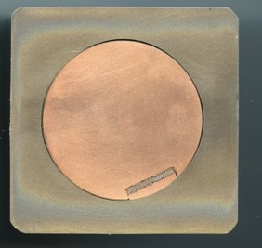

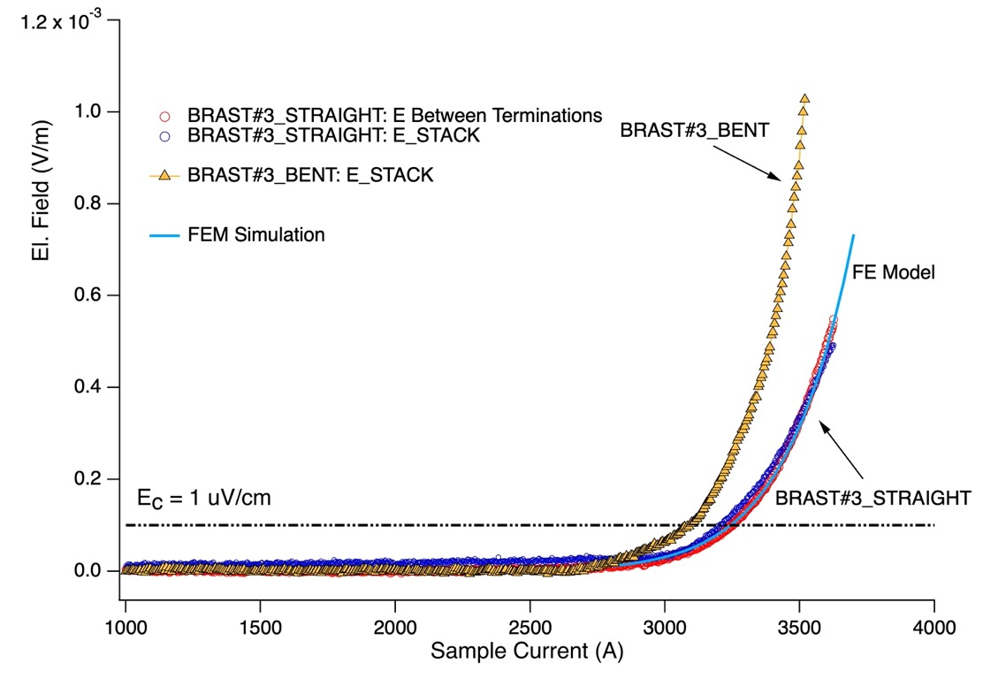
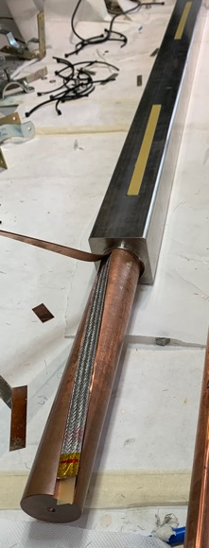
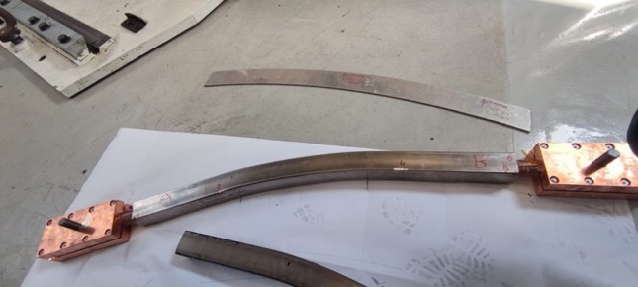
Initial qualification – BRAST (77K – s.f. tests)
But voltage signals somewhat difficult to interpret.
In the aim to clarify / verify the origin of the bending effect:
BRAST #3
Results already reported at:
(non soldered stack)
Conductor Bent to target radius = 1.5 m
Performance moderately affected by bending (5% reduction)
@ R = 1.5 m (DEMO CS relevant)
Sat-Af-Spe1-04

Slide 5
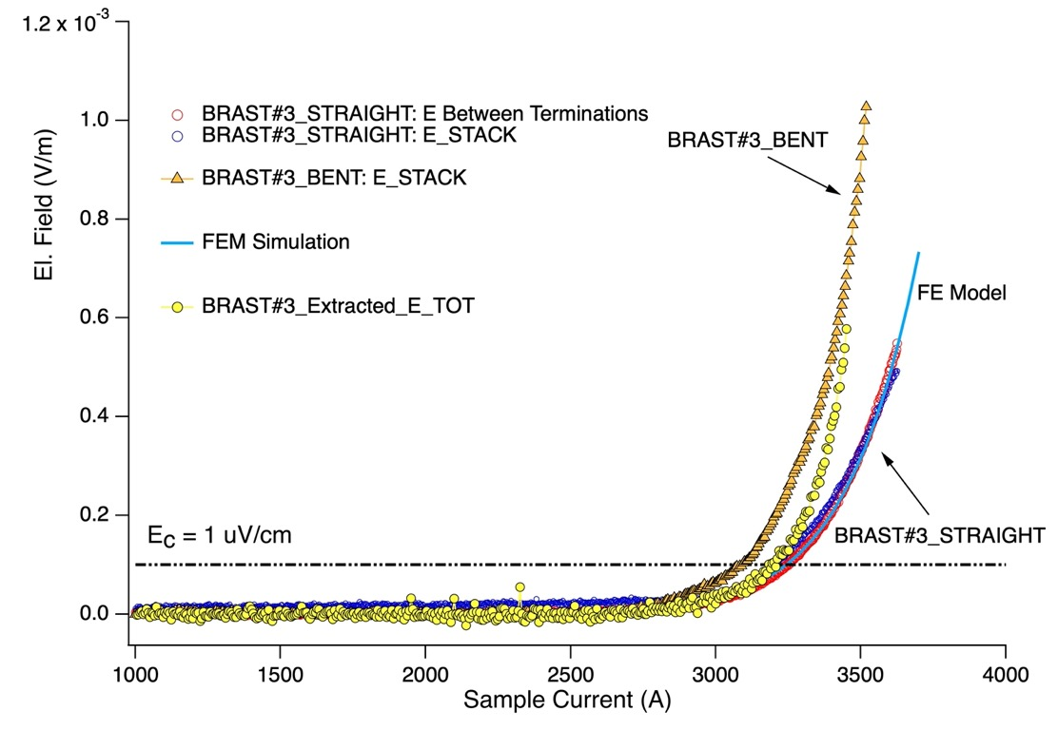
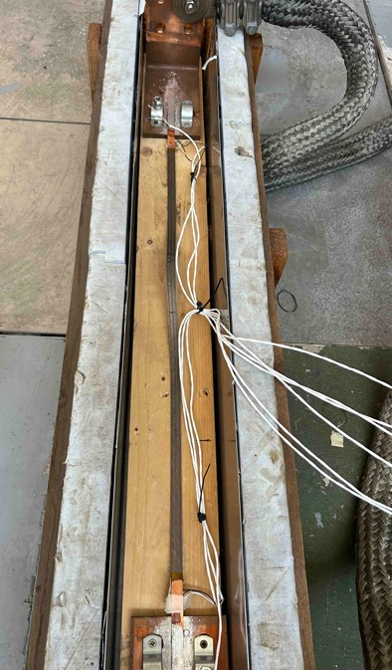
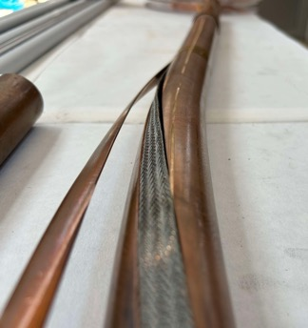
Initial qualification – BRAST (77K – s.f. tests) - bending
But voltage signals somewhat difficult to interpret.
In the aim to clarify / verify the origin of the bending effect:
BRAST #3
(non soldered stack)
BRAST was extracted from Bent conductor and re-tested
Apparently, the tape stack was not damaged during the bending
Sat-Af-Spe1-04

Slide 6
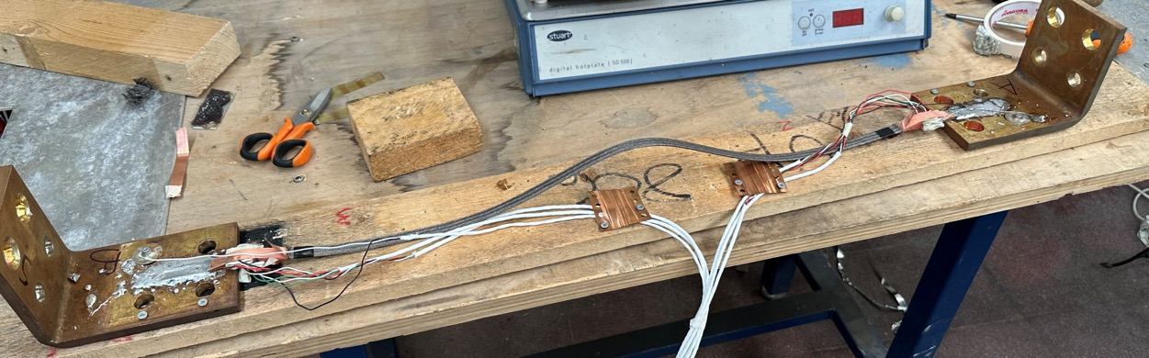
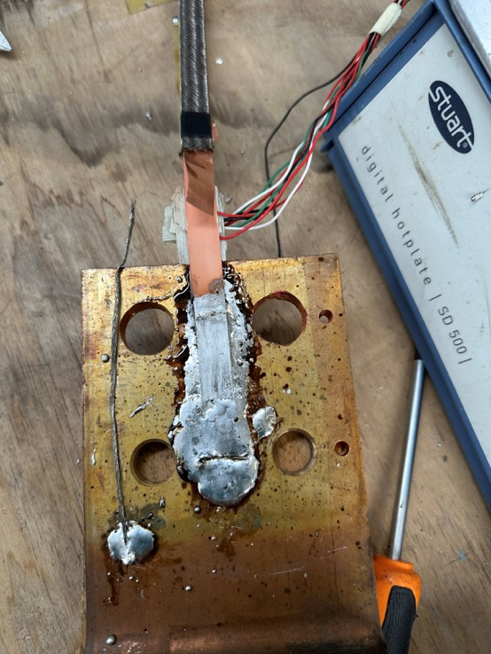
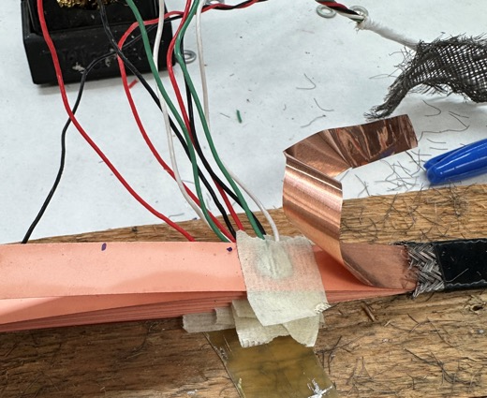
Current distribution study in BRAST (77K – s.f. tests)
Sample for current distribution study: «free-standing» BRAST with 9 tapes, 12 mm wide
Soldered terminations with staggered tapes
V_TERM-TAPE
V tape
Voltage taps welded on tapes:
Voltage between termination and tape, as well as along each tape, can be measured
V termination
Sat-Af-Spe1-04

Slide 7
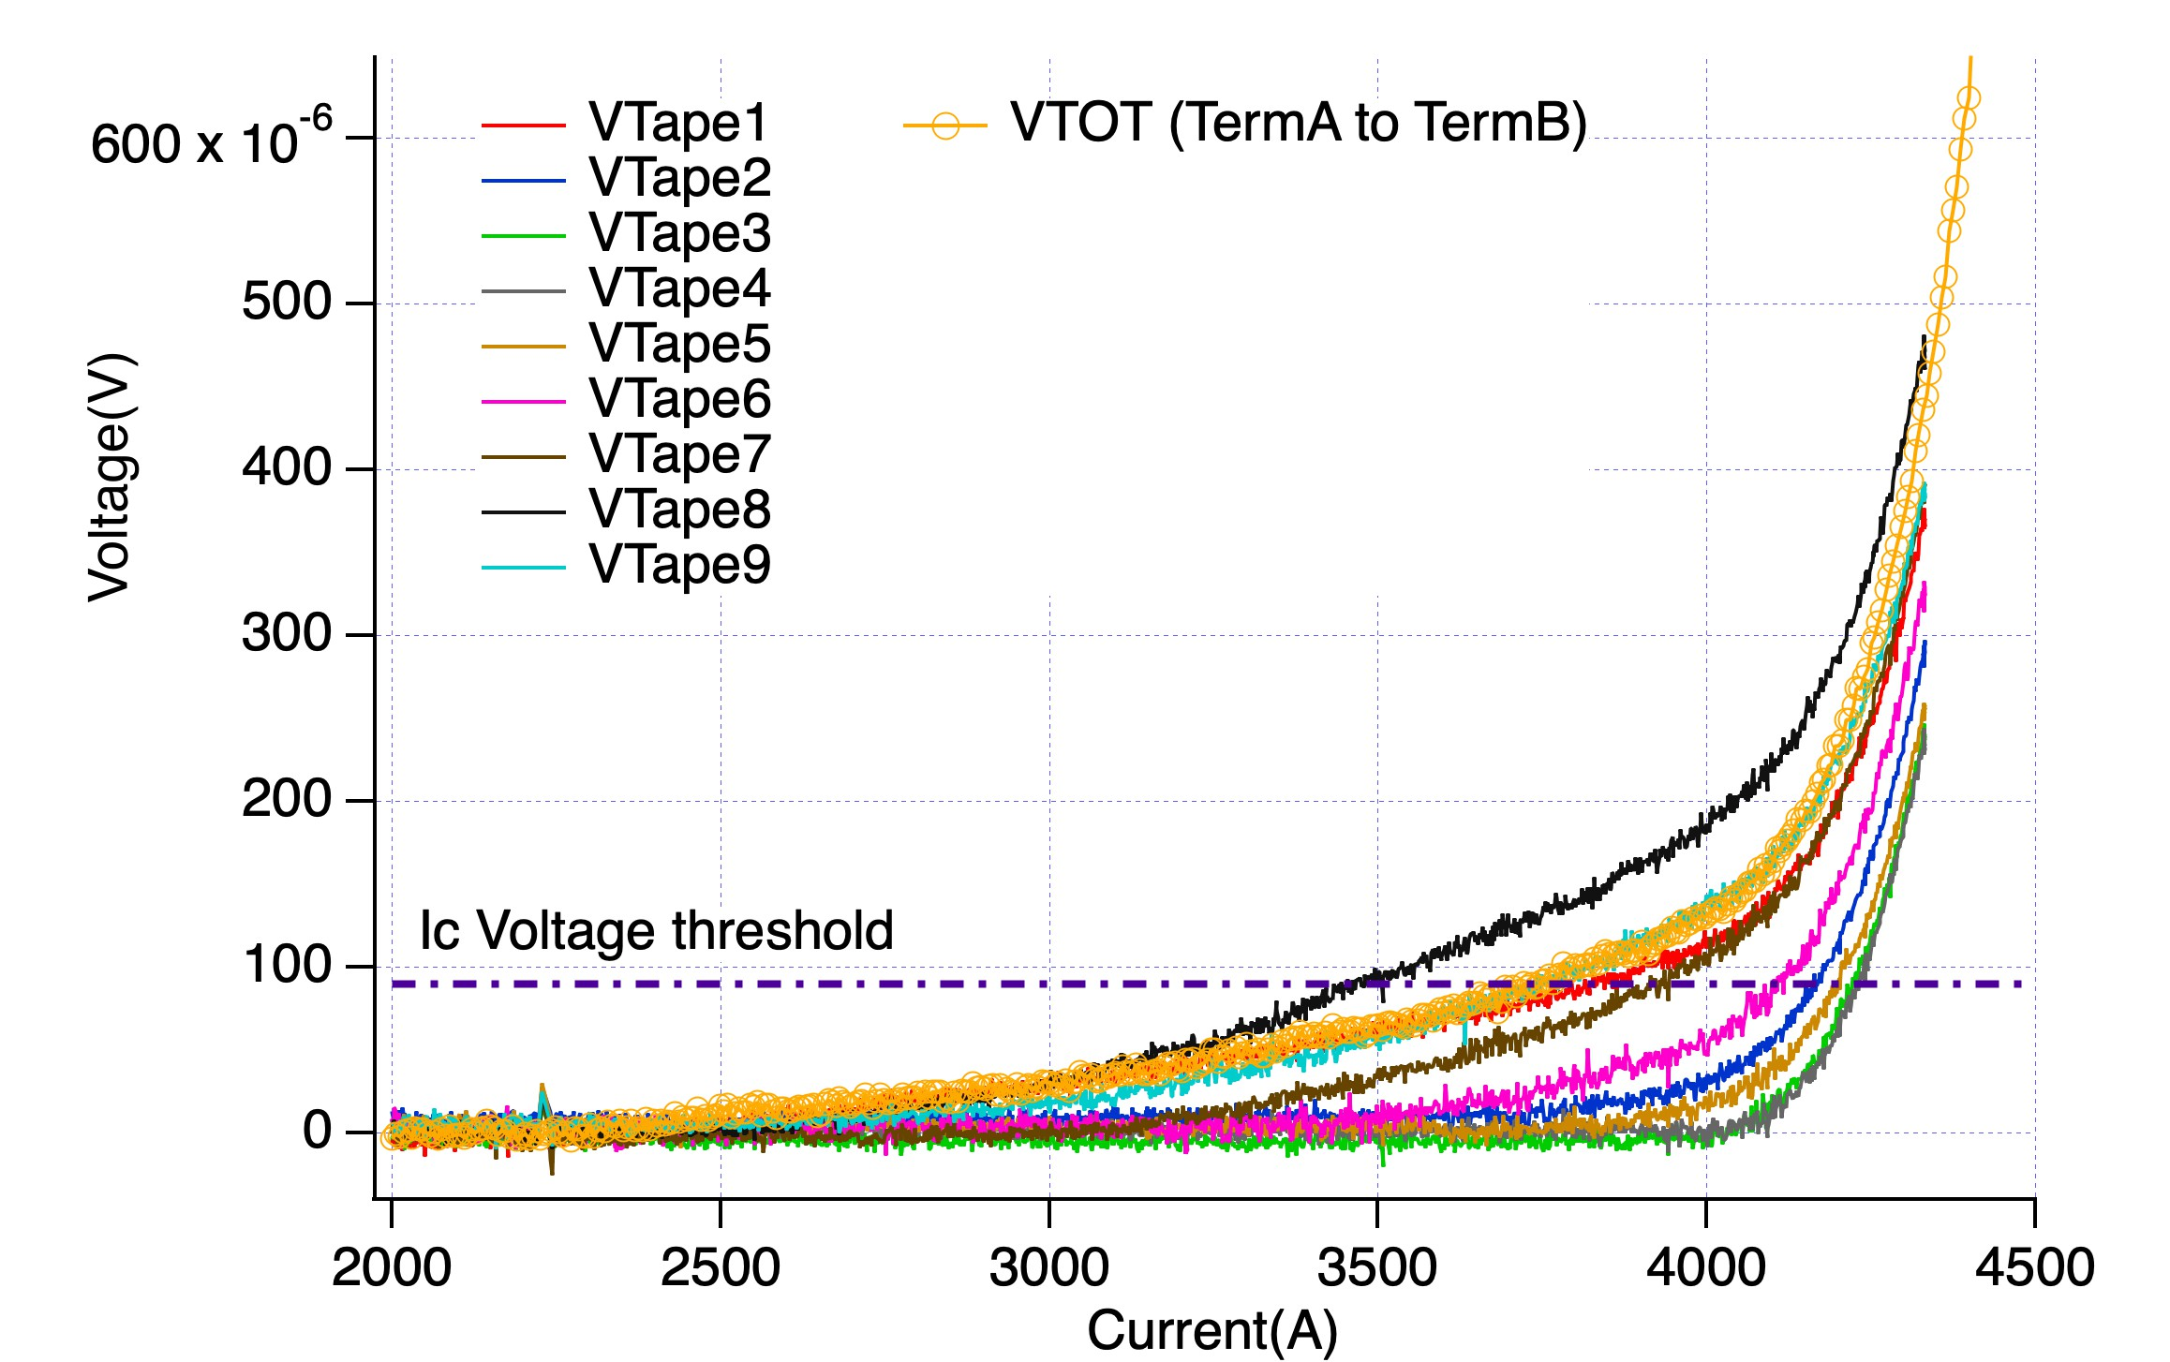
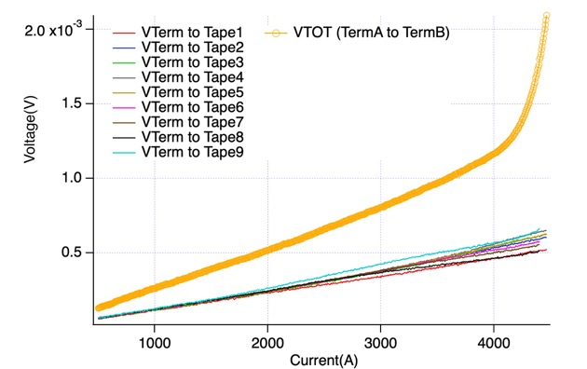
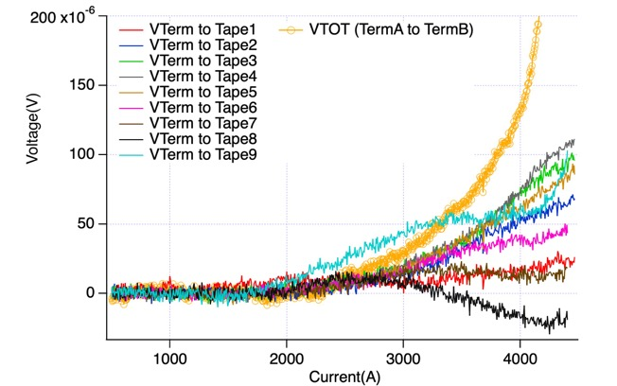
Current distribution study in BRAST (77K – s.f. tests)
Voltage along each tape during current ramp
Voltage between termination and each tape
Raw data
V after subtraction of the resistive component
Wide transition «spectrum» for the different tapes.
Resistance distribution at terminations.
Complex current re-distribution among tapes (in these samples, occurring at terminations); self-field effects also play a role.
Same qualitative behaviour as observed on the BRAST extracted from the bent conductor prototype, tested as well in «stand-alone» mode.
Sat-Af-Spe1-04

Slide 8
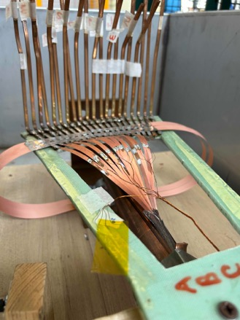
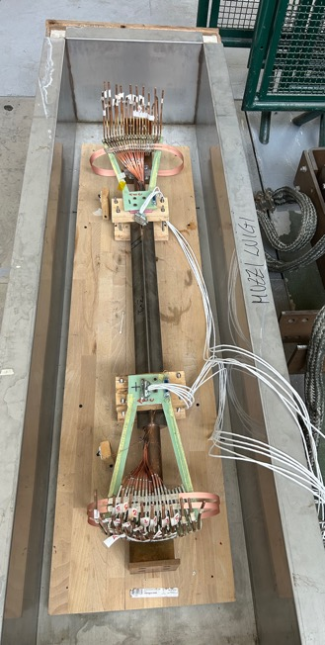
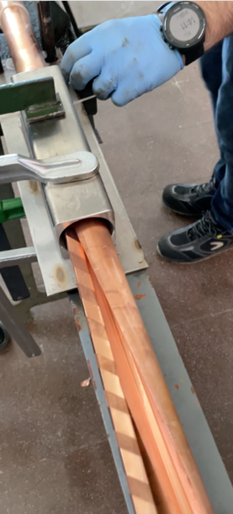
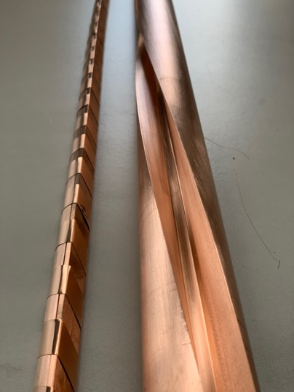
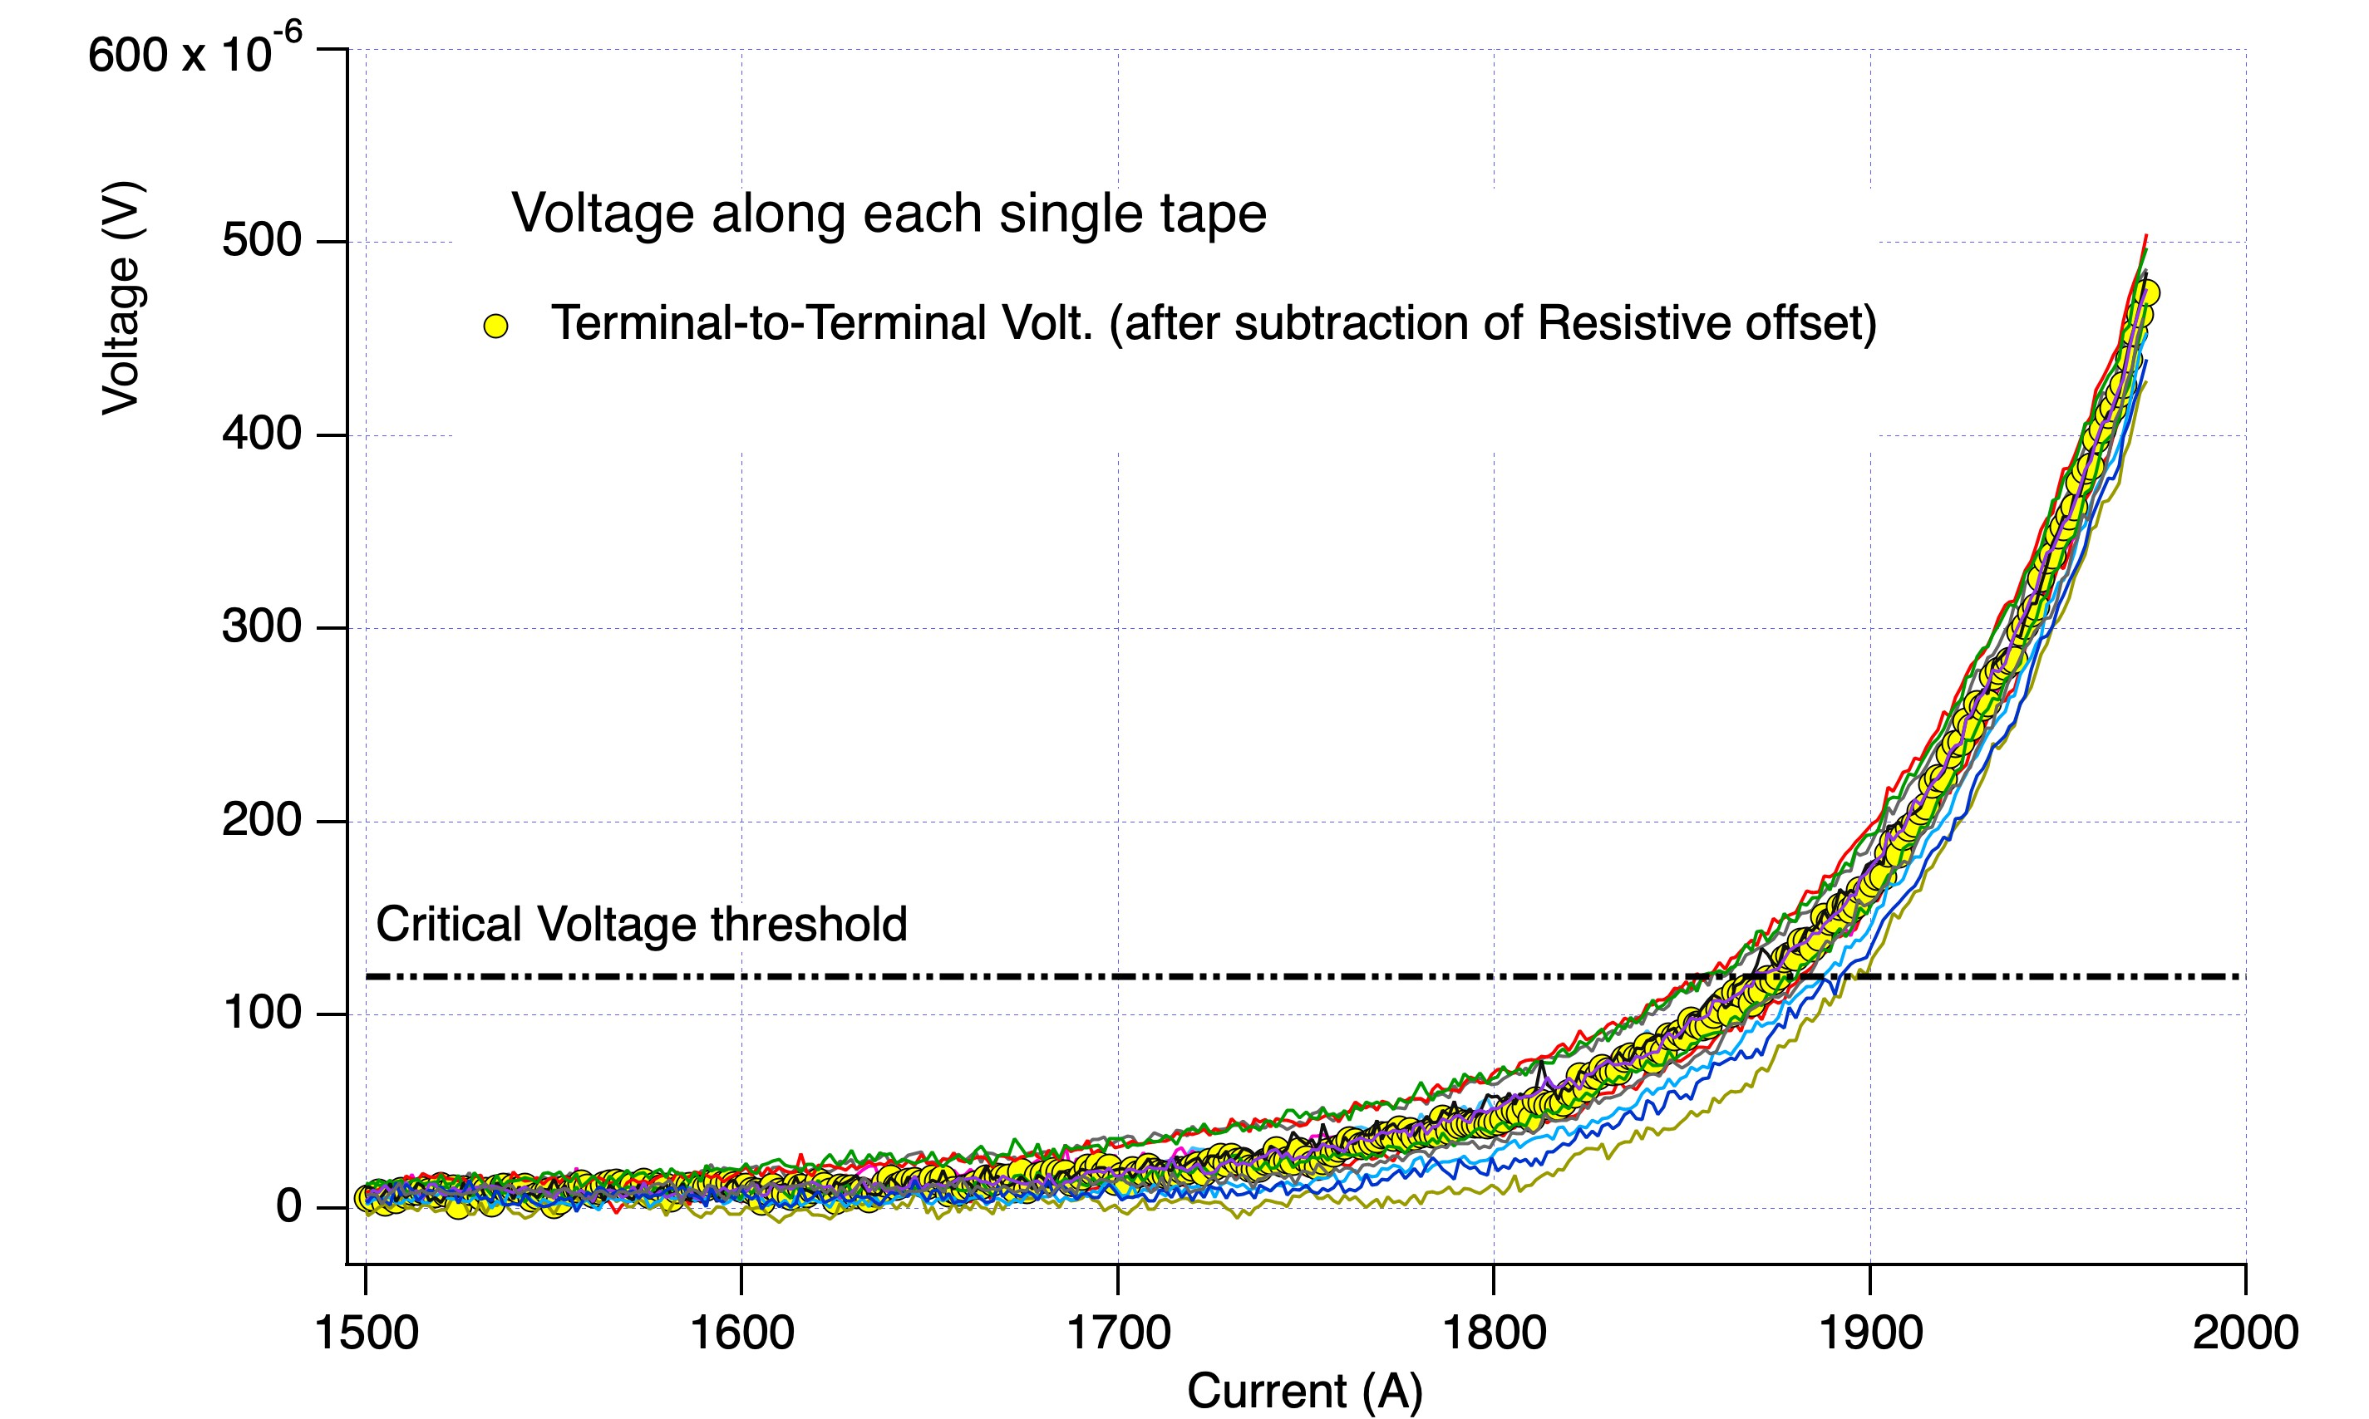
Qualification – SECAS#2: 3 x 5 tapes BRAST (4 mm)
Although not all experimental observations are fully clarified (some modelling activity is on-going), with all preliminary qualification tests, some of which reported here, we don’t see any evident showstopper to the application of the non-soldered, BRAST-based, SECAS conductor concept.
Next steps to qualification:
Verification of electro-magnetic performance in relevant I – B range
→ SULTAN test. Already working on that (see next slides).
Longer length test to investigate quench dynamics → still to be planned.
Also here: some spread between tapes
Sat-Af-Spe1-04

Slide 9
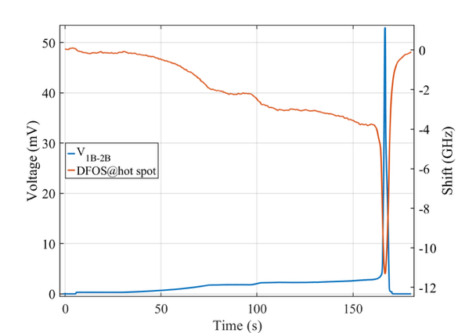
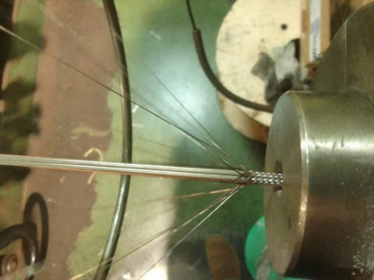

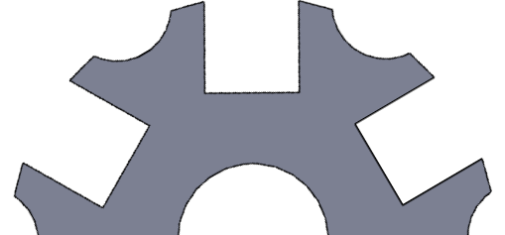
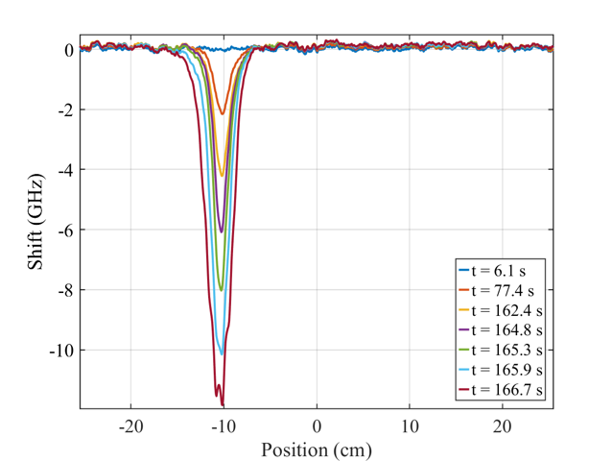
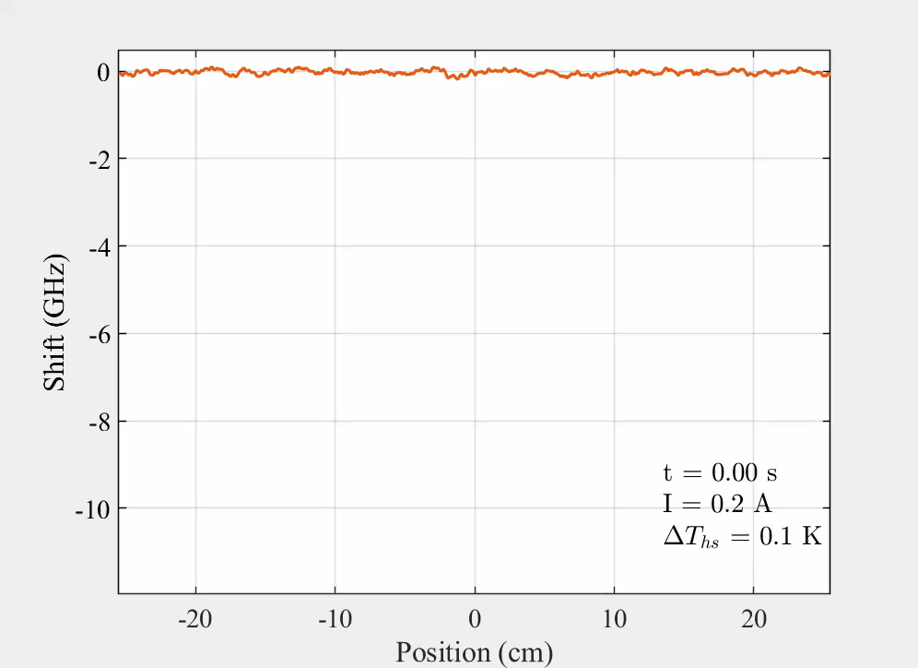
Pre-qualification – DFOS quench detection
Target: assess quench detection capability and implement FOS integration technology
Voltage + fiber response at quench location
Fiber in capillary tube within REBCO BRAST
AL CORE
LN₂
FLOW
The quench was due to a local defect in the stack
→ Well localized by the DFOS.
Fiber response along the cable during quench
What next?
BRAST and FOS in capillary tubes will be adopted for SECAS samples @SULTAN

Slide 10
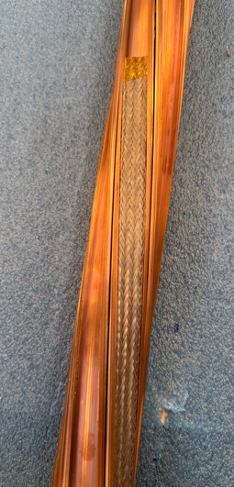
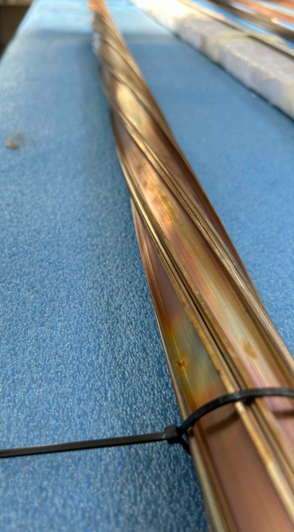
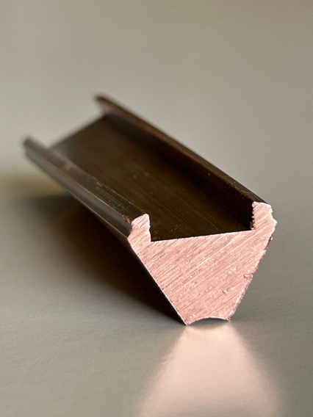
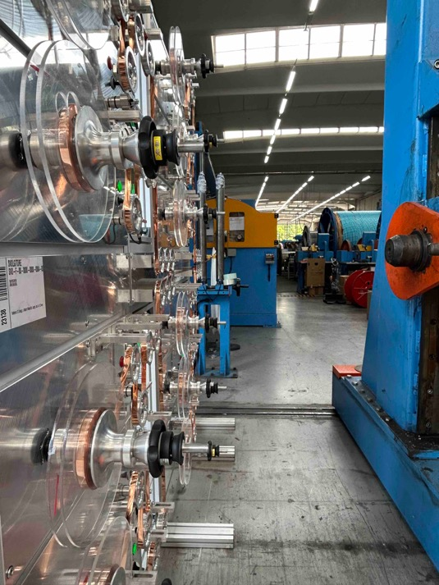
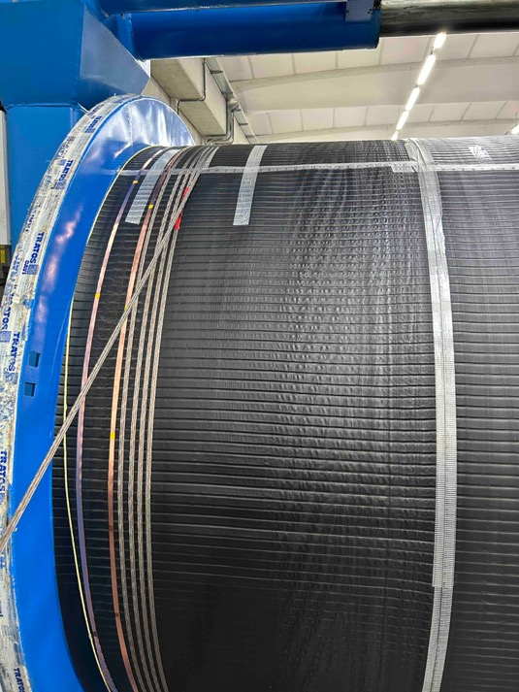
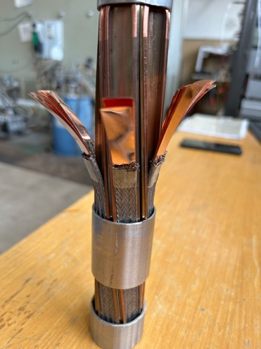
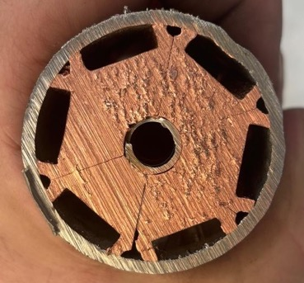
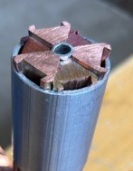
SULTAN sample preparation: some key steps
Cable assembly trials:
BRAST manufacture at:
Twisting of Cu sectors
Short piece of assembled SECAS
Sat-Af-Spe1-04

Slide 11
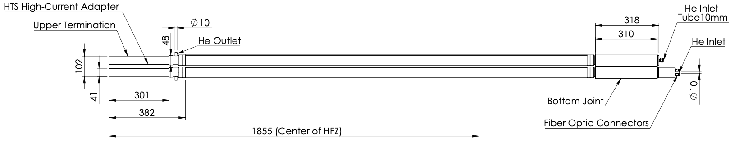
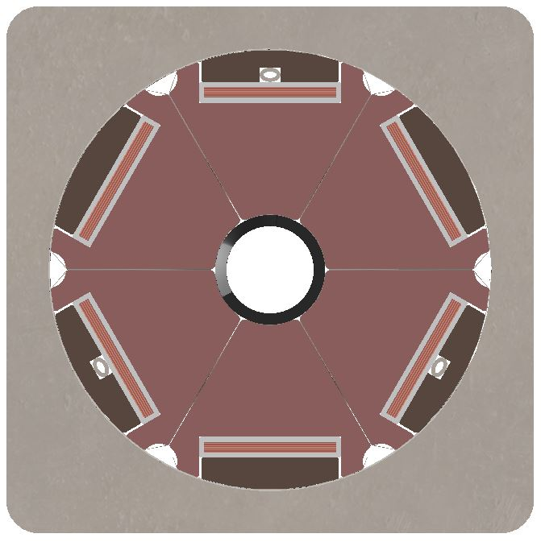
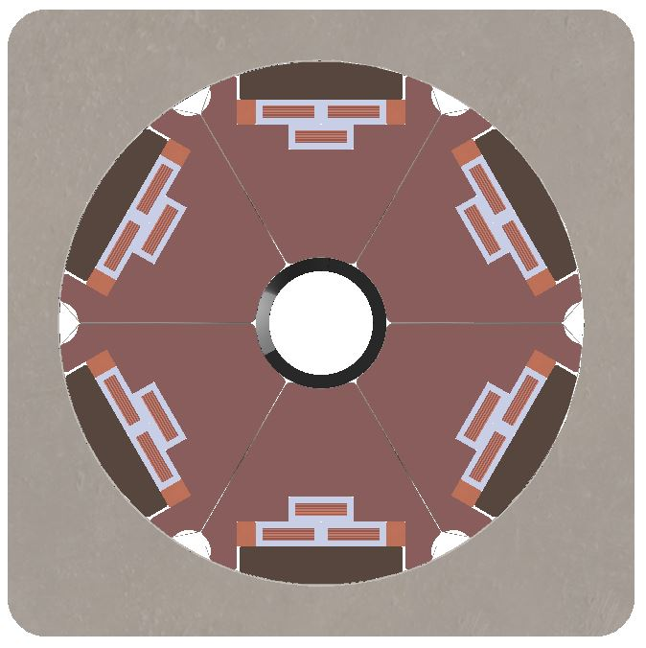
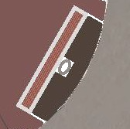
SECAS SULTAN sample
6 x 3 x BRAST with 4mm-wide tapes
6 x BRAST with 12mm-wide tapes
Cu closing fillers
Cu sectors
4 mm
Steel capillary for fiber-optics
Sat-Af-Spe1-04

Slide 12
Conclusive remarks
- qualification activities on the SECAS-BRAST high-current / high-field / low-losses conductor have been carried out so far, on prototypes tested at different phases of the possible processing steps;
- although still with some unclarified aspects of test outcomes, performance results are satisfactory and mostly in line with expectations;
- modelling activities are on-going, to help clarify the observed effects of current re-distribution among tapes occurring at terminations in short samples tested in self-field configuration.
- the design has evolved in parallel to the development of industrial processing for applicable concepts.
- the manufacture of SECAS prototype lengths and assembly of a full-size sample with different tape arrangements is on-going, for in-field characterization in SULTAN → sample ready by the end of this month.
Sat-Af-Spe1-04

Slide 13
BACK-UP SLIDES
Sat-Af-Spe1-04

Slide 14
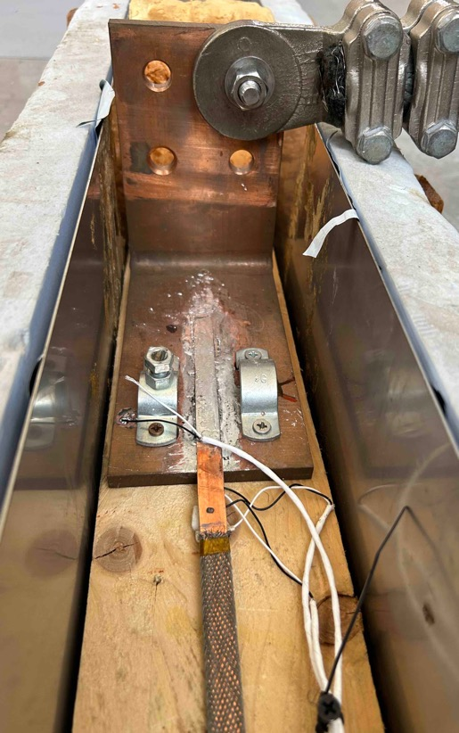
Initial qualification – BRAST (77K – s.f. tests)
BRAST #3
(non soldered stack)
V_between terminal block and tape
(a «measure» of the current flowing through that specific tape?)
BRAST was extracted from Bent conductor and re-tested
V_TERM-TAPE
For:
V_TERM-TAPE 10
(the uppermost tape here)
V_TERM-TAPE 5
(the middle one within the stack)
Soldered termination with staggered tapes
At the same time, we could measure the voltage along each tape: V_TAPE
V_TERM-TAPE 1
(the closest to the Cu terminal block here, but the outermost during tests in bent conductor)
Sat-Af-Spe1-04

Slide 15
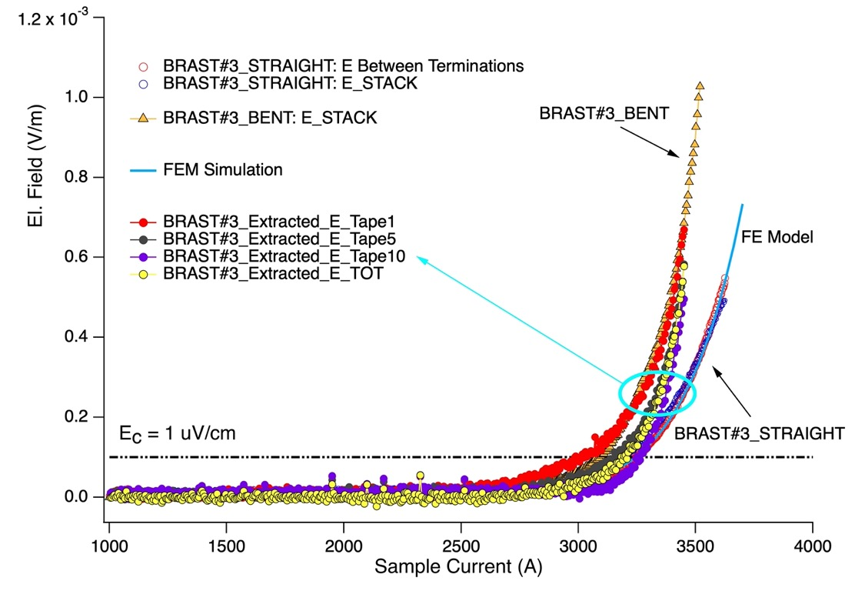
Initial qualification – BRAST (77K – s.f. tests) - bending
Electric field along the different tapes
BRAST #3
(non soldered stack)
BRAST was extracted from Bent conductor and re-tested
Voltage development is different on the different tapes within the stack. Effects of self-field, and effects of current distribution / re-distribution (at terminations, in these samples) should be clarified.
Either through modelling, or by means of dedicated tests.
Same qualitative behaviour observed an all tested prototypes
Sat-Af-Spe1-04

Slide 16
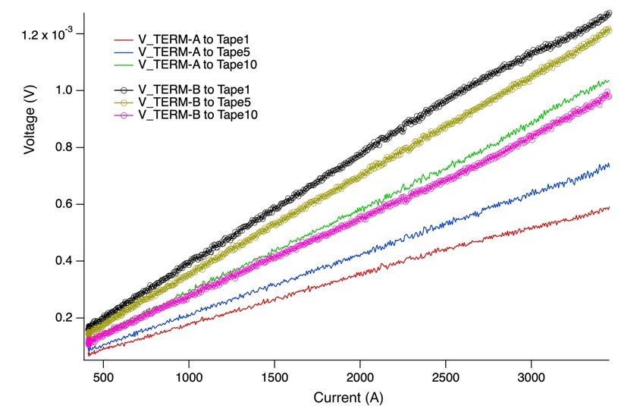
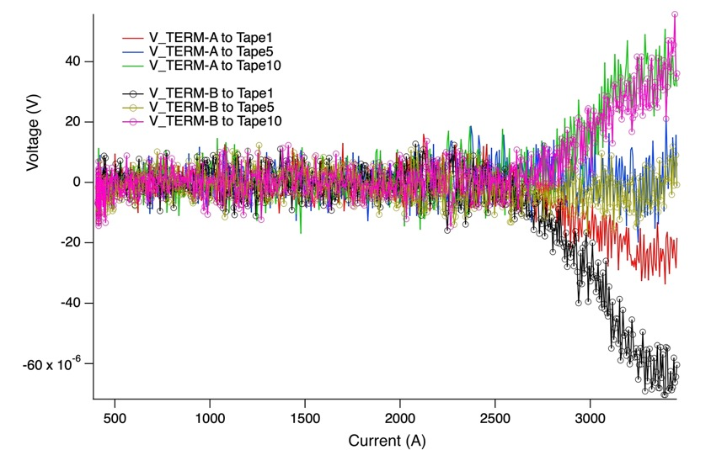
Initial qualification – BRAST (77K – s.f. tests) - bending
Electric field between termination and tape
Raw Voltages
Voltages after subtraction of the initial resistive slope
Evidence of a current transfer occurring at terminations during the transition, from Tape 1 to Tape 10?
Sat-Af-Spe1-04

