Slide 1

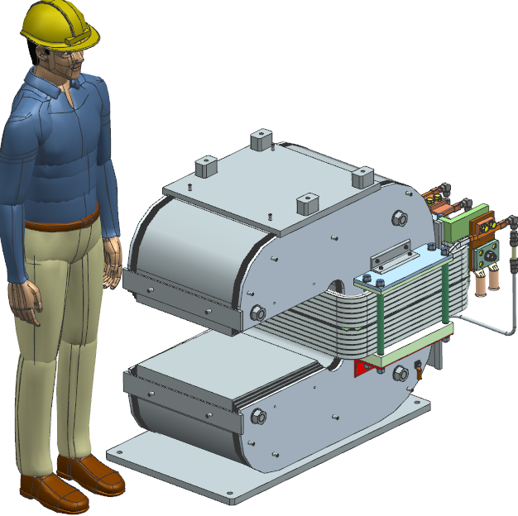
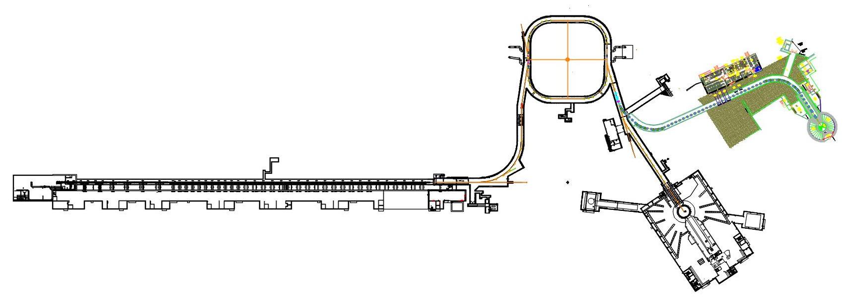
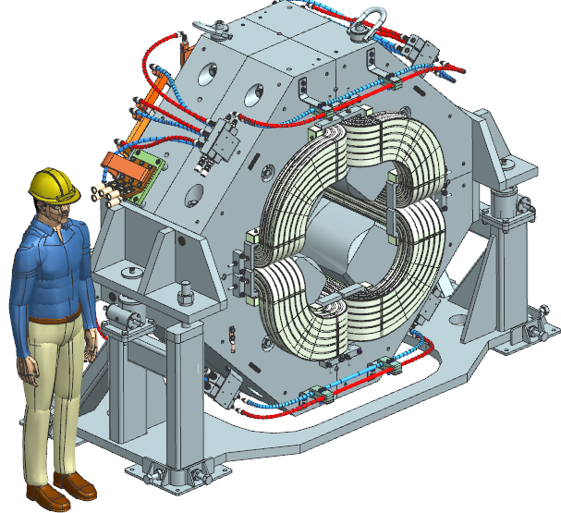
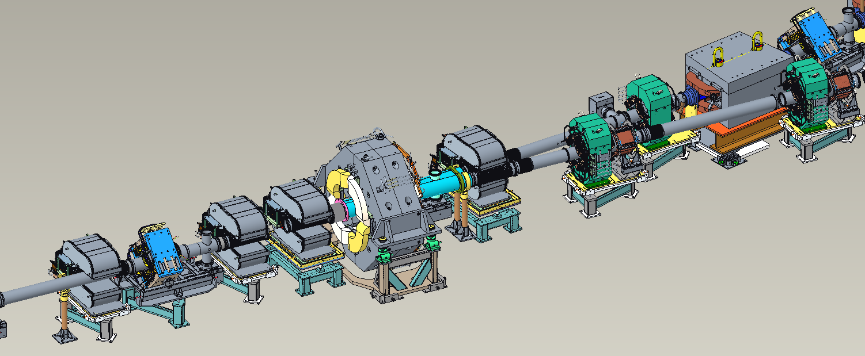
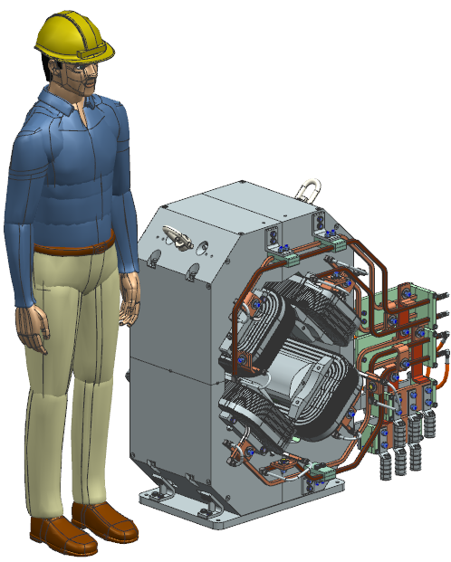
Thu-Af-Po.01-03, ID# 340
# 340
Development of Design for the STS Extraction Magnet System
V. Chernenok, S. Cheban, D. J Harding, V. Kashikhin, T. Strauss, B. Szabo – FNAL
M. Allitt, L. Boyd – ORNL
Second Target Station Project
The Oak Ridge National Laboratory Second Target Station (STS) Project will enhance the Spallation Neutron Source by adding a new neutron source. The STS will have world-leading peak brightness and will provide new science capabilities for measurements across broader ranges of time and length scales, real-time, and enable smaller sample sizes.
The Ring-to-Second-Target Beam Transport (RTST) system is vital in directing high-energy proton beams to the new target. A key element of the RTST system is the extraction magnets, which are tasked with precise beam extraction and transport. Within the framework of this work, Fermilab is responsible for carrying out the development of 3 types of magnets: Pulsed Dipole, Large Aperture Quadrupole and Narrow Quadrupole.
Pulsed Dipole
It generates an integrated field of ≥ 0.1839 T-m, ± 0.1% for ≥ 2 ms at 15 Hz. Its field ramps from < 5 Gauss to operating level and back within 33 ms, good field area of ≥ ± 45 mm (H) and ≥ ± 57 mm (V). The C-shaped magnet yoke is assembled from the low carbon steel laminations.
Parameters | Value | Units
Gap | 250 | mm
Ampere-turns | 38543 | AT
Peak current | 1606 | A
Gap center field | 0.188 | T
Core length | 500 | mm
Effective length | 883 | mm
Total mass | 3500 | kg
Accumulator ring
Strips electrons from H- ions to create protons
Compresses pulse length to < 1 µs, increasing intensity
60 Hz repetition rate
Second Target Station
700kW average power
15 pulses/sec
Rotating tungsten target
Optimized for cold neutrons
Large Aperture Quadrupole
It engineered to deliver an integrated field of ≥ 3.0872 T, ± 0.1% ensuring precise beam focusing and alignment. The good field radius of the magnet is ≥ 176 mm. The aperture diameter is designed to be ≥ 400 mm , The aperture diameter is designed to be 400mm to accommodate two beam tubes and operate with DC current.
Pulsed dipole
Linac
Accelerates H- ions
1 msec pulse length
1.3 GeV max energy
2.8 MW max power
60 Hz repetition rate
Parameters | Value | Units
Aperture | 400 | mm
Ampere-turns | 50760 | AT
Peak current | 1538 | A
Integrated field gradient | 2.806 | T-m
Core length | 700 | mm
Effective length | 881 | mm
Total mass | 17300 | kg
First Target Station
2 MW average power
45 pulses/sec
Liquid Hg target
Optimized for thermal neutrons
Accelerator Systems – Future State
Large Aperture Quadrupole
Beam to 2nd Target
Narrow Quadrupole
The Narrow Quadrupole has an integrated field of 2.9650 T, ± 1%. The aperture is ≥ 209 mm, and a compact width ≤ 700 mm. Each main coil includes a trim coil, with four cooling branches keeping temperature below 60 °C and operate with DC current.
Parameters | Value | Units
Aperture | 209 | mm
Ampere-turns | 27400 | AT
Peak current | 978 | A
Integrated field gradient | 2.956 | T-m
Core length | 400 | mm
Effective length | 487 | mm
Total mass | 1915 | kg
Pulsed Dipole
Beam to 1st Target
Narrow Quadrupole
Large Aperture Quadrupole
Narrow Quadrupole
Extraction beam to 1st and 2nd target stations

