Slide 1


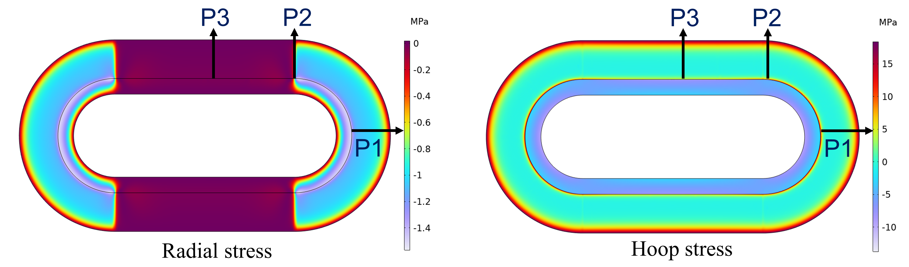
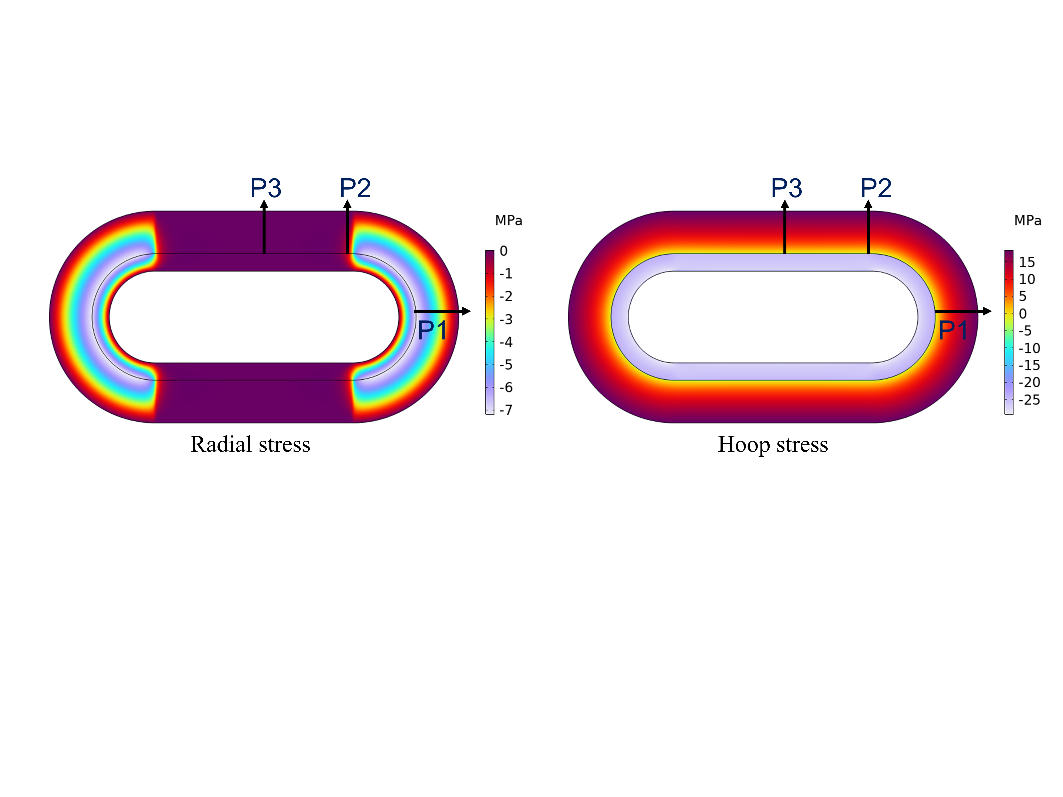
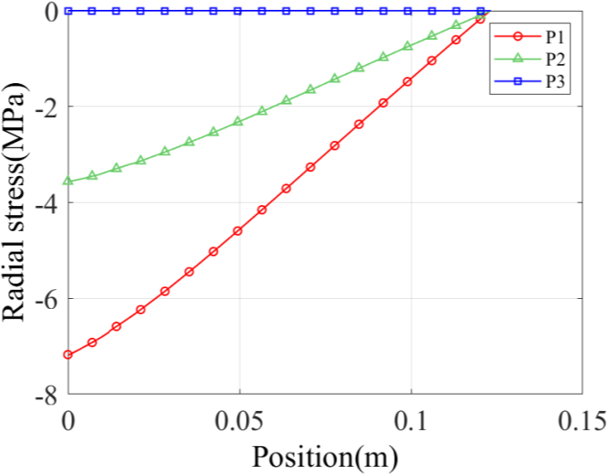
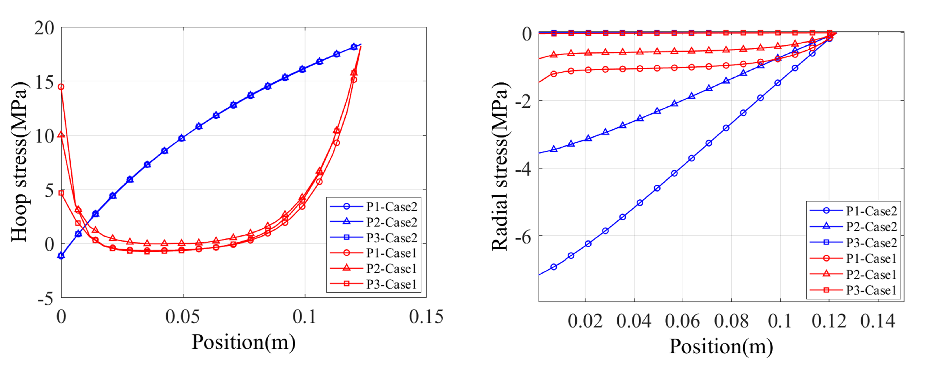
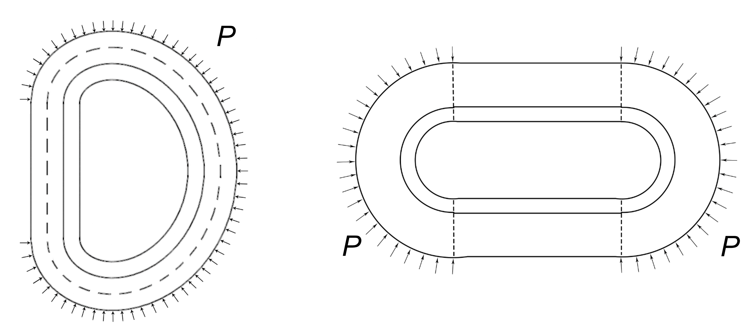
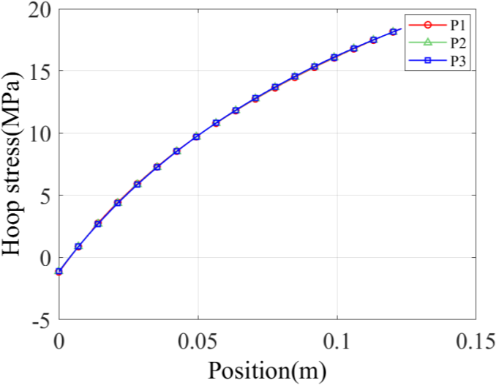
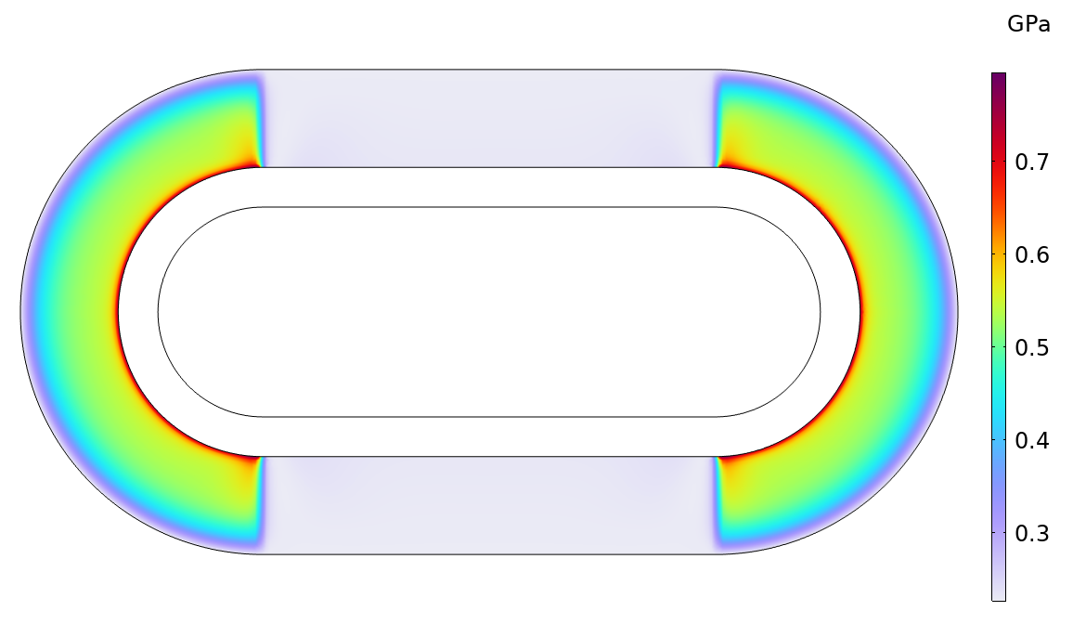
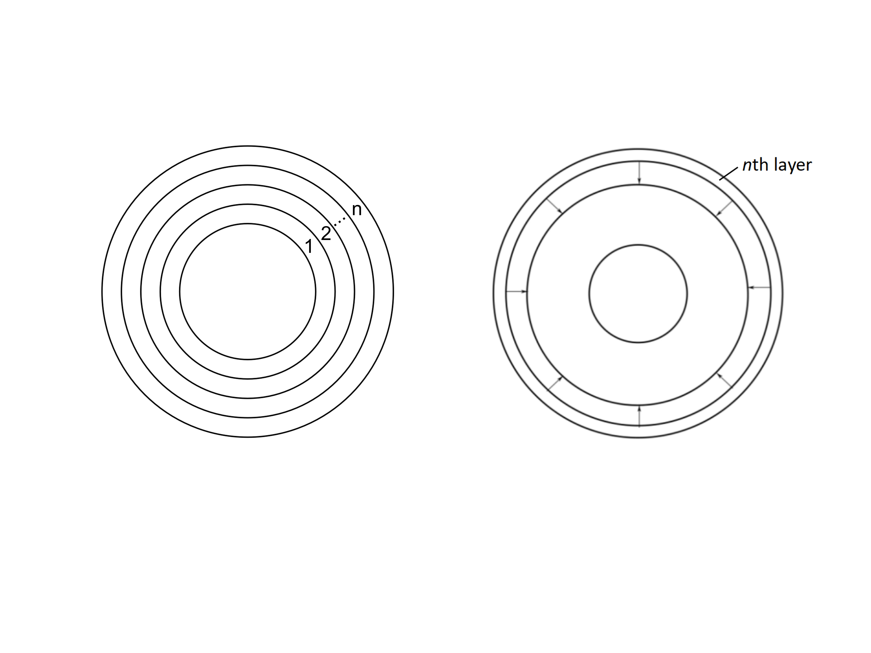
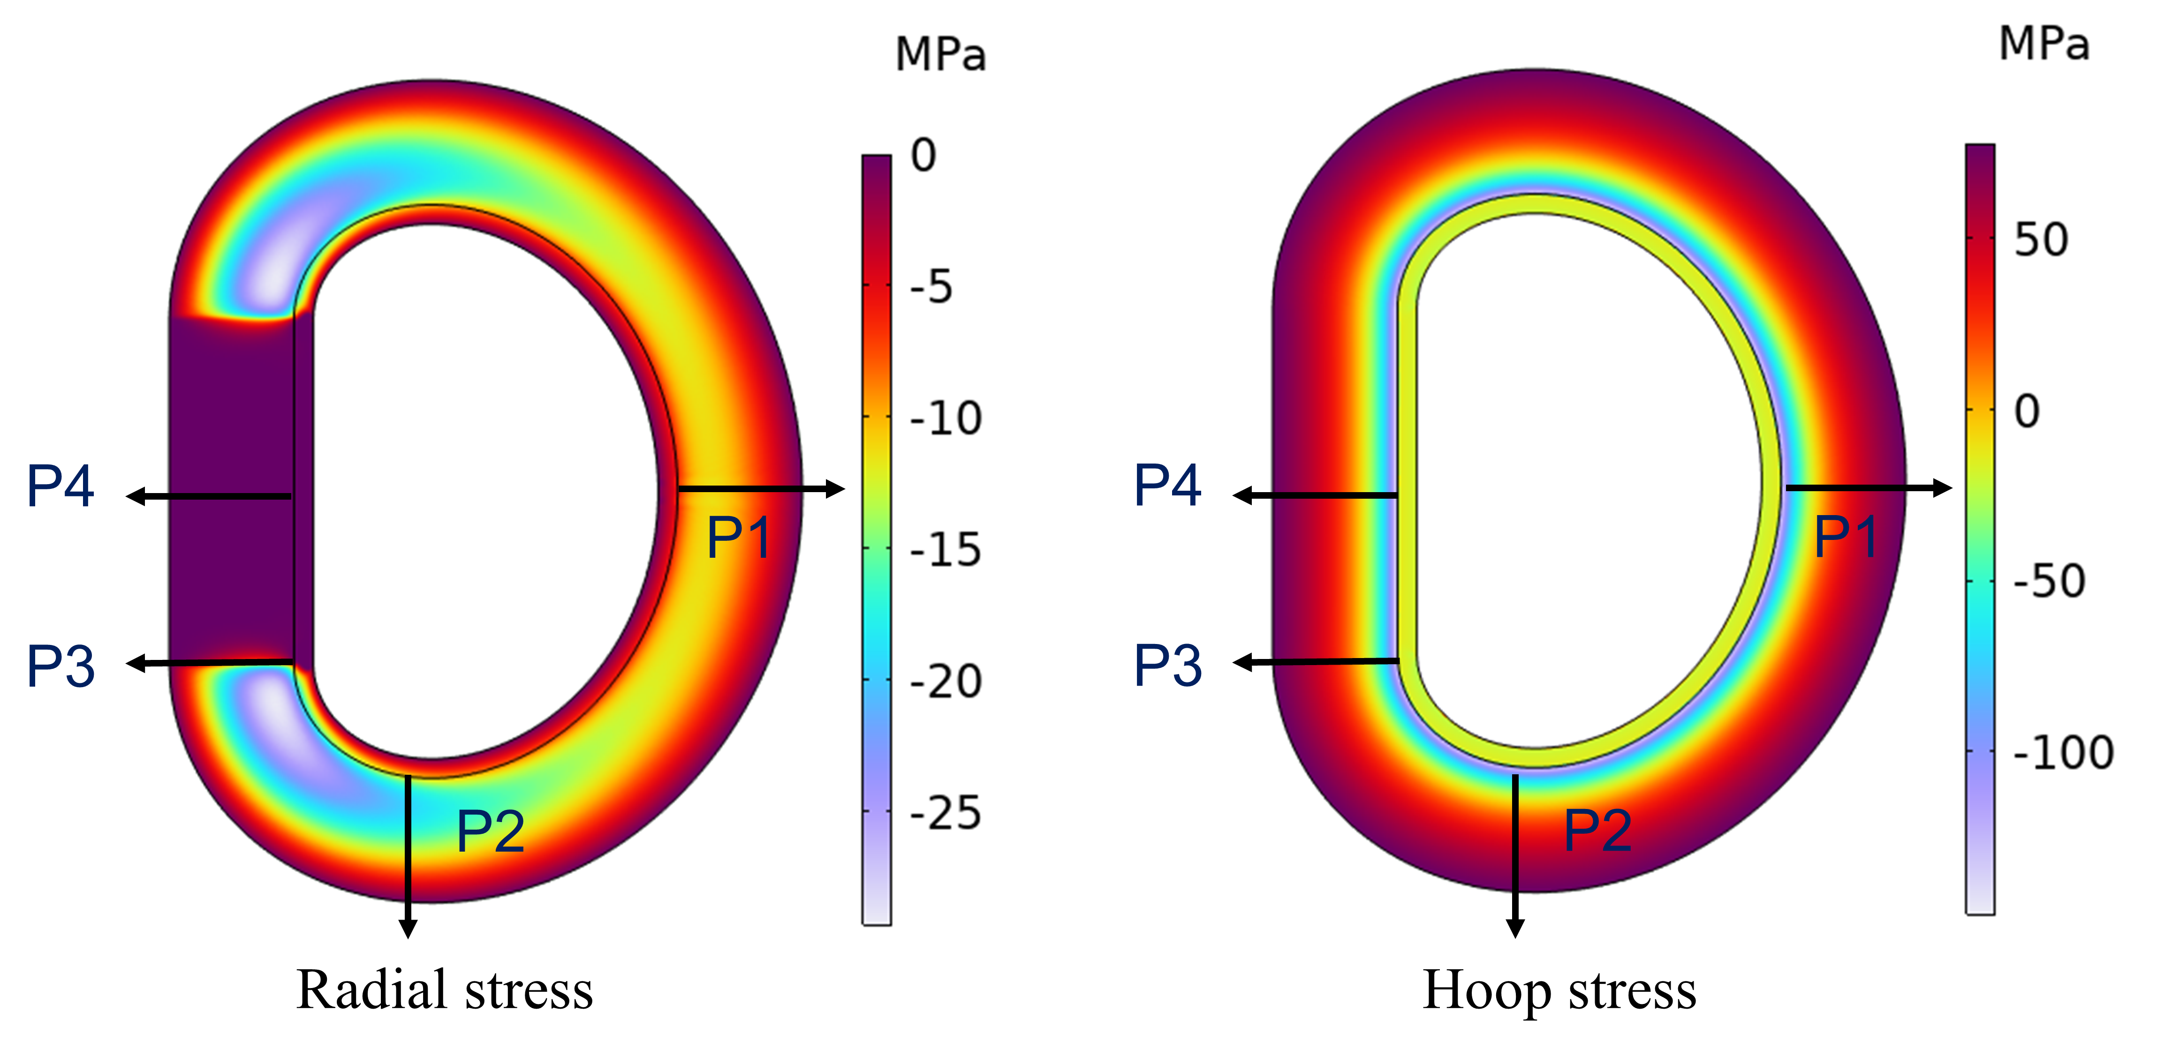
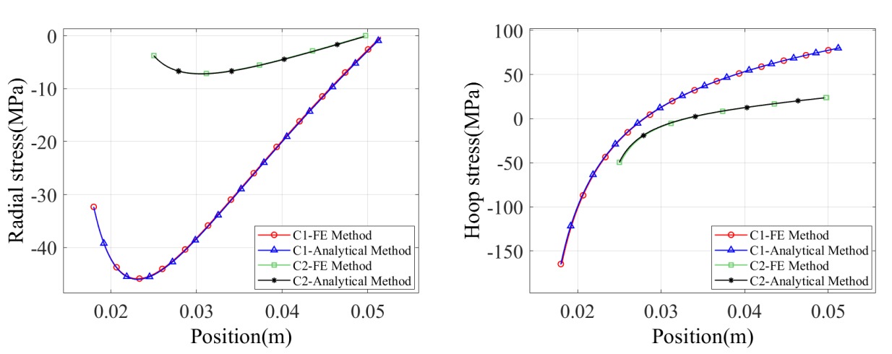
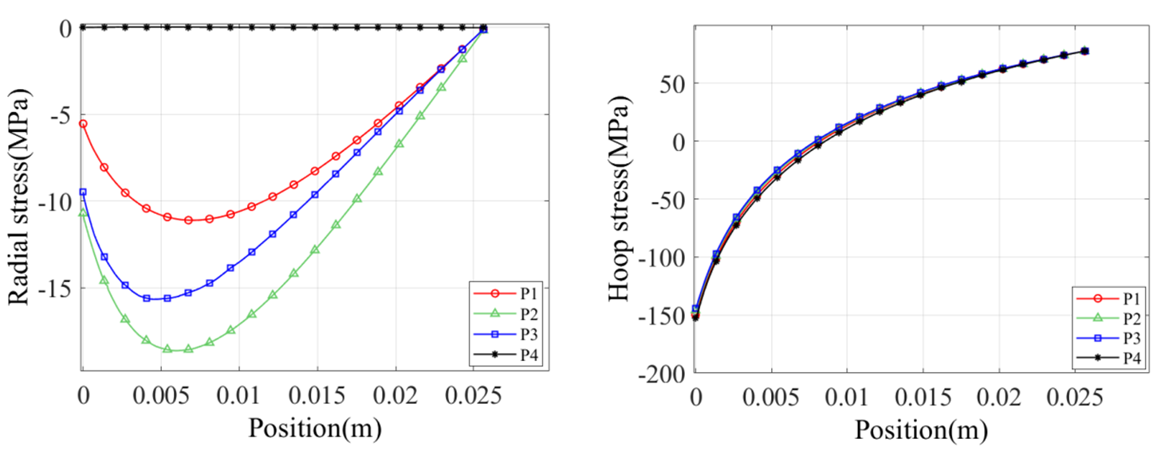
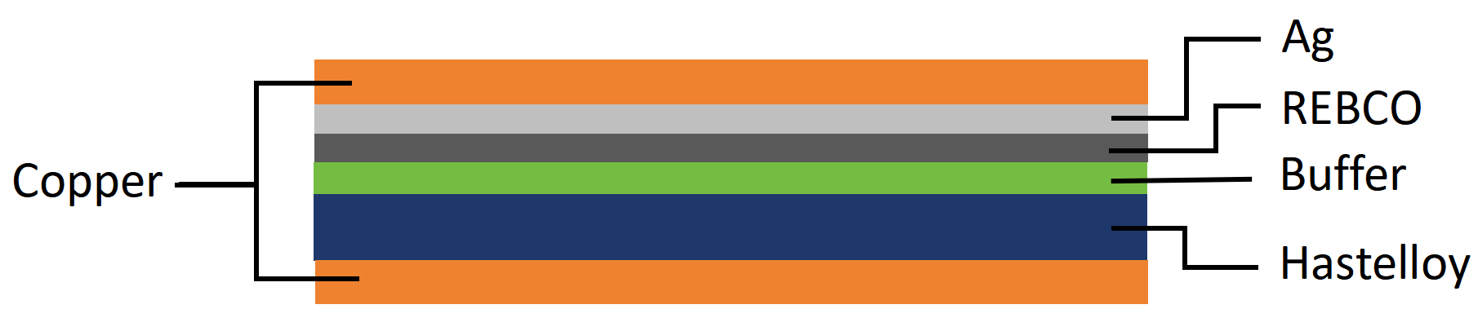
Finite Element Method for Calculating Winding Stress in Non-Circular High-Temperature Superconducting Coils
Zhihua Li, Li Lu, Zhuoyan Zhong, Wei Wu
School of Electrical Engineering, Shanghai Jiao Tong University, China
Presentation ID:Thu-Mo-Po.05-08
Abstract
Modeling steps
Stress distributions in non-circular coils
Stress distributions considering compressibility
Complex stress distribution arises in high-temperature superconducting (HTS) coil based on REBCO coated conductors, which is affected by the applied winding tension, thermal contraction during cooling down, and electromagnetic forces when energizing the coil.
The analysis of winding stress in coil presents a greater challenge compared to thermal and electromagnetic stresses. For circular HTS coils, the distributions of winding stress has been analyzed by analytical methods, which are not applicable to coils with complex structures, such as racetrack coils and D-shaped coils.
In this study, a finite element (FE) method model was proposed for analyzing the stress distributions of HTS coils with non-circular geometries during winding process. Comparison between the traditional analytical model and the proposed FE method model was obtained, which validated the latter one according to the calculated results of two circular coils. In the end, our proposed method was used to analyze the stress distribution of a racetrack coil and a D-shaped coil.
Construct geometry of coil including two parts: bobbin and coil.
(2) Set material parameters of the bobbin and the coil.
(3) Calculate the stress distributions during the winding process of every turn of coil. When winding the (i+1)th turn, it is equivalent to adding the (i+1)th annular ring to the coil, exerting pressure, P, on the outer surface of the ith turn.
Where T_{w} is winding tension, ρ is the radius of curvature, d is width of tape.
For the circular sections of racetrack coils, ρ(x)=r .But for the D-shaped coil, the radius of curvature of D-shaped coils changes with position. The radius of curvature at point (x₀, y₀) in the coil winding is calculated as follows:
(4) Sum all results in Step (3) and add the initial prestress to obtain the overall stress distribution of the coil.
This FE method is applied to analyze the stress distributions of two coils:
A racetrack coil used in electromagnetic levitation
A D-shaped coil used in magnetic confinement controllable nuclear fusion fields.
The main parameters of the two coils are listed in the table on the right.
In practice, the coil winding is comprised of a stack of the wound materials, exhibiting a nonlinear stress-strain relationship which can be expressed as:
Where ε_{r} is strain, l₀ is the initial gap between two adjacent stacked tapes, λ is compressibility characteristic, h is the thickness of tape, p is pressure.
Stress distributions in the racetrack coil considering compressibility
Model assumptions
Case1: considering compressibility
Case2: not considering compressibility
In practice, coils are spiral and their mechanical structure are very complex. In order to simplify modeling, the following assumptions are adopted:
(1) The coil is regarded as an infinite number of coaxial rings, and the winding process of the coil is considered as an increment of coaxial rings.
(2) The coil is under generalized plane stress condition, which assumes that stress in the winding axis (Z axis) direction is zero, 𝜎_{z} = 0.
(3) The inner and the outer boundaries of the coil undergoes free motion, indicating that the radial stresses on these boundaries are zero, 𝜎_{ri}, 𝜎_{ro} = 0.
(4) The homogenization method was applied to simply the layered structure of REBCO tape. (The average material parameters were used in the calculations)
In the radial direction:
Pressure given by winding process on coils of different shapes
Stress distributions in the racetrack coil during winding process
Small young’s modulus
In racetrack coil:
The radial stress in circular sections is relatively high, whereas it is nearly zero in straight sections.
The hoop stresses along different paths is similar.
Case1
Small support strength
Validation
In D-shaped coil:
Distribution of young’s modulus in radial direction.
Small radial stress
Large hoop stress
This method is validated by comparison with traditional analytical methods based on simulation results of the radial and hoop stresses in two circular coils. The results obtained through FE method are observed to be nearly identical to those derived from the analytical method, indicating high accuracy of the proposed FE method.
The values of radial stress seem to vary inversely with the values of radius of curvature of the D-shaped coil.
The radial stress is almost zero in the straight section
Under the influence of straight section, the radial stress at P3 is less than that at P2, contradicting Conclusion 1.
Conclusion
A finite element method was proposed to analyze the stress distributions of non-circular coils during winding process. This method is validated by comparison with traditional analytical methods.
In irregularly coils, non-uniform stress distribution is primarily attributed to variations in the coil's radius of curvature.
Compressive stress are generated in the coil during winding process. We can infer that the modification of winding tension can offset part of the excessive tensile thermal and electromagnetic stresses of the coil.
Other factors, such as compressibility of stacked HTS tapes, can significantly affect on the stress distributions of the coil.
Cross-section of stacked cylinder.
The process of winding nth layer.
Layered structure of REBCO tape.
Homogenized REBCO tape.
Winding stress distributions along radial and hoop direction in circular coils with different methods.
Stress distributions in the D-shaped coil during winding process

