Slide 1
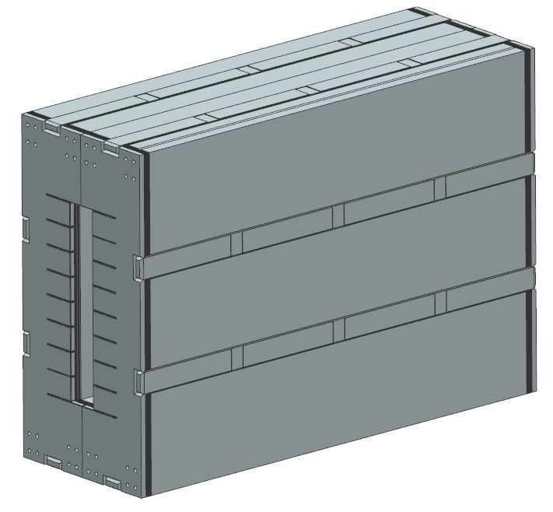
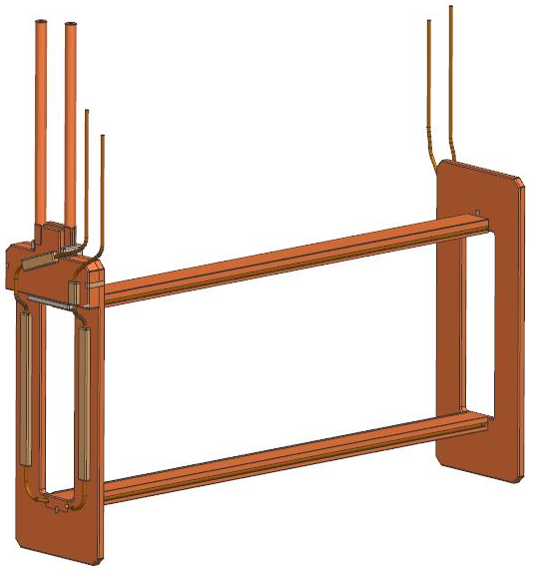
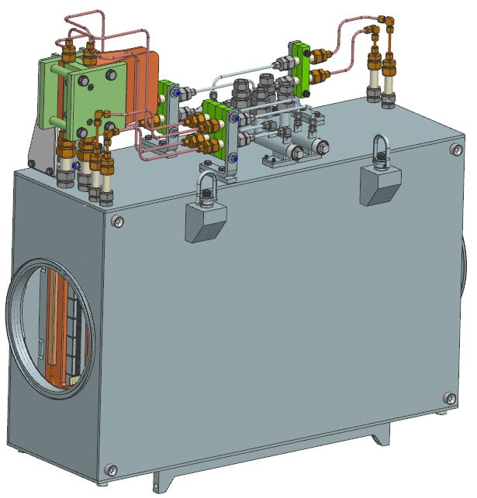
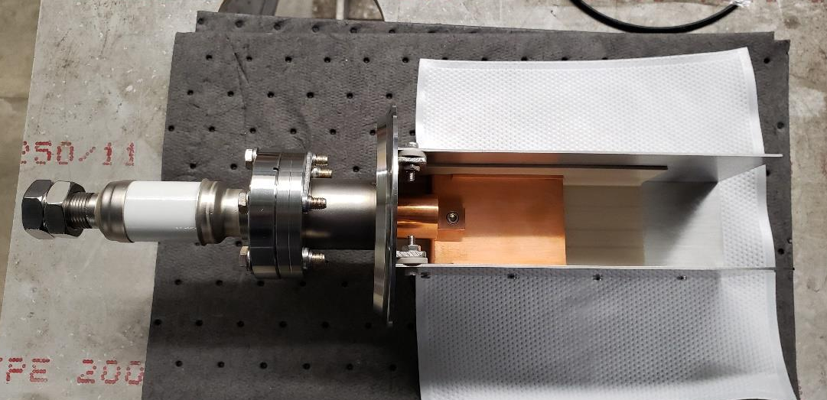
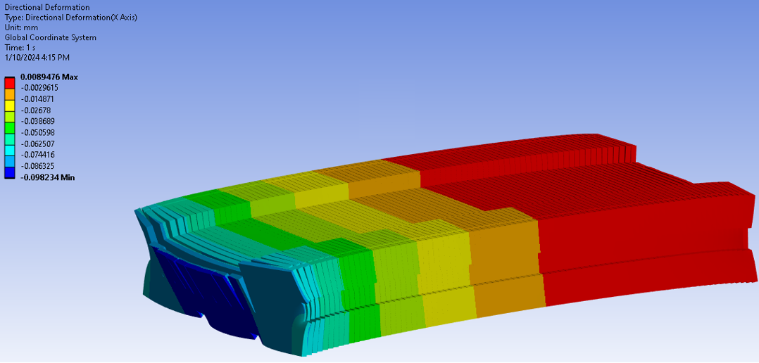
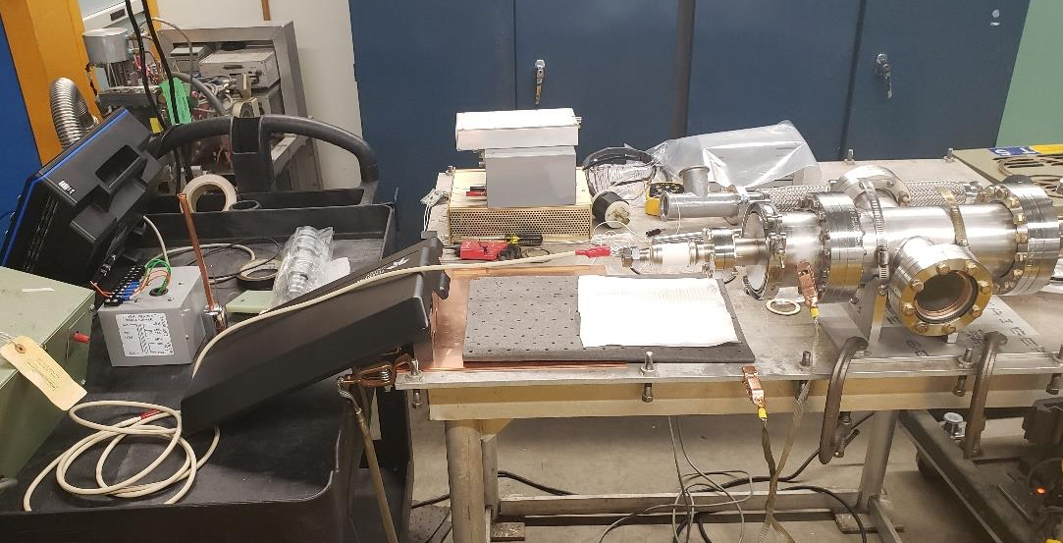


Fri-Mo-Po.07-05, ID# 344
Mechanical Design of the PIP-II ORBUMP Pulsed Dipole Magnet
D. Karas, K. Badgley, Z. Chen, V. Chernenok, M. Davidson, D. Harding, D. Johnson, V. Kashikhin, W. Robotham, T. Strauss, B. Szabo, J. Vander Meulen – FNAL
PIP-II ORBUMP Magnet Overview
Core Design and Clamping
1:1 Scale Sample Partial Discharge Test
Fermilab’s Proton Improvement Plan Phase II (PIP-II) will enable the production of the world’s most intense, high-energy neutrino beam for future experiments. The magnet pulse rate in the injection system will increase from 15 Hz to 20 Hz and requires a ~30% magnetic field increase in the PIP-II Orbital Bump (ORBUMP) dipole magnets at injection. The beam optics analysis establishes the magnetic parameters and results in a dogleg-shaped injected beam orbit. This is created by four identical vertical bending, single turn ORBUMP magnets connected in series by a power distribution stripline.
The magnet core is comprised of 0.127 mm thick, low carbon steel laminations with a C-5 inorganic coating and is secured in a SS vacuum box. The core is clamped together using external tie bars welded to the end plates.
The high voltage performance of the unreinforced PEEK isolating the coil from the core was investigated under high vacuum. A 1:1 scale section of the copper bus and insulator were assembled within a steel U-channel and placed within a vacuum vessel. The vacuum levels ranged 10⁻⁶ to 10⁻³ Torr and testing was sustained for >1 minute at ~5 kV rms. No partial discharge waveforms were recorded within these vacuum ranges which shows no concerns for partial discharge within the magnet while operated in sufficient vacuum.
ORBUMP Magnet
Mechanical Design and
Magnetic Parameters
Clamped Core with External Tie Bars
ORBUMP Coil
The core clamping design was chosen to best minimize the deflection post welding of the tie bars. ANSYS FEA was used to characterize the deflection in which was represented by 10 mm sections with frictional contacts. 150 psi was applied to the end plates in the stacking direction to simulate the reaction force from stacking the laminations. The total directional deflection indicates a maximum deflection of roughly 0.1 mm. Further evaluation shall be conducted with a prototype core.
Parameters | Units | Values
Proton Beam Energy | MeV | 800
Pulse Repetition Rate | Hz | 20
Magnetic Field Pulsed Ramp Up/Down | ms | 0.2
Magnetic Field Pulse Plateau | ms | 0.6
Maximum Integrated Field | T-m | 0.35
Field Homogeneity | % | 0.05
Good Field Area Width | mm | 250
Peak Current | kA | ≤20
Gap | mm | 20
Laminated Core Length | mm | 850
Directional Deflection of ORBUMP Core
Top: Partial Discharge Testing Fixture
Bottom: Vacuum Setup

