Slide 1
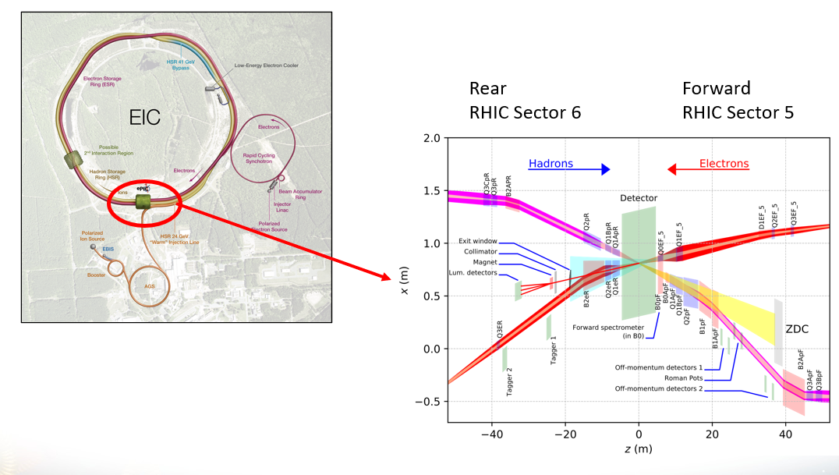
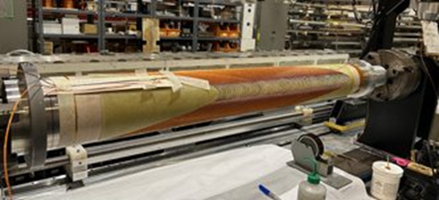
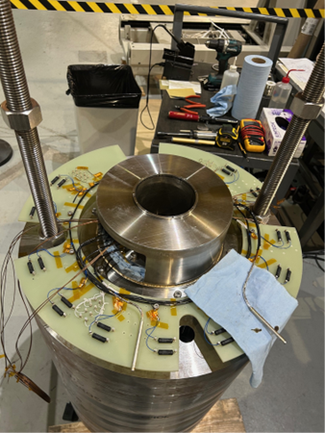
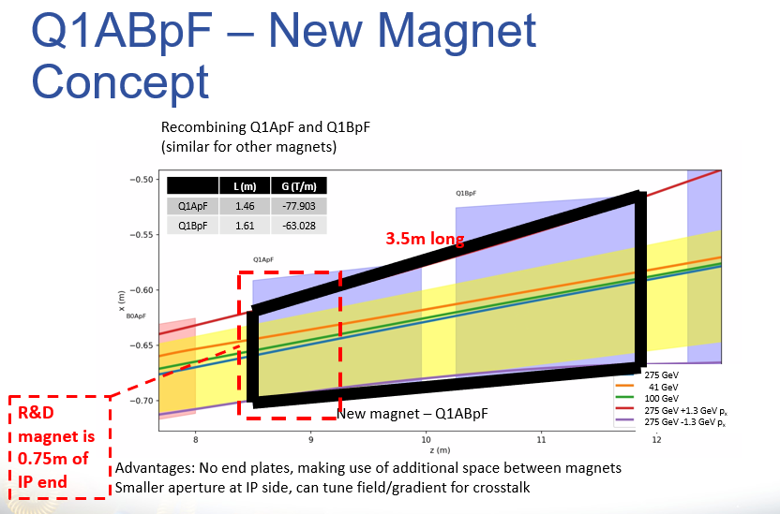
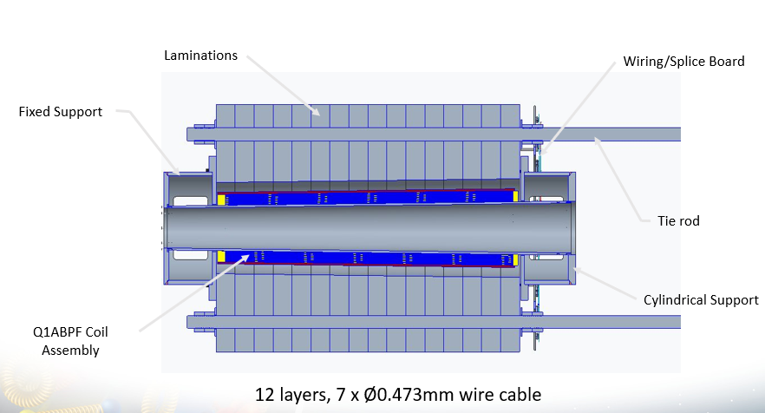
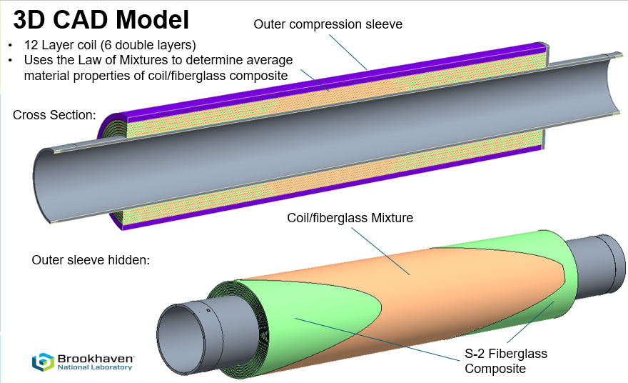
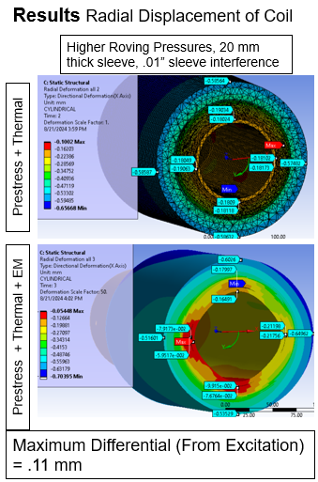
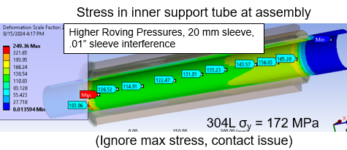
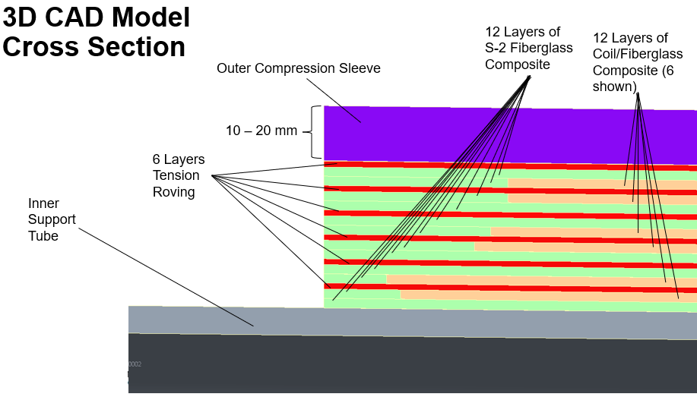
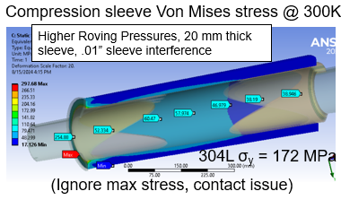
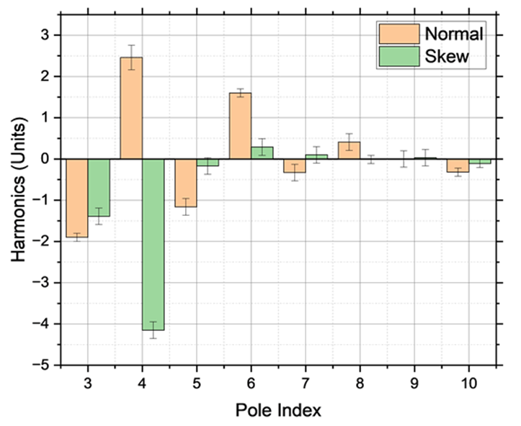
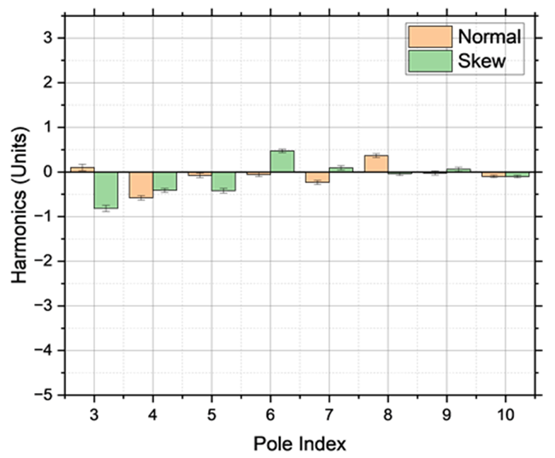
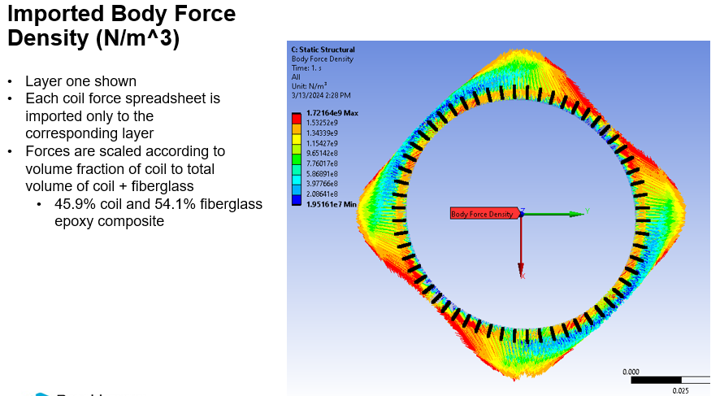
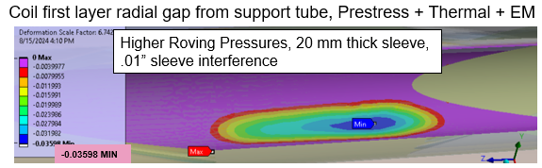
Construction of a Superconducting “Direct Wind” R&D Magnet for the EIC Interaction Region
M. D. Anerella, Y. Bai, J. Becker, A. Ben-Yahia, A. Drees, J. Escallier, P. Joshi, F. Kurian, A. Marone, C. Runyan, V. Teotia, W. Wahl, P. Xu, Brookhaven National Laboratory, Upton, NY 11973, U.S.A.. H. Witte, MIT, LNS
Abstract- Brookhaven National Laboratory (BNL) was chosen to host the international Electron-Ion Collider (EIC), which will collide high energy and highly polarized hadron and electron beams with a center of mass energy up to 140 GeV. The Interaction Region (IR) requires several large aperture, relatively high field superconducting dipole and quadrupole magnets, some of which are very closely spaced. A value engineering effort is underway as part of the EIC Project to construct and test a Direct Wind magnet (coil comprised of NbTi conductor deposited directly onto a support tube, in this instance tapered, and secured mechanically against Lorentz forces afterwards) to replace two Rutherford cable collared magnets. This magnet exceeds the combination of aperture, number of coil layers, and magnetic field, as compared to existing accelerator and R&D Direct Wind magnets to date. Furthermore, construction has been completed using a newly commissioned winding machine, upgraded in anticipation of upcoming EIC production coil fabrication. Construction issues, lessons learned, and results shall be discussed, including the planned and accomplished corrections to multipoles made in successive coil layers based on warm magnetic measurements of preceding layers.
EIC Interaction Region Overview
Fabrication Status
Coil fabrication complete
Magnet assembly, wiring complete
One tapered direct wind magnet replaces 2 Rutherford cable magnets
(Q1ApF and Q1BpF)
Q1ABpF – New Magnet Concept
Mechanical Design
Structural Analysis
Multipole Corrections During Construction
Lessons Learned
Corrections only after layers 6, 8, 10, 12
Data after layer 6 Data after layer 12
Wiring file errors
Wires overlapping
Corner radii too small
Incorrect taper
Very large number of filler parts required
Immediate term – increase labor resources to match need
Short term – design/build/use stamping die to cut shapes
Long term – identify & purchase programmable planar cutter
Cable twist pitch
Two varieties used, the smaller of the two proved more flexible
Order production cable to preferred configuration
Delamination after initial cure of layer 10
Greatest number of DW coil layers to date
Successfully remediated
Procedure revised to ward against future occurrence, all layers, all coils
Add pre-winding software checks of wiring files
b₄
b₃
a₃
a₃
b₄
a₄
b₃
a₄
SUMMARY
An R&D magnet has been designed & built to a design which represents a cost savings and a technical improvement over (2) Rutherford cable magnets in the EIC IR which it would replace. It is the most challenging Direct Wind magnet built to date and is scheduled to be tested this summer.
*Work supported by Brookhaven Science Associates, LLC under Contract No. DE-SC0012704 with the US Department of Energy.

