Slide 1



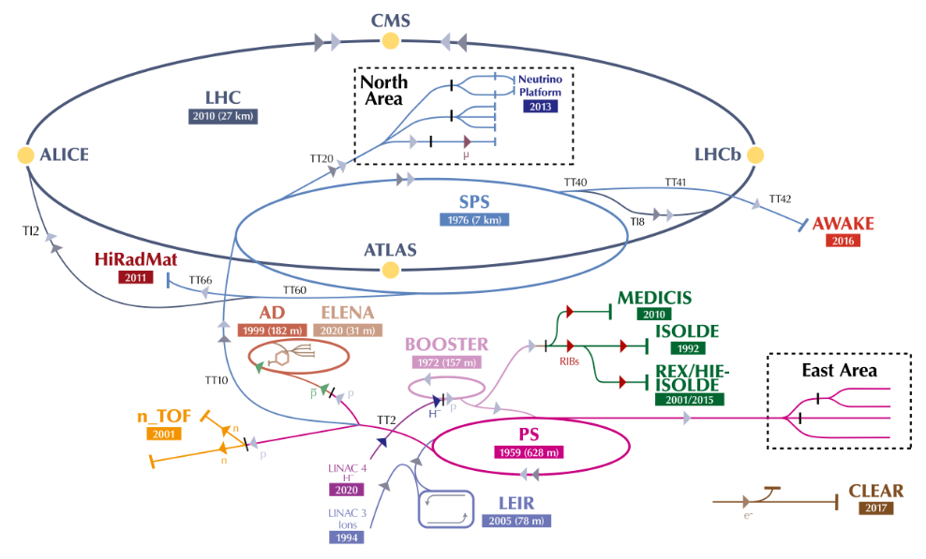
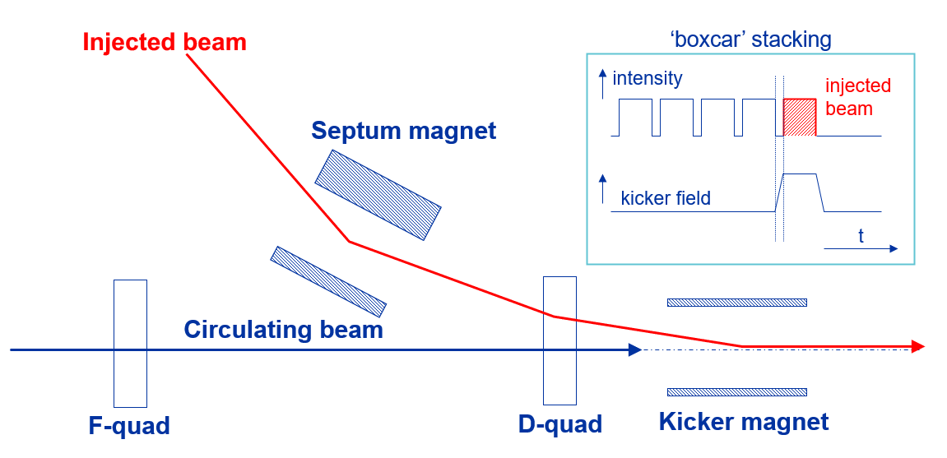
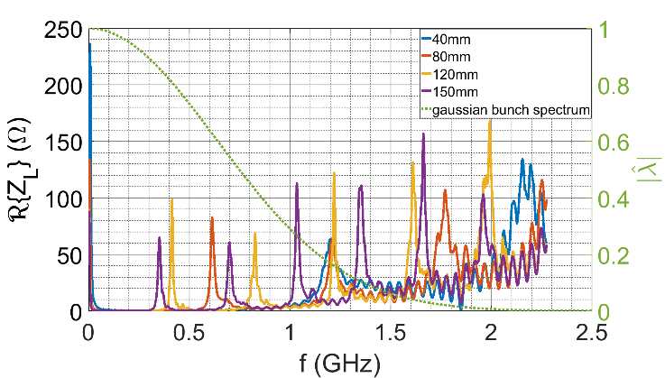
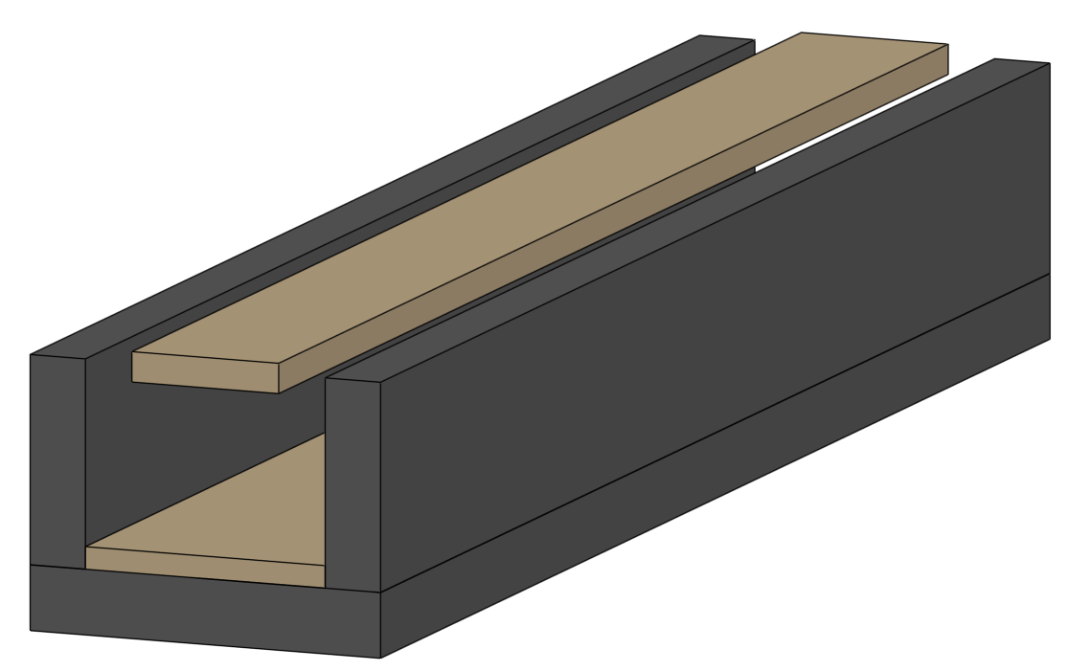
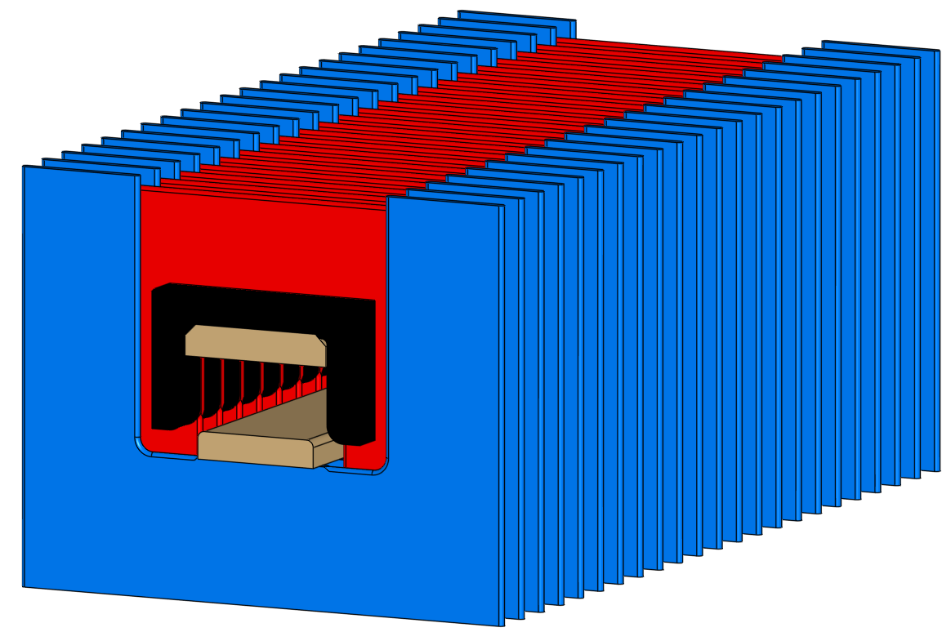
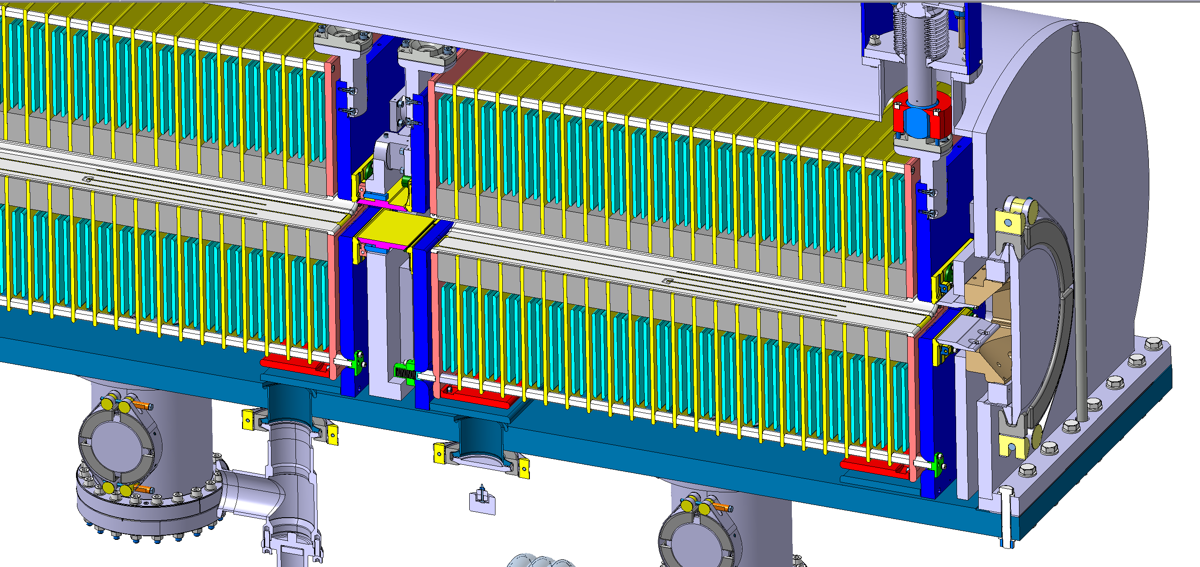
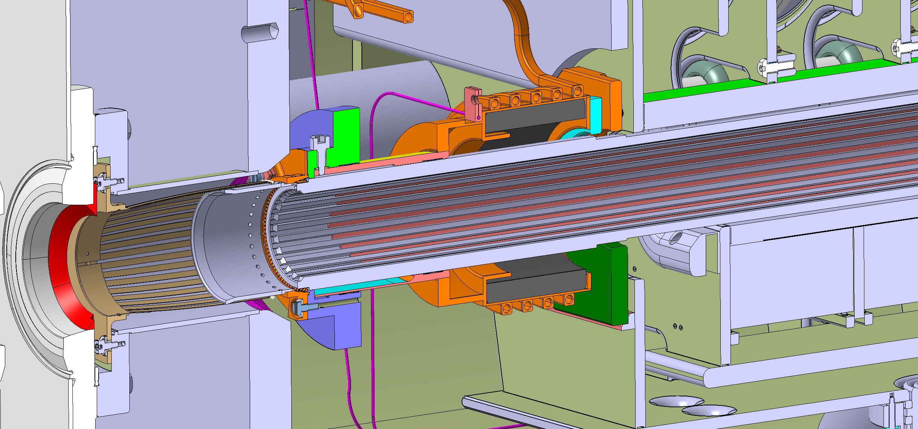
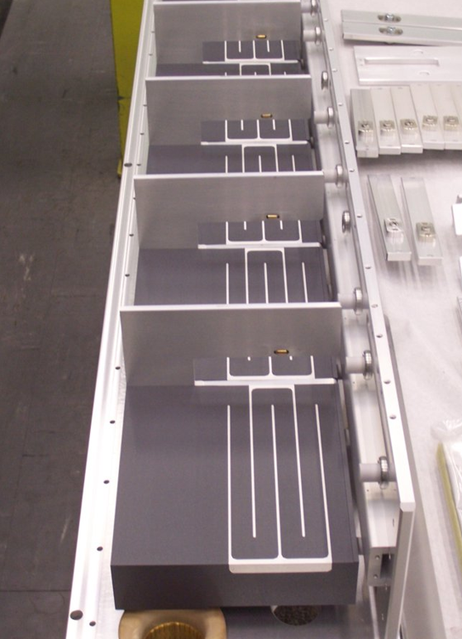
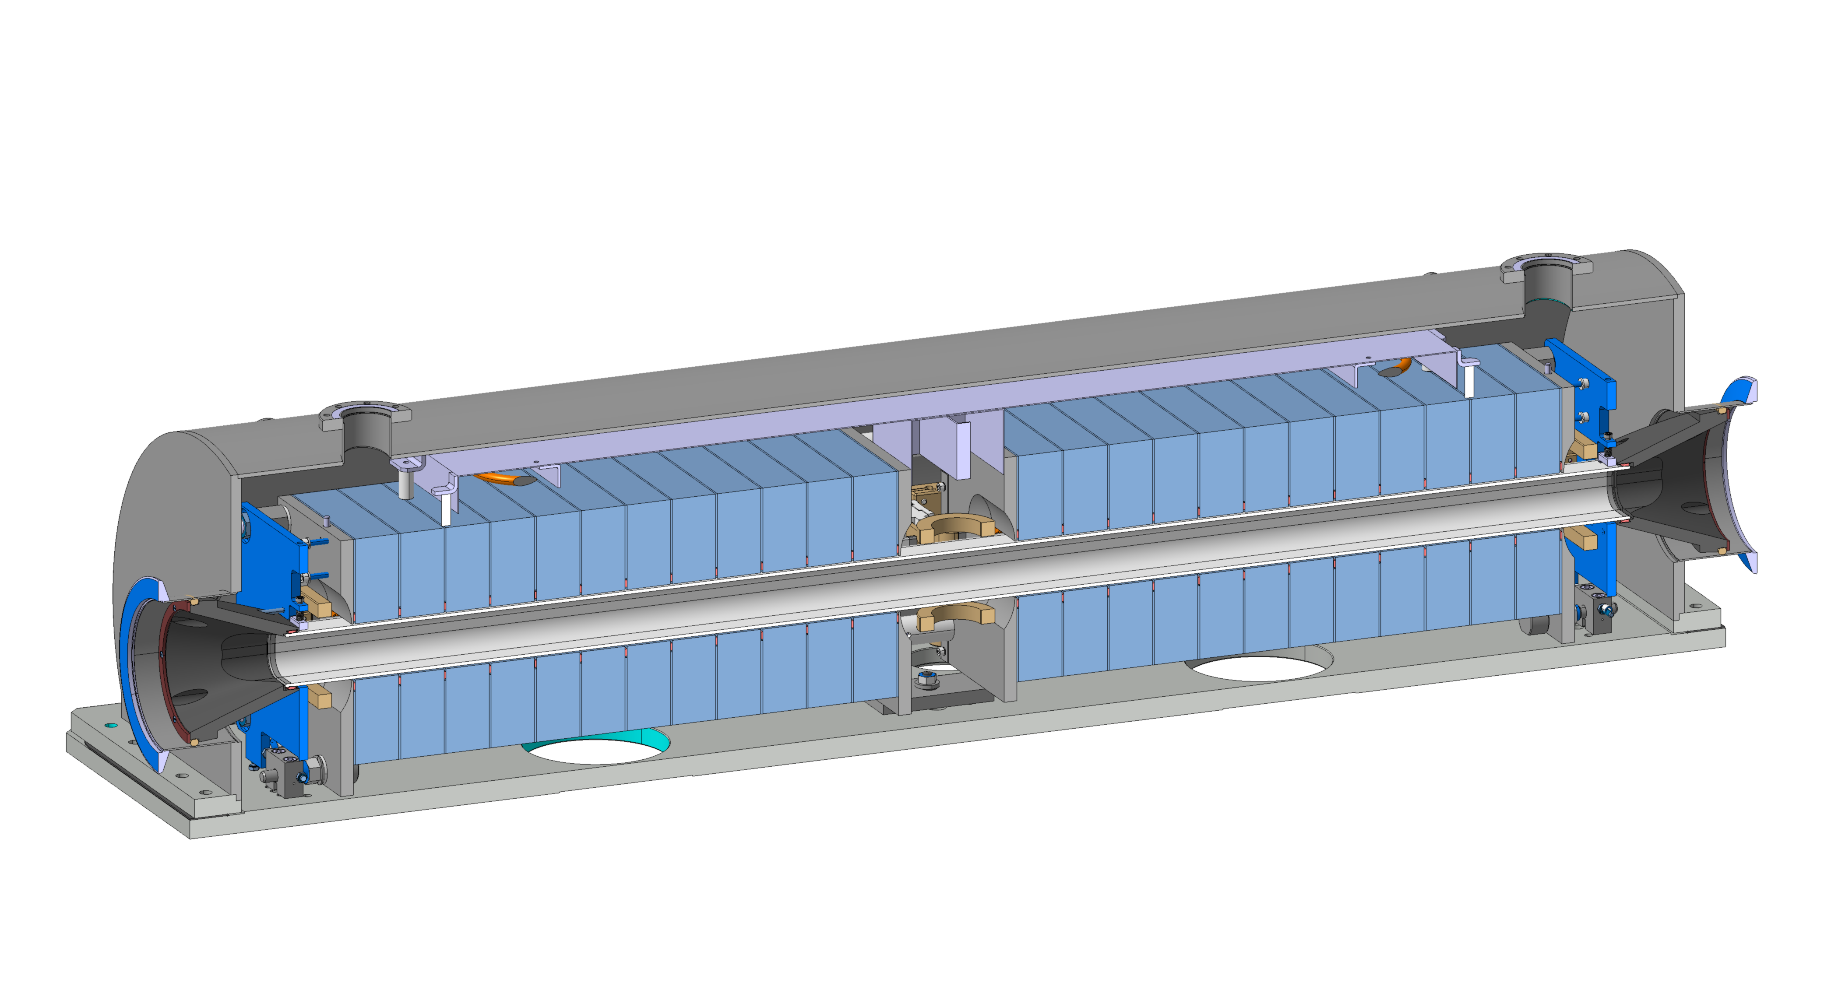
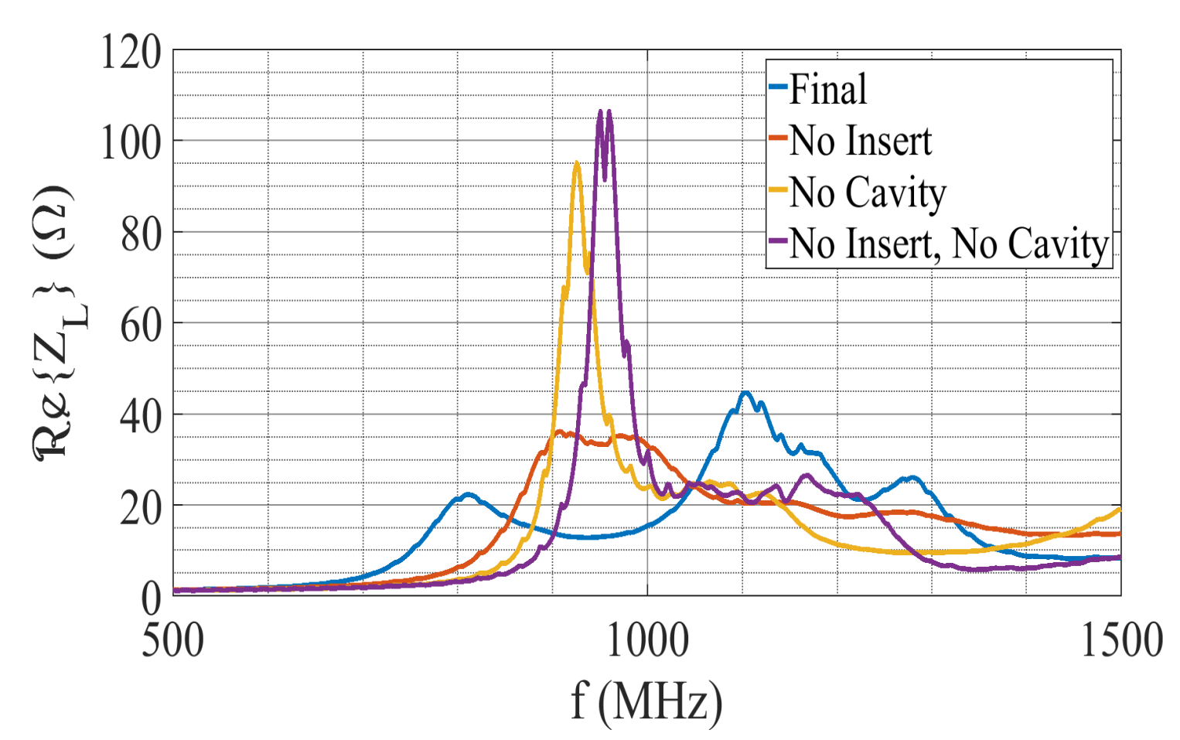

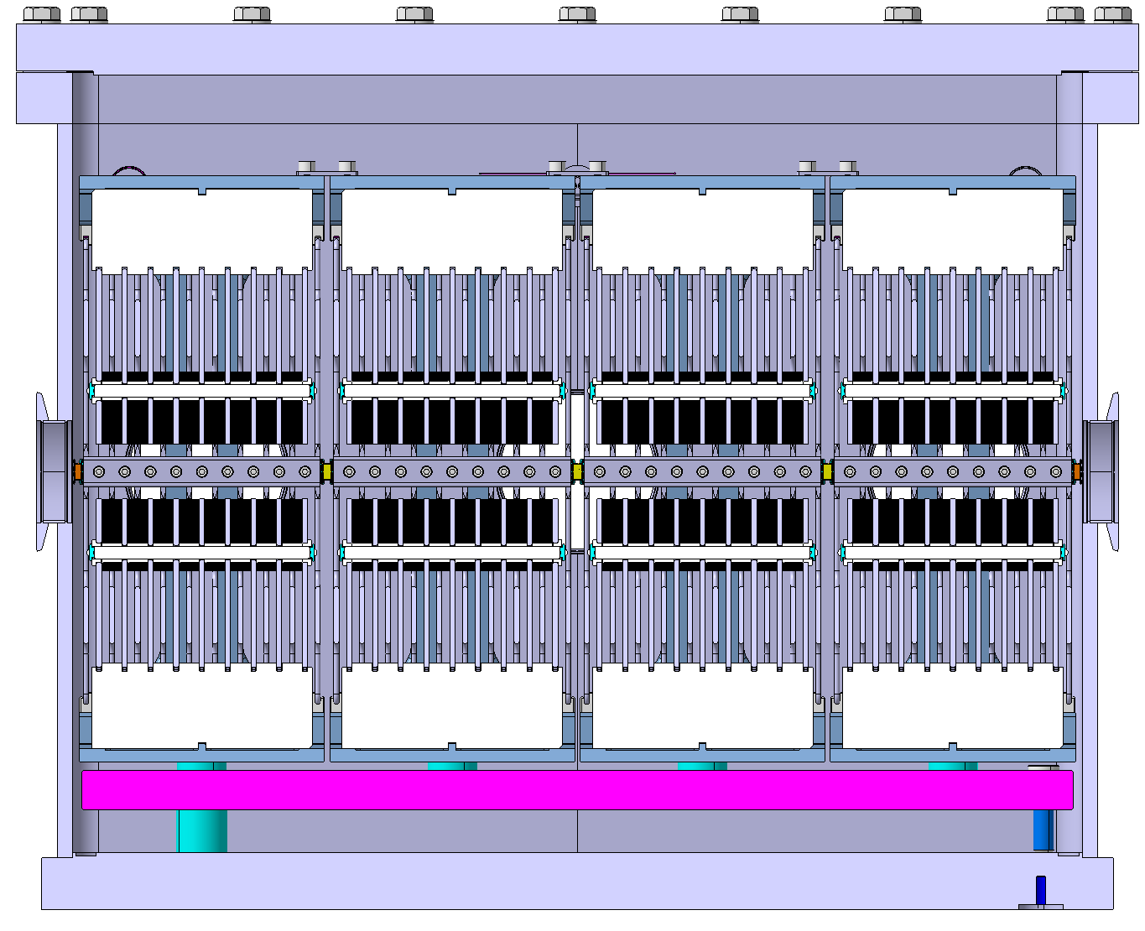
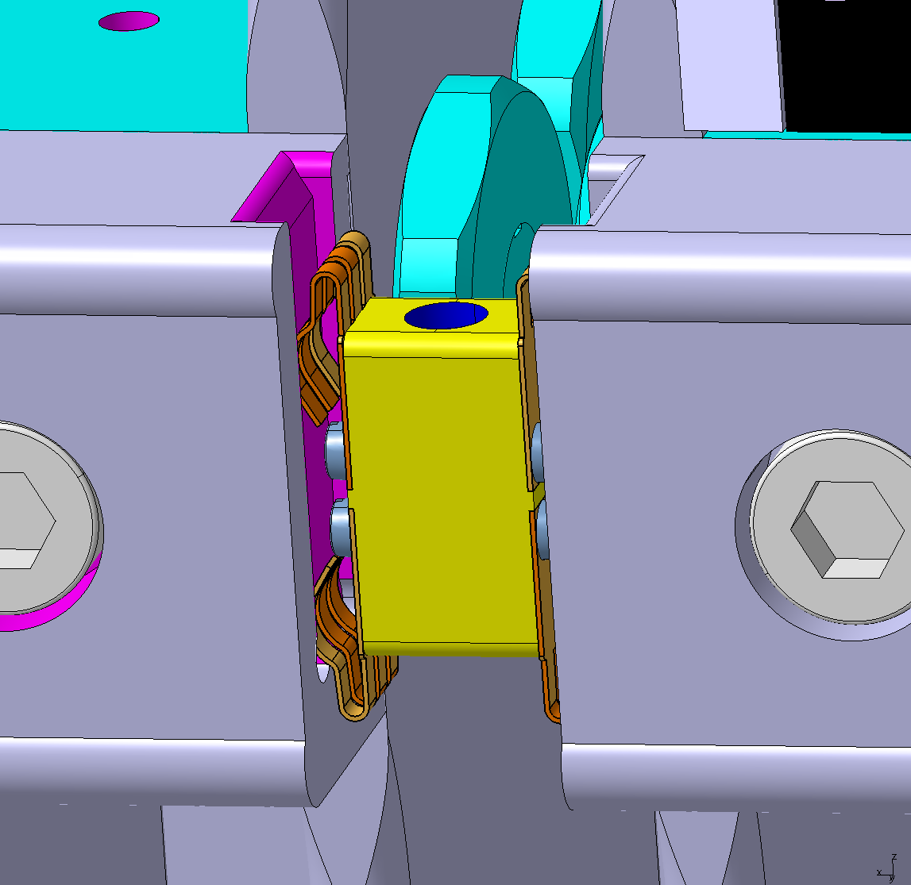
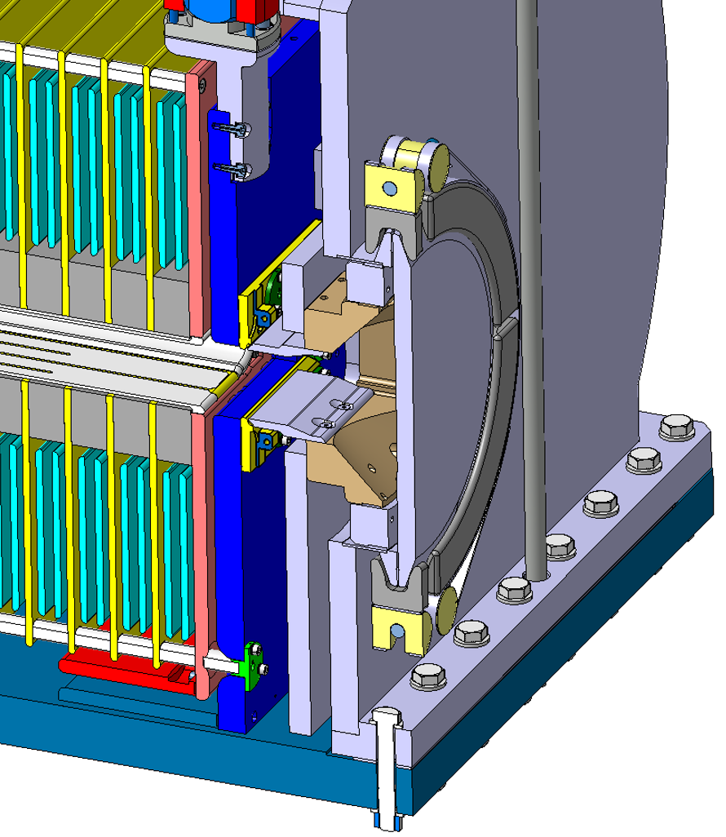
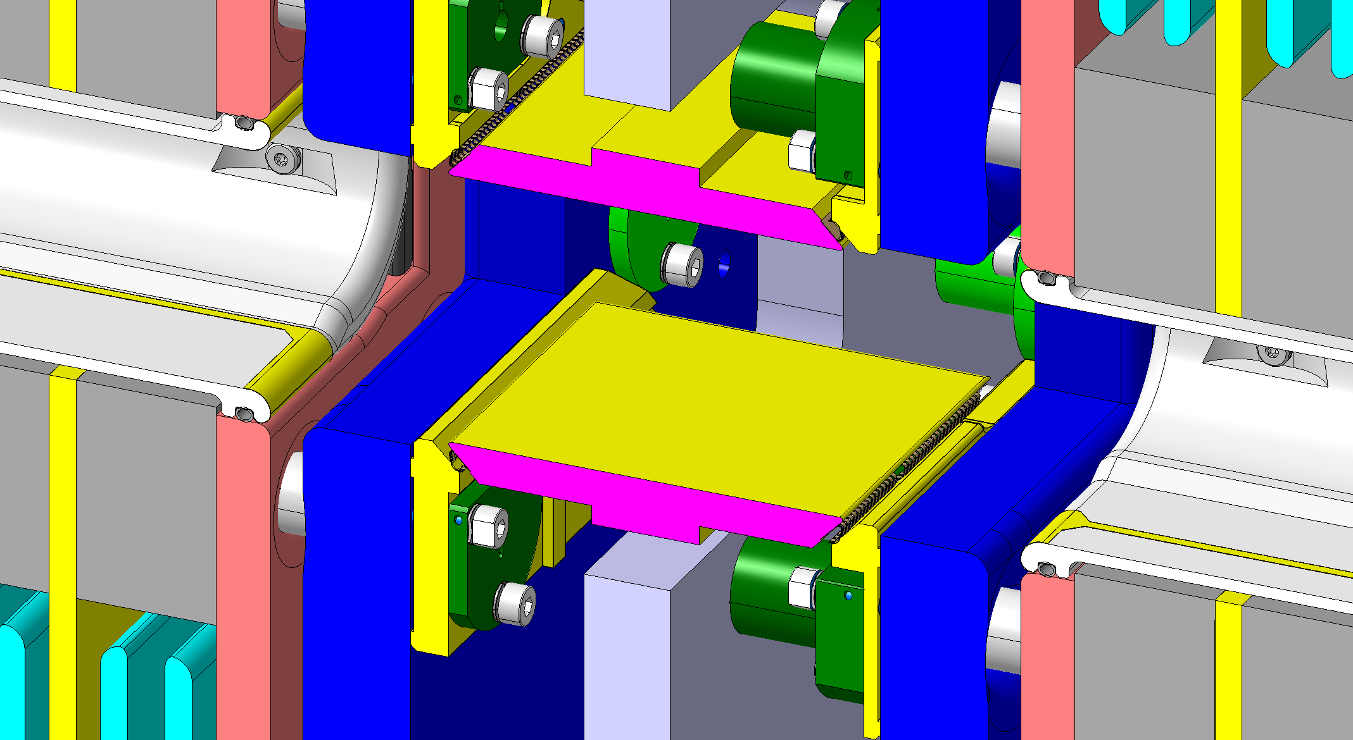
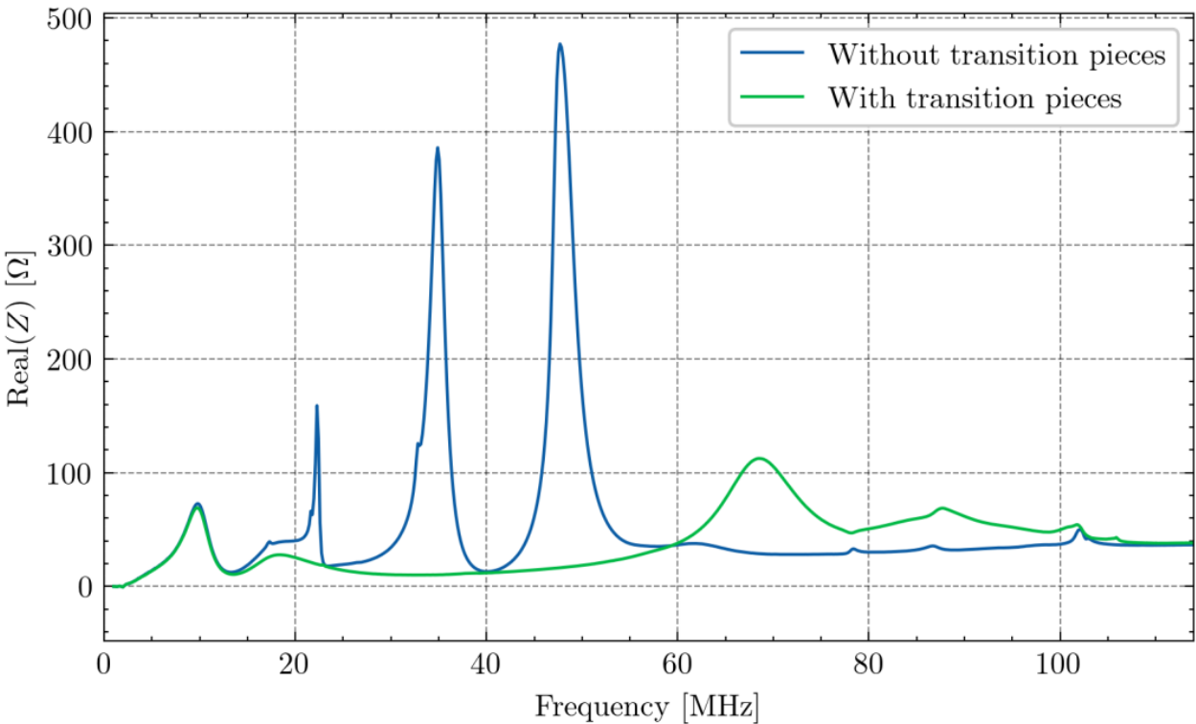
Design strategies for beam impedance reduction
of kicker magnets in particle accelerators
Pavlina Trubacova, M. Barnes, L. M. C. Feliciano, M. D. Zumel, L. Ducimetiere, G. Favia, T. Kramer, V. Namora, M. Neroni, D. Standen, C. Vollinger and C. Zannini | CERN - Geneva, Switzerland
Abstract - In high-energy particle accelerators, kicker magnets are essential for injecting and extracting particle beams using fast-pulsed magnetic fields. A key challenge in their design is minimizing beam coupling impedance to maintain beam stability and reduce induced power losses while preserving the fast rise and fall times of the magnetic pulse. This paper presents innovative principles and mechanical approaches for reducing beam impedance in several kicker magnets operating under vacuum across the CERN complex. Kicker magnets use ferrite or laminated steel as a magnetic yoke, which is susceptible to beam-induced heating. The proposed techniques aim to screen the ferrite yoke, provide a low impedance path for the beam image current, and eliminate cavities that could generate resonances. Simultaneously, the screen must allow the passage of fast pulsed magnetic fields.
Techniques include the insertion of ceramic chambers holding screen conductors, serigraphy of conductive paint, and thin metallization by sputtering. Bridges can eliminate cavities between adjacent magnets or vacuum vessels. The performance of these design strategies is evaluated through a combination of high-frequency simulations, laboratory impedance measurements, magnetic field assessments, and temperature monitoring of kicker magnets after installation in accelerators. The results demonstrate significant improvements, which are discussed in detail. This work establishes a foundation for further innovations in kicker magnet design, with the potential to enhance existing systems and guide the development for future accelerators such as FCC-ee, with shorter bunches, where the impedance is even more important.
Introduction
Beam impedance in kicker magnets
Kicker magnets are key components used for beam deflection in CERN’s accelerator complex.
They operate at high voltage, often under vacuum, with rise/fall times from nanoseconds to microseconds.
Designs vary depending on the beamline requirements (strength, timing, aperture, structure).
Many magnets were built decades ago, before beam coupling impedance became a major concern.
Higher beam intensities in modern accelerators (e.g. HL-LHC) have increased sensitivity to impedance effects.
Impedance mitigation has become critical and is addressed through new designs and system retrofits.
Beam impedance:
In a particle accelerator, a beam of charged particles generates an electromagnetic field. This field interacts with the surroundings of the accelerator.
Variations in the cross-section and finite conductivity of the walls cause the beam to excite additional electromagnetic fields.
These excited fields, left behind the source particle, are known as wakefields.
In the frequency domain, wakefields are characterized by the beam coupling impedance
Kicker magnets are major source of beam coupling impedance due to:
Lossy ferrite yokes
Structural discontinuities – cavity-like resonators
Mitigation strategies
Providing a continuous path for image currents
Screening the ferrite yoke from wakefields
Minimizing flange-to-flange discontinuities to avoid empty cavity-like resonators by adding transitions pieces
Shifting impedance spectrum to higher frequencies to reduce beam power deposition
Transverse beam impedance: adding of filters or improved termination matching
Re{Z} (Ω)
ˆ
The LHC beam bunch spectrum with a study of different lengths of capacitive coupling of screen conductors for the injection kicker (MKI) to shift the real part of longitudinal impedance towards higher frequencies where the beam spectrum carries less power [3].
Beam impedance effects
Bunch spectrum |λ|
[1]
HV plates
Beam energy loss and instabilities via both longitudinal and transverse beam coupling impedance:
Beam induced heating
  Directly dependant upon beam parameters
  Results from the product of the real part of longitudinal impedance and the beam spectrum
  If not limited -> Curie temperature of the ferrite, excessive vacuum outgassing, higher risk of high-voltage breakdowns
Beam instabilities
Return busbar
Frequency (MHz)
HV busbar
Validation methods
Yoke
Ferrite
Simulations to design and optimize impedance mitigation
Wire measurements pre- and post-implementation
In-situ temperature monitoring during beam operation
HV busbar
Lumped Inductance Kicker
Return busbar
Transmission line Kicker
Ground plates
[2]
Screening
Beam impedance mitigation design strategies
Screening solutions depend on the pulse rise time:
Microsecond-range rise time: Resistive coatings
Sub-microsecond rise time: Capacitively coupled conductive stripes
Conductive stripes
Design principles
Applied in transmission line-type kickers with fast rise times
Designed based on impedance simulations tailored to each specific kicker
Spacing, width and length -> direct impact on the overall impedance performance
Risk - It may introduce additional resonances -> anticipation during the design process
2.1 Serigraphy:
Silver-based paint applied directly to ferrite or ceramic
Uniform paint thickness, without droplets or irregularities, otherwise possible sharp edges presenting high-voltage breakdown risks
2.2 Screen conductors:
Designed for long kickers where serigraphy with its sharp edges and limited thickness can increase the risk of high-voltage discharges in vacuum
Use elliptical solid wires embedded in ceramic grooves
Key Implementation Examples
SPS extraction kicker (MKE)
Long ferrite cells, serigraphy on ferrites
SPS injection kicker (MKP-L)
Serigraphy on ceramic substrate per module
~12x reduction in beam-induced temperature during 2023 scrubbing run
Resistive coating
Design principles
Used in lumped-inductance magnets with slower rise/fall times
Titanium (Ti) coatings applied via sputtering onto Al₂O₃ ceramic tubes
Controllable surface resistivity, strong adhesion to the ceramic substrate, excellent compatibility with ultra-high vacuum, and a low Secondary Electron Yield (SEY)
Thickness determines the resistivity and is carefully selected not to significantly degrade the rise and fall times or the field homogeneity
Key Implementation Examples
LHC dump kicker (MKD) & PS Booster bumpers (KSW):
Beam impedance mitigation strategy implemented from design stage
Coated ceramic tubes with 0.15 Ω/square Ti layer, magnet outside vacuum
Rise time increased by <1 µs for 3 µs nominal pulse
SPS dump kicker (MKDH)
Retrofit application – design study ongoing, aperture limitations exists
Magnet yoke is constructed from laminated magnetic steel instead of ferrite
Challenge: Ti-coated 1.5 m ceramic chamber inserted in existing system
Serigraphy
Ceramic chamber
Transitions with RF fingers
Vacuum tank
Magnet modules
Conical transition
LHC injection kicker (MKI)
Screen conductors in ceramic chamber
After extensive optimization, 60x reduction in beam-induced heating
Screening
Vacuum tank
RF Damper
Ground plate
MKE kicker longitudinal impedance
Ferrites
Transition with RF fingers
HV plate
Transitions with RF fingers
Laminated steel
Re{Z} (Ω)
Ceramic chamber
Screen conductors
Adjustable positioning
Titanium coating
Screen conductors & RF Damper
No Screen conductors
No RF Damper
No Screen con., No RF Damper
MKE-L10, with serigraphy
MKE-L8, no shielding
Re{Z} (Ω)
Conical transition
2 Magnet modules
Ceramic chamber
Frequency (MHz)
[4]
[4]
Frequency (MHz)
[5]
Transition pieces
Key Implementation Examples
1. Longer magnets equipped with beam screens:
SPS Injection Kicker (MKP-L):
Flat-surfaced transitions with RF fingers between all modules
Adjustable mounts for misalignment compensation
Amorphous carbon (a-C) coatings applied to transition surfaces reduces Secondary Electron Yield (SEY)
Mitigate risk of discharges
2. Short magnet without beam screens
PS Injection Kicker (KFA45):
RF-fingered transitions between ground busbars at the beam aperture level
Discontinuities in the vacuum system act as resonators, creating low-frequency impedance peaks-> beam instabilities
Transition pieces ensure electrical continuity between kicker modules and vacuum tanks.
Design Principles
Use of metal cones or plates with flexible lamellar contacts, RF fingers, maintained by dedicated supports
Design ensures:
sufficient contact pressure of RF fingers across operating temperatures
Compensation of misalignments or geometric imperfections
Magnetic field uniformity
Beam aperture preservation
Avoiding high-voltage discharge risks
Retrofit magnets - radiation activation to be taken into account
Ferrites
HV plate
Ground plate
Transition with RF fingers
Beam
Transition pieces
HV plates
Top and bottom transitions with RF fingers
4 magnet modules
HV busbar
RF fingers
Serigraphy
Ferrites
PS Fast Extraction Kickers (KFA71, KFA79):
Geometric constraints prevented direct connection at aperture level
RF-fingered transitions ~150 mm from aperture
Wire measurements confirmed significant impedance reduction
Vacuum tank
RF fingers to the ground
Re{Z} (Ω)
Ground plates
RF fingers connecting serigraphy to HV plate
Conical transition
Conclusion and outlook
Frequency (MHz)
[6]
Beam coupling impedance of kicker magnets has been reduced using dedicated design strategies.
These strategies were developed based on extensive experience and guided by high-frequency simulations.
Validated through laboratory impedance and field measurements and temperature monitoring during high-intensity beam operation
Early integration of impedance reduction techniques into the design phase is ideal to maintain beam aperture and magnet performance.
Beam impedance control is increasingly important for future accelerator projects like the Future Circular Collider (FCC).
References and with acknowledgments to ABT team
[1] Y. Dutheil: Injection and Extraction EDMS 2807405 / CAS 2022
[2] D. Standen et al., “FCC-ee Integration Requirements for Injection-Extraction Equipment”, in Proc. FCC-week 2025, Vienna, Austria, May 2025.
[3] L. Ducimetiere, M. Barnes, “Magnetic materials and impedance shielding at CERN for fast pulsed magnets,” in PULPOKS, Oxford, UK, 2020.
[4]L. Ducimetiere, M. Barnes, “Beam screening experience at CERN for fast pulsed magnets,” in PULPOKS, Geneva, Switzerland, 2018.
[5]V. Vlachodimitropoulos et al., “Studies Towards the New Beam Screen System of the LHC Injection Kicker Magnet for HL-LHC Operation”, in Proc. IPAC'19, doi:10.18429/JACoW-IPAC2019-THPRB074
[6] M. Neroni, Request for installation of transition pieces in KFA71-7. CERN, May 2025.. https://indico.cern.ch/event/1551270/contributions/6532614/attachments/3072697/5436318/NeroniMichela_ABTmeeting-210525.pdf

Slide 2
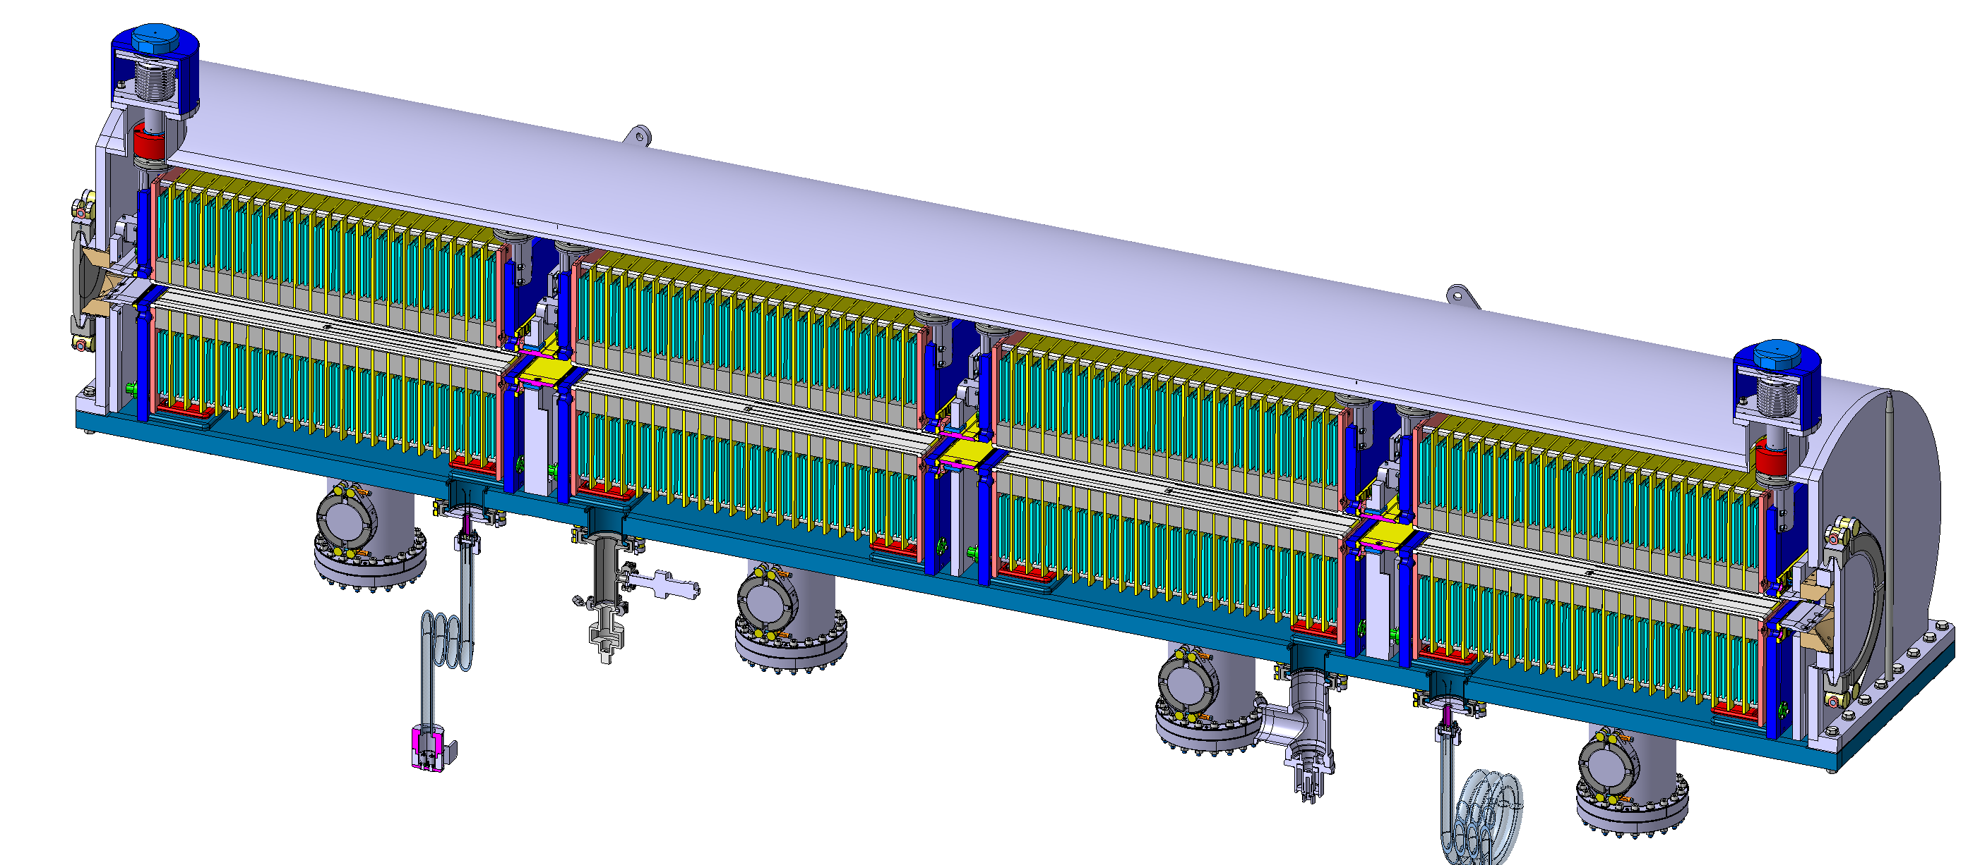
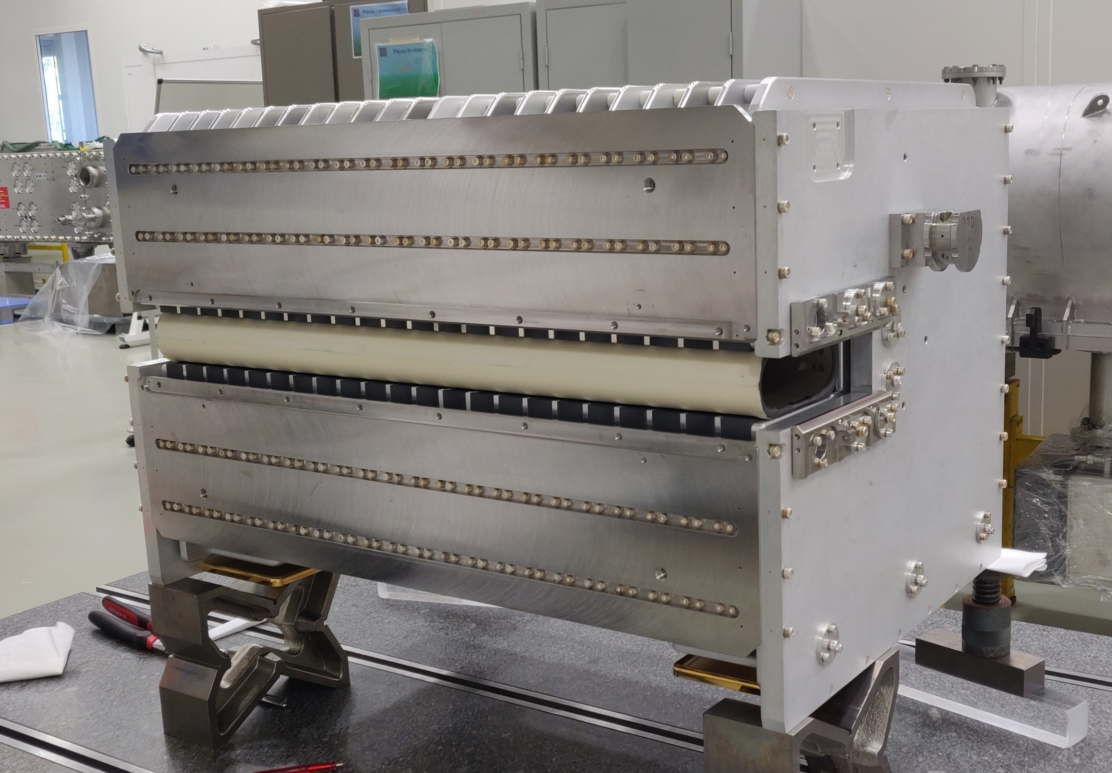
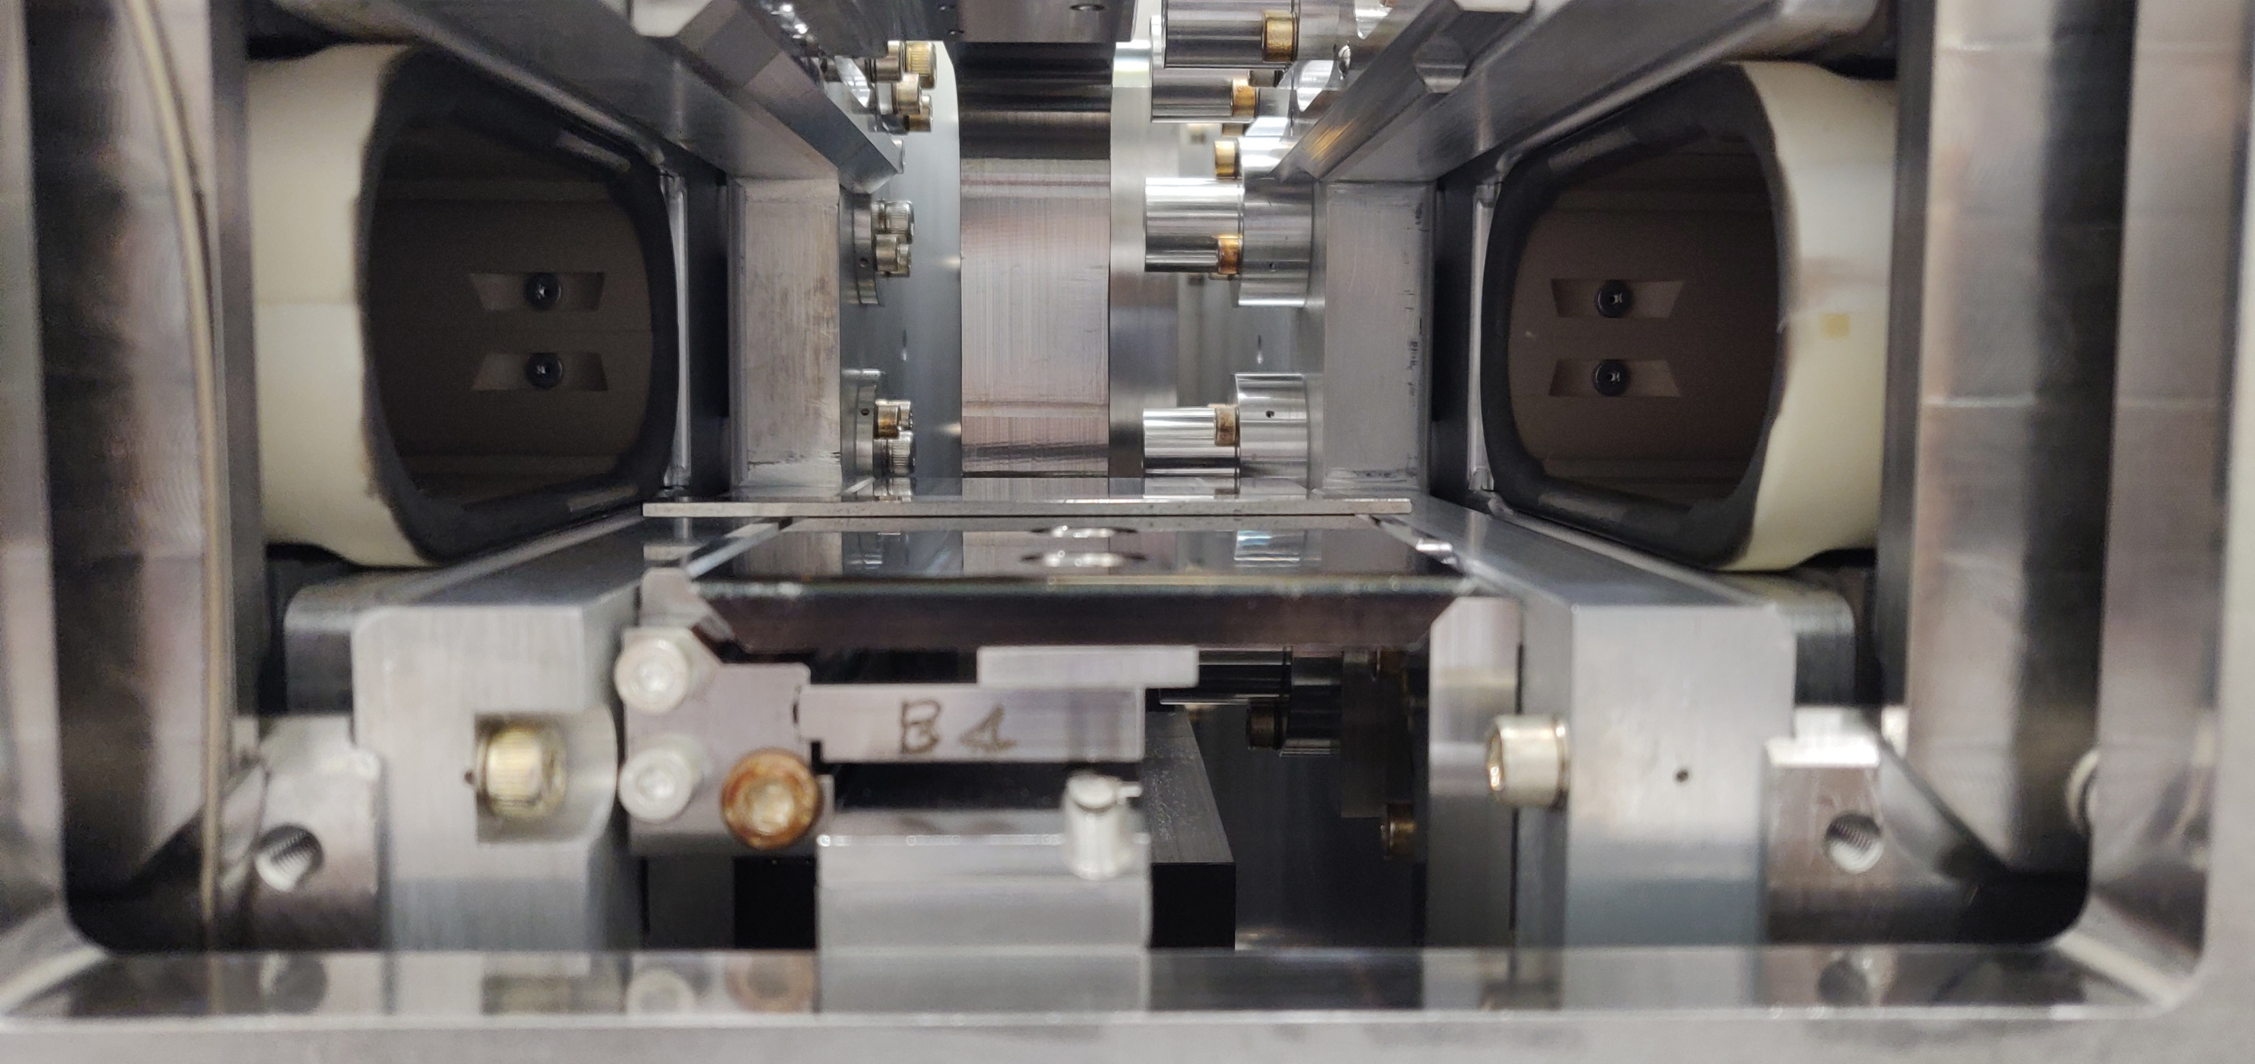
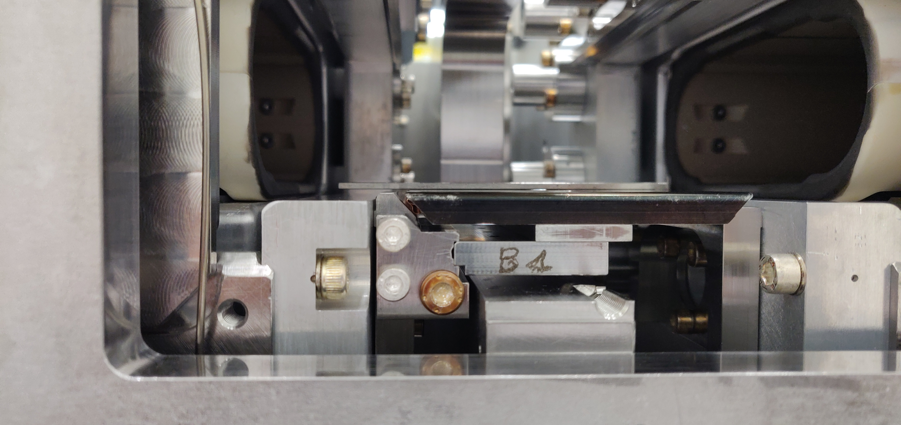
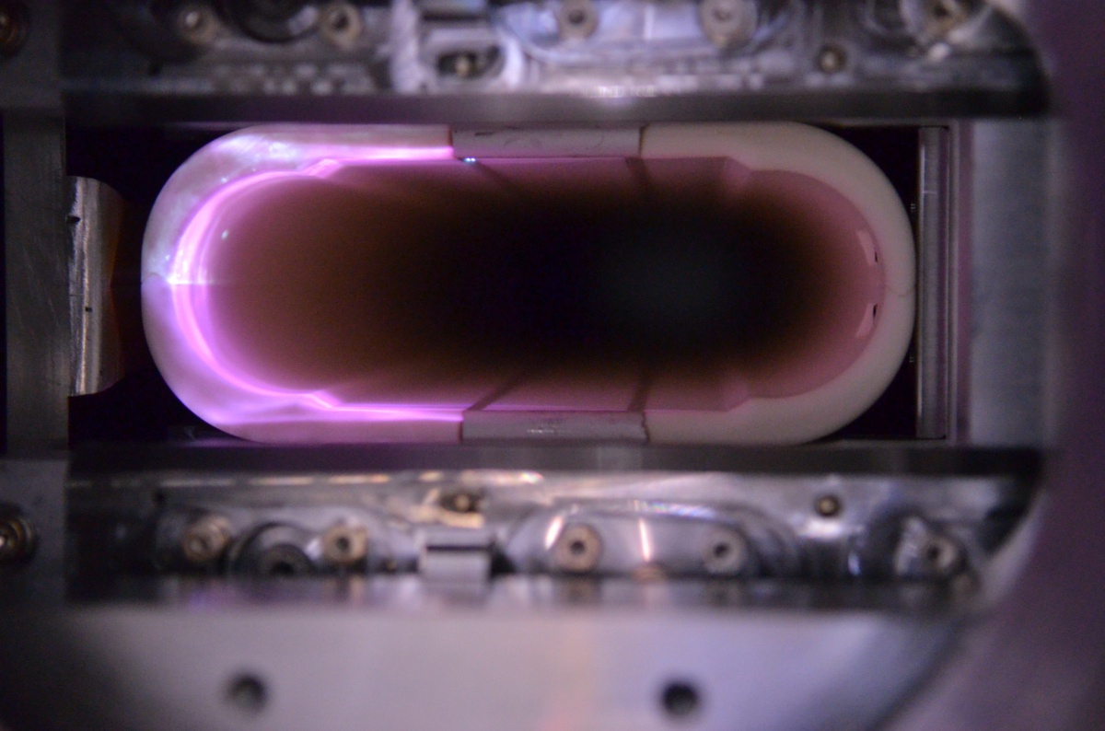
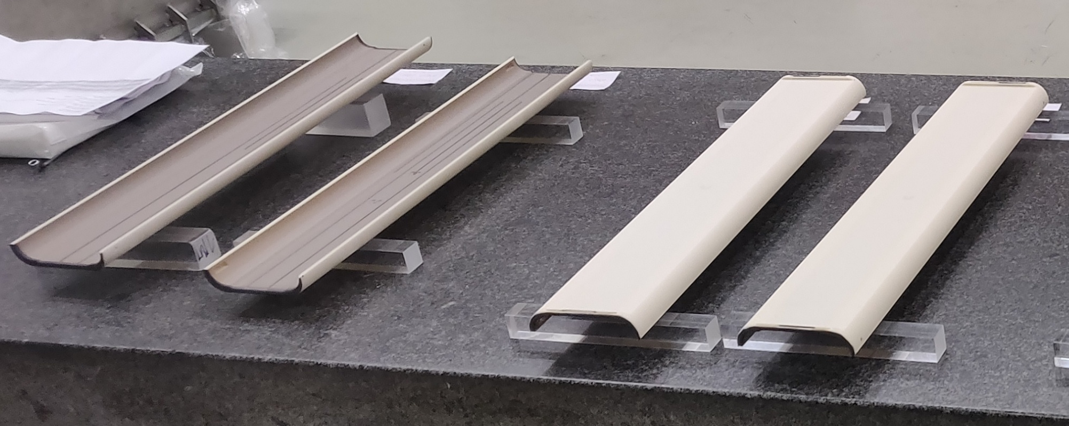
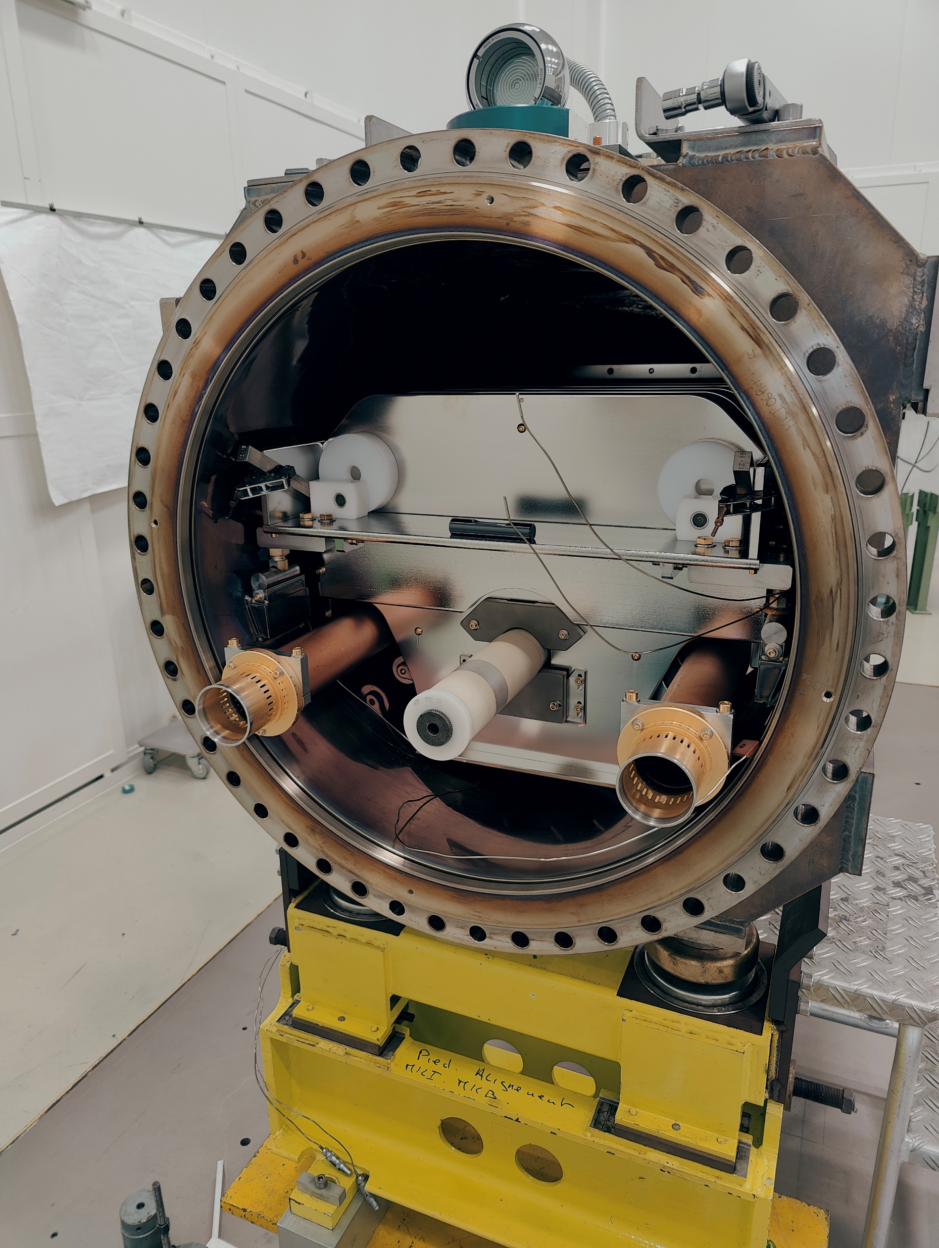
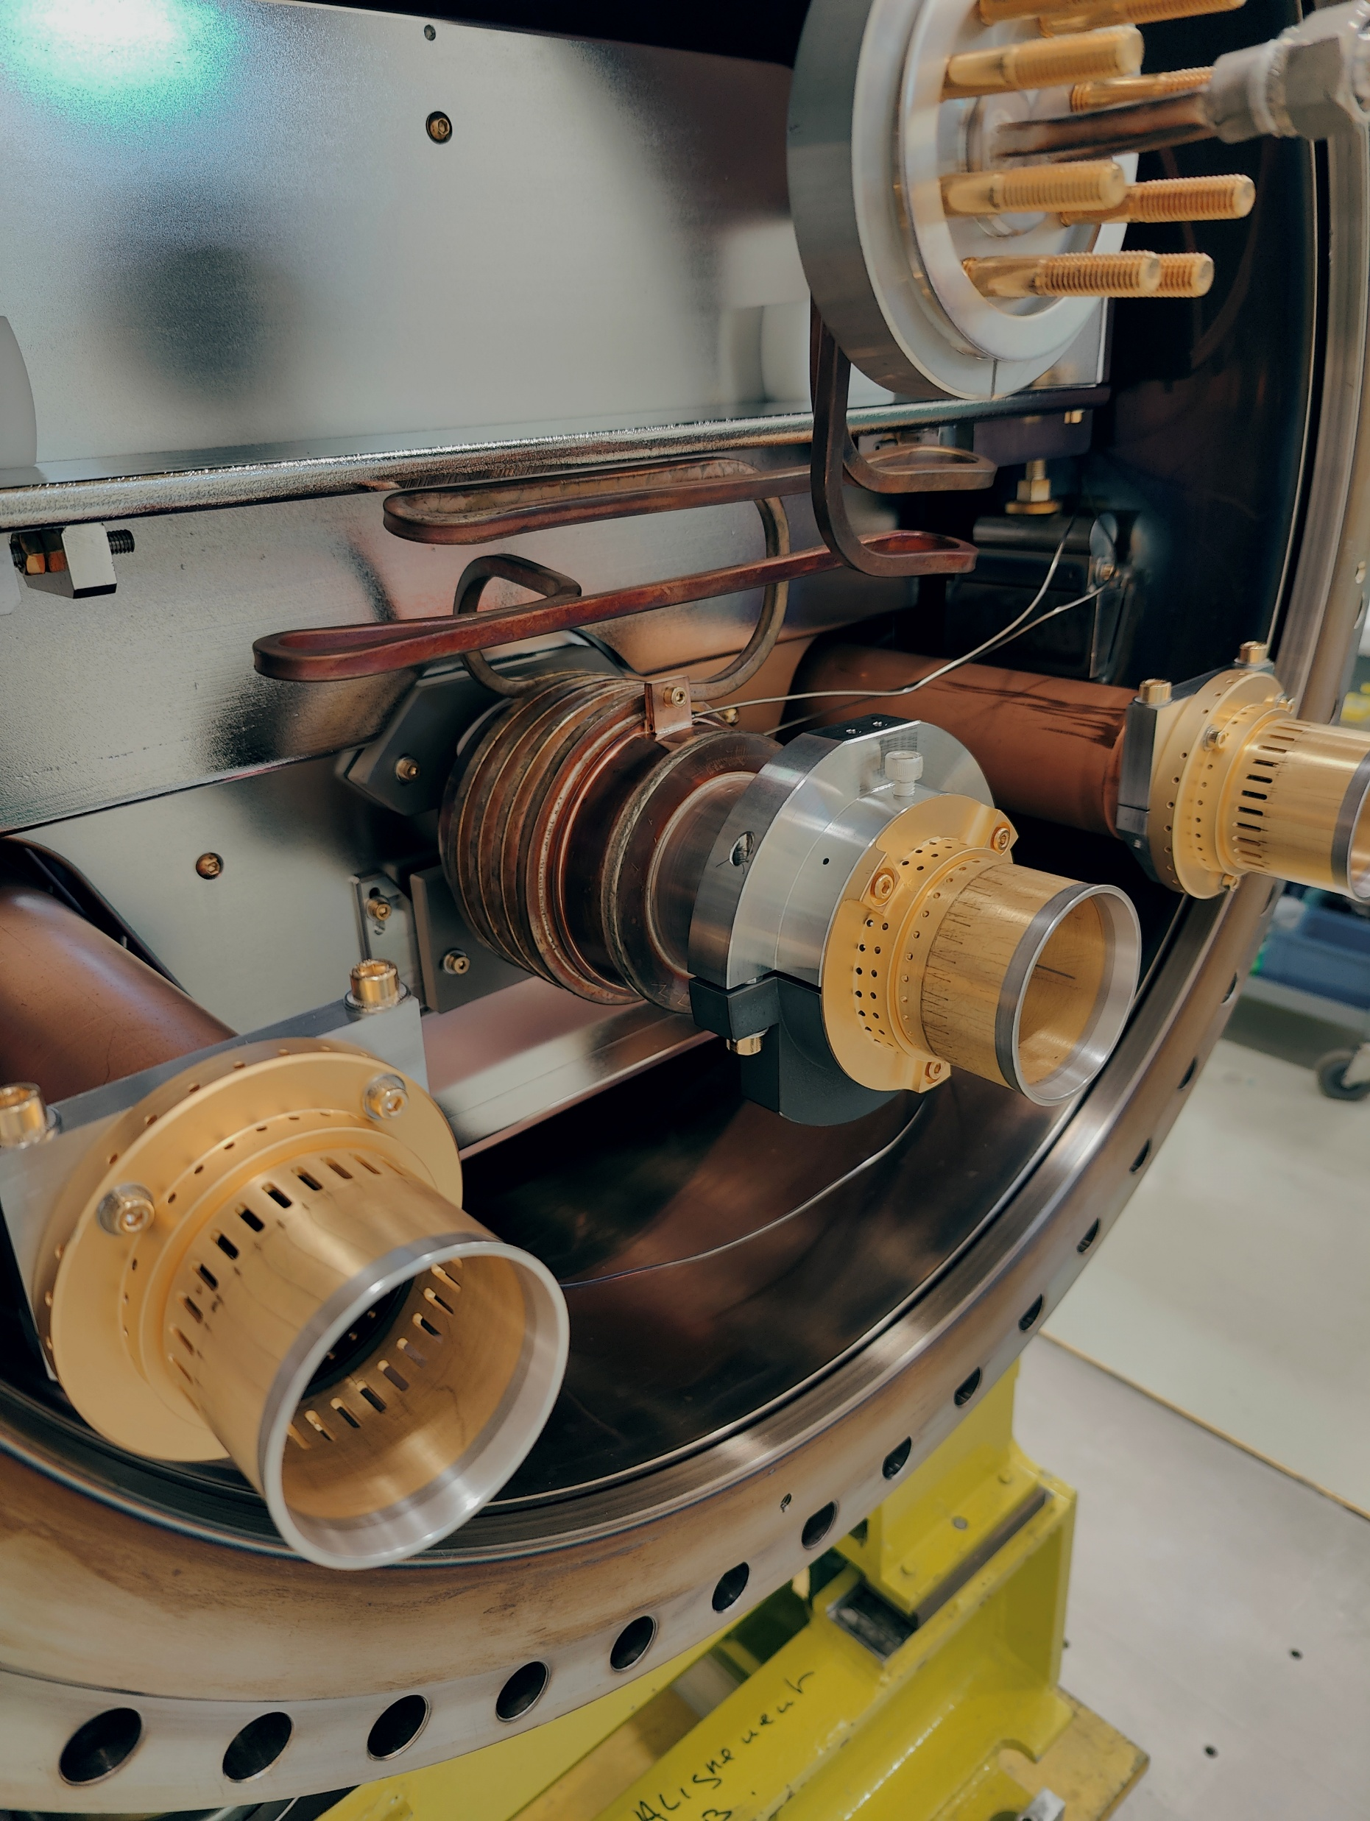
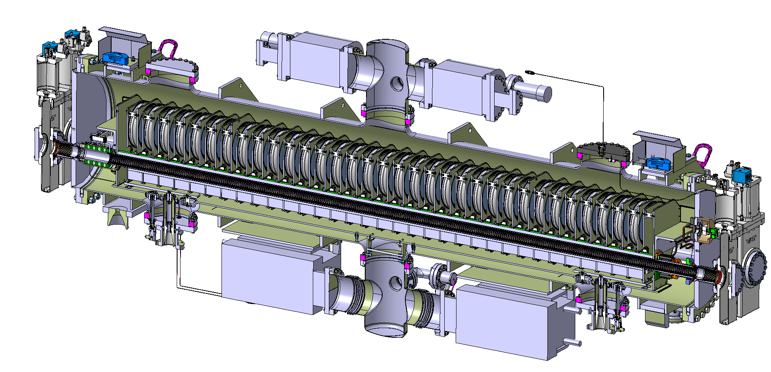
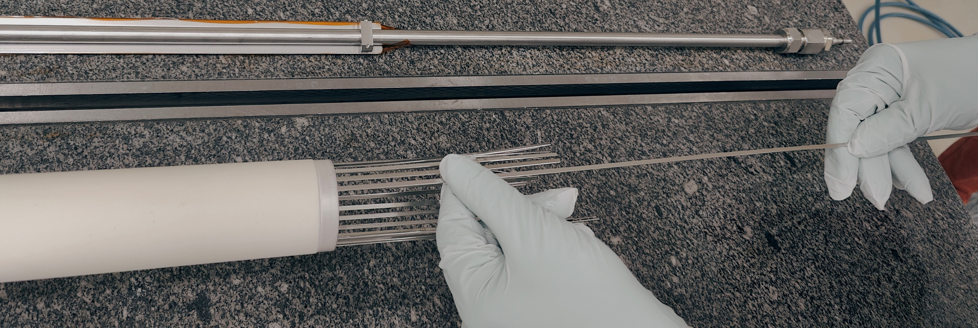
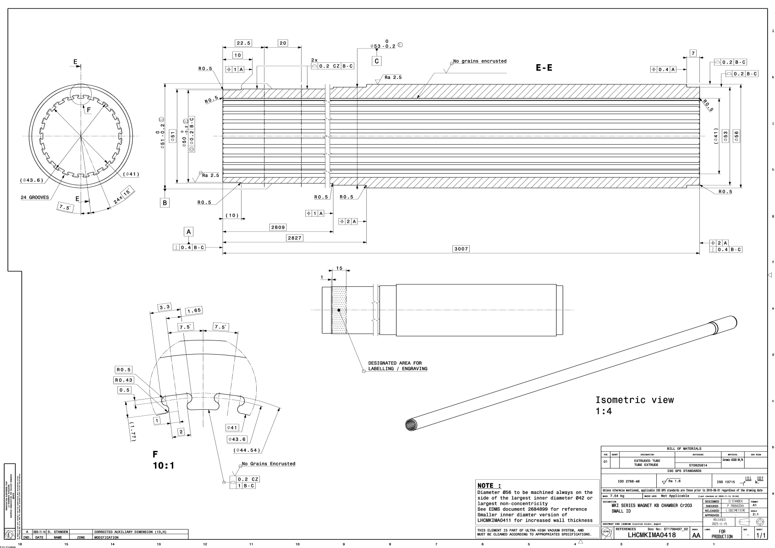
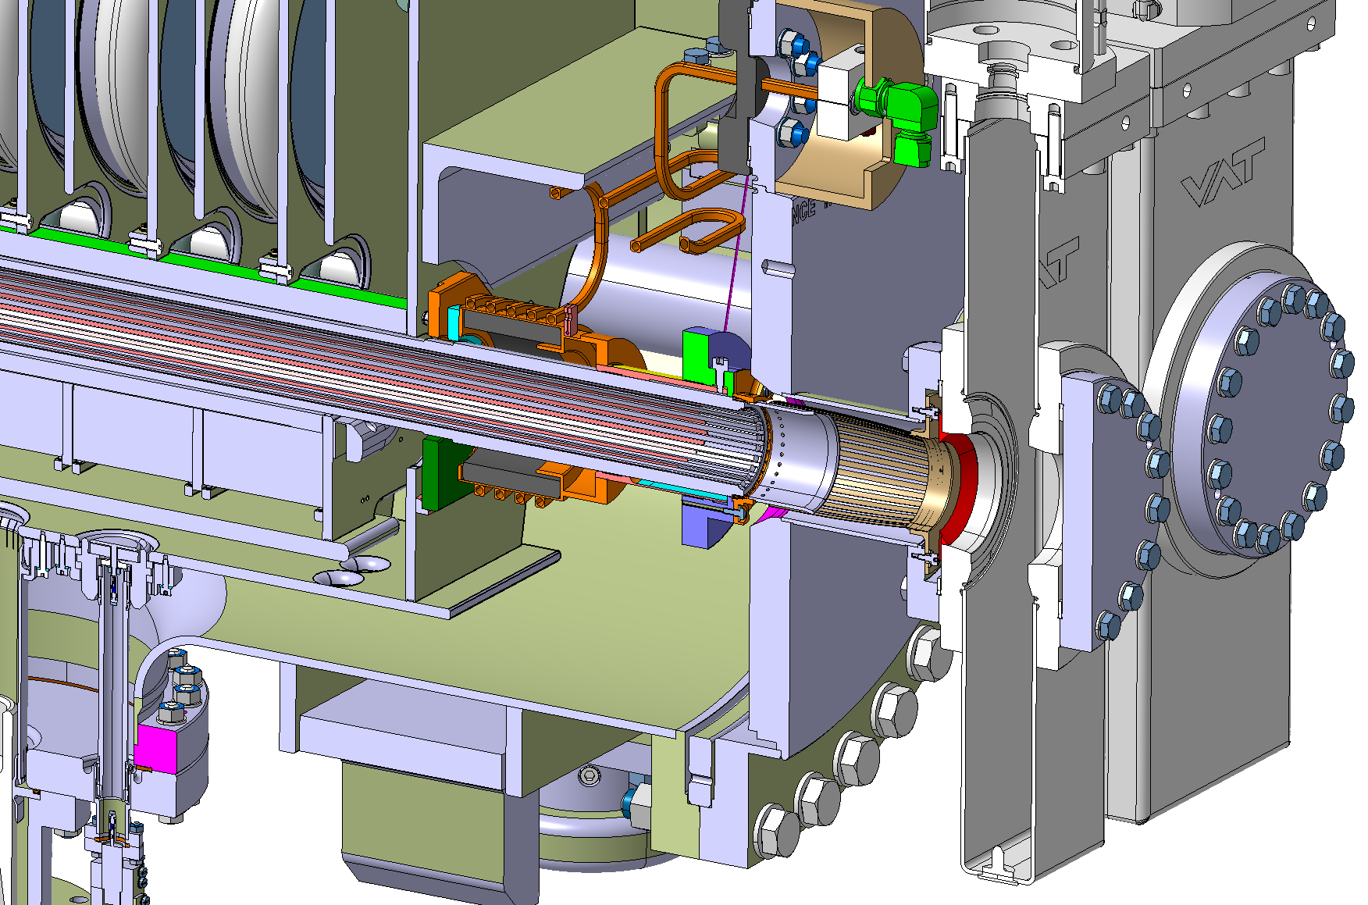
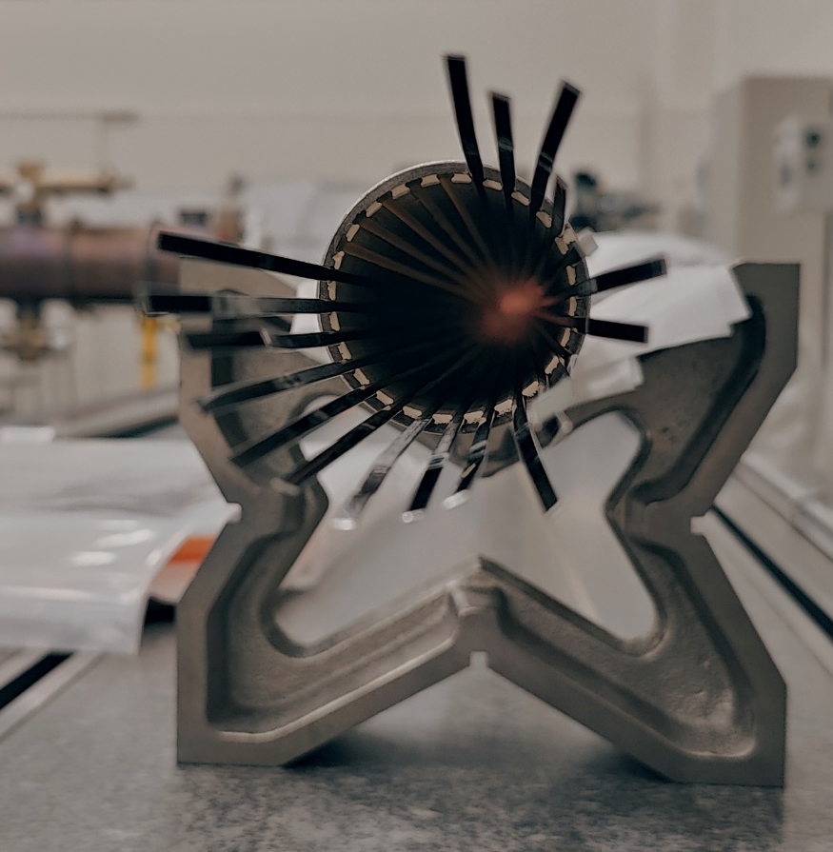
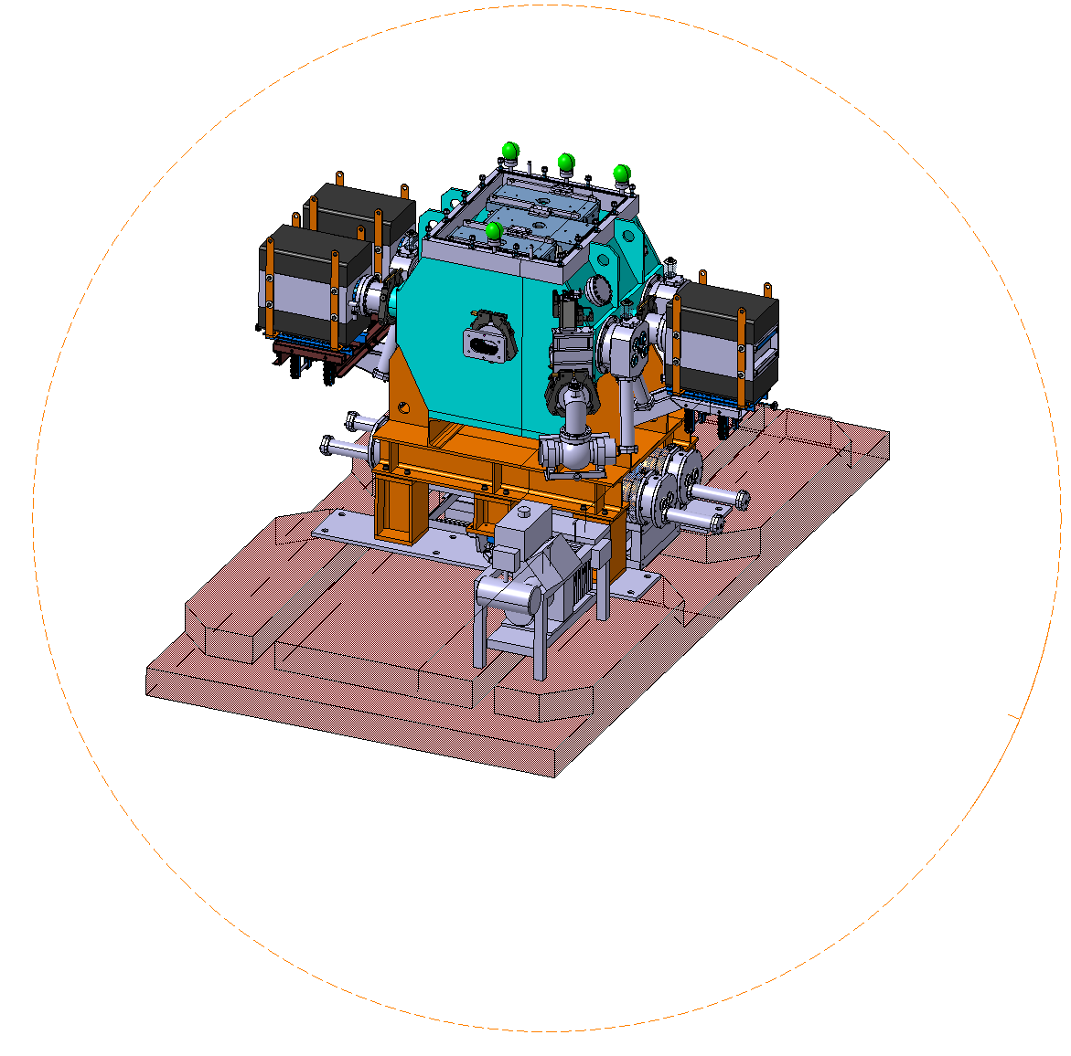
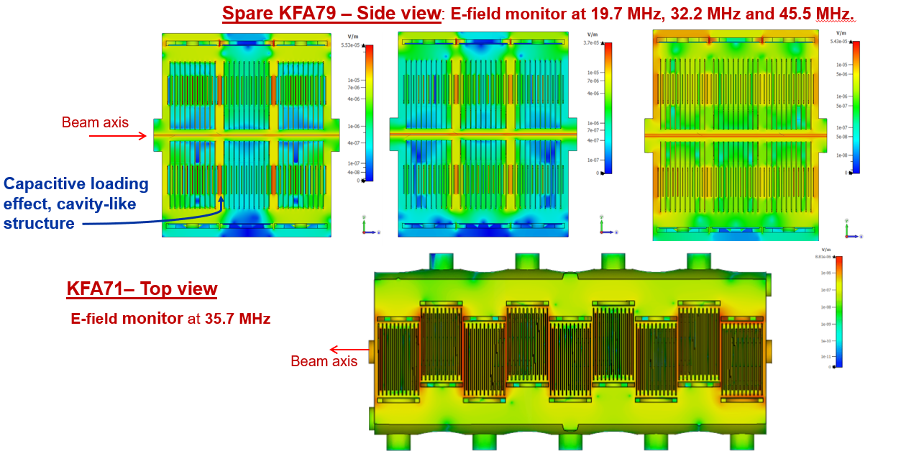
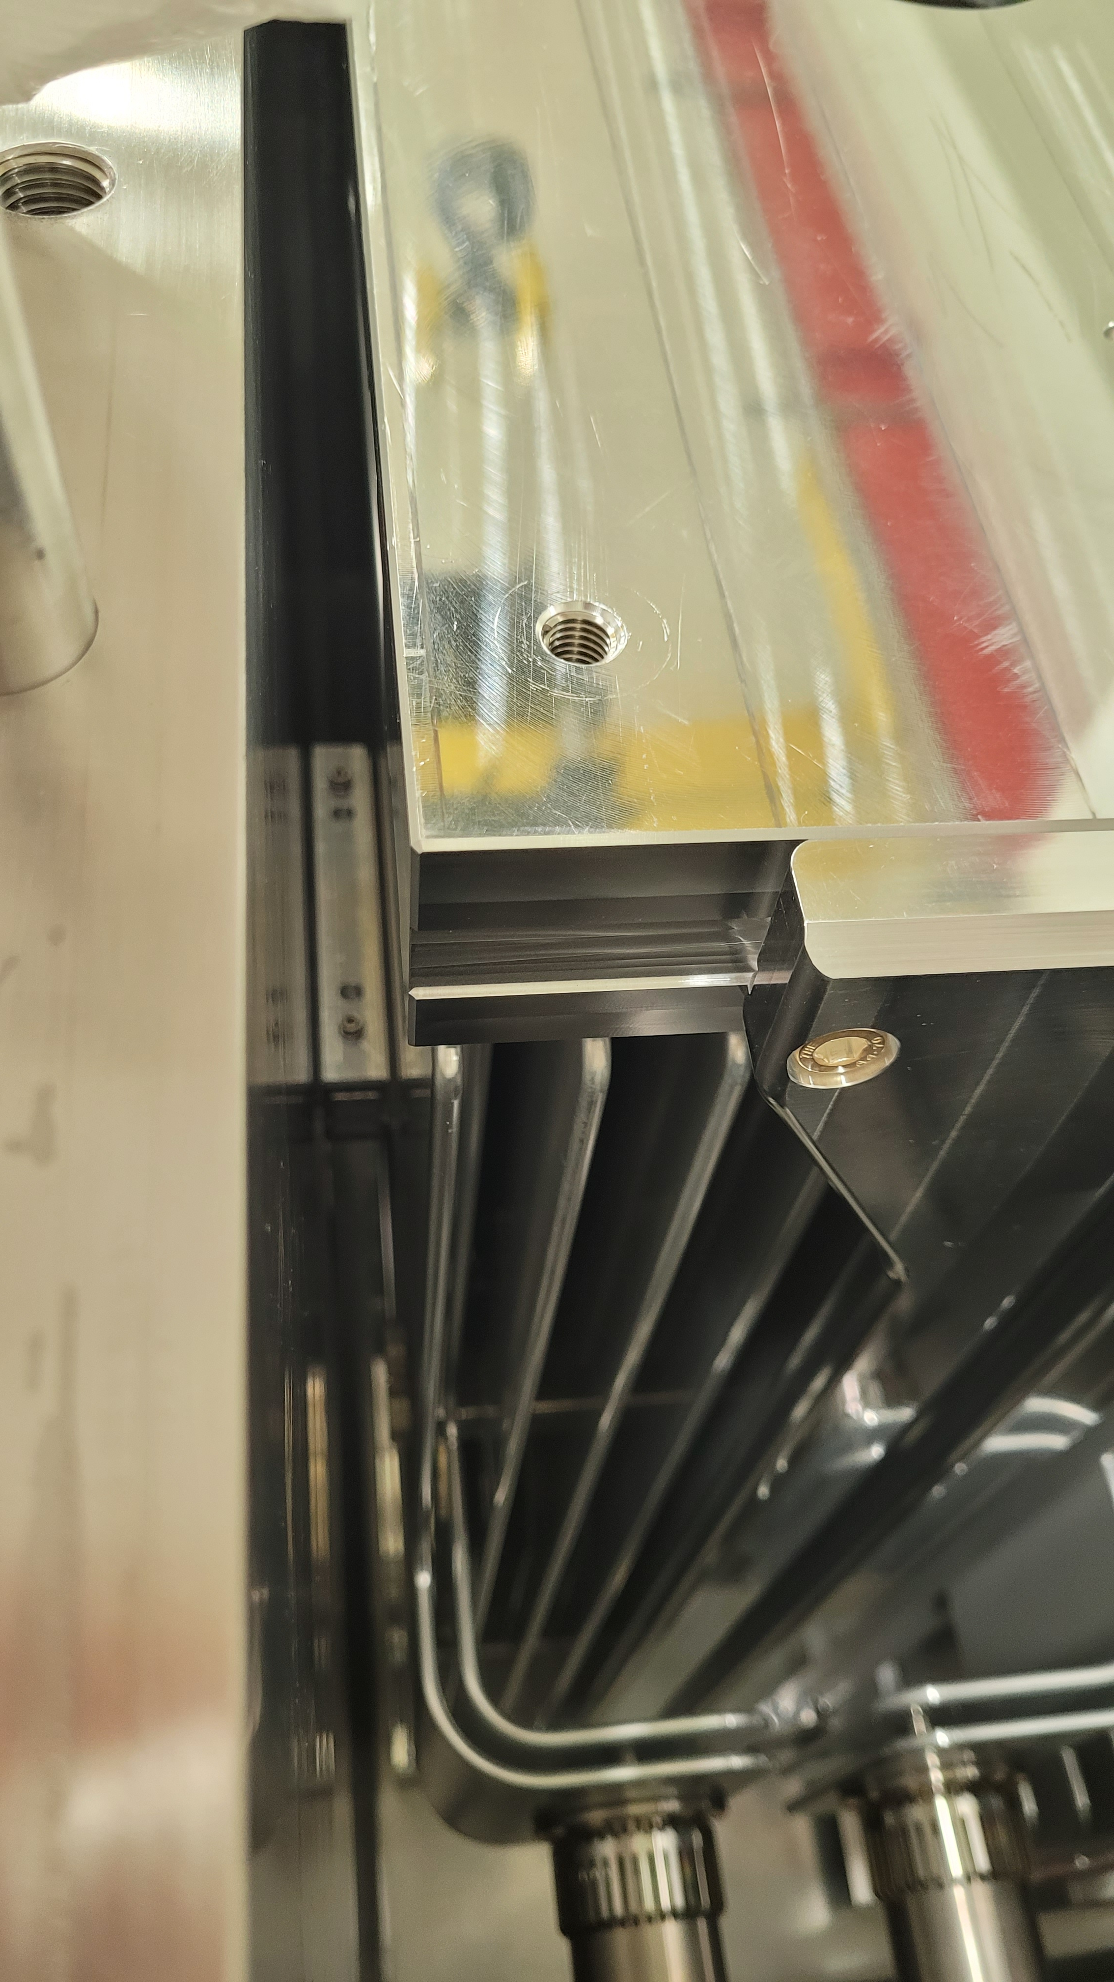
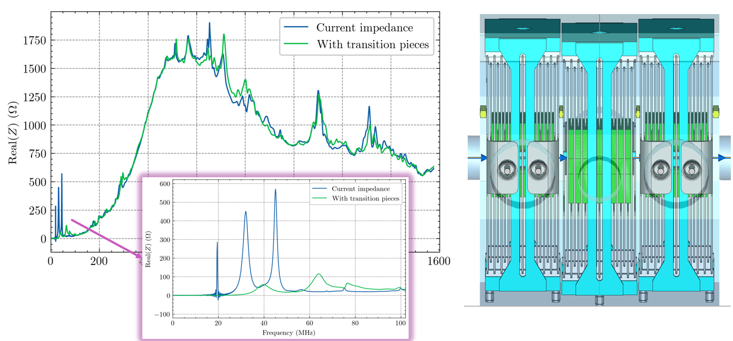
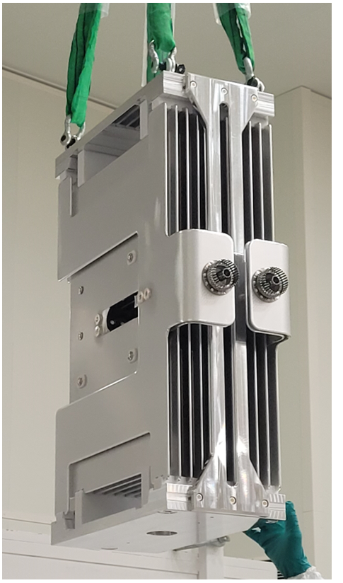
Screening
Transition pieces
SPS injection kicker (MKP-L)
Screening
Transition pieces
LHC injection kicker (MKI)
PS extraction kickers (KFA79 and KFA71)
Transition pieces
[6]
Simulation before and after insertion of transition pieces
Wire measurement with temporary transitions inserted at final positions

