Slide 1


Superconducting Rotating Machines As Part of the Special Session - Commercial Superconducting Magnets for the Future
Sastry Pamidi
Professor and Department Chair, Department of Electrical and Computer Engineering
Associate Director, Center for Advanced Power Systems
FAMU-FSU College of Engineering
Tallahassee, Florida, USA

Slide 2
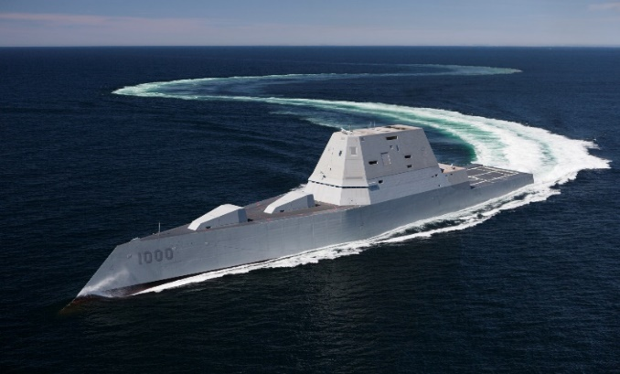

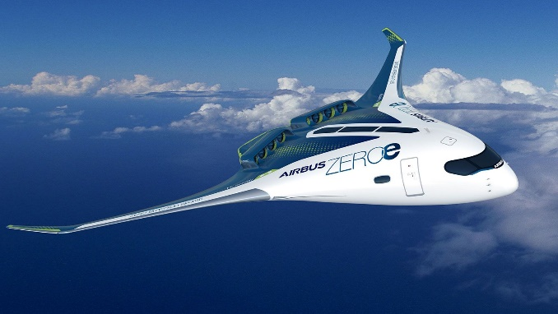
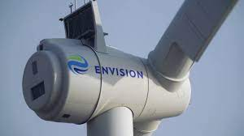
Increased Interest in Superconducting Rotating Machines
Net-Zero Emissions Targets
Focus on high energy efficiency
Enhanced interest in electrification
Electric Transportation
Aircraft and ships
Increased interest in superconducting rotating machines because of their ability to offer
High Power Density
Gravimetric and volumetric
High efficiency – zero resistance, high magnetic field and current loading
What is enabling superconducting and cryogenic machines and power conversion systems?
Increased Interest in CryoFuel – LH2
N+3 hybrid wing body (HWB) electric aircraft
All-electric ship commissioned by U.S. Navy
EcoSwing S/C Wind Generator

Slide 3
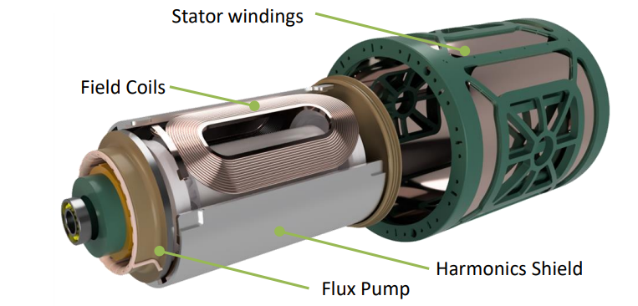
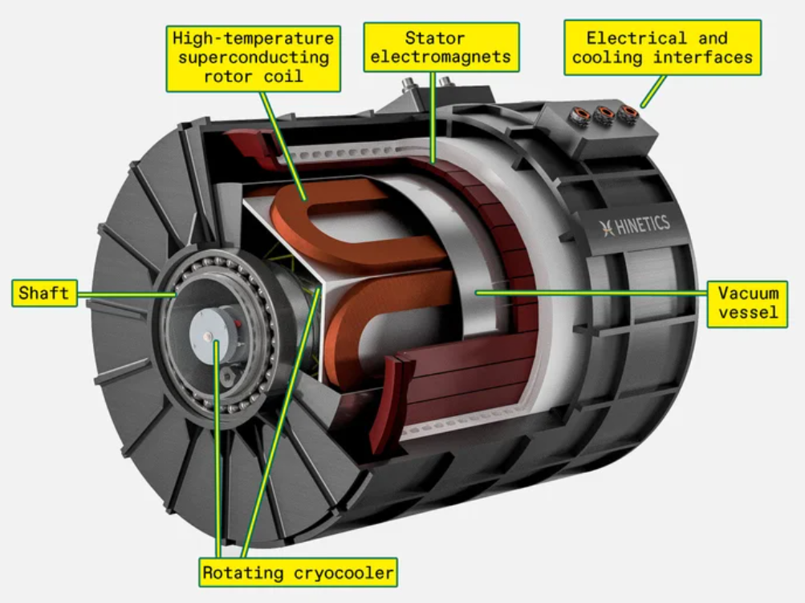
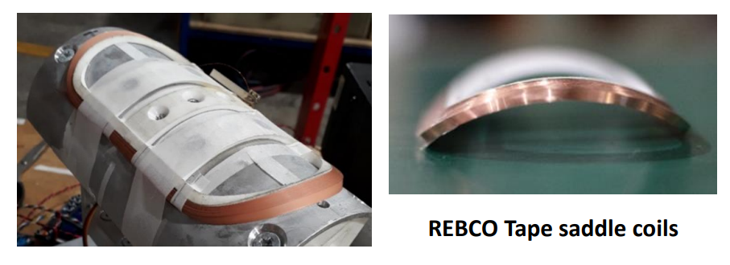



Fully and Partially Superconducting Machines are Being Designed and Tested
Source:
https://snf.ieeecsc.org/files/ieeecsc/slides/Badcock%20M4PL1%20Plenary%20presentation.pdf
Source: Electric Aircraft Motor Gets Superconducting Upgrade - IEEE Spectrum

Slide 4
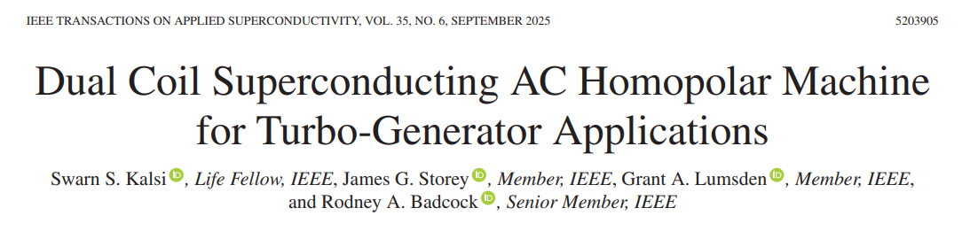
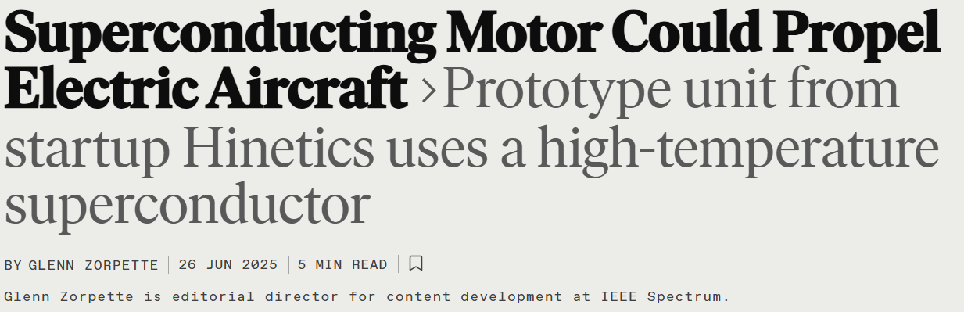
Many Groups are Working on Superconducting Rotating Machines
Calculated rated power of 5.5 MW with 97.6% efficiency at 8000 r/min, corresponding to a power density of 3.5 kW/kg
10 kW/kg
Next version is projected to 40kW/kg

Slide 5
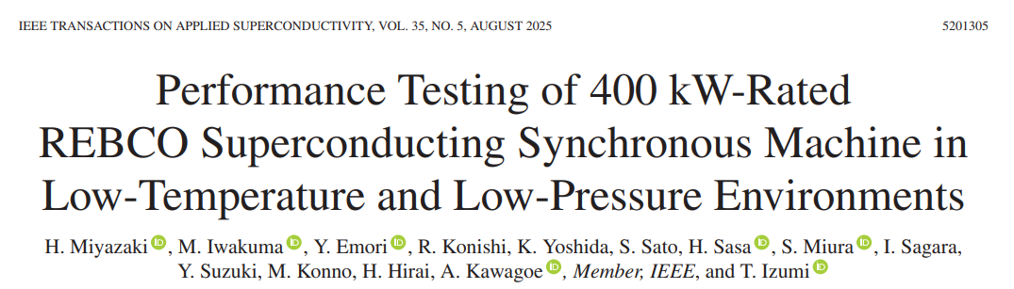
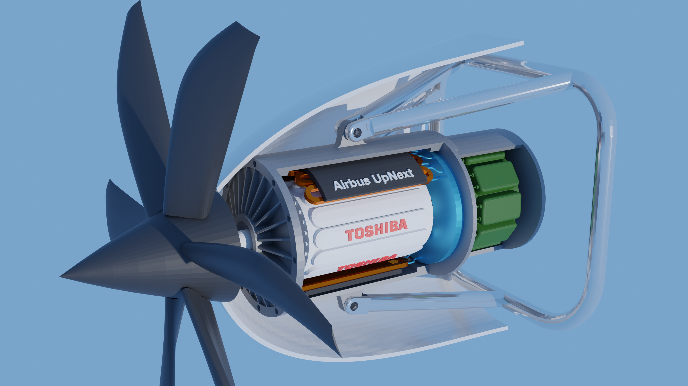
Many Groups are Working on Superconducting Rotating Machines
Developments in Japan
Airbus and Toshiba Partnership
https://www.airbus.com/en/newsroom/press-releases/2024-10-airbus-and-toshiba-to-partner-on-superconductivity-research

Slide 6
Developments Needed to Move Superconducting Rotating Machines to Marketplace
Low AC loss superconducting wires/cables
Multifilament wires – MgB2, Bi-2212, Striated REBCO
Conductor developments necessary for reducing losses further
Integrated cryogenic solutions
Reliable, high efficiency, and high-capacity cryogenic systems
Lightweight cryocoolers and integrated cryogenic systems – based on LH2 are needed
Low maintenance cryogenic systems are essential for electric transportation
Comprehensive electric powertrain test facilities for supporting the industry need to be established

