Slide 1
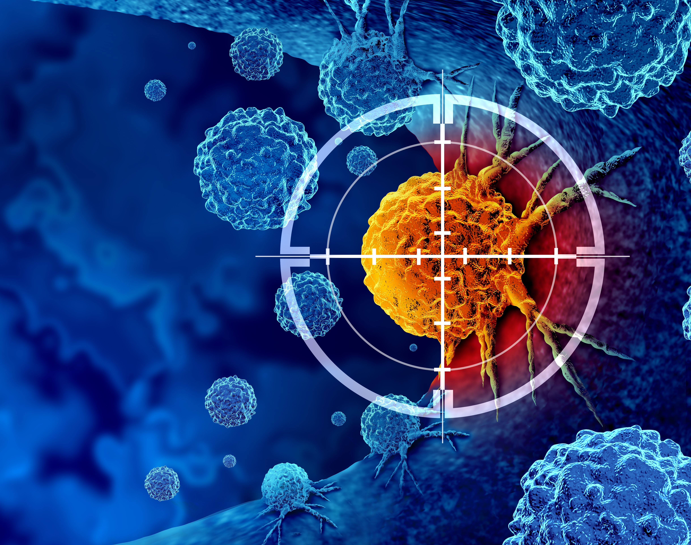


OUR MISSION:
Provide our clinicians a powerful new ensemble of device-led cancer-vanquishing weapons that will change radiation oncology.
SUPERCONDUCTIVITY ENABLES OUR SCIENCE & TECHNOLOGY
MT29

Slide 2
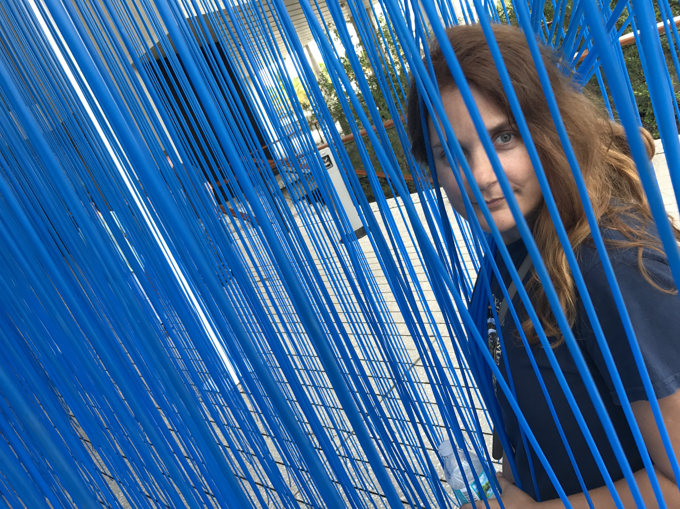
A Personal Story.

Slide 3
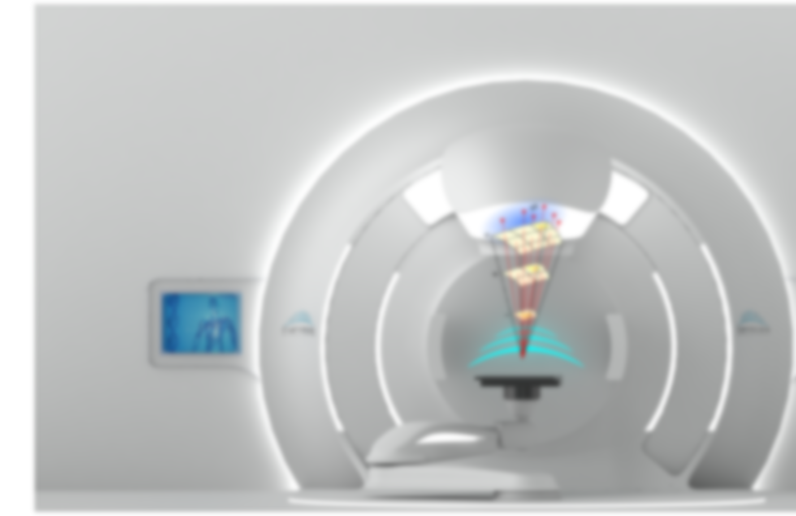
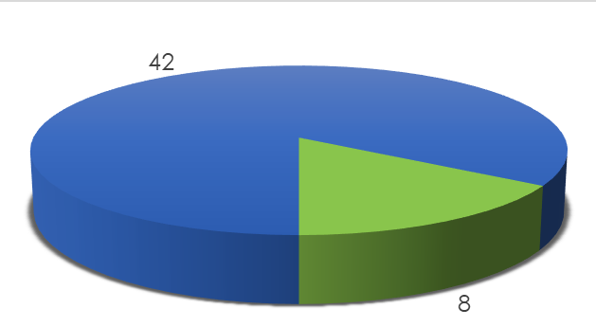
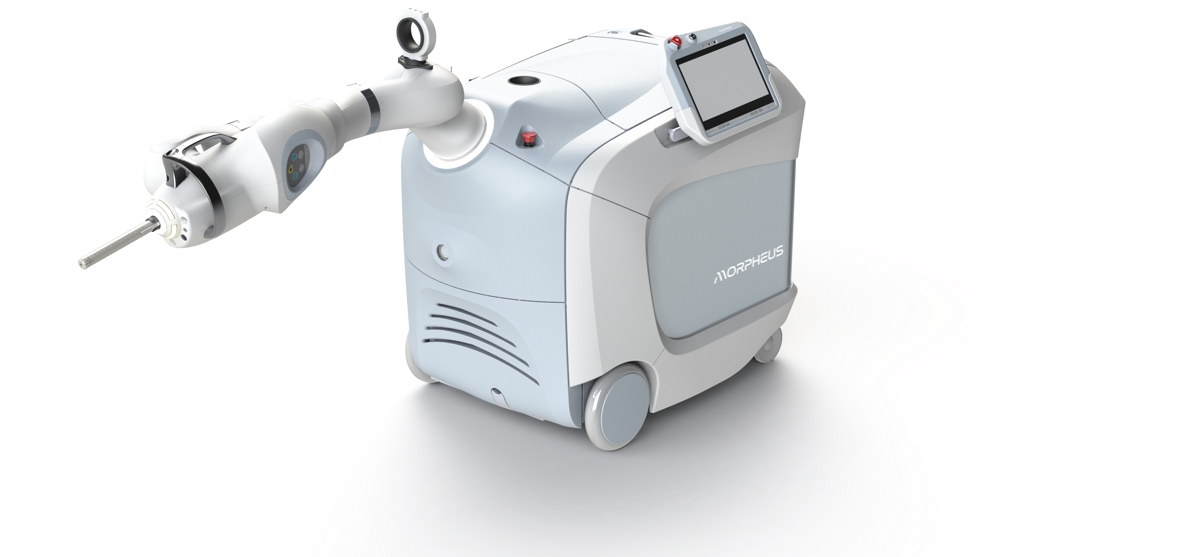
Company
Overview
STRONG PRODUCT PIPELINE – FY’25 COMMERCIALIZATION
Have a pipeline progression of commercial innovation that began generating revenue in 2024
Pioneering a line of proprietary products to replace current radiation therapy approaches of a growing multi-billion-dollar market
LUMINARY PARTNERS – CLINICAL WORK RAMP-UP
Major international luminary partners in place
Major market systems are enabled by unique technology that provides unparalleled treatment delivery with Beam Sculpting, targeting the cancer cells while sparing normal tissues
STRONG LEADERSHIP
Highly successful, experienced, and driven management team and board of directors
COMPLETED $42M OF $50M SERIES A ROUND
>14
40%
Active additional raise of $8M intended to enable company reach break even with lead products and enter clinic with flagship multi-billion-dollar product
Issued Patents
Equity Offered
68%
$75M
FUTURE IPO
5-Year
CAGR
Pre-Money Valuation
Targeting Initial Public Offering in ~24 months
>$10B
8.5%
Market Size
Market CAGR
EMPYREAN THERAPEUTICS RAMP-UP AND SPIN-OFF
Bringing the three compounds to Phase 1 and spin-off through Pharma deals and IPO

Slide 4








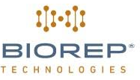


Empyrean Partners & Affiliates
MD Anderson
Founding member and partner of Empyrean and primary R&D Global Center of Excellence
Our Strategic Mission Enablers
KUKA Robotics
Mayo Clinic
The world leader in industrial and medical robotics in particular. Empyrean has a strategic alliance and partnership with KUKA, which is involved in the early R&D stages all the way through the luminary and commercialization phases.
Strategic partner and Global Center of Excellence for Clinical and Scientific research and development with focus on SFRT, Flash, and advanced RT devices and technologies development
Los Alamos National Labs
UCSD - CNT
Scientific and R&D partner for developing the Pegasus 1.0 microtron accelerator for Project Hermes..
Global Center of Excellence for therapeutic compounds development in collaboration with UCSD, at the Center for Novel Therapeutics (HomeLab).
Cleveland Clinic
Global Center of Excellence for RT Genomics R&D.
Stanford Cancer Institute
Clinical research and development Global Center of Excellence. Ring 0 Beta site.
Weizmann Institute of Science
Particle accelerator Global Center of Excellence. Core site for Empyrean’s Laser Plasma VHEE accelerator development.
Commercial Finance Partner
& Marquee Investor Backed By

Slide 5
Why Industry Matters?
Transitioning from research and academics to the public
Applying theoretical science to transformative & impactful applications
Lowering costs
Rapid transition from research to market
Implementing state-of-the-art (dormant) IP for the betterment of humanity

Slide 6
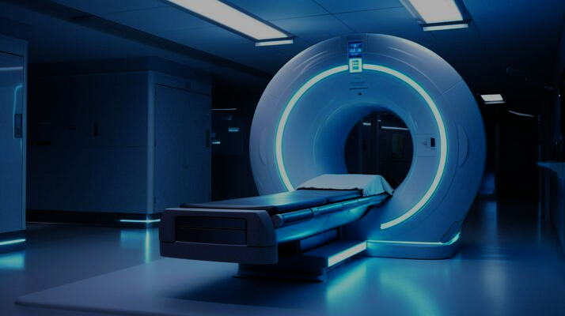


Global Radiation Oncology Market
Market is Comprised of Hospitals, Standalone Centers, Research Institutes & Universities.
Global Market Size:
$10B
By 2028
of all cancer cases in the U.S. involve some form of radiation therapy.
60%
of all radiation therapy procedures are done on a linear accelerator (LINAC).
80%
with an
8.5%
CAGR.

Slide 7

Superconducting technology beyond theory and concept: We are ready to build and scale up!

Slide 8
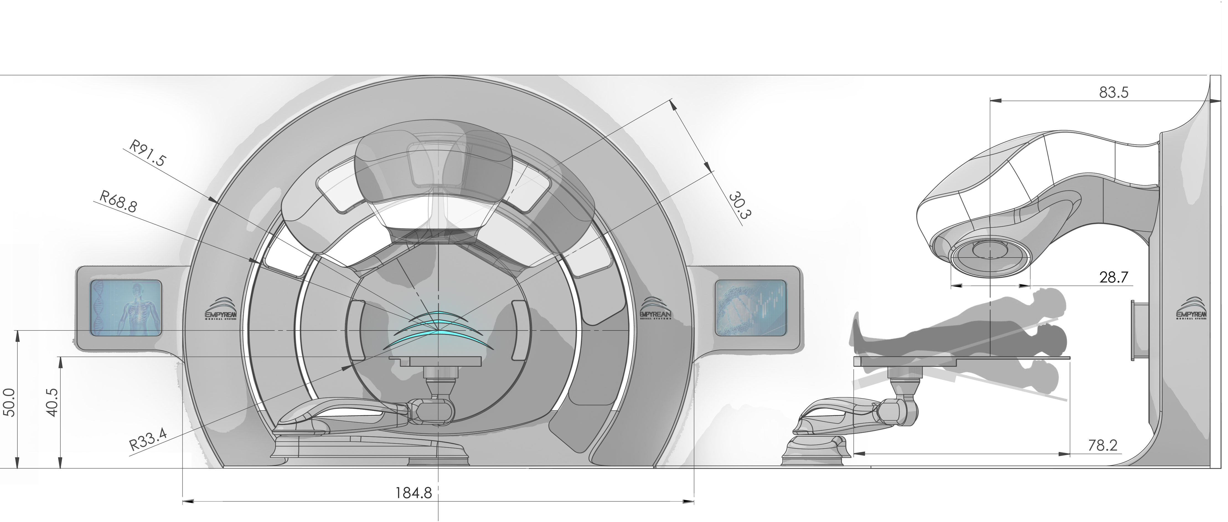

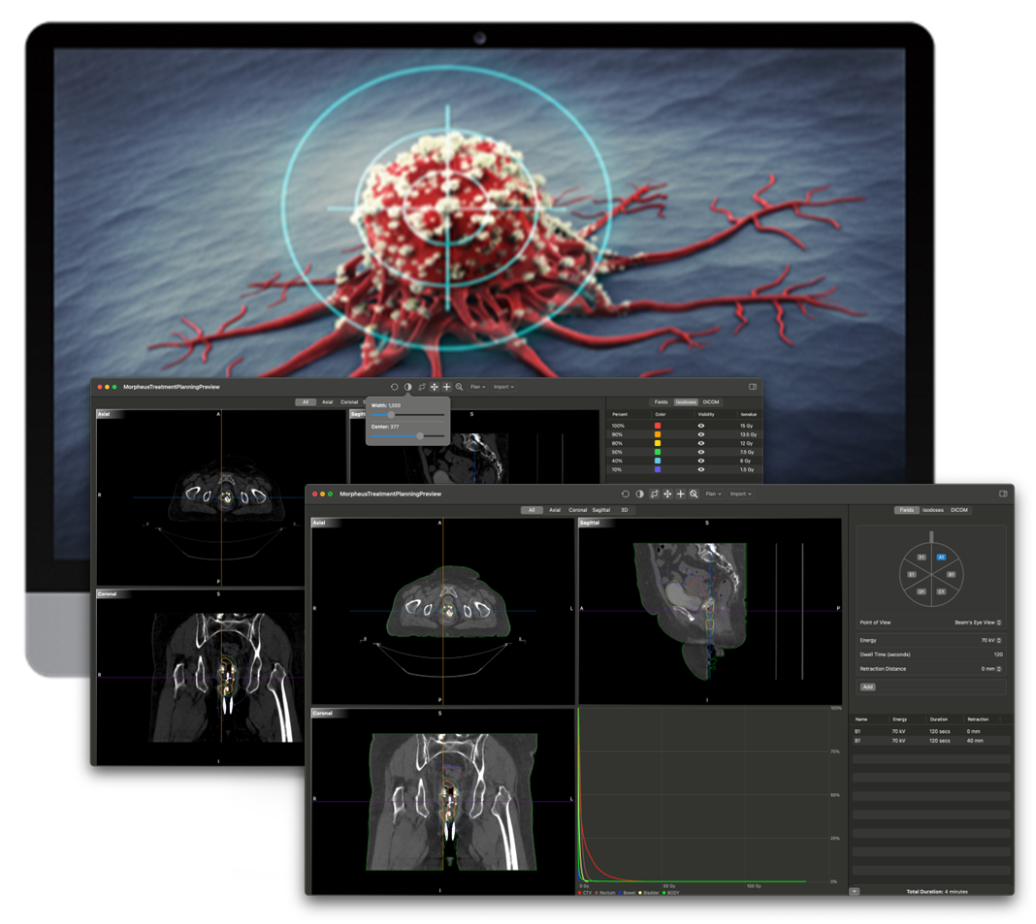

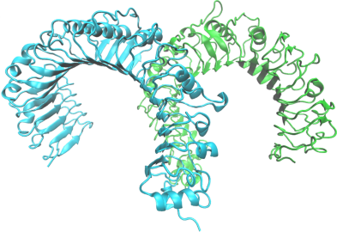

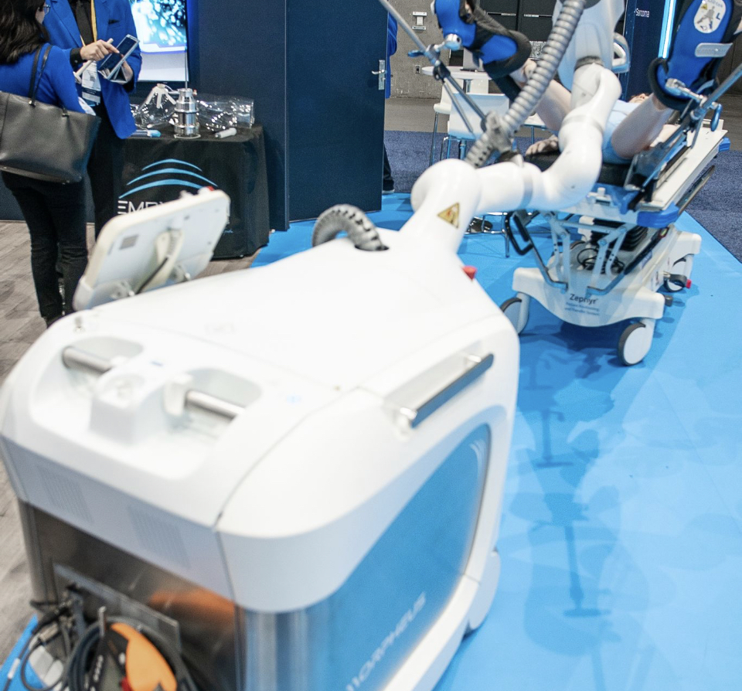
Empyrean-MD Anderson Collaborative R&D
Empyrean is an MD Anderson Company
MD Anderson is the Alpha Site for Project Hermes
EBRT
PROJECT HERMES
MD Anderson Licensed IP
Alpha System
Physics Development
Clinical Trials
Publications & Speaking
Treatment Planning Workstation
Robotic
Brachy
IORT
THERAPEPEUTICS
MORPHEUS + FLASH
Preclinical Trials
Clinical Publications
Phase I/II/III Trials
Device-Drug Treatment Protocols Development
New Development – Brachytherapy FLASH
Initial Clinical Work
New Treatment Protocols Development
Treatment Planning Workstation
Onco-Compounds

Slide 9
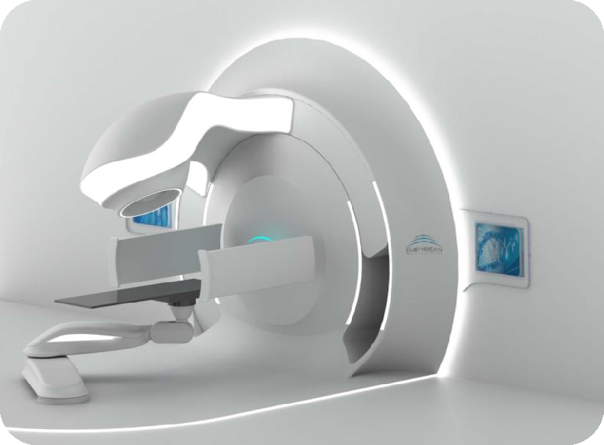

Disrupting Cancer Treatment with HTS
First-in-class non-invasive Magnetically-Optimized Very High Energy Electron Therapy (MOVHEET) for all types of solid tumor treatments
Intended to replace Proton Therapy, LINACs, TomoTherapy®, and CyberKnife® systems
New treatment modality that mitigates all the shortcomings of legacy systems
Enabled by new patented converging very high energy electron beam technology
Offers higher beam precision with a shorter treatment time in a non-invasive delivery
Will allow new, safer, and more efficacious treatment regimens that will augment patient outcomes.
CONFIDENTIAL

Slide 10
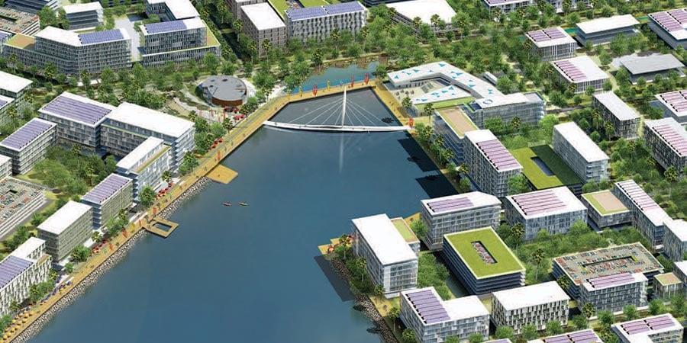



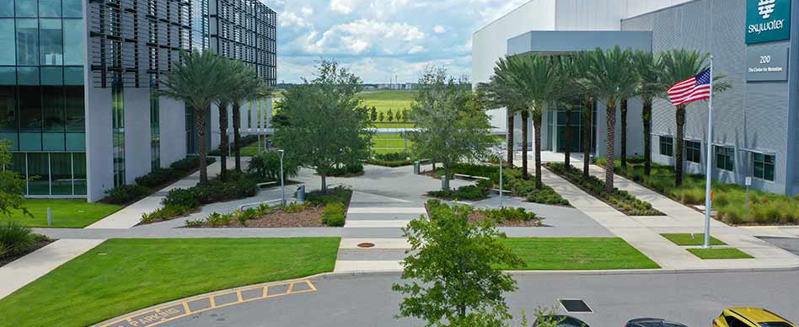
Empyrean EAGLE-1 Facility
EAGLE-1 R&D and production facility at NeoCity
Founding member of the Superconducting Ecosystem initiative
100,000 sq. Ft. Facility to be completed in 2028
Ramping up operations in FY’25
Systems and modules manufacturing and advanced materials R&D labs
Supported by Osceola County and the state of Florida
R&D center for MagLens™ and Pegasus™ VHEE accelerator modules for Project Hermes
Osceola County partnered with UCF and Valencia College for talent pooling, internships, and R&D programs.
Empyrean to create 60 new jobs within five years.

Slide 11
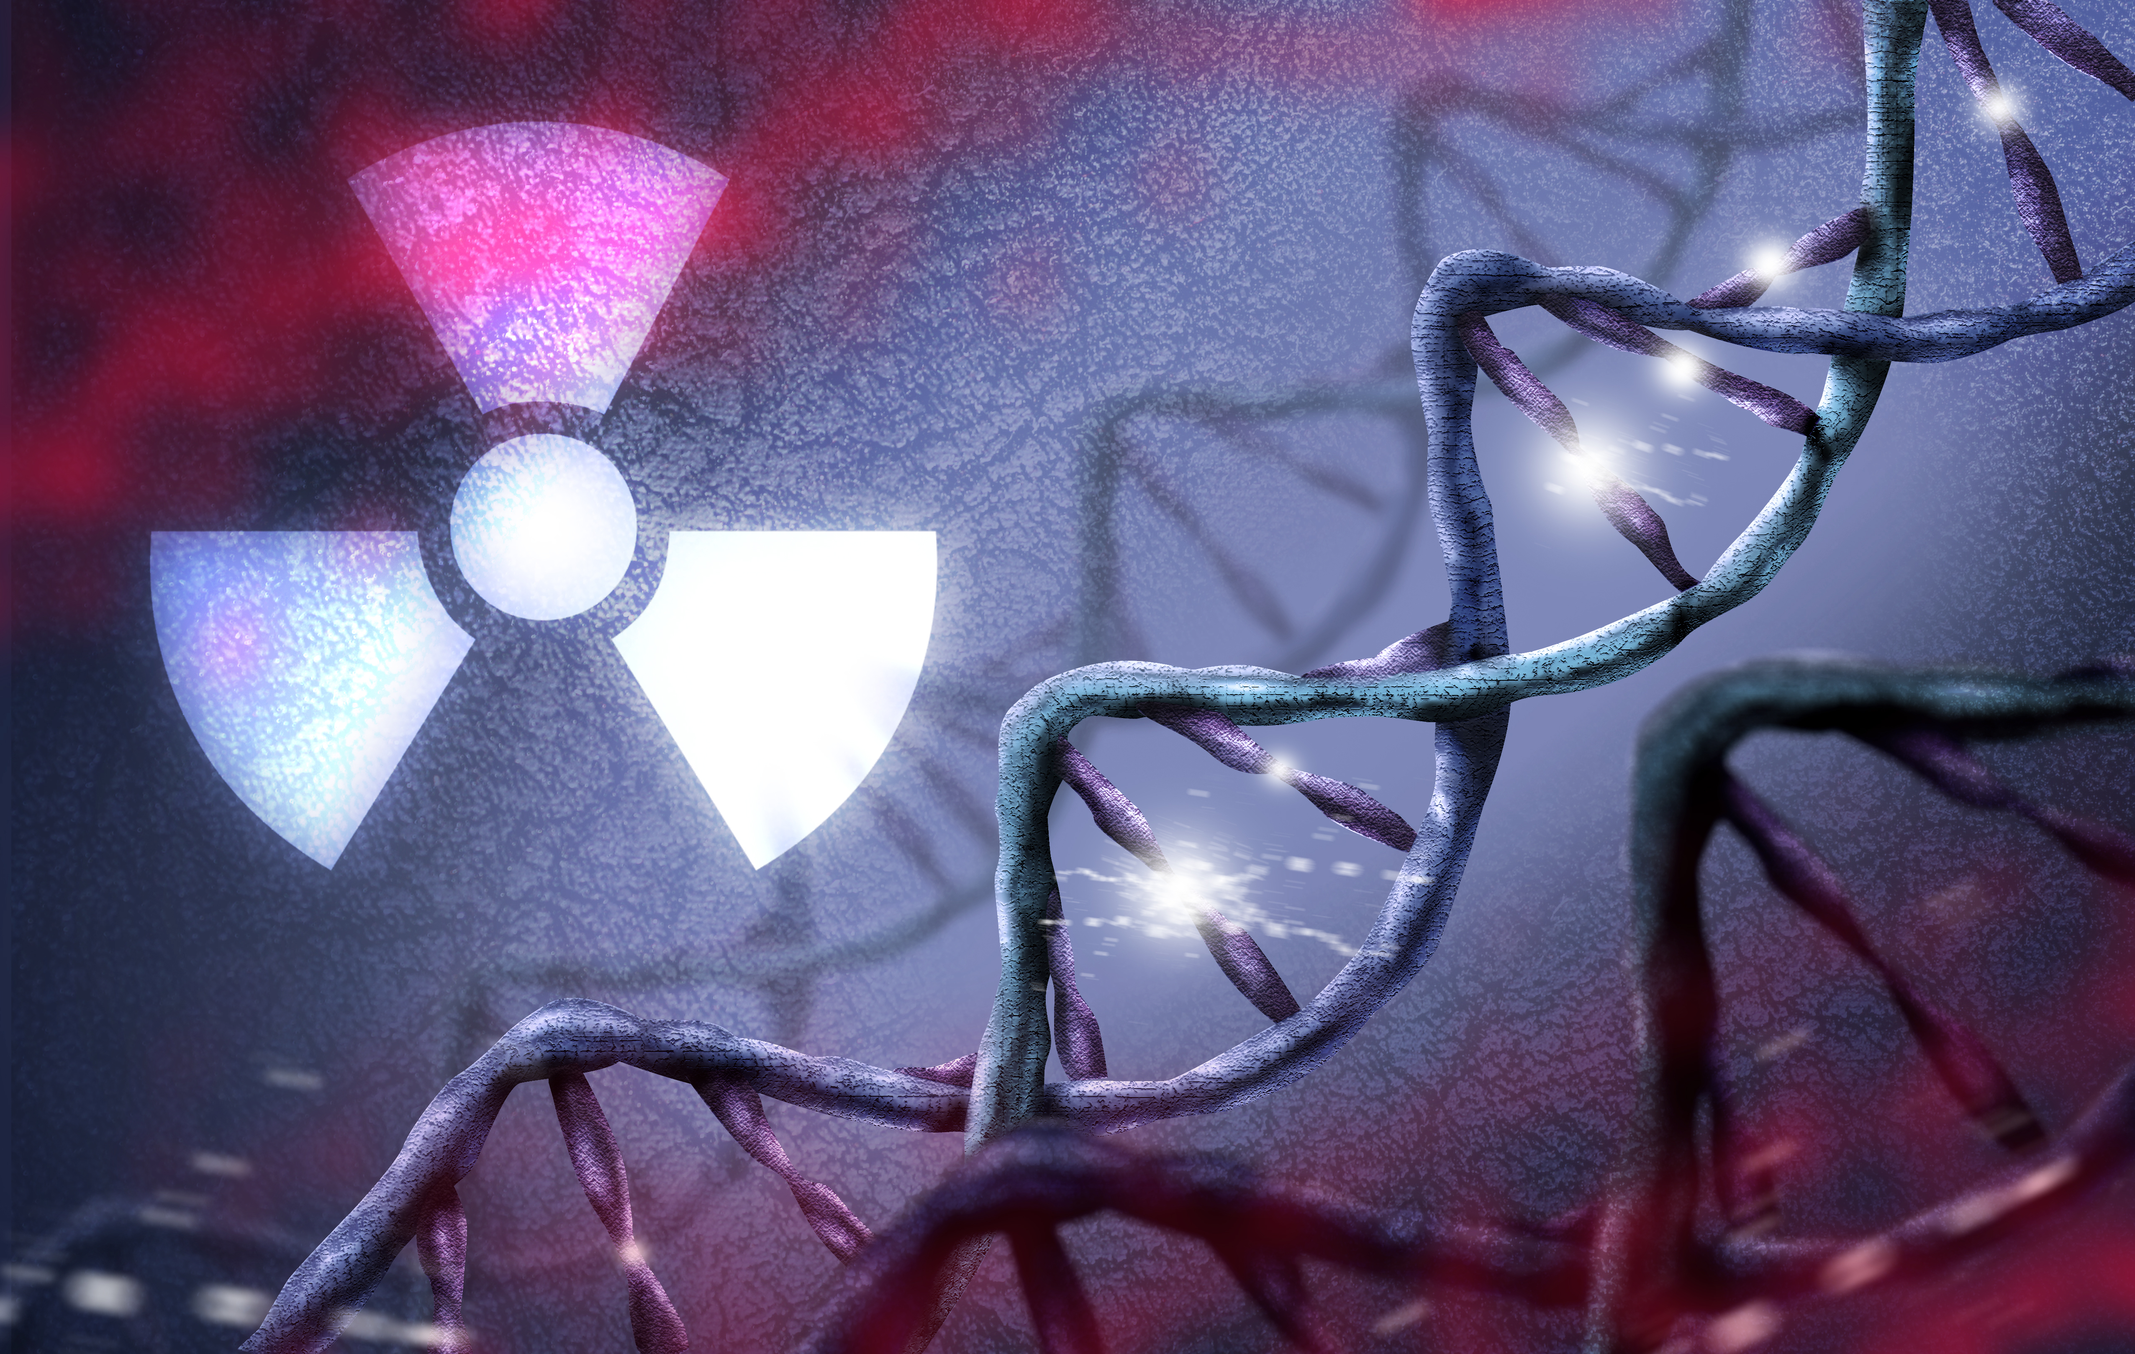
Call to Action
Increase and scale up REBCO tape production
Better management and allocation of federal capital
Improve industry-academic-federal collaboration

Slide 12
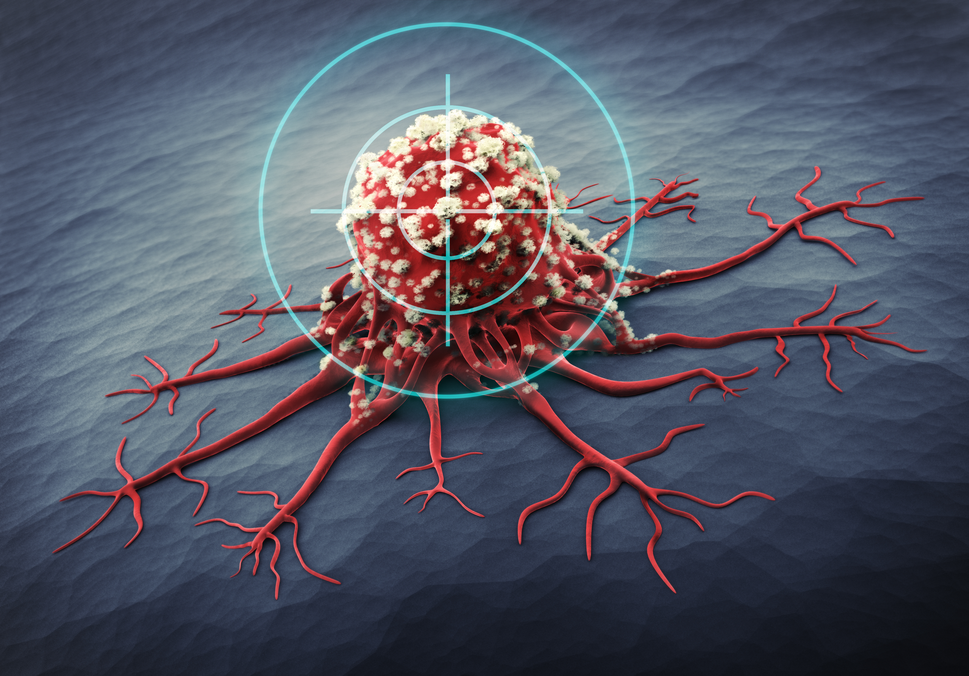

THANK YOU!

