Slide 1



Liquid Hydrogen for Sustainable Energy Systems: Latest Developments, Challenges and Opportunities
CEC/ICMC 2025
(M4Or1A-05, May 22, 2025 10:40 am)
David M. Sackey^{1,2}, Paul Iyanda^{1,2}, Chul H. Kim², Peter. Cheetham^{1,2}, Sastry V. Pamidi^{1,2}
¹Center for Advanced Power Systems, Florida State University, Florida, USA
²FAMU-FSU College of Engineering, Department of Electrical & Computer Engineering, Florida, USA

Slide 2
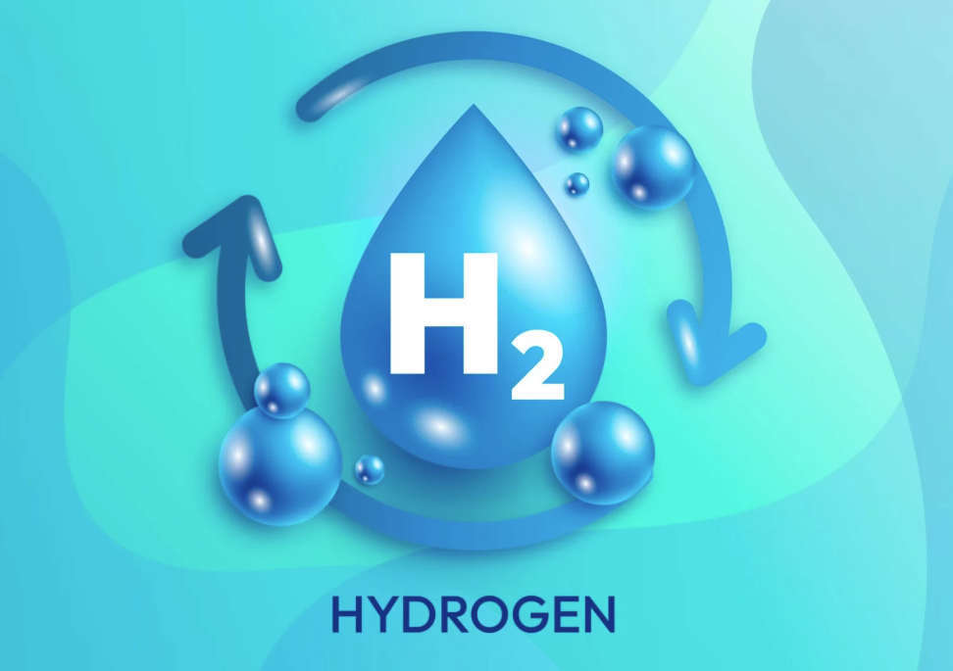
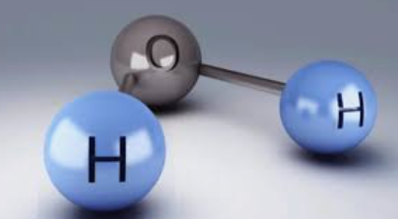
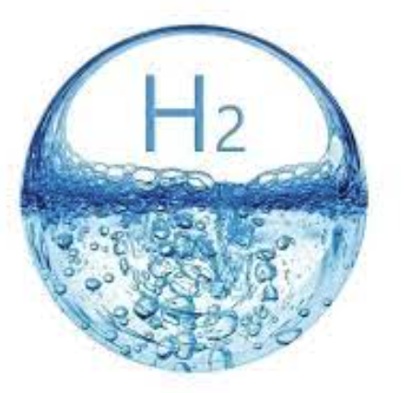
Outline
Why hydrogen & the SDGs
Hydrogen as an energy vector
Thermodynamic properties of H
Round trip efficiency of H
Liquefaction
  Liquefaction methods & cooling
LH storage and transportation
  Zero boil-off tanks (ZBOT)
2
2
2

Slide 3
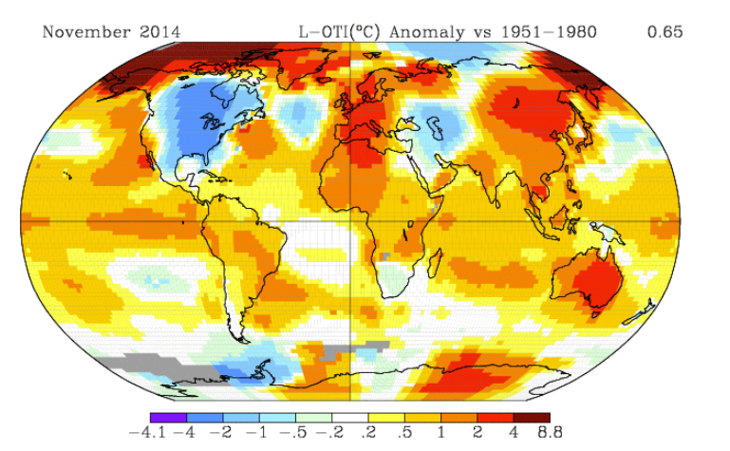



Environmental Reports
https://summitvoice.wordpress.com
https://abcnews.go.com/US/new-york-city-braces-major-flooding-heavy-rain/story?id=103593175
CNN.com/wildfires.

Slide 4
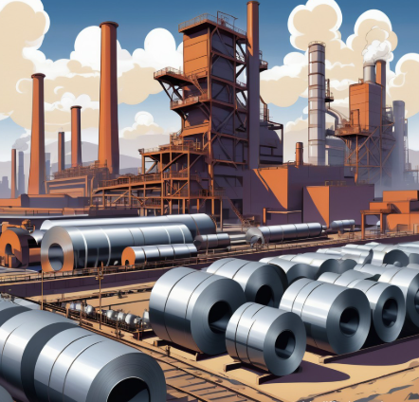
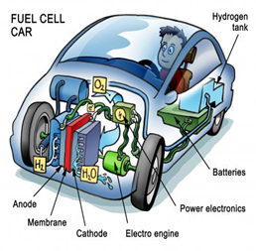


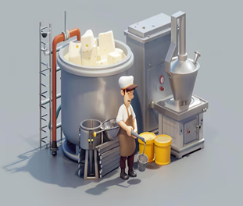
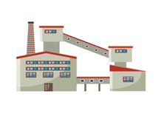
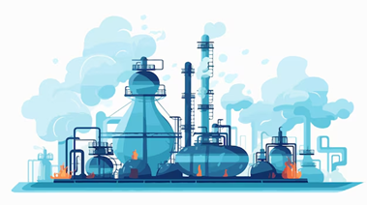
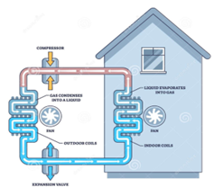
Hydrogen as an Energy Vector
Steel & Cement
Fuel cell
Buck-up power
Semiconductors
Food processing
Manufacturing
Chemicals processing
Cooling & Heating

Slide 5

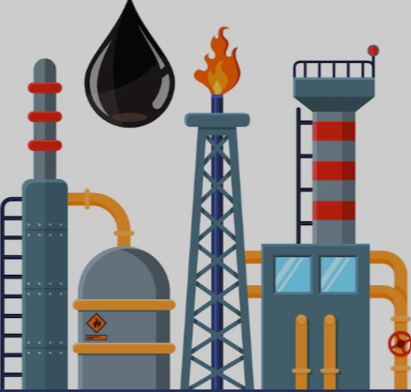


Hydrogen in the Hard-to-abate Sectors
Chemicals
Industry
Building
Transport
Methanol
Ammonia
HCL
Residential & Commercial
Combine Heat & Power
Refinery
Steel
Cement
Automobile
Marine
Aviation

Slide 6
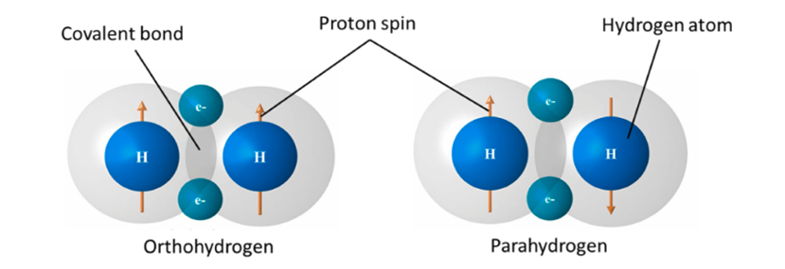
Thermodynamic Properties of H2 [1/3]
H2 isomers spin orientation of their nuclei, with differences properties (ortho & para) nuclei spin in opposite direction
For engineering calculation, an Equation of state (EOS) is required to analyse the ortho-para hydrogen mixtures
Above 240 K, the mixture ratio is 75 % ortho & 25 % para
Can be use as a cryogenic liquid at 20 K of 99.5 % parahydrogen
Has high energy per unit mass (Gravimetric Energy Density) of 120–142 MJ/kg compared to fossil fuel of 44 MJ/kg in STP of 298 K @ 1 atm
Has low volumetric density of 10.79 MJ/m³ and need to be liquefied
After liquification at 20 K the volumetric energy density is 8502 MJ/m3
Jacobsen, R.T., Leachman, J.W., Penoncello, S.G. and Lemmon, E.W., 2007. Current status of thermodynamic properties of hydrogen. International Journal of Thermophysics, 28, pp.758-772.

Slide 7
Thermodynamic Properties of Hydrogen [2/3]
Triple Point: is the unique combination of temperature and pressure at which solid, liquid, and gas phases of hydrogen coexist in equilibrium (13.8 K, 7.04 kPa)
  Cryogenic and calibration
Critical Point: point of the liquid-gas boundary, beyond which hydrogen exists as a supercritical fluid, where the distinction between liquid and gas disappears (33.2 K, 1.3 MPa)
  high-pressure hydrogen system (70 MPa eg: vehicle tanks)

Slide 8
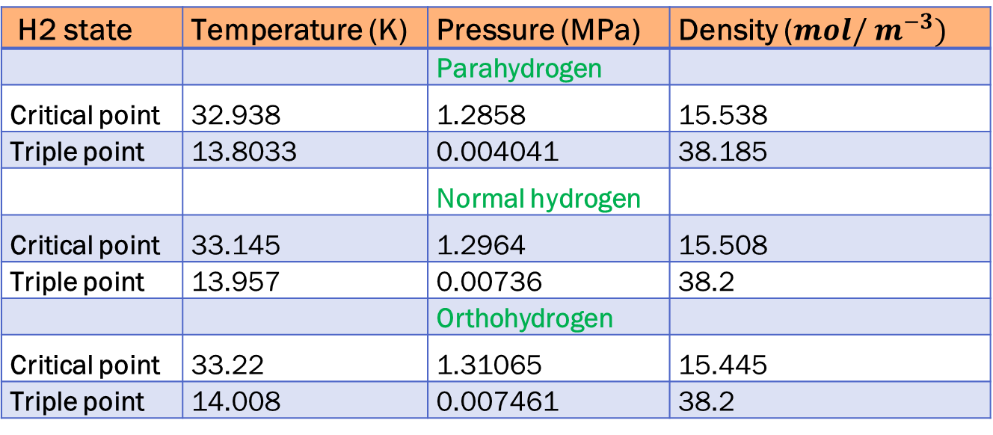
Thermodynamic Properties of Hydrogen [3/3]
H2 state | Temperature (K) | Pressure (MPa) | Density ($mol/ m^{−3})$
 |  | Parahydrogen
Critical point | 32.938 | 1.2858 | 15.538
Triple point | 13.8033 | 0.004041 | 38.185
 |  | Normal hydrogen
Critical point | 33.145 | 1.2964 | 15.508
Triple point | 13.957 | 0.00736 | 38.2
 |  | Orthohydrogen
Critical point | 33.22 | 1.31065 | 15.445
Triple point | 14.008 | 0.007461 | 38.2
R. T. Jacobsen, J. W. Leachman, S. G. Penoncello, and E. W. Lemmon, “Current status of thermodynamic properties of hydrogen,” Int J Thermophys, vol. 28, no. 3, pp. 758–772, 2007, doi: 10.1007/s10765-007-0226-7.

Slide 9
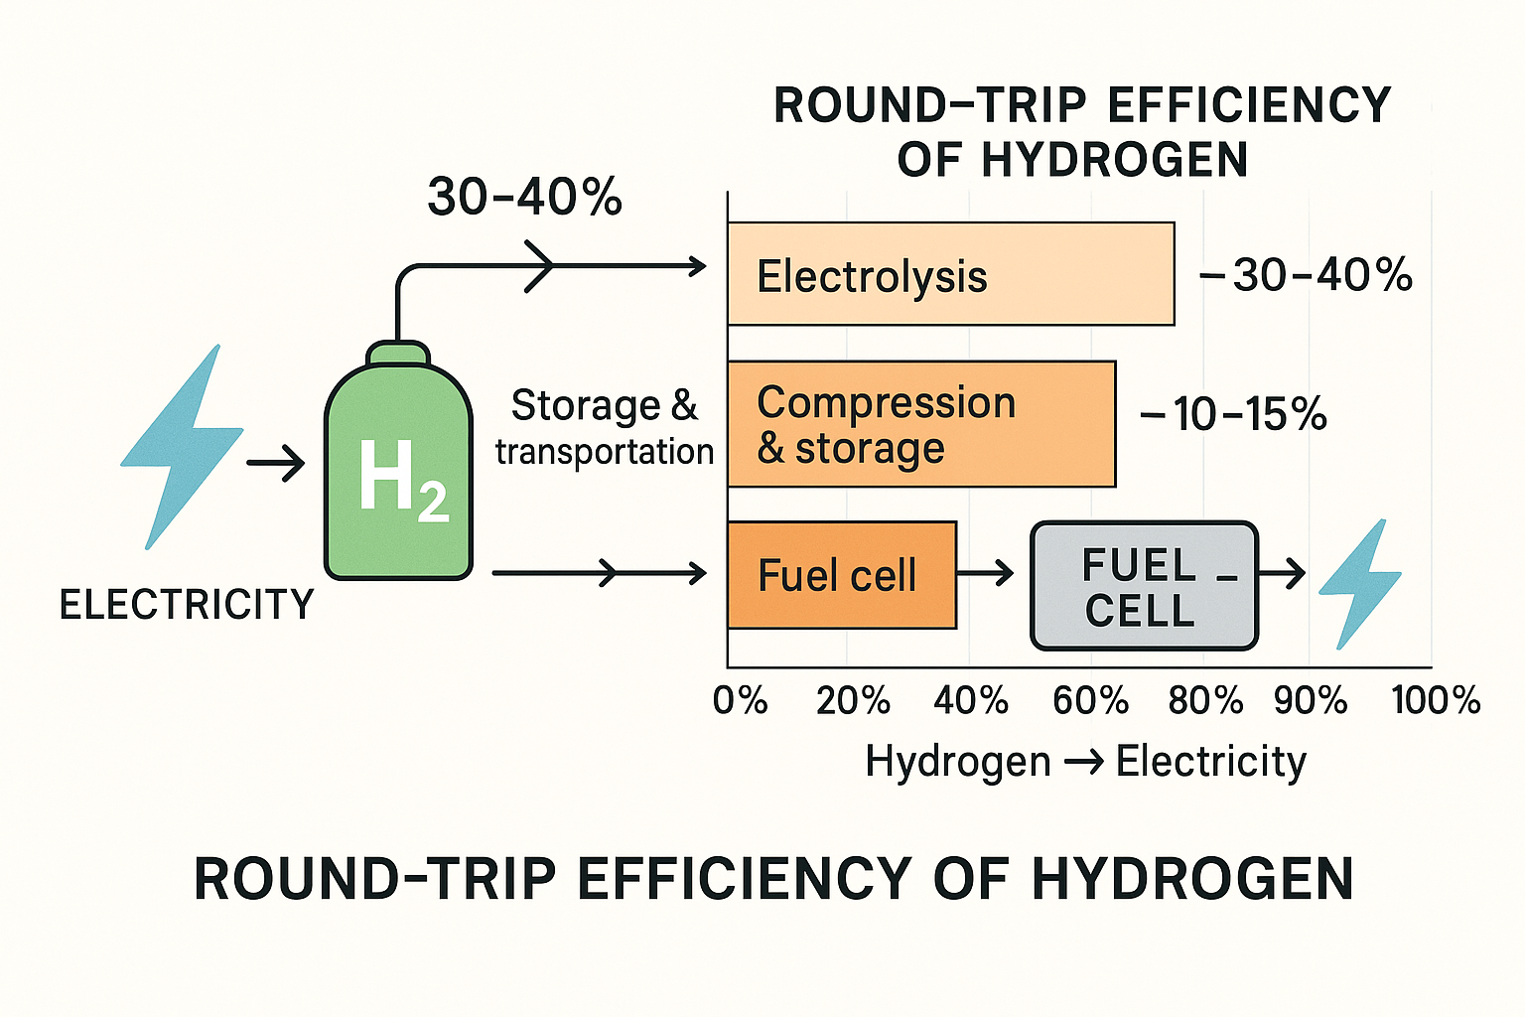
Round-trip Efficiency of Hydrogen
Production
Via electrolysis
Storage
compressed gas/ liquid
Transportation & distribution
Converting back to electricity

Slide 10
Hydrogen Liquefaction
S1
S2
S3
Gaseous hydrogen (H₂) is compress and cooled to a low temperature until it becomes a liquid at ~20 K @ 1 atm
Liquefaction has 3 stages
  Precooling, from ~ 298 K to 80 K
  ortho-to-parahydrogen conversion, from ~ 80 K to 30 K
  Liquefaction, from ~ 49 K to 20 K
There are several methods of liquefaction process and cooling
Liquefaction is energy-intensive, complex operational mechanisms and requires multiple stages of cooling. The reaction is enhanced by a catalyst to speed up the process to prevent boil-off
S. Z. Al Ghafri et al., “Hydrogen liquefaction: a review of the fundamental physics, engineering practice and future opportunities,” Apr. 21, 2022, Royal Society of Chemistry. doi: 10.1039/d2ee00099g.

Slide 11
Comparing Various Liquefaction Processes
Innovation Techology | Principle of operation | Technology rating | Advantages | Disadvantage
Thermoacoustic | Sound wave-induced cooling | Average | Eco-friendly | Complex design
Two-stage mixed refrigerant cycle | Optimized mixed refrigerant | High | Effective with minimal energy consumption | Complex design, high cost
Linde-Hampson cycle | Joule-Thompson expansion | Low | Simple layout with minimal maintenance | Low efficiency, high energy usage
Claude cycle | Involves expansion turbine | Average | Effective with high reliability | Complex design, high cost
Brayton cycle | Gas refrigeration | High | Efficient, minimal power consumption | Complex design, moderate cost
Magnetic refrigeration | Relies on the caloric effect | High | Efficient, no refrigerant | Complex design, high cost
S. S. Hosseini Dehshiri, “A new application of multi criteria decision making in energy technology in traditional buildings: A case study of Isfahan,” Energy, vol. 240, Feb. 2022, doi: 10.1016/j.energy.2021.122814
H. Wei, M. Hasanuzzaman, and J. Selvaraj, “Decision study and ANN-assisted multi-criteria optimization of a novel three-state solar-driven integrated process using energy storage for hydrogen liquefication: A case study for Malaysian solar status,” J Energy Storage, vol. 99, Oct. 2024, doi: 10.1016/j.est.2024.113216.

Slide 12
Hydrogen Liquefaction
Using conversional Claude liquefier is energy intensive and not efficient (~40-50 %)
Conventional liquefier is limited to a figure of merit (FOM) of ~0.35
  DOE target of "1-1-1“ to produce clean hydrogen @ $1 per 1 kg within one decade by 2031
  and to improve the liquefaction efficiency to be > 60 %, and 20 % < current cost of liquefiers
  DOE, total liquefaction in the USA ~794 mtpd (metric tons/day) from 14 plants
Using magnetocaloric effect to liquefy hydrogen (MCHL) is highly efficient
MCHL uses magnetic fields to execute an efficient magnetic regenerative liquefaction cycle without using gas compressors
MCHL increase the thermodynamic efficiency of the liquefiers FOM from ~ 0.3 to 0.5
Notardonato, W.U., Swanger, A.M., Fesmire, J.E., Jumper, K.M., Johnson, W.L. and Tomsik, T.M., 2017, December. Zero boil-off methods for large-scale liquid hydrogen tanks using integrated refrigeration and storage. In IOP conference series: materials science and engineering (Vol. 278, No. 1, p. 012012). IOP Publishing.
John Barclay and Corey Archipley,2023. MagnetoCaloric hydrogen liquefaction. DOE Hydrogen Program 2023 Annual Merit Review and Peer Evaluation Meeting AMR project IN004

Slide 13
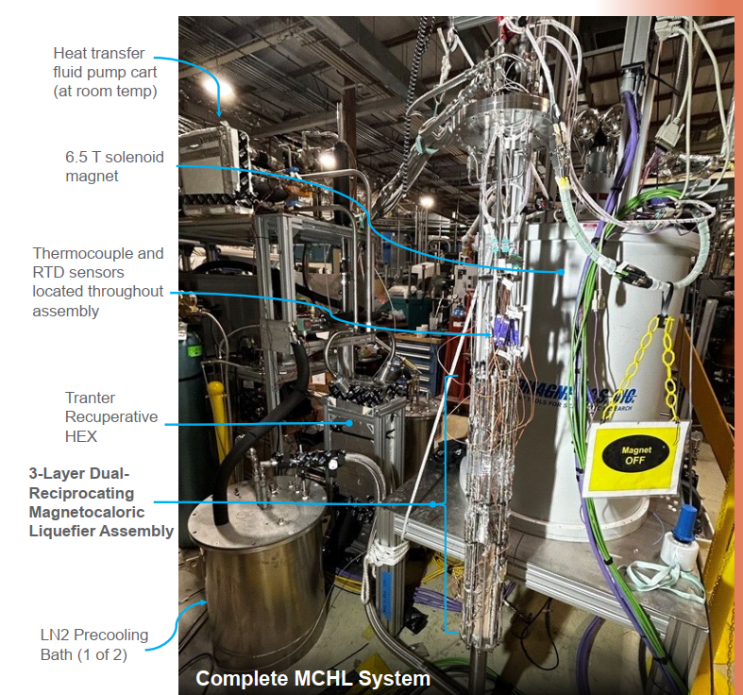
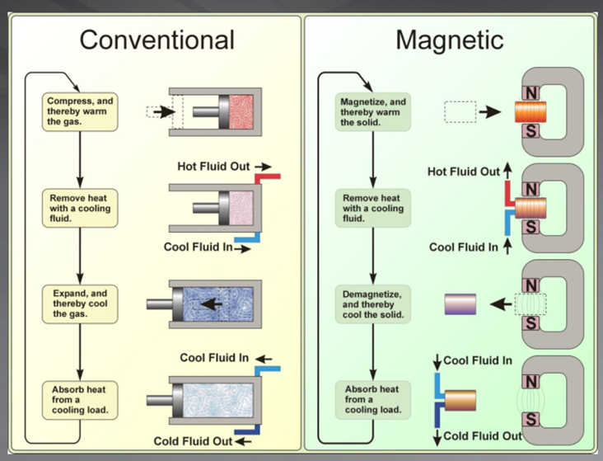
Magnetocaloric Hydrogen Liquefaction
MCHL set-up @ PNNLab
https://www.hydrogen.energy.gov/docs/hydrogenprogramlibraries/pdfs/review23/in004_barclay_2023_p-pdf.pdf?Status=Master
Jamie Holladey, Magnetocaloric Liquefaction, Pacific Northwest National Lab June 2016, project ID PD 131

Slide 14
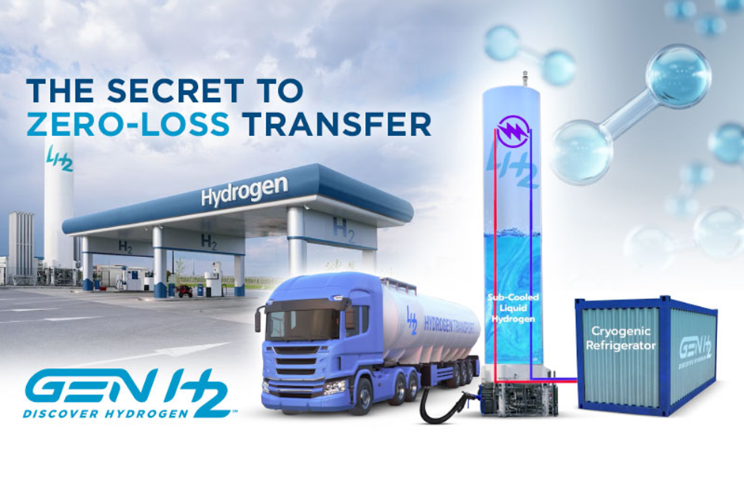
LH2 Transportation [1/2]
15-25 % of hydrogen is lost during truck or ship transportation
LH2 tanks experience evaporative losses with:
  1 % loss daily-due to normal evaporation
  13 % loss during off-loading from truck to tank
  3 % loss during dispensing from cavitation in the liquid pump/day
Superior cargo transportable trailers are used to transport LH2
For intercontinental transport, LH2 is carried using dedicated ships
https://genh2hydrogen.com/news/genh2s-cryo-solution-to-manage-the-molecule-for-zero-loss-hydrogen-transfer/

Slide 15
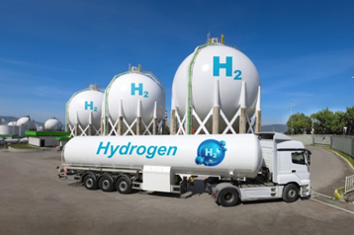
LH2 Transportation [2/2]
Liquid tankers are stable & used for high demand location
Liquid tanks on board marine vessels are also being explored for international shipping
Zero-Boil off tank(ZBOT) is a good option
NASA develop the MLI using heat flux sensors on the SHIIVER tank with both hydrogen and nitrogen
Johnson, W.L., Balasubramaniam, R. and Hibbs, R., 2022, May. Results of use of heat flux sensors on liquid hydrogen tanks. In IOP Conference Series: Materials Science and Engineering (Vol. 1240, No. 1, p. 012005). IOP Publishing.

Slide 16
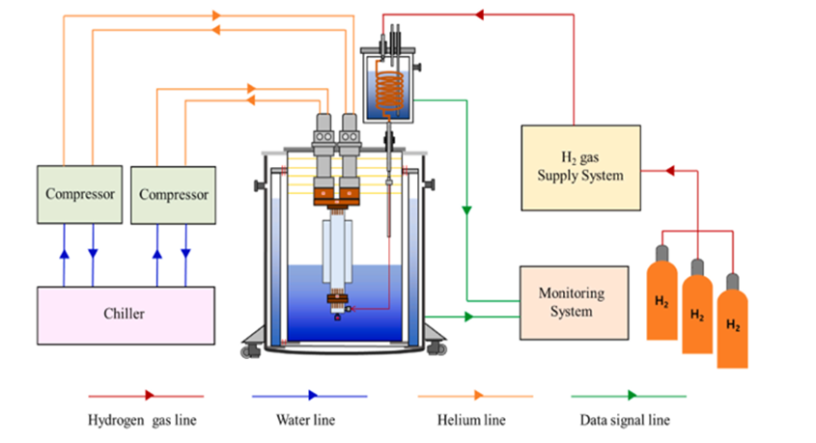
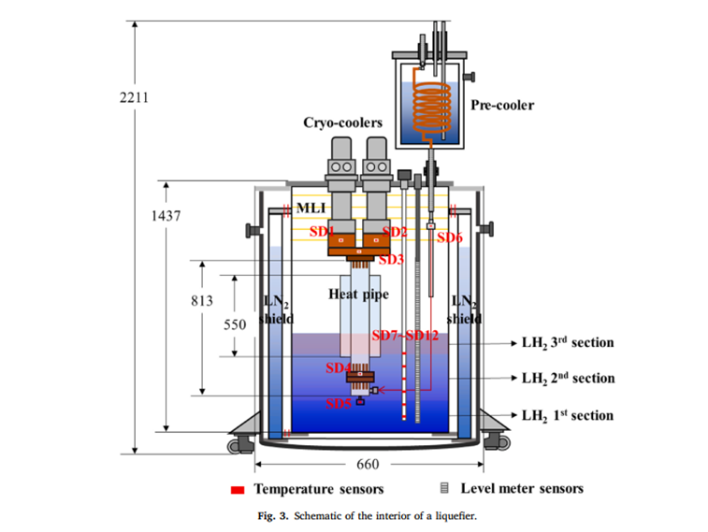
Zero Boil-Off Management
Condensing-type hydrogen reliquefaction system with two cryocoolers
Ha, D.W., Noh, H.W., Koo, T.H., Ko, R.K. and Seo, Y.M., 2024. Experimental study on the liquid hydrogen zero boil-off in a liquefaction system with an automatic control technology. International Journal of Hydrogen Energy, 83, pp.933-945.

Slide 17
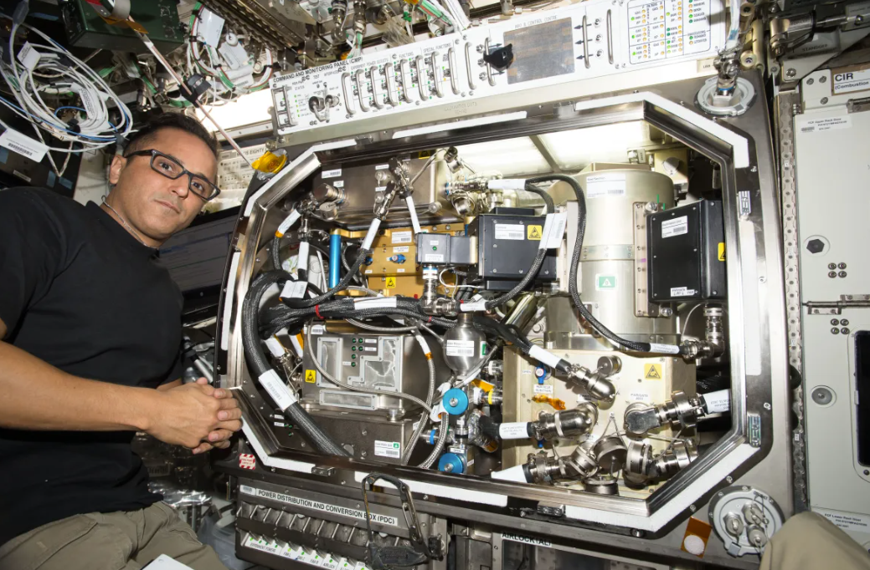
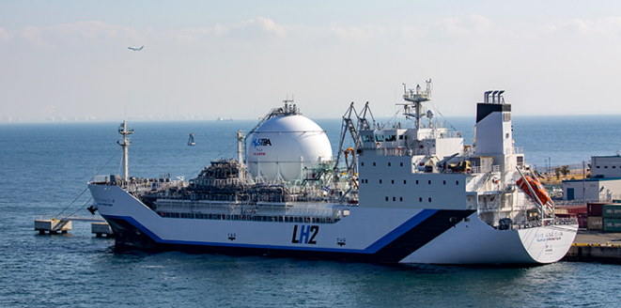

Zero Boil-Off tank (ZBOT) for LH2 [1/2]
Boil-off pressure is vented into “a self-pressuriser
This increases pressure between 2- 4 times
Pressurised gas is directed into the engine
Surplus boil-off gas is fed into fuel-cell stack to generate electricity
Power the LH2 pump for the motor and increase the car efficiency
NASA ZBOT installation @ space station
https://science.nasa.gov/science-research/science-enabling-technology/zero-boil-off-tank-experiments-to-enable-long-duration-space-exploration/
Toyota ZBOT for GR Corolla H2 car
World’s first ZBOT H2 carrier completes round trip (Australia-Japan)
https://www.cryogenicsociety.org/index.php?option=com_dailyplanetblog&view=entry&category=industry-news&id=396:toyota-says-it-has-solved-the-boiloff-problem
https://www.en-former.com/en/worlds-first-liquid-hydrogen-carrier-completes-round-trip/

Slide 18
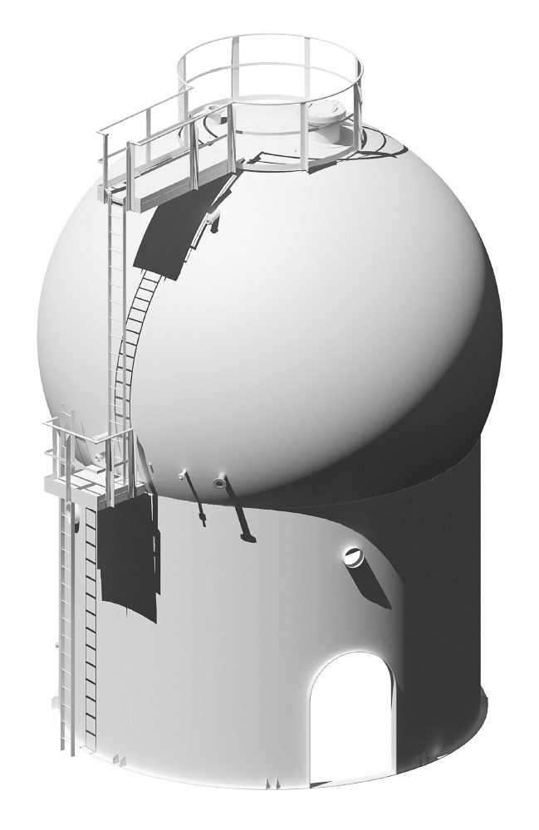



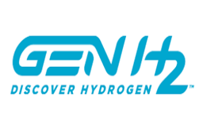

Zero Boil-Off tanks for LH2 [2/2]
A vacuum tank concept for large-scale (up to 100,000 cubic meters) of LH2 storage
NASA used-Integrated refrigeration and storage (IRAS) technology to remove energy from a liquid hydrogen (LH2) tank and control the state of the propellant
Re-liquefaction systems
Integrated hybrid systems
Active cooling loop
https://genh2hydrogen.com/press-release/liquid-hydrogen-storage-tank-first-commercial-scale-design-demonstrated-by-cbi-and-shell/

Slide 19
Conclusion
LH2 has high energy density (by mass)
When used in fuel cells, hydrogen produces water vapor as a by-product with no CO₂ emissions making it an environmentally friendly fuel option
LH2 is versatile - can be used in a variety of applications: fuel cells, internal combustion engines, industrial processes

Slide 20
Thank You
21

