Slide 1



A Review of the Effects of Strain at 4.2K on Electrical Resistivity and Strength in Bulk High Purity Al
K. Ted Hartwig^{1,2}
Abstract XXX, Talk M3Or2A-01
Session: M3Or2A “Special Session: High Purity Al for Low Temperature Applications”
11:15 a.m. – 1:45 p.m. Wednesday May 21, 2025
¹: Department of Materials Science and Engineering, Texas A&M University, College Station 77843
²:Shear Form, Inc. Bryan, Texas 77840

Slide 2
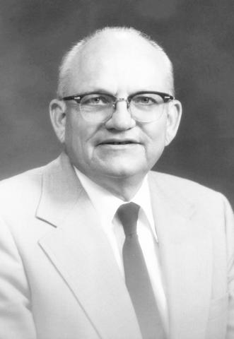
Special Acknowledgements
Roger W. Boom
UW-Madison Professor
Director ASC
Pioneer of SMES
Sponsor
Champion of pure
Al for the stabilizer
material in large scale SMES composite superconductors.
Chuck Oberly
Physicist/Engineer
WP AFB
Sponsor
Strong Proponent
for pure Al in composite cryo-conductors for aerospace applications.

Slide 3
More Acknowledgements
Ray J. DeFrese (MS Student TAMU)
Daniel Frutschi (Swiss IAESTE Student TAMU)
James T. Gehan (MS Student TAMU)
Peter Lehmann (Swiss IAESTE Student UW-M)
Alan Lumbus Canadian IAESTE Student TAMU)
L. Clark McDonald (PhD Student TAMU)
Joesef Roelli (Swiss IAESTE Student UW-M)
Hong Zou (MS Student TAMU)
C.Y. Hua (Chinese Scholar UW-M)
A. Takahashi (Sumitomo Chemical Co. Inc. Japan, Collaborator)
G.S. Yuan, Visiting Scholar, China)
David C. Foley (PhD Student TAMU)

Slide 4
Original Motivation and Current Interest
Initial Motivation
PhD Project (1972-1977) at UW-Madison – determine if dilute Al(Au) alloy is a stabilizer material for low temperature superconductors. This was a candidate for a strengthened high-conductivity cryo-conductor in large scale (commercial) SMES magnets.
Past Work
Research on numerous dilute Al alloys for cryo-conductor applications with emphasis on strain effects. Major support from DOE (at UW-Madison), USAF (TAMU), and Sumitomo Chemical Co. (TAMU).
Current Interest
Use of high purity Al for aerospace applications – electrical cryo-conductors in electric airplanes and satellite high conductivity components.

Slide 5
Background - Why choose Al for aerospace cryo-conductor applications?
Benefits of pure Al:
- Low density.
- Lower cost for the same RRR as Cu.
- Reasonable cost for high RRR (~1000) material.
- Low magneto-resistivity.
Potential drawbacks of pure Al for aerospace applications:
- Low strength.
- Poor joining characteristics (because of surface oxide and softening tendencies).
- Thermal stability if material is in a work-hardened condition.

Slide 6
Research areas we have examined for
Al cryo-conductor applications
Variables
  Purity in the higher purity range and some alloys.
  Temperature (4.2K to ambient) with emphasis on 4.2, 20, and 77K.
  Microctructure.
  Strain effects.
  Fabrication method (casting, extrusion, drawing, joining)
Properties
  Electrical resistivity (and RRR).
  Strength.
  Monotonic and cyclic strain effects on strength and electrical resistivity.
  Creep.

Slide 7
Focus Today
Strain effects on the electrical resistivity (and strength) of bulk pure Aluminum at 4.2K.

Slide 8
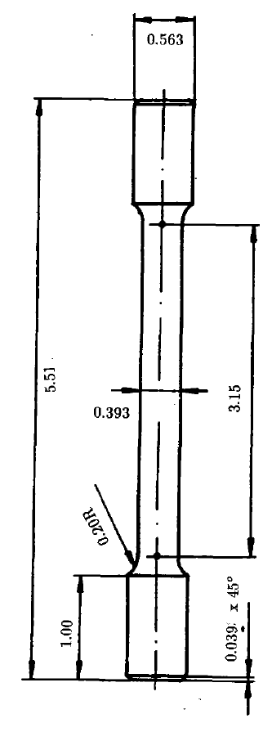
Material and Specimen Descriptions
Materials
Test Specimens
99.98 to 99.9995 Aluminum
RRR Range 150-10,000
Annealed to work hardened
Grain size range: submicron to millimeters
Sources:
  Alcoa (USA)
  Sumitomo Chemical (Japan)
  VAW (Germany)
Inch Dimensions

Slide 9
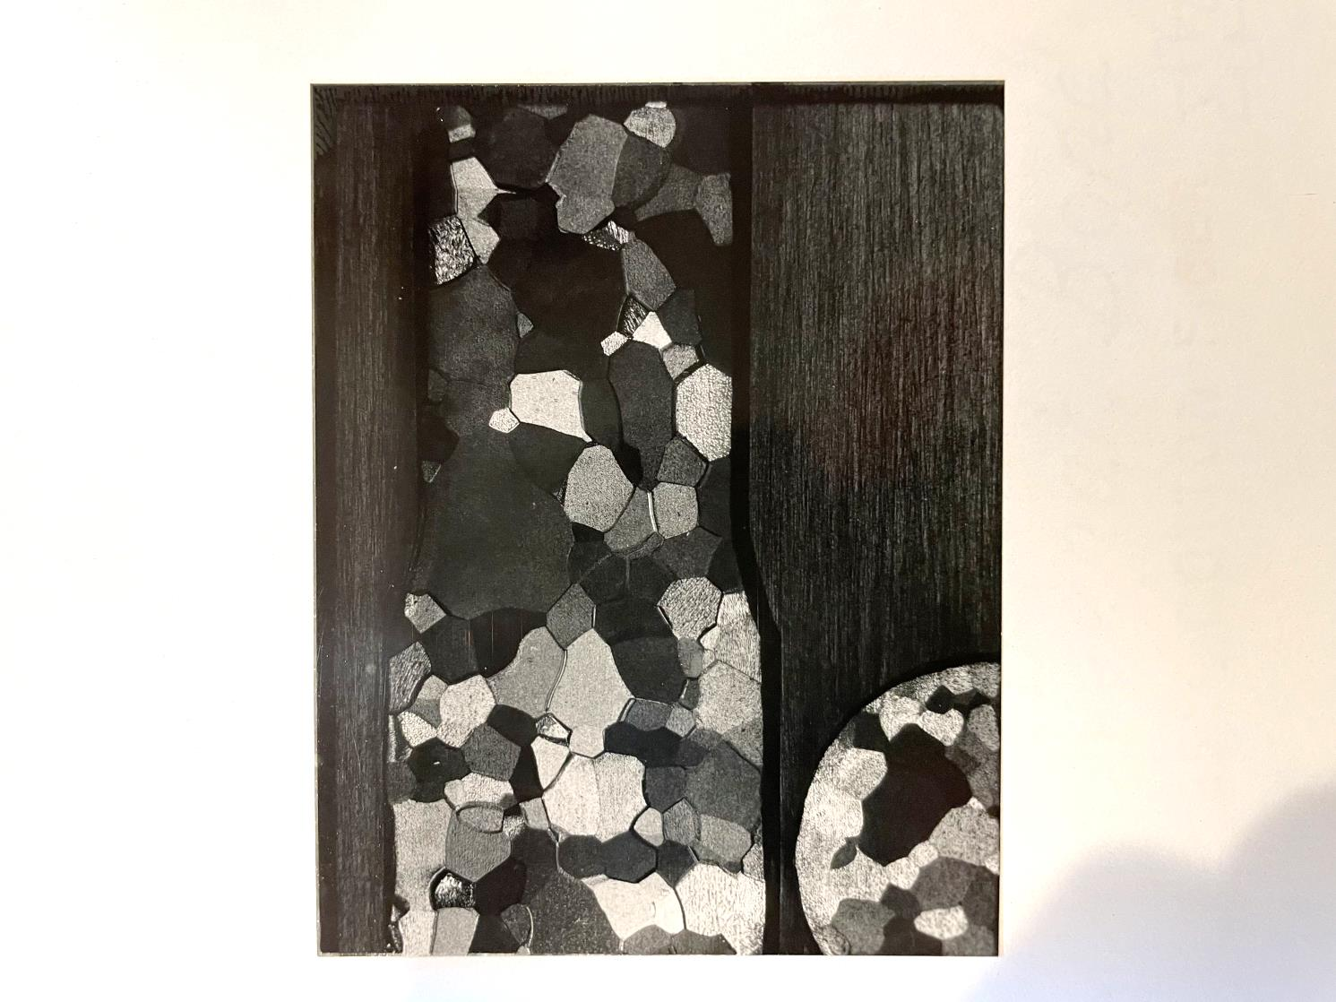
Nominal Microstructure of High Purity Al
99.999 Al
Fully annealed
3500 < RRR < 4000
0.393” (1 cm) gage diameter
Grain diameter in mm range.

Slide 10
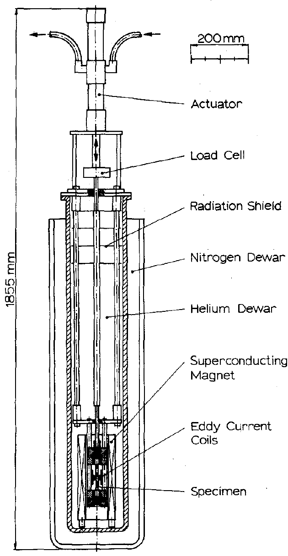
Mechanical Test Fixture
Variable temperature capability (4.2 – 77K).
Variable magnetic field capability to 8 tesla.
Stress by load cell.
Strain by strain gages.
Strain meas.error <1%.
Electrical resistivity by eddy current decay (ECD); meas. Error <1%.
References 2 and 3.

Slide 11
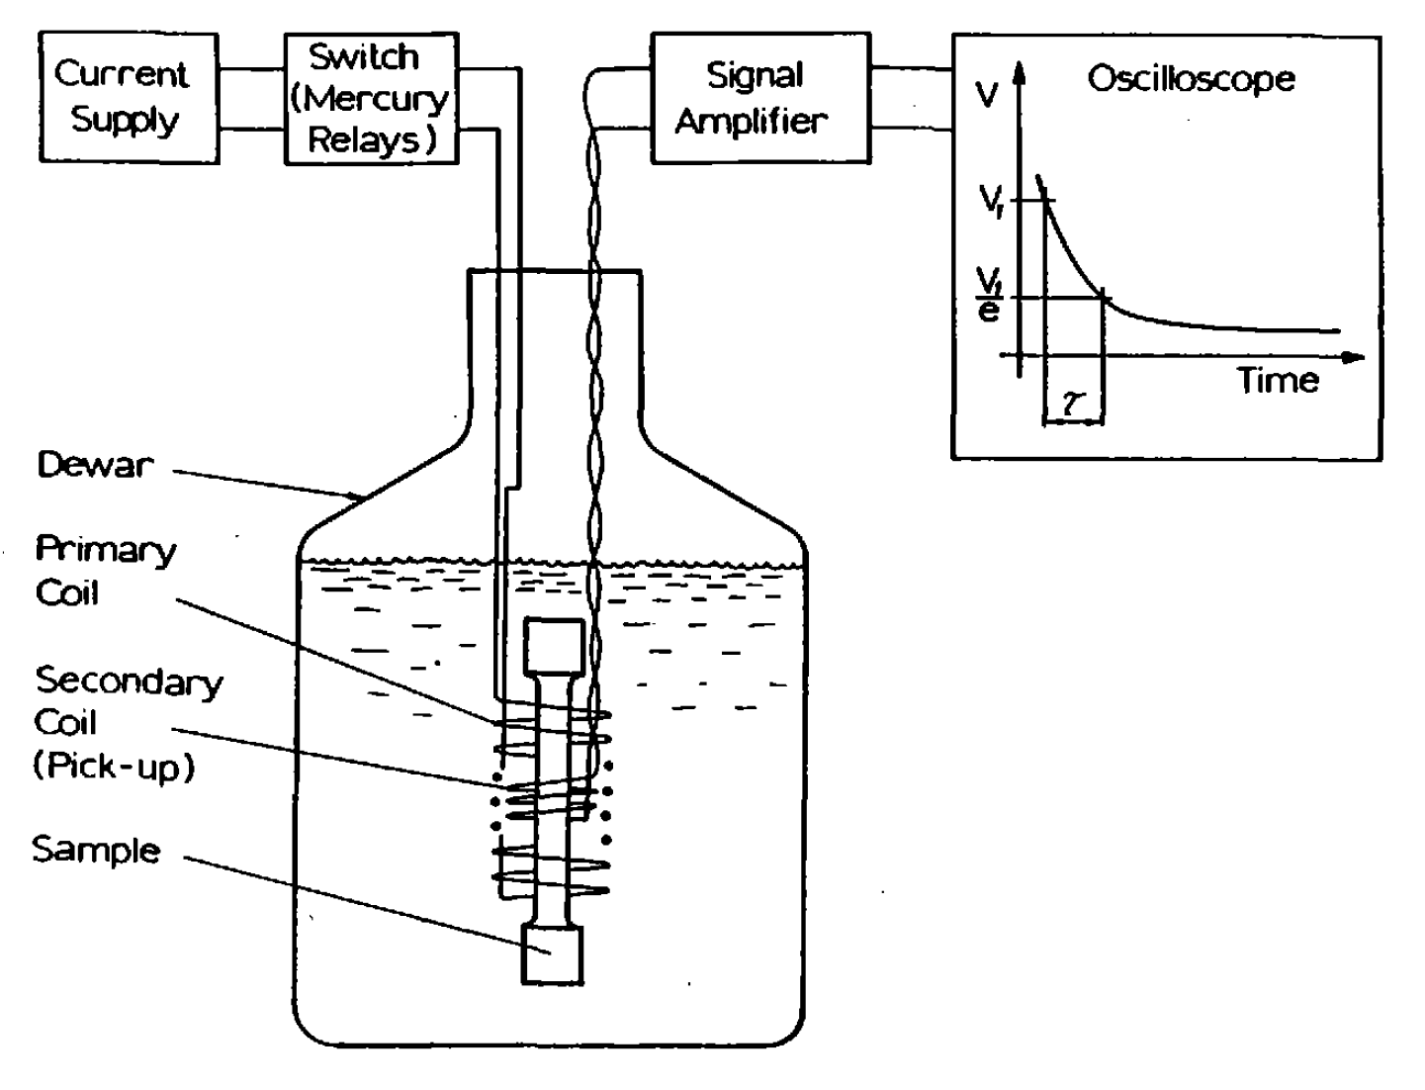
Electrical Resistivity by Eddy Current Decay (ECD)
Rapid measurements.
Contactless.
Meas. error <1%.
Best for very low resistivity materials.
Easy RRR determination.
Reference 1.

Slide 12
Experimental Procedures
Swage/draw 2.5 cm dia. pure Al bar to 1.6 cm dia. and
machine to test specimen dimensions.
Anneal at 500 C for 60 minutes.
Chemically polish and mount strain gages.
Mount in tensile fixture and cool with load control.
Initiate cyclic strain, record stress and strain, periodically stop, take resistivity measurements, continue stress cycles.

Slide 13
Results

Slide 14
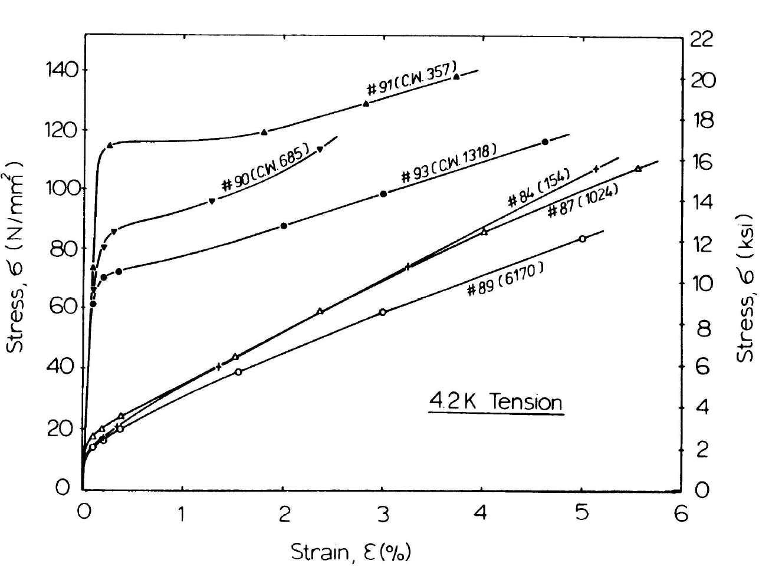
Stress versus Strain at 4.2K for Pure Al
Designations in parenthesis indicate
  Cold work (CW); 60%.
  Annealed (not noted)
  RRR (number)
Strength is only mildly dependent on purity (for these purity levels).
CW material has higher YS.
Reference 4.

Slide 15
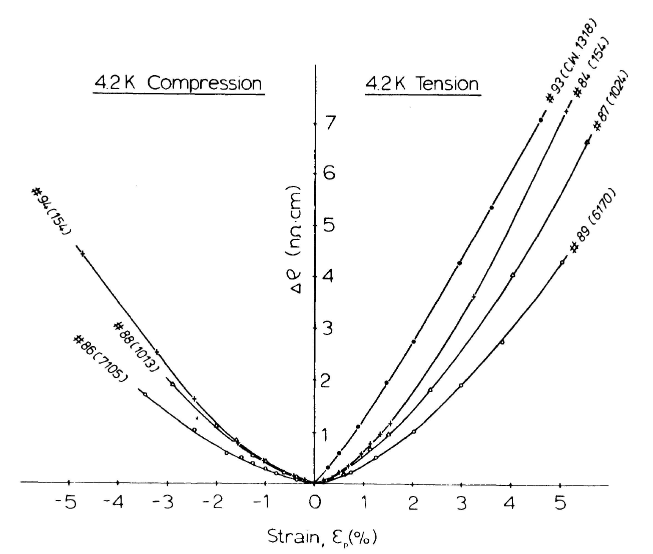
Resistivity Increase versus Monotonic Plastic Strain
Note CW and annealed materials.
Resistivity increases as plastic strain increases: from increase in numbers of vacancies and dislocations.
Modest dependence on purity.
Similar behavior for tension and compression.
Reference 4.

Slide 16
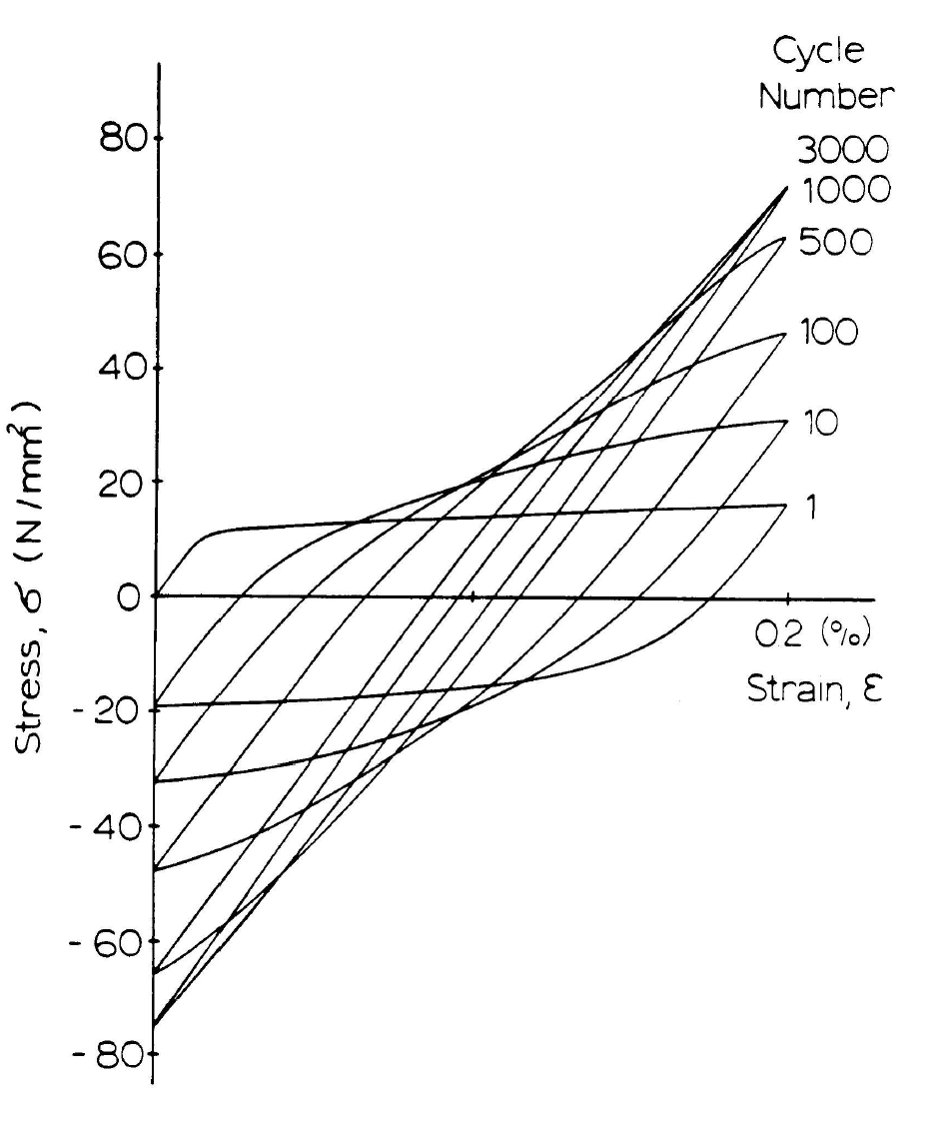
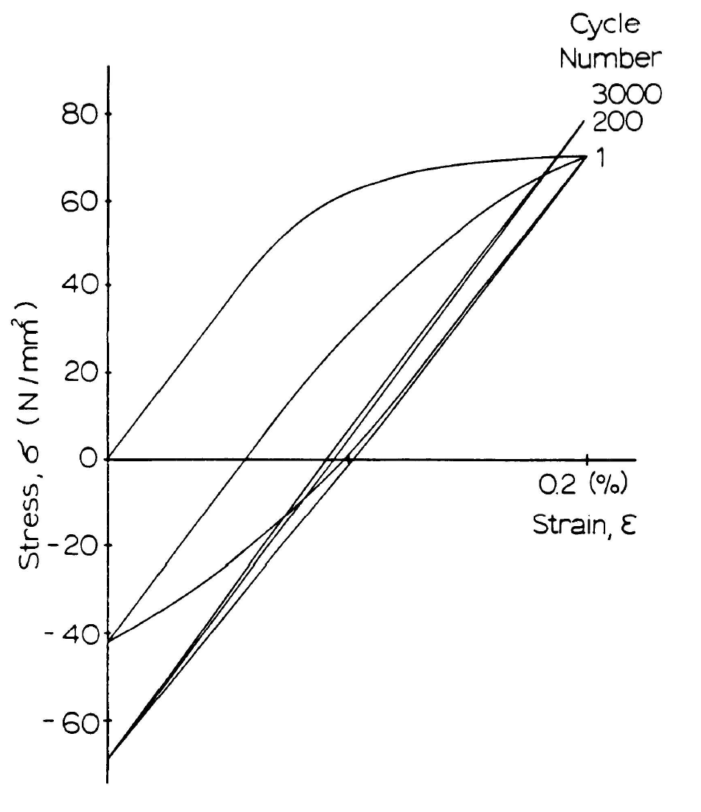
Effect of Cold Work on Cyclic Mechanical Behavior of 1000RRR Al (Ref. 5)
Annealed
Work Hardened (40%)

Slide 17
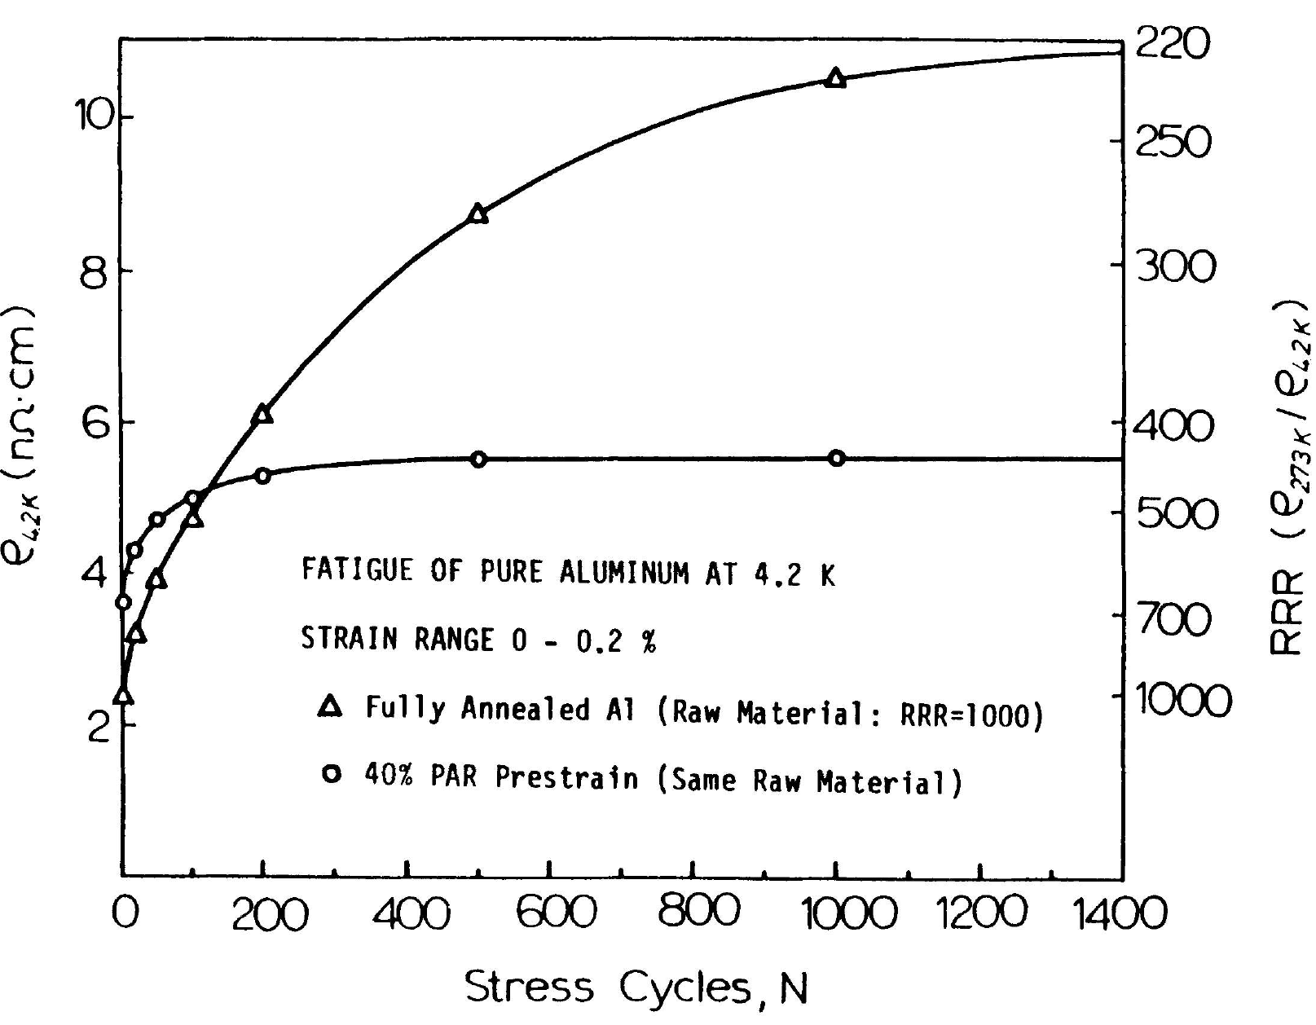
Resistivity versus Stress Cycles for Annealed and CW 1000 RRR Al
CW sample has higher initial RRR.
CW sample reaches plateau (saturation) earlier and indicates lower level of strain induced defects.
Final resistivity of CW sample is much lower than annealed material.
Reference 5.

Slide 18
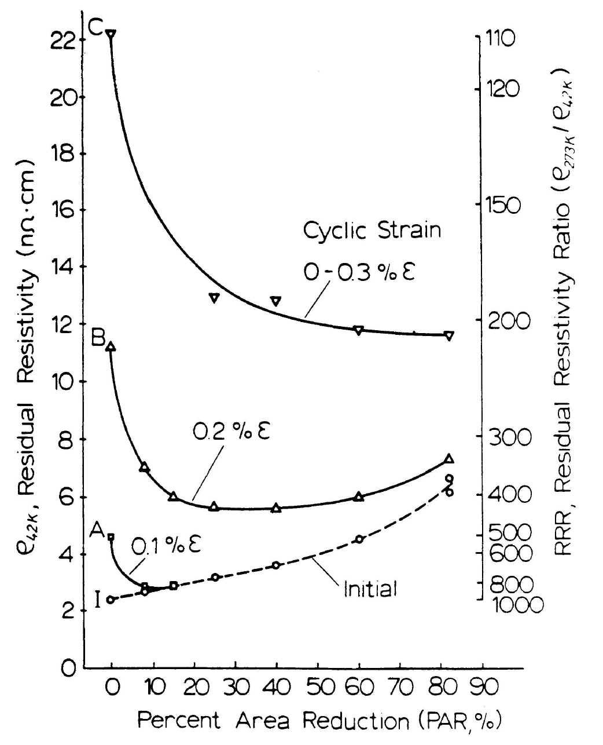
Cyclic Strain Resistivity v Percent Area Reduction for Cold Worked and Annealed 1000 RRR Al
Dashed curve is before cyclic stress.
Solid curves are after 3000 cycles.
Best pre-strain level may be dependent on cyclic strain level (see 0.2% case).
Reference 5.

Slide 19
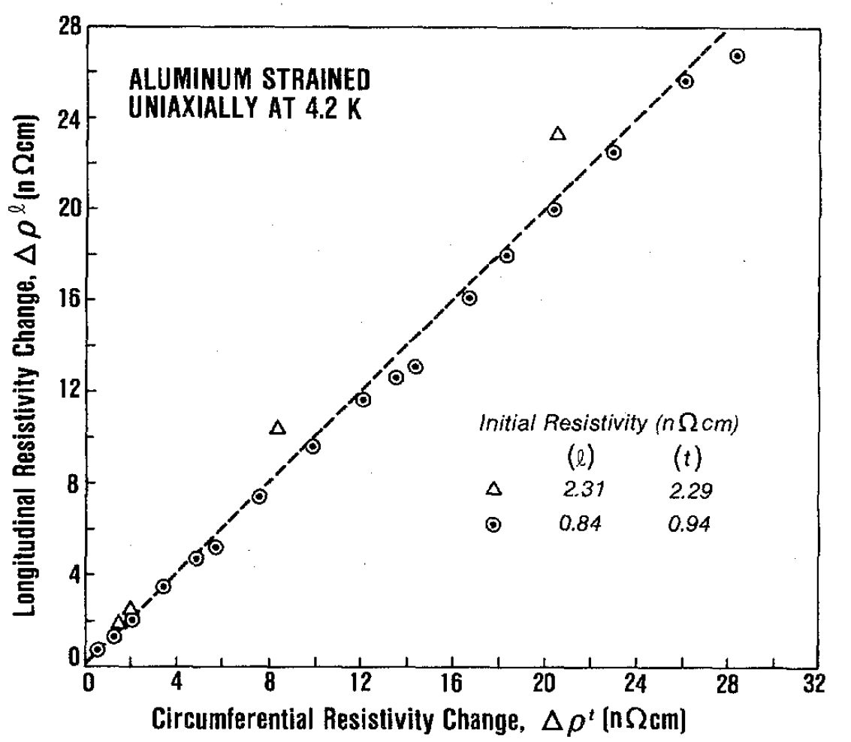
Longitudinal v Circumferential Resistivity
Longitudinal by 4-point probe; circumferential by ECD.
Results for 1000 and 4500 RRR Al.
Data points are for different levels of cyclic strain.
Dashed curve has slope 1 (equal circ. and long. values).
Max difference between circ. and long. resistivity is ~10%.
Reference 6.

Slide 20
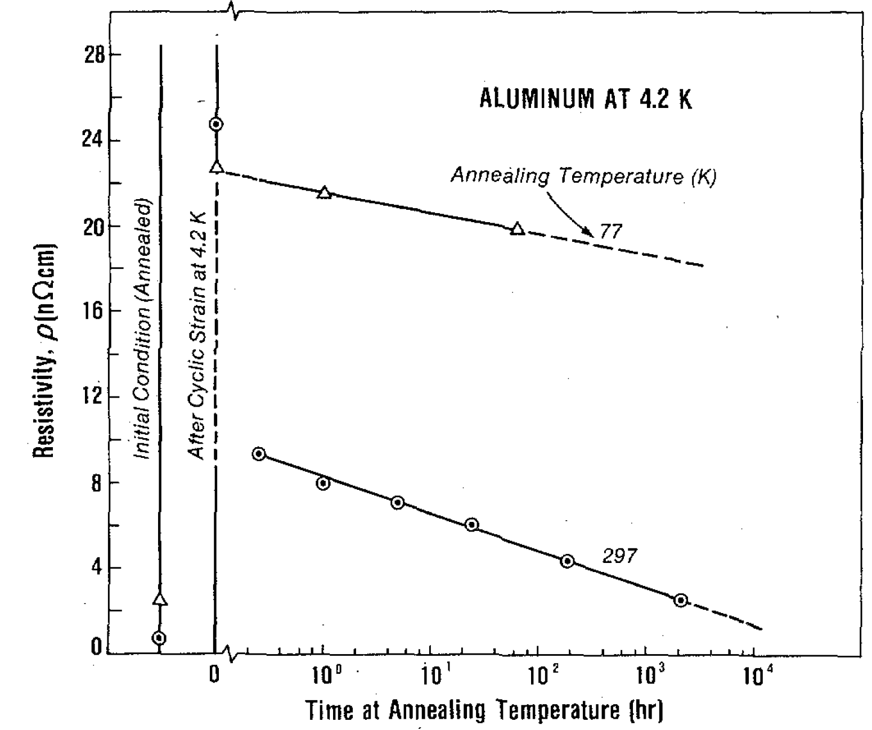
Influence of 77K and RT Annealing on Resistivity
0.3% Strain to 4000 cycles.
Note resistivity increase from strain.
No recovery seen at 4.2K.
About 5% recovery at 77K after 60 minutes.
60-70% recovery at RT after 10-20 minutes.
Reference 6.

Slide 21
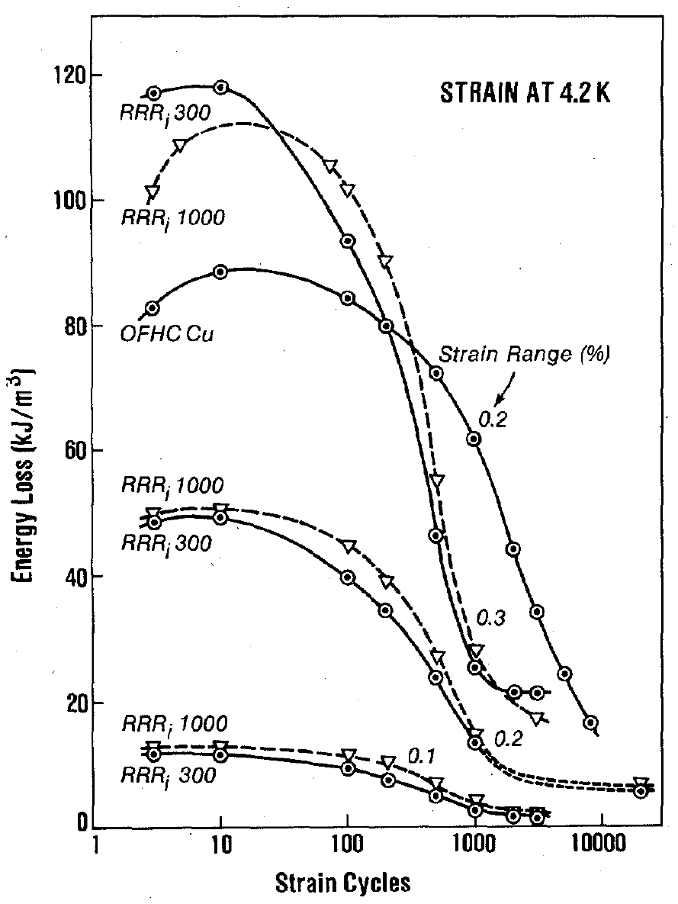
Cyclic Strain and Energy Loss in Al and Cu
Energy loss per cycle (area of hysteresis loop) in general decreases with cycling.
Loss scales with cyclic strain range.
Loss is similar for 300 and 1000 RRR Al.
Loss is much larger in Cu than in Al.
Cu loss curve has not reached equilibrium at 10,000 cycles.
Reference 6.

Slide 22
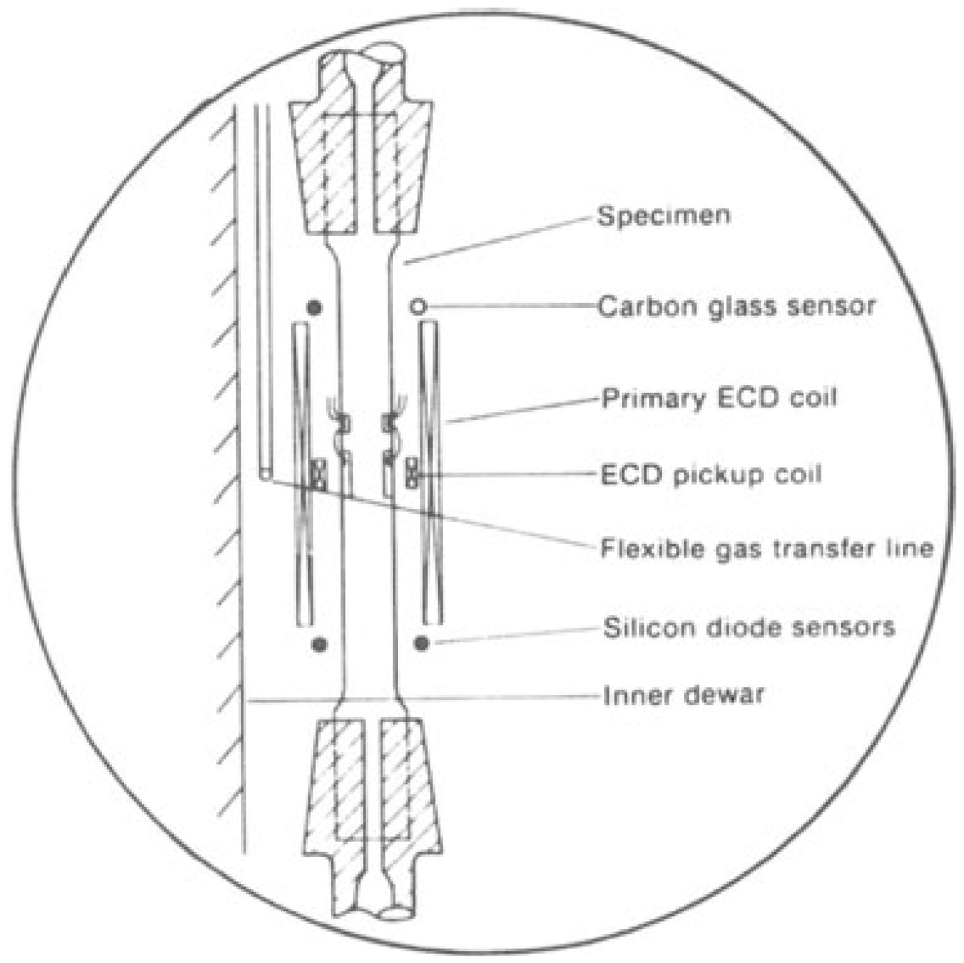
Testing at 20K
Variable temperature He gas system enables testing from 4.2K to 77K.
Gas flow for 20K testing was tangential to the test sample.
Reference 8.

Slide 23
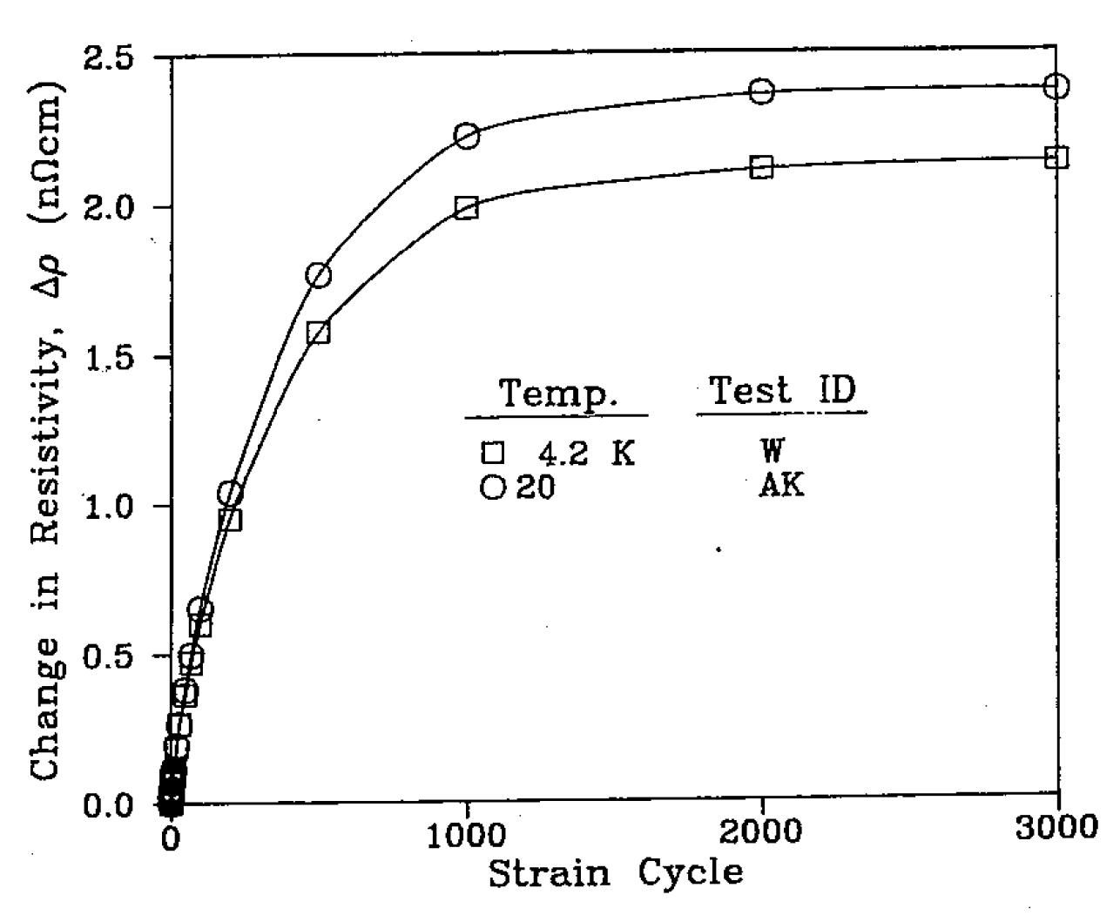
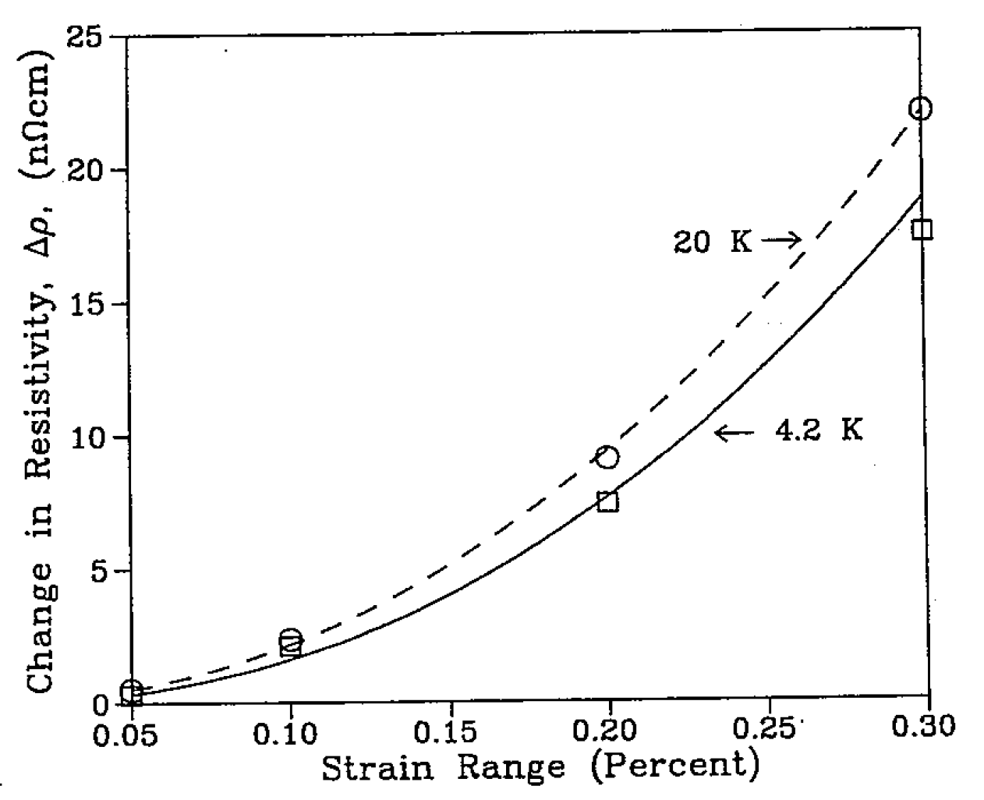
Cyclic Strain at 4.2K versus 20K in 4NAl (Ref. 7)
Change in Resistivity - Cyclic Strain (0.1%)
Influence of Strain Range (3000 Cy)

Slide 24
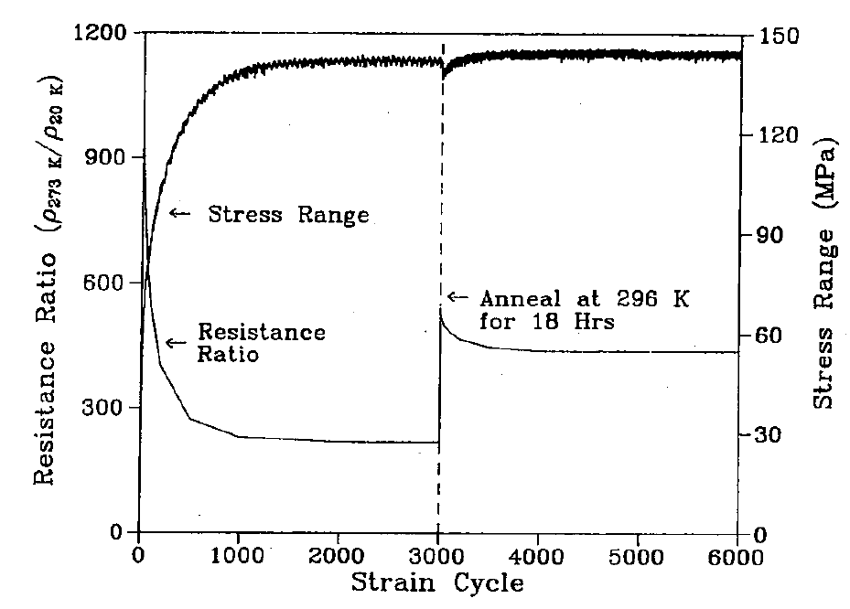
Annealing Effect on RRR and Stress Range at 20K
99.99 Al.
0.2% strain range.
Stress range is difference between max and min cyclic stress.
Note significant recovery by RT anneal.
Note modest degradation of resistivity for second 3000 cycles.
Reference 7.

Slide 25
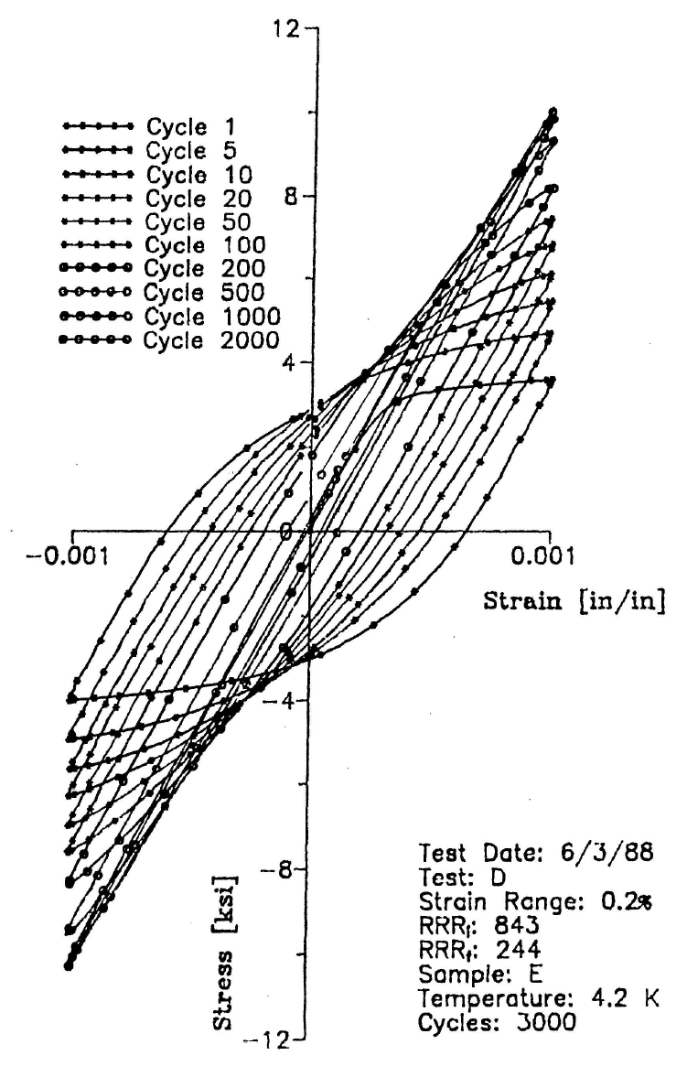
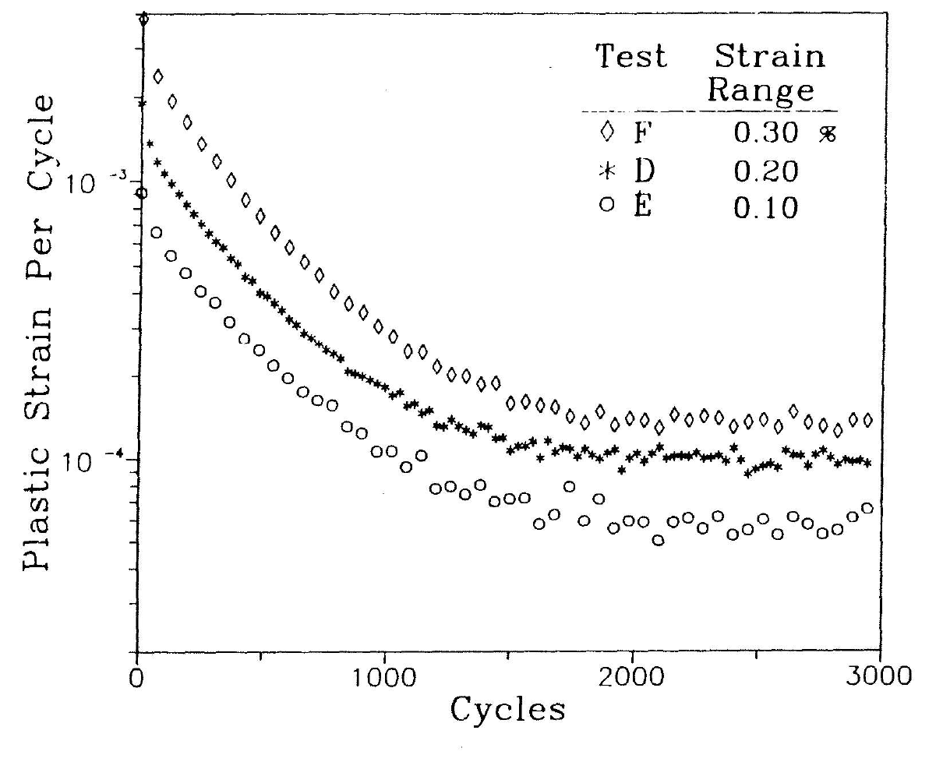
Plastic Strain per Cycle in ~850 RRR Al (Ref. 9)
Stress Strain Data (0.2%)
Plastic Strain per Cycle

Slide 26
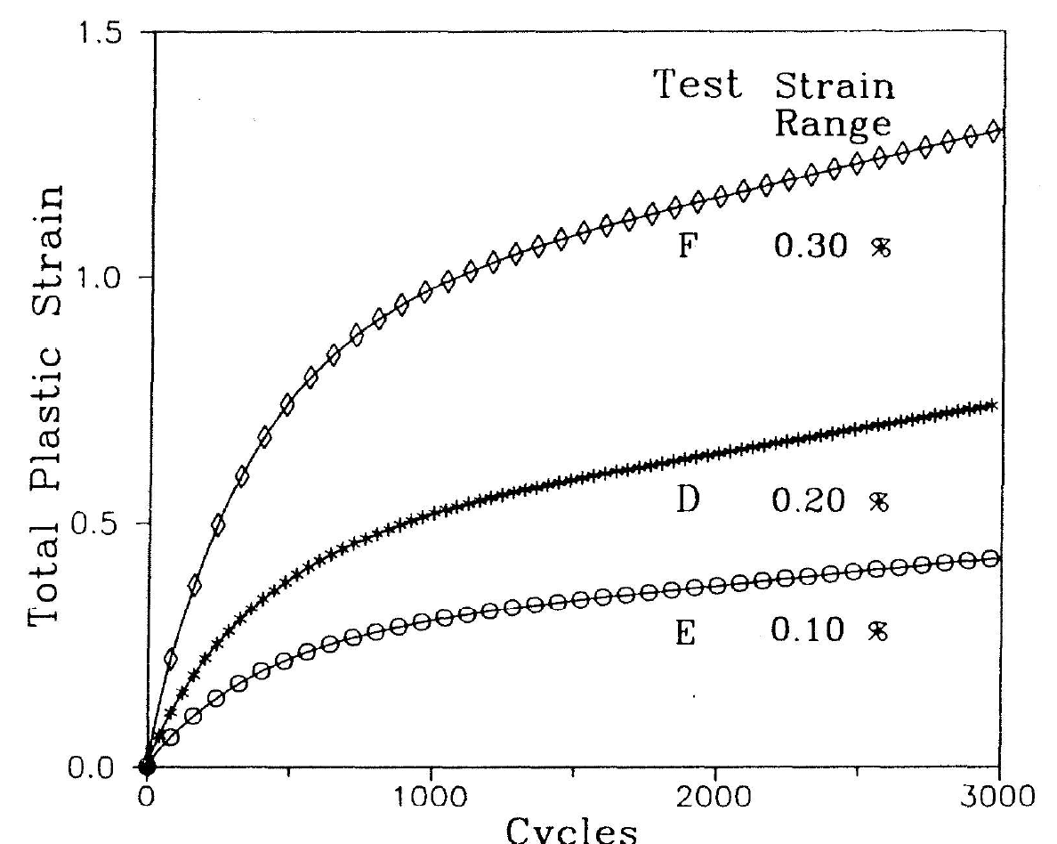
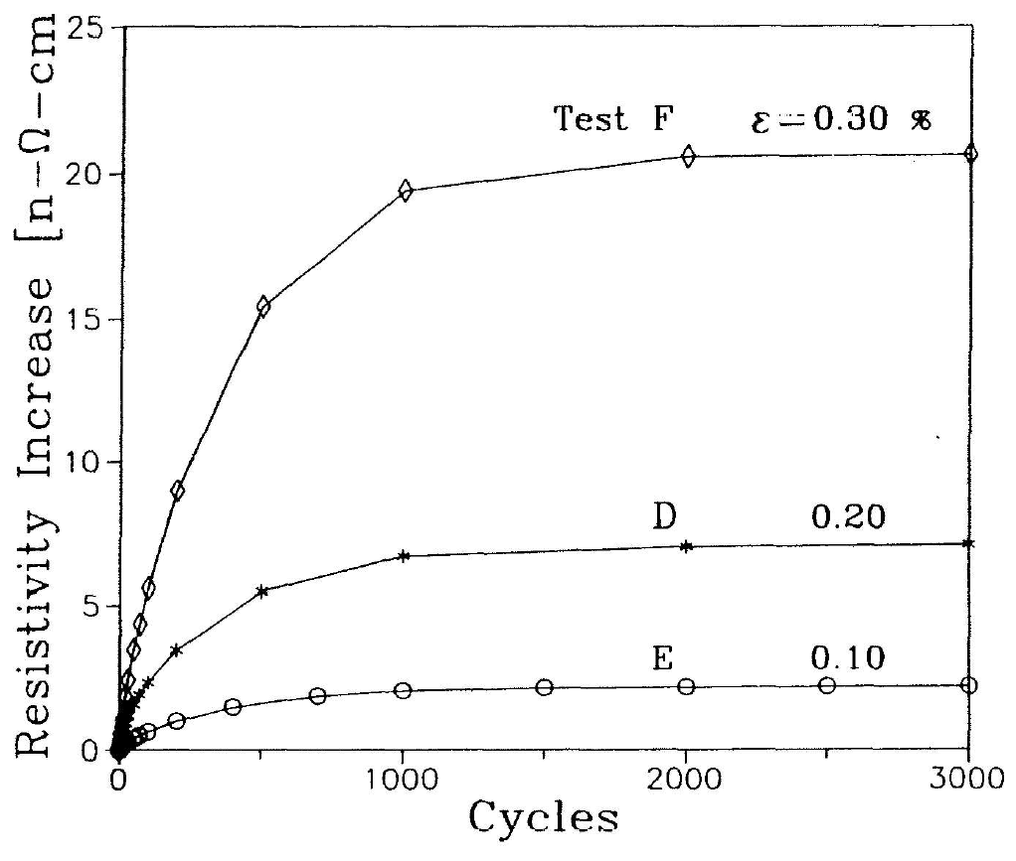
Cyclic Plastic Strain Accumulation (Ref. 9)
Versus Cycle Number
Associated Resistivity Increases

Slide 27
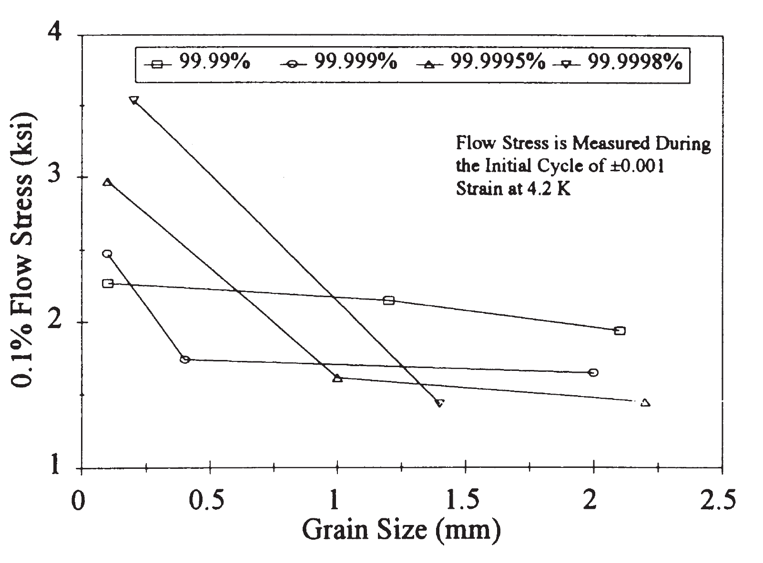
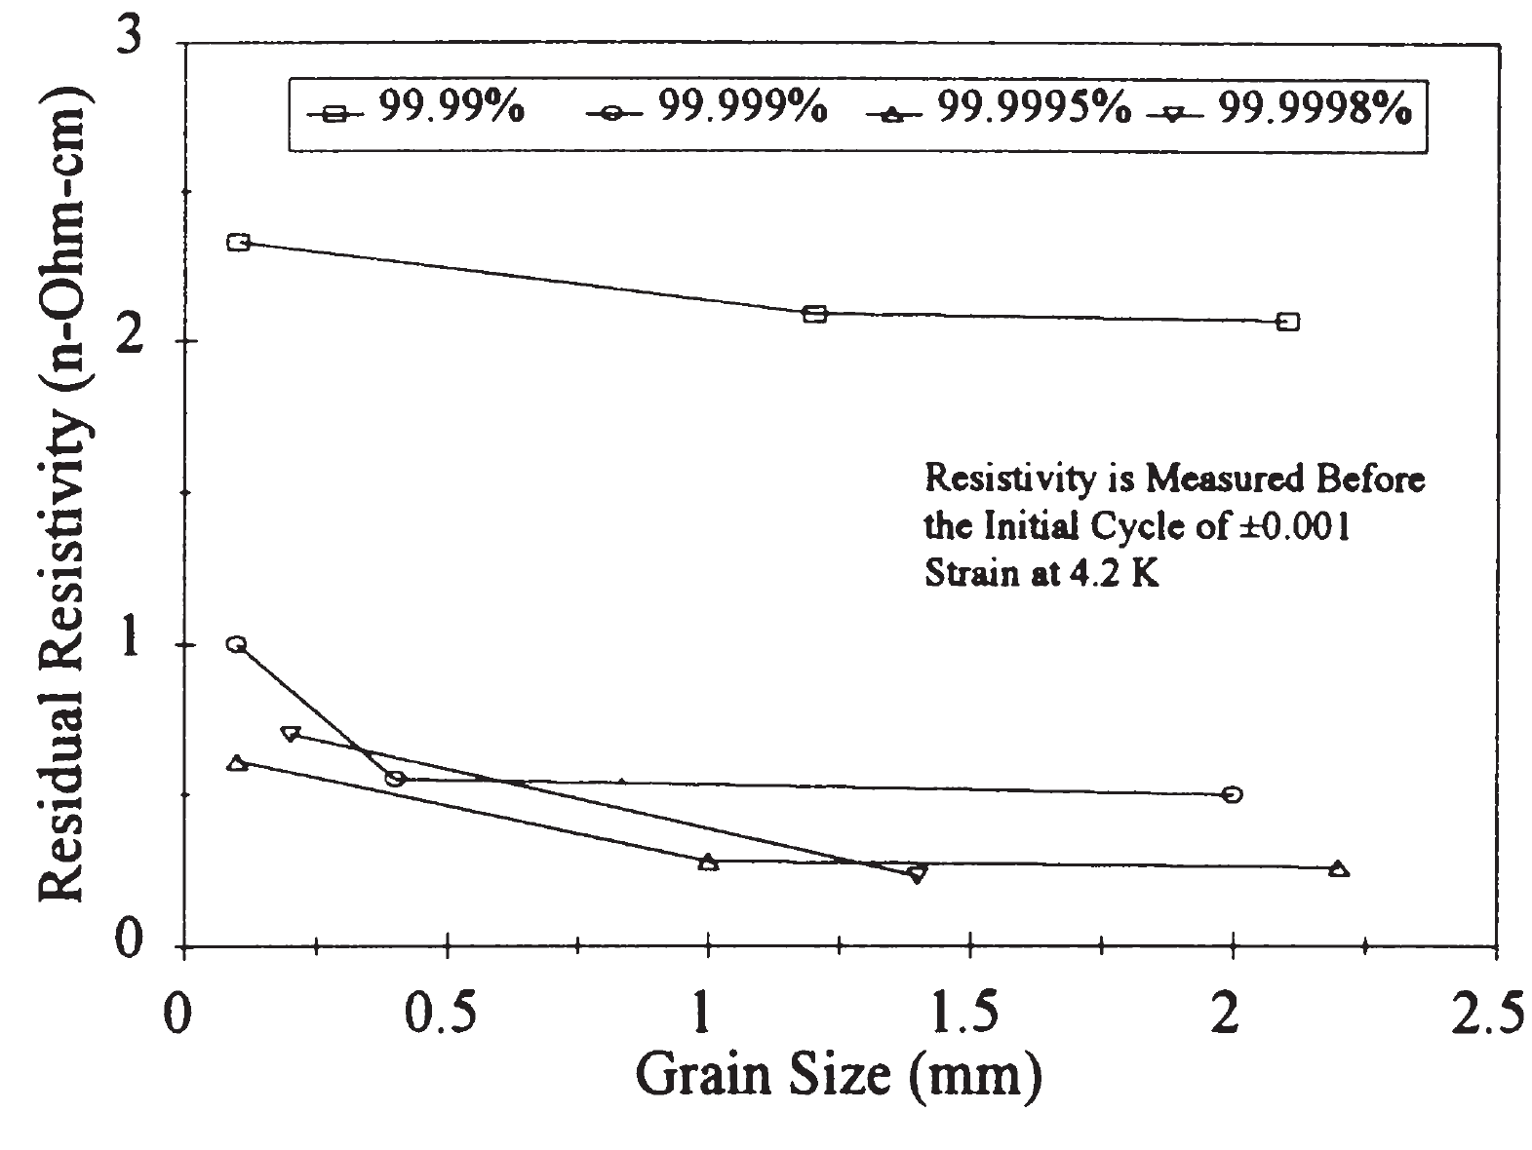
Grain Size Effect on Strength and Resistivity (Ref. 10)
Flow Stress v Grain Size
Resistivity v Grain Size

Slide 28
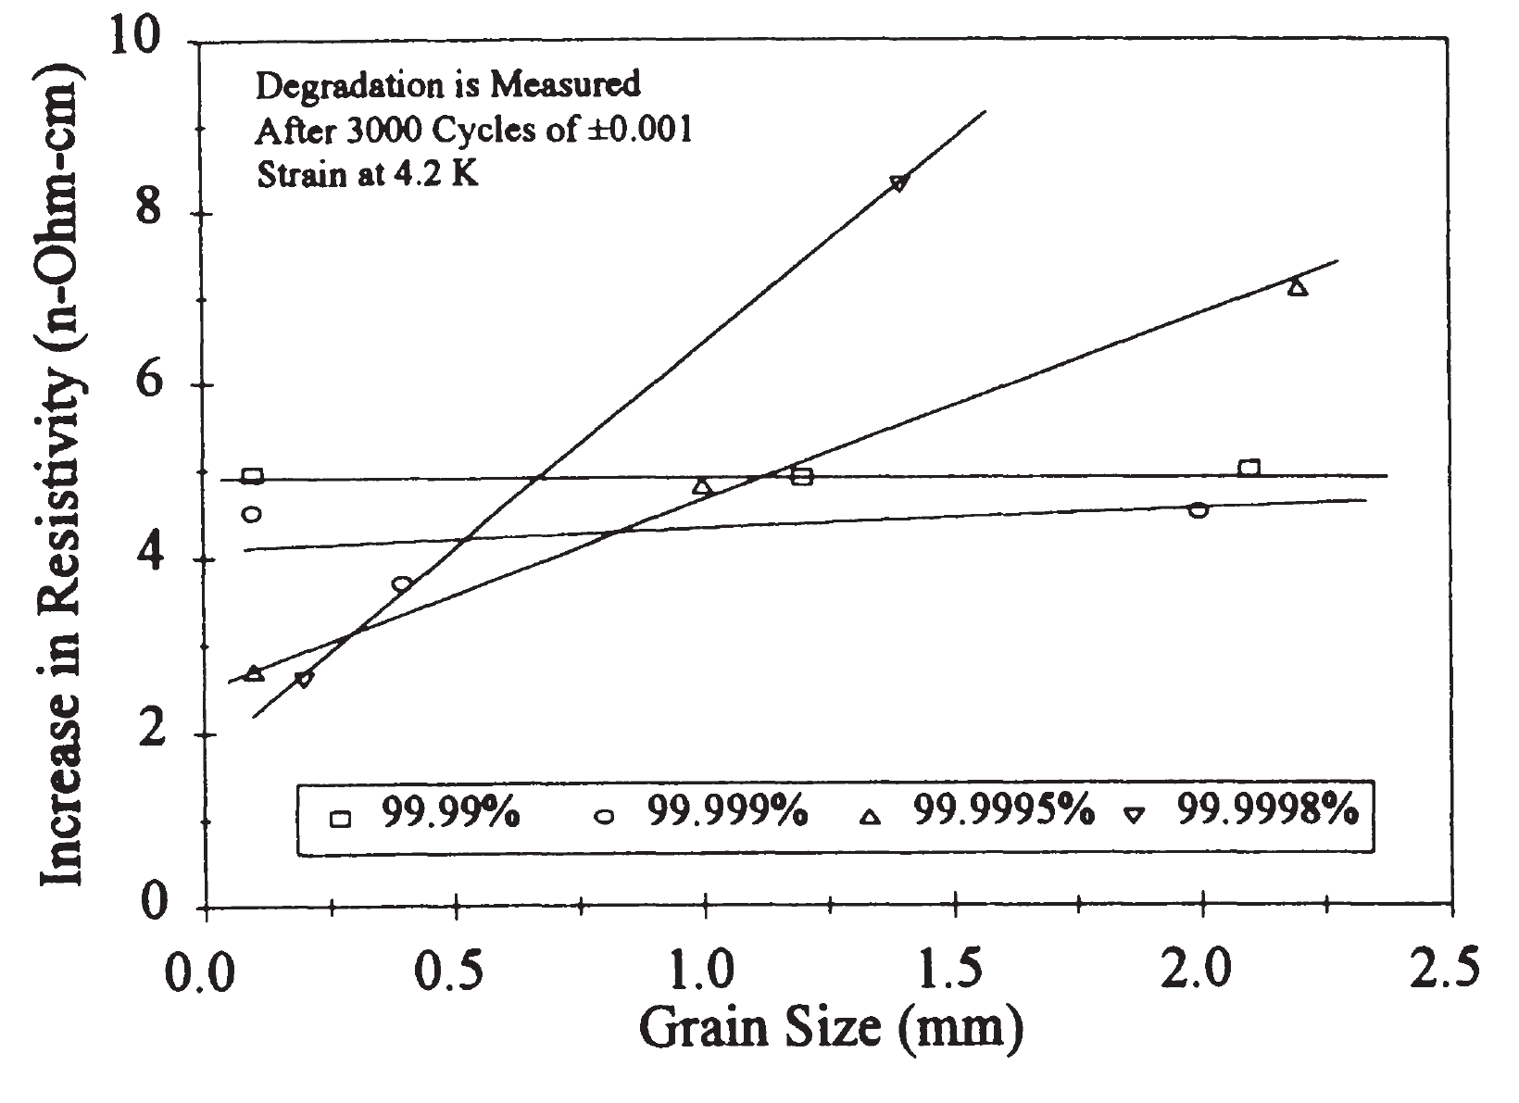
Grain Size and Purity Dependence on Resistivity Increase after Cyclic Strain at 4.2K
After 3000 cycles of 0.1% strain.
Lower purity shows little grain size (GS) dependance.
Higher purity shows higher resistivity increase as GS increases.
Reference 10.

Slide 29
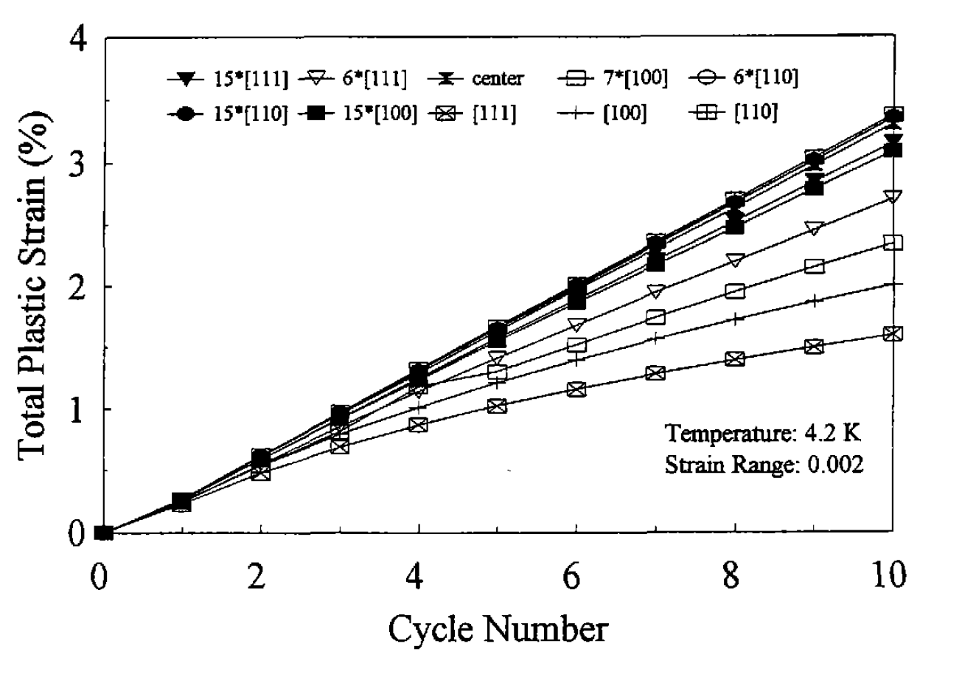
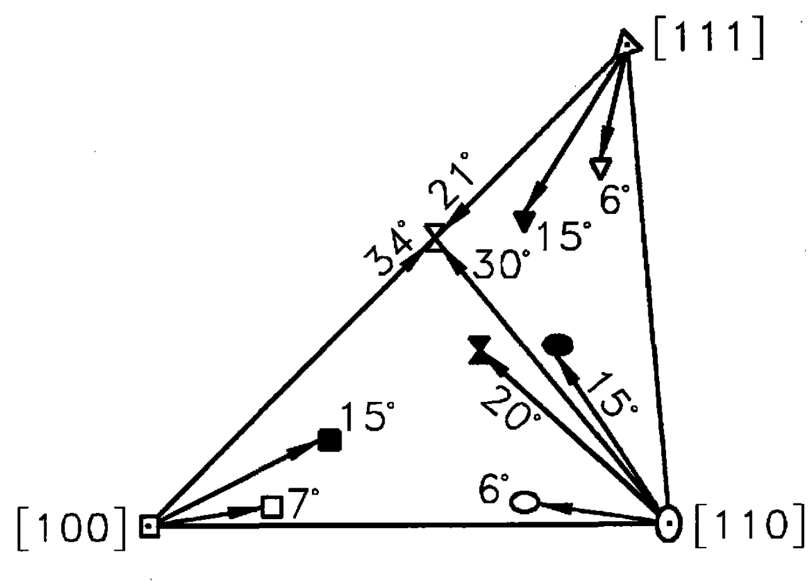
Pure Al Single Crystal Testing (Grain Orientation Effect)
Total Plastic Strain v Cycle Number
Orientations Tested

Slide 30
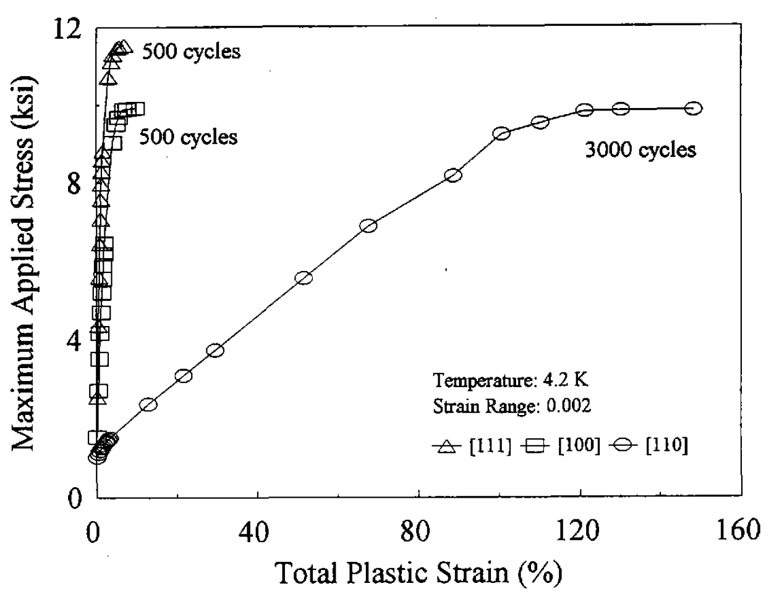
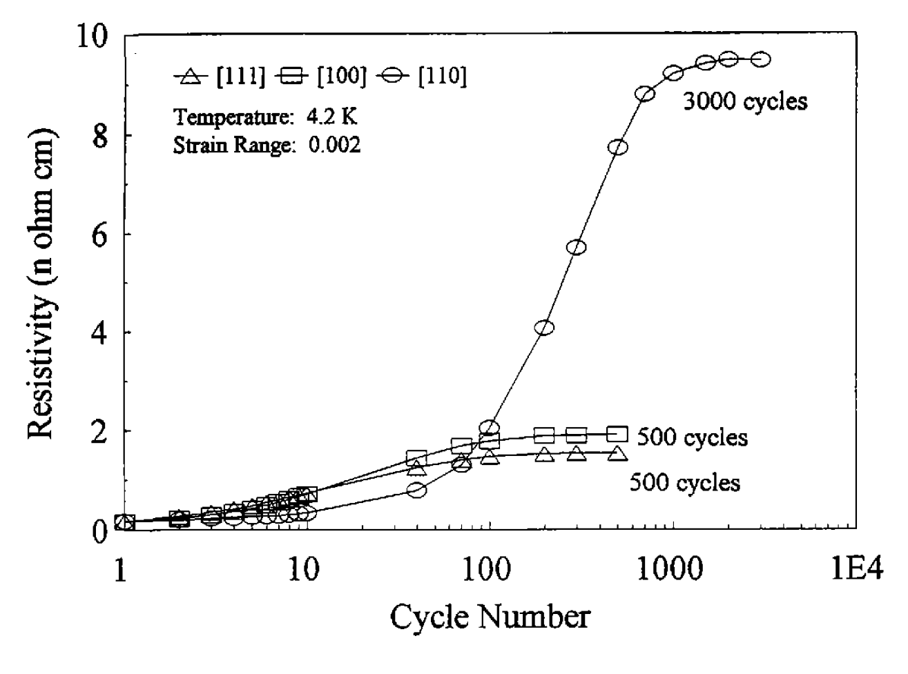
Total Plastic Strain and Resistivity Increase for Al Single Crystals Cycled at 4.2K
Mechanical Response
Resistivity Increase

Slide 31
Key Findings (Results) on Pure Al
Residual resistivity reaches saturation after 1000-1500 cycles of dynamic strain.
The resistivity increase from cyclic strain is linearly related to the cyclic strain range.
At “cyclic strain saturation”, pure Al becomes fully hard.
Strain induced resistivity increases are similar for the tension and compression cases.
Strain induced resistivity is slightly dependent on metal purity.
Strain induced resistivity is dependent on level of cold work.
Resistivity increases caused by strain at 4.2K decrease by 60-70% after exposure to room temperature for 10-20 minutes.
Strain at 20K causes a resistivity increase slightly larger than similar strain at 4.2K.
Grain refinement leads to lower levels of strain induced resistivity degradation.
The cyclic strain behavior of <111> and <100> textures show less resistivity increase than the <110> texture.
Resistivity degradation in composite wires can exceed that in monolithic Al wire.
Strain induced resistivity in OFHC Cu exceeds that of pure Al.

Slide 32
Conclusions
Factors that will improve the strain-resistivity behavior of pure Al (and other pure metals like Cu) cryo-conductors:
  Higher purity
  Grain refinement
  Cold work
  Room temperature annealing after low temperature strain
  <111> and <100> textures
Strain-resistivity tolerance in Al can be improved by optimizing the tradeoffs between the variables mentioned above for a particular strain environment.
A question arises: What about impurity element or type? Might some be better than others for strain tolerance?

Slide 33
References
J.T. Gehan, Total Plastic Strain and Electrical Resistivity in high purity aluminum cyclically strained at 4.2K, MS Thesis Texas A&M University 1988.
K.T. Hartwig, G.S. Yuan, and P. Lehmann, The Effects of Low Temperature Fatigue on the RRR and Strength of Pure Aluminum, IEEE Trans. on Magnetics, Vol. 21, No. 2, pp 161-164, March 1985.
P. Lehmann, G.S. Yuan, and K.T. Hartwig, Grip for Fatigue Testing Pure Aluminum, Cryogenics 25, pp 164-165, 1985.
K.T. Hartwig, G.S. Yuan and P. Lehmann, Strain Resistivity at 4.2 K in Pure Aluminum, Adv. Cryo. Engr. Materials, Vol. 32, pp. 405-412 (1986).
G.S. Yuan, P. Lehmann and K.T. Hartwig, The Effects of Prestrain on Low Temperature Fatigue Induced Resistivity in Pure Aluminum, Adv. Cryo. Engr. Materials, Vol. 32, pp. 413-419 (1986).
K.T. Hartwig and G.S. Yuan, Energy Loss, Anisotropy, Magneto-resistivity and Recovery in Aluminum Strained at 4.2 K, IEEE Trans. on Magnetics, Vol. MAG-23, No. 2, pp 1409-1412, March 1987.
K.T. Hartwig, A. Lumbis and J. Roelli, “Cyclic Strain Resistivity in Pure Aluminum at 20 K, Adv. Cryo. Engr. Materials, Vol. 36A, pp. 725-732 (1990).
A. Lumbis, J. Roelli, D. Frutschi, J.T. Gehan and K.T. Hartwig, Cryo-conductor Materials Testing System, Adv. Cryo. Engr. Materials, Vol. 36A, pp. 701-708 (1990).
J.T. Gehan and K.T. Hartwig, Total Plastic Strain and Electrical Resistivity in High Purity Aluminum Cyclically Strained at 4.2 K, Adv. Cryo. Engr. Materials, Vol. 36A, pp. 717-723 (1990).
L.C. McDonald, K.T. Hartwig and H. Zou, Effects of Grain Size and Purity on Low Temperature Cyclic Strain Degradation of Stabilizer Aluminum, Adv. Cryo. Engr. Materials, Vol. 42, pp. 1057-1062 (1996).
H. Zou, Electrical and mechanical studies of high purity aluminum single crystals at 4.2K under cyclic strain, MS Thesis Texas A&M University, 1995.
K.T. Hartwig and R. DeFrese, Mechanical and electrical testing on composite aluminum cryoconductors, Adv. Cryo. Engr. Materials, Vol 36, pp709-715, 1990.
F.R. Fickett, Aluminum 1. A review of resistive mechanisms in aluminum, Cryogenics, Vol. 11, pp. 349-367, October 1971.

Slide 34
Thank you for your attention.
I’d be happy to take questions.

Slide 35
EXTRA Slides

Slide 36
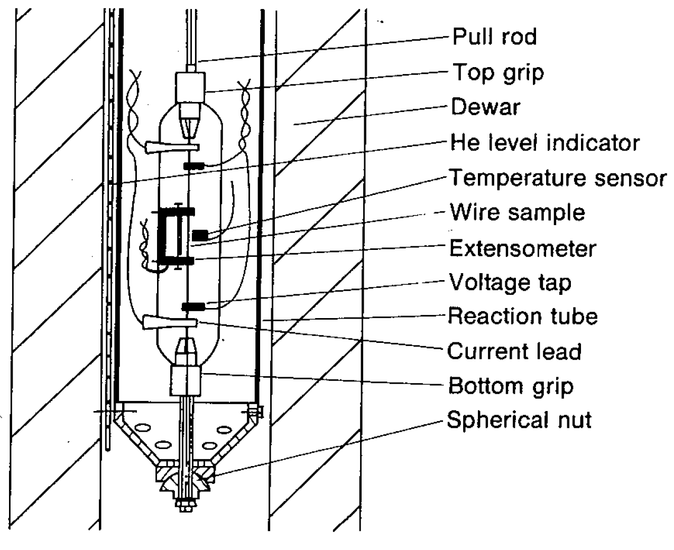
What About Composite Conductors?
Test Setup
Wire diameter 0.74 or 1.22 mm.
4 or 19 filaments of 99.999 Al in Al8Fe4Ce matrix.
Volume fraction Al ~50%.
Composite RRR(4.2K) 340-800.
Composite RRR(20K) 259-500.
Cyclic testing under load/stress control.
Reference 12.

Slide 37
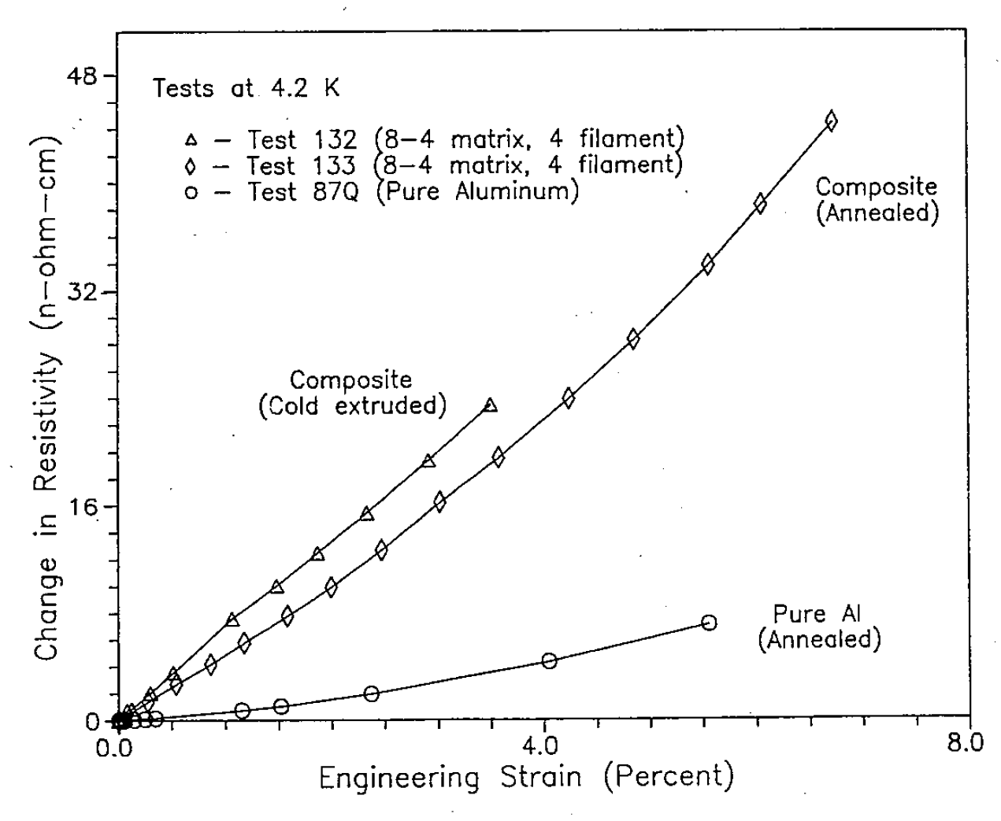
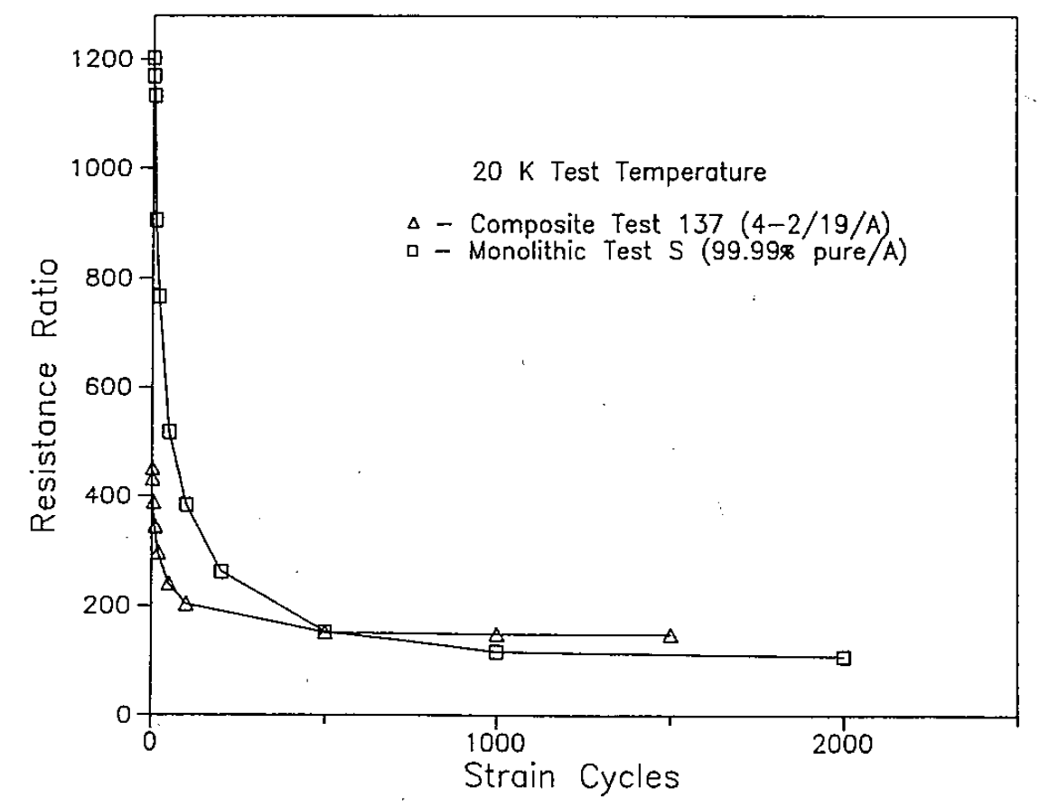
Strain Testing on Al Composite Conductor
Resistivity v Strain at 4.2K
Resistivity v Strain Cycles at 20K

Slide 38
Temperature Dependent Resistivity of Al
ρ(0K) ~ 0.00 nΩcm
ρ(T>150K) ∝ T
ρ(T~40K) ∝ T⁵
ρ(T<10K) ∝ T²-T³
ρ(4.2K) for 1000 RRR Al ≤ 1%
ρ(272.15K) + 2.48 ± 0.002 µΩcm

Slide 39
Vacancy (ρ_{v}) and Dislocation (ρ_{d}) Contributions to Resistivity
For Vacancies ρ_{v}(4K) = 2.6 ± 0.5µΩcm/at%
(Not temperature dependent;
removed by RT annealing.)
For Dislocations ρ_{d} = 0.2-0.9x10⁻¹⁹ Ωcm³
(Depends on temp.)
ρ_{d}(4K) = 2x10⁻¹⁹ Ωcm³
(Need to multiply by dislocation
density to get ρ.)
Ref. 13.

Slide 40
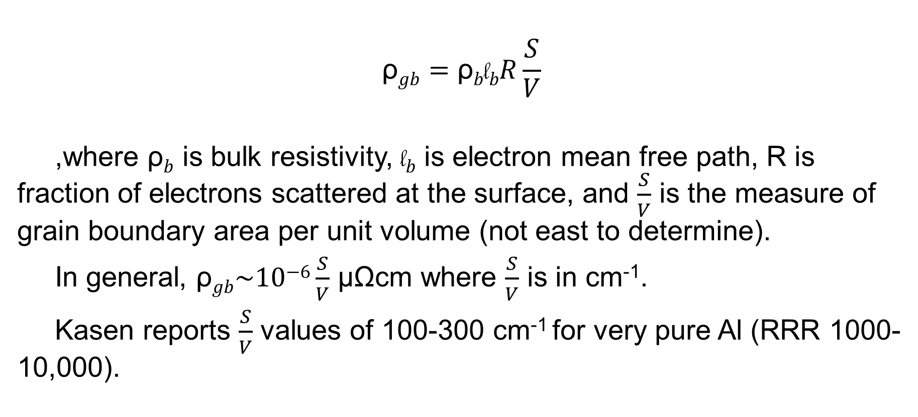
Grain Boundary Resistivity
$$\text{ρ}gb=\text{ρ}b\text{l}bR\frac{S}{V}$$
,where $\text{ρ}b$ is bulk resistivity, $\text{l}b$ is electron mean free path, R is fraction of electrons scattered at the surface, and $\frac{S}{V}$ is the measure of grain boundary area per unit volume (not east to determine).
In general, $\text{ρ}gb\sim \text{10}\text{−6}\frac{S}{V}$ µΩcm where $\frac{S}{V}$ is in cm⁻¹.
Kasen reports $\frac{S}{V}$ values of 100-300 cm⁻¹ for very pure Al (RRR 1000-10,000).

Slide 41
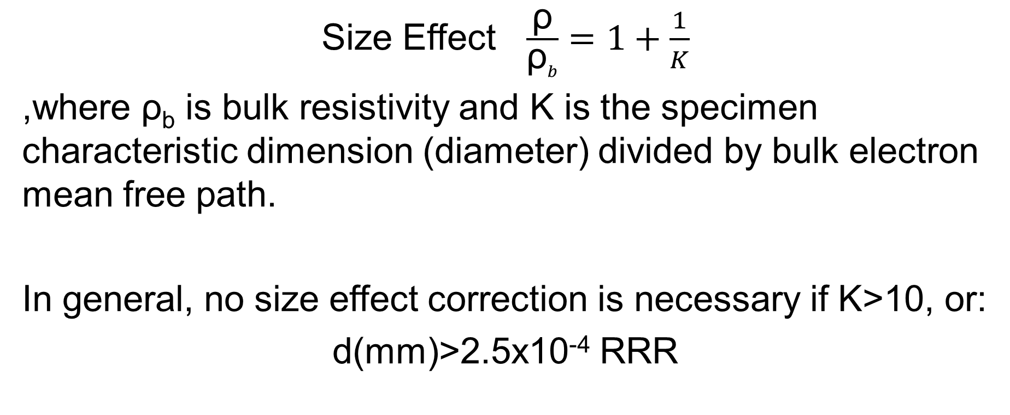
Size Effect Resistivity (ρ)
Size Effect $\frac{\text{ρ}}{\text{ρ}b}=1+\frac{1}{K}$
,where $\text{ρ}$_{b} is bulk resistivity and K is the specimen characteristic dimension (diameter) divided by bulk electron mean free path.
In general, no size effect correction is necessary if K>10, or:
d(mm)>2.5x10⁻⁴ RRR

Slide 42
Presentation Roadmap
Boom and Oberly Sponsors
More Acknowledgements
Motivation
Background
Specimen Descriptions
Stress and Strain Meas.
Resistivity Meas.
Experimental Procedures
Results (monotonic, cyclic, total plastic strain, purity, grain size, crystal orientation)
Summary of Results
Conclusions
References
Resistivity Contributions (if interest)

