Slide 1
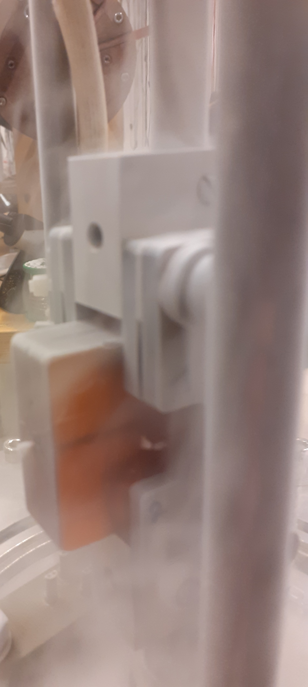
Relation between strain energy release rate and heat generated at cryogenic temperatures
the case for CTD-101K epoxy magnet impregnant
to improve understanding of stability of superconducting magnets
Jan van Steenlandt, Anna Kario, Simon Otten, Sander Wessel, Laurent Warnet, Hans van Oort and Herman ten Kate
University of Twente, The Netherlands, May 20, 2025.
1

Slide 2
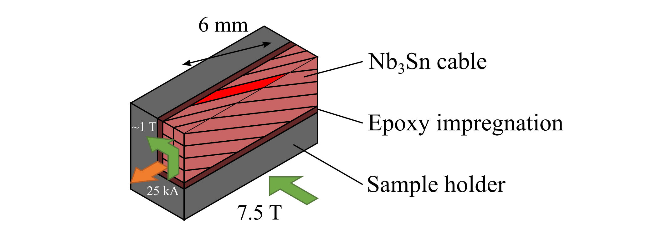
Why heat and strain energy release rate?
Stability of Nb₃Sn superconducting magnet windings highly depends on the type of magnet impregnant [1]
How to improve this stability?
Possible explanation: heat generated during fractures of the impregnant in the vicinity of Nb₃Sn, how much energy it takes to propagate?
How to quantify this?
Cable current [kA]
Limit of short strands
Current ramp number [-]
Notes:
The training is magnet architecture specific, in this case I show an example for CCT magnets

Slide 3
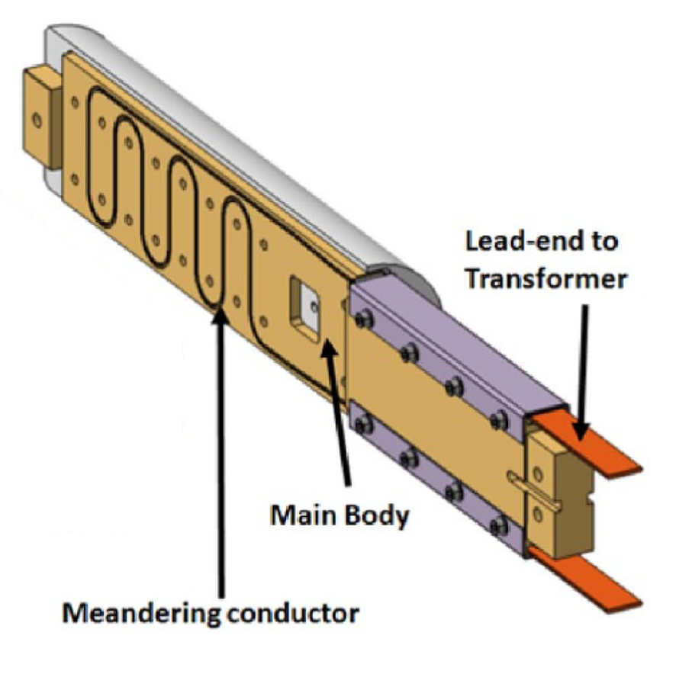
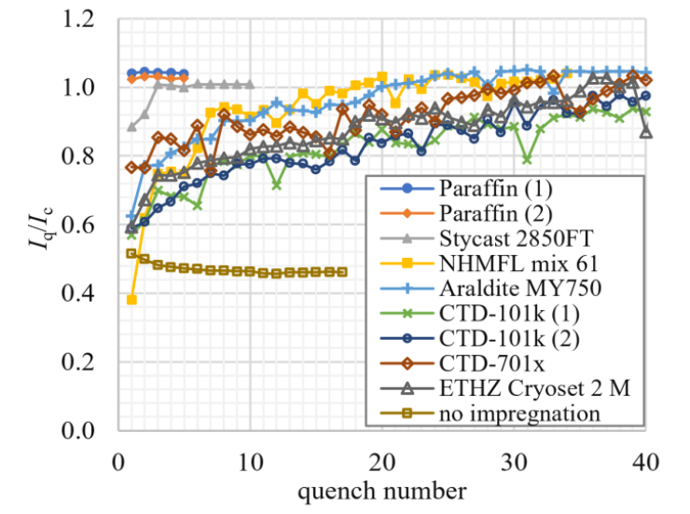
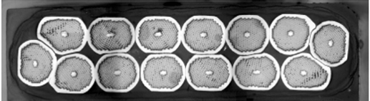
Motivation - Nb₃Sn cable/impregnants training study at Twente and PSI
BOX facility sample holder.
470 mm
BOX (Bonding Experiment) = small scale cable test facility to investigate different impregnants and surface treatments.
So far: large spread in training curves with pure epoxy resin impregnants and surface treatments, but also reduced training for particle filled epoxy resin and paraffine….
Trying to understand at strand level, interfaces with resin.
Training curves measured using the BOX facility.
Notes:
The training is magnet architecture specific, in this case I show an example for CCT magnets

Slide 4
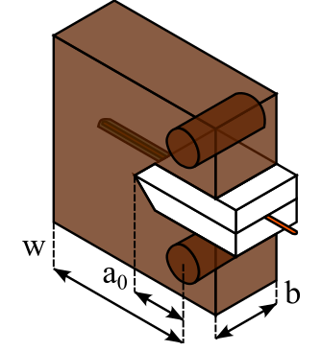

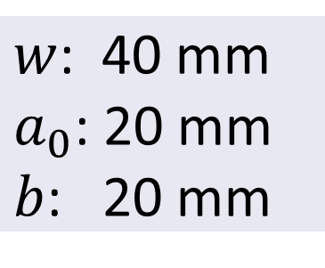
How did we measure this relation?
The release of mechanical energy is governed by the (critical) strain energy release rate $G$
→ Which fraction of $G$is dissipated and transferred into thermal energy?
How to measure this in a condition relevant for Nb₃Sn magnets?
We modified the so-called Compact Tension Double Cantilever Beam experiment (CT-DCB) based on ISO standard.
Included a representative dummy Nb₃Sn wire in the interface to see debonding at its surface…..
$w$: 40 mm
$a_{0}$: 20 mm
$b$: 20 mm
Notes:
The training is magnet architecture specific, in this case I show an example for CCT magnets

Slide 5
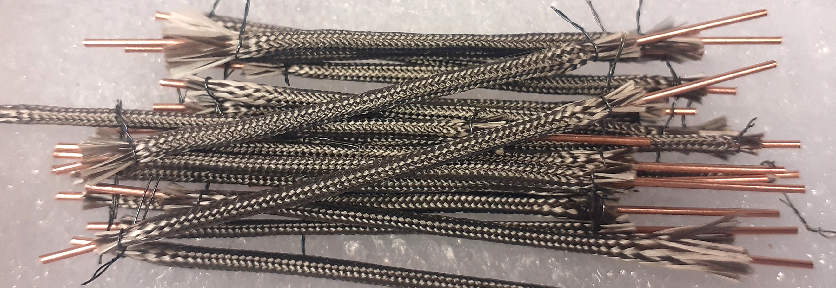
Preparations for the experiment
A working Nb₃Sn strand is represented as:
a 0.85 mm Ø copper tube
insulated with S-2 fiberglass
chemically treated with cabling lubricant
heat treated at 665 °C in Ar atmosphere
positioned parallel to the crack propagation in its plane
the tube allows a temperature sensor close to the fracture.
Notes:
The training is magnet architecture specific, in this case I show an example for CCT magnets

Slide 6
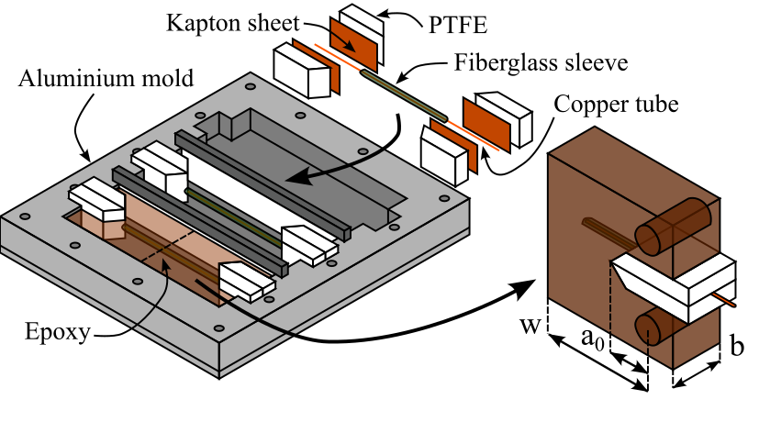
Making the sample…..
CTD-101K:
DGEBA* based
Common magnet impregnant
* diglycidyl ether of bisphenol A
Notes:
The training is magnet architecture specific, in this case I show an example for CCT magnets

Slide 7
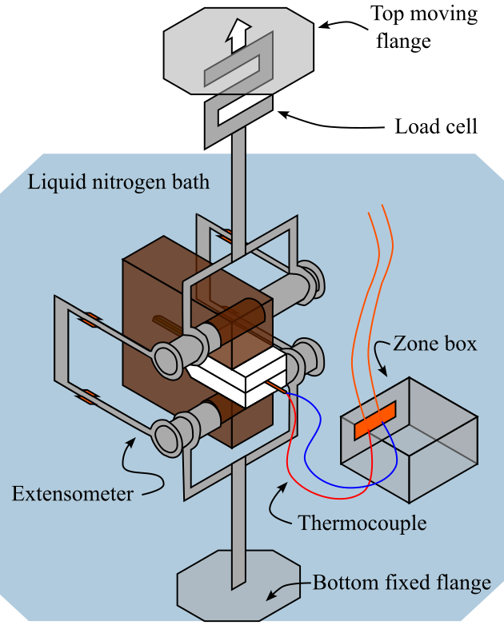
Setup of the experiment
Custom made cryogenic tensile stress-strain setup
Slowly submerged in liquid nitrogen at 77 K
Specimen loaded in mode I (⊥ to the crack plane)
Low loading rate of 1 µm/s
Measurands:
  Mechanical energy release
      Force load → S-type load cell
      Displacement → Cantilever extensometers
  Thermal heat load
      Temperature → type E thermocouple
  Setup compliance measured at cold with unnotched sample (solid block of CTD-101K)

Slide 8
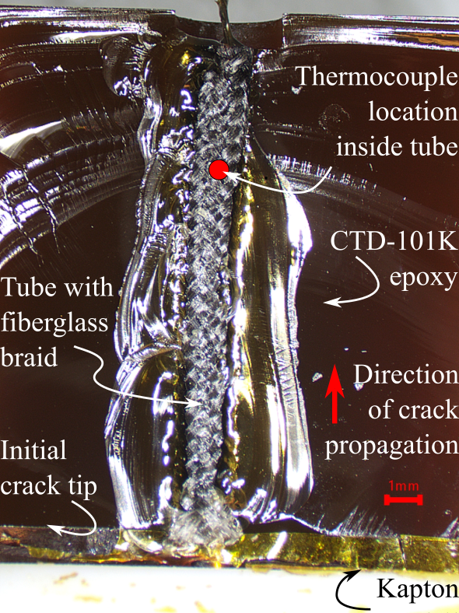
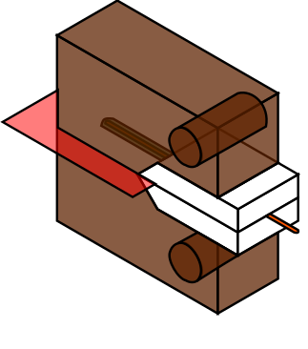
Examination of the sample after the test
Top view
Microscope image of the fracture surface after the test
Multiple crack arrest lines

Slide 9
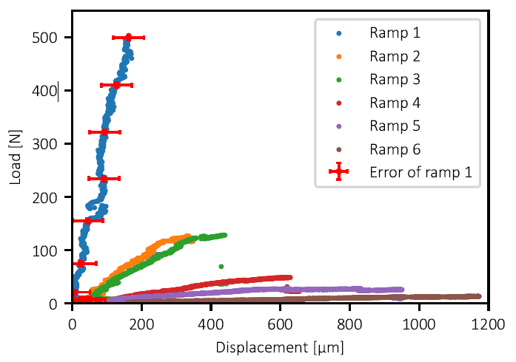
Measured load vs displacement at successive force ramps
Unstable crack propagation observed
Also with crack arrest
Several load cycles performed, each one shows decreasing slope
Only ramps 1, 3 and 4 show significant energy release and show a thermal response.
Error ± 1 α

Slide 10
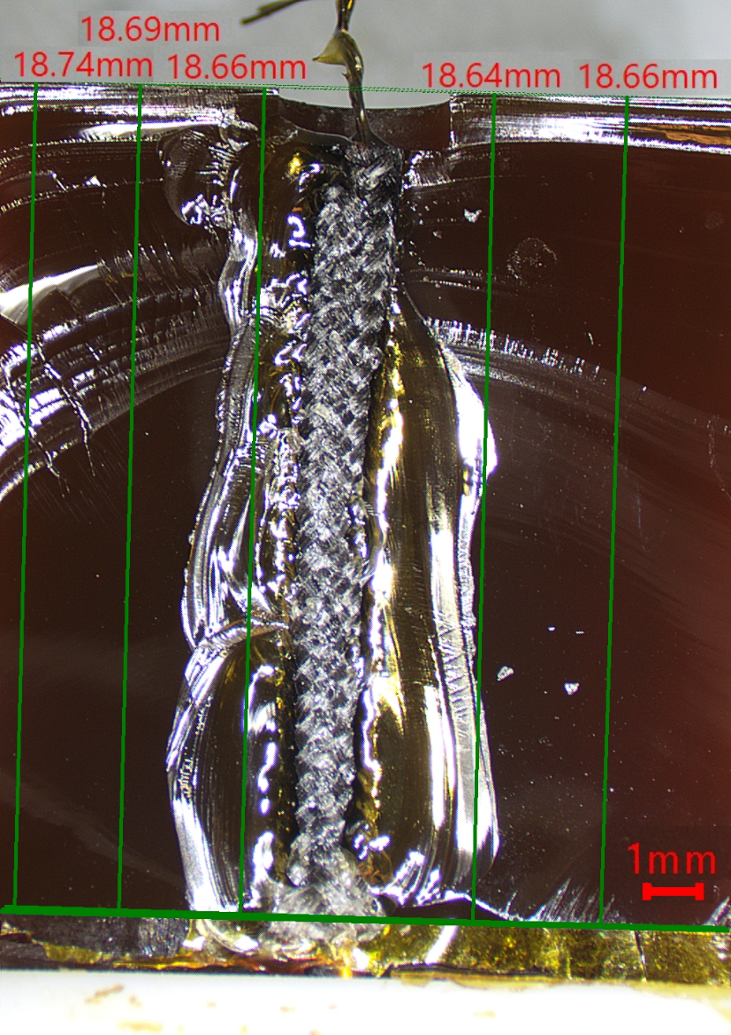
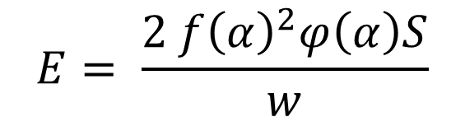
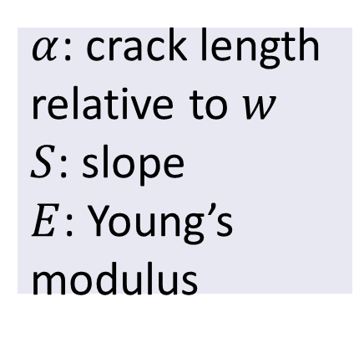
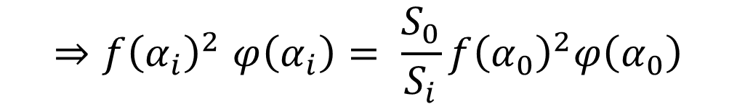
Determining the strain energy release
For determining the strain energy release rate, the crack length needs to be measured:
  Initial length measured on the fracture surfaces after test
  Crack length during each ramp based on slope and calculated using the compliance method:
  Calibration functions 𝑓𝜑 for CT-DCB specimens listed in the ISO standard [2].
$$E= \frac{2 {f\left(α\right)}^{2}φ\left(α\right)S}{w}$$
$α$: crack length relative to $w$
$S$: slope
$E$: Young’s modulus
Measured initial crack length at five locations using a microscope image of the fractured surfaces and digital image analysis software.
$${⇒f\left(α_{i}\right)}^{2}φ\left(α_{i}\right)= \frac{S_{0}}{S_{i}}{f\left(α_{0}\right)}^{2}φ\left(α_{0}\right)$$

Slide 11
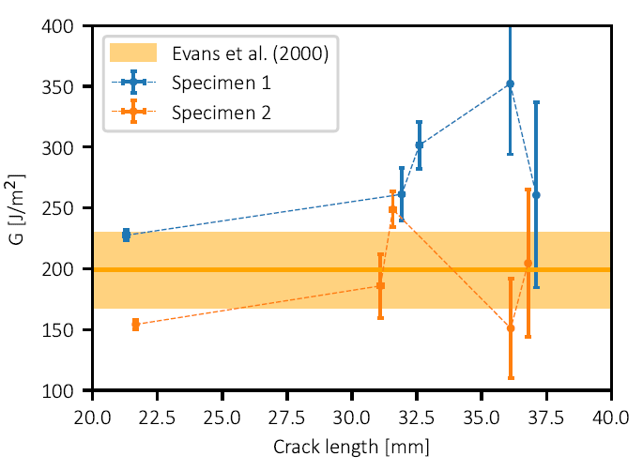

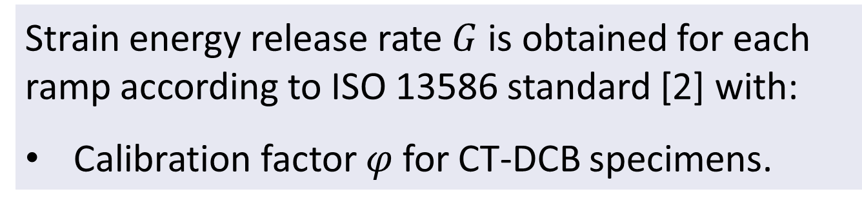

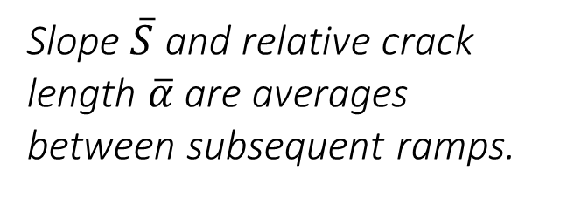
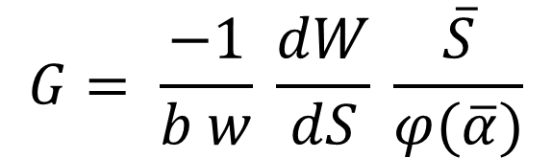
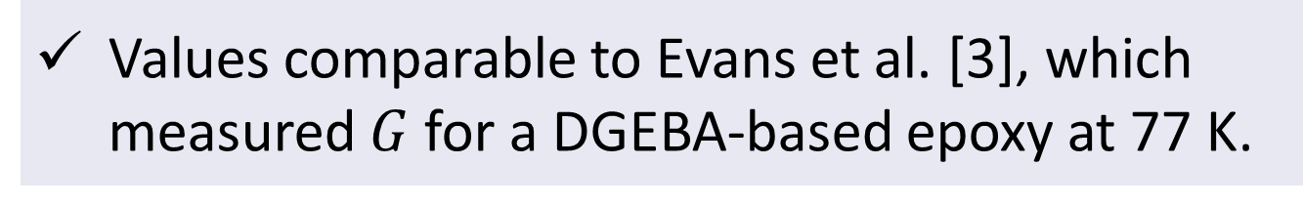
Measured strain energy release rate
Load [N]
$$G= \frac{−1}{b w} \frac{dW}{dS} \frac{\overline{S}}{φ(\overline{α})}$$
$$dW$$
$$dS$$
Slope $\overline{S}$ and relative crack length $\overline{α}$ are averages between subsequent ramps.
Displacement [μm]
Strain energy release rate $G$ is obtained for each ramp according to ISO 13586 standard [2] with:
Calibration factor 𝜑 for CT-DCB specimens.
Error ± 1 α
For two specimens & all ramps, we found:
G = 230 ± 30 J/m²
Values comparable to Evans et al. [3], which measured $G$for a DGEBA-based epoxy at 77 K.

Slide 12
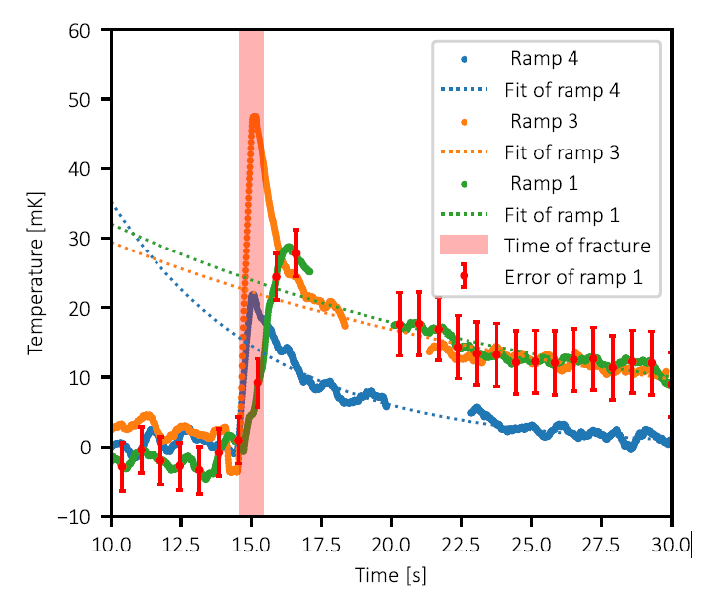
Measured temperature response due to cracking
Temperature rise in 10 to 50 mK range
Temperature rise is initially steep
Sharper for ramp 3, where the crack tip was located closer to the thermocouple in the tube
The Cu tube has a uniform temperature after 0.5 s followed by an exponential decay during cooldown.
Error ± 1α

Slide 13
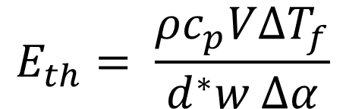
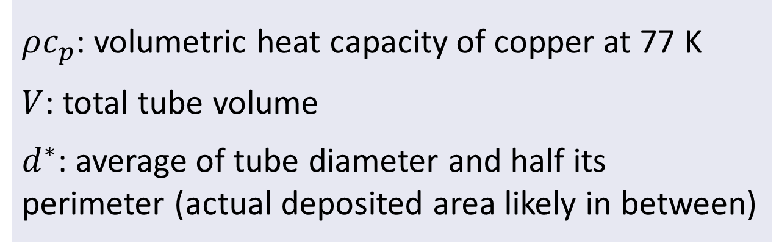



Results for the thermal energy release
Specimen | Ramp | $∆T$[mK] | $E_{th}$[J/m²]
1 | 1 | 24 ± 5 | 90 ± 30
 | 3 | 22 ± 4 | 260 ± 80
 | 4 | 15 ± 4 | 600 ± 220
2 | 1 | 24 ± 4 | 100 ± 30
 | 3 | 24 ± 5 | 220 ± 80
Temperature [K]
$$E_{th}= \frac{ρc_{p}V{∆T}_{f}}{d^{∗}w ∆α}$$
$${∆T}_{f}$$
$$t_{f}$$
Time [s]
Total surface thermal heat load deposited during each fracture event in J/m²:
First ramp close to half the measured strain energy release rate (230 J/m²) (two surfaces!)
Deviates for later ramps, likely due to a non-uniform crack front.
$ρc_{p}$: volumetric heat capacity of copper at 77 K
$V$: total tube volume
$d^{∗}$: average of tube diameter and half its perimeter (actual deposited area likely in between)
Evidence of 100% conversion

Slide 14
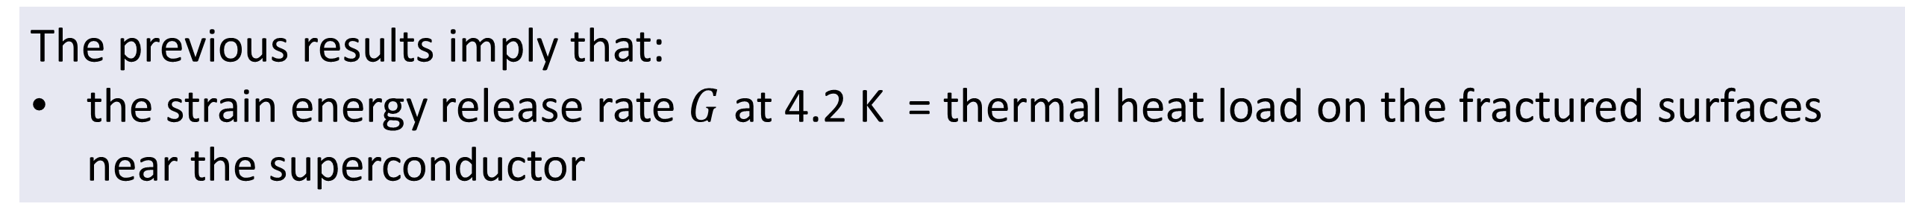
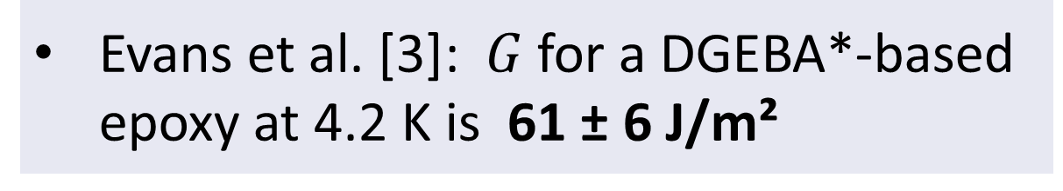
Implications for the stability of impregnated superconducting coils
The previous results imply that:
the strain energy release rate $G$ at 4.2 K = thermal heat load on the fractured surfaces near the superconductor
Sufficient heat load to destabilize?
Case study: Nb₃Sn cable with 21 strands and 25 kA current in a background magnetic field of 7.5 T [1]
Length of most critical strand vulnerable to heat load
Evans et al. [3]: $G$for a DGEBA*-based epoxy at 4.2 K is 61 ± 6 J/m²
* diglycidyl ether of bisphenol A

Slide 15
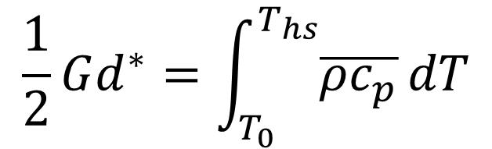

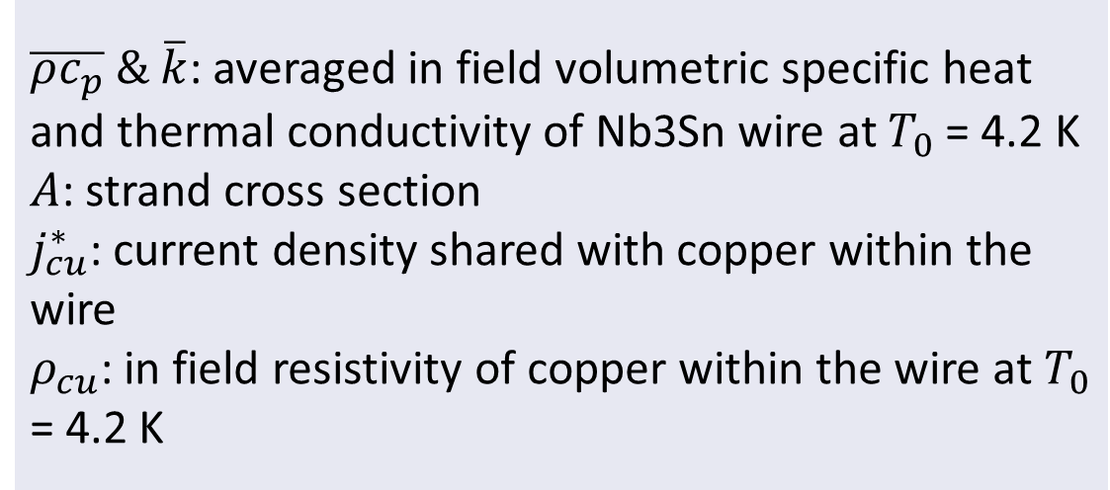
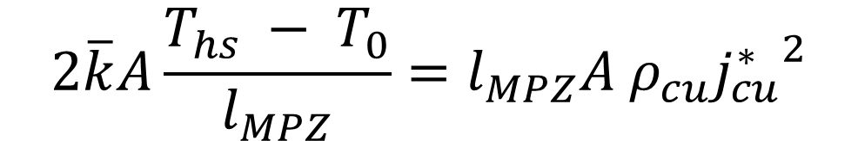
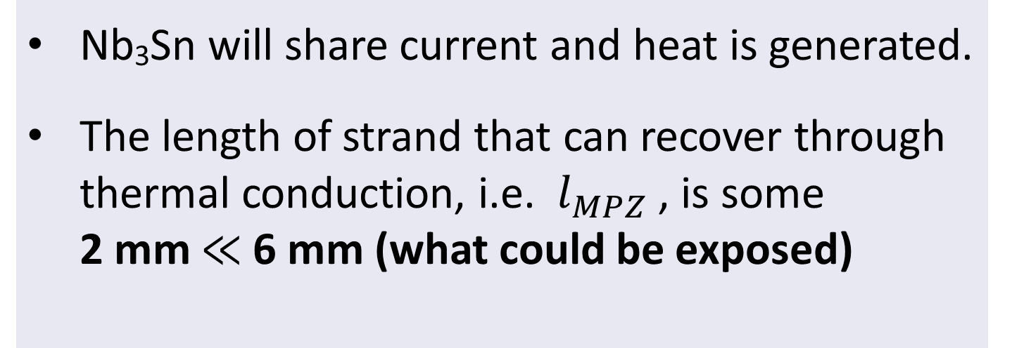
Stability model, method and results (simple model for illustration)
A $G$ of 61 ± 6 J/m² leads to a hot spot temperature $T_{hs}$in Nb₃Sn wire of 11 K.
$$\frac{1}{2}Gd^{∗}=\int_{T_{0}}^{T_{hs}}{\overline{{ρc}_{p}}}dT$$
Derivation based on Wilson (1983) [4]
Nb₃Sn will share current and heat is generated.
The length of strand that can recover through thermal conduction, i.e. $l_{MPZ}$, is some 2 mm $≪$ 6 mm (what could be exposed)
$$2\overline{k}A\frac{T_{hs} − T_{0}}{l_{MPZ}}=l_{MPZ}A ρ_{cu}{j_{cu}^{∗}}^{2}$$
$\overline{ρc_{p}} \& \overline{k}$: averaged in field volumetric specific heat and thermal conductivity of Nb3Sn wire at $T_{0}$ = 4.2 K
$A$: strand cross section
$j_{cu}^{∗}$: current density shared with copper within the wire
$ρ_{cu}$: in field resistivity of copper within the wire at $T_{0}$ = 4.2 K
More than sufficient to destabilize the Nb₃Sn cable !

Slide 16
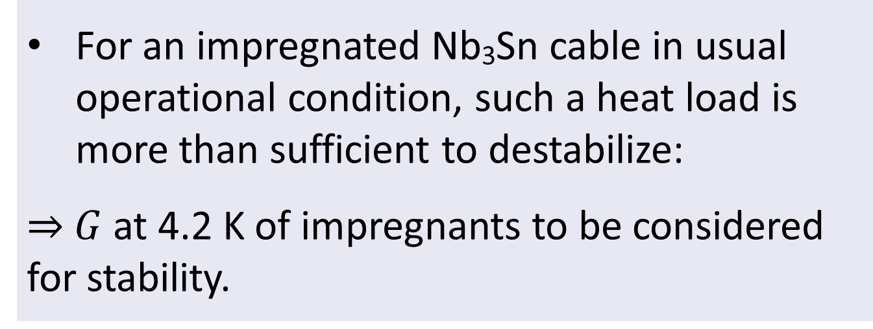
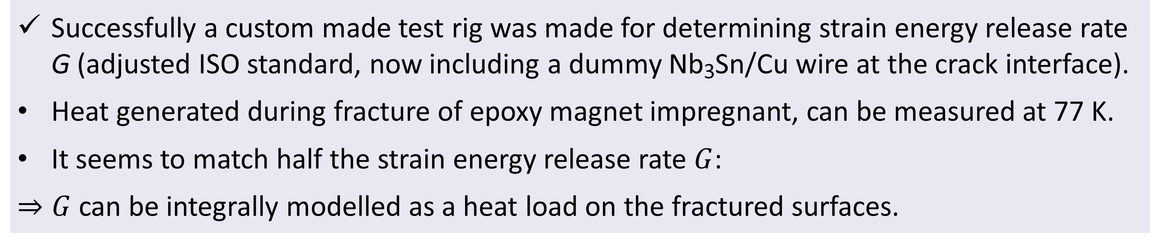
Conclusion
Successfully a custom made test rig was made for determining strain energy release rate G (adjusted ISO standard, now including a dummy Nb₃Sn/Cu wire at the crack interface).
Heat generated during fracture of epoxy magnet impregnant, can be measured at 77 K.
It seems to match half the strain energy release rate $G$:
$⇒G$ can be integrally modelled as a heat load on the fractured surfaces.
For an impregnated Nb₃Sn cable in usual operational condition, such a heat load is more than sufficient to destabilize:
⇒ $G$ at 4.2 K of impregnants to be considered for stability.

Slide 17
References
[1] Daly, M. et al. (2021). BOX: An efficient benchmark facility for the study and mitigation of interface-induced training in accelerator type high-field superconducting magnets. Superconductor Science and Technology, 34(11). https://doi.org/10.1088/1361-6668/ac2002
[2] S.N. (2018). Plastics — Determination of fracture toughness (GIC and KIC) — Linear elastic fracture mechanics (LEFM) approach. ISO 13586. Second edition.
[3] D. Evans and Z. Zhang. (2000). The Work of Fracture of Epoxide Resins at Temperatures to 4K. Advances in Cryogenic Engineering Materials, Springer, Boston, MA.
[4] M. N. Wilson. (1983). Superconducting Magnets. Oxford University Press.

