Slide 1
Development of Hydrogen-Filled Traveling-Wave Thermoacoustic Engine for Powering Pulse-Tube and Traveling-wave Refrigerators
C3Or3B-04
Matthew Shenton, Professor Jacob Leachman, Professor Konstantin Matveev
Cryogenic Engineering Conference
Reno, Nevada
May 21st, 2025
Need for Cryogenic Hydrogen Cooling
Thermoacoustic Theory
Traveling-Wave Systems
Conclusions and Future Work

Slide 2
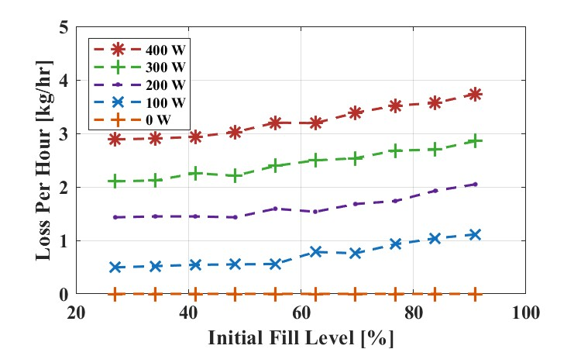
Zero Boil-Off LH2 Storage
Currently, storage tanks employ passive insulation but can maintain ~400 W of heat leak into the hydrogen.
3% of the mass of hydrogen in a tank is lost daily, resulting in about 130 kg of hydrogen per 4300 kg tank vented into the atmosphere [2].
The financial impact of these losses estimated using the Department of Energy’s dispensed hydrogen cost of $8-$11/kg comes to about $1,300 per tank [3].
Parametric Study | Average Reduction (%) | Predicted Yearly Hydrogen Savings (kg) | Yearly Cost Savings ($)
Reliquefied boil-off vapor | 92 | ~17,000 | ~137,000
100% mass efficient extraction | 72 | ~13,500 | ~108,000
Reliquefied vapor return | 65 | ~12,000 | ~97,000
90% mass efficient extraction | 48 | ~8,800 | ~71,000
17.2kPa pressure decrease during venting | 29 | ~5,400 | ~43,000
Reclaimed superheated vapor | 21 | ~3,900 | ~31,000
Vented superheated vapor | 5.7 | ~1,067 | ~8,500
Capturing and reliquefying boil-off vapor saves ~$137k in hydrogen.
Reliquefying return vapor during transfers increases the savings by ~$100k.
Utilize cryogenic refrigerators (cryocoolers) to eliminate hydrogen boil-off and reliquefy gaseous losses.
[1] Appel K. Numerical Modeling of Liquid Hydrogen Storage Tanks for the Reduction of Boil-Off Losses [Thesis]. [Pullman]: Washington State University; 2024. [2] Zhang F, Zhao P, Niu M, Maddy J. The survey of key technologies in hydrogen energy storage. Int J Hydrogen Energy. 2016 Sep 7;41(33):14535–52. [3] Koleva M, Rustagi N. DOE Hydrogen and Fuel Cells Program Record Title: Hydrogen Delivery and Dispensing Cost [Internet]. 2020.

Slide 3
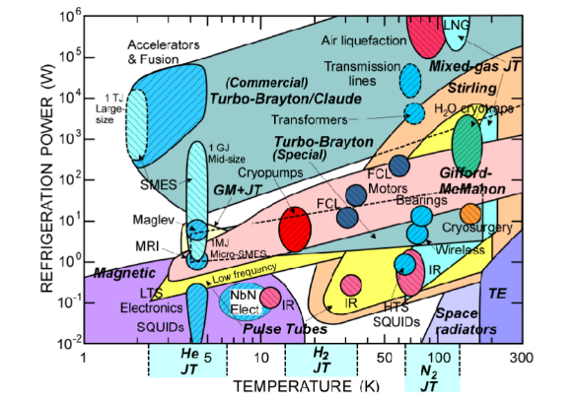
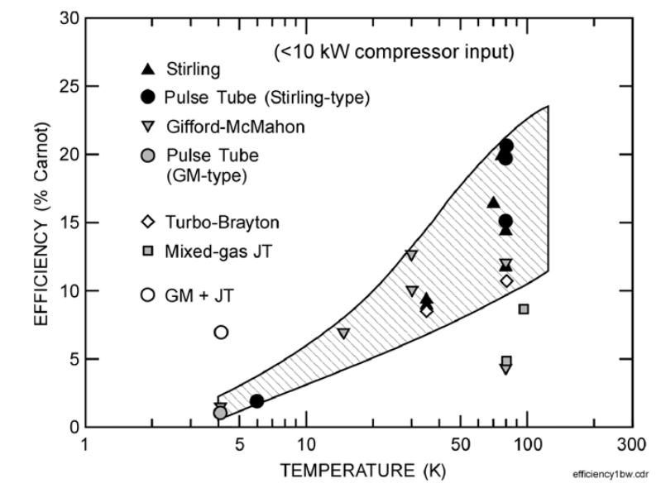
Need for Hydrogen Cryocoolers
Relevant hydrogen cooling cycles are needed between 50-1000 W and 15-35 K.
Scaling down Turbo-Brayton results in lower expander performance and higher expense.
Scaling up Gifford-McMahon and Stirling results in large regenerators with expensive materials, high maintenance, and low efficiency.
Market cryocoolers utilize ~12 kW compressors achieve cooling capacities on the order of 10-100 W with ~20% 2nd law efficiencies at 100 K.
Current configurations utilize moving components (rotary valves, displacers, etc.).
A robust cryocooler with an order of 10^2 cooling capacity to eliminate boil-off losses in LH2 storage vessels.
[4] Radebaugh, R. (2020). Review of Refrigeration Methods. https://trc.nist.gov/cryogenics/Papers/Review/2020-Review_of_Refrigeration_Methods.pdf
[5] Radebaugh, R. (2009). "Cryocoolers: the state of the art and recent developments." Journal of Physics: Condensed Matter 21(16): 164219.

Slide 4
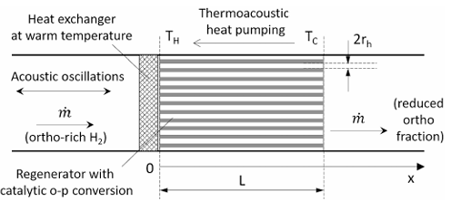
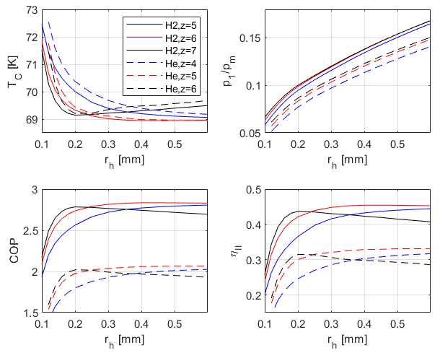
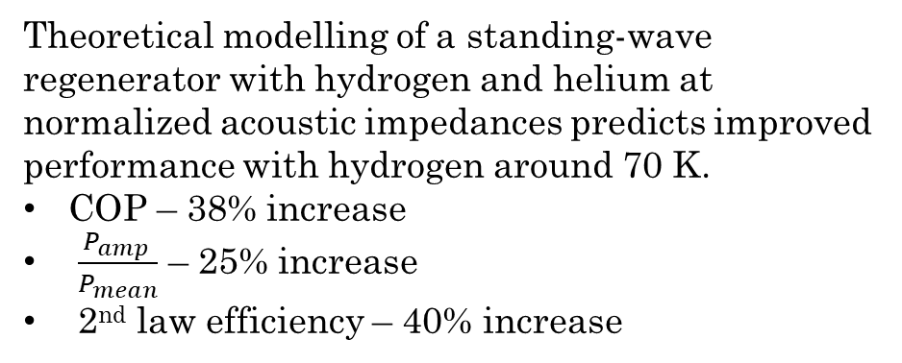
Development of a Hydrogen Cryocooler
Thermoacoustic oscillations are sound waves in piping networks of cryogenic systems driven by the large temperature gradients.
Oscillations inside porous solid structures (regenerators) result in significant heat transport from low to high-temperature regions, producing refrigeration [6].
Hydrogen thermoacoustic oscillations are an alternative driving mechanism with no moving parts.
[2]
Theoretical modelling of a standing-wave regenerator with hydrogen and helium at normalized acoustic impedances predicts improved performance with hydrogen around 70 K.
COP – 38% increase
$\frac{P_{amp }}{P_{mean}}$ – 25% increase
2nd law efficiency – 40% increase
[6] Swift GW. Thermoacoustics: A unifying perspective for some engines and refrigerators. Mellville, NY, USA: Acoustical society of America; 2003.
[7] Matveev KI. Unsteady model for standing-wave thermoacoustic engines. Journal of Non-Equilibrium Thermodynamics. 2010;35(2):85-96.

Slide 5
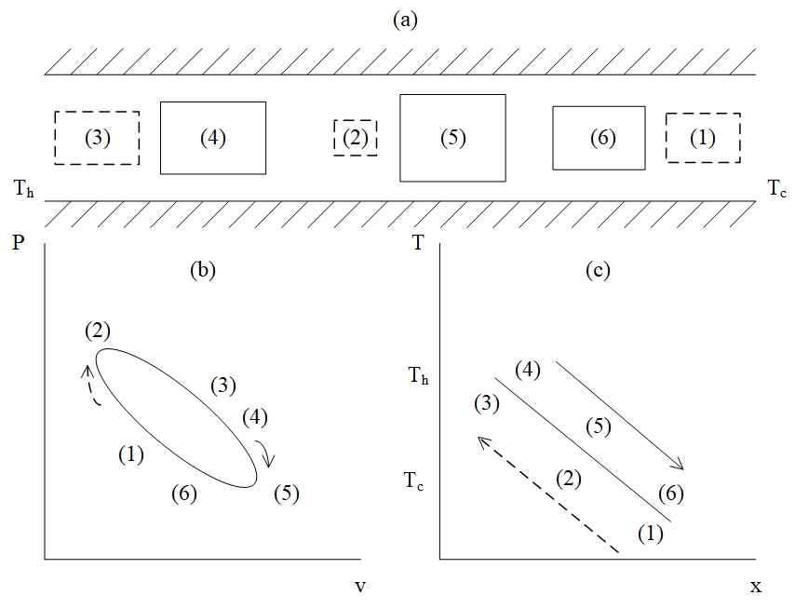
Thermoacoustic Systems: Traveling-Wave Engine
1 – 2: Particle is starting to traverse from the cold end to the hot end of the regenerator losing entropy into the wall.
2 – 3: Particle continues traversing from cold to hot and starts accepting entropy from the wall.
3 – 4: Particle begins moving from hot to cold and continues to increase entropy.
4 – 5: Particle starts transferring entropy into the wall and continues to move to the cold end.
5 – 6: Particle continues to reduce in entropy and starts reducing in volume.

Slide 6
Thermoacoustic Systems: Traveling-Wave Engine
1 – 2: Particle is starting to traverse from the cold end to the hot end of the regenerator losing entropy into the wall.
2 – 3: Particle continues traversing from cold to hot and starts accepting entropy from the wall.
3 – 4: Particle begins moving from hot to cold and continues to increase entropy.
4 – 5: Particle starts transferring entropy into the wall and continues to move to the cold end.
5 – 6: Particle continues to reduce in entropy and starts reducing in volume.

Slide 7
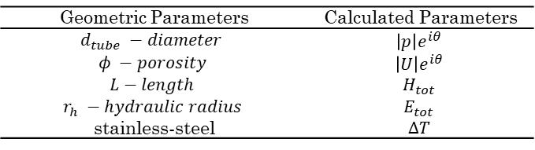
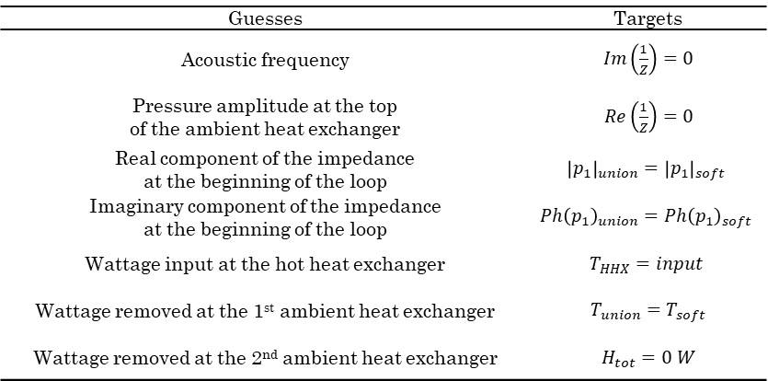
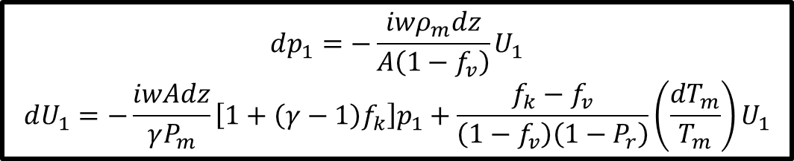
Thermoacoustic Theory
DeltaEC (Los Alamos National Laboratory) is used to predict the performance of different configurations for a traveling-wave thermoacoustic engine and refrigerator.
Input different elements and geometric configurations like a regenerator.
Boundary conditions are defined as guesses and targets in the program.
Calculates solutions for acoustic parameters and thermal parameters through the shooting method.
$$dp_{1}=−\frac{iwρ_{m}dz}{A\left(1−f_{v}\right)}U_{1}$$
$$dU_{1}=−\frac{iwAdz}{γP_{m}}\left[1+\left(γ−1\right)f_{k}\right]p_{1}+\frac{f_{k}−f_{v}}{\left(1−f_{v}\right)\left(1−P_{r}\right)}\left(\frac{dT_{m}}{T_{m}}\right)U_{1}$$
[6]
Geometric Parameters | Calculated Parameters
$$d_{tube} −diameter$$ | $$\left|p\right|e^{iθ}$$
$$φ −porosity$$ | $$\left|U\right|e^{iθ}$$
$$L−length$$ | $$H_{tot}$$
$$r_{h} −hydraulic radius$$ | $$E_{tot}$$
stainless-steel | $$∆T$$
Guesses | Targets
Acoustic frequency | $Im\left(\frac{1}{Z}\right)=0$
Pressure amplitude at the top of the ambient heat exchanger | $Re\left(\frac{1}{Z}\right)=0$
Real component of the impedance at the beginning of the loop | $${\left|p_{1}\right|}_{union}={\left|p_{1}\right|}_{soft}$$
Imaginary component of the impedance at the beginning of the loop | $$Ph{\left(p_{1}\right)}_{union}=Ph{\left(p_{1}\right)}_{soft}$$
Wattage input at the hot heat exchanger | $$T_{HHX}=input$$
Wattage removed at the 1st ambient heat exchanger | $T_{union}=T_{soft}$
Wattage removed at the 2nd ambient heat exchanger | $H_{tot}=0 W$
Demonstrate initial performance of a small-scale hydrogen traveling wave system.

Slide 8
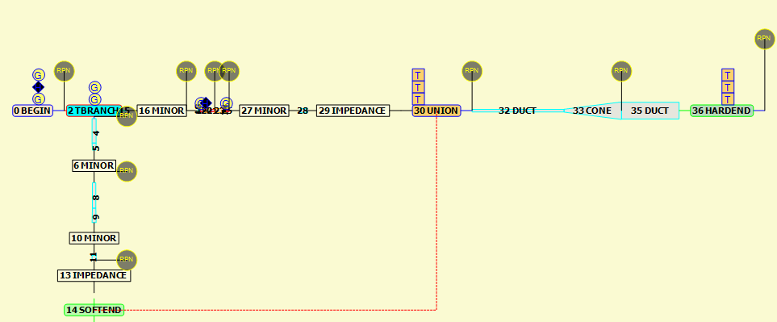
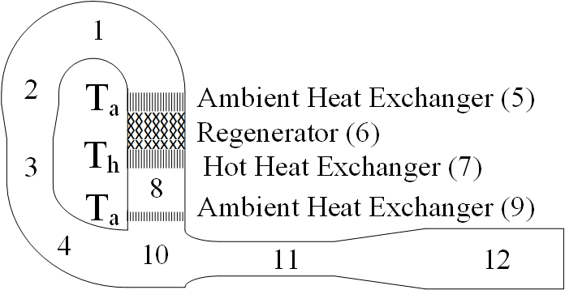
Traveling-Wave Engine Demonstrator
Studies utilize hydrogen as the working fluid at 20 bar and are simulated with stainless steel as the construction material.
36 total elements encompassing two heat exchangers, a regenerator, elements for the toroidal tube network and elements for the resonator network.

Slide 9
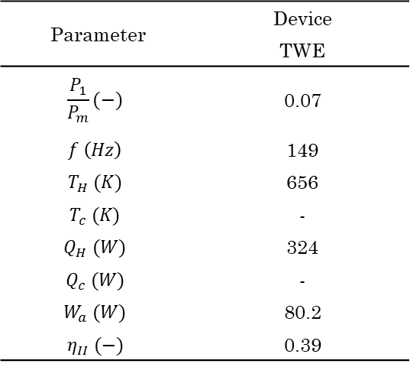
Traveling-Wave Engine Demonstrator
Studies utilize hydrogen as the working fluid at 20 bar and are simulated with stainless steel as the construction material.
34 total elements encompassing two heat exchangers, a regenerator, elements for the toroidal tube network and elements for the resonator network.
Traveling-wave engine produced 80 W of useable acoustic power with a hot temperature of ~650 K and an input of 324 W equating a 2nd law efficiency of 39%.
Parameter | Device
 | TWE
$$\frac{P_{1}}{P_{m}}(−)$$ | 0.07
$$f \left(Hz\right)$$ | 149
$$T_{H} (K)$$ | 656
$$T_{c} (K)$$ | -
$$Q_{H} (W)$$ | 324
$$Q_{c} (W)$$ | -
$$W_{a} (W)$$ | 80.2
$$η_{II} (−)$$ | 0.39

Slide 10
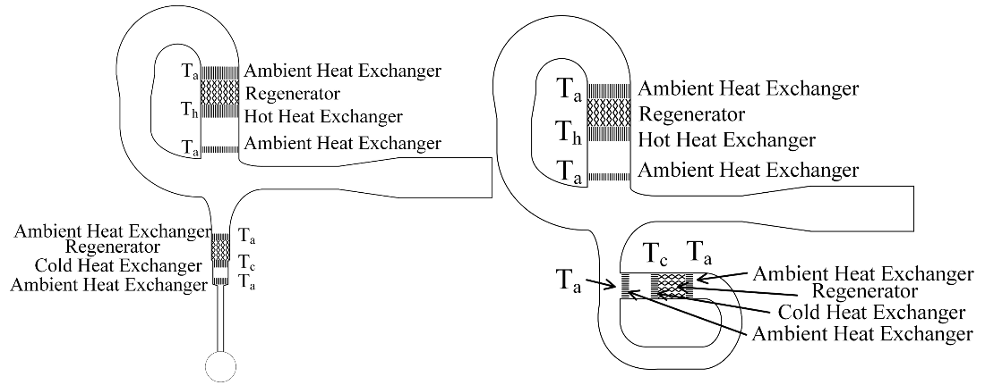
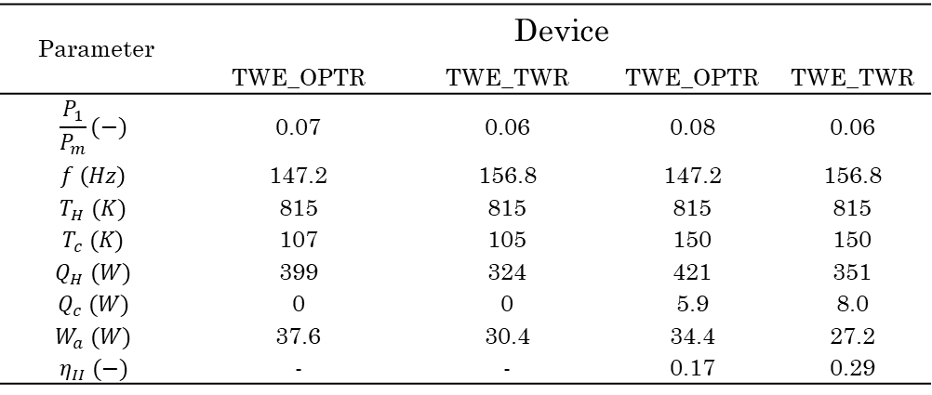
Traveling-Wave Cryocooler Demonstrator
The traveling-wave engine provides acoustic power to a pulse-tube and traveling-wave refrigerator.
2 scenarios are simulated at constant hot temperature:
Lowest cold temperature
Heat load at 150 K cold temperature
The combination traveling-wave engine and refrigerator was more efficient (30%) and reach a lower temperature than the pulse-tube.
Parameter | Device
 | TWE_OPTR | TWE_TWR | TWE_OPTR | TWE_TWR
$$\frac{P_{1}}{P_{m}}(−)$$ | 0.07 | 0.06 | 0.08 | 0.06
$$f \left(Hz\right)$$ | 147.2 | 156.8 | 147.2 | 156.8
$$T_{H} (K)$$ | 815 | 815 | 815 | 815
$$T_{c} (K)$$ | 107 | 105 | 150 | 150
$$Q_{H} (W)$$ | 399 | 324 | 421 | 351
$$Q_{c} (W)$$ | 0 | 0 | 5.9 | 8.0
$$W_{a} (W)$$ | 37.6 | 30.4 | 34.4 | 27.2
$$η_{II} (−)$$ | - | - | 0.17 | 0.29

Slide 11
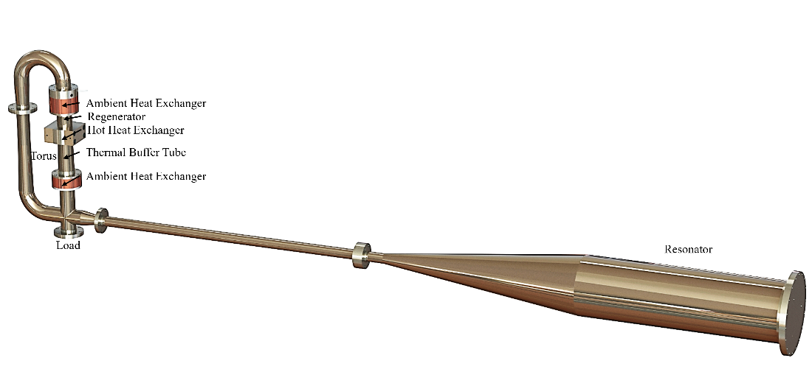
Conclusions and Future Work
Initial performance of hydrogen traveling-wave thermoacoustic systems were quantified.
Future work includes:
Analyzing the effect of ortho-parahydrogen conversion in a catalyzed regenerator
Construction of demonstrators in progress for validation measurements
Implement flow through cooling of hydrogen into the demonstrator
Scale to required cooling capacity and commercialize

Slide 12
Thank You!
This work was sponsored by the National Science Foundation.
Matthew Shenton
matthew.shenton@wsu.edu
+1 208 840 0587

Slide 13
References
[1] Appel K. Numerical Modeling of Liquid Hydrogen Storage Tanks for the Reduction of Boil-Off Losses [Thesis]. [Pullman]: Washington State University; 2024.
[2] Zhang F, Zhao P, Niu M and Maddy J 2016 Int J Hydrogen Energy. 41 14535–52.
[3] Koleva M, Rustagi N. DOE Hydrogen and Fuel Cells Program Record Title: Hydrogen Delivery and Dispensing Cost [Internet]. 2020.
[4] https://trc.nist.gov/cryogenics/Papers/Review/2020-Review_of_Refrigeration_Methods.pdf
[5] Radebaugh, R. (2009). "Cryocoolers: the state of the art and recent developments." Journal of Physics: Condensed Matter 21(16): 164219.
[6] Swift GW. Thermoacoustics: A unifying perspective for some engines and refrigerators. Mellville, NY, USA: Acoustical society of America; 2003.
[7] Matveev KI. Unsteady model for standing-wave thermoacoustic engines. Journal of Non-Equilibrium Thermodynamics. 2010;35(2):85-96.

