Slide 1

Comparative Analysis on Recrystallization and Recovery of High and Low RRR Niobium
Z-H Sung, K Howard, D Bafia, W Misiewicz, S Posen
May 19, 2025

Slide 2
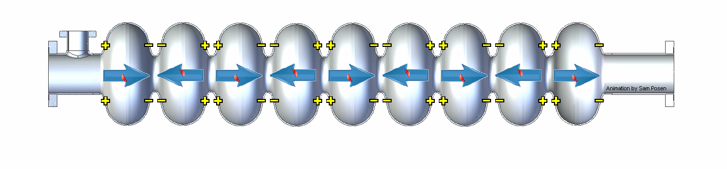
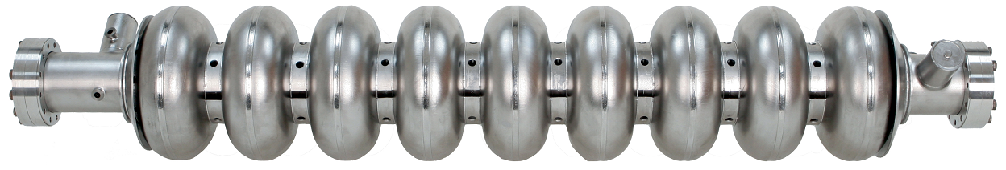
SRF Cavities for Particle Accelerators
Materials: high purity (RRR > 250) niobium metallic superconductor
High quality EM resonators: Typical Q₀ > 10¹⁰
Large electric field generated along the cavity axis
Particle beam gains energy as it passes through
Courtesy of S Posen (FNAL)
~1 m

Slide 3
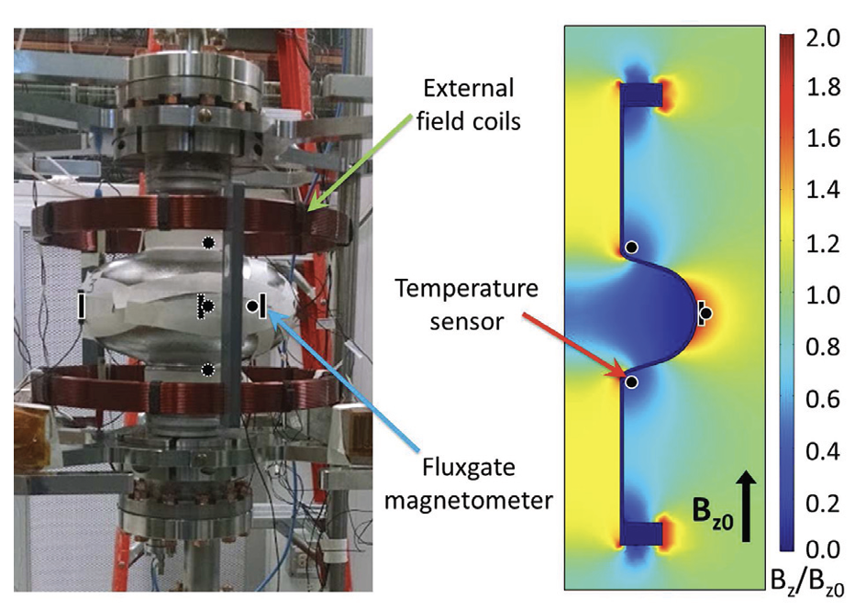
Flux expulsion studies in a single cell SRF Nb cavities
Spatial thermal gradients during cooldown can significantly improve the expulsion of magnetic flux.
High RRR Nb materials can be vulnerable to flux trapping that substantially degrades performance.
Flux expulsion behavior can be substantially enhanced through UHV thermal treatment.
Apparatus used to measure flux expulsion and simulation used to determine the magnetic field enhancement factor for full expulsion
S Posen, Proceedings of IPAC 2016

Slide 4
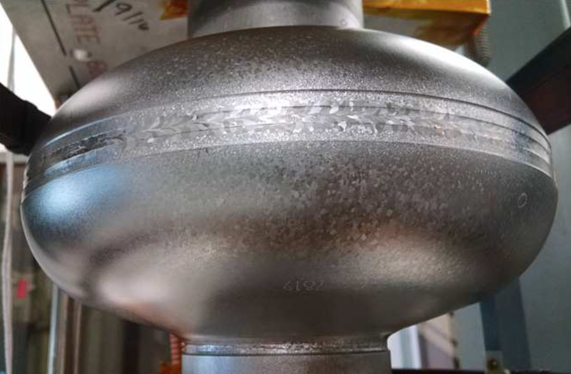
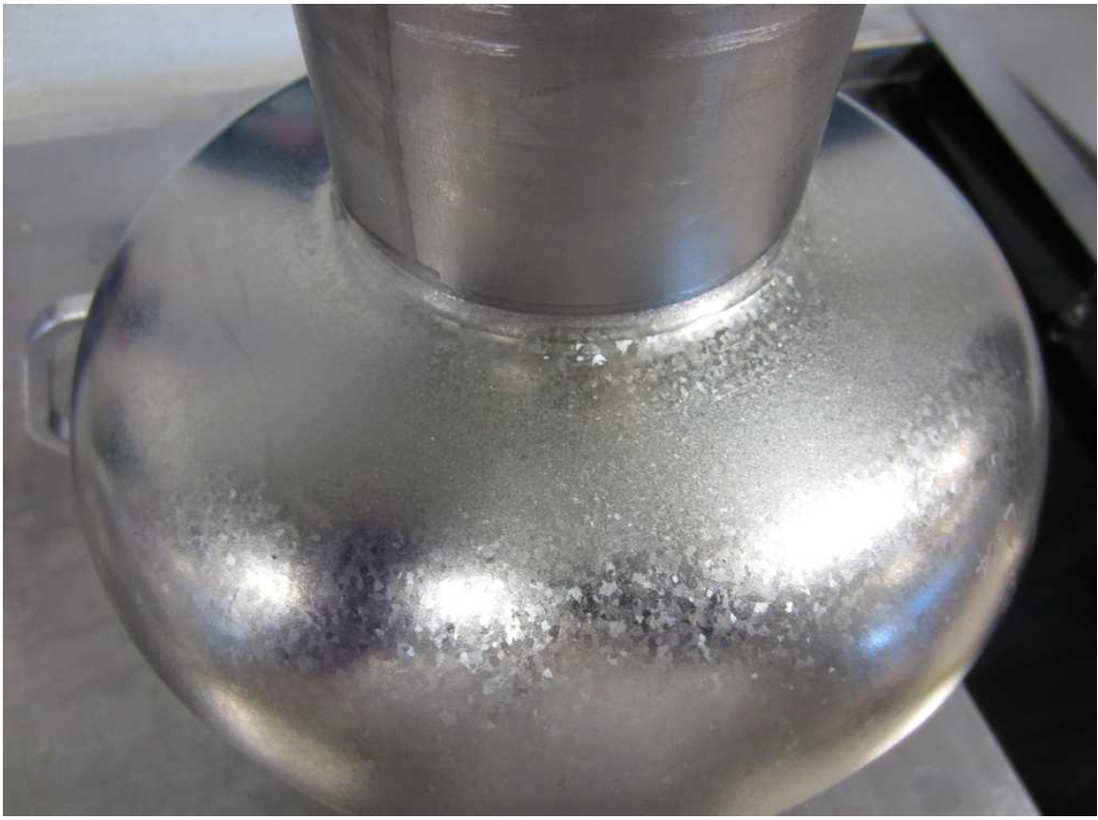
Improvement in expulsion is correlated with grain growth
LCLS-II material with weak expulsion,
after 900 C
NX11301
LCLS-II material with strong expulsion, after 900 C
TD10974
Why is 800 C enough to grow giant grains in some Nb but 1000 C required for others?
Wah Chang
800 C only
It is crucially important to look into the bulk Nb
1000 C 4 hrs
Tokyo Denkai

Slide 5
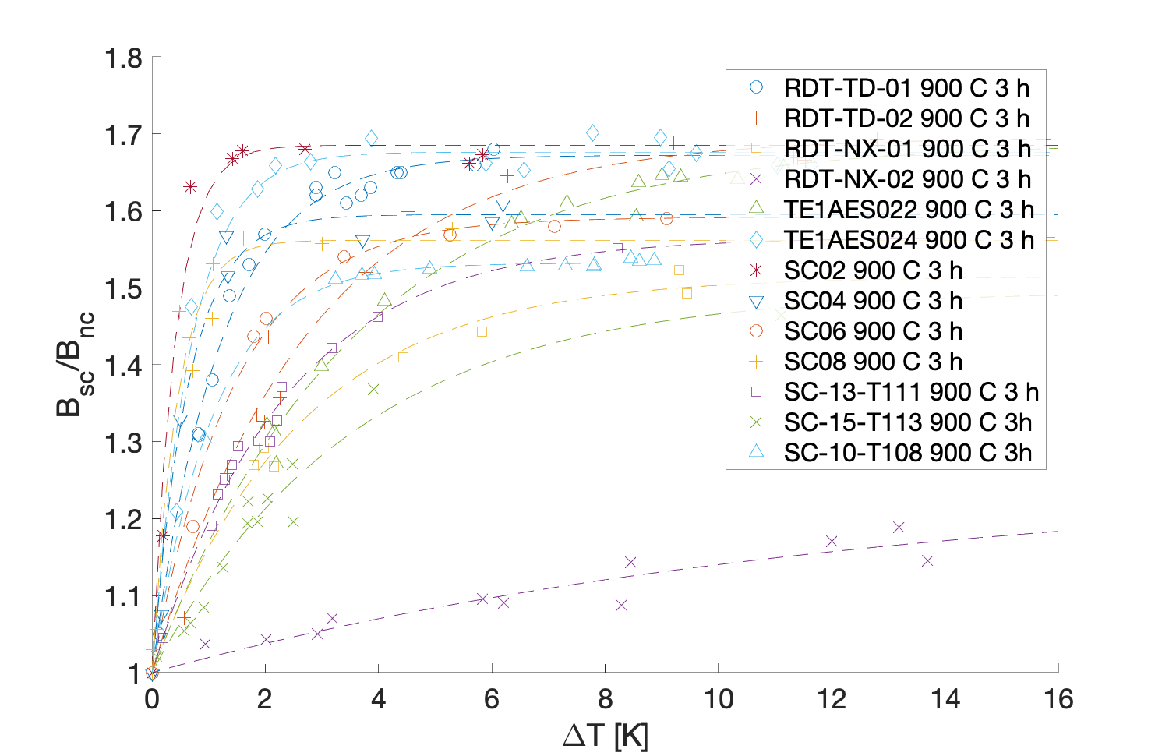


Variations of Flux expulsion behavior related to the vendors
$\frac{B_{SC}}{B_{NC}} \sim 1.7$ : 70%
Nb Sheet | Cavity
Serial # | Serial #
T10205 | TD01
T10971 | TD02
N10786 | NX01
N11302 | NX02
T13688 | SC04
T13971 | SC06
T13128 | SC08
T13456 | SC02
250 | TE1AES024
78XX | TE1AES022
$\frac{B_{SC}}{B_{NC}} \sim 1$ : 0%
Courtesy of S Posen

Slide 6
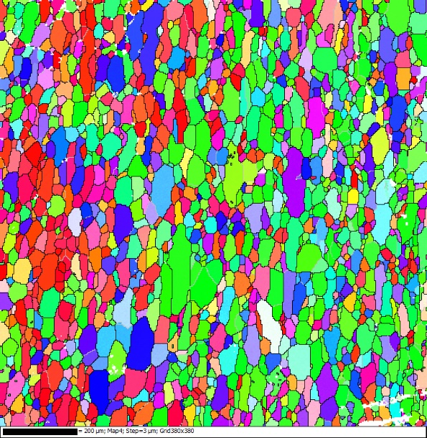
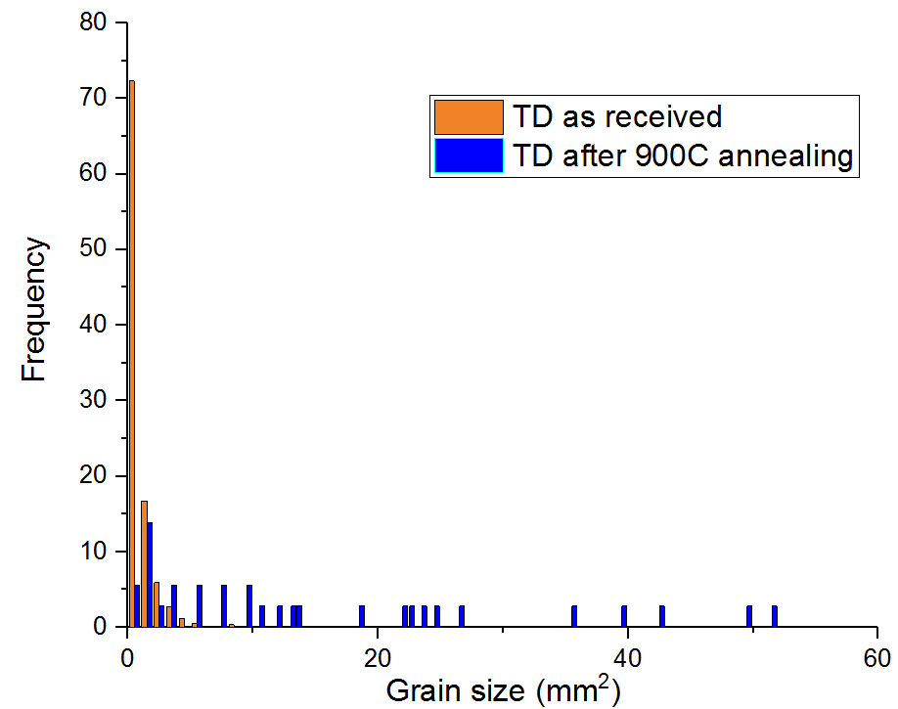
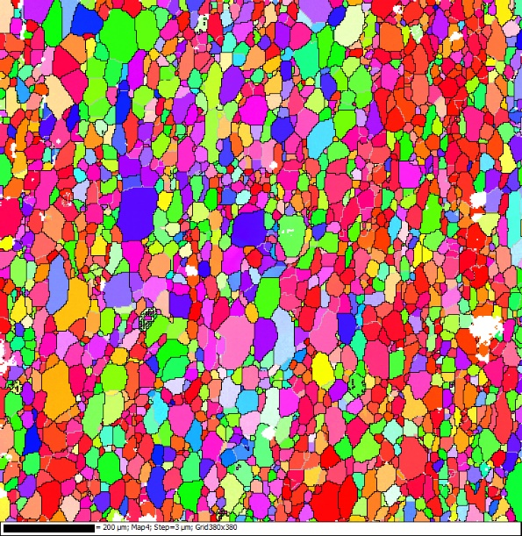
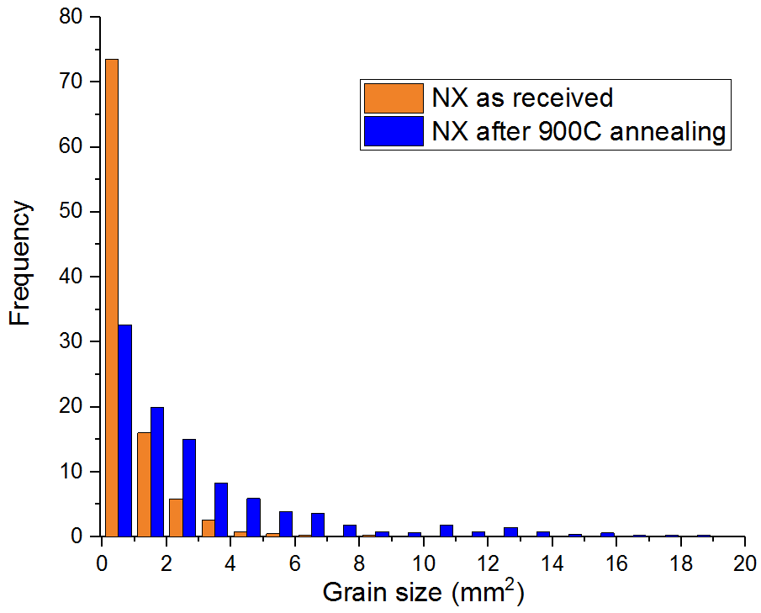
Coupon studies with metallography showed a threshold for grain growth
After annealing at 900C
TD
-good flux expulsion after 900C-
After annealing at 900C
Ningxia
-bad flux expulsion-
In both cases, there is some grain growth due to the 900C annealing
In the TD sample the grain growth is much larger than in the Ningxia

Slide 7
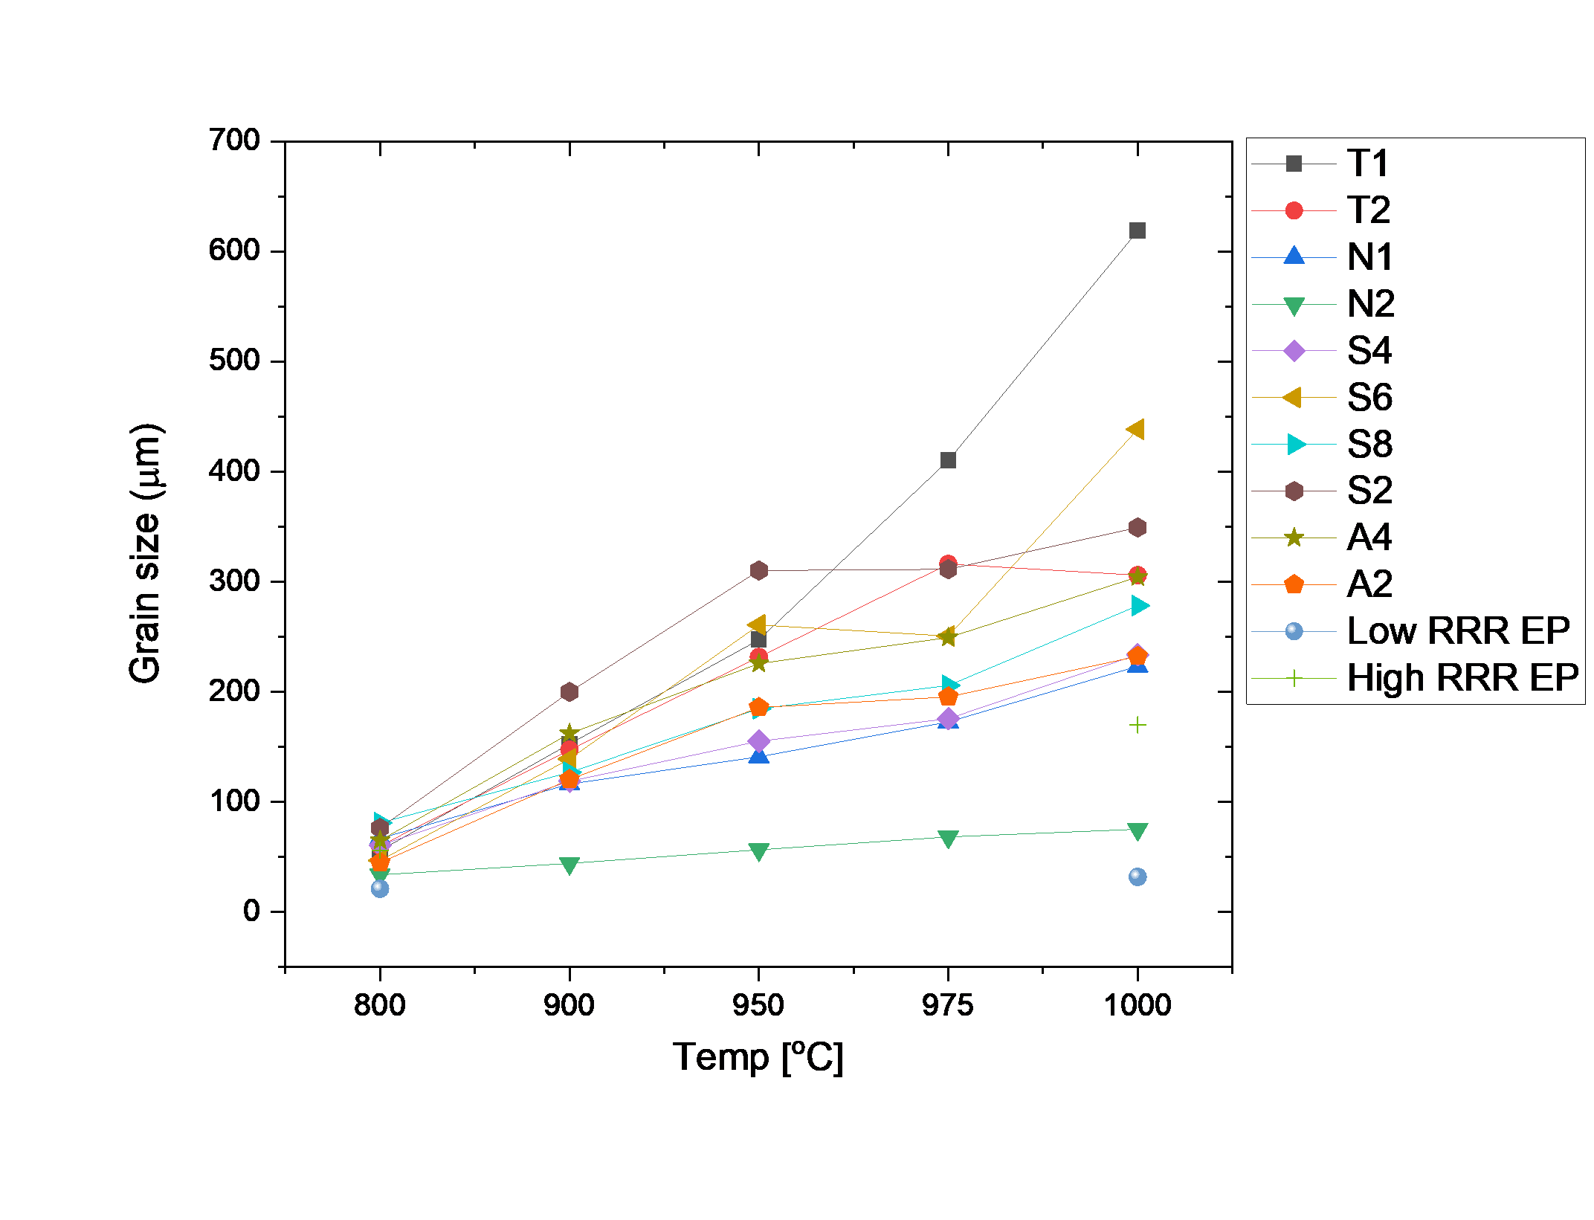
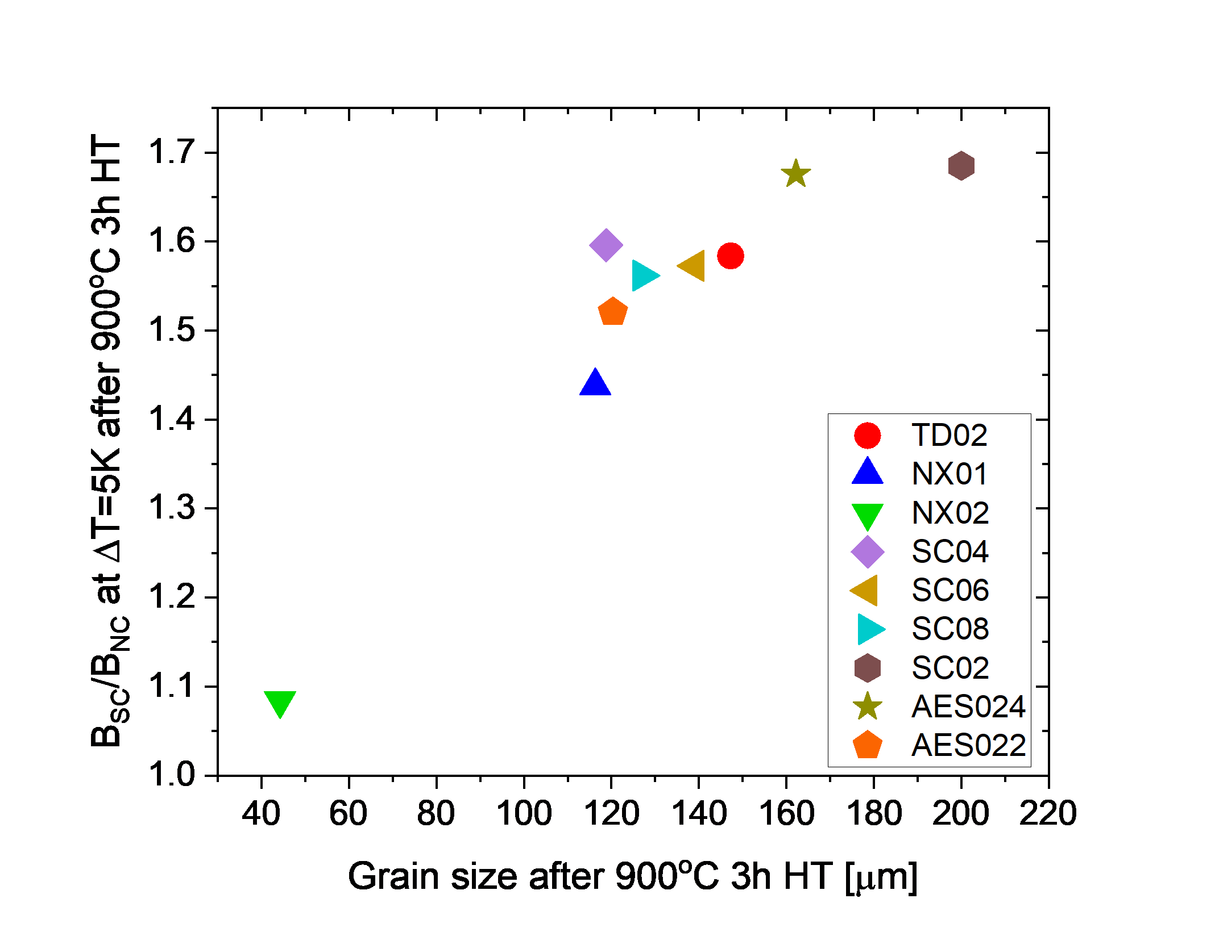
Grain size evaluation with HT: Annealing at $≥$ 900°C leads to better flux expulsion behavior on the SRF cavities, but depending on the materials
Grain size (HT) vs Temperature
Grain size (HT) vs Flux Expulsion Rate
Sung et al 2023 Supercond. Sci. Technol. 36 095015

Slide 8
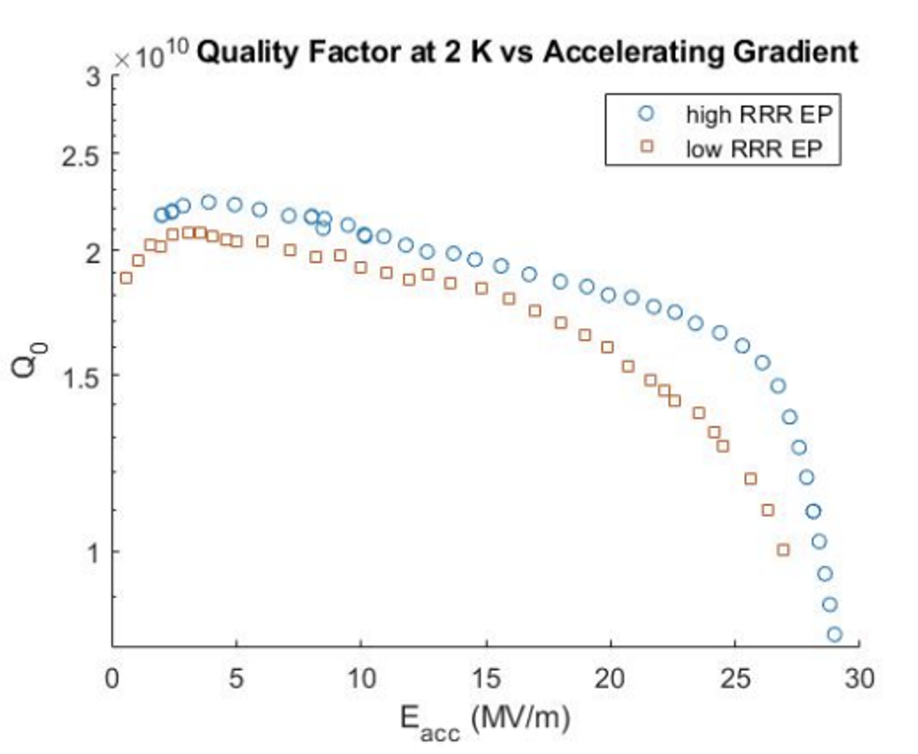
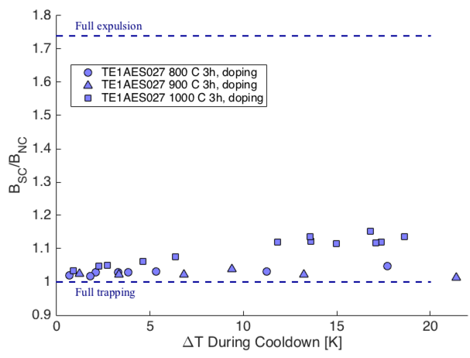
Low RRR (< 50) study to extend its application, compared to high RRR;
The range of low RRR application has not been yet clearly understood
Flux expulsion behavior of a low RRR cavity
Comparison of Quality factor at 2K vs Accelerating gradient for low and high RRR

Slide 9
Material study required to optimize cavity surface treatments
Recrystallization/coarsening of Nb grains is different between the sample and the cavity.
Still unknown, “What is the primary source of flux expulsion?”
  Dislocations? Impurities? Or Strained structure?
  These are also obstacles for complete grain growth
Higher annealing temperature can risk the cavity stiffness for tuning.
Need to establish a proper scenario for SRF Nb
What are the limitations of recrystallization and recovery of the cavity wall for optimal flux expulsion efficiency?

Slide 10
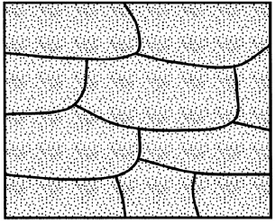
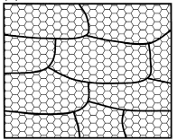
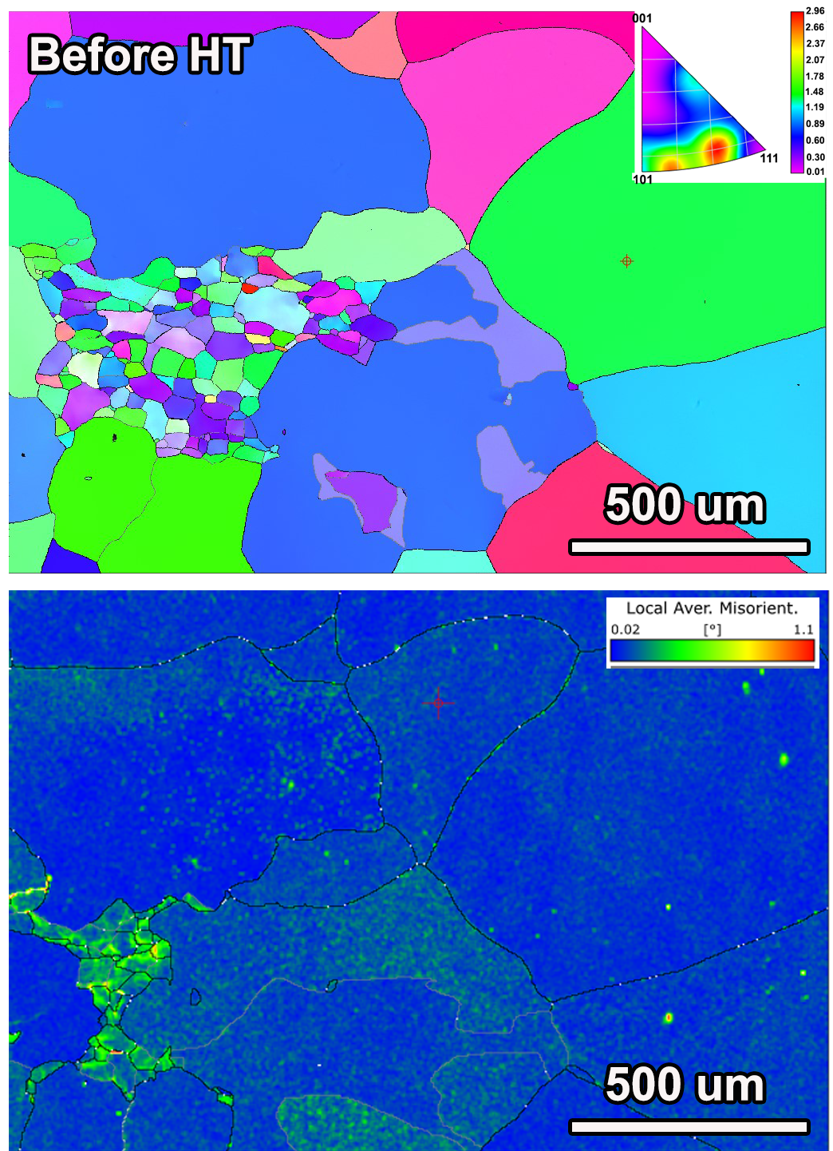
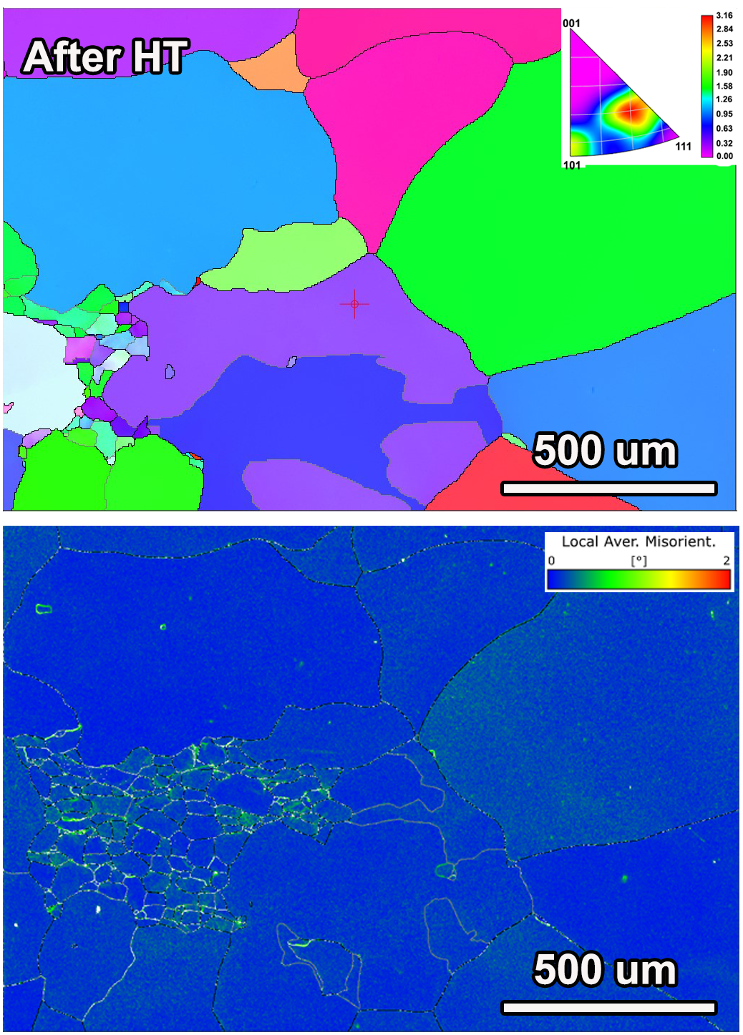
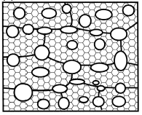
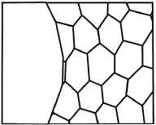
Cavity wall experienced abnormal Grain Growth, rather than normal (isothermal) grain growth
AGG has occurred when a minority of grain growth much larger than the majority
Strained State
Recovered
Practically occurred in the SRF Nb cut-out coupon
Cavity cutout X section
N-doped Cavity
After 800C/3hrs HT
at UHV
Annealing
Fully recrystallization

Slide 11
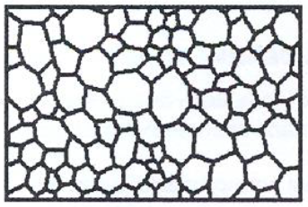
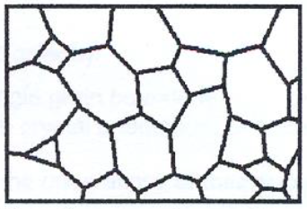
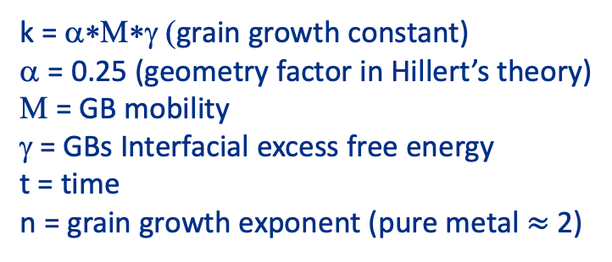

Initially, we investigated grain growth behavior using residual parts after cavity fabrication; cutout coupons has limitations on the thermal treatment
Normal (isothermal) grain growth, Mostly in our SRF Nb coupon samples
As received
800C
Kinetics of the grain growth
$$D^{n}−D_{0}^{n}=k∙t$$
D = avg. grain size
D₀ = initial avg. grain
k = α∗Μ∗γ (grain growth constant)
α = 0.25 (geometry factor in Hillert’s theory)
Μ = GB mobility
γ = GBs Interfacial excess free energy
t = time
n = grain growth exponent (pure metal $≈$ 2)
Annealing
1000C

Slide 12
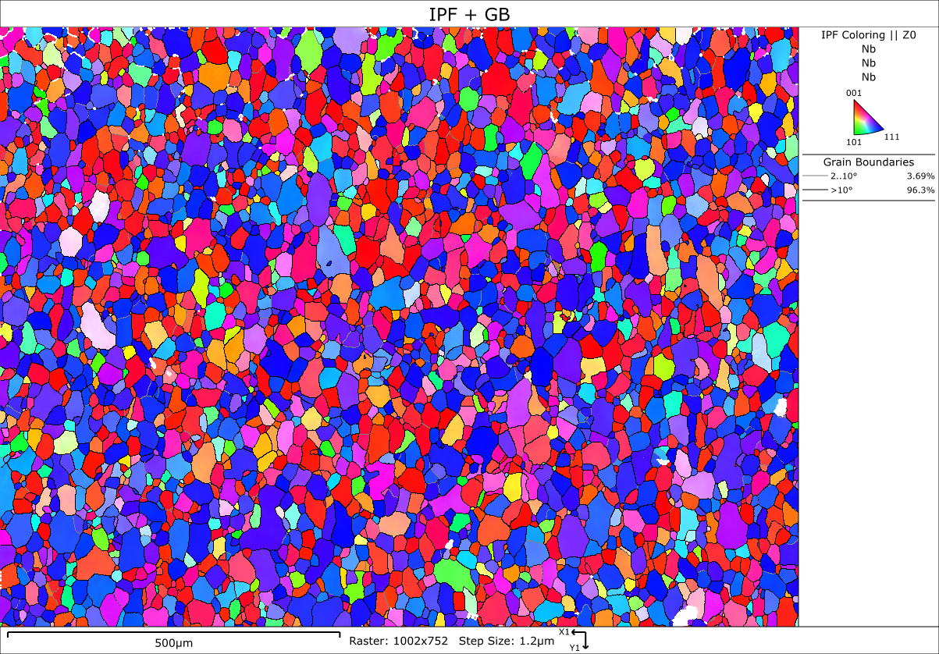
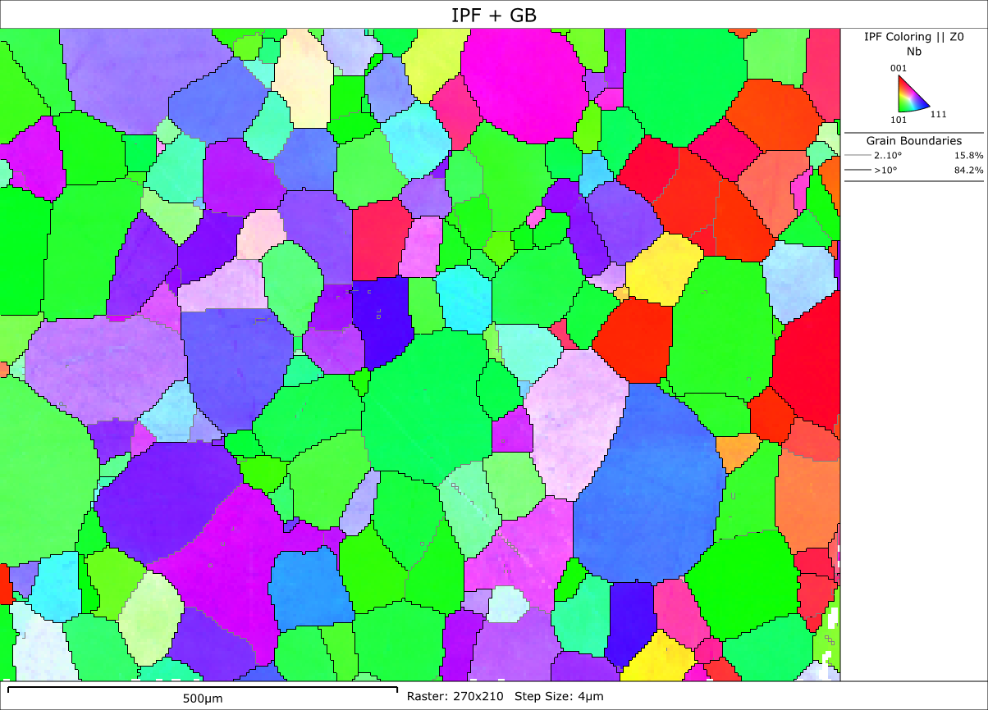
High vs Low RRR coupons from the residual Nb sheets after 800°C HT
Low RRR
High RRR
Avg. Grain diameter = 26 μm
Avg. Grain diameter = 60 μm

Slide 13
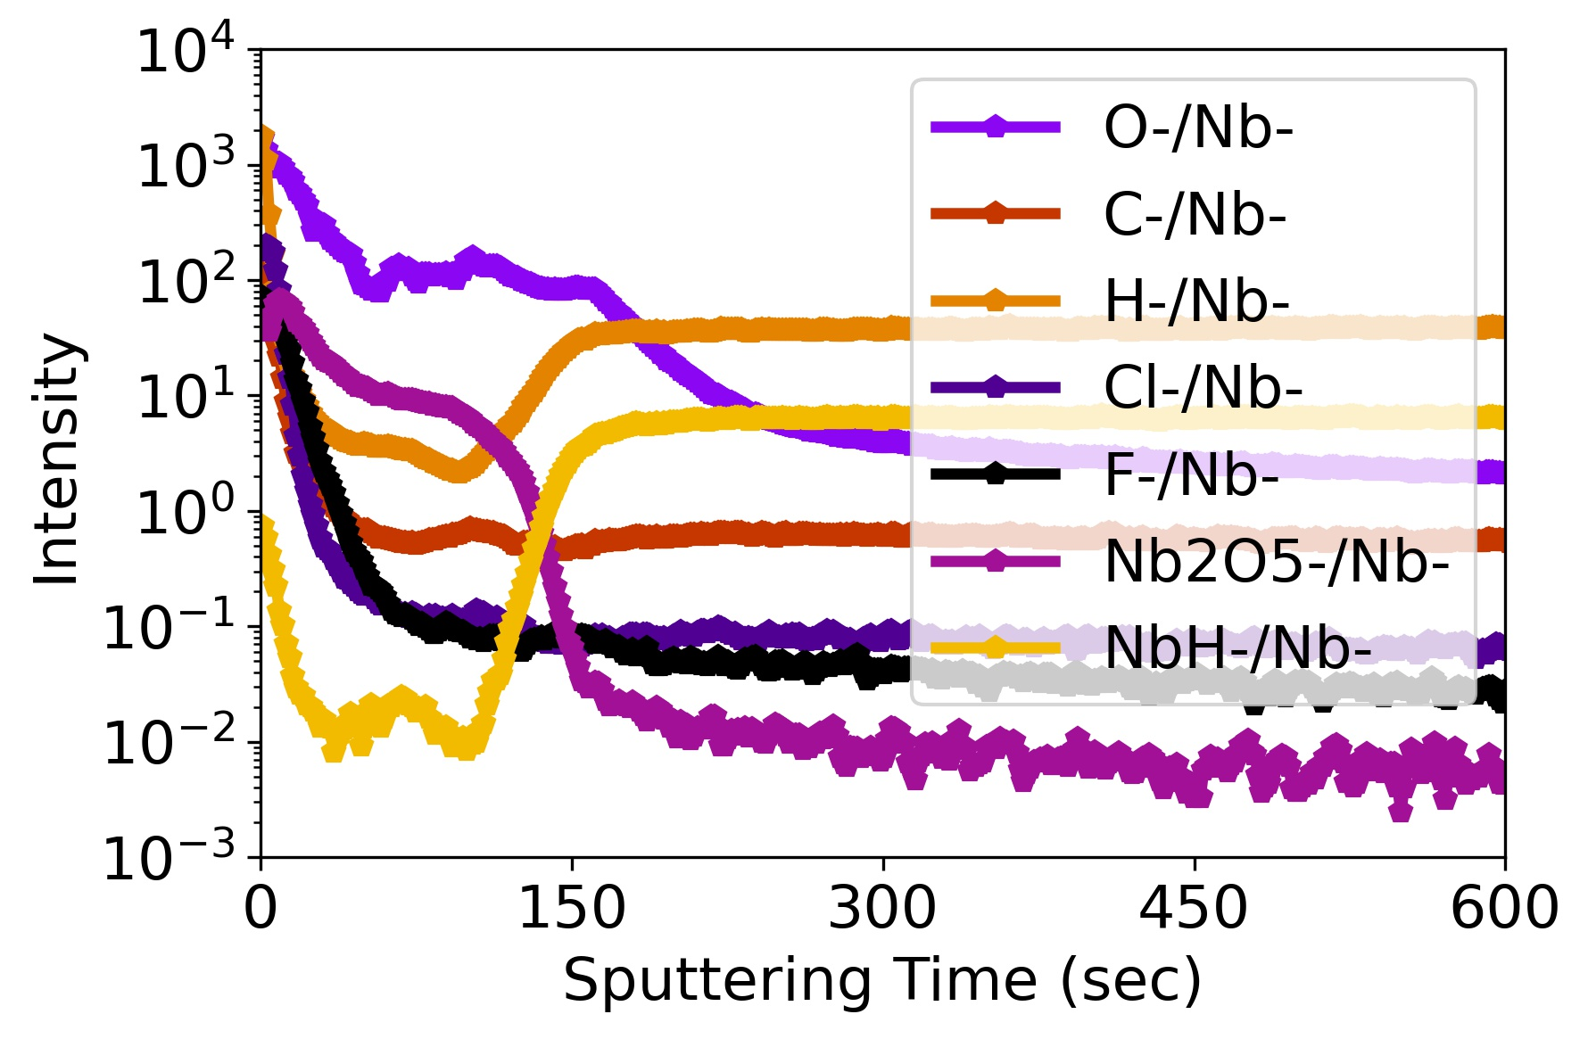
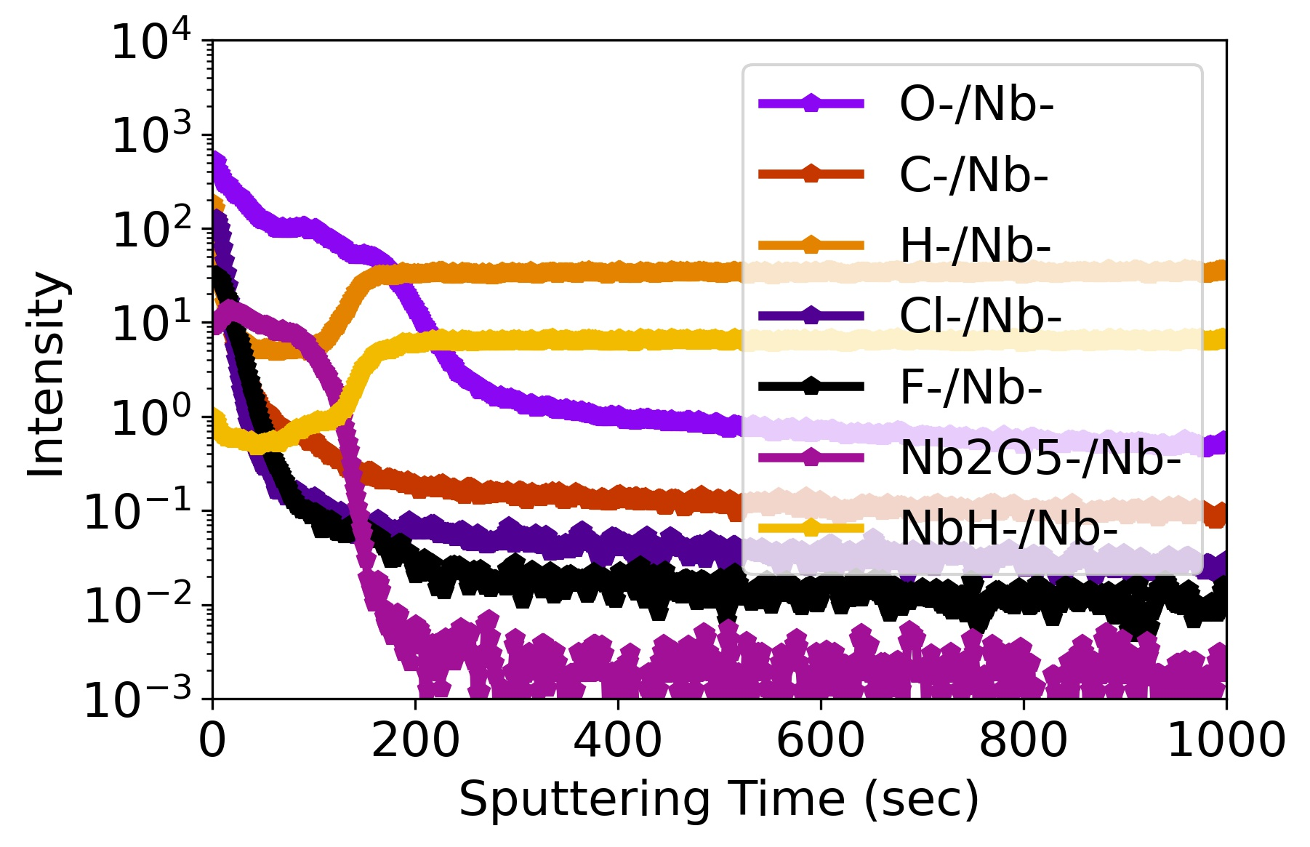
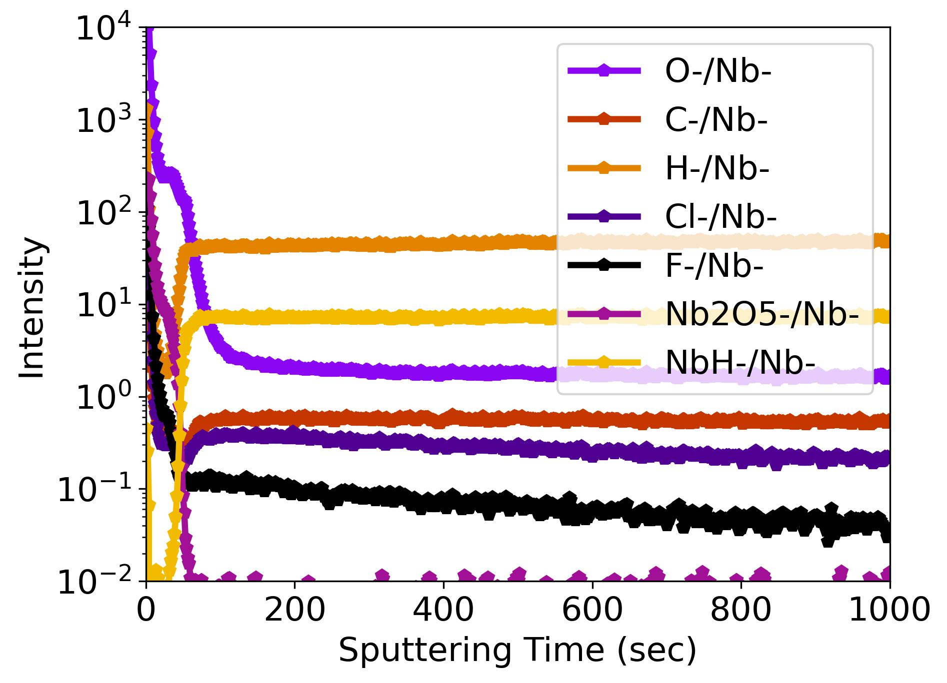
After polishing
Low RRR
High RRR
Cutout coupon
H
O
The impurity on the grain growth is likely oxygens and hydrogens
Sample | Low RRR(coupon) | High RRR (coupon) | H9 (cutout)
Grain size | < 30 um | > 50 um | >> 50 um
Grain boundaries impurities | Not clear (but high) | Not clear (but high) | Not clear (but high)
Impurity before polishing | Supposed higher than others | Same as low RRR | N/A (but would be very low)
Impurity after polishing | Similar | Similar | Similar
Nb2O layer | ~ 10 nm (200 sec sputtering time) | ~ 10 nm | ~ 7 nm
Oxygen | High | Little higher than H9 | Low
Hydrogen | Similar | Similar | Similar
Hydride size/population | Small (< 50 um)/low (?) | High (>> 50 um)/high (?) | High (>> 50 um)/high (?)
Courtesy of A Murthy

Slide 14
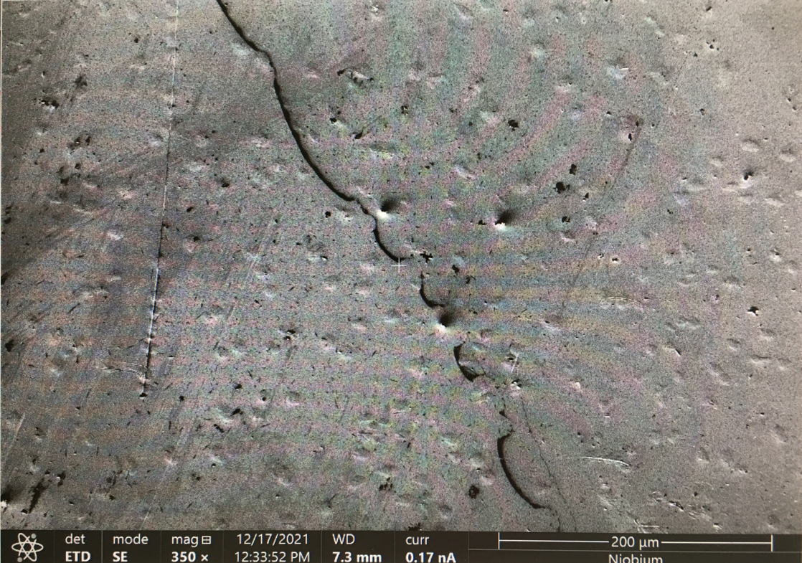
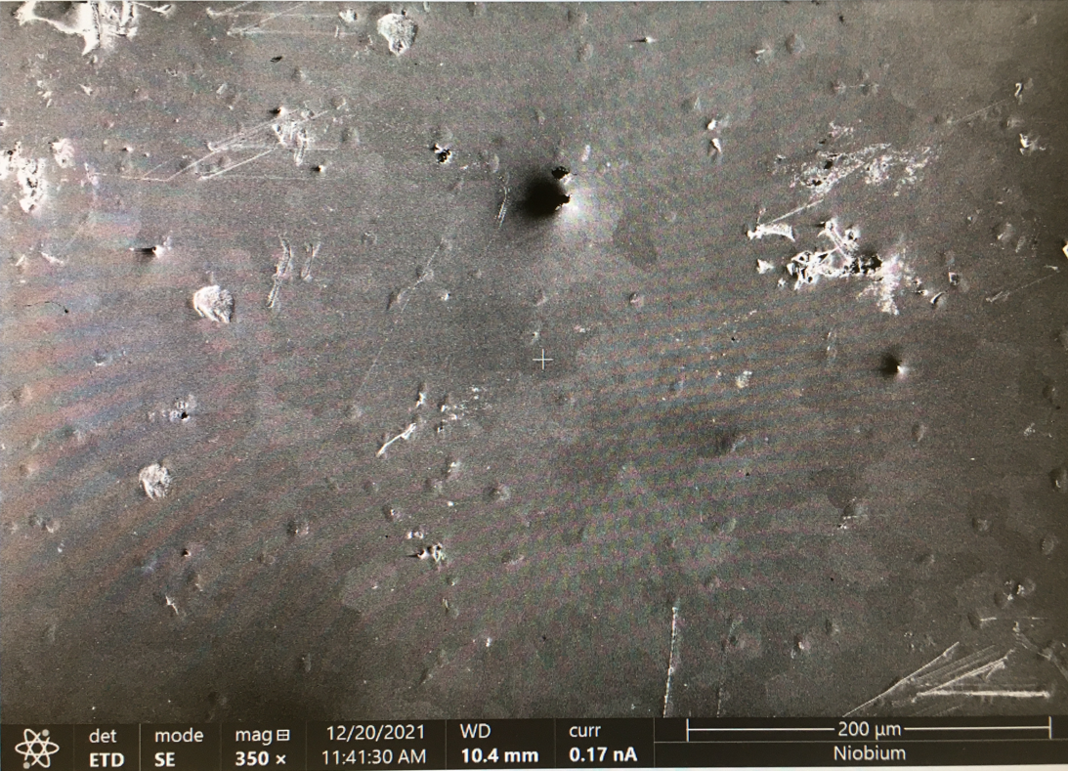
Cryogenic – Scanning electron microscopy: no NbH phase precipitation on low RRR samples, appeared on high RRR samples
High RRR
Low RRR
*both high RRR and low RRR samples stayed on vibration polisher for 4 days at the same puck
Nb hydride precipitations, similar to those observed by cryogenic confocal microscopy

Slide 15
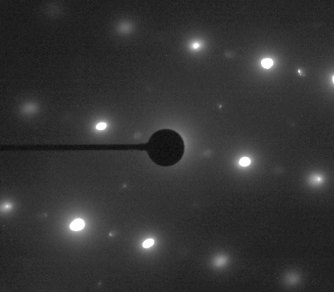
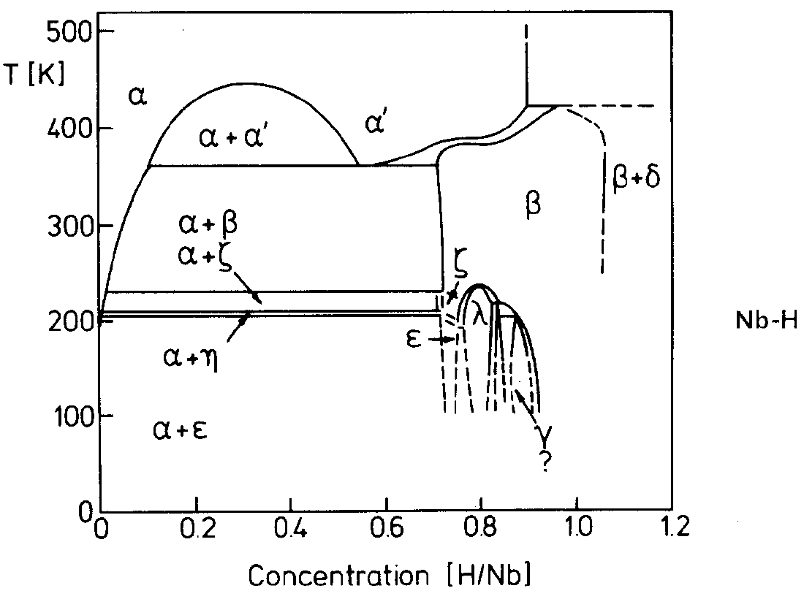
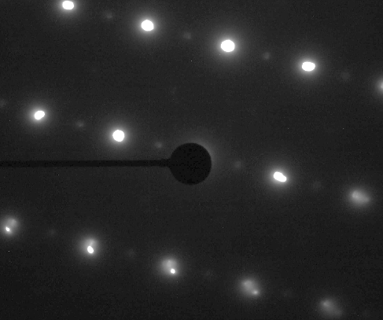
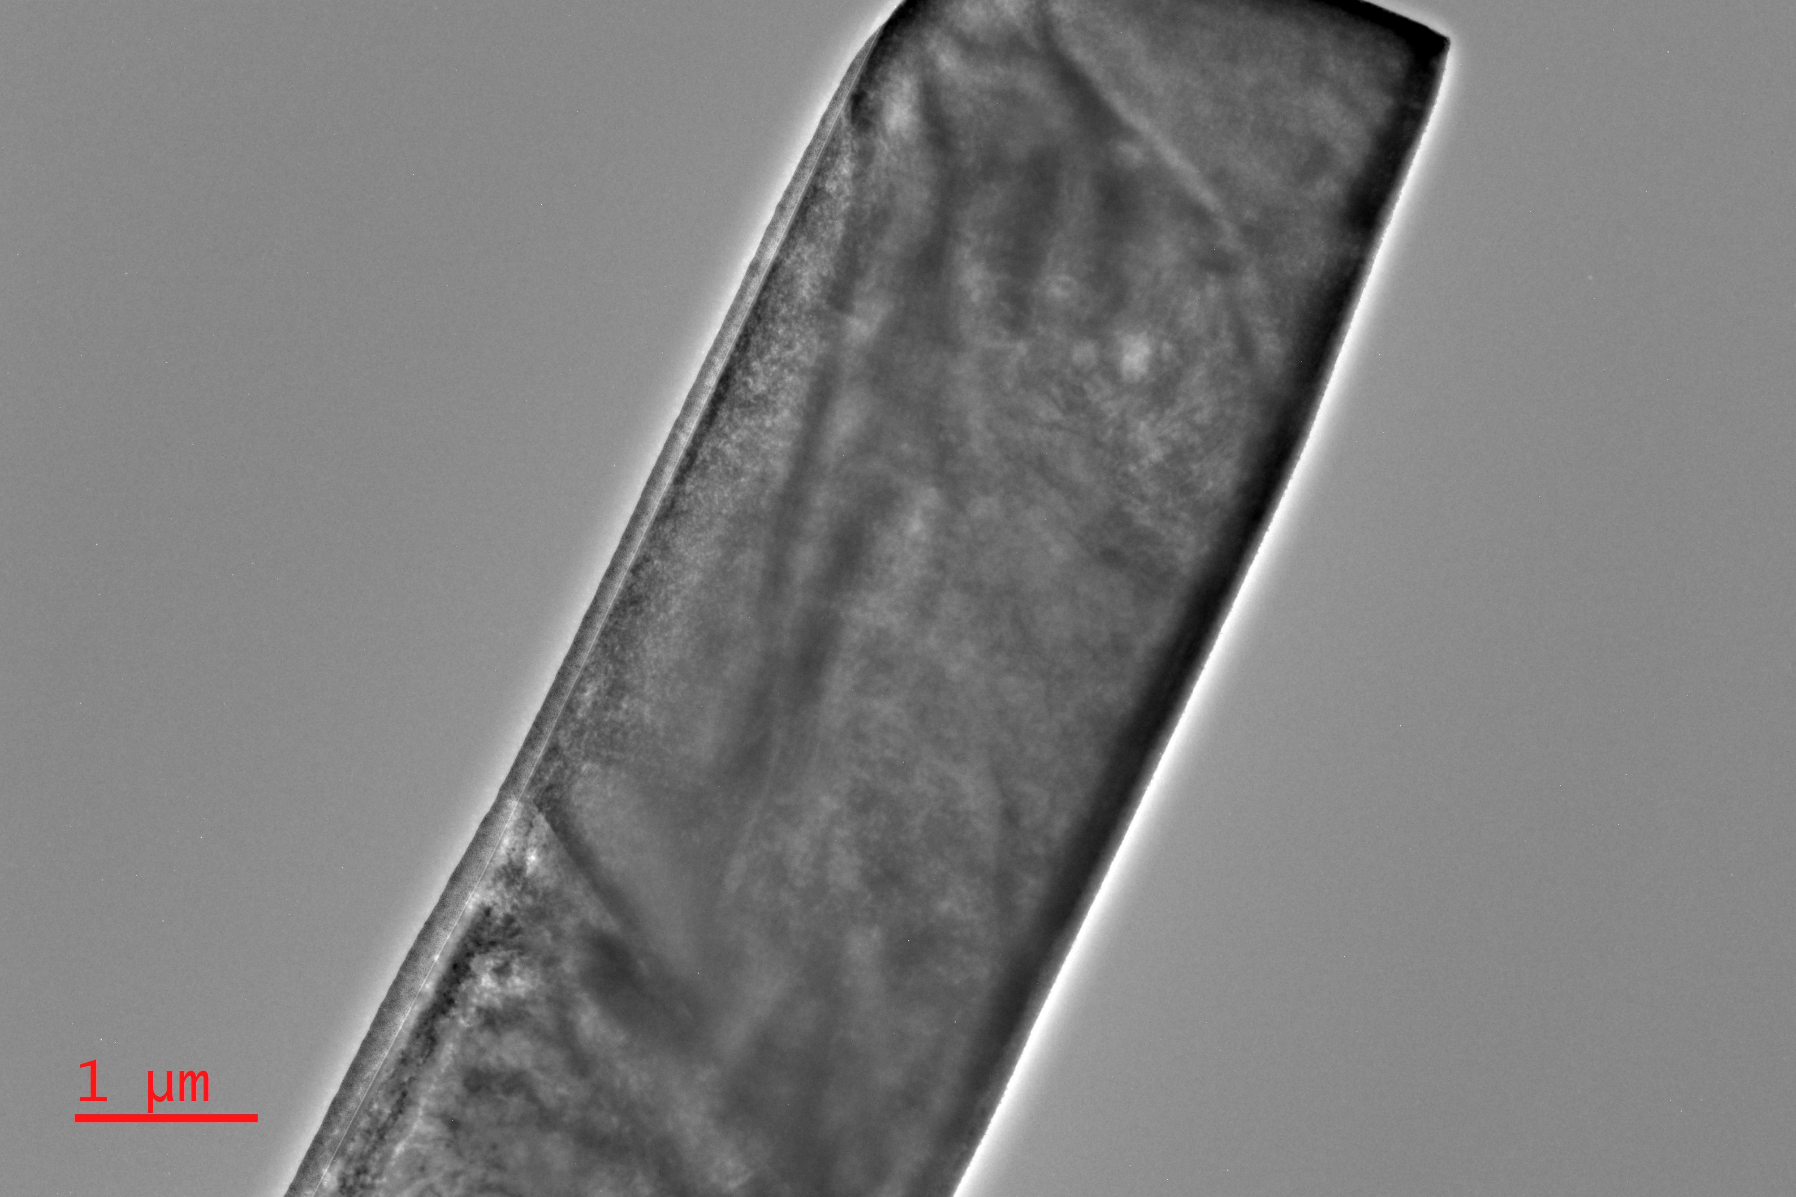
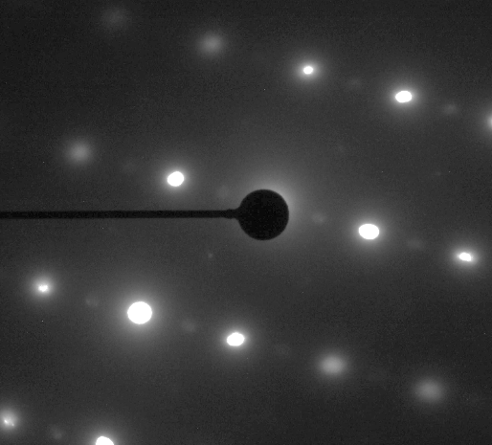
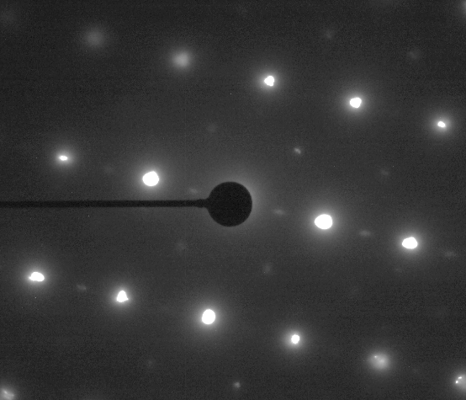
Cryogenic – Transmission electron microscopy shows NbH phase preferentially precipitates on high RRR samples
Cryo-TEM on high RRR Nb at 106 K for 2 hr
Phase diagram equilibrium phases are Nb + ε-NbH_{0.75} at 106 K
But we still observe β-NbH with newly nucleated ζ-NbH_{0.5}
→ microstructures seem to matter in the nucleation of hydrides
Courtesy of J-Y Lee
Nanoscale of ζ–NbH_{0.5} nucleates along the whole region

Slide 16
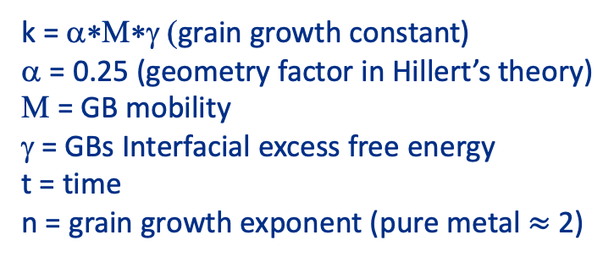



Kinetics of the grain growth: To estimate grain coarsening / recrystallization for flux expulsion without practical higher temperature annealing
Isothermal grain growth with residual (coupon) sample
k = α∗Μ∗γ (grain growth constant)
α = 0.25 (geometry factor in Hillert’s theory)
Μ = GB mobility
γ = GBs Interfacial excess free energy
t = time
n = grain growth exponent (pure metal $≈$ 2)
$$D^{n}−D_{0}^{n}=k∙t$$
D = avg. grain size
D₀ = initial avg. grain
The grain growth rate increases with an increase in temperature, because the average migration rate of the grain boundaries is proportional to exp(-Q/RT).
Q = The activation energy of grain growth
R = Gas constant
T = the absolute temperature
$$\frac{d(D)}{dt}=kD^{−1}e^{−Q/RT}$$
$$ln\left(\frac{D^{2}−D_{0}^{2}}{t}\right)=ln⁡(k)+\left(−\frac{Q}{R}\right)∙\left(\frac{1}{T}\right)$$
Hillert, M. (1965) On the Theory of Normal and Abnormal Grain Growth. Acta Metallurgica, 13, 227-238.
Hsun Hu & B. B. Rath. (1970), On the time exponent in isothermal grain growth, Transport Phenomena, 1, pages 3181–3184

Slide 17
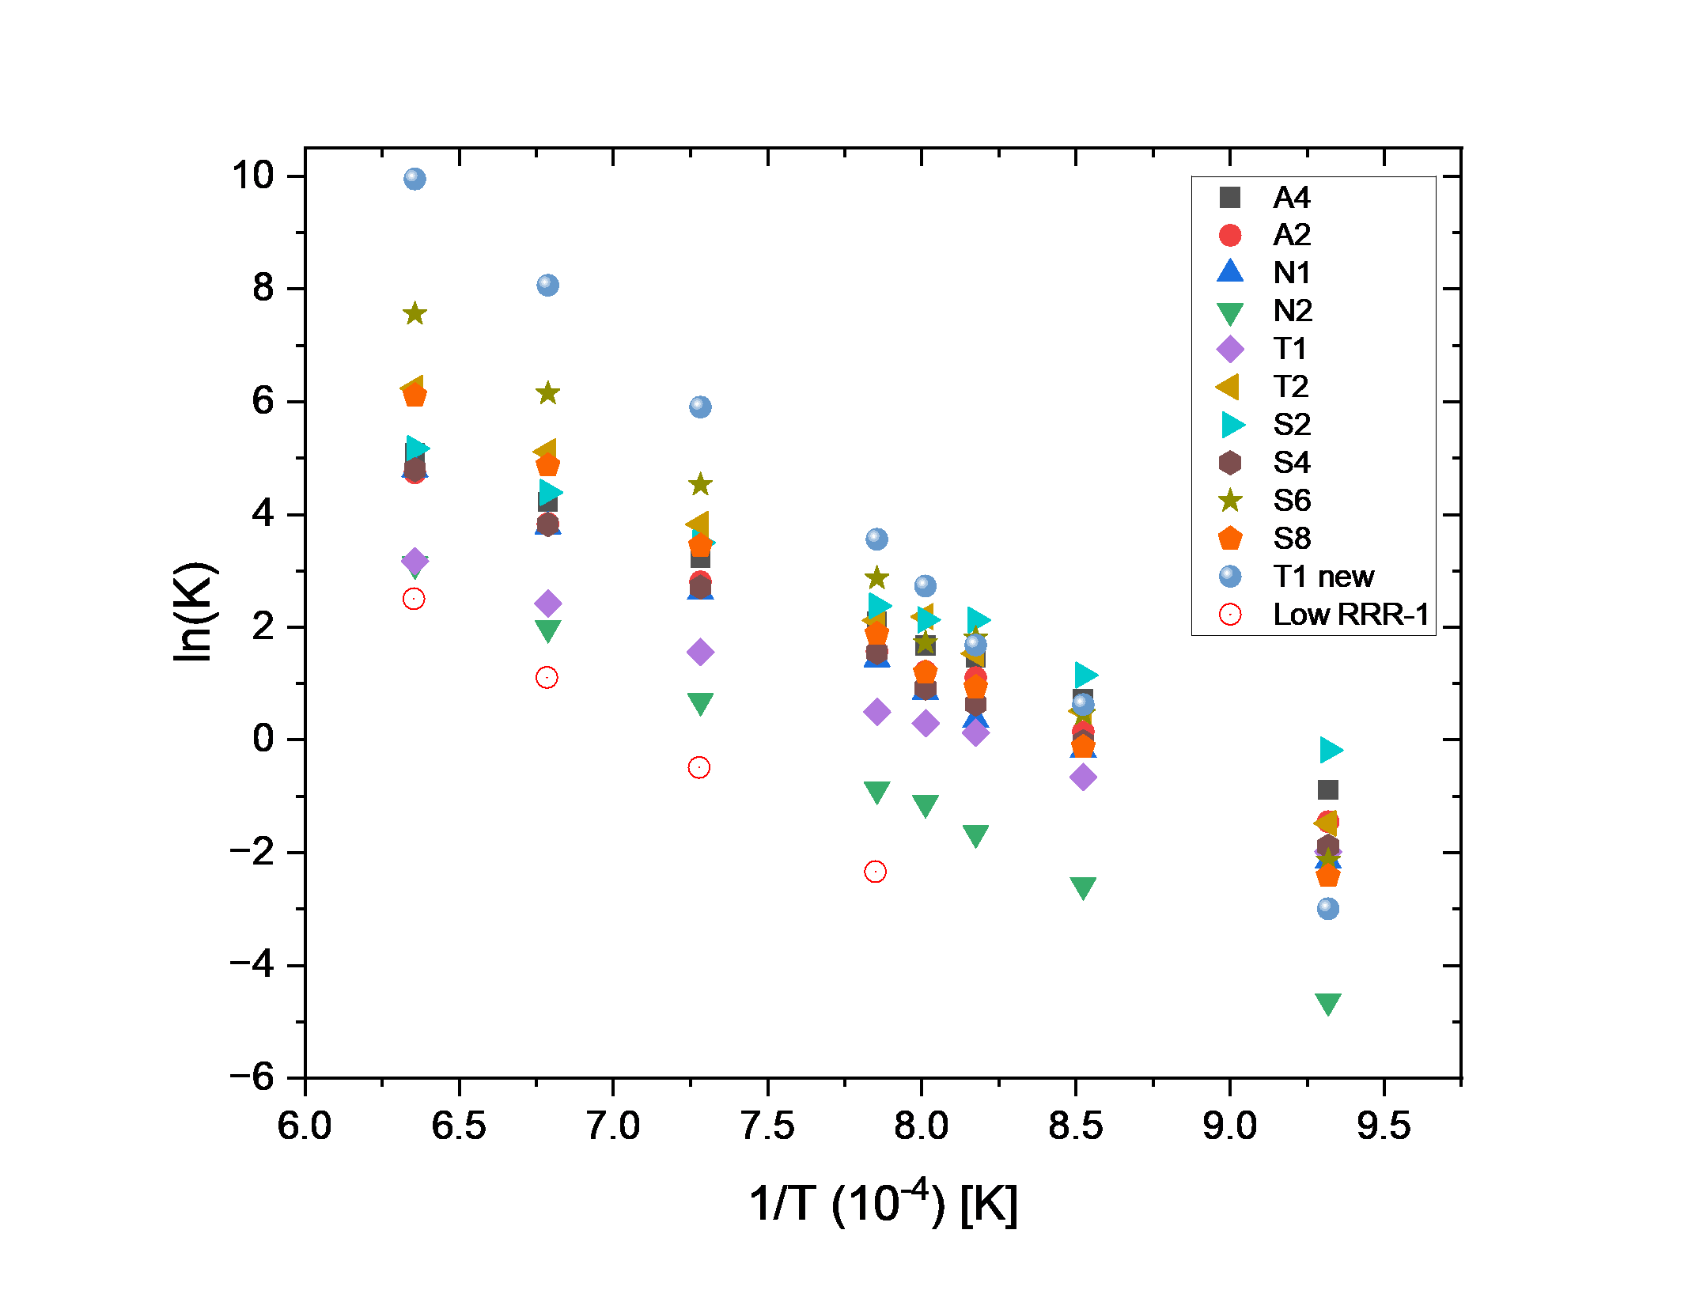
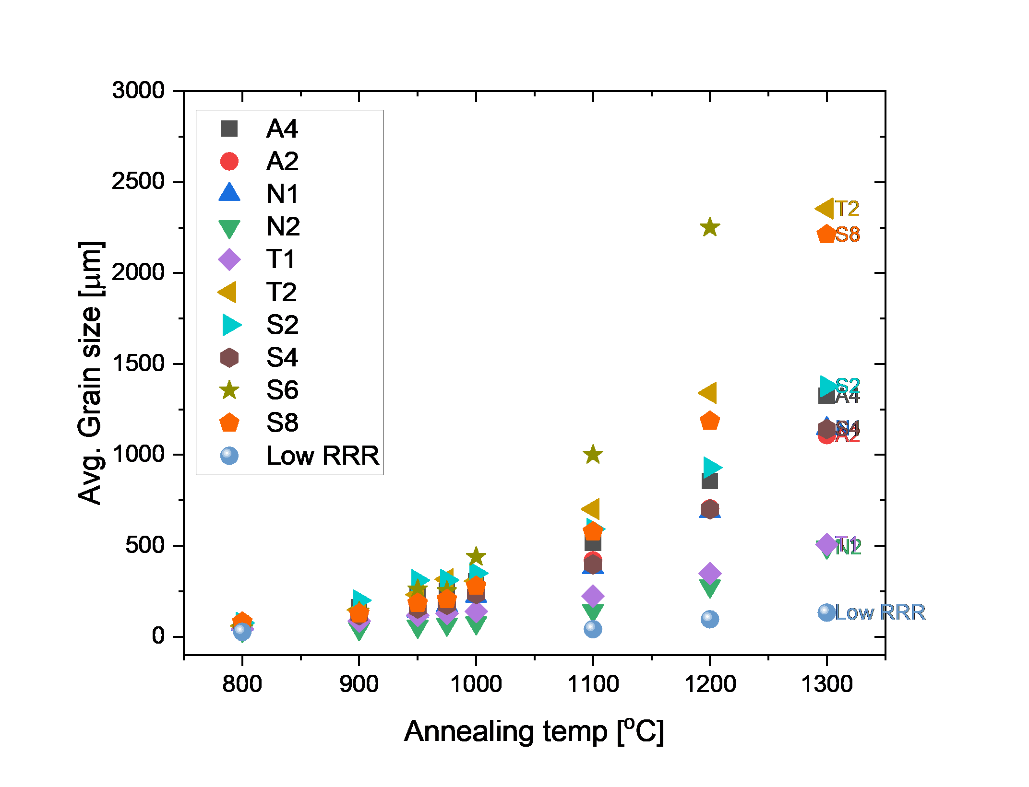
Recrystallization of low RRR won’t be sufficient for proper flux expulsion even after 1300°C annealing, otherwise, most of the high RRR show complete recrystallization
Estimate ln(k) value from the linear equation obtained below 1100°C
Expected grain size growth
Good flux expulsion samples show an exponential increasing in grain size

Slide 18
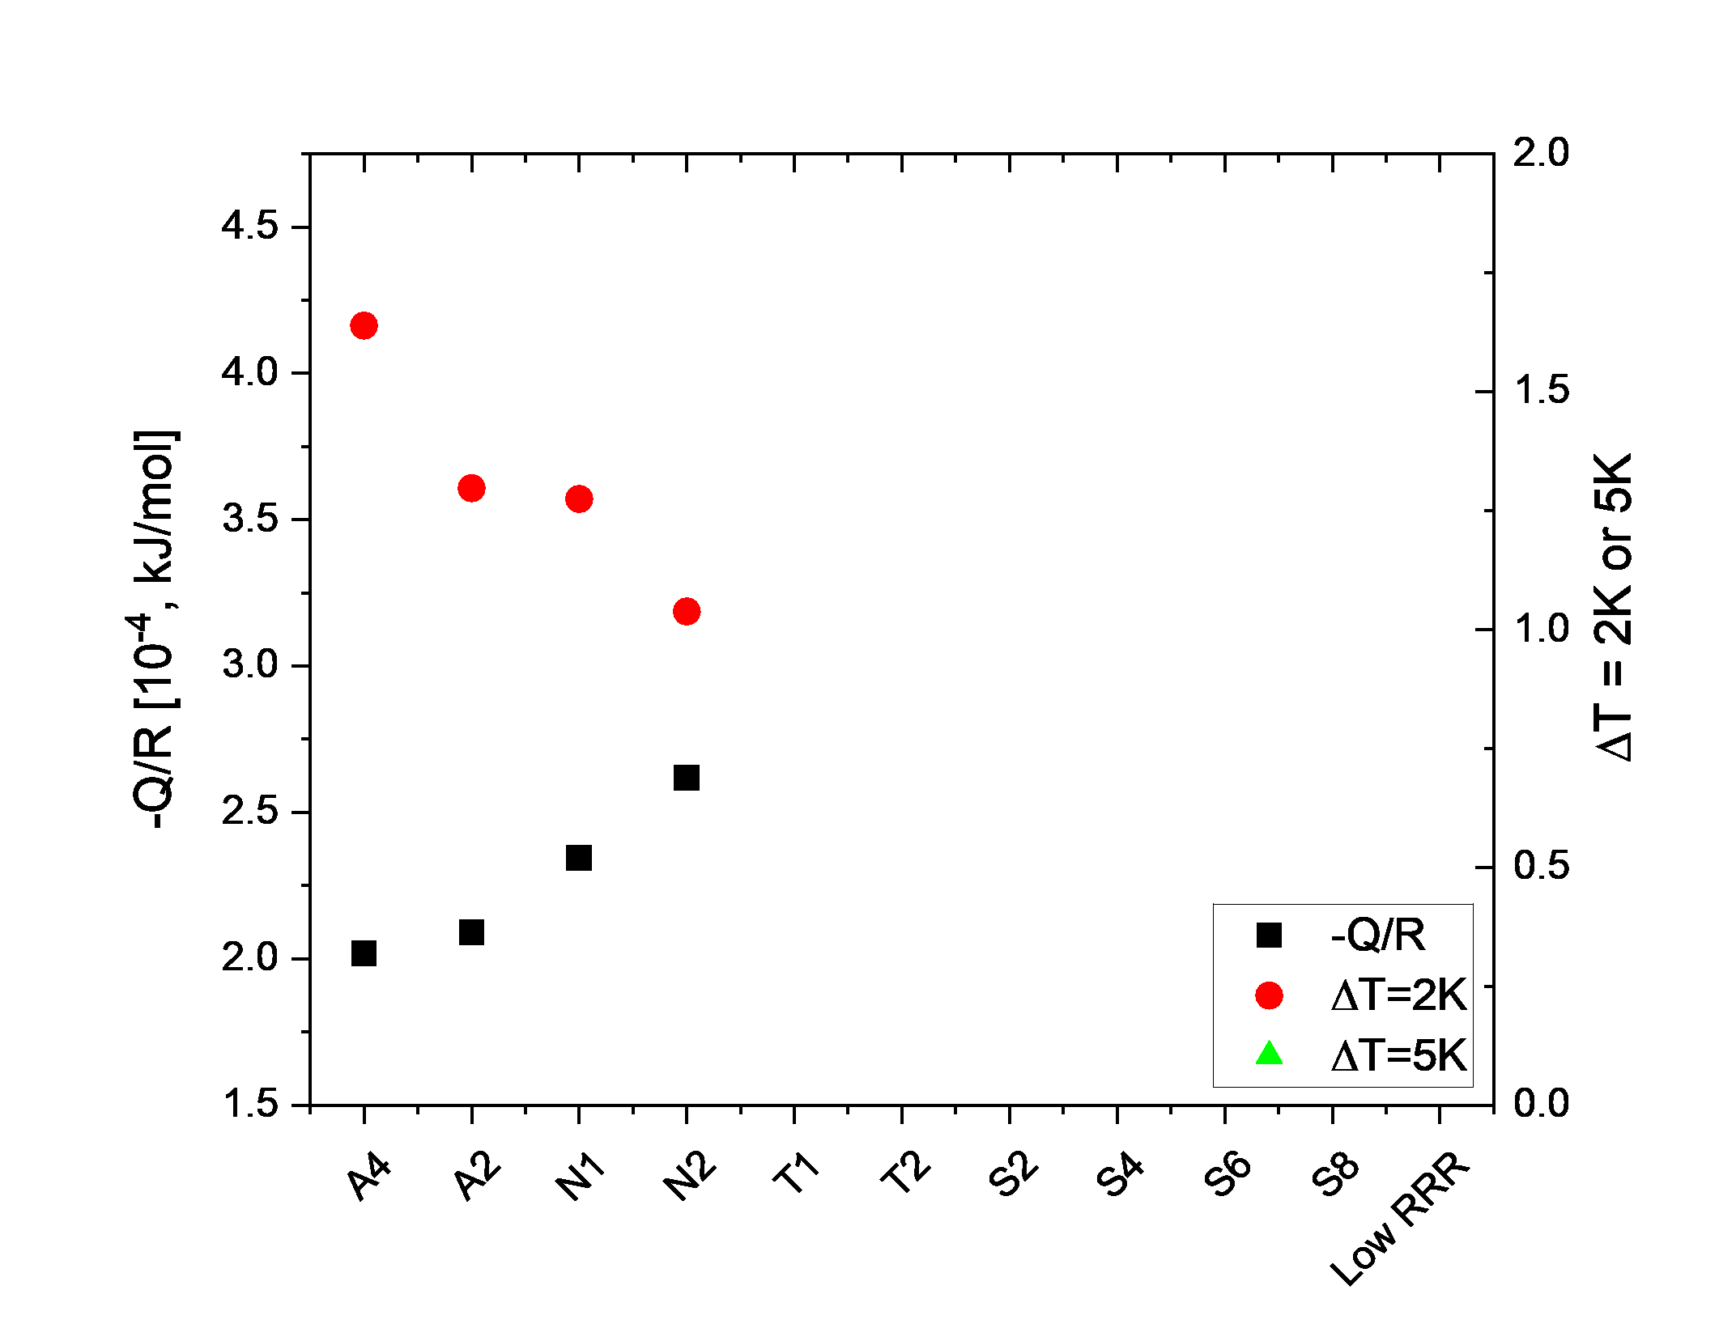

Activation energy (-Q/R) Vs Flux expulsion behavior (B_{sc}/B_{nc})
The cavity exhibits a higher expulsion rate (≥ 1.6) with a lower activation energy (-Q/R).
This indicates that the grain growth is likely easier with a fast migration velocity of grain boundaries and less interference by impurities or dislocations
$$\frac{B_{SC}}{B_{NC}} \sim 1.6:60\%$$

Slide 19
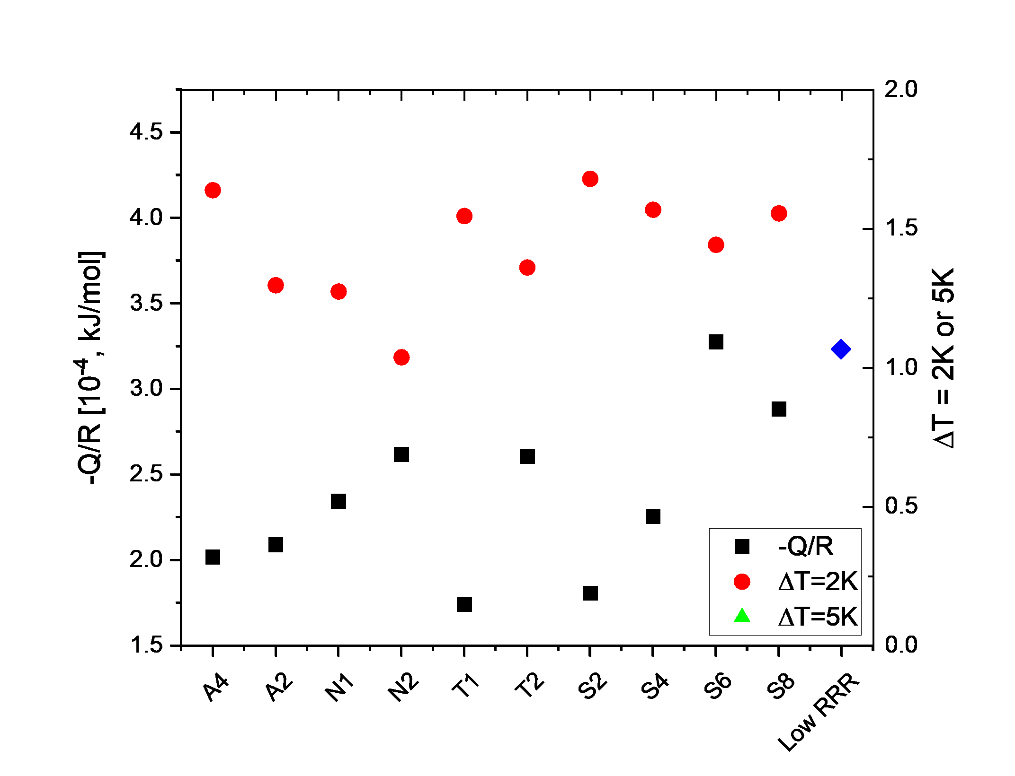
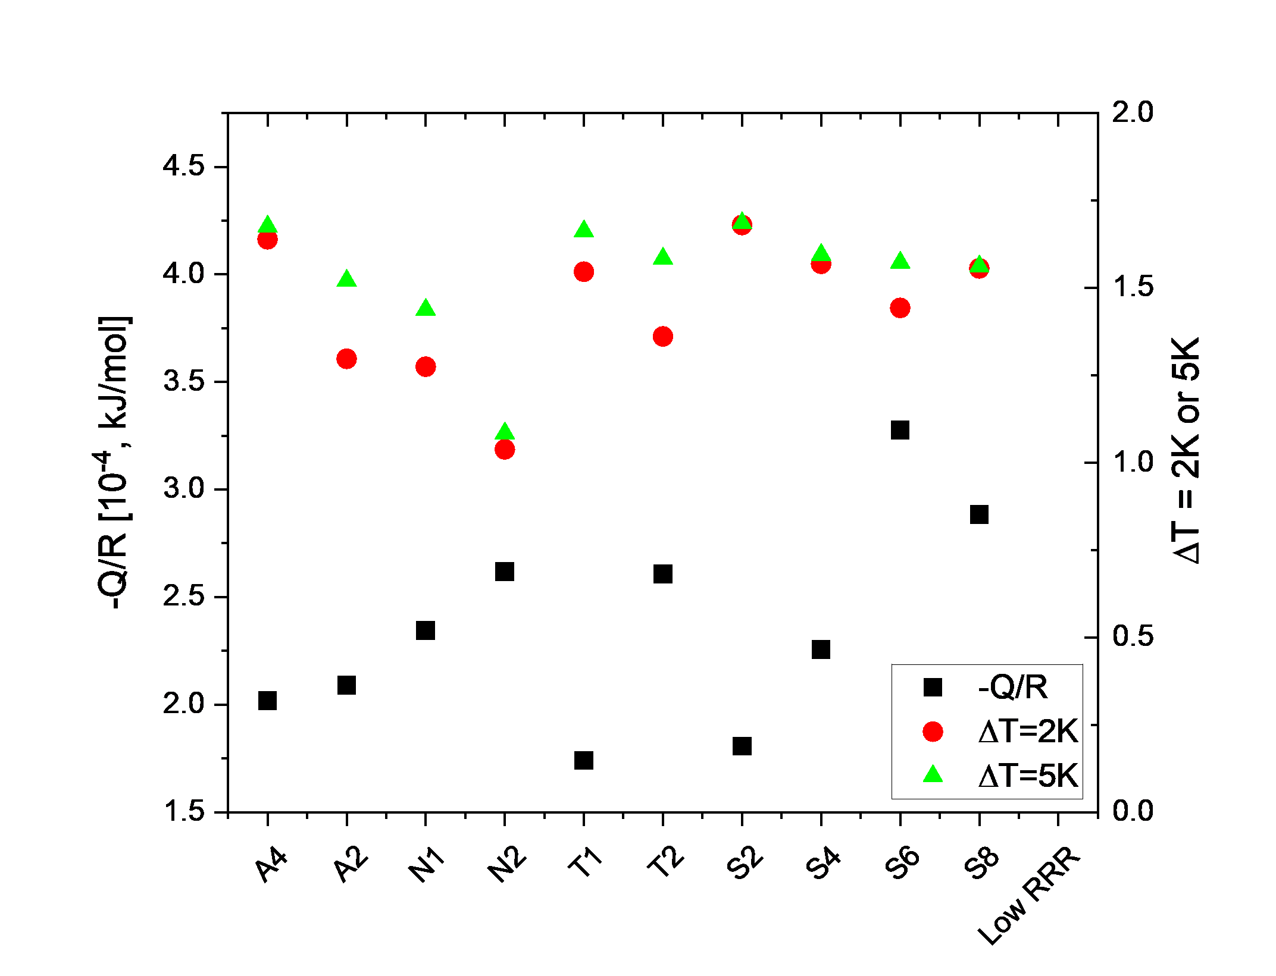
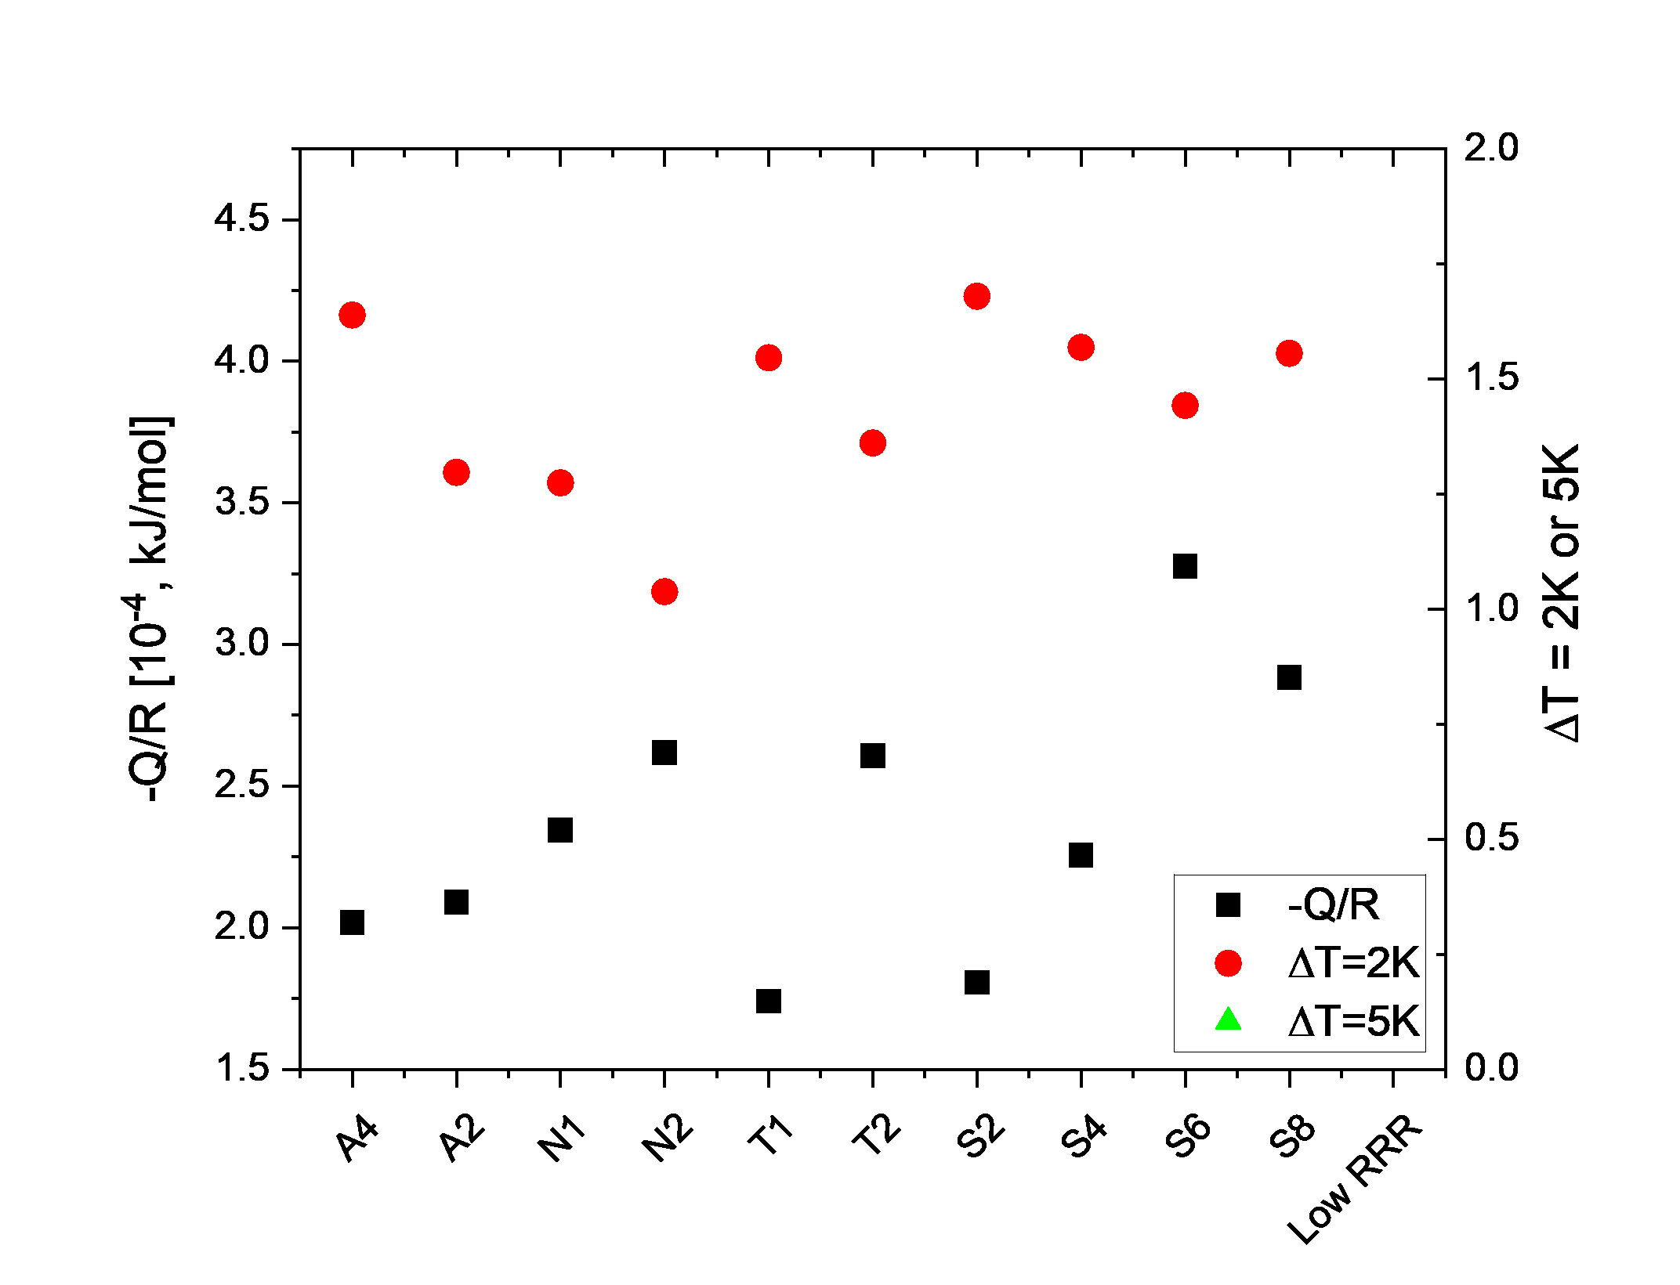

Grain-grown kinetic energy (-Q/R) vs Bsc/Bnc rate
Bsc/Bnc at 2K and 5K shows similar trends
$$\frac{B_{SC}}{B_{NC}} \sim 1.6$$
Low RRR material shows higher (-Q/R)

Slide 20
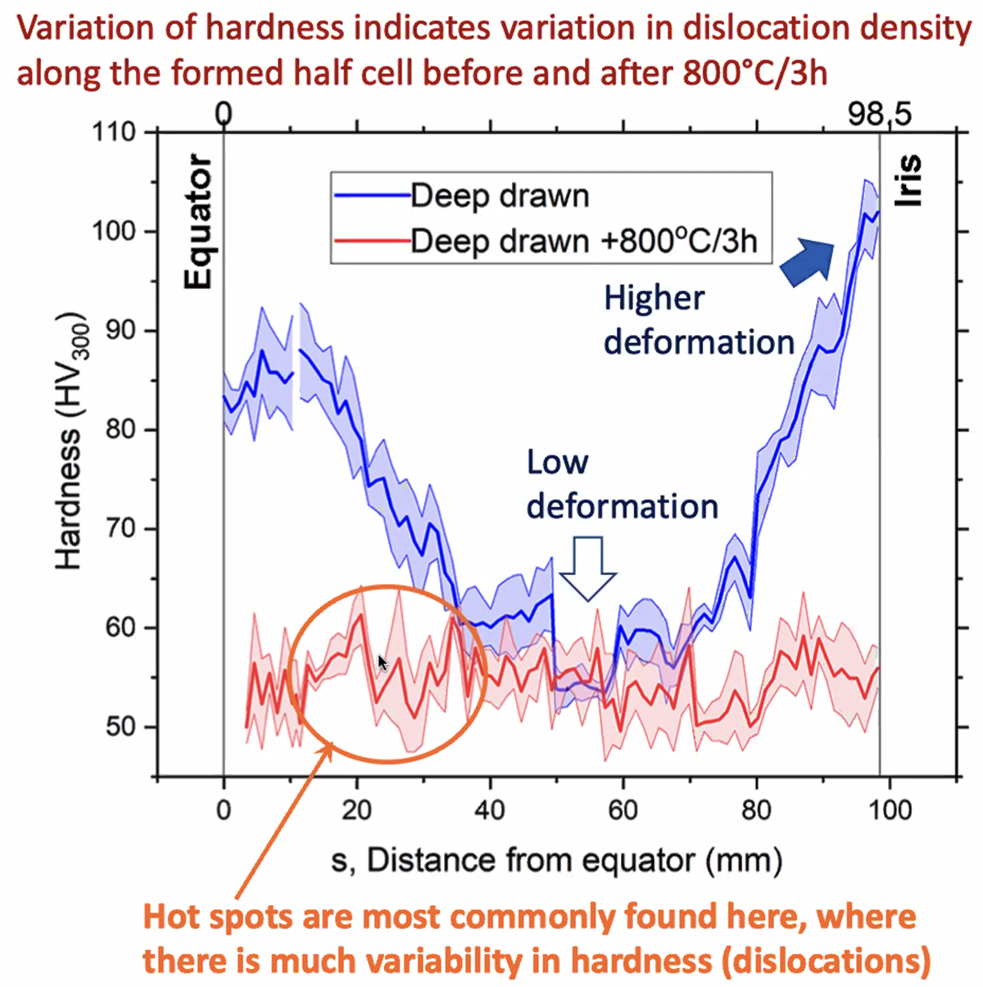
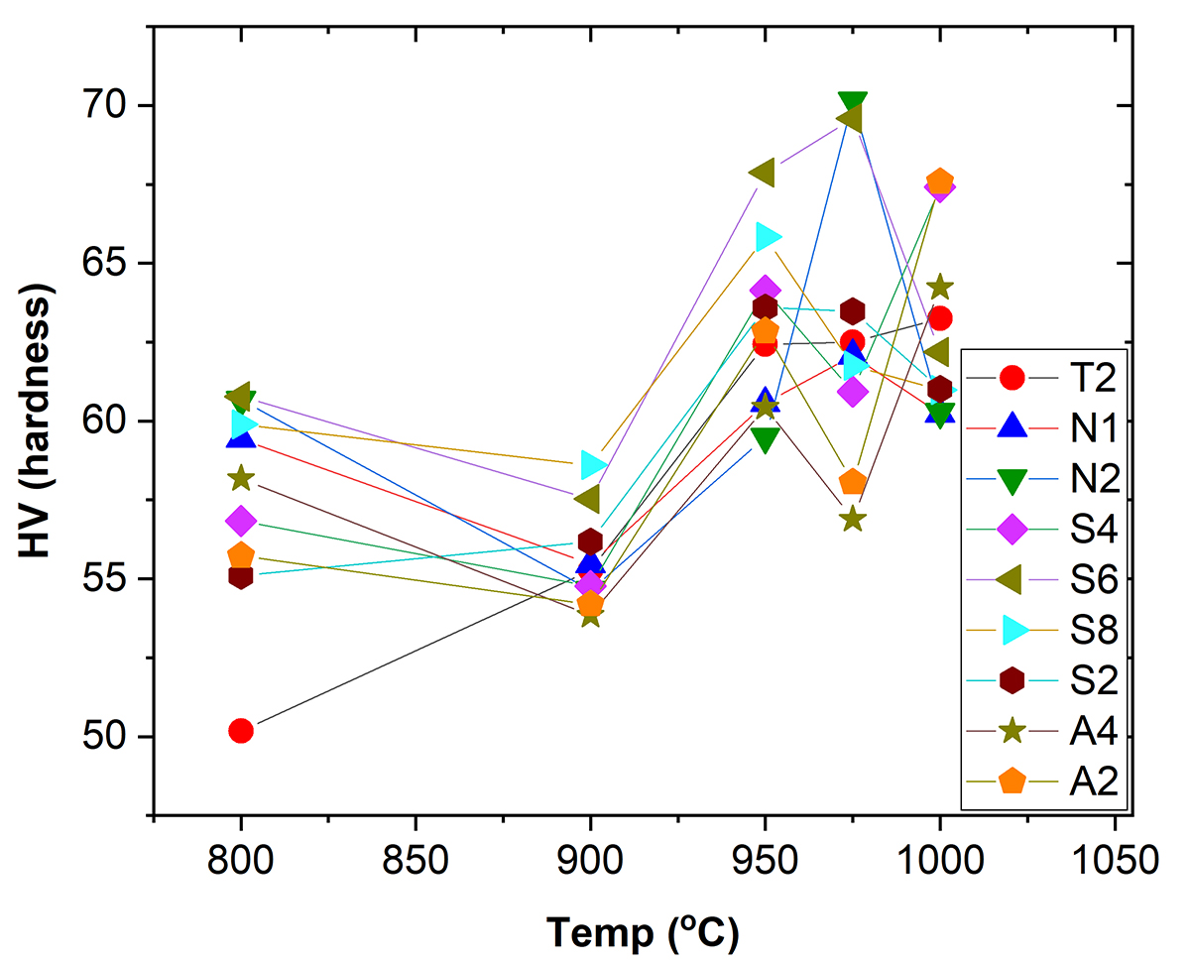
No significant softening has been observed up to 1000°C (mostly ~ 200 mm average grain size for high RRR)
Hardness vs Annealing temperature
Khanal et al., Supercond. Sci. Technol. 38 (2025) 015015
Low RRR ~ 60 HV after 1100°C

Slide 21
Summary
A flux expulsion study on a single cell cavity suggested that the expulsion efficiency depends on the materials provided by the vendor.
A materials study on the residual part revealed that its efficiency is highly associated with the intrinsic materials' recrystallization and recovery properties.
  800C vs. 900C, but higher annealing temperatures would be more suggestive of better flux expulsion behavior.
Cryogenic microscopy showed that there is a distinct impurity effect on hydride precipitation, especially oxygen, between low and high RRR.
Low RRR material is limited to full or optimal recrystallization
  Estimated even after 1300C,
  Need more activation energy (Q) -> impurities such as oxygen or dislocations.
The coupons from the cavity with good flux expulsion cavities show low activation energy for recrystallization and recovery
  Less impurities

Slide 22
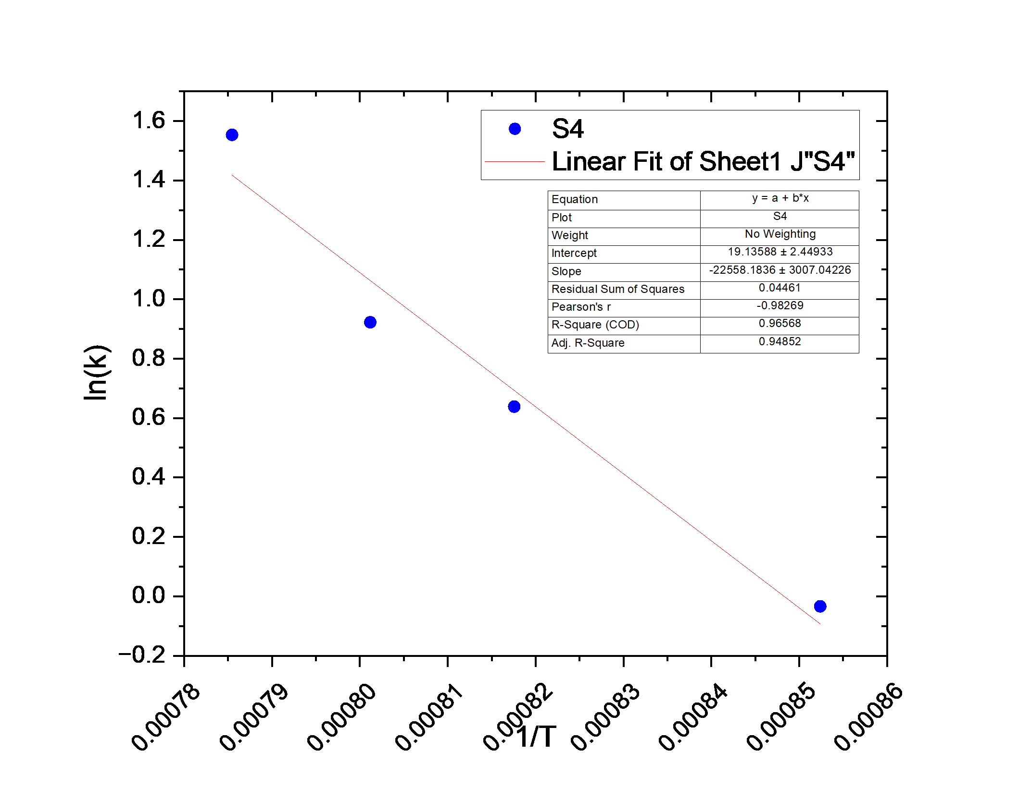
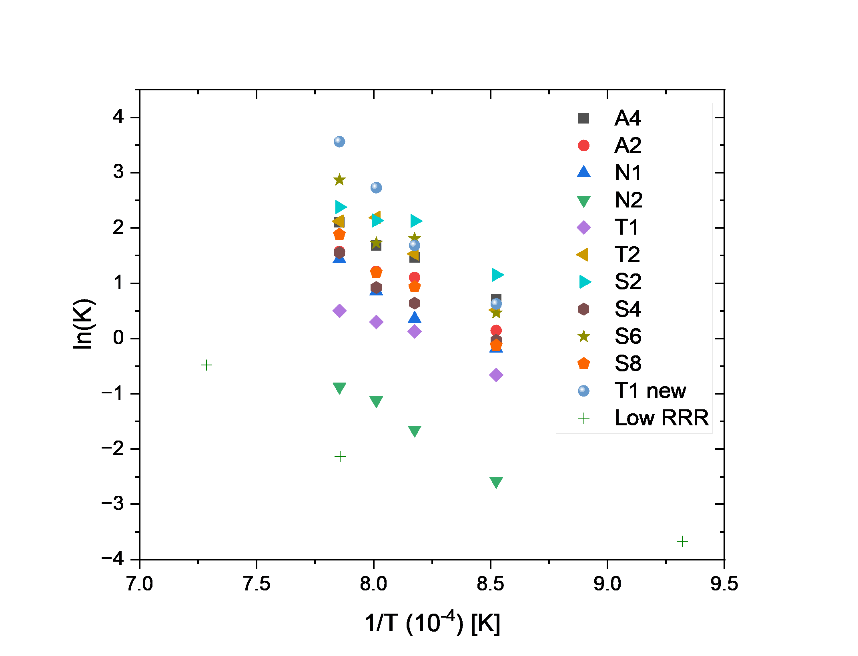



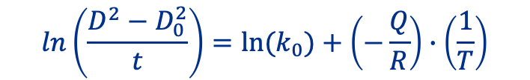
ln(k) vs 1/T
$$ln\left(\frac{D^{2}−D_{0}^{2}}{t}\right)=ln⁡(k_{0})+\left(−\frac{Q}{R}\right)∙\left(\frac{1}{T}\right)$$
$$ln\left(\frac{D^{2}−D_{0}^{2}}{t}\right)=ln⁡(k)$$
$$\left(−\frac{Q}{R}\right)=slope$$
$$\ln\left(k_{0}\right)=αMf$$

Slide 23
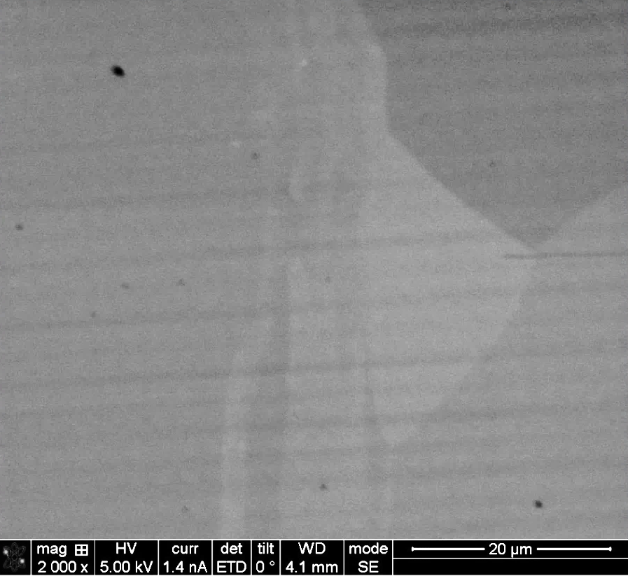



Grain 1
Grain 3
Grain 1
Grain 3
Grain 2
Grain 2
Sub-grain structures in Grain 2 with local misorientation

Slide 24



HR-TEM on Possible dislocation tangles 1
Region 2
~8º of misorientation across possible dislocation tangles
Region 1
Nb [110]
Possible dislocation tangles causing local misorientation
Region 1
Region 2

Slide 25





AGG: Zener pinning effect = GBs dragging effect by impurities or dislocations while recrystallization
impurities
GB
Kinetics of the abnormal grain growth
$$D^{n}−D_{0}^{n}=\frac{k_{A}}{k_{n}^{1/n}}∙\left(\frac{n}{n−1}\right)∙t^{\left(\frac{n−1}{n}\right)}$$
$$k_{A}=Abnormal Grain growth constant$$
$$k_{n}=Normal Grain growth constant$$

Slide 26


-Q/R vs ln(k₀) for coupon samples
These high RRR coupons are not in an ideal state.
  Some amounts of impurities and dislocations exist in the samples.
The activation energy term (-Q/R) decreases with increasing in ln(k₀) term.
  In case of a non-ideal recrystallization environment, ln(k₀) describes not only grain mobilities (M) but also grain retarding force (f_{retard})due to impurities/dislocations.
The linearity indicates that higher impurity contents require higher activation energy for grain growth and recrystallization.
$$k\left[\frac{1}{T}\right]=M_{0}∗f_{retard}∗\exp\left(\frac{−Q}{R∗T}\right)=A∙e^{(−\frac{Q}{RT}) }$$

Slide 27




My approach assumption is “No significant impurities effects, but only dislocation effect on grain growth SRF grade Nb”
$$\frac{dD}{dt}=M{(ΔF)}^{\frac{1}{n}−1}$$
$$\frac{dD}{dt}=K{(\frac{1}{D}−F_{retard})}^{\frac{1}{n}−1}$$
$$k\left[\frac{1}{T}\right]=M_{0}∗F_{retard}∗\exp\left(\frac{−Q}{R∗T}\right)=A∙e^{(−\frac{Q}{RT}) }$$
M = grain boundary mobility
ΔF = the net driving force of grain growth
n = the time exponent
Q = activation energy of GB

Slide 28
Abstract
Transition niobium (Nb) metal has been widely accepted in superconducting technology due to its strong isotropic superconductivity. Its high mechanical formability allows the application of the radio frequency (RF) resonator (cavity) by fabricating a complex device form. The residual resistivity ratio (RRR: 300K/10K) is used to define the purity of superconducting Nb. To date, high RRR Nb (> 250) is known to exhibit ultimate low electrical surface resistance in the RF regime, which enables obtaining a high-quality factor, defined as the stored energy in terms of power dissipation. A high RRR Nb cavity significantly expels magnetic flux with post-treatment at 900°C for 3 hours, which promises acceptable RF performance. However, the flux expulsion ratio of a low RRR Nb cavity remains unsatisfactory even with 1000°C treatment. We suppose that a lack of understanding of the engineering process for the grain growth and recovery of the strained structure likely abandons the feasibility of lower RRR Nb application. In this study, we compare recrystallization and recovery between low and high RRR Nb regarding abnormal and normal grain growth in terms of annealing temperature and time. The comparison is based on evaluating grains and sub-grains coarsening and dislocation annihilation. Dislocation propagation associated with deformation is also investigated by nano-indentation. The same fashion of annealing is applied to both low and high RRR Nb materials in a high vacuum environment to minimize foreign element effects on the pinning of the grain boundary. Based on the evaluated trend on the recovery and recrystallization of high RRR Nb, we estimate the thermal treatment threshold for low RRR Nb, in which an optimal RF performance with sufficient magnetic flux expulsion can be achieved.

