Slide 1
Maintenance of SCL3 cryogenic helium plant for Korean heavy ion accelerator after 3 years of operation
* This work was supported by the Institute for Basic Science (IBS-I001-D1)
CEC/ICMC25: C1Or2A-01
Junghyun Yoo
On behalf of cryogenic system team
Institute for Rare Isotope Science (IRIS), Institute for Basic Science (IBS)
19th May 2025 (Mon.)
Notes:
Hello, I’m Junghyun Yoo from IRIS, South Korea.
I’m working for a Korean heavy ion accelerator and my major responsibility is the operation and maintenance of the helium cryogenic plant for SCL3 section.
It is very honor for me to have a presentation in this CEC-ICEC2025.
The title of my presentation is “Maintenance of SCL3 cryogenic helium plant for Korean heavy ion accelerator after 3 years operation”.

Slide 2
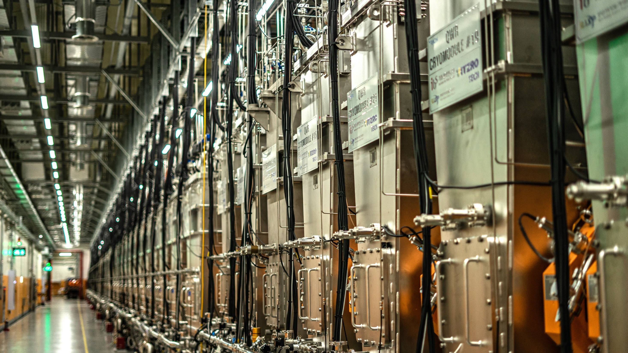
Content
01
Introduction
02
Preparation for the maintenance
03
Maintenance results
04
Conclusion and future work
Notes:
This is the content for my presentation.
First, I will introduce the Korean heavy ion accelerator and the cryogenic helium plant for SCL3 section,
And I will have the presentation in the order of “Preparation for the maintenance”, “Maintenance results” and “conclusion and future work”.

Slide 3
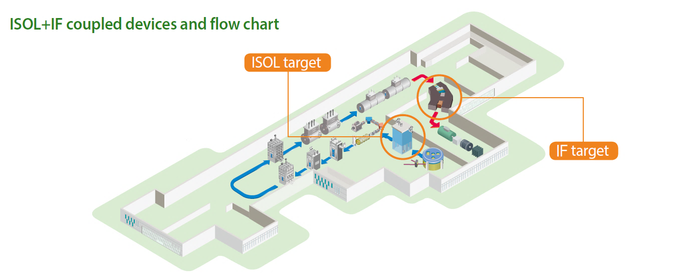
Introduction – Korean heavy-ion accelerator, RAON
ISOL + IF
Two superconducting linear accelerators (LINAC) - SCL3 & SCL2
→ Need cryogenic system!
SCL2 LINAC (~300 m)
SCL3 LINAC (~100 m)
Notes:
This is a brief picture of the Korean heavy ion accelerator.
The name of the Korean heavy ion accelerator is RAON.
RAON has two superconducting linear accelerators, SCL3 section and SCL2 section.
The length of SCL3 LINAC is around 100 m, and the length of SCL2 LINAC is three times longer than SCL3 section.
Both LINACs consist of hundreds of superconducting cavities, so the cryogenic system is necessary for RAON.

Slide 4
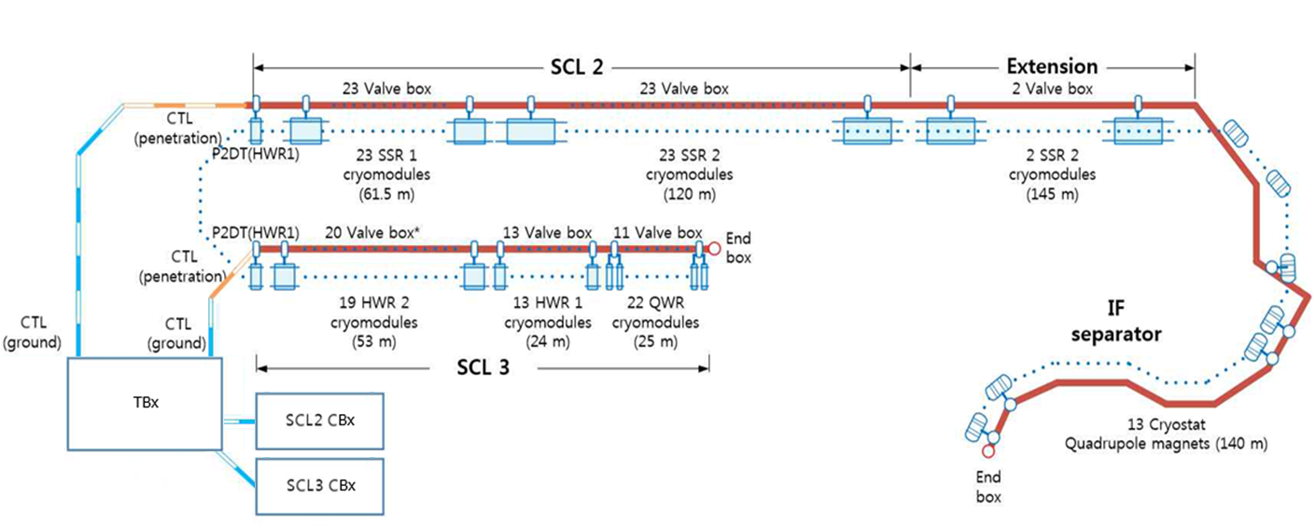
Introduction – Current status of the cryogenic system in RAON
SCL2 section: 2nd stage (Not finished yet, ~2030)
= Main
distribution box)
SCL3 section: 1st stage
(Operation, 2023~)
IRIS finished construction of SCL3 section (2022)
IRIS has operated SCL3 section of RAON (2022~)
* 1st run (2022.09 ~ 2023.06, 10 months continuous operation)
* 2nd run (2024.02 ~ 2024.09, 8 months continuous operation)
Notes:
This is a picture for the overview of the cryogenic system in the Korean heavy ion accelerator.
There are two dedicated cryogenic helium plants for each LINAC.
Each cryoplant makes 4.5 K cryogenic helium and transfers the cryogenic helium to each LINAC through the main distribution box and transfer line.
The transferred cryogenic helium is distributed by each valve box for the cryomodule and the helium is finally supplied to each cavity.
SCL2 section is still constructing now and SCL3 section was constructed on 2022 and has been operated since 2022.

Slide 5
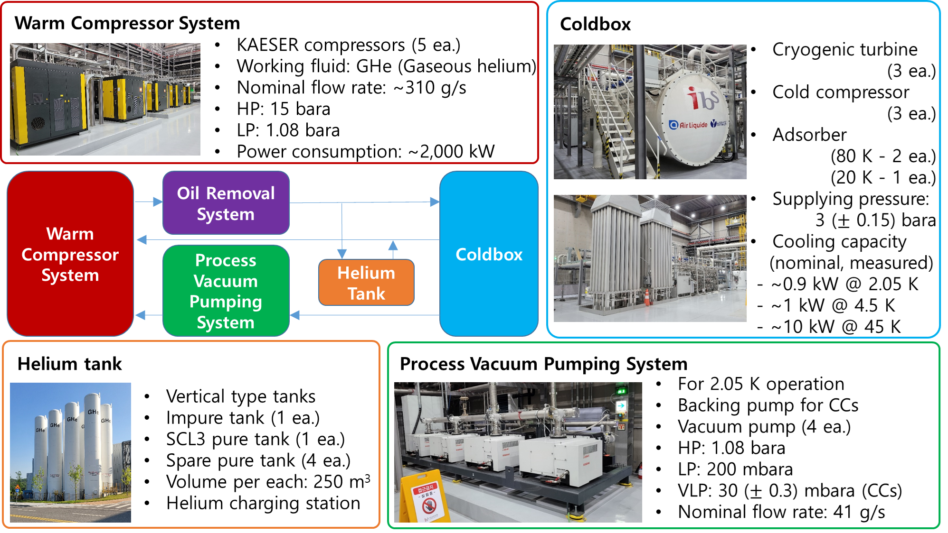
Introduction – Cryogenic helium plant for SCL3 section
Notes:
Now, I’d like to introduce SCL3 cryogenic helium plant.
SCL3 cryoplant has five warm helium compressors. four of them are for normal operation and another one is on standby to prepare for a sudden trip of a compressor.
The working fluid is pure helium and the nominal mass flow rate is three hundred ten gram per second.
The high pressure is fifteen bar absolute, and the low pressure is one point eight bar absolute.
On the coldbox side, there are three cryogenic turbines for 4.5 K operation.
Also, there are PVPS and three cold compressors for 2 K operation.
The SCL3 cryoplant can make three temperature areas, 45 K for thermal shield, 4.5 K for QWR cavities and 2 K for HWR cavities.
The measured cooling capacity during the site acceptance test was 10 kW for 45 K, 1 kW for 4.5 K and 0.9 kW for 2 K.

Slide 6
Introduction – Operation results in 2024 (2nd run)
2 K Availability (NOT include period for cool-down, 4 K standby and warm-up)
2 K operation period | 150 days - 2024.03.27 (Finished 2 K pumpdown) ~ 2024.08.23 (the last beam service)
Unavailability | 2 days - Compressor trip due to loosening the connection of the sensor wire (1 day) - Stop of one 2 K pump (PVPS) & stabilization (1 day)
2 K availability | 98.7% - 148 days / 150 days
Helium return rate (Calculated with HePAK, temperature and pressure sensors)
Amount of helium before cool-down | 1588.1 kg (Starting cool-down: 2024.02.19)
Amount of helium after warm-up | 1549.8 kg (Finishing warm-up: 2024.10.14)
Helium return rate | 97.6% (During 244 days)
Notes:
I’d like to briefly introduce our operation results in 2024 as 2 K availability and helium return rate.
IRIS had 150 days for a 2 K operation period in 2024.
There were two days of unavailability due to the sudden compressor trip and the planned stop of one 2 K pump.
Therefore, the 2 K availability was 98.7% during 150 days.
The helium return rate was calculated by the comparison of helium amount before starting cooldown and finishing warm-up.
Our final helium return rate was 97.6% during 244 days.

Slide 7
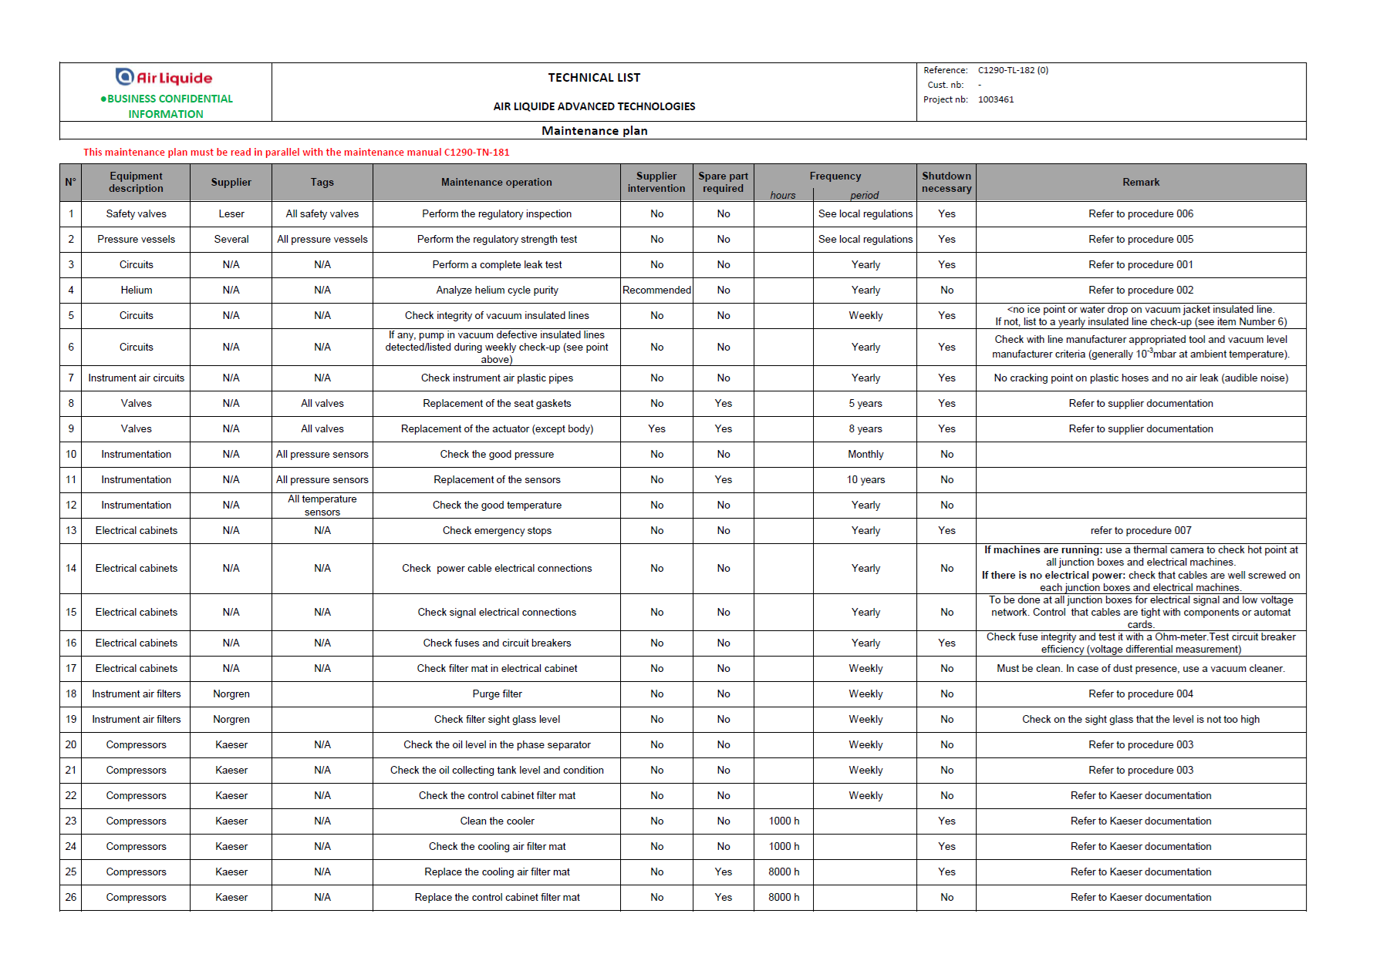
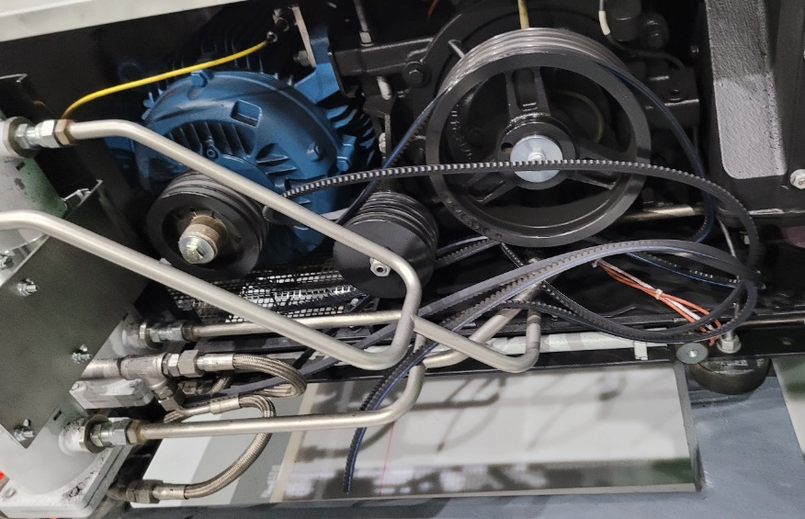
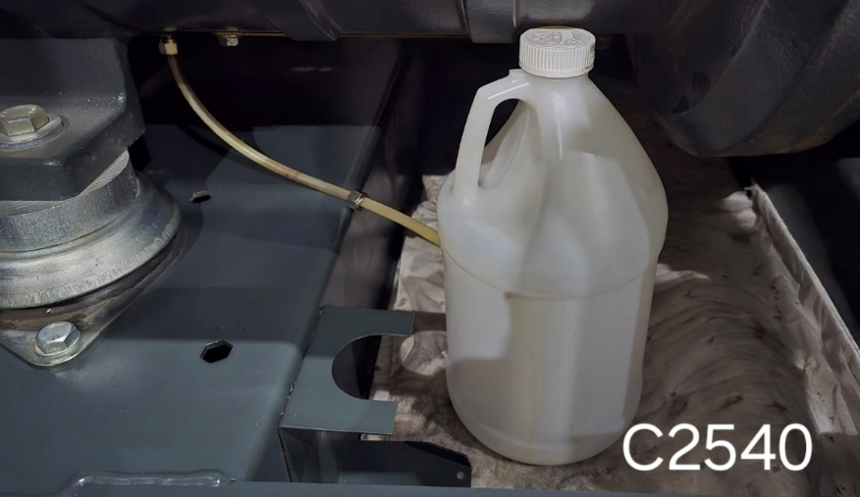
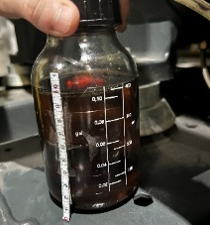
Preparation for the maintenance – listing maintenance items
1. Suggested items from the manufacturer
2. Issued items during the operation
Failure of belt in 2 K pump
One of 2 K pumps
Increasing oil leakage @ WCS
(Preventive)~ 80 ea. for 3 years maintenance
(Repair/improvement) ~ 100 ea.
Notes:
During the operation in 2024, I made the maintenance list to immediately start the maintenance activity after warm-up.
For us, there were two types of maintenance items.
First, the manufacturer of the cryoplant suggested the preventive maintenance item at the handover.
Around 80 items corresponded with the manufacturer’s suggestion.
Second, there were some issued points during our operation.
The number of issued points was around 100 each, so I made the maintenance list for a total 180 items.

Slide 8
Preparation for the maintenance – direction of the maintenance
* Turn-key → Cost & Delay ↑↑↑
* Contracting each vendor → Cost & Delay ↓
Direction of the construction phase
Direction of the maintenance
ALAT – SCL3 cryoplant
KAESER
SAUER
KAESER
SAUER
Warm compressors
Recovery compressors
Warm compressors
Recovery compressors
LEYBOLD
EDWARDS
ETC
LEYBOLD
EDWARDS
ETC
PVPS
Vacuum pumps
ETC
PVPS
Vacuum pumps
ETC
HANYANG
ALAT
HANYANG
ALAT
Installation
ORS
& Coldbox
Installation
ORS
& Coldbox
Need ~20 ea. of separate contracts
with each vendor
Notes:
Next, I decided the direction of the maintenance.
The construction of the cryoplant was handled as turn-key, but there were some issues with the cost and schedule.
So, I decided to conclude the contract with each vendor.
As a result, this needs around 20 separate contracts and handling the contract by myself.

Slide 9
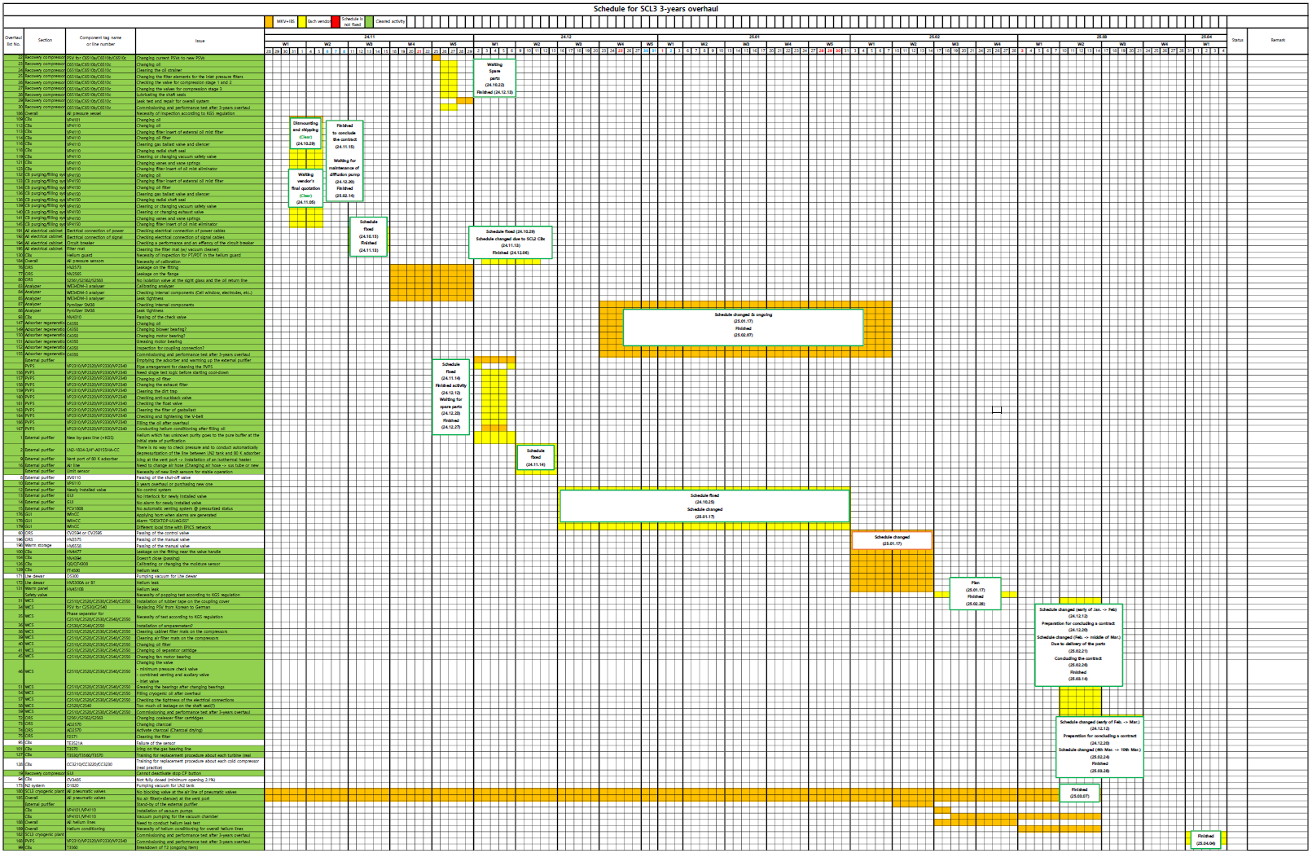
Preparation for the maintenance – Schedule arrangement
Period: 2024.11~2025.03
Recovery system
Vacuum system
Control cabinet
Blower & Leak points
PVPS
External purifier
(Mechanical & Software)
Leak points
WCS
ORS & Coldbox
Etc
Commissioning
Notes:
After the decision on the direction, I contacted each vendor, discussed the work scope with the vendors, concluded the contracts and arranged the schedule.
Our warm-up was planned for October 2024, and the 3rd cooldown was scheduled for April 2025, so I made a plan to conduct the maintenance activities from November 2024 to March 2025.

Slide 10
Maintenance results – Summary
Objective | - 3 years overhaul for SCL3 cryogenic helium plant
Period | - Preparation*: 2024.03 ~ 2025.02 (12 months) *Contact, discussion, concluding the contract - Activity: 2024.11 ~ 2025.03 (5 months)
Spent budget | ~ 602,000 USD (~ 2.9% of the construction cost)
Number of the contracts | ~ 20 ea.
Involved partner company | - Air Liquide Cryogenic Services (France) - Hanyang engineering (South Korea) - KAESER Korea (South Korea) - Metec International (South Korea) - POSS engineering (South Korea) - Leybolds Korea (South Korea) - GEFI (France) - EDWARDS Korea (South Korea) - PDK (South Korea) - Solyeon Tech. (South Korea) - MKV (South Korea) - Other appreciated companies
Total 18 companies from
South Korea (16)
France (2)
Notes:
This is the summary of the maintenance results.
The objective was 3 years overhaul for SCL3 cryogenic helium plant, the preparation period was 12 months.
The maintenance activities were conducted from November 2024 to March. 2025.
The spent budget was around six million two thousand dollars and this corresponded to two point nine percent of the construction cost.
The number of contracts was around twenty and eighteen companies were involved.

Slide 11
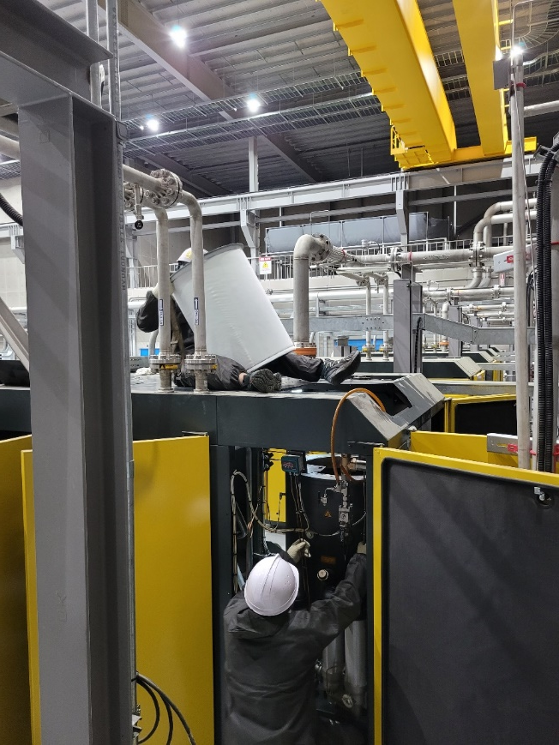
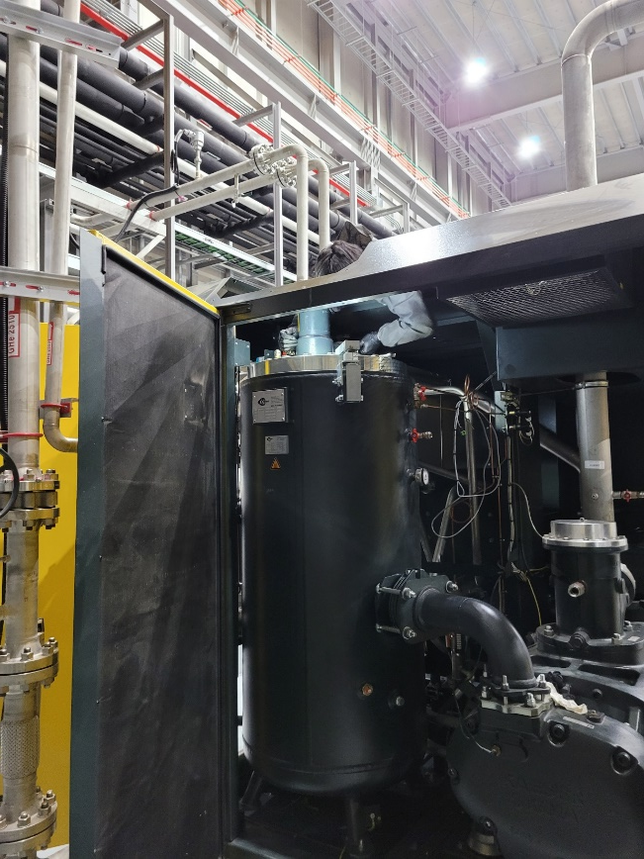
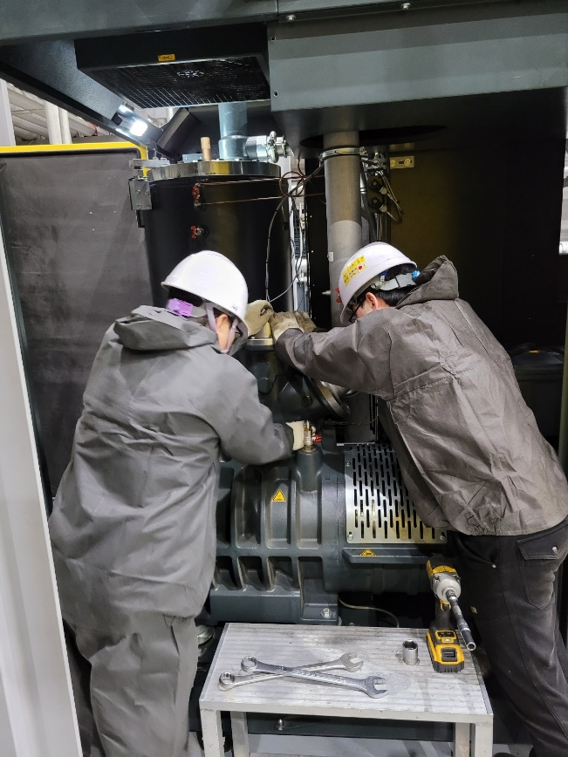
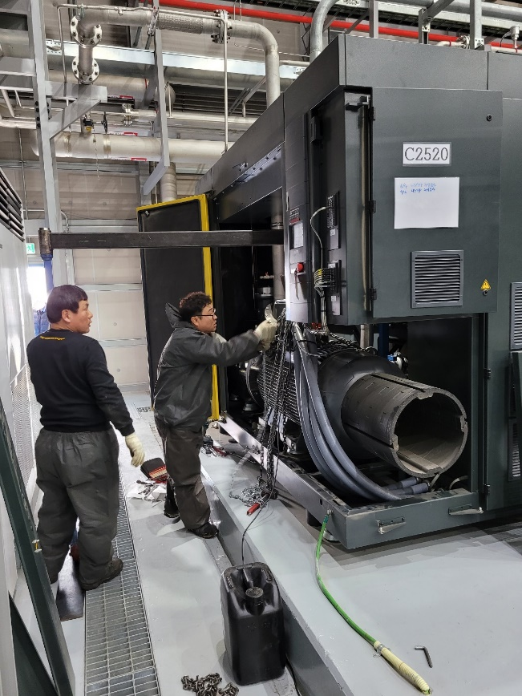
Maintenance results – Photos; Warm compressors
Maintenance for the warm compressors
  Replacement of the oil separator cartridges
  Replacement of the vent valves, check valves, by-pass valves and inlet valves
  Replacement of the shaft seals
  Etc (replacement of fans, checking the cable connection…)
Notes:
Let me introduce some details of the maintenance activities.
For the warm helium compressors, we replaced the oil separator cartridges, several valves, fans and the shaft seals like the pictures.

Slide 12
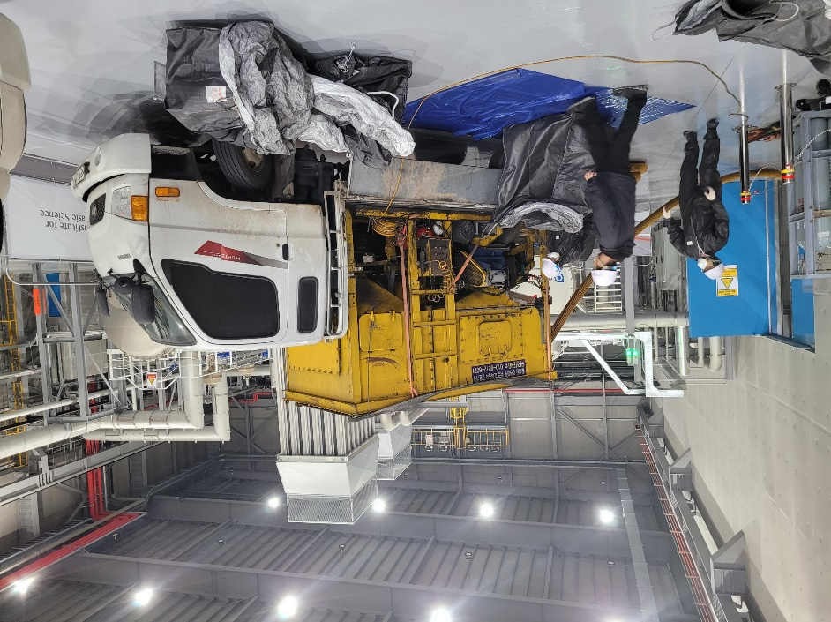
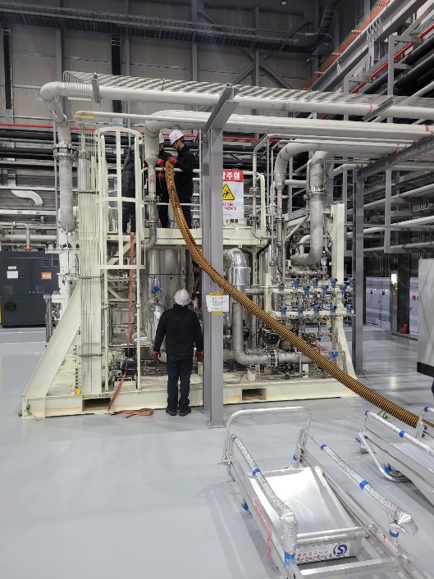
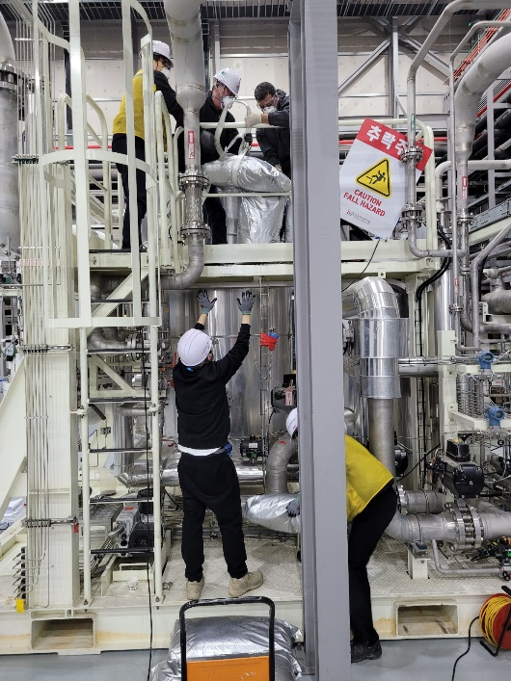
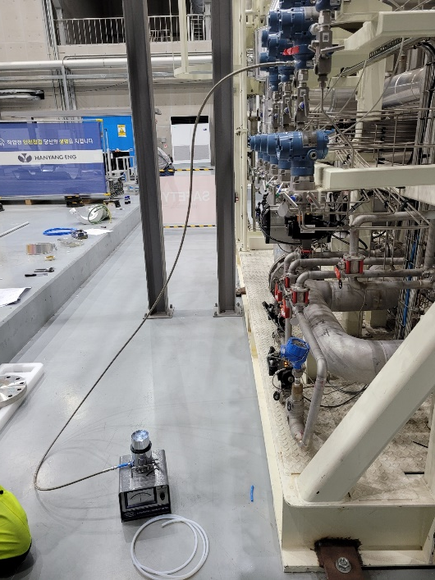
Maintenance results – Photos; ORS (Charcoal)
Maintenance for the ORS charcoal tower
  Removing the old charcoal (activated carbon) with a vacuum suction truck
  Cleaning the inside of the tower
  Filling the new charcoal
  Removing the charcoal dust
  Regeneration of the new charcoal (D.P. < -70 ℃)
Notes:
For ORS charcoal tower, we replaced the charcoal.
First, we removed the old charcoal with the vacuum suction truck, and cleaned the inside of the charcoal tower.
Next, we carefully filled the new charcoal to the charcoal tower to avoid damage to the charcoal and removed the charcoal dust during the filling.
Last, we baked the new charcoal with hot nitrogen until the dew point of the nitrogen reached -70 degrees Celsius.

Slide 13
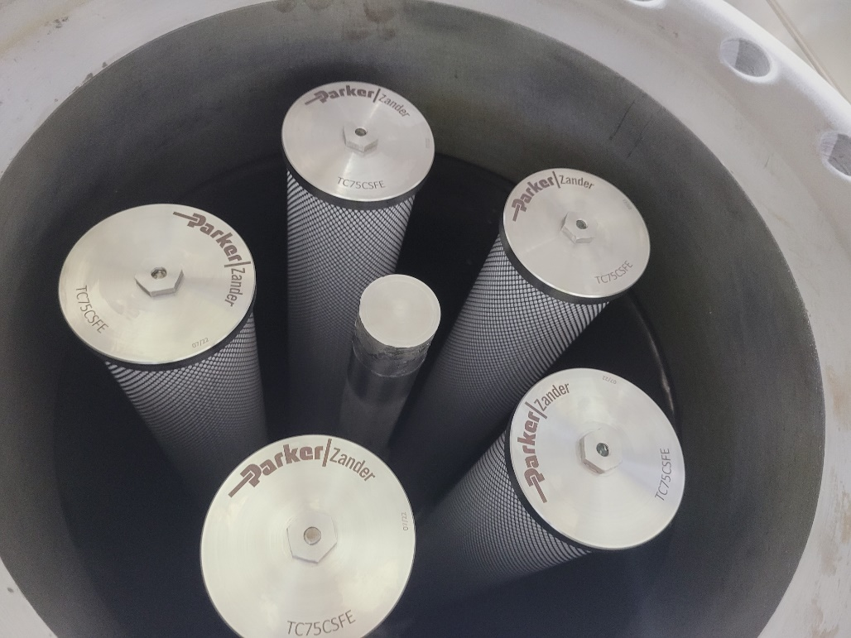
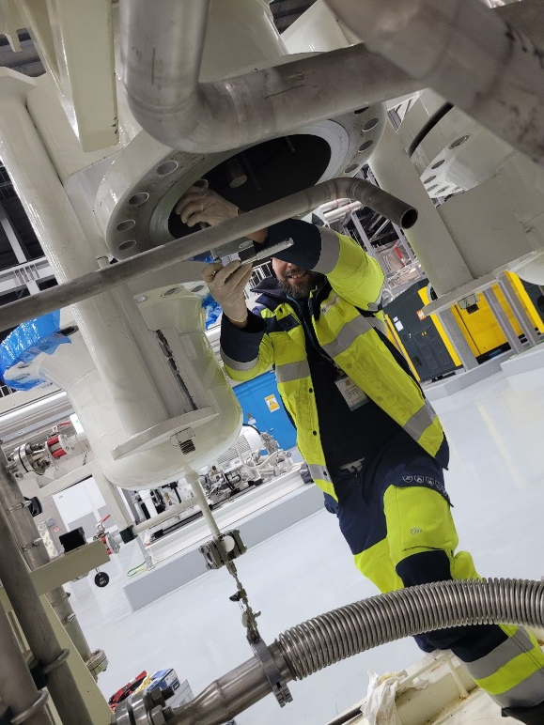
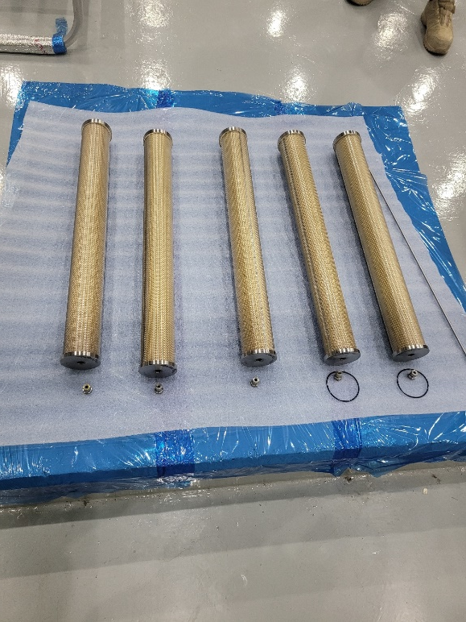
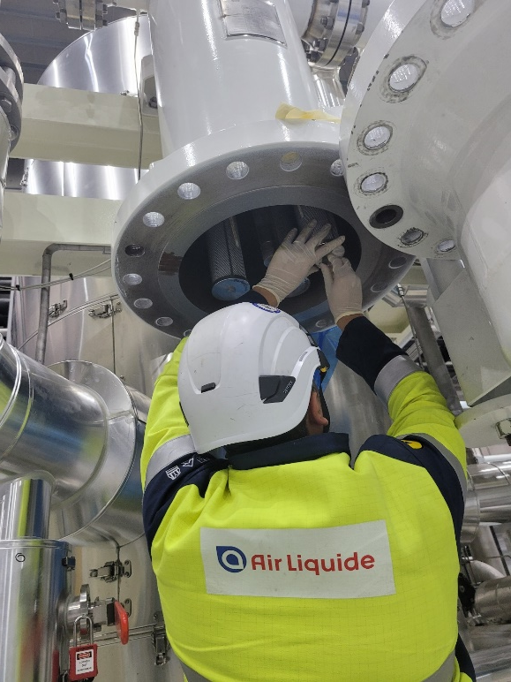
Maintenance results – Photos; ORS (Coalescer)
Maintenance for the ORS coalescing vessel
  Removing the old coalescing filters
  Cleaning the inside of the vessel
  Installing the new coalescing filters
Notes:
For ORS coalescing vessel, we removed the coalescing filters, cleaned the inside of the coalescing vessels and installed the new coalescing filters.

Slide 14
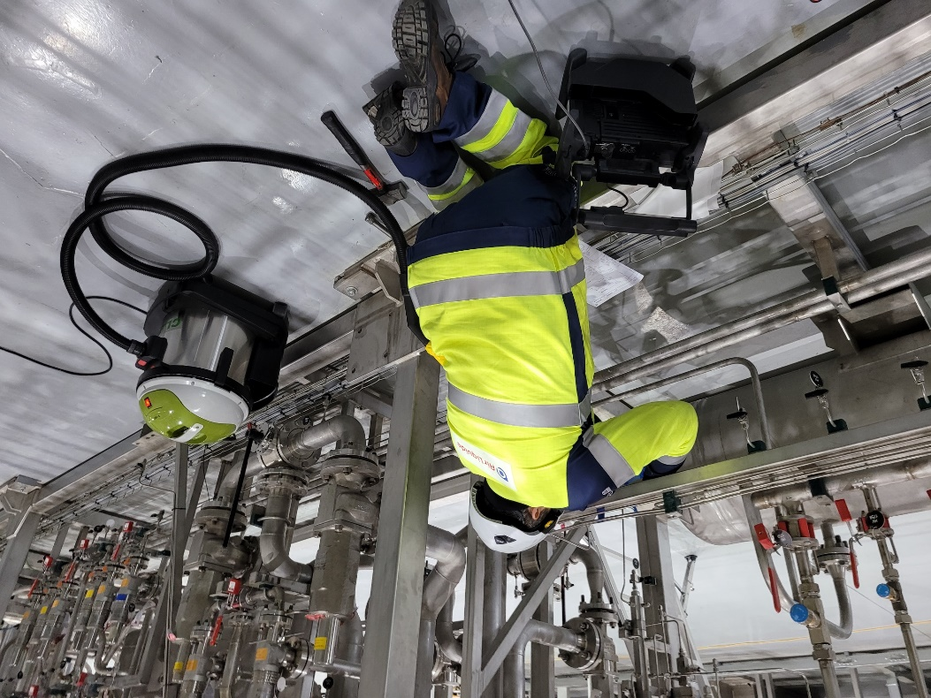
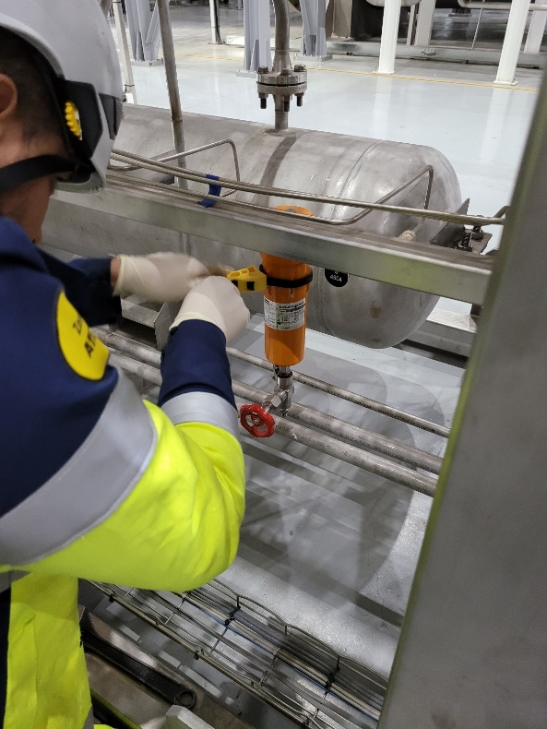
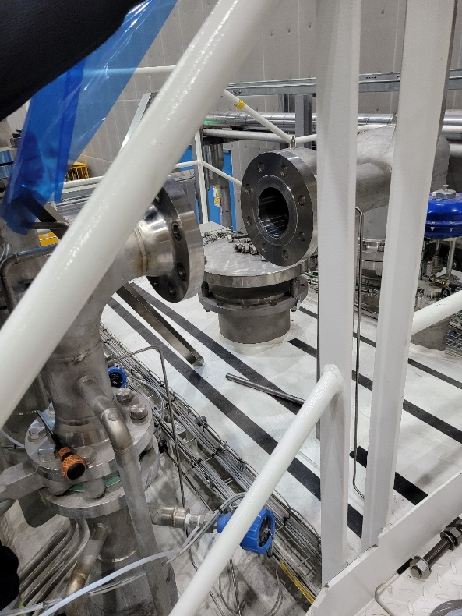
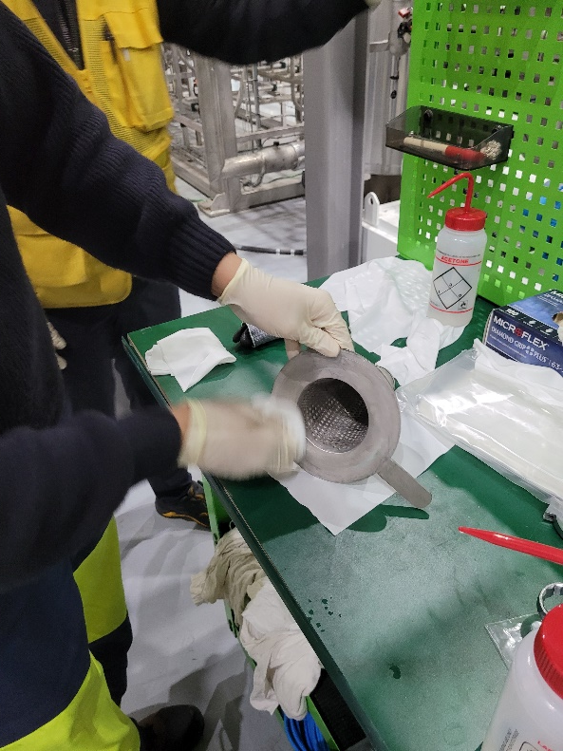
Maintenance results – Photos; Coldbox
Maintenance for the coldbox
  Inspecting and cleaning the inlet filter of the gas bearing line for the turbines
  Inspecting and cleaning the inlet filter of the coldbox
Notes:
For the coldbox side, we checked and cleaned the inlet filters for the turbine gas bearing and the coldbox.
Fortunately, there was no severe pollution.

Slide 15
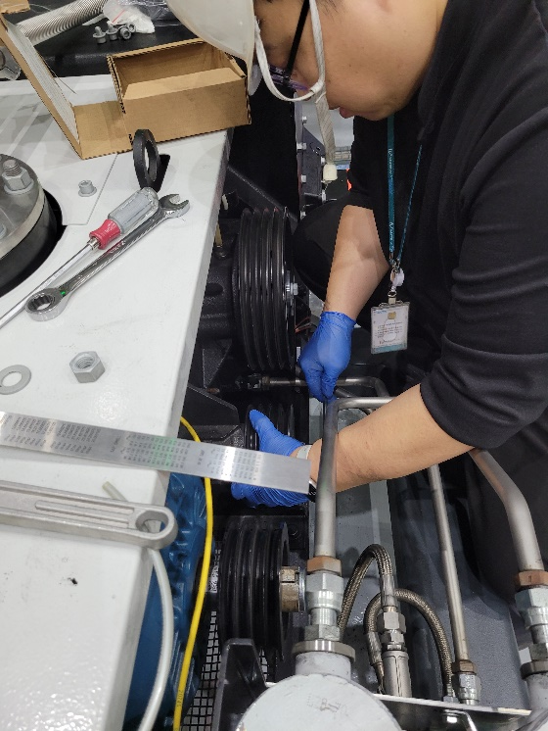
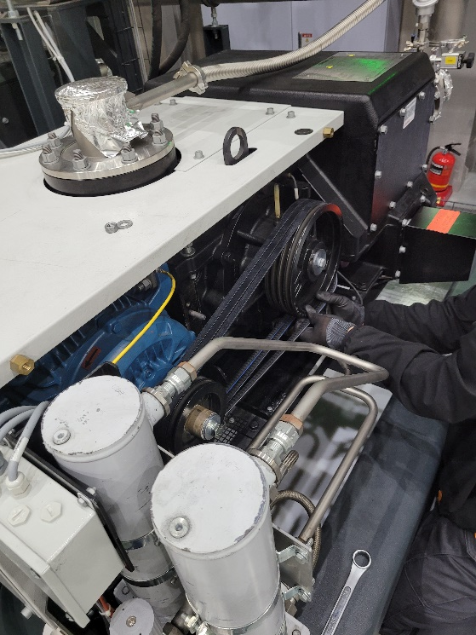
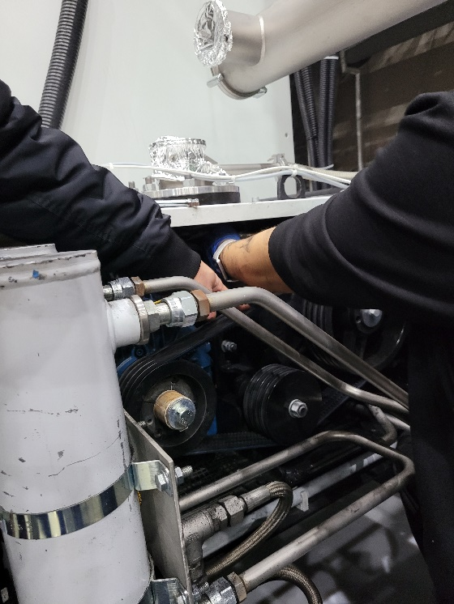
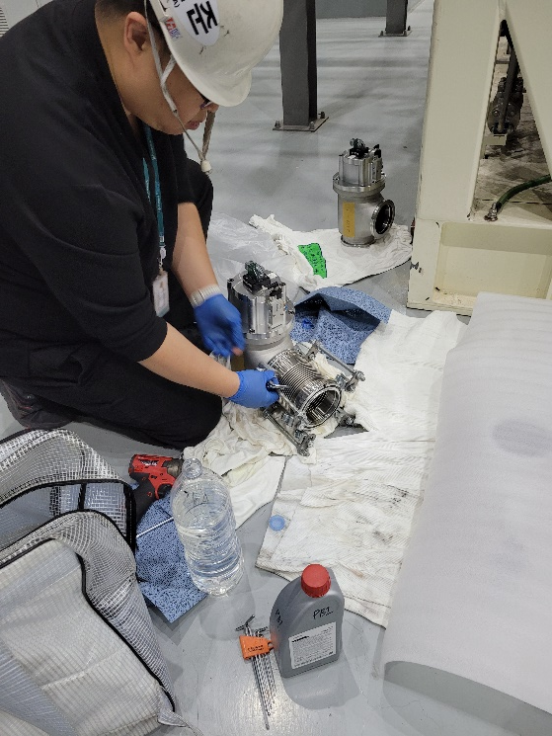
Maintenance results – Photos; PVPS
Maintenance for the PVPS
  Adjustment for the alignment of the pulleys
  Installation of a new belt
  Adjustment for the belt tension
  Essential cleaning
Snapped belt
Notes:
For PVPS, the belt of one pump was snapped during the machine test.
Therefore, we adjusted the alignment of the pulleys for the all pumps and installed a new belt for the snapped pump.
After that, we adjusted the belt tension.

Slide 16
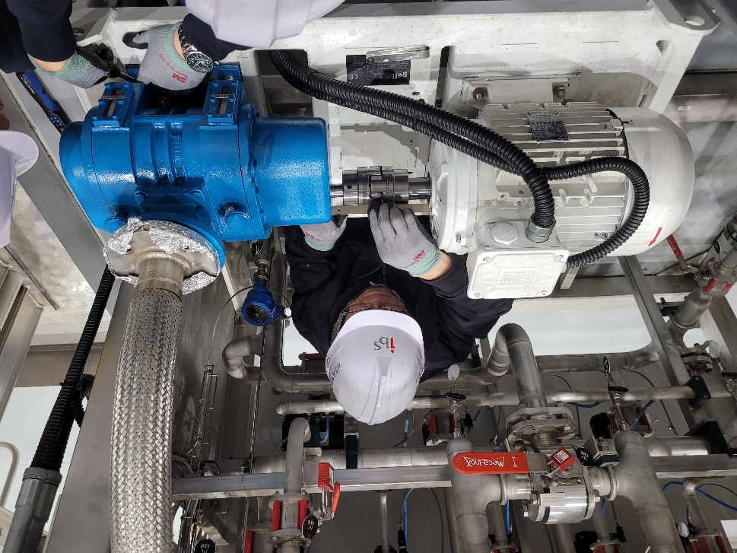
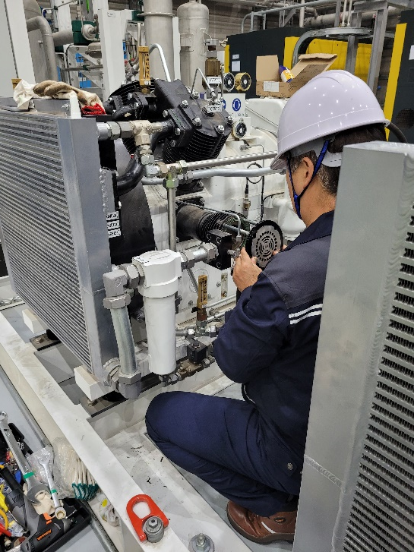
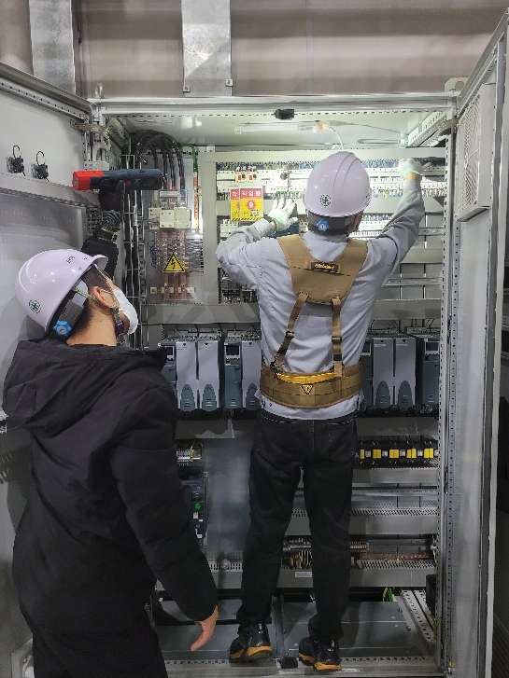
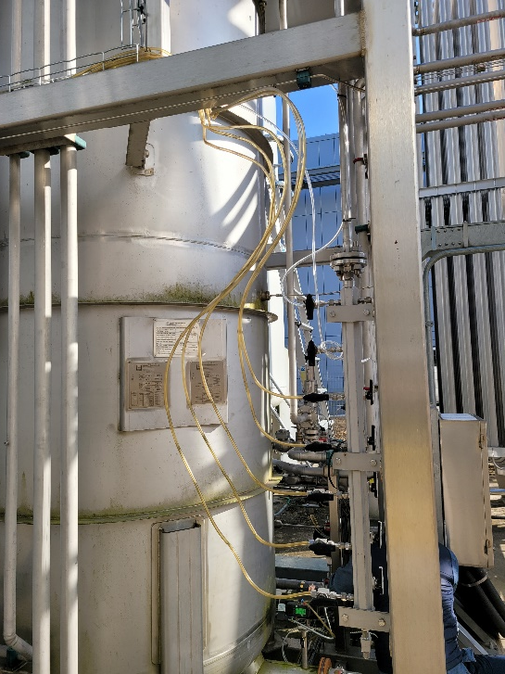
Maintenance results – Photos; etc. (Preventive)
Preventive maintenance for the other items
  Maintenance of the recovery compressors
  Inspection of the control cabinet
  Maintenance of the external purifier
  Maintenance of the blower for the cryogenic adsorbers
Notes:
For others, we conducted maintenance of the recovery compressors, electrical panels, external purifier and blower including the single commissioning.

Slide 17
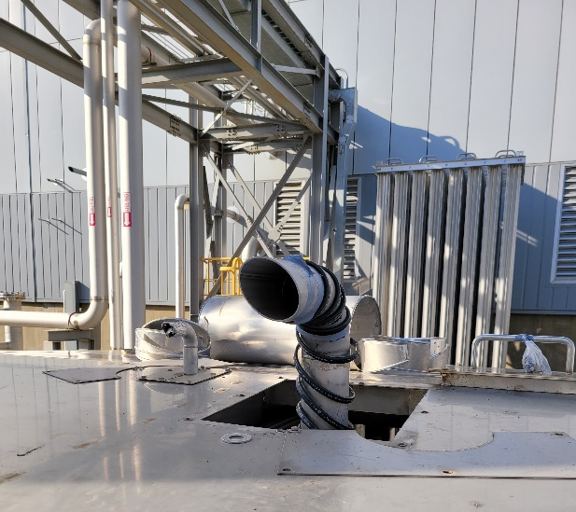
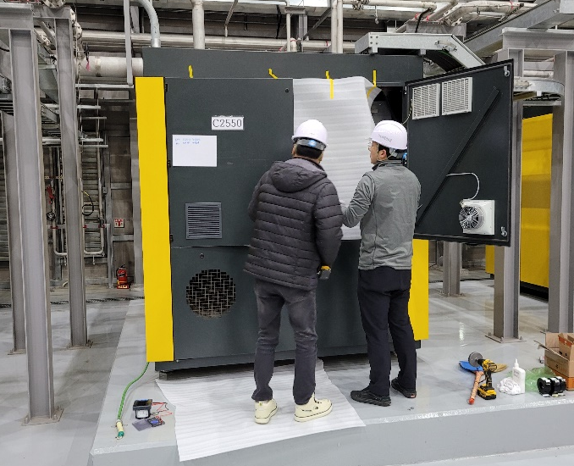
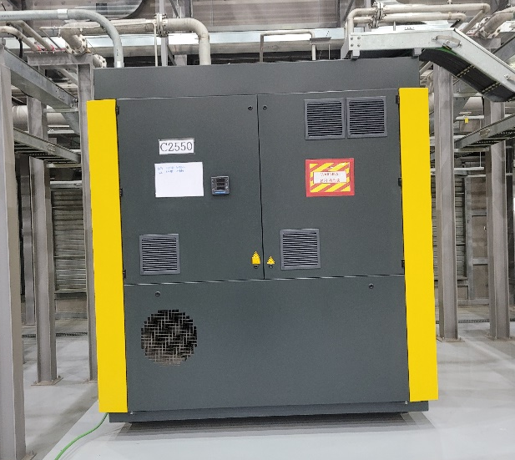
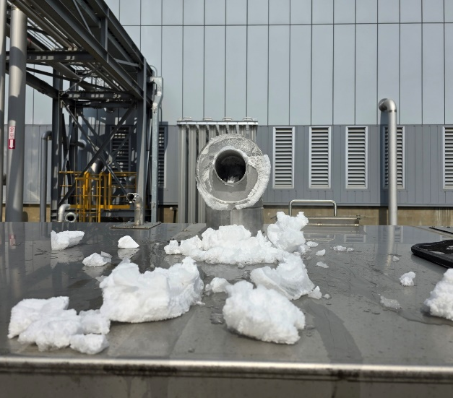
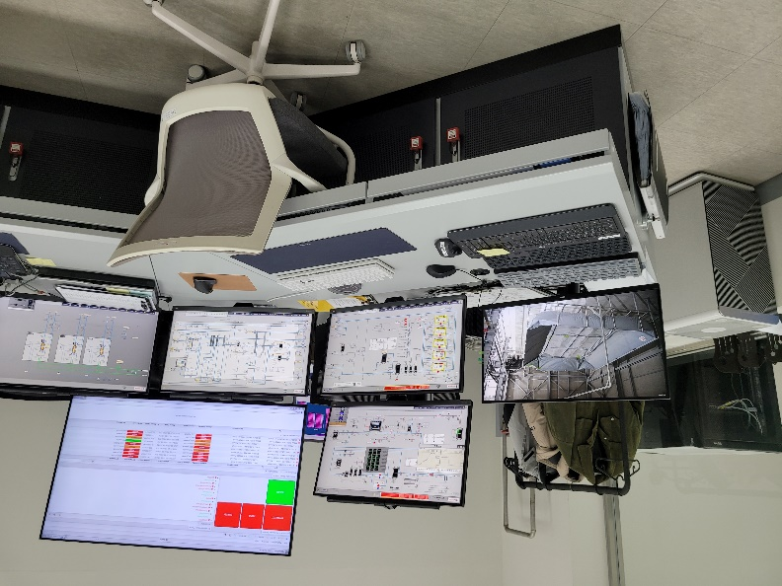
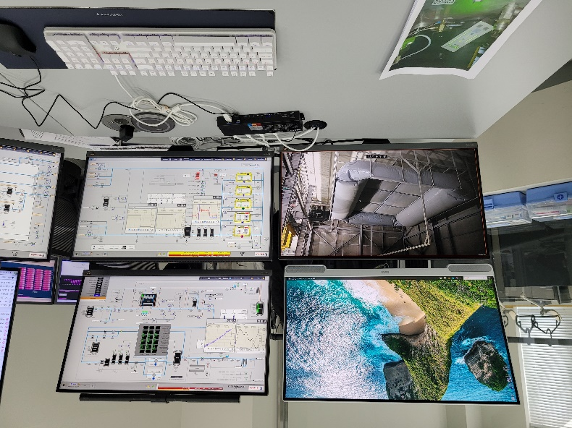
Maintenance results – Photos; etc. (Improvement)
Installation of an isothermal heater
Installation of ammeters
Controlling three PCs
with three separate mouse & keyboard
Controlling
four PCs
with one integrated mouse & keyboard
Notes:
The front pages presented the preventive maintenance, but this page shows some small improvement activities.
We installed an isothermal heater to melt icing on the cryogenic vent line, and ammeters on the warm compressors to monitor the status of the compressors during the normal operation.
Also, we operated three separate PCs with three separate mouses and keyboards but now we can operate four PCs with one integrated mouse and keyboard.

Slide 18
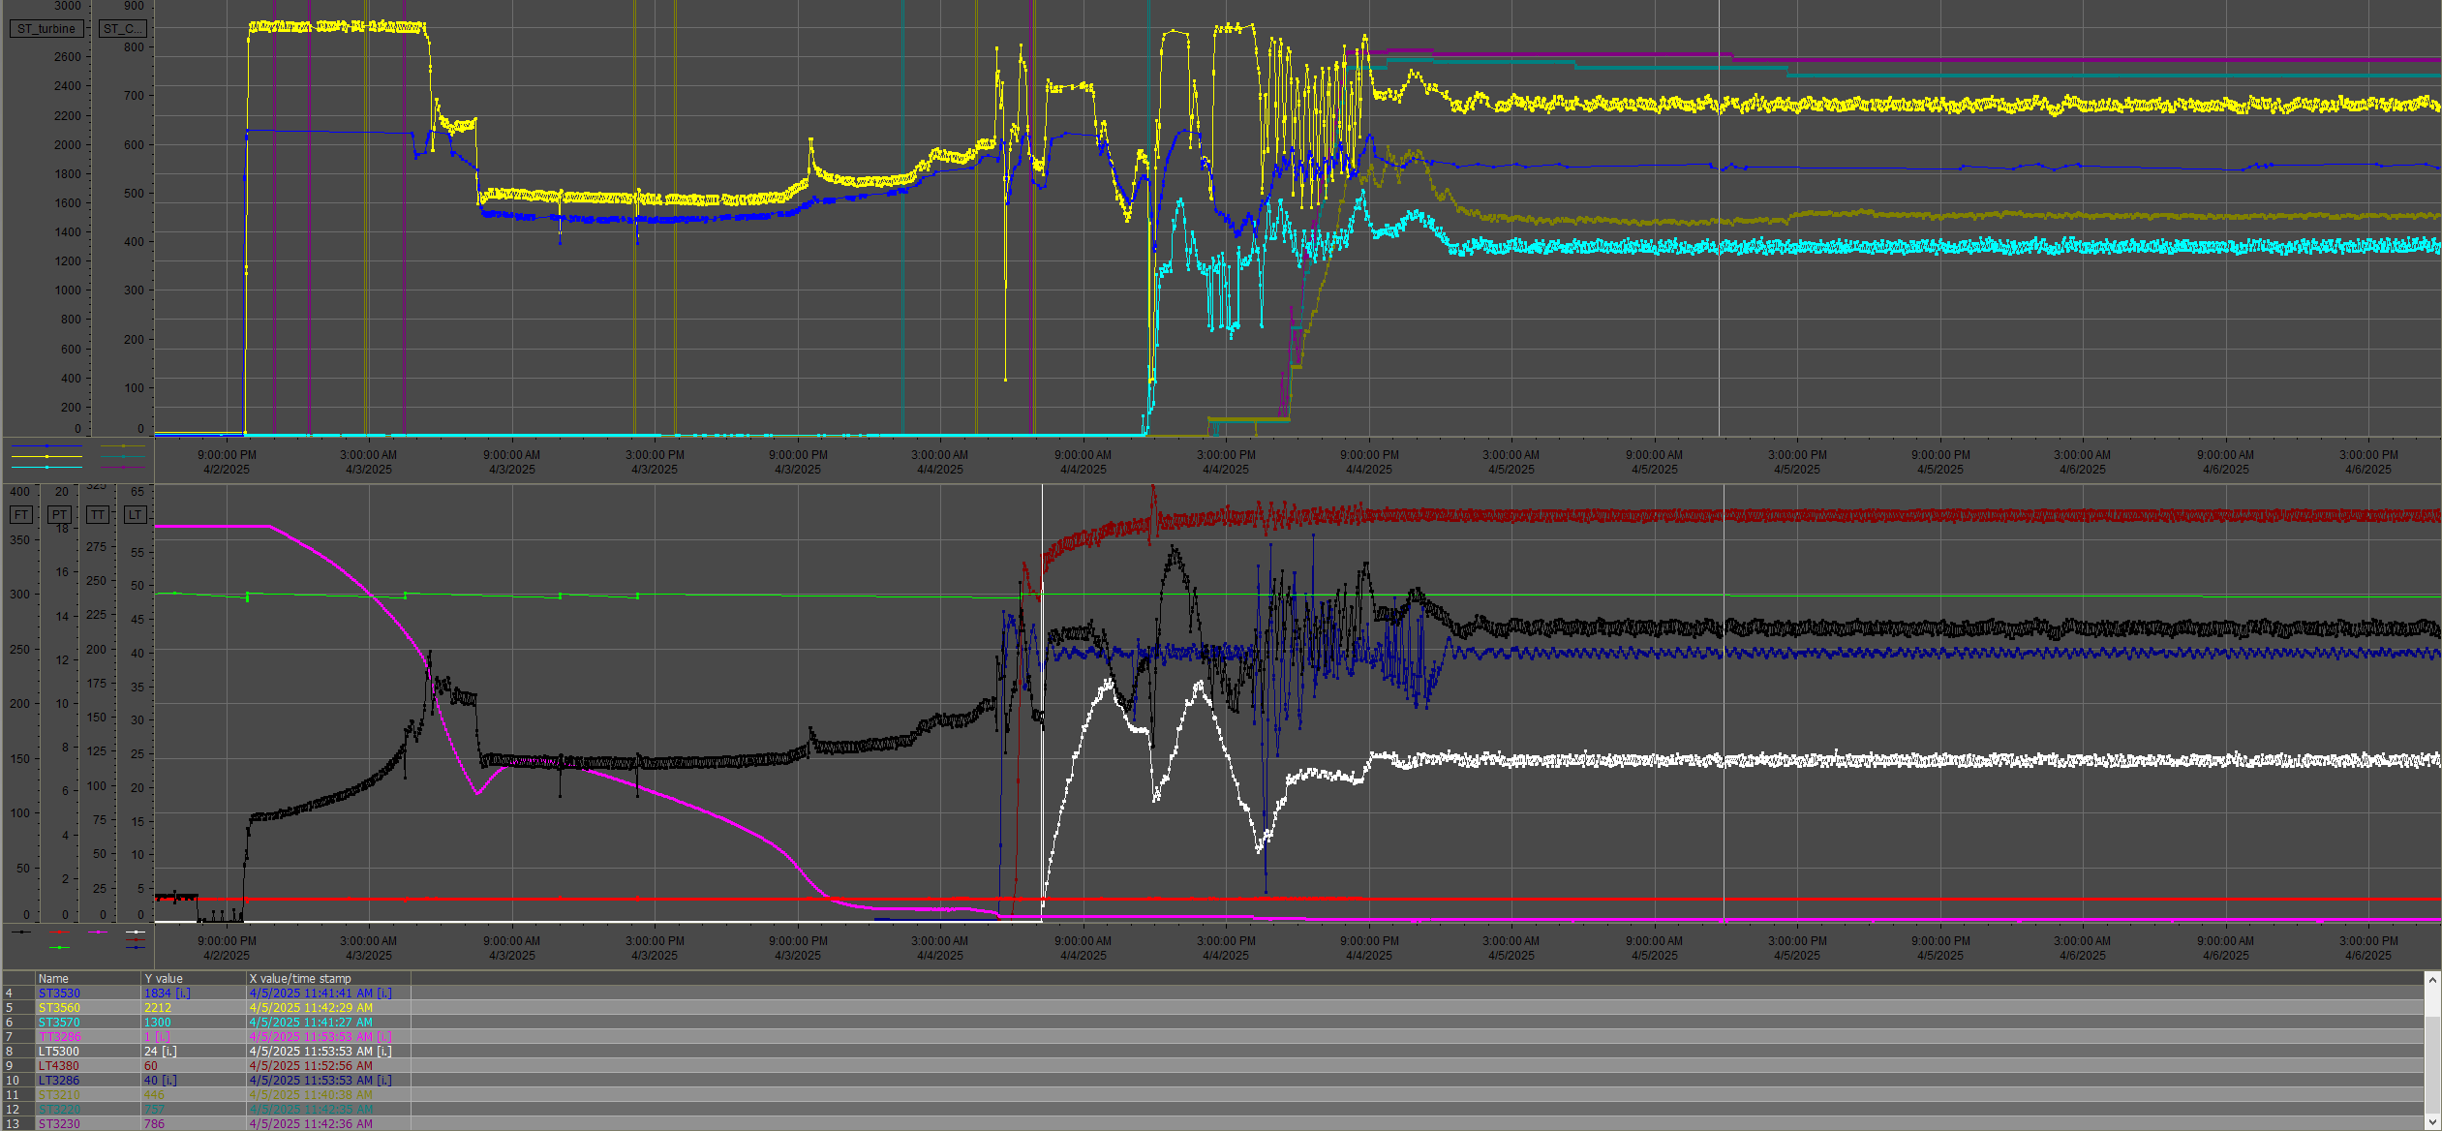
Maintenance results – Commissioning
Reaching 2 K without any severe issues!
Speed of
cryomachines
(Turbine, CCs)
→ Stable
Mass flow rate
& LHe level
→ Stable
Temperature of the
2 K vessel → 2 K
Notes:
After finishing the maintenance activities, we conducted a single refrigeration test of the cryoplant.
As a result, we could smoothly reach 2 K and finally confirm that our 3 years maintenance was well done.

Slide 19
Conclusion and future work
IRIS has operated the SCL3 section of the Korean heavy ion accelerator since 2022.
IRIS completed the 2nd operation of the SCL3 section and started a 3 years maintenance of SCL3 cryoplant in November 2024.
IRIS completed the 3 years maintenance in March 2025 and confirmed the maintenance result with commissioning (single refrigeration test of SCL3 cryogenic helium plant).
Now, IRIS started the 3rd operation with LINAC in April 2025 and our target is a continuous operation for 1.5 years.
Notes:
So, the conclusion for my presentation is,

Slide 20
Special thanks to…
IRIS accelerator division;
IRIS procurement team;
MKV maintenance team;
MKV operation team;
MKV headquarters;
ALAT commissioning team;
Yeon Sei, Chung
Won Jong, Jung | Jeehyun, Cho | YeongIck, Chang | HyeonJeong, Son
Jaiho, Seo | Duckgi, Kim | Dongwan, Kim | Junghoon, Ha
Jinsoo, Park | Eunsung, Kim | Chahyun, Park | Han-seul, Kim
Jiwoo, Yun | Inseong, Song | Ji-hyeon, Lee | Joonho, Jang
Yoonkeon, Im
Sangwook, Park | Gwanghyun, Park
Mustapha, Ouhaddou | Hohyun, Kwak
Notes:
Lastly, I would like to express my special thanks to all of the people who helped me for the maintenance.

Slide 21
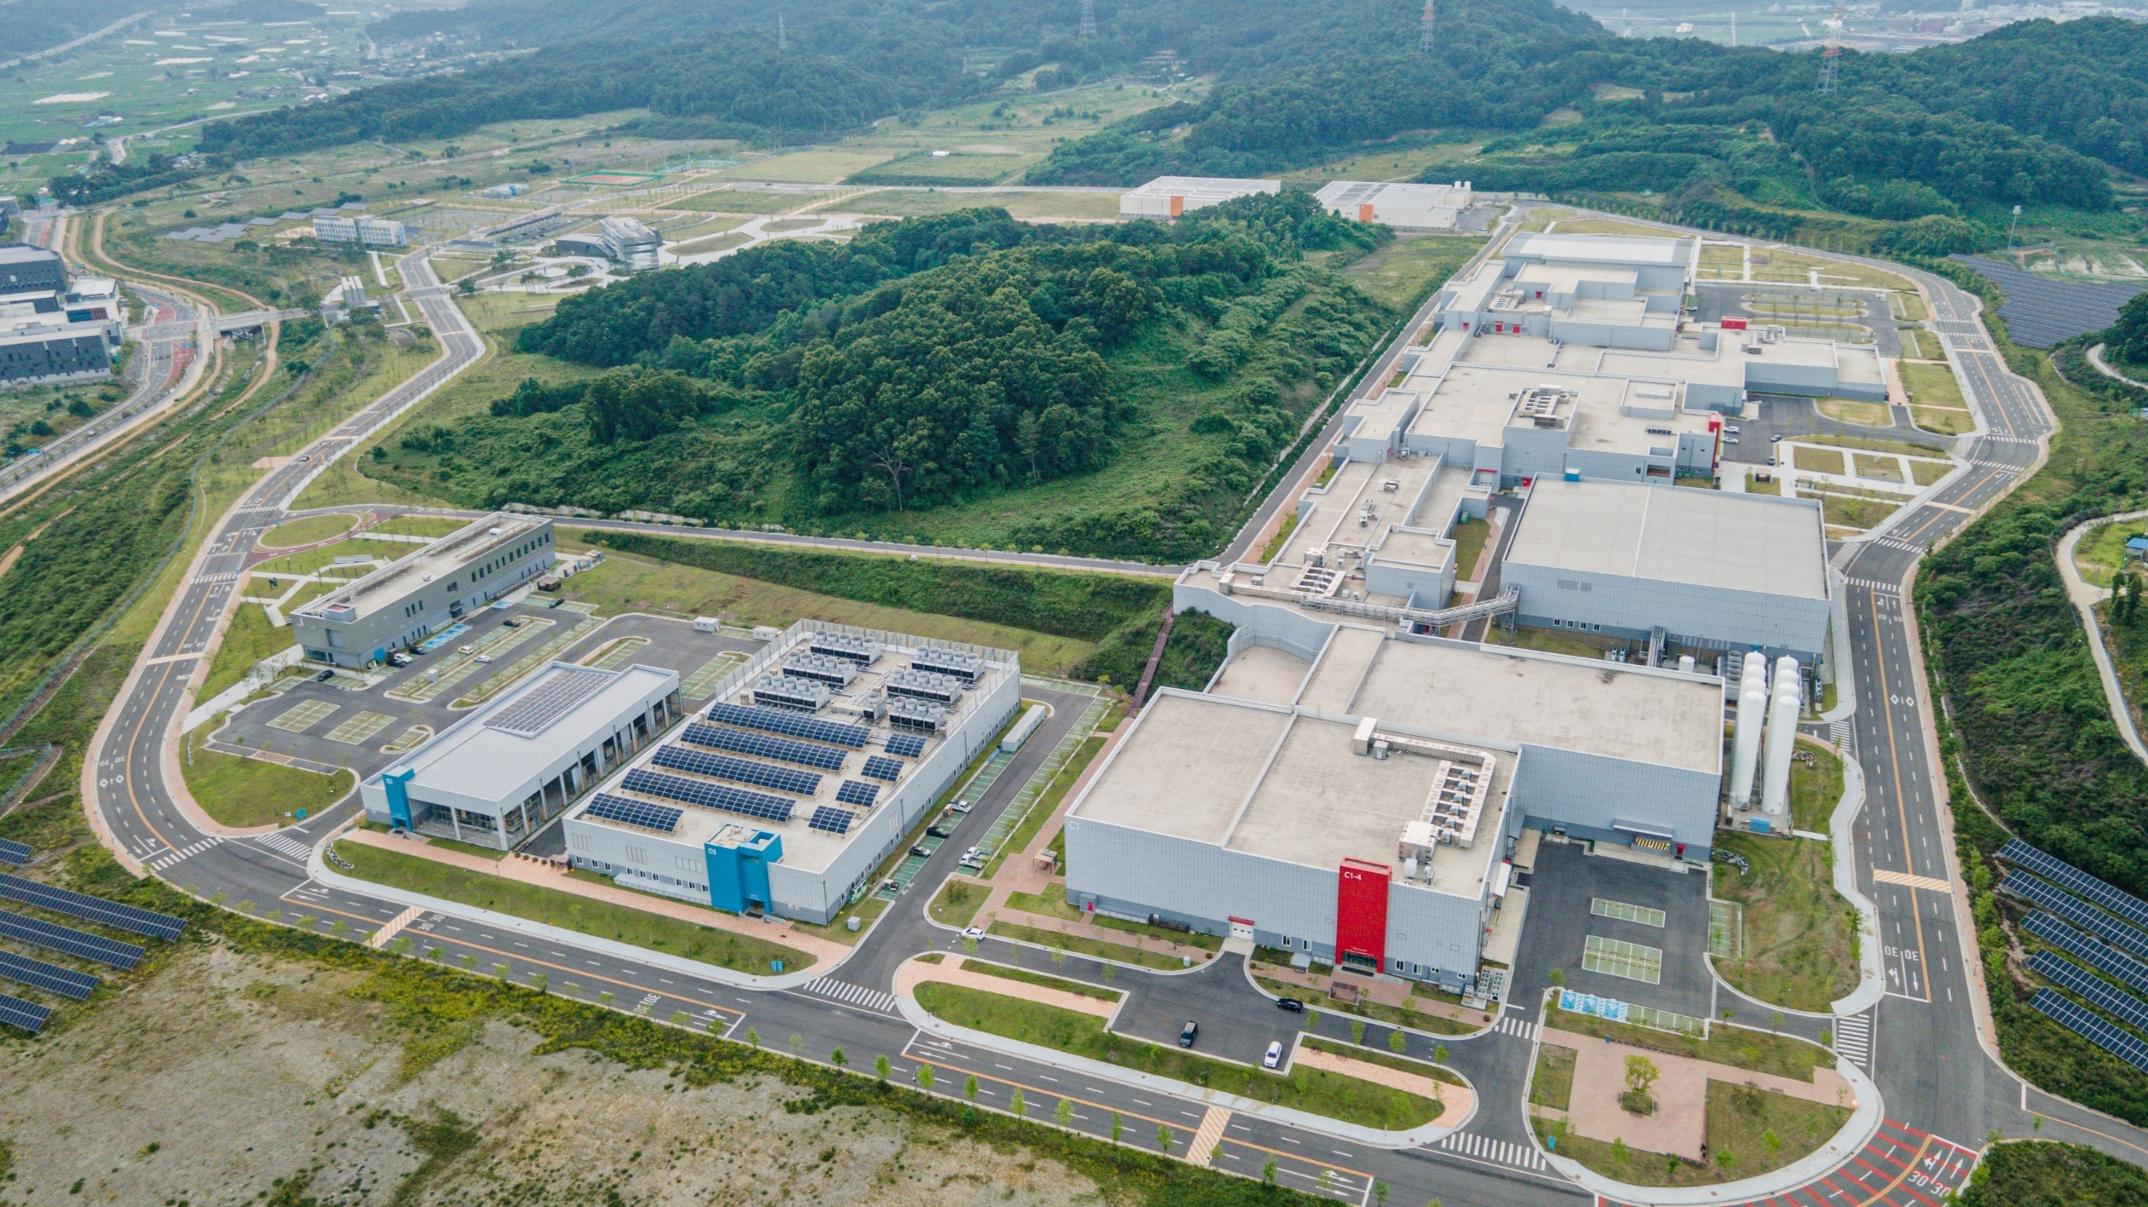


Thank you!
Any questions?
Junghyun Yoo (Research fellow, trikara@ibs.re.kr)
Notes:
This is the end of my presentation.
If you have any questions or opinions, please feel free to contact me.
Thank you.

