Slide 1

Thermal performance of common bulk-fill cryogenic insulation materials in helium and hydrogen background gasses
Cryogenic Engineering Conference
Thursday May 22nd, 2025
Adam Swanger
NASA Kennedy Space Center, Cryogenics Test Laboratory, KSC, FL 32899 USA
M4Or1B-04

Slide 2
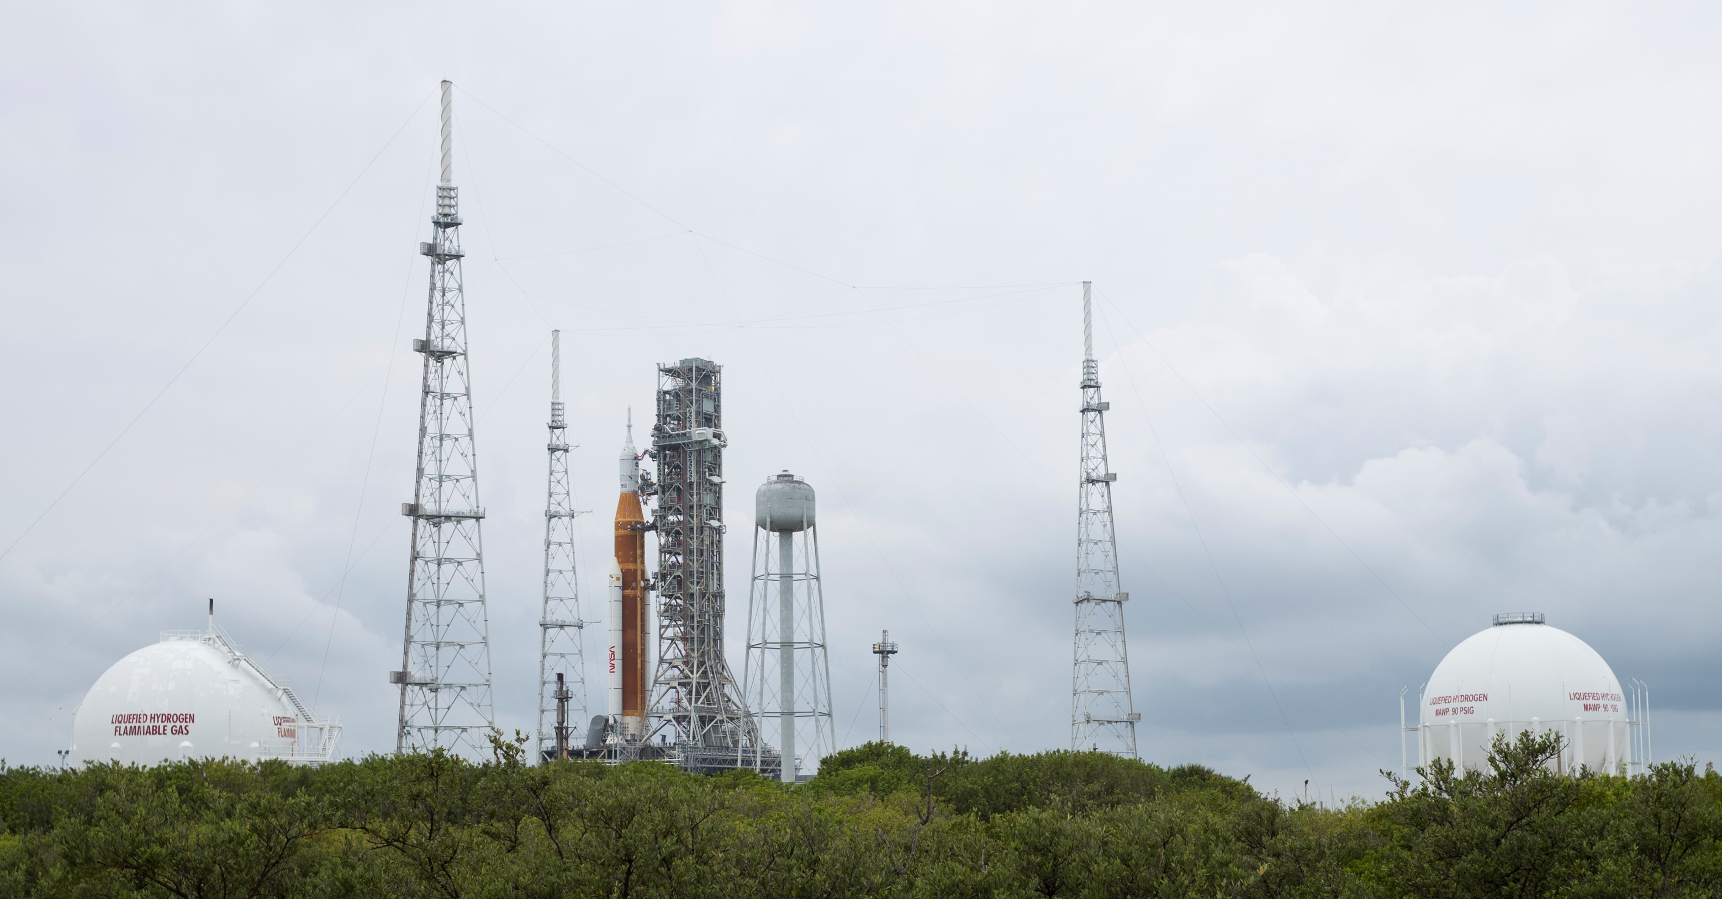
INTRODUCTION
2
Virtually all liquid hydrogen (LH₂) storage tanks ever built have been vacuum-insulated
Shop-built tanks are insulated with MLI
Field-erected tanks insulated with bulk-fill powder
NASA KSC currently owns & operates the largest LH₂ tanks in the world
Image: NASA

Slide 3
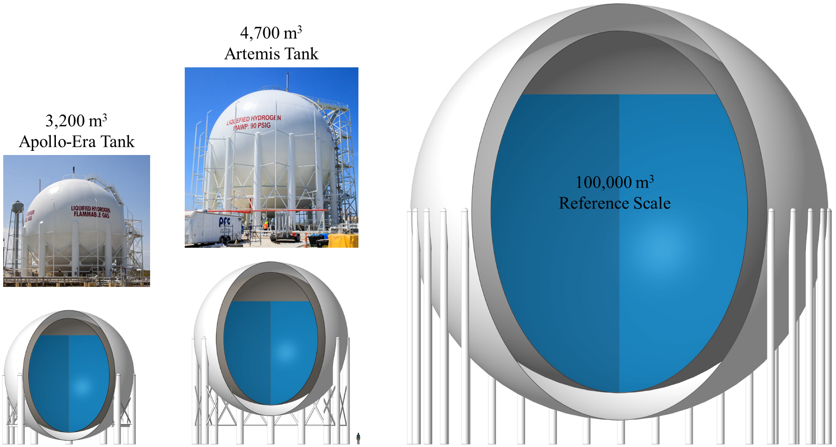
INTRODUCTION
3
To support LH₂ at future shipping terminal requires tanks 10x to 15x larger than the new vessel at KSC
Eventually, it will become impractical or impossible to build VJ tanks to-scale
  Non-VJ LH₂ storage tanks have not been attempted
In 2021, US DOE funded effort to design a non-VJ tank at 100,000 m³
Image: NASA

Slide 4
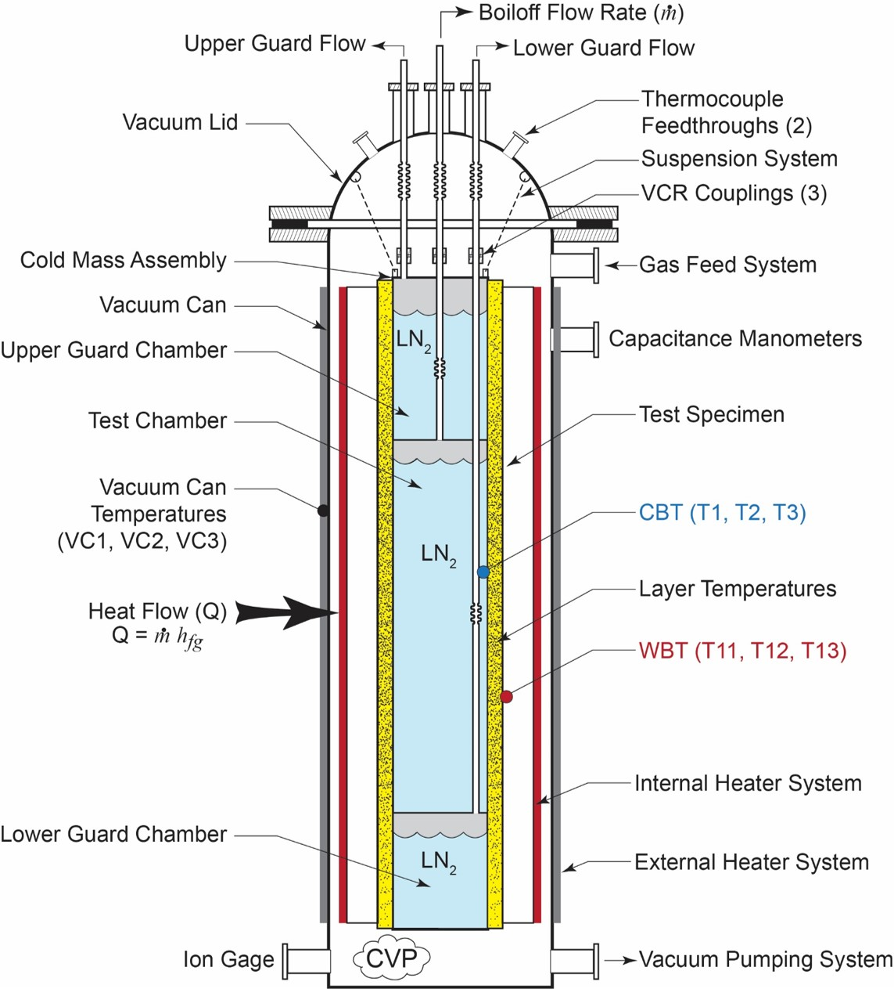
INTRODUCTION
4
For a non-VJ LH₂ tank, what background gas is suitable in the insulation space?
  All background gasses condense at LH₂ temperatures except for helium, and hydrogen itself
  Either gas will result in reduced insulation performance, but to what extent?
Cryogenics Test Laboratory at NASA KSC specializes in characterization of thermal insulation systems
  CS100 LN₂ boiloff calorimeter used to examine performance of two bulk-fill insulations in helium and hydrogen background gases
  Methodology per ASTM C1774
Image: NASA

Slide 5
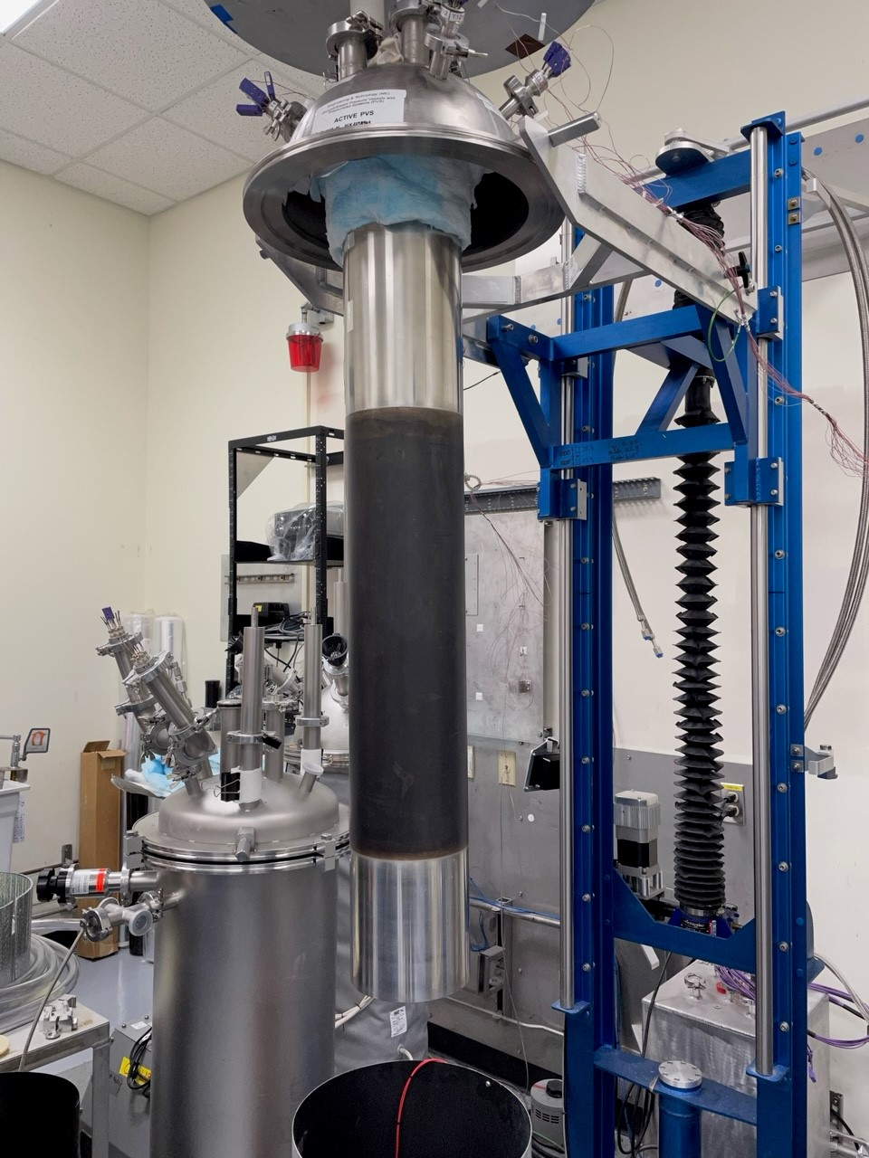
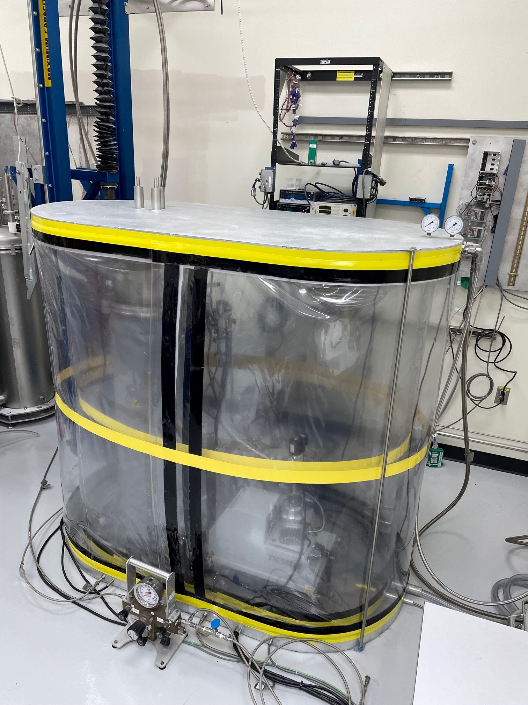
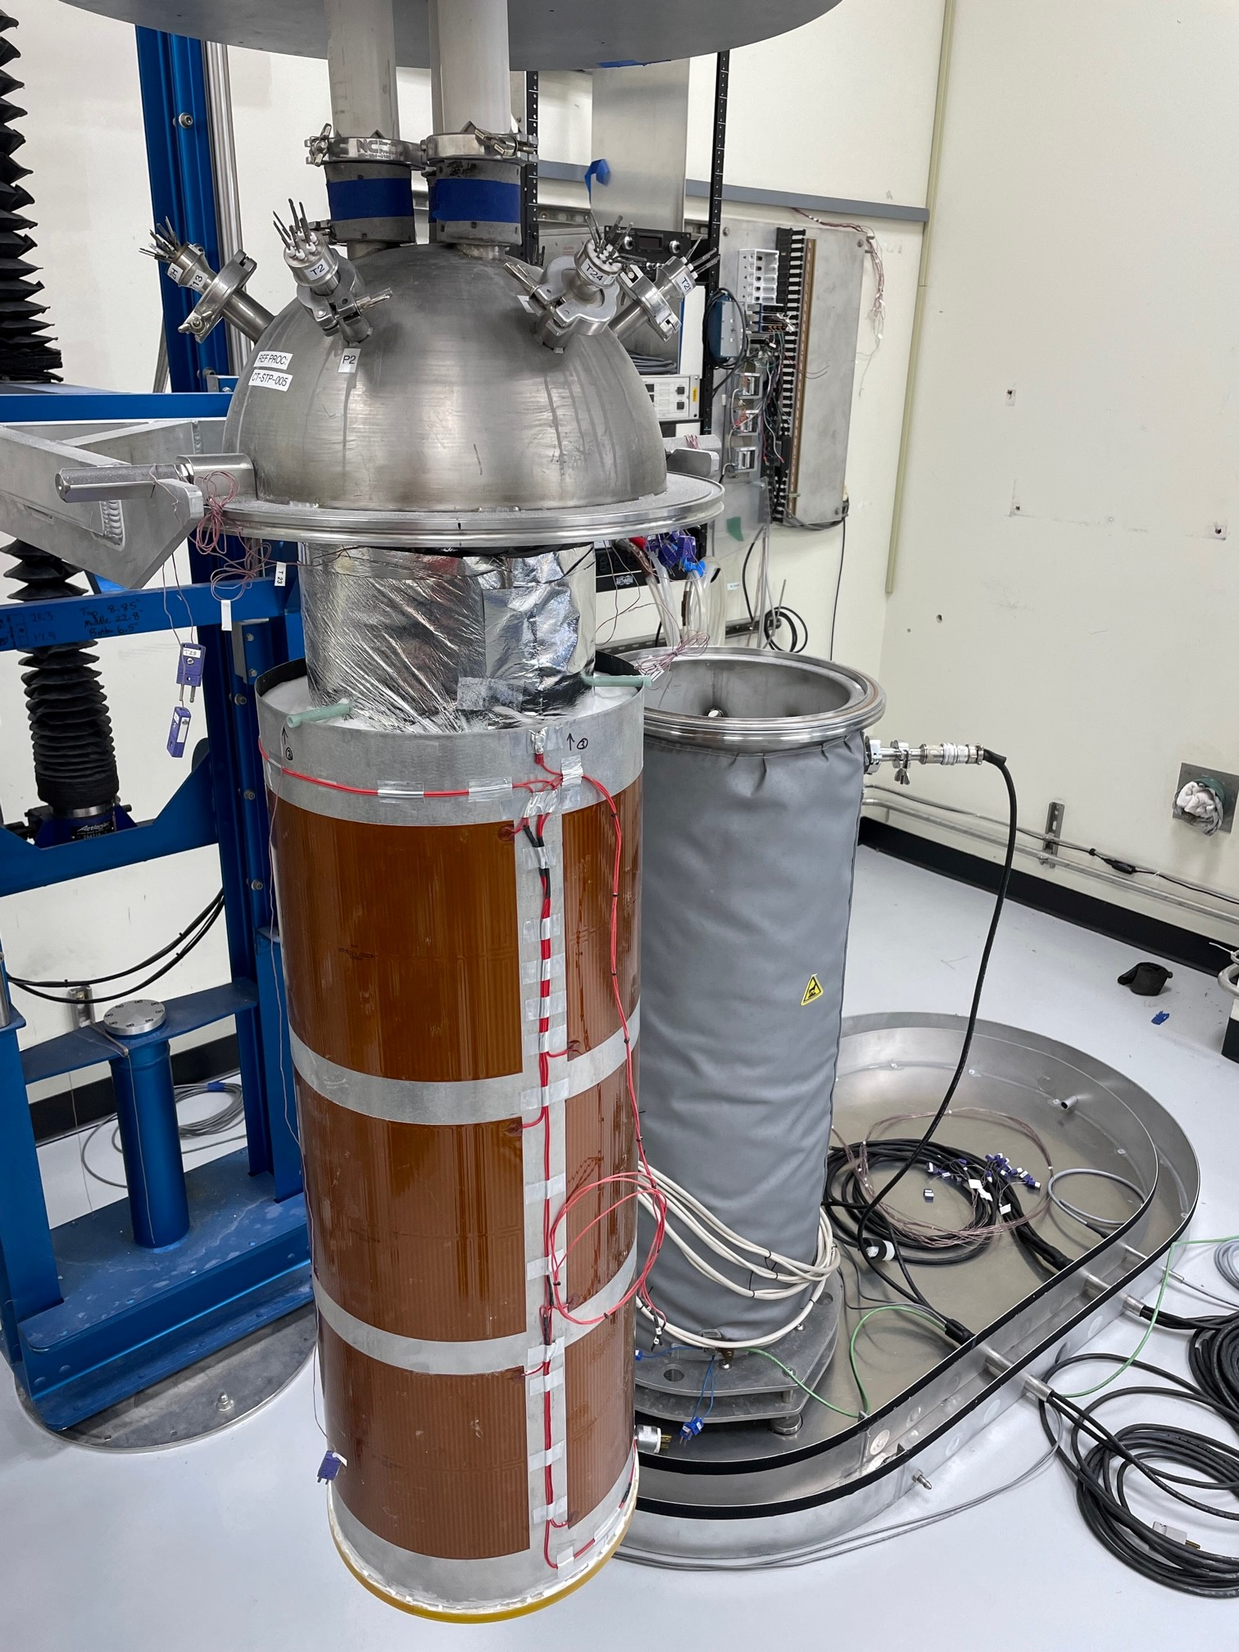
CS100 Test setup
5
Numerous modifications to test in flammable background gas
Images: NASA
Vacuum Chamber
GN₂ Purged Enclosure
Test Section
Guards
Heater Sleeve
CS100 Cold-Mass Assembly
Bulk-Fill Test Setup
Flammable Gas Setup

Slide 6
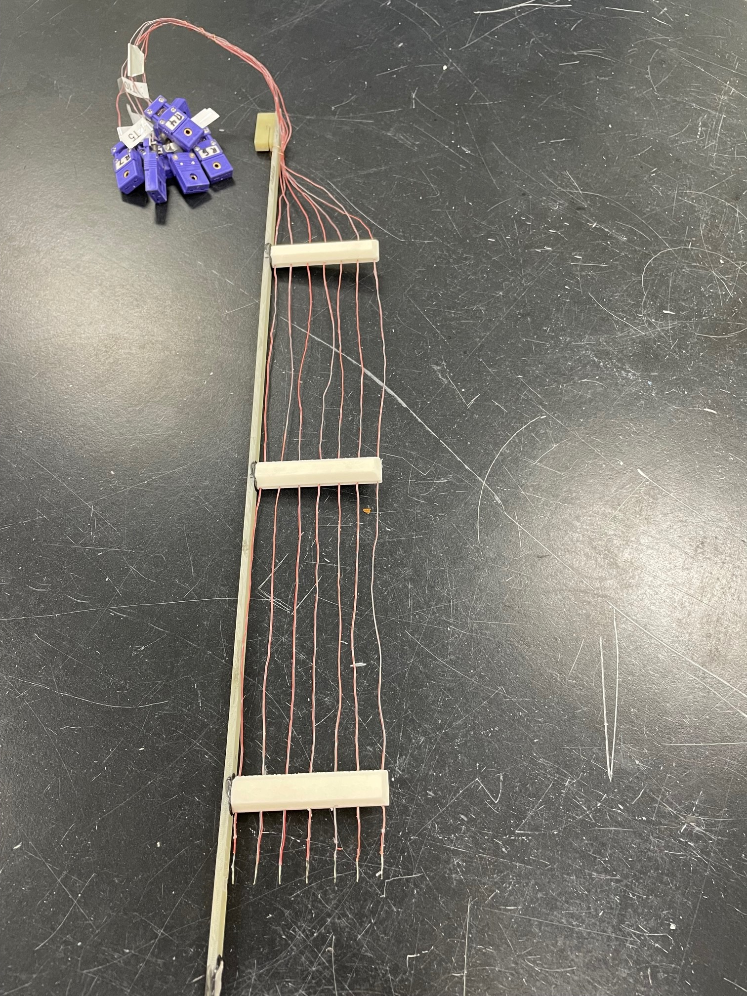
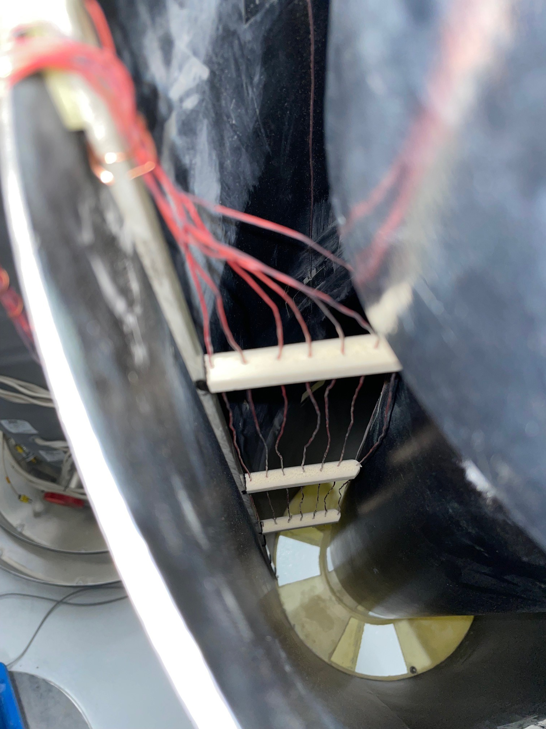
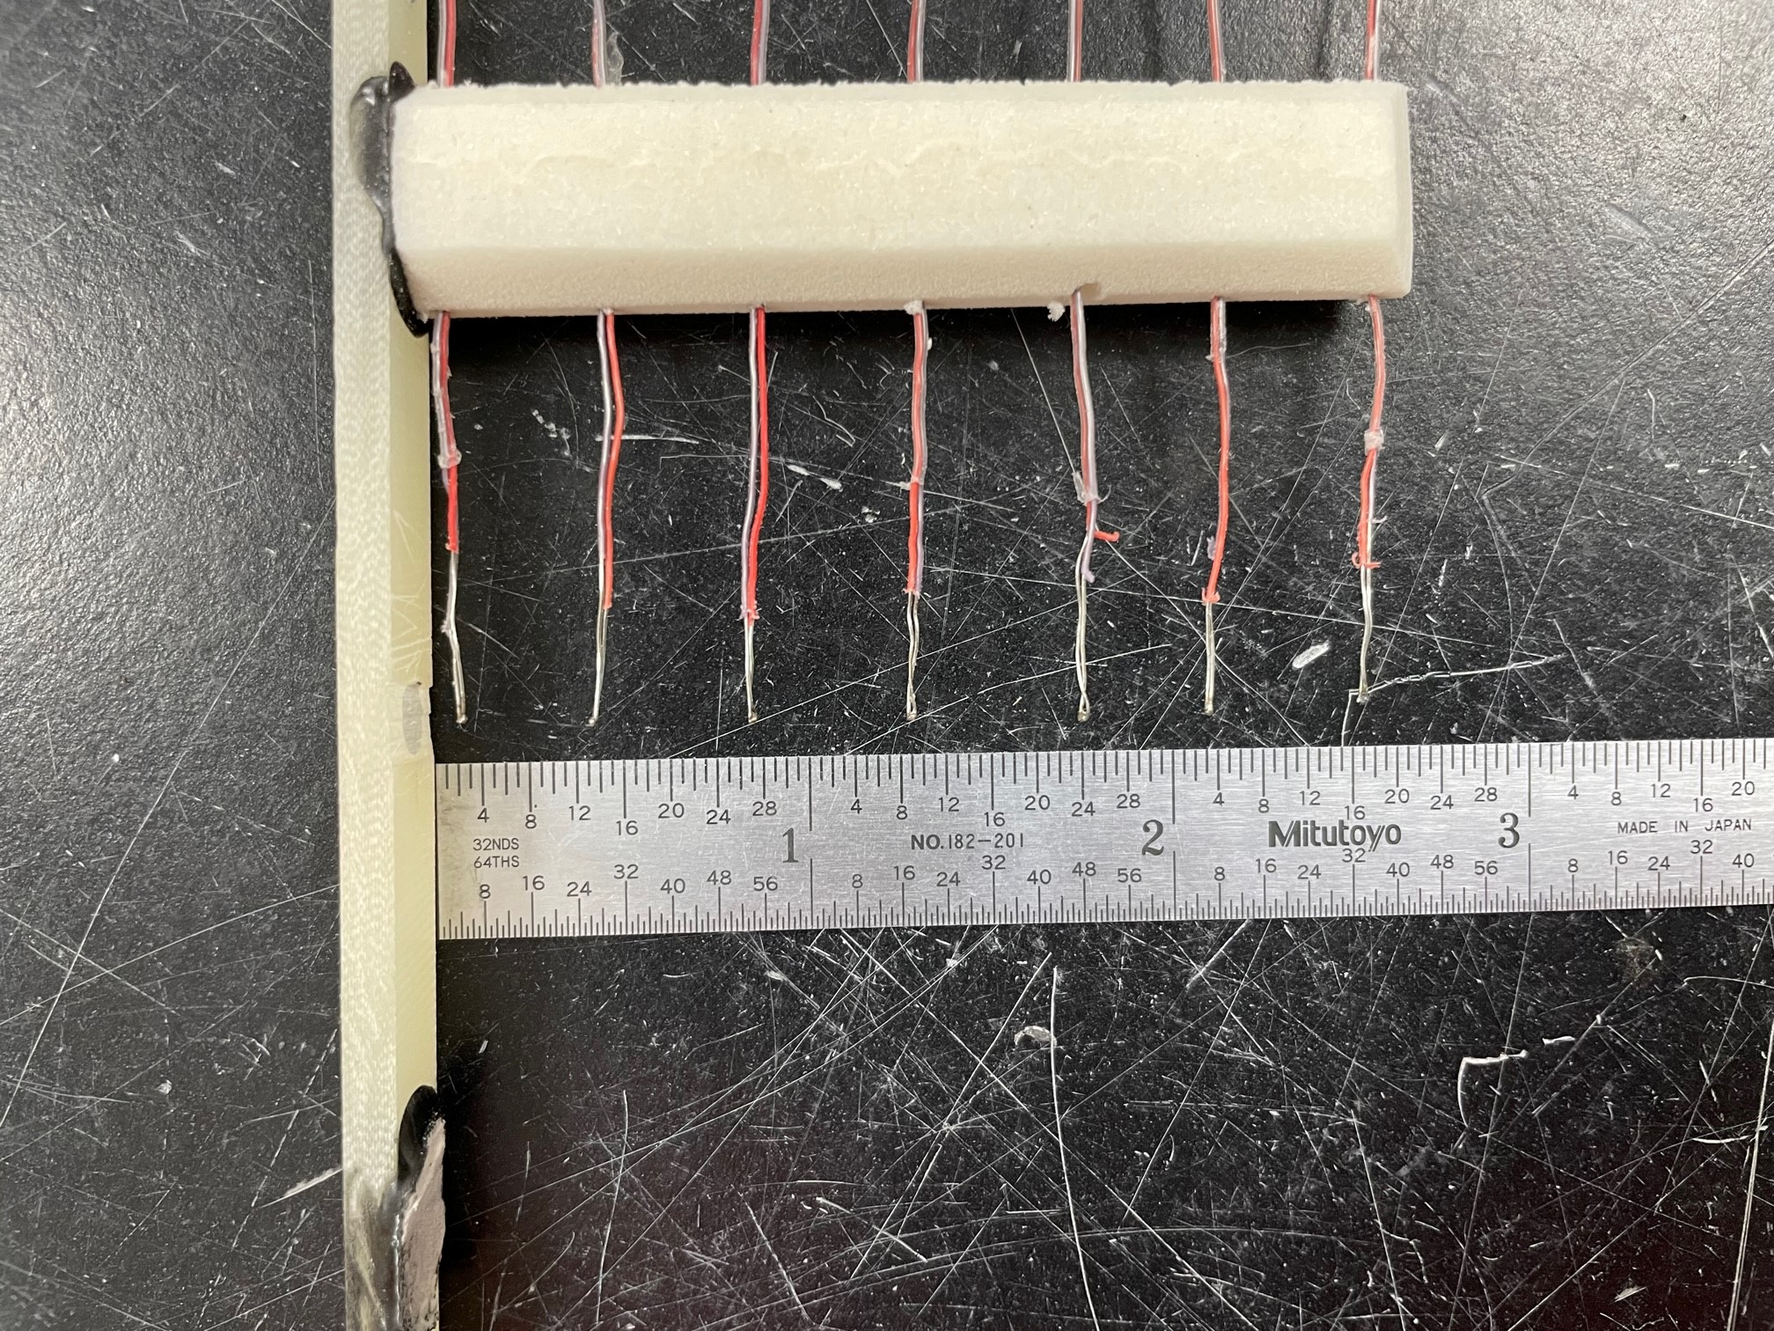
CS100 Test setup
6
Radial temperature rake assembly to measure thermal profile
Insulation Samples
Low Density Perlite
  Ryolex, 3-S type
  49.1 kg/m³
  Particle size: <0.149 mm to 1.19 mm
High Density Perlite
  Ryolex, 39 type
  123.3 kg/m³
  Particle size: <0.149 mm to 0.595 mm
Glass Bubbles
  3M, K1 type
  75 kg/m³
  Particle size: 30 to 115 microns, 65 micron average
Images: NASA

Slide 7
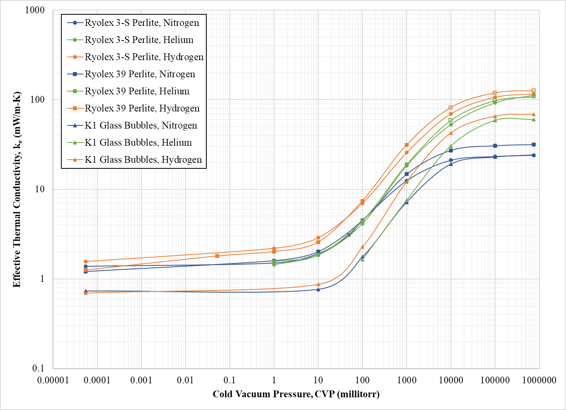
Test results - Effective Thermal Conductivity
7
Nominal warm and cold boundary temperatures = 293 K and 78 K
Open markers represent pseudo-steady-state tests
GHe & GH₂ were considerably worse than GN₂, but not directly proportional to gas thermal conductivity increases
Thermal Conductivity vs. Nitrogen
 | Helium | Hydrogen
Gas Only | 6.6 | 7.3
3-S Perlite | 4.3 | 5.8
39 Perlite | 3.4 | 4.0
K1 GB | 2.5 | 2.8

Slide 8
Test results - Effective Thermal Conductivity
8
<1 torr, the three insulations performed similarly, except in hydrogen
Low density perlite and K1 glass bubbles are virtually identical >1 torr in nitrogen, but not the other gasses
High density perlite outperforms low density at high vacuum, while GB is roughly 2 times better

Slide 9
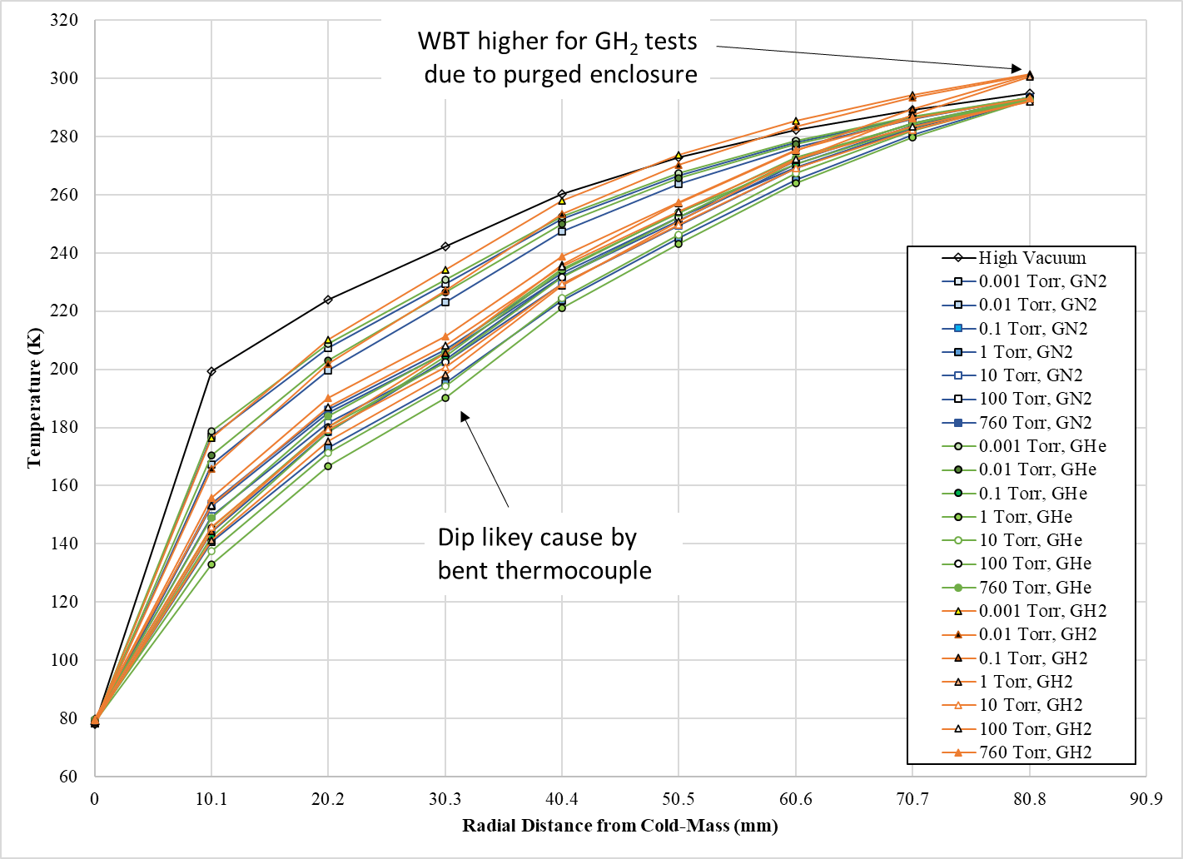
Test results – radial thermal profile
9
High density perlite profile shown for all tests
  Other insulation showed similar behavior
Large ΔT in the first 10.1 mm layer; decrease with higher heat loads
  ΔT = 123 K at high vacuum; 57% of the total across the sample
  Remaining thickness appears more predictable
  May be caused by the rake design, but analysis suggests not
  Flattest curve was almost always 1 or 10 torr

Slide 10
conclusion
10
Three different common bulk-fill insulation materials using in large, field-erected LH₂ storage tanks were tested in helium and hydrogen background gasses
ASTM standard CS100 LN₂ boiloff calorimeter used to obtain effective thermal conductivity values and radial thermal profiles between 293 K and 78 K
  Significant modifications to CS100 necessary for flammable gas testing
As expected, all samples performed worse than nitrogen background gas, but not directly proportional to the increase in gas conductivities
  Both perlite samples had similar performance at 760 torr in helium and hydrogen (k_{e,avg}=115.7 mW/m-K)
  K1 glass bubbles outperformed both perlite samples in hydrogen and helium, roughly 44% lower on average

Slide 11
11
THANK YOU FOR YOUR ATTENTION!
QUESTIONS?

