Slide 1

Development of a Test Apparatus for Thermal Conductivity Measurements of Insulation Materials with Adsorbed Nitrogen Between 20 and 77 K
C1Or4A-02
Cryogenic Engineering Conference
Justin Jessop, Professor Jacob Leachman, Professor Konstantin Matveev
Reno, Nevada
May 19th, 2025

Slide 2
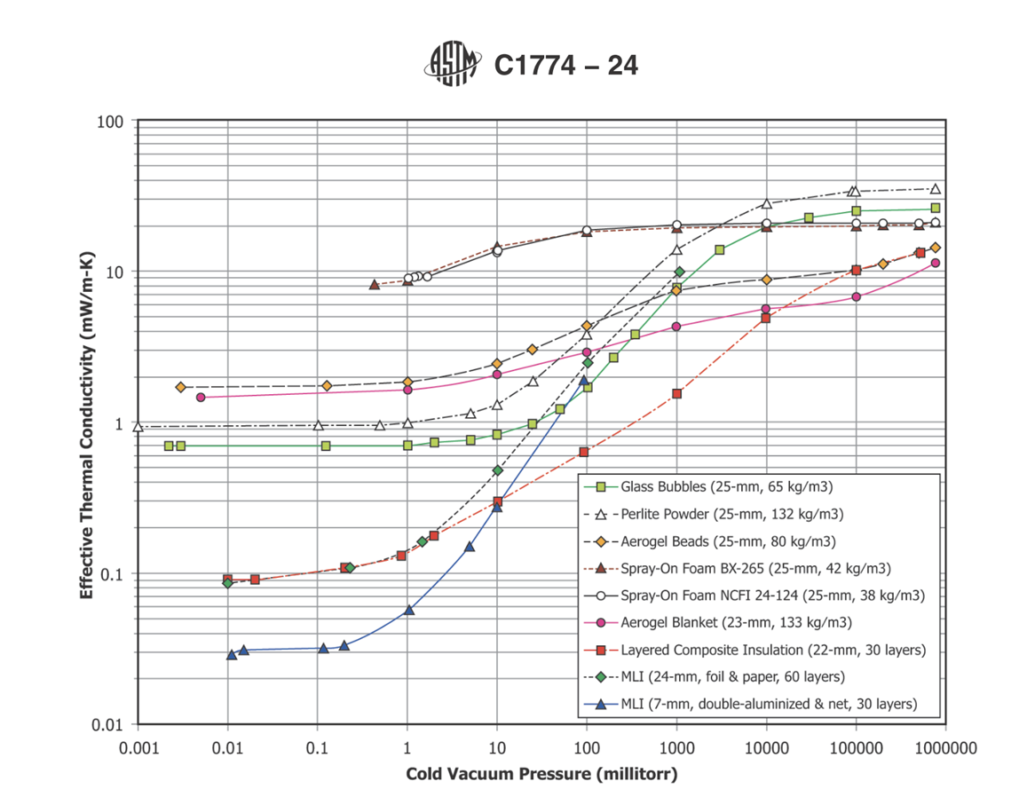



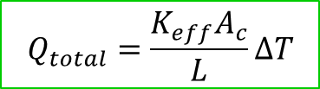



Vacuum Insulation
Motivation:
  Liquid hydrogen is stored at 20 K.
  Convection, conduction, and radiation heat transfer must be mitigated to store without significant boil off.
  Effective conductivity allows the three heat transfer modes to be simply analyzed for insulations.
  Vacuum insulated vessels provide the best insulation but can be improved with filler insulations.
  Many measurements at 77 K (liquid nitrogen), limited measurements at 20 K (liquid hydrogen).
$$T_{C}$$
$$Q_{rad}$$
$$T_{H}$$
$$Q_{conv}$$
$$Q_{total}=Q_{conv}+Q_{cond}+Q_{rad}$$
$$Q_{cond}$$
$$Q_{total}=\frac{K_{eff}A_{c}}{L}ΔT$$
[1] “Guide for Thermal Performance Testing of Cryogenic Insulation Systems,” Mar. 15, 2024, ASTM International, West Conshohocken, PA. doi: 10.1520/C1774-24.

Slide 3
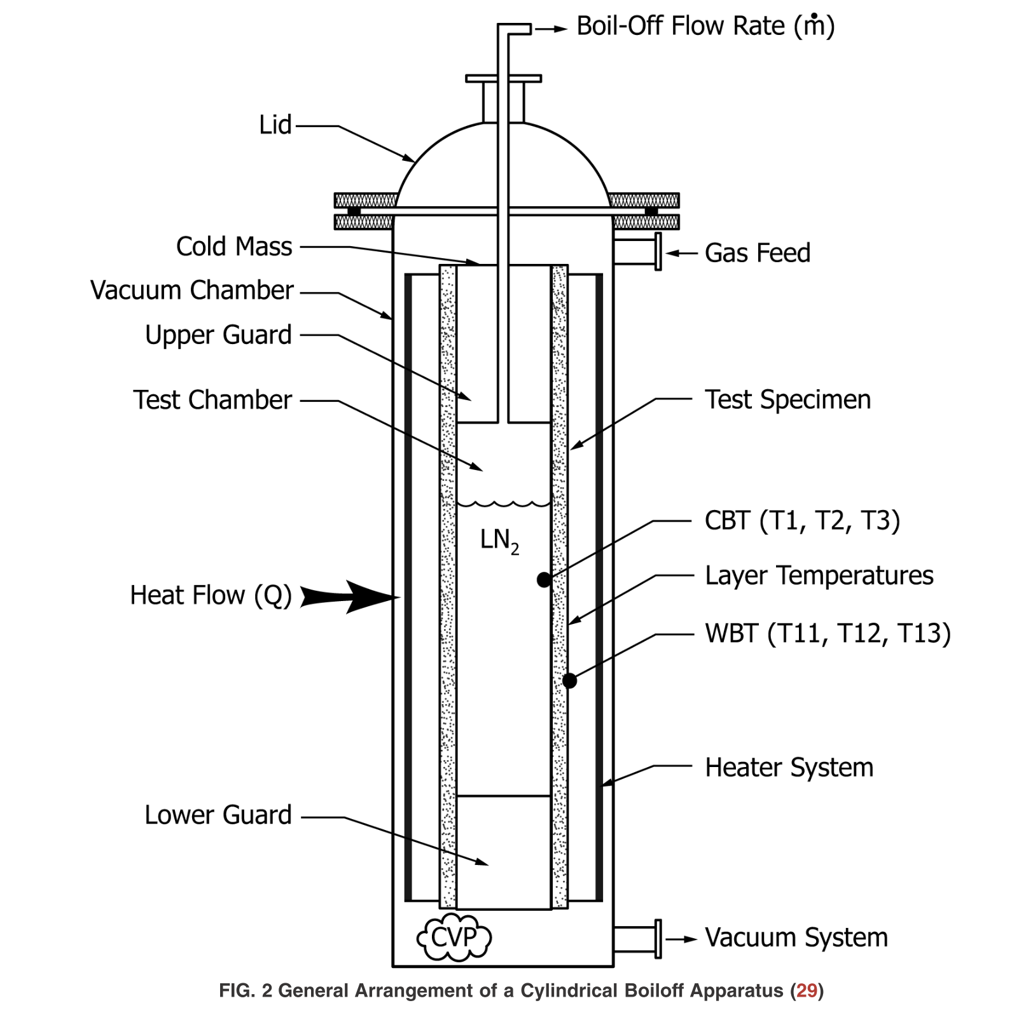
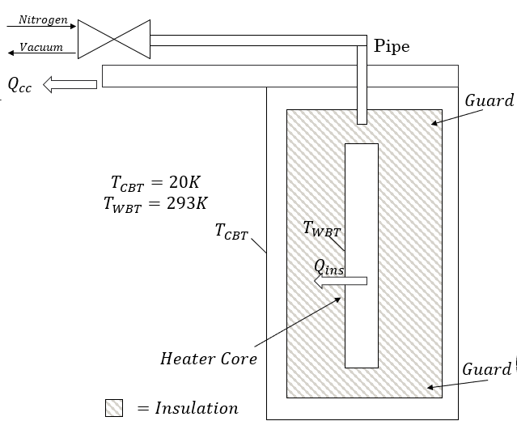
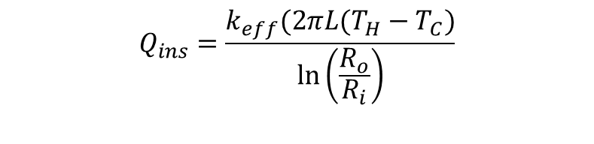
Conceptual Design
Previous work:
  The majority of measurements collected by NASA.
  Achieved via boil-off calorimetry with liquid nitrogen, but no loss of vacuum measurements.
This work:
Guarded cryocooler with nested concentric cylinders for radial heat transfer.
Can measure any cold boundary from 77 – 20 K with no cryogen necessary.
Warm boundary maintained with heater.
Ability to pull vacuum and introduce gas in the sealed insulation space.
$$Q_{ins}=\frac{k_{eff}(2πL(T_{H}−T_{C})}{\ln\left(\frac{R_{o}}{R_{i}}\right)}$$
[1]
  Goal: Collect steady-state and transient measurements at a cold boundary temperature of 20 K for Aerogel, MLI, and Microbubbles with an accurately $\left(±1\frac{mW}{m−K}\right)$.

Slide 4
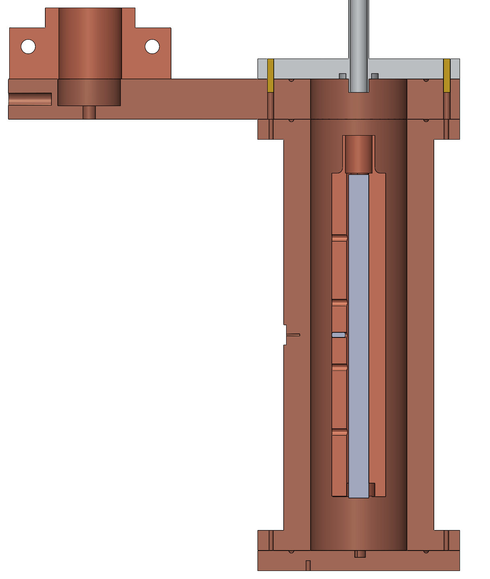
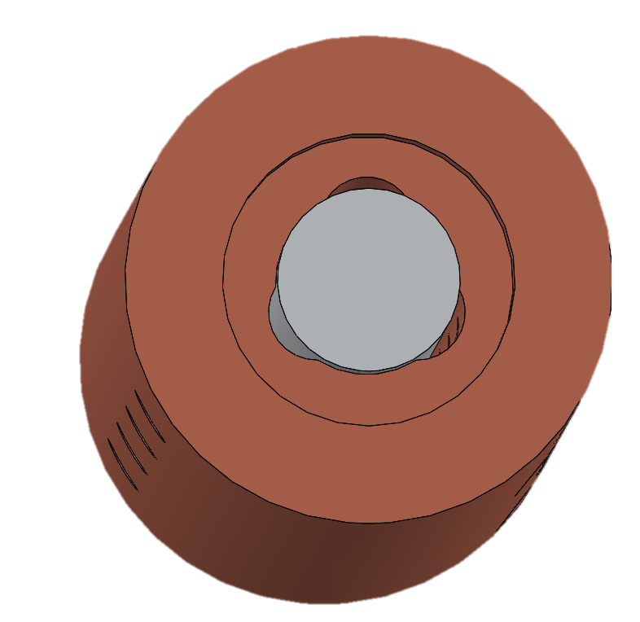
Design
Cryocooler (CC)
Top Flange
Gas & Vacuum Pipe
CC Mount Flange
Goal of test cell:
  Maintain isothermal warm and cold boundaries.
  Minimize axial heat flows.
Guard Heater
Preliminary design decisions:
  Guard heater: need to maintain cold boundary temperature.
  Stainless steel top flange for weldability and reduced heat out of system.
  Indium seals.
  Copper heater core for isothermal conditions, radii off of heater to provide gas path to distribute evenly.
  Aerogel for guard insulation and heater core support.
  7 Temp sensors.
Bottom View
Heater Core
Gas Path
235 mm
10 mm
Aerogel Guards
Cartridge Heater
Need a thermal model to ensure axial heat flows sufficiently small.
= Temperature Sensors
= Guard insulation
45.5 mm
Cross section of test cell
Notes:
Drop tanks of helium in current so if we can autonmously do this with h2 and not just external sources and mixutres….
The large temperature gradient between liquid hydrogen (21 K) and surfaces results in large volumetric expansion of the fluid (~700x) and corresponding pressure surges. Pressure surging increases the risk of wear on components and potential for component failure. Surging will also result in uneven flow distributions going to the downstream consumer.
Why did we pick what we picked? Say out…

Slide 5
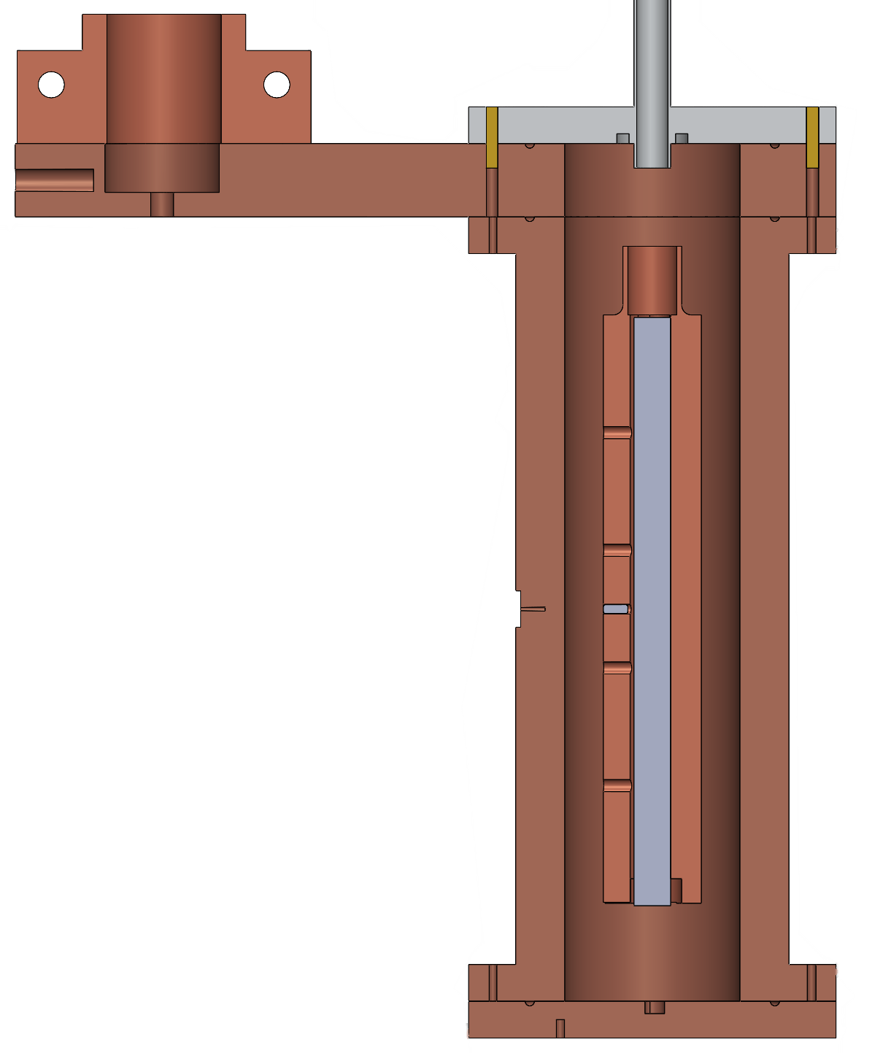









Thermal Model
Varied thermal conductivity in the insulation space to determine the total axial to radial heat flow ratio.
All potential conductivities within the bounds of the cryocoolers refrigeration capacity at 20 K.
$$Q_{cc}=7000 mW$$
$$Q_{guard}$$
$Q_{ax,rad}=\frac{Q_{guard,total}}{Q_{ins}}$
Thermal Model
$$Q_{ins}$$
$$293 K$$
Microbubble $k_{eff}$
$$20 K$$
Vacuum $k_{eff}$
$$Q_{guard}$$
Axial heat flows sufficiently minimized in insulation space.
= Guard insulation

Slide 6
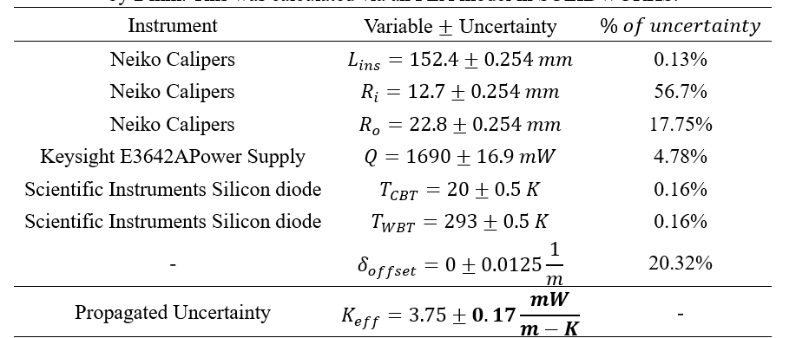
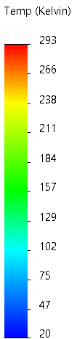
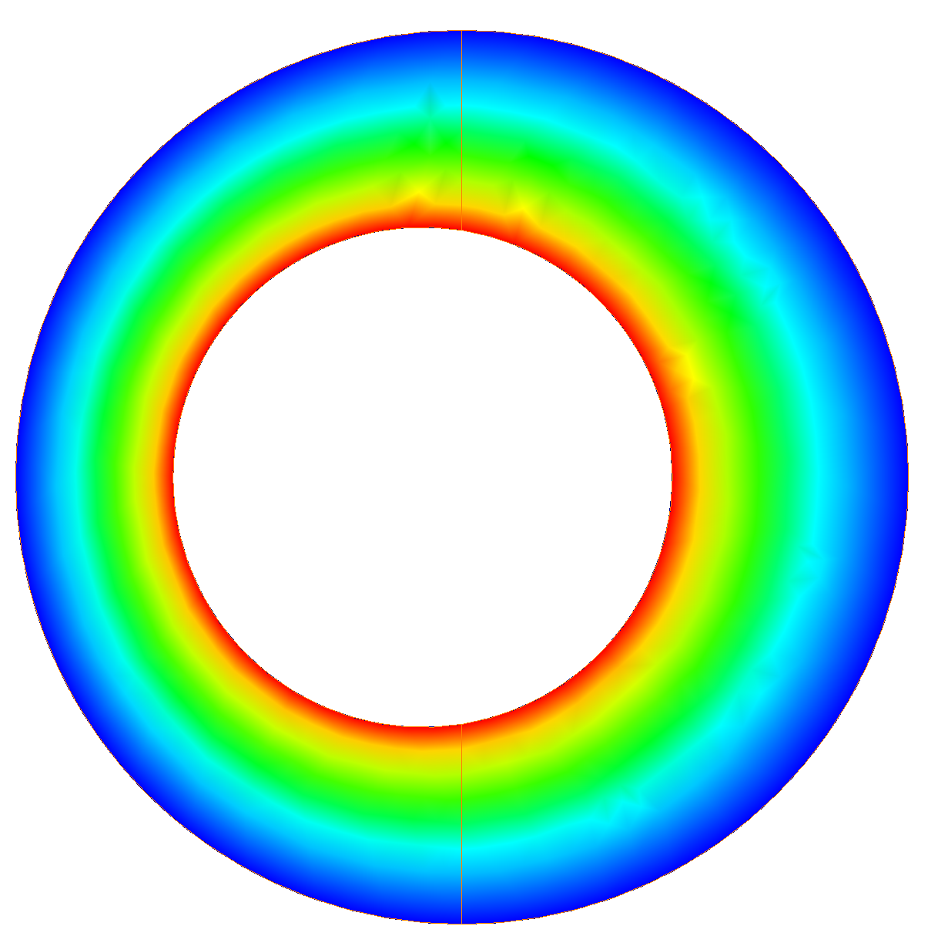
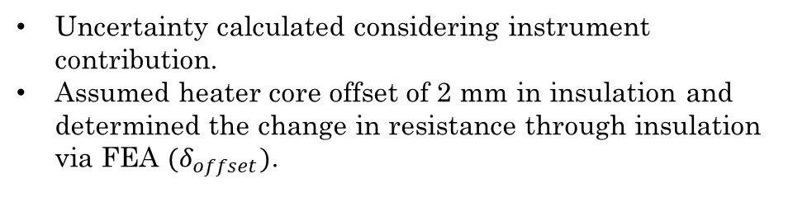








Cross section of test cell
Measurement Uncertainty
Uncertainty calculated considering instrument contribution.
Assumed heater core offset of 2 mm in insulation and determined the change in resistance through insulation via FEA ${(δ}_{offset})$.
$$Q:1690±16.9 mW$$
$$T_{WBT}:293±0.5 K$$
235 mm
$$T_{CBT}:20±0.5 K$$
152 mm
$R_{o}:22.8±0.25$mm
$R_{i}:12.7±0.25$ mm
$$k_{eff}=Q_{ins}∗\frac{δ_{offset}}{ΔT}$$
$δ:0±2$ mm
Theoretical uncertainty is well within $±1\frac{mW}{m−K}.$
= Temperature Sensors
= Guard insulation

Slide 7
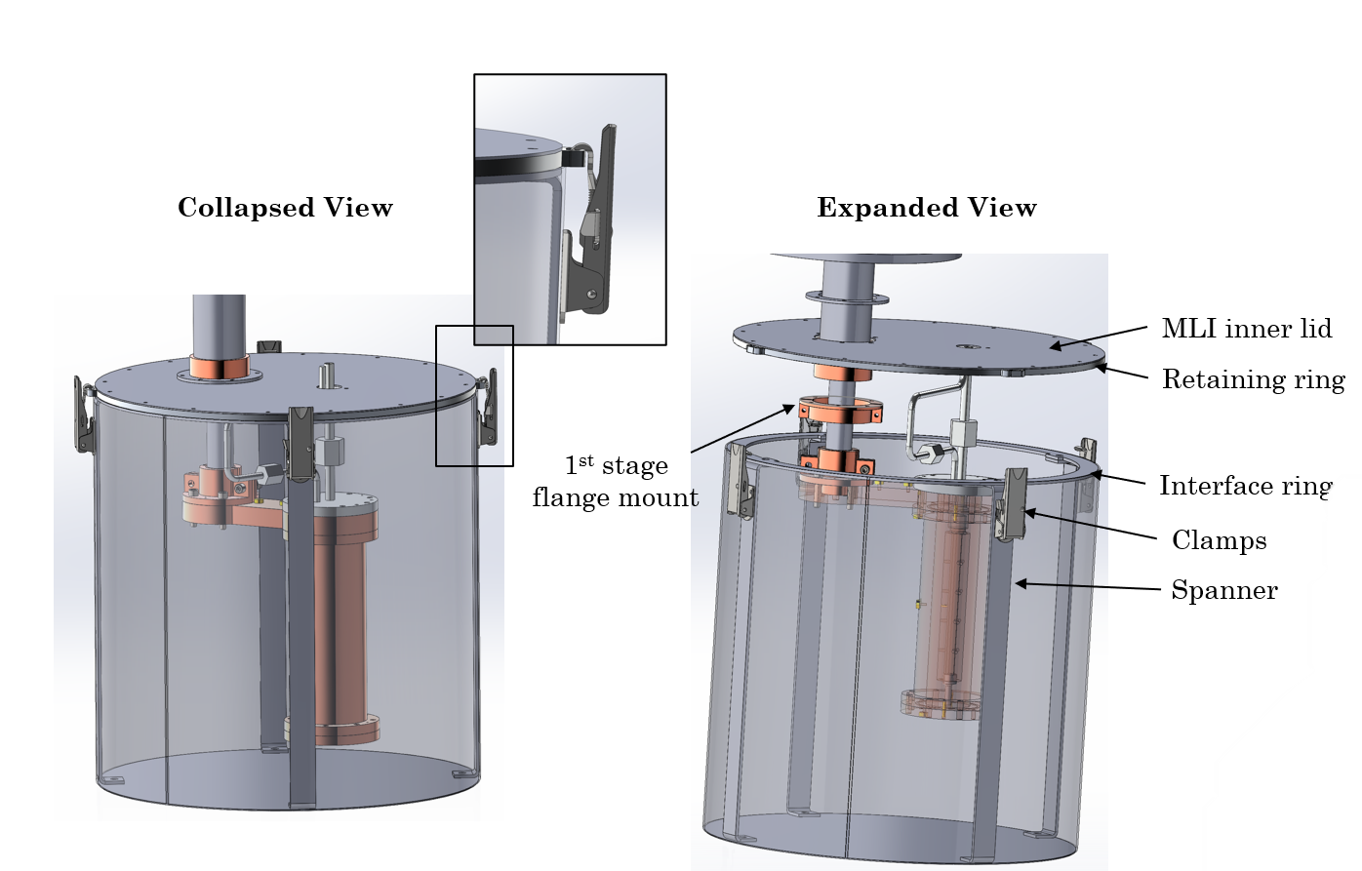
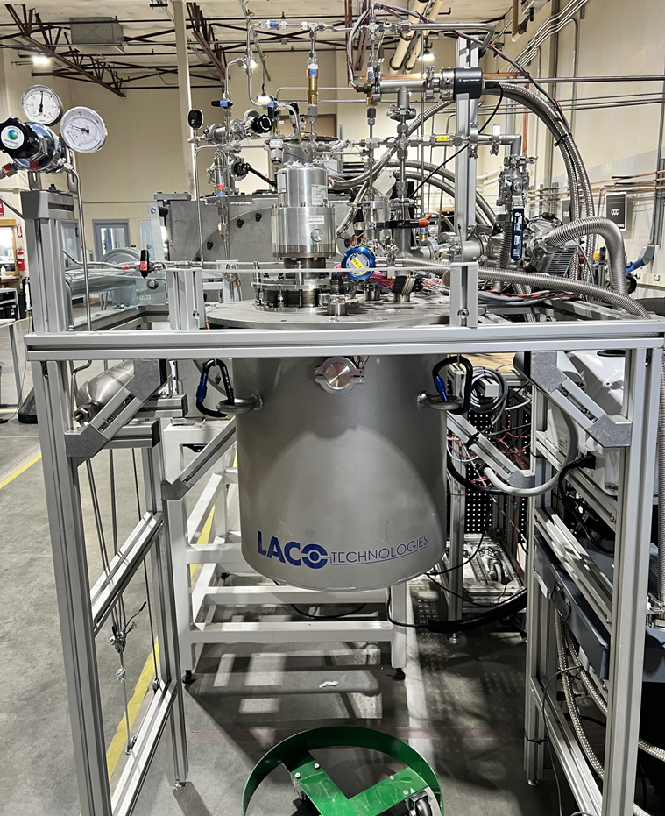
Cryostat Design
Key Features:
Vacuum chamber – Lip seal, welded eyelets for raising and lowering via pulley system. Quick disconnect via carabiners.
Everything fixtured to lid allows test cell to be worked on from chair.
MLI has 4 adjustable quick-connect clamps.
Achieves a vacuum level of 10^-5 Pa and bottoms out at ~8 K with only 2 W of cooling.

Slide 8
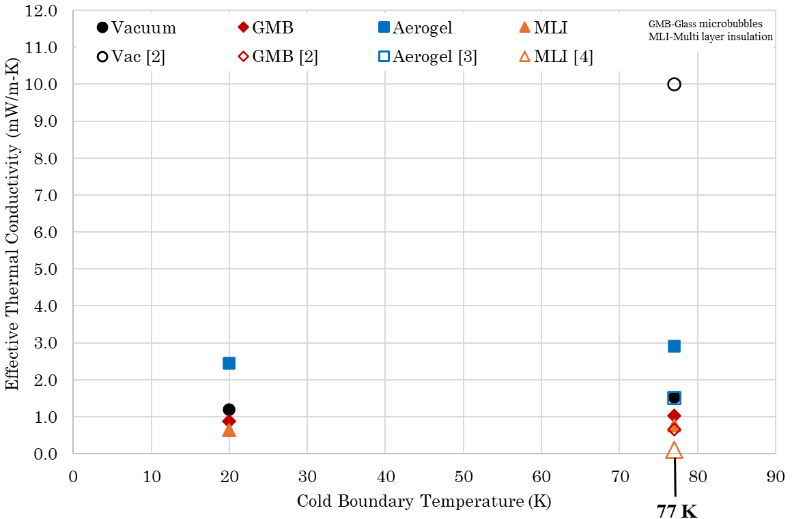
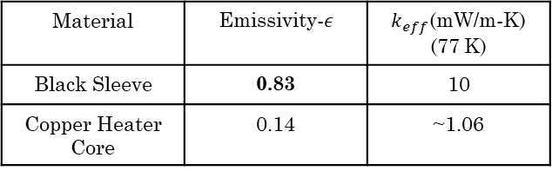

Preliminary Results
High vacuum provides best insulation (<0.01 Pa).
Measurements from 20-77 K with a warm boundary of 293 K.
Measurements for vacuum only are lower than literature.
→Copper emissivity much lower than black sleeve utilized in NASA study [2].
Bias uncertainty associated with heat leak out of test cell.
$$Q_{rad}=σεA(T_{WBT}^{4}−T_{CBT}^{4})$$
Material | Emissivity-$ε$ | $k_{eff}$(mW/m-K) (77 K)
Black Sleeve | 0.83 | 10
Copper Heater Core | 0.14 | ~1.06
Need to apply a correction to account for bias uncertainty.
[2] Scholtens, B. E., Fesmire, J. E., Sass, J. P., Augustynowicz, S. D., & Heckle, K. W. (2008). Cryogenic thermal performance testing of bulk-fill and aerogel insulation materials. AIP Conference Proceedings, 985, 152–159. https://doi.org/10.1063/1.2908517
[3] Coffman, B. E., Fesmire, J. E., White, S., Gould, G., & Augustynowicz, S. (2010). Aerogel blanket insulation materials for cryogenic applications. AIP Conference Proceedings, 1218, 913–920. https://doi.org/10.1063/1.3422458
[4] Fesmire, J. E., & Johnson, W. L. (2015). Thermal Performance Data for Multilayer Insulation Systems Tested between 293 K and 77 K.

Slide 9
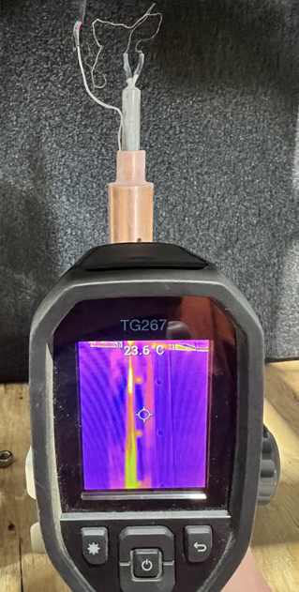








Bias Uncertainty
$$T=20 K$$
Bias uncertainty caused by heat conduction from wires leading to heater core contacting cold pipe.
Wires were insulated from cold pipe to reduce heat leak.
Infrared camera used to measure emissivity of heater core.
Radiation heat transfer was calculated and used to create a heat leak correction for vacuum only testing.
Correction was applied to measurements to account for total heat leak into test cell.
$$Q_{wires}$$
$$T=293 K$$
$$Heater Core$$
$$Q_{ins}$$
$$293 K$$
$$Q_{rad}=σεA(T_{WBT}^{4}−T_{CBT}^{4})$$
Emissivity Measurement
$$Q_{Heater}=Q_{rad}+Q_{heat leak}$$

Slide 10
Conclusions
  Steady state testing providing 77-20 K measurements of insulations (corrected preliminary results shown below).
  Best performance with MLI and microbubbles. Vacuum alone outperforms aerogel in the high vacuum regime (<0.01 Pa).
  Heat flux during transient loss of vacuum measurements to be collected.
Preliminary Results
*
* Reference vacuum omitted for clarity

Slide 11
Thank You!
These results have been established in collaboration with Airbus
Justin Jessop
justin.jessop@wsu.edu
+1-509-202-7449

