Slide 1
PIP-II CDS & CM Cryogenics Controls System
C2Or4B-06
FERMILAB-SLIDES-25-0098-PIP2-TD
May 20, 2025
Pratik Patel, R.Dhuley, A.Faraj, A.Martinez, V.Patel, W.Soyars, S.Yoon
CEC/ICMC 2025
Acknowledgement: This presentation has been authored by FermiForward Discovery Group, LLC under Contract No. 89243024CSC000002 with the U.S. Department of Energy, Office of Science, Office of High Energy Physics.

Slide 2
Overview - Topics Covered
PIP-II Introduction
CDS & CM Overview
CDS Controls Fact Sheet
PLC, Remote IO & Relay Racks
Overall & Detailed Architecture
Valves and Instrumentation Integration in Controls
EPICS development
Completed and future activities

Slide 3
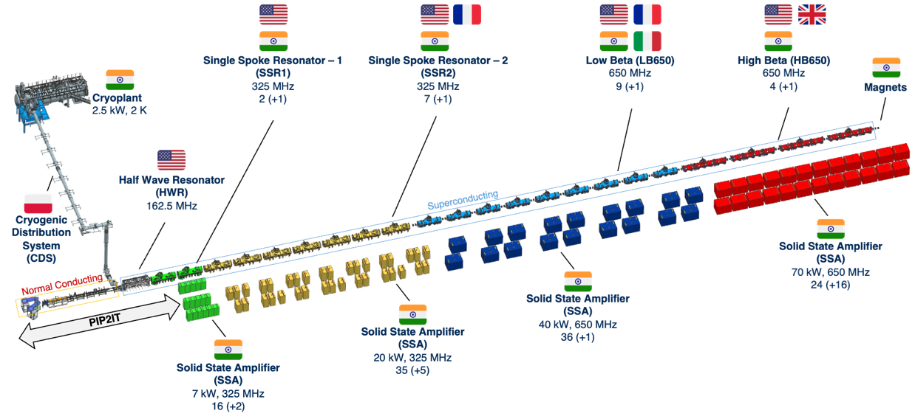
PIP-II Introduction
Proton Improvement Plan – II (PIP-II) is an upgrade of the Fermilab (in Batavia, Illinois, USA) accelerator complex that amongst other includes a new superconducting radiofrequency linear particle accelerator (linac)
PIP-II is the world’s highest energy and power continuous-wave linac, and the US first accelerator project to be built with major international contributions.

Slide 4
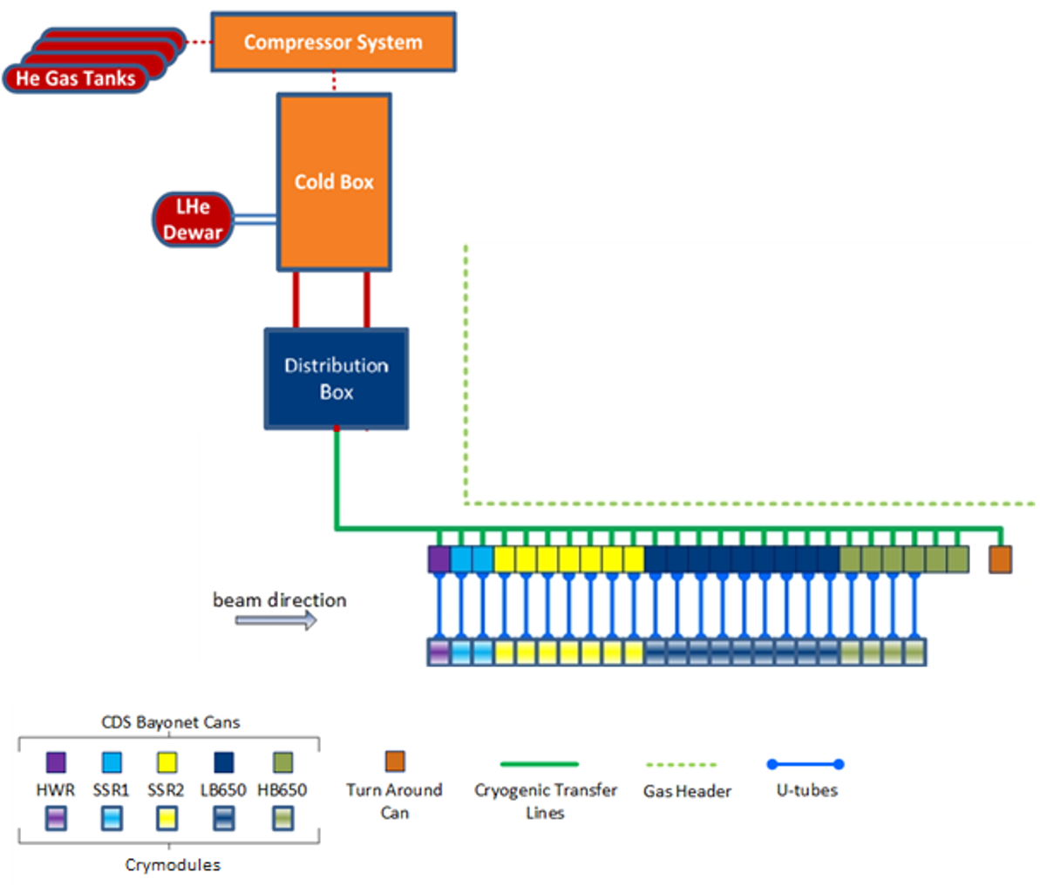
CDS & CM Overview
The PIP-II linac is kept at cryogenic temperatures using helium gas supplied by a Cryogenic Distribution System (CDS)
Cryogenic Distribution System (CDS)
Transfers cryogenic helium between Coldbox and Linac
Cryomodules (CM) linac
Use cryogenic helium to cool SRF cavities, couplers, intercept shields, and more.

Slide 5
CDS Controls Fact Sheet
CDS and Cryomodules Controls consists of V&I of following systems:
  1x DVB
  23x Cryomodules and 25x Bayonet Cans
  1x Turnaround Can
Sensors | Totals
Platinum 100 | 438
Cernox (CX-1030, CCS TVO) | 721
Pressure Transducers | 227
Control Valves | 362
Liquid Level | 25
Flowmeters | 25
Heater | 190
Vacuum Transducers | 23
RF Interlock | 23
Rupture Disc Indicator | 23
IO | Totals
AI Channel | 695
AO Channel | 190
DI Channel | 593
DO Channel | 213
LK 240-8P Channel | 1170
SIPART PS2 Channel | 394
Controls Highlight
2x Redundant PLC Cabinets
24x Remote IO Cabinets
48x Relay Racks for Sipart, Lakeshores, Level Transmitter, Heater Power Supplies etc.
Very Large Cryogenics Controls system with >3300 I/O channels, >1200 Temperature Sensors, > 365 Control Valves, > 190 Heater Power Supplies etc.
Each Rittal Cabinets and Relay is being built per UL508A standard.
I/O modules have been considered with 20% margin+ additional module for each remote I/O cabinet.

Slide 6
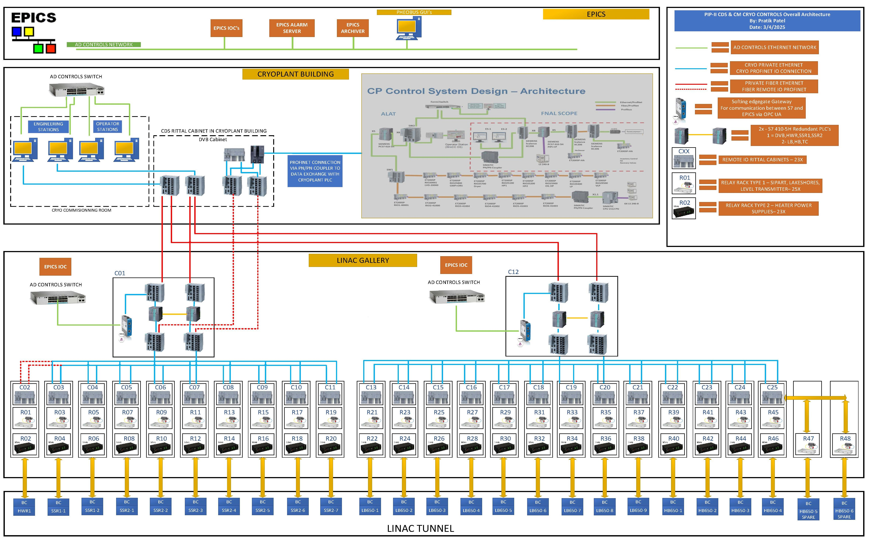
Overall Architecture
6

Slide 7
Detailed Architecture

Slide 8
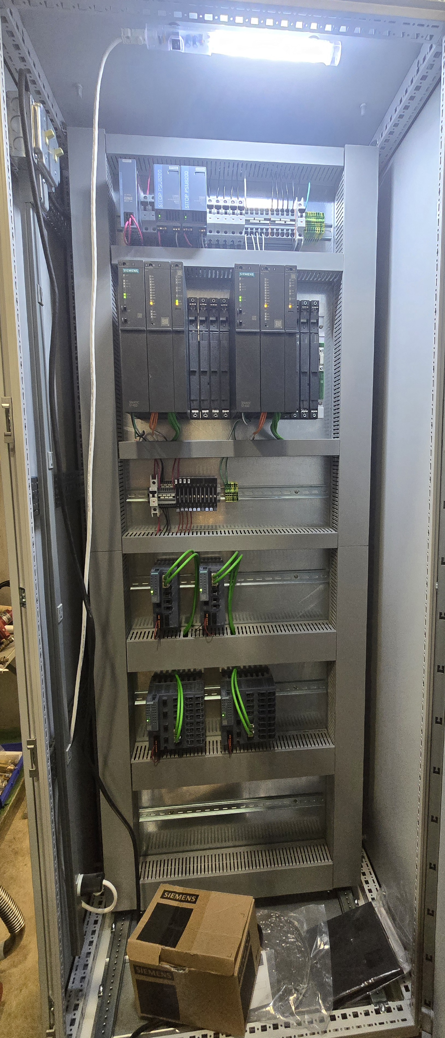
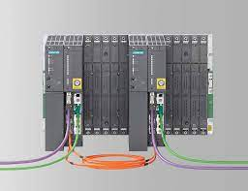
PLC based controls approach
PLC-Based Redundant Controls: 2x Siemens S7410-5H PLC in Redundant system
Selection of S7410-5H allows for High availability & Redundant operation.
PLC Assignment:
  Redundant PLC 1&2- DVB, HWR, SSR1, SSR2
  Redundant PLC 3&4- LB650,HB650,TC
Cryogenics group familiarity with existing PCS7 at PIP-II CM Test Facility, and other test facilities.

Slide 9
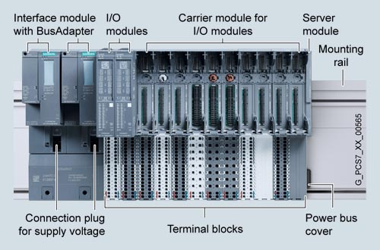
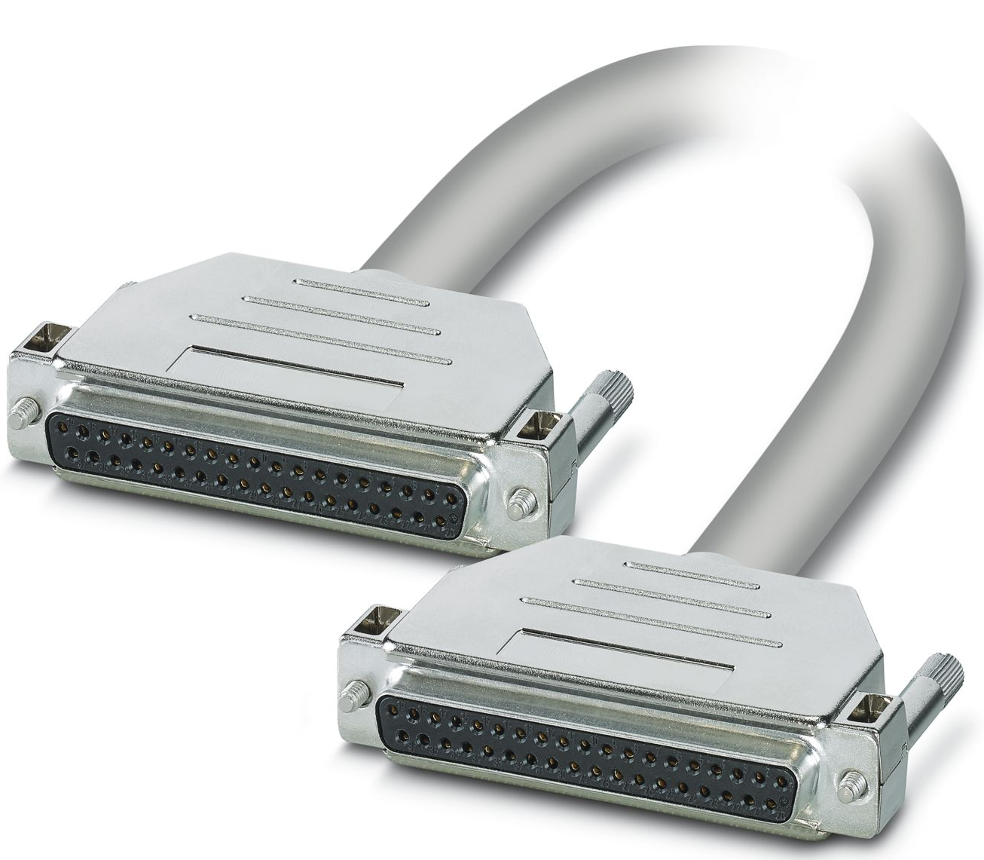
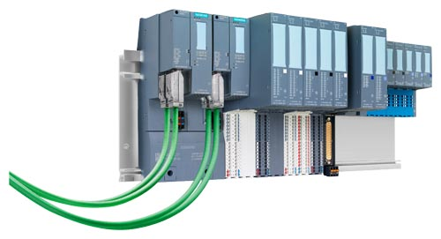
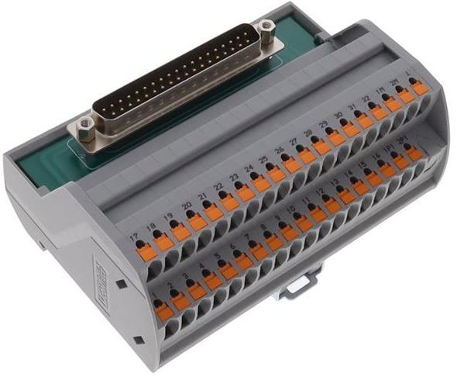
Profinet Remote I/O
ET200-SP-HA Profinet Remote I/O is used per each CM and will be installed in each Rittal Cabinet per Cryomodule.
I/O break out modules from Phoenix Contact are used for easier wiring and troubleshooting.

Slide 10
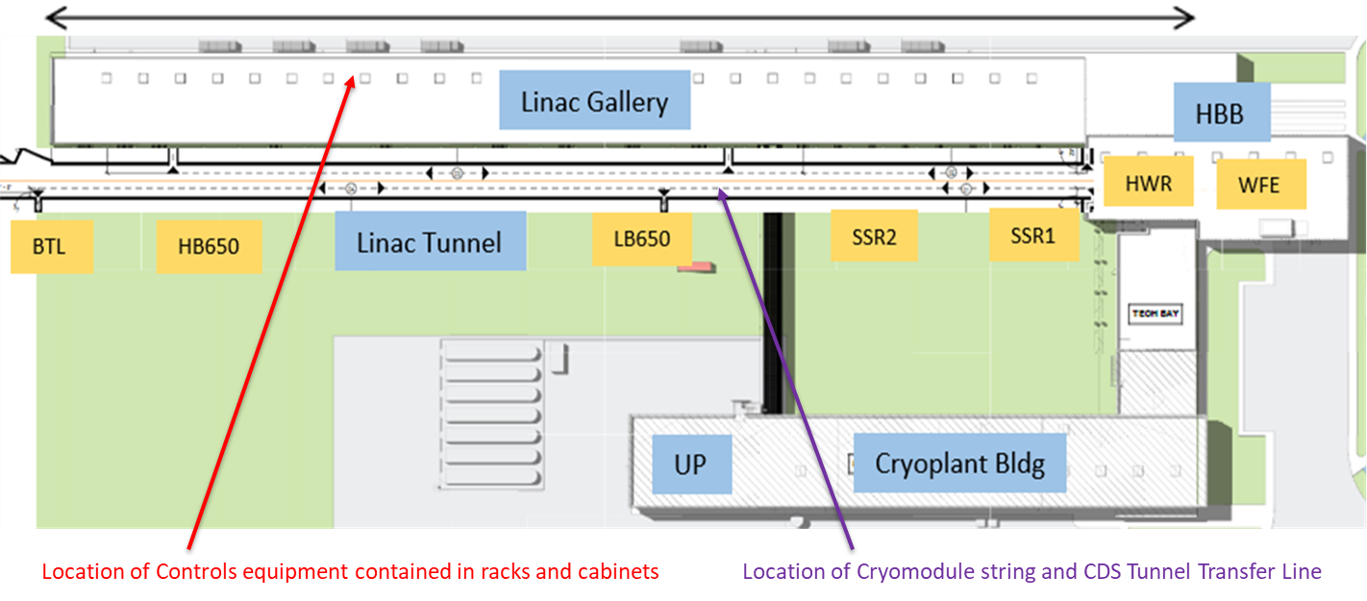
Linac Gallery Cabinets and Racks Layout
Cabinets and Relay Racks final layout in the Linac Gallery floor is designed considering Profinet and other protocols length limit.
  Profinet = 100m
  Profibus = 1200 meter
  Fiber = <2000m
~250m

Slide 11

Temperature sensors
PIP-II cryogenics systems have more than 1150 cryogenic temperature sensors of Platinum RTD, Temati TVOs, and Cernox type
To read these thermometers, the Control System has a bank of Lakeshore 240-8P modules that are connected to the PLC as Profinet I/O converted from Profibus via gateway IE/PB Link in each Remote I/O cabinet.

Slide 12
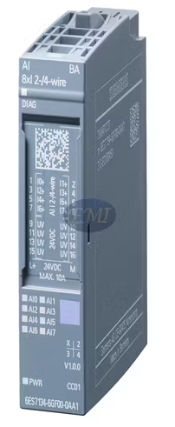
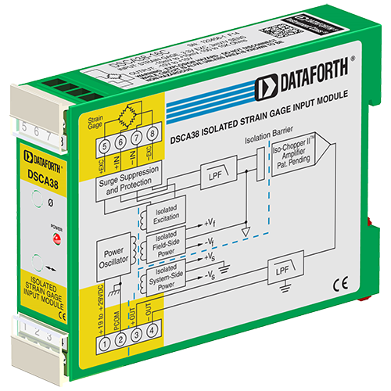
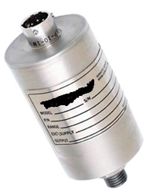
Pressure Transmitters
Each pressure transmitter outputs a 4-20 mA signal that is connected on a 2-wire, 4-20 mA loop to the associated I/O module.
Tunnel Pressure Transducers are in Radiation area, so they are no active electronics and have mV/V output. Dataforth Strain Gage Input Signal Conditioner is used in-between to send 4-20 ma signal to PLC input.

Slide 13
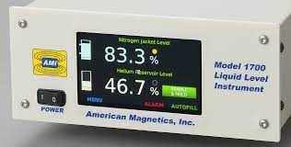
Level Transmitters
Each Cryomodule and the Turnaround Can have a American Magnetics liquid helium level probe 2K with a 59 cm active length for measuring the liquid helium levels within the cryogenic equipment.
We will utilize AMI Model 1700 transmitter box 2K configured to condition the level probe readback to a 4-20 mA signal that is than connected to the associated I/O module for readback to the PLC.

Slide 14
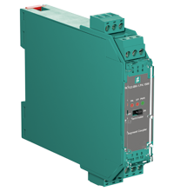
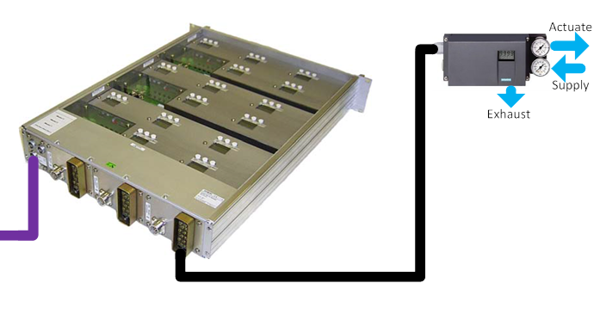
Valve Positioners
The valve positioners will utilize Siemens 15 channel SIPART PS2 drawer.
  Total 365 Valves
The rack mounted SIPART PS2 communicate via Profibus PA. We will utilize a Profibus DP/PA coupler in each I/O cabinet.
Model Name: Pepperl+Fuchs KFD2-BR-1.PA.1500

Slide 15
Heaters
Cryomodules contain up to four different types of heaters with various groupings/configurations.
Coupler Heaters:
  Dalton 10W (1/4" OD x 1" long) Model W2C010. Each cryomodule cavity has one coupler and each coupler contains 4 heaters.
  The 4 heaters per coupler will be grouped and wired in parallel and shall be powered by a single power supply
Cavity Heaters:
  Heater Minco HAP6949. For each Cryomodule, all cavity heaters will be wired in parallel and shall be powered by a single power supply.
Helium Can Heaters:
  Dalton model W4C050 (1/2" OD x 5" long), 100 Watts, 50 Volts Cartridge Heater
  The heater has four-wires (current/voltage) for powering/monitoring of heater
  Each Cryomodule has one helium can heater. Each helium can heater is protected from over temperature by liquild level interlock and operated at maximum of 50 W.
Current Lead Heaters (SSR1 and SSR2 Cryomodules):
  Dalton 10W (1/4" OD x 1" long) Model W2C010
  There is one current lead associated with each solenoid, four in SSR1 and three in SSR2
190 total Acopian Power Supplies are used as Cryo Group already has familiarity with using them at Test Facilities

Slide 16
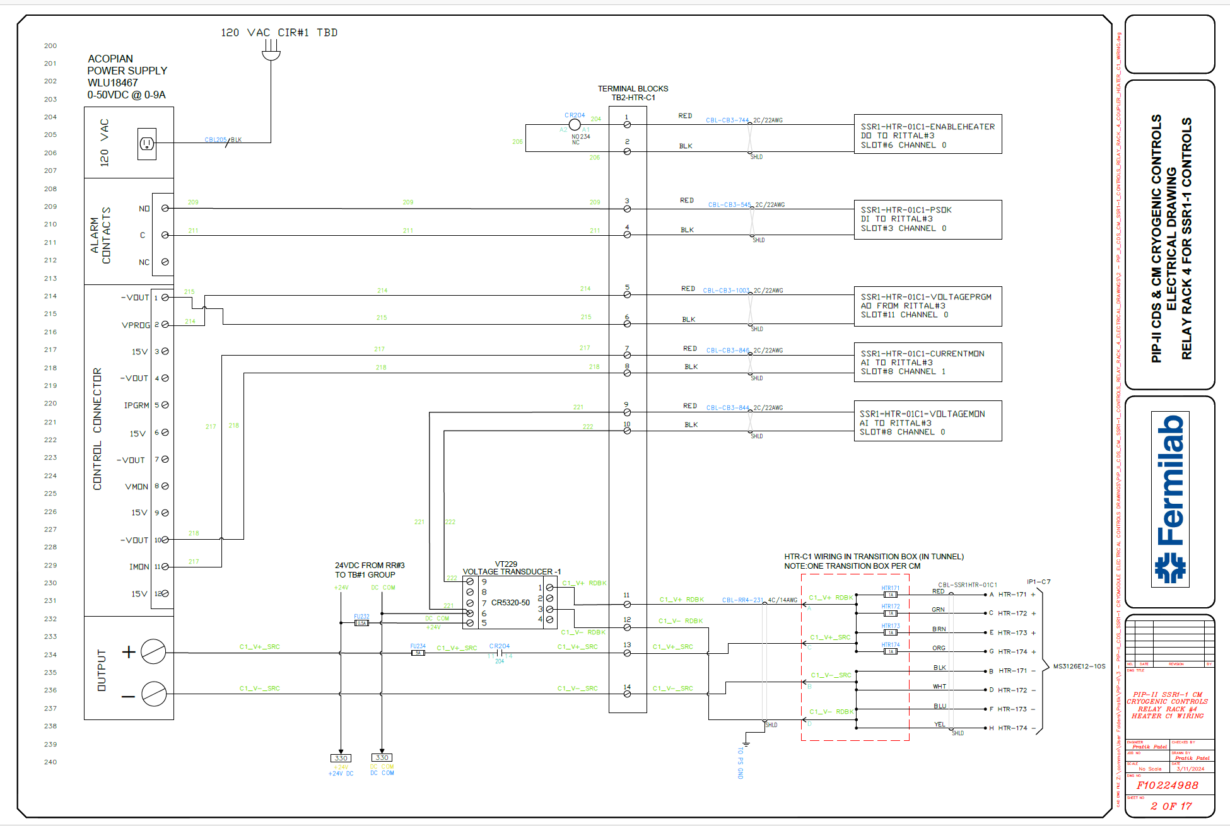
Heaters Control
Each Heater PS is integrated with PLC using combination of external components and direct PS interface for heater control and monitoring:
  Relay – Enable/Disable Power Supply Output
  Heater PS Alarm feedback
  4-20ma Signal from PLC Analog Out to Heater PS for Voltage Control
  Voltage Transducer for voltage feedback.
  Heater PS Current output for current feedback

Slide 17
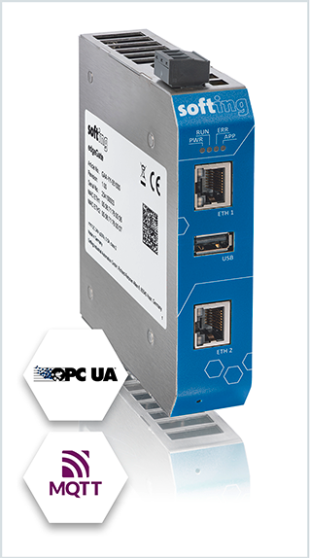
EPICS Development
We will use Softing EdgeGate Gateway for data handshake between S7 Controllers and EPICS IOC using OPC UA protocol. Currently being commissioned at PIP-II CM Test Facility.
Softing gateway can be setup via easy web interface, no software's needed. 2 independent ports allows for isolation of Fermi Network and Private PLC network.
Use of gateway will prevent dependency on Windows based Computer and updates and will have dedicated hardware for communication.
Gateway solution would replace existing Windows based Computers used for communication using Kepware OPCUA.
Phoebus Screens, Alarming, Datalogging development is in initial phase.

Slide 18
Completed and Ongoing Activities
All Materials have been procured.
All electrical design, drawings and BOM is completed.
Local UL508A panel shop has been awarded contract to fabricate 24x Rittals and 48 Relay Racks
  Fermilab procured materials have been shipped to sub-contractor and initial cabinets are being built.
Cable pull database has been established and 50% completed.

Slide 19
Next Steps
Programming Starts – Mid June 2025
EPICS HMI Development Starts – March 2026
Manage Fabrication Contract – May2025~April 2026
Installation and Commissioning

Slide 20
Thank you
Any questions?

